Slide 1
Exploring
the Origin of Mass
using Pseudoscalar Mesons
Craig Roberts

Slide 2
Strong Interactions in the Standard Model
Only apparent scale in chromodynamics is mass of the quark field
Quark mass is said to be generated by Higgs boson.
In connection with everyday matter, that mass is 1/250th of the natural (empirical) scale for strong interactions,
viz. more-than two orders-of-magnitude smaller
Plainly, the Higgs-generated mass is very far removed from the natural scale for strongly-interacting matter
Nuclear physics mass-scale – 1 GeV – is an emergent feature of the Standard Model
No amount of staring at L_{QCD} can reveal that scale
Contrast with quantum electrodynamics, e.g. spectrum of hydrogen levels measured in units of m_{e}, which appears in L_{QED}

Slide 3
Trace Anomaly
Classically, in a scale invariant theory
the energy-momentum tensor must be traceless: T_{μμ} ≡ 0
Regularisation and renormalisation of (ultraviolet) divergences in Quantum Chromodynamics introduces a mass-scale
… dimensional transmutation: mass-dimensionless quantities become dependent on a mass-scale, ζ
α → α(ζ) in QCD’s (massless) Lagrangian density, L(m=0)
⇒ ∂_{μ}D_{μ} = δL/δσ = αβ(α) dL/dα = β(α) ¼G_{μν} G_{μν} = T_{ρρ} =: Θ₀
Quantisation of renormalisable four-dimensional theory forces nonzero value for trace of energy-momentum tensor
Trace anomaly
QCD β function
Notes:
Alpha -> alpha(zeta) seems to be enough to generate M(zeta), which is large for zeta small.

Slide 4
Where is the mass?

Slide 5
Trace Anomaly
Knowing that a trace anomaly exists does not deliver a great deal
… Indicates only that a mass-scale must exist
Can one compute and/or understand the magnitude of that scale?
One can certainly measure the magnitude … consider proton:
In the chiral limit the entirety of the proton’s mass is produced by the trace anomaly, Θ₀
… In QCD, Θ₀ measures the strength of gluon self-interactions
… so, from one perspective,
m_{p} is (somehow) completely generated by glue.

Slide 6
On the other hand …

Slide 7
Trace Anomaly
In the chiral limit
⇒
Does this mean that the scale anomaly vanishes trivially in the pion state, i.e. gluons contribute nothing to the pion mass?
Difficult way to obtain “zero”!
Easier to imagine that “zero” owes to cancellations between different operator contributions to the expectation value of Θ₀.
Of course, such precise cancellation should not be an accident.
It could only arise naturally because
of some symmetry and/or symmetry-breaking pattern.

Slide 8
Whence “1” and yet “0” ?
No statement of the question
“How does the mass of the proton arise?”
is complete without the additional clause
“How does the pion remain massless?”
Natural visible-matter mass-scale must emerge simultaneously with apparent preservation of scale invariance in related systems
Expectation value of Θ₀ in pion is always zero, irrespective of the size of the natural mass-scale for strong interactions = m_{p}

Slide 9
Whence “1” and yet “0” ?
No statement of the question
“How does the mass of the proton arise?”
is complete without the additional clause
“How does the pion remain massless?”
Natural visible-matter mass-scale must emerge simultaneously with apparent preservation of scale invariance in related systems
Expectation value of Θ₀ in pion is always zero, irrespective of the size of the natural mass-scale for strong interactions = m_{p}
Elucidate the entire array
of empirical consequences
of the mechanism responsible
so that the theory can be validated

Slide 10
Gluon Gap Equation
Pinch Technique: Theory and Applications
Daniele Binosi & Joannis Papavassiliou
Phys. Rept. 479 (2009) 1-152

Slide 11
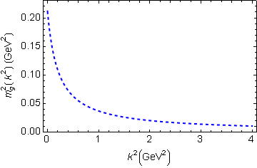
In QCD: Gluons become massive!
Bridging a gap between continuum-QCD and ab initio predictions of hadron observables, D. Binosi et al., arXiv:1412.4782 [nucl-th], Phys. Lett. B742 (2015) 183-188
Running gluon mass
Gluons are cannibals – a particle species whose members become massive by eating each other!
μ_{g} ≈ ½ m_{p}
$$α_{S}(0)≈π$$
Expression of trace anomaly:
Massless glue becomes massive
gluon mass-squared function
Power-law suppressed in ultraviolet, so invisible in perturbation theory
5%
Interaction model for the gap equation, S.-x.Qin et al., arXiv:1108.0603 [nucl-th], Phys. Rev. C 84 (2011) 042202(R) [5 pages]
Class A: Combining DSE, lQCD and pQCD analyses of QCD’s gauge sector

Slide 12
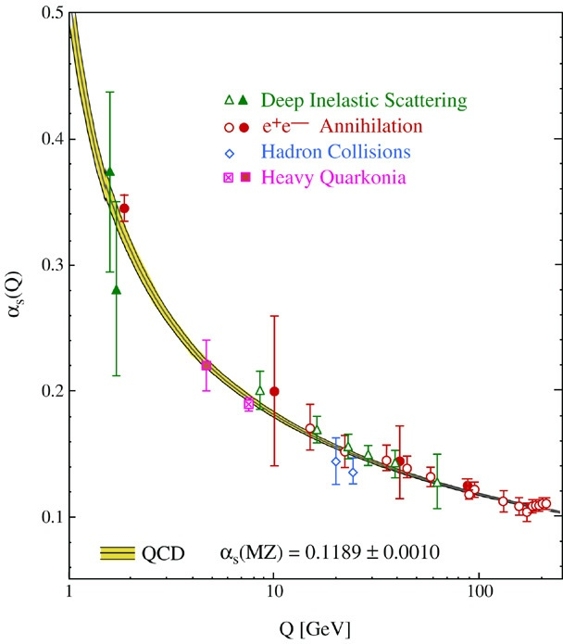
QCD’s Running Coupling
This is where we live
⇐
What’s happening
out here?!

Slide 13
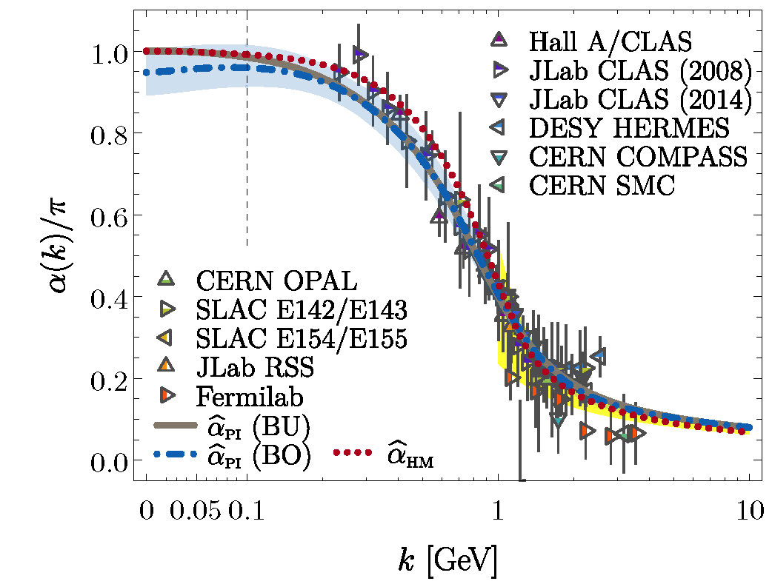
Process-independent effective-charge in QCD
Process independent strong running coupling
Binosi, Mezrag, Papavassiliou, Roberts, Rodriguez-Quintero
arXiv:1612.04835 [nucl-th], Phys. Rev. D 96 (2017) 054026/1-7
The QCD Running Coupling,
A. Deur, S. J. Brodsky and G. F. de Teramond,
Prog. Part. Nucl. Phys. 90 (2016) 1-74
Modern continuum & lattice methods for analysing gauge sector enable
“Gell-Mann – Low”
running charge to be defined in QCD
Combined continuum and lattice analysis of QCD’s gauge sector yields a parameter-free prediction
N.B. Qualitative change in α̂_{PI}(k) at k ≈ ½ m_{p}

Slide 14
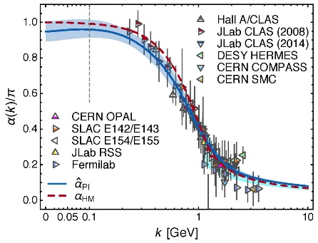
QCD Effective Charge
α̂_{PI} is a new type of effective charge
direct analogue of the Gell-Mann–Low effective coupling in QED, i.e. completely determined by the gauge-boson two-point function.
α̂_{PI} is
process-independent
appears in every one of QCD’s dynamical equations of motion
known to unify a vast array of observables
α̂_{PI} possesses an infrared-stable fixed-point
Nonperturbative analysis demonstrating absence of a Landau pole in QCD
QCD is IR finite, owing to dynamical generation of gluon mass-scale
Asymptotic freedom ⇒ QCD is well-defined at UV momenta
QCD is therefore unique amongst known 4D quantum field theories
Potentially, defined & internally consistent at all momenta

Slide 15
QCD Effective Charge
α̂_{PI} is a new type of effective charge
direct analogue of the Gell-Mann–Low effective coupling in QED, i.e. completely determined by the gauge-boson two-point function.
α̂_{PI} is
process-independent
appears in every one of QCD’s dynamical equations of motion
known to unify a vast array of observables
α̂_{PI} possesses an infrared-stable fixed-point
Nonperturbative analysis demonstrating absence of a Landau pole in QCD
QCD is IR finite, owing to dynamical generation of gluon mass-scale
Asymptotic freedom ⇒ QCD is well-defined at UV momenta
QCD is therefore unique amongst known 4D quantum field theories
Potentially, defined & internally consistent at all momenta
Conceivably, therefore,
QCD can serve as a basis
for theories that take physics
beyond the Standard Model

Slide 16
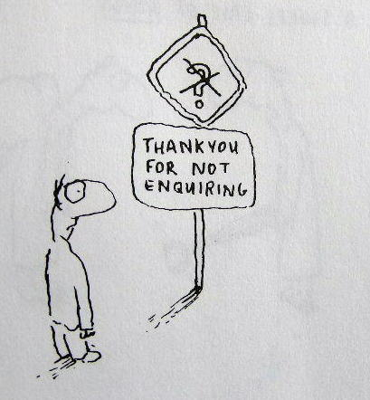
Enigma of Mass

Slide 17
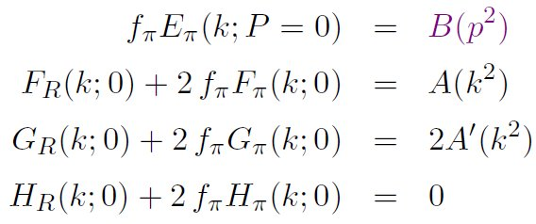
Pion’s Goldberger -Treiman relation
Maris, Roberts and Tandy
nucl-th/9707003, Phys.Lett. B420 (1998) 267-273
Pion’s Bethe-Salpeter amplitude
Solution of the Bethe-Salpeter equation
Dressed-quark propagator
Axial-vector Ward-Takahashi identity entails
This means that π necessarily has dressed-quark L=0 & L=1 components in any frame
Twist-3 on light-front
B(k²)
Owing to DCSB
& Exact in
Chiral QCD
Miracle: two body problem solved, almost completely, once solution of one body problem is known

Slide 18
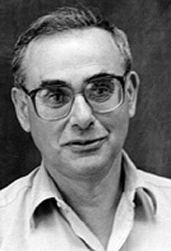
Enigma of mass
f_{π} E_{π}(p²) = B(p²)
This algebraic identity is why QCD’s pion is massless in the chiral limit
The quark level Goldberger-Treiman relation shows that DCSB has a very deep and far reaching impact on physics within the strong interaction sector of the Standard Model; viz.,
Goldstone's theorem is fundamentally an expression of equivalence between the one-body problem and the two-body problem in the pseudoscalar channel.
This emphasises that Goldstone's theorem has a pointwise expression in QCD
Hence, pion properties are an almost direct measure of
the dressed-quark mass function.
Thus, enigmatically, the properties of the massless pion
are the cleanest expression of the mechanism that is
responsible for almost all the visible mass in the universe.

Slide 19
Whence “0” ?

Slide 20
Whence “0” ?
The answer is algebraic

Slide 21
Pion masslessness
Munczek, H. J., Phys. Rev. D 52 (1995) pp. 4736-4740
Bender, A., Roberts, C.D. and von Smekal, L., Phys. Lett. B 380 (1996) pp. 7-12
Maris, P. , Roberts, C.D. and Tandy, P.C., Phys. Lett. B 420 (1998) pp. 267-273
Binosi, Chang, Papavassiliou, Qin, Roberts, Phys. Rev. D 93 (2016) 096010/1-7
Obtain a coupled set of gap- and Bethe-Salpeter equations
Bethe-Salpeter Kernel:
valence-quarks with a momentum-dependent running mass produced by self-interacting gluons, which have given themselves a running mass
Interactions of arbitrary but enumerable complexity involving these “basis vectors”
Chiral limit:
Algebraic proof
at any & each finite order in symmetry-preserving construction of kernels for
the gap (quark dressing)
and Bethe-Salpeter (bound-state) equations,
there is a precise cancellation between
mass-generating effect of dressing the valence-quarks
and attraction introduced by the scattering events
Cancellation guarantees that
simple system, which began massless,
becomes a complex system, with
a nontrivial bound-state wave function
attached to a pole in the scattering matrix, which remains at P²=0 …
Interacting, bound system remains massless!

Slide 22
Pion masslessness
Munczek, H. J., Phys. Rev. D 52 (1995) pp. 4736-4740
Bender, A., Roberts, C.D. and von Smekal, L., Phys. Lett. B 380 (1996) pp. 7-12
Maris, P. , Roberts, C.D. and Tandy, P.C., Phys. Lett. B 420 (1998) pp. 267-273
Binosi, Chang, Papavassiliou, Qin, Roberts, Phys. Rev. D 93 (2016) 096010/1-7
Obtain a coupled set of gap- and Bethe-Salpeter equations
Bethe-Salpeter Kernel:
valence-quarks with a momentum-dependent running mass produced by self-interacting gluons, which have given themselves a running mass
Interactions of arbitrary but enumerable complexity involving these “basis vectors”
Chiral limit:
Algebraic proof
at any & each finite order in symmetry-preserving construction of kernels for
the gap (quark dressing)
and Bethe-Salpeter (bound-state) equations,
there is a precise cancellation between
mass-generating effect of dressing the valence-quarks
and attraction introduced by the scattering events
Cancellation guarantees that
simple system, which began massless,
becomes a complex system, with
a nontrivial bound-state wave function
attached to a pole in the scattering matrix, which remains at P²=0 …
Interacting, bound system remains massless
Quantum field theory statement:
In the pseudsocalar channel, the dynamically generated mass of the two fermions is precisely cancelled by the attractive interactions between them – iff –
f_{π} E_{π}(p²) = B(p²)

Slide 23
Revealing Mass

Slide 24
Consequences … 1
Mass is dynamically generated in QCD: Scale ∼ Λ_{QCD}
Empirically Λ_{QCD} ≈ 0.2 GeV … Standard Model can’t predict this value.
Gluon self-interactions make Λ_{QCD} ≈ 0.2 GeV possible.
They do not guarantee it.
Understanding of observables (almost always) depends on
frame of reference and scale of probe
gluons and quarks → dressed quasiparticles:
massless in perturbation theory
possess mass functions which are large at infrared momenta ≤ m_{g} ≈ 2 Λ_{QCD}
at hadronic scale: wave functions, cross-sections, etc. are most readily understood using evolving quasiparticle operators for dressed-g, -q
Each contains a (distinct) countable infinity of partons
⇒ All bound-states have GeV-scale masses
⇒ Except Nambu-Goldstone modes
DCSB: whilst constituents are massive, NG-modes are (nearly) massless

Slide 25
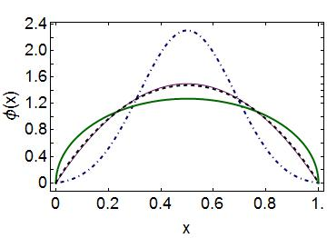
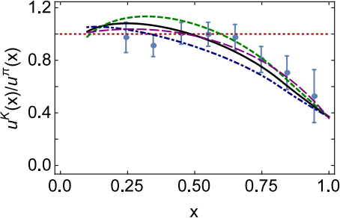
Consequences … 2
QCD’s unique Gell-Mann–Low effective coupling
Infrared finite … α(∼ 0) ≈ π
Landau pole of perturbation theory is
eliminated by emergence of gluon mass
Cross-sections are free of infrared divergences
PDAs of ground-state S-wave mesons and baryons are broad, concave functions
Numerous empirical consequences ⇒ empirically verifiable
Hadron elastic and transition form factors
Emergent vs Explicit (Higgs) mass generation
s-quark defines a boundary:
emergent mass generation dominates for m < m_{s}
but explicit (Higgs) mass is most important for m > m_{s}
s-quark/u-quark comparisons in parton distributions
are a sensitive probe of emergent mass and its distribution
cc̅
ss̅
ud̅
glue in π ≫ glue in K

Slide 26
Consequences … 3
Existence of nonpointlike scalar and axial-vector diquarks in nucleon.
Axial-vector correlations are essential
Empirically verifiable consequences
Example … proton’s tensor charges:
δ_{T}d ≠ 0 ⇒ rules-out scalar-diquark-only nucleon
δ_{T}u ≈ 4 | δ_{T}d| … understood via highly-correlated proton wave function
Baryon resonances:
Relative strengths of 0+ and 1+ change & new diquarks appear (0- & 1-)
Vast array of new predictions whose testing is crucial to validating the emergent mass paradigm
Hybrid Mesons
Just like diquark correlations exist in baryons …
q_{g}= g+q and q̅_{g} = g+q̅ correlations very probably also exist in systems with valence glue.
Hybrid mesons may be understood as
highly-correlated q_{g}q̅ ↔ qq̅_{g} bound-states

Slide 27
Observing Mass

Slide 28
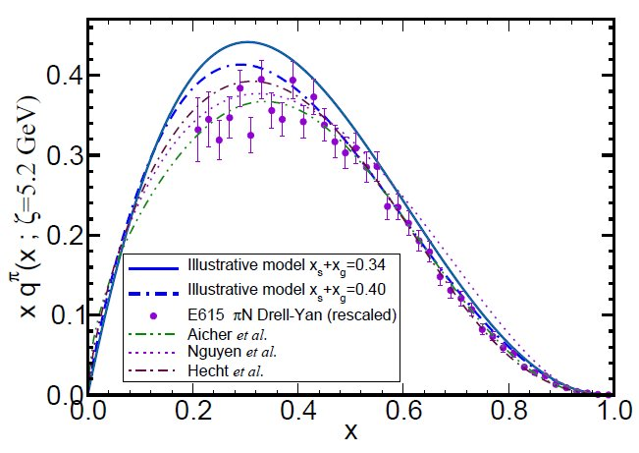
π & K Valence-quark Distribution Functions

Slide 29
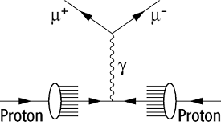
Continuum QCD prediction of π valence-quark distributions
Pion
Owing to absence of pion targets, the pion’s valence-quark distribution functions are measured via the Drell-Yan process:
π p → μ⁺ μ⁻ X
Consider a theory in which quarks scatter via a vector-boson exchange interaction whose k²>>m_{G}² behaviour is (1/k²)^{β},
Then at a resolving scale Q₀
u_{π}(x;Q₀) ~ (1-x)^{2β}
namely, the large-x behaviour of the quark distribution function is a direct measure of the momentum-dependence of the underlying interaction.
In QCD, β=1 and hence
^{QCD} u_{π}(x;Q₀) ~ (1-x)²
QCD: Q>Q₀ ⇒ 2 → 2+γ, γ > 0

Slide 30
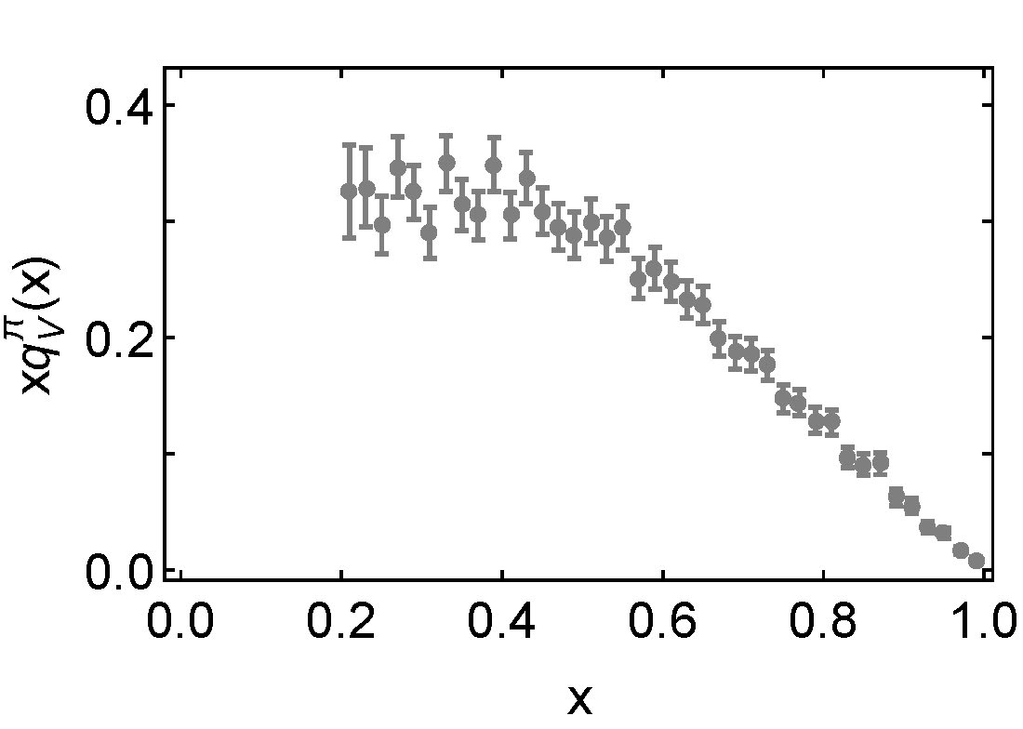
Empirical status of the Pion’s valence-quark distributions
Pion
Owing to absence of pion targets, the pion’s valence-quark distribution functions are measured via the Drell-Yan process:
π p → μ⁺ μ⁻ X
Three experiments:
CERN (1983 & 1985)
FNAL (1989).
None more recent
Conway et al.
Phys. Rev. D 39, 92 (1989)
Leading-order analysis of
the Drell-Yan data: Q² ≈ 27 GeV²
~ 400 citations

Slide 31
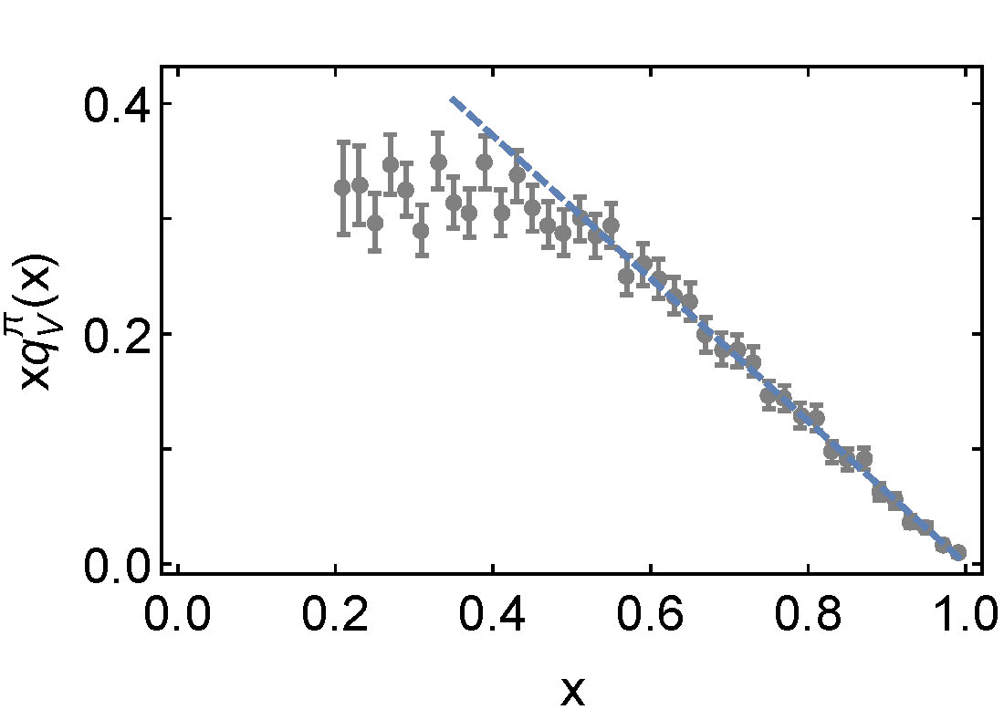
Empirical status of the Pion’s valence-quark distributions
Pion
Owing to absence of pion targets, the pion’s valence-quark distribution functions are measured via the Drell-Yan process:
π p → μ⁺ μ⁻ X
Three experiments:
CERN (1983 & 1985)
FNAL (1989).
None more recent
Conway et al.
Phys. Rev. D 39, 92 (1989)
Leading-order analysis of
the Drell-Yan data: Q² ≈ 27 GeV²
Controversial!
∝ (1-x)¹

Slide 32
π valence-quark distributions 20 Years of Evolution
1989 … Conway et al. Phys. Rev. D 39, 92 (1989)
Leading-order analysis of Drell-Yan data: Q² ≈ 27 GeV²
∝ (1-x)¹

Slide 33
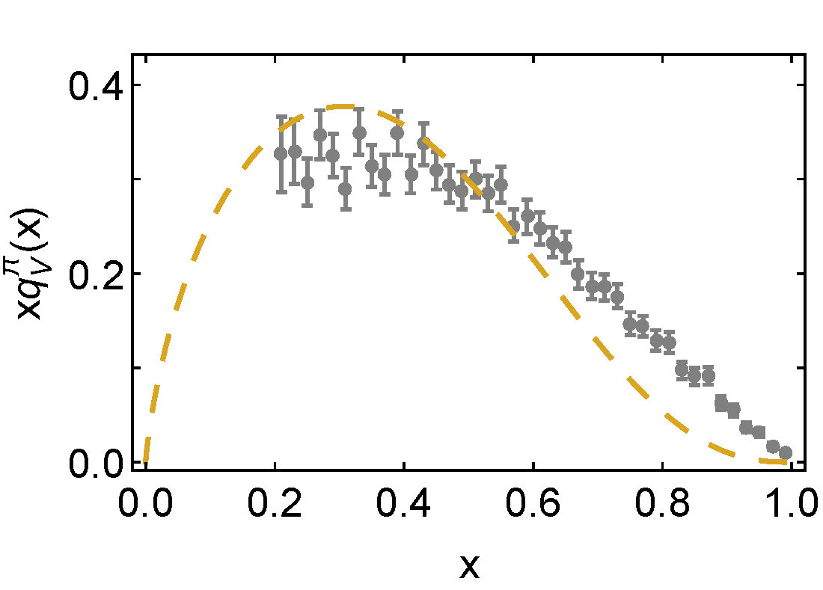
π valence-quark distributions 20 Years of Evolution
1989 … Conway et al. Phys. Rev. D 39, 92 (1989)
Leading-order analysis of Drell-Yan data: Q² ≈ 27 GeV²
2000 … Hecht et al. Phys.Rev. C 63 (2001) 025213
QCD-connected model prediction
∝ (1-x)¹
∝ (1-x)^{2.7}

Slide 34
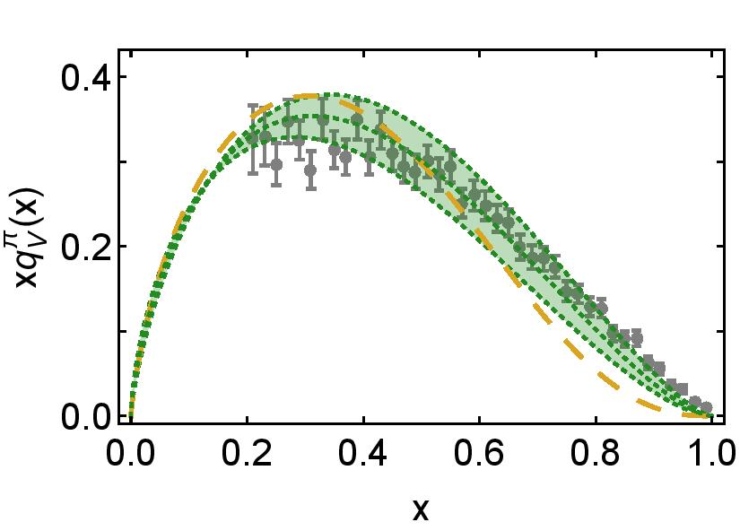
π valence-quark distributions 20 Years of Evolution
1989 … Conway et al. Phys. Rev. D 39, 92 (1989)
Leading-order analysis of Drell-Yan data: Q² ≈ 27 GeV²
2000 … Hecht et al. Phys.Rev. C 63 (2001) 025213
QCD-connected model prediction
2005 … Wijesooriya, Reimer, Holt, Phys. Rev. C 72 (2005) 065203
Partial NLO analysis of E615 data
Large-x power-law → 1.54±0.08
∝ (1-x)¹
∝ (1-x)^{2.7}

Slide 35
π valence-quark distributions 20 Years of Evolution
1989 … Conway et al. Phys. Rev. D 39, 92 (1989)
Leading-order analysis of Drell-Yan data: Q² ≈ 27 GeV²
2000 … Hecht et al. Phys.Rev. C 63 (2001) 025213
QCD-connected model prediction
2005 … Wijesooriya, Reimer, Holt Phys. Rev. C 72 (2005) 065203
Partial NLO analysis of E615 data
Large-x power-law → 1.54±0.08
2010/02 … Controversy highlighted: Holt & Roberts, Rev. Mod. Phys. 82 (2010) 2991-3044
∝ (1-x)¹
∝ (1-x)^{2.7}

Slide 36
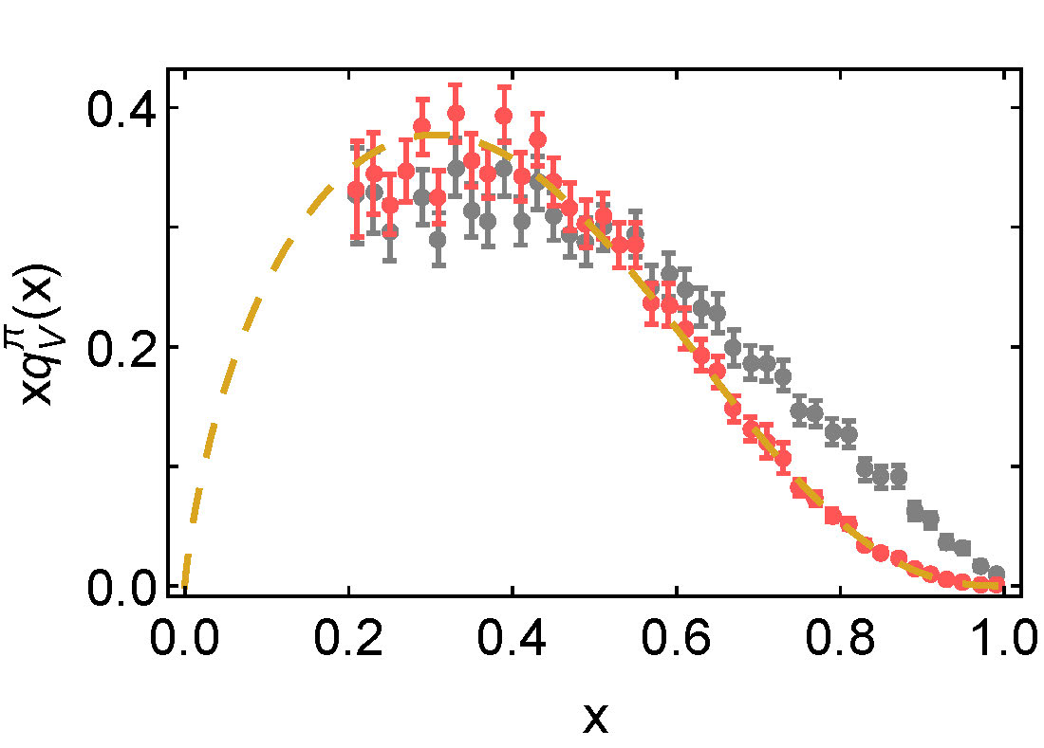
π valence-quark distributions 20 Years of Evolution
1989 … Conway et al. Phys. Rev. D 39, 92 (1989)
Leading-order analysis of Drell-Yan data: Q² ≈ 27 GeV²
2000 … Hecht et al. Phys.Rev. C 63 (2001) 025213
QCD-connected model prediction
2010/02 … Controversy highlighted: Holt & Roberts, Rev. Mod. Phys. 82 (2010) 2991-3044
2010/09 … Reconsideration of data: Aicher et al., Phys. Rev. Lett. 105 (2010) 252003
Consistent next-to-leading-order analysis
Large-x power-law → 2.6(1)
∝ (1-x)^{2.7}

Slide 37
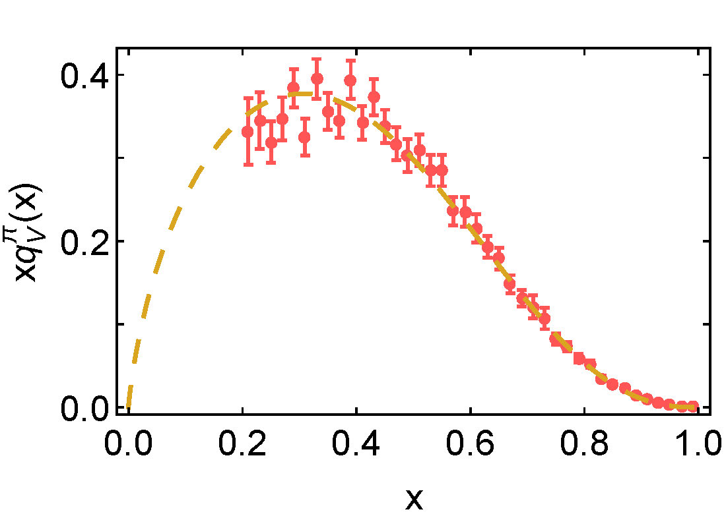
π valence-quark distributions 20 Years of Evolution
1989 … Conway et al. Phys. Rev. D 39, 92 (1989)
Leading-order analysis of Drell-Yan data: Q² ≈ 27 GeV²
2000 … Hecht et al. Phys.Rev. C 63 (2001) 025213
QCD-connected model prediction
2010/02 … Controversy highlighted: Holt & Roberts, Rev. Mod. Phys. 82 (2010) 2991-3044
2010/09 … Reconsideration of data: Aicher et al., Phys. Rev. Lett. 105 (2010) 252003
Consistent next-to-leading-order analysis
Large-x power-law → 2.6(1)
∝ (1-x)^{2.7}

Slide 38
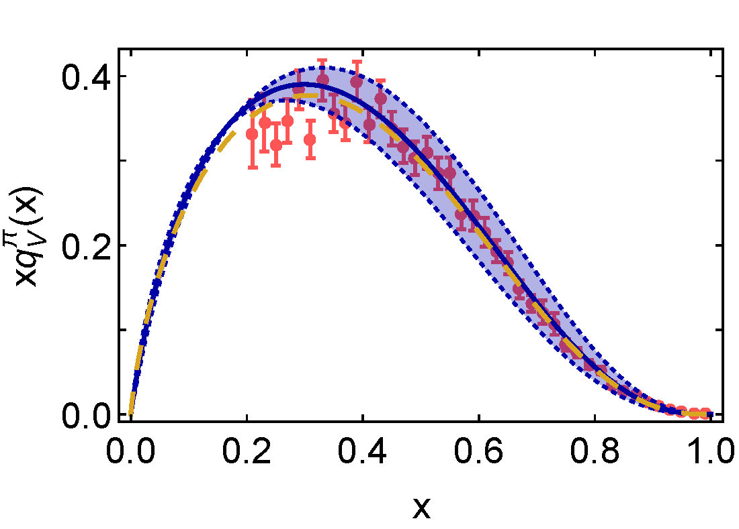
π valence-quark distributions 20 Years of Evolution
2010/09 … Reconsideration of data: Aicher et al., Phys. Rev. Lett. 105 (2010) 252003
Consistent next-to-leading-order analysis
2019/04 … Ding, et al.
Continuum QCD prediction, using most sophisticated bound-state kernels currently available

Slide 39
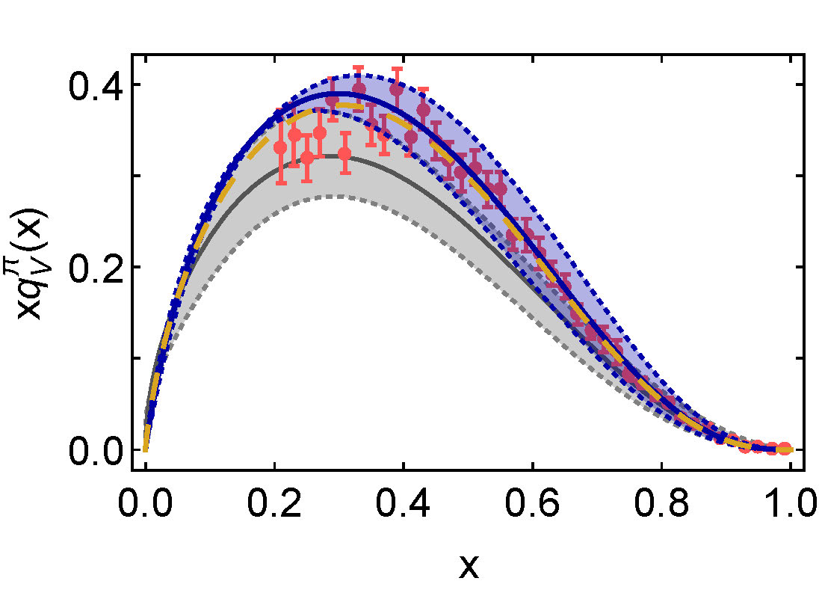
π valence-quark distributions 20 Years of Evolution
Large-x exponent ^{ζ = 5.2GeV} and momentum^{ζ = 2GeV}
Continuum … 2.3(1) & <2x> = 0.52±0.04
Lattice … 2.2(1) & <2x> = 0.42±0.05
2010/09 … Reconsideration of data: Aicher et al., Phys. Rev. Lett. 105 (2010) 252003
Consistent next-to-leading-order analysis
2019/04 … Ding, et al.
Continuum QCD prediction, using most sophisticated bound-state kernels currently available
2019/01 … Sufian, et al.
1st exploratory lattice-QCD calculation,
using lattice-calculable matrix element obtained through spatially-separated current-current correlations in coordinate space
m_{π}² = 9 m_{π}²-physical

Slide 40
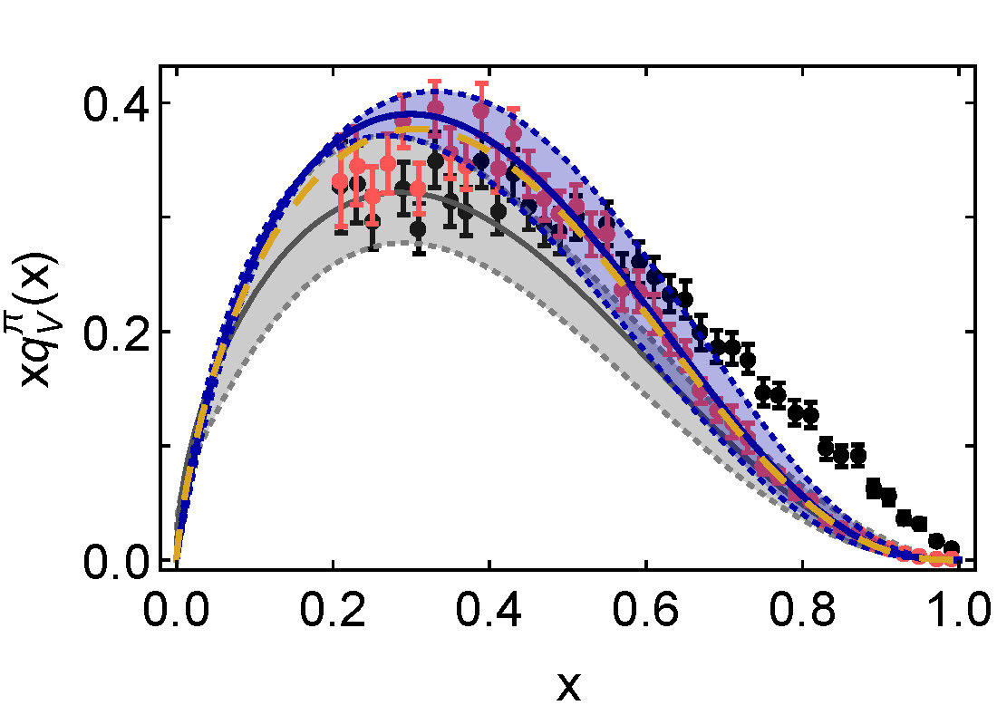
π valence-quark distributions 20 Years of Evolution
Large-x exponent ^{ζ = 5.2GeV} and momentum^{ζ = 2GeV}
Continuum … 2.3(1) & <2x> = 0.52±0.04
Lattice … 2.2(1) & <2x> = 0.42±0.05
Large-x exponent ^{ζ = 5.2GeV} and momentum^{ζ = 2GeV}
Continuum … 2.3(1) & <2x> = 0.52±0.04
Lattice … 2.2(1) & <2x> = 0.42±0.05
2010/09 … Reconsideration of data: Aicher et al., Phys. Rev. Lett. 105 (2010) 252003
Consistent next-to-leading-order analysis
2019/04 … Ding, et al.
Continuum QCD prediction, using most sophisticated bound-state kernels currently available
2019/01 … Sufian, et al.
1st exploratory lattice-QCD calculation,
using lattice-calculable matrix element obtained through spatially-separated current-current correlations in coordinate space
m_{π}² = 9 m_{π}²-physical
Modellers still ignoring QCD
& violating symmetries
Phenomenologists question analysis
of Aicher et al.

Slide 41
π & K PDFs
Urgent need for Newer Data
Persistent controversy regarding the Bjorken-x ≃1 behaviour of the pion’s valence-quark PDF
Single modest-quality measurement of u^{K}(x)/u^{π}(x) (1980) cannot be considered definitive.
Approved experiment, using tagged DIS at JLab 12, should contribute to a resolution of pion question
Similar technique might also serve for the kaon … experiment approved
Future:
New mesonic Drell-Yan measurements at modern facilities (COMPASS at LHC) could yield valuable information on π and K PDFs
Discussed extensively in “Letter of Intent: A New QCD facility at the M2 beam line of the CERN SPS (COMPASS++/AMBER)” [http://arxiv.org/abs/arXiv:1808.00848]
EIC would be capable of providing access to π and K PDFs through measurements of forward nucleon structure functions.

Slide 42
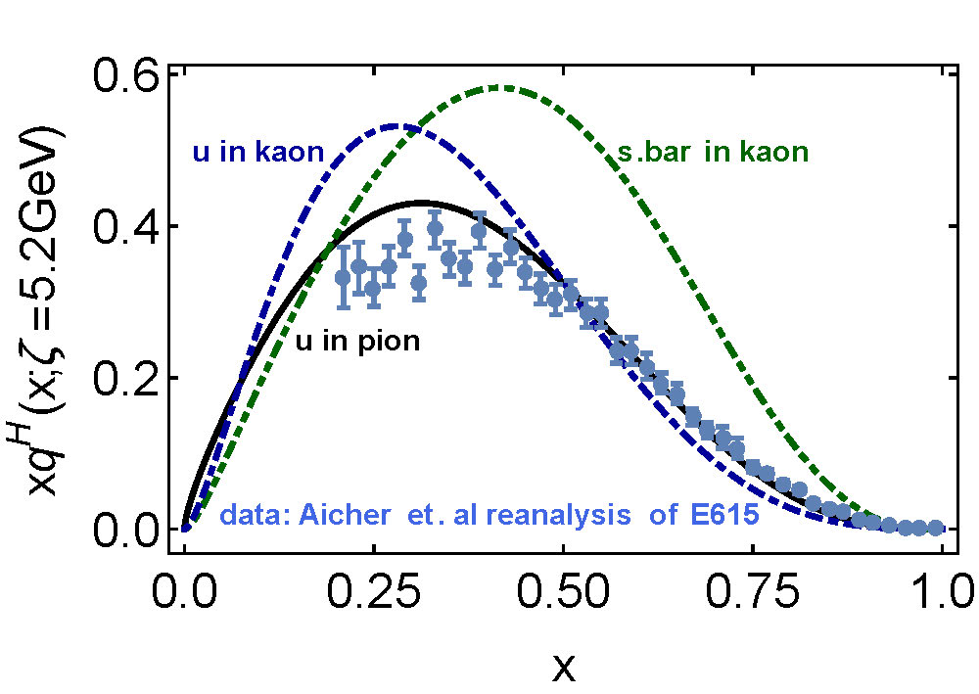
Kaon’s gluon content
0%
10%
〈x〉_{g}^{K}(ζ_{H}) = 0.05 ± 0.05
⇒ Valence quarks carry
95% of kaon’s
momentum at ζ_{H}
DGLAP-evolved to ζ₂
Valence-quarks carry ⅔ of kaon’s light-front momentum
Cf. Only ½ for the pion

Slide 43
π & K PDFs
Valence-quark distribution functions in the kaon and pion,
Chen Chen, Lei Chang et al.
arXiv:1602.01502 [nucl-th], Phys. Rev. D93 (2016) 074021/1-11
Marked differences between π & K gluon content
ζ_{H}:
Whilst $\frac{1}{3}$ ∼ $\frac{1}{5}$of pion’s light-front momentum carried by glue
$Only \frac{1}{20}$ of the kaon’s light-front momentum lies with glue
ζ₂² = 4 GeV²
Glue carries $\frac{1}{2}$ of pion’s momentum and $\frac{1}{3}$ of kaon’s momentum
Evident in differences between large-x behaviour of valence-quark distributions in these two mesons
Signal of Nambu-Goldstone boson character of π
Nearly complete cancellation between
one-particle dressing and binding attraction
in this almost-massless pseudoscalar system
2 Mass_{Q} + U_{g} ≈ 0

Slide 44
π & K PDFs
Valence-quark distribution functions in the kaon and pion,
Chen Chen, Lei Chang et al.
arXiv:1602.01502 [nucl-th], Phys. Rev. D93 (2016) 074021/1-11
Understanding the emergence and character of Nambu-Goldstone modes in the Standard Model is critical
Nambu-Goldstone modes are nonpointlike!
Intimately connected with origin of mass!
Possibly/Probably(?) inseparable from expression of confinement!
Difference between gluon content of π & K is measurable … using well-designed EIC
Write a definitive new chapter in future textbooks on the Standard Model

Slide 45
Epilogue

Slide 46
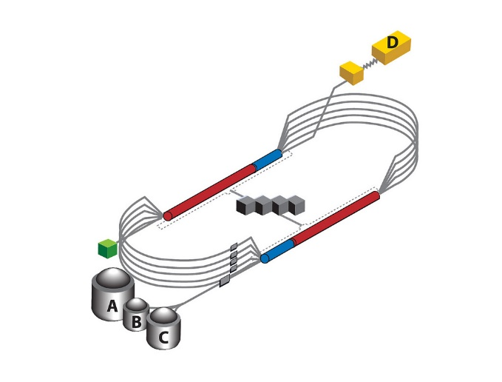
Epilogue
Challenge: Explain and Understand
the Origin and Distribution of the Vast Bulk of Visible Mass
Current Paradigm: Quantum Chromodynamics
QCD is plausibly a mathematically well-defined quantum field theory,
The only one we’ve ever produced
Consequently, it is a worthwhile paradigm for developing Beyond-SM theories
Challenge is to reveal the content of strong-QCD
Tough Problem
Progress and Insights
being delivered by amalgam of
Experiment
Phenomenology
Theory
Must continue into eras of

