Slide 1

Jefferson Lab Report
Bob McKeown
2019 GHP Workshop

Slide 2
Outline
Recent Highlights
12 GeV Program, PAC
Future Projects
EIC
Summary

Slide 3
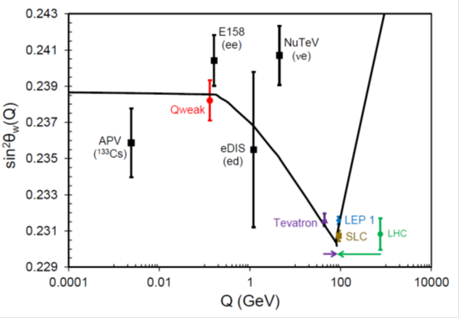
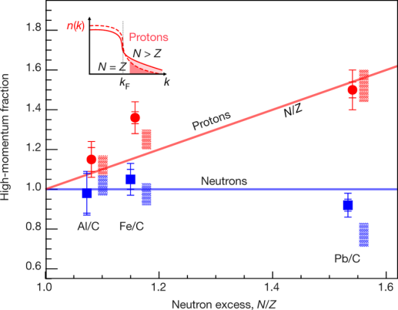
Results Published in Nature
Final Qweak results:
Nature 557, 207–211 (2018)
An accurate calculation of the nucleon axial charge with lattice QCD:
Nature 558, 91-94 (2018)
The weak charge of the proton – “Qweak”, represents the (tiny) difference of the charge of the proton and it’s mirror image
The pressure distribution in the proton:
Nature 557 (2018) no.7705, 396-399
Ultrafast Nucleons in Asymmetric Nuclei:
Nature 560 (2018) no.7720, 617-621
Analysis of 6 GeV CLAS DVCS data on the proton.
Modified Structure of Protons and Neutrons in Correlated Pairs (accepted)
Annual NP 2021 Budget Presentation

Slide 4
Jefferson Lab User Growth
“Other Users” include US National Labs and Industry

Slide 5
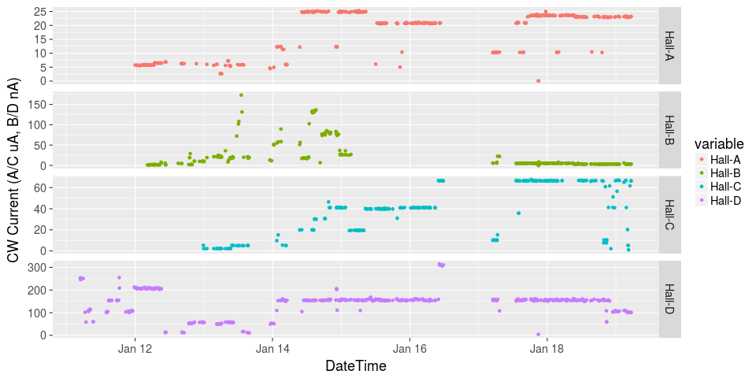
Initiated Four Hall Operation!
μA
A up!
nA
Installation
B up!
Beam Current
Pass Change
μA
C up!
D up!
nA

Slide 6
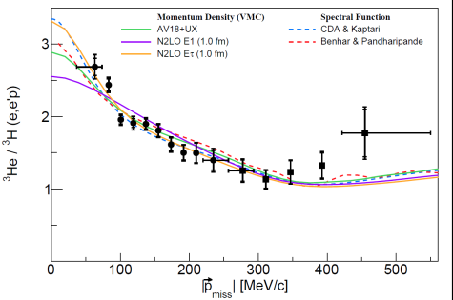
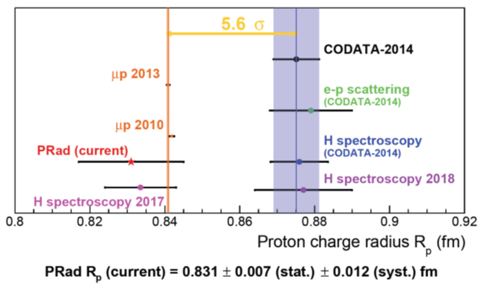
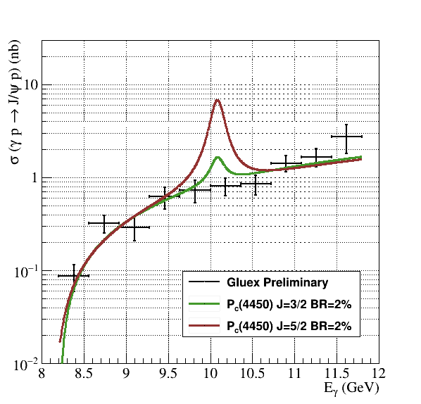
12 GeV Science Era in Full Swing!
Hall A:
  Tritium family of experiments – all 4 complete!
  Ran APEX, Installation of PREX/CREX underway
Hall B:
  First phase of Run Group A complete
  Started Run Group B (deuterium)
  PRad current results
  HPS run in summer 2019
Hall C:
  3.7 experiments completed
  F₂^{d}/F₂^{p} preliminary result
  Search for LHCb pentaquark complete
Hall D:
  GlueX phase I complete
  Threshold J/ψ manuscript in preparation
  DIRC enhancement under test
  Primex-η getting started

Slide 7

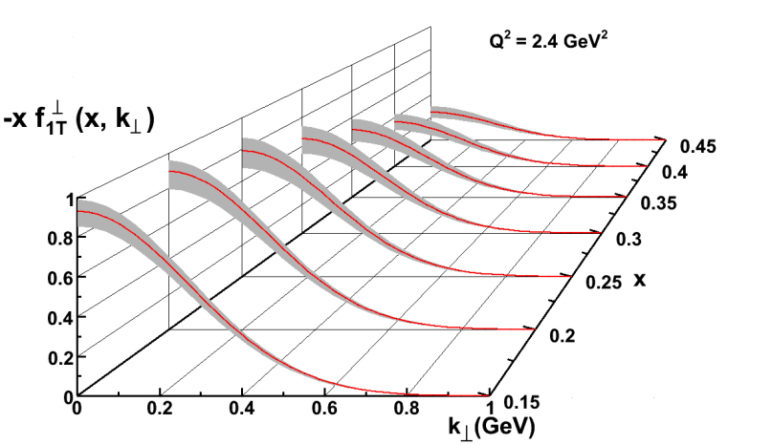
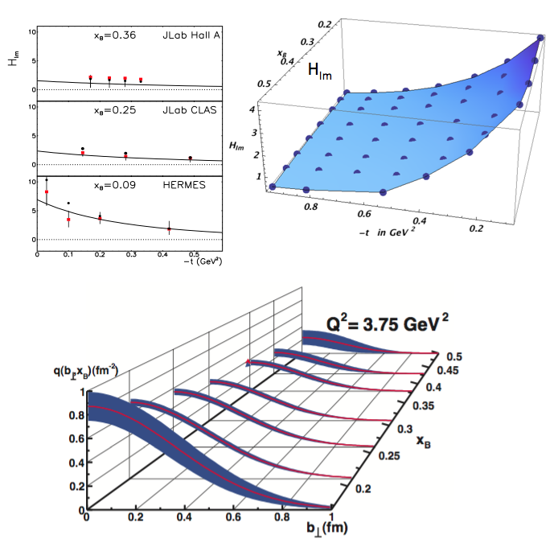
Nuclear Femtography
5D
Transverse Momentum Distribution (TMD)
– Confined motion in a nucleon (semi-inclusive DIS)
Generalized Parton Distribution (GPD)
– Spatial imaging (exclusive DVCS)
Requires
– High luminosity
– Polarized beams and targets
– Sophisticated detector systems
3D
Center for Nuclear Femtography
Proposal to Commonwealth of Virginia
  Initial request of $0.5M for pilot study awarded; funding of ~$2M/year envisioned
Consortium of Virginia universities
Theoretical physics, experimental physics, computation, data science, statistics – interdisciplinary effort
Benefit to 12 GeV program and future EIC studies
Symposium on Imaging and Visualization in Science’ , UVa, Dec. 10-11, 2018.
Major new capability
with JLab @ 12 GeV

Slide 8
Approved experiments (thru march 17)
Topic | Hall A | Hall B | Hall C | Hall D | Other | Total
Hadron spectra as probes of QCD | 0 | 2 | 1 | 3 | 0 | 6
Transverse structure of the hadrons | 6 | 3 | 3 | 1 | 0 | 13
longitudinal structure of the hadrons | 2 | 3 | 7 | 0 | 0 | 12
3D structure of the hadrons | 5 | 9 | 6 | 0 | 0 | 20
Hadrons and cold nuclear matter | 8 | 5 | 7 | 0 | 1 | 21
Low-energy tests of the Standard Model and Fundamental Symmetries | 3 | 1 | 0 | 1 | 2 | 7
Total | 24 | 23 | 24 | 5 | 3 | 79
Total Experiments Completed | 6.9 | 5.4 | 4.8 | 1.2 | 0 | 18.3
Total Experiments Remaining | 17.1 | 17.6 | 19.2 | 3.8 | 3.0 | 60.7

Slide 9
Approved Experiments – PAC Days (thru March 17)
Topic | Hall A | Hall B | Hall C | Hall D | Other | Total
Hadron spectra as probes of QCD | 0 | 219 | 11 | 540 | 0 | 770
Transverse structure of the hadrons | 150.5 | 85 | 110 | 25 | 0 | 370.5
longitudinal structure of the hadrons | 65 | 230 | 211 | 0 | 0 | 506
3D structure of the hadrons | 409 | 872 | 197 | 0 | 0 | 1478
Hadrons and cold nuclear matter | 220 | 275 | 205 | 0 | 14 | 714
Low-energy tests of the Standard Model and Fundamental Symmetries | 547 | 180 | 0 | 79 | 60 | 866
Total Days | 1392 | 1861 | 734 | 644 | 74 | 4704.5
Total Days - (includes MOLLER) | 917.5 | 1861 | 734 | 644 | 28 | 4184.5
Total Approved Run Group Days (includes MIE) | 1392 | 1026 | 691 | 444 | 74 | 3626.5
Total Approved Run Group Days (includes MOLLER) | 917.5 | 1026 | 691 | 444 | 28 | 3106.5
Total Days Completed | 173.5 | 145 | 111.5 | 132 | 0 | 562
Total Days Remaining | 744 | 881 | 579.5 | 312 | 28 | 2545
A Decade of Experiments!

Slide 10
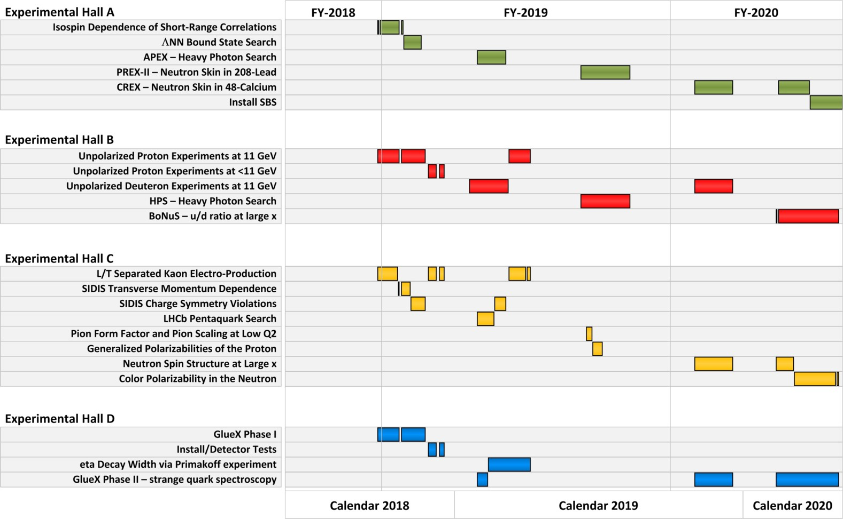
Published FY19-20 Schedule

Slide 11
PAC47
July 29th - August 2, 2019
Proposals will be due June 10 (call being drafted)
New members: Markus Diehl, Barbara Erasmus,
Matthias Grosse Perdekamp
Will initiate Jeopardy process...

Slide 12
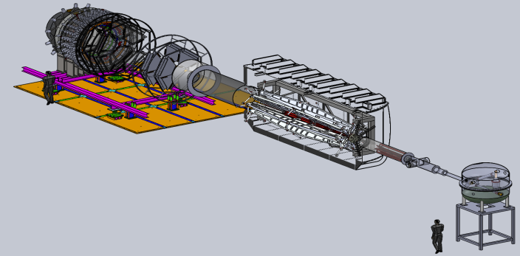

Future Projects
MOLLER experiment
(Possible MIE – FY20-24)
– Precision Standard Model Test
– DOE science review (Sept. 2014) – strong endorsement
– Director’s Cost, Schedule and Technical review held Dec. 2016
– CD-0 approved, Dec. 2016
– FY20 start in Pres. budget
– Director’s Review April 24-26, 2019
SoLID
– Large acceptance, high lumi
– SIDIS and PVDIS
– CLEO Solenoid 
– International collaboration
– Director’s review (Feb. 2015)
 new pre-CDR complete
– Director’s review in CY19
– Awaiting science review from ONP

Slide 13

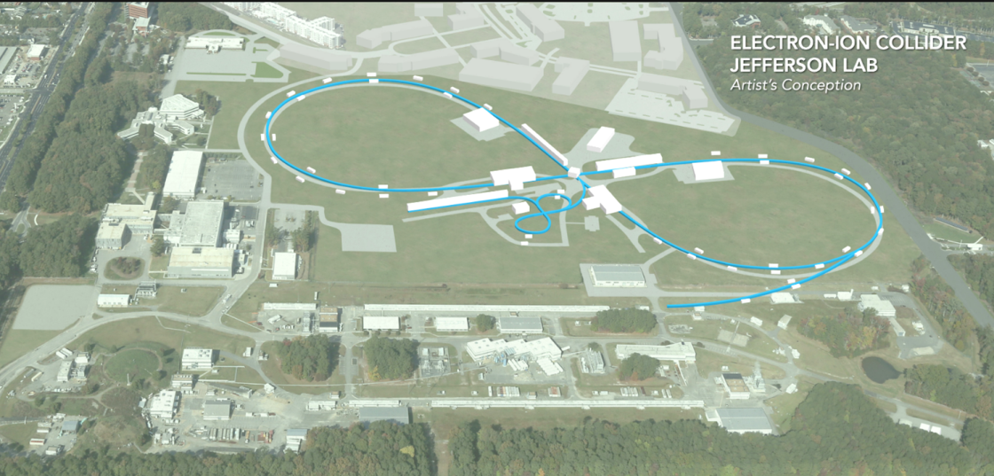
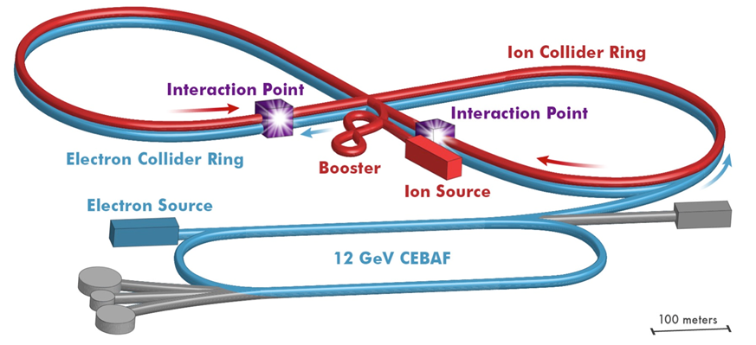
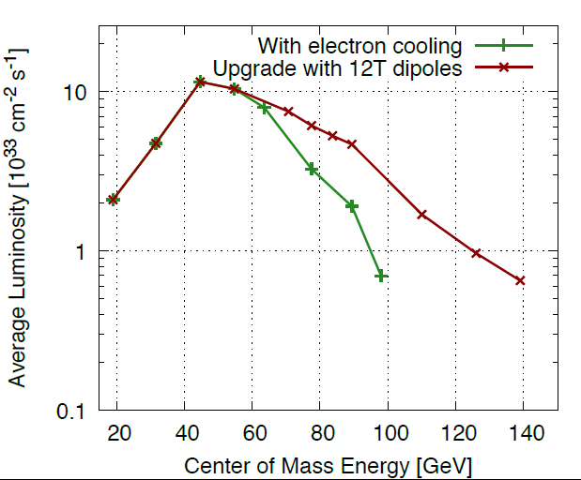

Electron Ion Collider at Jefferson Lab
JLab EIC Figure 8 Concept
    High Polarization (including deuterons)
    High Luminosity
    Energy Range: √s : 20 to 100-140 GeV (magnet technology choice)
    Low technical risk
    Flexible timeframe for construction
    consistent w/running 12 GeV CEBAF
    High performance, low-risk, well-reviewed
    Cost effective operations
    Fulfills White Paper, NAS Requirements
100 fb⁻¹/yr
PreCDR under revision,
E_{CM} 65100GeV
Annual NP 2021 Budget Presentation

Slide 14

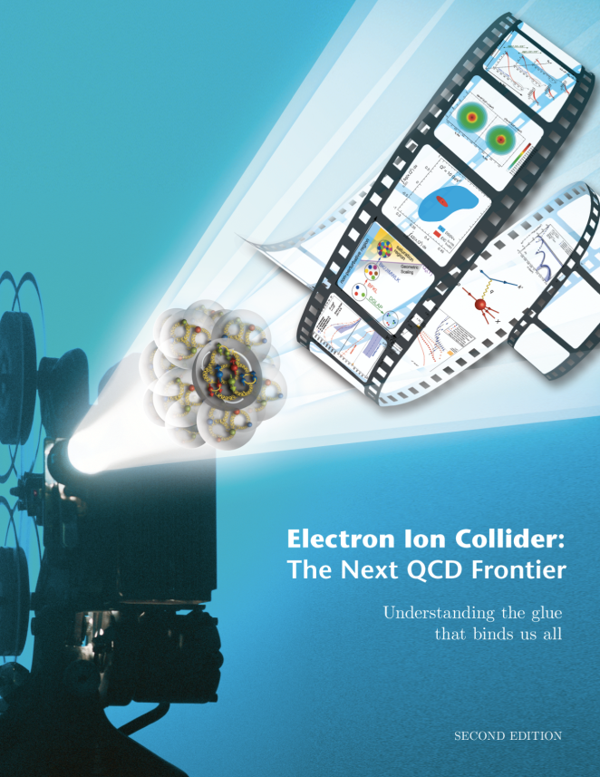
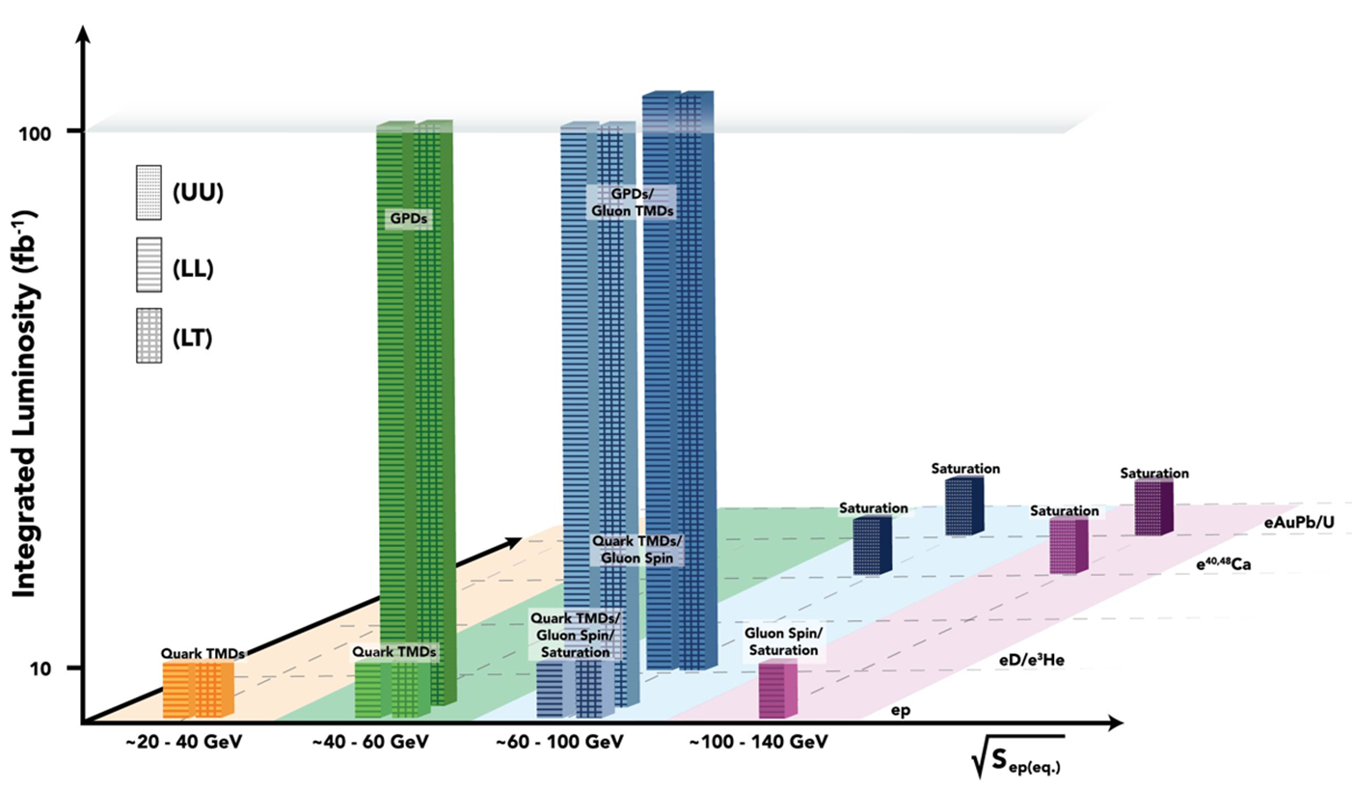
EIC white paper Science goals
Note: Total of ~640 fb⁻¹
  10³⁴ cm⁻²s⁻¹  6 fb⁻¹/week,
  ( >100 fb⁻¹ /year)
  10³³ cm⁻²s⁻¹  0.6 fb⁻¹/week,
  ( >10 fb⁻¹ /year)

Slide 15

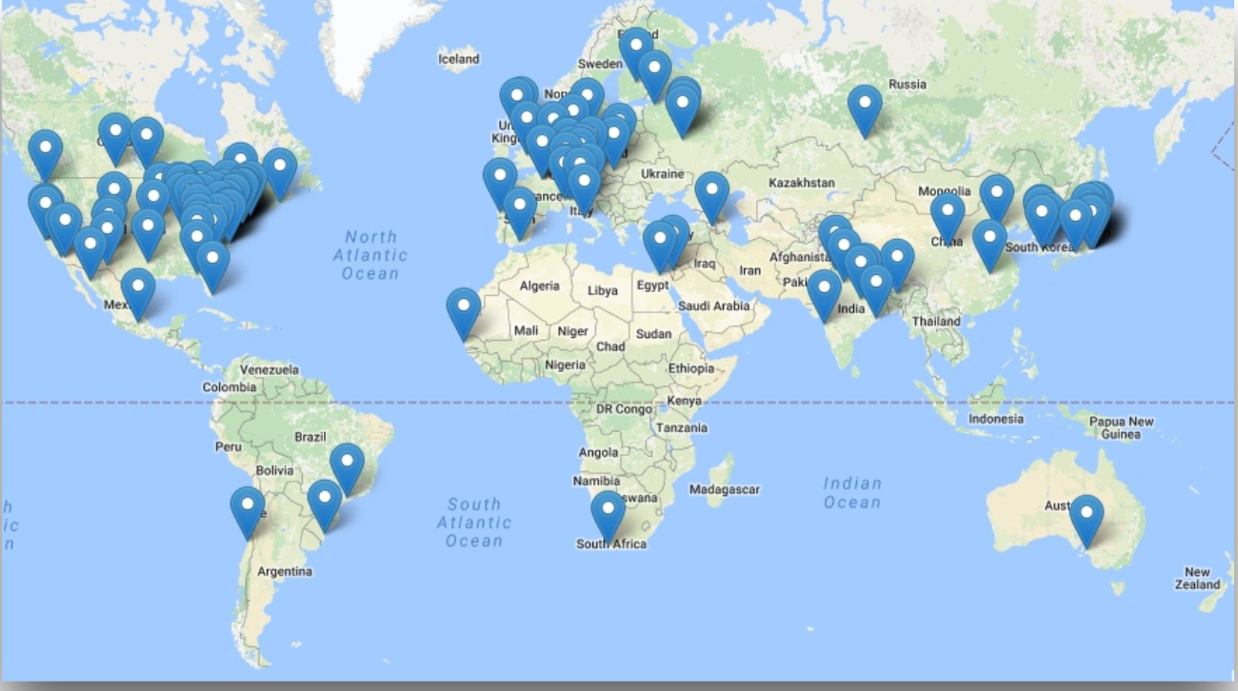
EIC Users Group and International Interest
Formed 2016, currently: 849 members
180 institutions, 30 countries

Slide 16
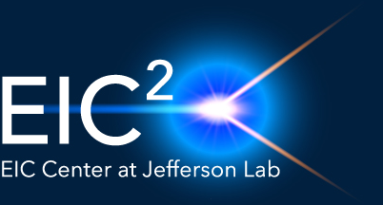
Electron-Ion Collider Center
The Electron-Ion Collider Center (EIC²@JLab) is an organization to advance and promote the science program at a future electron-ion collier (EIC) facility. Particular emphasis is on the close connection of EIC science to the current Jefferson Lab 12 GeV CEBAF science program.
EIC seminars
Enhance EIC coverage at HUGS and JLab User Meeting
Graduate Fellowships
Postdoctoral Fellowships
Fellowship applications due April 30, 2019
https://www.eiccenter.org/?q=jefferson-lab-eic-fellowships

Slide 17

2019 EICUG Meeting

Slide 18
Summary
12 GeV science program at JLab is underway
  4 Hall operation is now routine
  A broad program of 78 approved experiments with many opportunities for discovery is planned
  Initial science results are already being reported
Future Equipment projects
  MOLLER: CD0 – hope for FY20 start
  SoLID: Prepare for DOE science review
  NSF mid-scale?
EIC status continues to develop
- Community developments
- JLEIC design effort continues

