Slide 1
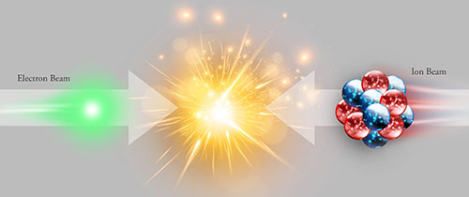
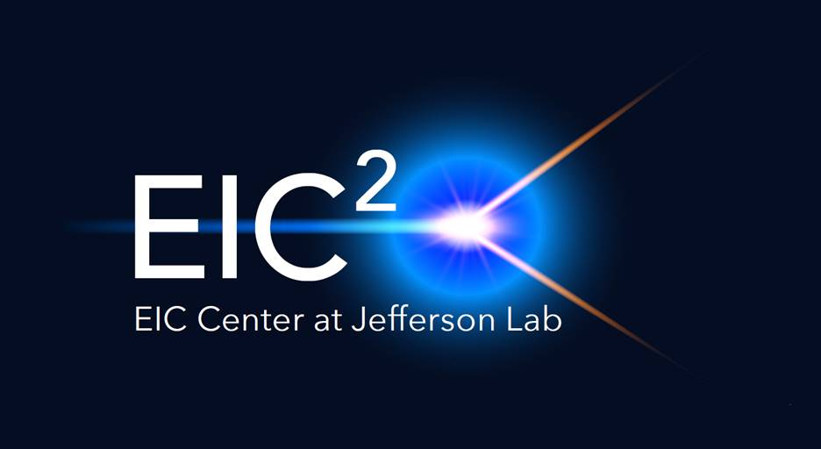
EIC Detector Requirements
Rik Yoshida
EIC Collaboration Meeting, JLab, October 30, 2018

Slide 2
Outline
The Fundamental Science Questions
  Three NAS questions
Quarks, gluons; nucleons and nuclei.
  Collinear partons, evolution and saturation
  Transverse momenta and positions
What we need to measure.
Current detector concepts.
Background for electron-ion machines.
More than one detector?
Conclusions

Slide 3
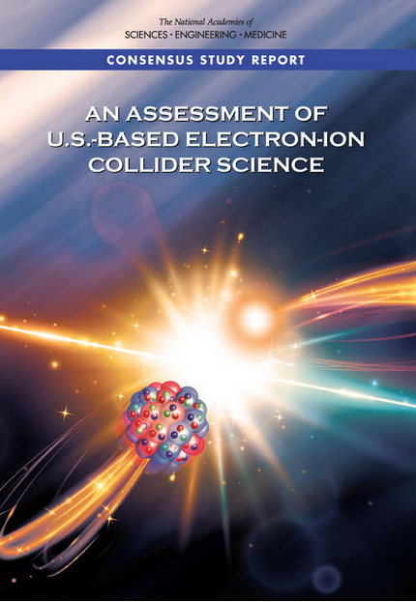
Findings of the NAS committee
Finding 1: An EIC can uniquely address three profound questions about nucleons—neutrons and protons—and how they are assembled to form the nuclei of atoms:
  How does the mass of the nucleon arise?
  How does the spin of the nucleon arise?
  What are the emergent properties of dense systems of gluons?
Finding 2: These three high-priority science questions can be answered by an EIC with highly polarized beams of electrons and ions, with sufficiently high luminosity and sufficient, and variable, center-of-mass energy.

Slide 4
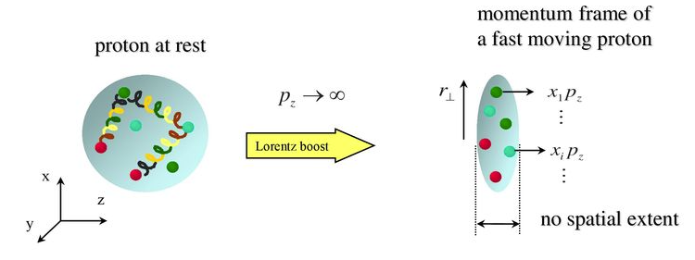
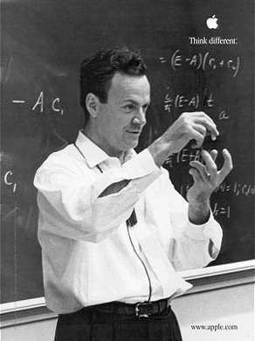

Parton Model
Feynman
Imagine the proton is moving very (very) fast.
Then the proton is “flattened” due to Lorenz contraction.
If the proton content (“partons”) is probed quickly enough
then perhaps we can measure what fraction of the momentum
the parton being probed (called Bjorken-x).
Bjorken

Slide 5
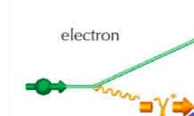
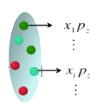
Quantum Entanglement resolved (for Bjorken-x)
As long as the the probe has small
enough wavelength, the probe (the
virtual photon) and the proton are not
entangled. (factorization)
This means we can measure the momentum distributions of quarks and gluons..
but in 1 direction only.
The momentum distribution itself has its origins in the un-calculable part of
QCD. So we gain an imperfect picture of the proton.

Slide 6
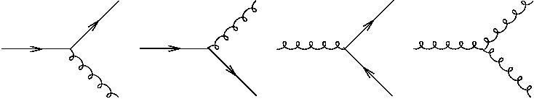
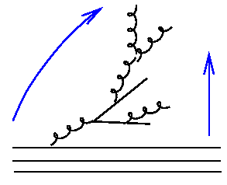

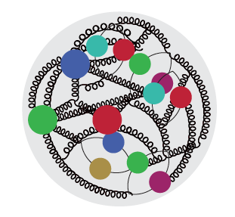
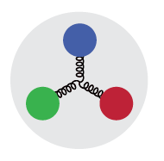
Measuring x-distributions
resolution
smaller x
x ≈ 10⁻⁴
Probe non-linear dynamics
short exposure time
x ≈ 10⁻²
Probe rad. dominated
medium exposure time
x ≈ 0.3
Probe valence quarks
long exposure time

Slide 7
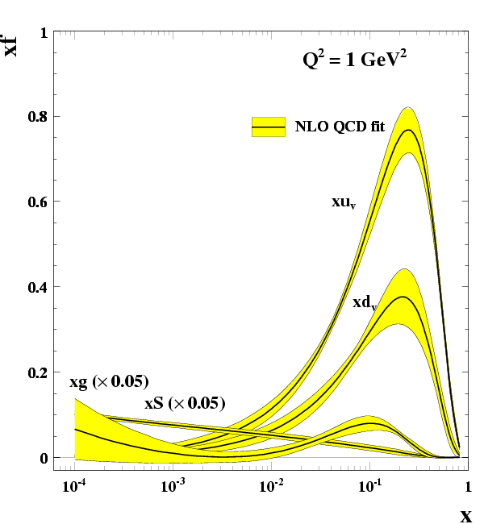

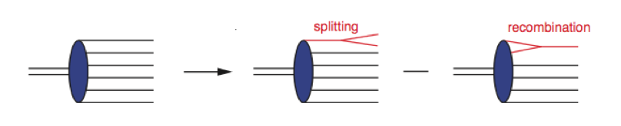
Measuring x-distributions
How far can this rise go on?
A part of question 3

Slide 8
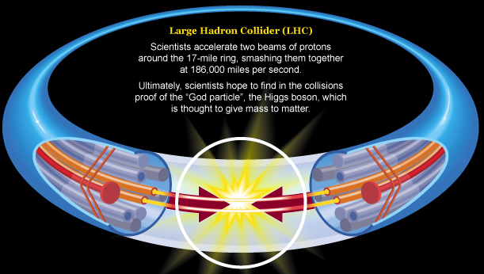
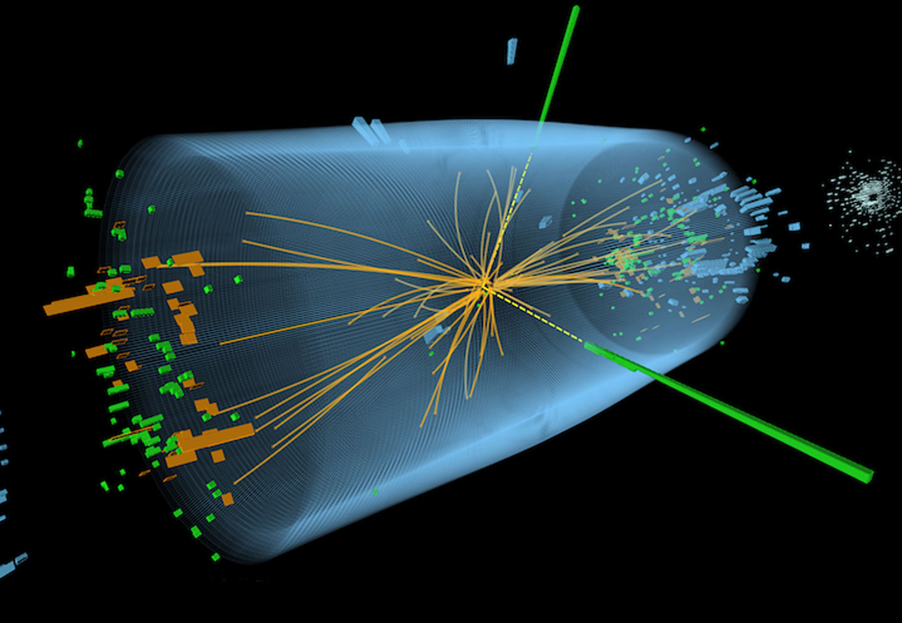
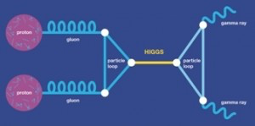
Large Hadron Collider
Beam of quarks and gluons

Slide 9
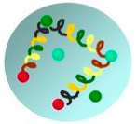
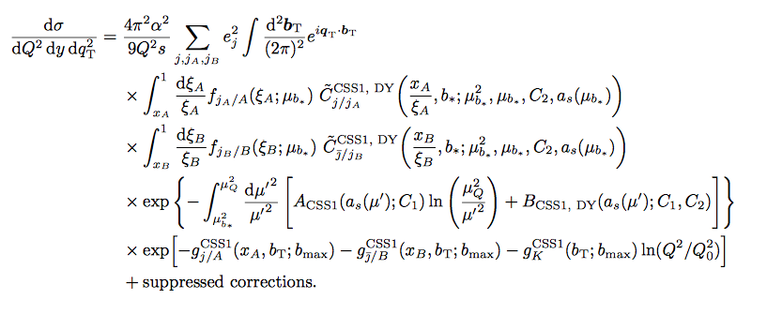
Learning to “turn” the proton
Fast proton as seen from the side
Fast proton seen head-on
QCD Theory development in last 30 years
New Factorization
Old factorization

Slide 10
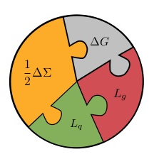

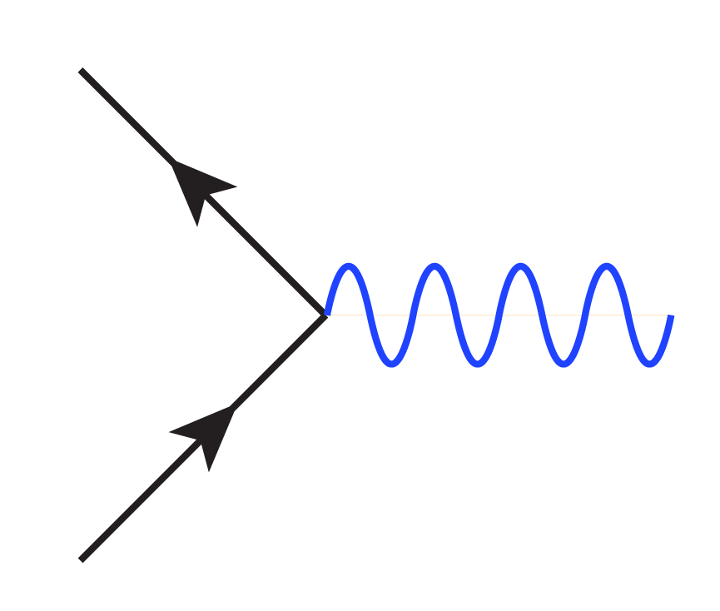
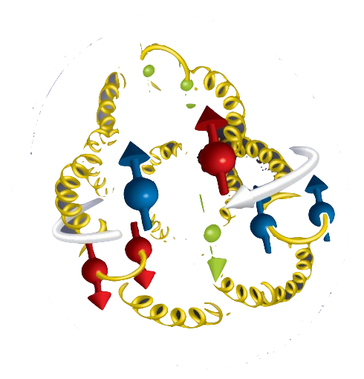
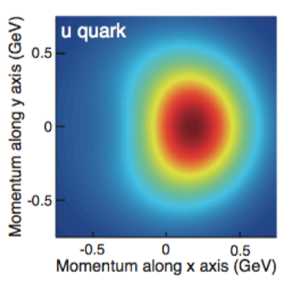
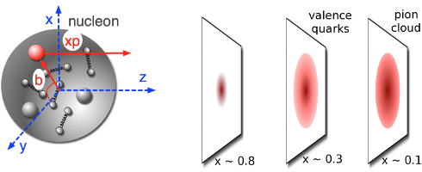
EIC Science (questions 1 & 2)
example: Spin Puzzle
Try to gain
dynamical
understanding
Some naïve expectations
Momentum imaging
(TMD’s)
Proton is transversely
polarized
p
b
Spatial Imaging (GPDs)
Measure the quarks (and gluons) and relate this information to nucleon characteristics
Imaging → Measuring the correlations of position, momentum, spin, density: map the
relationship between the parton state and the nucleon state.

Slide 11
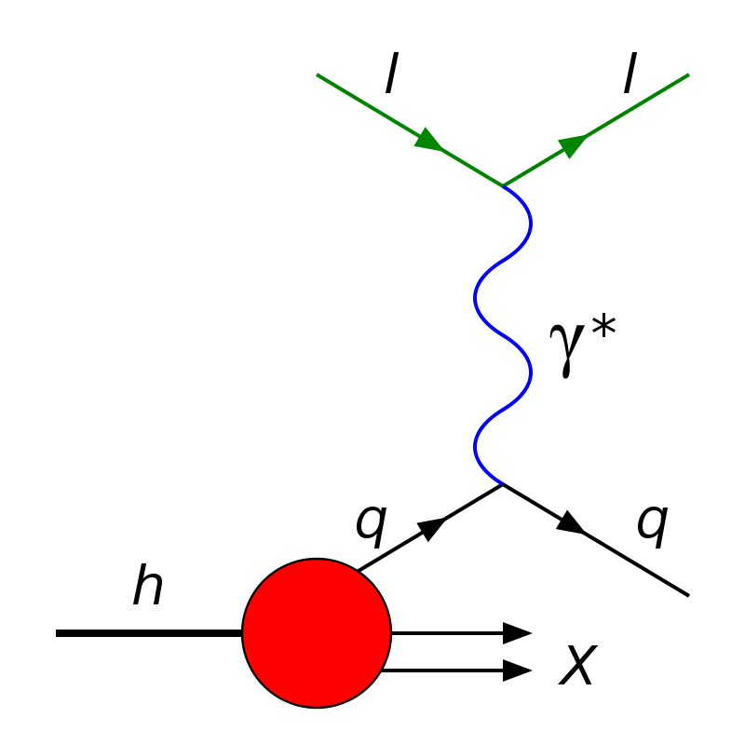
What do we need to measure?

Slide 12
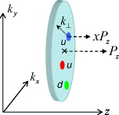

Consider the Transverse Momentum
This interaction stays in the scattering
plane in the absence of transverse
momentum carried by the initial quark
100 GeV
We want to measure momentum in/out of plane
~100 MeV
Also need particle ID: flavor structure of the proton

Slide 13
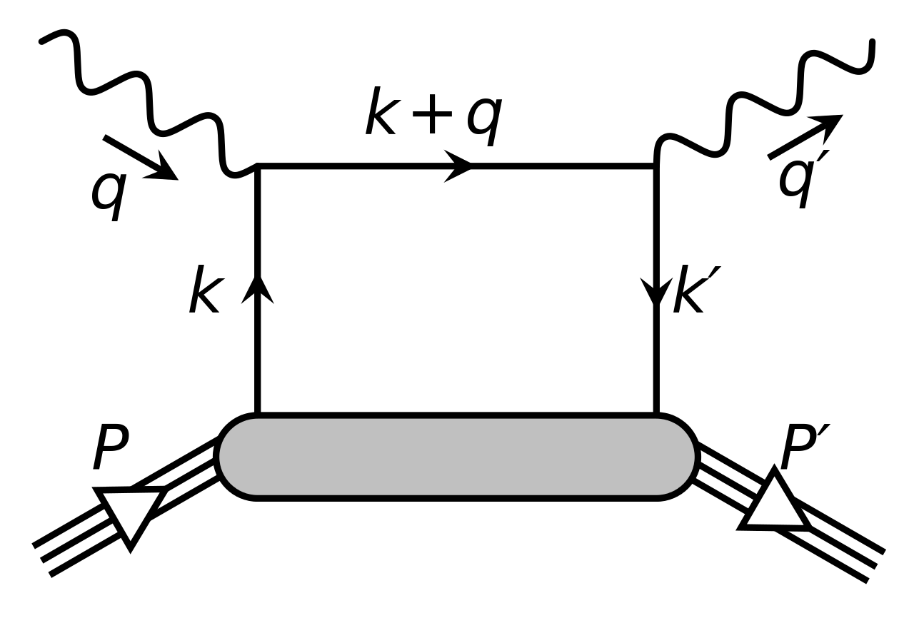
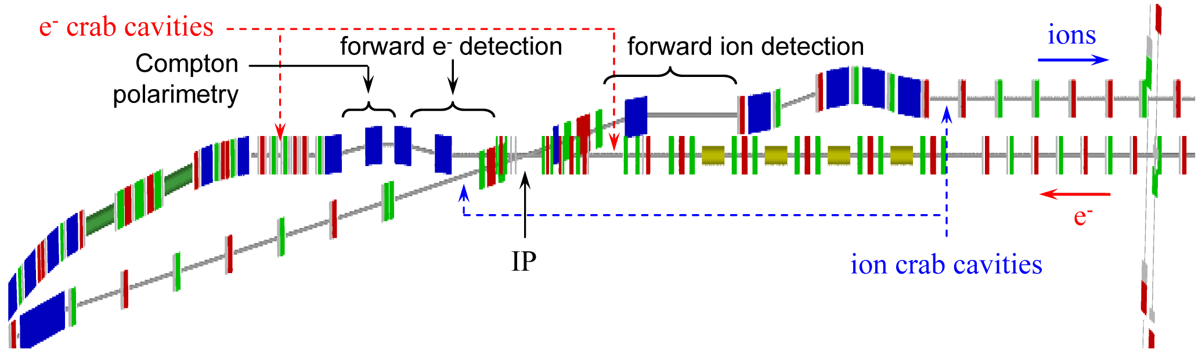
Using Interactions where protons stays intact
Deeply Virtual Compton Scattering
The Pt of the final state proton carries information
on the impact parameter of the collision
Measure Transvers position of the struck parton
JLEIC example
Extended detector: 80+ m
Crossing angle and FFQ’s with wide aperture

Slide 14
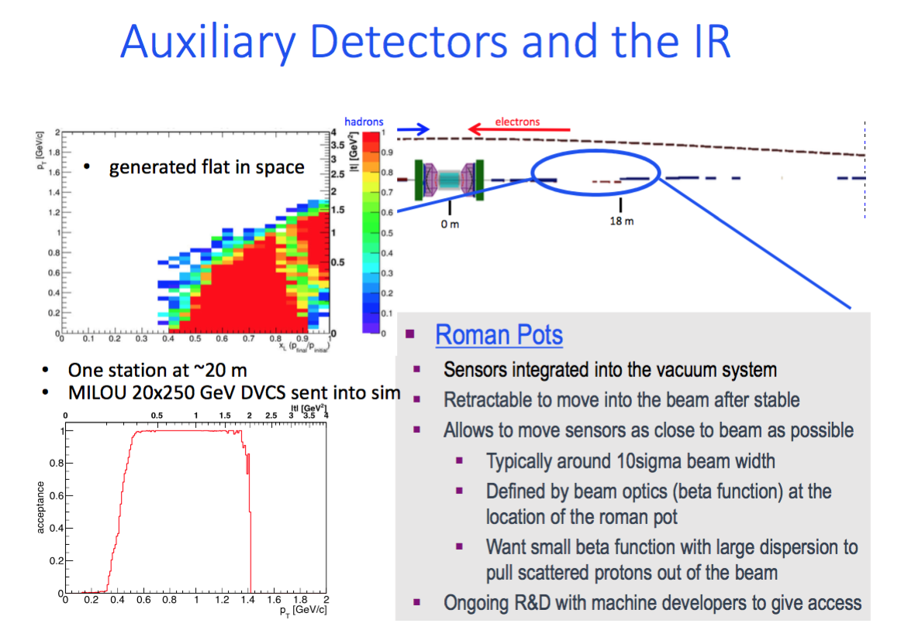
eRHIC Forward Hadron Detector Concept
Richard Petti Spin 2016

Slide 15
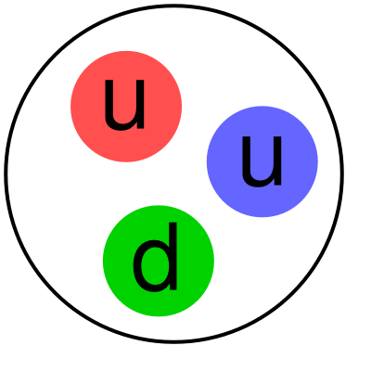
Detector and IR: Final State Particles
EIC detector must accept and measure
all particles from the interaction.
(Unlike existing collider detectors!)
Scattered electron
Ion beamline
Electron beamline
Particles Associated with Initial Ion
Particles associated with struck parton
Beam Elements
Central
Detector
Beam elements limit forward acceptance
Central Solenoid not effective for forward
Beam Elements

Slide 16
QCD at Extremes: Parton Saturation
HERA discovered a dramatic rise in the number
of gluons carrying a small fractional longitudinal
momentum of the proton (i.e. small-x).
This cannot go on forever as
x becomes smaller and smaller:
parton recombination must
balance parton splitting.
i.e. Saturation—unobserved at
HERA for a proton. (expected
at extreme low x)
In nuclei, the interaction probability enhanced by A^{⅓}
Will nuclei saturate faster as color leaks out of nucleons?

Slide 17
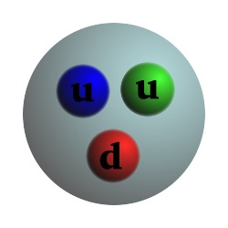
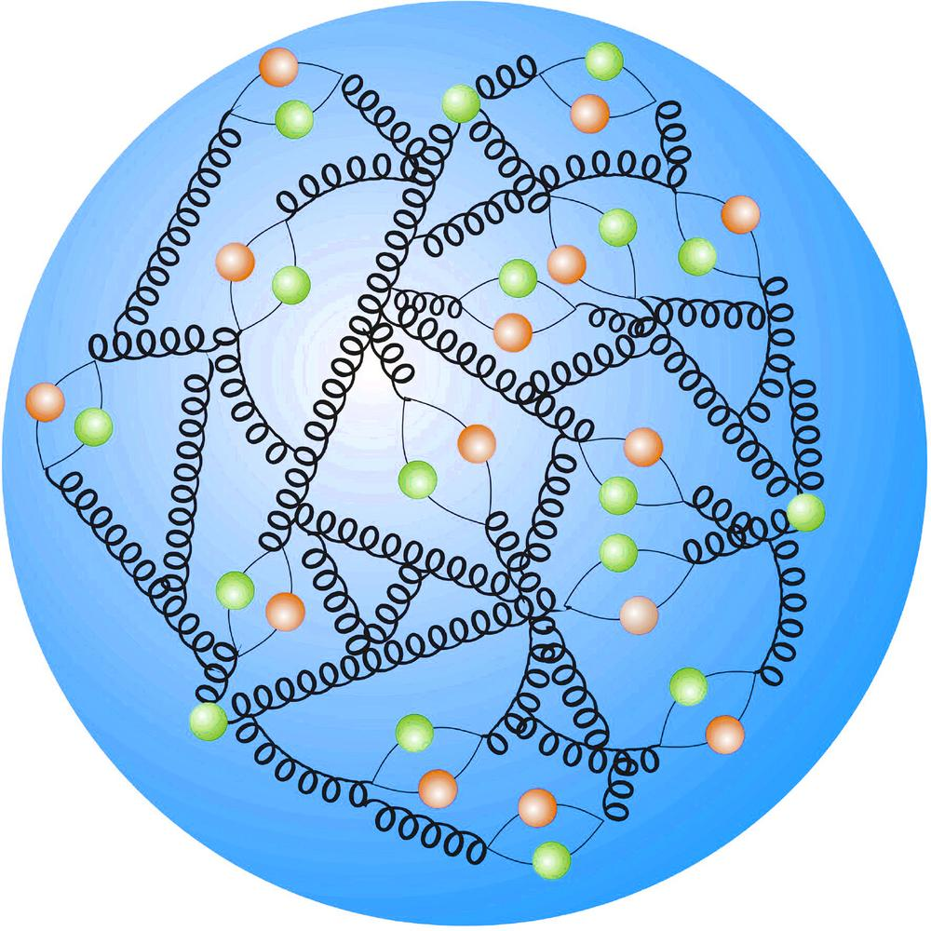
Partons at low and high-x
EIC is an electron-parton collider.
“parton beam energy” depends on what x you are probing

Slide 18
Specialized Detectors: think about lox-x
Highly asymmetric collision at the parton level
E_{electron_beam}
Since x → 0, energy is tending to 0
at x = 10⁻⁴⁻⁵
Parton energy ~ 10 MeV
Beam Energy ~10 GeV
Where does the final state go?

Slide 19
Final States for low-x
y ~ 1 (lowest x)
electron energy < E_{beam} Relatively high angle
10 GeV total
“remnant”, p for diff.
y ~ 0.1 (same Q², somewhat larger x)
10 GeV total
“remnant”, p for diff.
electron energy ≈ E_{beam} Low angle
Left side is essentially fixed target kinematics

Slide 20
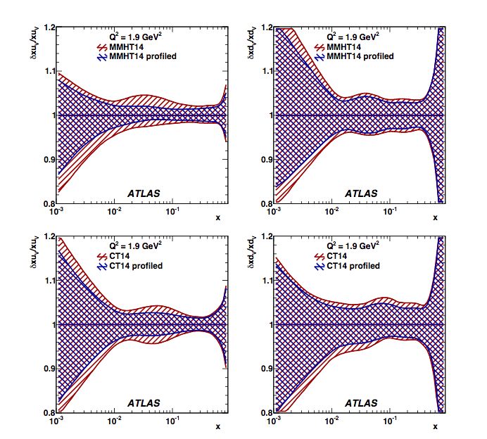
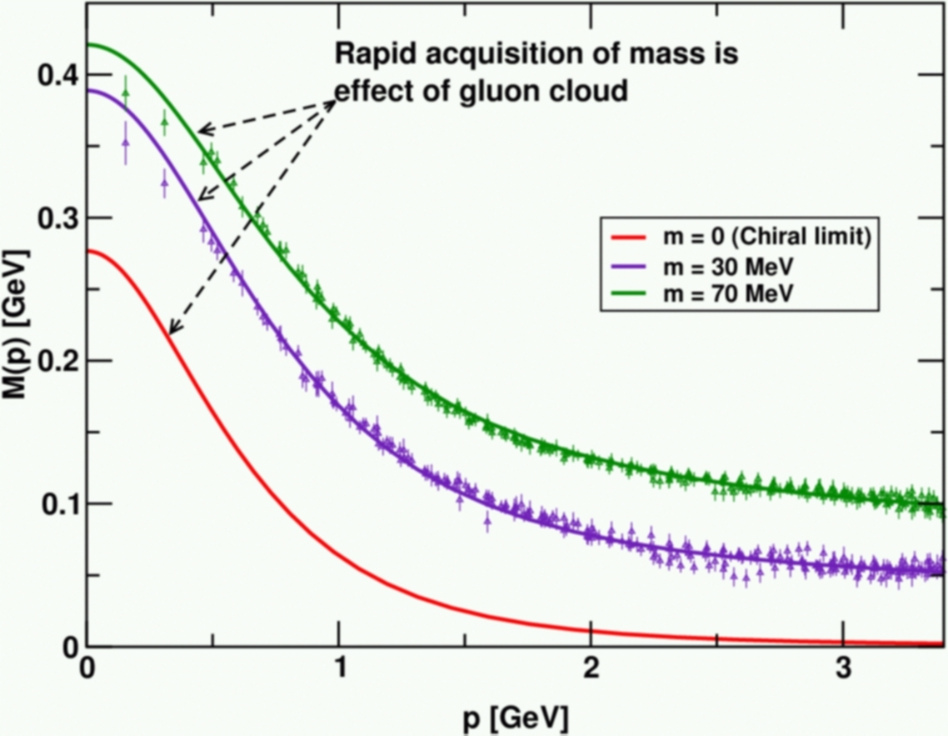
Why measure at high-x?
(see Cloet)
(See Olness)
Dynamical Symmetry Breaking
Pion/Kaon structure at high-x and origin of mass
High-x uncertainties and LHC searches
Many reasons to do high-x at EIC

Slide 21
High-x Kinematics
Highly asymmetric collision at the parton level (the other way)
Parton carrying xE_{proton_beam}
E_{electron_beam}
Since x ->1, this is like the beam energy
Parton energy ~100 GeV
Electron Beam ~10 GeV
Where does the final state go?

Slide 22
Where do the particles go?
Need a very precise measurement to get x
Most of the time:
E_{electron} ≅ E_{electron_beam}
θ ~ Q²
beamline
E _{jet}
E_{proton_beam}
= X
This is hard to measure: a jet close to beam pipe

Slide 23
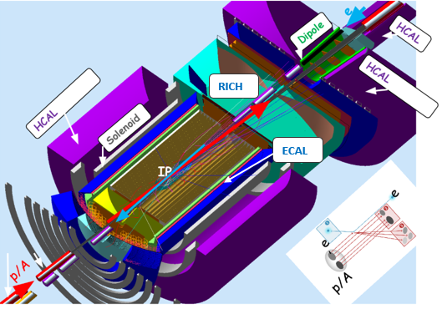
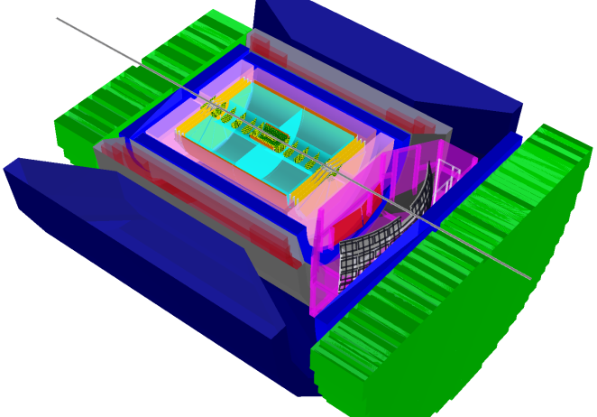
Current Central Detector Concepts
Upstream Ion FFQ
JLEIC EXAMPLE
Downstream Ion FFQ
IP
3.5 m
7 m
~4 m tracking
~1.5m Č
~2m Č
~1.5m CAL
~2.5m CAL+dipole 1
MOMENTUM
PARTICLE ID
CAL II
ENERGY

Slide 24
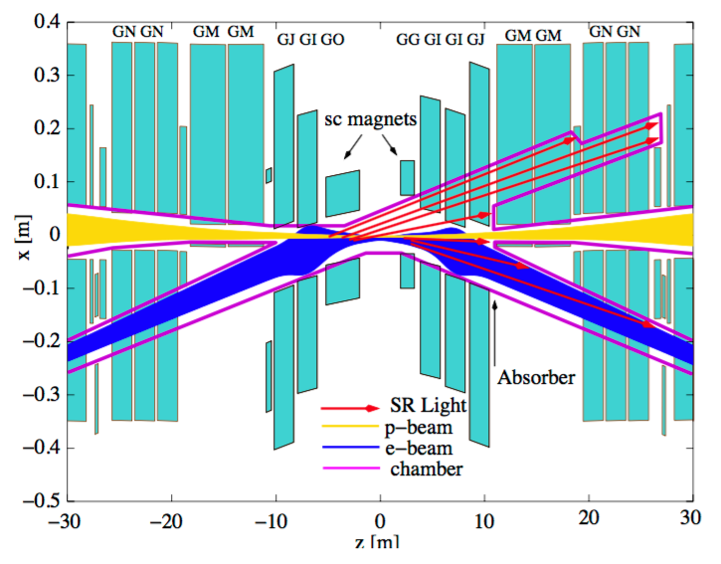
DIS Collider: Beam background
HERA II IR
JLEIC IR
JLEIC example
HERA II
No electron bend before IP. (last bend 120m away)
Two beams share only 2 m of beam pipe.
Synchrotron from final focus doe not go in the proton beam direction.
Drawing experience from B-factories
95% of background: proton-(synch-induced)gas from this region.
Electron bends at ~10 m for head-on collision with proton. Synch fan.
The two beams share ~20m beam pipe
Synchrotron from final focus goes in the proton beam direction

Slide 25
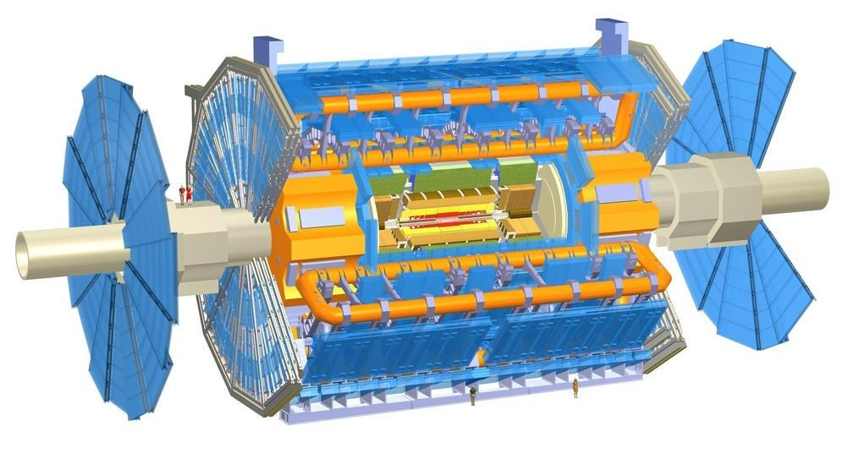
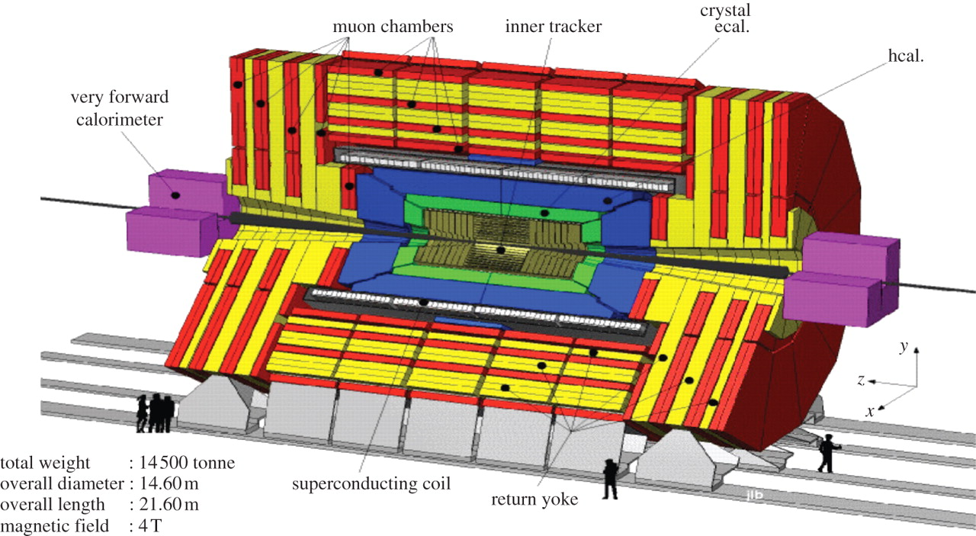
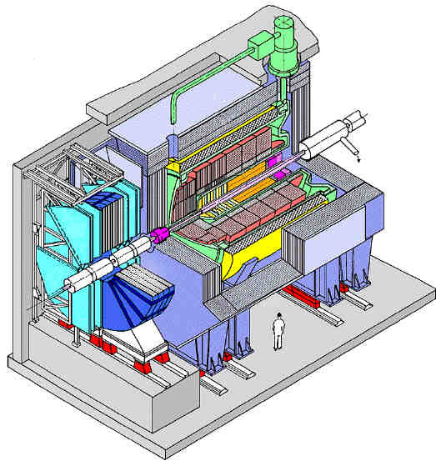
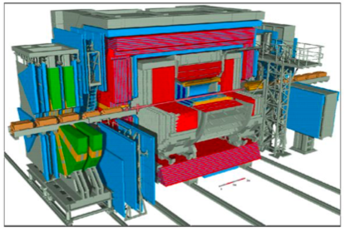
Two Multi-purpose detectors
ATLAS
CMS
and
ZEUS
H1
and

Slide 26
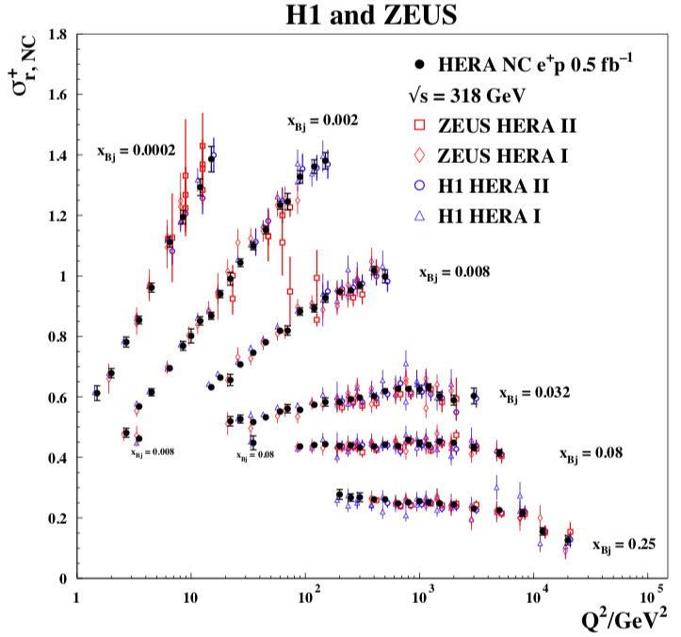
Two Detectors Combined results
Dramatic cancellation
of systematic uncertainties
(How this happens is a
talk in itself)
Cannot be duplicated
by just “being careful”
about systematic uncertainties
in a single detector.
Has to do with multiple
measurements of quantities
using different methods
and detectors.
Q: can we design a single detector to do this?

Slide 27
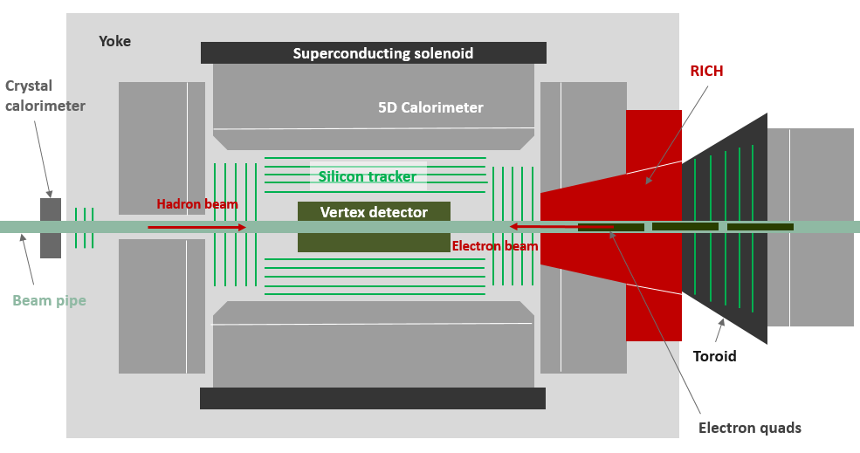
4 Detector Concepts for the EIC
Brookhaven concept: BEAST
Jefferson lab concept: JLEIC
sPhenix → ePhenix
Argonne concept: TOPSiDE

Slide 28
New Physics Topic being discussed
Nucleon Sea (Aidala)
  INT-17-68W
Pion and Kaon Structure (Cloët) –whitepaper forthcoming
  Argonne June, 2017
  CUA, May, 2018
Jets and Heavy Flavors (Neill)
  2017 Santa Fe Jets and Heavy Flavor meeting
Fragmentation (Radici)
  Fragmentation Function 2018
Light Ions (Cosyn) –whitepaper forthcoming
  Polarized Light Ions Workshop 2018
There were other ad-hoc meetings: represented in parallel sessions.
  e.g. BSM and EW

Slide 29
Conclusions
EIC science questions from the NAS report
  How does the mass of the nucleon arise?
  How does the spin of the nucleon arise?
  What are the emergent properties of dense systems of gluons?
Detectors to begin to answer these questions need to
  Measure the (small) momenta transverse to the collision directions both in:
    The particles associated with the struck parton
    The particles associated with the initial hadron (ion).
  In the central detector, measure
    The flavor structure of the ion (i.e. need particle ID)
    Measure at extreme kinematics (both low-x and high-x)
  All of this implies very well integrated detector/IR designs.
New Physics topics are arising all of the time. (new requirements)

Slide 30
BACKUP

Slide 31
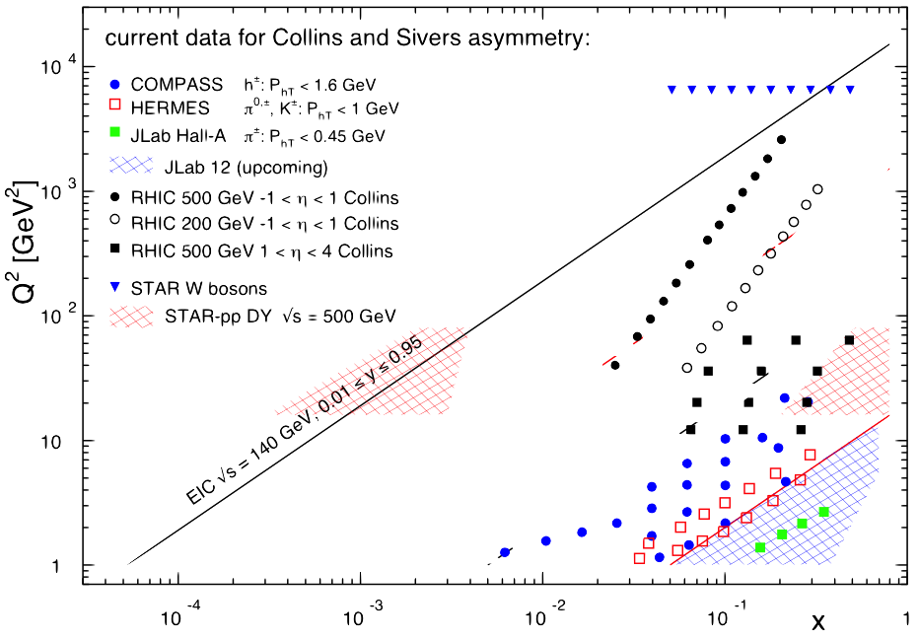
EIC Kinematic Coverage
EIC √s = 100 GeV, y=0.95
upgrade
EIC √s = 20 GeV, y=0.05

Slide 32
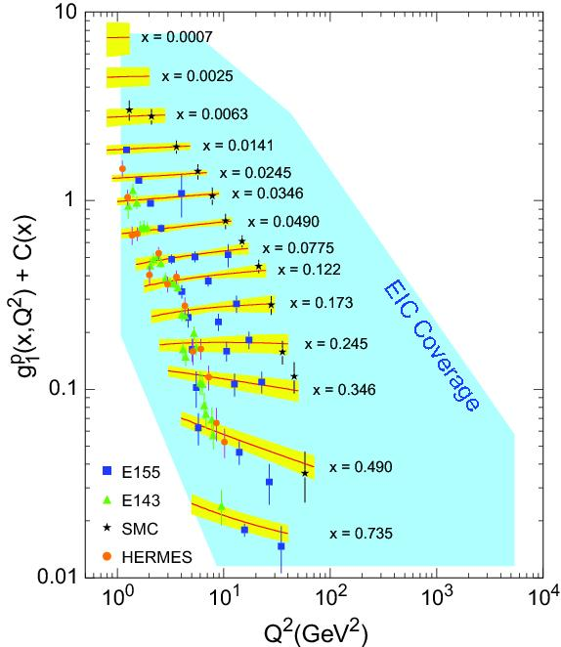
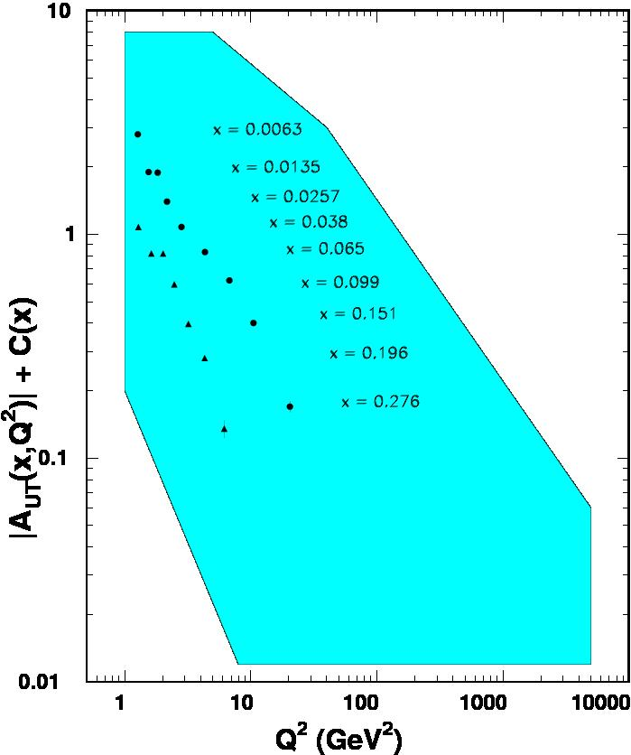

World Data on F₂^{p}
World Data on g₁^{p}
World Data on h₁^{p}
Similar for F₂^{n}
Similar for g₂^{p}, g₂^{n} (and b₁^{d})
F_{UT}^{sin(φh+φs)}(x,Q²) + C(x) $∝h1$
Note: need to update plots for COMPASS data
An EIC makes it possible!
EIC coverage
COMPASS
HERMES
transverse spin ~ angular momentum
momentum
spin

Slide 33
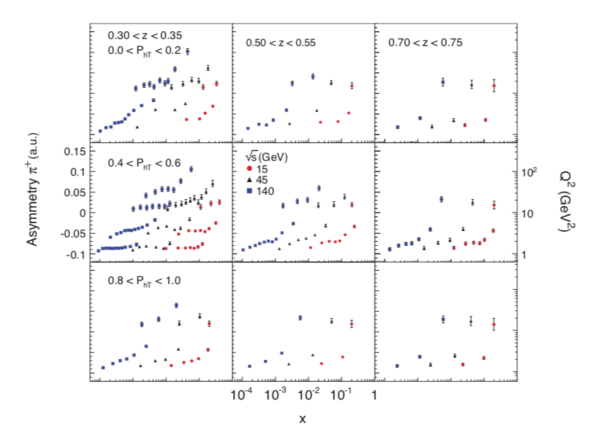
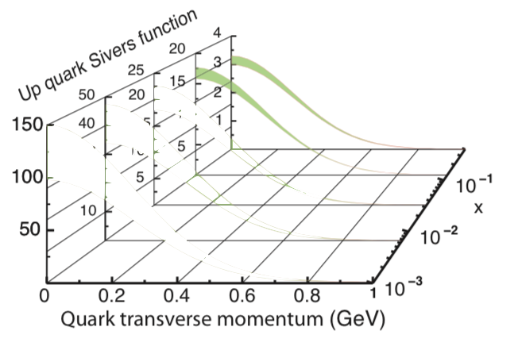
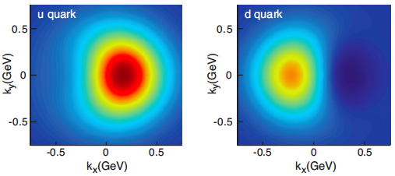
Projected Sivers Asymmetry at EIC
30 fb⁻¹ total data for u quark Sivers
x2 for d quark
~ 60 fb⁻¹ assuming 70% polarization
CEBAF 12 Range
EIC Range

Slide 34
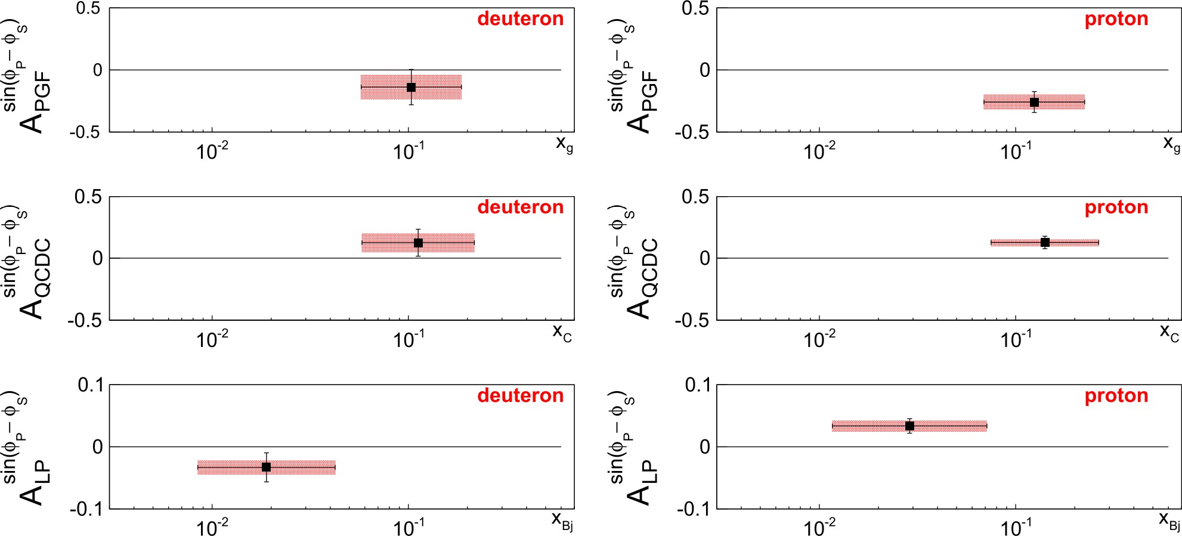
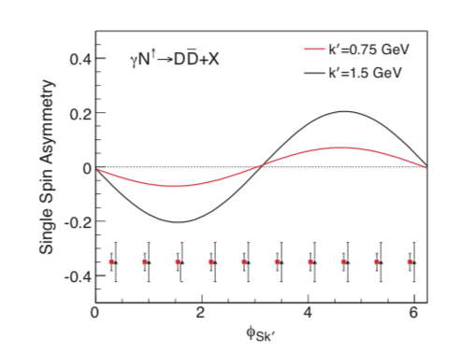

Gluon Sivers Effect
C. Adolph et al. (COMPASS Collaboration), Phys. Lett. B 772, 854 (2017).
EIC Projection
Gluon Sivers effect
using charm tagging. 100 fb⁻¹
100 fb⁻¹ of data corresponds to ~1 year data taking at average luminosity 10³⁴ cm ⁻² s ⁻¹
This assumes machine effectively runs ~30% of available time during 1 year.

Slide 35

Polarized Light Ions
Workshop held in Gent this February
Organized by W. Cosyn, A. Deshpande, D. Ryckebusch, C. Weiss
Whitepaper under preparation.
Talk tomorrow by P. Nadel-Turonski, W. Cosyn and A. Del Dotto
c.f. also talk by E. Long in parallel session here Monday.

Slide 36

Tagging → Neutron spin structure
Tag the recoil proton:
Study the neutron’s q-g spin structure function.
Also for other few body nuclei
A. Del Dotto talk on Thursday
C. Weiss et al, see https://www.jlab.org/theory/tag/
Notes:
36

Slide 37


Example: Polarized Light Ions
m = 0
m = ±1
Deuteron spatial distribution depends on the spin state m
Spin-1 in B-field leads to 3 Zeeman sublevels
Normalization
(n⁺ + n⁻ + n⁰) = 1
m=+1
m=0
m=-1
Vector Polarization
P_{z} : (n⁺ - n⁻)
(-1 < P_{z} < +1)
Tensor polarization
P_{zz} : (n⁺ - n⁰) – (n⁰ – n⁻)
(-2 < P_{zz} < +1)

Slide 38


b1 Structure Function
Leading Twist
b₁ =
difference of helicity-0/helicity non-zero states of the deuteron
Probe the tensor polarization of the sea quarks.
Signature of “exotic” effects in nuclei.
i.e. deviation of deuteron from a simple system of two bound nucleons.
q⁰ : Probability to scatter from a quark (any flavor) carrying momentum fraction x while
the Deuteron is in state m=0
q¹ : Probability to scatter from a quark (any flavor) carrying momentum fraction x while
the Deuteron is in state |m| = 1
Nice mix of nuclear and quark physics
Measured in DIS (so probing quarks), but depends solely on the deuteron spin state

Slide 39
(Tagged) Polarized Neutron Structure
C. Weiss et al, see https://www.jlab.org/theory/tag/

Slide 40

Exotic Glue in Nuclei
Exotic Glue in Nuclei =
gluons not associated with individual nucleons in nucleus
operator in nucleon = 0 & operator in nuclei ≠ 0
Targets with J ≥ 1 have leading twist gluon contribution
Δ(x,Q²): double helicity flip (Jaffe and Manohar, 1989)
Changes both photon and target helicity by two units…
Measurable in unpolarized Deep Inelastic Scattering with a transversely polarized J ≥ 1 target like the deuteron as azimuthal variation.
Parton model interpretation:
Δ(x,Q²) informs how much more momentum of a transversely polarized particle is carried by a gluon with spin aligned rather than perpendicular to it in the transverse plane.
Shanahan, Detmold, et al.
LQCD calculation: gluon transversity distribution in the deuteron, m_{π} = 800 MeV → First evidence for non-nucleonic gluon contributions to nuclear structure
Notes:
40

Slide 41

Polarized Deuterons
Charge density of vector and tensor polarized deuteron
(A. Freese, I. Cloet, ANL)

Slide 42

EIC Performance Requirements: NAS report
√s_{ep} range ~20 to ~100 GeV upgradable to ~140 GeV
Ion beams from D to heaviest stable nuclei
100 to 1000 times HERA luminosity
At least ~70% polarization for electrons, protons and light ions
One or more IR with integrated detector with high acceptance

