Slide 1



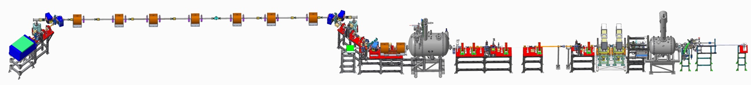
Coherent Electron Cooling Test and Future Plans
Vladimir N Litvinenko for the CeC group:
Five C-AD/SBU physicists and there SBU PhD students

Slide 2
It takes a world-wide village to design, built and operate CeC

Slide 3
Content
- Why strong hadron cooling is needed
- Results of Run 18
- Plans for future CeC experiments
- Q&A

Slide 4
Why CeC is needed?
High luminosity of US future electron-ion collider(EIC) is critical for success of its physics program
  2018 NAS Assessment of U.S.-Based Electron-Ion Collider Science states: The accelerator challenges are two fold: a high degree of polarization for both beams, and high luminosity.
CeC is the most promising technique for boosting the EIC luminosity
  2018 eRHIC pCDR review states: The major risk factors are strong hadron cooling of the hadron beams to achieve high luminosity, and the preservation of electron polarization in the electron storage ring. The Strong Hadron cooling [Coherent Electron Cooling (CeC)] is needed to reach 10³⁴/(cm²s) luminosity. Although the CeC has been demonstrated in simulations, the approved “proof of principle experiment” should have a highest priority for RHIC

Slide 5
Conclusions first
The CeC project reached only partial success:
  we built and commissioned the-state-of art accelerator delivering electron beam with designed quality
  the ultimate goal of the CeC project – experimental demonstration of the CeC was not realized yet
The main reason: previously unknown type of micro-bunching Plasma Cascade Instability (PCI)
The CeC group developed
  Ways of suppressing PCI where it is not needed
  Use PCI for experimental demonstrating micro-bunching amplifier CeC
We design CeC with micro-bunching plasma-cascade amplifier and procured most of the necessary hardware
Notes:
Key processes of CeC were never demonstrated.

Slide 6
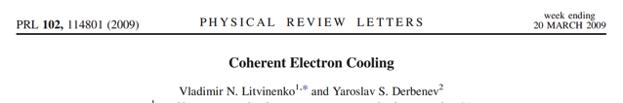
What is a CeC?
It is a stochastic cooling at optical frequencies
All proposed CeC systems are based on the same basic scheme
In modulator electron beam picks-up density modulation (“imprint”) from individual ions
This modulation is amplified in a broad-band high frequency amplifier (instability)
In a kicker, ion’s momentum is corrected by electric field induced in the electron beam
Important feature of an amplifier– its frequency bandwidth
CeC with two amplifiers: FEL and PCA does not require separating electron and hadron beams

Slide 7
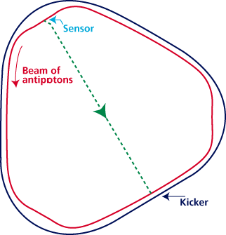
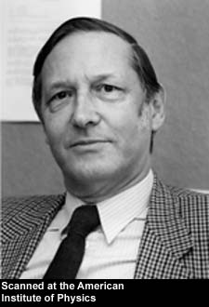
Critical conditions for the stochastic cooler
Linearity: Amplifier must be linear (no saturation) and low noise
Overlapping: Amplified signal induced by individual particle in the modulator (pick-up, sensor) must overlap with the particle in the kicker
Bandwidth: Does not matter how high is the gain of amplifier, cooling decrement per turn can not exceed 1/N_{s}, where N_{s} is number of the particles fitting inside the response time of the system: τ~ 1/Δf
S. van der Meer
1984 Nobel physics prize
RF stochastic cooling is reaching its limits at ~ 10 GHz bandwidth
S. van der Meer, Rev. Mod.Phys. 57, (1985) p.689
S. van der Meer, 1972, Stochastic cooling of betatron oscillations is ISR, CERN/ISR-PO/72-31
Notes:
Can it work for a bunched beam?

Slide 8
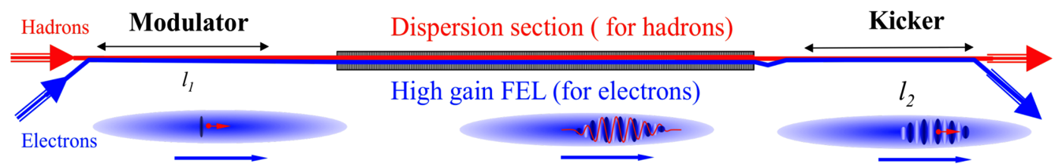
CeC proof-of-principle experiment
Started in FY10 as 2-year BNL’s LDRD “Simulation, Design, Prototyping of an FEL-Based Coherent Electron Cooling”
From FY11 till FY 17 was supported by DOE Office of Nuclear Physics as part of Research and Development for Next Generation Nuclear Physics Accelerator Facilities
By design it was a cost-effective version of CeC with FEL amplifier, which does not require expensive separation and delay system of 26.5 GeV/u ion beam
We took advantage of available equipment from DoE’s SBR program, DoE BES project at SBU and our UK collaborators
All through the years CeC was strongly supported by C-AD personnel and management
Goal of the project was to verify physics behind the the concept and to experimentally demonstrate Coherent electron Cooling

Slide 9
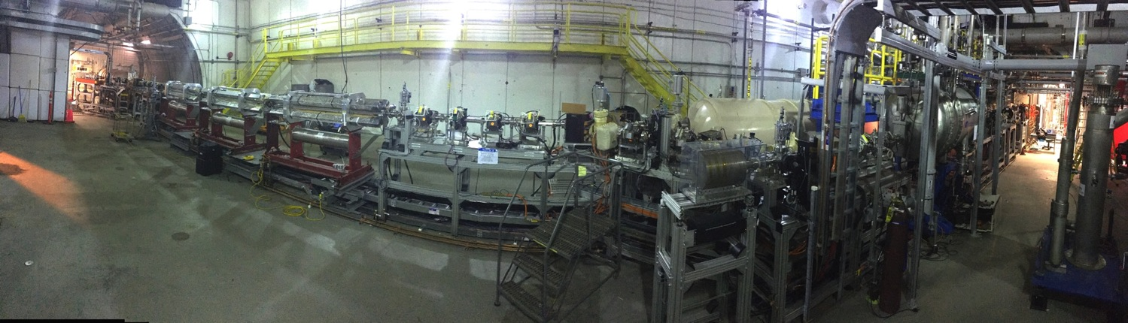
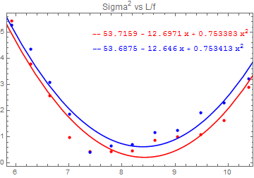
State of the art CeC system
Kicker
Modulator
FEL amplifier
Dogleg
CeC Accelerator
From inside RHIC ring
Quarter-wave SRF photo-electron gun
4 K operating temperature
CsK₂Sb Cathode operating for months
Up to 10.7 nC charge per bunch
Record low normalized emittance
of 0.32 mm mrad at 0.5 nC
and many more innovations in accelerator physics and technology

Slide 10
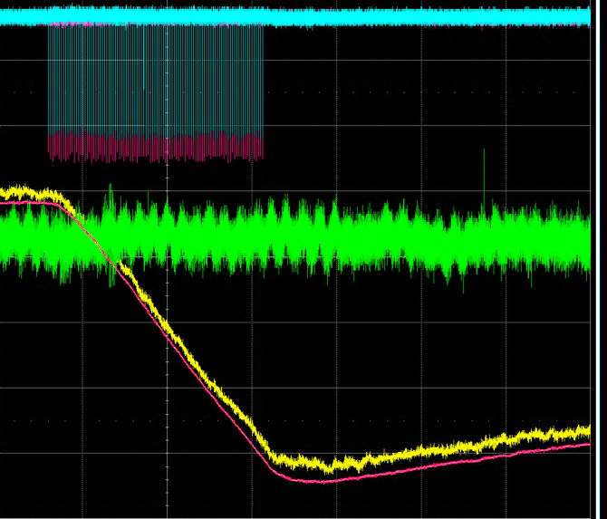
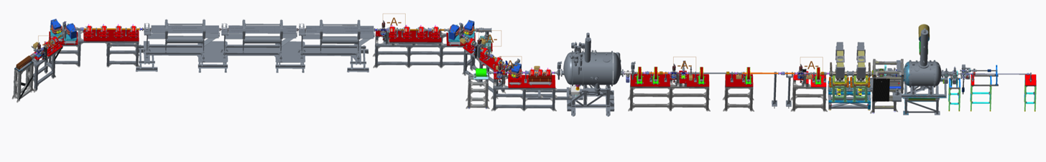
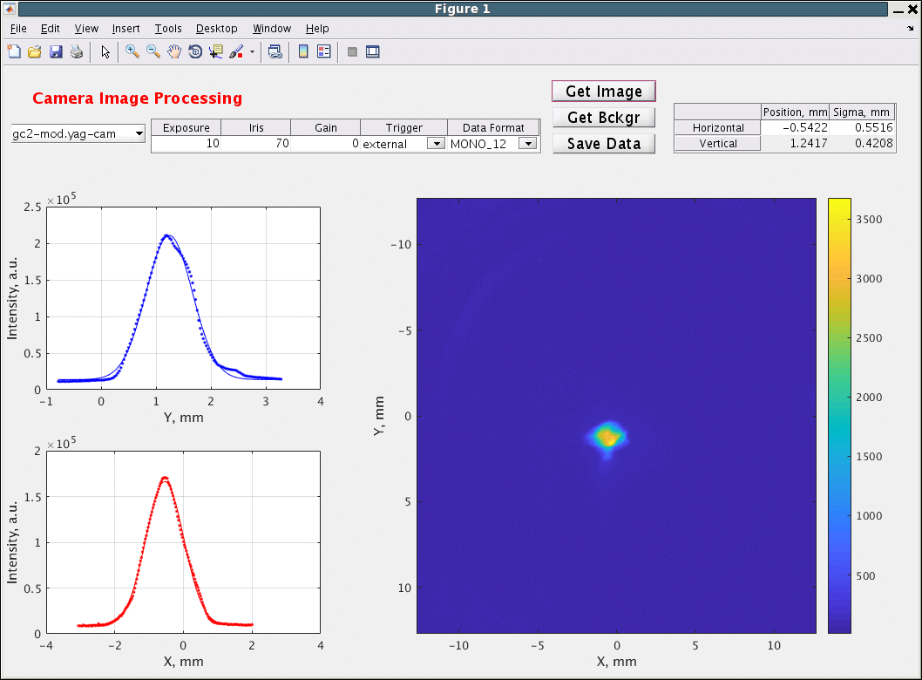
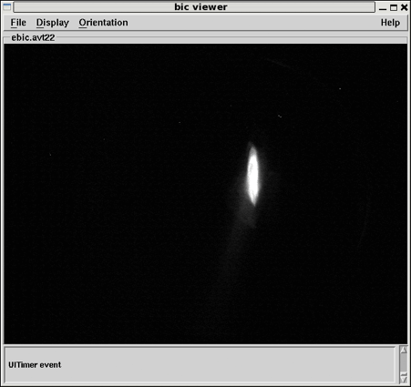
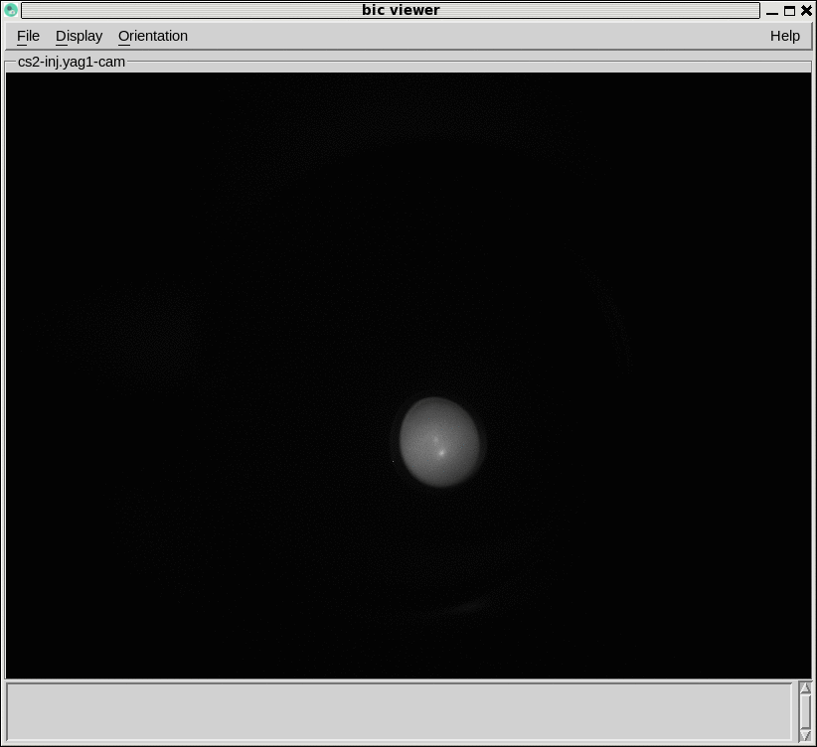
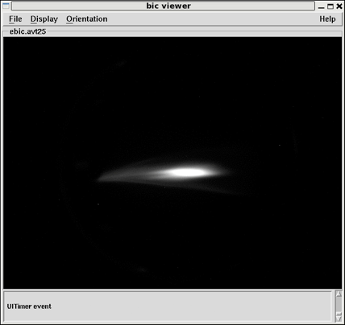
Accelerator & FEL
performed well
Parameter | Design | Status | Comment
Species in RHIC | Au⁺⁷⁹, 40 GeV/u | Au⁺⁷⁹ 26.5 GeV/u | ✔, To match e-beam
Electron energy | 21.95 MeV | 14.56 MeV | Linac’s quench limit
Charge per electron bunch | 0.5-5 nC | 0.1- 10.7 nC | ✔
Peak current | 100 A | 50 -100A | ✔
Bunch duration, psec | 10-50 | 12 | ✔
Normalized beam emittance | < 5 mm mrad | 3 - 5 mm mrad | ✔
FEL wavelength | 13 μm | 31 μm | ✔, new IR diagnostics
Repetition rate | 78.17 kHz | 78.17 kHz | ✔
CW beam | <400 μΑ | 150 μΑ | ✔
Train of
100 bunches
Signal from IR pyroelectric detector at 31 μm
1.25 MV
SRF photo-gun
and cathode
manipulation system
CeC “kicker”
4 quads
CeC FEL amplifier
3 helical wigglers
CeC modulator
4 quads
Dog-leg:
3 dipoles 3 quads
13.1 MeV
SRF linac
Low energy transport beam-line
with 5 solenoids
Bunching
RF cavities
IR diagnostics
Common section with RHIC
High power beam dump
1 dipole, 2 quads
Low power
beam dump
Beam before
compression
Matched e-beam
at
the FEL entrance
Beam at the end of the CeC system
Compressed beam
in the dogleg

Slide 11
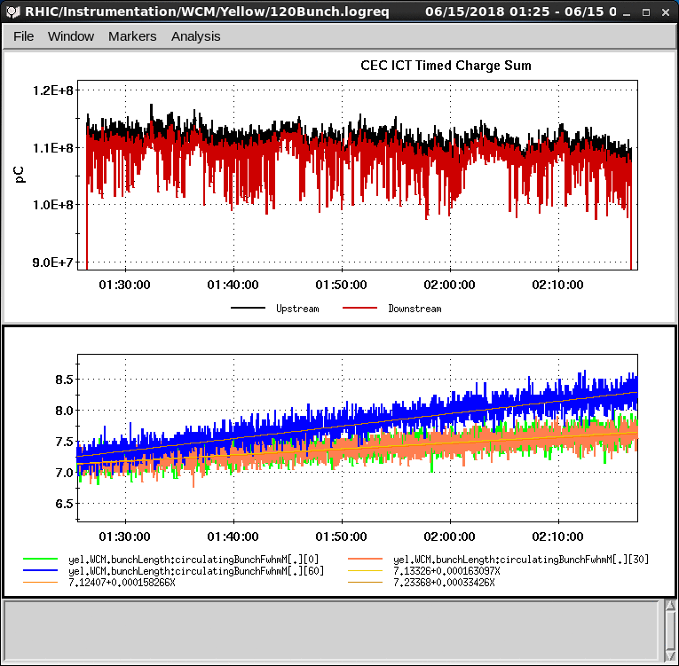
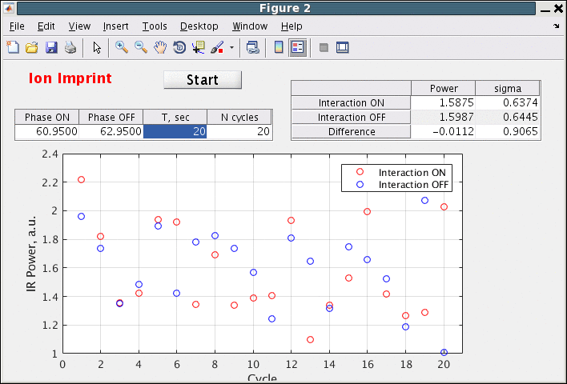
Expected and measured relative change in the FEL signal with overlapping and separated beams. Each point corresponds to 16 or cycles of 20 FEL power measurements for overlapped and separated beams. Data analysis indicate RMS error of 2%.
Two main results
Search for ion’s imprint
Heating of ion beam by lasing e-beam
e-beam current, μA
120
110
100
90
RMS bunch length
nsec
Interacting ion bunch
+/- 3 σ
Witness bunches
Top plot :electron beam current through the CeC ~ 110 μΑ or 1.4 nC per bunch at 78 kHz.
Bottom plots: evolution of the bunch lengths for interacting (blue trace) and witness bunches (orange and green traces)
Typical cycle
800 measurement
Heating of ion beam was occurring only with a perfect overlap of the beams and high FEL gain. Reducing the FEL gain eliminated the heating.

Slide 12
Plausible causes
Relativistic factors of electron and ion beams are separated by more than 2.5%-3% - Very unlikely
  This is extremely unlikely: RHIC beam energy is known with 0.1% accuracy and electron beam energy is calibrated using dipole magnet with 0.1% accuracy.
FEL saturation - in this case increase in the input signal would be muted - Very unlikely
  Strongly reduced FEL gain was used for the imprint studies. Genesis simulation confirmed this assumption.
Debye screening of ions does not occur after 1/2 of plasma oscillation - Eliminated
  Required slice energy spread of 0.75% and normalized emittance > 10 μm rad with peak current of 100 A.
Reduced transverse overlap: either extremely low electron beam emittance ~ 1 μm rad or a large ~2.5 mm orbit separation of two beams - Eliminated
  +/-2 mm separation is required , measured values were within +/- 0.5 mm
  Measured slice emittance of the beam and found it to be expected 5-7 μm rad
Shot noise of the ion beam is suppressed around 30 μm (10 THz): it would be the most profound finding.
  Theory: we discovered a number of effects which should prevent such “entanglement.
  Simulation with SPACE code of the 26.5 GeV/u Au ion beam propagating for about 27 km in intentionally smooth lattice indicated no observable changes in the THz range shot noise.

Slide 13
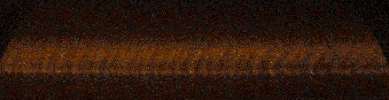
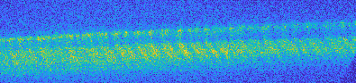
Explanation the “imprint” studies results
Three months of intense studies excluded a number of plausible explanations except one: excessive high frequency noise in the electron beam:
  Noise in e-beam exceeds that expected from Poisson statistics (N^{-1/2}) by orders of magnitude
  The micro-bunching is amplified when e-beam propagates from the gun to the linac
  The mechanism is the Plasma-Cascade Instability (PCI)
  The modulation is upshifted via beam compression to the FEL frequency of 10 THz
We experimentally observed a broad-band 0.4-0.7 THz density modulation in the uncompressed electron beam exiting the low-energy beamline
The 20-fold compression used in the CeC “imprint” studies would result in 10 THz (e.g. 30 μm) e-beam density modulation
Experiment: uncompressed beam
Notes:
Here I plan to discuss the Poisson noise expected from

Slide 14
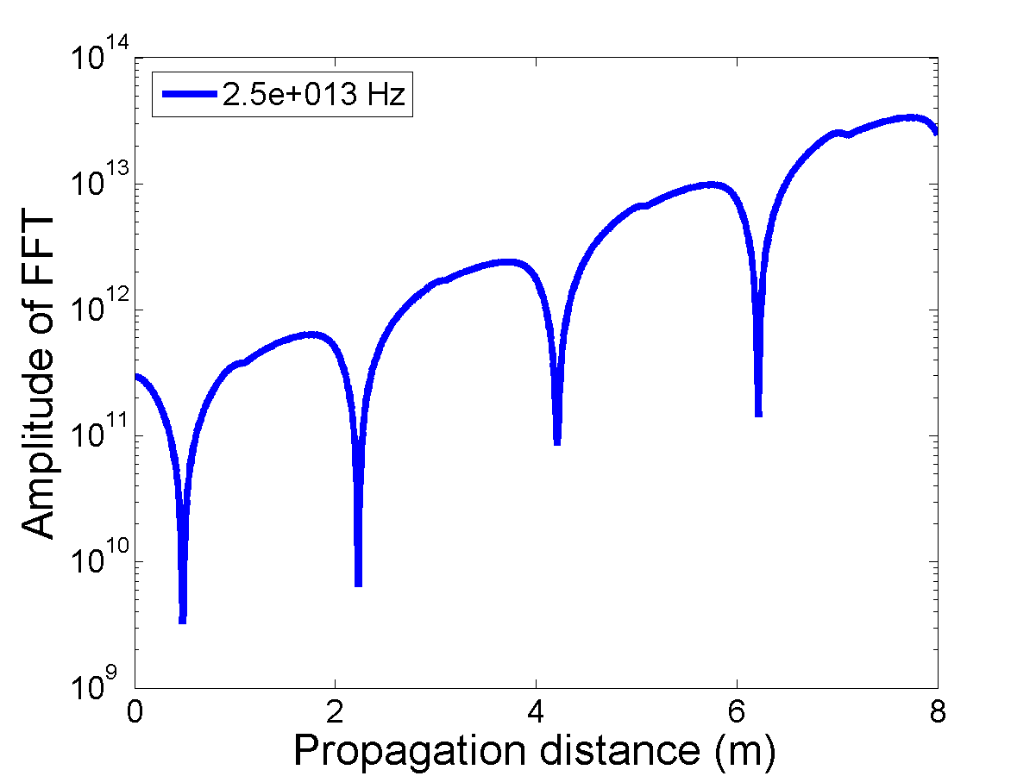
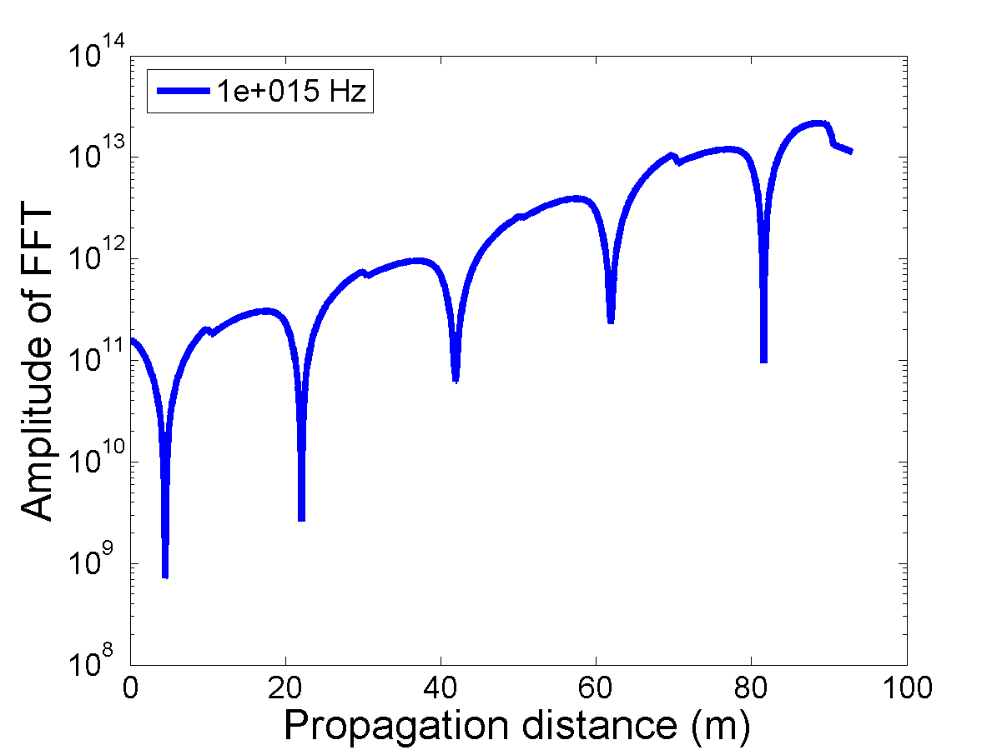
What is Plasma-Cascade Instability?
The Plasma-Cascade Instability (PCI) is a longitudinal micro-bunching instability occurring in a beam propagating along straight trajectory
Idea of PCI caused by periodic modulation of the transverse beam size was suggested recently: /arxiv.org/abs/1802.08677
We explored this idea both theoretically and numerically in January 2018 with focus on cost-effective CeC for eRHIC and a possible test using existing CeC system for 3D cooling
We had good agreement between the theory and 3D simulations for periodic systems
Recent experimental studies clearly demonstrated PCI in the low energy beam transport (LEBT) of the CeC accelerator at THz frequencies
Stability
CeC test
@ 25 THz
eRHIC PCA CeC
@ 1,000 THz

Slide 15
What we learned from the CeC experiment?
We had discovered excessive high frequency (10 THz) noise in the electron beam, suppression of which is critically important for designing and building any CeC cooler
We found explanation of this phenomenon in the beam dynamics - the Plasma-Cascade Instability
This instability can significantly modify e-beam quality at microscopic scale and is very hard to observe experimentally
It would be impossible to find this phenomena without the experiment that we had conducted
We experimentally demonstrated that PCI is present in the low-energy transport of the CeC accelerator
We had developed theory and numerical tools to accurately simulate PCI at constant beam energy .Development of theoretical and numerical tools for arbitrary accelerator lattices is in progress
We propose to tame this high-frequency broad-band instability for designing and testing a cost-effective CeC

Slide 16
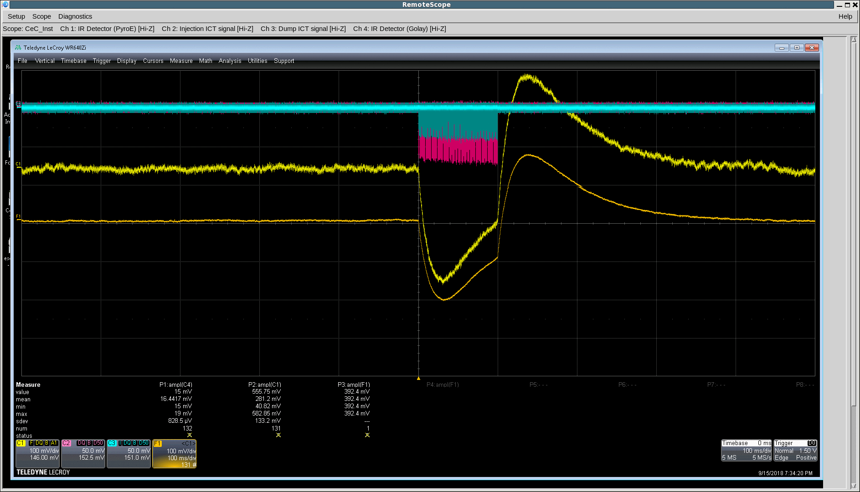
Dumbest possible test: power of radiation from bending magnet
IR detector signal induced by radiation from 45-degree bending magnet by 7,800 electron bunches 0.65 nC per bunch charge. Energy is 300x larger than spontaneous radiation

Slide 17
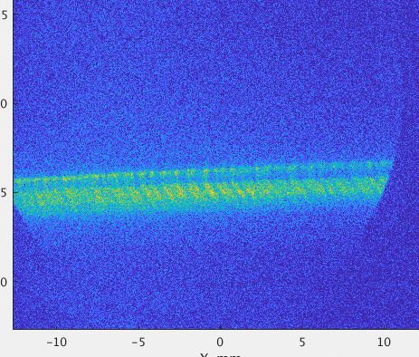
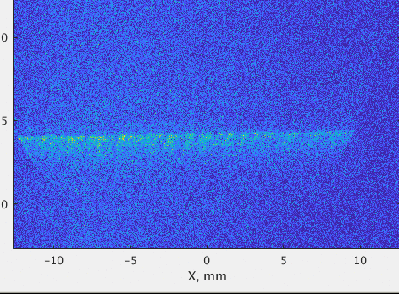
Turning linac & dogleg into e-beam psec time-resolved studies: t->E->x transformer
100 kV
0.7 THz structure
200 kV
0.7 THz structure
1.75 MeV e-beam
Operate SRF linac at low 100-200 kV voltage and zero-crossing to insert t-dependent chip: t->E
Use D=1.36 m of the dogleg (quads off) as energy spectrometer: E->x

Slide 18


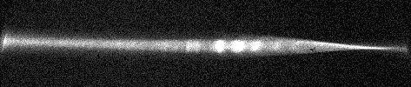


Selected results: uncompressed bunch
3D simulations (SPACE)
Experimental results
High charge - strong PCI
Low charge - weak or no PCI

Slide 19
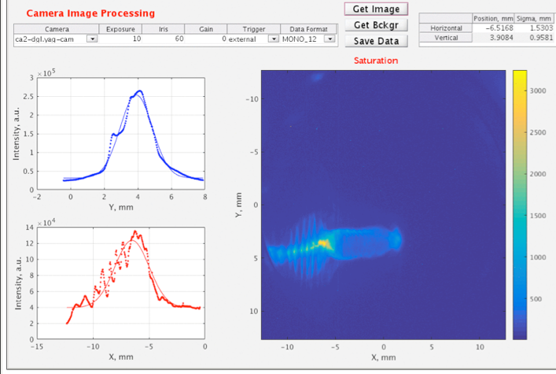
Selected results: 20x compressed bunch
20 psec
Impact-T simulations

Slide 20
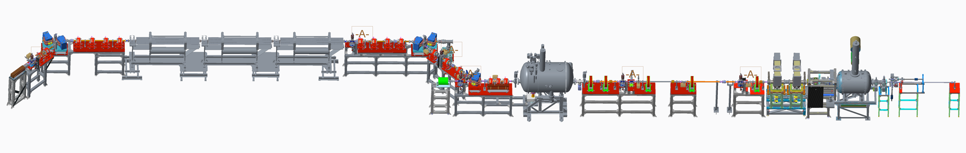

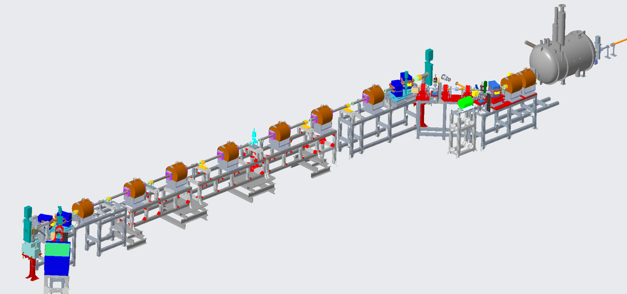
Design of CeC experiment using Plasma-Cascade Amplifier (PCA)
Unchanged
Kicker
Modulator
4-cell PCA
Unchanged
New equipment

Slide 21
Evolution of modulation in PCA
Plasma-Cascade micro-bunching Amplifier and Coherent electron Cooling of Hadron Beams, V.N. Litvinenko, G. Wang, D. Kayran, Y. Jing, J. Ma and I. Pinayev, arXiv:1802.08677

Slide 22
Evolution of modulation in PCA

Slide 23
Evolution of a single ion imprint in 4-cell 8-meter ling PCA

Slide 24
Evolution of the 26.5 GeV/u ion bunch profile in RHIC

Slide 25
Proposed experimental CeC program
FY19 – produce all PCA hardware
– retune CeC accelerator & eliminate shortcomings
– suppress excessive noise in the electron beam
FY20 – install PCA equipment in the IP2 common section
– commission PCA equipment at the IP2
– optimize IR diagnostics for PCA
– test PCA-based CeC
FY21 –demonstrate the PCA-based microbunching CeC at γ=28.5
FY22 – no RHIC run – fixes
FY23 – 3D cooling in PCA-based CeC at γ=28.5
– evaluate PCA-based CeC performance

Slide 26
Numerical tests
3D simulations of a CeC with 4-cell PCA for test experiment and eRHIC
High gain (>100) and very large bandwidth: 25 THz for test experiment and 1,000 THz (1 PHz) for CeC cooling 275 GeV protons
These are cost effective system – they do not need expensive separation system for hadrons and will be capable of 3D cooling hadron beams in RHIC and eRHIC independently of the design choice
Still, it will be important to demonstrate this untested micro-bunching cooling technique experimentally
Name | ACeC test | eRHIC
PCA | 4 sections | 4 sections
γ | 28.5 | 275
L | 2.00 | 20.00
a₀ | 2.00E-04 | 1.00E-04
Peak current | 100.00 | 250.00
β* | 0.14 | 0.69
ε_{norm} | 8.00E-06 | 4.00E-06
k_{sc} | 3.56 | 3.76
k_{β} | 7.02 | 14.55
ε_{geom} | 2.81E-07 | 1.45E-08
Energy spread | 3.00E-04 | 3.00E-04
Frequency, THz | 25.00 | 1,000.00
ACeC test
@ 25 THz
eRHIC CeC
@
1,000 THz

Slide 27
PCA micro-bunching CeC for EIC
Examples
Electron bunches
Energy – to match hadron beam energy
Charge per bunch – 1 nC or 2.5 nC
Peak current – 200 – 250 A
Energy spread 3x10⁻⁴
Normalized emittance – 8 mm mrad
Local cooling time: 9.8 seconds for 275 GeV protons
Energy, GeV | εh, norm | εv, norm | RMS bunch length, cm | 3D Cooling time, min Q=1 nC | 3D Cooling time, min Q=2.5 nC
275 | 0.25 μm | 0.25 μm | 5 | 20 | 7
275 | 2.7 μm | 0.38 μm | 5 | 50 | 20
200 | 0.9 μm | 0.18 μm | 1 | 5 | 2

Slide 28
Conclusions
CeC RHIC Run 18 was both challenging and successful
  build the state of the art accelerator and FEL system with all beam parameters necessary for the CeC experiment had been demonstrated
  high gain FEL amplifier was commissioned
  a new, previously unexplored, phenomenon was discovered
Experiment-driven discoveries are critical for designing and building operational CeC - one of the reason to continue the CeC experimental program
PCA-based microbunching CeC test needs minimal investments and can be completed in four years. It is fully compatible with low energy RHIC
PCA-based microbunching CeC is a high-performance but also a cost-effective path towards a realistic and cost-effective cooling system for high luminosity EIC
Join us if you are interested in this project

Slide 29
Back-up slides

Slide 30
How to “tame” Plasma-Cascade Instability?
Beam envelope equation
Longitudinal plasma oscillations:
can be either stable or unstable
Stability
The longitudinal plasma oscillations are described by Hill’s equation with time (s) dependent frequency
The solution is presented by 2x2 unimodular matrix, which can be either stable or unstable
Finding stable solution of Hill’s equations is a standard accelerator physics problem – the process is called optics matching
The complication for suppressing PCI is that the plasma frequency is defined by a self-consistent solution for the peak current and the beam envelope. Hence, while the process is more elaborate that a traditional “optics matching”, it is still has clear path stable solutions.

Slide 31
Suppressing PCI in LEBT

Slide 32
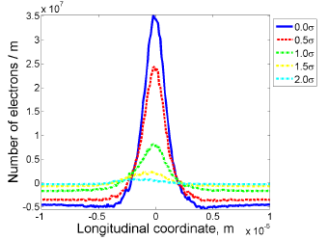
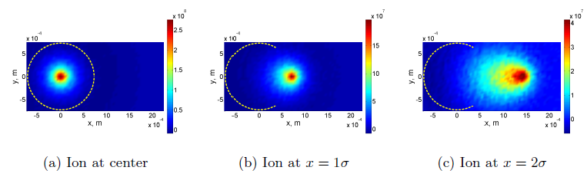
”Imprint” case
Imprint of the shot noise from ions is a directs consequence of Debye screening by electrons
Expert in the field never questioned its validity.
Considered to be a “slam dunk” e for matching relativistic factors of the beams
An excellent agreement between theory and simulation
Sophisticated 3D code simulated the imprint in a realistic bema in the quadrupole beam-line
Sensitivity to various parameters had been checked
In all cases the imprint from the ion beam should at least double the FEL power
During the experimental studies, the FEL was operated well below saturation
Theory
3D simulations
J. Ma, with code SPACE

Slide 33
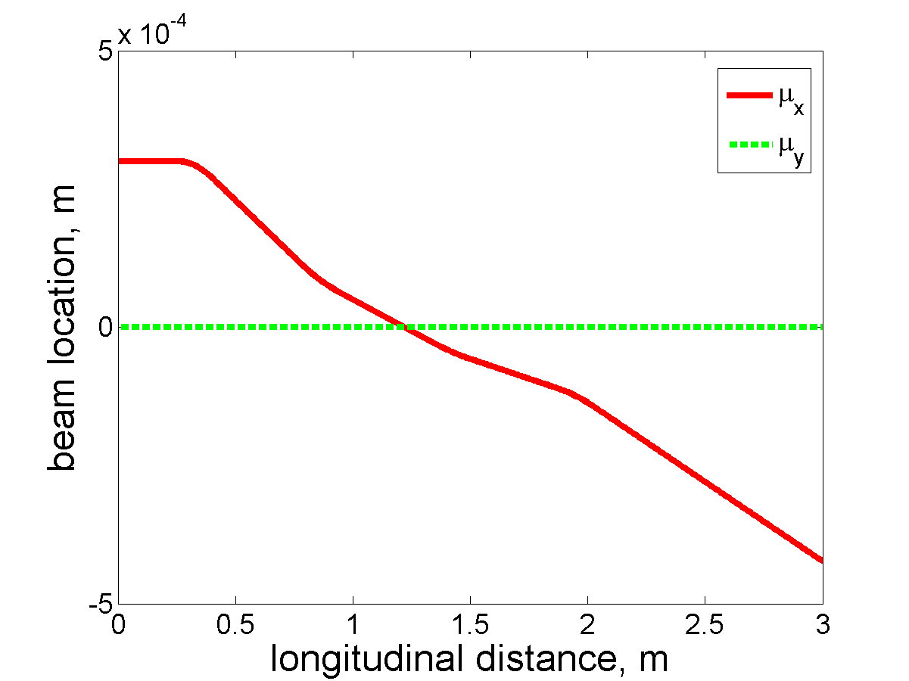
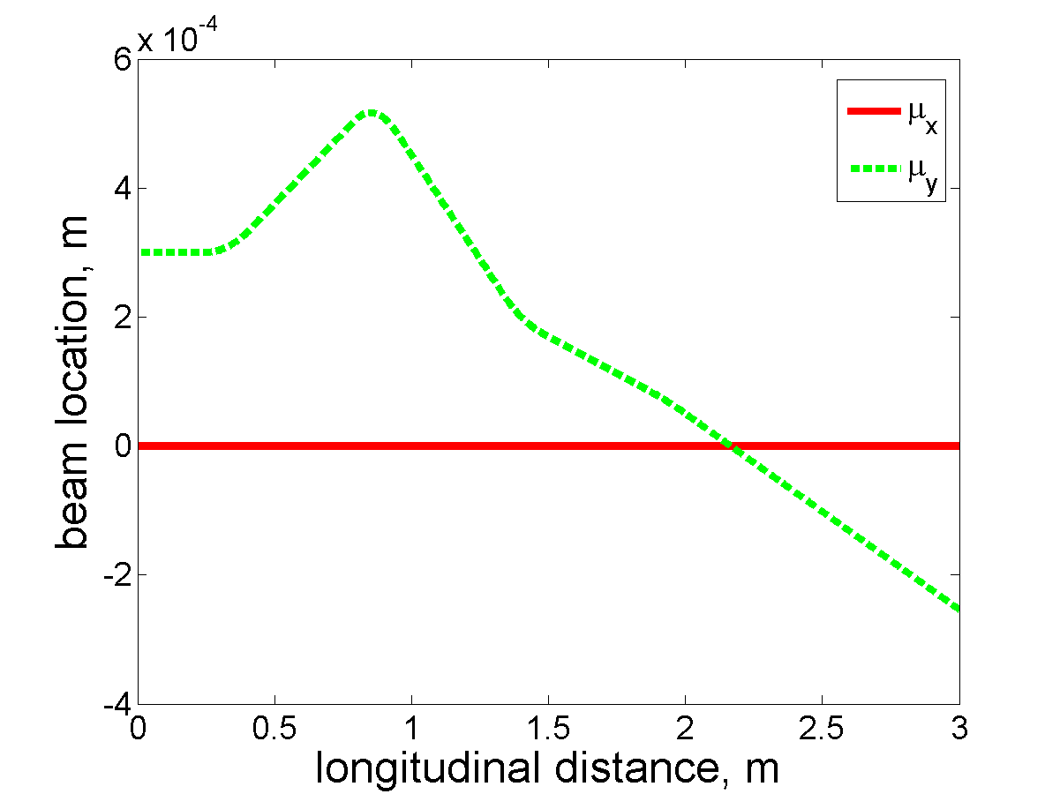
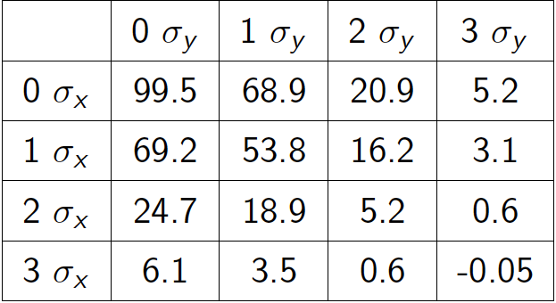
Selected numerical results
 | Without Ions | With Ions | Ratio (Amplitude) | Expected FEL power increase
dE/E=1e-3, ∆x = ∆y = 0 | 6.1524e-5 | 1.3219e-4 | 2.1486 | 4.6165
dE/E=3e-3, ∆x = ∆y = 0 | 6.3565e-5 | 8.9365e-5 | 1.4059 | 1.9766
dE/E=3e-3, ∆x = 3e − 4m | 6.0151e-5 | 8.6825e-5 | 1.4435 | 2.0834
dE/E=3e-3, ∆y = 3e − 4m | 5.2372e-5 | 7.7714e-5 | 1.4839 | 2.020
Dependence of charge induced by individual ion on its displacement from the electron beam axis in the CeC modulator
© J. Ma, with code SPACE

Slide 34
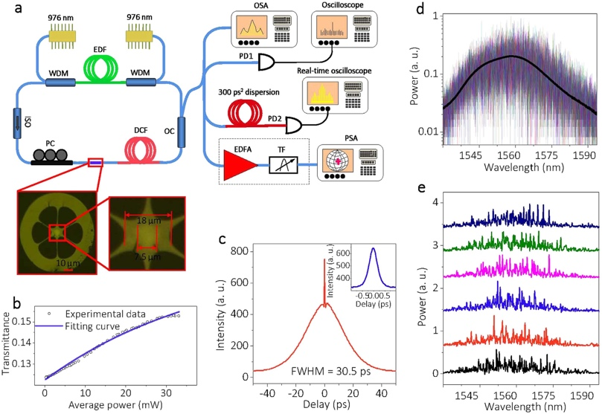
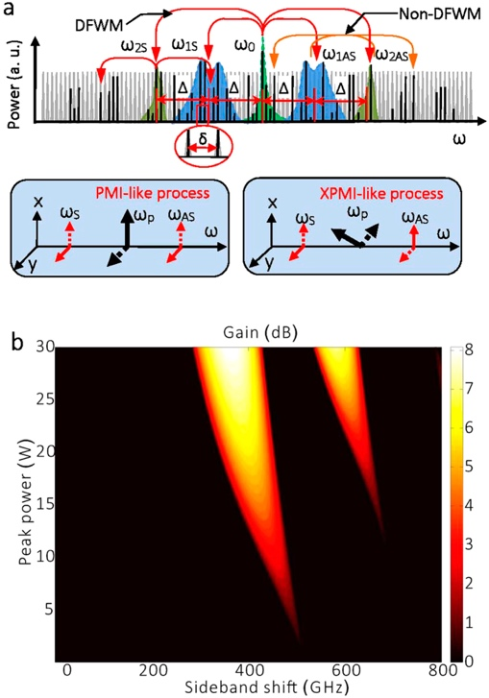
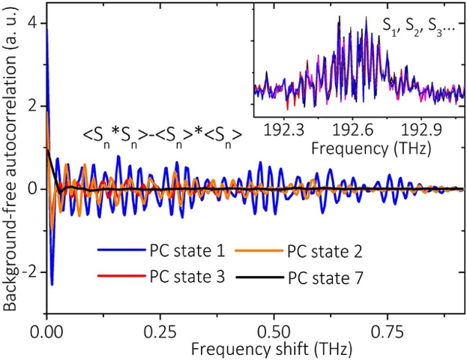
Sidebands of the fiber laser https://www.ncbi.nlm.nih.gov/pmc/articles/PMC4850403/pdf/srep24995.pdf

