Slide 1
eRHIC Hadron Beam Polarization
Haixin Huang
Oct. 31, 2018
Protons
³He⁺²
Deuterons

Slide 2
What Have Been Known (before)
It has been shown in past meetings that 6 snakes are needed for polarized ³He⁺² beam in eRHIC.
The limited (few particles) simulations show that polarization can be preserved through a few strongest intrinsic resonances for both He³ and proton beams. Polarization preservation on the eRHIC ramp is expected for polarized protons and ³He⁺².
The polarized proton acceleration in the injectors will be the same as now, except we want to find ways to preserve transverse emittance along the acceleration in the AGS.

Slide 3
What’s New?
There are some small changes in beam parameters (bunch intensity, transverse emittance) for various running scenarios (with and without hadron cooling). Just need to confirm that the parameters are fine.
The assumed injection scheme: 330 bunches injected into 360 RF buckets. 330 bunches will be splitted into 660 or 1320 bunches at store for certain modes of operation.
An AC dipole will be added in the Booster to overcome two intrinsic resonances for polarized ³He⁺² so that the AGS injection energy can be increased and the effect of stronger cold snake on orbit excursion can be mitigated. The partial snake strength is set as 15% (cold) and 15%(warm) with both betatron tunes inside the spin tune gap, but could go higher if needed (for hosting both betatron tunes). We have plans for polarized ³He⁺² in next a few years.
Polarized deuteron is difficult but not impossible. Some work has been done to study the details.

Slide 4
Polarization at AGS Extraction vs. Intensity
At 2.7*10¹¹, polarization is about 67%. The source polarization is 81-82%.

Slide 5
IPM Emittance at AGS Extraction vs. Intensity
Emittance reduction was done through scraping in the Booster.
At 2.7*10¹¹, vertical emittance is about 2.6π, horizontal emittance is about 2.0π. The vertical one is still larger than the design requirement and requires some work.

Slide 6
Emittance and Intensity Requirements
With strong hadron cooling, the highest bunch intensity 6E10 requires 2.7E11 AGS bunch intensity (90% transfer and ramp efficiency and split 1 to 4). The listed vertical emittance is within the reach of AGS achieved values. The polarization reached so far is 67% for this bunch intensity.
Without cooling, the highest bunch intensity 10.1E10 requires 2.33E11 AGS bunch intensity (90% transfer and ramp efficiency and split 1 to 2). The listed vertical emittance is within the reach of AGS achieved values. The polarization reached so far is 69% for this bunch intensity.

Slide 7
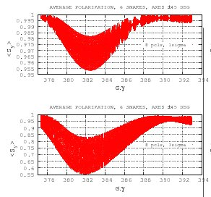
2-snake (left) vs. 6-snake(right)
1σ
1σ
Note different vertical scales.
3σ
3σ
ZGOUBI tracking for particles with σ=2.5π crossing one of three strongest intrinsic resonances: 411-Q_{y}.

Slide 8
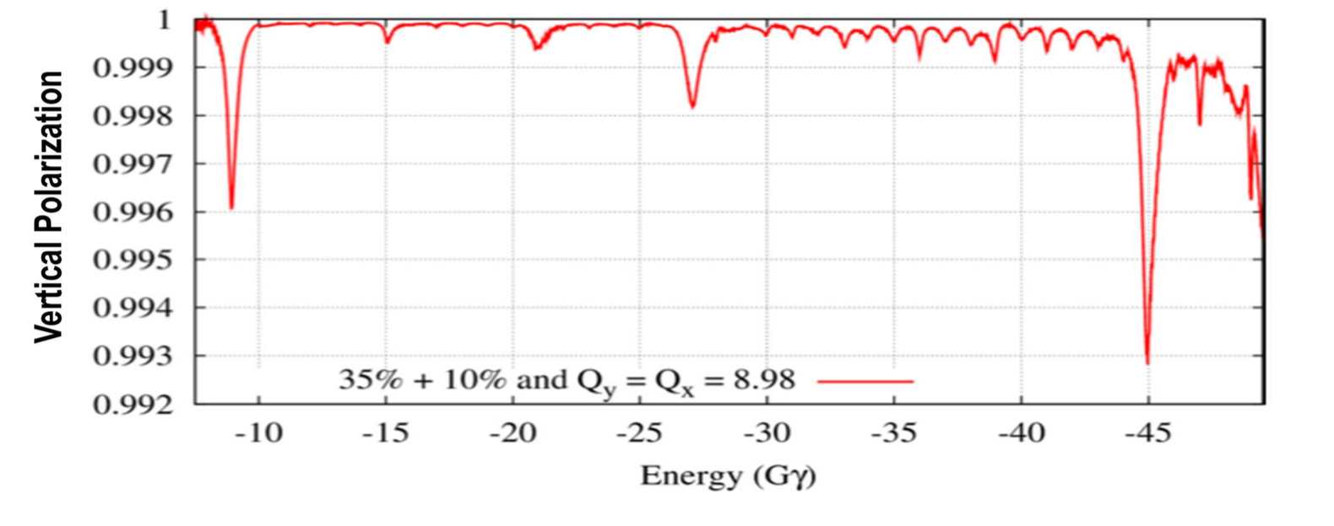
Polarized ³He⁺² in Injectors
An AC dipole will be installed in the Booster to overcome a few intrinsic resonances. This opens doors to raise the injection energy in the AGS.
The polarized ³He⁺² source will be ready by 2020.
The test of polarized ³He⁺² acceleration in the injectors will follow after that.
Two 35%+15% partial snakes generate large enough spin tune gap so that both betatron tunes can be put into gap to avoid all depolarizing resonances.

Slide 9
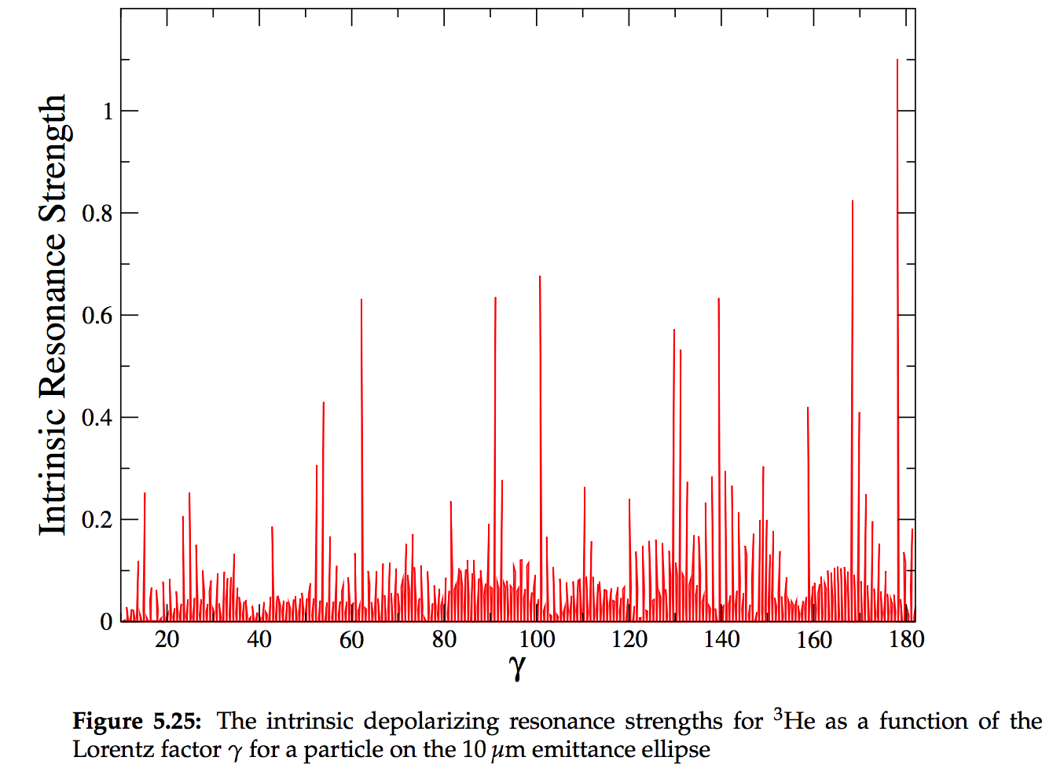
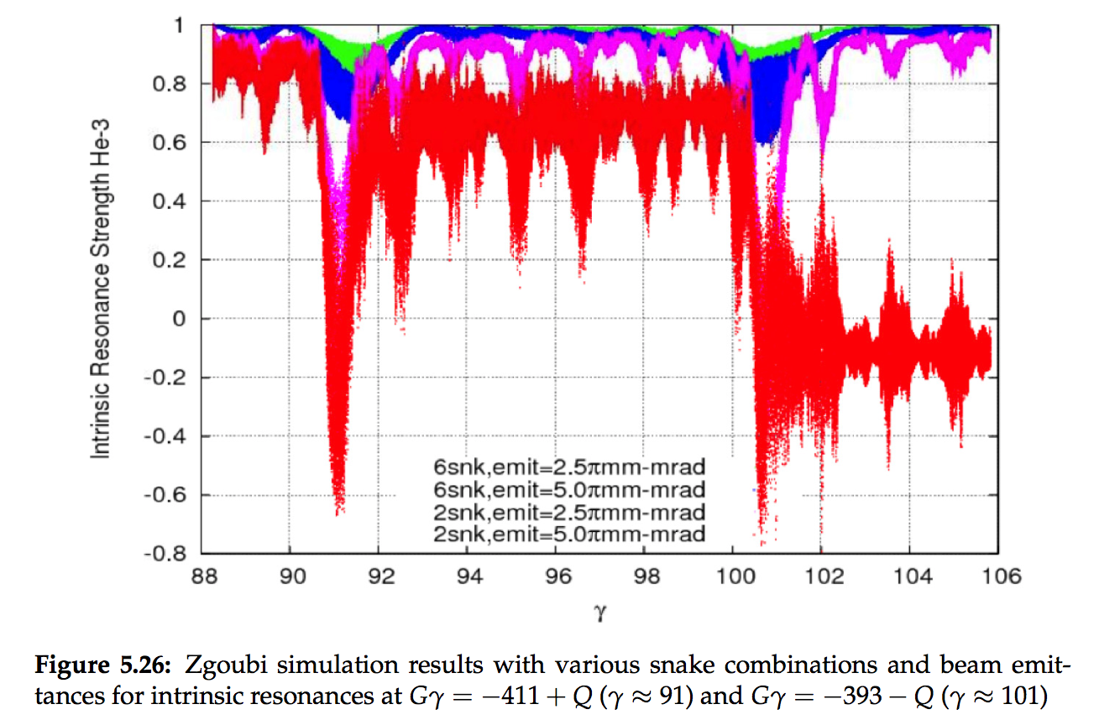
Simulations for Polarized ³He⁺²
Vertical Polarization
The simulation to cross last strong intrinsic resonance remains to be done.
Vertical Polarization

Slide 10
Polarized Deuterons in eRHIC
Unpolarized deuteron beam has been used in RHIC during ion physics program.
Present RHIC/eRHIC physics program does not include polarized deuterons.
However, the possibility of acceleration of polarized deuteron in RHIC was evaluated in the past (S.Y. Lee and E.D. Courant) and shown feasible.
In eRHIC hadron ring
Small deuteron G:
Much higher magnetic field required for spin rotation
(Siberian Snakes not feasible)
But:
Weaker resonances
Small number of resonances
(makes it possible to deal with individual resonances)
 | p | ³He⁺² | d
m, GeV | 0.938 | 2.808 | 1.876
G | 1.79 | -4.18 | -0.143
E/u, GeV | 24-275 | 10-183 | 12-137
|Gγ | | 45.5-525.5 | 48.5-818 | 1.6-20.9

Slide 11
What to Do If a Full Snake Is Not Practical?
We had similar constraint in the AGS: magnetic field from a full snake is too strong and associated orbit excursion is also too large.
The imperfection resonances were overcome by 1) harmonic orbit correction (used in 1980s and now in the AGS Booster); 2) partial snake.
The intrinsic resonance were overcome by
Speed up crossing of intrinsic resonances by betatron strong tune jumps (~0.2 in one turn, ~0.2 in 10 turns for strong ones; ~0.04 in 35 turns for weak ones);
Enhancement of strong intrinsic resonances by creating coherent betatron oscillations using an AC dipole;
Radial jump for weak intrinsic resonances
Strong partial snake(s)
Taking advantage of small number of resonances one can address particular resonances, by applying known accelerator technologies.
Increased machine setup time (compared with a setup relying on Siberian Snakes for protons and 3He⁺² ) but feasible.
Haixin Huang

Slide 12
Polarized Deuterons in the Injectors
Gγ range in the Booster: -0.14 to -0.22. No imperfection resonance. If fractional tune is not between 0.14 and 0.22 (or 0.78-0.86), no need to concern about intrinsic one either.
Gγ range in the AGS: -0.22 to -1.6. One very weak imperfection resonance. Three intrinsic resonances but none of them is enhanced with superperiod of 12. For the given AGS ramp rate, none of these causes polarization loss.
AtR line: With such a small G value and no snake in the AGS, the spin match in the AtR line is not an issue. Tracking shows that there would be no visible spin mismatch.

Slide 13
Resonance Strength for Deuterons in Hadron Ring (DEPOL)
From the d-Au run in 2016, the expected rms emittance of deuteron should be less than 2π. The rms orbit error should be under 0.3mm. The resonance strengths are estimated with these beam conditions with run17 pp lattice.

Slide 14
Polarized Deuterons in eRHIC Hadron Ring
Gγ range: -1.6 to -20.9. 19 imperfection resonances. With rms orbit error of 0.3mm, the strongest resonance strength is less than 0.0015. From the nominal ramp rate in RHIC d-Au run, the ramp rate is about dγ/dt=90/220s=>resonance crossing rate α=1.2E-7.
A partial snake can be used to overcome these resonances. The required partial snake snake strength is 0.22%. The existing snake is not strong enough. Adding a solenoid is a solution. 15Tm warm solenoid (0.22% partial snake) should work. AGS Solenoid: 4.7Tm and 2.4m long.

Slide 15
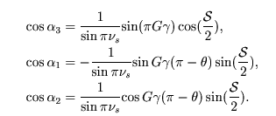
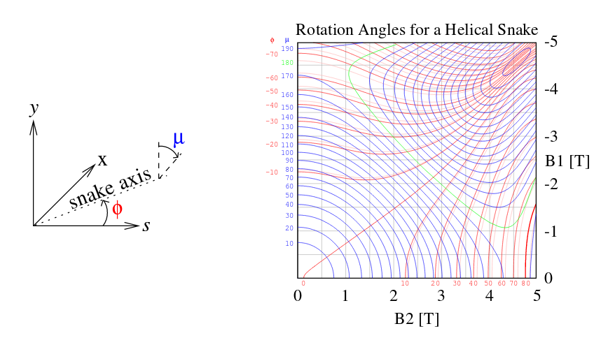
Using Spin Rotators as Partial Snake
The other option is to use spin rotators around an IR as partial snake. In this case, the spin is naturally longitudinal at Gγ=int. At the other IR π/3 away, spin will be longitudinal at Gγ=3*int.
Stable spin direction for a partial snake with longitudinal rotating axis is:
θ=0 at 1st IR, θ=10π/6 at 2nd IR
Vertical
Horizontal
Longitudinal

Slide 16
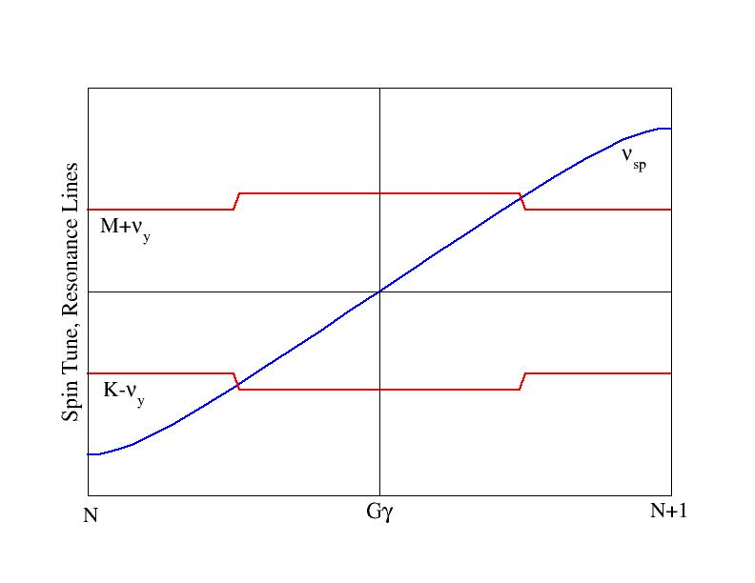
Modest Vertical Tune Jump
For an isolated resonance,
And resonance crossing rate is given by:
AGS tune jump system gives change of ν_{x} is 0.04 in 100 μs. If we use a similar PS for about 11 times larger rigidity, the expected tune change would be 0.04 in 1140μs or 0.013 in 380μs (30 turns). The resonance crossing speed would be 7E-5, which is 600 times faster than the regular ramp rate in RHIC. One possibility is to use γ_{tr} quads.

Slide 17
Polarization after Each Resonance
At two strongest resonances, normal ramp is better than tune jump.

Slide 18
Summary
Currently, RHIC proton ring is able to deliver 60% polarization at 255GeV for collisions with 1.8*10¹¹ bunch intensity.
For the planned various eRHIC operation scenarios, AGS can deliver 67-70% polarization. Additional polarization gain would come from the emittance preservation in the injectors and/or higher source polarization.
Polarized ³He⁺² development is expected in about two years when the source is available. An AC dipole will be installed in the Booster in the near future. The beam test with proton beam will be done first. If successful, it opens possibility to increase AGS injection energy so that stronger partial snake can be used and more tune space will be available for putting both betatron tunes into spin tune gap.
Polarized deuteron possibility has been explored. The imperfection resonances can be overcome by a solenoid partial snake. The intrinsic resonance can be overcome with modest tune jump. If deuteron beam is determined to be needed, source development should start.

Slide 19
Acknowledgement and References
Thanks to the discussions and inputs from T. Roser, V. Ptitsyn, V. Ranjbar, G. Robert-Demolaize, Y. Luo, C. Montag.
References for Polarized Deuterons:
S.Y. Lee and L. Ratner, NIM A306(1991)51-55.
E. Courant, AGS/RHIC/Spin Note 66 (1997).
W. MacKay CA Tech Note 296 (2007).

Slide 20
Backup Slides

Slide 21
Vertical Intrinsic Resonance Spectrum in RHIC
0.45
If the polarization loss threshold for 2-snake is at 0.18, to reduce strong ones to 0.18 requires vertical emittance reduction by a factor 6.25. If threshold is .25, need a factor 3.24 reduction.
0.18
Almost no polarization loss on the ramp below 100GeV. About 10-15% loss between 100 and 250/255GeV.

