Slide 1
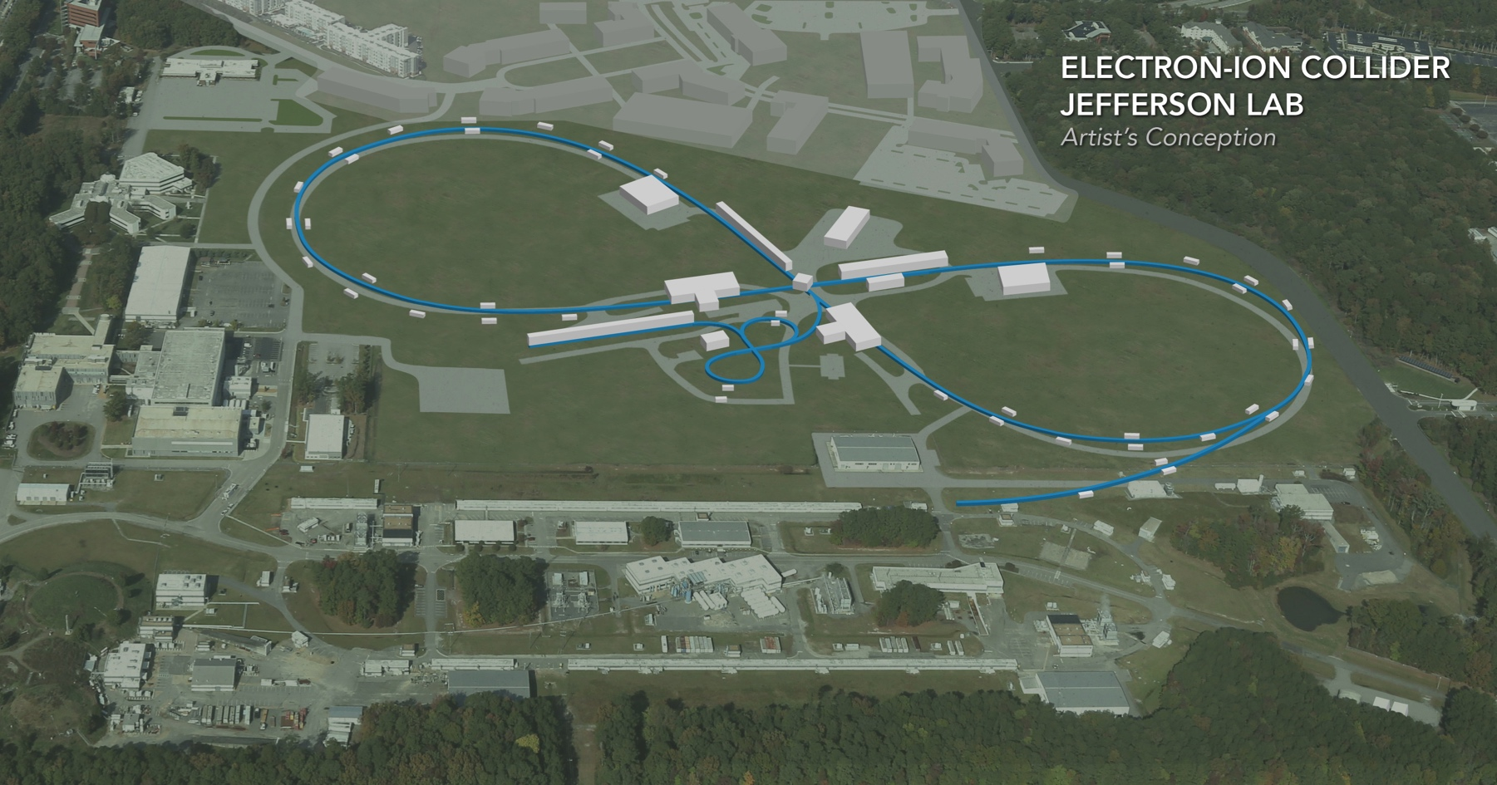
JLEIC IR Design Update
Vasiliy Morozov on behalf of JLEIC collaboration
Supported in part by DoE NP EIC R&D FOA funds
EIC Accelerator Collaboration Meeting
October 29 - November 1, 2018

Slide 2
Outline
Full-acceptance detector concept
Forward hadron detection
Low-$Q^{2}$ tagger
IR magnets
Background studies
Geometry tagging
IR optimization for 200 GeV/c

Slide 3
Full Acceptance Detector Concept
Would like to get ~100% acceptance for the whole event
Central Detector/Solenoid
Ion beamline
Scattered Electron
Electron beamline
Dipole
Dipole
Forward (Ion) Detector
Particles Associated with struck parton
Particles Associated
with Initial Ion

Slide 4
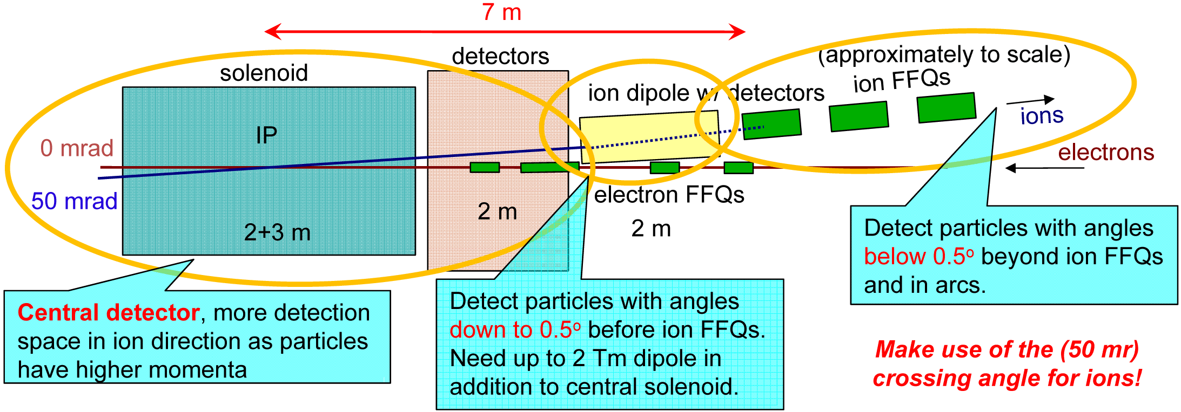
Schematic of Full-Acceptance Detector
50 mrad crossing angle
Forward hadron detection in three stages
Endcap
Small dipole covering angles up to ~2-3°
Far forward, up to ~10 mrad, for particles passing through accelerator quads
Low-Q2 tagger
Small-angle electron detection

Slide 5
JLEIC Interaction Region Layout
Design of the IR has been stable for a few years with only minor modifications
Recent focus has been on reconciling detection requirements and engineering constraints
GEMC model has been developed and is being used for simulations
IP
e
Compton polarimetry
forward ion detection
ions
forward e detection
spectrometers
dispersion suppressor/
geometric match
p
(top view in GEANT4)
e
low-Q² electron detection
and Compton polarimeter
Forward hadron spectrometer
ZDC

Slide 6
Forward Hadron Detection
Electron and ion beams have to cross at an angle in an EIC, JLEIC: 50 mrad
Create space for independent electron and ion IR magnets
Avoid parasitic collisions of shortly-spaces bunches
Improves detections
Improves detector background
Two forward charged hadron detector regions:
Region 1: Forward, small dipole covering scattering angles from 0.5 up to ~2-3° (before quads)
Region 2: Far forward, up to ~10 mrad, for particles passing through (large aperture) accelerator quads. Subsequent dipoles for precision measurements.
Neutrals are detected in a zero-degree calorimeter (ZDC)
Region 1: ~7 m
Region 2: ~45 m

Slide 7
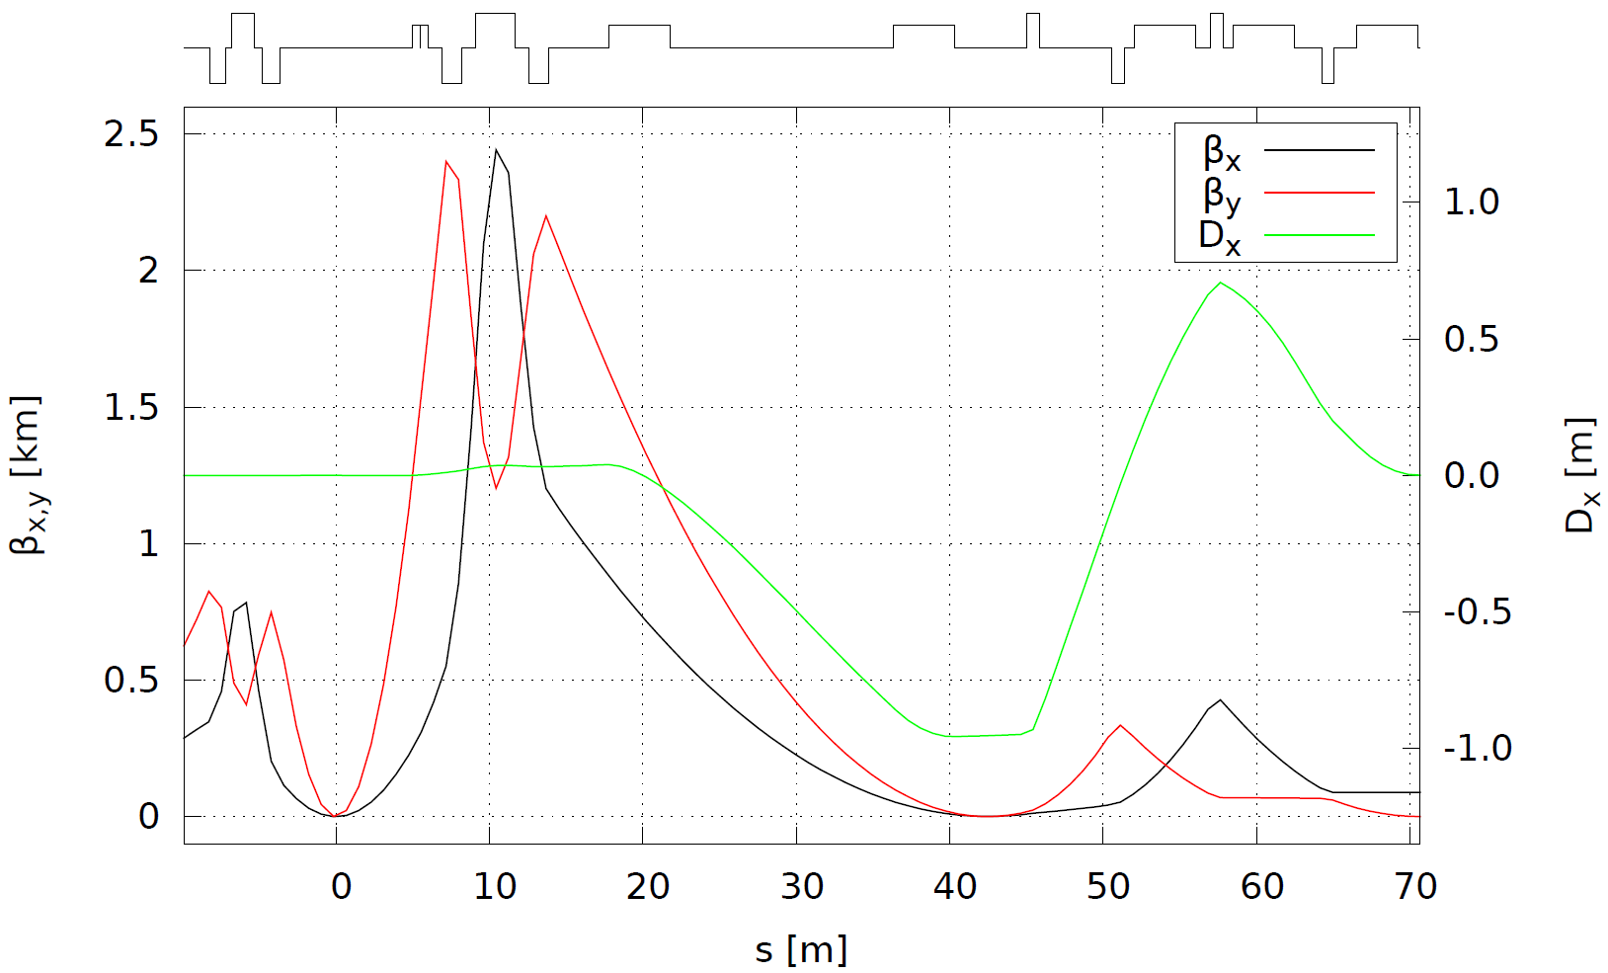
Ion IR Optics
Pole-tip fields are limited to 6 T
iBDS1
Geometric match and dispersion suppression
FFB
IP
FFB
Far-forward detection
iBDS2
iBDS3
ions
$β_{x/y}=10/2$ cm
$σ_{x/y}=21.7/4.3 μ$m
$σ_{x^{′}/y^{′}}=0.22$ mrad
$β_{x/y}=69/$37 cm
$D_{x}=−0.95$ m
$σ_{x/y}=292/19 μ$m
$σ_{x^{′}/y^{′}}=16/50 μ$rad
$Δx_{fr}=D_{x}Δ(Bρ)/(Bρ)$
Secondary
focus
IP

Slide 8
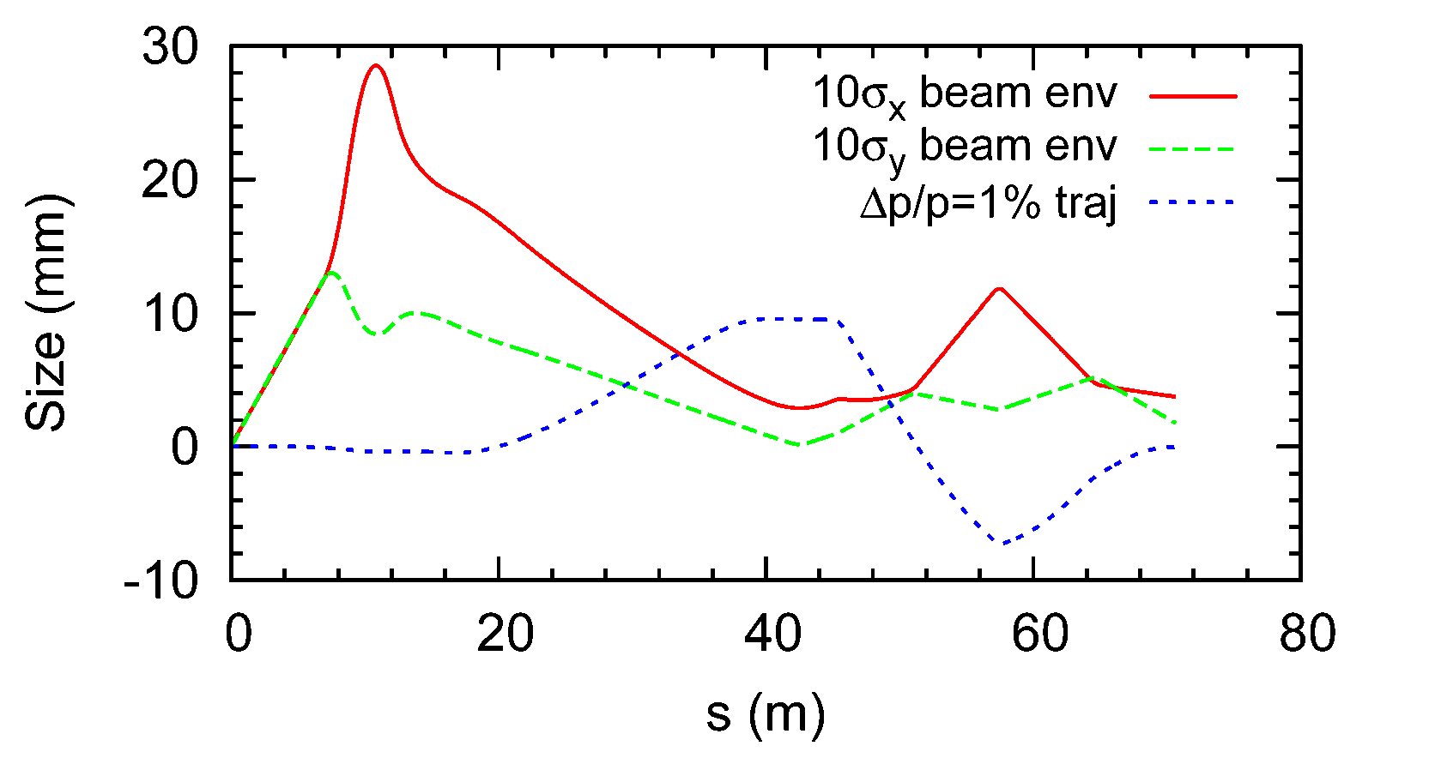
Ion Beam Envelope and 0.99$Bρ$ Trajectory
Assuming beam momentum of 100 GeV/c, ultimate normalized $x/y$ emittances $εxN/εyN$ of 0.35/0.07 $μ$m, and ultimate momentum spread $p/p$ of $3×{10}^{−4}$
The horizontal size includes both betatron and dispersive components

Slide 9
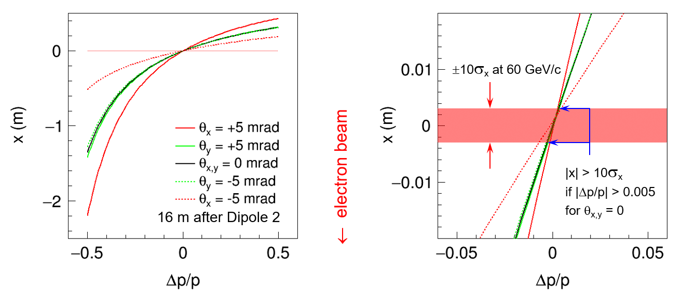
Momentum & Angular Resolution
Protons with $p/p$ spread are launched at different angles to nominal trajectory
Resulting deflection is observed at the second focal point
Particles with large deflections can be detected closer to the dipole
Crab tilt at the second focus may reduce momentum acceptance to $p/p>1\%$

Slide 10
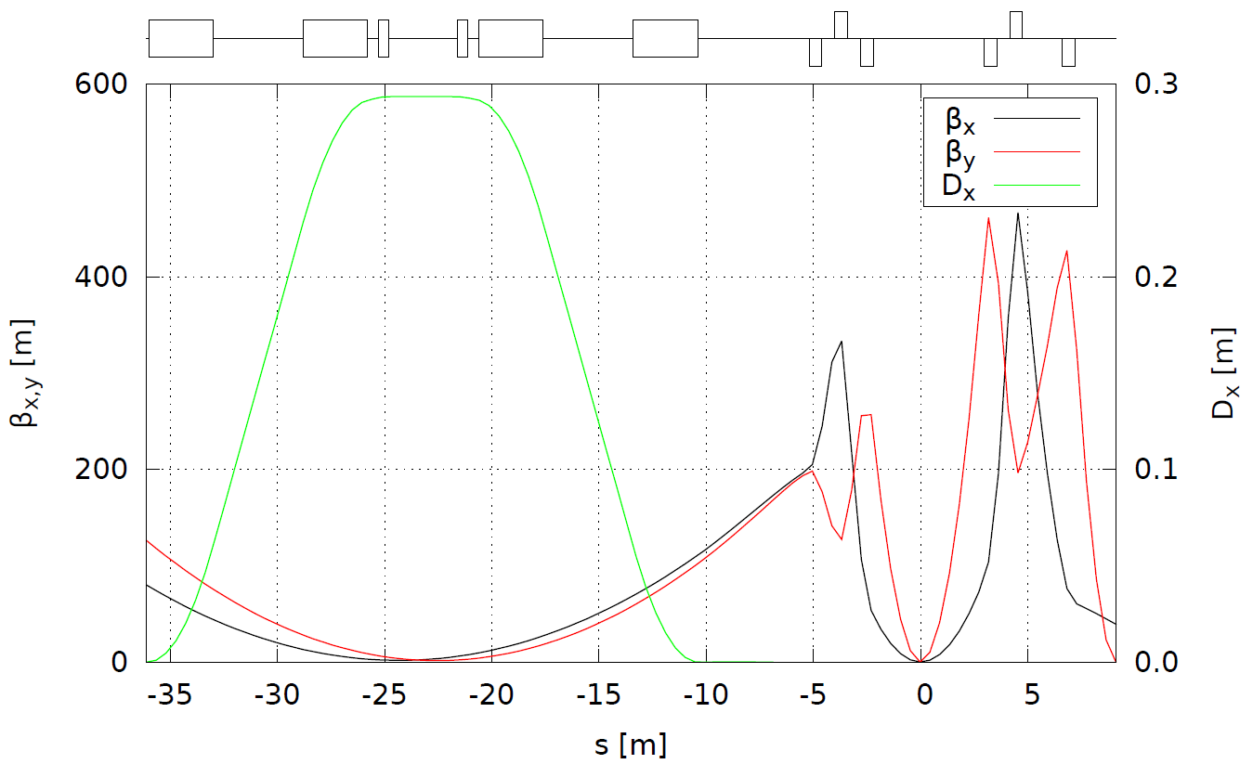
Electron IR Optics
Dipole chicane
Compton polarimeter
Low-$Q^{2}$ tagger
FFB
FFB
electrons
Secondary focus
IP

Slide 11
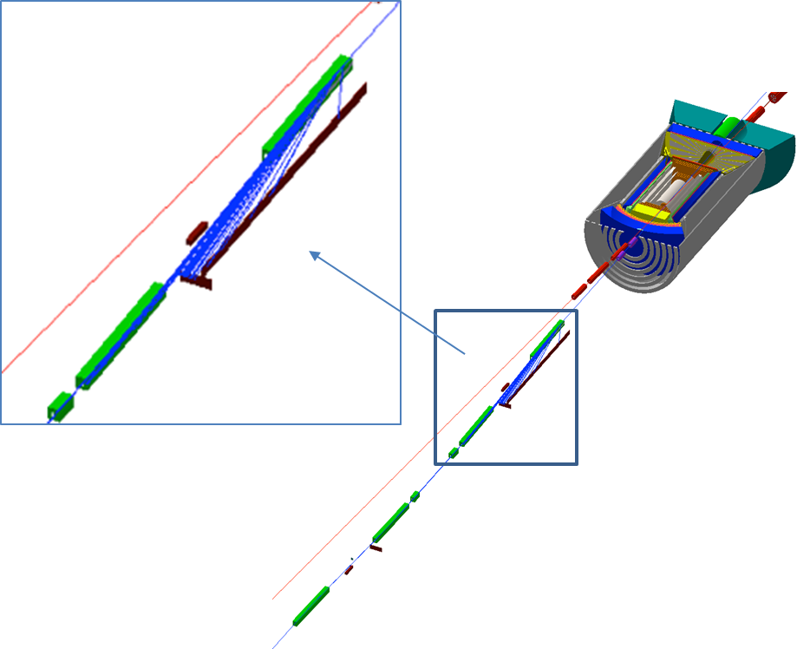
Low $Q^{2}$ Tagger in JLEIC
Dipole chicane for high-resolution detection of low-Q² electrons
Compton polarimetry has been integrated to the interaction region design
same polarization at laser as at IP due to zero net bend
non-invasive monitoring of electron polarization

Slide 12
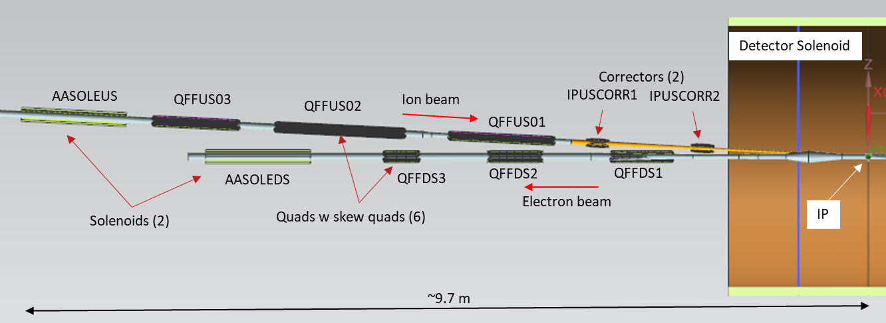
Development of IR Magnet Specifications (DoE FOA project)
IR magnet engineering design/analysis
Design of the multipole correction scheme in the IR region, relate LARP experience
Identify limits in magnet parameters which directly affect the IR performance
Relate existing magnet data to the EIC performance requirements including scaling to the IR design
Heat and radiation loads on IR magnets
Perform magnetic analysis and initial optimization, considering LARP design, BNL EIC IR quadrupole prototype, and others
Mechanical and magnetic design of an optimized IR quadrupole
Incorporate optimized IR quadrupole lessons/features and finalize IR layout
See talk by Tim Michalski

Slide 13
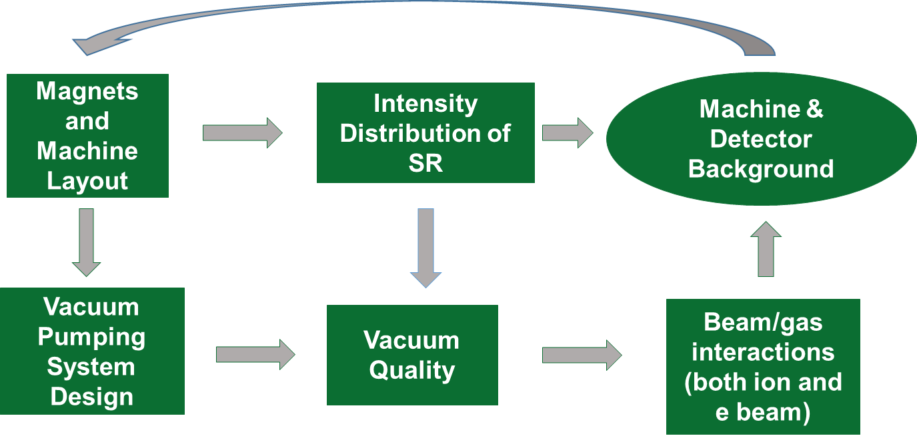
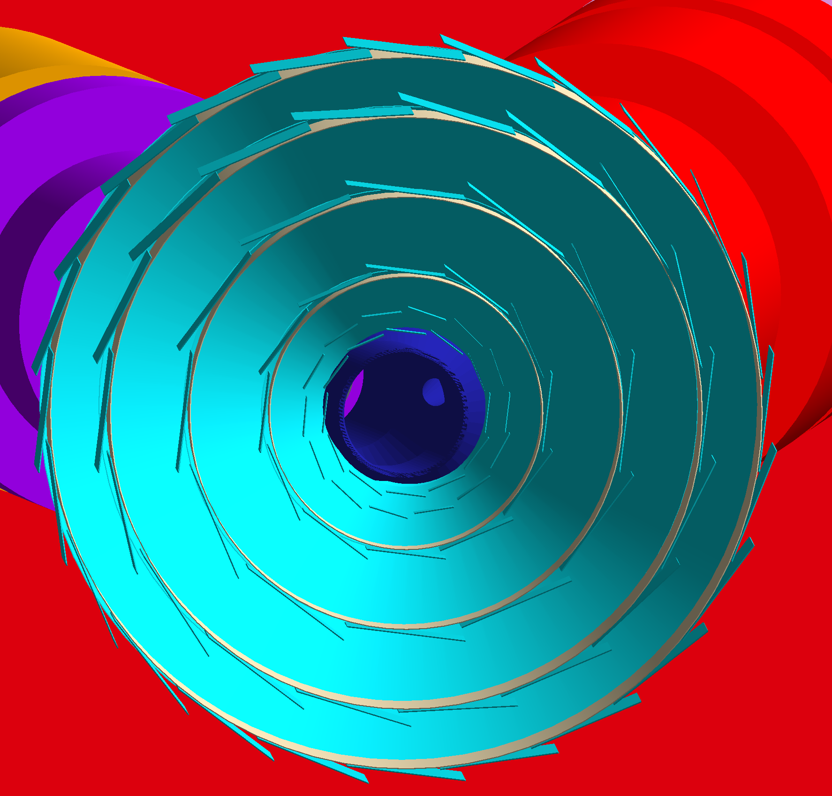
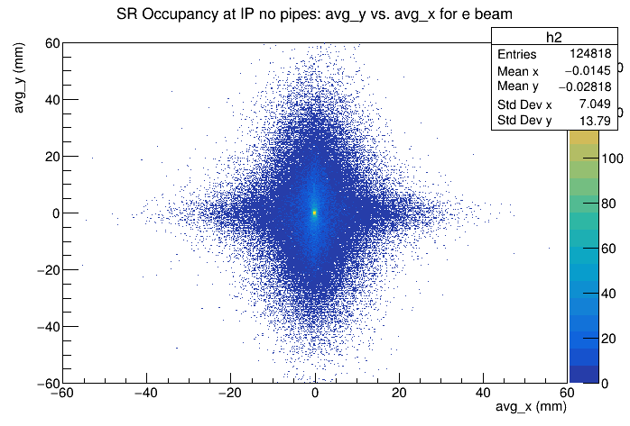
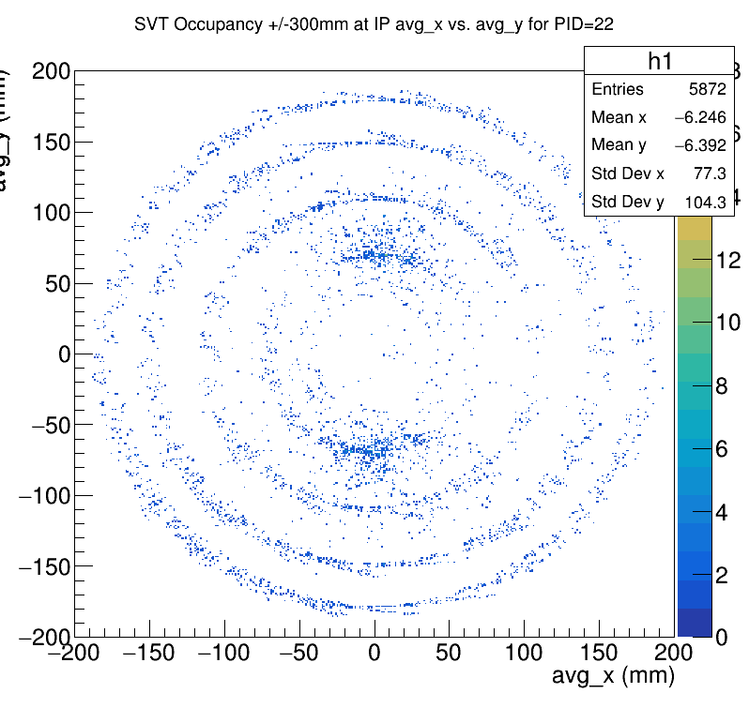
Background Studies (Supported by Generic EIC Detector R&D)
Project leads: Latifa Elouadrhiri and Charles Hyde

Slide 14
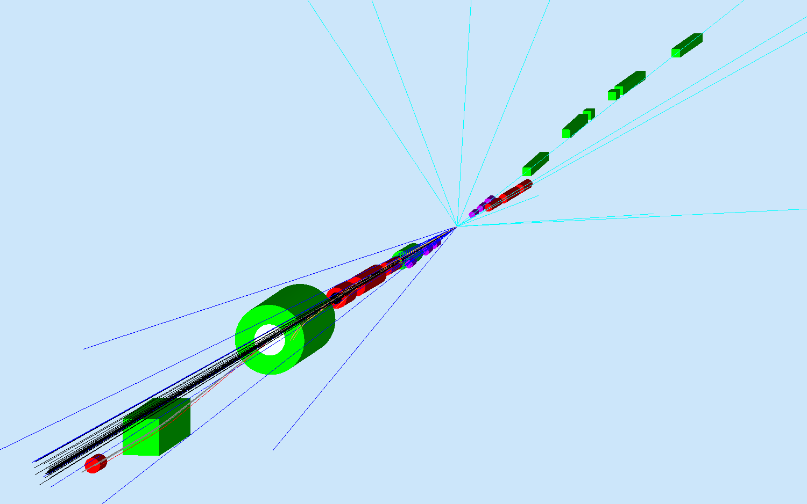
Geometry Tagging for Heavy Ions (Completed JLab LDRD Project)
Simulation of detector performance for saturation and hadronization studies
See talk by Amy Sy

Slide 15
Streamlining IR Updates
With many parties involved, need to find a way to reliably synchronize the IR models between accelerator, detector and engineering groups.
Accelerator Lattice
MAD-X
Largely
automated
Detector Model
GEMC
Engineering Design
CAD
Largely
automated

Slide 16
Modifying IR Design for 200 GeV/c
Constraints
Maximum pole-tip fields at 200 GeV/c of 6 T
Minimum impact on the forward hadron acceptance compared to the 100 GeV/c design
Minimum impact on the luminosity performance compared to the 100 GeV/c design
Minimum impact on the beam dynamics compared to the 100 GeV/c design
Options explored
Reduced FF Quad Apertures
Doubled Detector Space and Halved Crossing Angle
Doubled Quad Lengths
1.5x Quad Lengths and 2/3 Crossing Angle
✓

Slide 17
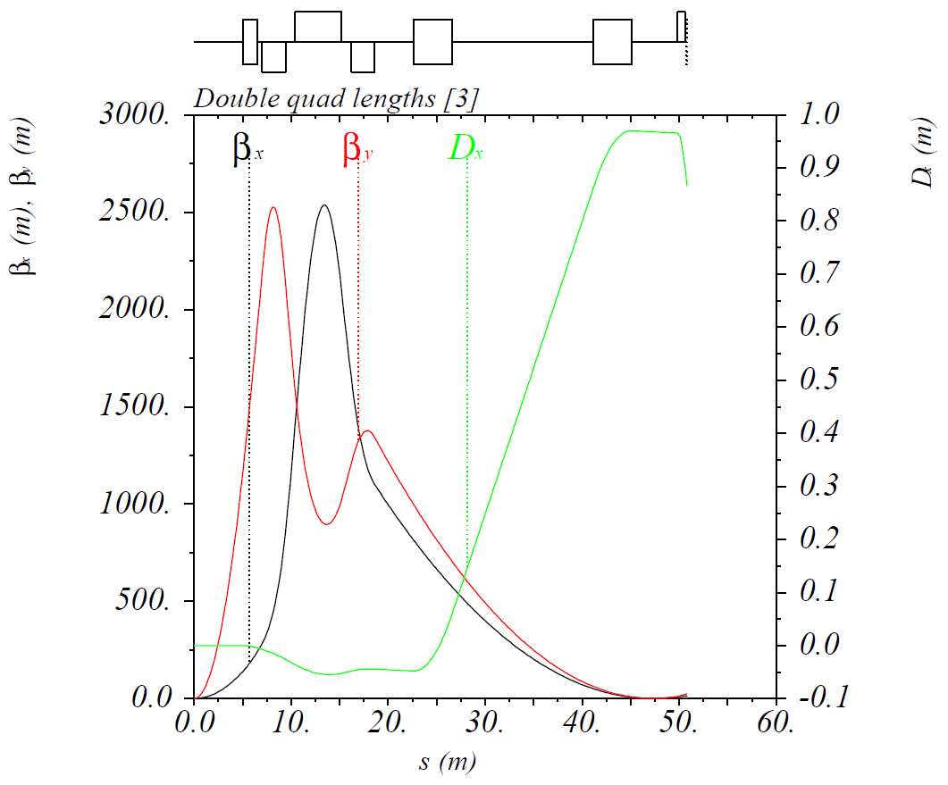
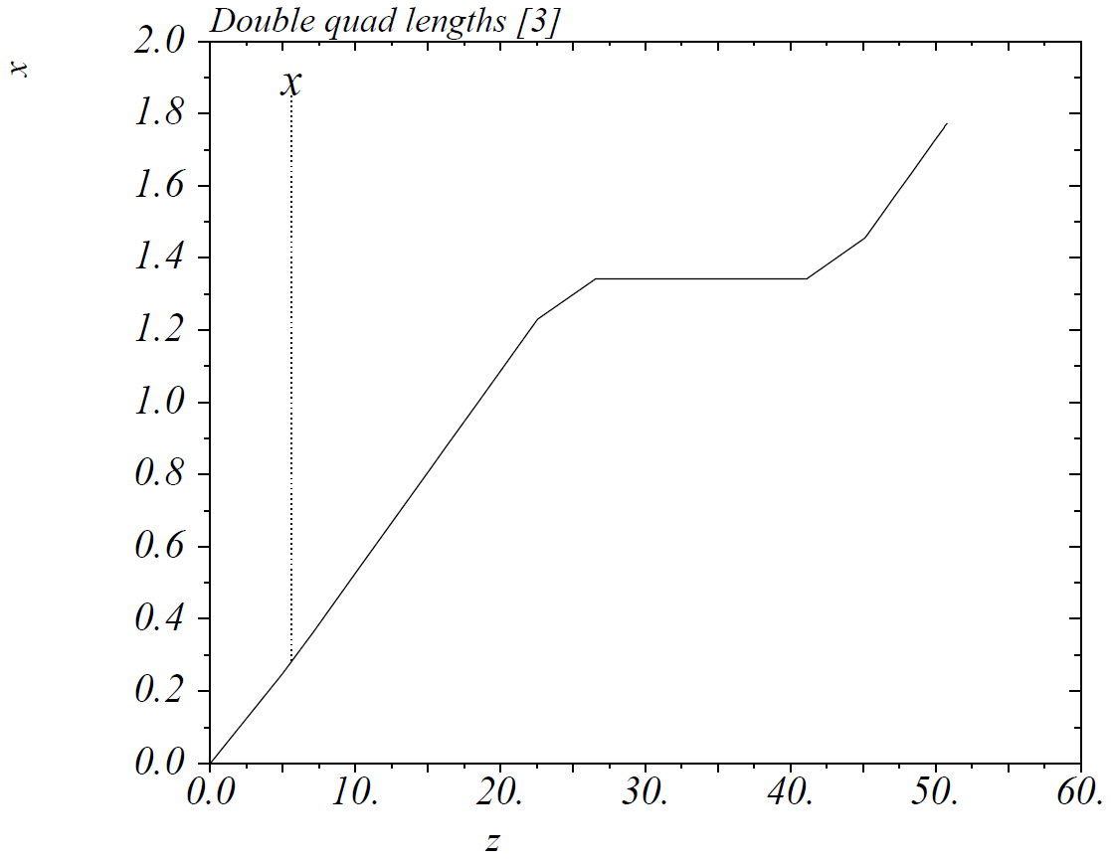
Doubled Quad Lengths
Keep maximum $β$-functions at ~2500 m ⇒ same maximum beam size
Quad apertures ≡ 6 T / $\left({∂B_{y}}/{∂x}\right)$ at 200 GeV/c = 85 / 152 / 196 mm (radius)
$θ≡$ Quad aperture / distance from IP to quad’s far end = 9.1 / 10.0 / 10.5 mrad
$β_{x,y}^{∗}$ = 18 / 2.15 cm ⇒ $L/{L_{0}}=0.72$, $D_{x}$ at roman pot = 0.97 m

Slide 18
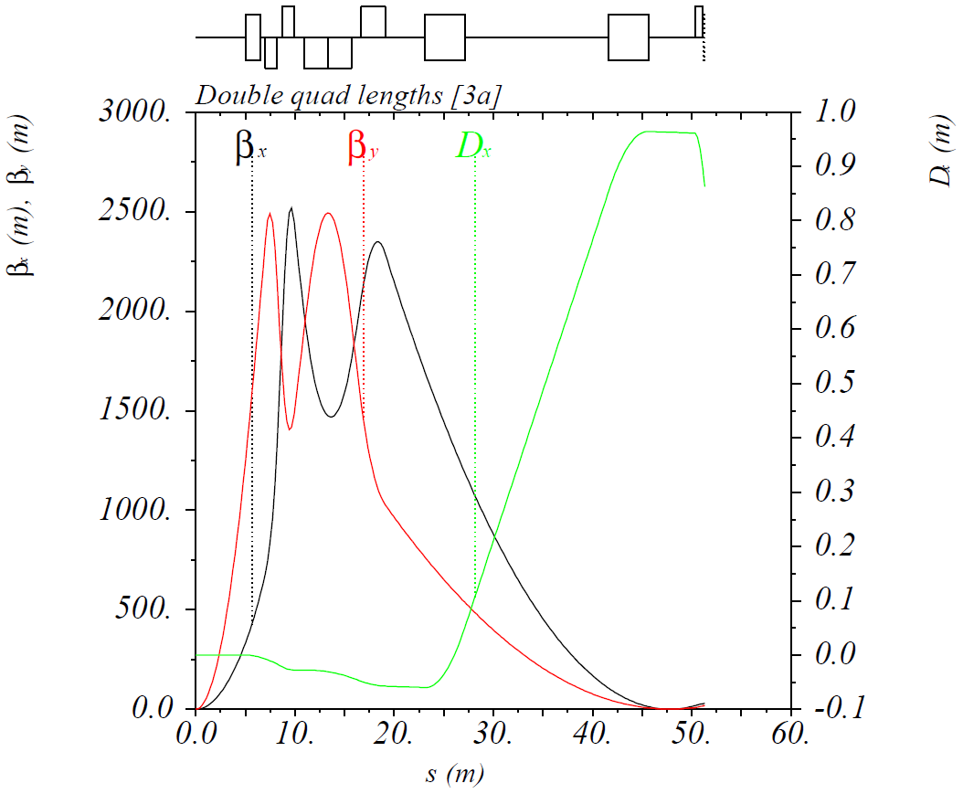
Performance Optimization at Lower Energies
Cut first FFQ in half and use the halves as the first and second FFQs at lower energies
Can run in this mode up to 65 GeV/c proton momentum
$β_{x,y}^{∗}$ = 7.5 / 2 cm ⇒ luminosity improvement by a factor of $L/{L_{0}}=$ 1.15 (up to $p_{p}=$ 65 GeV/c)

Slide 19
Conclusions
The full-acceptance detector concept has been stable for the last few years, there have been only minor lattice modifications
Recent focus has been on
Engineering design (talk by Tim Michalski)
Background studies (lead by Latifa Elouadrhiri and Charles Hyde)
Detector simulations (see e.g. talk by Amy Sy)
We are currently developing a procedure to quickly synchronize the accelerator, detector and engineering IR models
Have a path forward to modify the IR design for 200 GeV with minimum impact on performance and without introducing additional risks

