Slide 1
IR Magnet Layout & Design: eRHIC
2018 EIC Accelerator Collaboration Meeting
Co-Chairs: V. Ptitsyn (BNL), Y. Zhang (Jefferson Lab)
29 October to 1 November 2018, JLab CEBAF Center
Brett Parker and Holger Witte Brookhaven National Lab
30 October, 2018

Slide 2
Presentation Outline
Review eRHIC IR Magnets (preCDR).
Report on EIC IR Magnet Common R&D (Fast Track Nb₃Sn with NbTi Active Shield).
Discuss our ongoing “Value Engineering” (Primary Goal: Further reduce cost & risk).

Slide 3
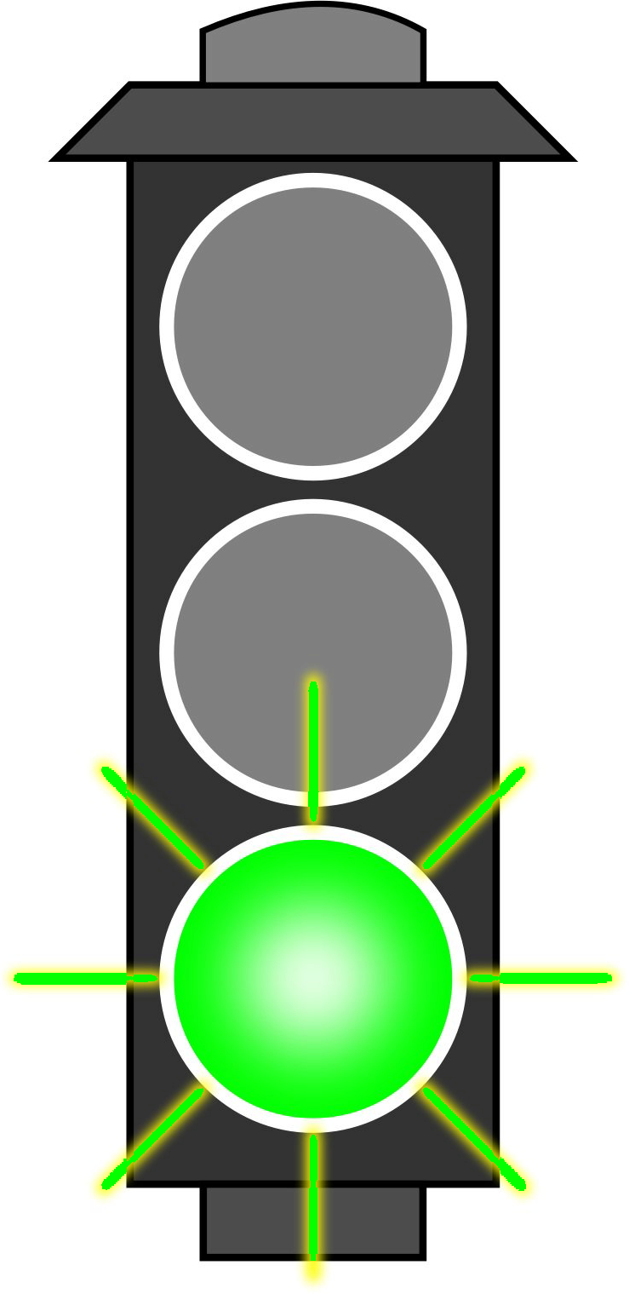
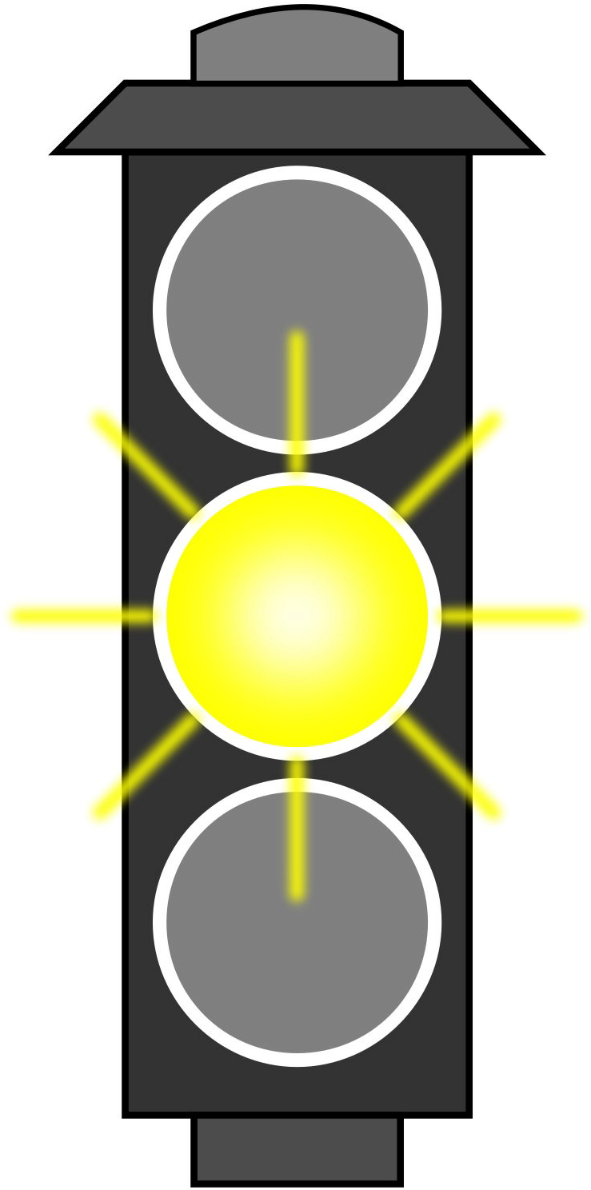
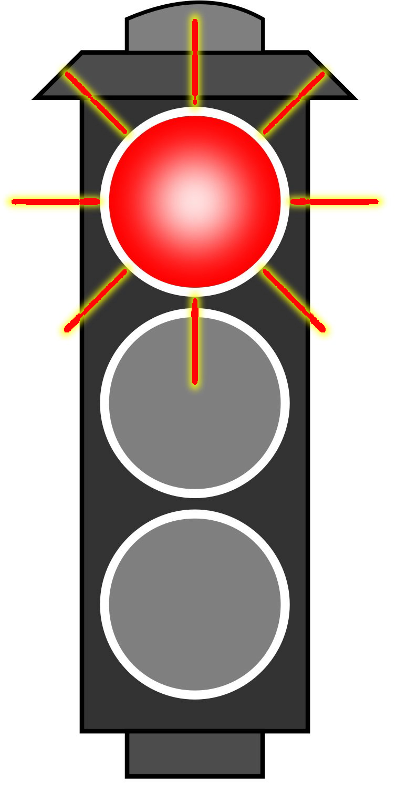
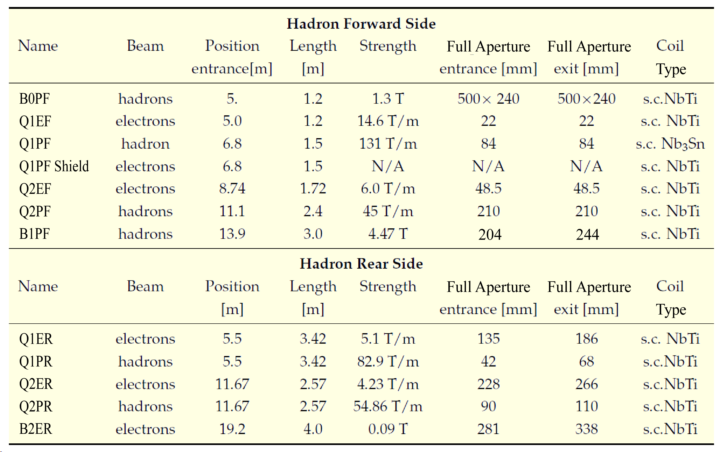
IR Magnet Table: From eRHIC preCDR
Magnet is easy
“good to go”
Magnet is hard
“take care, we must watch out”
Magnet is novel
“check critical
parameters”
*
*
*
*Alternate backup concept exists for these magnets.

Slide 4
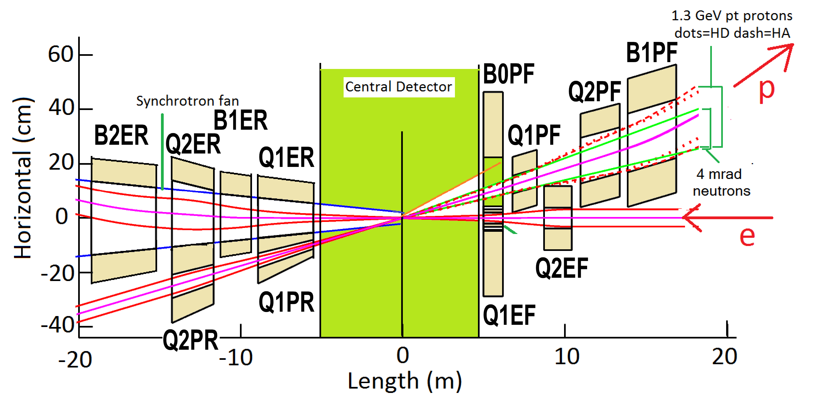
Requirements
Rear Side
Forward Side
The experiment requires ±4.5 m free space for the detector.
First stage of beam separation uses a crossing angle (there is no separator dipole inside detector and no dipole field to spoil RICH/PID).
Closest electron and hadron IR magnets are side-by-side in common cryostat in order to keep L* small as possible and minimize peak betas and the IR chromaticity contribution.
Forward (i.e. outgoing hadron) side, need three stages of beam separation.
Separate electrons and hadrons via crossing angle.
Separate small/intermediate angle hadrons via B0 spectrometer magnet.
Separate circulating hadrons from 4.5 mrad neutron cone (ZDC) and 5 mrad forward charged particles (Roman Pots) via the B1 spectrometer magnet.
Above forward physics acceptance requirements lead to large apertures (much larger than the 10 σ hadron beam) and for 275 GeV protons yields large coil fields from which the electron beam, within its own much smaller aperture, has to be protected.

Slide 5
Requirements
Rear Side
Forward Side
On rear (i.e. outgoing electron) side situation is reversed. Small hadron beam apertures; large e-beam apertures.
Rear side uses weak dipoles to separate:
Circulating e-beam from photons direct from IP (Lumi Monitor)
And to detect scattered electrons from the IP (Physics e-Tagger).
We do not let synrad hit first magnets in order to avoid creating experimental background due to albedo backscatter,
Synrad tails from the upstream IR quads should cleanly pass through first few rear side superconducting e-beam magnets,
So e-beam apertures are larger than neighboring hadron apertures.

Slide 6
Assumptions
Rear Side
Forward Side
Place IR magnets as close as possible outside ± 4.5 m detector region (minimize beta peaks and chromaticity) .
Use as small as possible 22 mrad crossing angle (minimize crab cavity voltage requirements).
Aperture assumptions: 10 σ protons/ions, 15 σ electrons and 13 σ for synrad (actual forward hadron apertures driven by physics not beam size).
Most magnets use well established NbTi conductor (main exception is Nb₃Sn for Q1PF) and use normal LHe cooling (not He-II superfluid).
Use cold beam pipes to minimize coil radii (this reduces both coil peak field and external magnetic flux and the external field shielding needed at e-beam).
Using superfluid He-II would further increase the coil radii in order to create independently cooled beam pipes (remind: 1 A hadron beam; 2.5 A e-beam).
Use of BNL Direct Wind technology as much as possible (for the wide variety of individual magnet coil designs required, we minimize creation of new magnet production tooling).
†
†At this point baseline has no accelerator magnets inside the detector; however, it is possible that a small, weak e-quad inside the detector on the forward side could reduce peak betas and chromaticity, reduce size of synrad cone and increase rear side acceptance without impacting forward hadron acceptance.

Slide 7
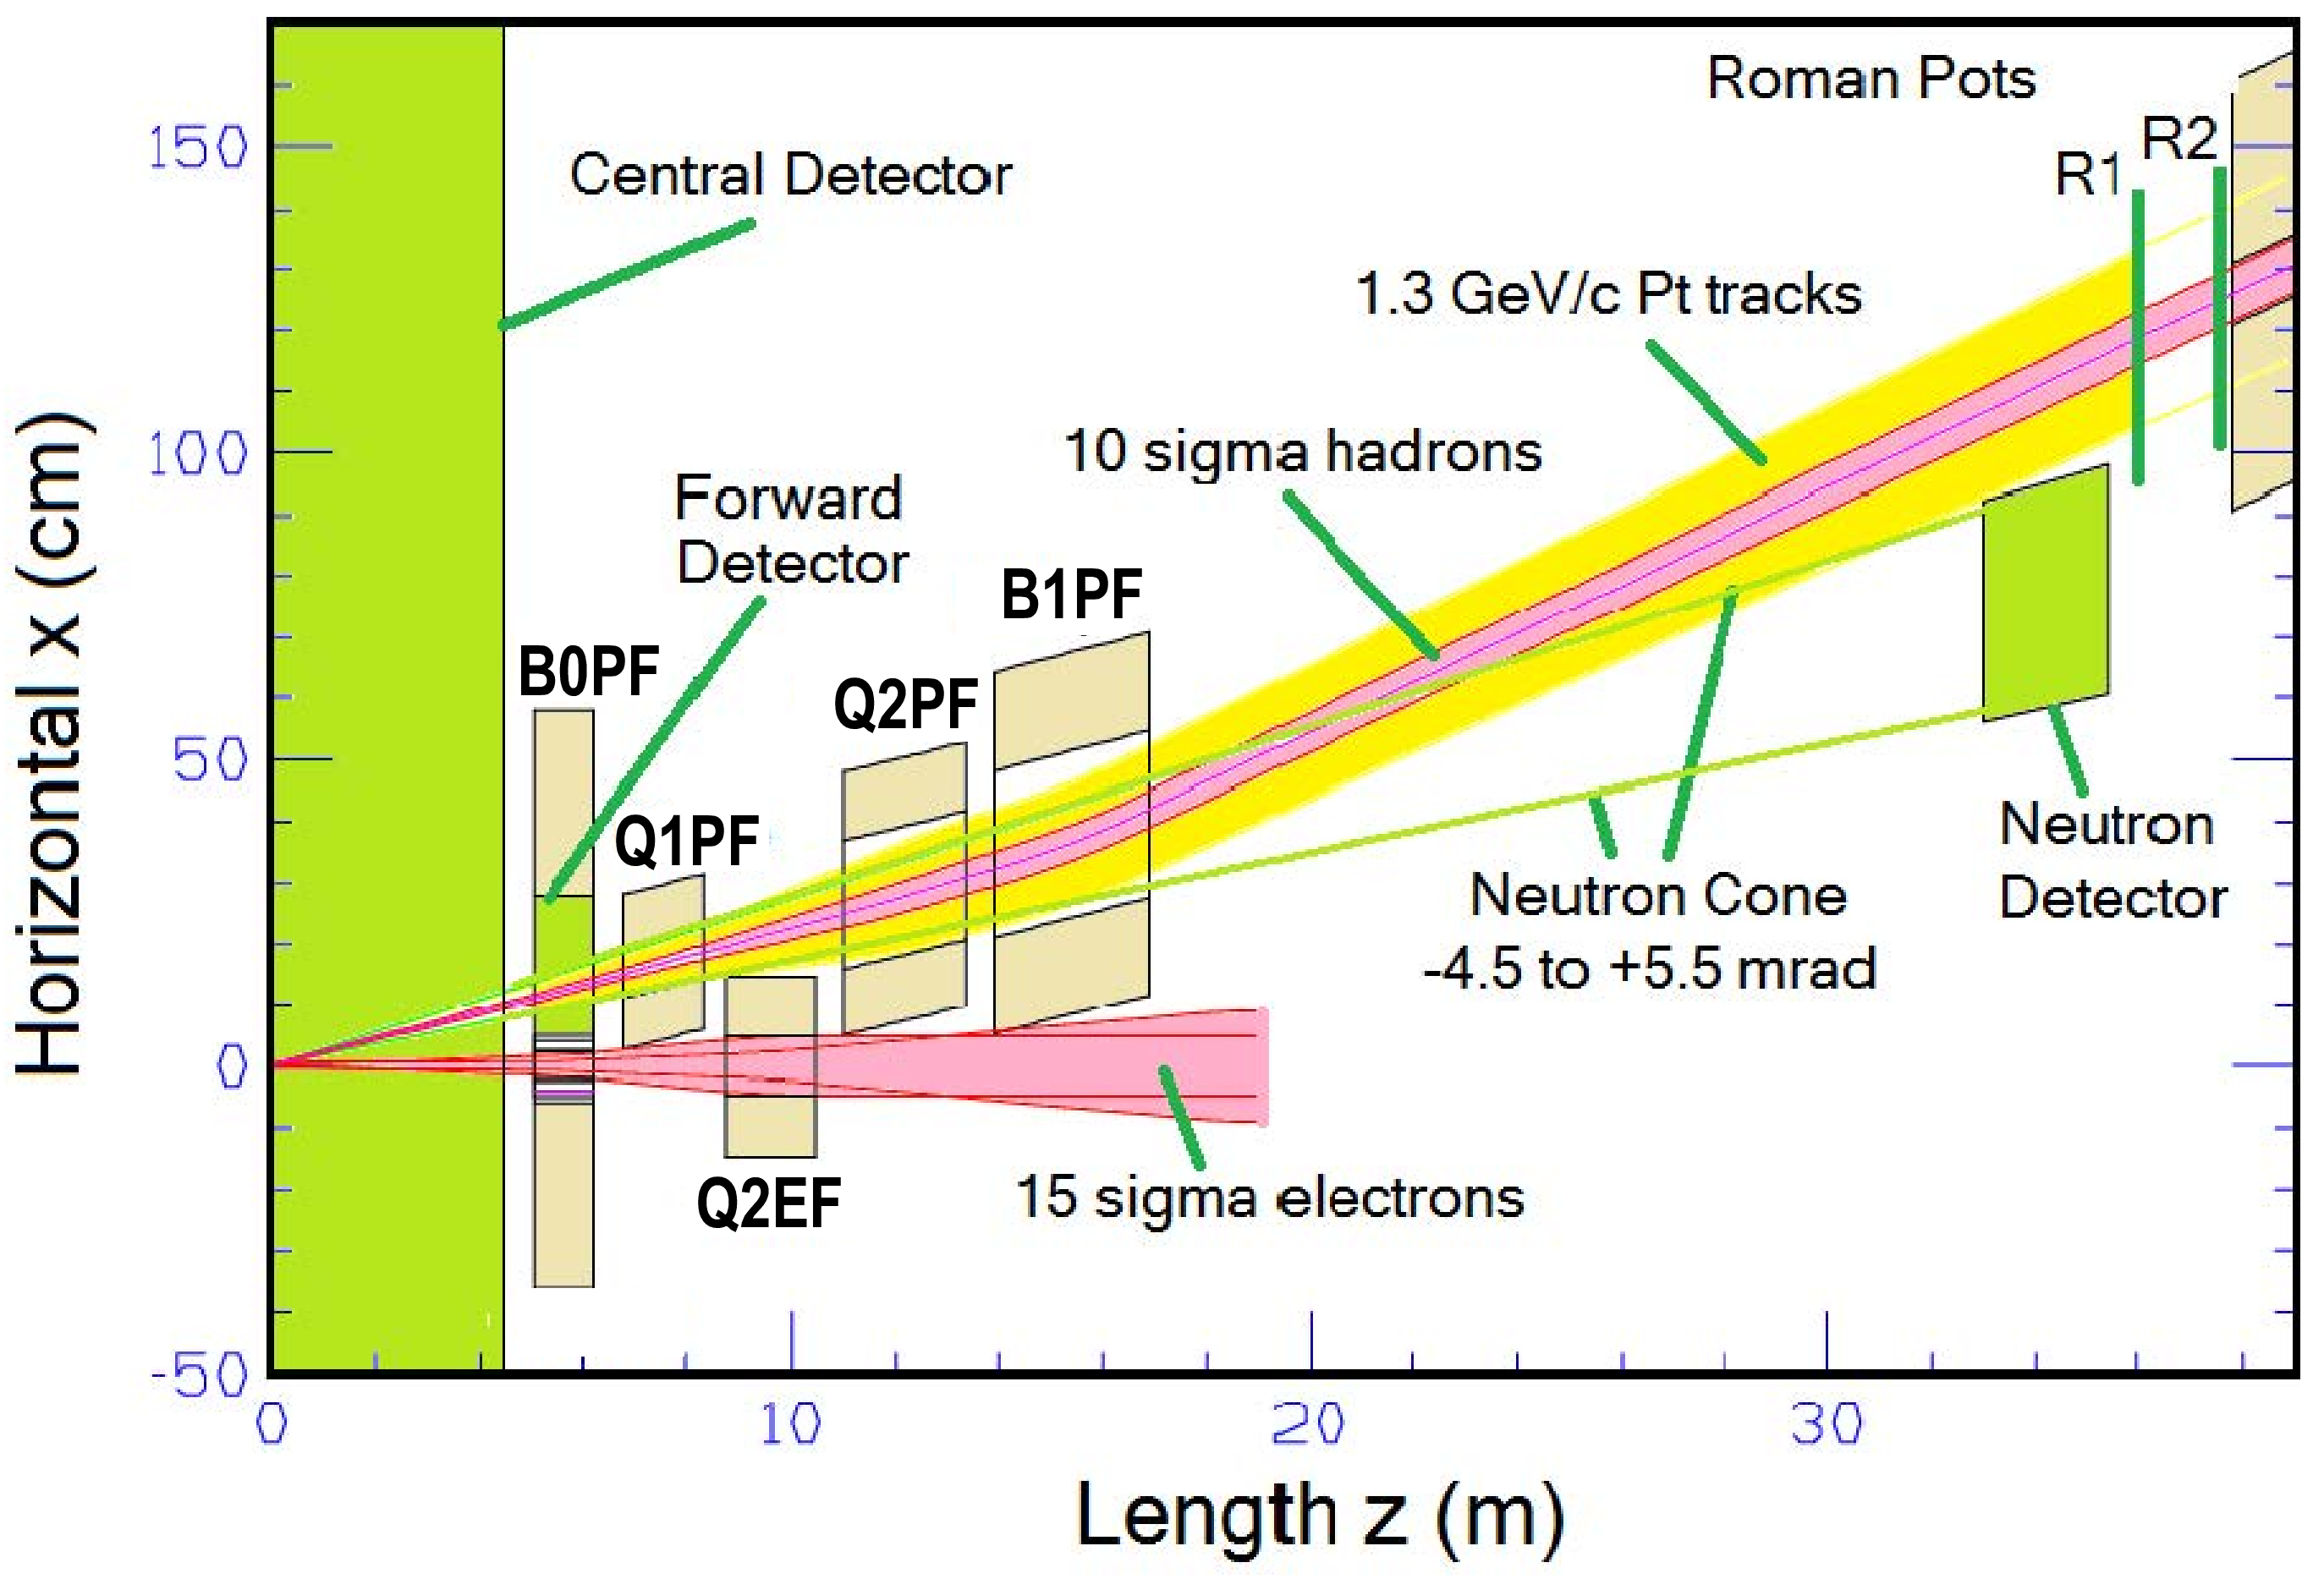
eRHIC IR Magnet Forward Layout
Forward physics dominates these apertures!
-> Proton/Ions ->
-> Neutrons ->
<- Electrons <-
(preCDR)
Critical Magnet

Slide 8
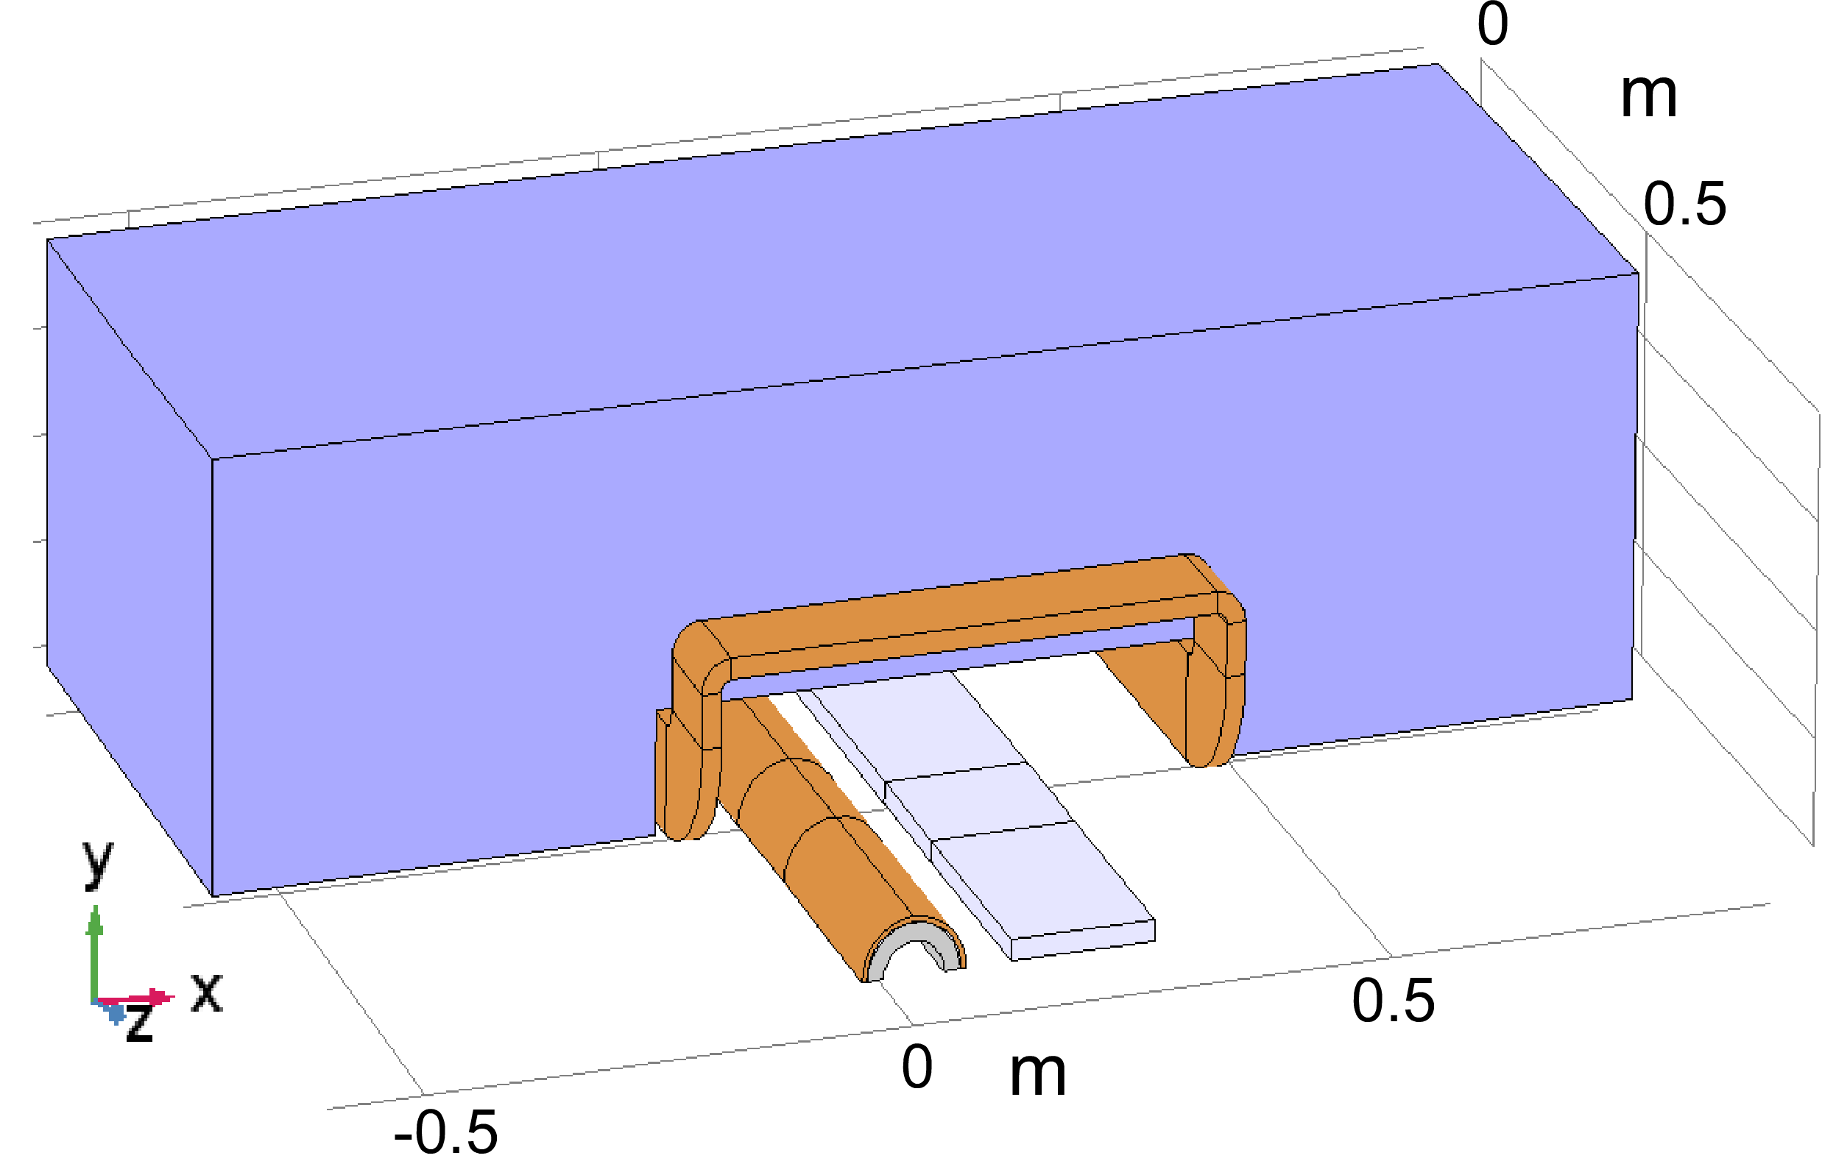
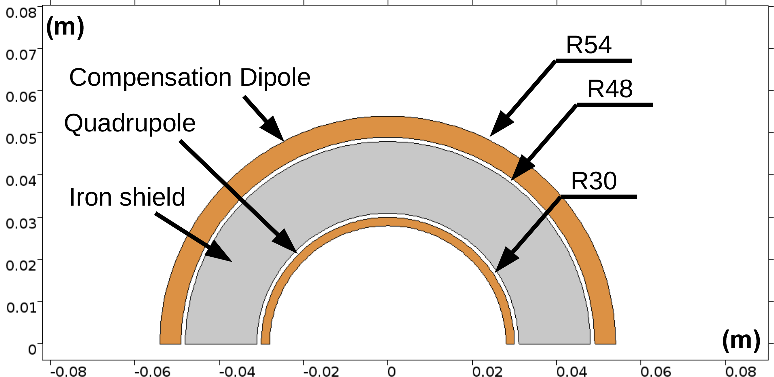
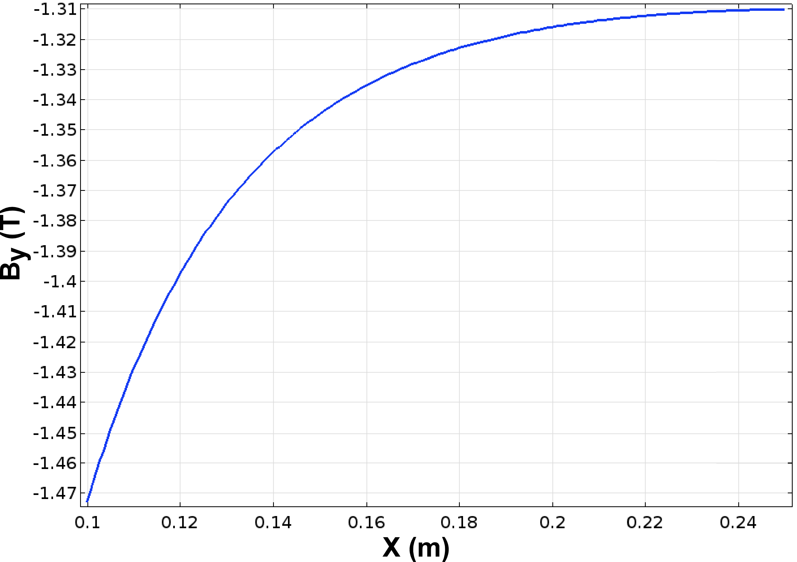
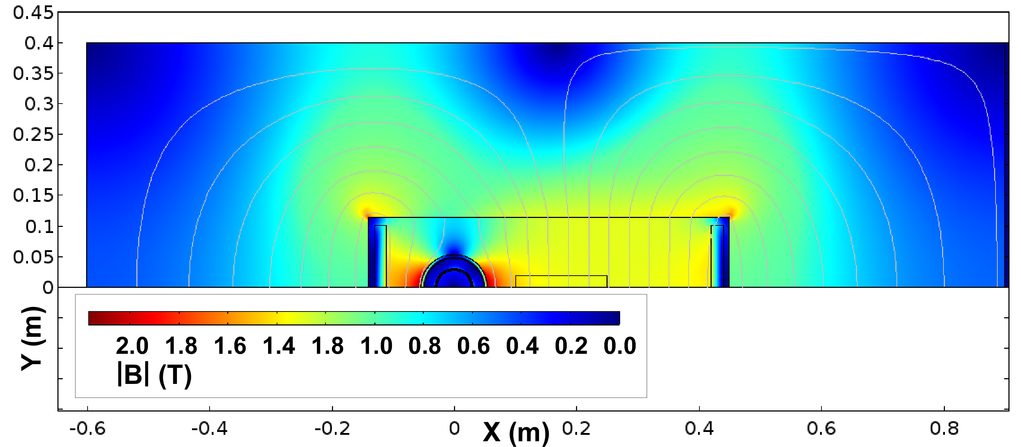
eRHIC: B0 Spectrometer*
(Holger Witte, BNL)
Rear Side
B0 Magnetic Yoke
Forward Side
Magnet is aligned with the e-beam, so p-beam enters at 22 mrad angle.
1.3 T Cancel Coil Detail
Superconducting Coils
Q1EF
p-Beam sweeps across this region
(preCDR)
e-Beam
Cancel Coil Influence
Experimental
Detector Here
Field Profile Outside the Dipole Cancel Coil
Holger has a new B0 coil design that improves the field linearity.
*Have Sweet Spot dipole as backup design.

Slide 9
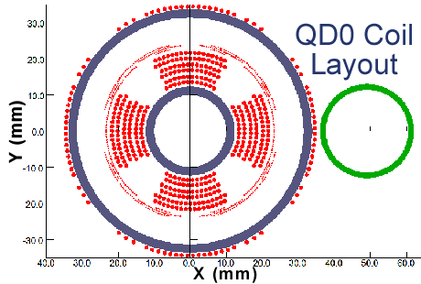
Design for Compact Superconducting Magnet Used in the ILC 14 mr Layout.
14 mr crossing angle via compact self-shielded QD0 coil windings.
Extracted beam passes just outside coil into separate focusing channel.
Cryostat to fit within limited space inside detector at L* = 4.1 m.
Incoming Beam
Outgoing Beam
Off
On
148 T/m
140 T/m
QD0 with active shield off/on

Slide 10
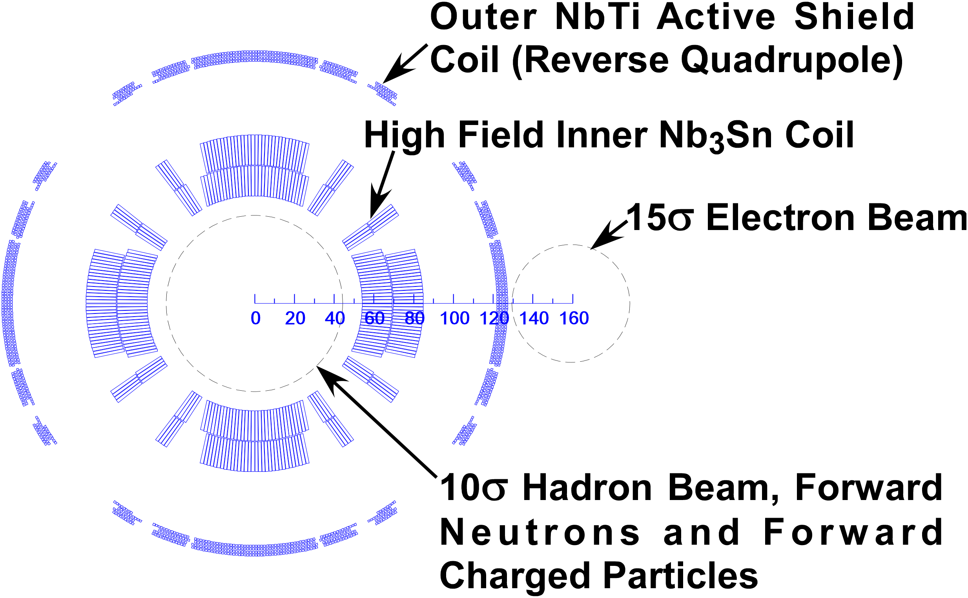
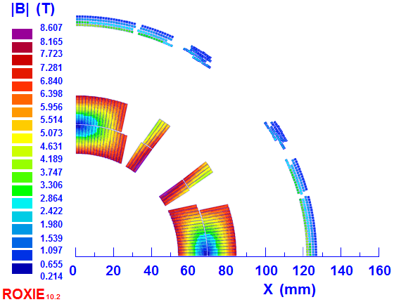
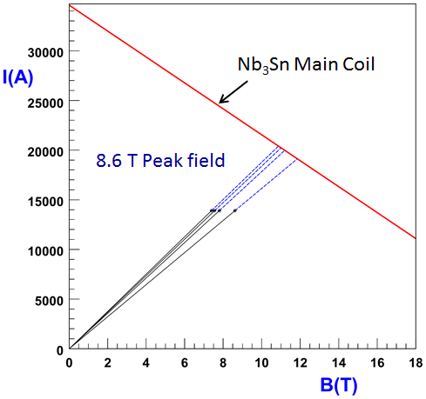
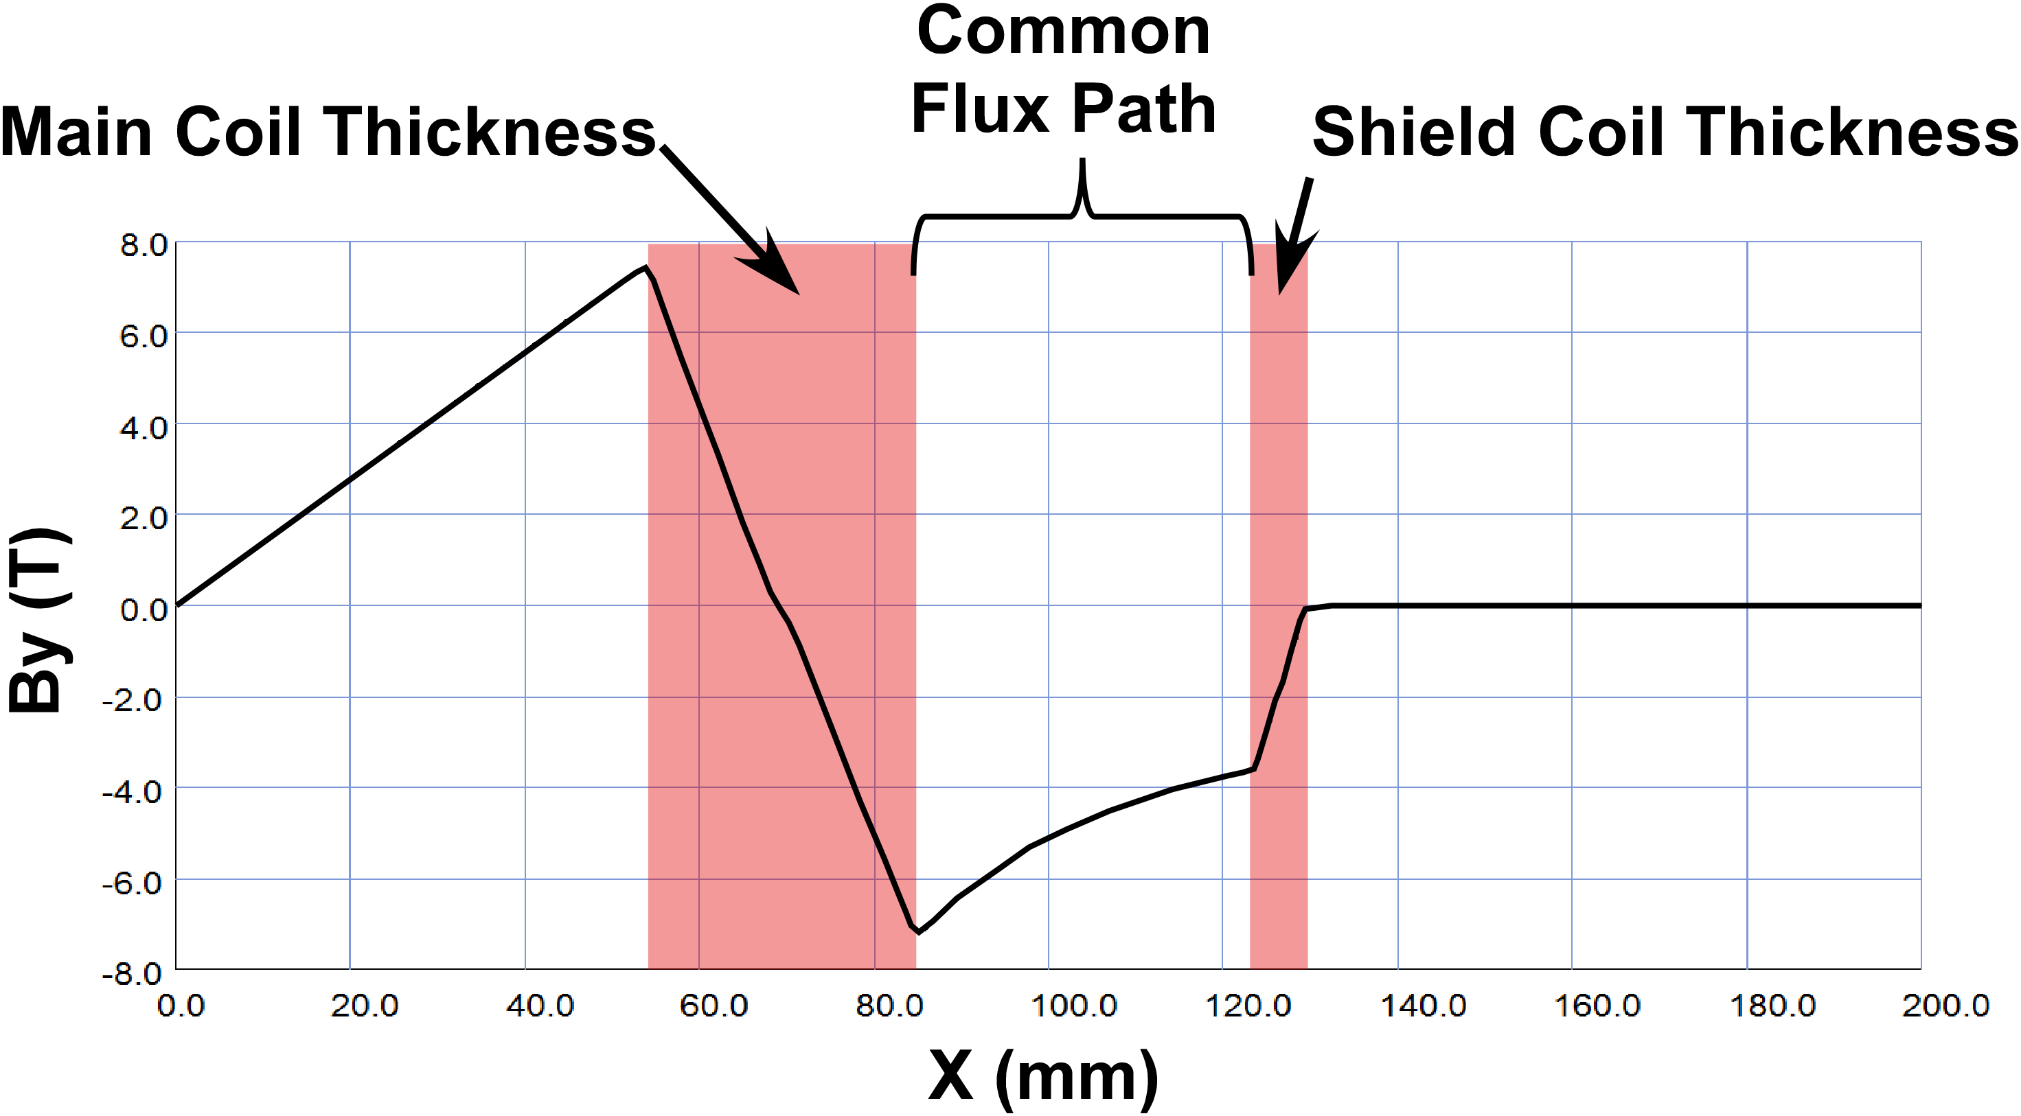
eRHIC: Q1PF Design
(preCDR)
Rear Side
Forward Side
For 140 T/m Gradient
8.6 T peak field
An active shield kills the external field but also reduces the gradient inside main aperture.

Slide 11
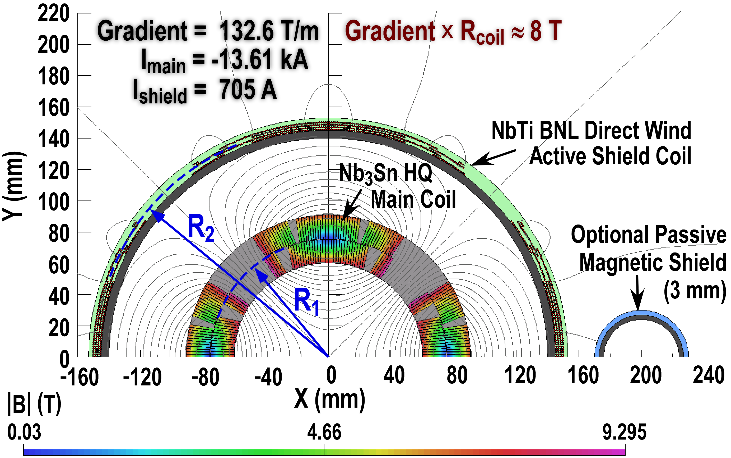
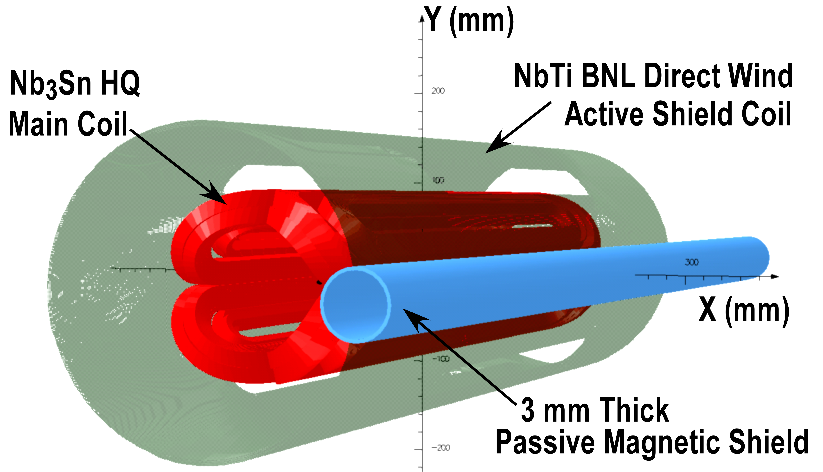
Active Shielding for EIC IR Quadrupoles
Actively Shielded Coil Designs
Coil Field |B| T
As with the ILC QD0 we can use an Active Shield (here an anti-quad) to eliminate the external field.
An Active Shield is useful for large crossing angles, since one can null the external field over a large region.
Field cancellation leads to gradient loss
Active Shield magnets are of interest for both the BNL and JLAB EIC IR designs and thus represent an area of common R&D interest.
2D and 3D Models
G_{Final} = [ 1 – (R₁/R₂)⁴ ] G_{Main}
Here 9.3 T at coil but few gauss at e-beam!
Models correspond to the “Fast Track” R&D actively shielded quad now in production.

Slide 12
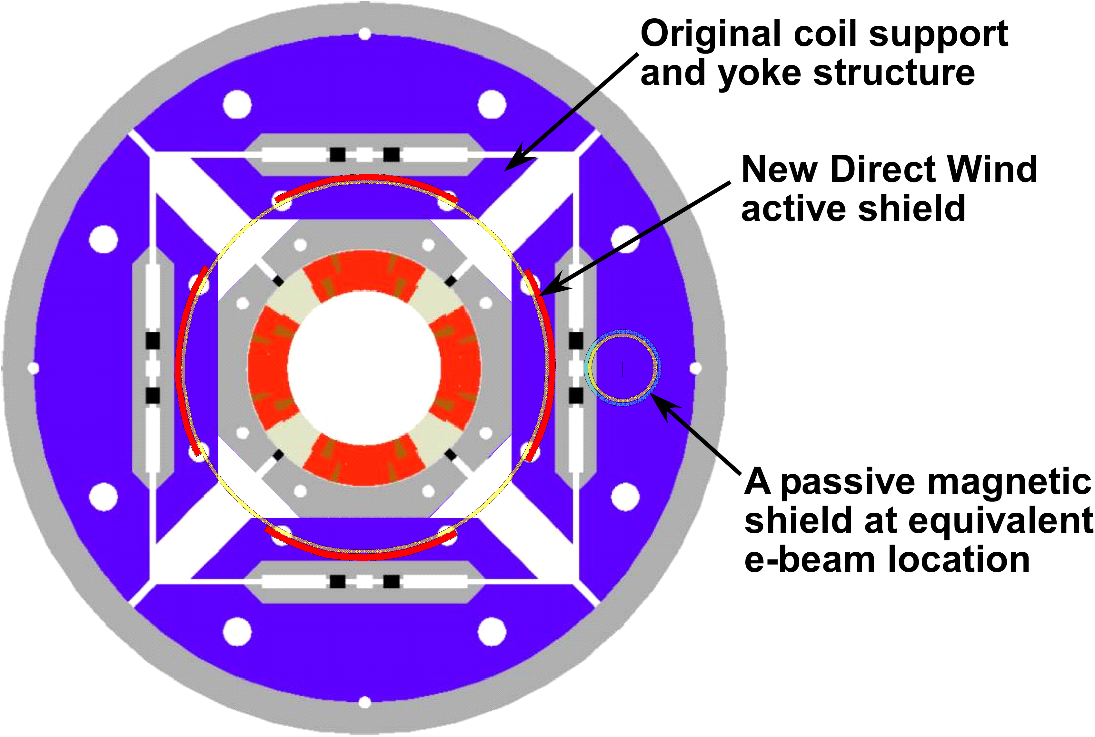
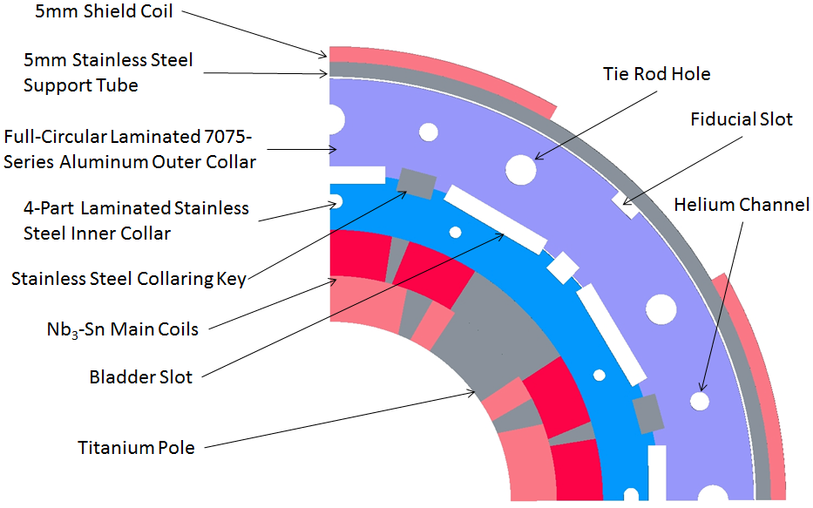
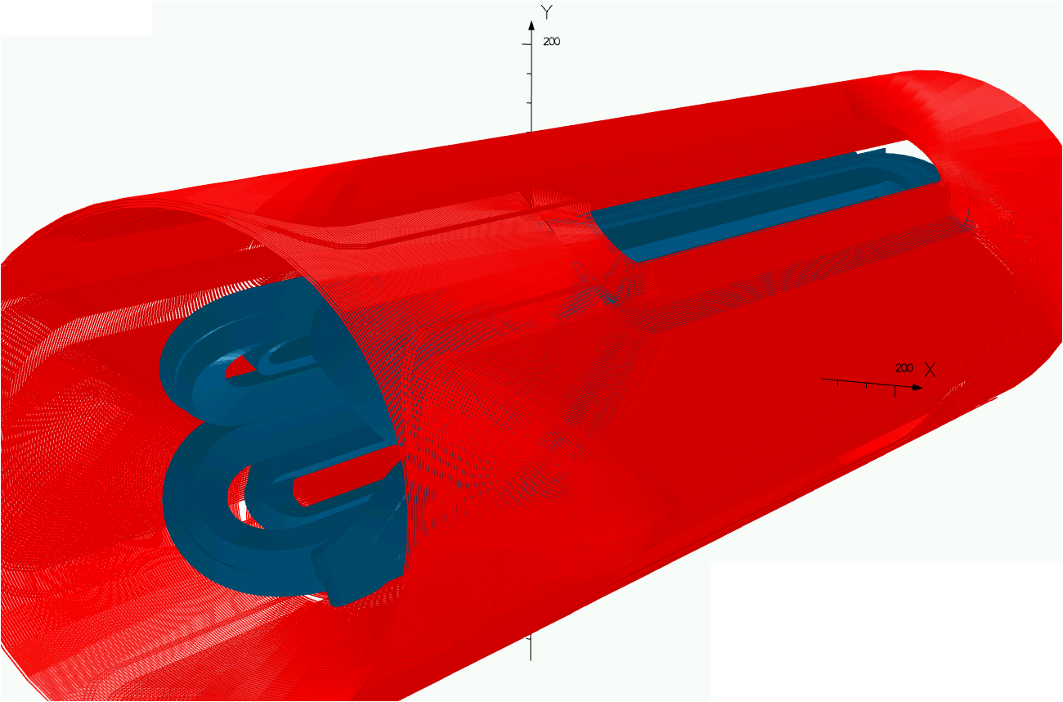
eRHIC and JLEIC: Fast Track R&D
Rear Side
Forward Side
Use existing Nb₃Sn coils (from LARP work) with a new active shield to prove out Q1PF concept.
Main challenge is limited space for mechanical structure.
NbTi active shield coil around an Nb₃Sn inner coil
New proposed compact mechanical structure
LARP mechanical structure comparison
See B. Parker, et.al., IPAC18 paper, WEPMF014, “Fast Track Actively Shielded Nb3Sn IR Quadrupole R&D,” at URL: https://doi.org/10.18429/JACoW-IPAC2018-WEPMF014

Slide 13
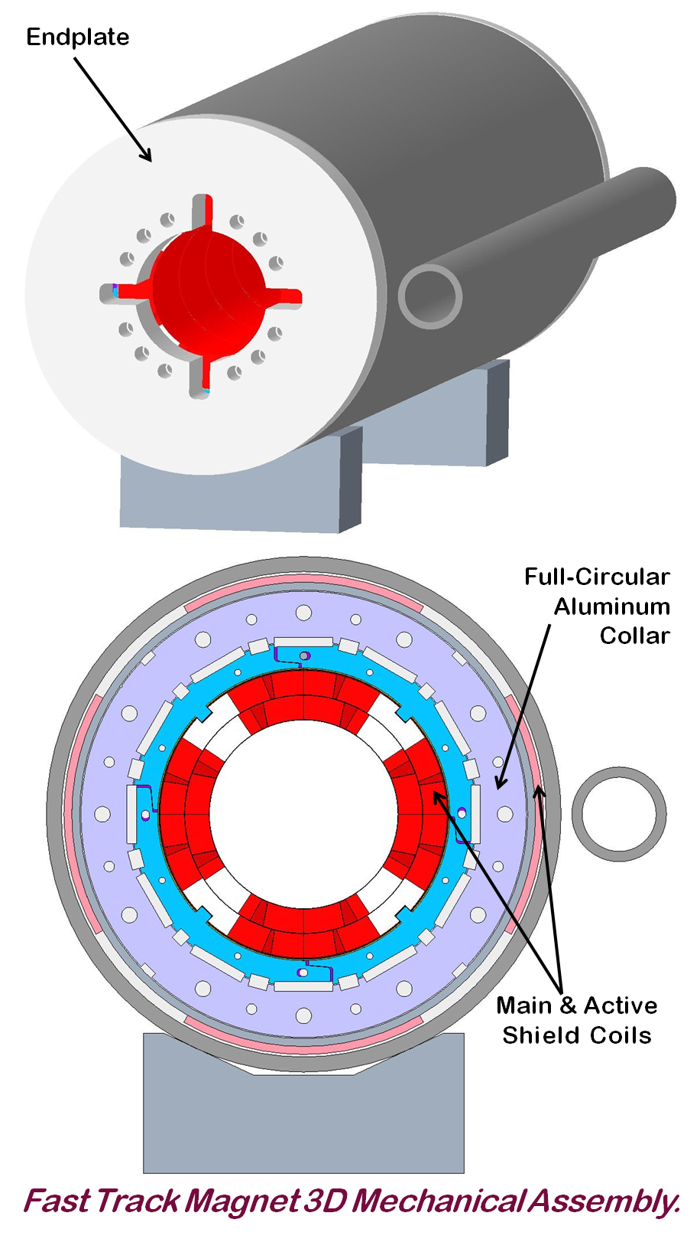
Fast Track R&D Magnet: Design Summary
Longitudinal prestress is applied from endplates.
Linear transfer function (i.e. no yoke to saturate).
Coordinated operation using two power supplies.

Slide 14
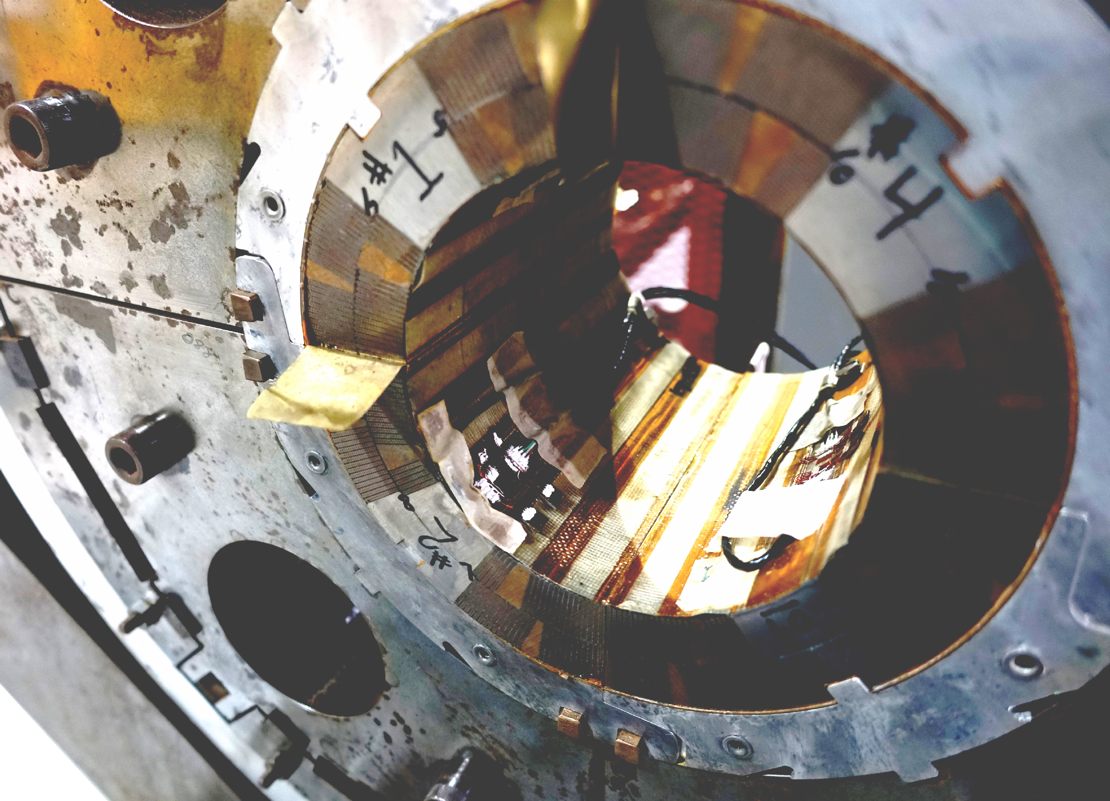
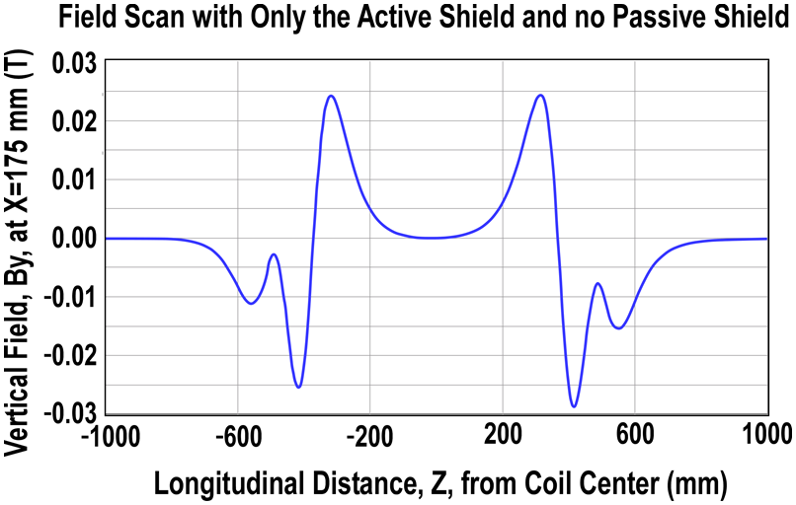
Fast Track R&D Magnet: Present Status
Work on main assembly design in progress,
Shield quad support tube order placed,
Short main quad mechanical assembly test underway,
Direct Wind machine modifications for shield quad fabrication underway,
Waiting for Nb₃Sn coils to arrive from LBNL.
Reuse Instrumented HQ Coil Pieces
Old Mechanical Test Assembly

Slide 15
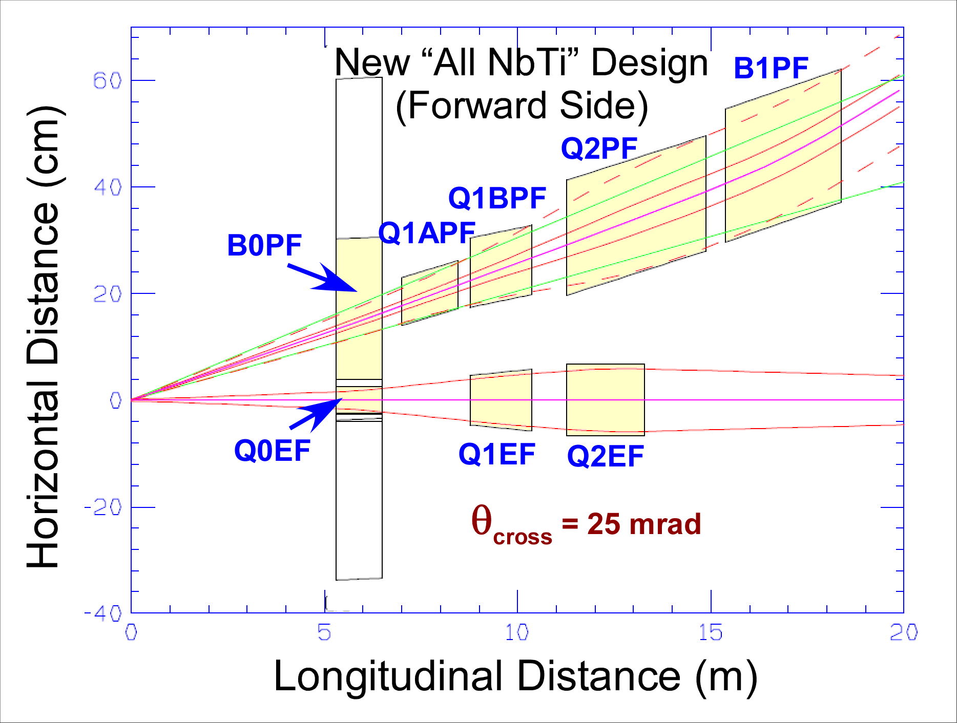
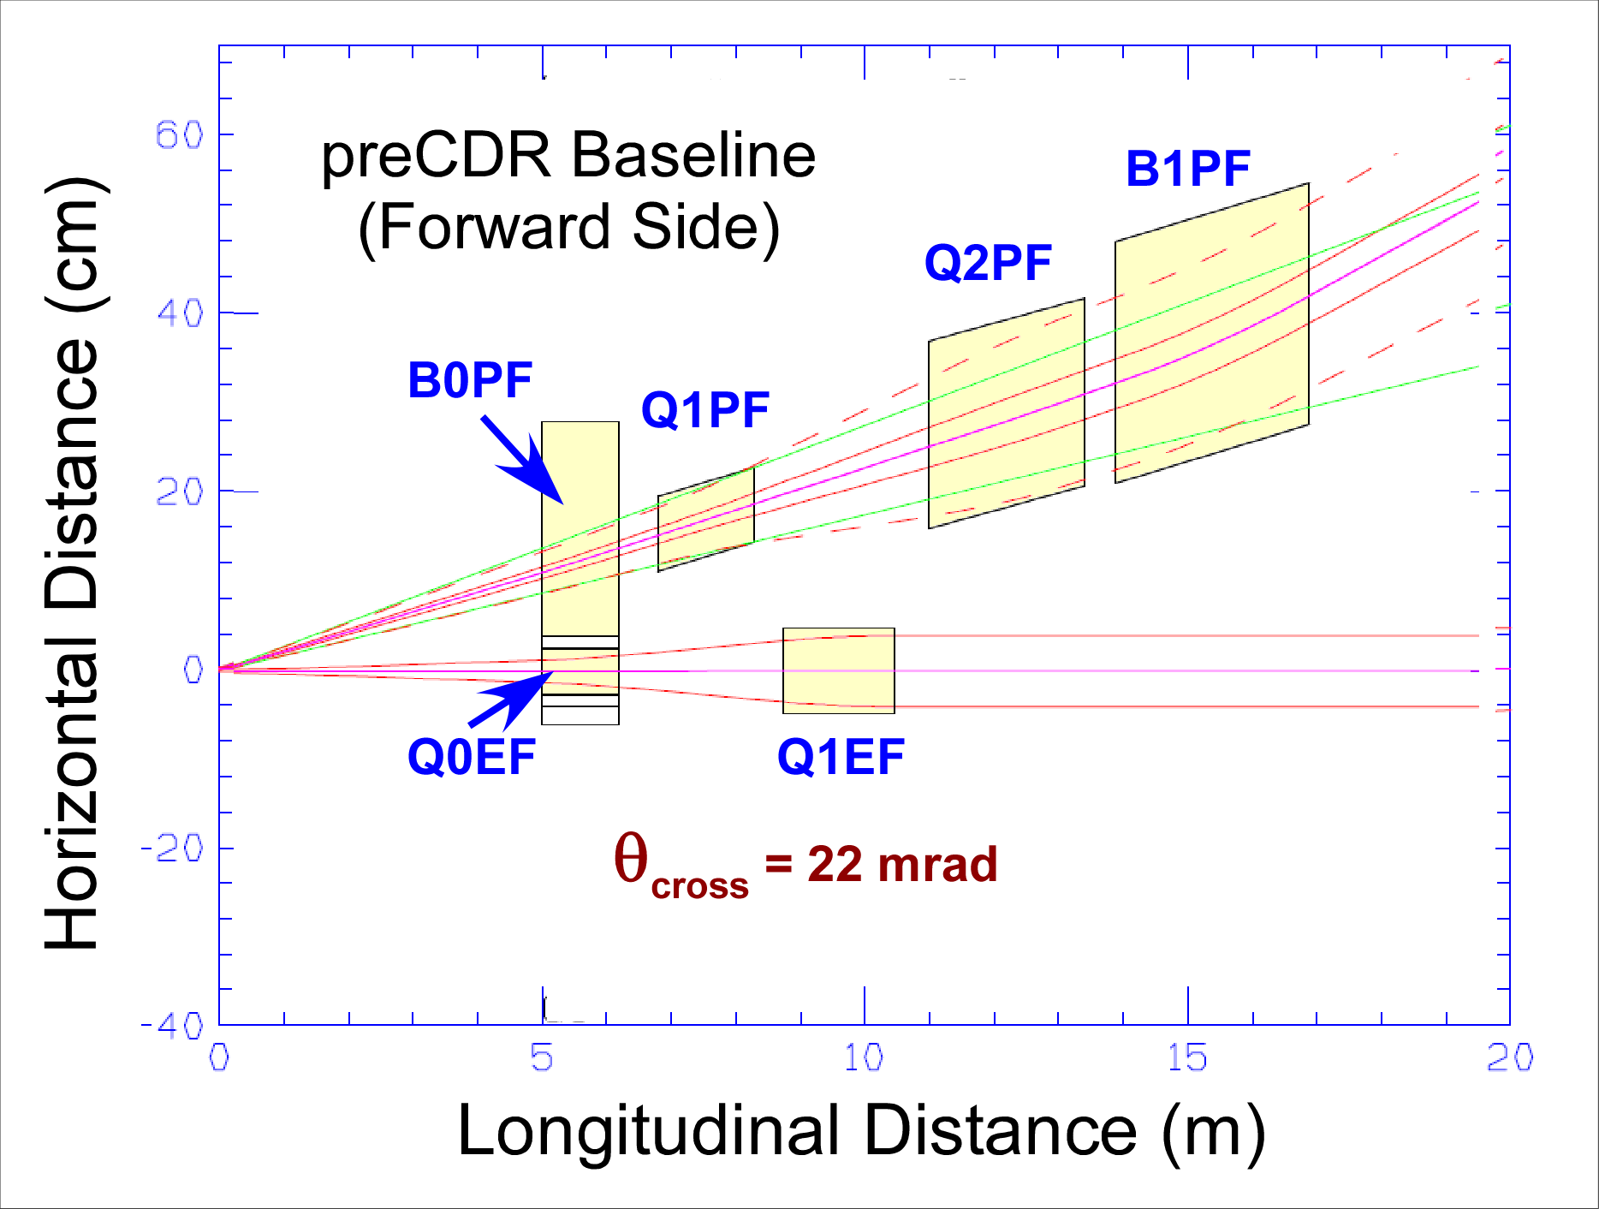
eRHIC IR Value Engineering (Overlay)*
*Coordinate Reference = e-beam direction.

Slide 16
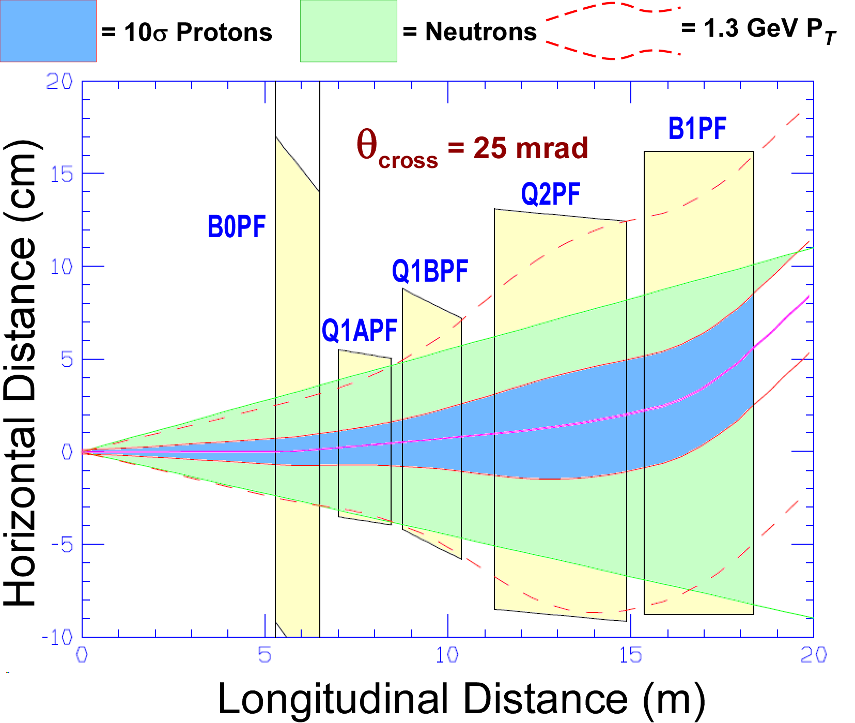
Value Engineering Forward Hadron Magnets Detail*
Developing a new aperture Nb₃Sn magnet is a high cost activity; look to use only NbTi.
In our internal cost review we found that developing a new style Nb₃Sn coil is expensive (tooling and prototype).
Note that for Fast Track R&D we avoid this cost by reusing an existing coil.
By lengthening Q1PF, we reduce its gradient to what NbTi can provide.
Doing this we give up “slot” between Q1PF and Q2PF, so we have to overlap coils with electron quadrupoles.
With 25 mrad crossing angle, there is sufficient yoke space to avoid magnetic cross talk between the two apertures.
We minimize transverse size of Q1PF by splitting the new longer coil into two coils, A and B, with different apertures.
By offsetting and rotating Q1APF and Q1BPF we provide required forward acceptance (as shown in plot).
*Coordinate Reference = hadron beam direction.

Slide 17
BNL Direct Wind: Coil Winding Movie
Flexible, cost effective coil production.
Flexible, cost effective coil production.
17

Slide 18
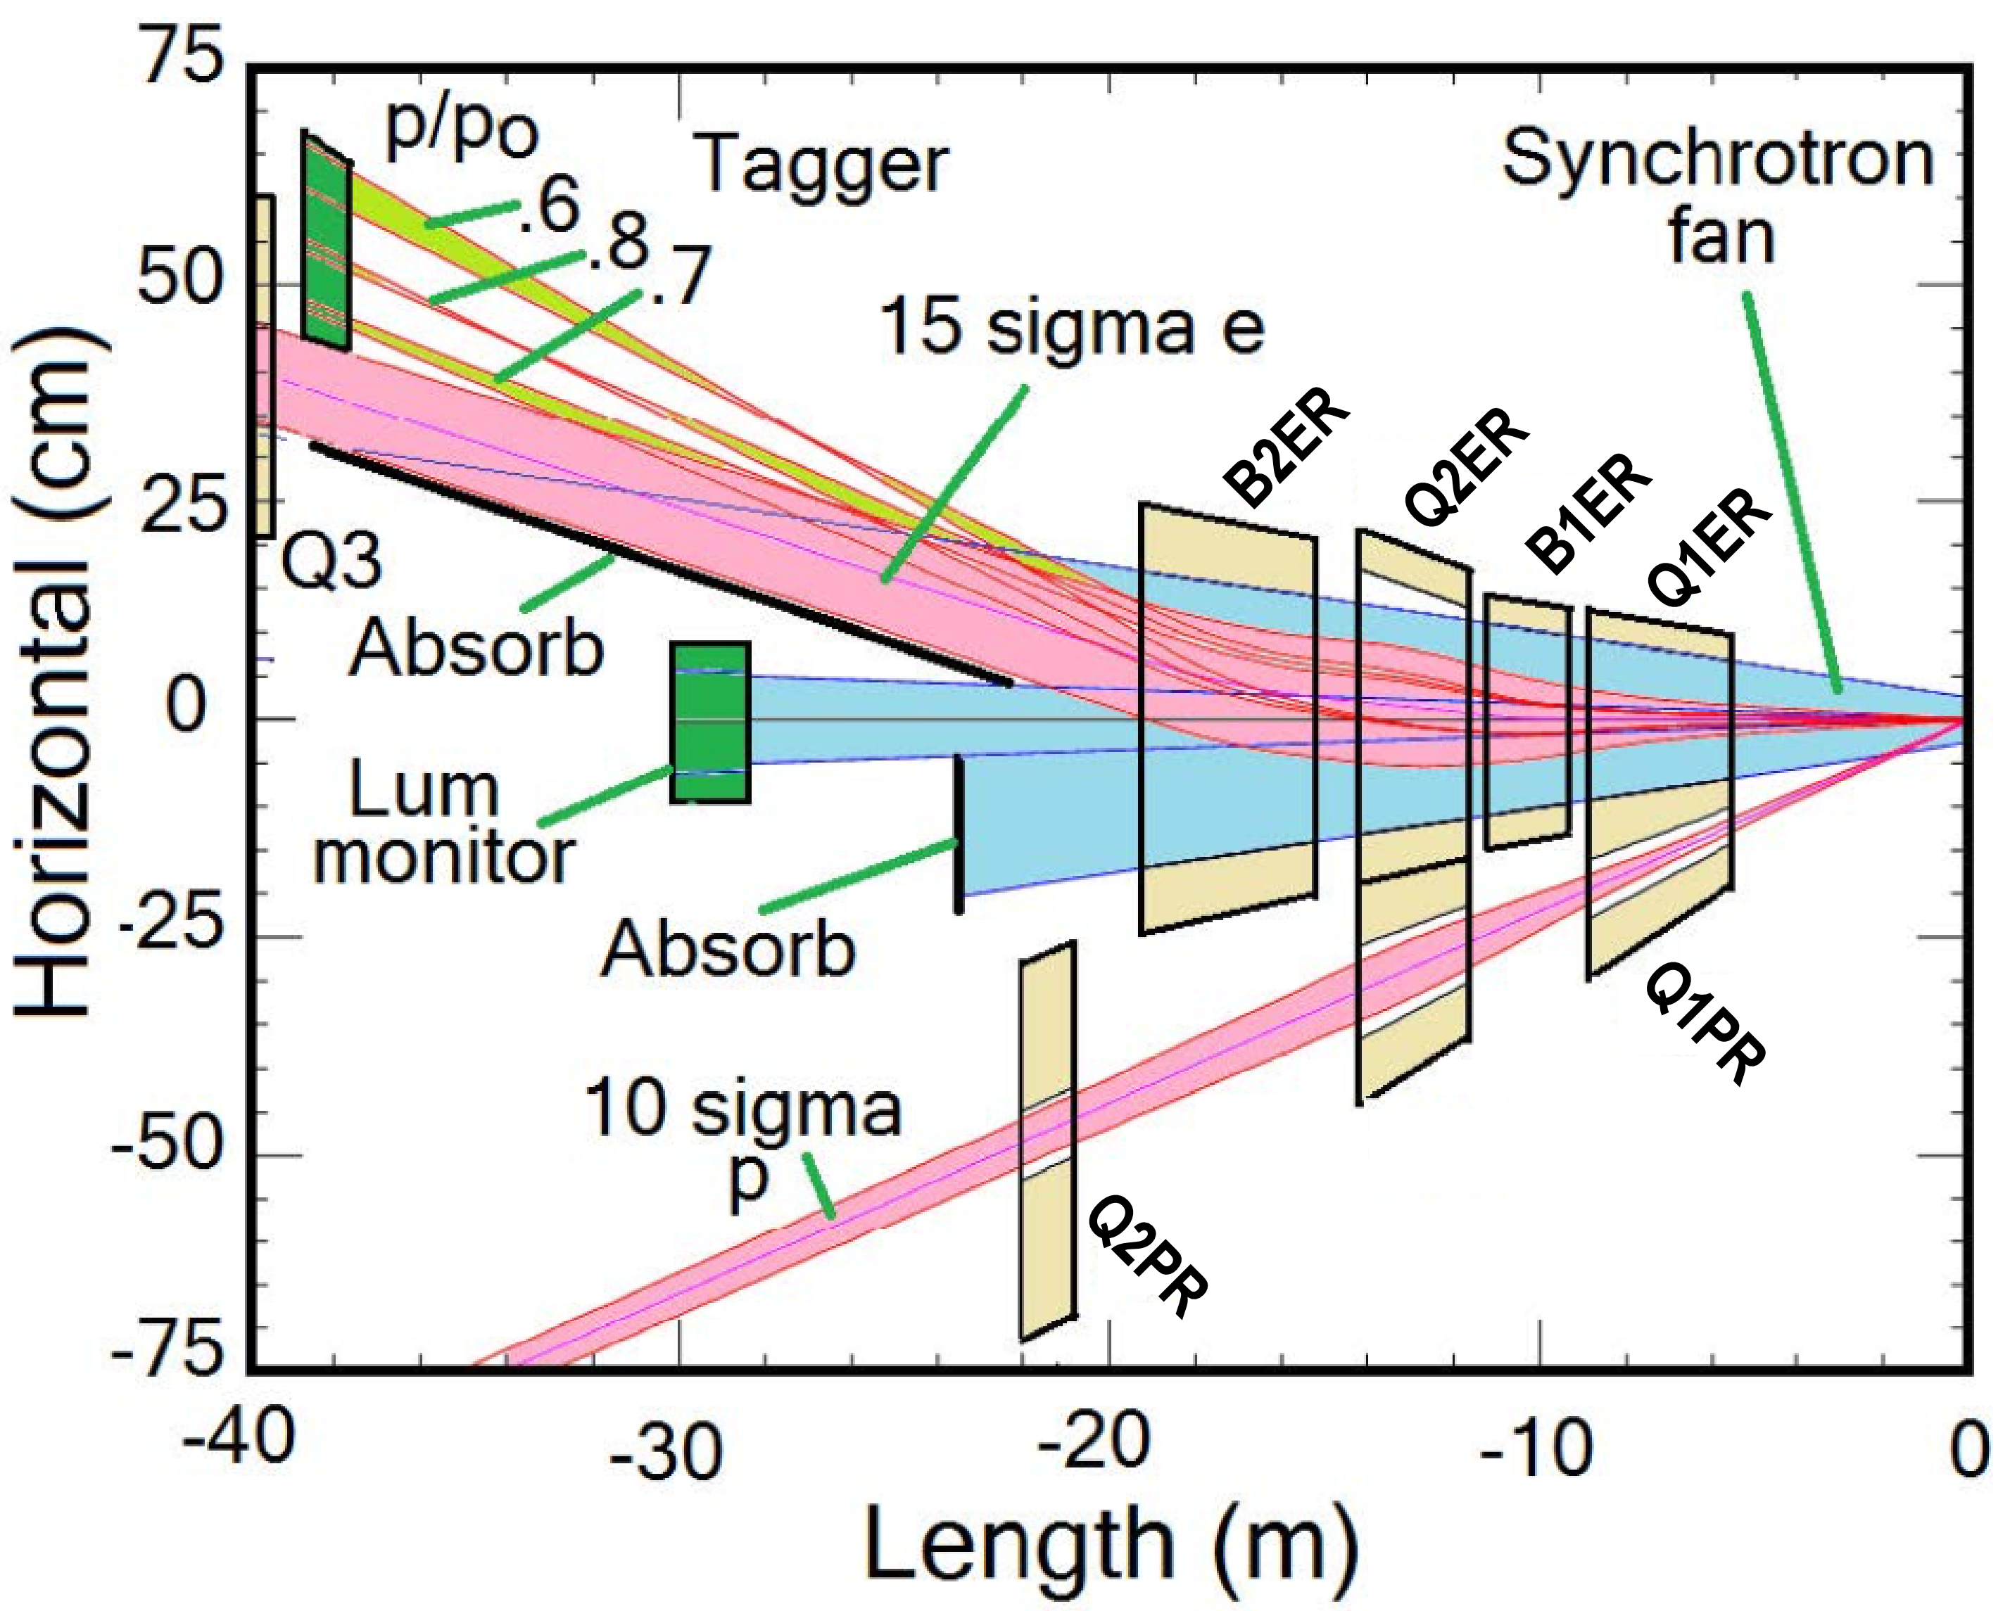
eRHIC IR Magnet Rear Layout (preCDR)
Synrad dominates these aperture sizes!
<- Electrons <-
<- Lumi Signal <-
<- Synrad <-
-> Protons ->
Critical Magnet

Slide 19
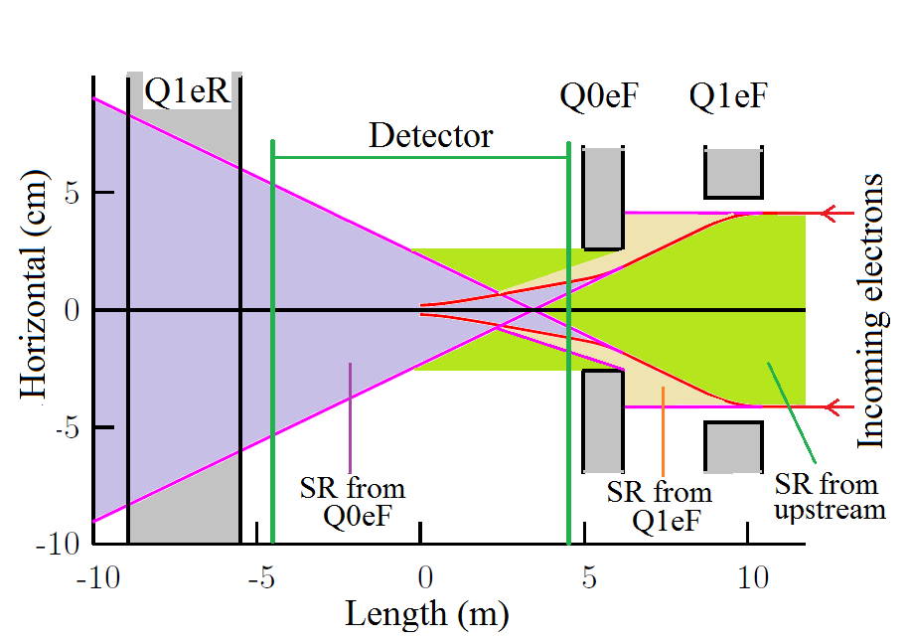
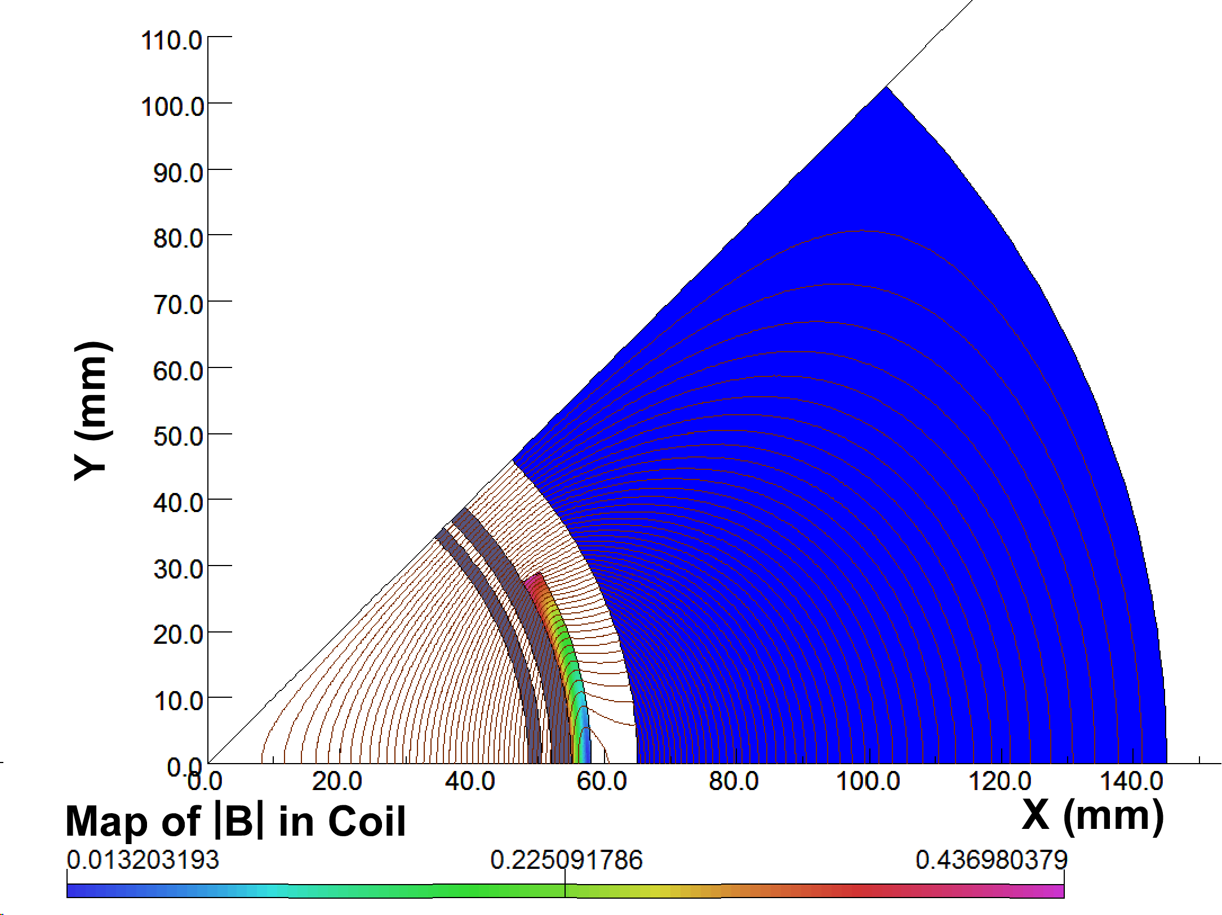
eRHIC: Q1EF/Q2EF
(preCDR)
Rear Side
Forward Side
Q2EF is very simple and has a yoke that kills its external field.
Relatively easy to provide 15 σ aperture (coil like a corrector).
But Q1EF/Q2EF generate quadrupole synrad that should pass cleanly through the IR and out downstream electron magnets.
Q1EF/Q2EF Synrad Diagram
Q2EF |B| Map
6 T/m Gradient
0.44 T Peak Field
Synrad
stay clear
Unsaturated yoke with almost zero external field.

Slide 20
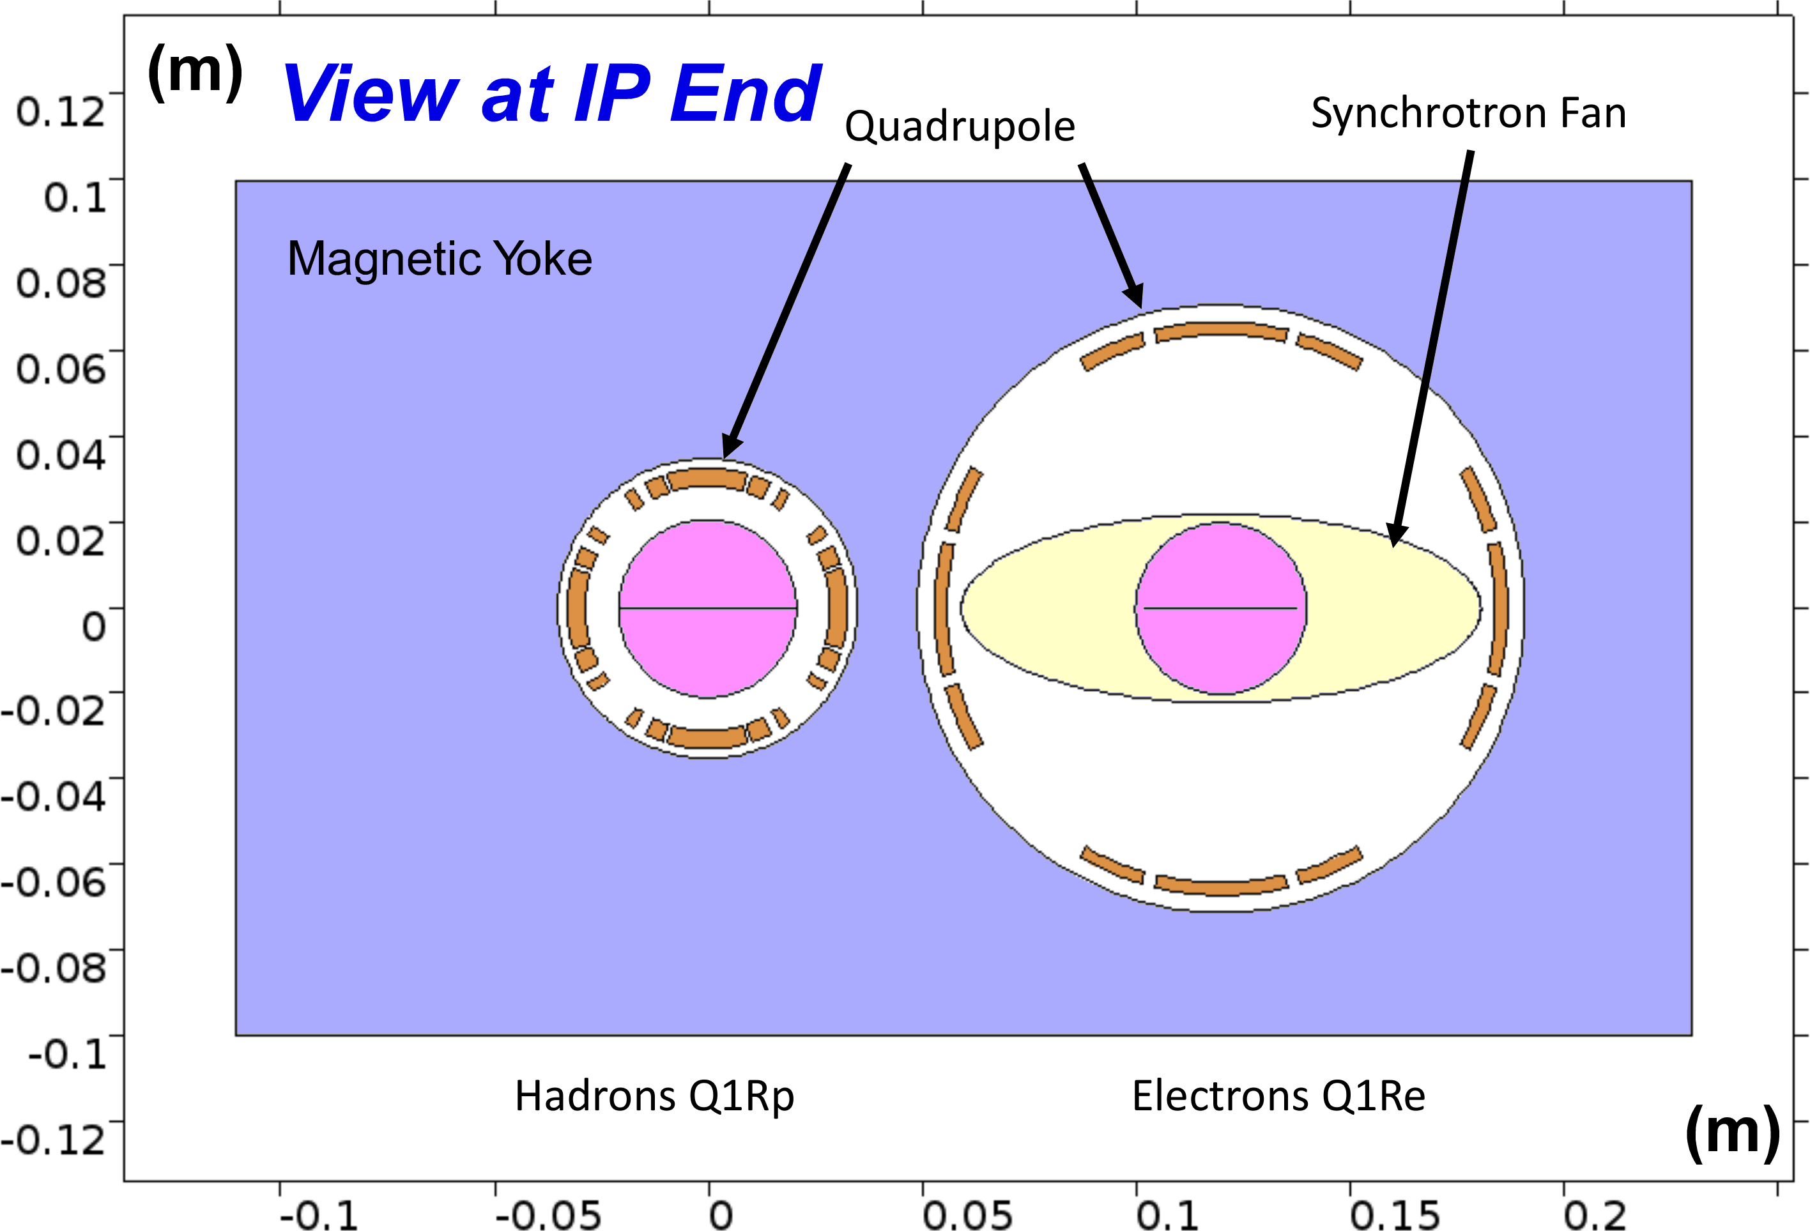
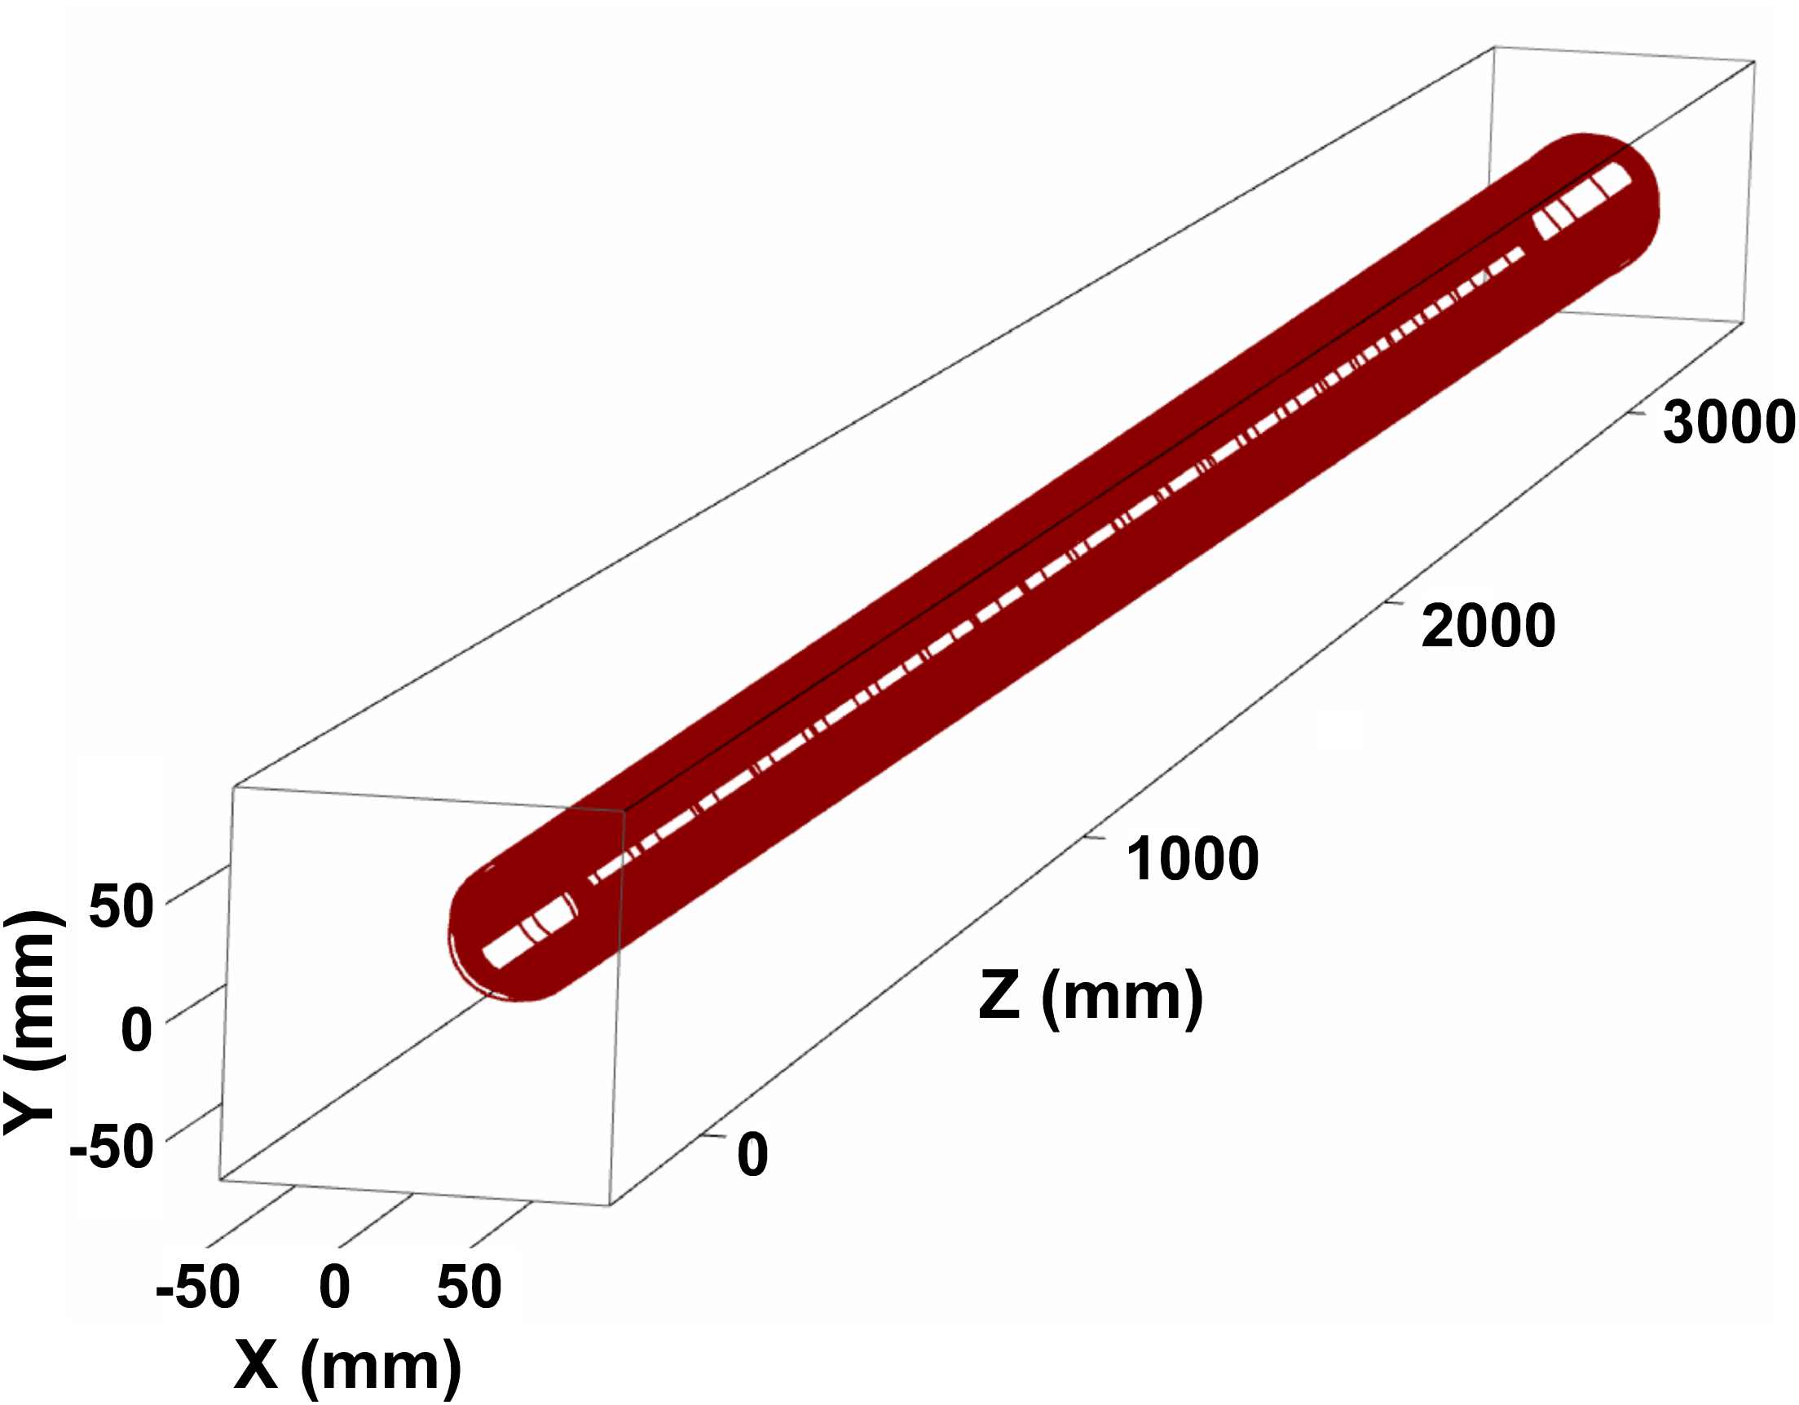
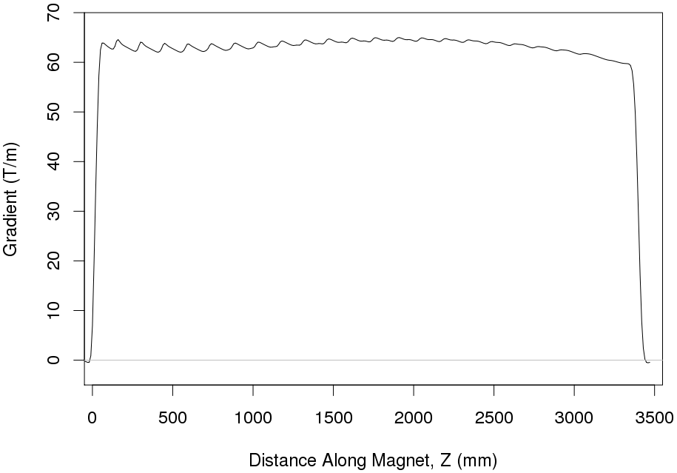
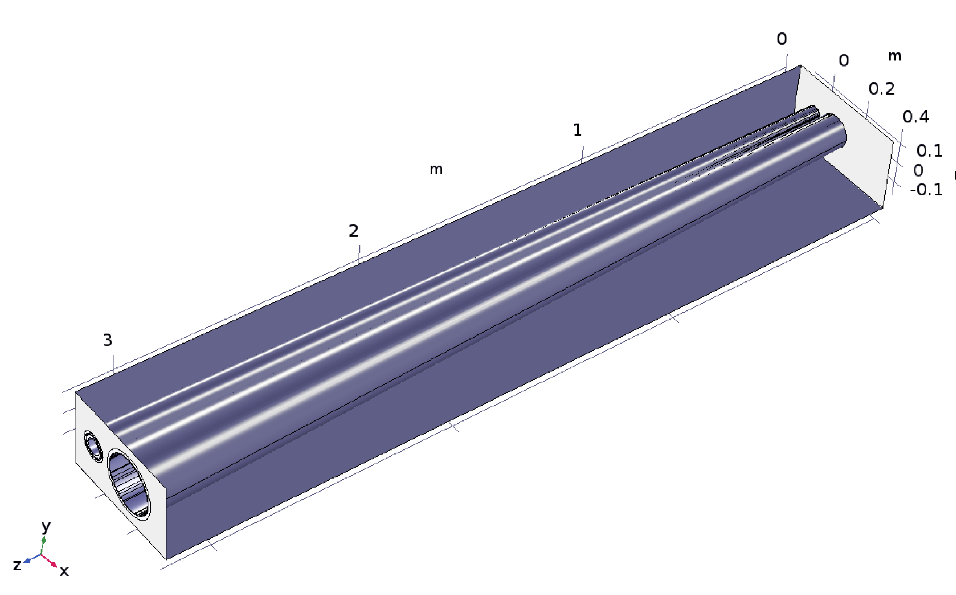
eRHIC: (preCDR) Q1PR/Q1ER Designs
Rear Side
Both quads are side-by-side in a common yoke.
Must pass through synrad fan from the upstream Q2EF/Q1EF IR quads.
Tapered coils maximize yoke thickness between apertures (reduce yoke saturation between apertures and magnetic crosstalk).
Q2PR/Q2ER have similar design but not as challenging due to the larger beam separation at their location.
B1RE/B2RE are low-field dipoles with tapered coils and thin yokes.
Forward Side
Q1PR/Q1ER
Concept for a Direct Wind tapered coil design for Q1PR that has a nearly
constant gradient
along its entire
length
Q1PR Gradient Z Dependence
As the coil radius increases the gradient would naturally drop. but we can use techniques developed for the design of the SuperKEKB external field cancel coils to keep gradient constant.
LDRD to do Double Helical coil R&D!

Slide 21
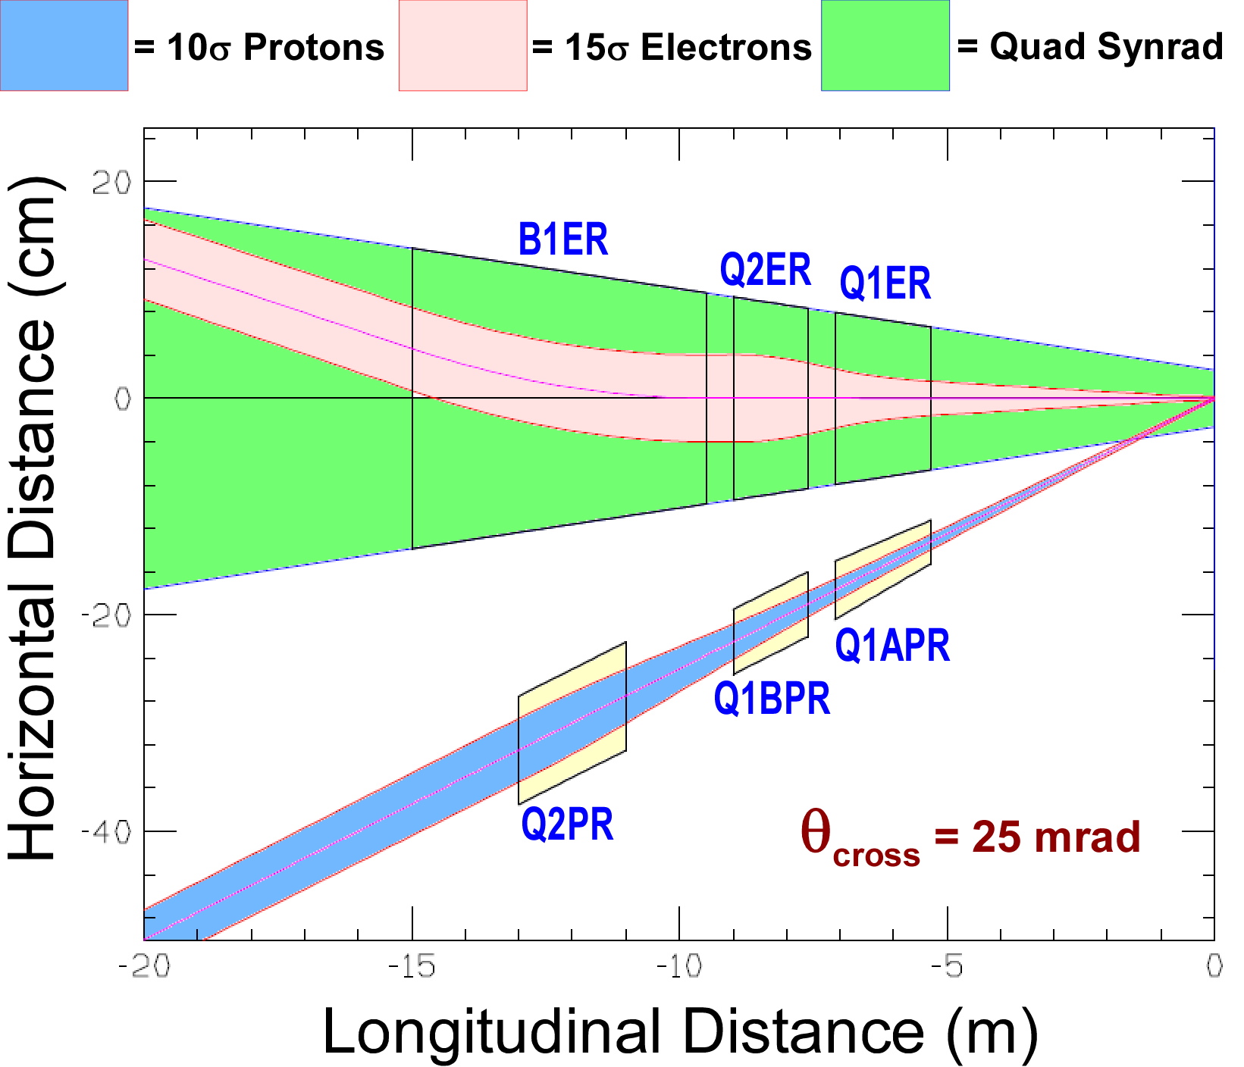
Value Engineering Rear Side Magnets*
Adjustment of new forward electron quads, Q2AEF and Q2BEF, softens synrad spectrum while narrowing the synrad cone (reduce rear e-apertures).
Here decreasing Q1ER and Q2ER quad separation dramatically reduces rear beta peaks (chromaticity); increase of quad synrad critical energy not an issue.
Rear electron magnets have low peak fields and large, tapered apertures are ok (can use Direct Wind).
B1ER dipole separates electrons from “lumi signal” line of sight back to IP.
Rear proton apertures are much smaller than forward side and with added yoke material magnet cross talk not an issue.
Q1APR aperture is shown here with a taper but it may be possible to use an untapered coil (can use Direct Wind).
With the new 25 mrad crossing angle, the yoke space between apertures dramatically increases.
<- Electrons <-
<- Synrad <-
15σ is “small” compared to aperture; getting good field quality is fairly easy.
-> Protons ->
*Coordinate Reference = e-beam direction.

Slide 22
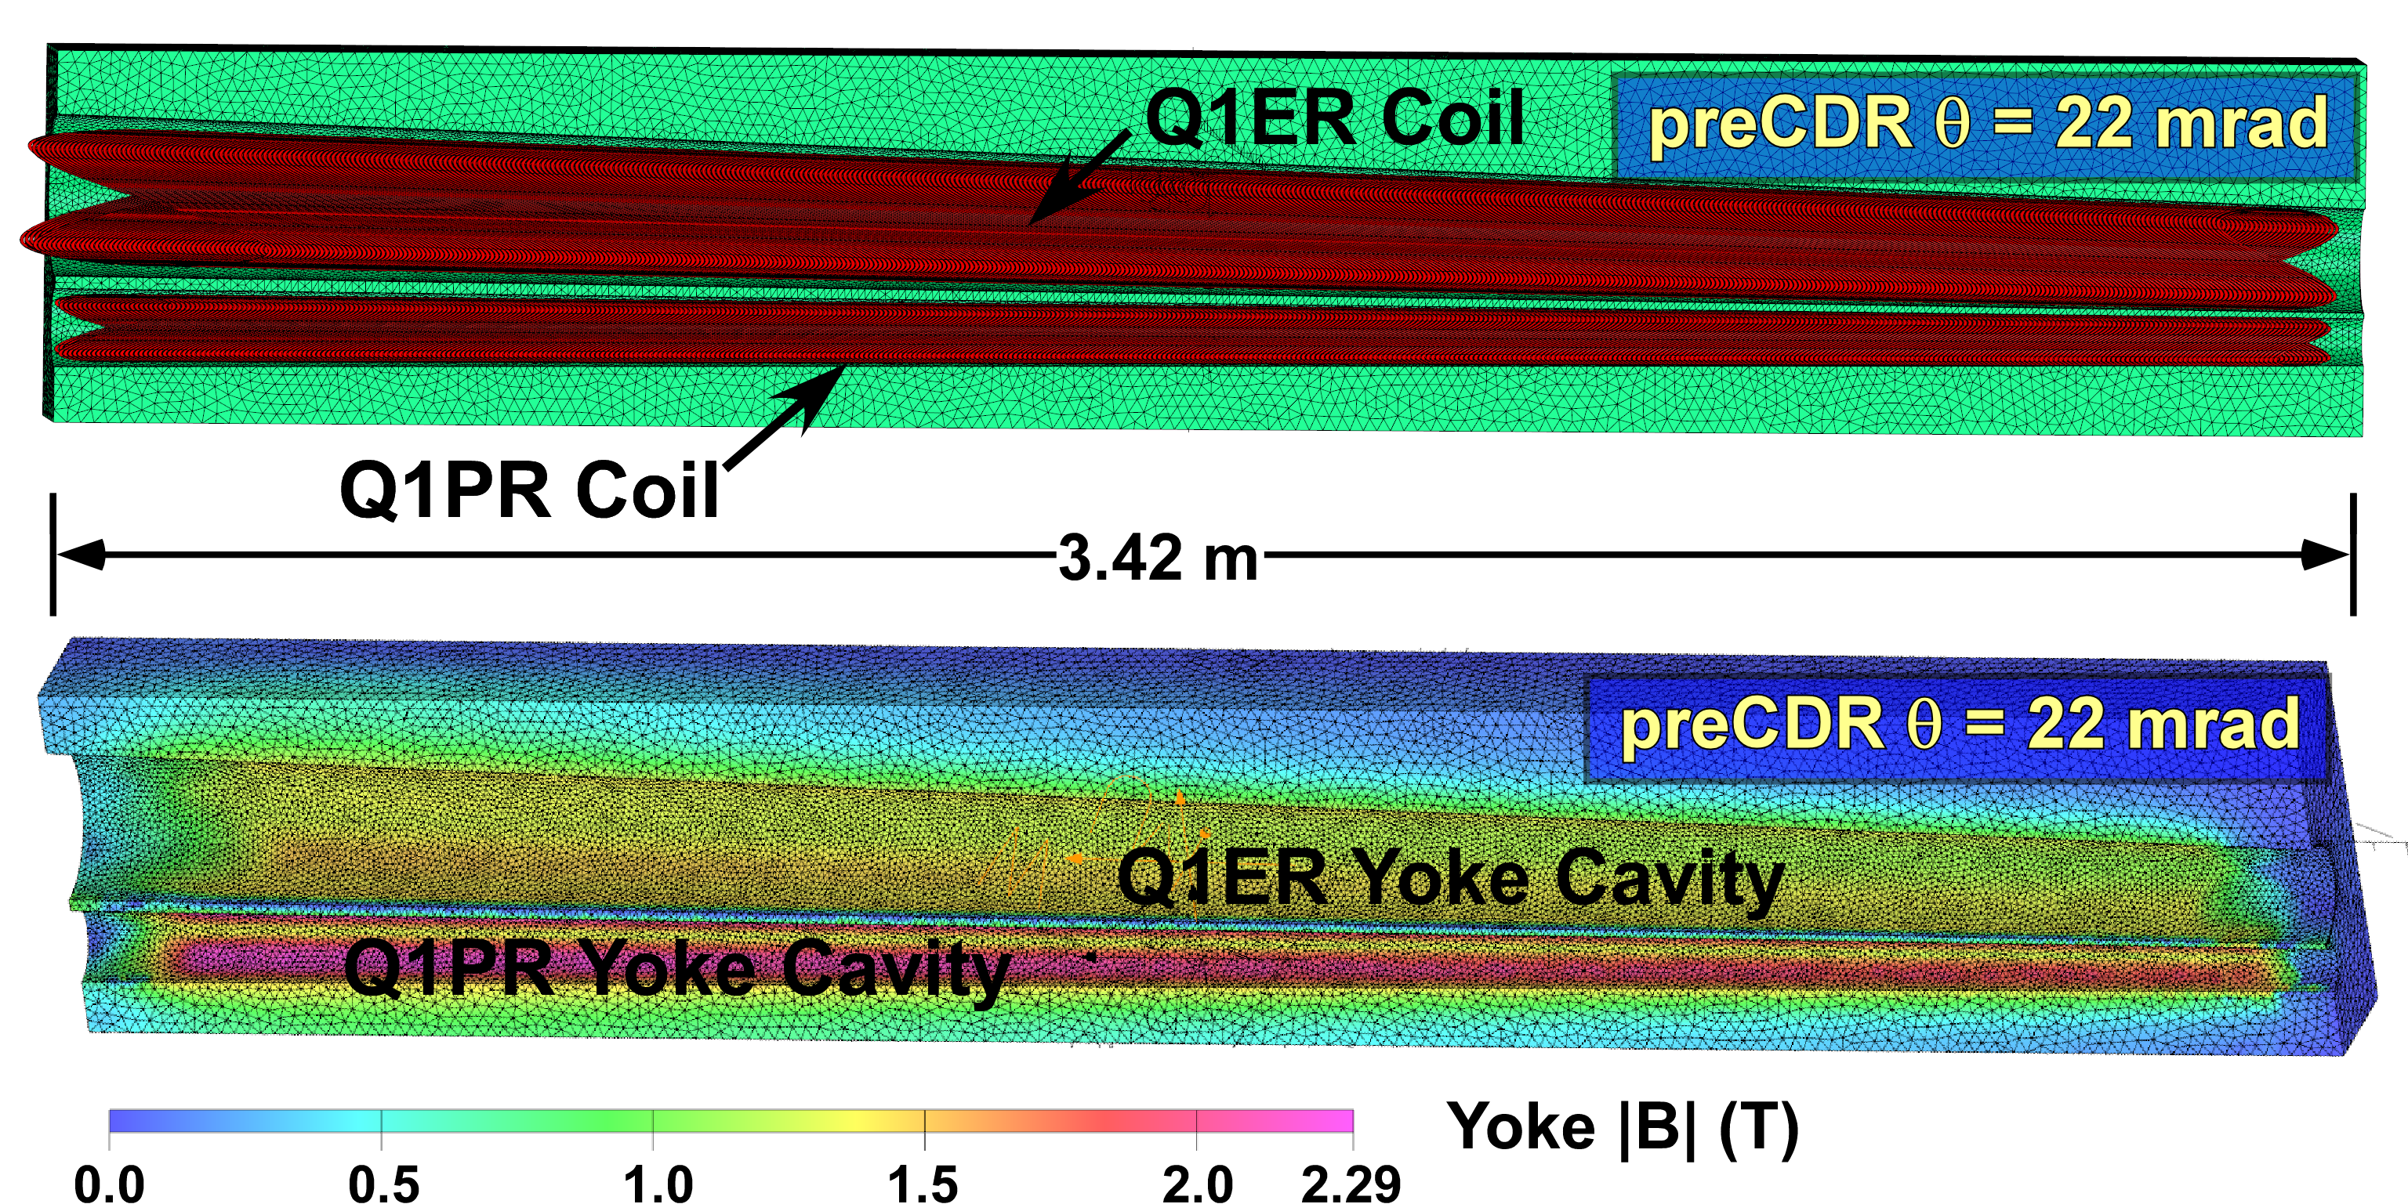
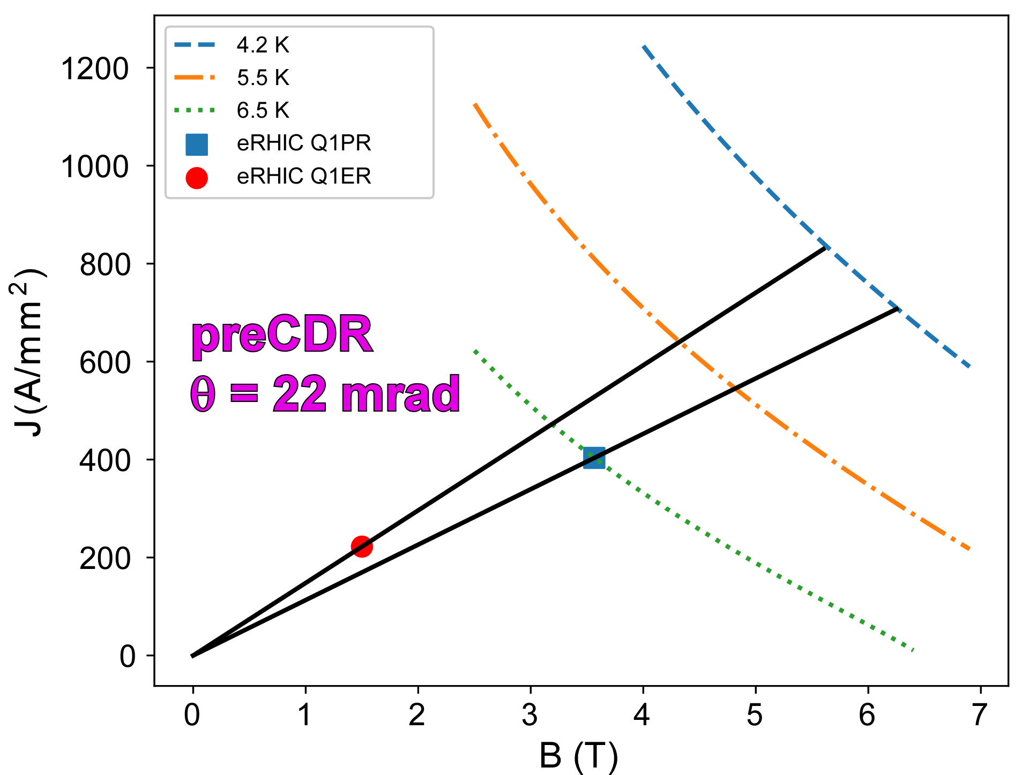
Dual Aperture Tapered Coil R&D*
NbTi Load Lines
Q1PR/Q1ER Example for Rear Side Magnets
With increase to 25 mrad crossing angle, yoke thickness between coils significantly increases (reduce yoke saturation and cross talk).
Now Q1PR may not need to be tapered (Q1ER will still be tapered).
Investigate winding tapered magnets with constant gradient via Direct Wind in Double Helical (Canted Cosine) geometry (with LDRD).
BNL LDRD Double Helical R&D Coil
H. Witte, B. Parker, and B. Palmer, “The eRHIC IR Q1 Rear Side Magnet,” submitted to 2018 Applied Superconductivity Conference (ASC18), Seattle, USA, October 28 – November 2, 2018.
*LDRD funding is now approved for
Direct Wind Double Helical Coil R&D.

Slide 23
Value Engineering Forward Side Quads
Name L_{mag} G R₁ R₁*G R₂ R₂*G
(m) (T/m) (mm) (T) (mm) (T)
Q0EF 1.20 -12.7 26.0 0.3 26.0 0.3
Q1APF 1.46 -77.9 45.0 3.5 45.0 3.5
Q1BPF 1.61 -63.0 65.0 4.1 65.0 4.1
Q1EF 1.61 1.7 46.4 0.1 58.0 0.1
Q2PF 3.60 39.7 108.0 4.3 108.0 4.3
Q2EF 2.00 3.8 63.5 0.2 63.5 0.2
Here is only forward side tapered coil.
At 25 mrad crossing angle yoke thickness between coils is sufficient to keep cross talk between apertures to a tolerable level (we can consider adding a “split” between P/E yokes to make independent).
Measure of magnet difficulty, product of aperture x radius, indicates that all coil can be NbTi (Note actual peak fields somewhat higher!).
First pass coil designs for hadron quads assume Rutherford cable (collared coil) construction but it should be possible to use Direct Wind for these magnets to reduce tooling and production costs.

Slide 24
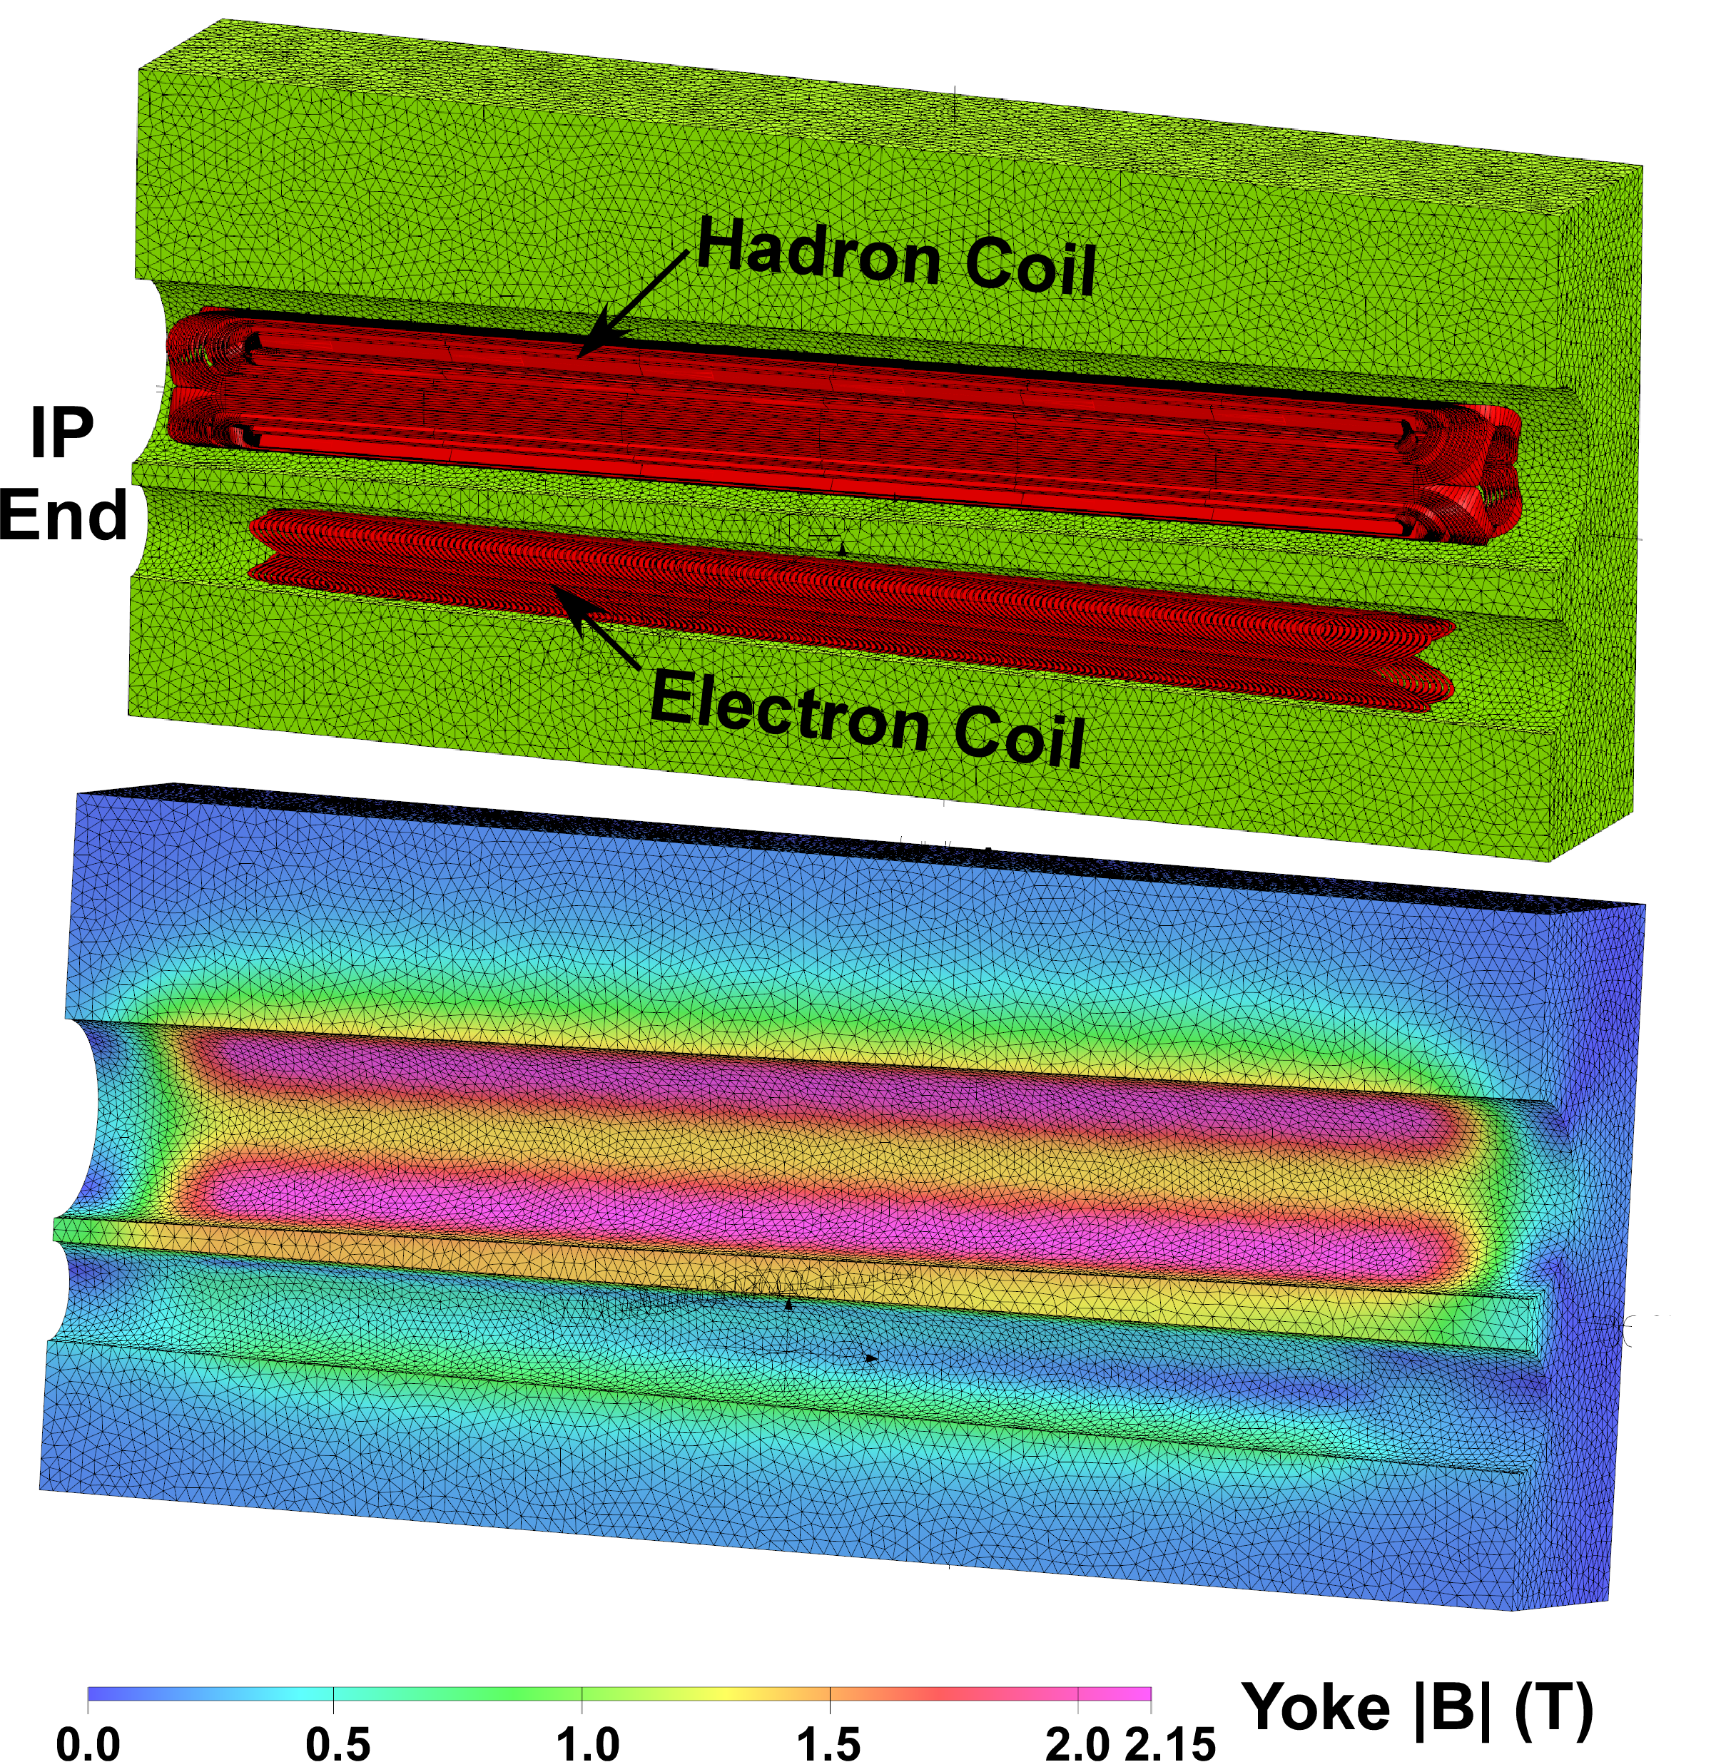
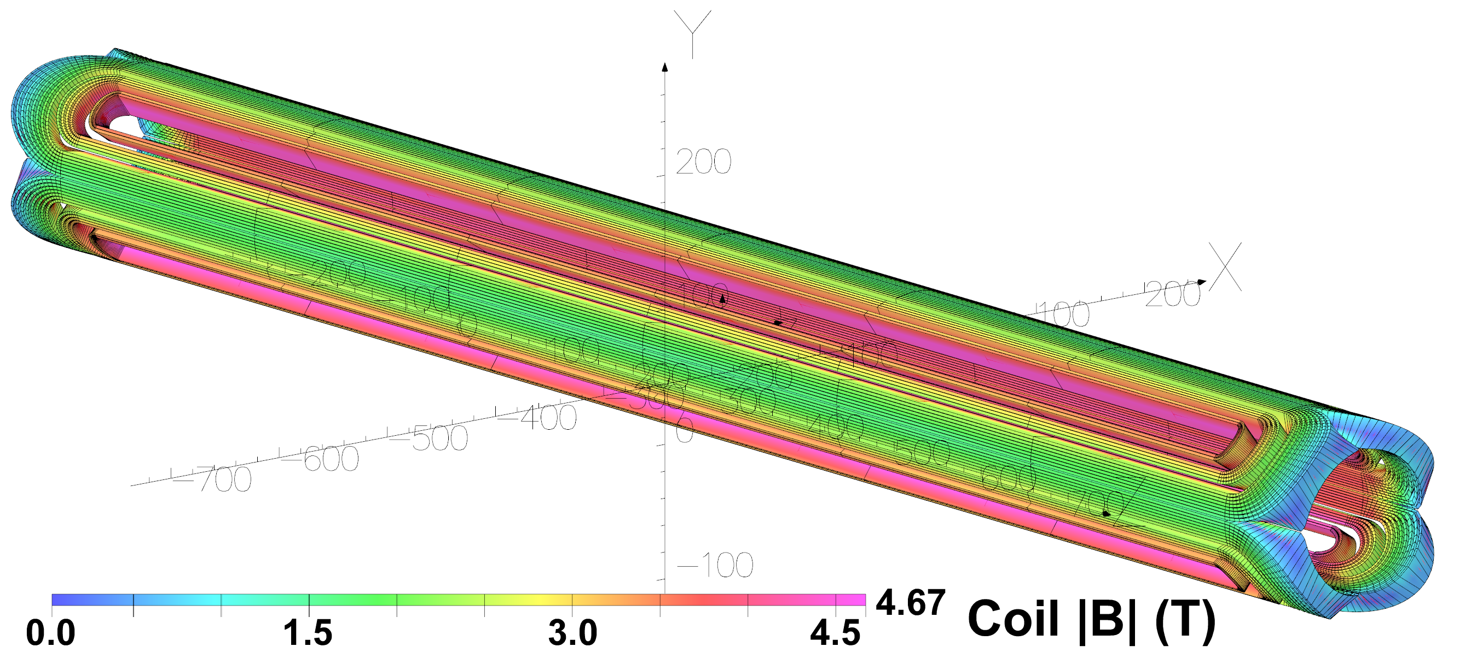
Value Engineering Forward Side Quads
NbTi Hadron Coil Field Map
The electron beam coils for all the forward quads will be Direct Wind.
The hadron coil designs should be updated to reflect using Direct Wind production in order to avoid having to make tooling for 3 new coil apertures.

Slide 25
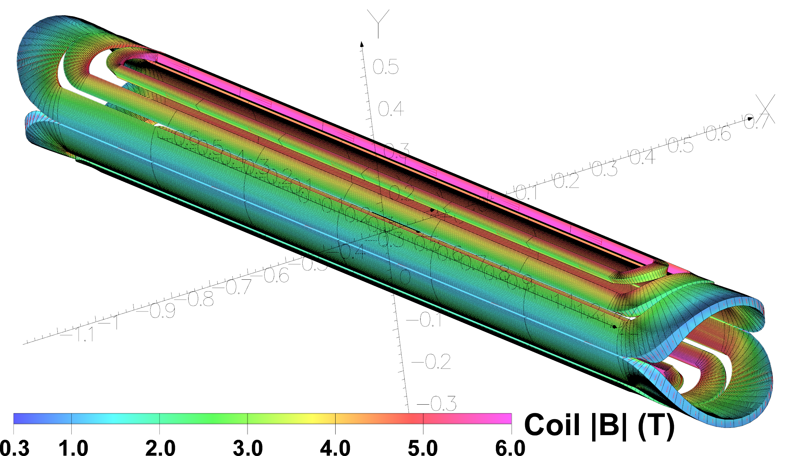
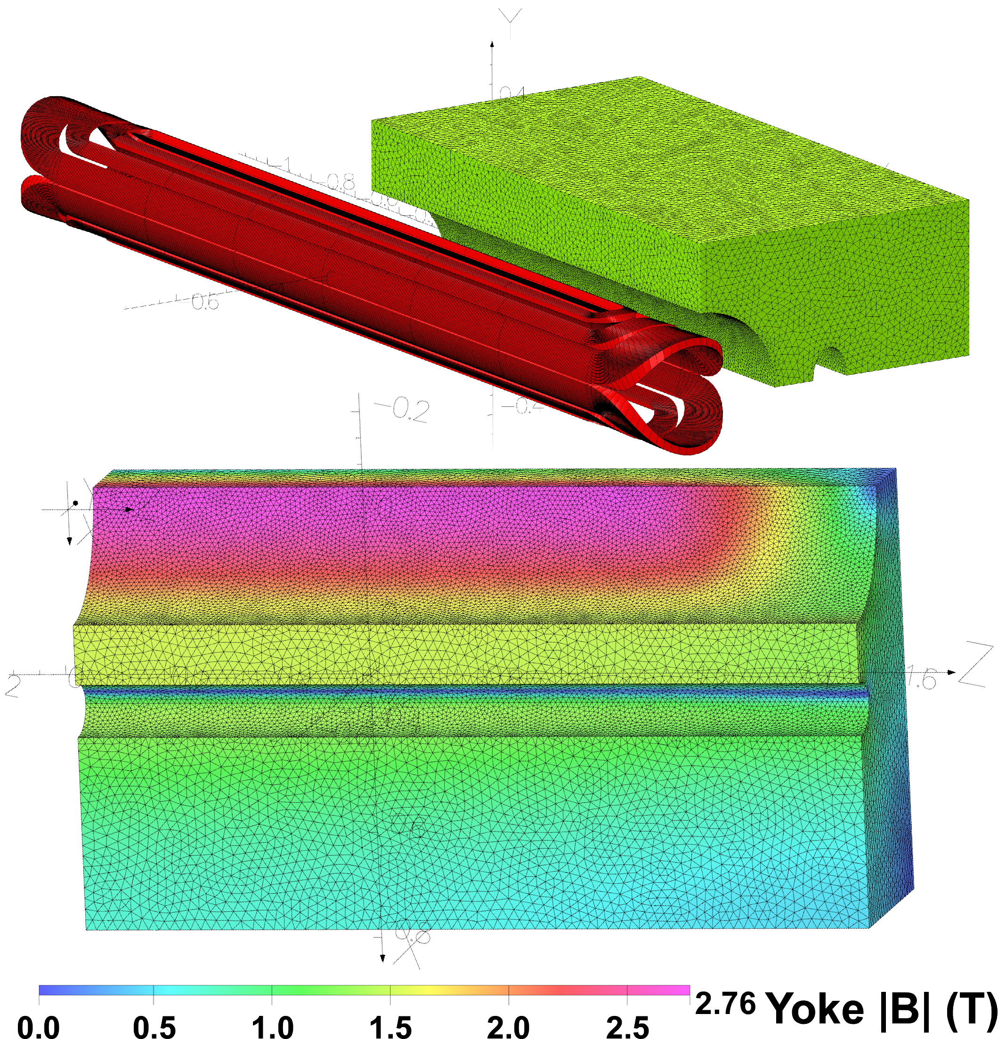
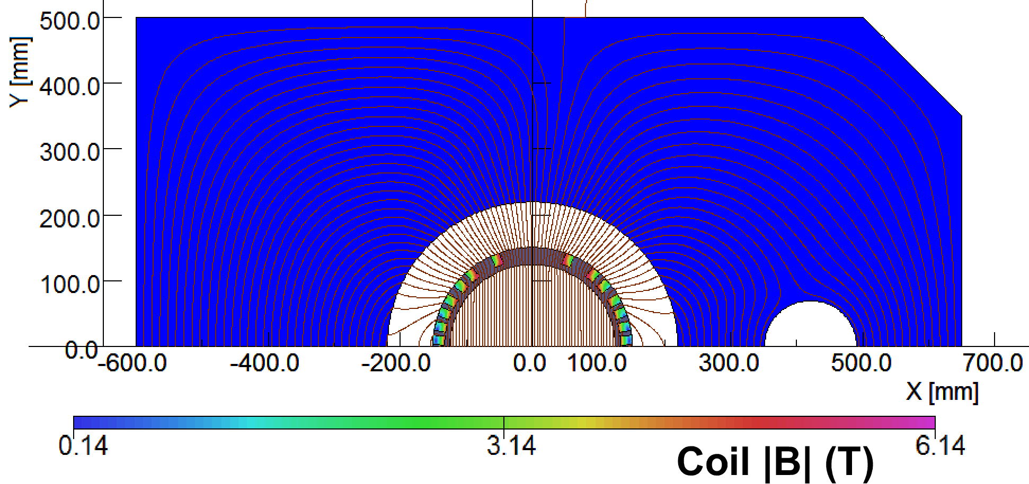
Value Engineering B1PF Forward Dipole
Name L_{mag} B R
(m) (T) (mm)
B1PF 3.00 4.57 125
B1PF Dipole Coil Field Map
Preliminary B1PF Design
Hadron Coil
Need special tooling for just one dipole!
Hadron Yoke
B1PF Conductor in Slots Cartoon*
Electron Cutout
*Technique used to make RHIC helical dipoles.

Slide 26
IR Magnet Table: New eRHIC 25 mrad
Magnet is easy
“good to go”
Magnet is hard
“take care, we must watch out”
Magnet is novel
“check critical
parameters”
*
*
*Alternate backup concepts exist for these magnets.

Slide 27
eRHIC IR Magnet Presentation Summary
The common EIC active shielding R&D (Fast Track test) is proceeding well.
We are proceeding with value engineering to improve upon eRHIC preCDR (cost/risk).
Main impact is using dual aperture (some tapered) magnets; BNL LDRD funding will be used to test wind Double Helical coils.
All magnets now use NbTi and all probably can be manufactured via BNL Direct Wind.
Thank you for your attention.

Slide 28
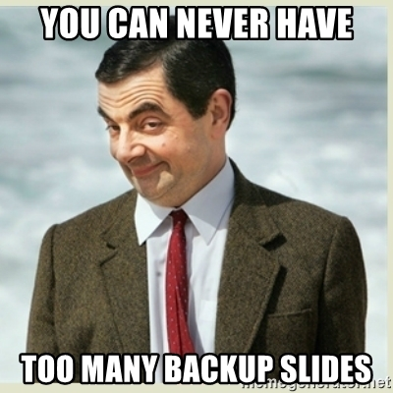
Backup Materials (9 Slides)
Double Helix Coil R&D
Concept (3 slides)
Fab’ via Direct Wind (1 slide)
Fast Track Magnet R&D
Field calculations (2 slides)
Mechanical simulations (3 slides)

Slide 29
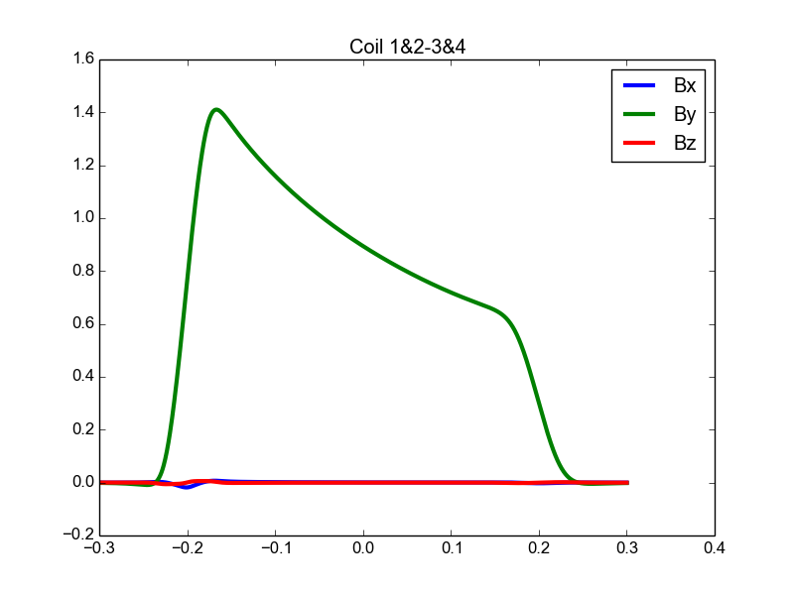
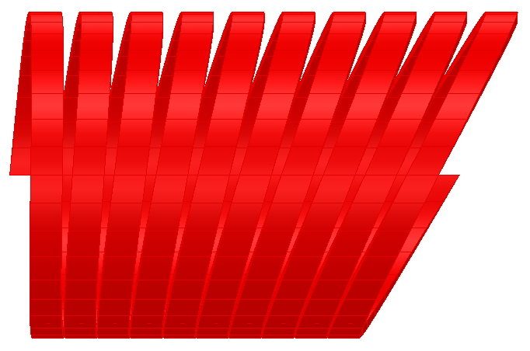
Concept: Double Helix Coils
Cosine theta magnet
Superposition of two currents
Meyer et al., 1970
Existing code: tapered double helix coils
Issue: multipole strength varies
Helical coils: adjust tilt angle to compensate for this
Demonstrate to work for B0 magnet
Witte, WEPMF017, IPAC2018.
Combination: novel
Tapered Quadrupole Magnet
J
J_{Σ}
J₁
J₂
Notes:
3.5 min

Slide 30
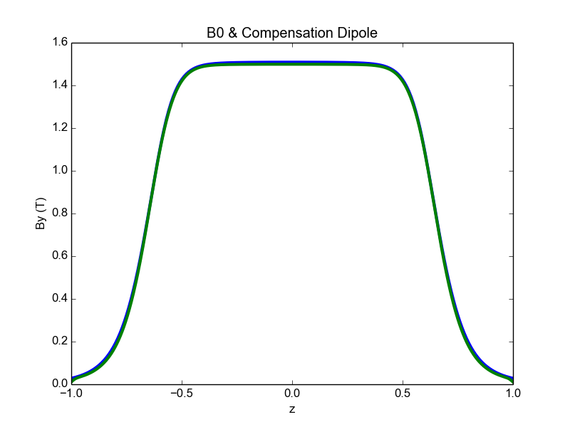
BO: Spectrometer Magnet
B0 3D model
Both beams share same aperture
Required fields:
Hadrons: 1.3T dipole
Electrons: 15 T/m quad
Use anti-dipole to shield electrons from dipole field
Problem: need to match fringe field
p+
e-
B0
Compensation

Slide 31
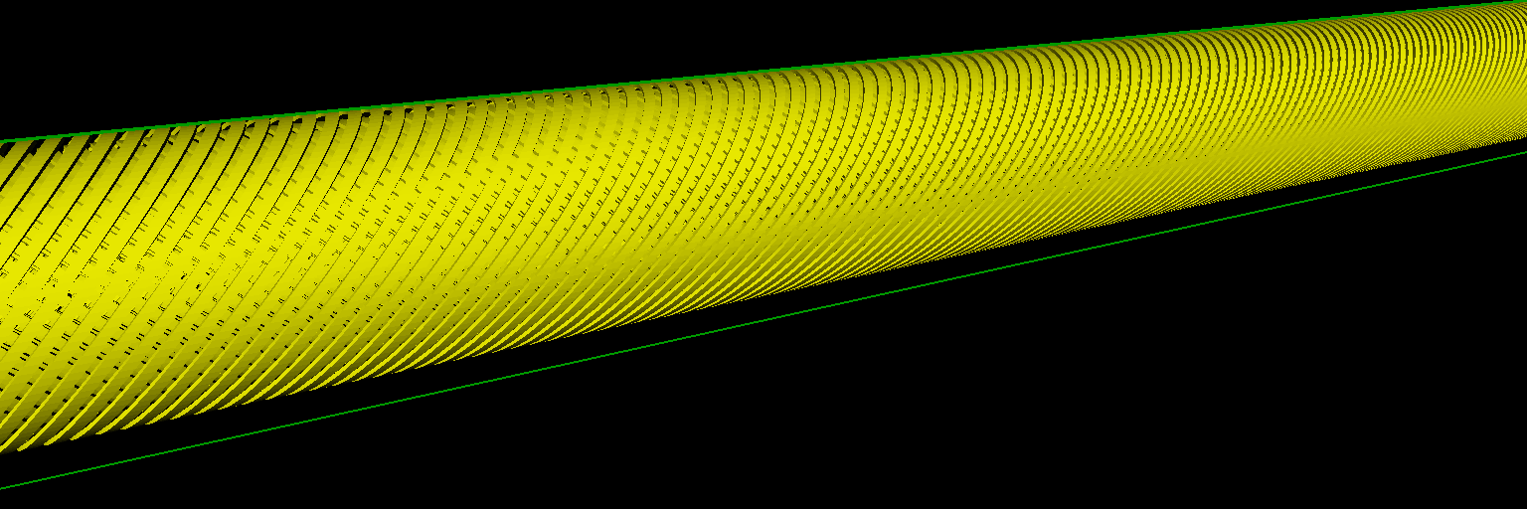
B0 Compensation Double Helix Coil
Center
End

Slide 32
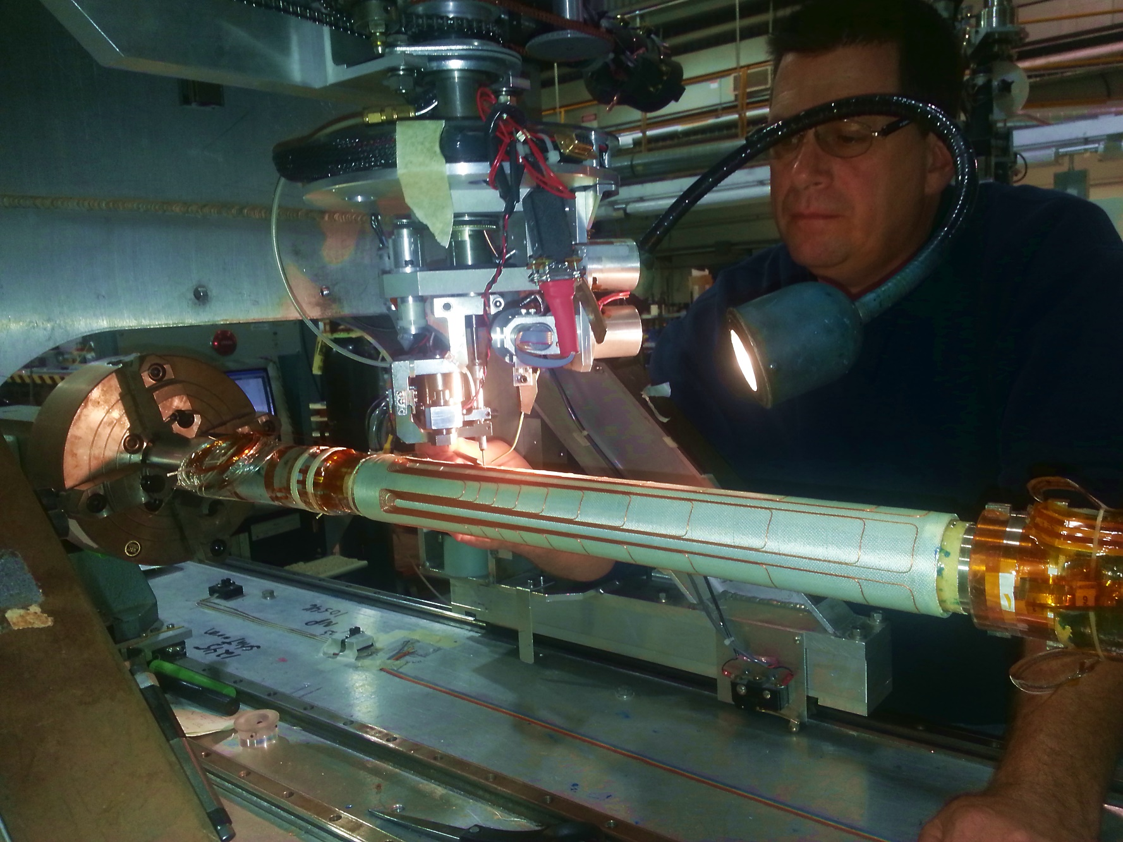
BNL SMD Direct Wind Machine
Winding the SuperKEKB
b₅ Sperpentine Coil
Modifications required for
Double-helix coil (LDRD)
B. Parker, et.al., "THE SUPERKEKB INTERACTION REGION CORRECTOR MAGNETS,"
Contribution TUPMB041 to Proceedings of IPAC2016, Busan, Korea, May 2016, pp. 1193-1195.
B. Parker, et.al., "SUPERCONDUCTING CORRECTOR IR MAGNET PRODUCTION FOR SUPERKEKB,"
Contribution THPBA07 to Proceedings of PAC2013, Pasadena, CA USA, pp. 1241-1243.
B. Parker, et al., “Direct Wind Superconducting Corrector Magnets for the SuperKEKB IR,”
Contribution WEEPPB013, to IPAC12, New Orleans, USA, May, 2012.

Slide 33
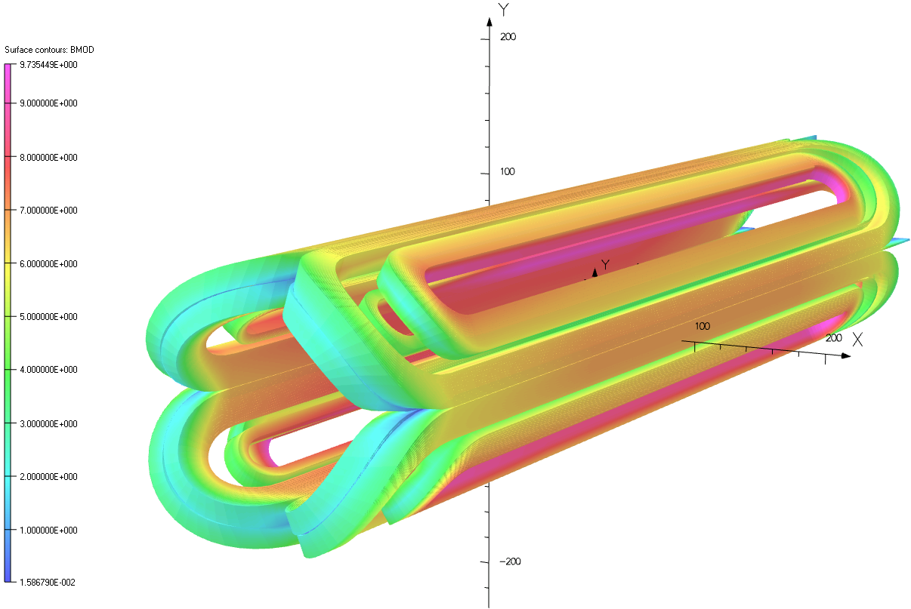
Fast Track R&D Magnet: Nb₃Sn Main Coil 3D |B|
Main Coil |B| (T) for G_{net} = 134 T/m

Slide 34
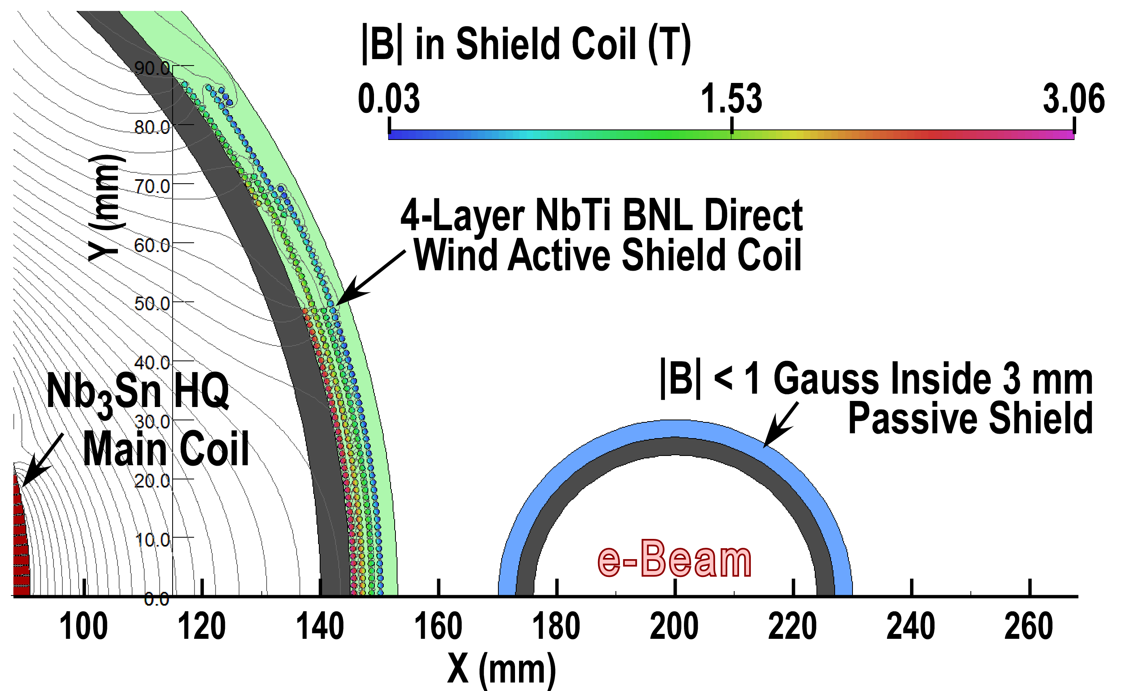
A Fast Track R&D Quadrupole Magnet Concept

Slide 35
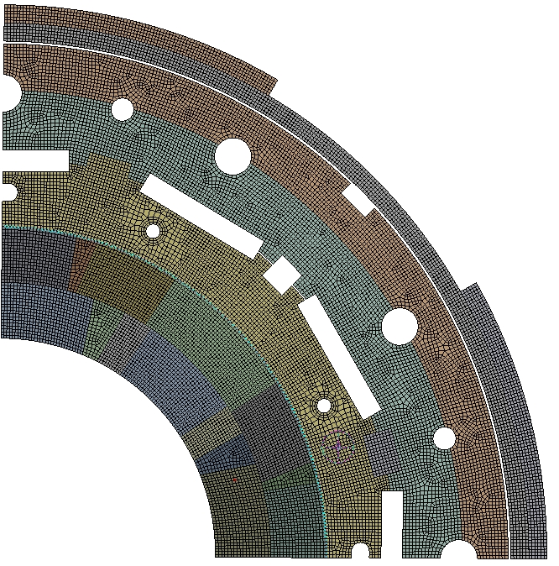
Fast Track R&D Magnet: 2D Mechanical FE Mesh
FE Mesh Features

Slide 36
Fast Track R&D Magnet: ANSYS FE Simulation
Cool-Down and Power to 133 T/m
Radial Deformation (mm)
Component Equivalent Stress (MPa)

Slide 37
Fast Track R&D Magnet: ANSYS FE Simulation
Bladders On
Keyed
Cool Down
120
100
80
Coil Stress (MPa)
60
40
20
Powered
0
Bladders On
Keyed
Cool Down
Powered

