Slide 1
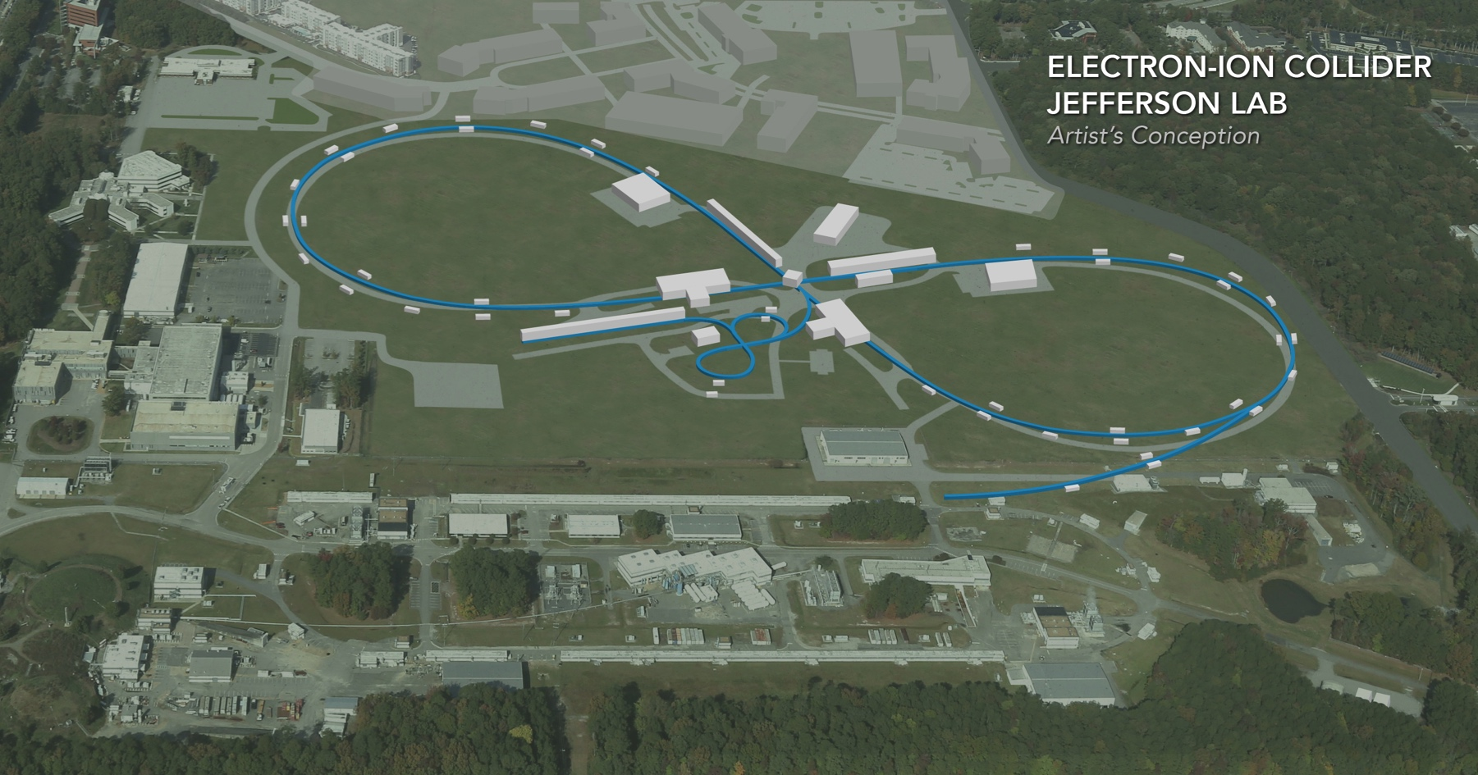
Validation of EIC IR Magnet Parameters and Requirements Using Existing Magnet Results
Tim Michalski
Mark Wiseman, V. Morozov, Renuka Rajput-Ghoshal : Jefferson Lab
Michael Sullivan, Yuri Nosochkov: SLAC
GianLuca Sabbi: LBL
EIC Accelerator Collaboration Meeting
October 29 - November 1, 2018

Slide 2
Presentation Outline
Overview of Interaction Region Requirements
Interaction Region Layout Overview
FFQ Parameters – Detector Acceptance
Dynamic Aperture
Multipole Analysis
Corrector Schemes
Extrapolation of Existing Magnet Data – Beam Dynamics Aspects
Extrapolation of Existing Magnet Data – Engineering Aspects
Heat and Radiation Loads on IR Magnets
Timetable of Activities
Summary

Slide 3
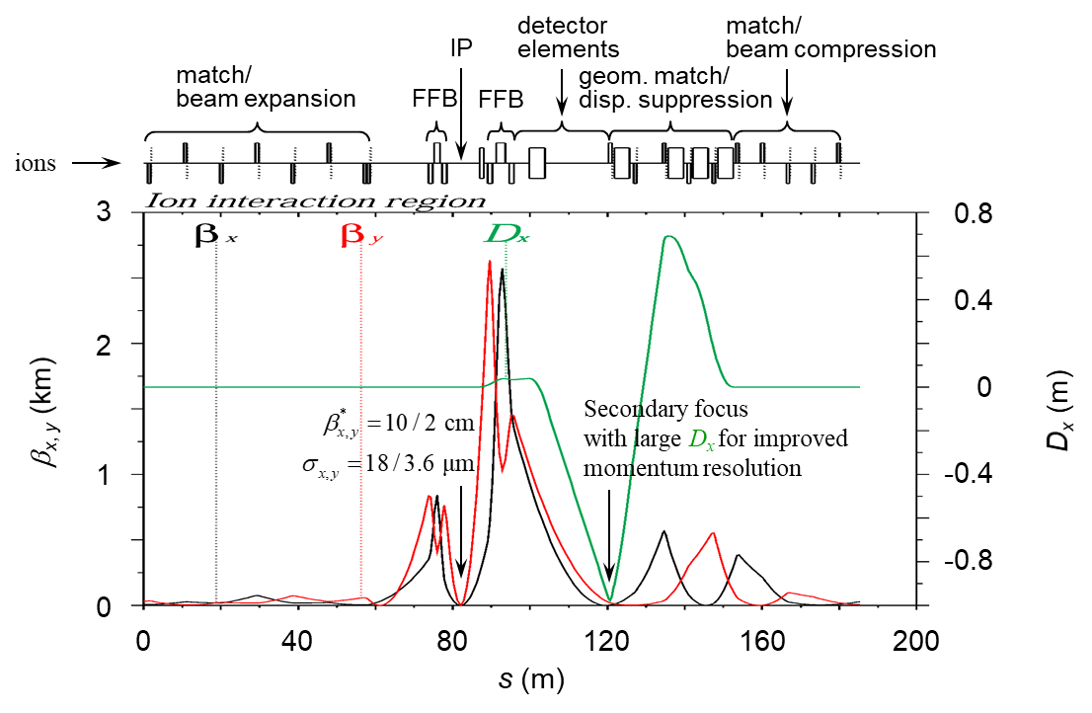
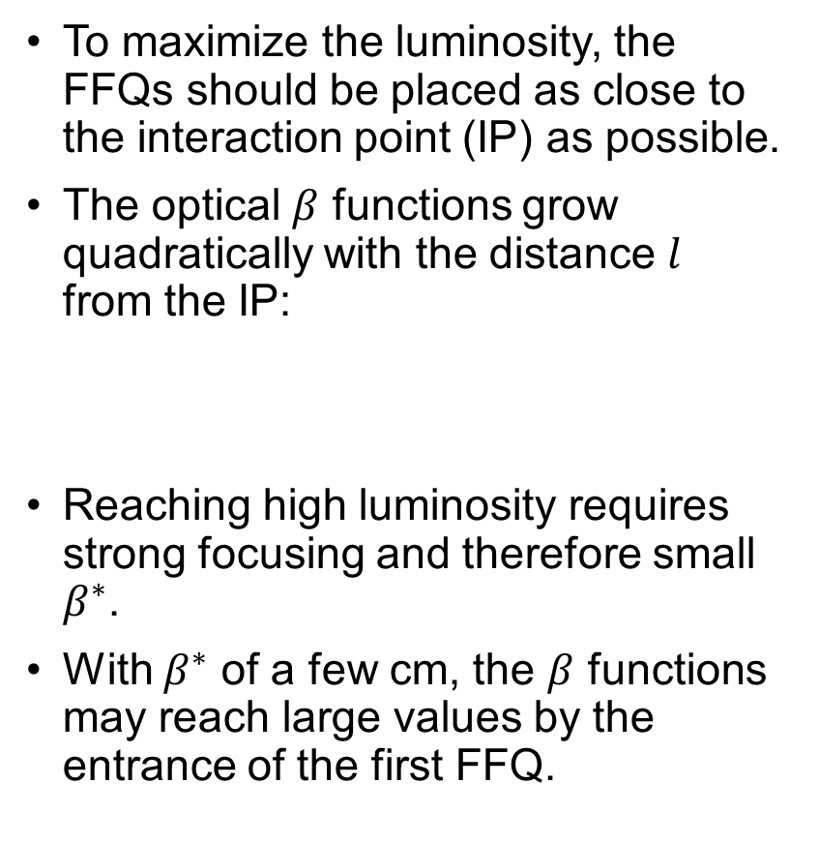
Overview of the Interaction Region Requirements
To maximize the luminosity, the FFQs should be placed as close to the interaction point (IP) as possible.
The optical $β$ functions grow quadratically with the distance $l$ from the IP:
Reaching high luminosity requires strong focusing and therefore small $β^{∗}$.
With $β^{∗}$ of a few cm, the $β$ functions may reach large values by the entrance of the first FFQ.
Beam optics of the ion detector region.

Slide 4
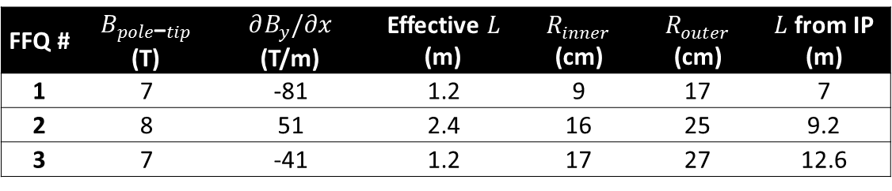
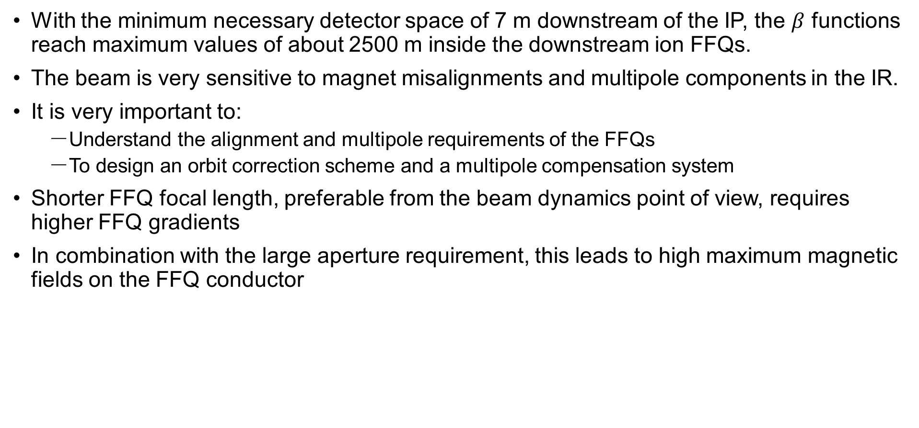
Overview of the Interaction Region Requirements
With the minimum necessary detector space of 7 m downstream of the IP, the $β$ functions reach maximum values of about 2500 m inside the downstream ion FFQs.
The beam is very sensitive to magnet misalignments and multipole components in the IR.
It is very important to:
  Understand the alignment and multipole requirements of the FFQs
  To design an orbit correction scheme and a multipole compensation system
Shorter FFQ focal length, preferable from the beam dynamics point of view, requires higher FFQ gradients
In combination with the large aperture requirement, this leads to high maximum magnetic fields on the FFQ conductor
Typical parameters of the downstream ion FFQs for JLEIC. The magnetic field values are shown for 100 GeV/c protons. The distance from the IP is the distance from the IP to the magnet face oriented towards the IP. Rinner≡Bpole-tip/(∂By/∂x)
FFQ # | $B_{pole\text{−}tip}$ (T) | $∂B_{y}/∂x$ (T/m) | Effective $L$ (m) | $R_{inner}$ (cm) | $R_{outer}$ (cm) | $L$ from IP (m)
1 | 7 | -81 | 1.2 | 9 | 17 | 7
2 | 8 | 51 | 2.4 | 16 | 25 | 9.2
3 | 7 | -41 | 1.2 | 17 | 27 | 12.6

Slide 5
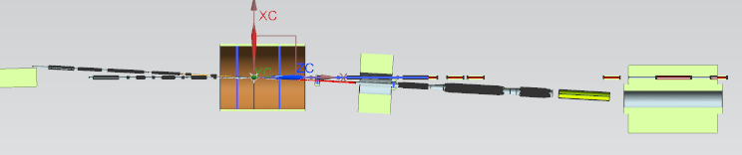
Interaction Region Layout Overview
The design thus far considered six distinct areas of magnets
  Detector Solenoid ( 4 m)
  SB1 dipole (1.5 m)
  SB2 dipole (~4.6 m)
  Ion entrant side cryostat (~8.7 m)
  Electron entrant cryostat, between the Detector Solenoid and SB1 (~2.6 m)
  Ion down beam cryostat between the two spectrometer dipoles (~10.4 m)
~32 m
i
e
3
4
5
1
2
6

Slide 6
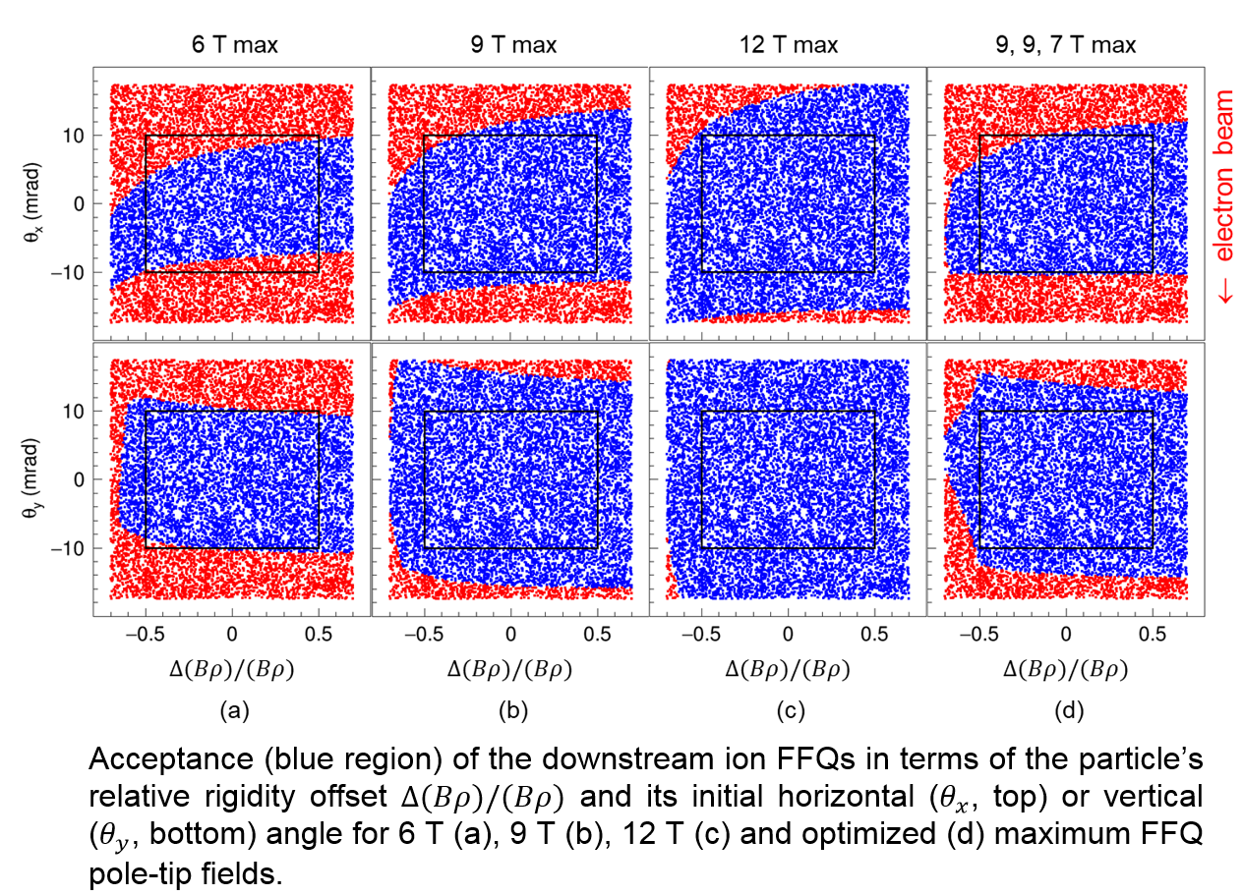
FFQ Parameters – Detector Acceptance
Downstream ion FFQ parameters are driven by forward detection considerations
Desire a clear line of sight from the IP through the FFQ apertures within a cone of about 20 mrad
Forward acceptance to charged particles studied using GEANT4 for multiple protons originating at the IP with different initial angles and rigidity offsets with respect to the nominal proton beam.
All particles that go outside the apertures anywhere inside the quads are considered lost.

Slide 7
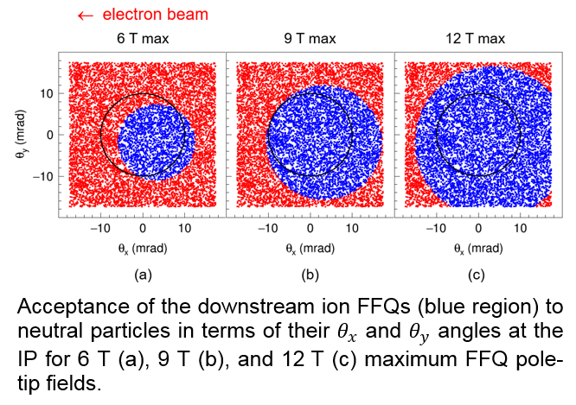

FFQ Parameters – Detector Acceptance
Simulation of neutral particles for 6, 9, and 12 T FFQ pole-tip fields
The transmitted particles are indicated in blue. The black circle outlines $±{0.5}^{∘}$ cone.
Adequate acceptance to neutral particles.
Higher acceptance is more preferable for nuclear physics experiments.

Slide 8
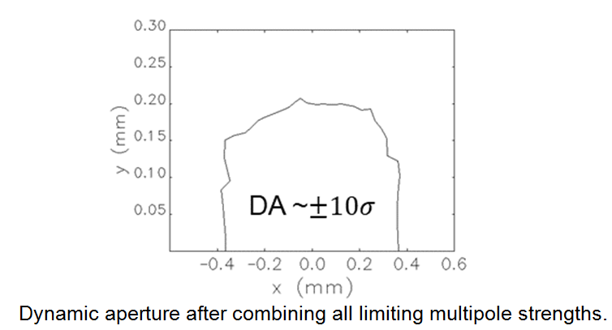
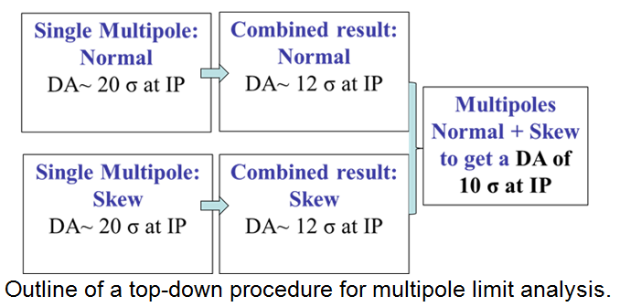
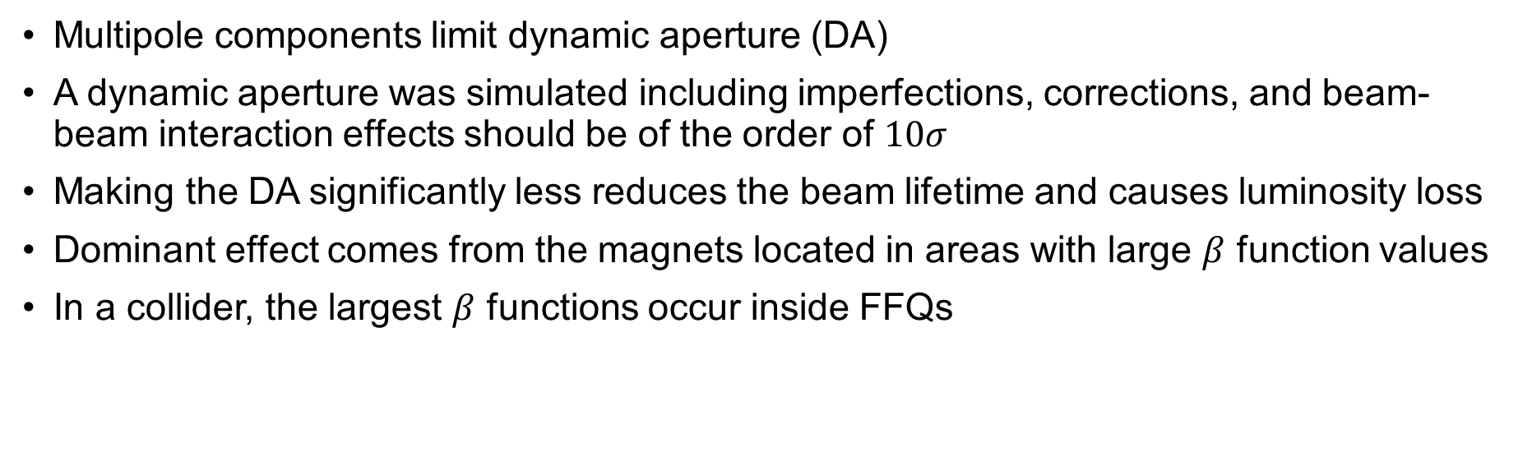
Dynamic Aperture
Multipole components limit dynamic aperture (DA)
A dynamic aperture was simulated including imperfections, corrections, and beam-beam interaction effects should be of the order of $10σ$
Making the DA significantly less reduces the beam lifetime and causes luminosity loss
Dominant effect comes from the magnets located in areas with large $β$ function values
In a collider, the largest $β$ functions occur inside FFQs

Slide 9
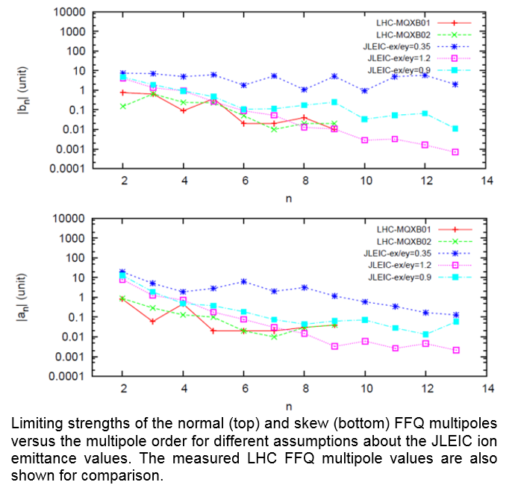
Multipole Initial Analysis
The limiting multipole strengths serve as multipole tolerances for magnet designers.
This analysis is very preliminary.
Requires further assessment of:
  Misalignments
  Orbit correction
  Multipole correction
  Beam-beam interaction

Slide 10
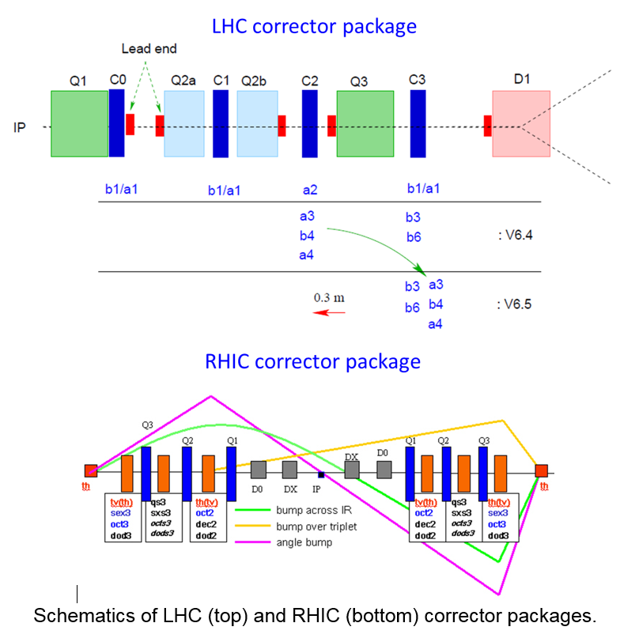
Corrector Schemes
Design of the orbit correction scheme in the IR
  Integration of orbit correctors and diagnostics
  Tolerances on the alignment of elements
  Specification of orbit corrector and diagnostics requirements
Design of the multipole correction scheme in the IR
  Integration of multipole correctors
  Specification of multipole field without multipole correction
  Simulation of local compensation of magnet multipoles
  Specification of multipole field after compensation
  Specification of multipole corrector strength and alignment requirements
  Impact of coil end multipoles and their compensation
Space requirements including coil ends, cryostats, orbit and multipole correctors, and diagnostics
Identification of key magnet parameters to verify using existing magnet data and to test by prototyping

Slide 11



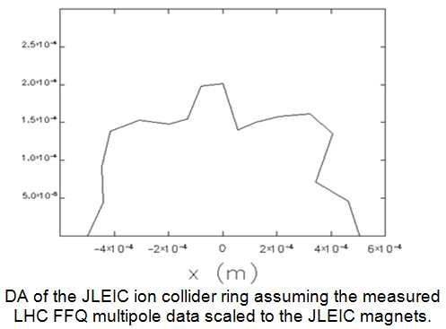
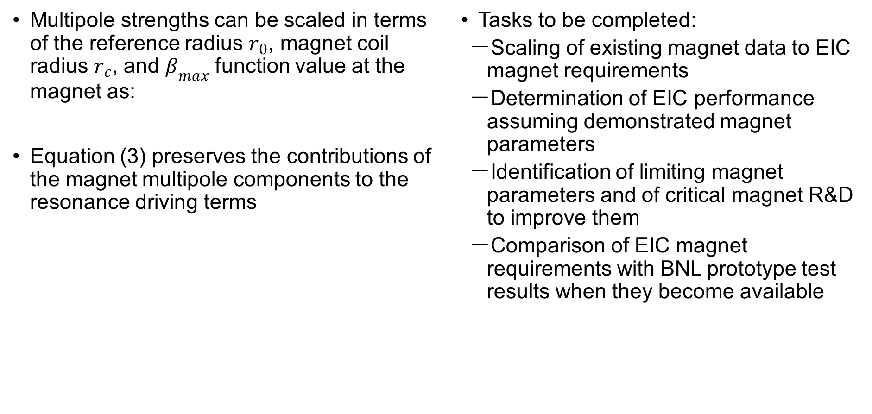
Extrapolation of Existing Magnet Data – Beam Dynamics Aspects
Multipole strengths can be scaled in terms of the reference radius $r_{0}$, magnet coil radius $r_{c}$, and $β_{max}$ function value at the magnet as:
Equation (3) preserves the contributions of the magnet multipole components to the resonance driving terms
Tasks to be completed:
  Scaling of existing magnet data to EIC magnet requirements
  Determination of EIC performance assuming demonstrated magnet parameters
  Identification of limiting magnet parameters and of critical magnet R&D to improve them
  Comparison of EIC magnet requirements with BNL prototype test results when they become available

Slide 12
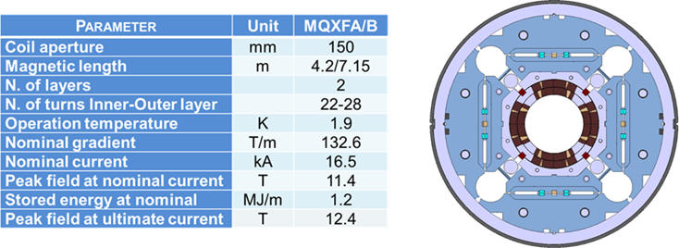
Extrapolation of Existing Magnet Data – Engineering Aspects
Design challenges stated in IR Magnet Layout/Design – JLEIC presentation
Iterate and optimize on the key parameters (coil radius, gradient and magnetic length)
The main reference – LHC accelerator research program (LARP) in support of the HL-LHC
JLEIC, in comparison to HL-LHC, has larger aperture and close proximity to electron beamline
Tasks to be completed:
  Exploration of alternative conductor technologies
  Assess how LARP HL-LHC FFQs translates to the JLEIC IR FFQ magnets
  Comparison of alternative mechanical structure designs - LARP FFQ, BNL High Gradient Shielded Quadrupole
  Analysis of field quality that can be achieved in Nb3Sn

Slide 13
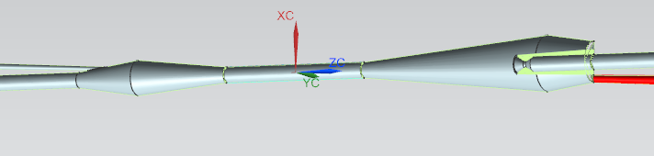
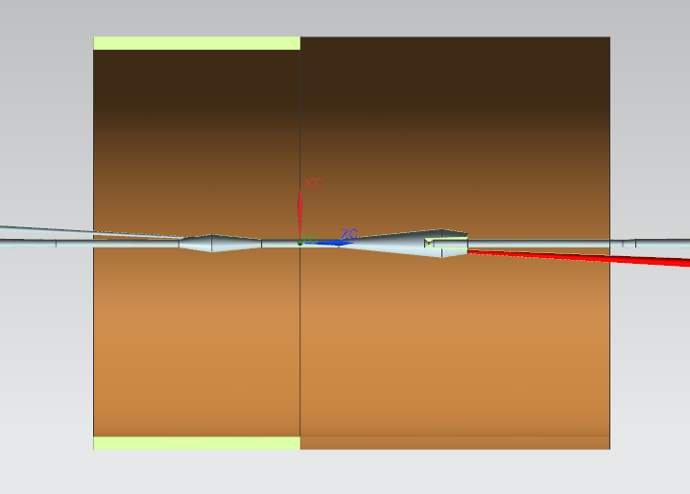
Heat and Radiation Loads on IR Magnets
For each FFQ change, modeling of the SR backgrounds must be reassessed
The next step is modeling secondary scattering from beam pipe surfaces / mask tips
Interaction point
i
e
160 cm
240 cm

Slide 14
Timetable of Activities
Task | YR 1 Q1 | YR 1 Q2 | YR 1 Q3 | YR 1 Q4 | YR 2 Q1 | YR 2 Q2 | YR 2 Q3 | YR 2 Q4
IR orbit correction | X | X
IR with existing magnet data |  |  | X | X
IR multipole correction |  |  |  | X | X | X | X | X
SR heat loads and shielding | X | X | X | X | X | X | X | X
Feedback on magnet requirements from the accelerator physics team | X | X
Assess magnet space requirements to ensure a realistic IR layout |  | X | X
Formulate field error tables based on LARP experience |  |  | X | X
Explore and select from alternative magnet and structure options | X | X | X | X
Mechanical and magnetic analysis of proposed design |  |  |  |  | X | X | X | X
Incorporate experience from BNL model design, fabrication, and test |  |  |  |  | X | X | X | X
Update IR layouts based on results of project |  |  |  |  |  | X | X | X

Slide 15
Summary
Development of a sound IR design is necessary for a successful EIC
An initial JLEIC design has been completed as part of the FY’17 Base R&D
The design of the electron IR corrector scheme is nearly complete
A plan for assessing specifications and their effects has been developed

Slide 16
Thank you for your attention.
Are there any questions?

