Slide 1


HL-LHC Nb₃Sn IR Quadrupoles progress and EIC applications
G. Sabbi, LBNL
EIC Collaboration Meeting 2018
JLab, October 30, 2018

Slide 2
Presentation Outline
Nb₃Sn IR Quadrupole R&D and MQXF Prototype Development for HL-LHC by LARP and AUP
Selected LARP and AUP developments of particular relevance to EIC
  HQ coils for use in actively shielded quadrupole FOA
  Mechanical design requirements and optimization
  Field quality measurements in MQXF models
AUP project status and preparations for production
  Project documentation
Summary

Slide 3
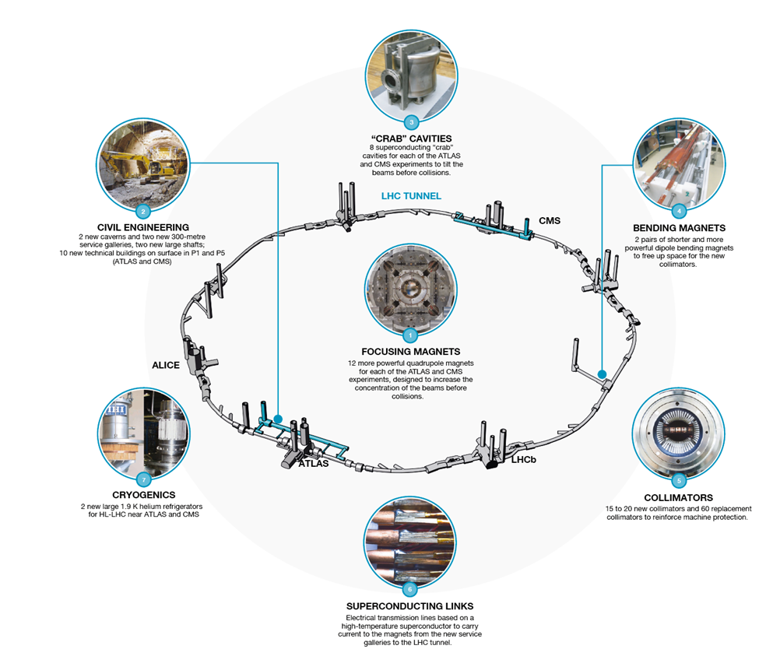
High Luminosity LHC (HL-LHC)
New hardware configuration and beam parameters to reach a peak luminosity of 5×10³⁴ cm⁻²s⁻¹ with levelling and an integrated luminosity of 250 fb⁻¹ per year
Interaction region:
TAXS
Q1-Q2a-Q2b-Q3
D1
All correctors
Heavy shielding
Matching section
TAXN
D2
Crab Cavities
Q4 cold mass
Correctors
Q5 (Q5@1.9K in P6)
New collimators
Dispersion suppressor:
IP2: new collimators
IP7: new collimation with 11 T dipoles
General:
cryogenics, protection, vacuum, diagnostics, injection, extraction, controls, surface and underground infrastructure
The HL-LHC upgrades affect ~1.2 km of the LHC accelerator:

Slide 4
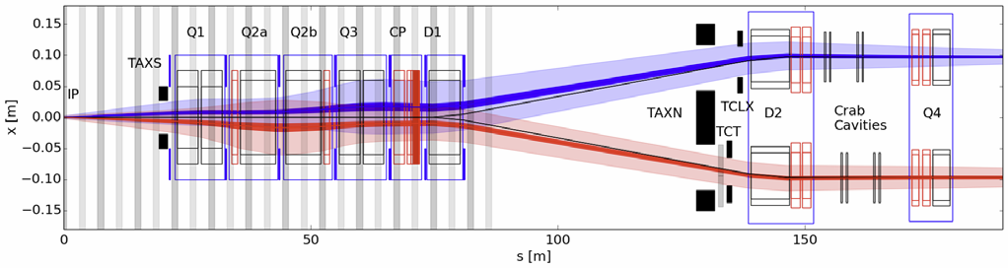
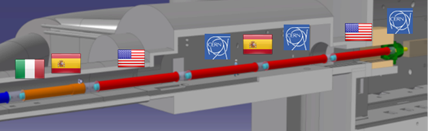
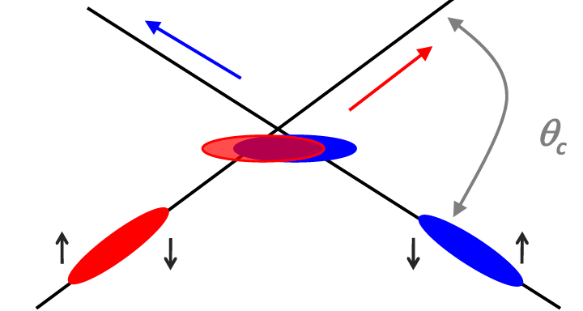
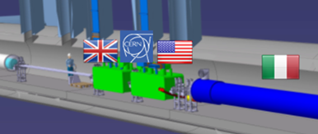

U.S. contributions to HL-LHC
Insertion Region layout from the IP to Q4
Large Aperture IR Quadrupoles:
From 70 mm MQXA/B to 150 mm MQXF
From NbTi to Nb₃Sn for higher field/gradient
Minimum β* from 0.55 m to 0.15 m
Compatible with 10x integrated luminosity
Crab cavities:
Deflect bunch at IP to collide head-on
Restore luminosity loss due to crossing angle
Requires compact superconducting cavities

Slide 5
Nb₃Sn technology: Potential and Challenges
Potential:
Nb₃Sn critical temperature and field are about a factor of 2 larger than in NbTi
Significantly expands the magnet design space: higher field and temperature margin
Challenges:
Material | NbTi | Nb₃Sn
Dipole Limit | ~ 10 T | ~ 16 T
Reaction | N/A | ~ 675⁰C
Insulation | Polyimide | S/E Glass
Coil parts | G-10 | Stainless
Irreversible Axial Strain | N/A | 0.2-0.5 %
Transverse stress | N/A | ~ 200 MPa
Brittle material: severe damage in cabling/winding
  React coils after winding
  New materials (insulation, coil parts)
High sensitivity to stress/strain:
  Epoxy impregnation
  New mechanical designs

Slide 6
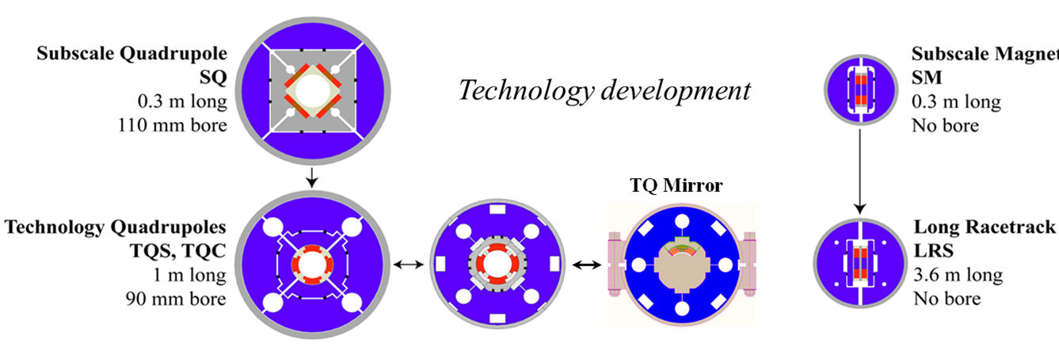
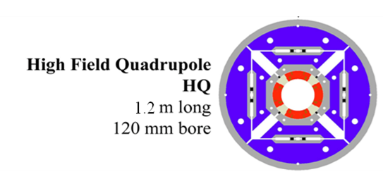
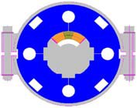
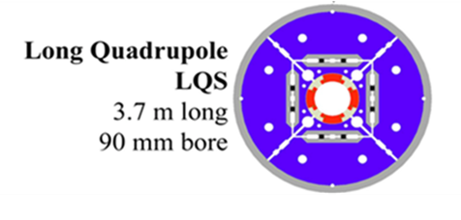
LARP Model Magnet Reference Chart
Started from simple configurations directed at basic technology studies and
progressed to incorporate all requirements for operation in the accelerator
Technology Development
Large aperture quadrupoles
HQ and LQ Mirrors
Long quadrupoles
HQM

Slide 7
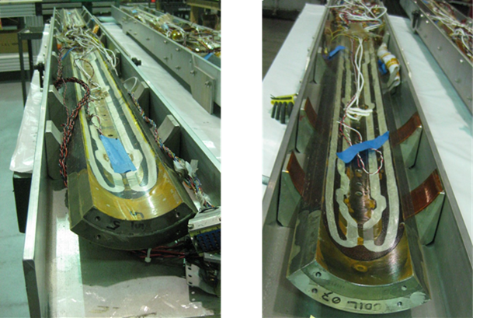
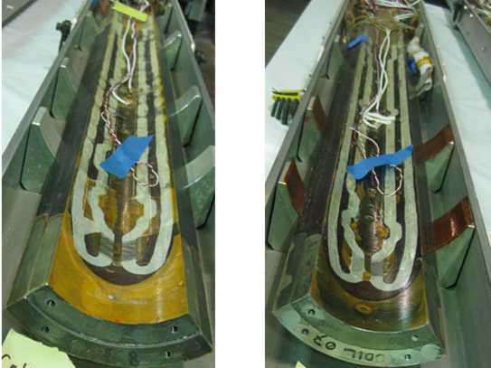
HQ Coils for EIC Q1P Model
Coil #5, 7, 8, 9 were used in the HQ01d & HQ01e reaching 170-184 T/m (4.5-1.9K)
Test name |  | Coils # | Max I_{q}(A) | Max I_{q} % ss | Max grad (T/m)
HQ01a |  | 1,2,3,4 | 13680 | 79 | 156
HQ01b |  | 1,4,5,6 | 13308 | 77 | 152
HQ01c |  | 1,5,7,8 | 12099 | 70 | 139
HQ01d |  | 5,7,8,9 | 14892 | 86 | 170
HQ01e |  | 5,7,8,9 | 14830 | 86 | 169
HQ01e2 | 4.3 K | 5,7,8,9 | 14681 | 85 | 167
 | 1.9 K |  | 16262 | 85 | 184
Coil #5
Coil #7
Coil #8
Coil #9

Slide 8
HQ Coil Status
Activities performed at LBNL since FOA start:
Retrieved coils from storage and performed a visual inspection for any sign of damage to coil, instrumentation and wiring (strain gauges)
Sequential R (voltage taps) and quench heater resistance measurements and comparison with previous readings
Selected Hi-pot targets based on latest known data and performed Hi-pot
Performed impulse tests up to 500 V
Conclusion: coils are usable for the EIC test, after installing new strain gauges
Next steps:
Ship coils to BNL using HQ coil shipping tooling (currently at BNL)
Install new strain gauges (at BNL)
Define the magnet test goals and protection strategy and refine the electrical requirements and QA accordingly

Slide 9
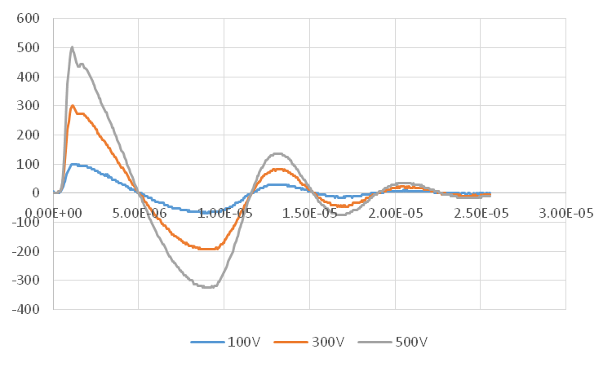
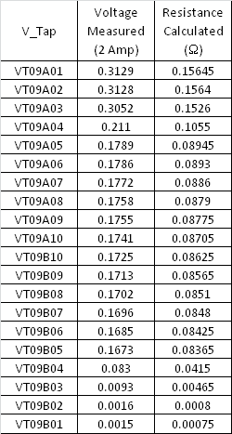
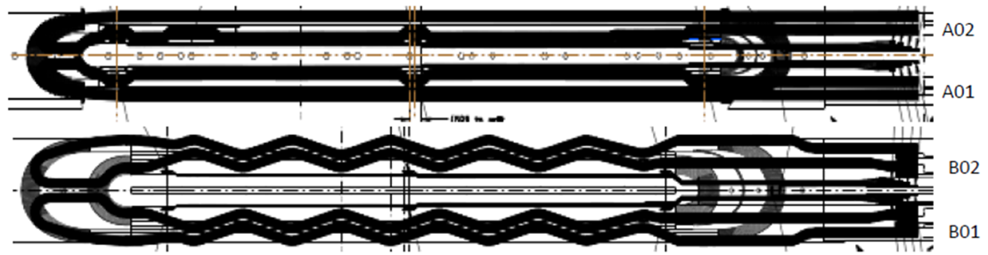
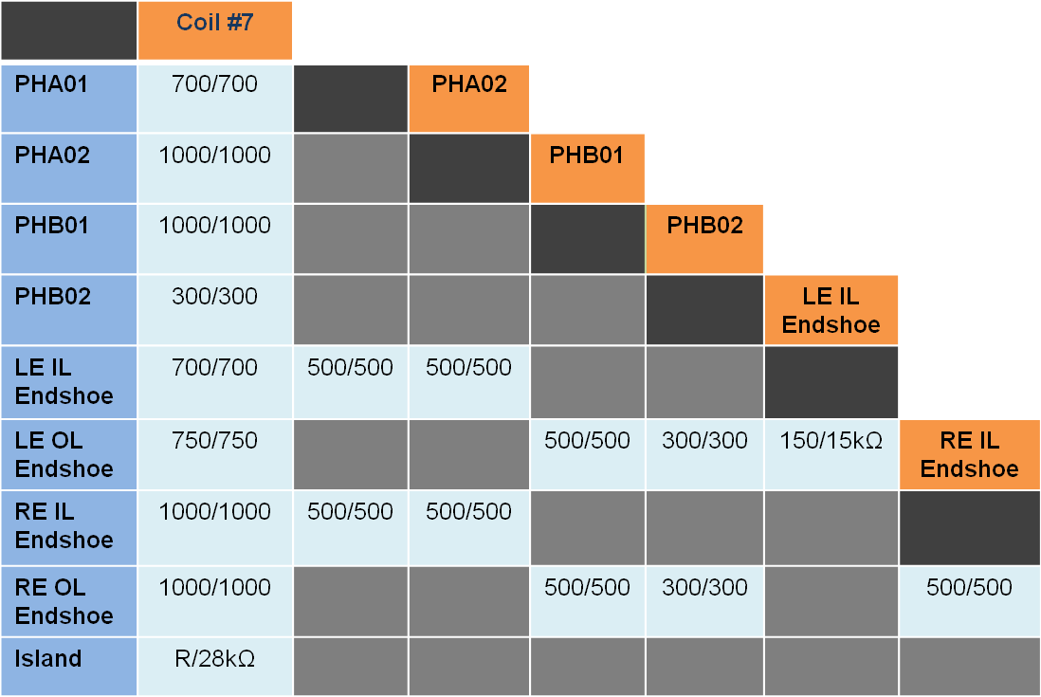
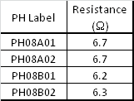
HQ coil QA Results
Coil 9 V-taps
Coil 5 impulse test
Coil 7 hi-pot
Coil 8 heaters

Slide 10
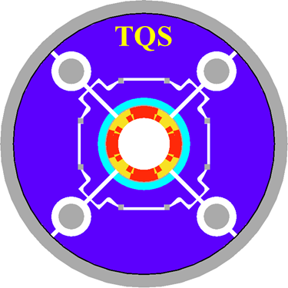
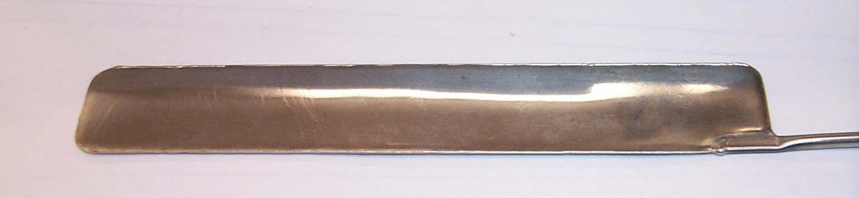
Mechanical Design of High Field Nb₃Sn Magnets
Mechanical design of Nb₃Sn magnets needs to satisfy stringent constraints
  Full support without exceeding conductor stress limits
LARP approach relies on aluminum shell on iron yoke, preloaded with pressurized bladders and interference keys
  Minimize and precisely control warm pre-load
  Increase to full pre-load during cool-down, avoiding overshoot
Aluminum
shell
Slots for
pressurized
bladders
Water-pressurized bladder for assembly pre-load
Iron
yoke
Interference
Keys
Axial
rods

Slide 11
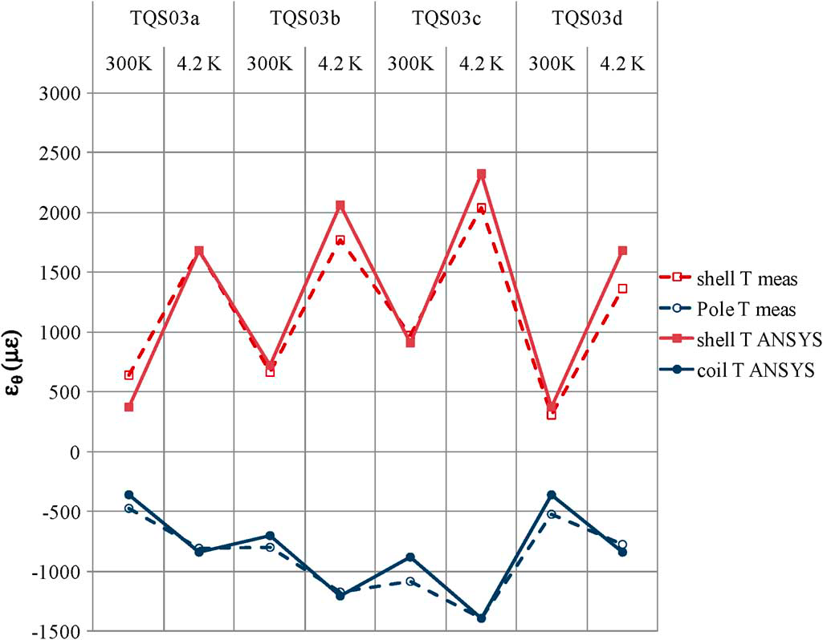
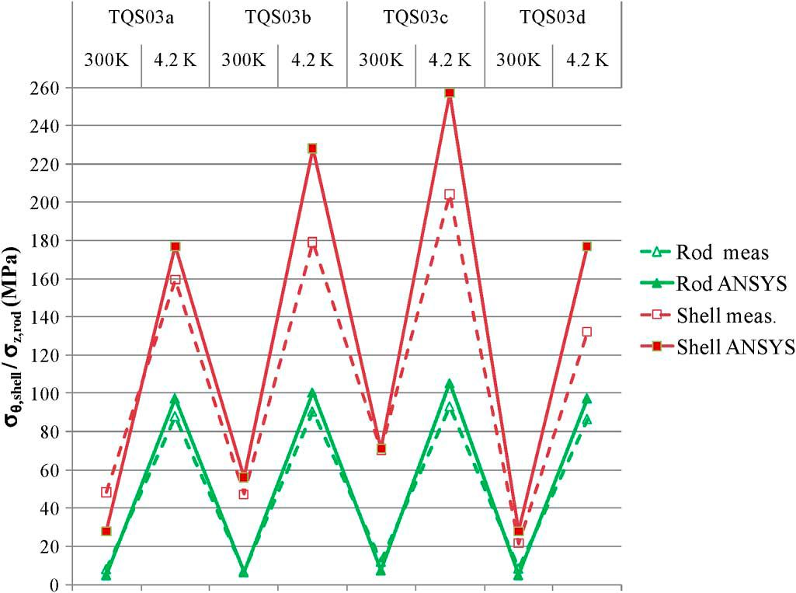
TQS03 Pre-load History and Verification
Comparison of ANSYS results and strain gauge measurements
  External shell, axial rods and coil poles
Required for each individual magnet and test
Ref: H. Felice et al., IEEE Trans. Appl. Supercond., vol. 21, no. 3, June 2011.

Slide 12
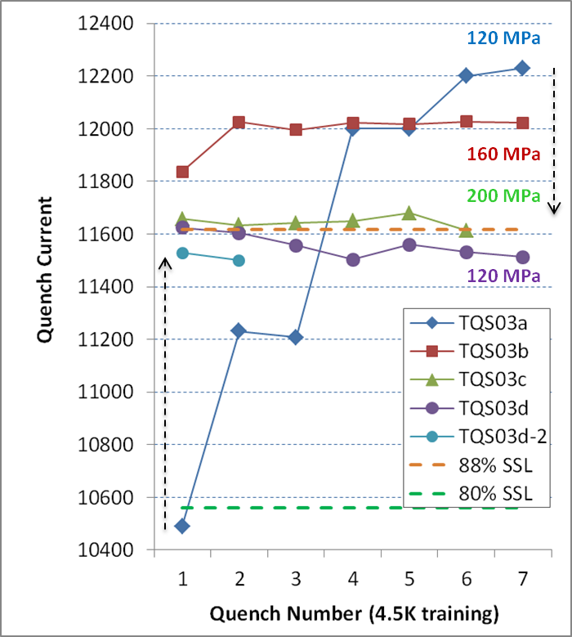
Pre-load optimization and stress limits in TQ
Balance speed of training and consistent plateau after thermal cycle vs. degradation
Four tests performed at CERN in TQS03 models with different pre-load
Increasing pre-load in a/b/c (pole ave.120/160/200 MPa) gives more stable but lower plateau (93/91/88%)
Degradation is permanent: TQS03d with lower pre-load does not recover initial level

Slide 13
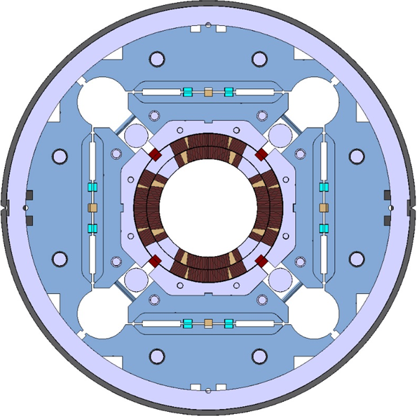
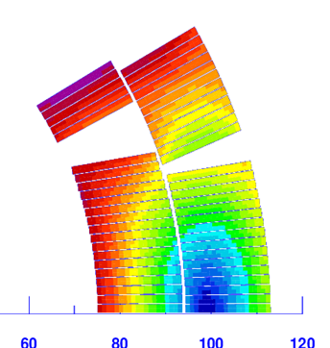
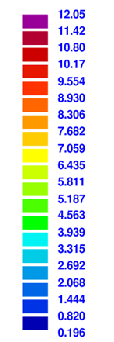
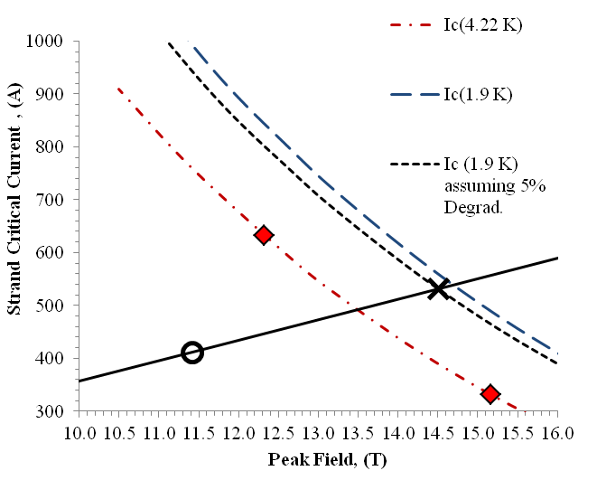

MQXF Design
Magnetic field in the coil
Load line and conductor limits
-4%
Max
Design cross-section is based on reacted cable dimensions
77% I_{ss}
Coil and Magnet Parameters
Strand and Cable Parameters
Parameter | Unit | MQXF
Coil aperture | mm | 150
Magnetic Length (MQXFA, B) | m | 4.2, 7.15
Number of turns (inner layer) |  | 17+5
Number of turns (outer layer) |  | 16+12
Inter-layer insulation | mm | 0.66
Current (nominal, ultimate) | kA | 16.48, 17.89
Gradient (nominal, ultimate) | T/m | 132.6, 143.2
Peak field (nominal, ultimate) | T | 11.4, 12.3
Strand I_{c} at 4.2K (12T, 15T) | A | 632, 331
Short sample current | kA | 21.24
Parameter | Unit | MQXF
Strand diameter | mm | 0.85 ± 0.003
Number of Strands |  | 40
Mid-Thickness (unreacted) | mm | 1.525 ± 0.010
Width (unreacted) | mm | 18.15 ± 0.05 mm
Mid-Thickness (reacted) | mm | 1.594
Width (reacted) | mm | 18.363
Keystone Angle |  | 0.40° ± 0.1°
Pitch | mm | 109 ± 3
Core Width, Thickness | mm | 12, 0.025
Insulation Thickness | mm | 0.145 ± 0.005

Slide 14
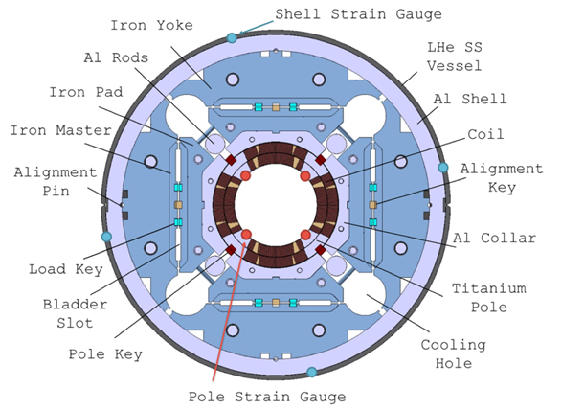
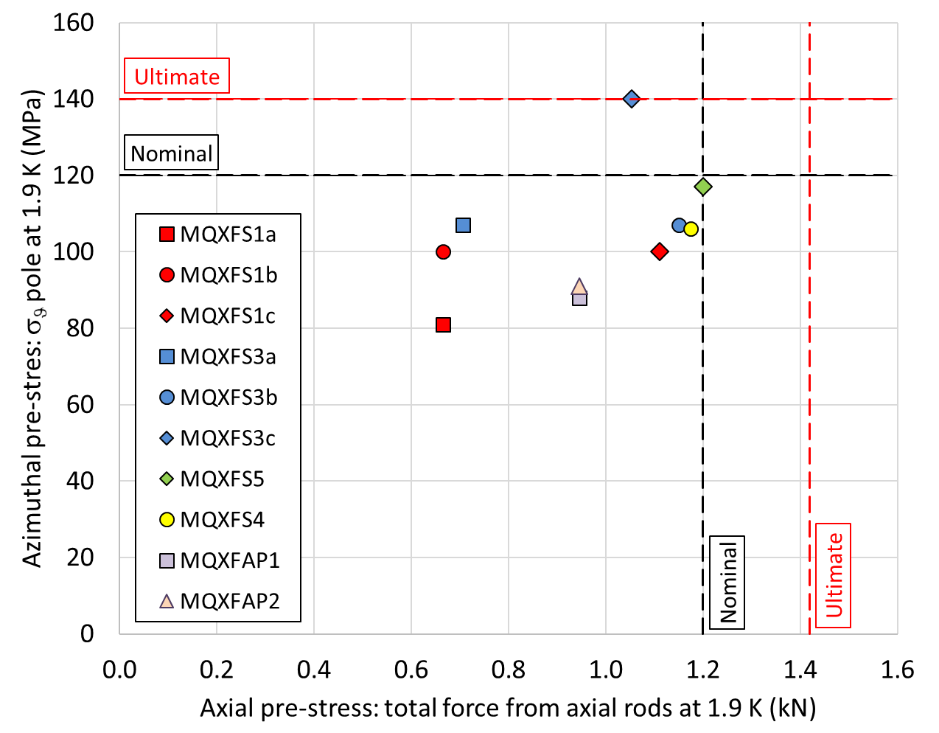
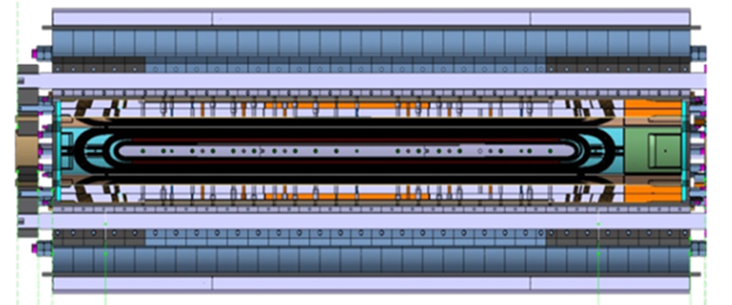
MQXF Mechanical Structure and Pre-load
MQXF short models (1.2 m)
  MQXFS1
  MQXFS3
  MQXFS5
  MQXFS4

Slide 15
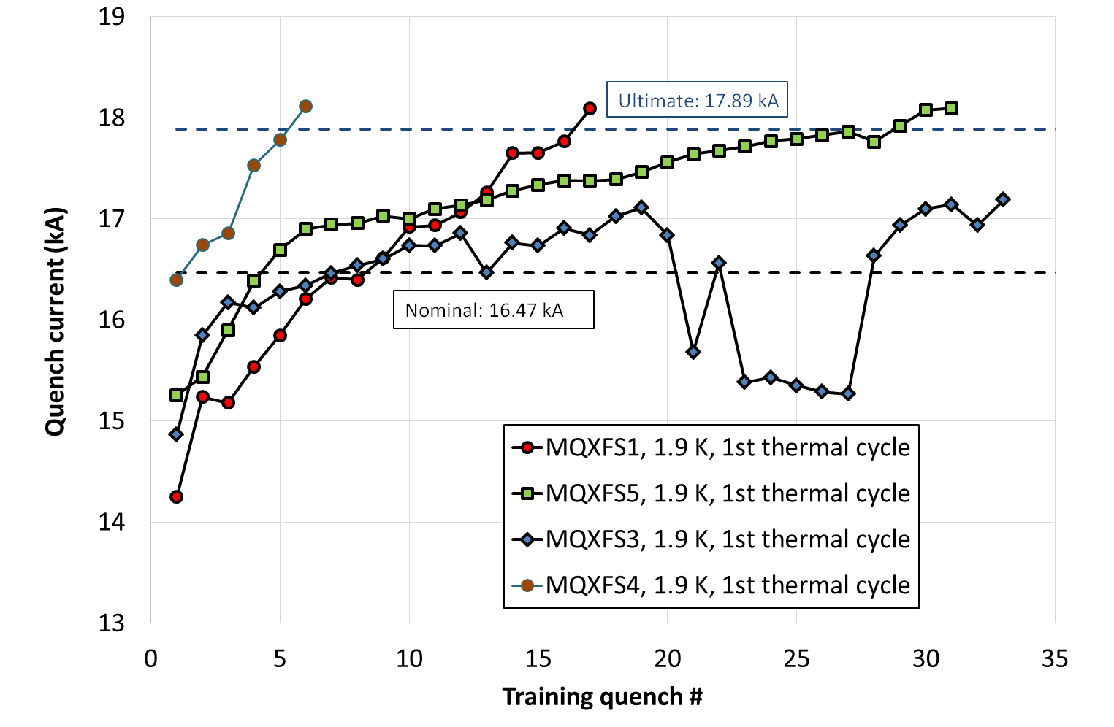
Short Model Test Results

Slide 16
Field Quality Table

Slide 17
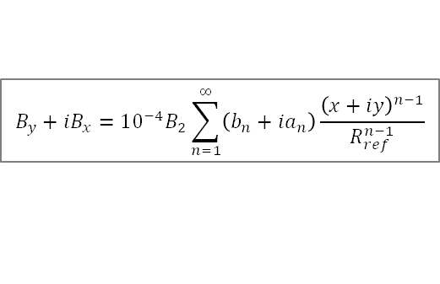
Field Quality Measurements in Short Models
$$B_{y}+iB_{x}={10}^{−4}B_{2}\sum_{n=1}^{∞}{\left(b_{n}+ia_{n}\right)\frac{{\left(x+iy\right)}^{n−1}}{R_{ref}^{n−1}}}$$
R_{ref} = 50 mm
The dominant source of field errors is the coil geometry and its initial assembly in the collared coil.
Steady improvements in coil uniformity during short model and prototype development by better consistency of parts and processes

Slide 18
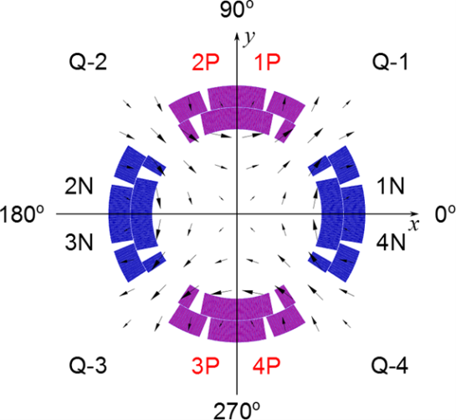
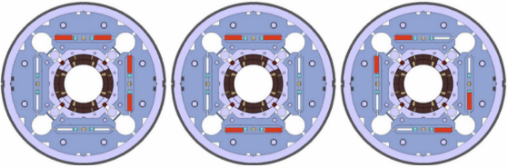
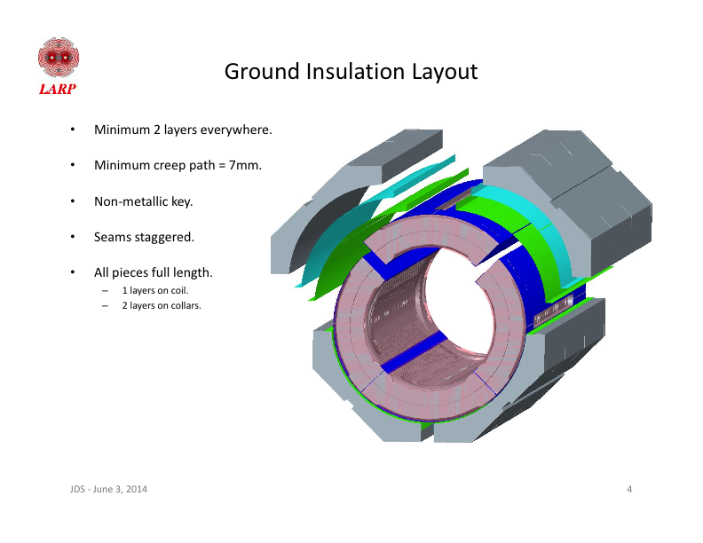
Comparison of Measurements and Calculations
Coil pack shim configurations
Coil pack shim definitions
Shim (μm) | MQXFS1 |  | MQXFS3 |  | MQXFS5
Quadrant | Rad. | Azim. | Rad. | Azim. | Rad. | Azim.
1 | 50 | 0 | 0 | 150 | 0 | 25
2 | 0 | 0 | 0 | 50 | 0 | 75
3 | 100 | 50 | 0 | 0 | 0 | 100
4 | 0 | 0 | 0 | 50 | 0 | 0
Radial
Azimuthal
Coil pack shims results
Magnetic shims configurations and results
MQXFS1a warm measurements and calculations
Harmonic | b₃ | a₃ | b₄ | a₄ | b₅ | a₅
Measured | -3.24 | 3.46 | 0.30 | -4.18 | 2.47 | -0.55
Calculated | -1.53 | 1.52 | 0.00 | -4.64 | 0.69 | 0.69
Δ (M-C) | -1.71 | 1.94 | 0.30 | 0.46 | 1.78 | -1.24
MQXFS3a warm measurements and calculations
Harmonic | b₃ | a₃ | b₄ | a₄ | b₅ | a₅
Measured | -1.69 | -1.30 | 2.13 | 2.75 | -2.37 | -1.55
Calculated | 0.67 | -0.67 | 0.00 | -0.72 | -1.33 | -1.33
Δ (M-C) | -2.36 | -0.63 | 2.13 | 3.47 | -1.04 | -0.22
MQXFS1c
MQXFS3a
MQXFS5a
 | M | C
Δb₃ | 3.51 | 4.22
Δa₃ | -3.92 | -4.24
Δb₄ | 0.01 | 0.00
Δa₄ | -1.69 | 0.00
 | M | C
Δb₃ | 1.17 | 0.00
Δa₃ | -0.59 | 0.00
Δb₄ | -2.55 | -2.88
Δa₄ | 0.83 | 0.00
 | M | C
Δb₃ | -0.40 | 0.00
Δa₃ | -0.40 | 0.00
Δb₄ | -0.22 | 0.00
Δa₄ | 0.71 | 0.84
MQXFS5a warm measurements and calculations
Harmonic | b₃ | a₃ | b₄ | a₄ | b₅ | a₅
Measured | -1.30 | -0.27 | 0.55 | -1.96 | 0.35 | -0.22
Calculated | -0.68 | 0.00 | 0.00 | -0.72 | 1.33 | 0.00
Δ (M-C) | -0.62 | -0.27 | 0.55 | -1.24 | -0.98 | -0.22
M: Measured shim effect; C: calculated shim effect
Harmonics targeted for correction are shown in yellow

Slide 19
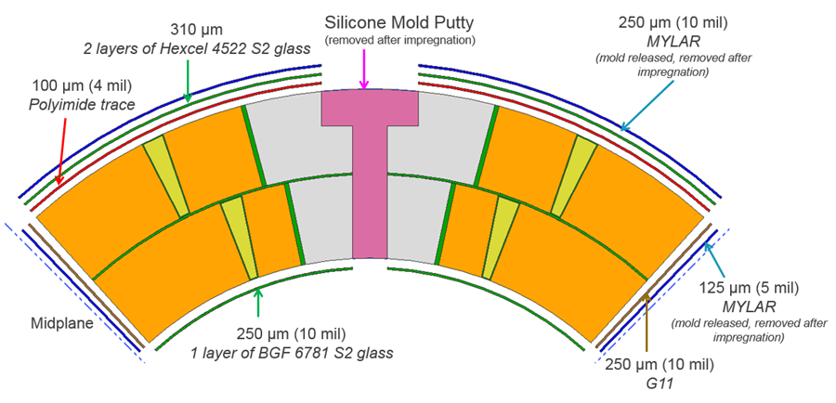
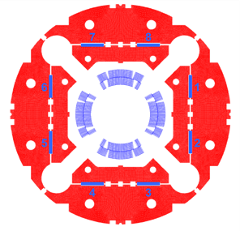
Tuning Capabilities
1) Coil shims (pole and mid-plane)
Correct systematic deviations in allowed harmonics b₆ and b₁₀
Compensate pole/mid-plane to maintain total arc length
2) Coil pack (mid-plane and radial)
Primary goal is compensate coil size deviations to achieve pre-load targets and homogeneity
Mid-plane shims are generally preferable for field quality
3) Magnetic shims after assembly:
Iron bars of variable thickness inserted in the bladder slots
High field correction capability: ±5 (b₃ and a₃); ±3 (b₄); ±1 (a₄)
Smaller limits for combinations; also consider effect on b₂, a₂
Calculated corrections for coil shims
Shim Size (μm) |  | Inner layer |  | Outer layer
Mid-plane | Pole | Δb₆ | Δb₁₀ | Δb₆ | Δb₁₀
+125 | 0 | -2.5 | -0.5 | -0.6 | 0.0
0 | +125 | +1.5 | -0.1 | +0.6 | 0.0
+125 | -125 | -4.3 | -0.5 | -1.3 | 0.0
-125 | +125 | +3.9 | +0.5 | +1.4 | 0.0
Calculated effect of magnetic shims
Shimming configuration | Multipoles affected | Harmonic correction
1, 2, 3, 8 | +b₃ , +b₅ | +3.2, +0.2
4, 5, 6, 7 | -b₃ , -b₅ | -3.2 , -0.2
1, 2, 4, 7 | +b₃ , +b₅ | +5.2 , +0.6
3, 5, 6, 8 | -b₃ , -b₅ | -5.2 , +0.6
1, 2, 5, 6 | +b₄ | +2.8
3, 4, 7, 8 | -b₄ | -2.8
1, 3, 4, 6 | +a₃ , -a₅ | +5.2 , -0.6
2, 5, 7, 8 | -a₃ , +a₅ | +5.2 , -0.6
1, 4, 5, 8 | -a₄ | -0.8
2, 3, 6, 7 | +a₄ | +0.8
1, 6, 7, 8 | -a₃ , +a₅ | -3.1 , +0.2
2, 3, 4, 5 | +a₃ , -a₅ | -3.1 , +0.2

Slide 20
HL-LHC Accelerator Upgrade Project
HL-LHC AUP is a formal DOE Construction Project established to fulfill a US contribution to HL-LHC
  CD-0 (Mission Need) approved in 2016
  CD-1 (Cost Range) approved 2017
    Also obtained CD-3a (Long Lead Procurement) for Nb₃Sn wire
  CD-2 (Project Baseline) in progress
  CD-3 (Start of Construction)
  CD-4 (Project Completion)
DOE funded activities take place at FNAL, BNL, LBNL
  Fermilab is the lead lab and project office site
  Technical effort is almost evenly split among the three Labs
  Additional US institutions contribute through contractual activities: Old Dominion University, National High Magnetic Field Lab, Argonne National Laboratory, Jefferson Lab, SLAC

Slide 21
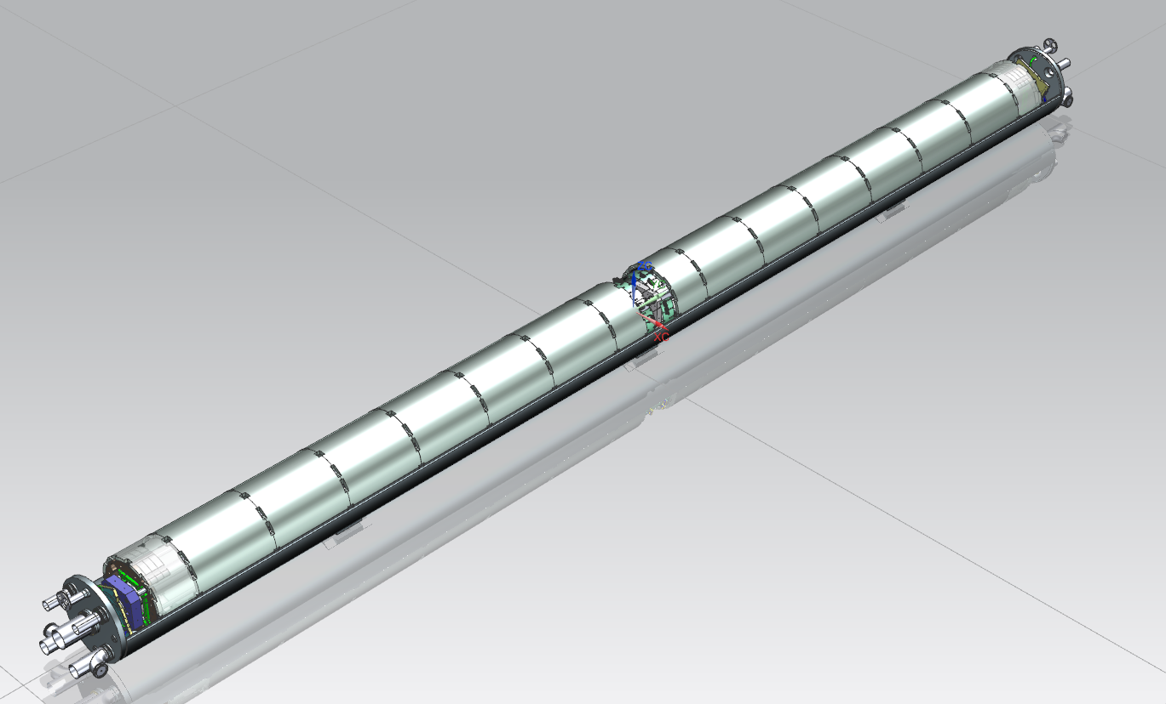
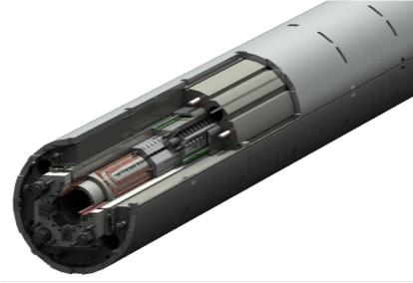
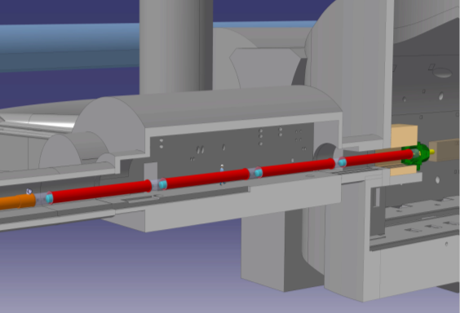
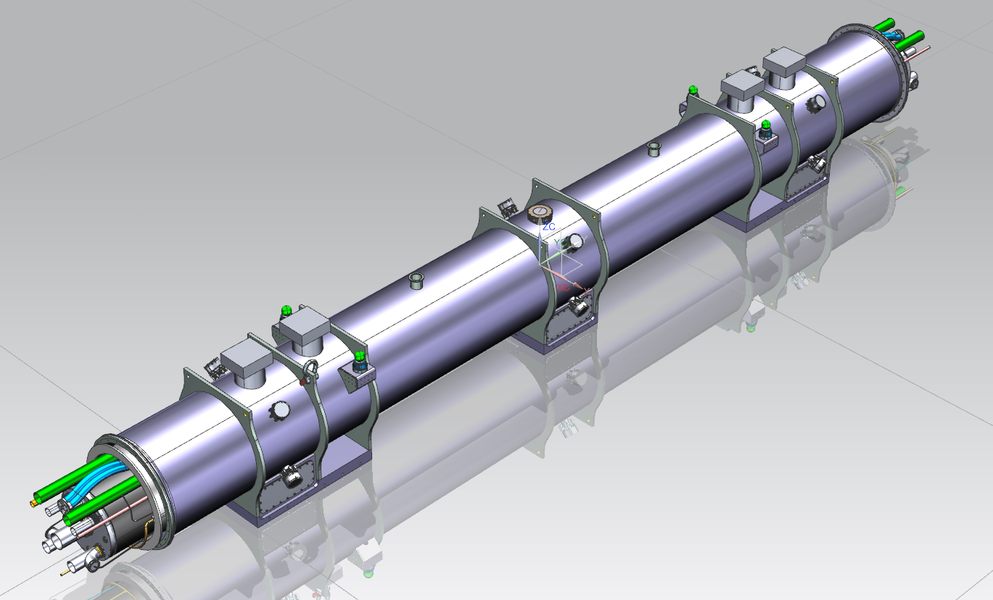
US Deliverables: Q1/Q3 Cryo-assemblies
Two MQXFA units of 4.2 m magnetic length are assembled in a single cold mass
8 cryo-assemblies are required for installation in the tunnel
AUP scope includes 1 pre-series, 9 series production (1 spare)
Magnet
(MQXFA)
Cold Mass
(LMQXFA)
Q2a/b
Q1
Q3
Cryo-assembly
(LQXFA/B)
21

Slide 22
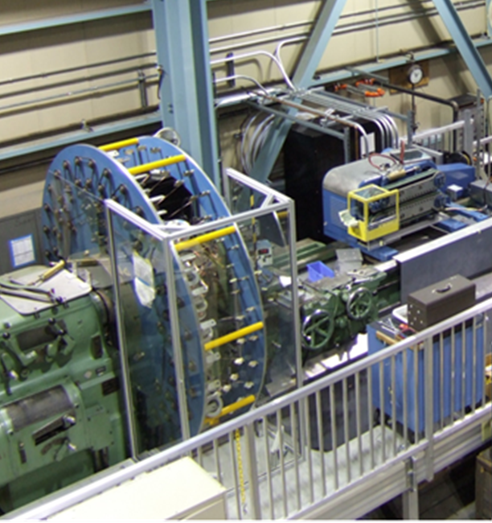
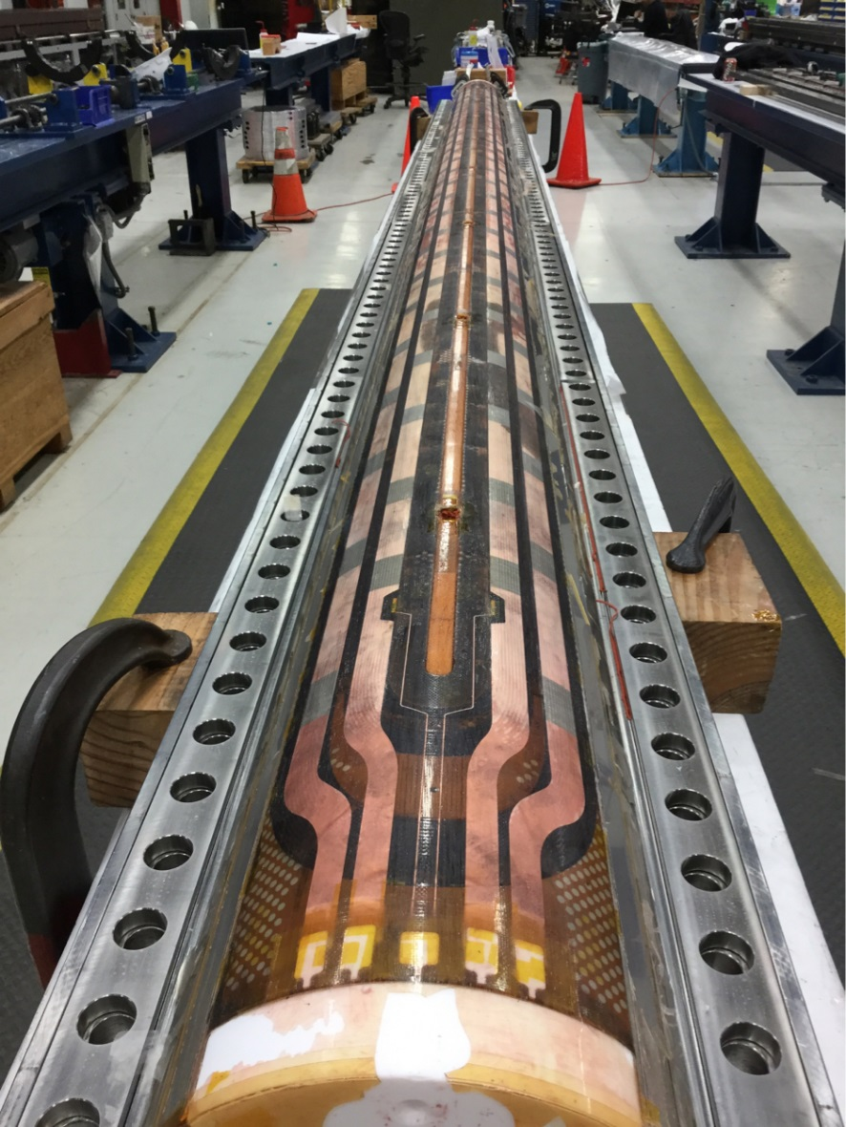
AUP Progress toward Production
Cables (LBNL):
  Fabricated: 26 (12 by LARP, 14 by AUP)
  Accepted: 25
  Quarantined: 1 (cross-over close to minimum length)
Coils (FNAL):
  Fabricated: 10 (completed) + 3 (under fabrication)
  Accepted: 6
  Rejected: 1 (damage during curing)
  Quarantined: 3 (electrical weakness to coil parts)
Coils (BNL):
  Completed commissioning of new winding & curing equipment for MQXFA coils
  Completed winding and curing of 1st production coil
Structures (LBNL):
  Assembled MQXFAP1 and MQXFAP2
  Procurement of MQXFAP3 parts in progress.
Vertical Test (BNL)
  MQXFAP1 test completed and MQXFAP2 in progress
Cabling machine (LBNL)
Coil 107 (FNAL)

Slide 23
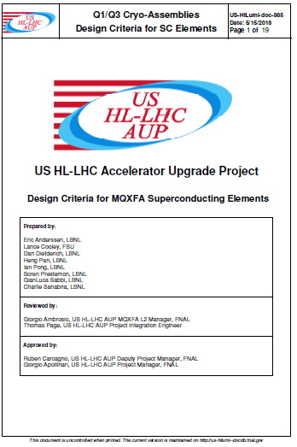
AUP Project Documentation
Future projects will benefit from AUP documentation of design and fabrication procedures
Summary table - coil | Symbol | Unit | Value
Coil expansion after reaction (width) |  | % | 1.2
Coil expansion after reaction (thickness) |  | % | 4.5
Coil expansion after reaction (length) |  | % | ‑0.4 to ‑0.2
Maximum acceptable localized tension at the coil‑pole interface |  | MPa | <20
Coil azimuthal stress at assembly | σ_{θ} | MPa | <120
Coil azimuthal stress at cool‑down | σ_{θ} | MPa | <200
Coil azimuthal stress at powering | σ_{θ} | MPa | <200
Coil longitudinal strain | ε_{z} | % | <0.2
Maximum acceptable Hot spot temperature | T_{hs} | K | <350

Slide 24
Summary
The EIC physics goals place demanding requirements on the Interaction Region layout and magnets
Different approaches and technologies should be explored to meet these challenges
Solutions based on high field and large aperture quadrupoles can leverage the large investment made for HL-LHC
  Fundamental R&D by LARP
  Hardware (especially coils) in the aperture range of (90) 120-150 mm
  Production and project experience and documentation from LHC-AUP
EIC IR studies and optimization can take advantage of HL-LHC design, performance, field quality and cost data
EIC development should focus on mechanical structures and integration to meet the specific IR requirements and constraints
  Consistent with HL-LHC R&D and production experience

