Slide 1
High current polarized electron sources
Luca Cultrera

Slide 2
Outline
Spin polarized photocathode requirements
  eRHIC and Linac Ring option;
Non-Exaustive state-of-the-art of GaAs-based photocathodes;
Photocathode R&D at Cornell University
Cs₂Te activated GaAs;
New venues for improving polarized sources;

Slide 3
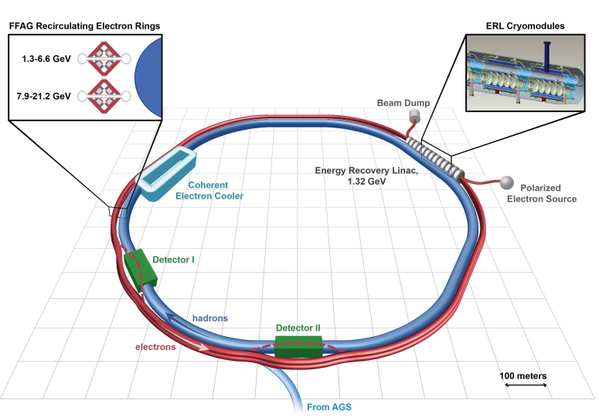
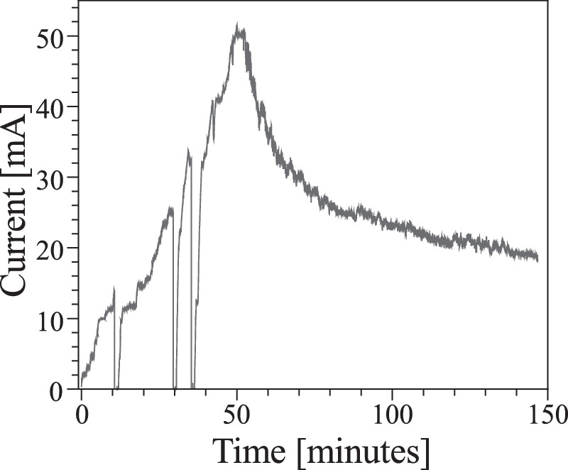
eRHIC and the linac ring option
The linac-ring option needed polarized electron beam with average currents up to 50 mA.
GaAs @ 532 nm (~5 Watts)
200 Coulomb
QE ~ 2%
QE ~ 10%
B. Dunham et al, Appl. Phys. Lett. 102, 034105 (2013)
Electron sources was based on III-V semiconductors photocathodes materials that cannot sustain that average current for longer than few minutes.
Limited effort to address the actual challenge of improving the polarized photocathodes using new classes of materials and/or activation strategies

Slide 4
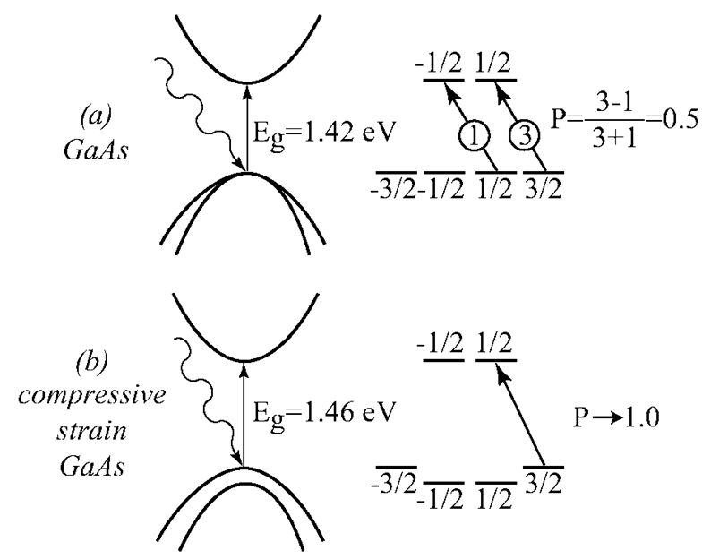
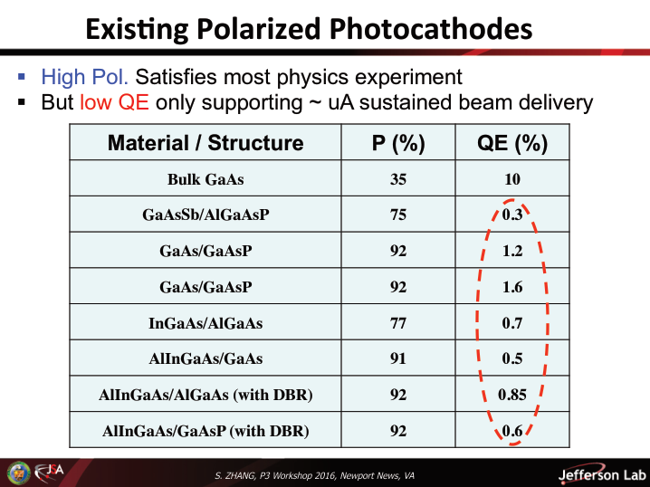
Existing photocathodes
At 1.6% QE the required laser power “on the cathode” @800 nm to generate 50 mA is about 5 Watts
All these photocathodes requires Cs-O activation to achieve Negative Electron Affinity (NEA) and vacuum levels better than 10⁻¹¹ Torr to survive a few days (without even running the beam)

Slide 5
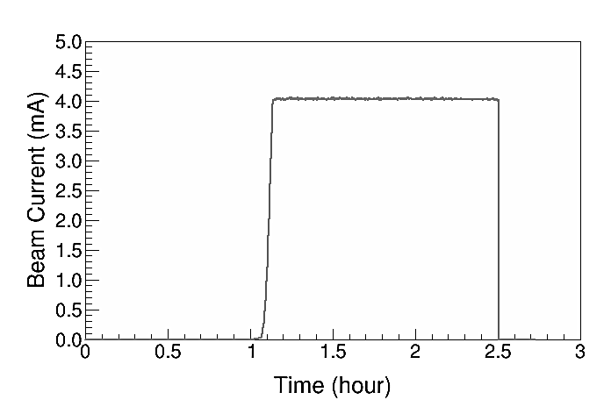
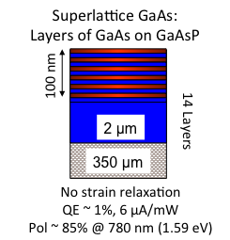
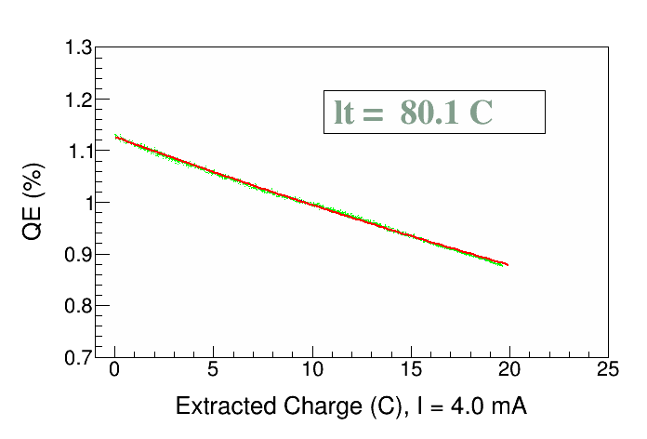
State-of-the-art of polarized electron sources
Superlattices are the best choice
Parameter | Value | Value
Laser Rep Rate | 499 MHz | 1500 MHz
Laser Pulse Length | 30 ps | 50 ps
Laser Wavelength | 780 nm | 780 nm
Laser Spot Size | 0.45 mm | 0.35 mm
Photocathode | GaAs/GaAsP | GaAs/GaAsP
Gun Voltage | 100 kV | 200 kV
Beam Current | 1 mA | 4 mA
Run Duration | 8.25 hr | 1.4 hr
Extracted Charge | 30.3 C | 20 C
Charge Lifetime | 210 C | 80 C
Fluence Lifetime | 132 kC/cm² | 83 kC/cm²
Bunch Charge | 2.0 pC | 2.7 pC
Peak Current | 67 mA | 53 mA
Peak Current Density | 42 A/cm² | 55 A/cm²
QE(q) = QE₀ e^{–(q / 80)}
Up to 4 mA of polarized e-beam
Lifetime limited to few hours
J. Grames et al., PAC07, THPMS064
R. Suleiman et al., PAC11, WEODS3

Slide 6
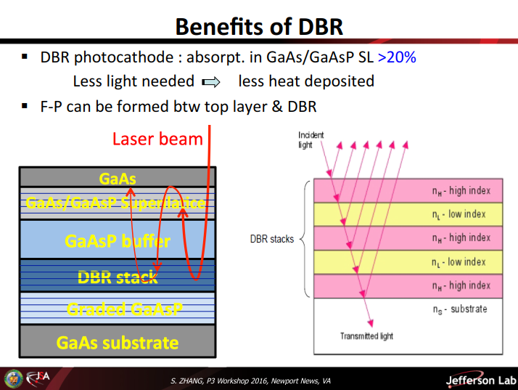
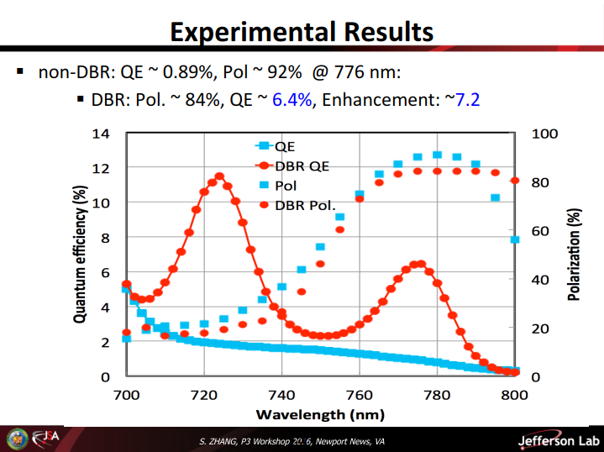
Distributed Bragg Reflector
Total laser absorption in the SL layer is usually <5%
A DBR can be used to reflect the unused laser beam back to the SL
QE is now a factor 6 larger
Potential for higher currents
Less laser power, less heat to dissipate
Quite complex structure

Slide 7
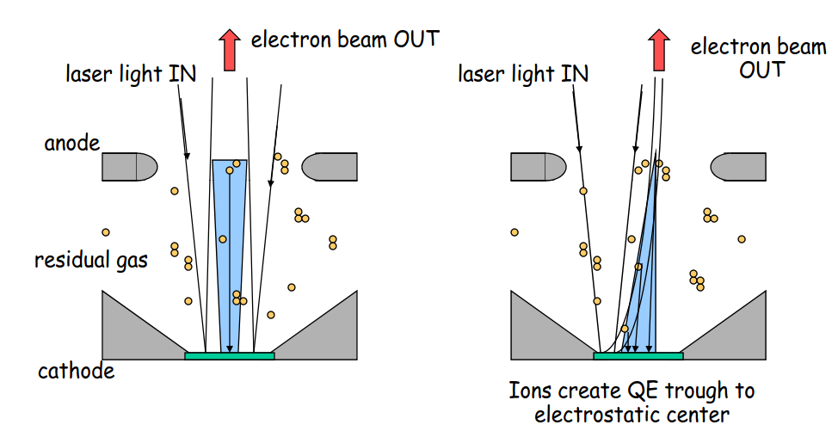
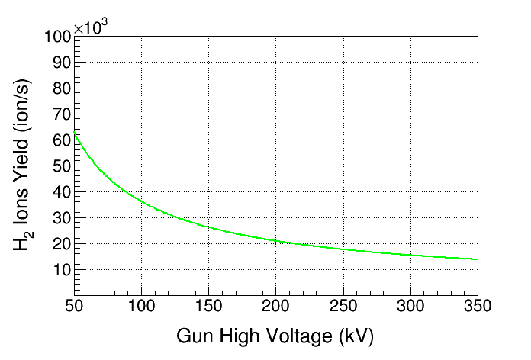
But QE alone is not sufficient
NEA is achieved and can be maintained only in extreme vacuum
  XHV require massive pumping to reach 10⁻¹² Torr;
Ions backstreaming is still limiting operating lifetime
  Clearing electrodes and or biased anode;
  Higher gun voltages;
At 350kV, only <50% of ions are created compared to 130kV
I=2.0 mA, P=8.0 × 10⁻¹² Torr
A single HV breakdown event inside the gun
Can get the vacuum high enough to instantly
“kill” the cathode
Courtesy of J. Grames

Slide 8
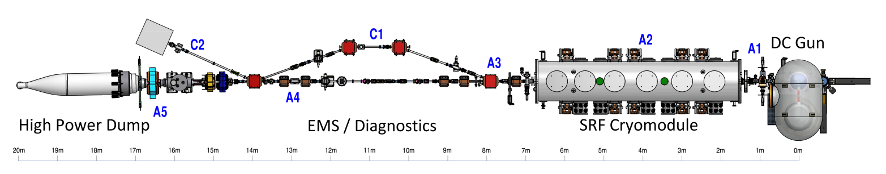
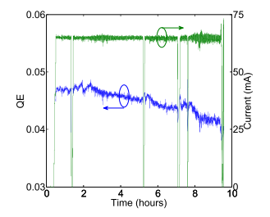
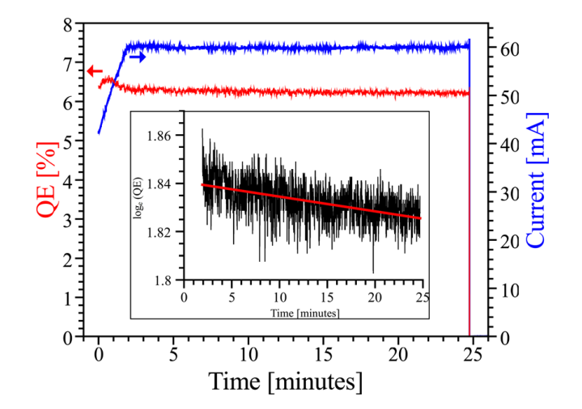
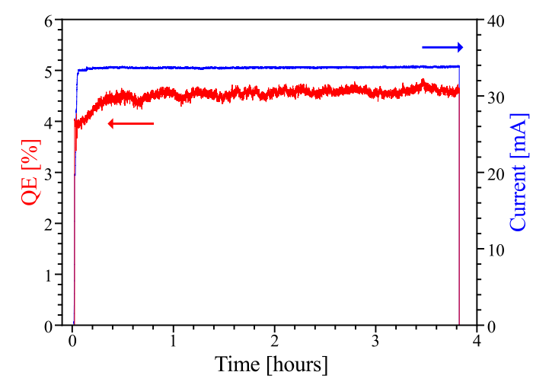
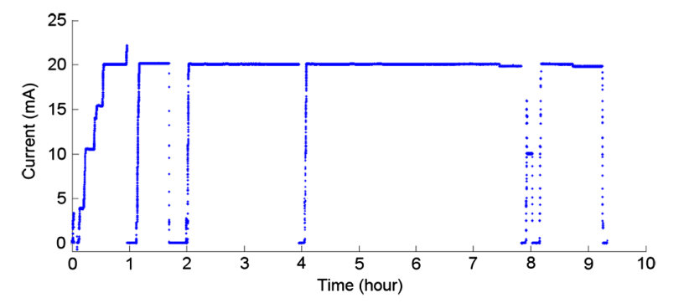
ERL R&D aimed at high average currents
The Cornell ERL injector prototype has demonstrated the highest levels of average current
Up 75 mA (held for a few minutes)
100
80
Na₂KSb
CsK₂Sb
60
40
20
Cs₃Sb
CsK₂Sb
But also GaAs, GaAsP, GaN…
L. Cultrera et al., Physical Review ST- Accelerators and Beams 14 (2011) 120101
B. Dunham, et al., Appl. Phys. Lett. 102 (2013) 034105
L. Cultrera et al, Appl. Phys. Lett. 103 (2013) 103504

Slide 9
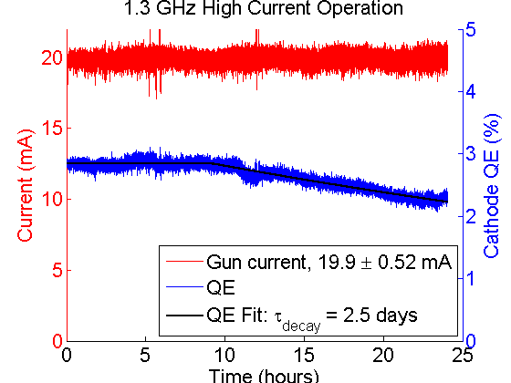
Na₂KSb: 24 hours long run…
> 2600 Coulombs
Time (hours)
These results were possible because we choose
investing in experimenting with cathode materials….

Slide 10
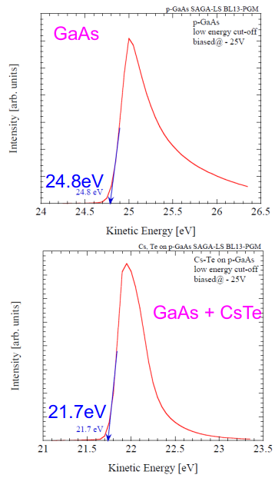
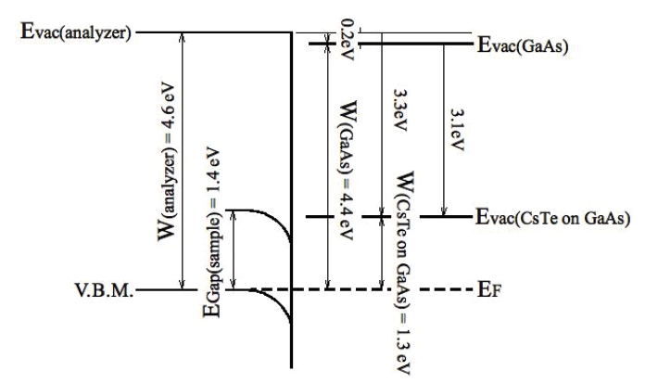
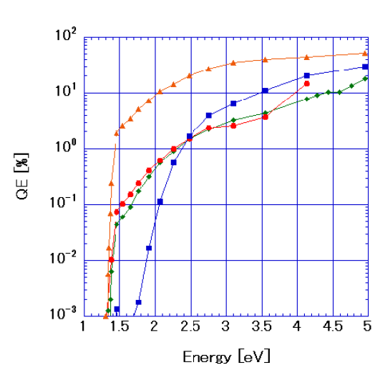
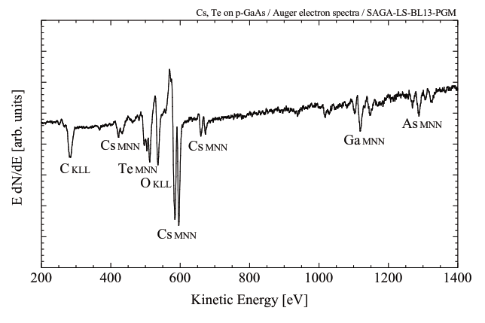
Alternatives to Cs-O for NEA
There are alternative ways for generating the NEA on GaAs that are less sensitive to vacuum conditions?
H. Sugiyama et al , J. Phys. Conf. Series 298 012014 (2011)
Δφ=(24.8-21.7)= 3.1eV
M. Kuriki, P3 workshop, LBNL, 2014

Slide 11
Cs₂Te over GaAs can yield NEA!!
Cs₂Te is used in many RF gun (FLASH, DESY, LBNL…)
Promises:
  Operating gun at higher voltages;
  Operation in RF (and SRF) guns;
  Long term cathodes storage;
  Cathodes transport in suitcases;
Will the Cs₂Te layer preserve the spin polarization during the electron transport?

Slide 12
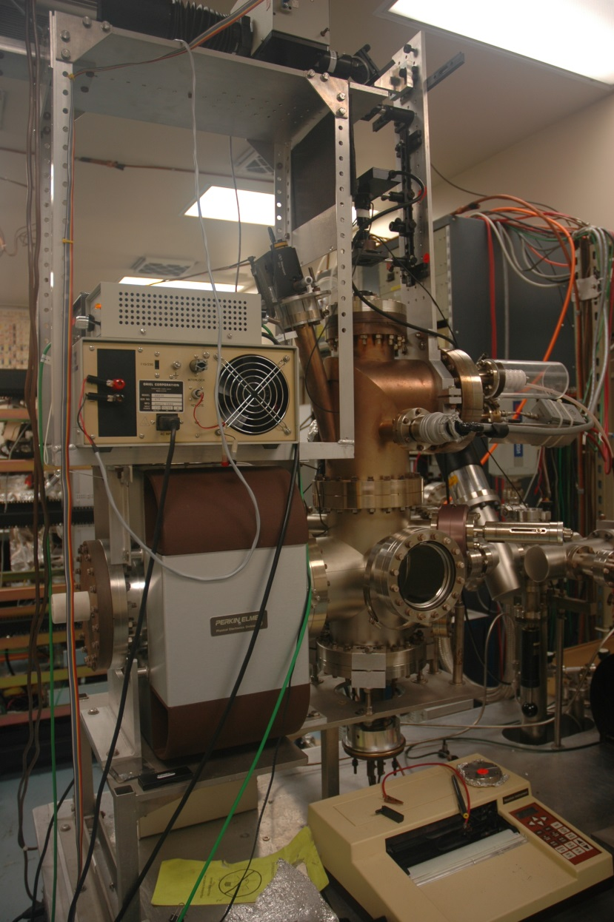
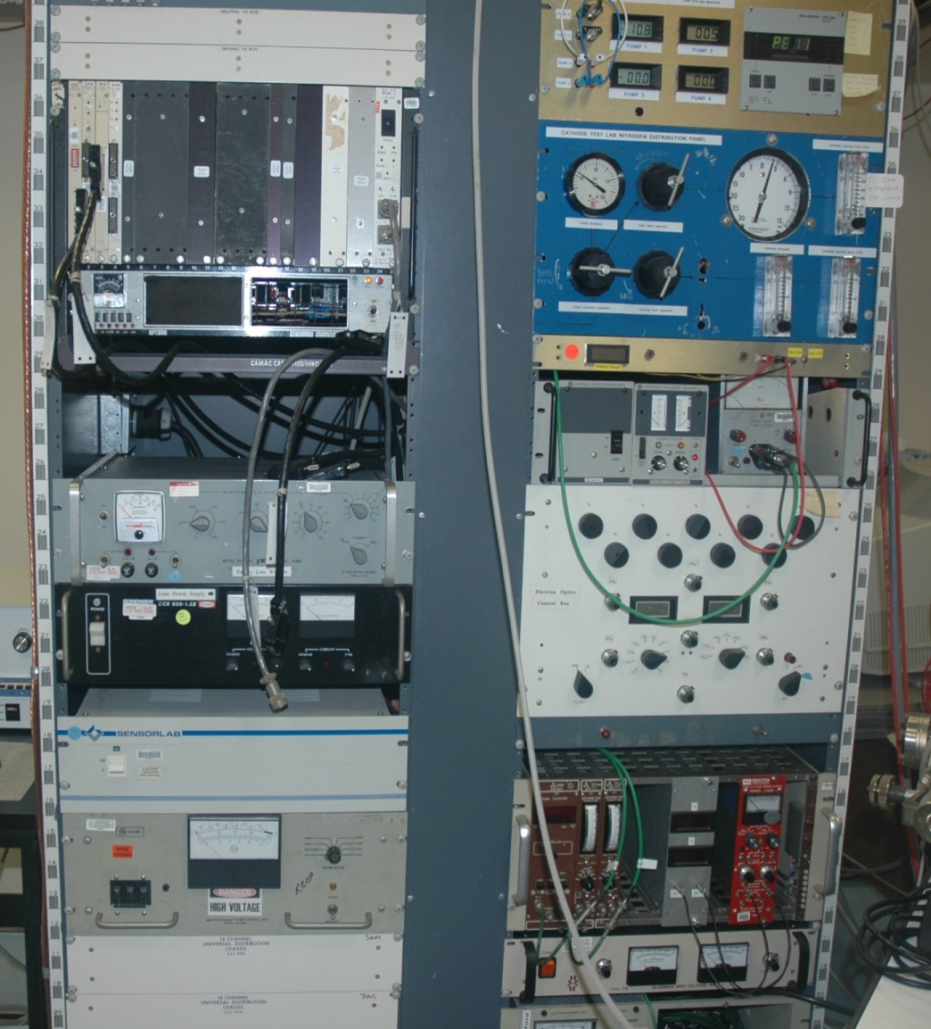
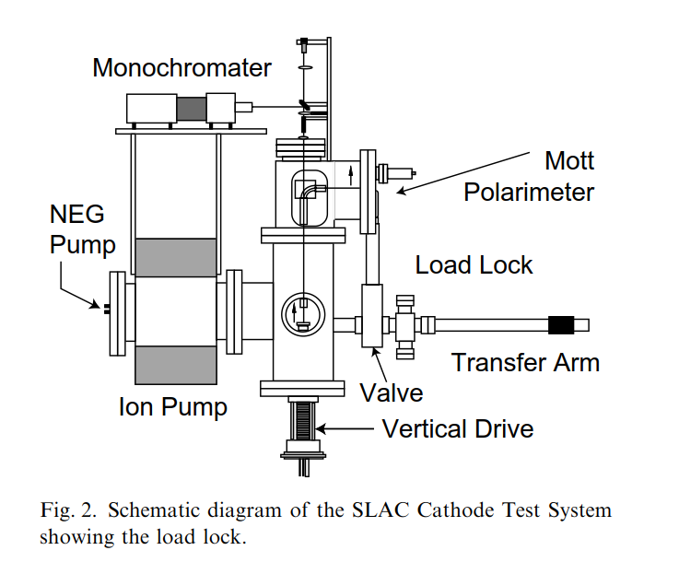
Mott polarimeter @SLAC
Mott target and detectors
Electrostatic lens
distributer
Electrostatic bend
Detector threshold HV
Electrostatic lens
Power supply
Cesiation Chamber
Channeltrons HV
and counters
SLAC => Jlab => Cornell University
In 1993!!

Slide 13
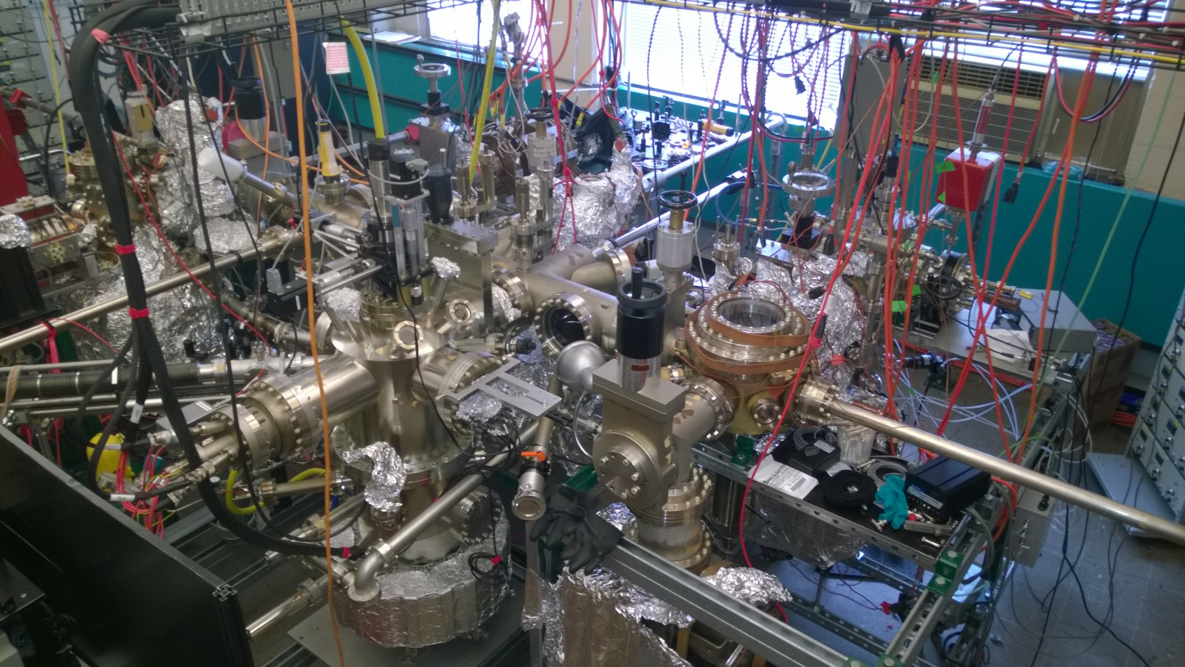
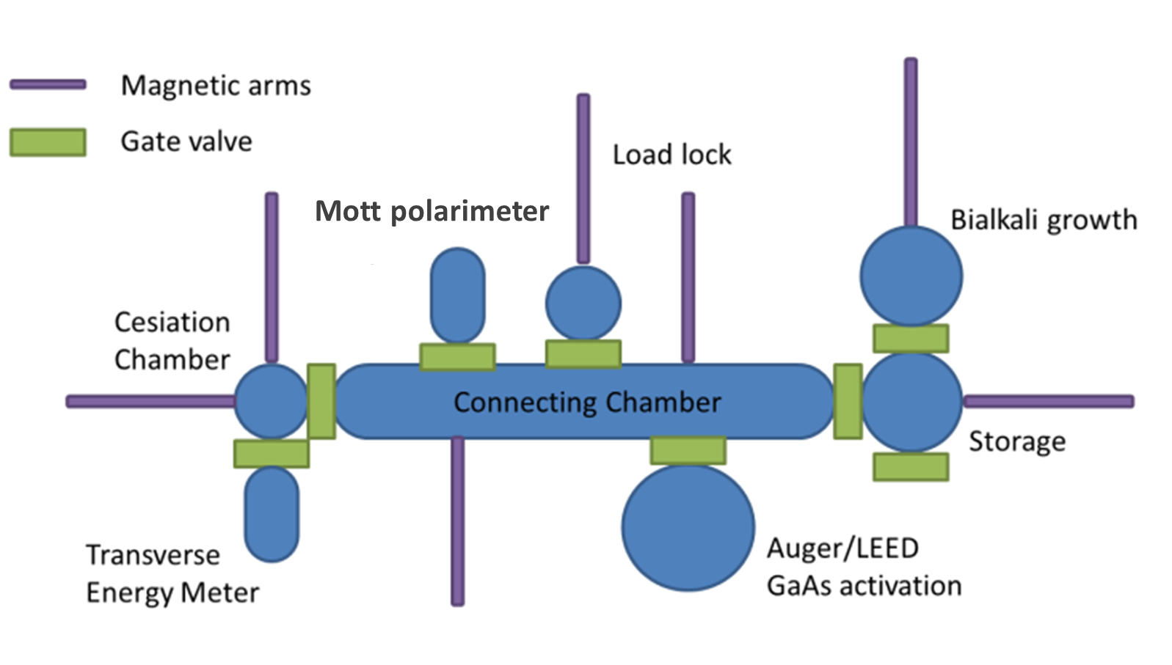
Photocathode Lab

Slide 14
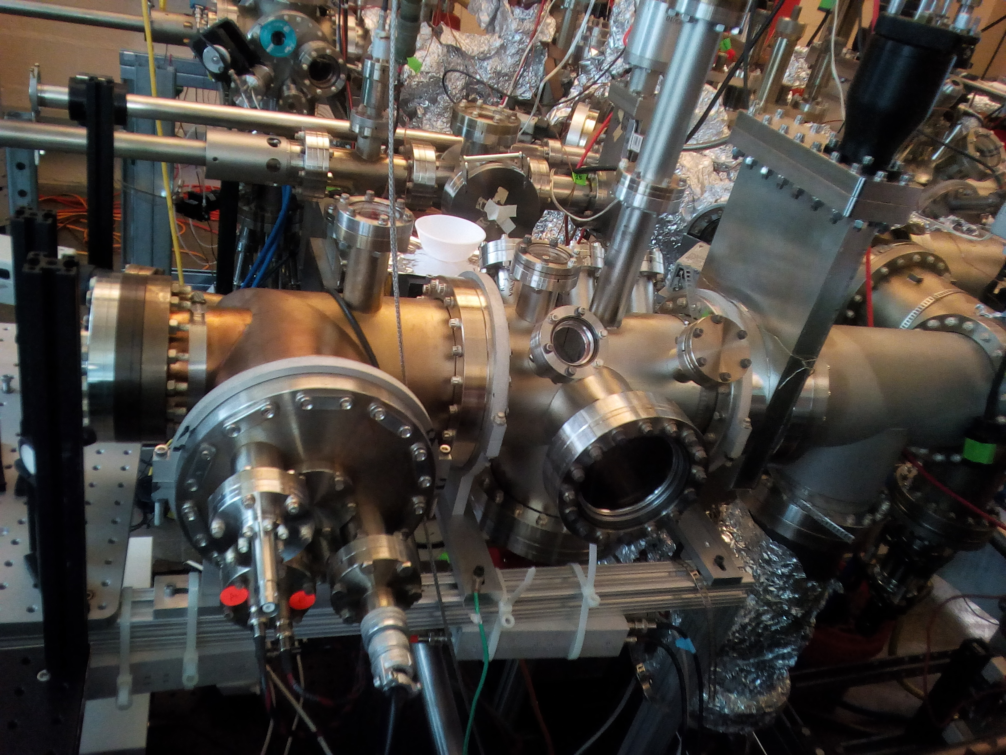
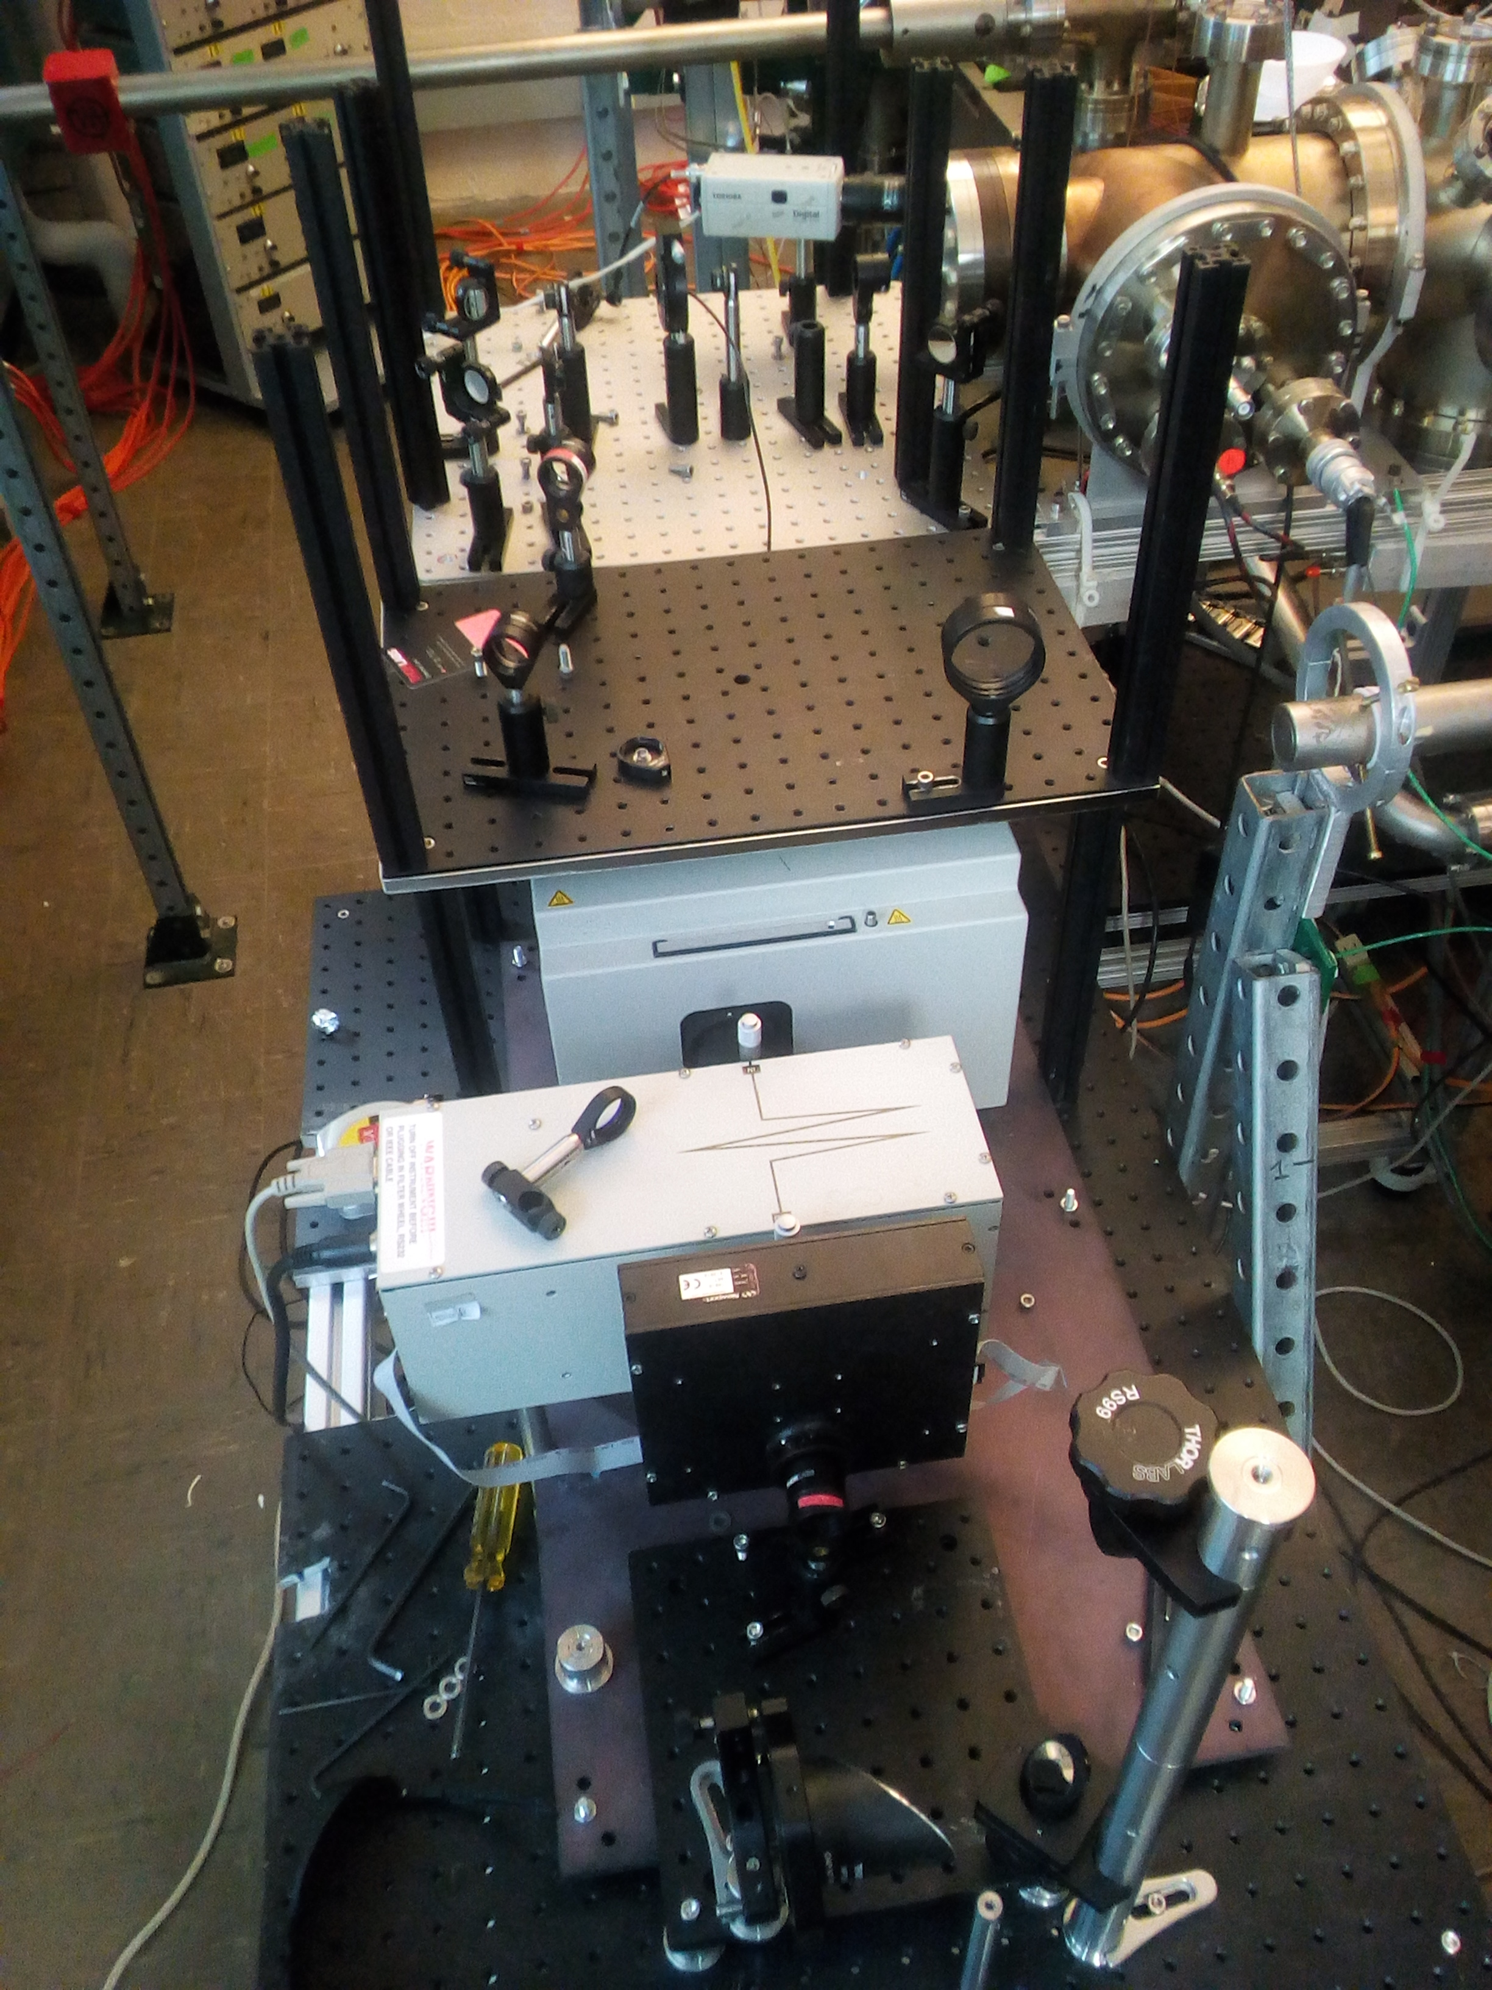
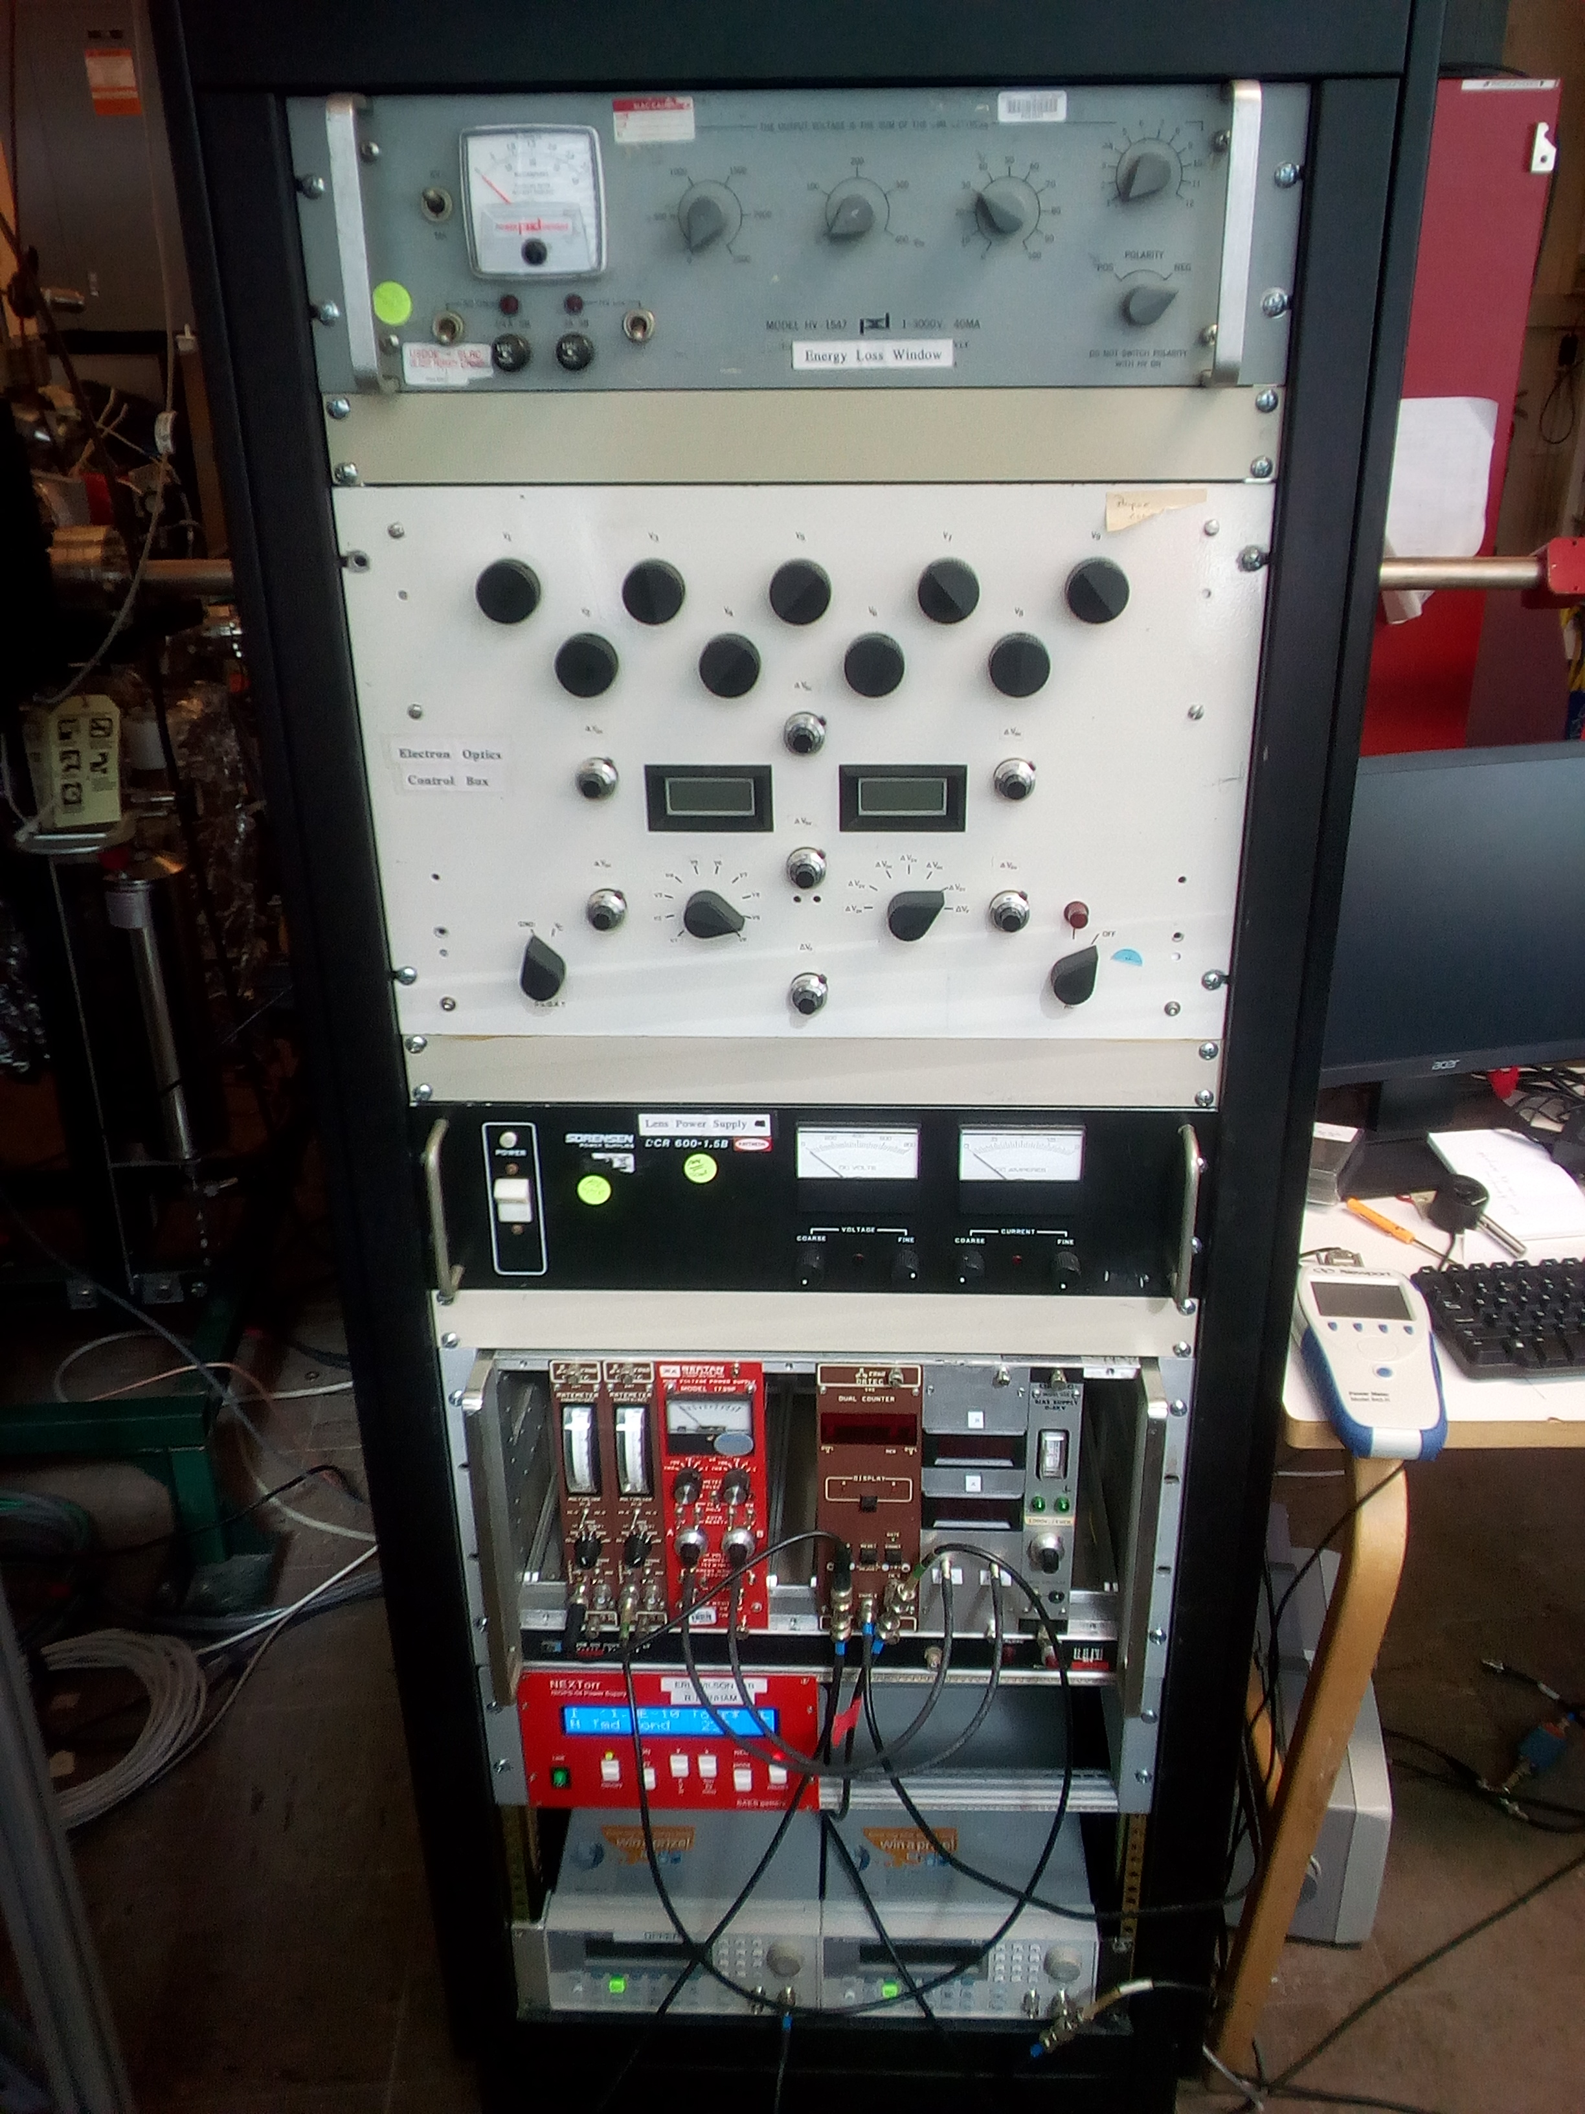
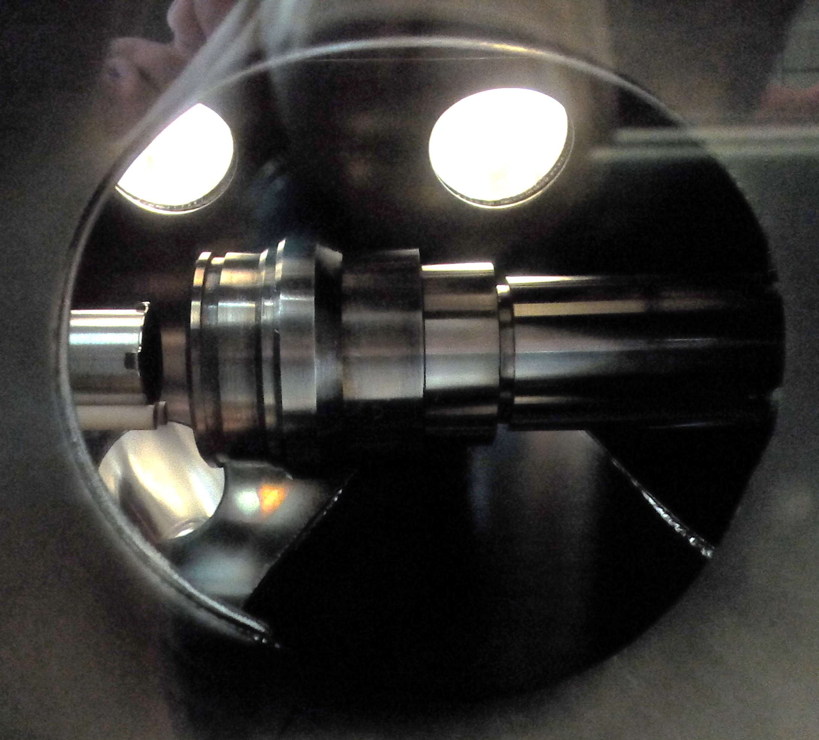
Mott polarimeter @ CU
Vacuum level is below 10⁻¹⁰ Torr
Electrostatic bend
Mott target and detectors
Bulk GaAs cathode
The retarding field Mott polarimeter has been refurbished upgraded and fully integrated into the photocathode lab UHV installation.
Thanks to M. Poelker and M. Stuzman for helping in debugging and setting up the polarimeter

Slide 15
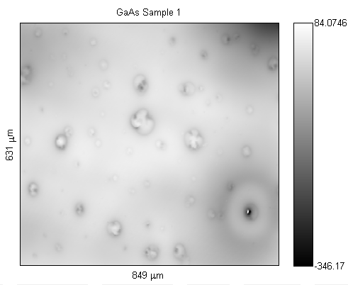
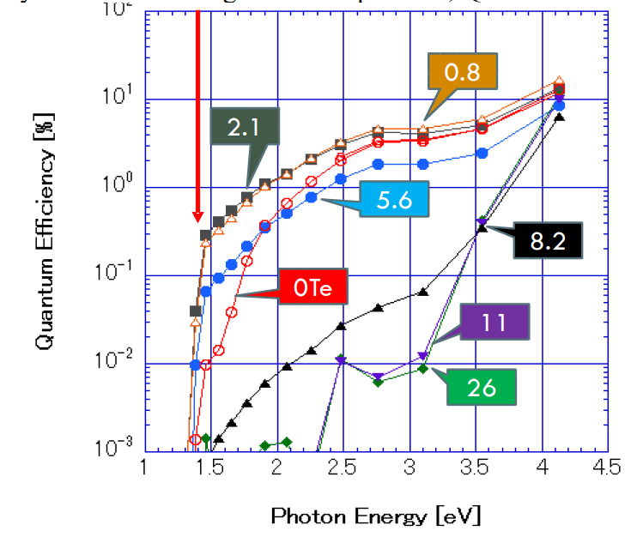
Cs₂Te on GaAs
GaAs substrate samples p-type Zn doped 1e18 cm-3
Wet etch to remove oxide and passivate surface
-H₂SO₄:H₂O₂:H₂O (20:1:1) 2 min @ RT
-HCl:iPA (20:80) 3 min @ RT
Rough surface
Many pits
Heat cleaning at 400 C overnight
Room Temperature Cs activation yields ~3% QE @ 532nm
Surface is clean enough to perform NEA activation!!
We also used H₃PO₄ and HF to remove the oxides with HF giving the best results in terms of QE

Slide 16
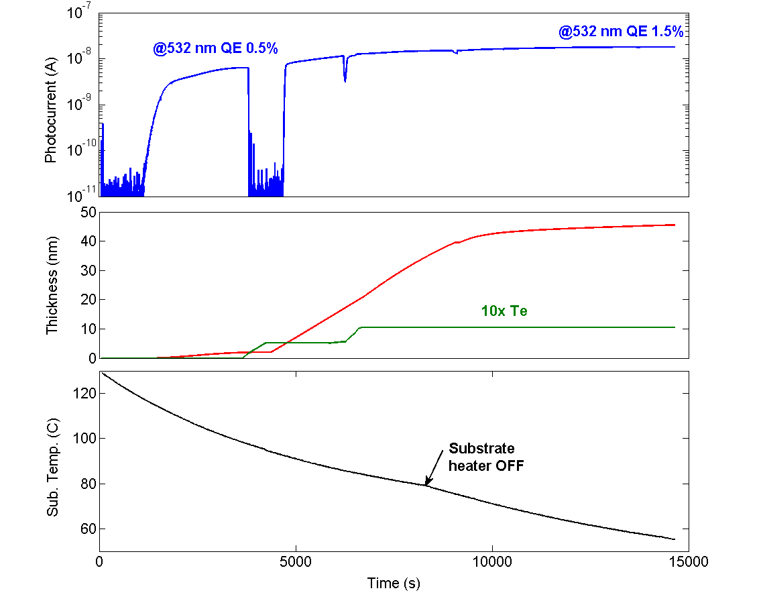
Growth Cs₂Te on GaAs
Cs+Te
Cs
Te
Cs
Cs
~1 nm of Te => ~2 nm Cs₂Te

Slide 17
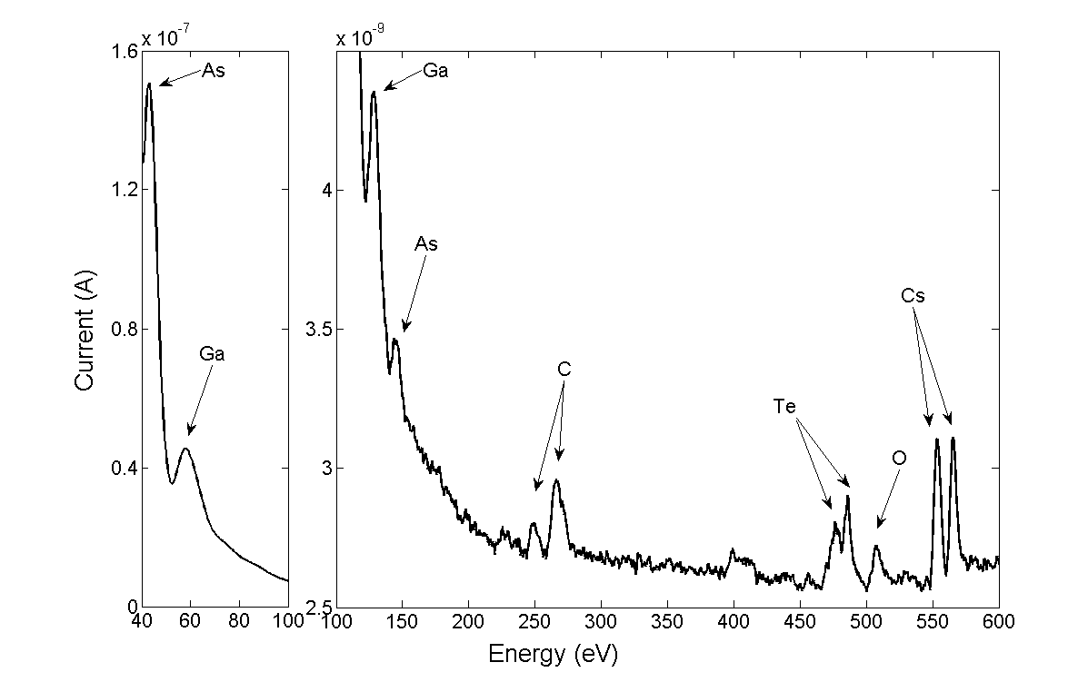
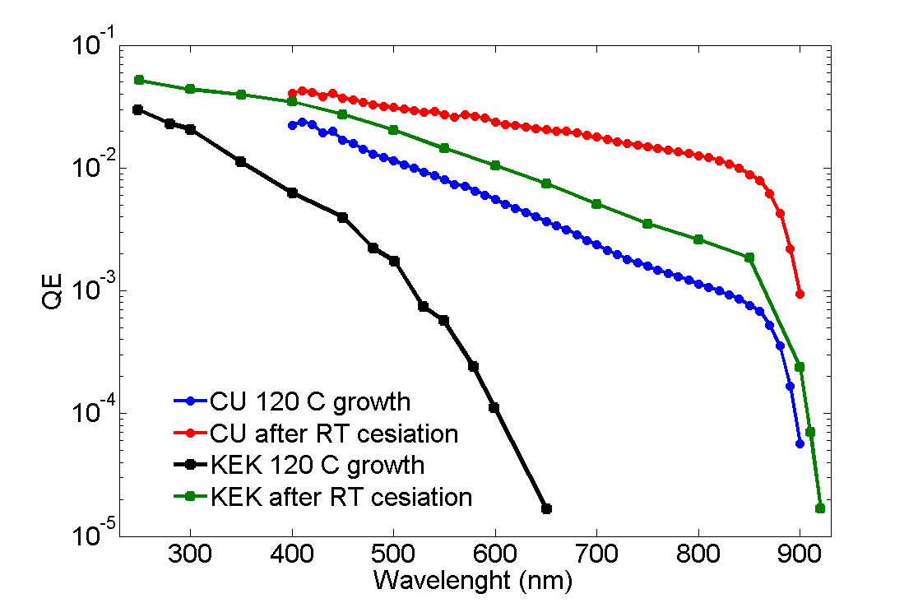
Cs₂Te on GaAs
Auger spectroscopy confirms the presence of Cs and Te over the GaAs surface
Ga ans As peaks are still visible meaning that the CsTe layer is thinner than few nm
C and O peaks likely coming from the e-gun
We do NOT see an emission threshold shift
Partial coverage of the surface?

Slide 18
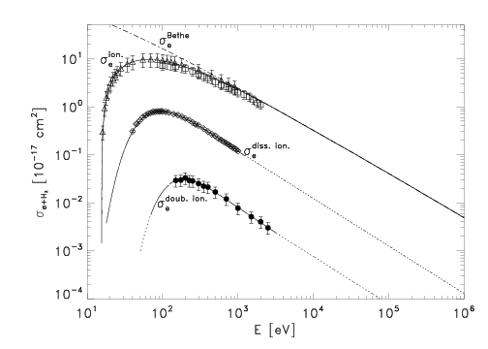
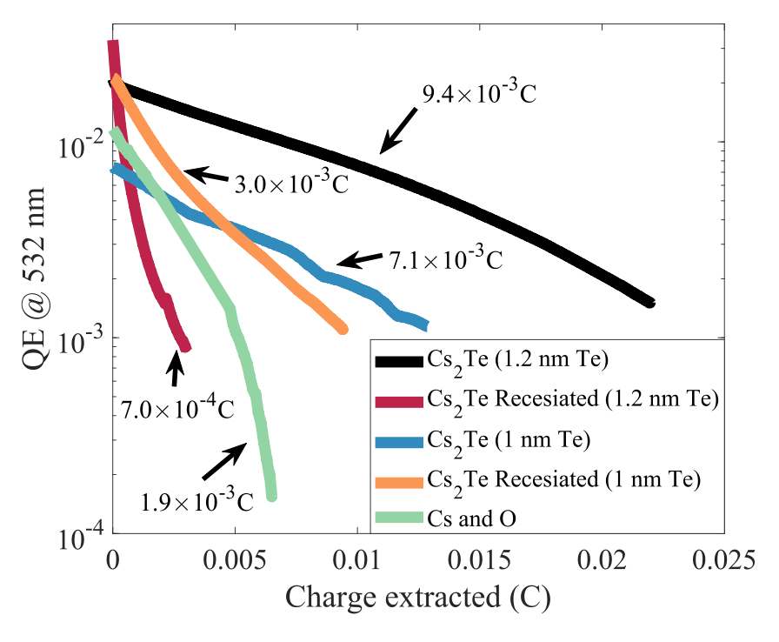
Cs₂Te on GaAs
Beam energy in our setup is about 40 eV
@532 nm
5X LIFETIME!
Beam energy in PES gun
About 3 order of magnitude larger probability to ionize hydrogen than in a real gun
Due to low energy electron the ion back bombardment damage is likely to affect the very surface of our samples.
Why the re-cesiated samples have a lower lifetime than the as-grown samples?
Could it be because the Cs stays only at the surface?

Slide 19
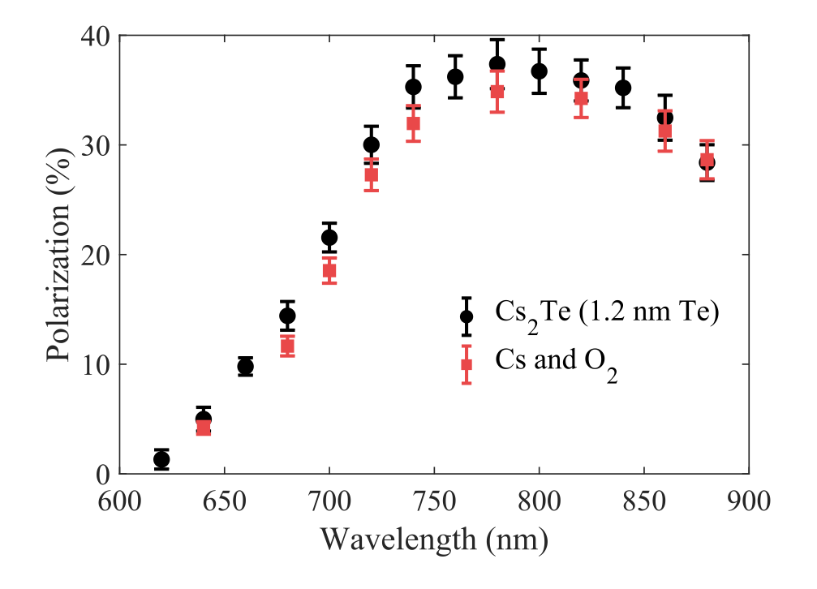
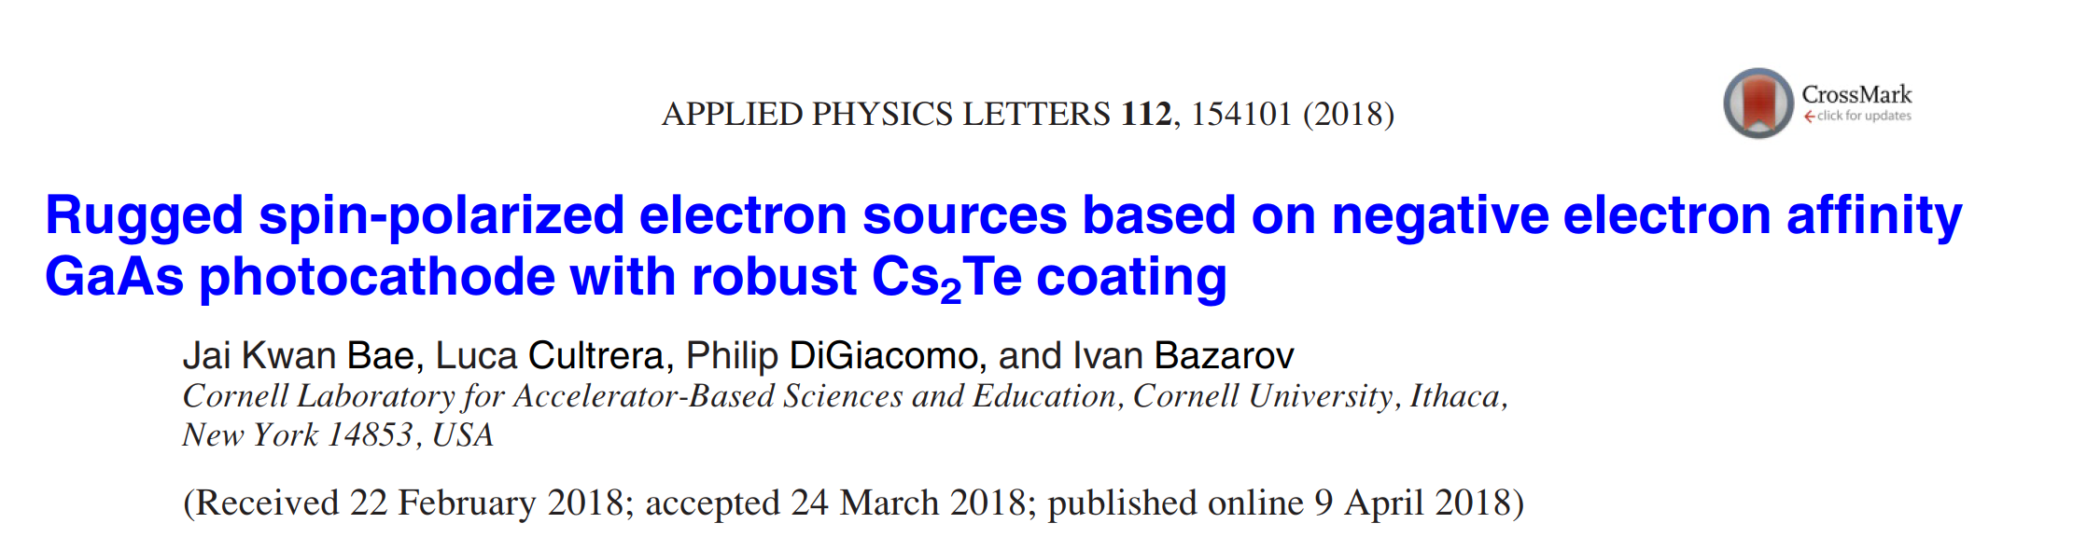
Electron beam polarization
The same GaAs wafer was activated first with Cs-O and later with Cs₂Te
Spin polarization is not affected by the Cs₂Te surface layer

Slide 20
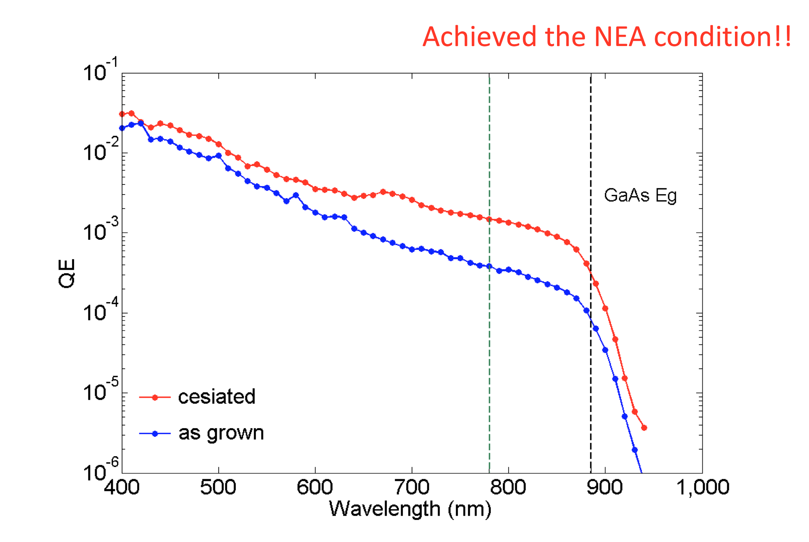
3 weeks ago…
We attempted achieving NEA with a new material
(considering patenting the method)
QEs are not that exciting
(we believed the wet etch with H₃PO₄ was not effective)
but anyway this new coating shows 30x lifetime w.r.t. Cs-O

Slide 21
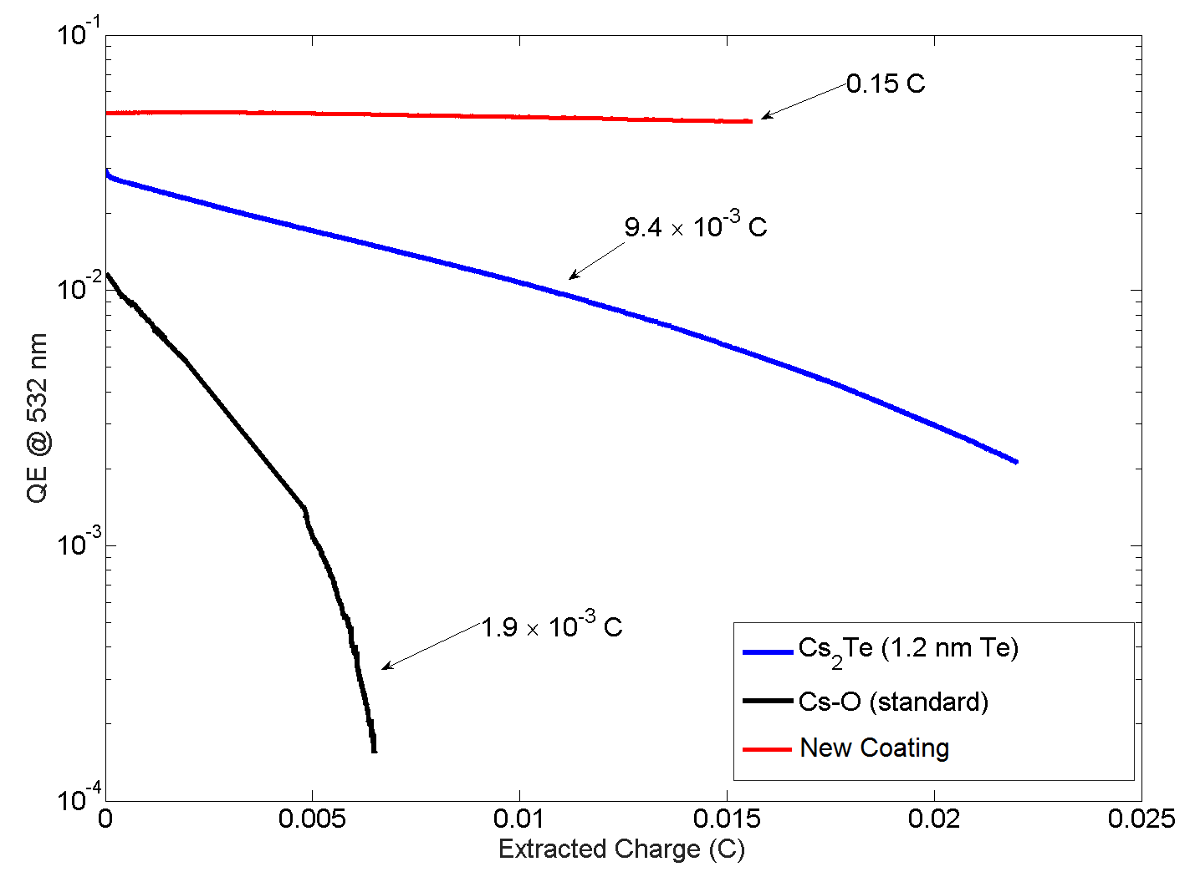
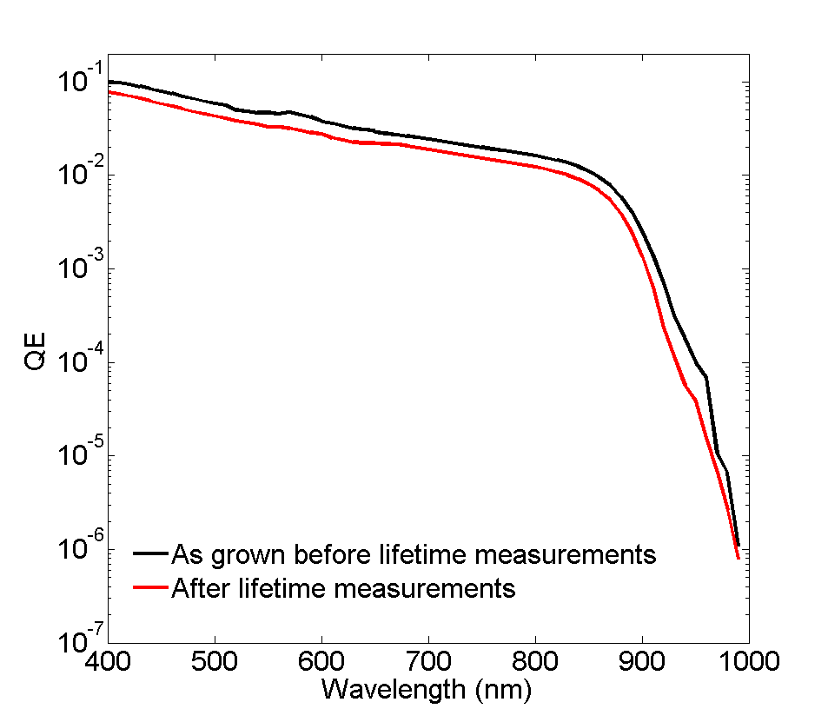
Last week results
5% @ 532nm
0.15 C
We used HF based wet etching
and 600 C heat clean cycle to fully remove oxides from GaAs surface
~20 nm thin coating
0.0093 C
0.0019 C
2% @ 780nm
LIFETIME UNDER SIMILAR CONDITION IS MEASURED TO BE ABOUT 80x LONGER
Polarization will be measured soon
(but, as for Cs₂Te, we do not anticipate issues)

Slide 22
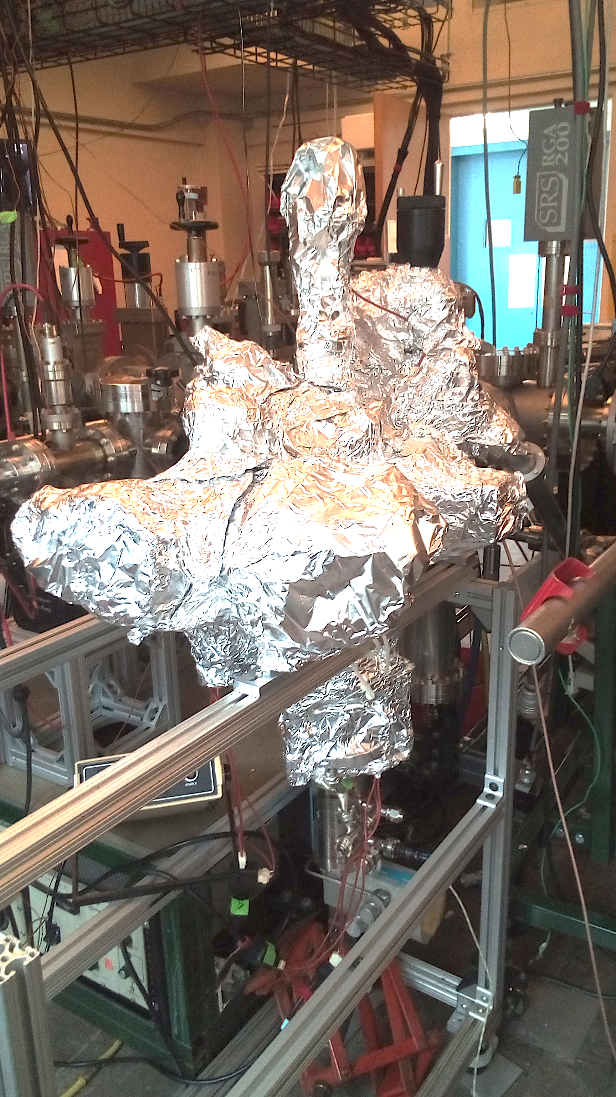
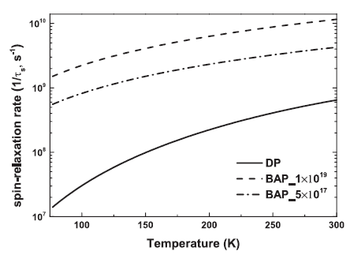
Polarization in few days
The polarimeter is currently being baked
Upgraded with a cryogenic sample holder
W. Liu et al., APPLIED PHYSICS LETTERS 109, 252104 (2016)
Improve the beam spin polarization by mitigating the relaxation rates as function of temperature

Slide 23
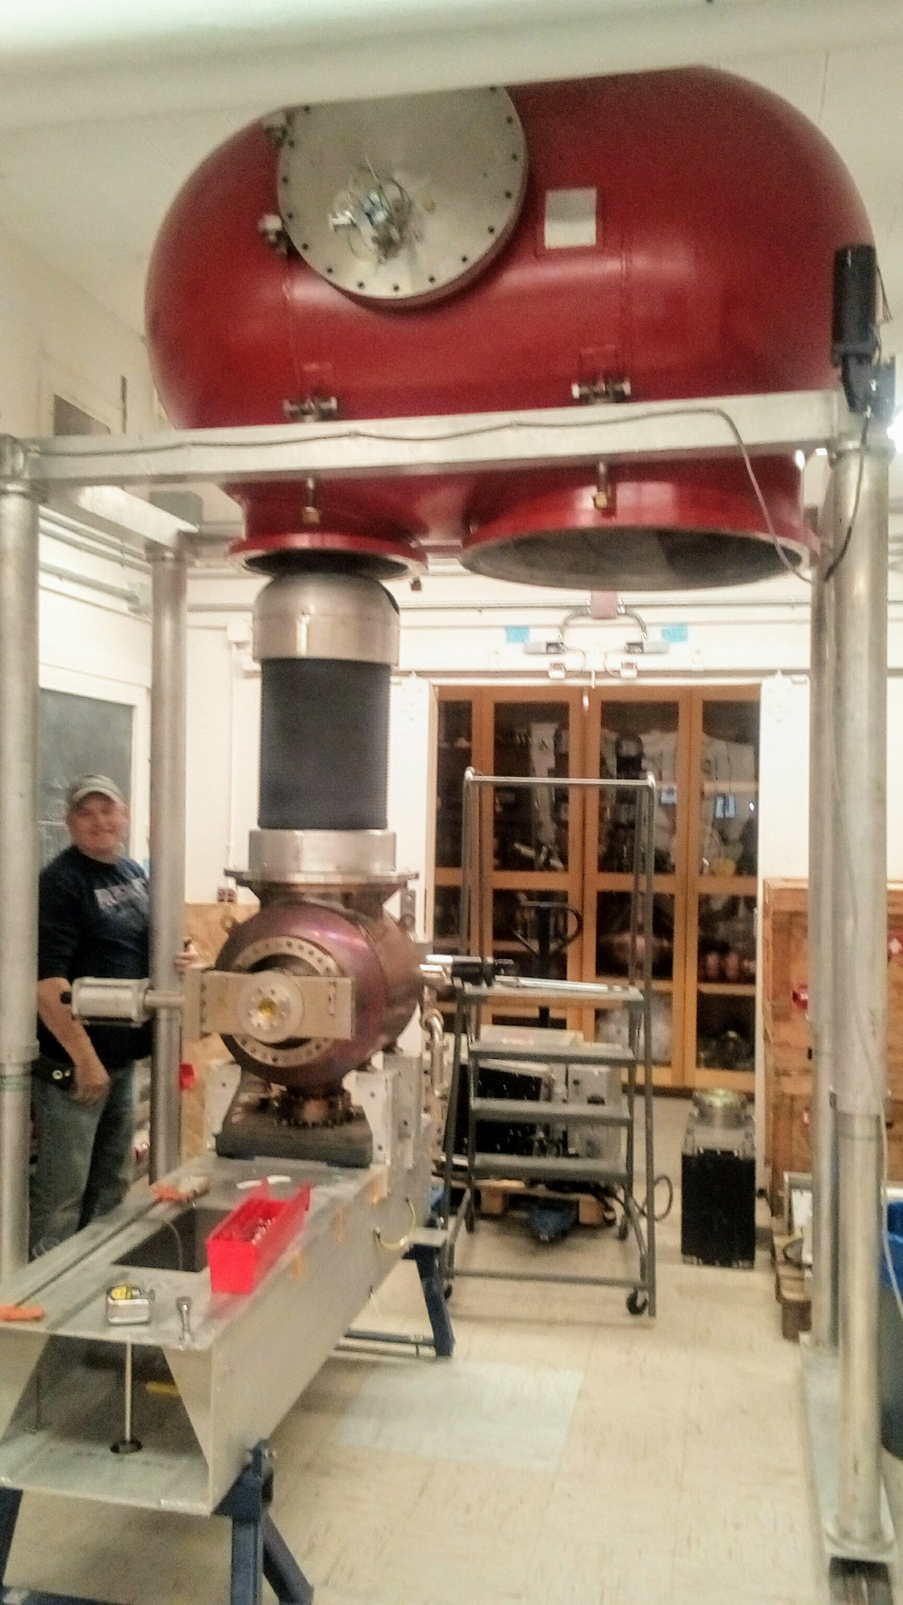
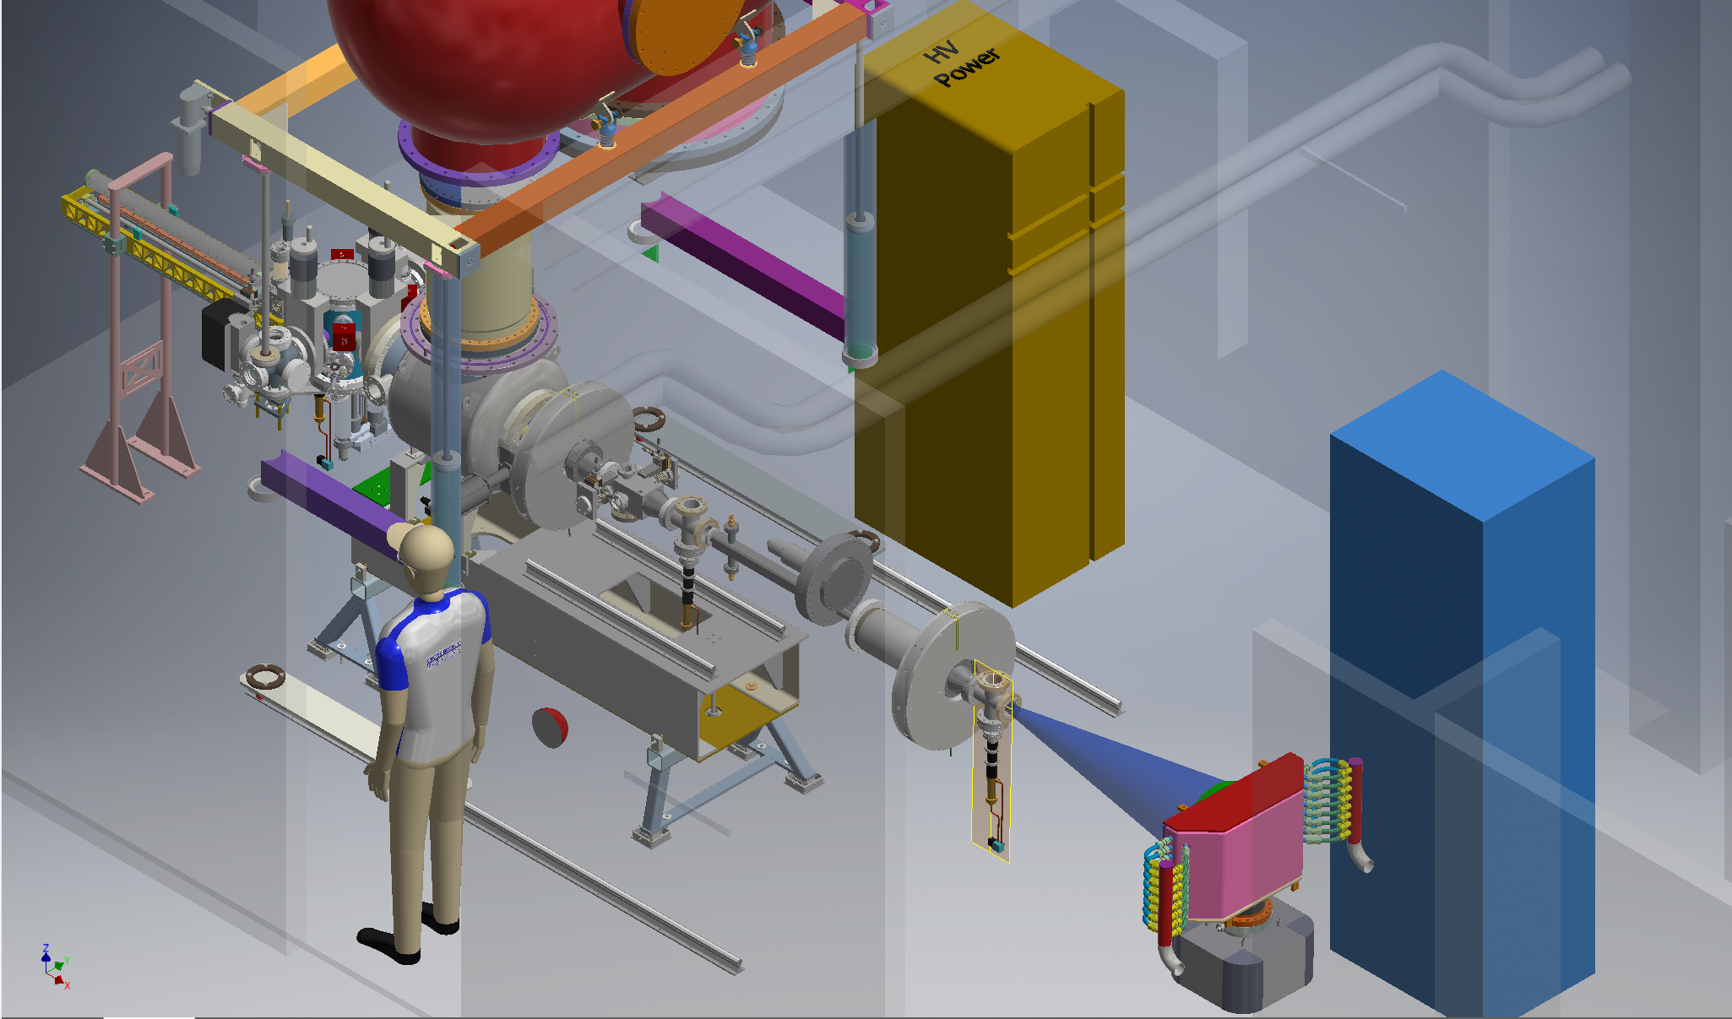
In the near future
We plan to perform test in our 400 kV gun in 2019
Aiming at demonstrating high average current levels and measuring lifetime

Slide 24
Conclusions
Robust PES capable of high currents:
  most relevant for LR-eRHIC;
  Longer operational lifetime;
  Other application (…polarized positrons);
PES still based on III-Vs semiconductor:
  Robust NEA activation can yield almost two orders of magnitude longer lifetime;
  Polarization measurement in few days;
  Lifetime measurement in the gun in few months;

Slide 25
Thank you for the attention!!
Acknowledgements to:
NP-DOE (DE-SC0016203 and DE-SC0019122)
NSF (PHY-1461111)
and collaborators:
Ivan Bazarov (PI),
Jai Kwan Bae (graduate student),
And the photocathode development group at CLASSE

Slide 26
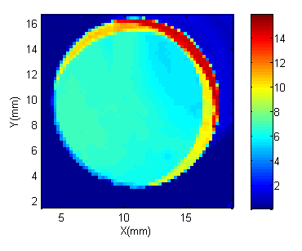
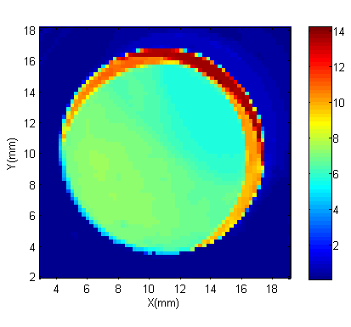
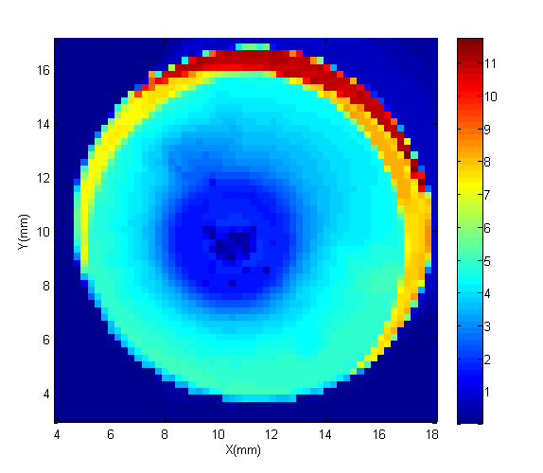
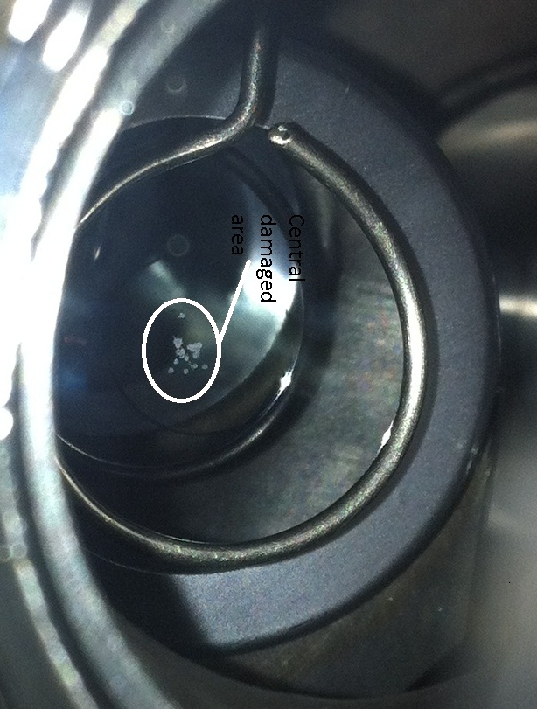


Alkali antimonides ion back bombardment
Central damaged area
Fresh cathode
~10 mA
2 hours
No RF trips
~20 mA
2 hours
many RF trips
Stay away from the electrostatic center!

Slide 27







Nitrides
453 nm
785 nm
Electron beam polarization is only 0.13%
Expected result because the GaN had hcp rather than cubic structure
Band bending
simulation
results
Air stable NEA without Cs !!

Slide 28

Alternative approaches
Are III-Vs our only option to generate intense spin polarized photo-currents?
Half-metal can be resourceful!
Electronic band structure depends on spin polarization
Polarization up to 100% are possible
Within the conduction band
Let see a few examples….

Slide 29



CrO₂
Kamper et al, PRL 59, 2788 (1987)
Mustonen et al, PRB 93, 014405(2016)
Ef
φ
Stable material
Lowest workfunction is 3.4eV
Require UV light
Up to 4.4 eV photon energy only one spin can be photoexcited => 100% polarization
Attema et al, PRB 77, 165109 (2008)

Slide 30





Spin filters
Spin dependent barrier below Tc
Jutong et al, PRB 86, 205310 (2012)
Cu
EuO
Cu

Slide 31

Can we make real electron beams?
Muller et al, PRL 29, 1651 (1972)
Field emission experiment W/EuS date back in 1972
Required operation at cryo-temperatures to get EuS<Tc
Polarization of 89±7 % was measured at 21K

