Slide 1
Why does the EIC require strong hadron cooling
F. Willeke
BNL
October 30, 2018

Slide 2
Outline
Luminosity and IBS
High Luminosity parameters for JLEIC and eRHIC
Methods of strong Hadron Cooling

Slide 3
Intra beam scattering limits luminosity lifetime (and luminosity)
Intrabeam scattering: Lorentz boosted multiple Coulomb scattering inside bunches
Growth rate depends on Nγ⁻¹/ (ε_{x}ε_{y}ε_{s})
(assuming adiabatic damping for hadrons)
Transverse growths depends on the square of the dispersion
Factor γ in Δp
longitudinal
transverse

Slide 4
EIC Luminosity and IBS
$L=\frac{f_{0}{n_{b}N}_{p}N_{e}}{4πσ_{x}σ_{y}}= \frac{I_{e}I_{p}}{4πe{f_{0}n}_{b}\sqrt{ε_{xp}β_{xp}}∙\sqrt{ε_{yp}β_{yp}}}$
$$σ_{x,y,p}=σ_{x,y,e}$$
Luminosity is also limited by strength of beam-beam interaction
Beam-beam Tunshift
$$ξ_{x,y,e,p}=\frac{r_{p,e}N_{p,e}β_{x,y,e,p}}{2πγ_{e,p}∙ε_{x,y,p,e}β_{x,y,p,e}∙\left(1+{σ_{y,x}}/{σ_{x,y}}\right)}$$
$$ef_{0}{n_{b}N}_{e,p}=I_{e,p,max}$$
IBS growth rate
$\frac{1}{τ_{ibs}}∝ \frac{N_{p}}{ε_{x}ε_{y}ε_{s}}$
Start: maximum, well optimized luminosity without cooling,
Then: increase luminosity
For example by
Increase n_{b}➔ N_{p} , ε_{x}, ε_{y} , scale down with n_{b} , ε_{s,} σ_{s} scale with 1/n_{b}, reduce β,
1/τ_{ibs} scales with n_{b} ➔ need cooling
Decrease β ➔need to decrease σ_{s} by incr U_{rf} ➔ σ_{e} larger + more nonlin ξ
⎝ need cooling

Slide 5
Emittance growth
Cooling will not only IBS, but also other sources of emittance growth
Intrabeam scattering
Noisy beam-beam offset and beam-beam interaction
Residual effects of crab crossing (effect of sinusoidal RF field)
Dipole noise and tune-shift with amplitude
Beam-Gas scattering
Nonlinear diffusion
Random bb offset 5% of sigma,
1.6 micron , 1σ particle, 10 sec storage time ~1% emittance growth

Slide 6
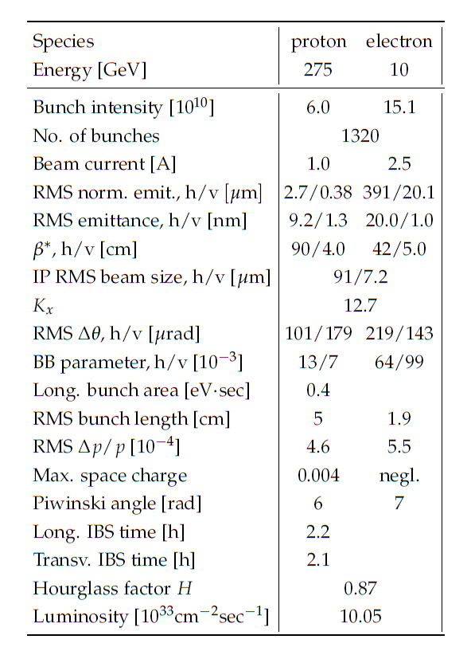
eRHIC High Luminosity Parameters
Strong cooling required
No cooling required

Slide 7
JLEIC e-p Parameters (pre-CDR, Yuhong Zhang)I
CM energy | GeV | 21.9 (low) |  | 44.7 (medium) |  | 63.3 (high)
 |  | p | e | p | e | p | e
Beam energy | GeV | 40 | 3 | 100 | 5 | 100 | 10
Collision frequency | MHz | 476 |  | 476 |  | 476
Particles per bunch | 10¹⁰ | 0.98 | 3.7 | 0.98 | 3.7 | 0.98 | 0.93
Beam current | A | 0.75 | 2.8 | 0.75 | 2.8 | 0.75 | 0.71
Polarization | % | 80 | 80 | 80 | 80 | 80 | 75
Bunch length, RMS | cm | 3 | 1 | 1 | 1 | 1 | 1
Norm. emitt., horiz./vert. | μm | 0.3/0.3 | 24/24 | 0.5/0.1 | 54/10.8 | 0.9/0.18 | 432/86.4
Horizontal & vertical β* | cm | 8/8 | 13.5/13.5 | 6/1.2 | 5.1/1 | 10.5/2.1 | 4/0.8
Vert. beam-beam param. |  | 0.015 | 0.092 | 0.015 | 0.068 | 0.002 | 0.009
Laslett tune-shift |  | 0.06 | 7x10⁻⁴ | 0.055 | 6x10⁻⁴ | 0.03 | 7x10⁻⁵
Detector space, up/down | m | 3.6/7 | 3.2/3 | 3.6/7 | 3.2/3 | 3.6/7 | 3.2/3
Hourglass(HG) reduction |  | 1 |  | 0.87 |  | 0.86
Luminosity/IP, w/HG, 10³³ | cm⁻²s⁻¹ | 2.5 |  | 21.4 |  | 1.7
@ IBS growth time ~10min

Slide 8
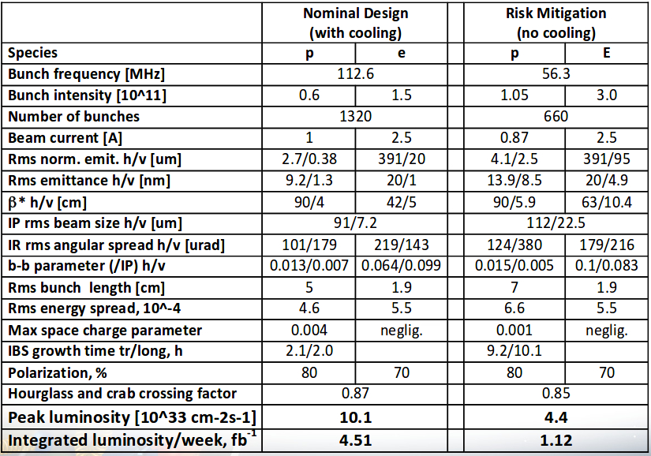
eRHIC average luminosity with and without cooling

Slide 9
Cooling Methods Under Study
Bunched beam (incoherent) electron cooling using ERL (e current requirements exceed present capabilities
Bunched beam (incoherent) electron cooling with recirculatory ring, ERL electron beam source (JLEIC design is based on recirculating cooler)
Bunched beam (incoherent) electron cooling with electron storage ring for the cooling beam (under study, FOA 8/19)
Coherent electron cooling with FEL amplifier (PoP experiment at BNL)
Coherent electron cooling with ERL electron beam and multi-stage micro-bunching amplifier (under study, FOA 19/19)
Coherent electron cooling with micro-bunching amplifier and with electron storage ring (under study, FOA 19/19)
And more ….
Optical stochastic cooling
Coherent electron cooling with induction linac driver …

Slide 10
Conclusions
Strong hadron cooling is necessary to exploit the capacity in high beam intensity in maximizing luminosity
For eRHIC Strong hadron cooling should boost the peak luminosity by a factor of ~2.5, but the average luminosity by factor four
Strong hadron cooling is desirable to provide a safety margin for managing noise effects, residual crab-crossing effects
There are several methods of strong hadron cooling under study
First experimental results being discussed

