Slide 1
IR/MDI requirements for the EIC
M. Sullivan
for the
EIC Accelerator Collaboration Meeting
October 29 – Nov 1, 2018

Slide 2
Outline
Introduction
Accelerator Issues
Detector Issues
Engineering Issues
Final Focus Magnets
Backgrounds
Other issues
Summary

Slide 3
Introduction
The interaction region is one of the more challenging parts of any accelerator design
There are many different (and usually conflicting) constraints from both the accelerator and from the detector
I will try to touch on some of these issues

Slide 4
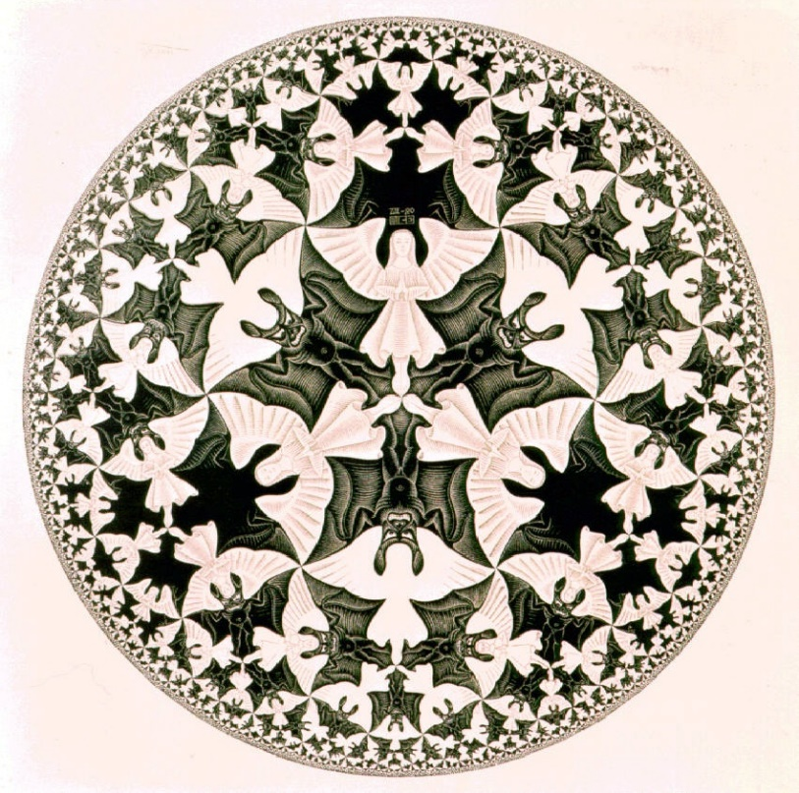
Physics
As I understand it, the EIC will be used to measure how the proton surface (or near surface) works
Somehow, the strong force fades to zero at the proton radius
We want to study events that scatter with small momentum transfers (low q² – very forward events)
Polarization is another physics requirement

Slide 5
Accelerator
The accelerator must deliver the beams to a collision point that maximizes the luminosity
The collision is inside a detector that has a large solenoidal magnetic field
Also, to maximize the luminosity the final focus magnets must be a close as possible to the IP
The beam currents are generally high (~1 A)
Usually there is a crossing angle in order to get the beams quickly in and out of collision
Polarization of the beams

Slide 6
Detector
The detector must be efficient in order to collect as much of the delivered luminosity as possible
For the EIC, the very forward acceptance is crucial
This is where most of the events of interest are located
The detector and the accelerator no longer have a well defined boundary
Detector components are spread out all along the outgoing beam trajectories
Measuring the polarization usually needs to be near the IP

Slide 7
Energy Range
The physics requires a range of energies for both beams
This complicates the overall accelerator design and, in particular, the IR design
The IR must be able to handle a lower-energy high-current as well as a higher-energy low-current electron beam
These two configurations have different IR issues
Synchrotron radiation at the electron beam high-energy setting
Beam current and beam bunch heating at the electron low-energy setting
Beam current and bunch heating for the proton beam

Slide 8
Engineering
With the detector and the machine components intertwined the engineering challenges become more interesting
Detector wants minimal material for supports and maximal acceptance for low angle events
Minimal outer size for final focus magnets
Maximal aperture size inside the final focus
Accelerator stability and force compensation require strong supports for accelerator elements
Cuts into detector acceptance and sometimes increases the size of the final focus magnets
Sometimes detectors can be placed in front of obstructions or in front of magnets

Slide 9
Final Focus Magnets
The large beam energy asymmetry and the different beams (e and P/ion) means the final focus magnets can be separated in Z for each beam
Allows for magnets to be closer transversely (not overlapping in Z)
The magnets still need to be as small as possible (radially) for maximum detector acceptance
Ion beam magnets can not affect the electron beam (too much perturbation)
Vice Versa for perturbations on the ion beam?

Slide 10
Backgrounds
Quick list of various backgrounds that must be studied
Synchrotron radiation (SR) from the electron beam
Upstream and downstream
Beam tail distributions
Beam-gas Bremsstrahlung
Coulomb scattering
Touschek scattering
Luminosity related backgrounds
Radiative electron scattering
Low-energy ee production
Neutron production

Slide 11
Beam Tails
All electron storage rings have a beam tail
Interactions with gas molecules
IBS (Touschek, etc.)
Beam tune shift
Nearby resonances in the tune plane
Other…
Usually sets the beam lifetime
The tail can be up to a few percent of the core distribution

Slide 12
Beam Tails
The collimators in the ring need to be set to a beam sigma that is smaller than the IP apertures
Else the IP becomes the tight spot in the ring and collects all of the beam backgrounds
So if the BSC in the IR is 15 sigma then the collimators must be ~12 sigma
The collimators will then set the electron beam lifetime
Based on recent super KEKB and Belle II experience beam tail distributions appear to be a significant source of detector background

Slide 13
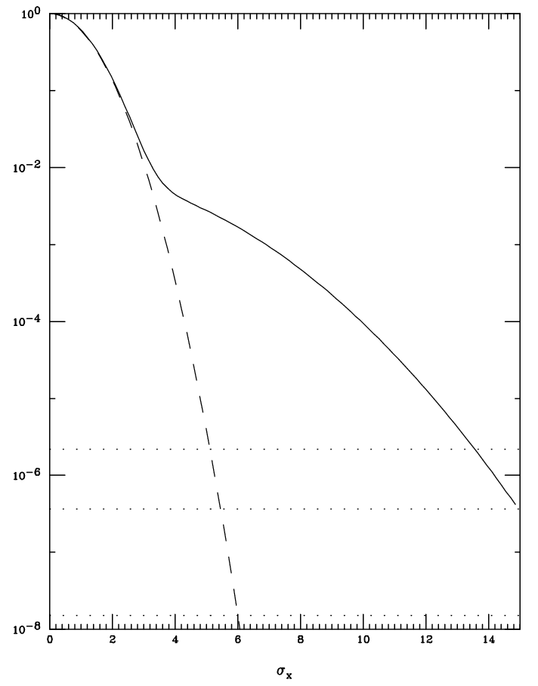
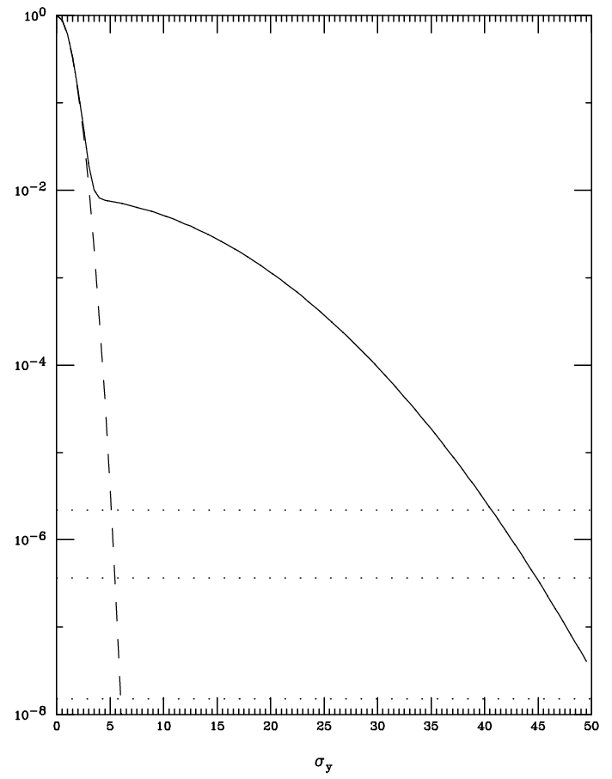
Beam Tails
The tails in the plots here are the ones I use for synchrotron radiation background calculations
The background distribution is a 2nd lower and wider gaussian
Where a = 8.5×10⁻³ and
b = 0.3 for x and
0.1 for y
The integral of the background distribution is about 0.3% of the total.
This might be on the low side especially for a new accelerator.
X beam tail
Y beam tail
$$e^{−\left(\frac{x^{2}}{2σ^{2}}\right)}+{ae}^{−\left(\frac{b^{2}x^{2}}{2σ^{2}}\right)}$$
gaussian
gaussian
10 min =~13σ
10 min =~40σ
1 hr = ~15σ
1 hr = ~45σ
M. Sands 6σ pt.
1 day
σ_{x}
σ_{y}

Slide 14
Some other Issues
Here I list various other issues that need to be included in the IR design
Vacuum pumping
Heating issues from the electron beam
Including SR
Less of a problem for the P/ion beam
Thin windows for the low-angle particles produced in the interaction
Supports
Solenoidal field compensation
Ion beamline magnetic field compensation for the electron beam

Slide 15
Summary and Conclusion
The accelerator and detector teams will have to work closely together in order to achieve a good design for the IR
The EIC IR is more complicated than ordinary IRs due to the need for maximum acceptance in the forward direction
The machine and detector design are intertwined now making the first point above even more important
This is an exciting new accelerator with many challenges and the physics is compelling!

