Slide 1
DOE Support to EIC Accelerator R&D and FOA Landscape
Manouchehr Farkhondeh
DOE Office of Nuclear Physics
EIC Accelerator Collaboration Meeting 2018
Thomas Jefferson Accelerator Facility
October 29, 2018

Slide 2
DOE Office of Science Accelerator R&D Categories
Short Term Accelerator R&D- Accelerator R&D with the potential for improved performance and/or new capabilities to existing NP scientific user facilities that will lead to new capabilities or improved operations. This is supported by NP and other program offices.
Mid-Term Accelerator R&D: Accelerator R&D with the potential for the development of the future generation of NP accelerators not under construction. This is supported by NP and other program offices.
Long-Term or generic Accelerator R&D: This is directly supported by the Office of High Energy Physics (HEP) although NP work often relevant.
Total annual direct NP investment in EIC-related accelerator R&D through competitive funding opportunity announcement (FOA) and National Laboratory Accelerator R&D is on the order of $13.5 M per year and increasing.

Slide 3
2015 NSAC LRP Report
RECOMMENDATION III (Page 4)
Gluons, the carriers of the strong force, bind ……
We recommend a high-energy high-luminosity polarized EIC as the highest priority for new facility construction following the
completion of FRIB.
INITIATIVES : (Page 5)
B: Initiative for Detector and Accelerator Research and Development
…………………………
We recommend vigorous detector and accelerator R&D in support of the neutrinoless double beta decay program and the EIC.
The key EIC machine parameters identified in the LRP were:
Polarized (~70%) electrons, protons, and light nuclei,
Ion beams from deuterons to the heaviest stable nuclei,
Variable center of mass energies ~20-100 GeV, upgradable to ~140 GeV,
High collision luminosity ~10³³-10³⁴ cm⁻²sec⁻¹, and
Possibly have more than one interaction region.

Slide 4
Planning Towards an EIC
  National Academy of Sciences (NAS) Study: Initiated an 18 month NAS study entitled: “US-BASED ELECTRON ION COLLIDER SCIENCE ASSESSMENT” Started in July 2016. (Report completed)
  FY16 FOA: Published competitive FOA (“Accelerator R&D for Next Generation NP Facilities”) focused on EIC-related R&D. NP has been funding competitive accelerator R&D since 2010 at ~$2M/year.
  NP Community Panel Review: Conducted NP community EIC R&D panel review charged with identifying high priority R&D aimed at technical risk reduction. Dr. Kevin Jones of SNS chaired this international panel. First face-to-face meeting was held November 29-December 2, 2016. Panel Report published in February 2017 (https://science.energy.gov/np/community-resources/reports/ )
  FY17: EIC-related Accelerator R&D plans received from Labs and universities and high priority R&D in the context of Jones report is supported.
  Bi-Annual FOA starting FY18: Published bi-annual FOA for competitive accelerator R&D based on R&D priorities established in the EIC panel report. (Awards selected for FY 18)
    Funding level: ~$8.8 M per year for FY18 and FY19.
    Funding sources: Combination of NP competitive accelerator R&D funds augmented with RHIC and CEBAF Accelerator Operations budget funding.

Slide 5
EIC Concepts
Current EIC concepts have emerged from national labs.
Strong collaborations at the labs and with universities to advance different concepts and common R&D relevant to all concepts:
  BNL: eRHIC based on a Ring-Ring concept
  TNJAF: JLEIC based on a high repetition rate figure-8 Ring-Ring concept
Note: At the time of the Jones panel review, BNL developing two different eRHIC concepts R-R and L-R. In April 2017, after the Jones report was published, BNL announced the R-R as the primary concept for eRHIC.

Slide 6
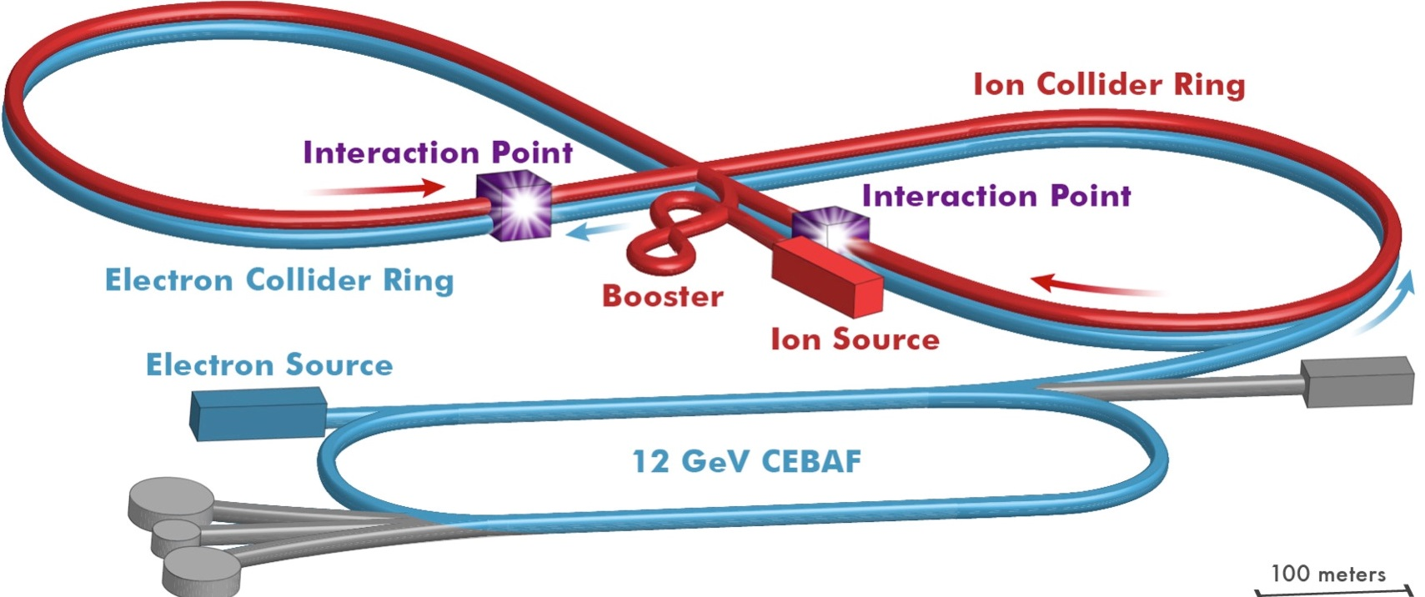
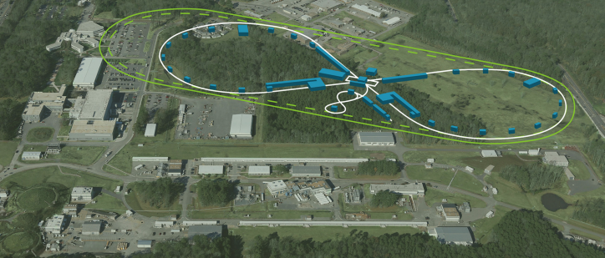
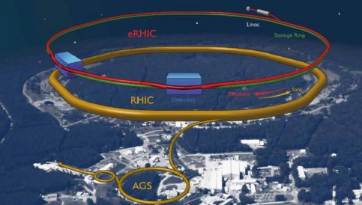
EIC Ring-Ring Design Concepts
JLEIC
eRHIC

Slide 7
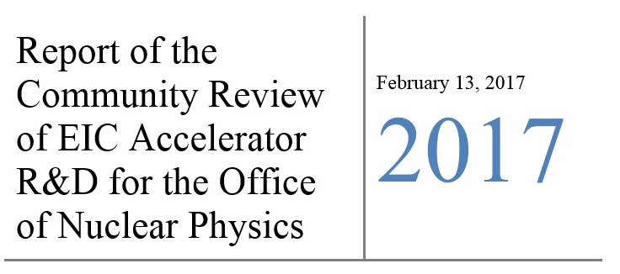
Jones Panel Priority Table:
The key EIC machine parameters identified in the LRP were:
Polarized (~70%) electrons, protons, and light nuclei,
Ion beams from deuterons to the heaviest stable nuclei,
Variable center of mass energies ~20-100 GeV, upgradable to ~140 GeV,
High collision luminosity ~10³³-10³⁴ cm⁻²sec⁻¹, and
Possibly have more than one interaction region.

Slide 8
Jones Report R&D Priorities
Priority: “High”, “Medium”, or “Low”, Sub-Priority: “A”, “B”, “C” or “None”
Proponent: “PANEL”, “BNL” or “JLAB”
Design Concept: “RR”, “LR” or “JLEIC”
Sub-Priority-A: The R&D elements that the panel judged to be applicable to all concepts presented are identified by “ALL” in the concept/proponent identifier column and are assigned sub-priority A. These are considered the most important to be addressed to reduce overall design risk.
Sub-Priority-B: The R&D elements that the panel judged to be applicable to individual concepts presented are identified by the appropriate concept identifier in the concept/proponent identifier column (e.g., LR, RR or JLEIC) and are assigned sub-priority B. These are considered to be second in importance to reduce overall design risk, but important to reduce the risk associated with a specific concept.
Sub-Priority-C: The R&D elements self-identified by the proponents are tabulated in lines 23-75 with the priority as deemed by the panel. Specific self-identified high priority R&D elements that have substantial correlation with the high priority global and concept-specific sub-priority A and B elements identified by the panel are denoted as sub-priority C to permit ready cross-reference when evaluating future R&D proposals.

Slide 9
Technical Challenges for EIC
EIC will be one of the most complex collider accelerators ever to be built. It will push the envelope in many fronts including high degrees of beam polarizations, high luminosity, beam cooling, beam dynamics, crab cavities for both beams, and an interaction region with complex magnets.
Required Accelerator R&D Advances for EIC (list from the Jones panel report)
  Hadron cooling techniques
  Polarized electron sources
  Ring magnet demonstrations
  Interaction region magnet design and prototyping
  Machine-detector interfaces
  Superconducting RF technology
  Large scale cryogenics technology
  High current ERL Linacs
  Crab cavity design, fabrication and testing (with beam)
  Beam and spin dynamics and benchmarking of simulation tools
  Electron cloud mitigation techniques

Slide 10
State of the Art Accelerator Technology for EIC
Beam Cooling: Beam cooling is one of the highest priority R&D for EIC. The challenge is to achieve the high collision luminosity of order ~10³³-10³⁴ cm⁻²sec⁻¹.
  High current multi-pass energy Recovery Linac (ERL)
  High current unpolarized electron injectors for ERL
Interaction Region
  Magnets: Challenging magnet designs to meet required high fields and field free regions for passage of primary beams.
  Crab cavities: Achieve maximized collision rates between bunches. No operational experience yet exists for crab cavities in hadron beams.
Storage ring Magnets: Challenging high field storage ring magnets are needed.
Polarized electron Sources: High bunch charges for the ring-ring concept
Simulation Codes: Benchmarking of realist EIC simulation tools against available data needs to be aggressively pursued.
Core competencies in these areas exist at NP and SC Labs and universities. Collaborations have formed to address these technical challenges.

Slide 11
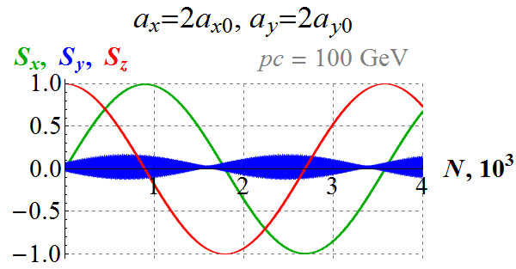
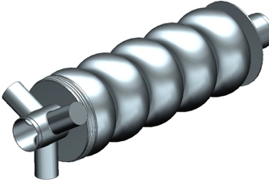
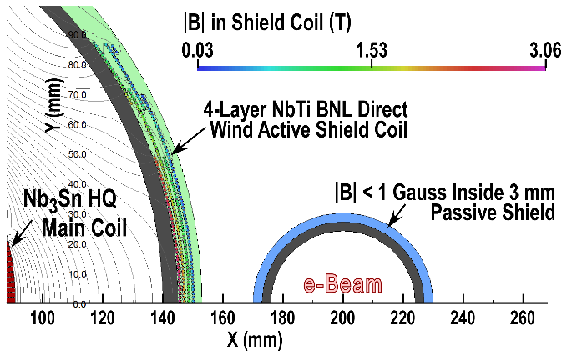
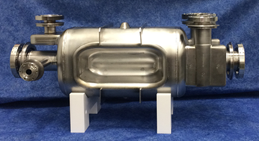
State of the Art Accelerator Technology for EIC
Schematic layout of IR
Spin: Nonlinearity of orbital motion-
V. Ptitsyn et al.
V. Morozov et al.
Crab Cavity
952.6 MHz cooler ERL (SCRF)
IR quadrupole magnet
ODU
952.6 MHz crab (SCRF)
B. Rimmer, et al.
S. De Silva et. Al.
B. Parker, et al.

Slide 12
Core Competencies for EIC at NP Labs and Universities
LBNL
Next Gen. ion source
Michigan State Univ.
(FRIB)
SRF technology
Ion sources
MIT
High current polarized
electron sources
Polarized ³He target
LBNL
Beam simulation
FNAL
Beam Cooling
ANL
Beam simulation
SRF technology
Cornell University
High current e. sources
SRF technology
BNL (RHIC)
Beam cooling
Crab Cavity design
Beam simulations
Colliders
Polarized ion sources
SC magnet design
BNL
Beam cooling
Crab Cavities
Beam simulations
Colliders
Polarized protons
SLAC
Beam simulation
TJNAF
SRF technology
ERL
Polarized electron sources
Beam simulations
SC magnet design
NP core competency
Northern IL University
Beam simulation
Old Dominion University
Crab cavity design
With NP EIC awards

Slide 13
FY017 : Accelerator R&D Plans
Due to delays in planned FOA we have asked TJNAF and BNL for their FY2017 R&D Plans (Base R&D and Additional-NP funds R&D if funding were available.)
Also requested R&D Plan from Labs and universities that had received funding from NP in FY2016. Collaborations with lead labs were encouraged.
Plans were received by June1, 2017. Evaluation of plans were completed by end of June and funding recommendations proceeded.
“Base fund (Taxed)”: BNL: $3.5M, TJNAF: $1.5M Total: $5.0M
“NP Accelerator R&D Funds”: $1.879M
FY2017 Accelerator R&D Funding distributions
BNL Base and NP funds
TJNAF Base and NP funds
ANL, FNAL NP funds
MIT, Cornell NP funds
TAMU, NIU NP funds

Slide 14
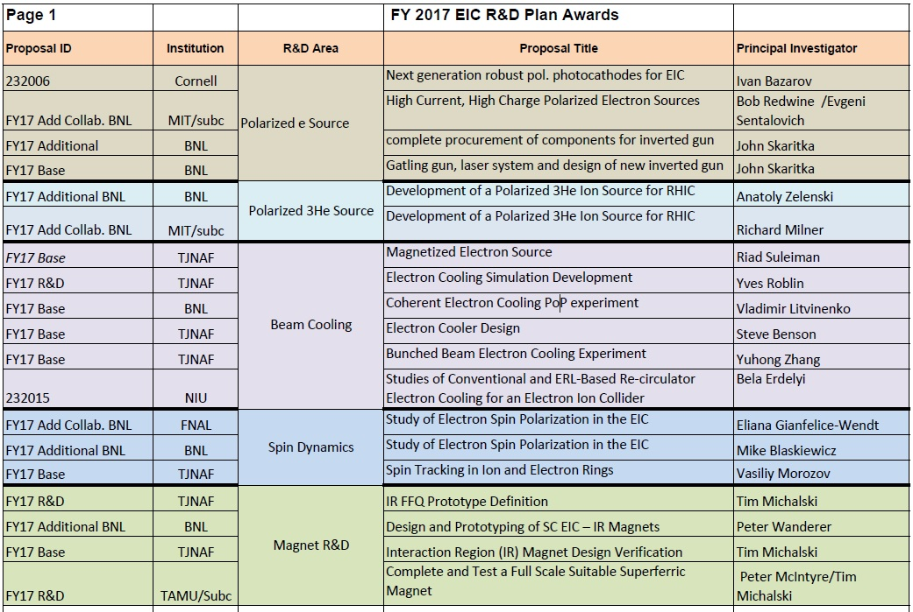
FY2017 R&D Plan Awards

Slide 15
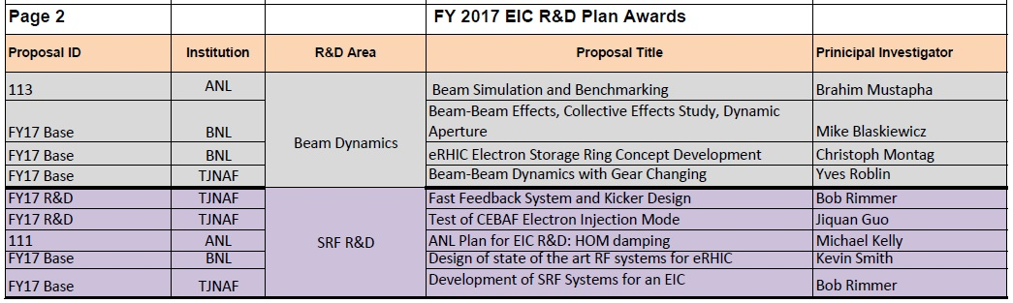
FY2017 R&D Plan Awards
Areas of R&D: Mostly included highest rated R&D priority areas identified in the Jones panel report. Also included few areas TJNAF and BNL were doing R&D prior to the Community report.
A two day Principal Investigator meeting is organized for November 13-14, 2018 for all PIs listed above to present their work to NP and other PIs to promote communication and collaboration amongst national labs and universities.

Slide 16
Communications between NP and PI for accelerator R&D work
Two modes of communications between PIs and NP office: Quarterly reports and an annual face to face meeting with all PI in one place.
Quarterly Reports
  PIs are asked to submit quarterly reports to NP in a “Small Project” format. The first one for FY 2017 funds was requested for a 6 months period. The 3rd quarter request was sent by Cassie on June 22, 2018. The 4th quarter request was sent on September 28, 2018.
PI Exchange Meeting
  For accelerator R&D efforts NP conducts annual “PI Exchange” meetings with presentations on current status of work by all Principal Investigators who received awards under previous fiscal year funds. The 2018 PI meeting will take place in November for all FY 2017 awards.

Slide 17
PI Exchange Meeting, November 13-14, 2018
Presentations on current status of work by all Principal Investigators (PIs) who received awards under FY2017 Lab R&D Plans. Cover the continued work under the FY 2016 funding opportunity announcements DE-FOA-0001556 and LAB 16-1556.
This is not a review and no review panel is involved. Presentations will be made to NP Office Program Managers and Division Directors, and possibly a few PMs from HEP and BES Program Offices.
To facilitate exchange of information between PIs and the NP Office and among PIs and institutions on all current and past EIC-related Accelerator R&D funded efforts.
A continuation of yearly meetings on NP supported Accelerator R&D for next generation NP facilities.
For the next year’s meeting (2019) will invite all PIs who received funding for NP in response to the FY18 FOA DE-FOA-0001848.

Slide 18
PI Meeting Presentation Guidelines:
Presentation guideline was sent to all PIs by email on October 25, 2018.
Each presentation should include the following information:
  Description of the project and the current status;
  The main goal of the project for which you received the FY 2017 Accelerator R&D Plan award. Specify if the award is part of the Lab Base R&D at BNL or TJNAF.
  Is the funding for this work continued by the FY 2018 NP Accelerator R&D FOA?
  A table showing annual budget and the total received to date (see below);
  A table showing major deliverables and schedule; and
  For each R&D task identify the priority and sub-priority designation(s) listed in the priority table of the 2017 Jones EIC R&D report. Also list the row number in the Jones report Priority table that corresponds to each of your task (Rows 1-75).

Slide 19
PI Meeting Presentation Guidelines (P. 2):
submit your presentation file to Ms. Brenda May (Brenda.May@science.doe.gov) before noon on Friday, November 9th.
It is essential that she has a copy of your final presentation by 8:00 am for the morning sessions and by 12:00 pm for the afternoon sessions on the day of your presentation.
There will be no written report or follow up actions required for this meeting.
Summary of expenditures by fiscal year (FY):
 | FY10+ FY11 | FY12+FY13 | FY14+ FY15 | FY16 +FY17 | Totals
a) Funds allocated
b) Actual costs to date

Slide 20
FY2017 Award PI Meeting Agenda

Slide 21
FY2017 Award PI Meeting Agenda

Slide 22
FY018 : Accelerator R&D Funding
FUNDING OPPORTUNITY ANNOUNCEMENT (FOA)
Research and Development for Next Generation Nuclear Physics Accelerator Facilities
Funding Opportunity Number : DE-DE-FOA-0001848
Announcement Type: Initial
CFDA Number: 81.049
ISSUE DATE: 12/01/2018
Application Due Date: 1/19/2018
A panel of experts helped NP select for funding the most suitable proposal(s) submitted to this FOA based on the SC merit review criteria and NP Program Criteria (Jones panel priority list and 2015 NSAC LRP) for the appropriated FY18 funds and a similar amount is planned for FY2019.
This was a two-year funding. The next NP Accelerator R&D FOA is expected to be published for FY20-21 funding.

Slide 23
Review Criteria for FY2018 FOA
This FOA Supports:
Merit Review Criteria
NP Program Criteria

Slide 24
Proposals submitted to
FY 2018 FOA
Institutions | Number of Proposals | Budget Request Y-1 ($k) | Budget Request y1+y2 ($k)
National Labs | 43 | 17,526 | 34,481
Universities | 12 | 3,966 | 7,931
Industry | 1 | 107 | 213
Totals | 56 | 21,599 | 42,625
Collaboration Proposals
Type of Proposals | No. of Proposals | Total Individual proposals
Collaborative | 16 | 43
Non-collaborative | 13 | 13
Totals | 29 | 56

Slide 26
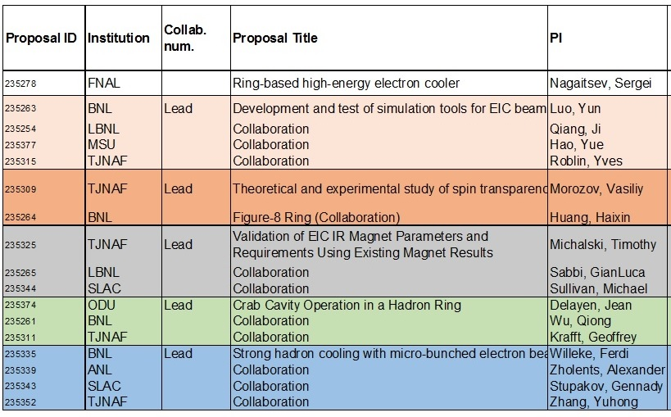
List of FY2018 FOA Awards Page 1
Most awards going to collaborative proposals

Slide 27
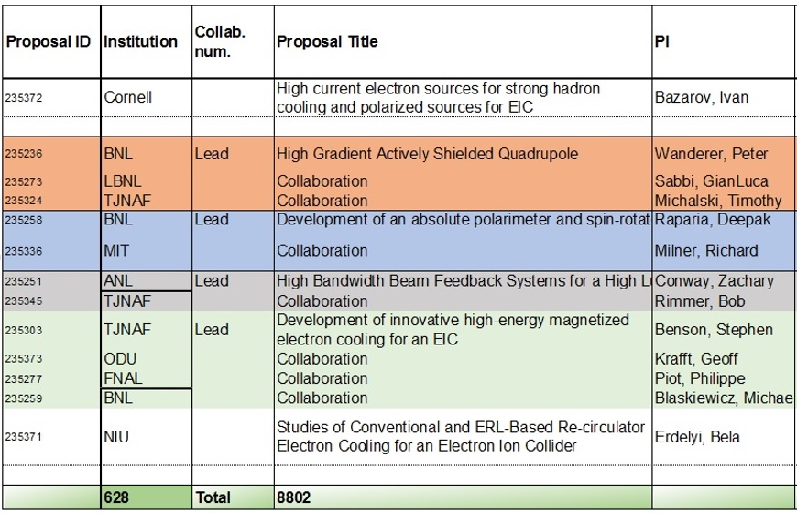
List of FY2018 FOA Awards Page 2
Funding level: FY 18 Enacted: $8.8M

Slide 28
FY019 : Accelerator R&D Funding
FUNDING OPPORTUNITY ANNOUNCEMENT (FOA)
Research and Development for Next Generation Nuclear Physics Accelerator Facilities
Funding Opportunity Number : DE-DE-FOA-0001848
Announcement Type: Initial
CFDA Number: 81.049
ISSUE DATE: 12/01/2018
Application Due Date: 1/19/2018
FY18 FOA was for 2 year funding
FY 19 appropriated fund should enable us to fund all FY18 awards for year 2. Will Contact PIs as what is needed to proceed to Year 2 funding
This was a two-year funding. The next NP Accelerator R&D FOA is expected to be published for FY20-21 funding.

Slide 29
Summary Remarks
With the 2015 NSAC LRP recommendation for an EIC, NP has developed a near-term plan for moving forward with an EIC:
  A NAS study of merits of US-based EIC
  An NP community panel review for setting priorities for EIC accelerator R&D
  Increased accelerator R&D funding
The realization of an EIC will require development of many cutting-edge accelerator technologies, securing U.S. leadership in accelerator R&D in the long-term.
NP will continue to support and nurture the core competencies needed to implement an EIC and will continue EIC R&D.
All NP funded accelerator R&D are tracked through quarterly reports by PIs and annual PI meetings. The next PI meeting is scheduled for November 13-14, 2018 and will cover all FY 2017 awards to Labs and universities.

Slide 30
Backup

Slide 31
Jones Panel Priority Table:
THIS IS TOO MUCH DETAIL- I would remove
Row No. | Proponent | Concept / Proponent Identifier | Title of R&D Element | Panel Priority | Panel Sub-Priority
1 | PANEL | ALL | Crab cavity operation in a hadron ring | High | A
2 | PANEL | ALL | High current single-pass ERL for hadron cooling | High | A
3 | PANEL | ALL | Strong hadron cooling | High | A
4 | PANEL | ALL | Benchmarking of realist EIC simulation tools against available data | High | A
5 | PANEL | ALL | Validation of magnet designs associated with high-acceptance interaction points by prototyping | High | A
6 | PANEL | ALL | Polarized ³He Source | High | A
7 | PANEL | LR | High current polarized and unpolarized electron sources | High | B
8 | PANEL | LR | Completion of the ongoing CeC demonstration (proof of principle) experiment | High | B
9 | PANEL | LR | High-current multi-pass ERL | High | B
10 | PANEL | LR | Concept for 3D hadron CeC beyond proof of principle | High | B
11 | PANEL | LR | SRF high power HOM damping | High | B
12 | PANEL | RR | Complete design of an electron lattice with a good dynamic aperture and a synchronization scheme and complete a comprehensive instability threshold study for this design | High | B
13 | PANEL | RR | High peak current multi-turn electron linac | High | B
Rows 1-22: “PANEL”, “A” or “B”
Sub-Priority-A Rows 1-6
Sub-Priority-B Rows 7-22

