Slide 1
Summary of Beam Cooling Parallel Session
Sergei Nagaitsev
EIC Accelerator Collaboration Meeting
Oct 31, 2018

Slide 2
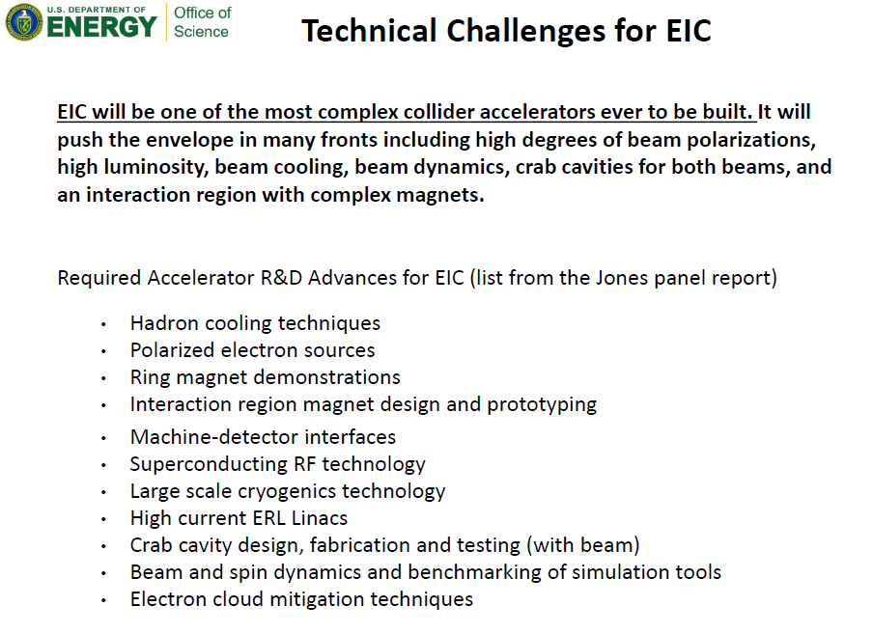
Introduction

Slide 3
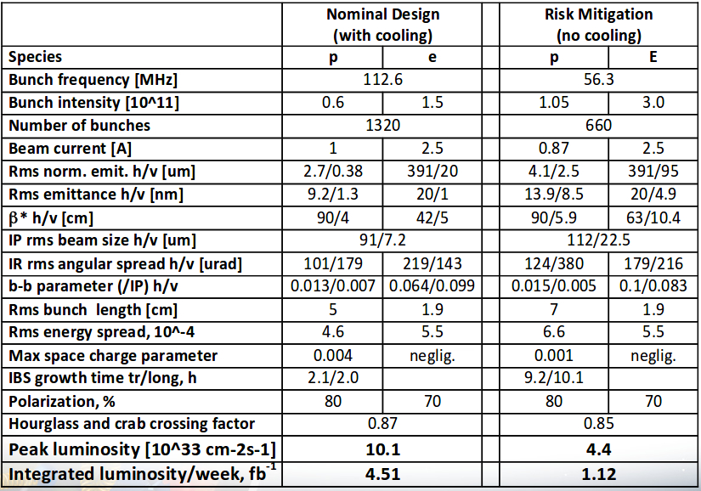
Need for cooling (F. Willeke)
An example parameter set for the eRHIC

Slide 4
Personal observations
The EIC cooling system is an interesting and challenging project in both accelerator science and technology
It is clear that conventional DC electron and microwave-range stochastic cooling are not applicable to the EIC (protons)
However, all concepts discussed at the meeting are some kind of a variation on either electron or stochastic cooling
It is interesting that (with exception of the OSC method) all proposed concepts rely on a high-quality high-current electron beam, advanced phase-space manipulations, precise understanding of linear and nonlinear optics
I am very impressed by the advances in experimental hardware procurement, installation and experimental tests.
  We are learning a lot from on-going experiments (CEC, LEReC and JLab-IMP experiments)

Slide 5
Main accelerator physics challenges
Obtaining and maintaining a high-quality high-current electron beam.
Advanced optics concepts (e.g. phase-space manipulations, precise R56 control)
In stochastic cooling methods, it is becoming clear that the nature is offering us a very large bandwidth media in plasma oscillations (in e-beam). The challenge is going to be in how to preserve this large bandwidth with a high gain amplification.
The optical stochastic method is a potentially interesting option for higher proton energies
  Optical amplifier remains challenging

Slide 6
Coherent Electron Cooling Test and Future Plans
CeC RHIC Run 18 was both challenging and successful
  build the state of the art accelerator and FEL system with all beam parameters necessary for the CeC experiment had been demonstrated
  high gain FEL amplifier was commissioned
  a new, previously unexplored, phenomenon was discovered
Plasma Cascade Amplifier based microbunching 3D CeC experimental test needs minimal investments and can be completed in four years
This low-cost CeC has cooling rates sufficient for proton beams both in eRHIC and JLEIC

Slide 7
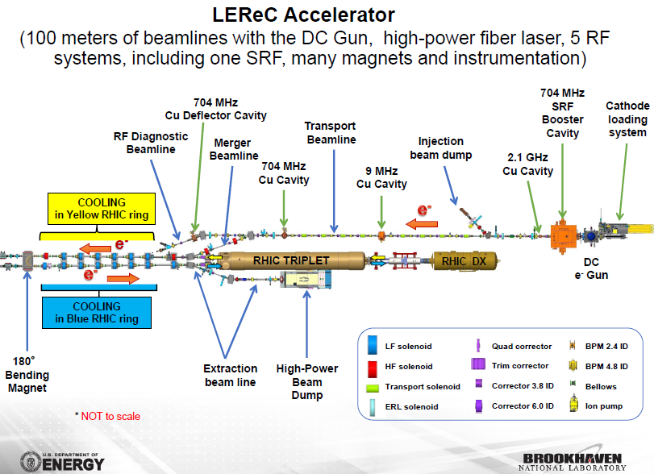

Slide 8
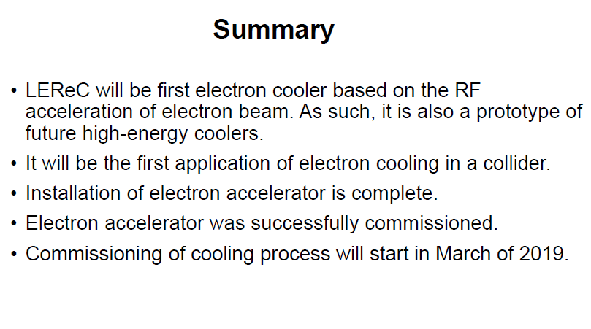
LEReC summary

Slide 9
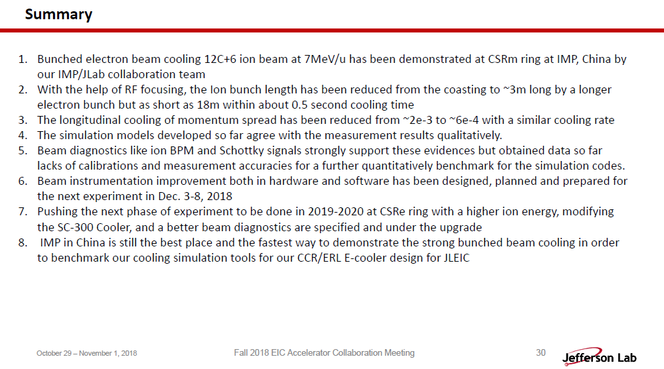
JLab - IMP collaboration on bunched beam cooling

Slide 10
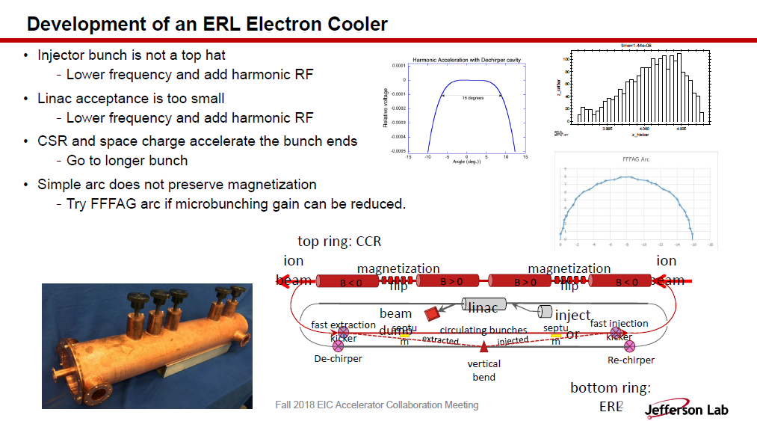
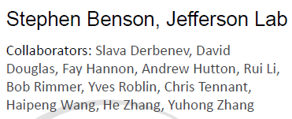

Slide 11
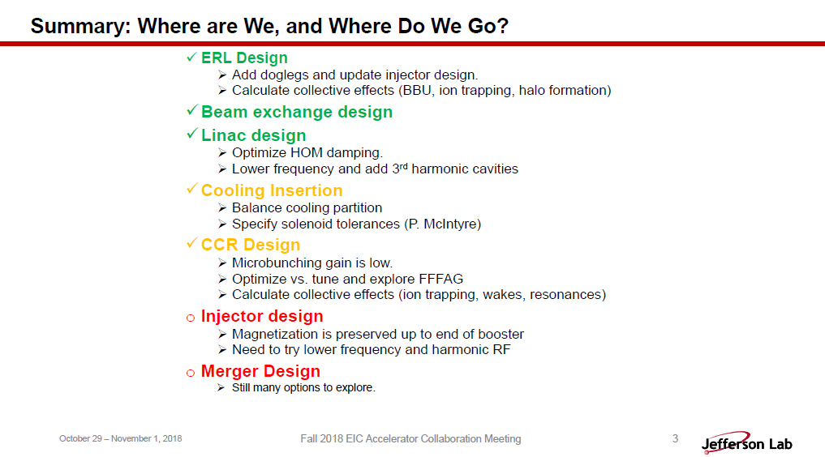
JLEIC ERL Cooler

Slide 12
JLEIC Electron Cooling simulations (He Zhang)
JLEIC implemented a multi-stage cooling scheme: reduce the emittance at the low energy; maintain the emittance at the higher energy.
Preliminary simulations have been done for JLEIC cooling scheme.
Heavy ion beam cooling is relatively easy.
Proton beam cooling is challenging due to the imbalance between the IBS and electron cooling (Cooling is roughly equal in all the three dimensions, while the IBS is highly imbalanced in the three dimensions with the horizontal IBS tens of times stronger than the other two directions’ IBS. As a result, no enough cooling in the horizontal direction and extra cooling in the other two directions).
Transverse coupling is introduced to transfer the horizontal IBS to the vertical direction and use the extra cooling in vertical direction.
Dispersion at the cooler is introduced to convert the extra longitudinal cooling to help the cooling in the transverse directions. But remaining extra longitudinal cooling may cause problems.
Dynamic effects due to the coupling and the dispersion at the cooler needs to be studied.
Simulation suggests the nominal parameters are achievable after deeper understanding of the process.
Flat electron beam provides stronger cooling than the round electron beam.
Fixed bunch length/momentum spread helps to mitigate the overcooling in the longitudinal direction.
JSPEC, the electron cooling and IBS simulation program, is under active development at JLab.

Slide 13
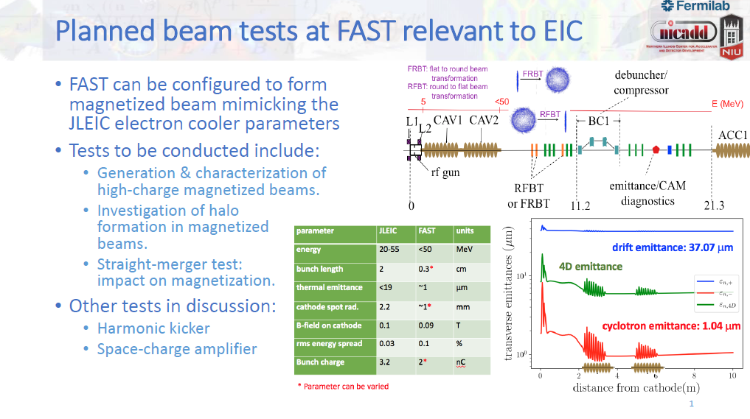
P. Piot

Slide 14
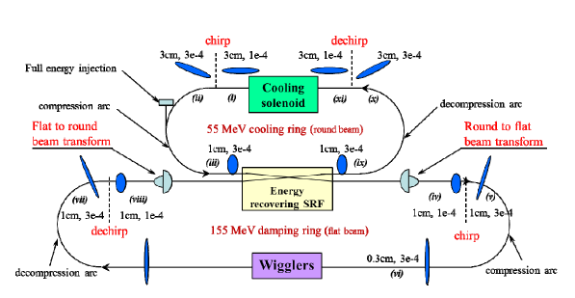
JLAB/ODU Energy Recovered Loop Accelerator
F. Lin, et al.,
IPAC 2016

Slide 15
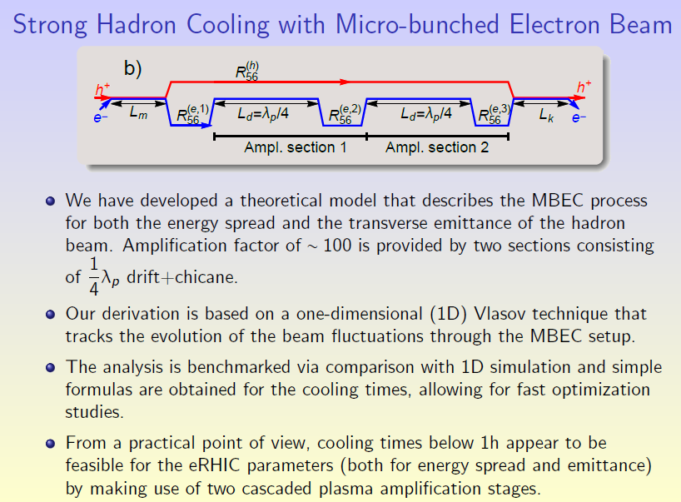
Micro-bunched coherent electron cooling (G. Stupakov)

Slide 16
V. Lebedev, Other Approaches: Stochastic Cooling
For transient-time cooling of bunched beam the emittance cooling rate at the optimal gain is:
where σ_{W} is the rms bandwidth
  It determines the theoretical maximum for the cooling rate
  If bunch length, σ_{s}, is much longer than amplification length, σ_{g}, the cooling rate is additionally reduced as σ_{g}/2σ_{s} !!!
OSC efficiency grows fast with energy
  Looks feasible for ERHIC at 275 GeV for cooling protons
  Cannot be useful in JLEIC at 100 GeV
Due to large Δp/p the optimal wavelength ≥10 μm
We need a solid concept for OA to move forward with the proposal: delay <2-3 mm, gain 40-50 dB, power ~100 kW

Slide 17
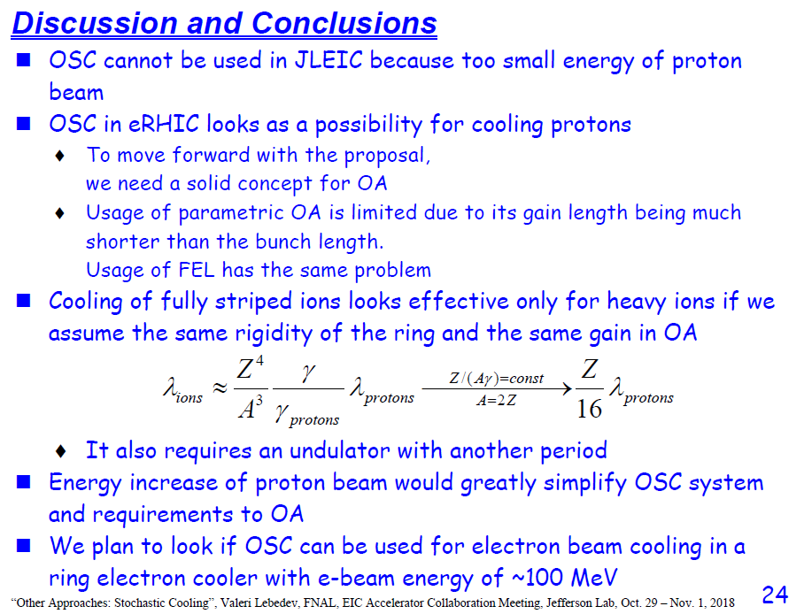
OSC (V. Lebedev)

Slide 18
Ring-based electron cooler (Fermilab)
Protons, 100 GeV
Cooling Section, 40-m, 2 kG
Electron ring (115 m circumference)
Beam dump
Electron Induction Linac
100 m, 55 MeV
We are considering a range of electron beam and linac parameters: 100-200 A beam current, 100 – 200 Hz rep. rate
Pulse length: 380 ns (to fill the ring)
Beam power to dump: 0.8 MW (worst case), 200 kW (best case)

Slide 19
Summary (my wish list)
Better understand stochastic cooling bandwidth vs gain trade-offs
Better understand common parameters in electron beam generation and optics. Are there synergies?
Better understand cooling vs proton energy trade-offs
Perhaps we can all benefit from a beam cooling and IBS school (USPAS-style).

