Slide 1
IR/MDI Summary
M. Sullivan
for the
EIC Accelerator Collaboration Meeting
October 29 – Nov 1, 2018

Slide 2
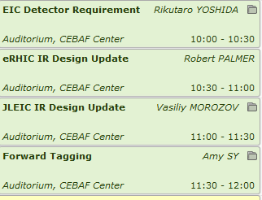
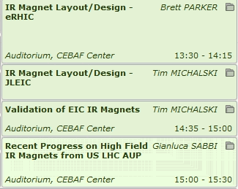
Presentations
We had a great series of presentations followed by an interesting discussion session

Slide 3

Physics
Findings of the NAS committee
Rik Yoshida gave us an excellent basic talk on the physics we want to find in the EIC
Finding 1: An EIC can uniquely address three profound questions about nucleons—neutrons and protons—and how they are assembled to form the nuclei of atoms:
  How does the mass of the nucleon arise?
  How does the spin of the nucleon arise?
  What are the emergent properties of dense systems of gluons?
Finding 2: These three high-priority science questions can be answered by an EIC with highly polarized beams of electrons and ions, with sufficiently high luminosity and sufficient, and variable, center-of-mass energy.
How far can this rise go on?

Slide 4
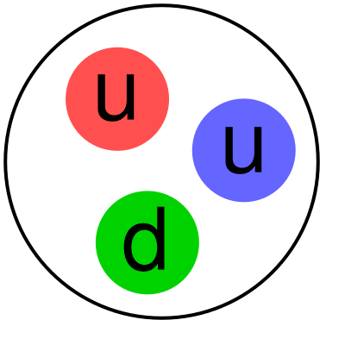
We want to get the entire final state
EIC detector must accept and measure
all particles from the interaction.
(Unlike existing collider detectors!)
Scattered electron
Hence the very forward detectors
Ion beamline
Electron beamline
Particles Associated with Initial Ion
Particles associated with struck parton
Beam Elements
Central
Detector
Beam elements limit forward acceptance
Central Solenoid not effective for forward
Beam Elements

Slide 5
eRHIC IR Design
Bob Palmer gave us a talk on the eRHIC IR design
  A clear exit for the upstream IR SR fans
  No magnets inside the detector area (±4.5m)
  Last upstream bend magnet for the electron is at -70 m
  25 mrad crossing angle

Slide 6
eRHIC IR SR fans

Slide 7
eRHIC IR lattice functions
Hadron betas
Electron worse case betas

Slide 8
Proton beam line Electron beam line

Slide 9
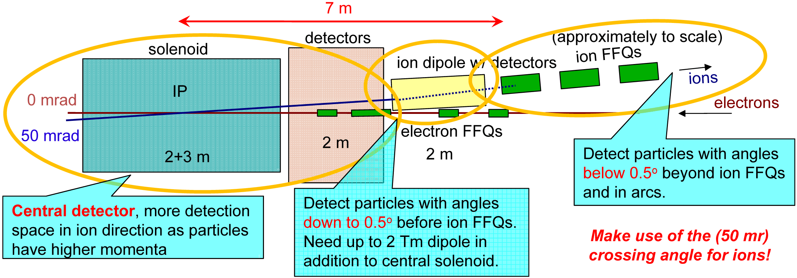
JLEIC IR
V. Morozov gave us an update of the JLEIC IR design
  50 mrad crossing angle
  Large aperture magnets for protons near the beam envelope
  Solenoid orbit compensation for hadrons

Slide 10
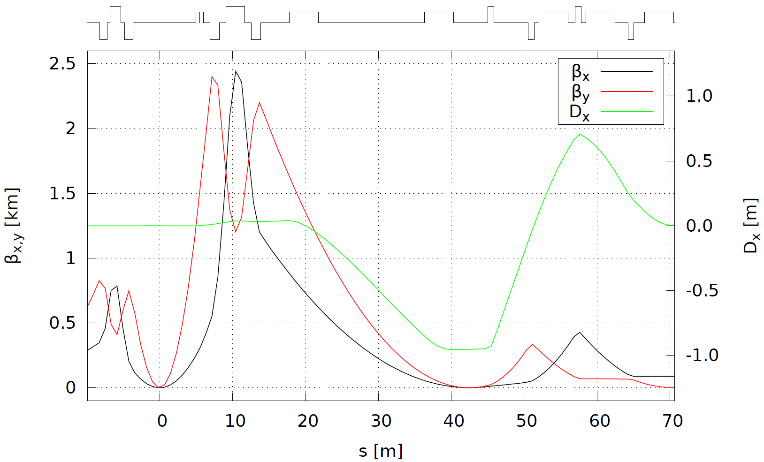
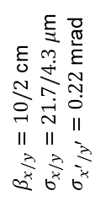
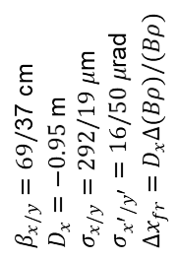
Very low angle scattered protons
iBDS1
Geometric match and dispersion suppression
FFB
IP
FFB
Far-forward detection
iBDS2
iBDS3
High dispersion region with a small waist allows for a Roman pot to get some of the protons that scatter but are still in the beam envelope when they leave the IP.
ions
$β_{x/y}=10/2$ cm
$σ_{x/y}=21.7/4.3 μ$m
$σ_{x^{′}/y^{′}}=0.22$ mrad
$β_{x/y}=69/$37 cm
$D_{x}=−0.95$ m
$σ_{x/y}=292/19 μ$m
$σ_{x^{′}/y^{′}}=16/50 μ$rad
$Δx_{fr}=D_{x}Δ(Bρ)/(Bρ)$
Secondary
focus
IP

Slide 11
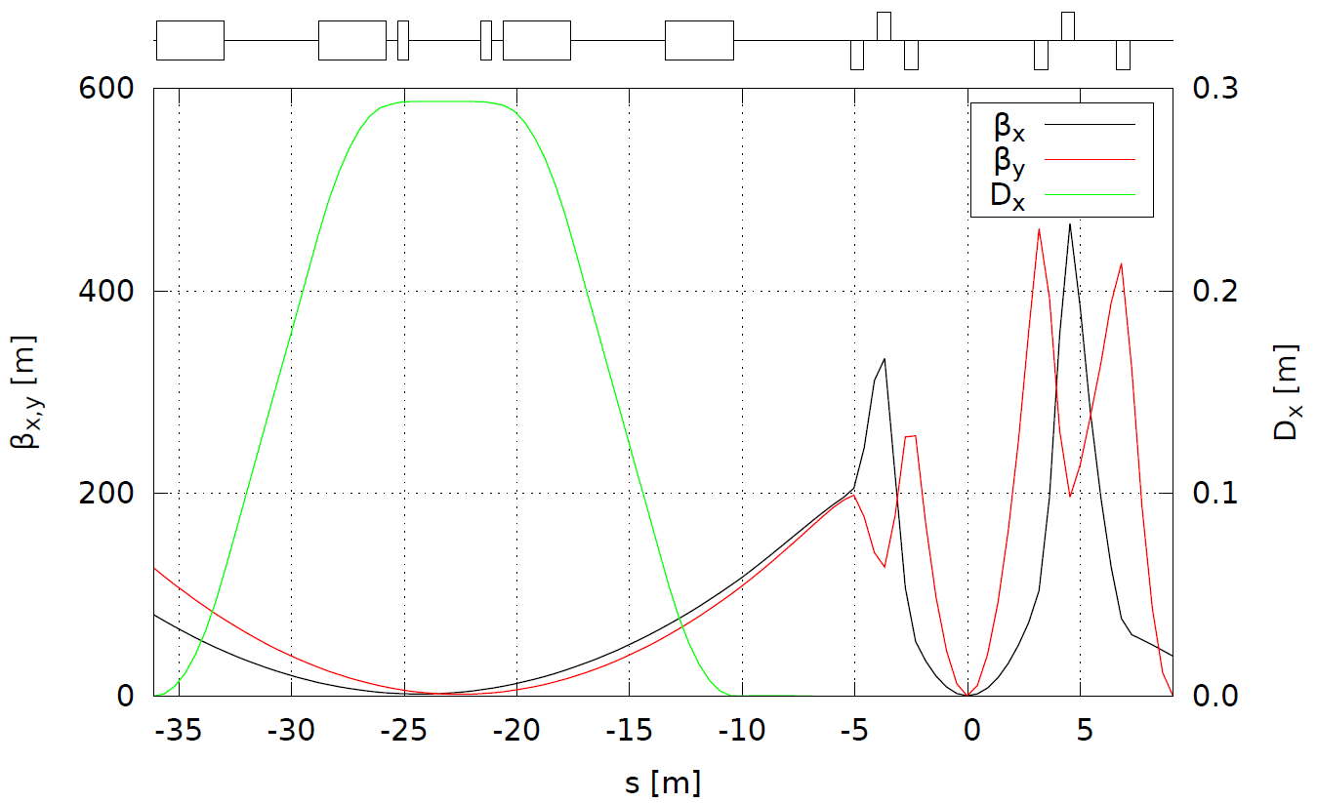
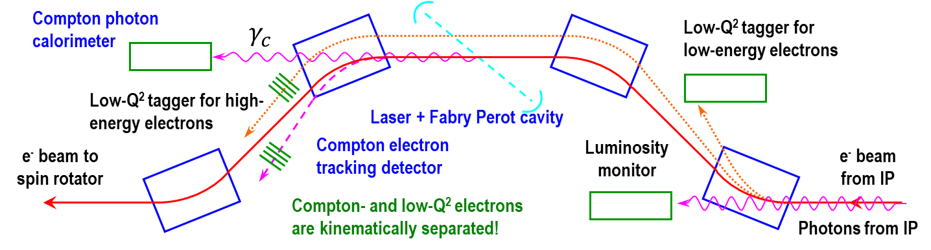

Electron Downstream
Dipole chicane
Compton polarimeter
Low-$Q^{2}$ tagger
FFB
FFB
electrons
Downstream electron beam has a luminosity monitor (as does eRHIC) and a polarimeter
Secondary focus
IP

Slide 12
Heavy ion tagging
A. Sy presented an interesting talk on Geometry Tagging for Heavy Ions
Coherence and gluon saturation
At low x and Q², the probe interacts coherently with all gluons in its path
The gluon density can be increased by going to lower x (higher CM energy), or increasing the nuclear thickness
  Heavy nuclei + selection of large path lengths through geometry tagging
  Extra boost from non-spherical nuclei?
Quark propagation and hadronization
Knowing the path length will greatly improve our understanding of what happens when a quark propagates through nuclear matter
  Energy loss, p_{T} broadening, etc.

Slide 13
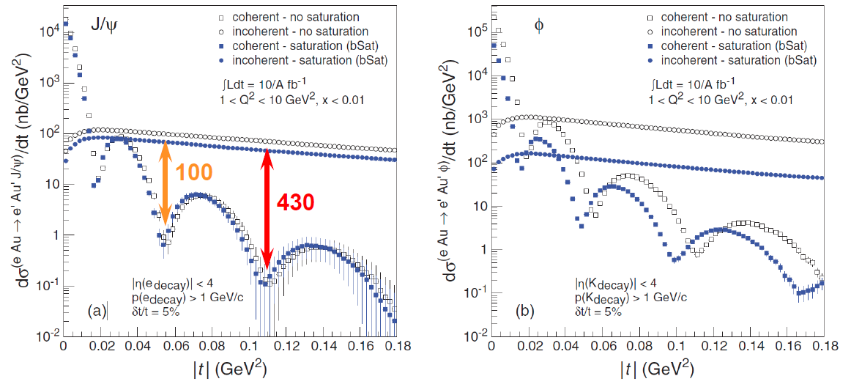
Coherent saturation vs t
The incoherent signal is nearly 1000 times higher than the coherent signal. A veto much be developed.

Slide 14
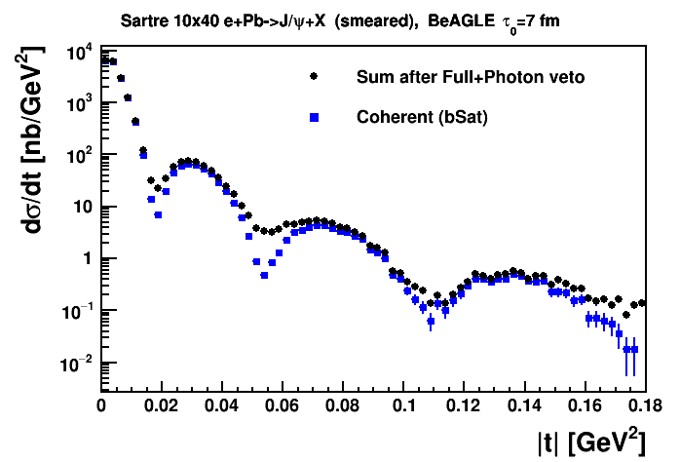
Coherent with saturation plot vs t (P_{t}²)
After applying several layers of incoherent vetoes we find that the third valley can be detected.
Study done with Beagle and Sartre modeling of the coherent and incoherent events

Slide 15
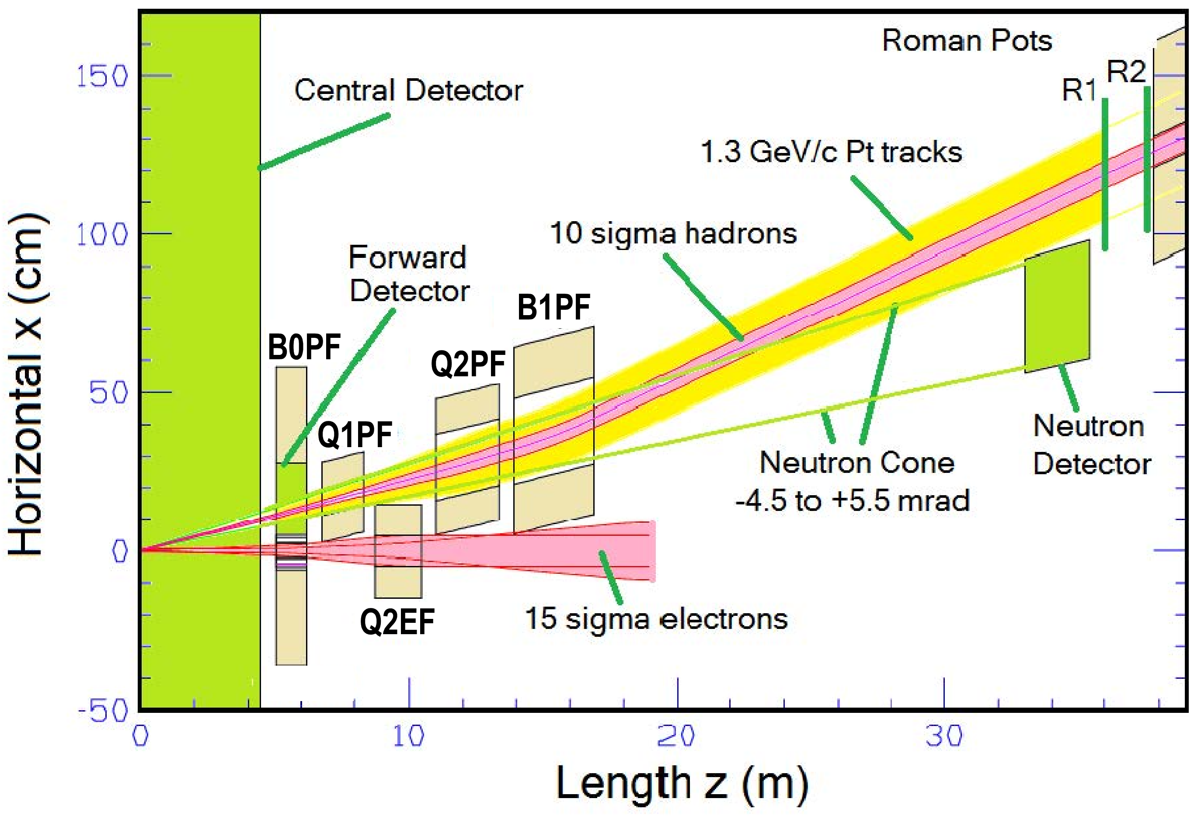
eRHIC IR magnets
B. Parker gave us a very detailed presentation of the IR magnet designs
  They have found a design that avoids Nb₃Sn magnets
Forward physics dominates these apertures!
-> Proton/Ions ->
-> Neutrons ->
<- Electrons <-
(preCDR)
Critical Magnet

Slide 16
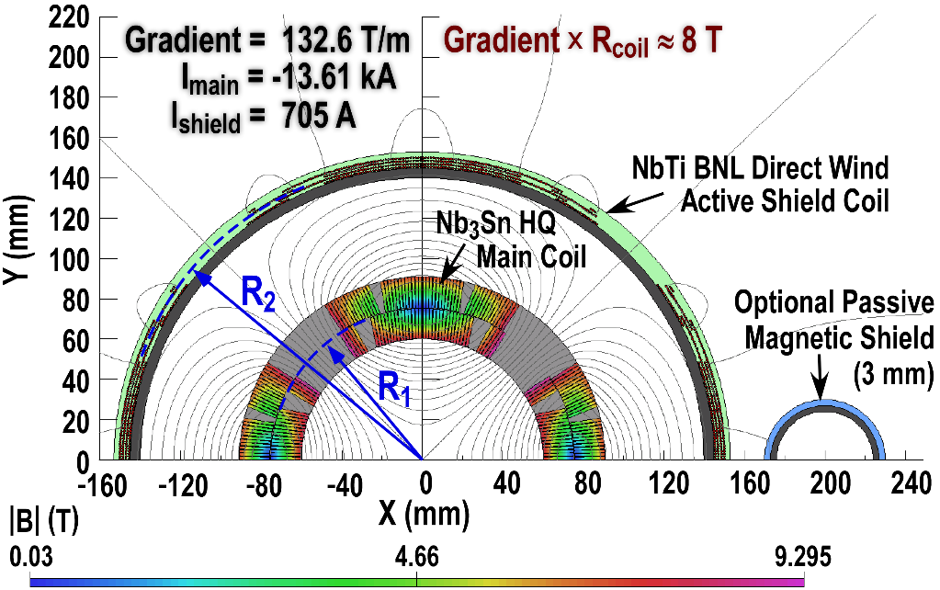
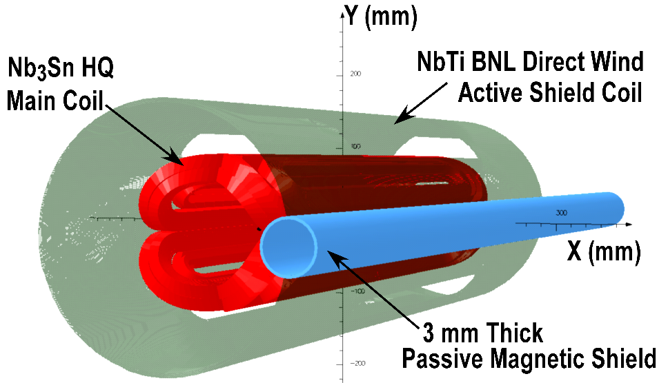
Active Shielding for EIC IR Quadrupoles
Actively Shielded Coil Designs
Coil Field |B| T
As with the ILC QD0 we can use an Active Shield (here an anti-quad) to eliminate the external field.
An Active Shield is useful for large crossing angles, since one can null the external field over a large region.
Field cancellation leads to gradient loss
Active Shield magnets are of interest for both the BNL and JLAB EIC IR designs and thus represent an area of common R&D interest.
2D and 3D Models
G_{Final} = [ 1 – (R₁/R₂)⁴ ] G_{Main}
Here 9.3 T at coil but few gauss at e-beam!
Models correspond to the “Fast Track” R&D actively shielded quad now in production.

Slide 17
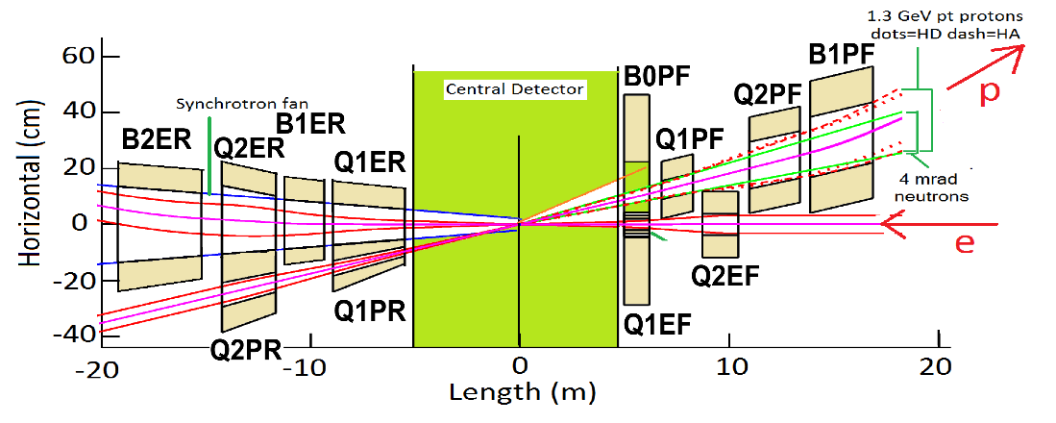
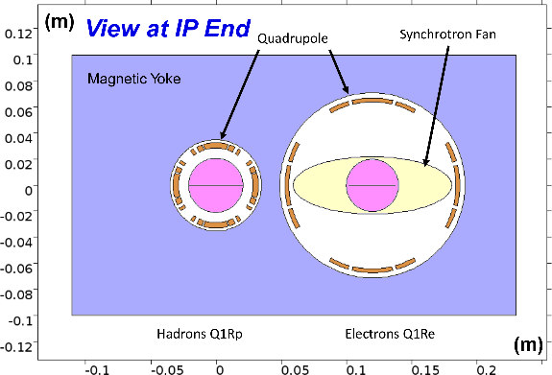
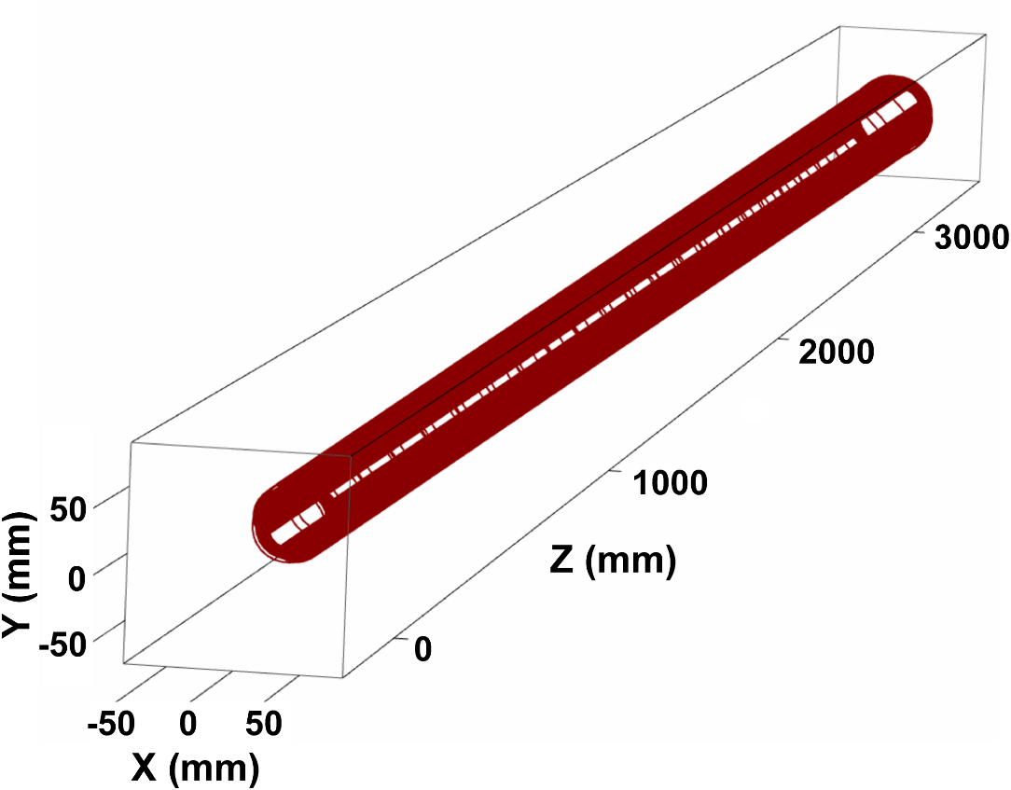
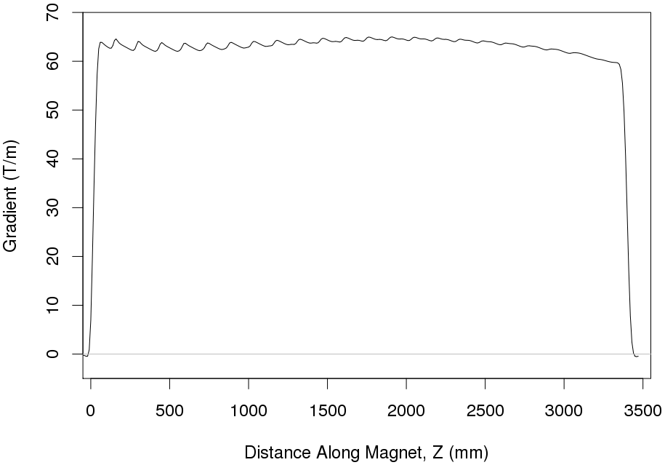
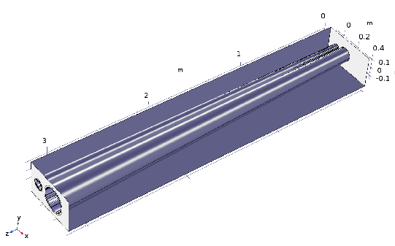
eRHIC: (preCDR)
Q1PR/Q1ER Designs
Rear Side
Both quads are side-by-side in a common yoke.
Must pass through synrad fan from the upstream Q2EF/Q1EF IR quads.
Tapered coils maximize yoke thickness between apertures (reduce yoke saturation between apertures and magnetic crosstalk).
Q2PR/Q2ER have similar design but not as challenging due to the larger beam separation at their location.
B1RE/B2RE are low-field dipoles with tapered coils and thin yokes.
Forward Side
This is one of the harder magnets to design. It has a tapered double bore inside a magnetic yoke.
Q1PR/Q1ER
Concept for a Direct Wind tapered coil design for Q1PR that has a nearly
constant gradient
along its entire
length
Q1PR Gradient Z Dependence
As the coil radius increases the gradient would naturally drop. but we can use techniques developed for the design of the SuperKEKB external field cancel coils to keep gradient constant.
LDRD to do Double Helical coil R&D!

Slide 18
JLEIC IR magnets
T. Michalski gave two presentations about the JLEIC magnets
  Magnets have been designed to first order
  Cryostat structures are being modeled
Coil design of a large aperture downstream ion final focus magnet

Slide 19
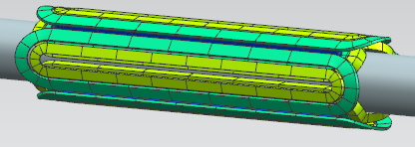
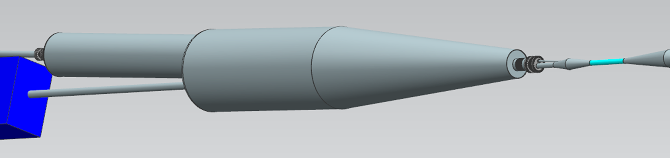
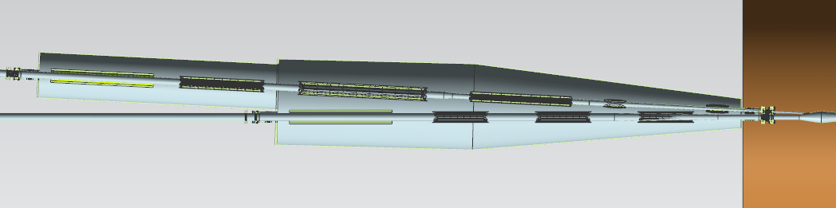
Ion Up Beam Area
Note that the cryostat is significantly larger than the magnets
‘Z’ spacing of the magnets
  Reserve 10 cm on each magnet end for field optimization, coil clamps, etc.
  Reserve 30 cm for a warm to cold transition and 10 cm for a bellows at the end of the cryostats
Eighteen plus multipole correctors and shielding coils in a single ~8.7 m long cryostat
  Three identical quads in electron line with nested skew quads
  Three quads in ion line with nested skew quads
  1.2 m solenoid in each line (same design)
  Two horizontal/vertical correctors in ion line near IP
Both the cryostat and cold mass will be supported in at least three locations with a minimum of twelve typical support rods on the cold mass.
A thermal shield will be included inside of the vacuum vessel and surround the entire cold mass.
The cryogenic feed and magnet lead can will be positioned on one side of the cryostat away from the detector elements.
Quad with nested skew quad
1st dipole in Compton chicane
AASOLEUS
i
QFFB3_US
QFFB2_US
QFFB1_US
IPUSCORR1
IPUSCORR2
e
EL SOL ANTI_DS
QFFDS3
QFFDS2
QFFDS1
~8.7 m

Slide 20
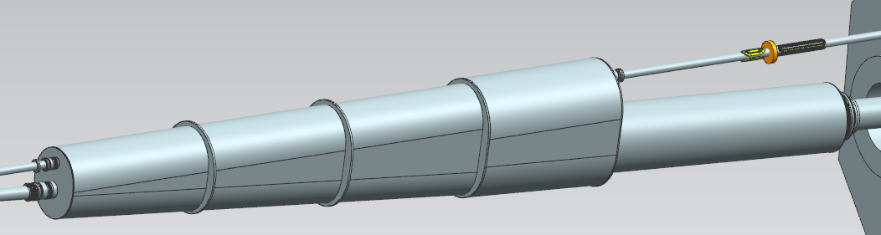
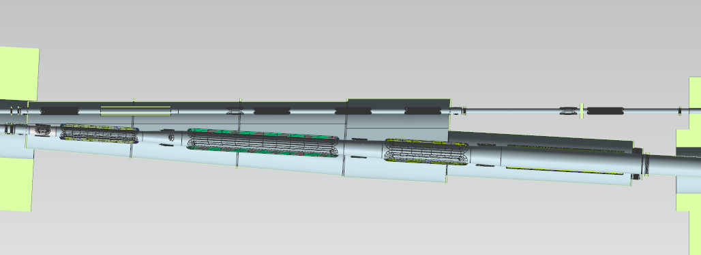
Ion Down Beam Area
Note that the cryostat is significantly larger than the magnets
Fourteen magnets plus multipole correctors and shield coils in a single ~10.4 m long cryostat
Transport quads are superconducting as warm magnets impinge on the radial space of the ion beamline – same design as the other electron FFQs
Three large bore, high strength quads in ion line (QFFB1, 2, 3)
Large bore solenoid in ion beam line (AASOLEDS)
Four separate skew quads in ion line – (QFFDS01S, 02S, 22S, 03S)
Looking at shielding design and magnet support structure near the QFFB2 magnet
SB1
QFFUS3
EL SOL ANTI_US
Transport Quads
e
Warm Quad Girder
QFFB1
QFFB2
QFFDS01S
QFFB3
AASOLEDS
QFFDS02S
QFFDS22S
QFFDS03S
i
SB2
~10.4 m

Slide 21
IR Parameter Validation
Overview of Interaction Region Requirements
Interaction Region Layout Overview
FFQ Parameters – Detector Acceptance
Dynamic Aperture
Multipole Analysis
Corrector Schemes
Extrapolation of Existing Magnet Data – Beam Dynamics Aspects
Extrapolation of Existing Magnet Data – Engineering Aspects
Heat and Radiation Loads on IR Magnets
Timetable of Activities
Summary

Slide 22
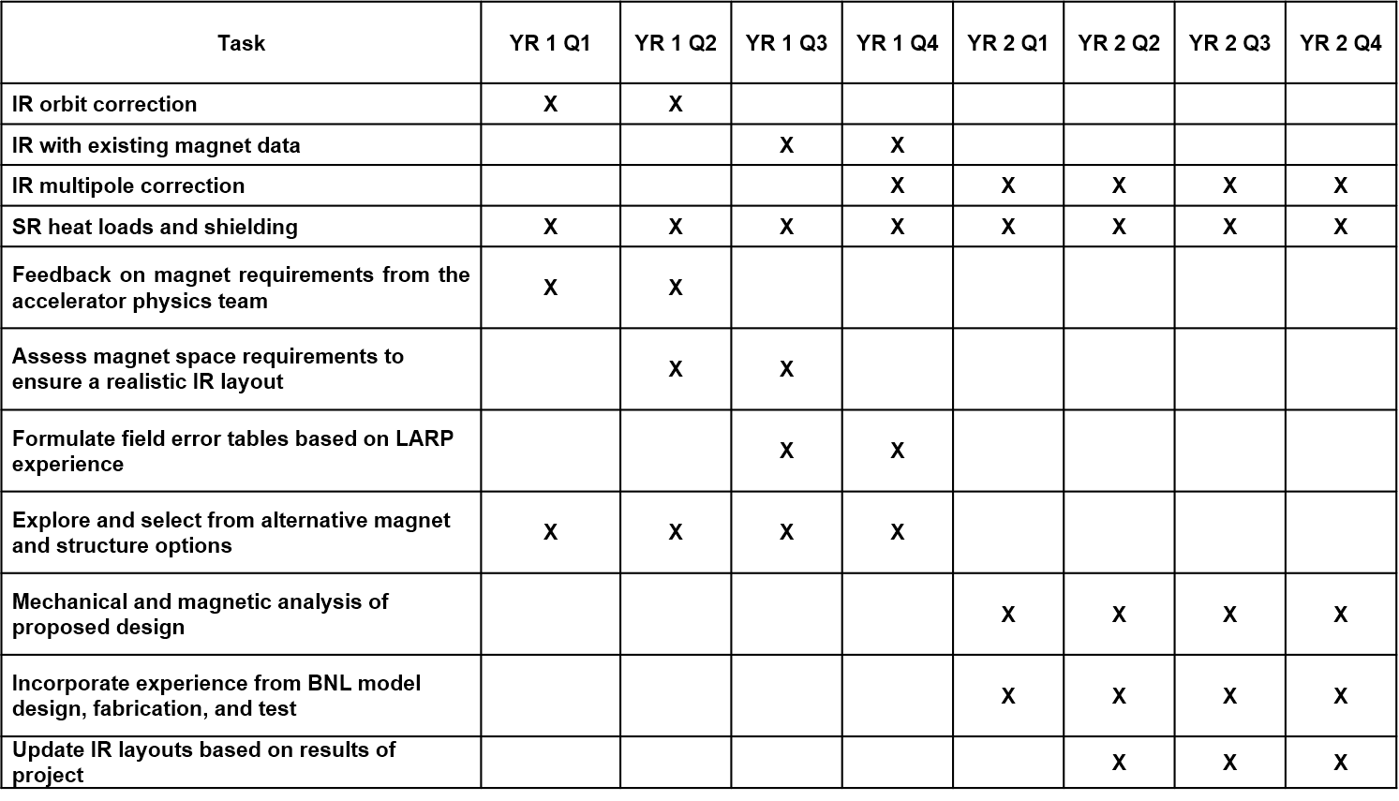
Validation of JLEIC IR
Tim showed a road map for the FOA funding and how we plan to meet the goals specified in the FOA.

Slide 23
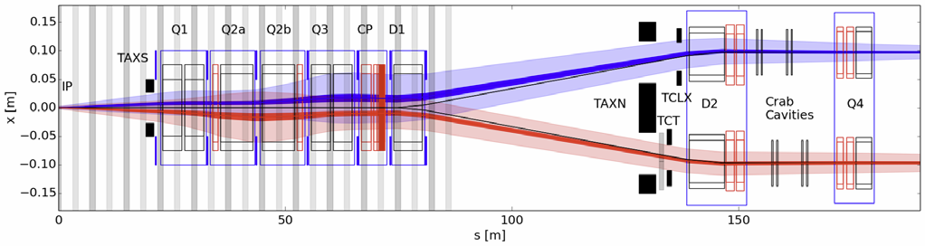
HL-LHC Magnets
G. Sabbi (LBNL) presented the design and construction of the high-luminosity magnets for the final focus of the LHC
  These are Nb₃Sn magnets
Large Aperture IR Quadrupoles:
From 70 mm MQXA/B to 150 mm MQXF
From NbTi to Nb₃Sn for higher field/gradient
Minimum β* from 0.55 m to 0.15 m
Compatible with 10x integrated luminosity

Slide 24
Nb₃Sn technology: Potential and Challenges
Potential:
Nb₃Sn critical temperature and field are about a factor of 2 larger than in NbTi
Significantly expands the magnet design space: higher field and temperature margin
He pointed out the difficulties and the benefits
Challenges:
Material | NbTi | Nb₃Sn
Dipole Limit | ~ 10 T | ~ 16 T
Reaction | N/A | ~ 675⁰C
Insulation | Polyimide | S/E Glass
Coil parts | G-10 | Stainless
Irreversible Axial Strain | N/A | 0.2-0.5 %
Transverse stress | N/A | ~ 200 MPa
Brittle material: severe damage in cabling/winding
  React coils after winding
  New materials (insulation, coil parts)
High sensitivity to stress/strain:
  Epoxy impregnation
  New mechanical designs

Slide 25
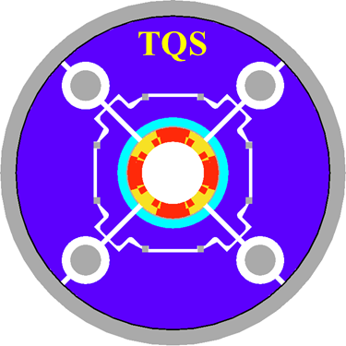
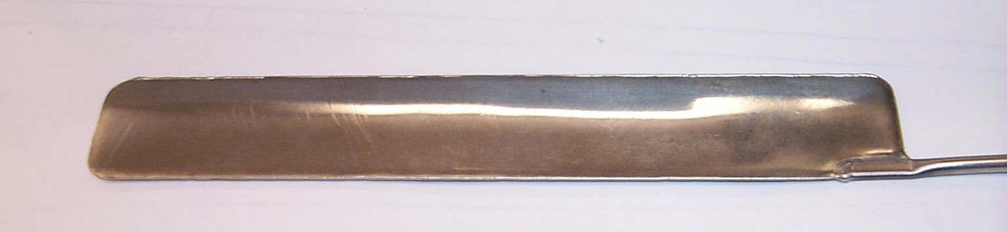
Mechanical Design of High Field Nb₃Sn Magnets
Mechanical design of Nb₃Sn magnets needs to satisfy stringent constraints
  Full support without exceeding conductor stress limits
LARP approach relies on aluminum shell on iron yoke, preloaded with pressurized bladders and interference keys
  Minimize and precisely control warm pre-load
  Increase to full pre-load during cool-down, avoiding overshoot
Aluminum
shell
Slots for
pressurized
bladders
In order to pre-stress the magnet design prior to cool-down, interference keys are inserted into the structure through the use of a water bladder. The magnet requires less training and has more repeatable quench maps.
Water-pressurized bladder for assembly pre-load
Interference
Keys
Axial
rods

Slide 26
Discussion session
After these talks we had a discussion session and came to some conclusions
  The detector groups (JLEIC and eRHIC) will try to put together a set of physics channels that best define the acceptance requirements for the detector
  We think that such a short list of channels will help to sharpen the detector acceptance requirements for the engineers and accelerator physicists

Slide 27
Discussion session (2)
We all have the feeling that there are lot of things that need to be done in order to make further progress and end up with valid IR designs and that manpower is limited (chicken or egg problem)
  Perhaps we can meet more often than once or twice a year and in smaller groups that are concentrating on a particular aspect of the design
  A case in point was mentioned by E. C. Aschenauer – the luminosity detector

Slide 28
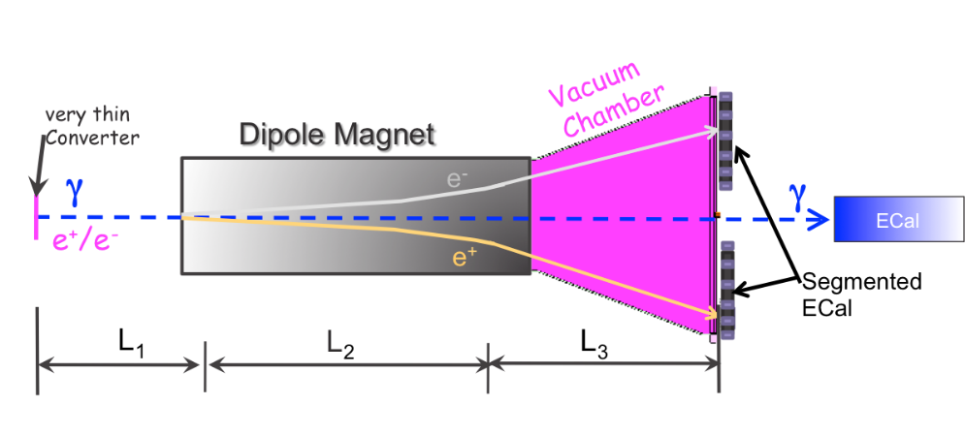
Requirements for Lepton Beam
Both teams (detector and accelerator) have an interest in this part of the IR.
The detector needs a precise measurement of the luminosity and, because of the two beam polarizations, preferably single bunch measurements. This also goes for the polarimeter.
The accelerator also needs to have the luminosity of every bunch as a great deal of information can be learned about the machine performance this way
Luminosity Detector
Concept:
Use Bremsstrahlung ep → epγ as reference cross section
different methods:
  Bethe Heitler, QED Compton, Pair Production
Hera: reached 1-2% systematic uncertainty
Goals for Luminosity Measurement:
Integrated luminosity with precision δL/L< 1%
Measurement of relative luminosity:
physics-asymmetry/10 → ~10⁻⁴ – 10⁻⁵
EIC challenges:
with 10³³ cm⁻²s⁻¹ one gets on average 23 bremsstrahlungs
photons/bunch for proton beam
→ A-beam Z²-dependence
Need more sophisticated solution
BH photon cone < 0.03 mrad
→ acceptance completely dominated by lepton beam size
pair spectrometer
low rate
High precision measurement for physics analysis
The calorimeters are outside of the primary synchrotron radiation fan
zero degree photon calorimeter
high rate
Fast feedback for machine tuning
measured energy proportional to # photons
subject to synchrotron radiation
E.C. Aschenauer

Slide 29
Discussion (3)
This is one case that was mentioned and there are obviously many more such topics that can be listed
  A possibility might be that a small team can take a shot at a particular topic with a serious attempt to study the problem in some detail (perhaps do some simulations or modeling) and then write up their results
  In this way it may be possible to chip away at our long list of “things to do”

Slide 30
Summary and Conclusion
The IR/MDI session made good progress at getting a better understanding of the two IR designs
Some of the difference stems from the initial parameter selections (i.e. no accelerator element inside ±4.5 m, or very short ion and electron bunches)
The presentations hammered home to me that we have a really complicated IR design (either machine!) out to at least ±30 m and beyond if we include crab cavities and polarimeters.
Both designs need further more detailed work in order to get a better grasp of the technical challenges ahead and to converge to a design we all feel can be built

