Slide 1
Collective Effects in eRHIC
Michael Blaskiewicz
Oct 29-Nov 1, 2018

Slide 2
Outline
Coherent Instabilities
Laslett Tune Shift in ESR
Intrabeam Scattering
Fast Beam Ion Instabilities
Vacuum Issues in the Hadron Ring
Conclusions

Slide 3
Coherent instability simulations [1]
V_{x} is the transverse voltage due to the wall induced wakes.
Assume the single sideband approximation is valid and take 1<Q<2 while modifying κ appropriately.
Update several (≈10) times per turn (betatron oscillation).
Nonlinear V(θ,τ) includes time dependent longitudinal space charge as well as synchrotron tune spread; important for collisionless damping.
Moment equations of corresponding Vlasov equation close in linear order.

Slide 4
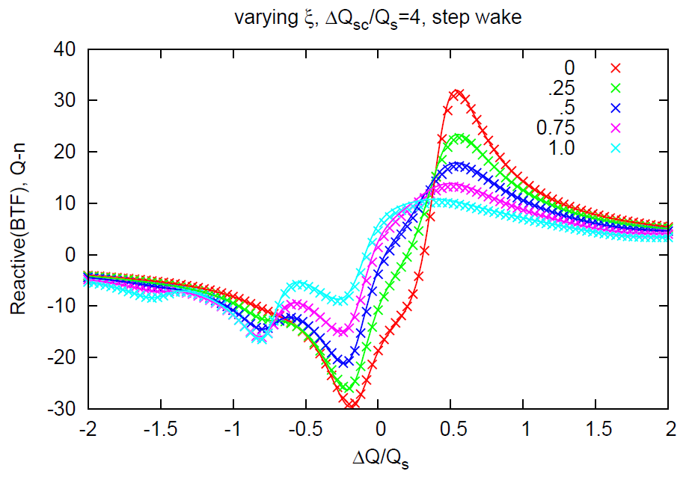
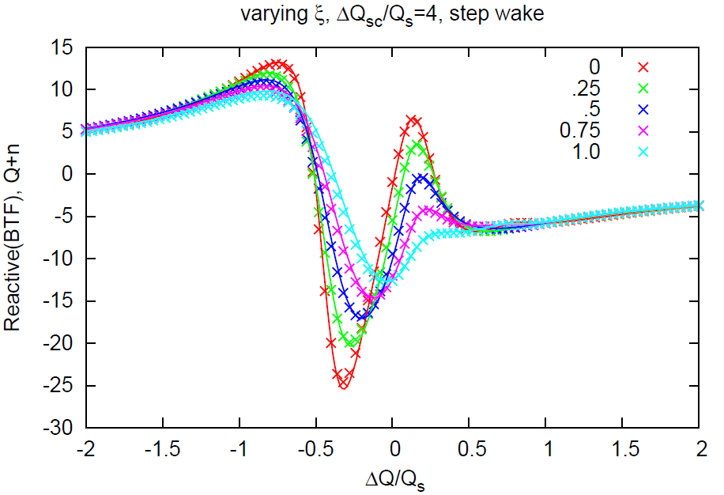
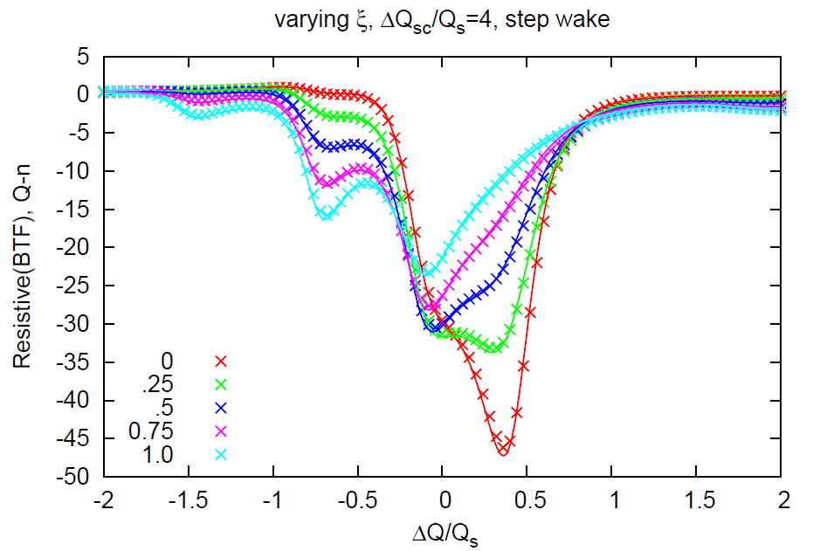
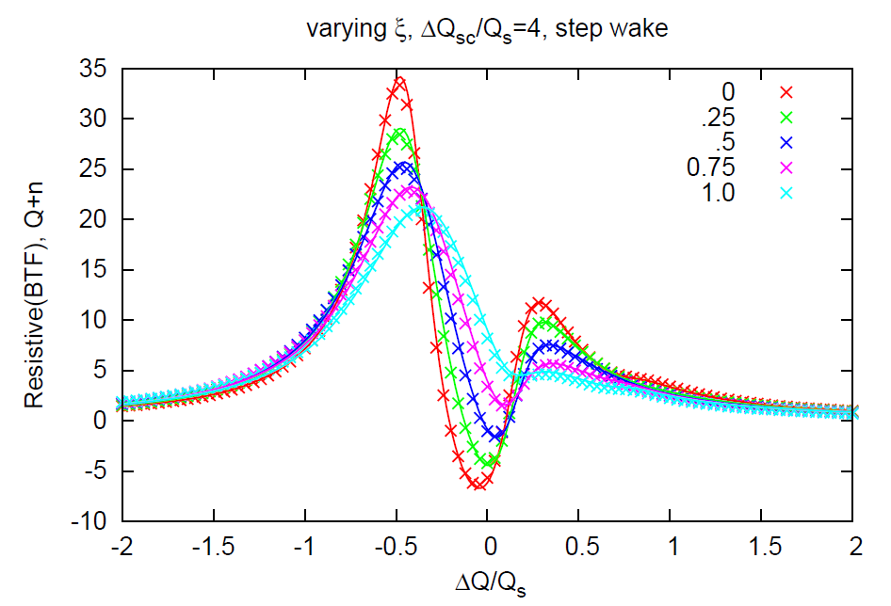
BTFs using simulations (lines) and solution of Vlasov equation (x). Full bunch length = ½ center wavelength. Good agreement suggests both are OK.[2]

Slide 5
Instabilities in the electron storage ring
Take a broad band impedance with |Z/n| = 0.1Ω. Model as a Q=2, f_{res} =20 GHz resonator.
The transverse impedance has same f_{res} and Q with Z_{y} = 2∙R ∙ |Z/n| / b² with R = 610 m, b=2 cm (0.3MΩ/m).
The narrow band HOMs are found from analysis of the RF cavities.
For simulations we take a uniform fill of 720 bunches and track 5 contiguous bunches. Coupled bunch modes (CBMs) are included.
One transverse and one longitudinal ‘worst possible’ HOM has been used so far. Transverse growth rates for CBMs using short bunches agree very well with handbook formulas.

Slide 6
Electron storage ring
The electrons require a longitudinal damper for narrow band CBMs
Broad band longitudinal instabilities and all transverse instabilities are Landau damped.

Slide 7
Fallback
The third harmonic RF system is challenging.
Increasing the 10 GeV energy spread to 1.0x10⁻³ and the 5 GeV spread to 1.2x10⁻³ allows us to operate at nominal bunch currents with no third harmonic system.
This places additional stress on the lattice design.
If we increase energy spread by increasing the strength of the reverse bends, we increase radiative losses.
This will reduce the allowed electron current at 10 GeV.
Increasing bunch length using RF modulation is being considered.

Slide 8
Instabilities in the hadron ring
Hadrons have space charge and no radiative damping. We need to be able to tell the difference between actual instabilities and growth due to finite N effects.
continuum

Slide 9
Proton results
Measured broad band impedances for RHIC are Z/n=5Ω, Z_{y}=10MΩ/m. Modeled as Q=2, 5GHz resonators.
Poorly known, narrow band modes are the main concern. Behavior at injection shown below.

Slide 10
Proton instabilities continued.
Transverse dipole mode at injection due to narrow band impedance.
The magenta sine wave is at the resonant frequency of the HOM.
The number of macroparticles was varied between 10⁵ and 2x10⁶.
No significant difference was seen.
We might need narrow band dampers for the protons.

Slide 11
Protons at 255 GeV (275 easier)
Top energy looks stable.
No transverse growth or single bunch longitudinal growth was see.
The figure on the right shows growth in the longitudinal emittance at flattop when we include the narrow band impedance.
The ratio of the number of macroparticles is 4.
The ratio of the growth rates is 3.8.

Slide 12
Rapid cycling synchrotron
Inject at 400 MeV in a 3.8 km ring
Designing for one bunch but, a short train is probably OK
Beam at injection is stable for parameters on the right.
Ramping simulations are starting.

Slide 13
Laslett tune shift in the ESR
Formula from Handbook [3]
5 GeV ΔQ_{x}=0.13, 10 GeV ΔQ_{x}=0.067
The focusing is very smoothly distributed so the beta beat associated with correcting the tune is expected to be very small. We need to verify this.

Slide 14
Intrabeam Scattering and Emittance Growth
We have Betacool and various other codes based on the Piwinski and/or Bjorken Mtingwa formalisms.
Recently implemented fully coupled Piwinski [4]
Betacool and uniform Piwinski used most so far.
When action diffusion rates are important (like in spin diffusion) we have subroutines to evaluate the relevant integrals [5].
Data (black) and simulation (magenta) of Au with IBS in RHIC over 5 hours.
Uniform lattice Piwinski model.
No free parameters.
1 hour 2 3 4 5
35 ns

Slide 15
Fast Beam Ion Instability (FBII) [6,7]
The fast beam ion instability is a transverse instability that saturates at a relatively low level.
In an electron ion collider this can be a big problem because the beam-beam force transmits the coherent motion of the electron bunches to the ions.
δx is electron bunch
offset

Slide 16
FBII
Slow variations in δx are OK but we need to worry about power in the lowest hadron betatron sideband. The emittance doubling time is.
Where ρ(n) is the correlation function of δx, ρ(0)=1.

Slide 17
FBII
As electrons travel around the storage ring they ionize background gas.
These ions are positively charged so the negatively charged electron bunches tend to focus them and keep them near the center of the beam pipe.
The net force on an electron bunch is equal and opposite to the net force it exerts on the ions.
If the electron bunches have small initial betatron oscillations these forces can cause the oscillations to grow.

Slide 18
FBII
Suppose the first bunch is offset.
Its ion cloud will kick subsequent bunches and be kicked by them.
The second plot happens ¼ betatron oscillation downstream
Vertical offset →
Time at a fixed azimuthal location →

Slide 19
FBII
The ionization happens continuously around the ring.
For the purposes of simulation we assume the ions are confined to thin lenses spaced evenly around the ring.
Too few lenses can lead to spurious resonances (differential equations versus maps)
The ions barely move during the passage of a single electron bunch, neglect it.
We want to reduce noise due to the small number of macroparticles. Use a smooth distribution for the electron bunch. Apply the same ion kick to all the electrons.

Slide 20
FBII
Algorithm: Consider a single ion slice and an electron bunch with offset r_{e} traversing this slice.
1. Calculate σ_{x} and σ_{y} for the electron bunch.
2. Create ion macroparticle pairs and r_{e}+r_{j} , r_{e}- r_{j} , j=1,..K taking r_{j} from the 2D gaussian distribution and weight by the actual number created. Add these to the distribution of ions for this slice.
3. Calculate the kicks on the ions assuming a gaussian charge distribution for the electrons. Add all the ion momentum kicks together.
4. Use momentum conservation and give all the electrons the same kick.

Slide 21
FBII
5. Drift the ions until the next electron bunch arrives and remove any that hit the wall of the beam pipe.
6. Do this to the ions in this slice for the rest of the electron bunches in the ring.
7. Transport the electrons to the next ion slice and repeat.
8. Do beam-beam kick (assuming quadrupole corrections) and (possibly) transverse damper once per turn.

Slide 22
FBII
The key to making this all work is that the ion slices interact strongly with the electrons but the ion slices do not strongly interact with each other and vice versa.
ions/meter/second
The clearing time is a few turns, tens of microseconds.
λ_{I}≈10⁶ ions/meter, λ_{e}≈10⁹ electrons/meter so electric fields from electrons are orders of magnitude larger than fields from ions.
The force on the electrons is E+vxB and is (vastly) dominated by the ions.

Slide 23
FBII
Initial simulations look reasonable.
These are for rigid electron bunches.
Code allows for many macro-electrons per bunch to take advantage of beam-beam and chromatic tune spread.

Slide 24
FBII
Initial results for eRHIC including beam-beam tune spread.
The plot on the right shows that between 2k and 200k particles the rms fluctuation in the electron centroid is just statistical.
If this holds until N_{m}= 100M we guarantee a 20 hour emittance doubling time.

Slide 25
Benchmarking and Moving Forward
The NSLS-II suffers from FBII and it is controlled with a damper.
They have shared data with us and have agreed to make some measurements expressly designed to test the simulation code.
We plan to modify the code to give kicks that are linear in offset with no memory of previous turns to compare with analytic theory.
The basic physics is pretty straightforward and no difficulties are anticipated on the computational side.
If instabilities are seen the difficulty will be in getting a clean enough pickup signal.

Slide 26
Cryogenic Limits in the Hadron Ring [8]
We need to coat the vacuum chamber with copper to reduce resistive heating below 1 W/m.
A mole employing magnetron sputtering is under development.
A niobium cavity with an insert to test the surface conductivity of the coating at cryogenic temperatures is being used to test deposition techniques.

Slide 27
Electron Clouds
We use CERN’s PyECLOUD code and my CSEC, upgraded for dipole fields.
Benchmarking in dipoles shows agreement at the 20% level.
Recent work at CERN on copper has shown that scrubbing can stop with a peak SEY of 1.6.
Both codes show that a peak SEY of 1.6 results in unacceptable electron clouds in eRHIC.
We need at add an extra layer over the clean copper.
We are looking at “black” copper and amorphous carbon coatings.
Amorphous carbon has a peak secondary yield less than 1 and will work.
Black copper requires R&D but has the benefit that it is fixed.
We are entering into an agreement with CERN to measure the SEY of our surfaces.

Slide 28
Conclusions
We have studied several collective effects issues and found that they will be manageable in a state of the art machine.
The most worrisome collective effects are fast beam ion instability in the electron storage ring and electron clouds in the hadron ring.
A concerted effort is being made to model these problems.
In the case of FBII, data are being gathered to both check the input parameters and the modeling itself.
If FBII appears unavoidable the noise in the damper is the primary concern and a concerted effort will go into low noise design.
For electron clouds we expect the secondary yield at no more than 1 so that safety is guaranteed.

Slide 29
References
[1] M. Blaskiewicz, TRANFT User’s Manual, BNL-77074-2006-IR
[2] M. Blaskiewicz, NAPAC13, froaa2
[3] Handbook of Accelerator Physics and Engineering, Chao, Tigner eds., World Scientific 1999, pg 113.
[4] A. Piwinski, DESY 90-113 (1990), also CERN 92-1, p 226 (1992).
[5] Zenkevich, Boine-Frankenheim and Bolshakov NIMA, v561, p 284, (2006)
[6] Stupakov, Raubenheimer & Zimmermann PRE 52, 5499 (1995). Also R&Z PRE 52, 5487
[7] R. Nagaoka, ICFA Newsletter #69, p 227 (2016) and references therein
[8] A. Hershcovitch et. al. IPAC2014 thpri114 and references therein

