Slide 1
CBETA, an test facility for the EIC
JLAB, 1 November 2018
Georg Hoffstaetter (Cornell)

Slide 2
Message
The accelerator I am presenting has beam parameters of an EIC electron cooler and provides a prototype for such an instrument.
It is unique in that it
is the first 4-turn SRF ERL
has the first NS FFA loop with large (x4) momentum aperture
has the first long-distance beam through Halbach magnets
has the largest electron beam power in an ERL
It is being constructed in a Cornell/BNL collaboration and its main components have been beam-tested.
It is commissioned in a world-wide collaboration, incl. JLAB, and an international ERL Technology Collaboration formed that supports such work.
It has applications beyond EIC research

Slide 3
High Beam Current at Reduced Cost
By recovering the Energy of accelerated beams, Energy Recovery Linacs (ERLs) make large beam powers possible that would otherwise be prohibitively expensive.
Linacs produce high beam qualities for scientific experiments and for industrial applications, but their beam power is limited by the available electrical power.
ERLs surpass this power limit: much larger beam currents and beam powers become available because the beam energy is recaptured.
How do ERLs compare to other accelerators?
high currents, like storage rings, because the energy is recovered,
high beam quality (low emittance, bunch length, and energy spread) like linacs, because each bunch traverses it only once,
tolerates beam disruption as each bunch is used only once before it’s discarded.
All these strengths of ERLs are beneficial to EIC cooling and for other high beam-intensity applications!

Slide 4
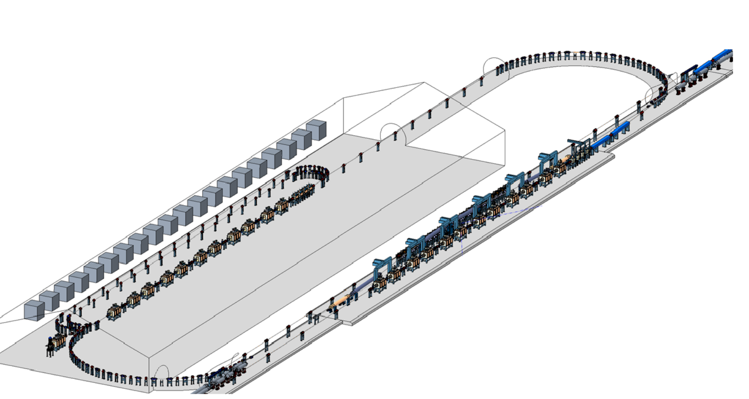
ERLs projects: Electron Ion Colliders
Strong Hadron Cooling for EICs
Both EIC projects, the one at BNL and the one at JLAB, plan to cool the hadron beam with electrons.
Required beams:
Up to 100 mA CW electron beams at
up to 150 MeV
Note: 15MW !
Previous projects have concerned
High-power FELs
Coherent light sources
Lithography for chip production
Compton backscattering sources

Slide 5
The test ERL in Cornell’s hall LOE
Cornell DC gun
100mA, 6MeV SRF injector (ICM)
600kW beam dump
100mA, 6-cavity SRF CW Linac (MLC)
Existing components at Cornell
6 MeV
6 MeV
+/- 36 MeV
Electron Current up to 320mA in the linac
Bunch charge Q of up to 2nC
Bunch repetition rate 1.3GHz/N
Beams of 100mA for 1 turn and 40mA for 4 turns
42, 78, 114, 150 MeV

Slide 6
The CBETA CDR
Previous funding leading to CBETA
2005 Start of construction of DC photo-emitter gun; to world record current (75mA).
2012 PD-Design on a hard x-ray 5GeV Cornell ERL, not built.
2013 Cornell’s ERL injector achieved world record brightness.
2014 White paper for CBETA in Cornell / BNL collaboration.
2016 2nC bunch charge for EIC.
2016 Construction funding by NYS begins.
2017 CBETA Design Report
2018 1st beam thorough SRF chain, one separator and one PMA unit.
Staring in 2020, CBETA will be available for R&D on high power beams!

Slide 7
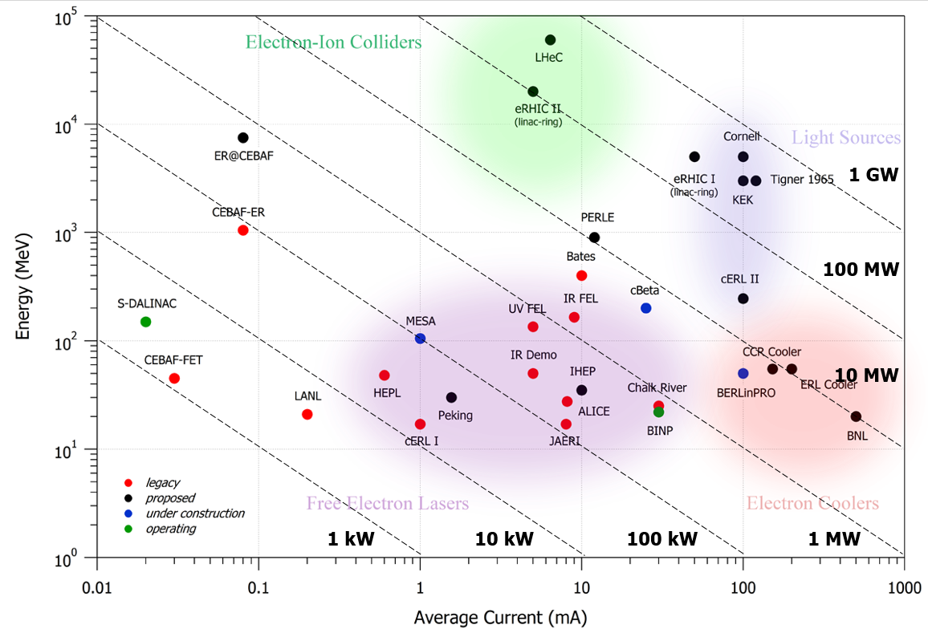
The beam power frontier
eRHIC cooler
CBETA has 150MeV and up to 40mA: 6MW beampower => Delete black
eRHIC cooler ERL has 150MeV and up to 100mA: up to 15mW

Slide 8
The beam power frontier
eRHIC cooler
Home projects of collaborators who joint in recent CBETA running

Slide 9
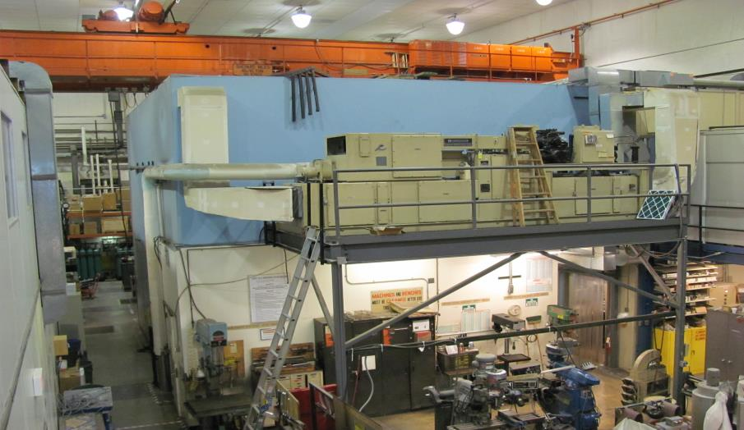
Hall L0E before CBETA
L0E contained approximately 7,000 square feet of Lab and Shop space

Slide 10
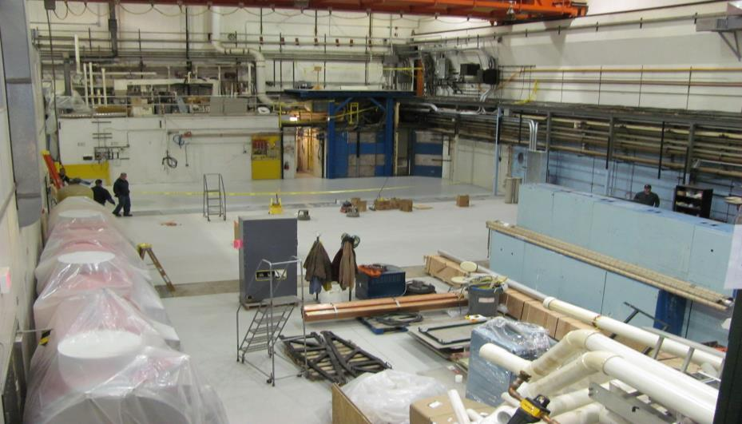
Spring 2015
70% of the existing technical-use space was removed for the initial phase

Slide 11
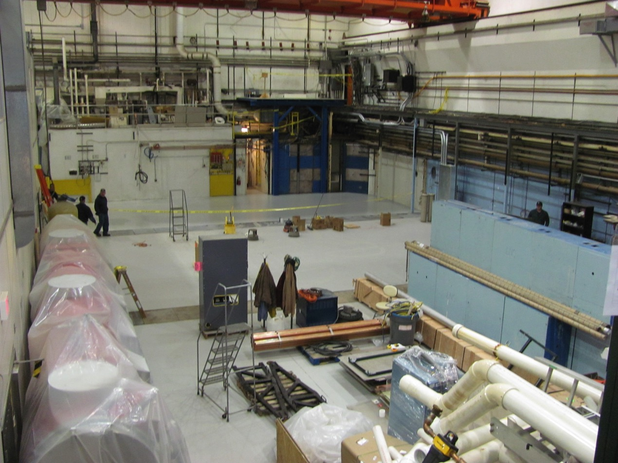
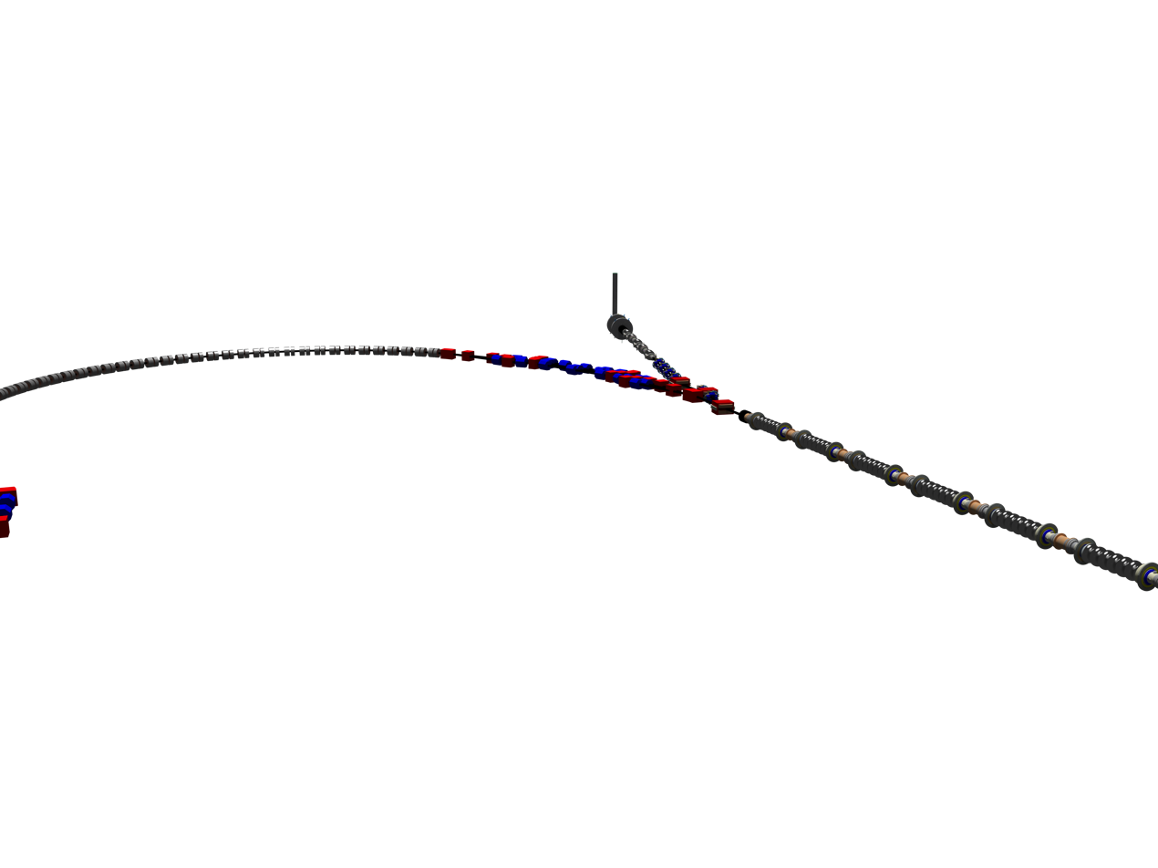
L0E cleaned with CBETA

Slide 12
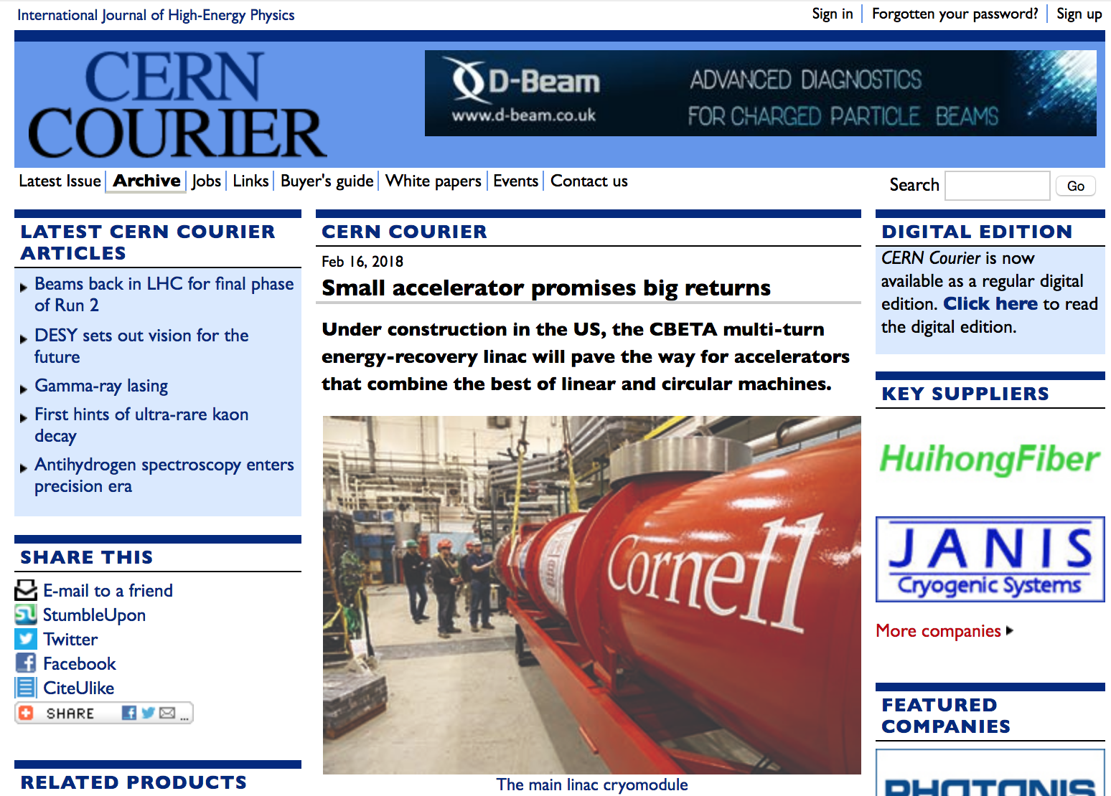
Installation milestones

Slide 13
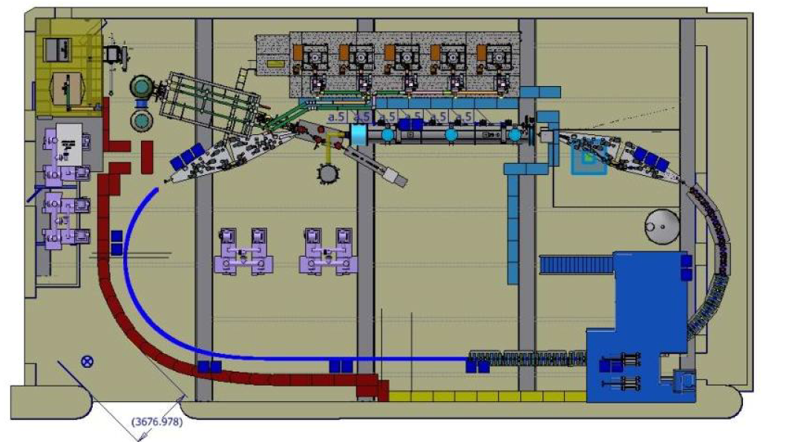
CBETA in its Hall L0E
Installed: DC gun

Slide 14
CBETA in its Hall L0E
Installed: DC gun, SRF injector

Slide 15
CBETA in its Hall L0E
Installed: DC gun, SRF injector, mirror diagnostics line

Slide 16
CBETA in its Hall L0E
Installed: DC gun, SRF injector, mirror diagnostics line, ERL cryomodule

Slide 17
CBETA in its Hall L0E
Installed: DC gun, SRF injector, mirror diagnostics line, ERL cryomodule
1st splitter of 8

Slide 18
CBETA in its Hall L0E
Installed: DC gun, SRF injector, mirror diagnostics line, ERL cryomodule
1st splitter of 8, 1st Fixed Field Alternating-gradient (FFA) girder of 25.

Slide 19
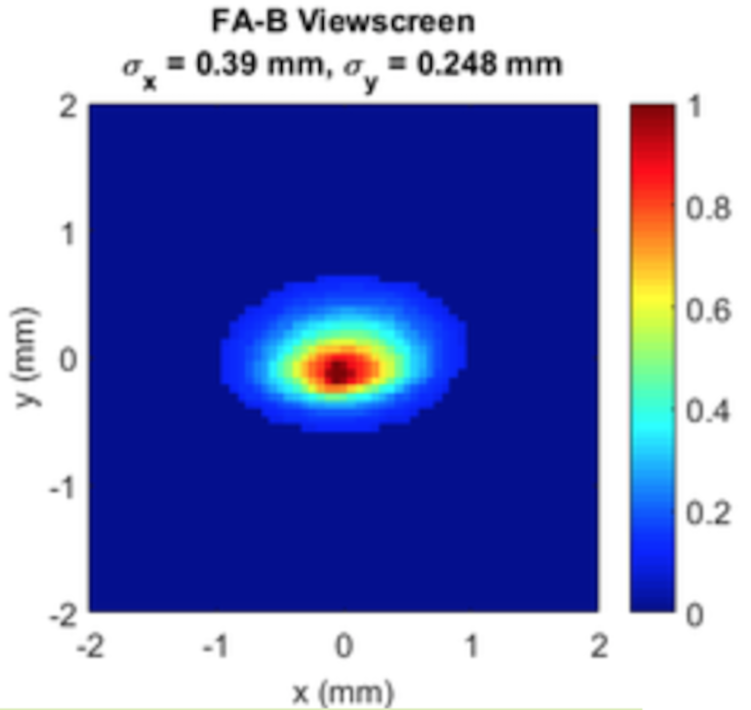
CBETA in its Hall L0E
The ERL Technology Collaboration (ERL-TC) is forming, modeled on the TTC, to support collaborative ERL research.
As a first step, visitors from 4 labs are participating in the current commissioning run: 3 from HZB/Germany, 2 from Darebury/UK, 3 from JLAB, 5 from BNL.
We encourage participation in the next commissioning period starting March 2019.

Slide 20
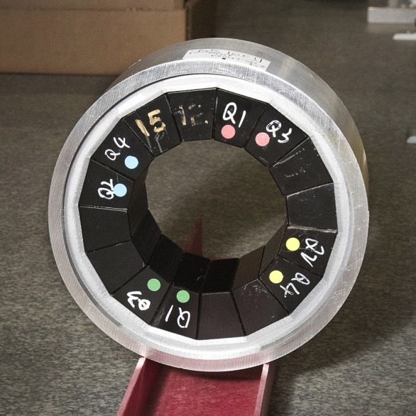
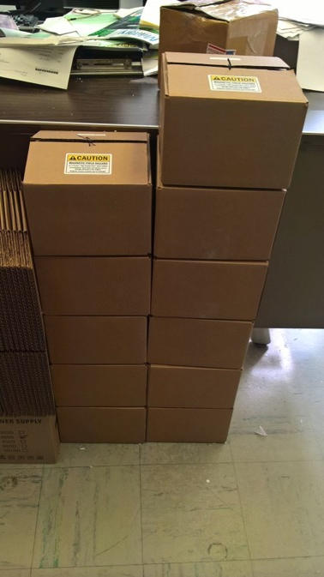
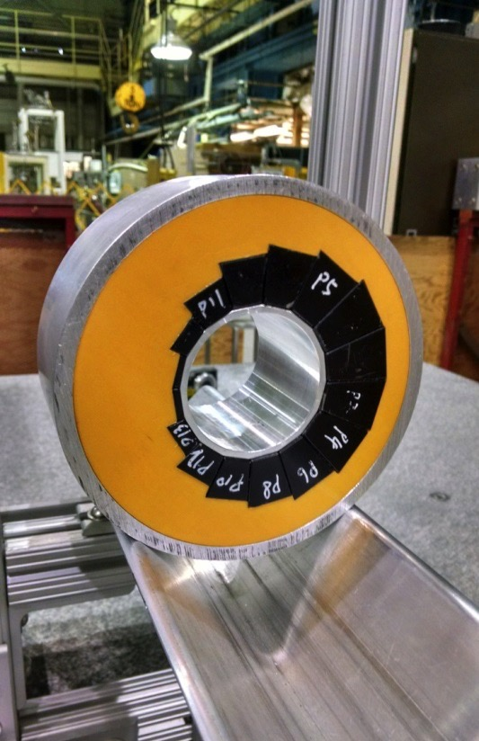
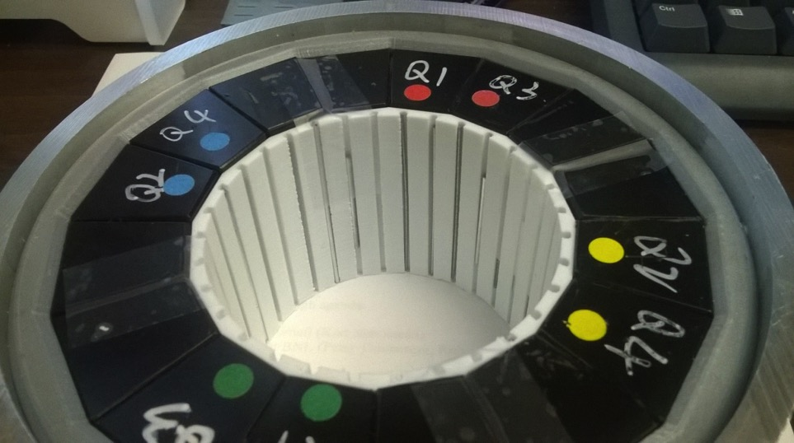
PoP QF
12 proof-of-principle magnets (6 QF, 6 BD) have been built as part of CBETA R&D.
Iron wire shimming has been done on 3 QFs and 6 BDs with good results.
PoP BD
PoP magnet series
Iron wire shims
January 30, 2017
Stephen Brooks, CBETA Technical Review
20

Slide 21
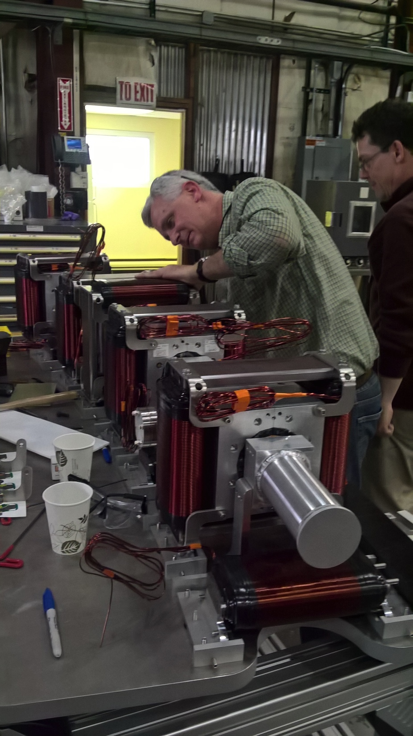
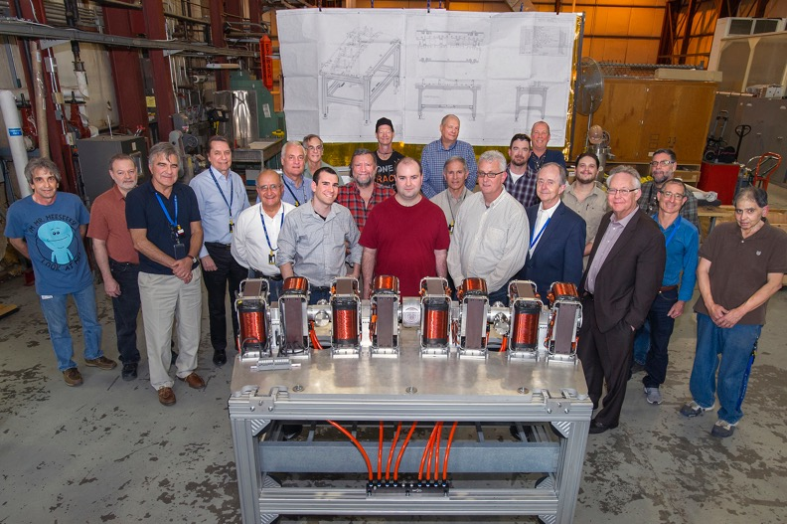
First Girder Construction

Slide 22
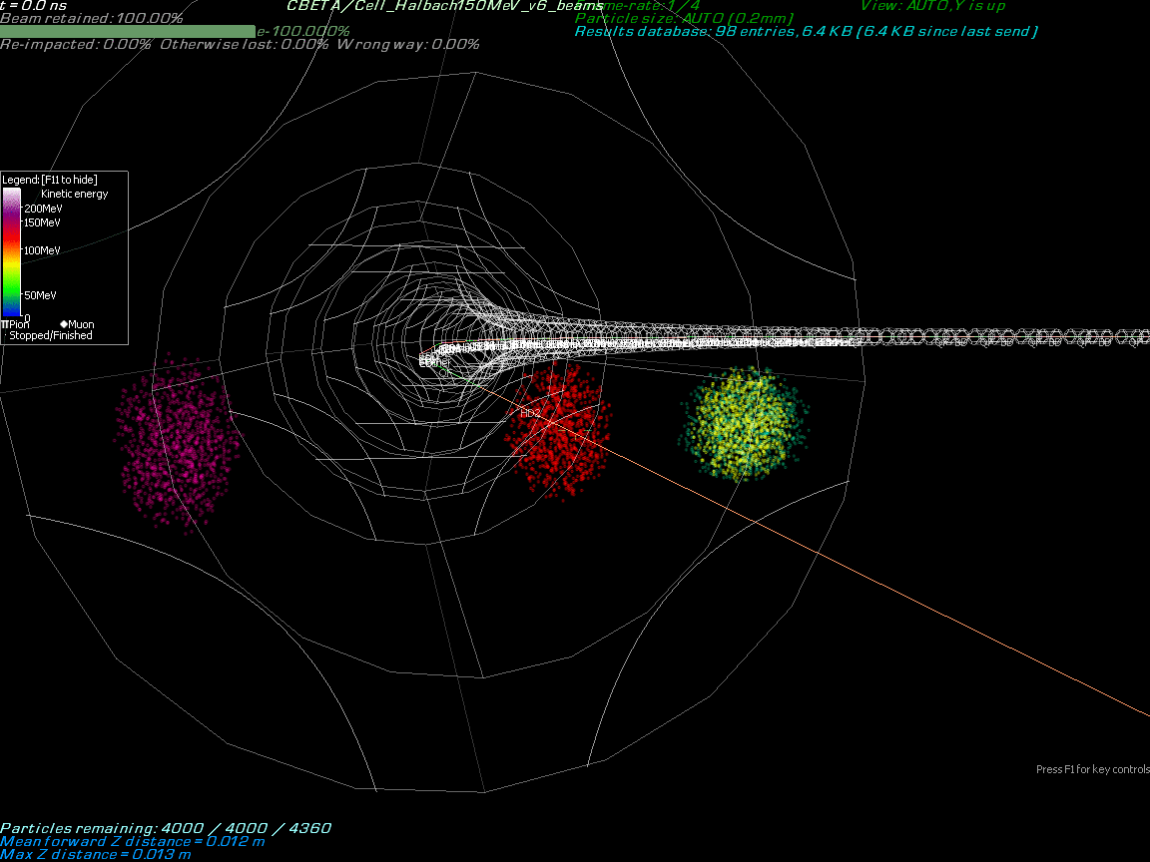
Final beam: 7 in one FFA chamber

Slide 23
Commissioning so far
DC gun currents up to 75mA
Record injector brightness to the theoretical limits.
MLC cavities function at high field an Q0 and their microphonics can be regulated.
DC gun, injector,
and MLC test
FAT April & May 2018
Main Linac Cryomodule (MLC)
Calibration
Maximum energy gain
Stability
Splitter / Permanent Magnet Arc (PMA)
Linear optics
BPM Correction
Orbit response
Dispersion / R₅₆
Tune
Path length adjustment
Injection Matching

Slide 24
Energy gains in cavities
Cavity | Stiffened | Field (MV) Design (Peak)
1 | No | 6 (9.5)
2 | Yes | 6 (10)
3 | No | 6 (7.5)
4 | Yes | 6 (10)
5 | No | 6 (8.5)
6 | Yes | 6 (11.3)
We have reached and exceeded our specifications by ~50 %!
Notes:
Using these strategies, we have been able to reach our field requirements, and in an energy scan experiment exceed them by almost 50%!

Slide 25
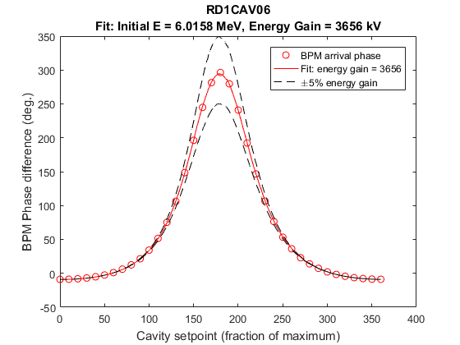
MLC Cavity Calibration
1) Beam enters at 6 MeV
2) Set cavity to ~few MeV energy gain, scan phase 0-360º
3) Measure arrive time (phase) at downstream BPM
4) Fit to numerical model
Three fit parameters:
Initial energy
Cavity energy gain
Overall phase
Cavity phase (deg.)

Slide 26
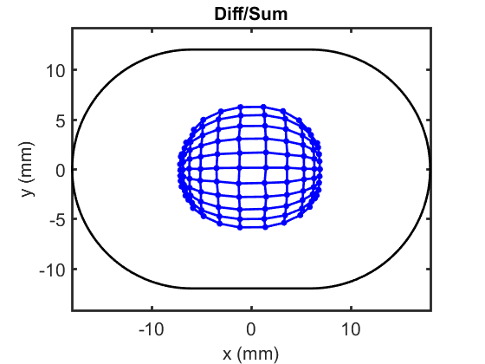
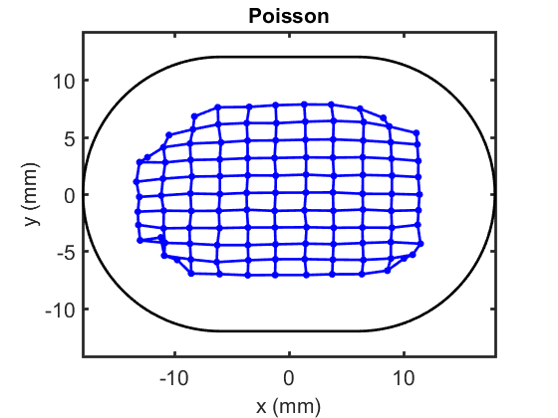
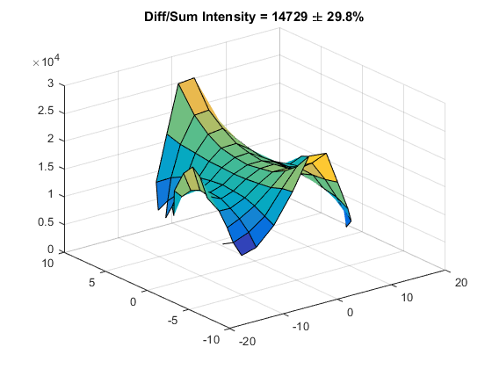
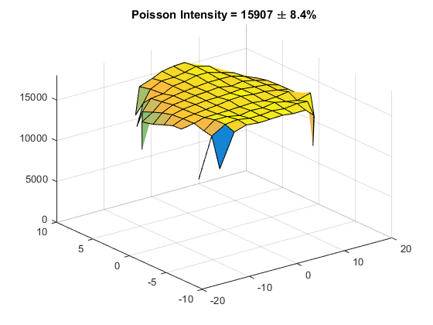
Nonlinear BPM calibration
Uncorrected
Corrected
Move beam in equal
H/V steps
After correction
Rectangular grid
Intensity uniform

Slide 27
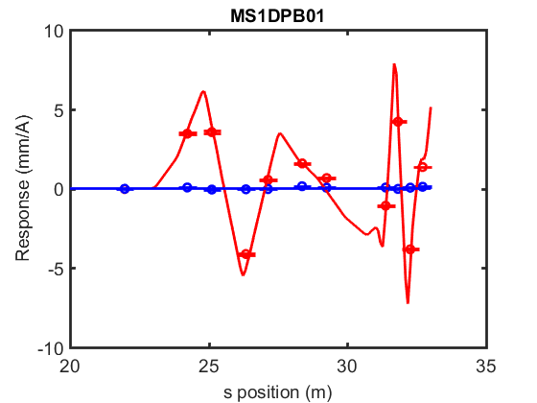
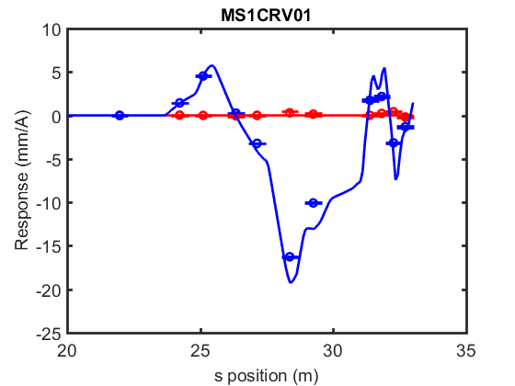
Orbit Response at 42 MeV
Response data was served live using the on-line model “CBETA-V”
Detailed measurements were taken to help refine the model off-line
Example: First horizontal dipole kick
Example: First vertical dipole kick

Slide 28
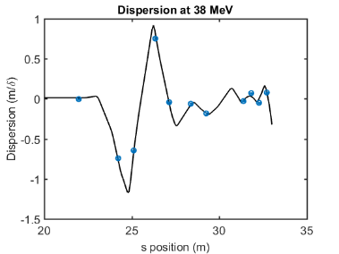
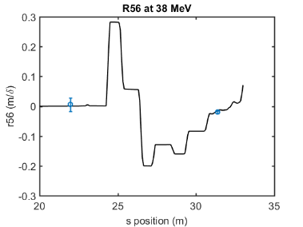
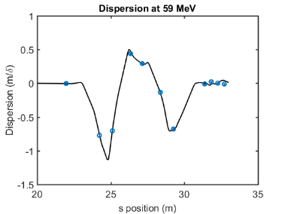
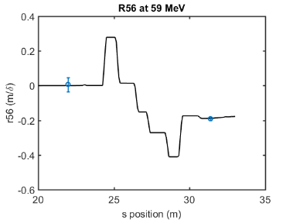
Dispersion and R56 vs. Energy
38 MeV
59 MeV

Slide 29
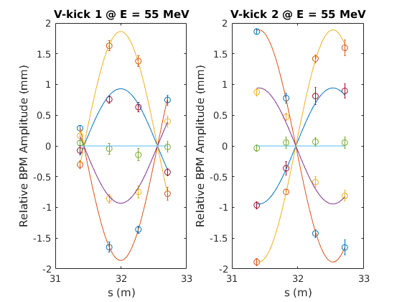
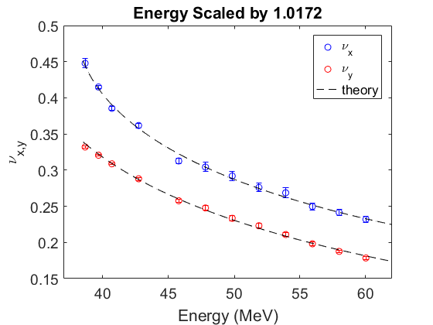
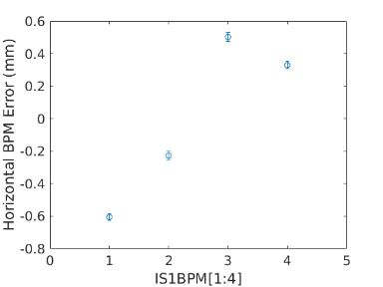
Tune Measurements vs. Energy

Slide 30
Final beam: 7 in one FFA chamber

Slide 31
CBETA in its Hall L0E
The ERL Technology Collaboration (ERL-TC) is forming, modeled on the TTC, to support collaborative ERL research.
As a first step, visitors from 4 labs are participating in the current commissioning run: 3 from HZB/Germany, 2 from Darebury/UK, 3 from JLAB, 5 from BNL.
We encourage participation in the next commissioning period starting March 2019.

Slide 32
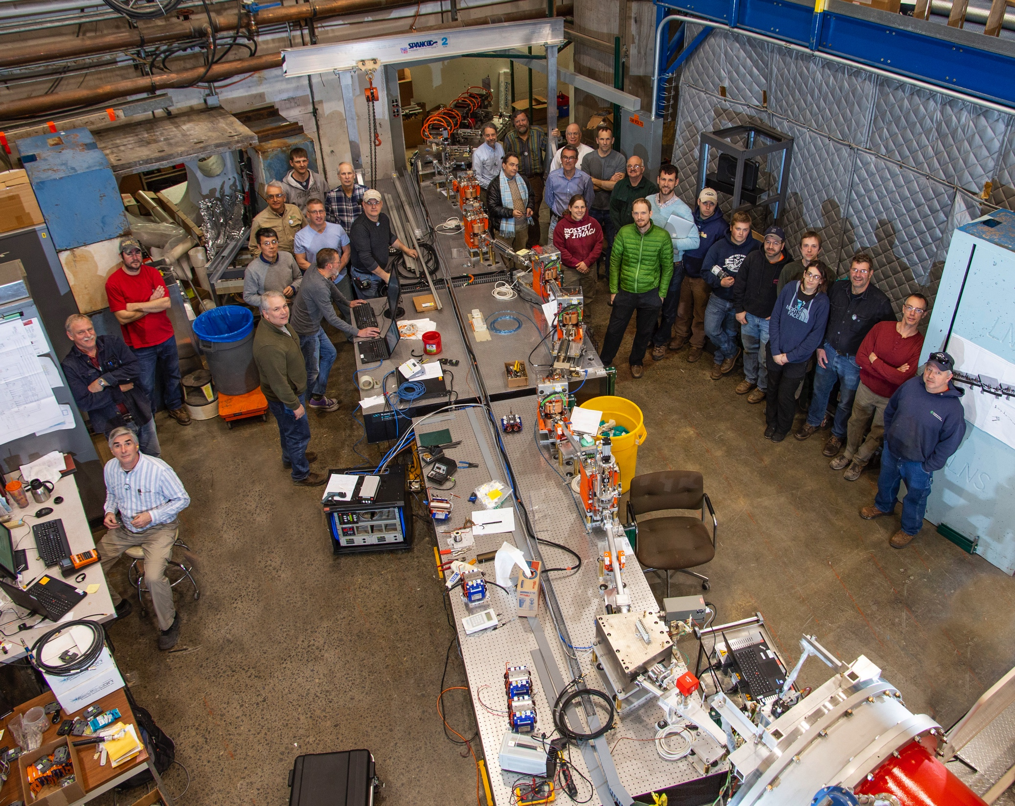
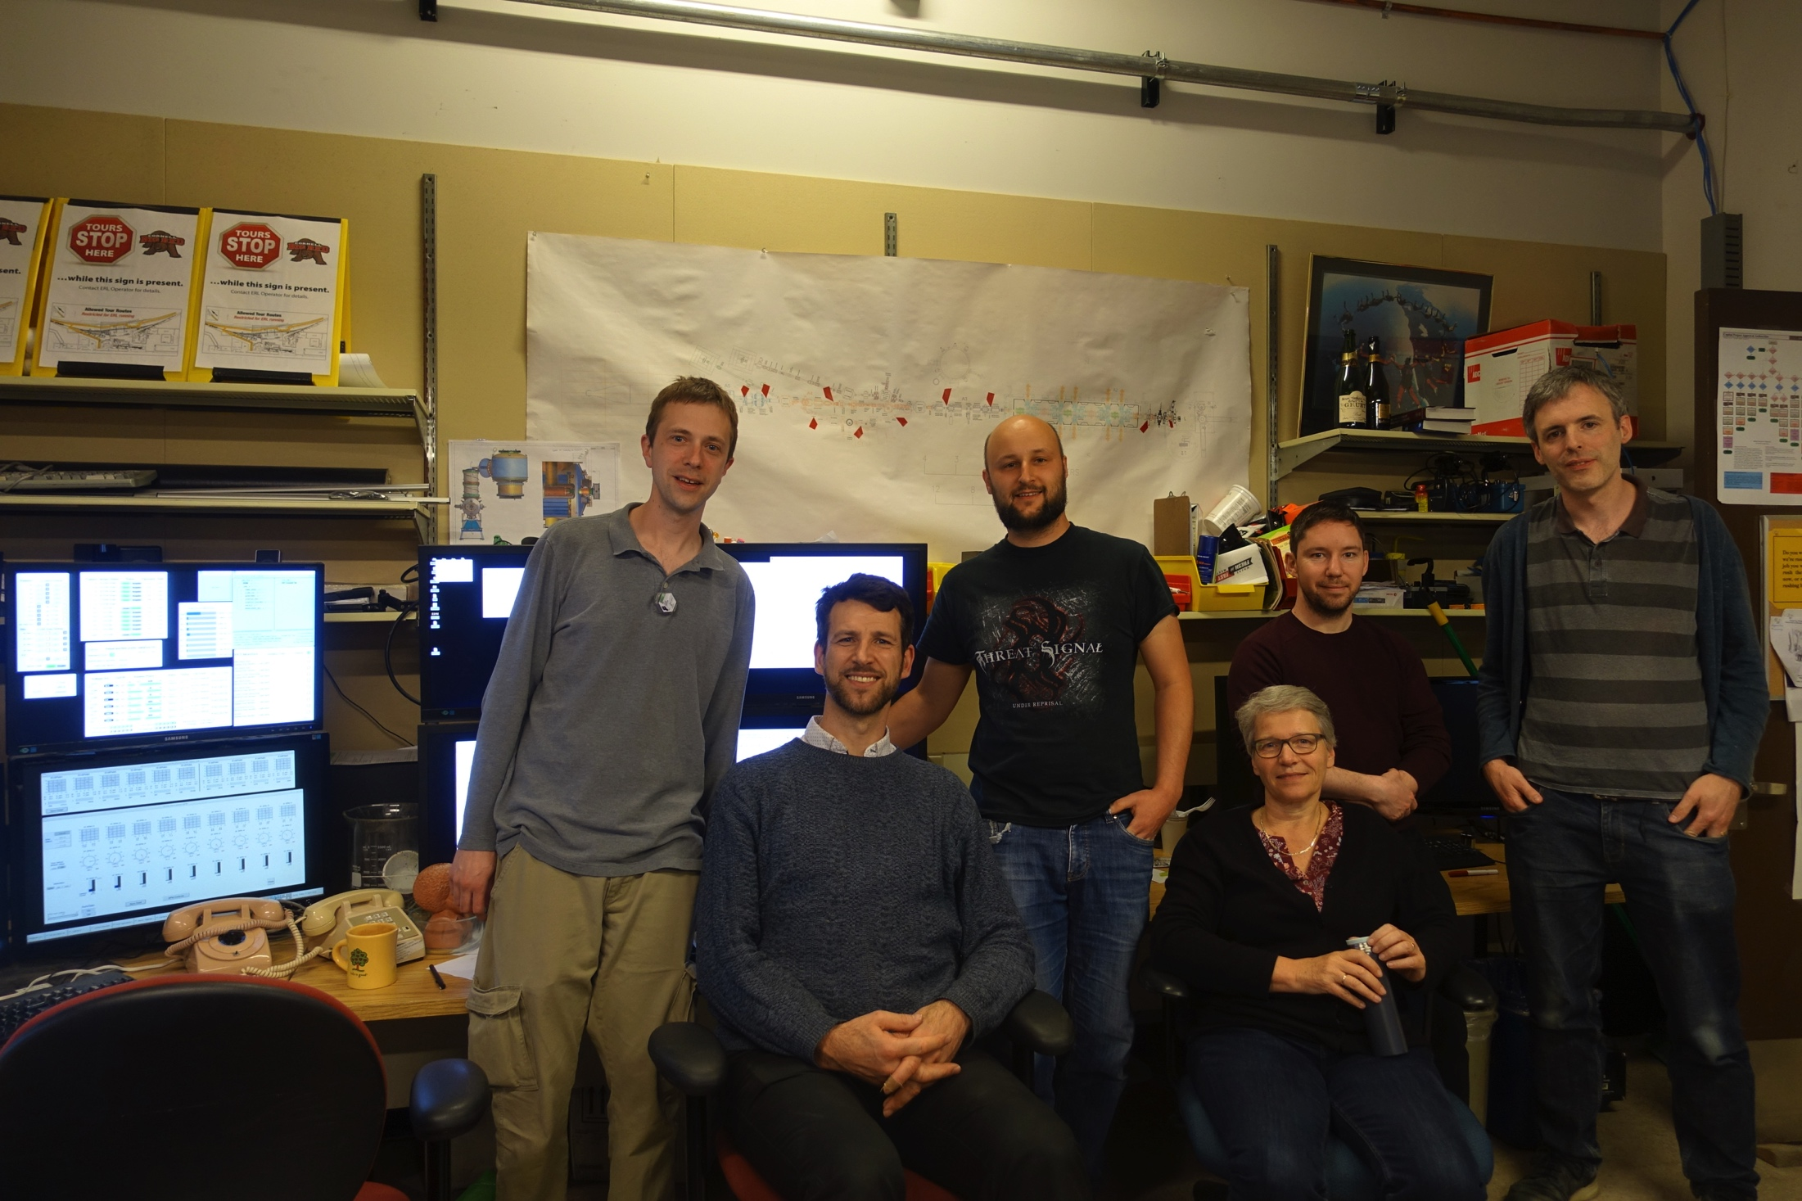
Main Linac Cryomodule
We encourage participation in the next commissioning period starting March 2019.
FFAG workshop 2017 visiting CBETA

Slide 33
The path is free for CBETA
# | Milestone (at the end of months) | Baseline | Actual
 | Funding start date |  | Oct-16
1 | Engineering design documentation complete | Jan-17
2 | Prototype girder assembled | Apr-17
3 | Magnet production approved | Jun-17
4 | Beam through Main Linac Cryomodule | Aug-17
5 | First production hybrid magnet tested | Dec-17
6 | Fractional Arc Test: beam through MLC & girder | Apr-18
7 | Girder production run complete | Nov-18
8 | Final assembly & pre-beam commissioning complete | Feb-19
9 | Single pass beam with factor of 2 energy scan | Jun-19
10 | Single pass beam with energy recovery | Oct-19
11 | Four pass beam with energy recovery (low current) | Dec-19
12 | Project complete | Apr-20

Slide 34
The test ERL in Cornell’s hall LOE
After commissioning to the current NYS funding goals in April 2020
Then available for High-power R&D
Cornell DC gun
100mA, 6MeV SRF injector (ICM)
600kW beam dump
100mA, 6-cavity SRF CW Linac (MLC)
6 MeV
6 MeV
+/- 36 MeV
Electron Current up to 320mA in the linac
Bunch charge Q of up to 2nC
Bunch repetition rate 1.3GHz/N
Beams of 100mA for 1 turn and 40mA for 4 turns
42, 78, 114, 150 MeV
1st beam though all essential components:

Slide 35
CBETA is then ready for EIC R&D
Prototyping EIC cooling (unprecedented beam powers of 6MW)
1) ERL operation for high-power beams (note SNS @ 1.4MW, PIP-II@1-2MW)
Current limits (BBU instabilities and component heating, micro-bunching)
Startup scenarios
Simultaneous beam measurements
2) High-power beam propagation
- Beam micro structure that can prevent cooling (pointed out by CeC)
Loss monitoring, component protection, and shielding
Intra-beam and rest-gas scattering
Beam halo dynamics and halo detection
3) High-brightness beam production
CW electron sources and space-charge dynamics, including dark currents
High-current polarized beams (see presentation by Luca Cultrera)
4) Low-emittance-growth beam propagation
High precision magnets
High precision beam dynamics control
Other EIC topics, e.g. for a linac-ring collider.

Slide 36
Questions?

Slide 37
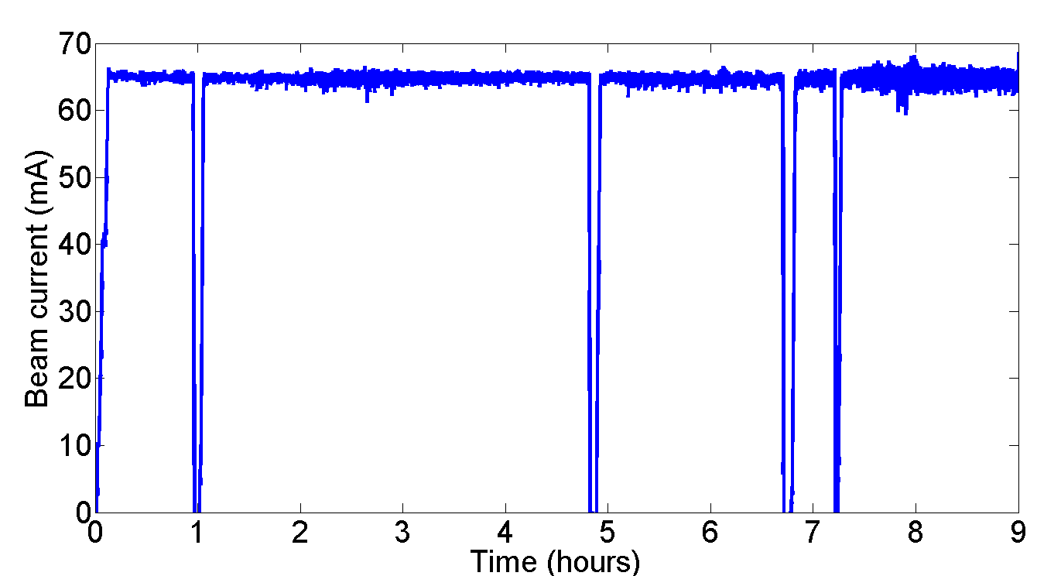
High Current Beams
Peak current of 75mA (world record)
NaKSb photocathode
High rep-rate laser
DC-Voltage source
Source achievements:
2.6 day 1/e lifetime at 65mA
8h at 65mA, at only 5W laser.
The gun group is now working on polarized guns of high current (See today at 11:30, High-Current Polarized e-Sources by Luca Cultrera)
This gun was copied at Cornell and commissioned at BNL for the RHIC Low Energy Run (another successful BNL / Cornell collaboration) as seen on Tuesday at 11:00, Status and Commissioning Results of LEReC by Alexei Fedotov)
DC-gun + SRF injector are now prototyped for industrial Mo99 production.

Slide 38
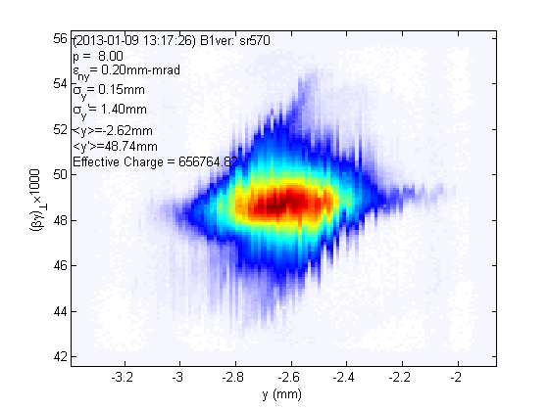
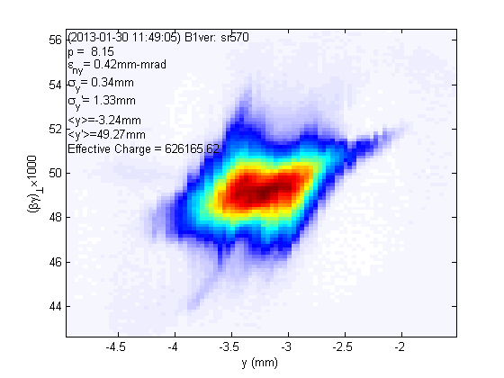
Beam Brightness
20 pC/bunch 80 pC/bunch
vertical phase space
vertical phase space
Normalized rms emittance (horizontal/vertical) 90% beam, E ~ 8 MeV, 2-3 ps
0.23/0.14 mm-mrad 0.51/0.29 mm-mrad
Normalized rms core* emittance (horizontal/vertical) @ core fraction (%)
0.14/0.09 mm-mrad @ 68% 0.24/0.18 mm-mrad @ 61%
*Phys. Rev. ST-AB 15 (2012) 050703
ArXiv: 1304.2708
At 5 GeV this gives 20x the world’s highest brightness (Petra-III)

Slide 39
Main linac cryomodule (MLC) achieved accelerating gradients
Limit.
Admin.
Admin.
Admin.
Quench
Admin.
FE
*FE processed out.
5 of 6 cavities had achieved design gradient of 16.2MV/m at 1.8K in MLC.
Cavity#4 is limited by quench so far, no detectable radiation during test.
Enough Voltage for 76MeV per ERL turn (where 36MeV are needed)

Slide 40
Main linac cryomodule (MLC) achieved surface losses (Q0)
*Q₀ at 14MV/m, FE started.
Target Qo 2.0e10 at 1.8K
*Q₀ after FE processed out.
*Q₀ at 16.2MV/m with severe FE.
*Q₀ after many quench.
1.8K
4 of 6 cavities had achieved design Q₀ of 2.0E+10 at 1.8K.
Q₀ of Cavity#6 had severe FE at 16MV/m.
Enough cooling for 73MV per ERL turn (where 36MeV are needed)

Slide 41
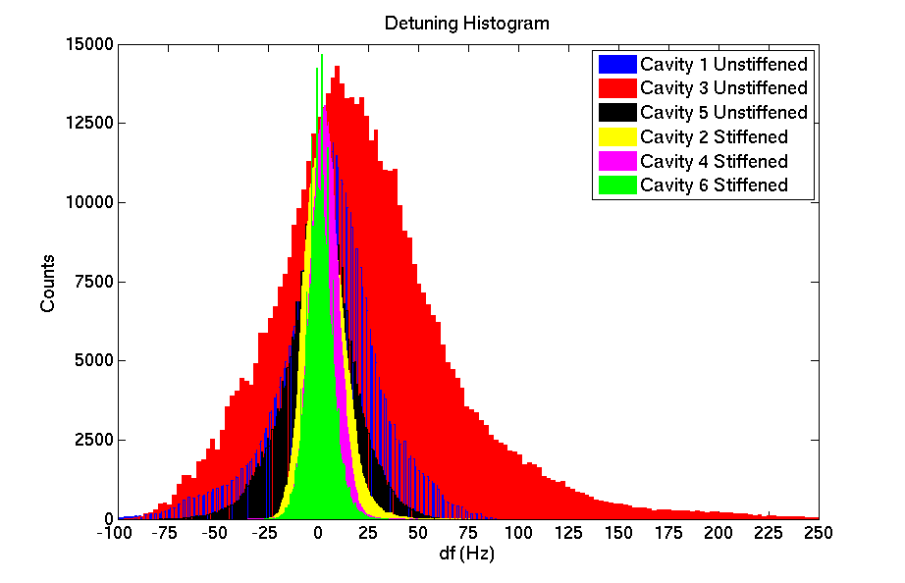
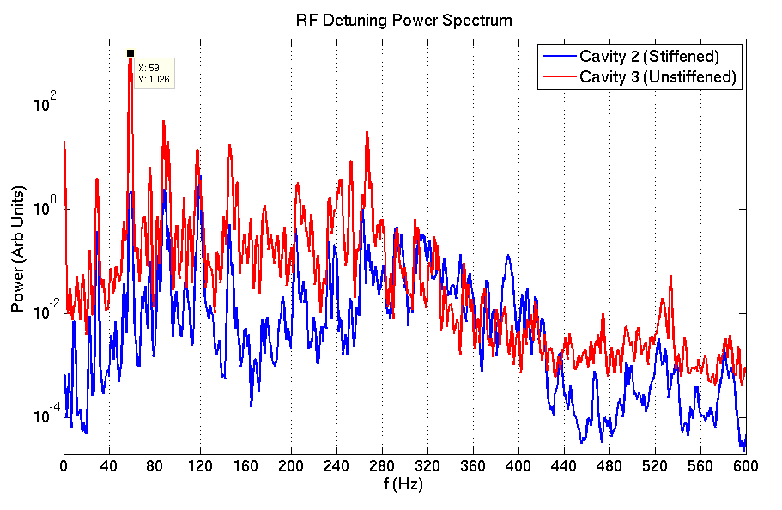
RF Detuning Measurements
Preliminary results:
Stiffened cavities have ~30Hz detuning, Un-stiffened cavities have ~150Hz detuning.
Design specs are ~20Hz.
Detuning spectrum showed large peaks at 60 Hz, 120 Hz.
Enough Voltage for about 50MeV per ERL turn, if microphonics is not reduced (where 36MeV are needed)

Slide 42
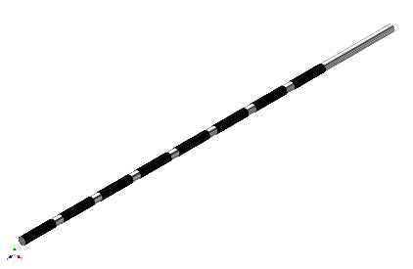
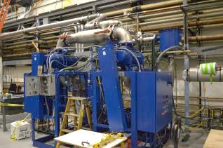
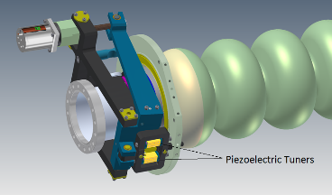
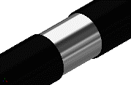
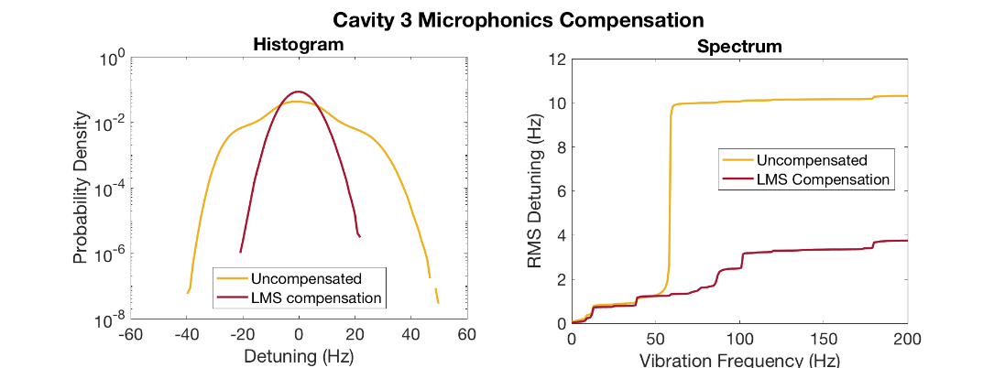
SRF microphonics stabilization
PhD work (Nilanjan Banerjee)
became essential for CBETA operation
1) Specified 70 potential microphonic sources
2) Identified thermo-achoustic sources
2) Deigned piezo control software
Valve Modification
Active Compensation
LCLS-II needs similar controls!
and we are in touch with LCLS-II teams at FNAL and JLAB.
Novel microphonics compensation reduces peak detuning by a factor of 2!
Notes:
The power requirements increase with detuning of the cavity, and due to the high Q of the cavities and the tight power budget, the detuning must be carefully controlled.
This poses a problem with vibrations in the cryomodule, generated by cryogenic pumps, valves and other machinery since they deform and lead to microphonics detuning.
To mitigate this problem, we have modified our cryogenic system and used piezo-electric actuators to actively compensate for the vibrations. We developed a novel algorithm which is capable of stably reducing microphonics by a factor of 2!

Slide 43
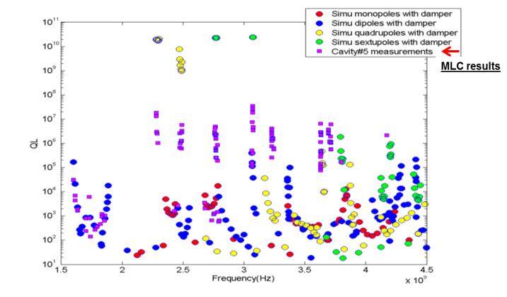
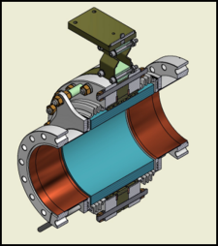
Current limits from HOMs
Dipole HOMs on MLC were strongly damped below Q~10⁴.
Consistent with HTC and simulation results.
HTC results were:
HOM heating: currents are limited to < 40mA in CBETA
BBU no HOM limits BBU to below 100mA in one turn

Slide 44
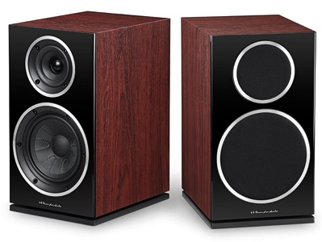
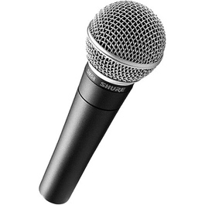
New current limit
Beam break up: a potential limit to ERL currents
Higher Order Modes
=

Slide 45
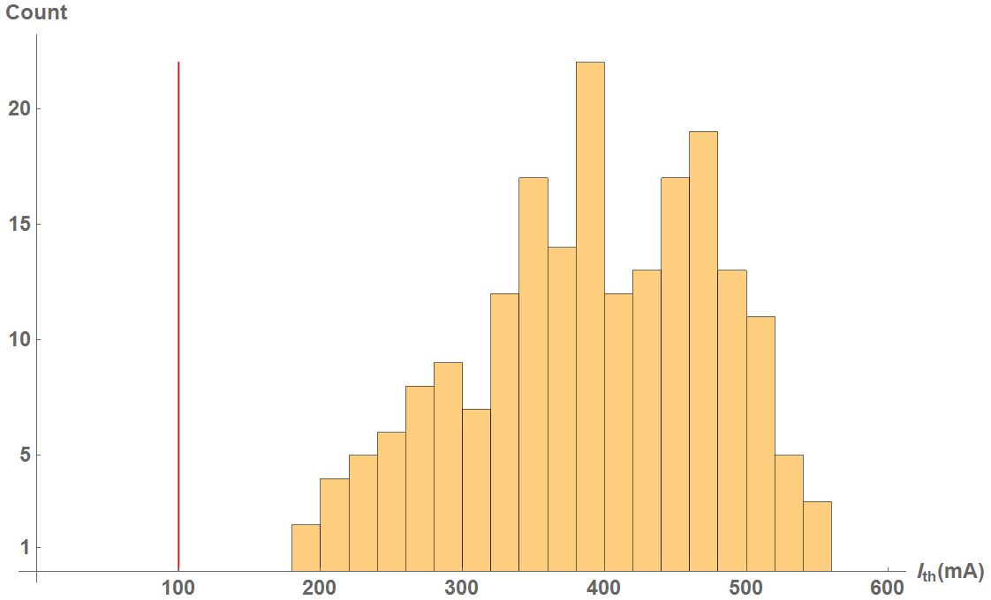
BBU for 1 pass in CBETA
CBETA 1-pass
Cavity shape error: 125 μm
100% of simulations have > 100mA

Slide 46
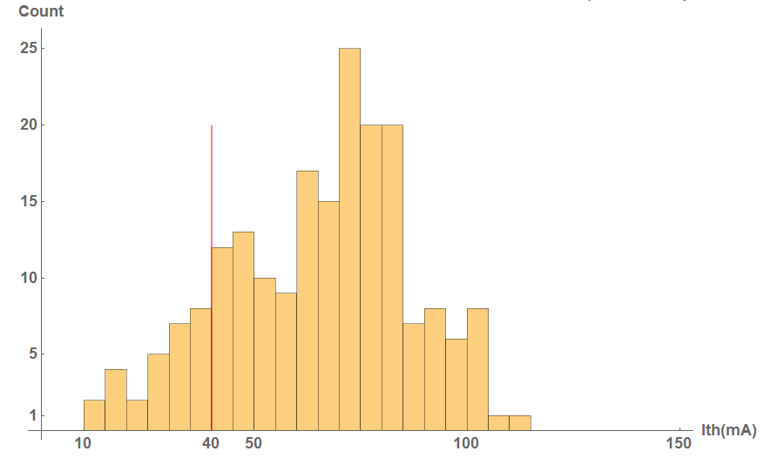
BBU for 4 passes in CBETA
CBETA 4-pass
Cavity shape error: 125 μm
x/y coupling is simulated to increase the threshold significantly
100% of simulations have > 100mA
86% of simulations have > 40mA

Slide 47
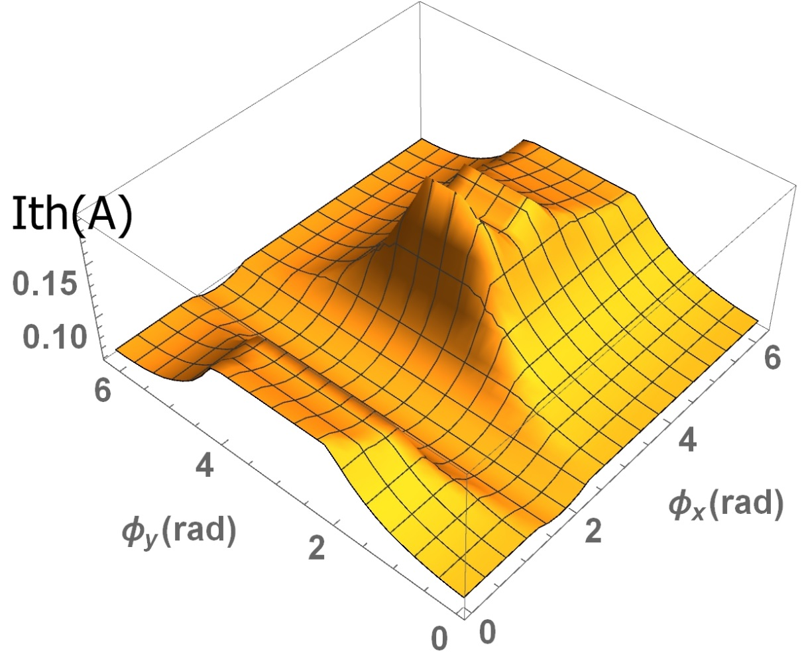
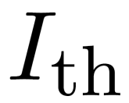
4-path ERL with variable phases
Min = 61 mA
Max = 193 mA
Nominal = 69 mA
results can improve

Slide 48
4-path ERL with x/y coupling
Min = 89 mA
Max = 131 mA
Nominal = 69 mA
results can improve
Conclusion: In 1-path ERLs the benefit from coupling and phase optimization can be significant. In multi-turn ERLs this benefit is much diminished.

Slide 49
Next-order BBU
Don’t forget that there is
Transverse Dipole BBU that is often considered and there are good codes
Longitudinal BBU
contained in the BMAD simulation code
It is important because they excite monopole (accelerating) modes with very large Q
Is minimized by T56=0 for all cavity couplings
Phase and time-of-flight tricks need to be checked against this instability.
Quadrupole BBU
- Is important because the frequencies of the lowest order Quadrupole modes are below the first higher order dipole modes. Their Q can therefore be extremely large.
Higher-order multipole BBU: Check out the simple scaling formulas in [1]
- Is usually benign if (C) is ok. But it can be important for similar reasons at (C).
[1] Recirculative BBU, G.H. Hoffstaetter in A. Chao, M. Tigner, Accelerator Handbook.

Slide 50
If EIC R&D would not come …
Continued commissioning for EIC studies (including electron cooling)
DarkLight – an experiment to find dark matter particles
Compact Compton source for hard x-rays – complementing CHESS’ range
THz laser – complementing CHESS’ range
Beam for time-resolved electron diffraction from 1-6MeV
Beam for Plasma Wakefield Acceleration with High Transformer Ratio
ASML medical isotope cavity testing with beam
Generic ERL accelerator physics
Preparations for Perle
Preparations for LHeC
High-Power beam dynamics testing
Permanent magnet and Fixed-Field Alternating-Gradient test bed for future accelerators

Slide 51
(A) DarkLight
The Darklight detector will fit around the resonantly extracted CBETA beam, if the movable support is redesigned.
Cornell is in contact with the DarkLight collaboration to submit a joint proposal.

Slide 52
Layout of extraction beam line
Extraction line contains:
Extra dipoles to guide the beam
Extra quadrupoles to maintain beam optics

Slide 53
Questions?

