Slide 1
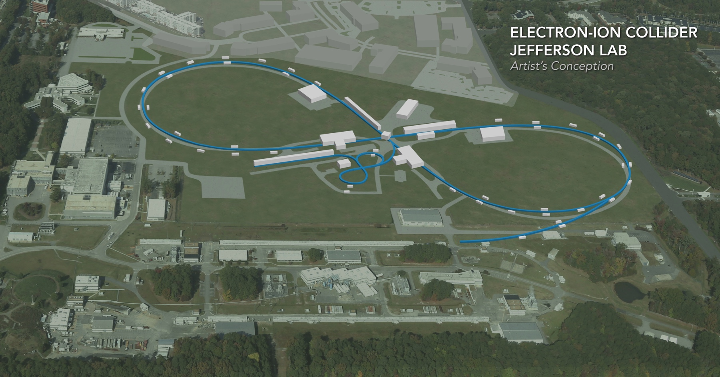
Spin Transparency Study and Test
V. Morozov, Y. Derbenev,
R. Huang, F. Lin (JLab)
H. Huang, F. Meot,
V. Ptitsyn (BNL)
A. Kondratenko,
M. Kondratenko (Novosibirsk)
Y. Filatov (MIPT)
Supported by DoE NP EIC R&D FOA funds
EIC Accelerator Collaboration Meeting
October 29 - November 1, 2018

Slide 2
Outline
Accelerators with “preferred spin direction” and “transparent to the spin”
Illustration of the “spin transparency” mode features and their analysis using figure-8 as an example
RHIC in the “spin transparent” mode
Relevance to eRHIC
Simulation model
Hardware requirements
Experimental scenarios
Goals and timeline

Slide 3


Conventional “Preferred Spin Direction” Mode
There exists a unique solution for the periodic spin motion along the closed orbit
The spin tune is different from zero
The polarization component along the periodic spin axis is preserved
All polarized beam machines had run in this mode so far
  Conventional racetrack accelerator with only vertical fields on the design orbit
    Preferred spin direction is vertical
  Racetrack accelerator with a single full Siberian snake
    Preferred spin direction is in horizontal plane and
    points along the snake axis at an orbital location
    opposite to the snake
  Racetrack accelerator with two full Siberian snakes
  located opposite to each other with their axes
  perpendicular to each other
    Preferred spin direction is vertical but changes sign
    after passing through a snake
$$⋅$$
$$×$$

Slide 4
“Spin Transparency” Mode
The spin motion is degenerate, any spin direction is periodic
The spin tune is zero
In an ideal case, any polarization direction is preserved
Examples of spin transparent accelerators
  Conventional racetrack accelerator with an integer spin tune (imperfection resonance)
  Racetrack accelerator with two full Siberian snakes
  located opposite to each other with their axes
  parallel to each other
  Figure-8 accelerator

Slide 5
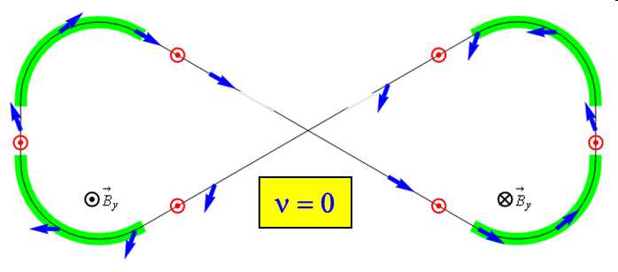
Figure-8 as Illustration of Spin Transparent Accelerator
Figure-8 ring is transparent to the spin motion: in an ideal structure, spin precession in one arc is cancelled by the other
Without additional fields, spin rotation is a priori unknown and occurs only due to closed orbit excursion and beam emittances
Additional fields are introduced to stabilize the spin motion by producing a spin rotation that is much greater than that due to imperfections

Slide 6
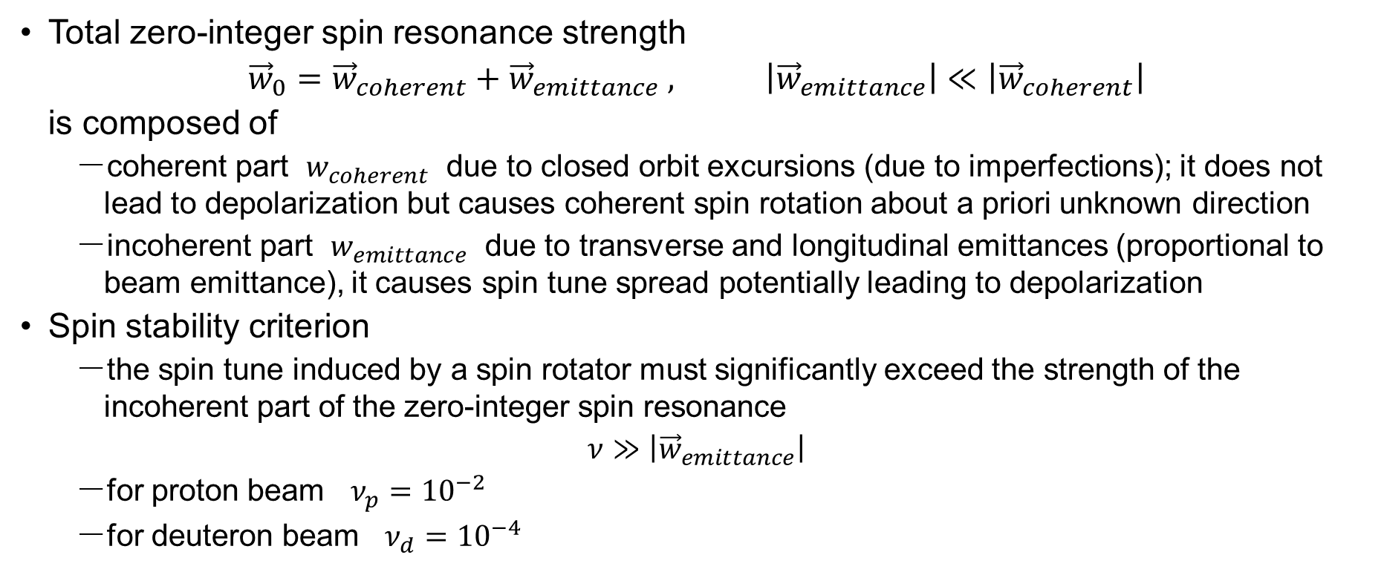
Zero-Integer Spin Resonance and Spin Stability Criterion
Total zero-integer spin resonance strength
$${\vec{w}}_{0}={\vec{w}}_{coherent}+{\vec{w}}_{emittance} , \left|{\vec{w}}_{emittance}\right|≪\left|{\vec{w}}_{coherent}\right|$$
is composed of
  coherent part $w_{coherent}$ due to closed orbit excursions (due to imperfections); it does not lead to depolarization but causes coherent spin rotation about a priori unknown direction
  incoherent part $w_{emittance}$ due to transverse and longitudinal emittances (proportional to beam emittance), it causes spin tune spread potentially leading to depolarization
Spin stability criterion
  the spin tune induced by a spin rotator must significantly exceed the strength of the incoherent part of the zero-integer spin resonance
  $$ν≫\left|{\vec{w}}_{emittance}\right|$$
  for proton beam $ν_{p}={10}^{−2}$
  for deuteron beam $ν_{d}={10}^{−4}$

Slide 7
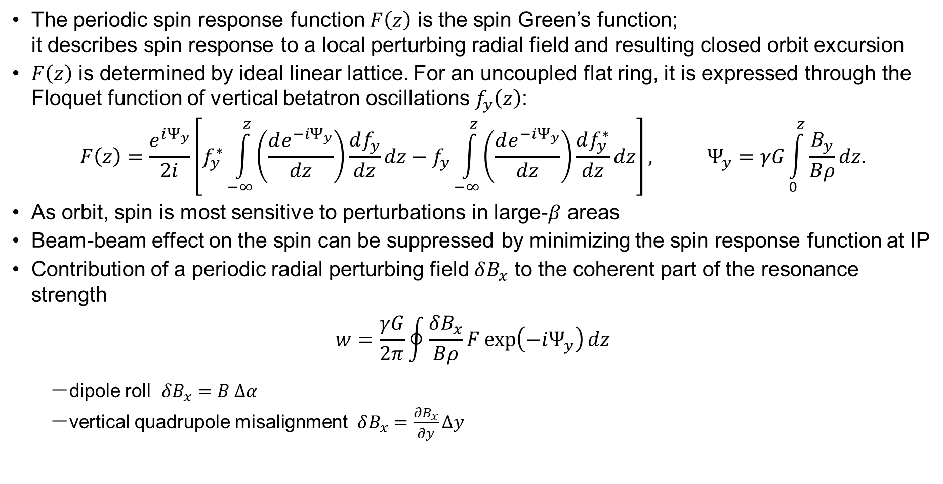
Spin Response Function
The periodic spin response function $F\left(z\right)$ is the spin Green’s function;
it describes spin response to a local perturbing radial field and resulting closed orbit excursion
$F\left(z\right)$ is determined by ideal linear lattice. For an uncoupled flat ring, it is expressed through the Floquet function of vertical betatron oscillations $f_{y}\left(z\right)$:
$$F\left(z\right)=\frac{e^{iΨ_{y}}}{2i}\left[f_{y}^{∗}\int_{−∞}^{z}{\left(\frac{de^{−iΨ_{y}}}{dz}\right)}\frac{df_{y}}{dz}dz−f_{y}\int_{−∞}^{z}{\left(\frac{de^{−iΨ_{y}}}{dz}\right)}\frac{df_{y}^{∗}}{dz}dz\right], Ψ_{y}=γG\int_{0}^{z}{\frac{B_{y}}{Bρ}}dz.$$
As orbit, spin is most sensitive to perturbations in large-$β$ areas
Beam-beam effect on the spin can be suppressed by minimizing the spin response function at IP
Contribution of a periodic radial perturbing field $δB_{x}$ to the coherent part of the resonance strength
$$w=\frac{γG}{2π}\oint{\frac{δB_{x}}{Bρ}F\exp\left(−iΨ_{y}\right)dz}$$
  dipole roll $δB_{x}=B Δα$
  vertical quadrupole misalignment $δB_{x}=\frac{∂B_{x}}{∂y}Δy$

Slide 8
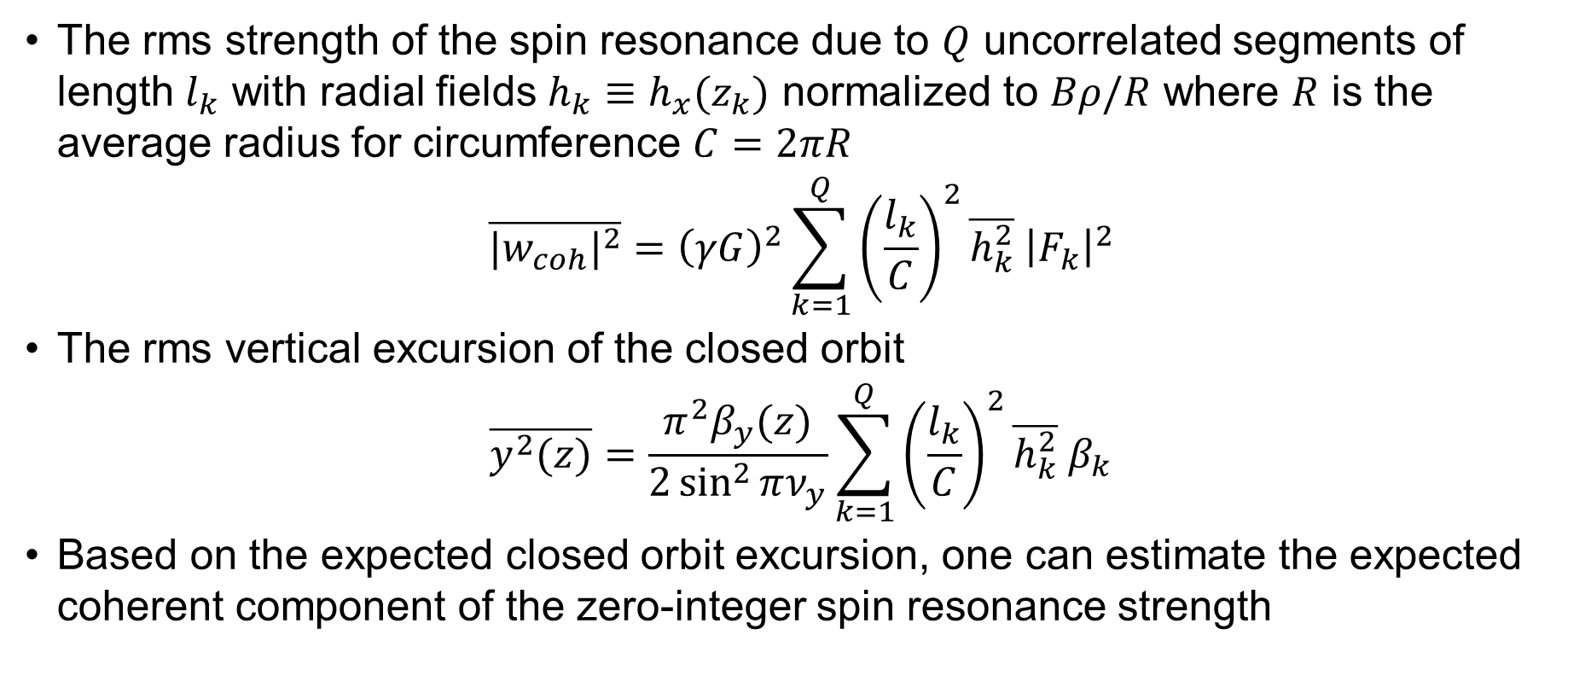
Statistical Model
The rms strength of the spin resonance due to $Q$ uncorrelated segments of length $l_{k}$ with radial fields $h_{k}≡h_{x}(z_{k})$ normalized to $Bρ/R$ where $R$ is the average radius for circumference $C=2πR$
$$\overline{{{|w}_{coh}|}^{2}}={\left(γG\right)}^{2}\sum_{k=1}^{Q}{{\left(\frac{l_{k}}{C}\right)}^{2}\overline{h_{k}^{2}} {\left|F_{k}\right|}^{2}}$$
The rms vertical excursion of the closed orbit
$$\overline{y^{2}(z)}=\frac{π^{2}β_{y}(z)}{2\sin^{2}{πν_{y}}}\sum_{k=1}^{Q}{{\left(\frac{l_{k}}{C}\right)}^{2}\overline{h_{k}^{2}} β_{k}}$$
Based on the expected closed orbit excursion, one can estimate the expected coherent component of the zero-integer spin resonance strength

Slide 9
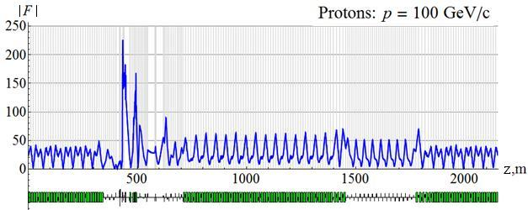
Spin Response Function of JLEIC Ion Collider Ring

Slide 10
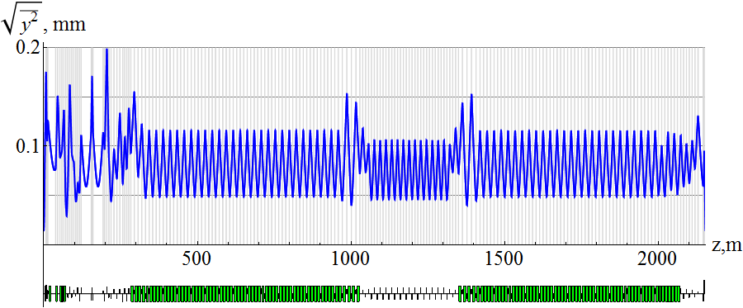
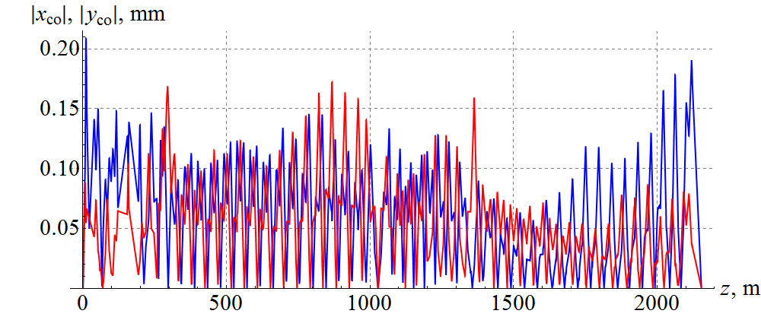
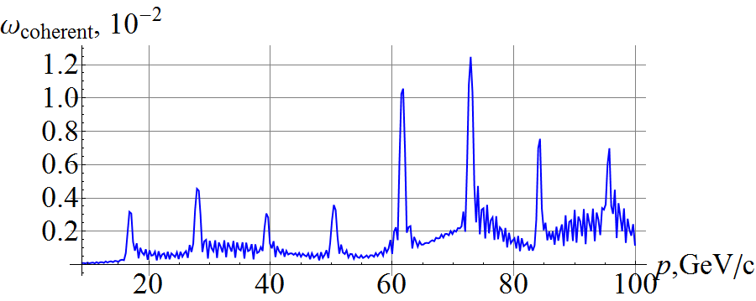
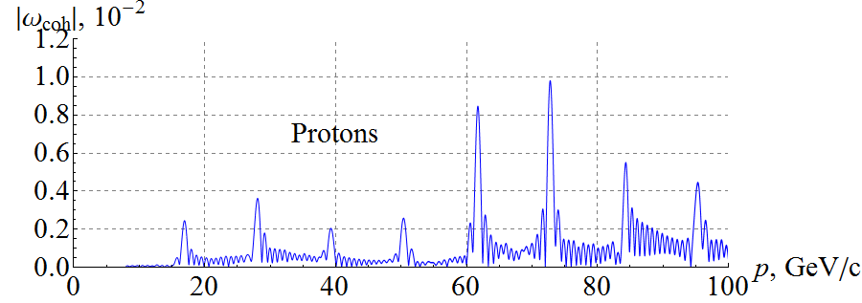
Analytic and Numerical Calculations of Resonance Strength
Statistical model
Zgoubi simulation using random quadrupole misalignments

Slide 11
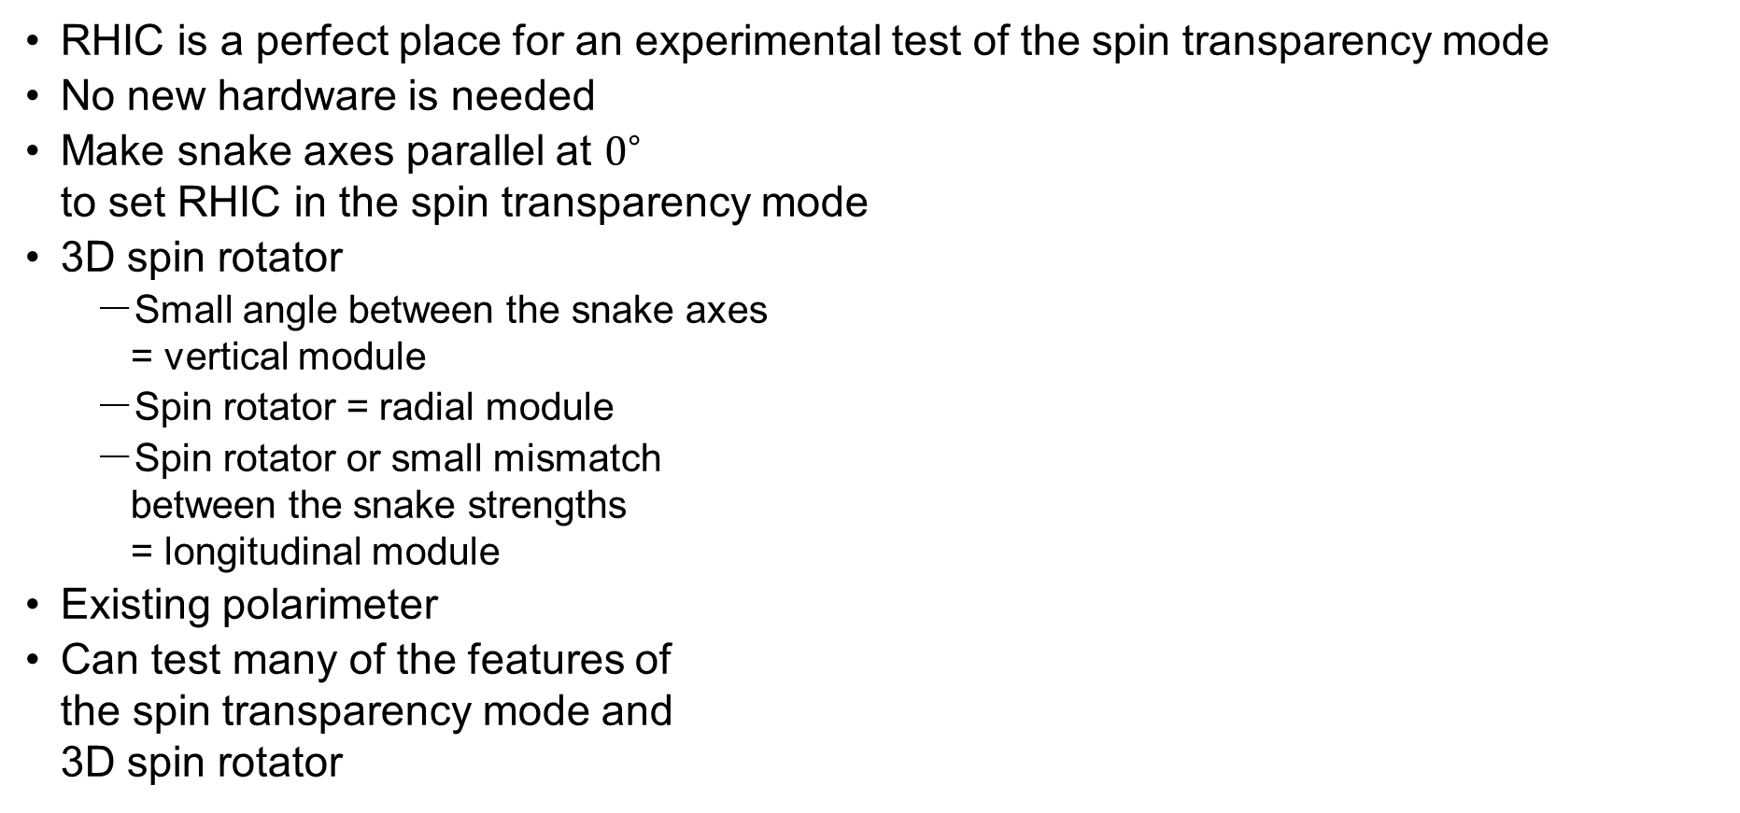
Setup of Spin Transparency Mode Test
RHIC is a perfect place for an experimental test of the spin transparency mode
No new hardware is needed
Make snake axes parallel at $0^{∘}$
to set RHIC in the spin transparency mode
3D spin rotator
  Small angle between the snake axes
  = vertical module
  Spin rotator = radial module
  Spin rotator or small mismatch
  between the snake strengths
  = longitudinal module
Existing polarimeter
Can test many of the features of
the spin transparency mode and
3D spin rotator

Slide 12





Potential Benefit to eRHIC
Configure the electron storage ring in the spin transparency mode
Two electron spin rotators around an IP serve as a full Siberian snake
Benefits
  Same lifetimes of the two spin states
  Simplified spin matching
Spin rotator
$$⋅$$
Spin rotator
IP
$$×$$
$$\vec{P}$$
$$\vec{P}$$
$$⋅$$

Slide 13
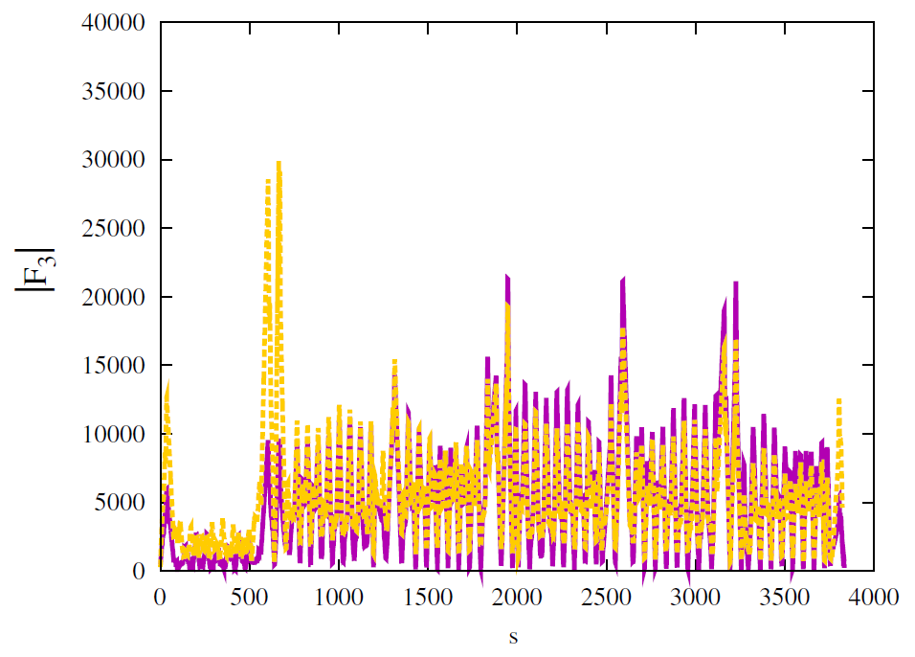
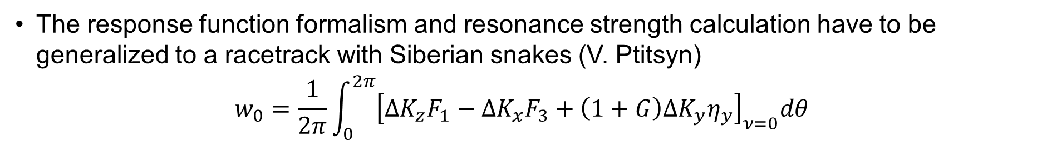
Spin Response Function of RHIC
The response function formalism and resonance strength calculation have to be generalized to a racetrack with Siberian snakes (V. Ptitsyn)
$$w_{0}=\frac{1}{2π}\int_{0}^{2π}{{\left[ΔK_{z}F_{1}−ΔK_{x}F_{3}+\left(1+G\right)ΔK_{y}η_{y}\right]}_{ν=0}dθ}$$

Slide 14
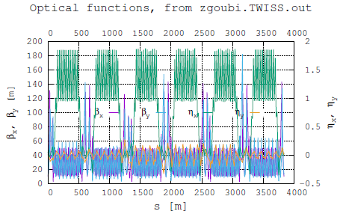
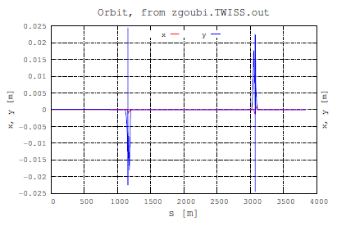
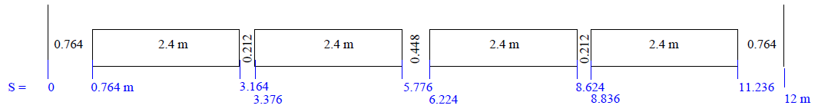
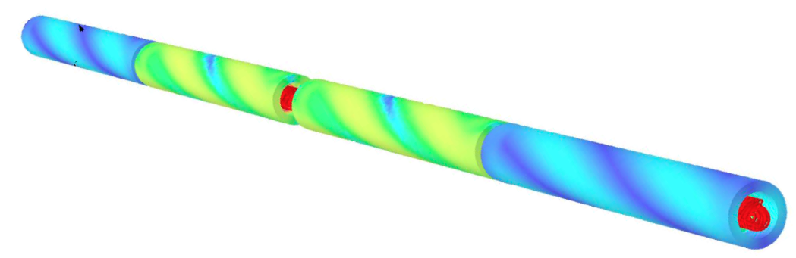
Model of RHIC with Snakes
Accurate Zgoubi model of RHIC with snakes exists (F. Meot)
Each snake is represented by four individual field maps for the four helices
The snake is symmetric with respect to its center
Can adjust snake strength and axis by adjusting strengths of the outer and inner fields
Model includes orbit correction

Slide 15
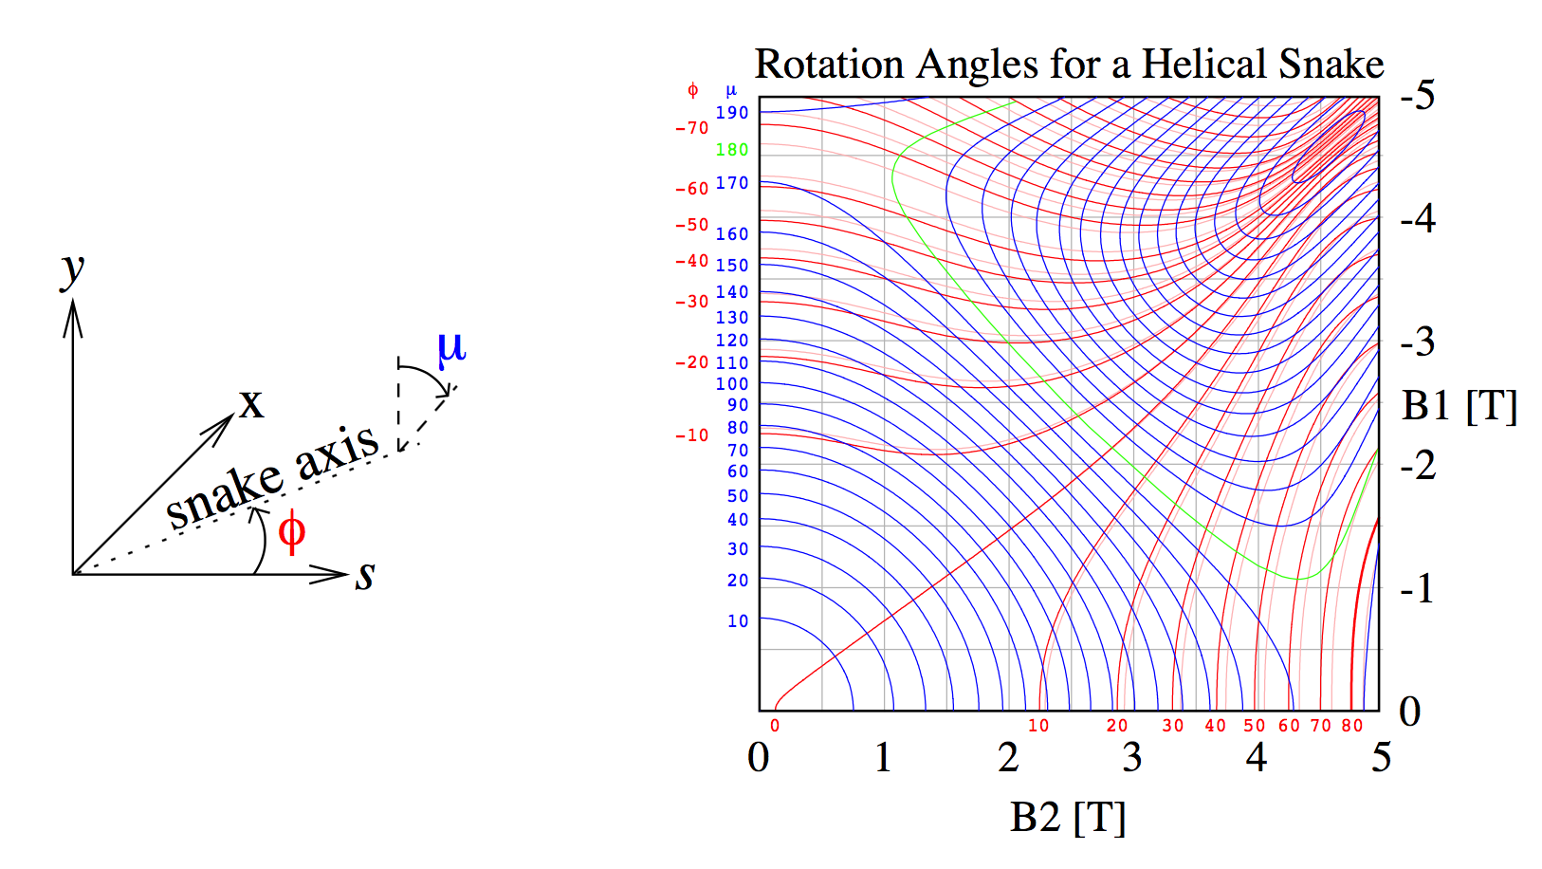
RHIC Snake Adjustment
It is optimal to adjust the snake axes to 0°
  Minimum field integral
  Minimum orbit excursion
No change in field and power supply polarities
Full snake with 0° axis

Slide 16
Hardware Requirements
Snakes can be set as needed and can be adjusted in real time at a rate of 1 A/s
Existing CNI polarimeter can provide relative measurement of both transverse polarization components in a few minutes
Spin rotators can provide the necessary longitudinal and radial spin rotations

Slide 17
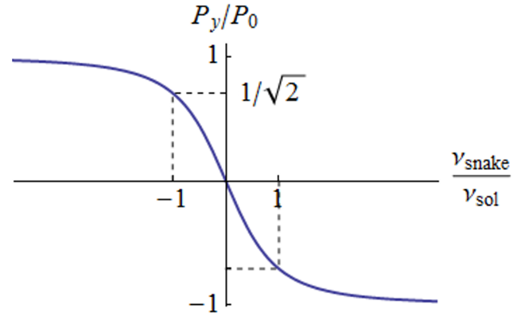
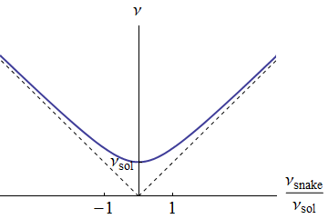
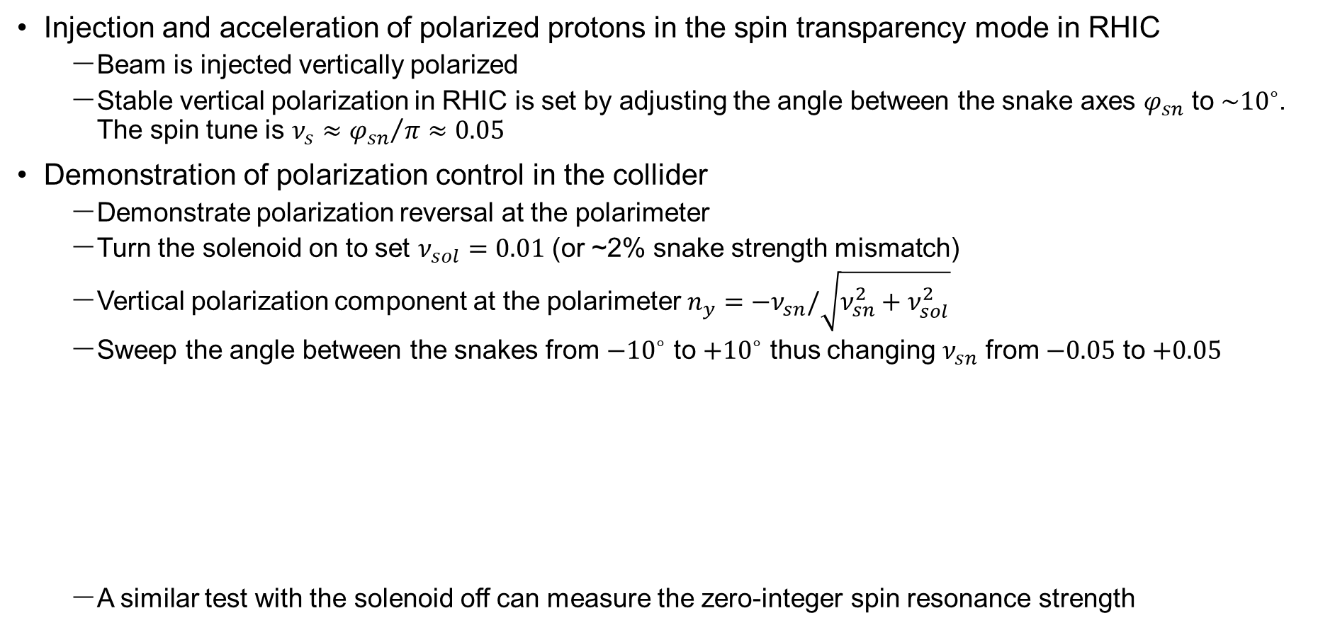
Experimental Scenarios
Injection and acceleration of polarized protons in the spin transparency mode in RHIC
  Beam is injected vertically polarized
  Stable vertical polarization in RHIC is set by adjusting the angle between the snake axes $φ_{sn}$ to $\sim {10}^{∘}$. The spin tune is $ν_{s}≈{φ_{sn}}/π≈0.05$
Demonstration of polarization control in the collider
  Demonstrate polarization reversal at the polarimeter
  Turn the solenoid on to set $ν_{sol}=0.01$ (or ~2% snake strength mismatch)
  Vertical polarization component at the polarimeter $n_{y}=−ν_{sn}/\sqrt{ν_{sn}^{2}+ν_{sol}^{2}}$
  Sweep the angle between the snakes from $−{10}^{∘}$ to $+{10}^{∘}$ thus changing $ν_{sn}$ from $−0.05$ to $+0.05$
  A similar test with the solenoid off can measure the zero-integer spin resonance strength

Slide 18
Project Tasks
Experimental demonstration of the spin transparency mode in RHIC and experimental verification of the spin transparency theory and spin tracking simulations
                Design of the spin transparency experiment in RHIC
                Extension of the spin transparency theory and numerical tools to a racetrack storage ring with Siberian snakes
                Calculation of the spin response function in RHIC
                Statistical analysis of the zero-integer spin resonance in RHIC
                Development of the spin control system parameters
                Simulations of the spin dynamics in the spin transparency mode in RHIC with random errors
                Evaluation of the feasibility and complexity of the technical capabilities of RHIC available for a spin transparency experiment
                Development of an experimental program to demonstrate key spin transparency mode features consistent with technical capabilities of RHIC
                Development of experimental procedures
                Simulation of experimental studies and documentation of predictions
                Preparation of an experimental proposal
                Presentation of the proposal at RHIC’s APEX
                Finalization of the proposal
                Participation in and completion of an experimental test
                Analysis of the experimental data
                Publication of the data in a refereed journal

Slide 19
Timeline
Personnel
  JLab: Ya.S. Derbenev, River Huang, F. Lin and V.S. Morozov
  BNL: H. Huang, F. Meot, V. Ptitsyn, P. Adams, and B. Schmidke
  Novosibirsk (subcontract): A.M. Kondratenko, M.A. Kondratenko, Yu.N. Filatov
Task | FY18 Q1 | FY18 Q2 | FY18 Q3 | FY18 Q4 | FY19 Q1 | FY19 Q2 | FY19 Q3 | FY19 Q4
1. Analysis and simulation of the spin transparency mode in RHIC
2. Evaluation of the technical capabilities of RHIC
3. Development of an experimental program
4. Preparation and submission of an experimental proposal
5. Completion of an experimental test
6. Analysis and publication of experimental data

