Slide 1
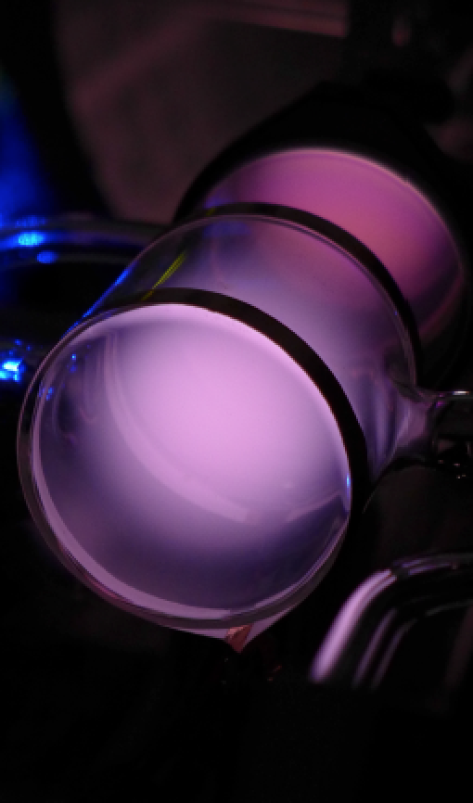


Development of a Polarized ³He Ion Source for RHIC/EIC
Motivation
ME optical pumping
Extended EBIS upgrade
Gas injection
Pulsed valve
Simulation of gas
injection
Feasibility test
Schedule
G. Atoian, E. Beebe, D. Raparia,
J. Ritter, A. Zelenski
M. Musgrave, J. Maxwell*, R. Milner
* Jefferson Lab
- Funded by DOE Office of Nuclear Physics R&D For Next Generation Accelerator Facilities
- Must Do EIC R&D (Jones Committee Report, February 2017)

Slide 2
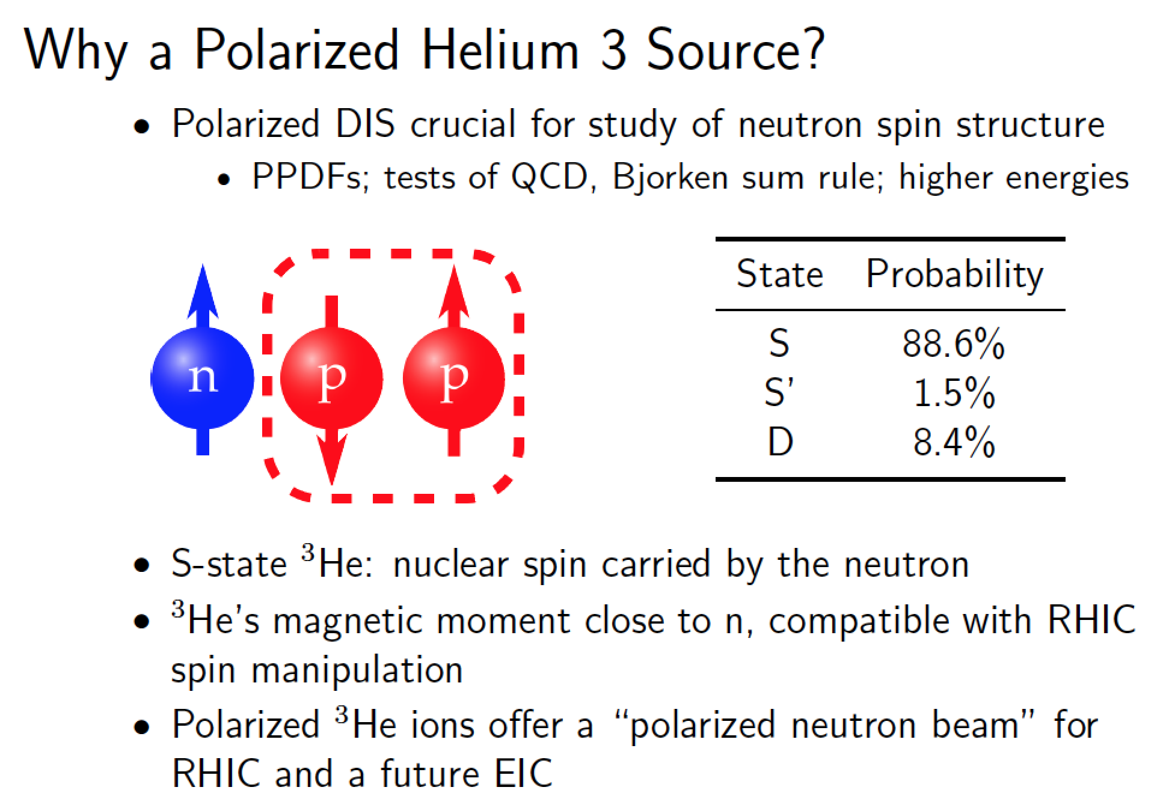
Why a Polarized ³He Source?

Slide 3
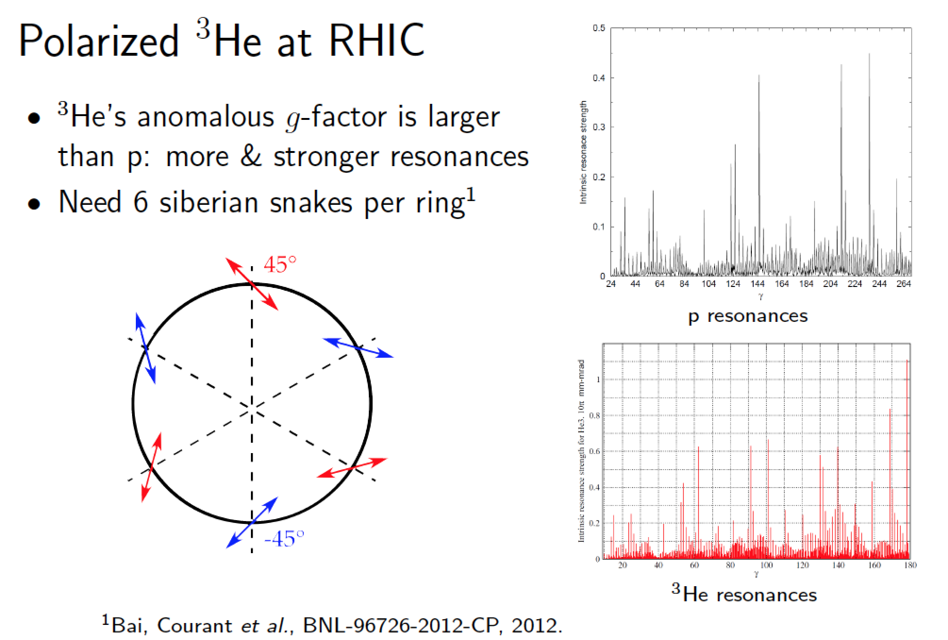
Polarized ³He at RHIC

Slide 4
Source Concept
Proposed originally by A. Zelenski and J. Alessi in ICFA Newsletter (2003)
Concept developed by BNL-MIT collaboration
Identified as high priority R&D for EIC by EICAC review in 2009, Office of Nuclear Physics Community Review in 2017, and the 2018 assessment of the US National Academy of Sciences.
Source design goals:
  Polarize ³He using optical pumping and injection into EBIS at 5 T
  Maximum polarization >70%
  Intensity 2.5 × 10¹¹ ³He++ ions in 20 𝜇s pulse (~4 mA peak current)
  Spin-flip in the beam transport line

Slide 5
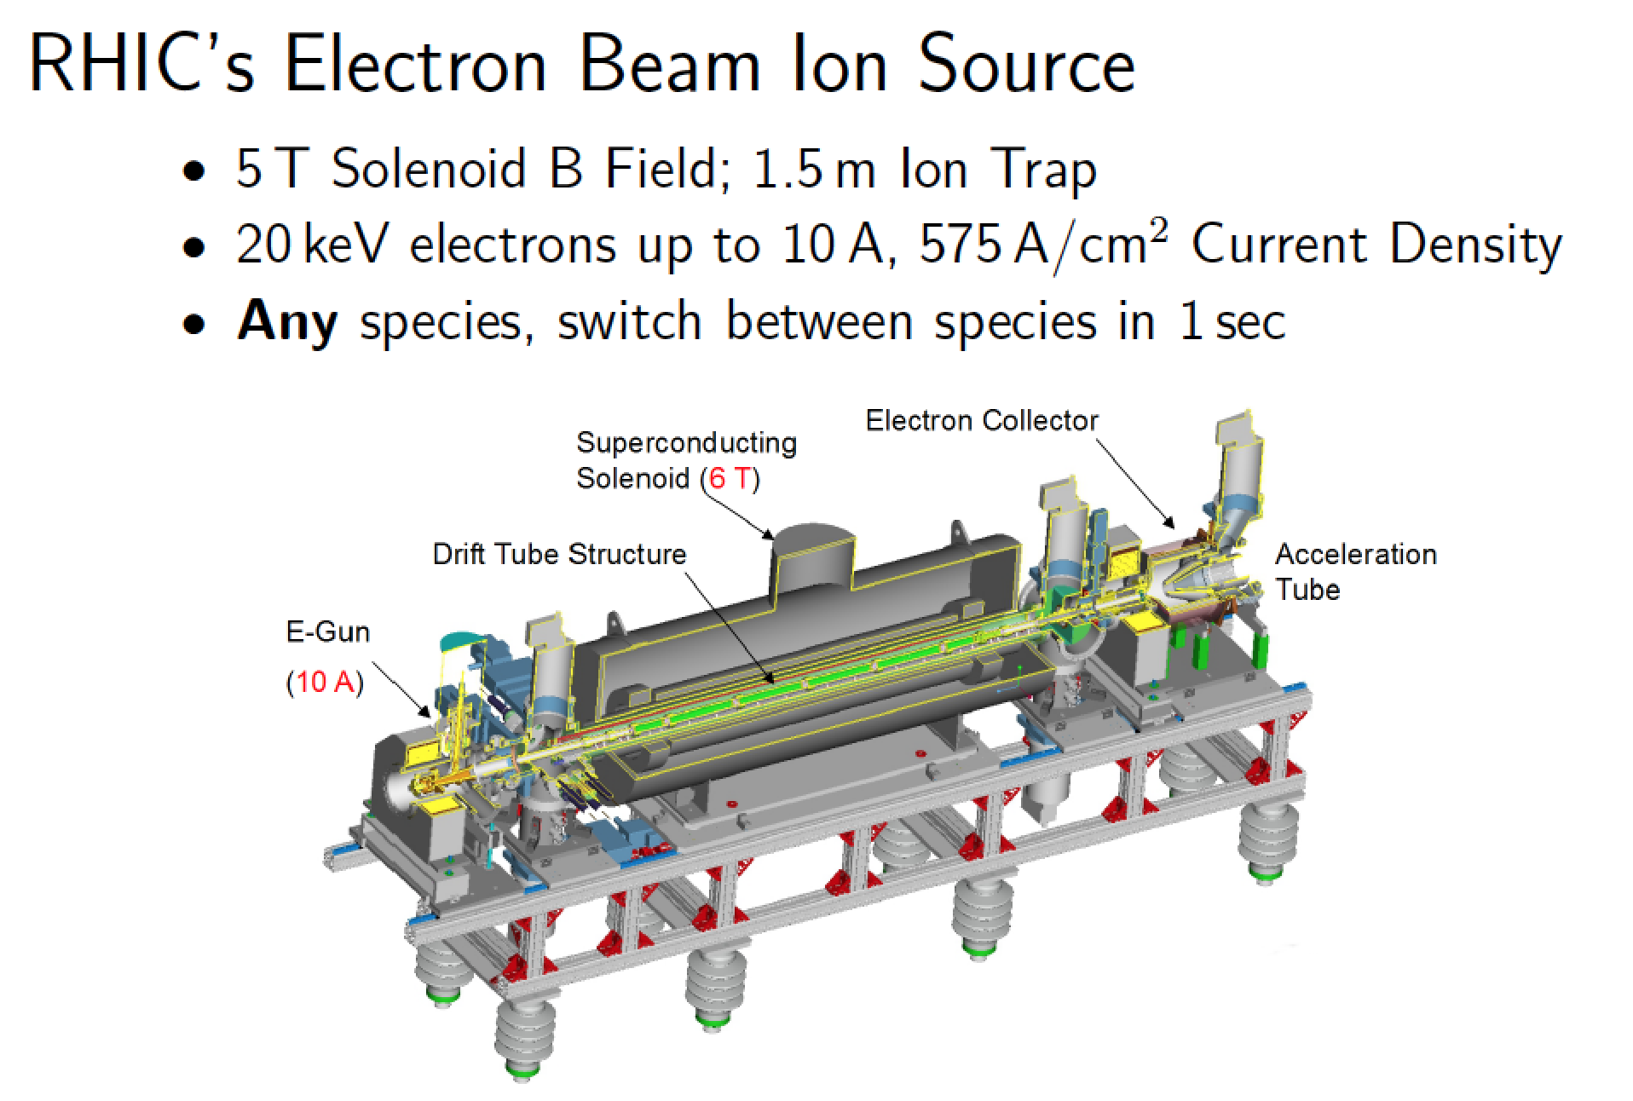
RHIC’s Electron Beam Ionization Source

Slide 6
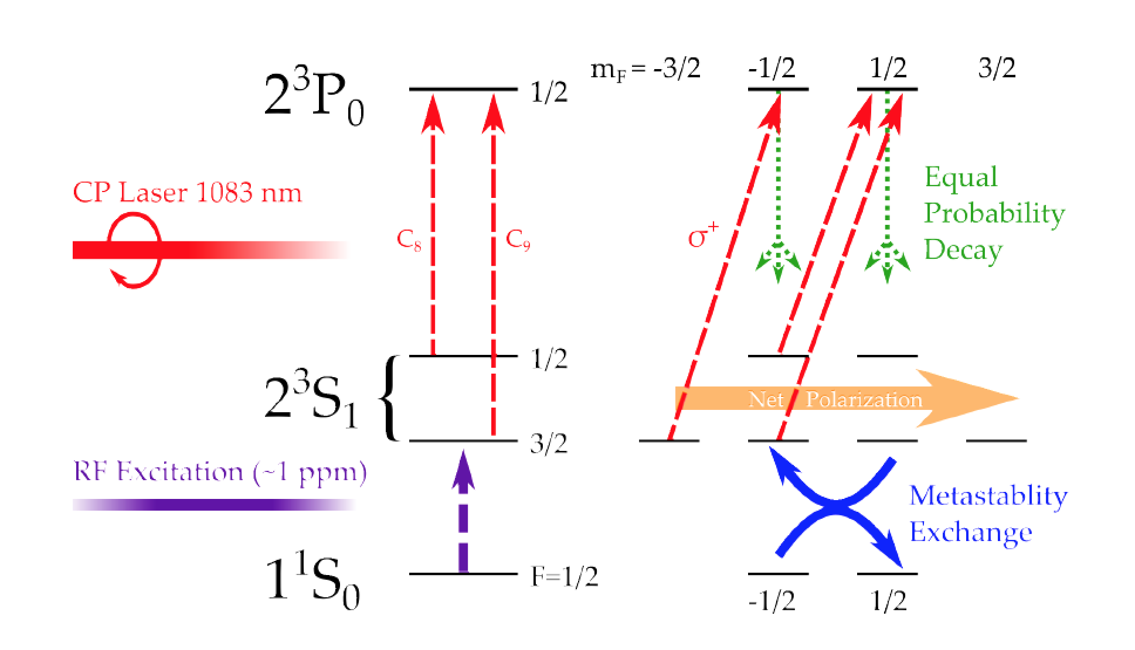
Metastability Exchange Optical Pumping

Slide 7
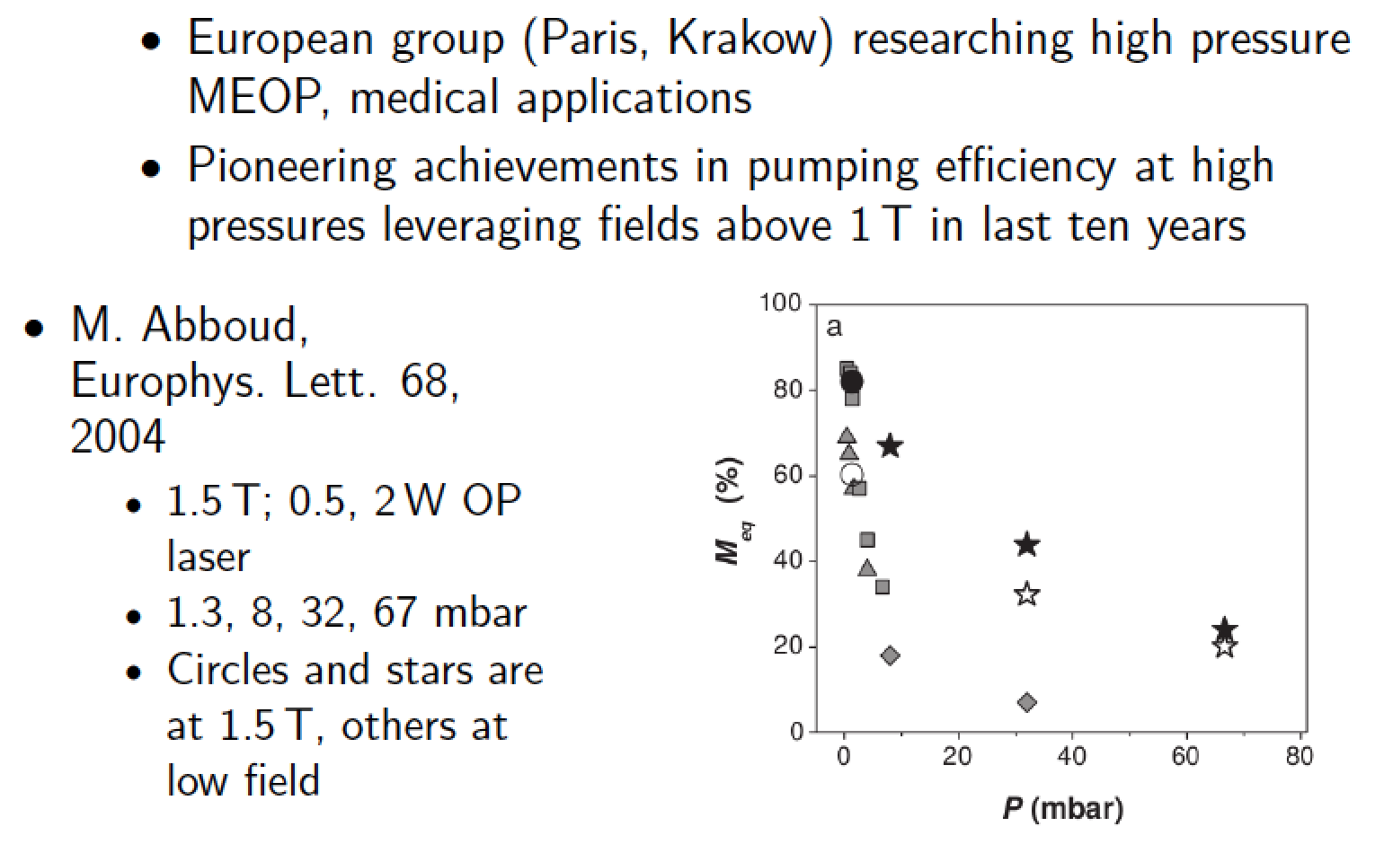
MEOP at High Magnetic Field

Slide 8
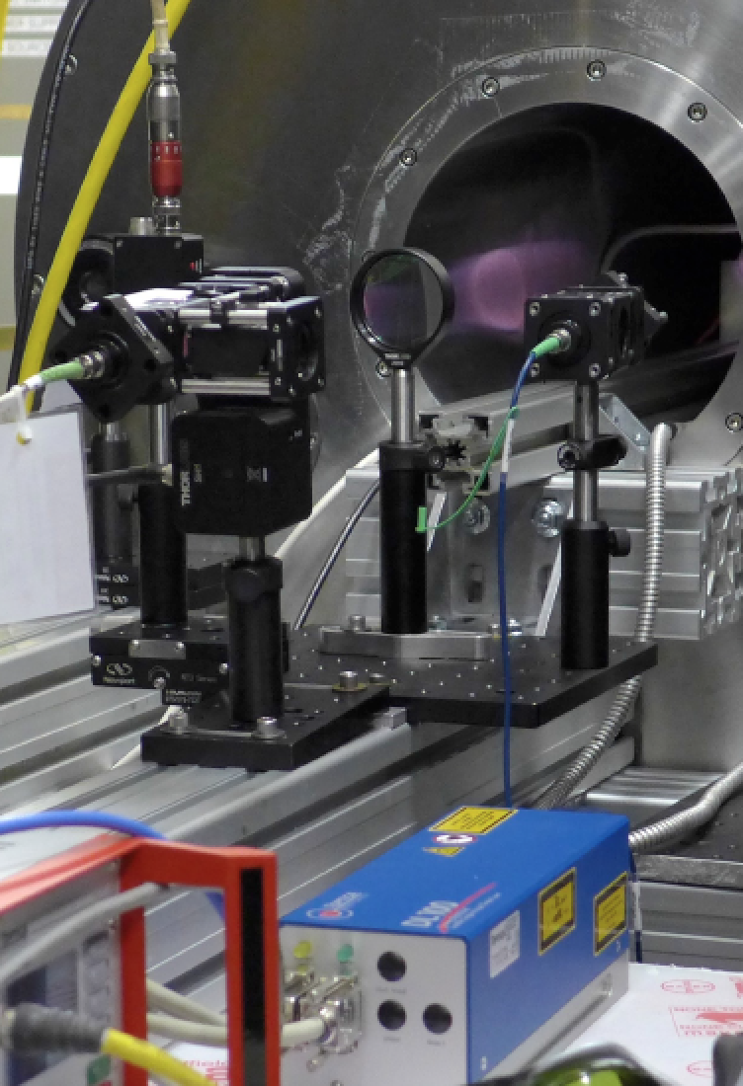
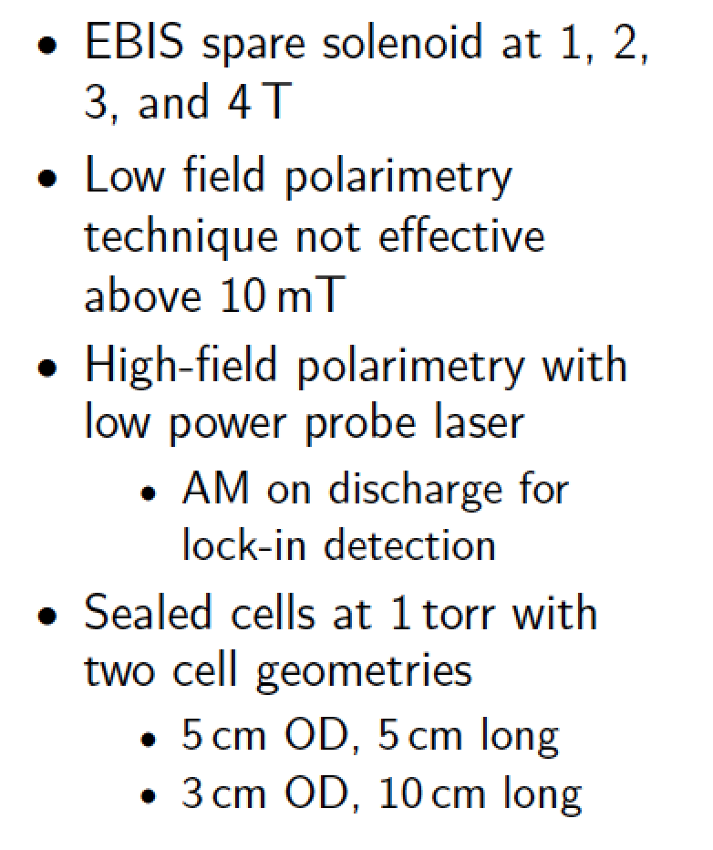
BNL High Field Tests

Slide 9
Optical Probe Polarimeter
Wavemeter
Probe laser, Toptica, diode laser
Pumping laser
³He cell
Detector
Pumping laser-Keopsys 10 W 1083 nm- fiber laser

Slide 10
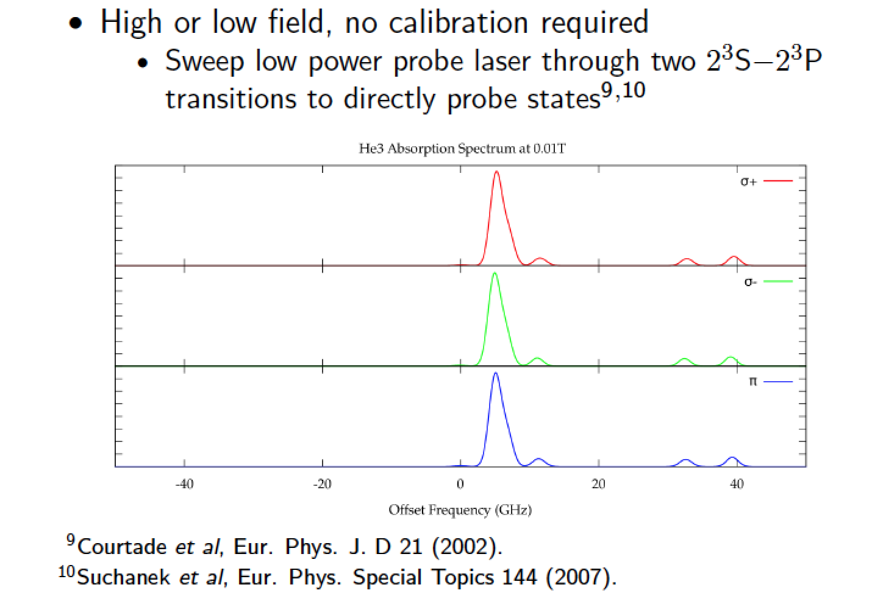
Optical Probe Polarimeter

Slide 11
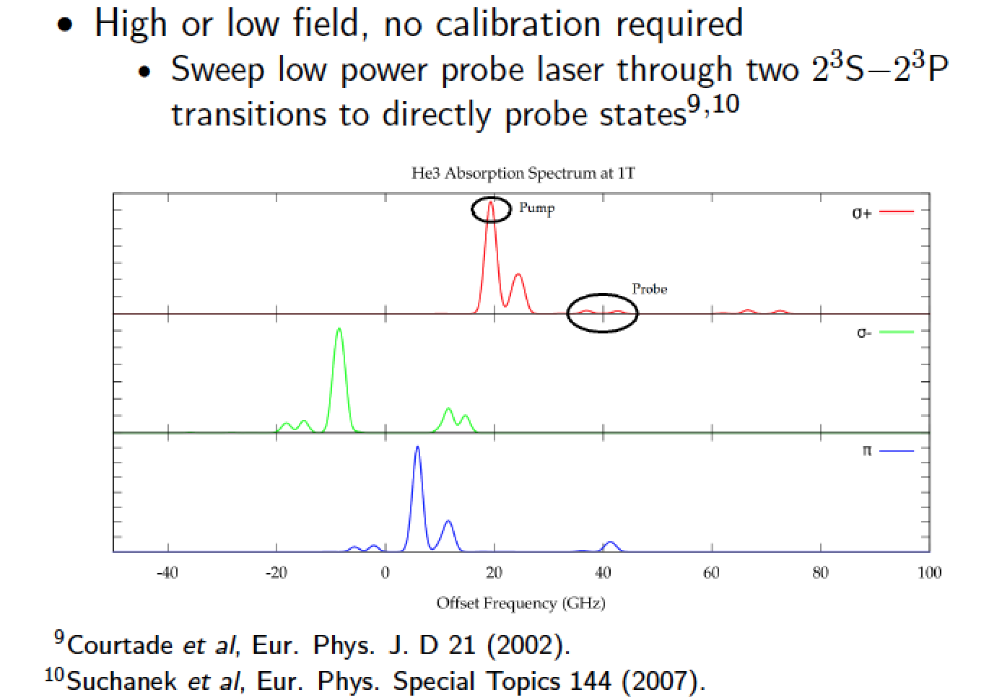
Optical Probe Polarimeter

Slide 12
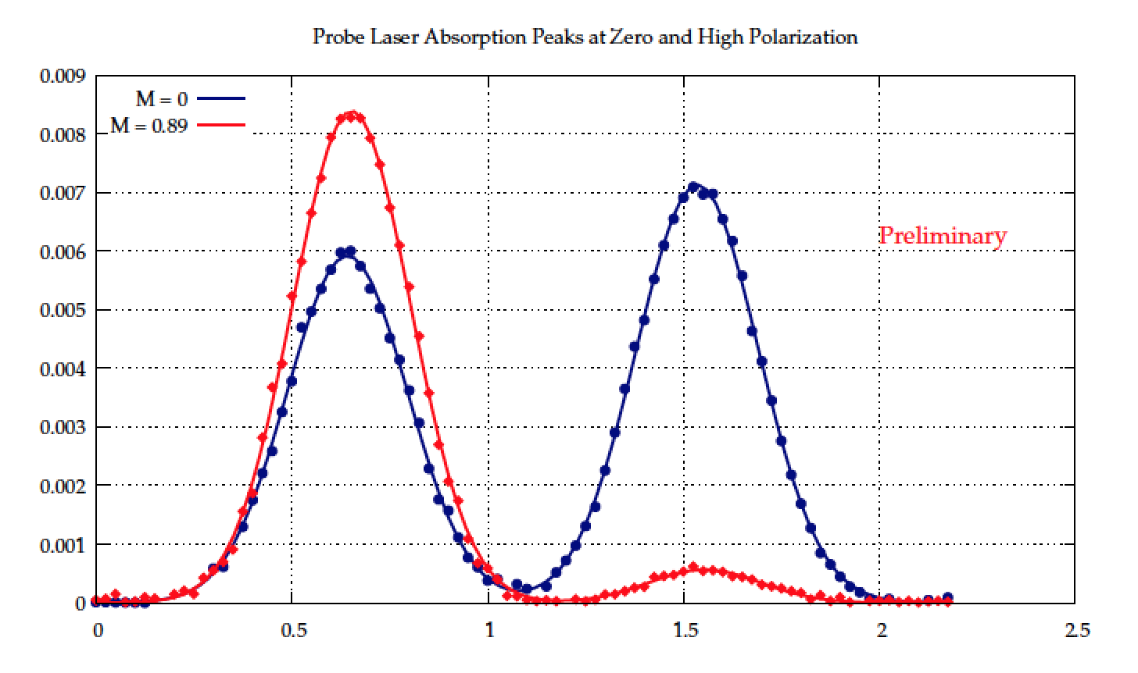
Measured Optical Pumping
Probe Laser Absorption Peaks at Zero and High Polarization

Slide 13
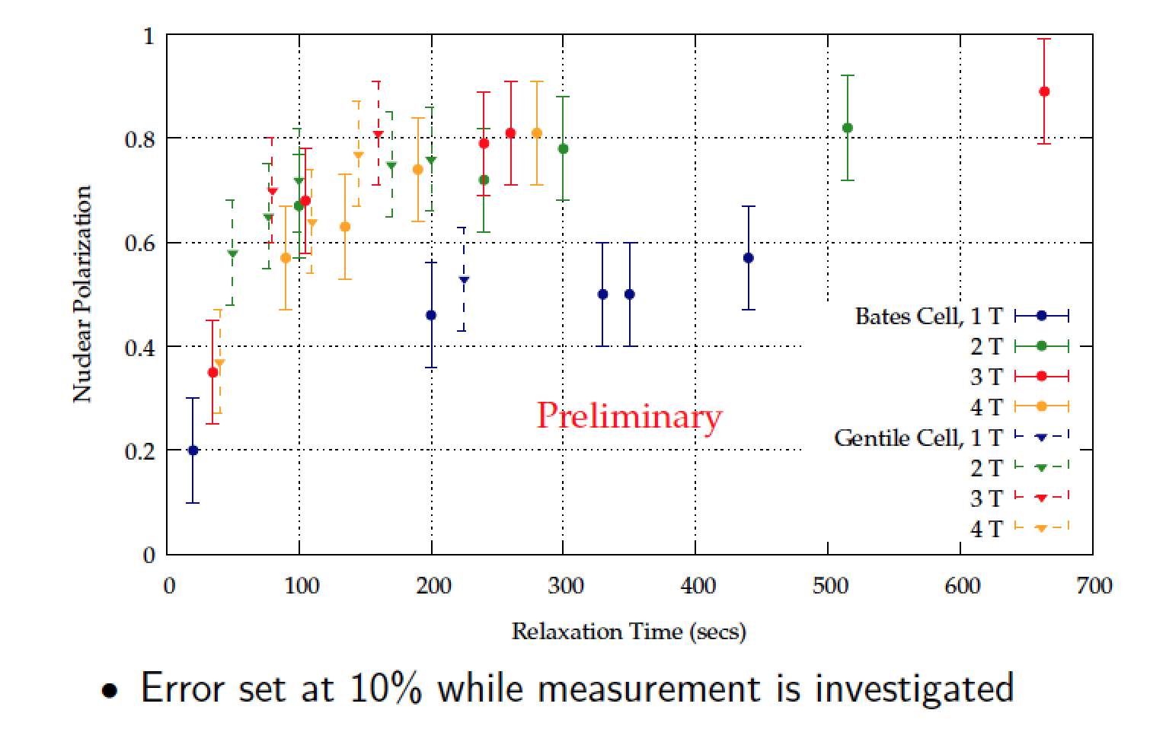
High Field Polarization Results

Slide 14
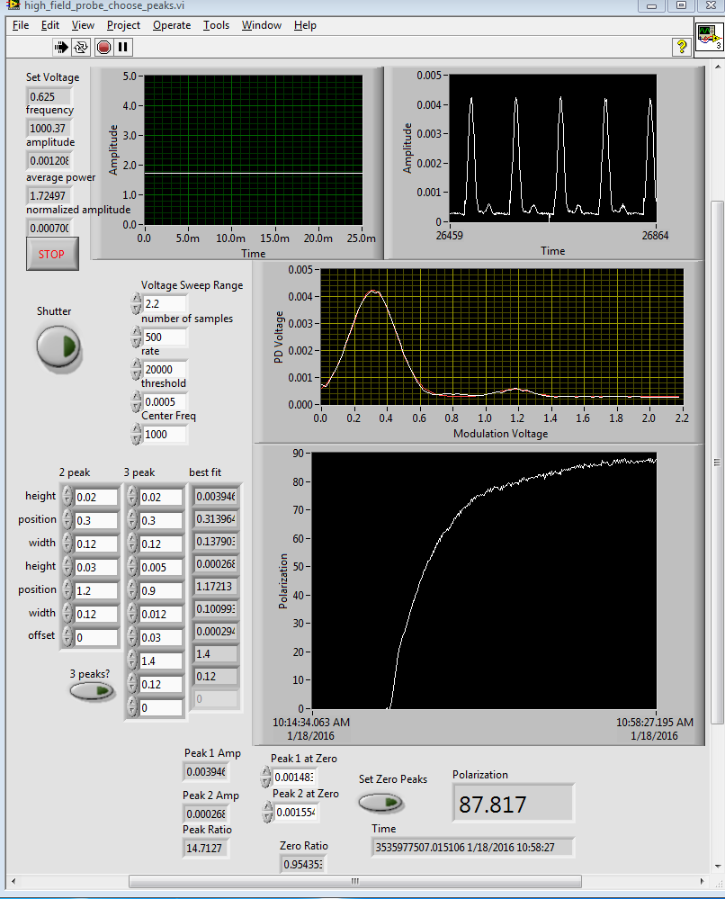
High Polarization at High Field
88% polarization
2 T magnetic field
30 mm OD cell
Pump- probe laser
absorption polarimeter
January 18, 2016

Slide 15
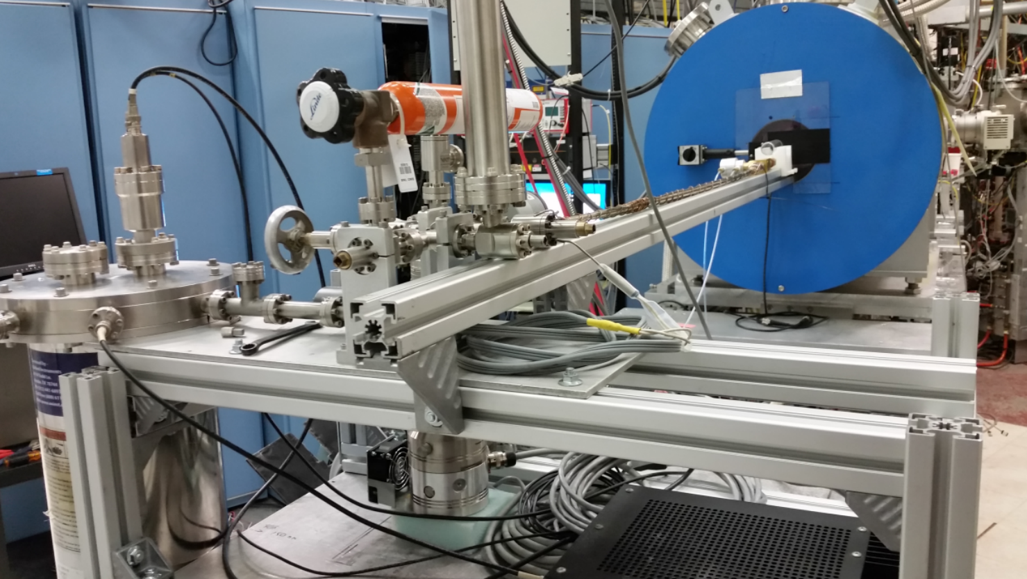
³He Polarization Setup using OPPIS 3.0 T Solenoid
September 2017

Slide 16
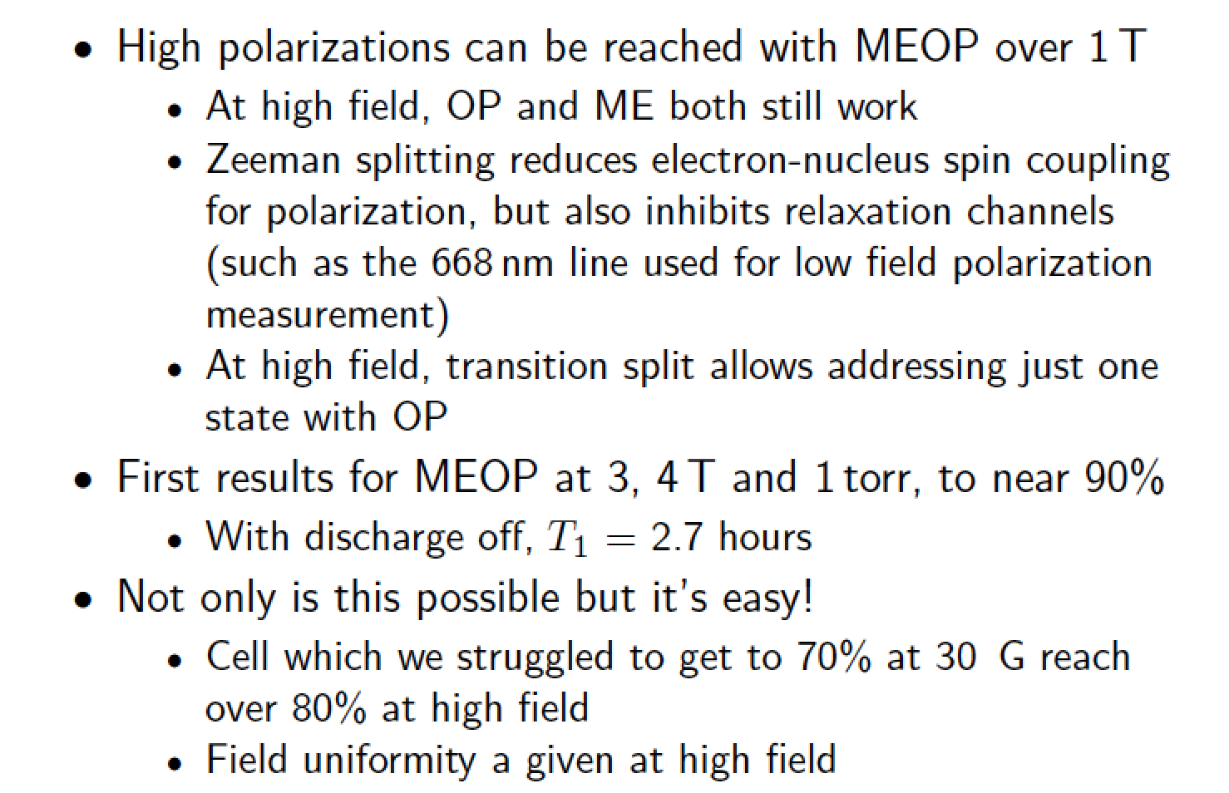
High Field Conclusions

Slide 17
The Path Forward
We have concluded that the high field optical pumping
clearly offers the best path forward to realize a polarized
³He ion source for RHIC
- high nuclear polarization of atom
- high degree of confidence that atom polarization is
preserved in injection process
A plan to implement this in a test configuration has been
developed.
Further, an NMR system has been built to absolutely
measure in a second, independent way the high field
nuclear polarization. This work is in progress.

Slide 18
Proposed Extended Trap EBIS
This upgrade provides us an opportunity to incorporate features which will allow us to use the EBIS for optimal injection of polarized ³He atoms.
The design provides space in the bore to incorporate a polarizing cell at the beginning of the first coil.
The design with a drift tube configuration in the first solenoid can be used as a “gas cell” region.
This will benefit production of all gaseous beams – e.g. ⁴He, Ne, Kr, Ar, Xe, O for NSRL.
The design will have good vacuum separation between the two magnets, by means of differential pumping.
The field dip will be minimized to preserve polarization.
This upgrade is also an opportunity to improve the reliability and maintainability of the conventional EBIS section (improved access to components, improved HV holdoff).

Slide 19
Extended EBIS Upgrade
Add a second 5 T superconducting solenoid for trap length extension: 40% increase in Au intensity
Install ³He polarization and injection system into the upstream solenoid
trap length
extension
³He polarization and injection systems

Slide 20
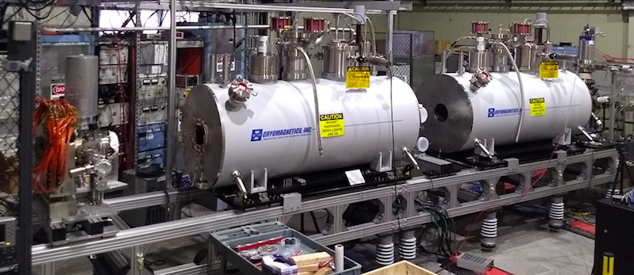
Current Setup of Extended EBIS Solenoids
Collector
Downstream superconducting solenoid
Gun
Upstream superconducting solenoid
Extended EBIS test setup

Slide 21
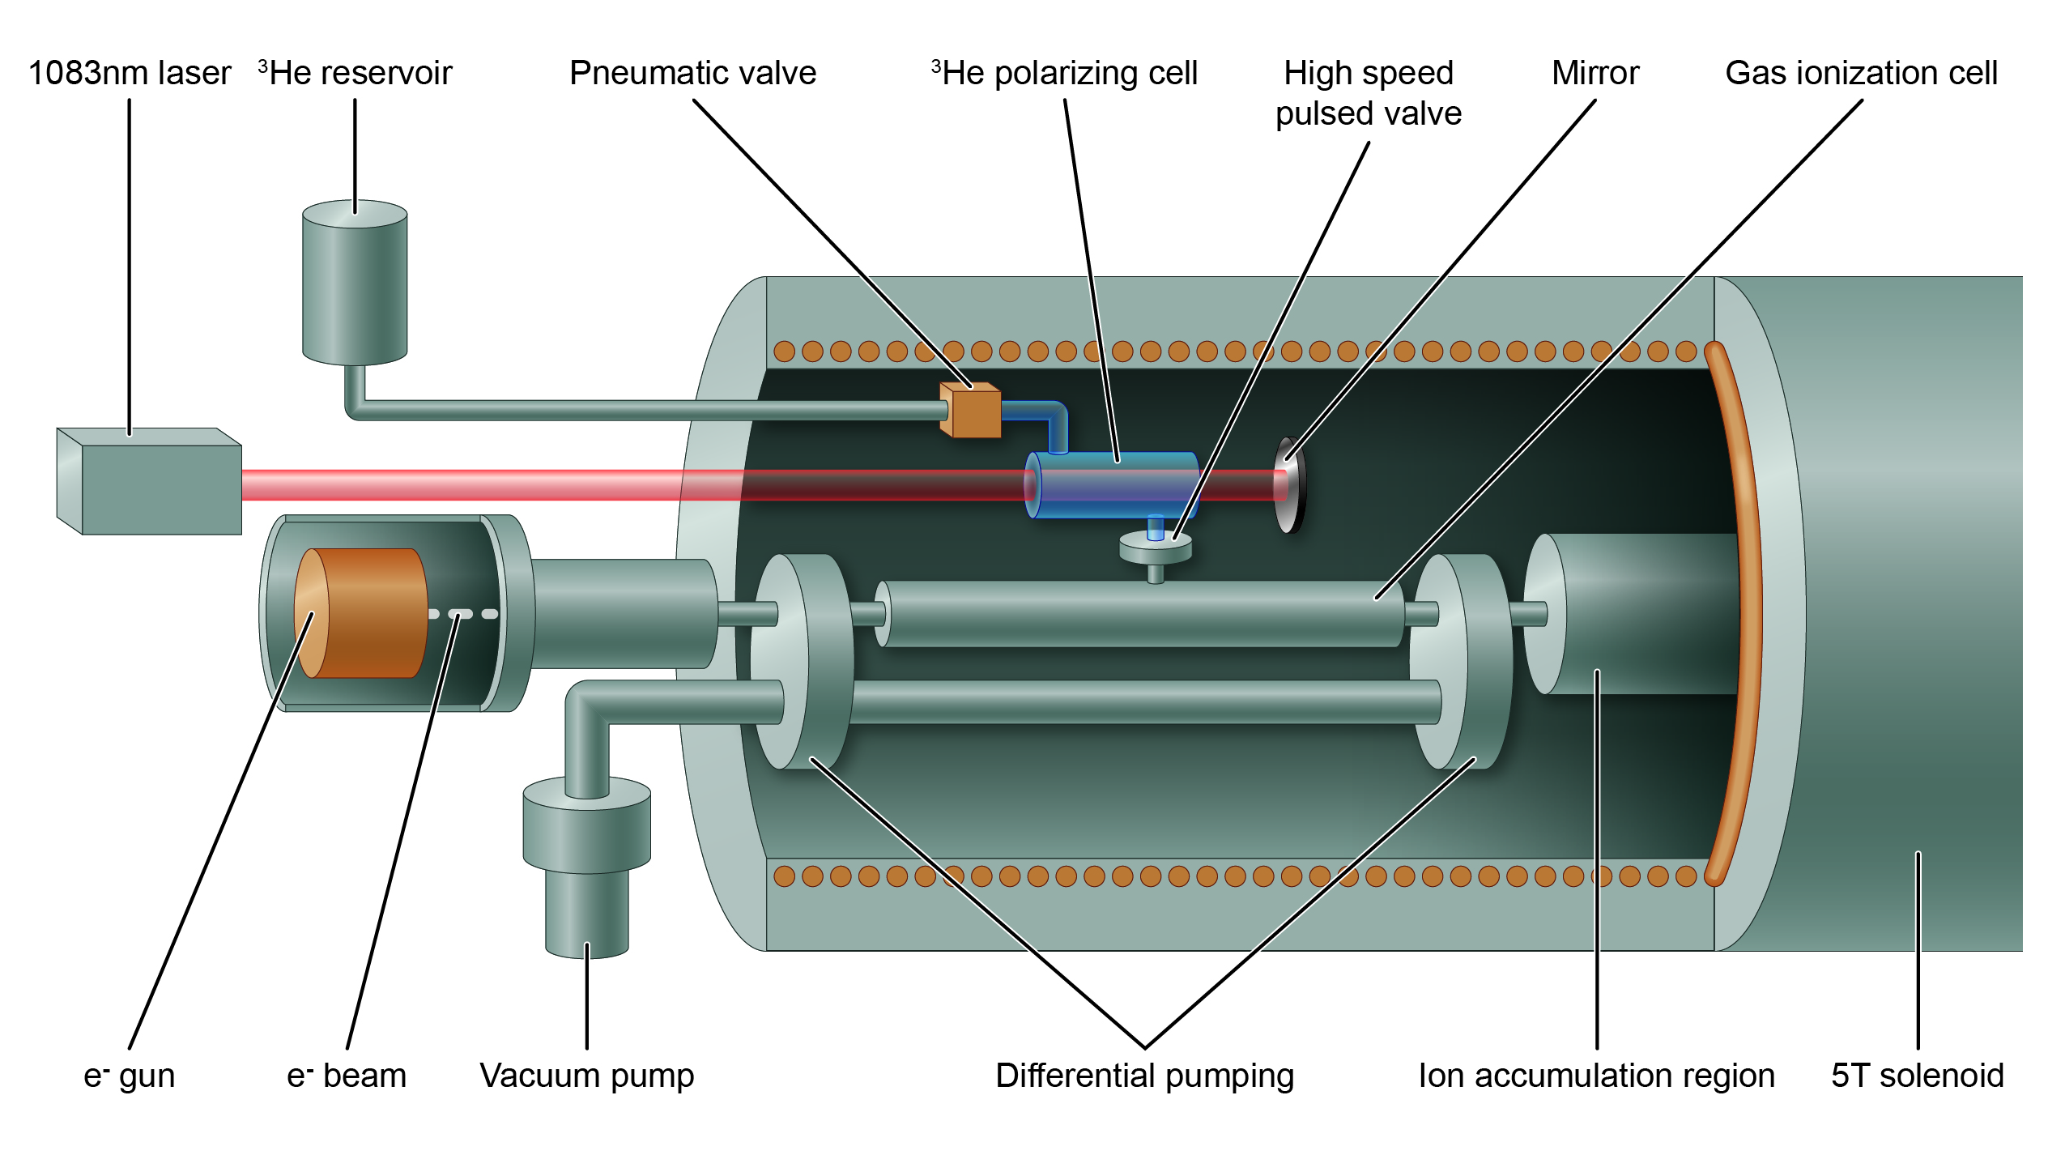
EBIS Upgrade with New Injector Solenoid for Polarized ³He⁺⁺ ion production

Slide 22
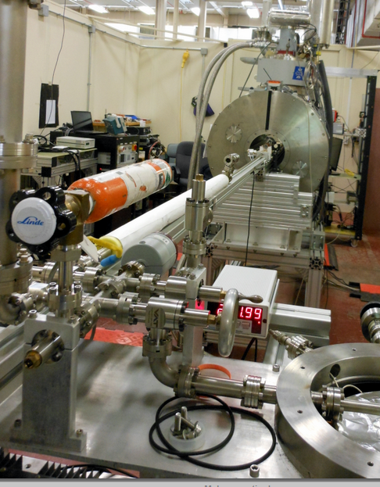
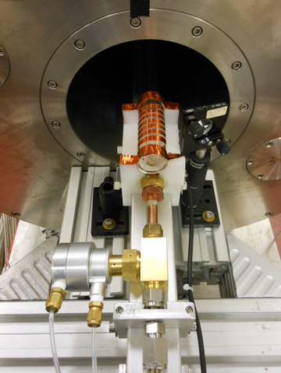
BNL: ³He-gas purification and filling system

Slide 23
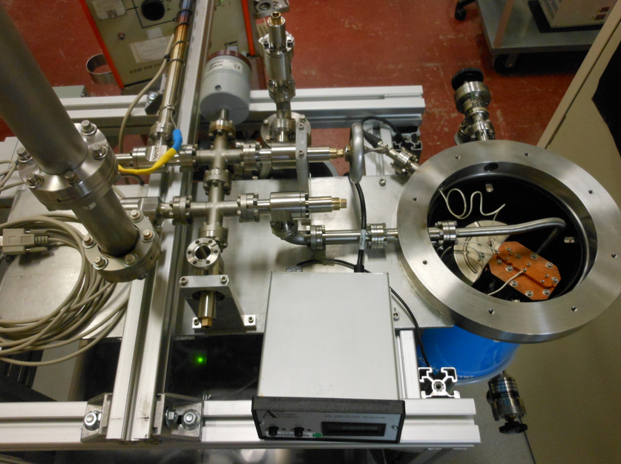
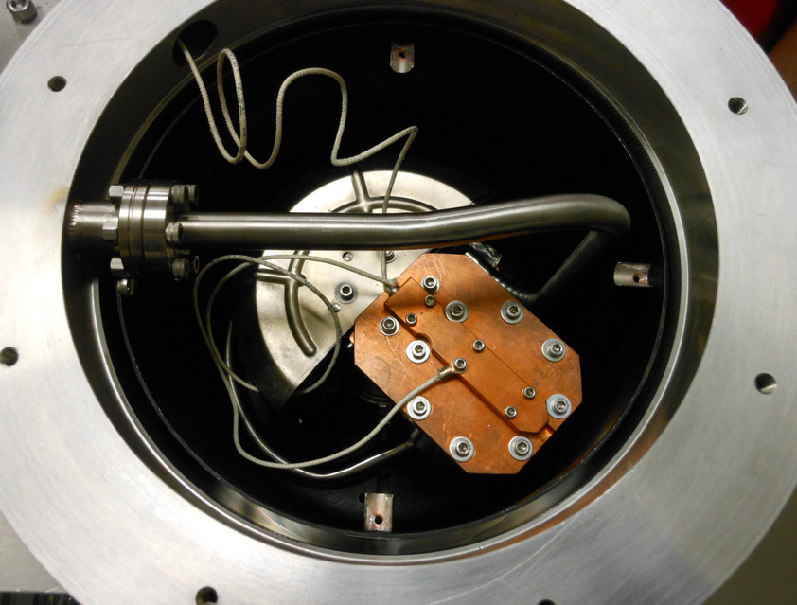
BNL: ³He cryo- purification system
³He cyro-purification and storage system was built from a modified CTI-8 cryo-pump.
Pumps everything except helium!

Slide 24
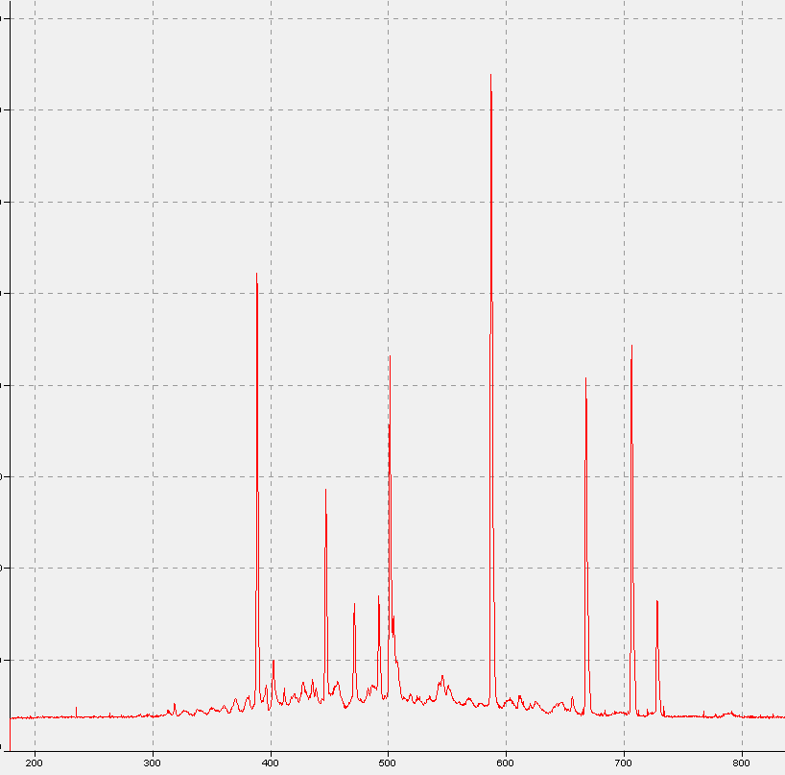
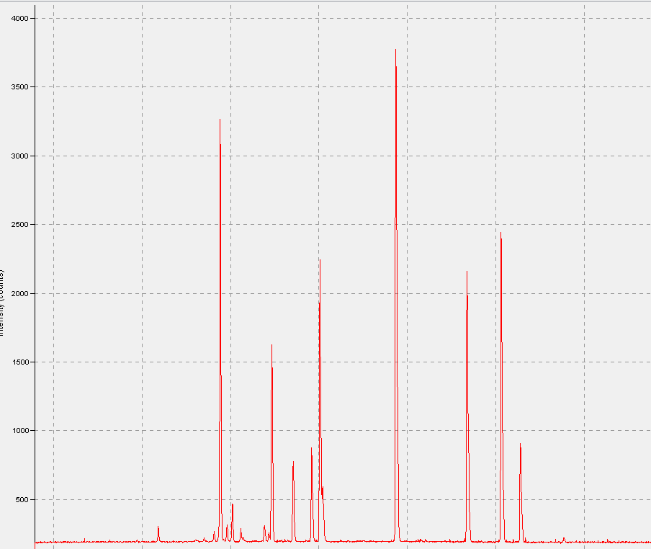
BNL: He RGA Spectra with CP-pumping at 45º K and RF discharge cleaning, no hydrogen 656 nm line!
Impurities in 3He gas from
the cell walls out-gassing
After 20 hrs Rf –discharge cleaning

Slide 25
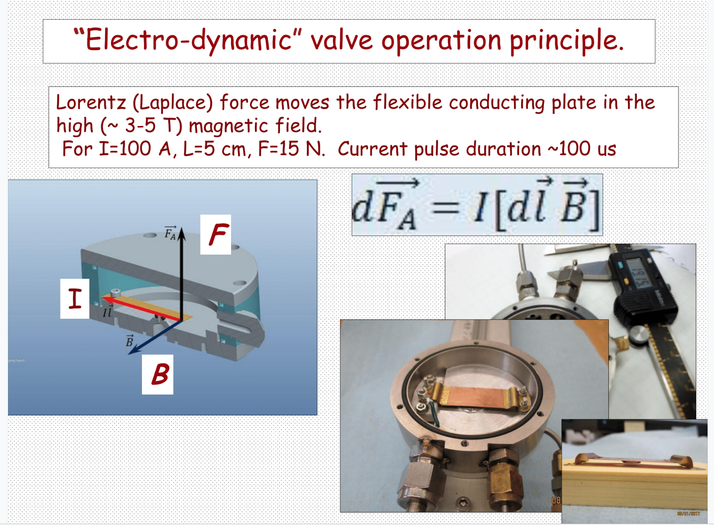
Electro-dynamic valve operation principle

Slide 26
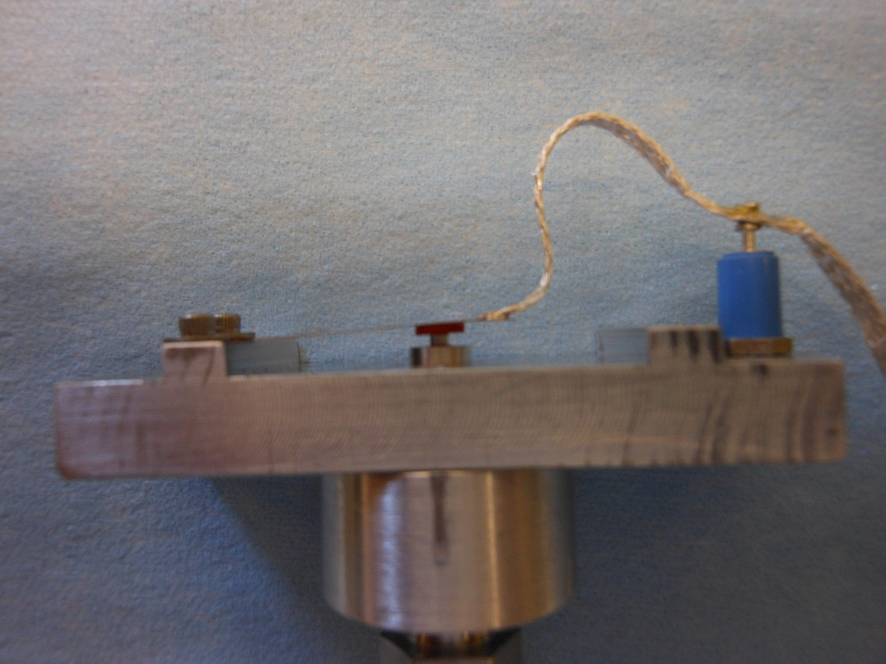
³He Pulsed Valve Development

Slide 27
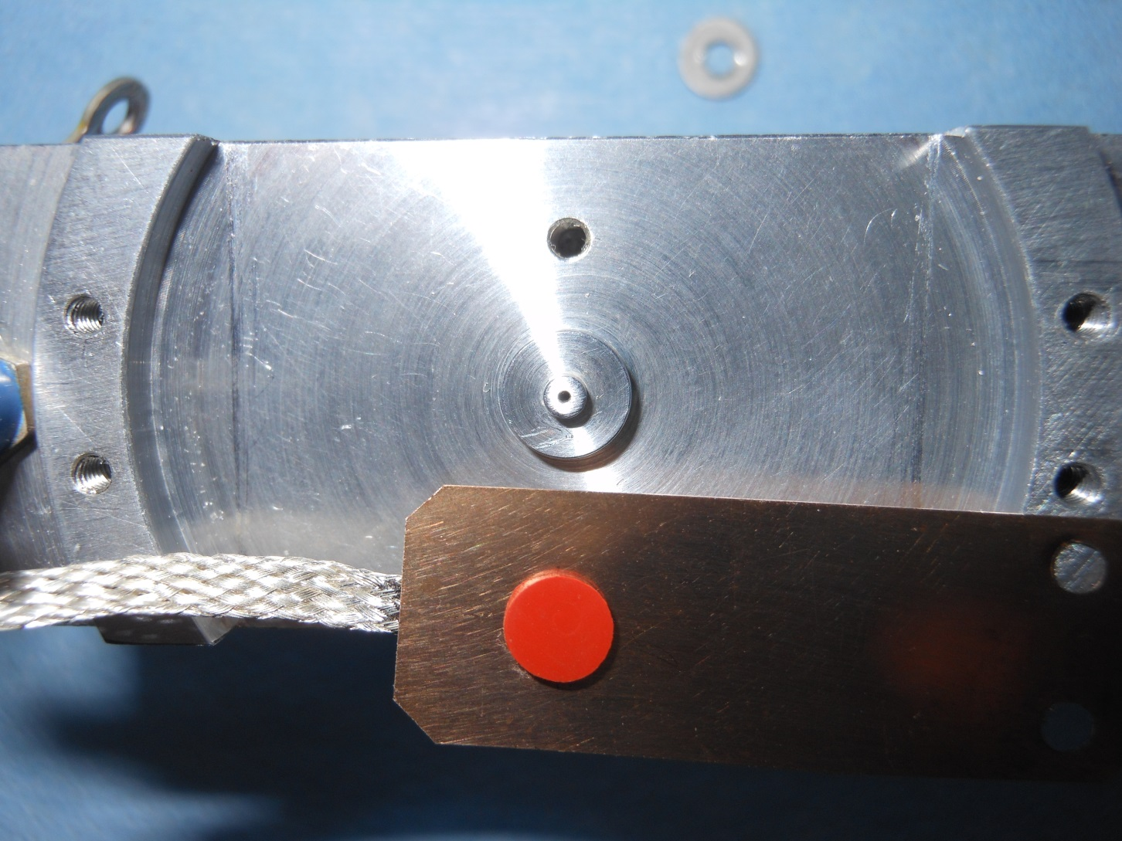
³He Pulsed Valve Development

Slide 28
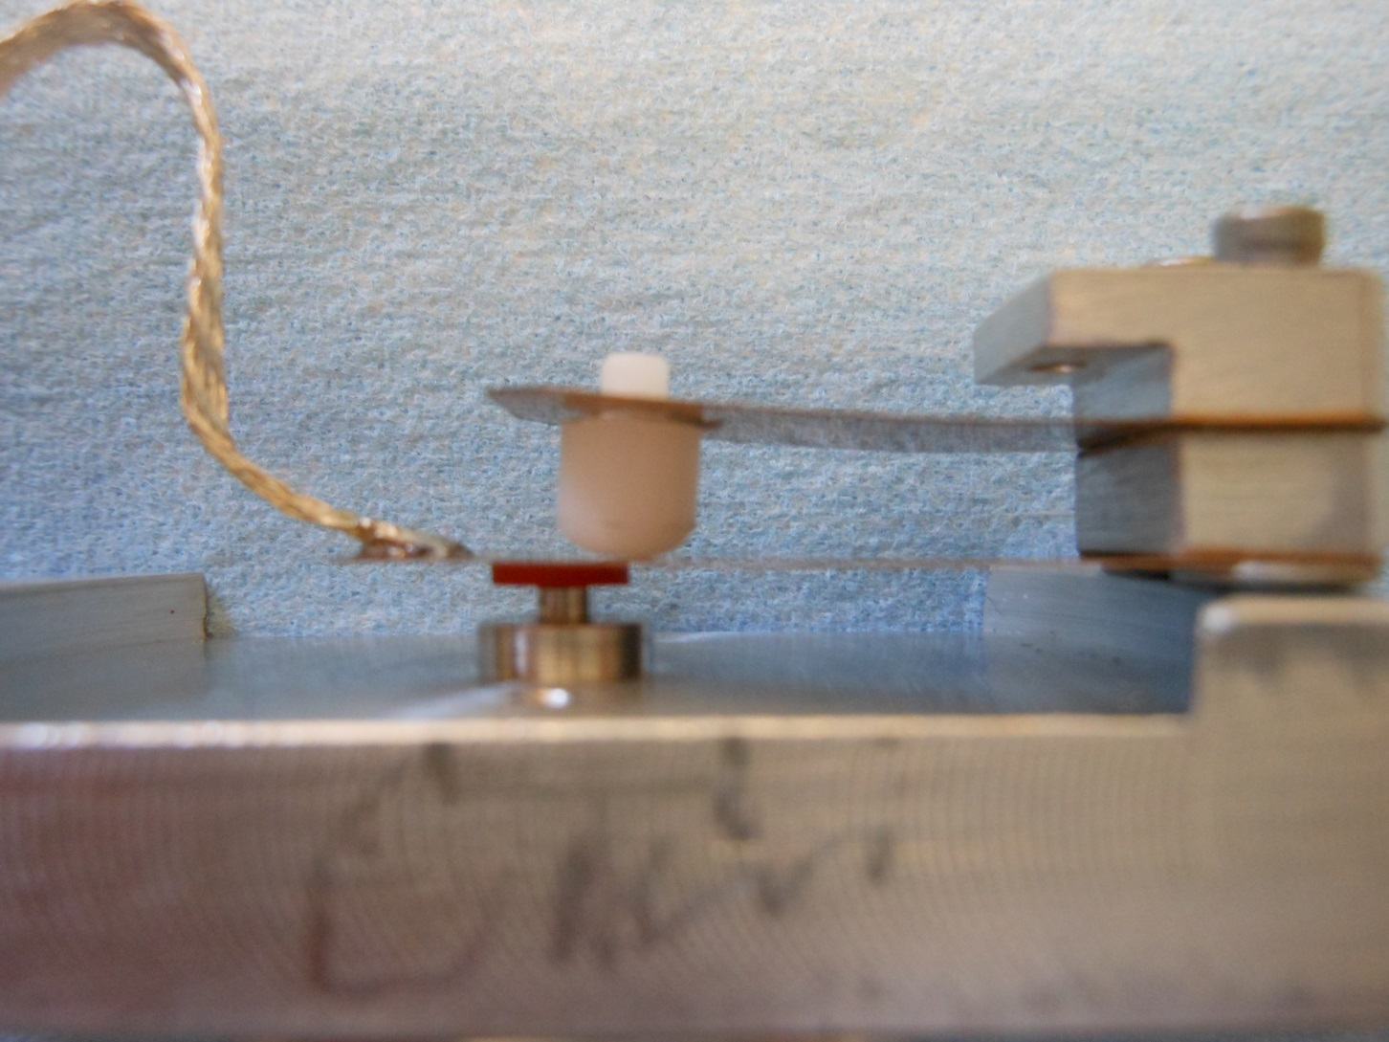
³He Pulsed Valve Development

Slide 29
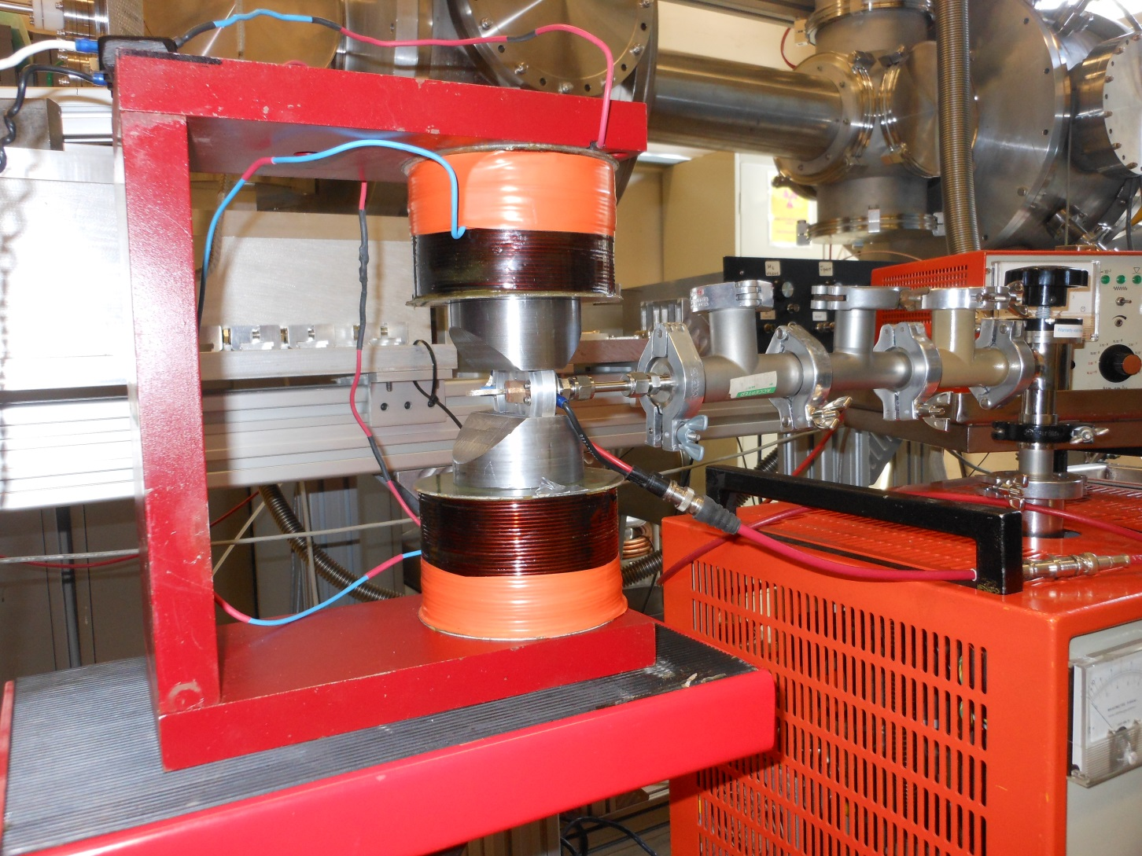
Valve Testing in 1 T Dipole Field

Slide 30
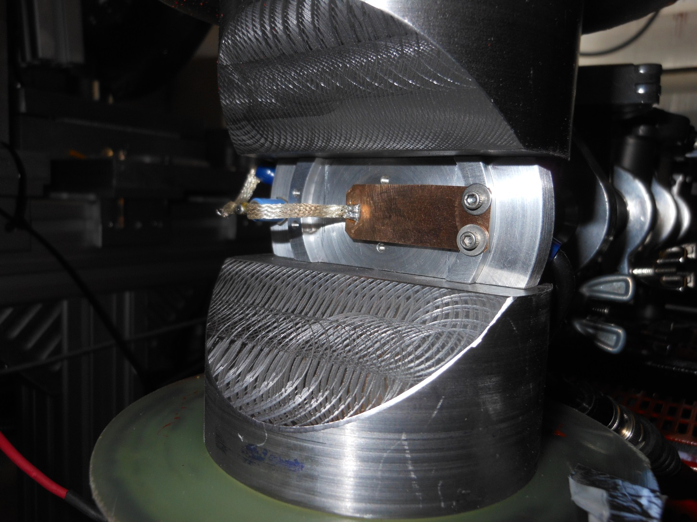
Valve Testing in 1 T Dipole Field

Slide 31
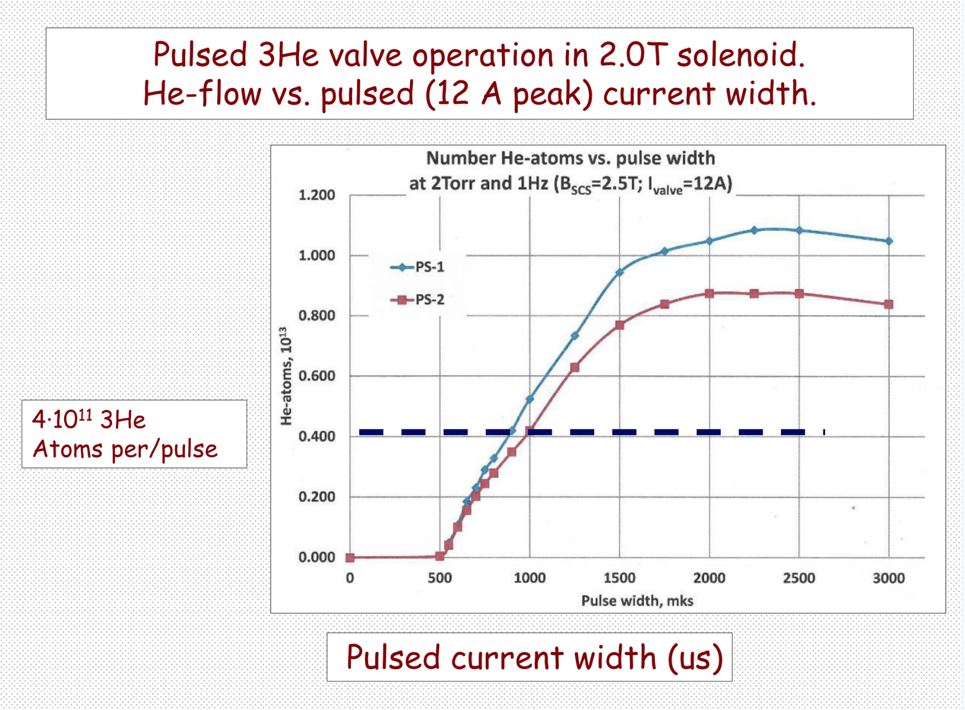
Pulsed ³He valve operation in 2.0 T solenoid

Slide 32
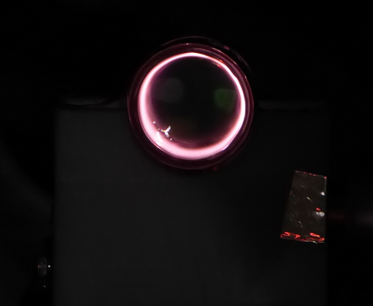
RF-discharge in 2.0 T magnetic field
³He-cell diameter-25mm
RF-discharge parameters strongly affect maximum polarization.
Optimization of the ³He -cell geometry (smaller diameter?) and electrodes for RF input should improve polarization.

Slide 33
Gas injection cell testing at the BNL TestEBIS
The BNL Extended EBIS will be composed of two axially adjacent superconducting solenoid modules to effectively extend the ion trapping region and thereby increase the ion charge per extracted pulse.
The upstream solenoid will house a high efficiency gas injection module which will facilitate injection of polarized ³He, H₂ and other gases.
One concept under consideration is the use of a 20-30 cm long, 10mm diameter “gas cell” with 5 mm diameter end caps to restrict gas flow out of the cell. Gas would be introduced via a pulsed valve, at the mid plane of the long gas cell from a radially adjacent glass gas (polarization) located reservoir radially adjacent in the high magnetic field. The stainless steel gas cell and end caps are electrically isolated to allow application of potentials necessary to provide 10 A electron beam propagation along the axis as well a manipulation of ions formed from the injected gas.

Slide 34
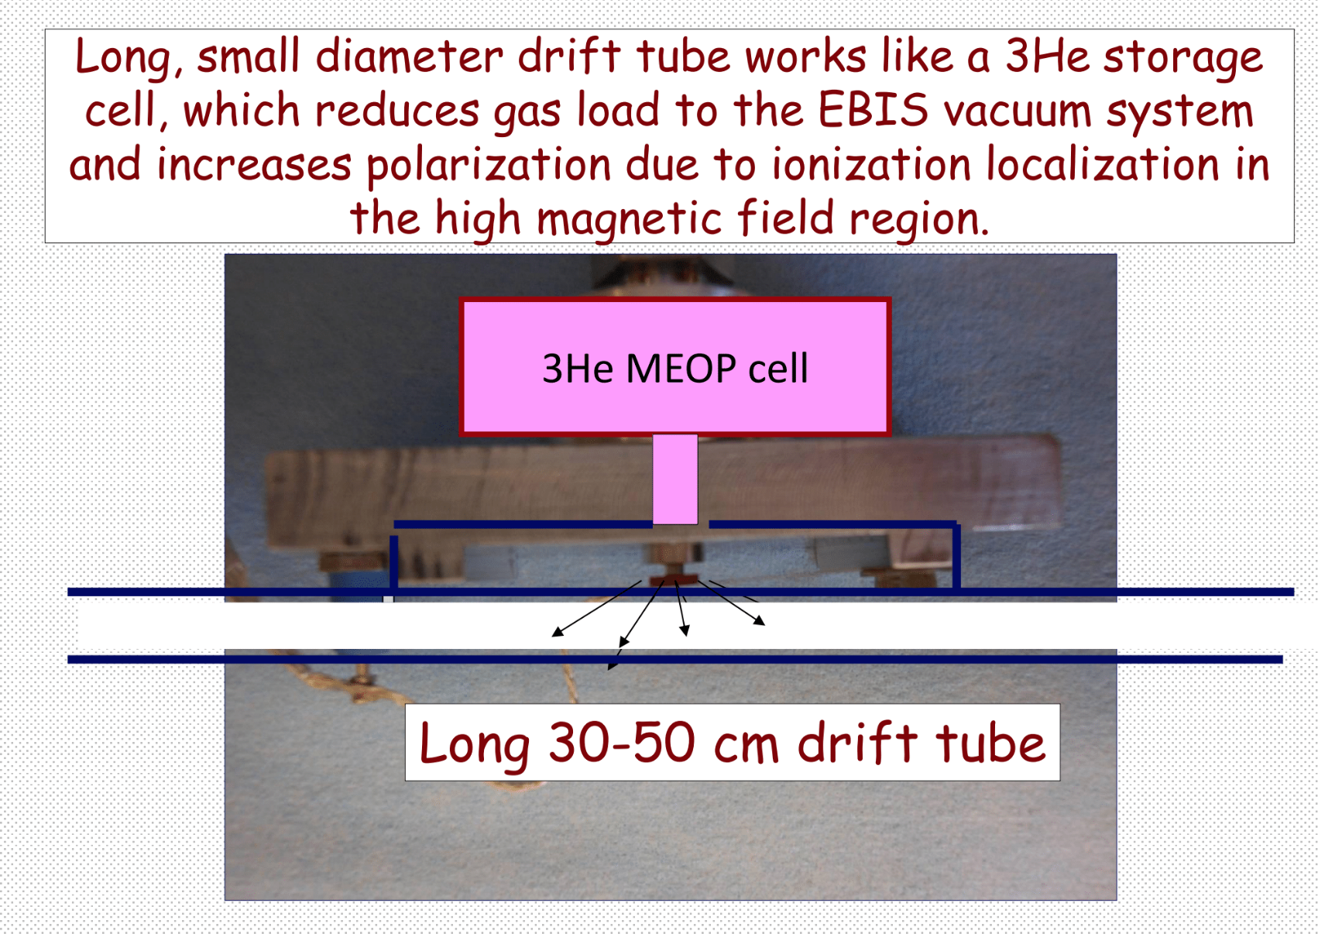
Long, small diameter drift tube works like a ³He storage cell,
which reduces gas load to the EBIS vacuum system and
Increases polarization due to ionization localization in the high
magnetic field region.

Slide 35
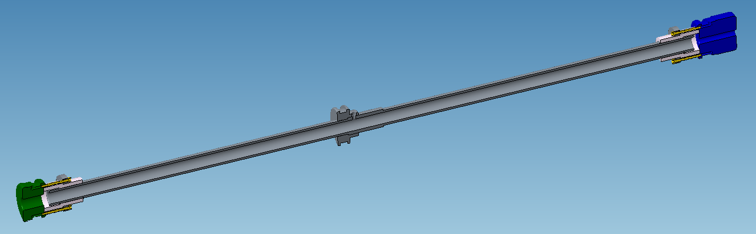
Gas Injection Cell with end caps for Electron Beam Tests at the BNL TestEBIS
The gas cell assembly consists of a 46 cm long, 10 mm diameter gas cell with an electrically isolated 3 cm long, 10 mm diameter upstream barrier electrode (green) and a 3 cm long, 5 mm diameter downstream barrier electrode (blue).
The electrodes are inserted into the existing TestEBIS 31mm diameter drift tubes. Electrical contact to three axially adjacent TestEBIS ion trap region drift tubes is made using RF springs around the circumference of each electrode insert.

Slide 36
Gas Cell Drift Tube Assembly
Electron Beam Test Results
Electron beams up to 6 A were successfully propagated through the assembly consisting of a 46 cm, 10 mm gas cell with a 3 cm long, 10 mm upstream barrier electrode and a 3 cm long, 5 mm diameter downstream barrier electrode.
Ion extraction from residual gas ions was made from both the 46 cm long, 10mm diameter “gas cell” and the remaining ionization region trap consisting of the 17 cm long, 31 mm diameter TestEBIS drift tube electrode. Ion transfer between the two adjacent trap regions with different diameters has also been tested.
No gas feed for gas injection was provided during these experiments, since this would require a substantial rework of the TestEBIS which was designed for external ion injection.
Preparations are underway for external Ion injection tests into the gas injection assembly at test EBIS.

Slide 37
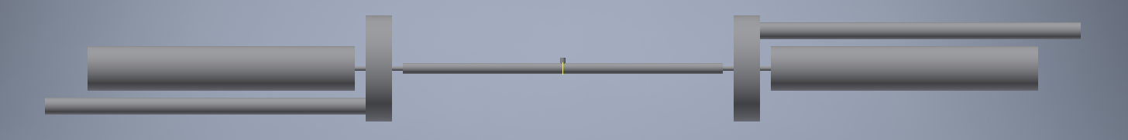
MolFlow Monte Carlo Model of Gas Injection
Ideal pumps
Gas Pulse
30 cm long, 1 cm diameter gas ionization cell
0.5 cm constrictions on either end of the ionization cell
~5.8x10⁹ ³He molecules injected into 23.6 cm³ volume
1x10⁻⁶ mbar pressure when diffused into ionization cell

Slide 38
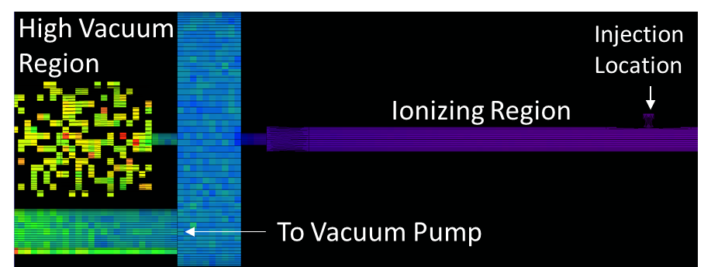
MolFlow Monte Carlo Model of Gas Injection
mbar
Simulation is paused 2 ms after injection when ³He gas is uniformly diffused in ionization region.

Slide 39

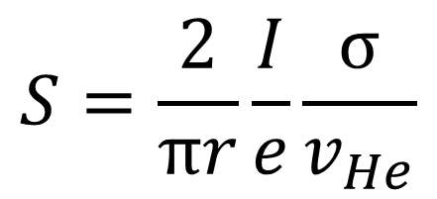
MolFlow Monte Carlo Model of Gas Injection
$$S=\frac{2}{πr}\frac{I}{e}\frac{σ}{v_{He}}$$
Electron Beam
1 mm diameter
10 Amp
10 keV
1% probability that ³He is ionized during traverse of electron beam
Treat electron beam as ideal pump with 99% transparency.
Pumping Rate of Electron Beam
no electron beam
10 Amp electron beam

Slide 40
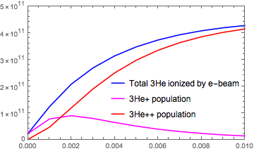
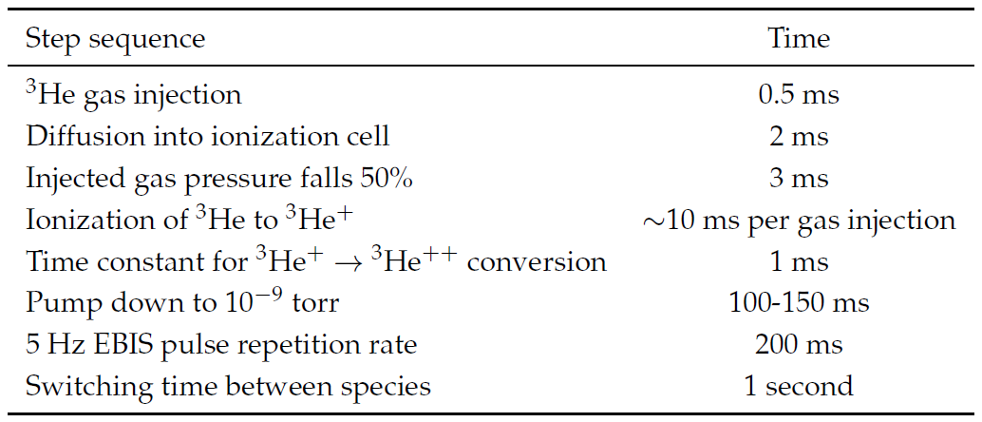
MolFlow Monte Carlo Model of Gas Injection
All time scales are encouraging!

Slide 41
Feasibility Experiment
Use extended EBIS and extract fully stripped polarized ³He⁺⁺ ions accelerated to 5.3 MeV
Measure ³He + ⁴He → ³He + ⁴He elastic scattering
Analyzing power has been measured to be 100% at 91º_{CM} at 5.3 MeV
Process yields 2.66 MeV ³He at 53.6º_{lab} and 2.64 MeV recoil ⁴He at 44.5º_{lab}
→
→

Slide 42
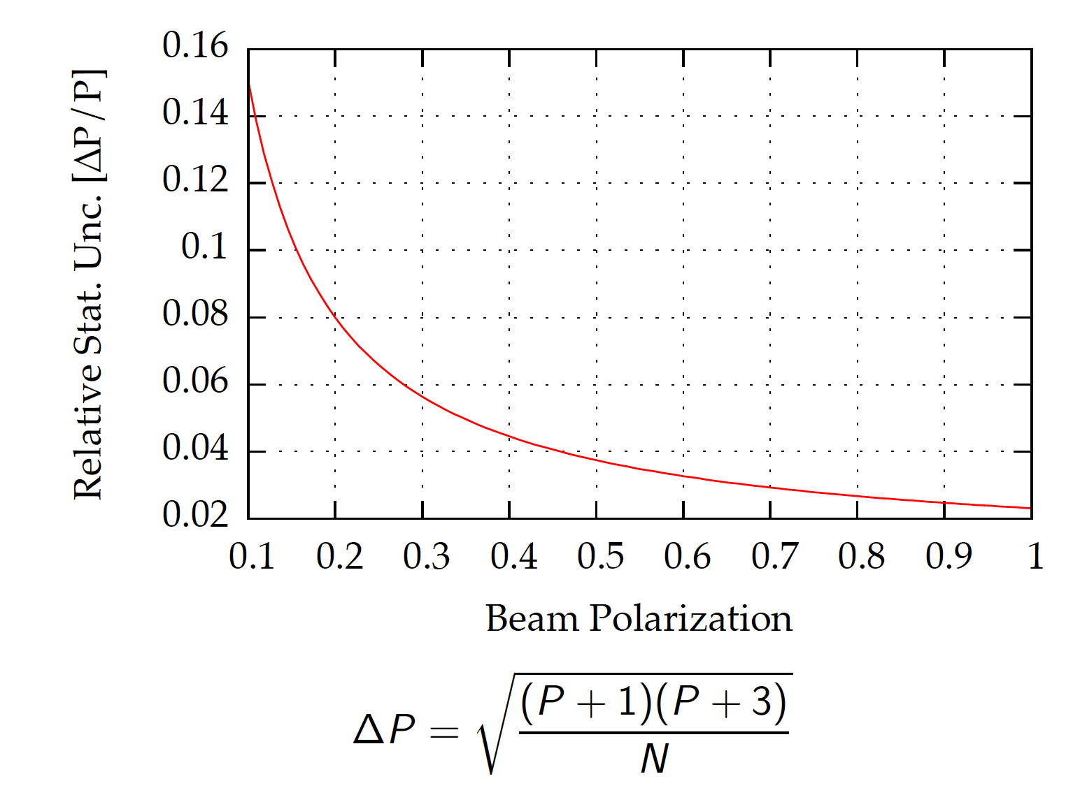
Precision after 1 minute @ 250 Hz

Slide 43
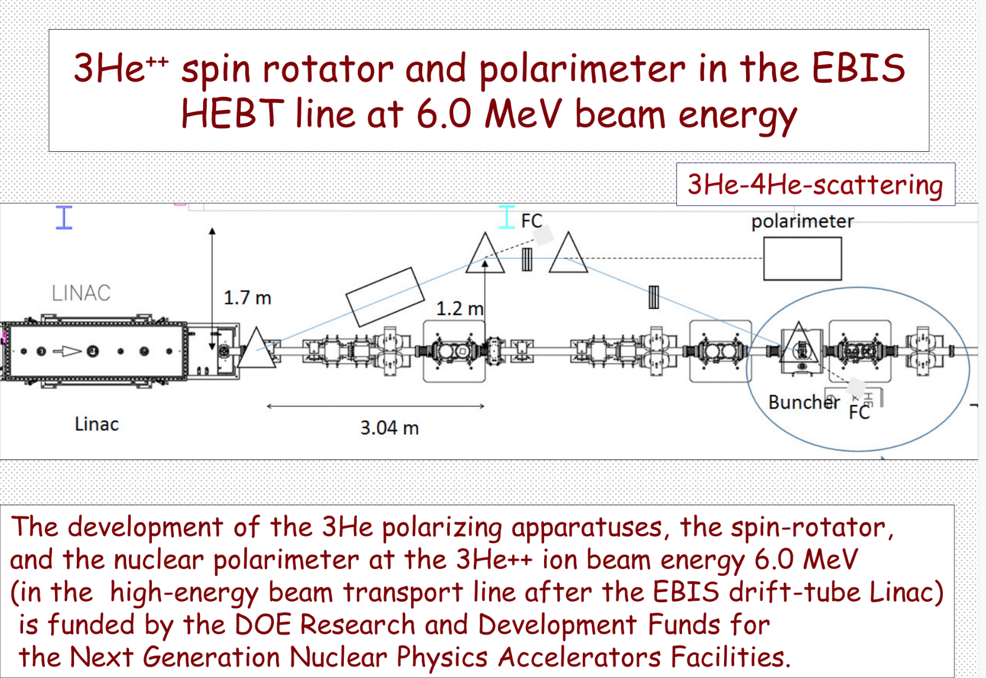
³He⁺⁺ spin rotator and polarimeter in the EBIS
HEBT line at 6.0 MeV beam energy
³He-⁴He scattering

Slide 44
Schedule
FY2016
High field optical pumping measurements
Development of ³He gas purification
FY2017
Superconducting magnet for trap length extension ordered
OPPIS converted into high field polarized ³He test system
FY2018
Superconducting magnets for EBIS extension delivered
Development of valve system and vacuum system
NMR calibration of high field optical pumping measurements
FY2019
Design of feasibility experiment and RHIC ³He polarimeter
Upgraded EBIS used for Gold run
FY2020
Construction of RHIC ³He polarimeter
Polarized ³He⁺⁺ beam of 2.5 x 10¹¹ ions/pulse and 70% polarization
Actual installation times have to be scheduled around the research programs of RHIC and the NASA Space Radiation Laboratory (NSRL).

Slide 45
Summary
The R&D effort has enabled development of key state-of-the-art MEOP technology at BNL and MIT.
Studies of ³He spin transport in magnetic field gradients have been carried out and are well understood.
High field optical pumping has been successfully developed. This was not anticipated at the beginning of this project.
A tandem EBIS looks ideal for optimal ³He polarization delivery and a feasibility demonstration of a realistic source is being developed.
We are on a path to have polarized ³He ions in RHIC early in the next decade.

