Slide 1
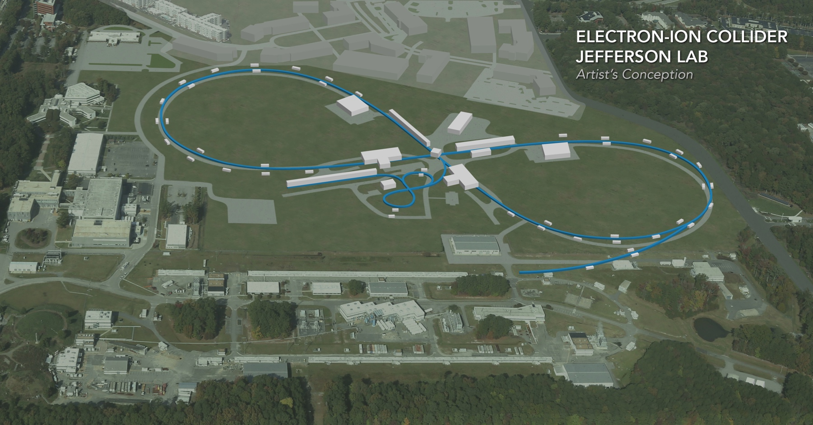
JLEIC ion beam bunch splitting
Randika Gamage
Old dominion university
EIC Accelerator Collaboration Meeting
October 29 - November 1, 2018

Slide 2
Overview
Introduction (JLEIC, layout, problem)
Theory (Longitudinal dynamics)
Debunch/Rebunch Method
Bunch Splitting Method
Genetic Algorithm Optimization
October 29 – November 1, 2018
Fall 2018 EIC Accelerator Collaboration Meeting

Slide 3
JLEIC
Nuclear Science Advisory Committee (NSAC) 2015 long range plan
“We recommend a high-energy high-luminosity polarized EIC as the highest priority for new facility construction following the completion of FRIB*”.
Highly polarized (~70%) electron and nucleon beams
Ion beams from deuteron to heavy nuclei
Variable center of mass energies ~20 - ~100GeV
Possibility of having more than one interaction region
High collision luminosity ~
$${10}^{33-34}{cm}^{-2}s^{-1}$$
*Facility for Rare Isotope Beams (Michigan State University)
October 29 – November 1, 2018
Fall 2018 EIC Accelerator Collaboration Meeting

Slide 4
JLEIC Layout
ARC
CEBAF center

Slide 5
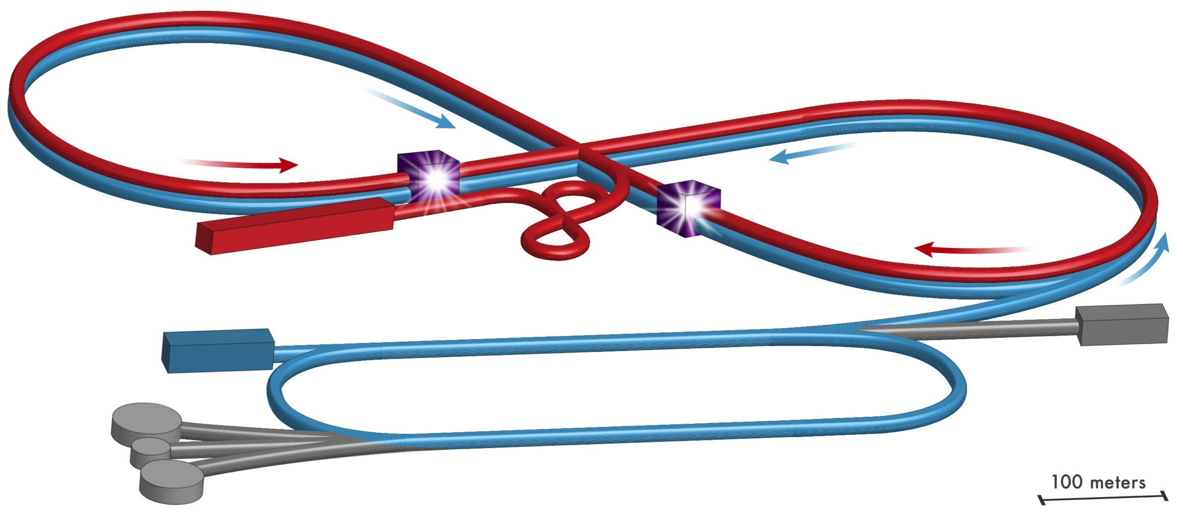
JLEIC Layout
Ion Collider Ring
Interaction Point
Interaction Point
Electron Collider Ring
Ion Source
Booster
Electron Source
12 GeV CEBAF
October 29 – November 1, 2018
Fall 2018 EIC Accelerator Collaboration Meeting

Slide 6
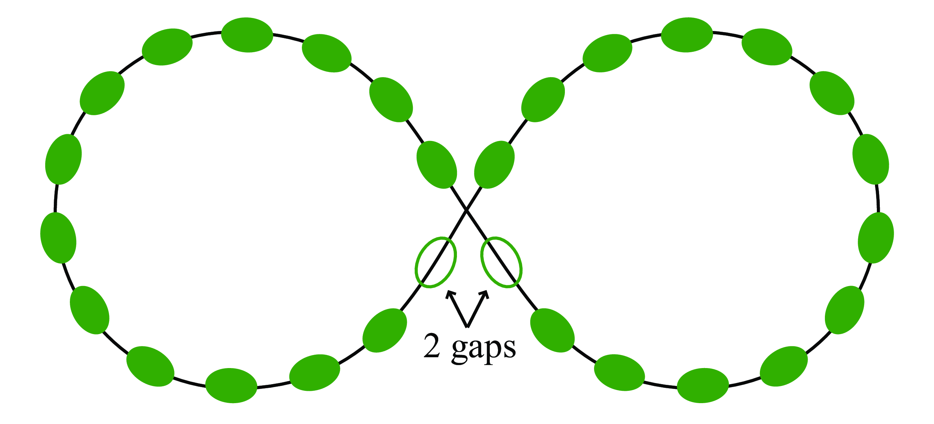
Parameters
$$E_{0}:Beamenergy$$
$$p_{0}:Beammomentum$$
$$δ=\frac{dp}{p_{0}}=\frac{1}{β^{2}}\frac{dE}{E_{0}}$$
$$η=\frac{1}{γ^{2}}-\frac{1}{γ_{tr}^{2}}:phaseslipfactor$$
$$C:ringcircumference$$
h=28 with 26 filled buckets and 2 empty buckets
$$c:speedoflight$$
$$h:harmonicnumber$$
$$V_{rf}:RFvoltage$$
$$φ_{s}:RFphaserelativetothebeam$$
￼

Slide 7
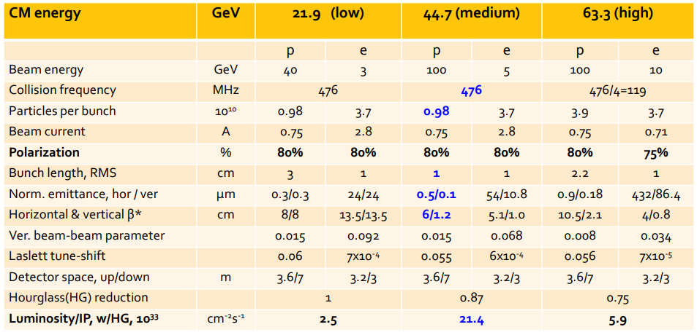
JLEIC Parameters

Slide 8
The problem
Inject 26 bunches at h=28 from the booster to the ion collider ring
Produce 3328 bunches at h=3584
Keep emittance growth to under 10% for the whole process
Possible Solutions
Debunch/Rebunch
Bunch splitting
Slip stacking
RF modulation
$$\}$$
Investigated in detail
$$\}$$
Discarded: large emittance growth

Slide 9
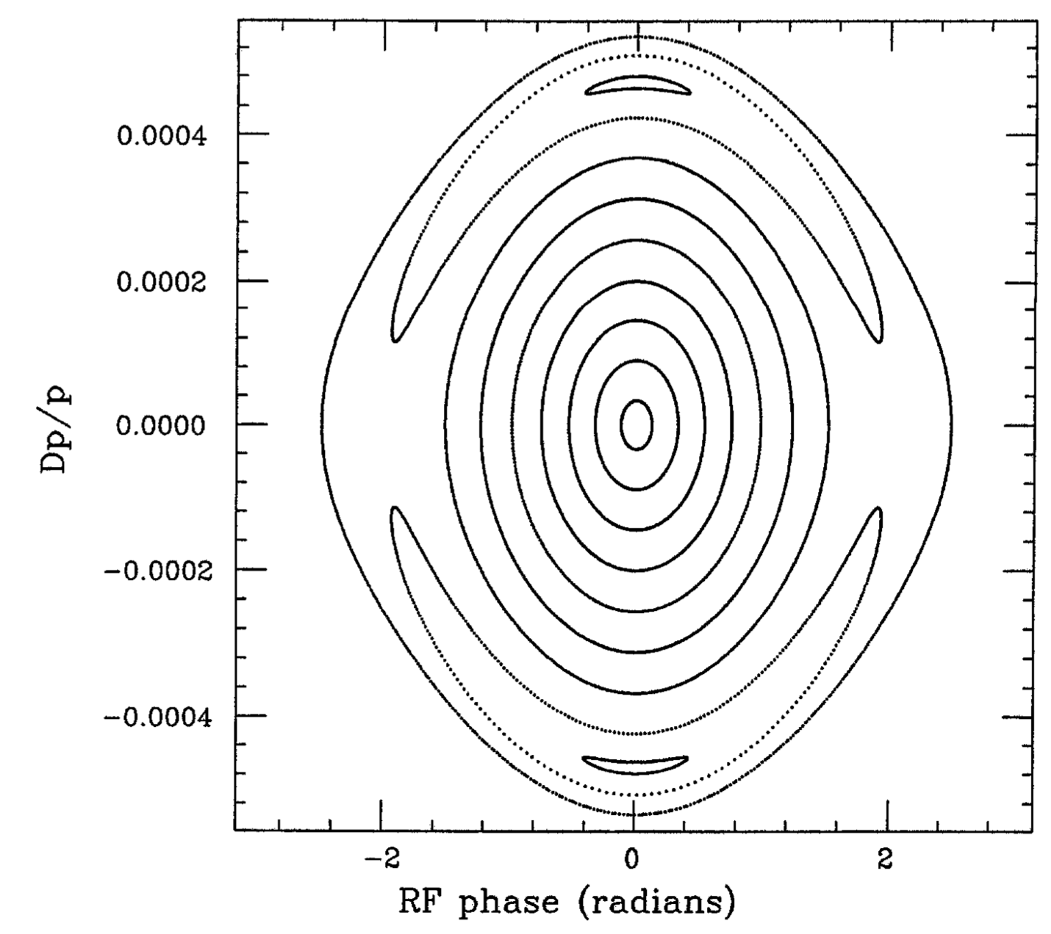
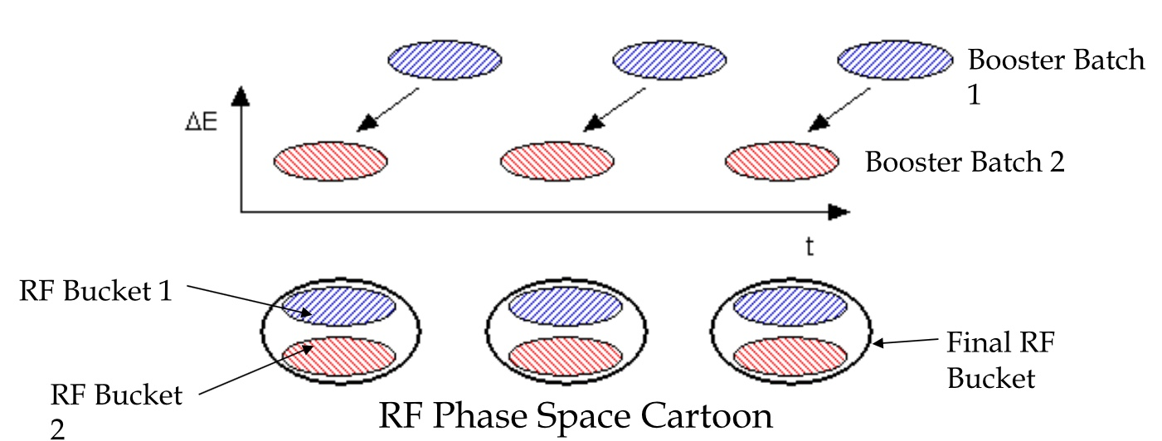
Slip stacking
RF modulation
Beam at higher energy and lower energy slipping each other till they are lined up longitudinally. Then both are captured by one RF bucket
Process is not adiabatic
High emittance growth
Use RF amplitude modulation to create resonance islands that capture beams in to separate groups.
Unequal intensities and emittance

Slide 10
Overview
Introduction (JLEIC, layout, problem)
Theory (Longitudinal dynamics)
Debunch/Rebunch Method
Bunch Splitting Method
Genetic Algorithm Optimization

Slide 11
Luminosity
Number of collisions that can be produced in a detector per area (cm²) per second
$$L=f_{0}N_{b}\frac{N_{+}N_{-}}{4πσ_{x}σ_{y}}$$
N+
N-
Where f0 is the revolution frequency, N+ N- is the number of particles in each bunch, and Nb is the number of bunches in the beam
Measurement of collected data (integrated luminosity)
Example of a high luminosity collider is the KEK-B with 2.11x10³⁴ cm⁻²s⁻¹
$$∫Ldt$$
￼

Slide 12
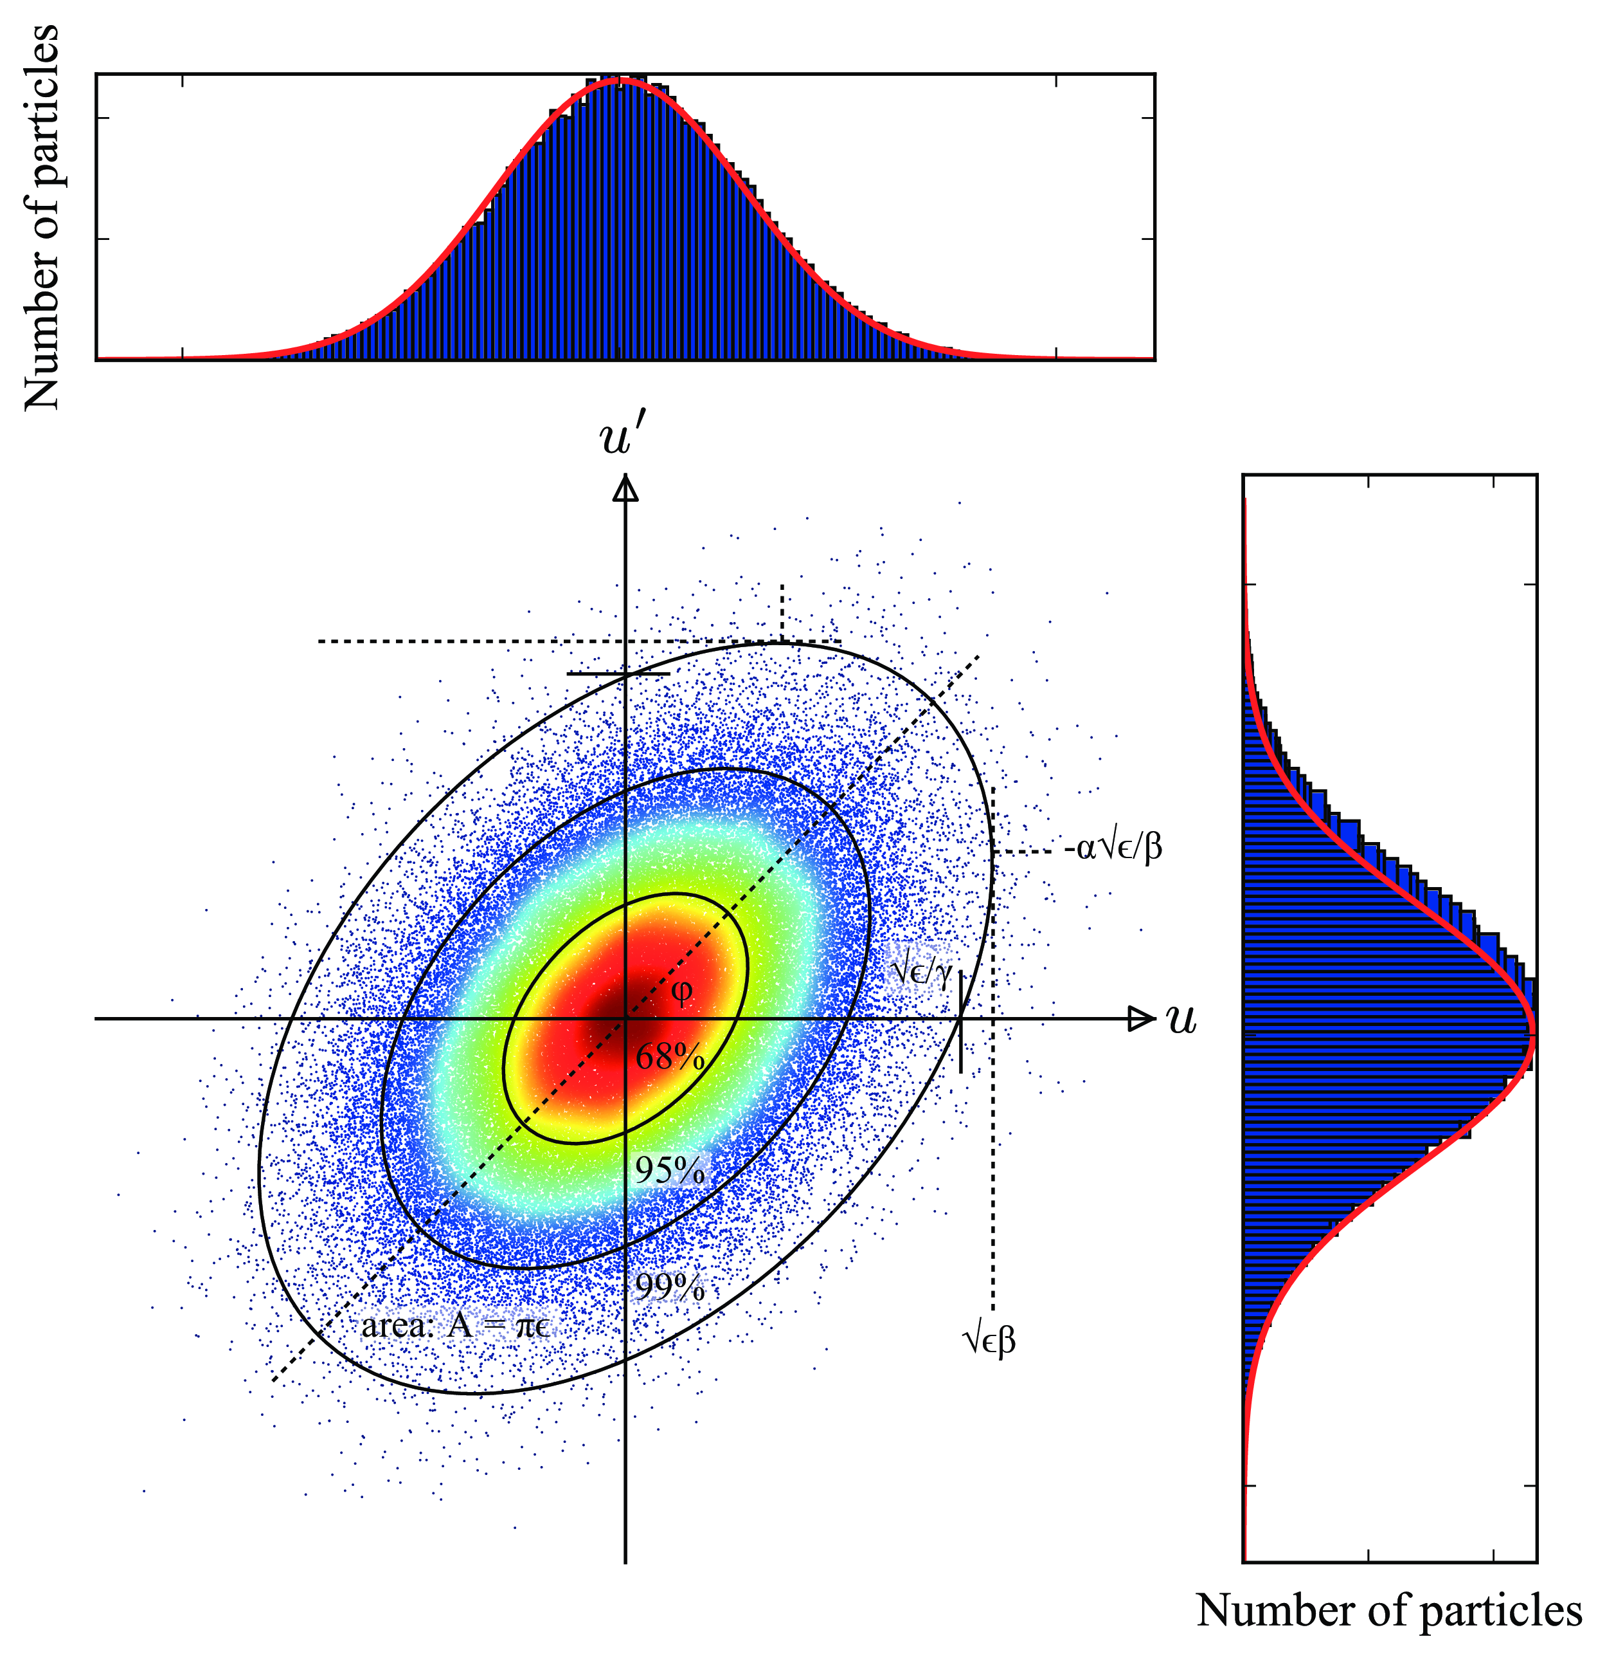
Emittance
Property of the beam that characterizes the area in phase space
6-D coordinates
Transverse emittance (mm-mrad)
Longitudinal emittance (eV-s)
Emittance does not go down unless cooling. It either stays the same or goes up.
Cooling can help reduce the emittance but for hadrons it is increasingly difficult
Objective : keep the emittance growth as low as possible
$$x,x^{′},y,y^{′},t,dE$$

Slide 13
Coasting beam
$$E_{0}+ΔE$$
$$E_{0}$$
$$t$$
$$E_{0}-ΔE$$
$$η=\frac{1}{γ^{2}}-\frac{1}{γ_{tr}^{2}}$$
$$t$$
￼

Slide 14
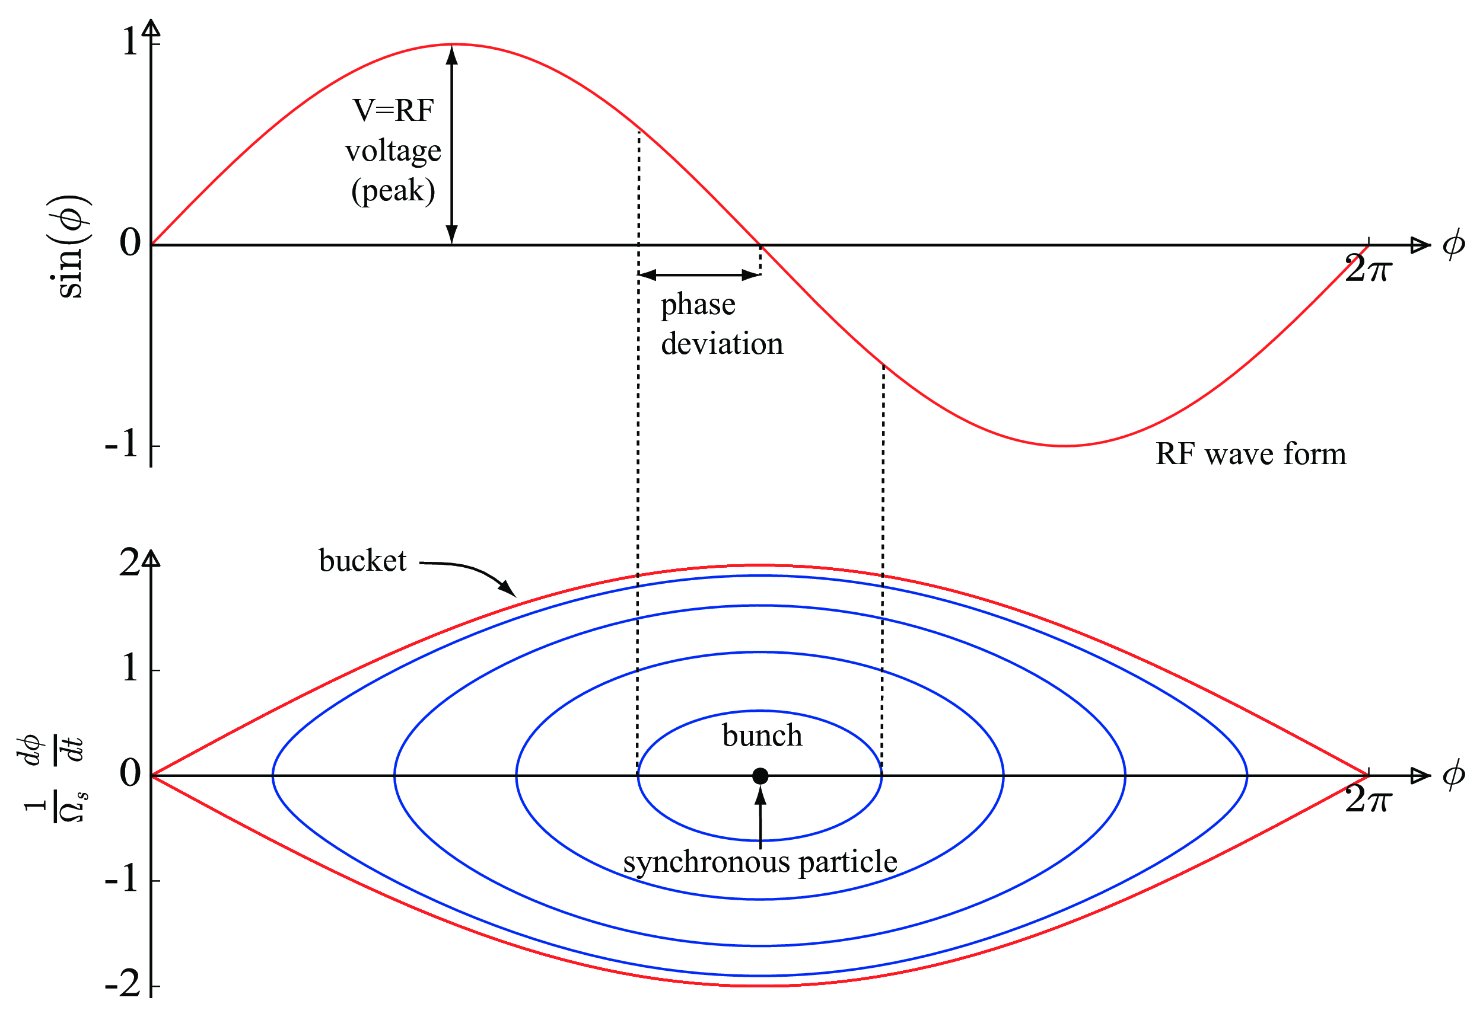
RF bucket height and the area
RF bucket height or the momentum acceptance
Bucket area is the area inside the separatrix where the particles perform synchrotron oscillations
$$\frac{dp}{p_{0}}=\sqrt{\frac{2qV}{E_{0}}\frac{β^{2}}{πhη}}→\frac{dp}{p_{o}}∝\sqrt{\frac{V}{h}}$$
$$A=\frac{8C}{πhc}\sqrt{\frac{E_{0}}{2hη}\frac{qV}{π}}→A∝\frac{1}{h}\sqrt{\frac{V}{h}}$$
￼

Slide 15
Synchrotron motion
$$H(φ,W)=p_{s}+(\frac{ω_{rf}^{2}η}{2β^{3}E_{0}c})W^{2}-\frac{qV}{2πβch}[cos(ϕ_{s}+φ)+φsinϕ_{s}]$$
$$whereφ=ϕ-ϕ_{s}andW=(E_{0}-E)/ω_{rf}$$
$$φ^{′}=\frac{∂H}{∂W}=\frac{ω_{rf}^{2}η}{β^{2}E_{0}c}W$$
$$W^{′}=\frac{∂H}{∂φ}=\frac{qV}{2πβch}[sinϕ_{s}-sin(ϕ_{s}+φ)]$$
Particles inside the bucket perform small oscillations called synchrotron oscillations
These oscillations are significantly smaller compared to the revolution frequency
Number of oscillations per one revolution period is called the synchrotron tune
Time it takes for one synchrotron oscillation is then given by
$$Q_{s}=\sqrt{\frac{qV_{rf}}{E_{0}}\frac{hη}{2πβ^{2}}cosϕ_{s}}[1/turn]→Q_{s}∝\sqrt{hV_{rf}}$$
$$T_{s}=\frac{1}{f_{rev}Q_{s}}[s]→T_{s}∝\frac{1}{\sqrt{hV_{rf}}}$$
$$T_{s}=\frac{1}{f_{rev}Q_{s}}[s]→T_{s}∝\frac{1}{\sqrt{hV_{rf}}}$$
￼

Slide 16
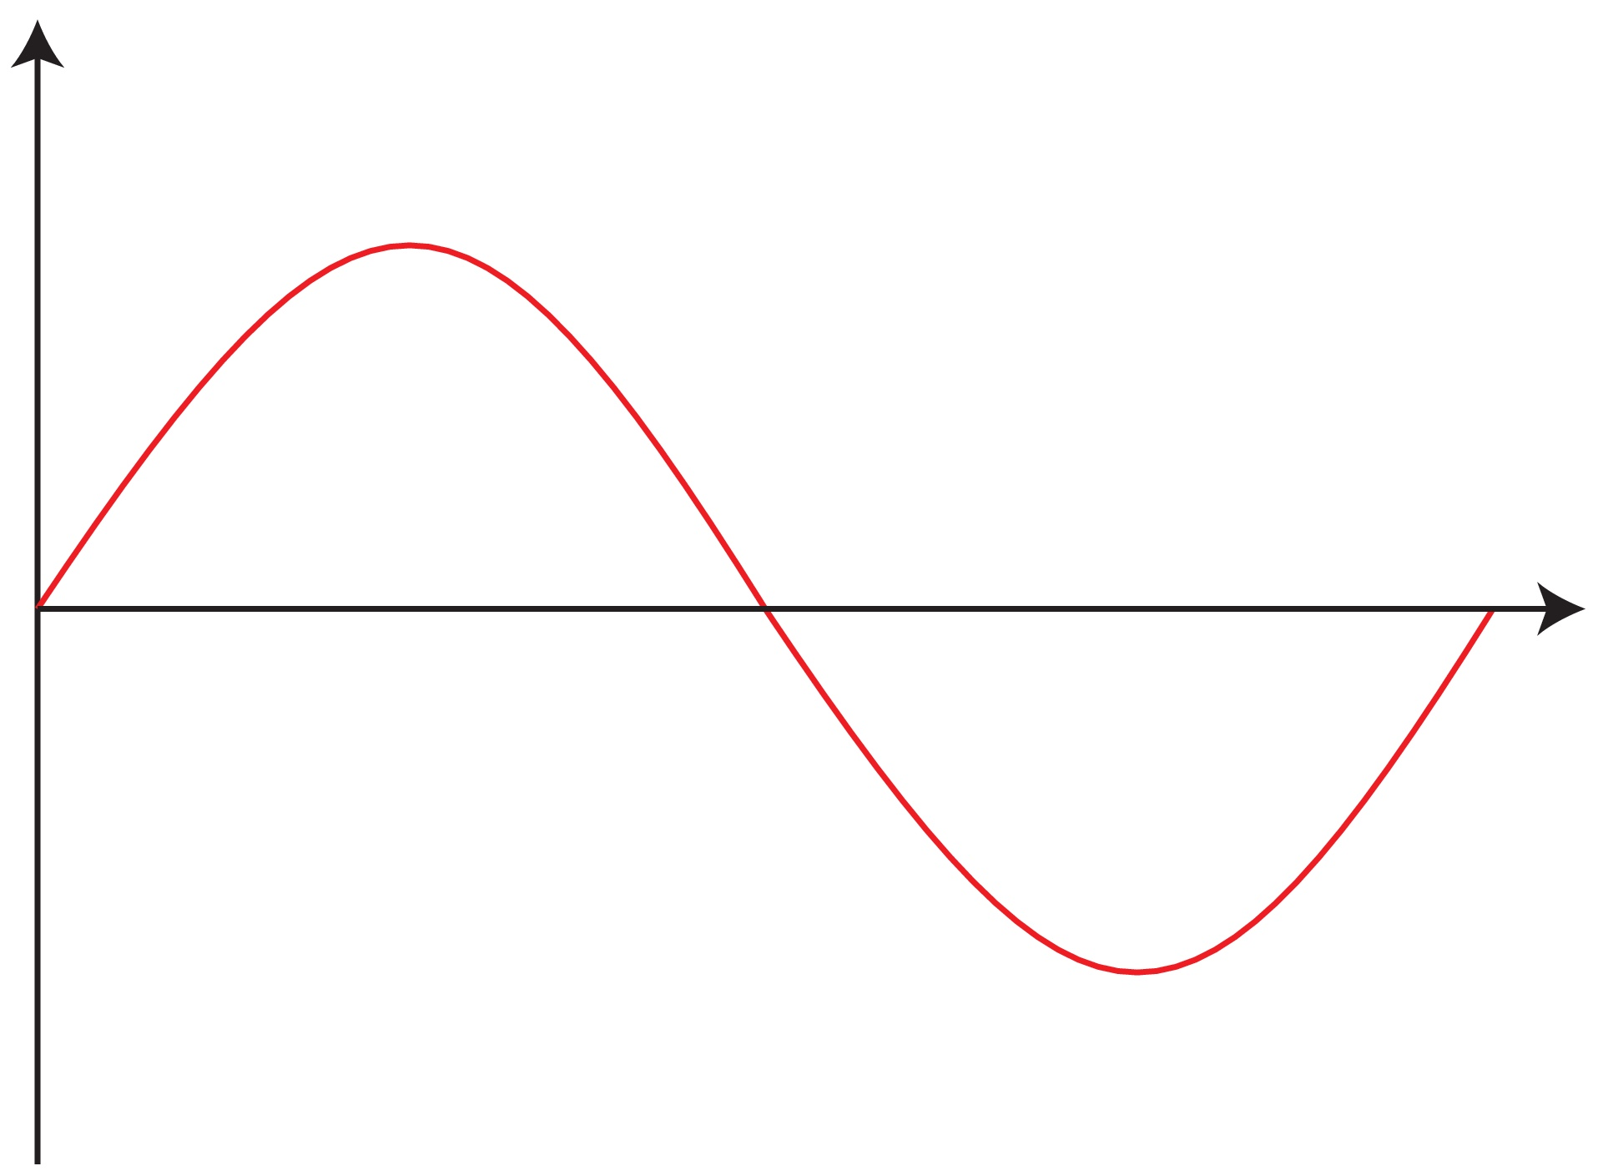
Synchrotron oscillations
$$V_{rf}$$
$$V_{rf}$$
$$τ$$
$$T_{rev}+τ$$
$$E_{0}+ΔE$$
$$E_{0}$$
$$t$$
$$t$$
$$E_{0}-ΔE$$
$$V_{rf}$$
$$V_{rf}$$
$$nT_{rev}+τ$$
$$t$$
$$t$$
￼

Slide 17
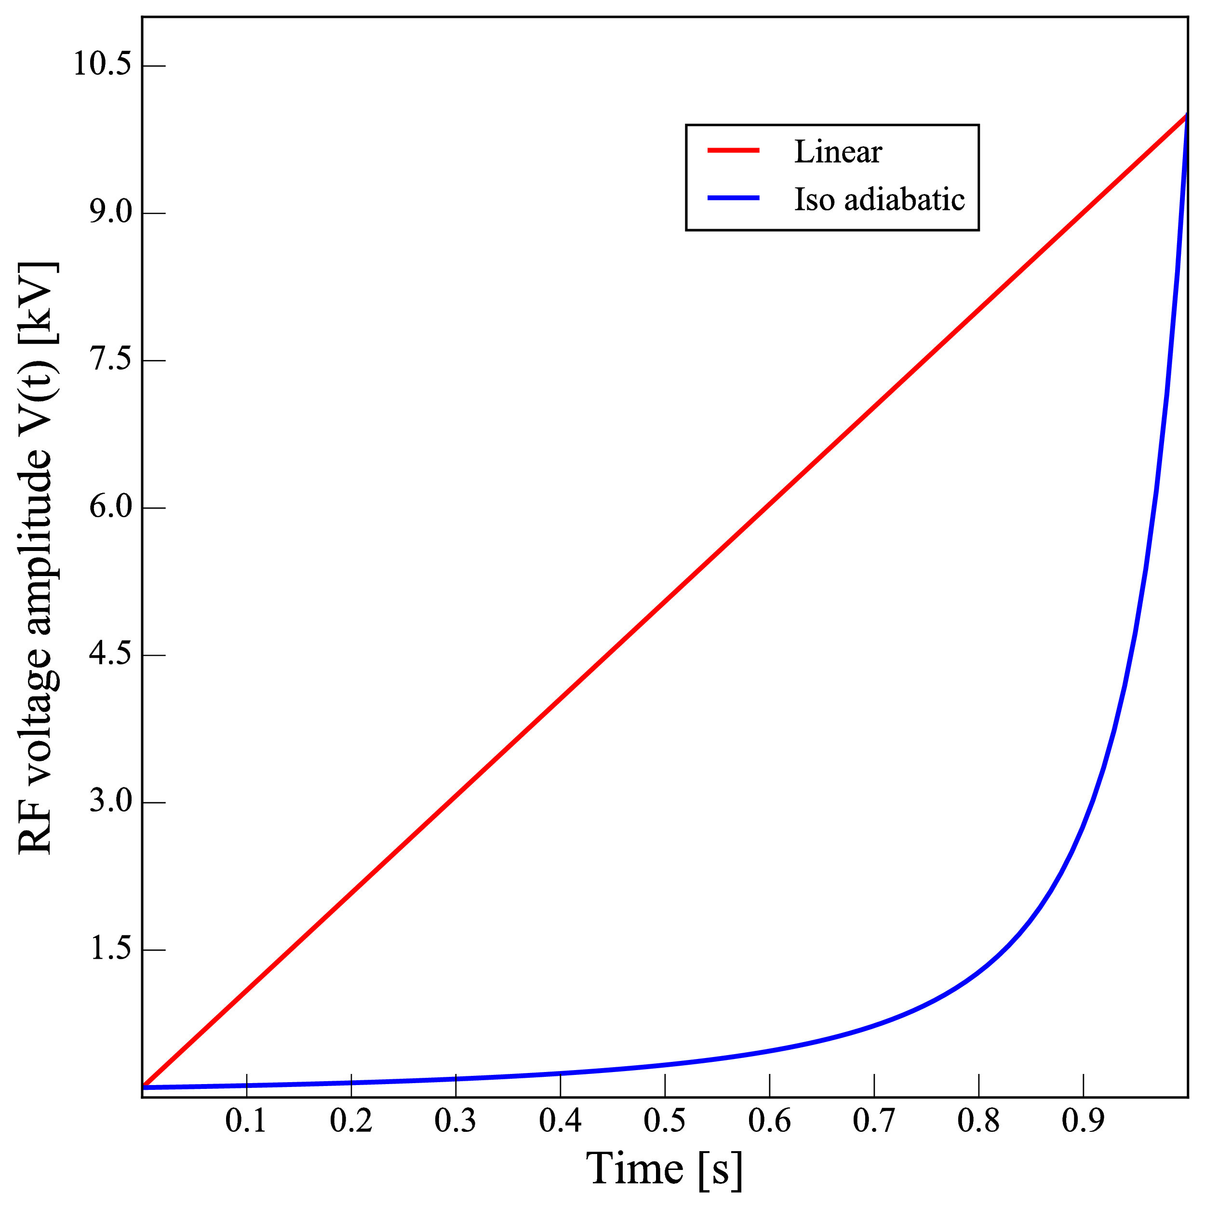
Adiabaticity parameter
In an adiabatic process, the particle distribution is continuously at equilibrium with the instantaneous values of the system
Adiabaticity parameter is used to determine the ramping times on RF systems
For a process to be adiabatic the condition is
$$V(t)=\frac{V_{i}}{{\left(1-\frac{t}{t_{ramp}}\left(1-\frac{\sqrt{V_{i}}}{\sqrt{V_{f}}}\right)\right)}^{2}}$$
$$T_{s}∝\frac{1}{\sqrt{V_{rf}}}$$
$$ϵ_{a}=\frac{1}{ω_{s}^{2}}\left|\frac{dω_{s}}{dt}\right|=\frac{1}{2π}\left|\frac{dT_{s}}{dt}\right|$$
$$ϵ_{a}<<1$$
$$t_{ramp}=\frac{1}{ϵ_{a}ω_{s}(V^{*})}$$
Non zero value
$$whereV^{*}isthelowestvoltageoftheramp$$
￼

Slide 18
Tracking codes
ESME
Developed at Fermilab to track longitudinal dynamics in a ring
Tracks longitudinal equations of motion
No need to specify accelerator elements
BLOND (previously used)
Ring mode implemented recently (2017)

Slide 19
Overview
Introduction (JLEIC, layout, problem)
Theory (Longitudinal dynamics)
Debunch/Rebunch Method
Bunch Splitting Method
Genetic Algorithm Optimization

Slide 20
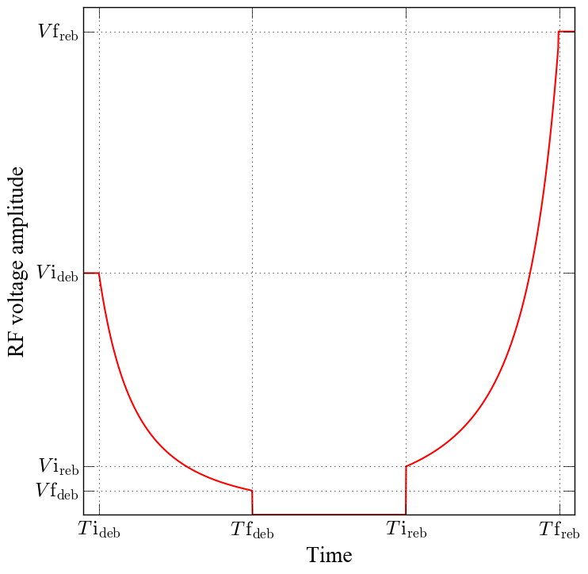
Debunch/Rebunch
h=3584
h=28
Ramp down the RF amplitude to zero and let the beam drift to become a coasting beam that fills the entire circumference of the ring, then ramp up the amplitude of the final harmonic system to capture the beam into bunches
Suffers from instability issues more than the other method
No abort gaps
￼

Slide 21
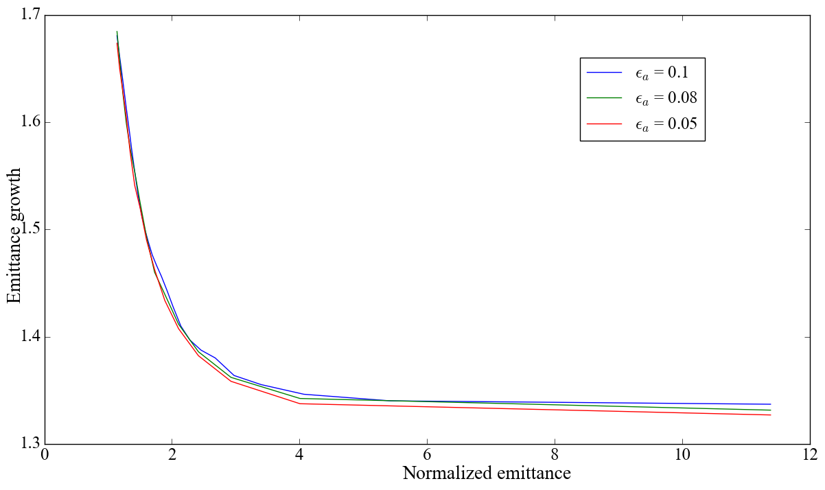
Emittance growth from debunching
Emittance growth of the debunching time depends on the scaled emittance.
Scaled emittance is the ratio of initial bunch emittance to final bucket size
Scaled emittance
$$t_{ramp}=\frac{1}{ϵ_{a}ω_{s}(V^{*})}h$$
$$ϵ_{N}=\frac{ϵ}{A(V*)}$$
$$t_{ramp}=\frac{1}{ϵ_{a}ω_{s}(V^{*})}h$$
$$ϵ_{N}=\frac{ϵ}{A(V*)}$$
￼

Slide 22
Fully coasting beam summary
The whole circumference is filled with beam.
No abort gaps.
Using the recent parameters from JLEIC collaboration meeting
Bunch length = 1 cm
95% emittance = 0.017eV-s
Momentum spread (rms) for a coasting beam = 1.5 MeV
Keil-Schnell Criterion
[Z/n] = 1.02 Ohms
$$\left|\frac{Z}{n}\right|≤\frac{(m_{e}c^{2}/q)|η|γβ^{2}}{I_{0}\left(q/A\right)}δ^{2}$$
￼

Slide 23
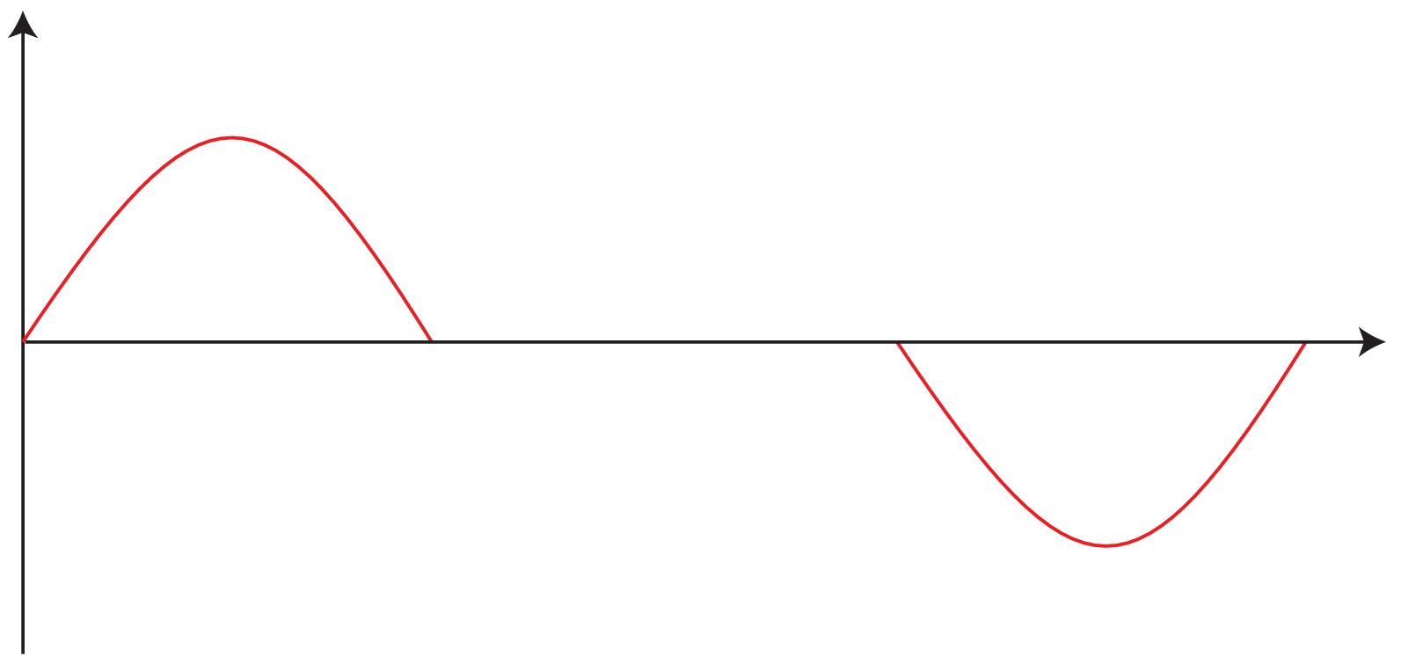
Using barrier buckets
Use barrier buckets in place of the abort gaps.
Preserves the abort gap.
Bunches do not become ‘fully’ coasting, so has a small synchrotron motion.
Momentum spread increases slightly compared to a fully coasting beam.
$$E_{0}+ΔE$$
$$V_{rf}$$
$$E_{0}$$
$$E_{0}-ΔE$$
$$t$$
￼

Slide 24
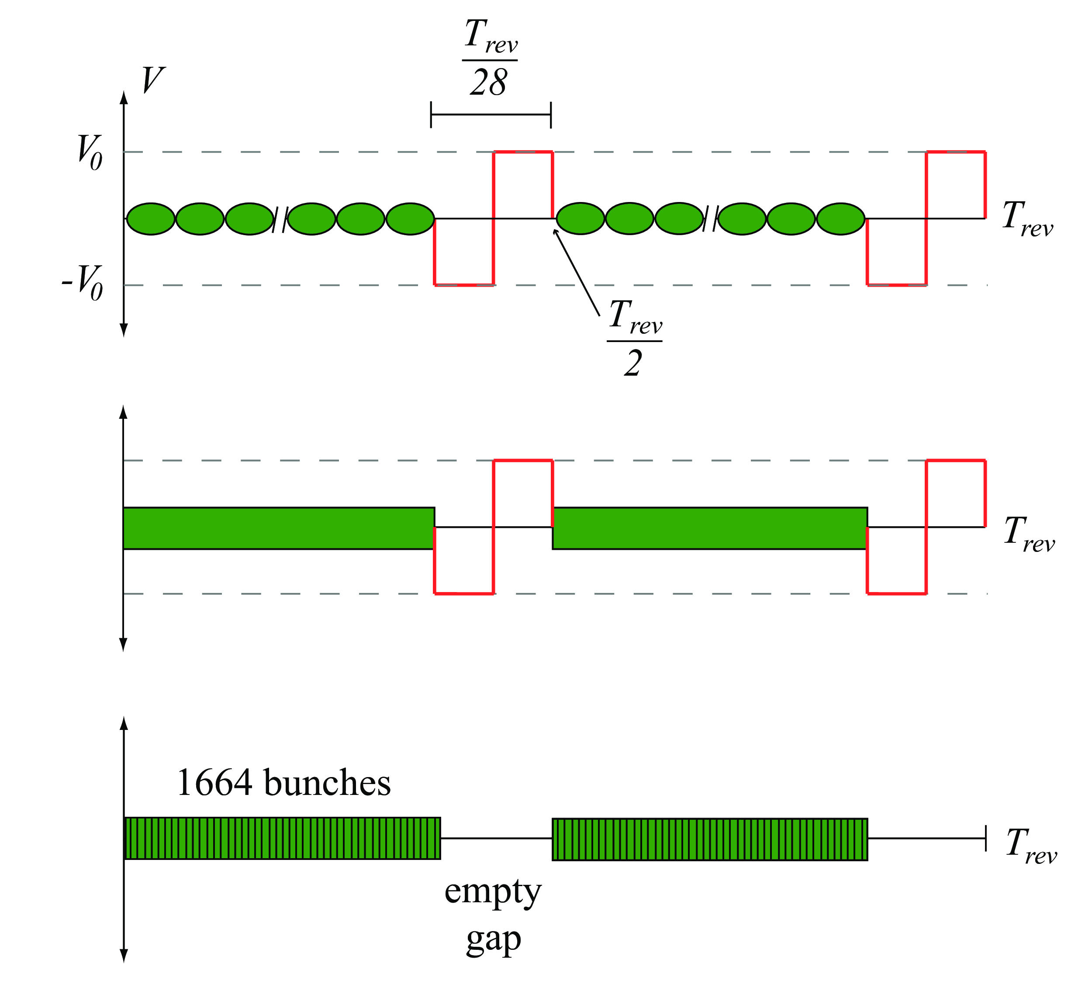
Injection and acceleration
Debunching and coasting
Rebunching
￼

Slide 25
Debunch/Rebunch
$$\left(h=28→h=112\right)$$

Slide 26
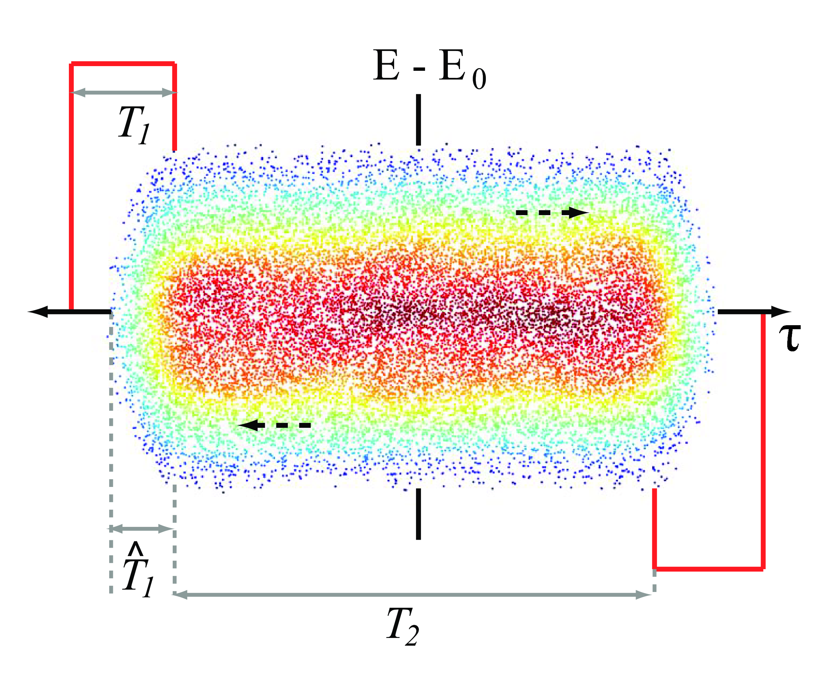
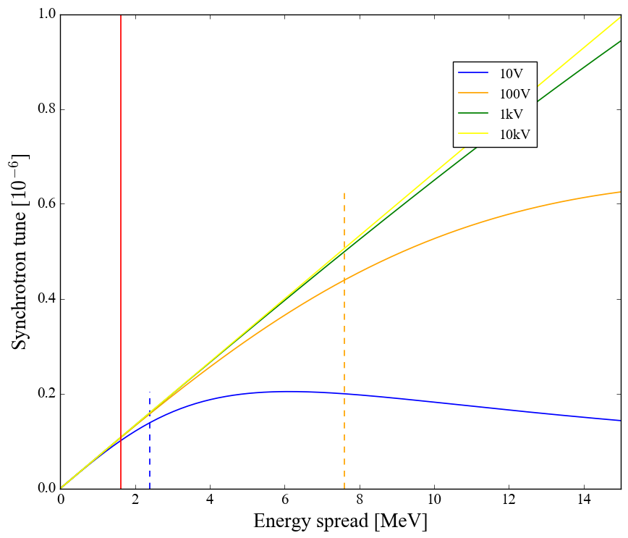
Synchrotron tune from barrier buckets
For JLEIC T1= 0.5* bucket(28) or 0.128 μs, T2=13* bucket(28) or 3.33 μs
rms energy spread for a complete adiabatic debunched beam is 1.62 MeV
Tune spread is too small (dotted lines show the bucket height for the relevant voltages)
￼

Slide 27
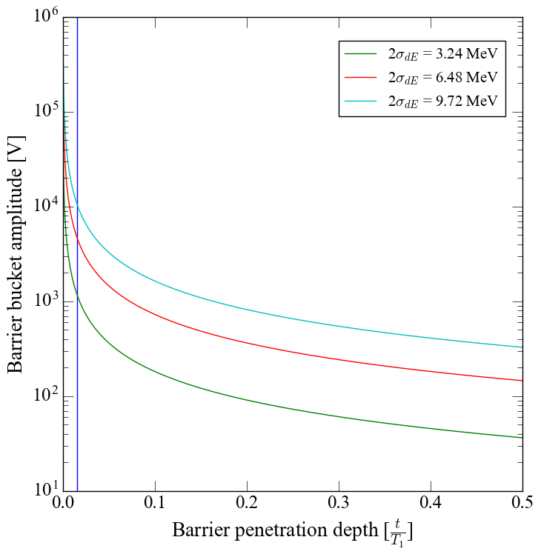
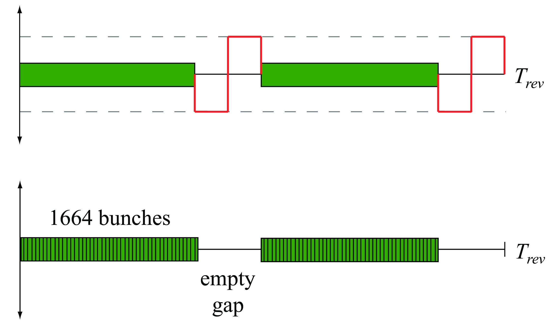
Barrier bucket voltage requirements
How much barrier voltage do we need?
Allowed barrier penetration depth ? 1 bucket for harmonic 3584
Current systems in operation or tested 1kV~40kV

Slide 28
Debunch/Rebunch summary
Required barrier bucket voltages are currently in use in other facilities.
Only require two RF sources for bunching and a cavity for the barrier buckets.
Preserves abort gaps.
Emittance growth is above tolerance.
Impedance threshold from Keil-Schnell is
Most recent impedance estimation from Dr. Rui Li
Impedance thresholds leave little room for error
$$\left|\frac{z}{n}\right|≃0.99Ω$$
$$\left|\frac{z}{n}\right|≃0.5Ω$$

Slide 29
Overview
Introduction (JLEIC, layout, problem)
Theory (Longitudinal dynamics)
Debunch/Rebunch Method
Bunch Splitting Method
Genetic Algorithm Optimization

Slide 30
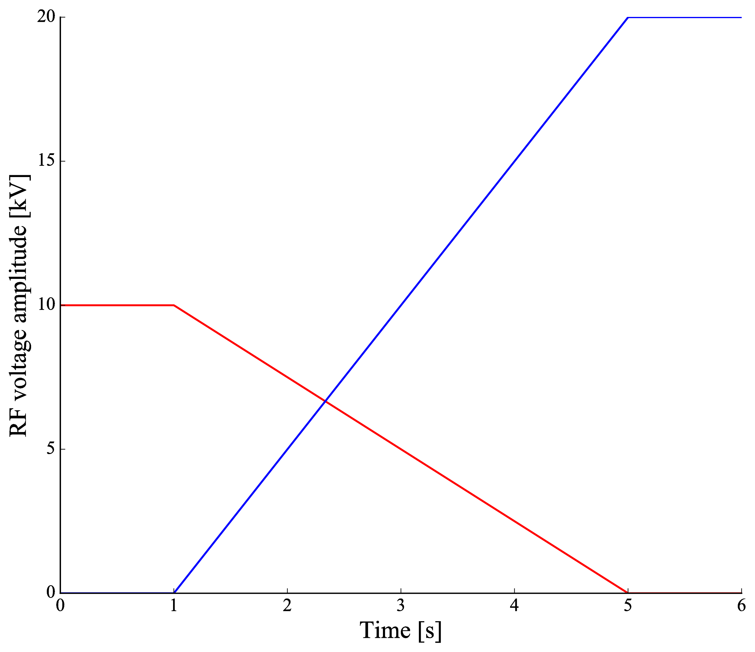
Bunch splitting
First introduced as bunch merging, where two bunches are merged together to produce one bunch with higher intensity.
Reversing the process to do the opposite to make small bunches with (ideally) one half the emittance of the initial bunch.
R. Garoby mentions using more that 5 synchrotron periods for the split time and using a larger bunch to bucket ratio.
Ramp down the first RF while ramping up the second RF.
$$T_{split}$$
h2=2*h1
h1
￼

Slide 31
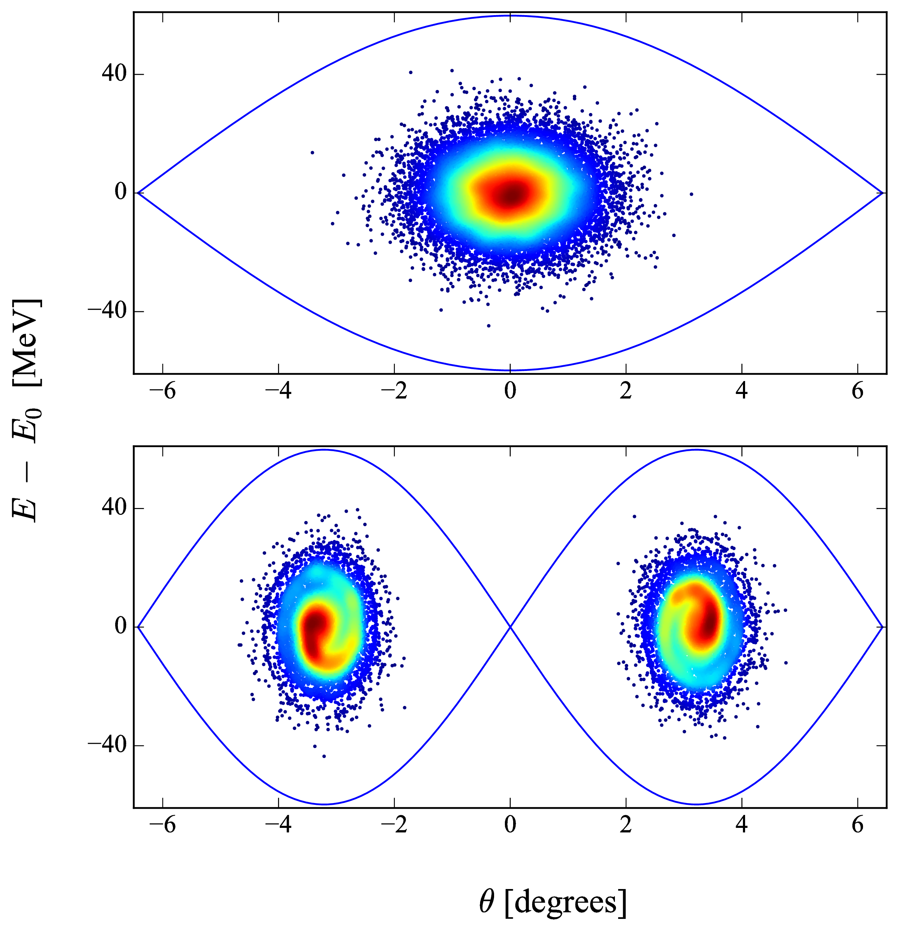
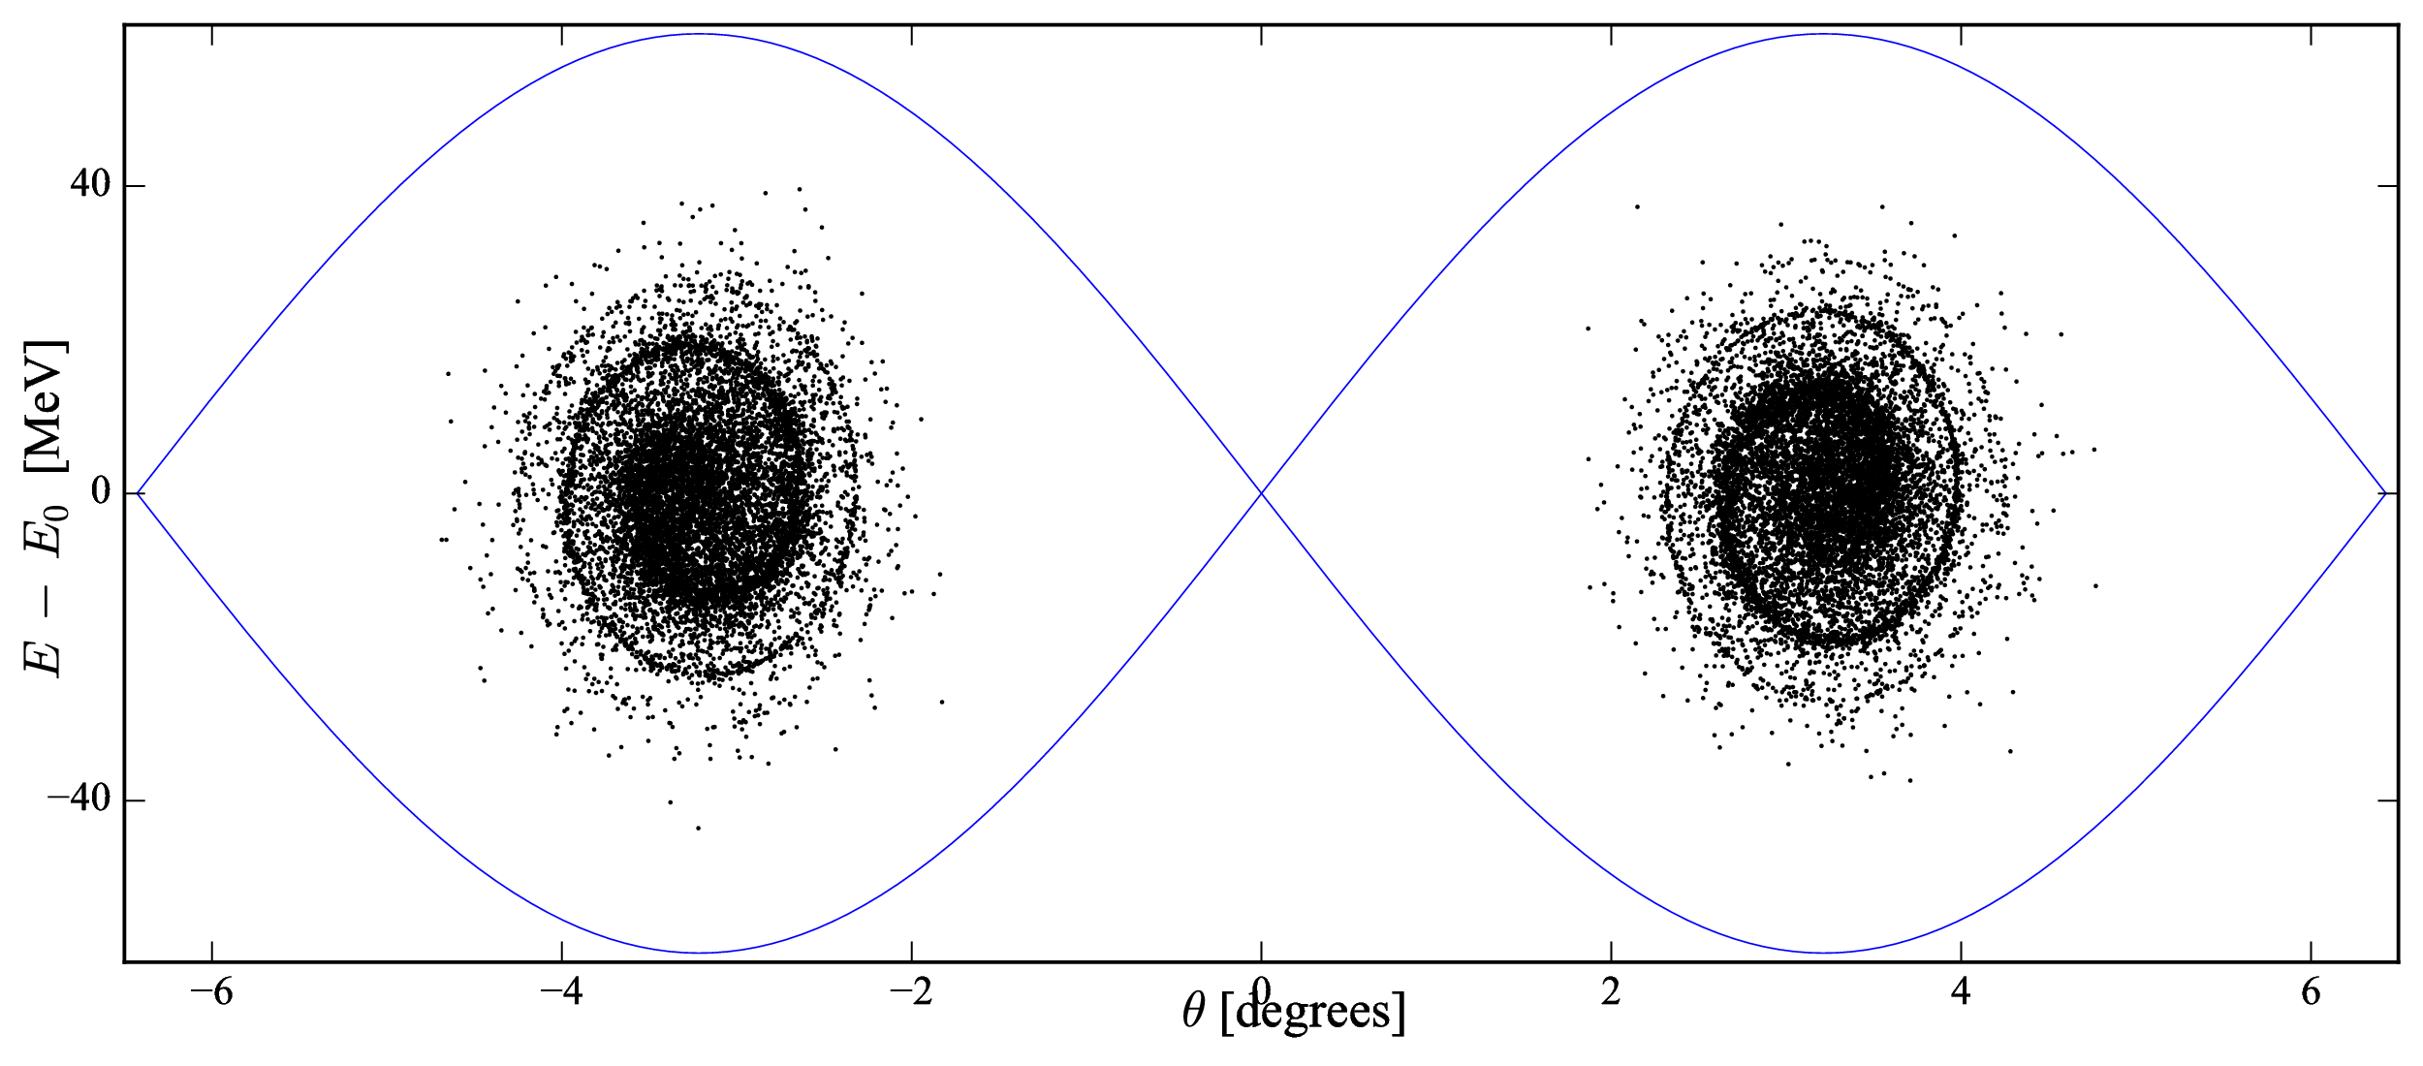
Bunch splitting
Split time = 10 synchrotron periods
Emittance growth =10%
￼

Slide 32
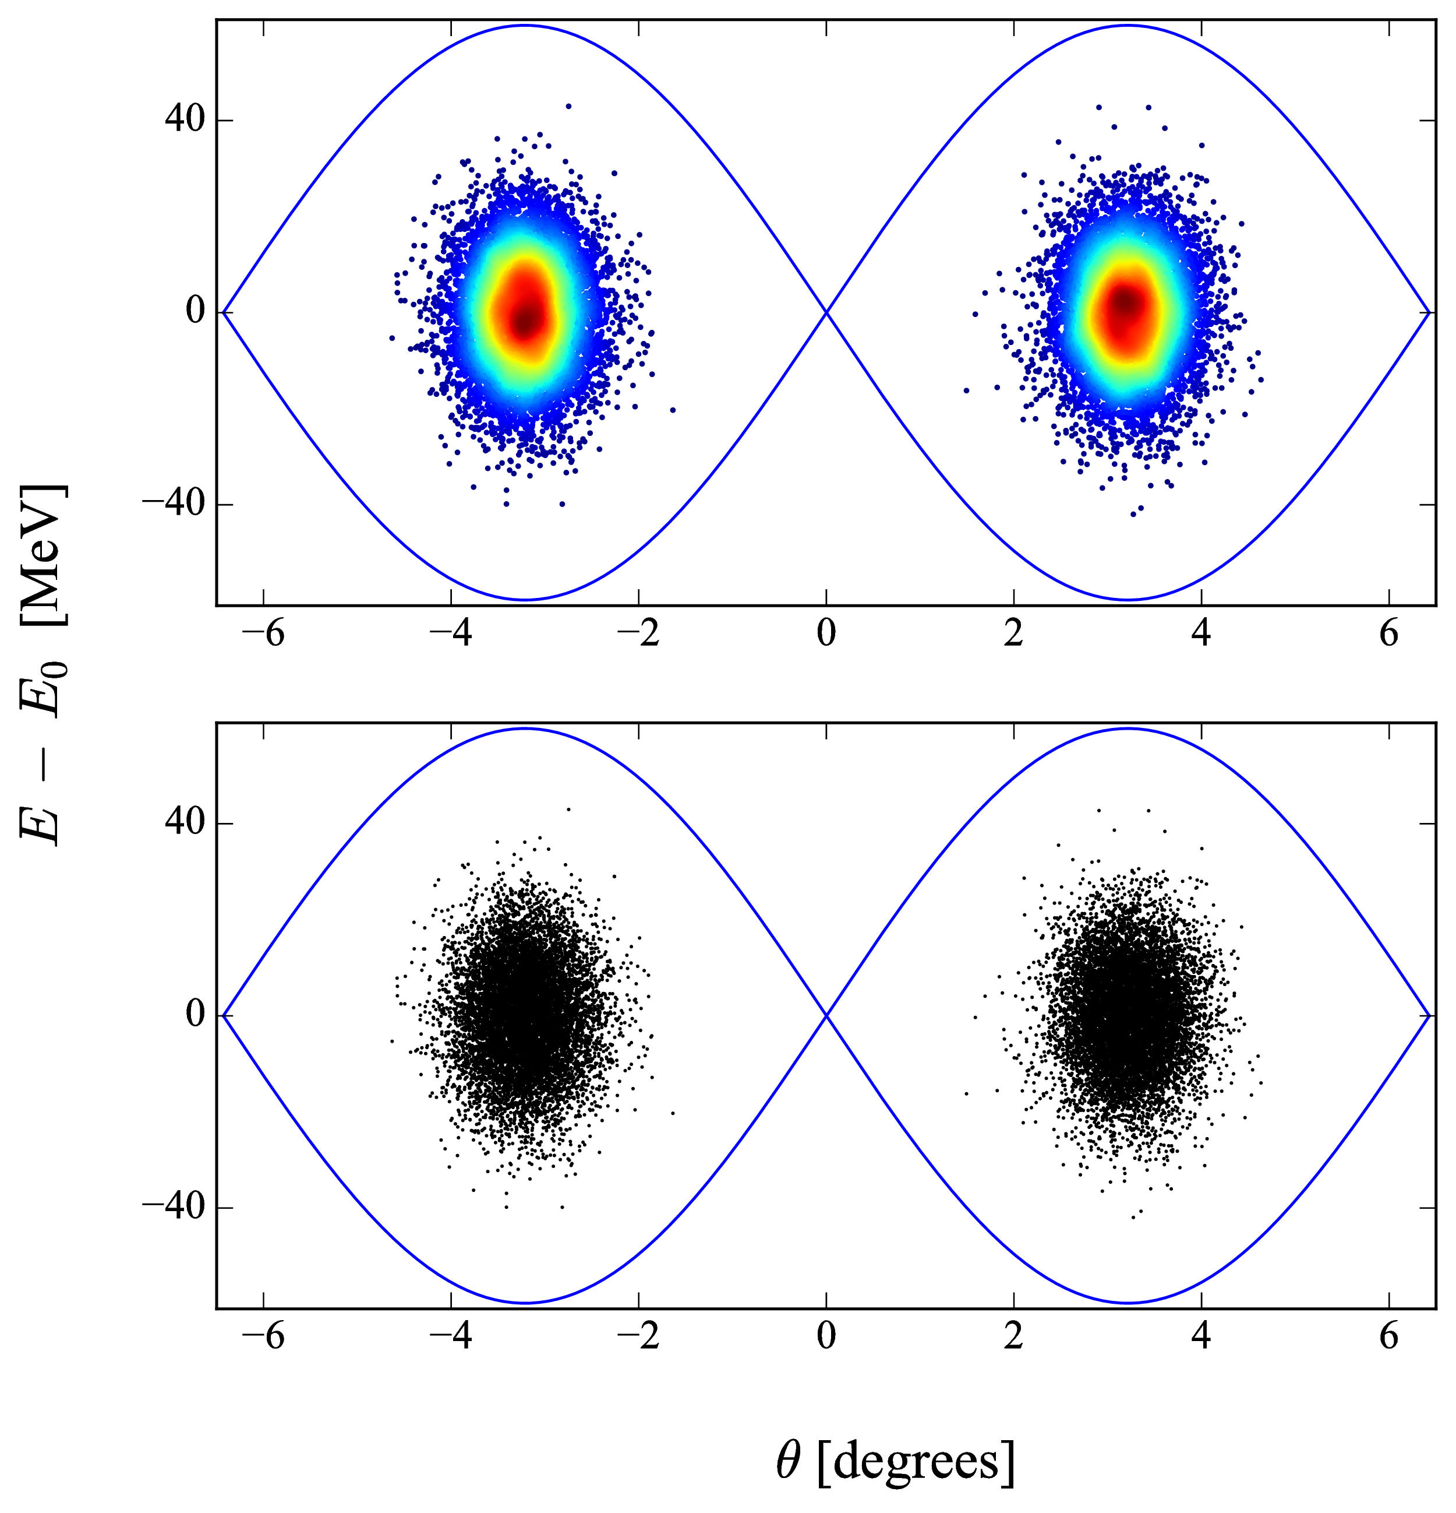
Bunch splitting
Split time= 50 synchrotron periods
Emittance growth < 1%

Slide 33
Parameter scan
JLEIC demands many splits to gain the final number of bunches
Having even a few percent of emittance growth is not preferred
Parameters that stand out for resulting emittance growth are the split time and the initial bunch size - hence a parameter scan was performed
Since the JLEIC system requires many consecutive splits, the parameters were converted to unit less parameters
Split times measured in Synchrotron periods and initial bunch emittance taken as a ratio to the bucket area.

Slide 34
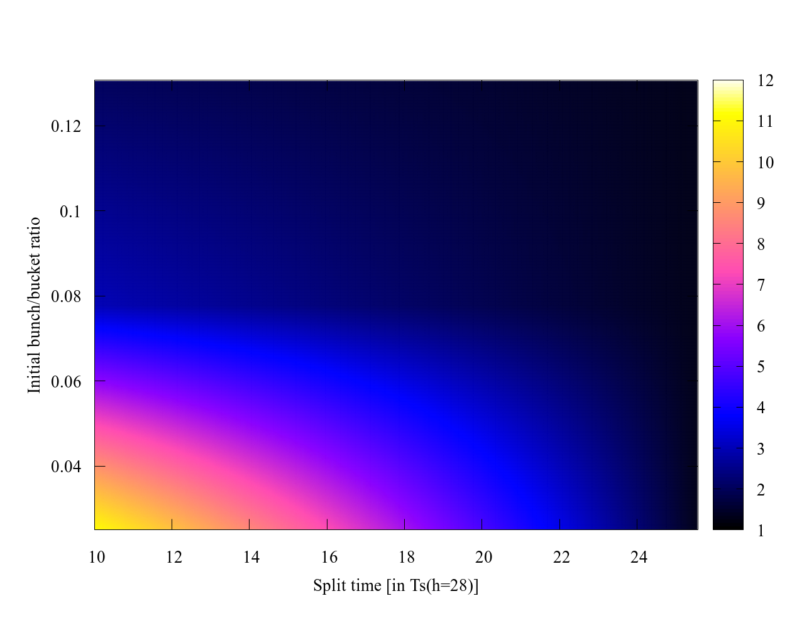
Parameter scan results (1/2)
Region of large emittance growth
Smalll split times and/or small initial bunch to bucket ratio
Relative emittance growth is well over 100%

Slide 35
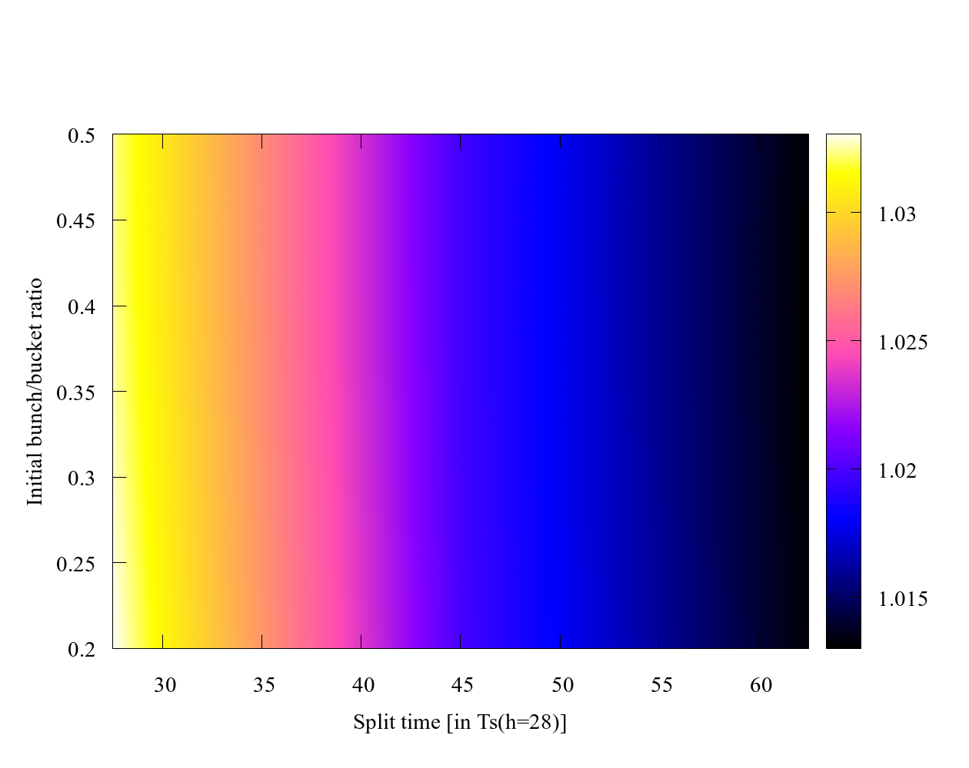
Parameter scan results (2/2)
Region of low emittance growth
Requires split time to be 50+ synchrotron periods
Almost immune to initial bunch to bucket ratios

Slide 36
Multiple splits
JLEIC requires 7 consecutive splits
Repeat the initial process while only changing RF harmonic and amplitude
Condition: h2=2*h1 and Vrf2=2*Vrf1
Keeps the total area of the buckets the same and bucket height the same.
A time interval equal to the split time was given before starting the next split to minimize decoherence
Split time scales with synchrotron period so the process becomes faster with each split.
$$\frac{dp}{p_{o}}∝\sqrt{\frac{V}{h}}$$
$$A∝\frac{1}{h}\sqrt{\frac{V}{h}}$$

Slide 37
Multiple splits

Slide 38
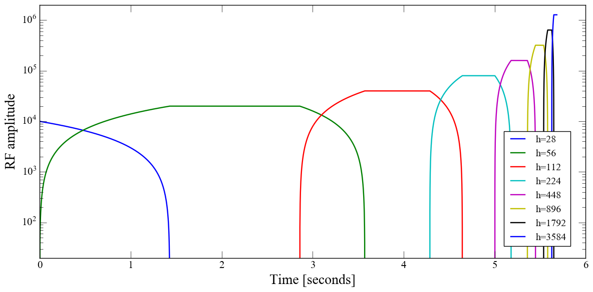
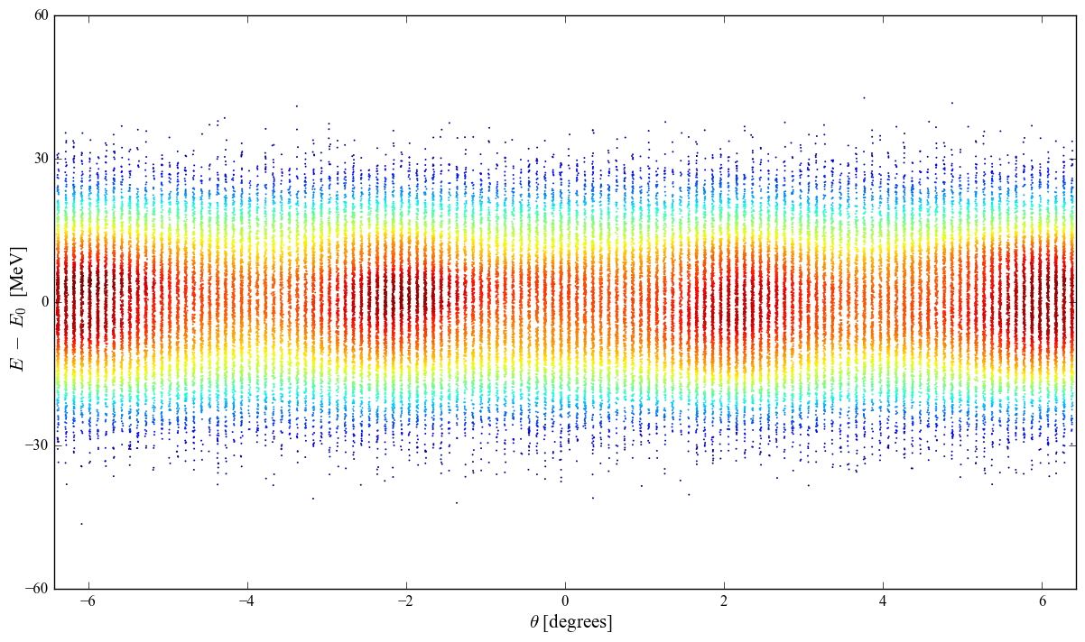
Multiple splits (10Ts)

Slide 39
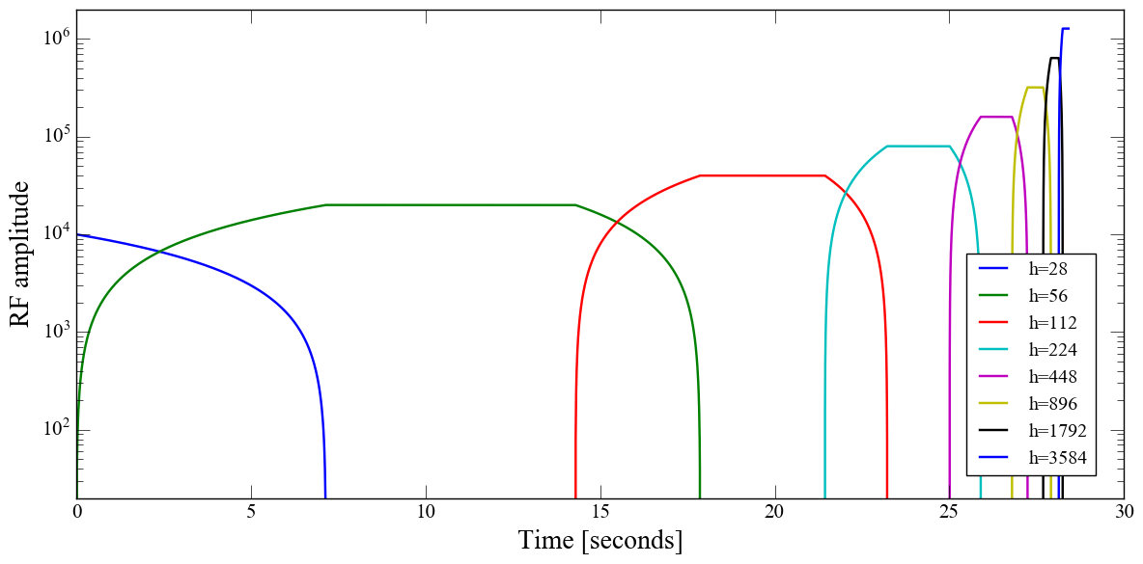
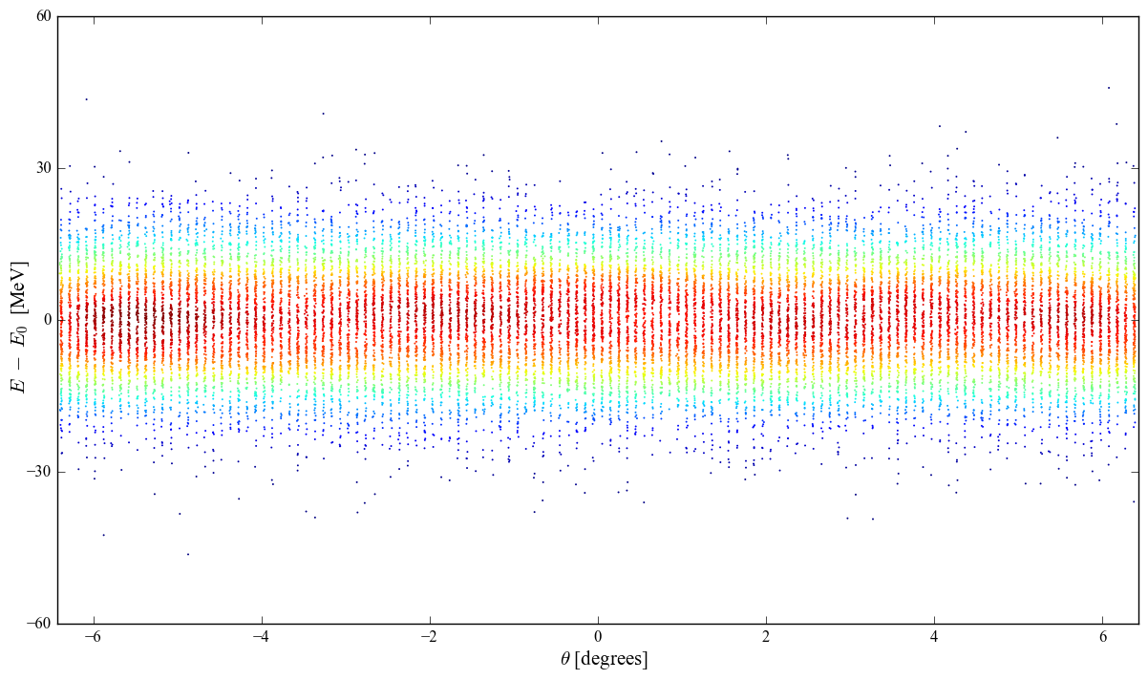
Multiple splits (50Ts)

Slide 40
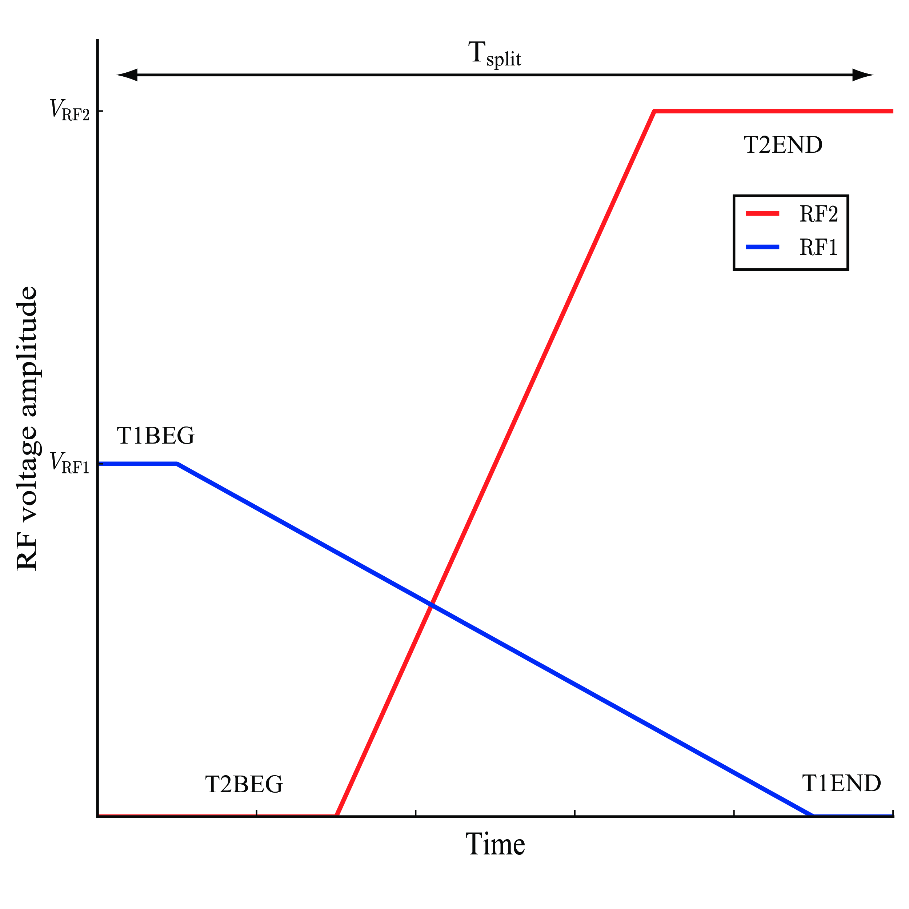
Single split optimization
Additional parameters
T1BEG: Start time for RF source 1
T1END: End time for RF source 1
T2BEG: Start time for RF source 2
T2END: End time for RF source 2
A genetic algorithm gives the advantage of not scanning the whole parameter space to find solutions.

Slide 41
Overview
Introduction (JLEIC, layout, problem)
Theory (Longitudinal dynamics)
Debunch/Rebunch Method
Bunch Splitting Method
Genetic Algorithm Optimization

Slide 42
Genetic algorithm
Evolutionary algorithm
Great for multi objective problems with n-dimensional search space
Generate
initial
population
Evaluate
objective
function
Record
population
results
End after a
set number of
generations
This results in the propagation of beneficial genes throughout the second generation and each generation being more suited for the environment than the last
Selection
Generate
new
population
Recombination
Mutation

Slide 43
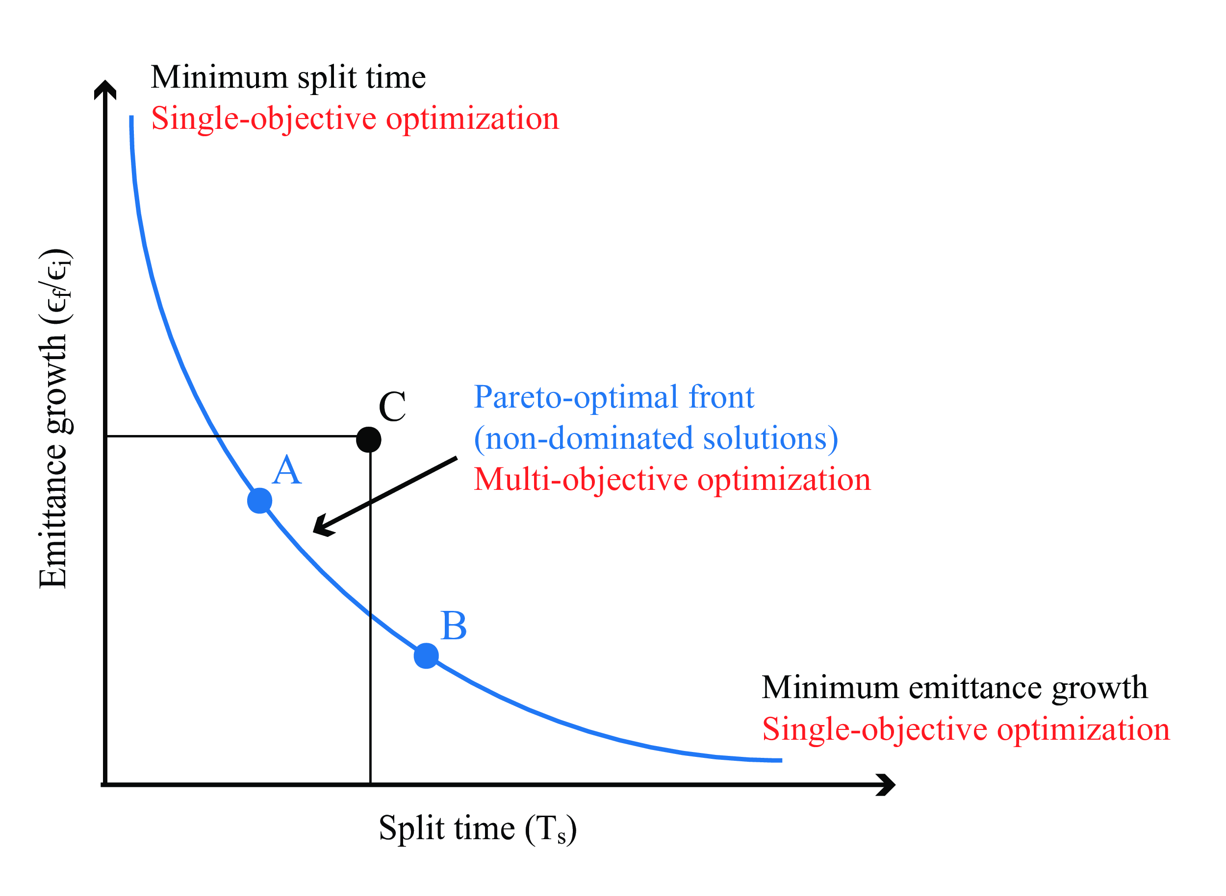
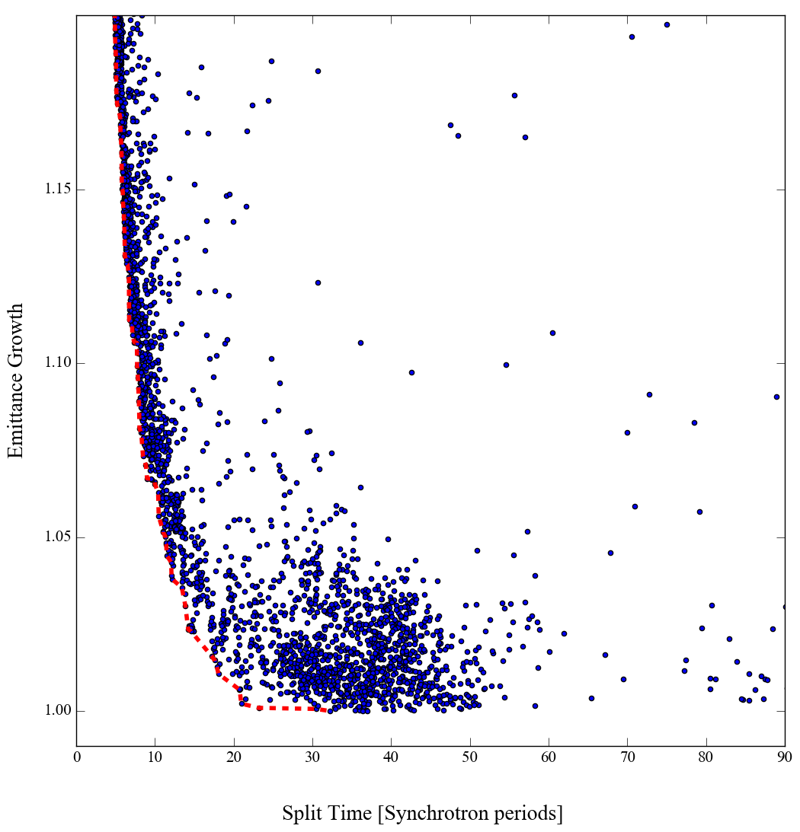
Pareto optimal front
A Pareto frontier is the line that goes through the non dominated solutions
Gives a trade off between two competing objectives (minimize emittance growth and shorter split times)
A and B are non dominated
C is not because it it dominated by both A and B

Slide 44
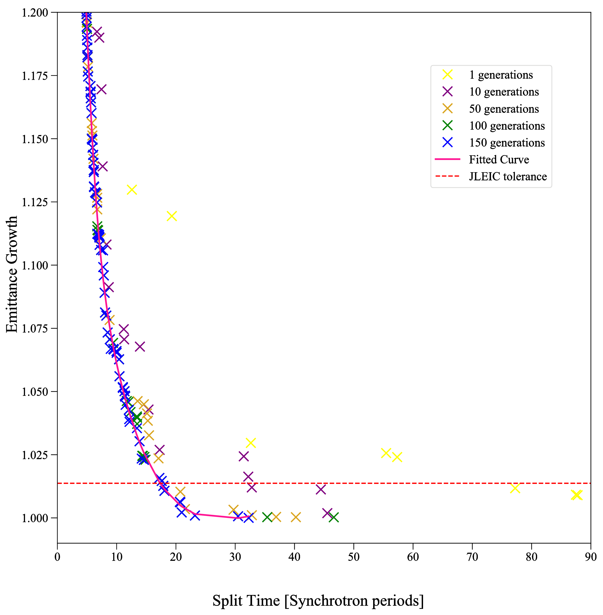
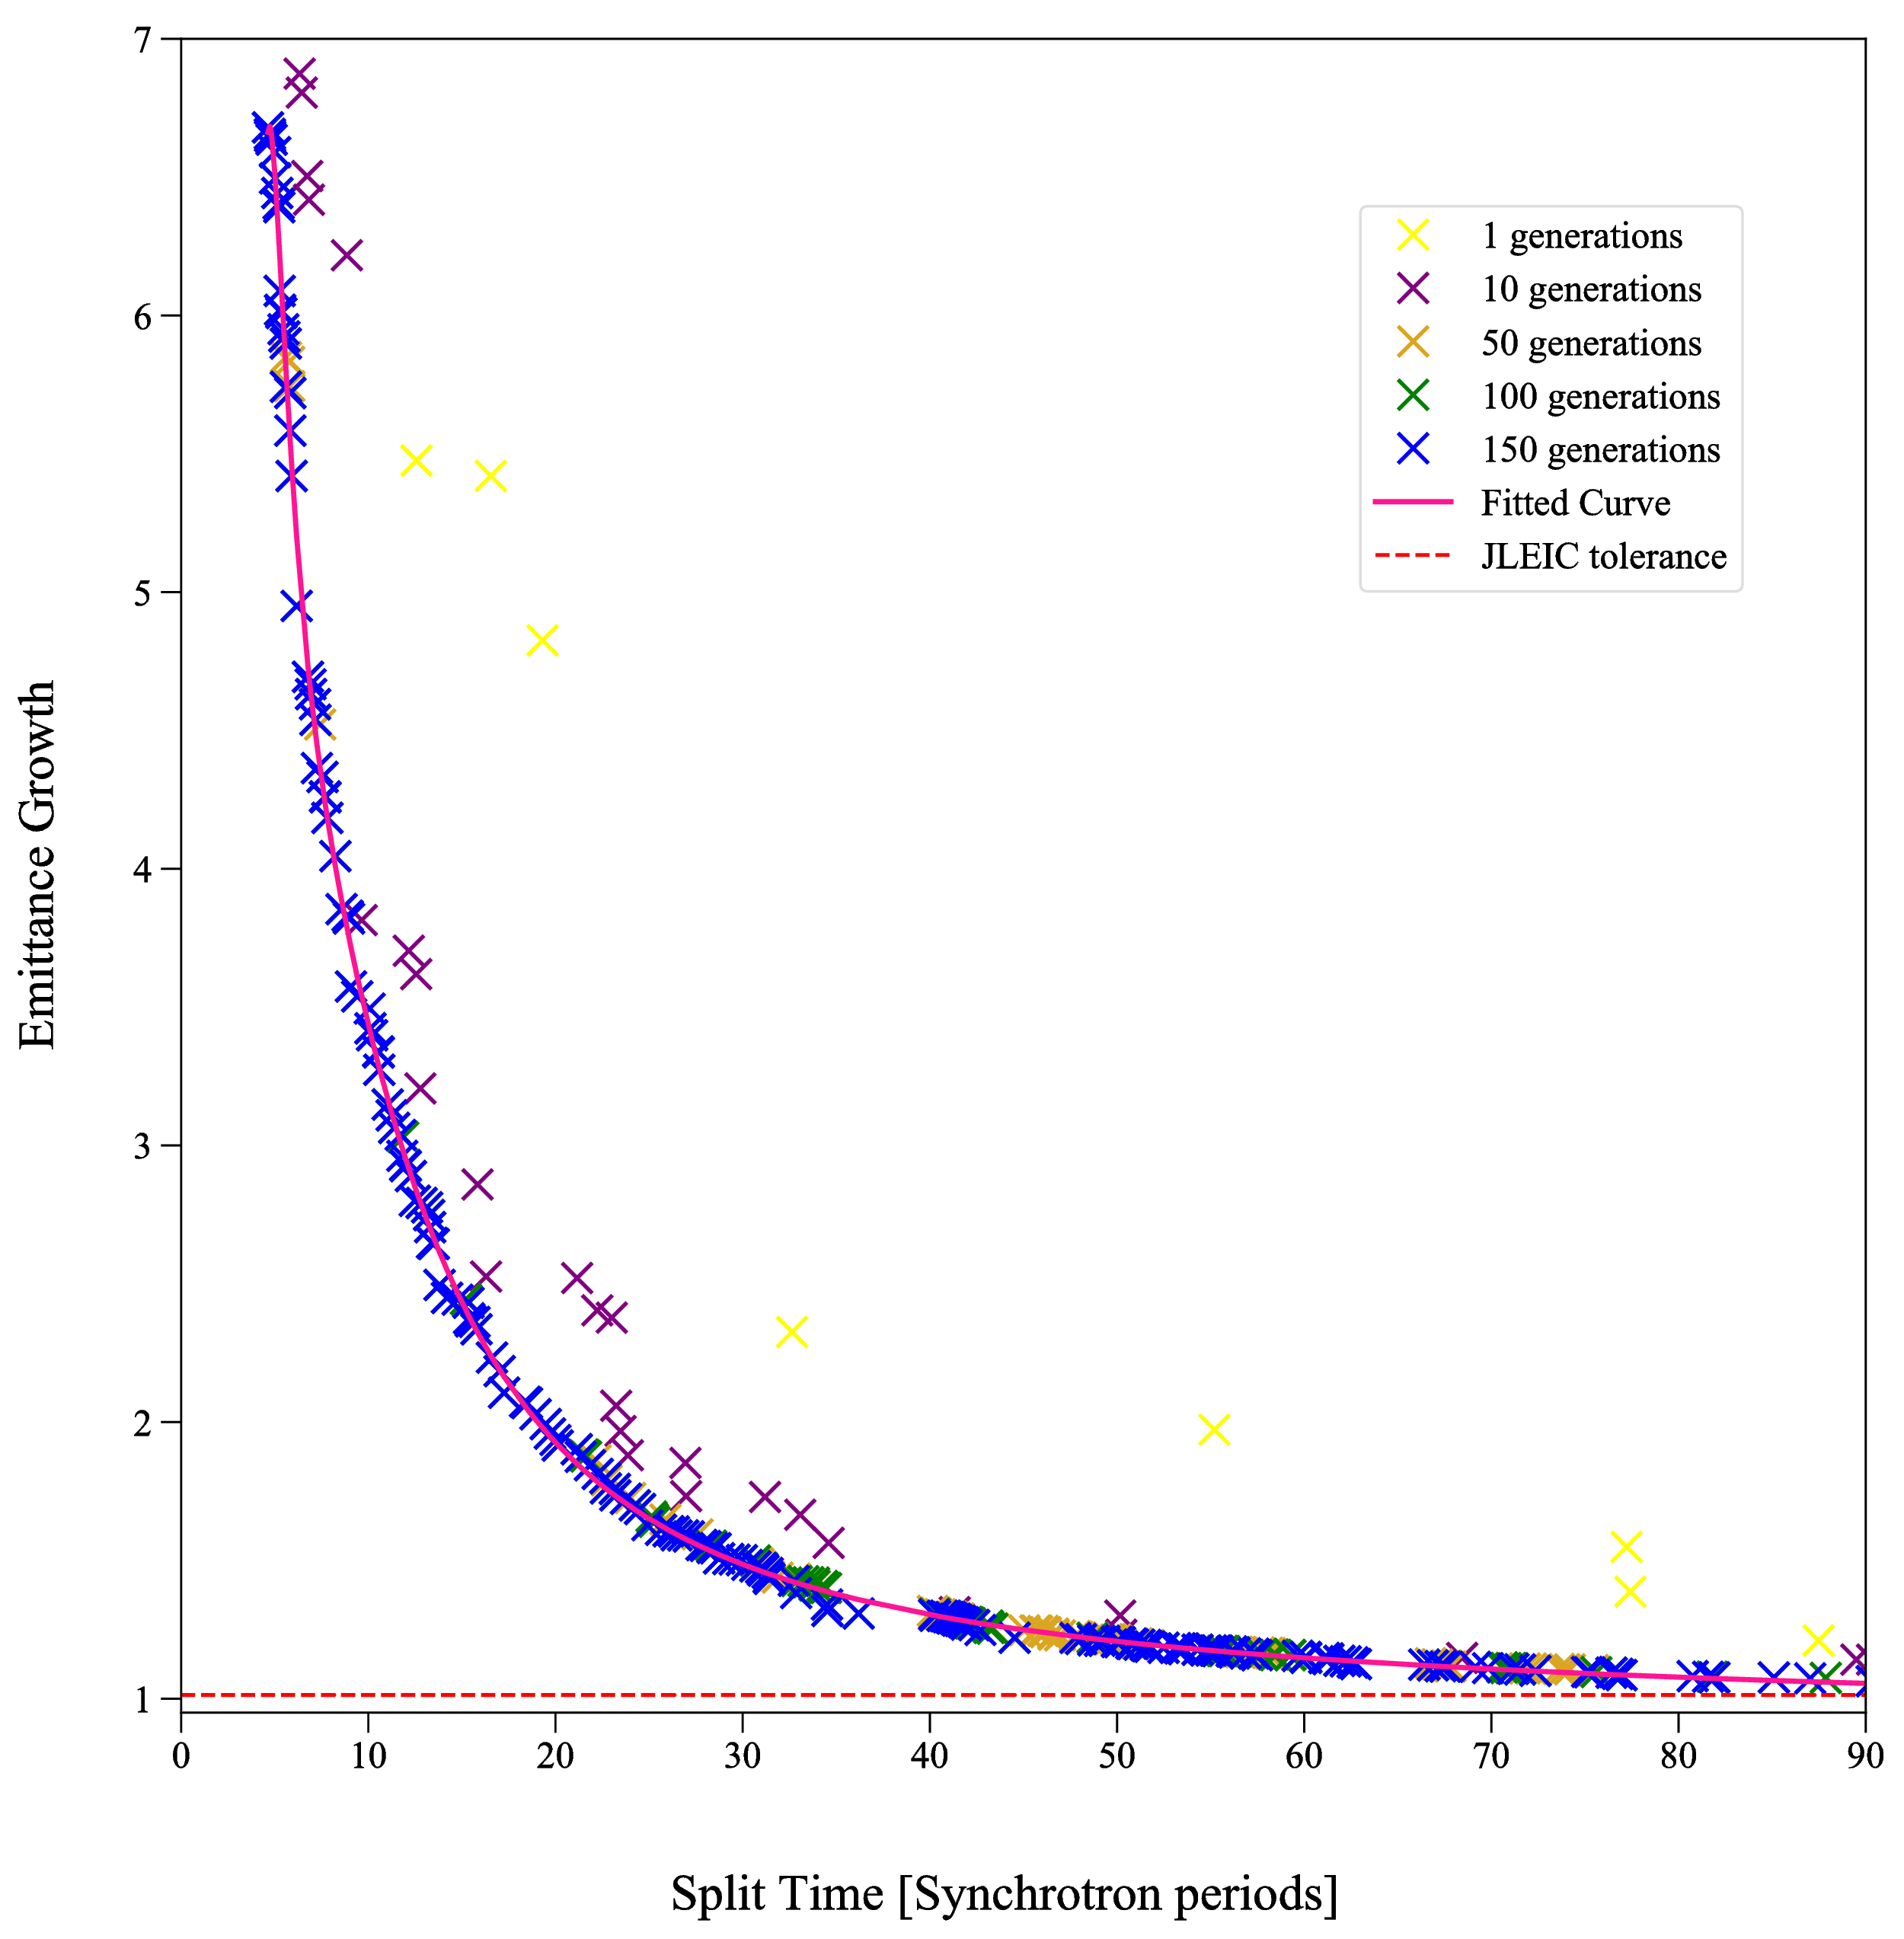
Linear voltage ramps
Fixed voltage ratio
Bunch to bucket ratio ~0.3
Parameters : T1BEG, T1END, T2BEG, T2END
Fixed voltage ratio
Bunch to bucket ratio ~0.05
Parameters : T1BEG, T1END, T2BEG, T2END

Slide 45
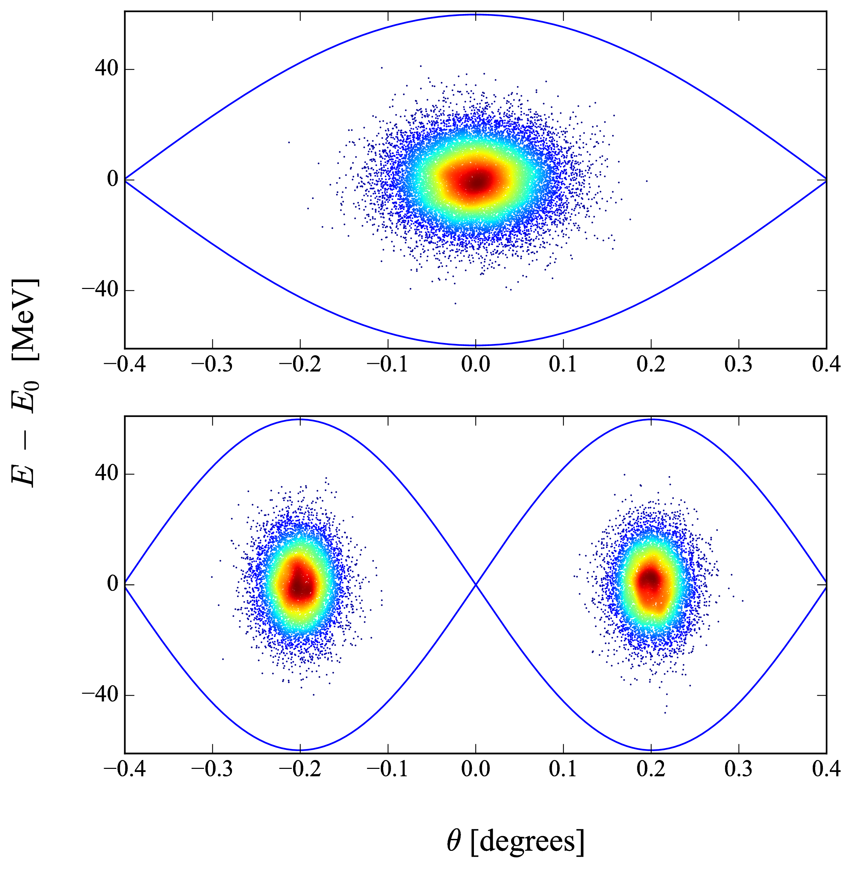
GA results
22 Synchrotron periods
V
t

Slide 46
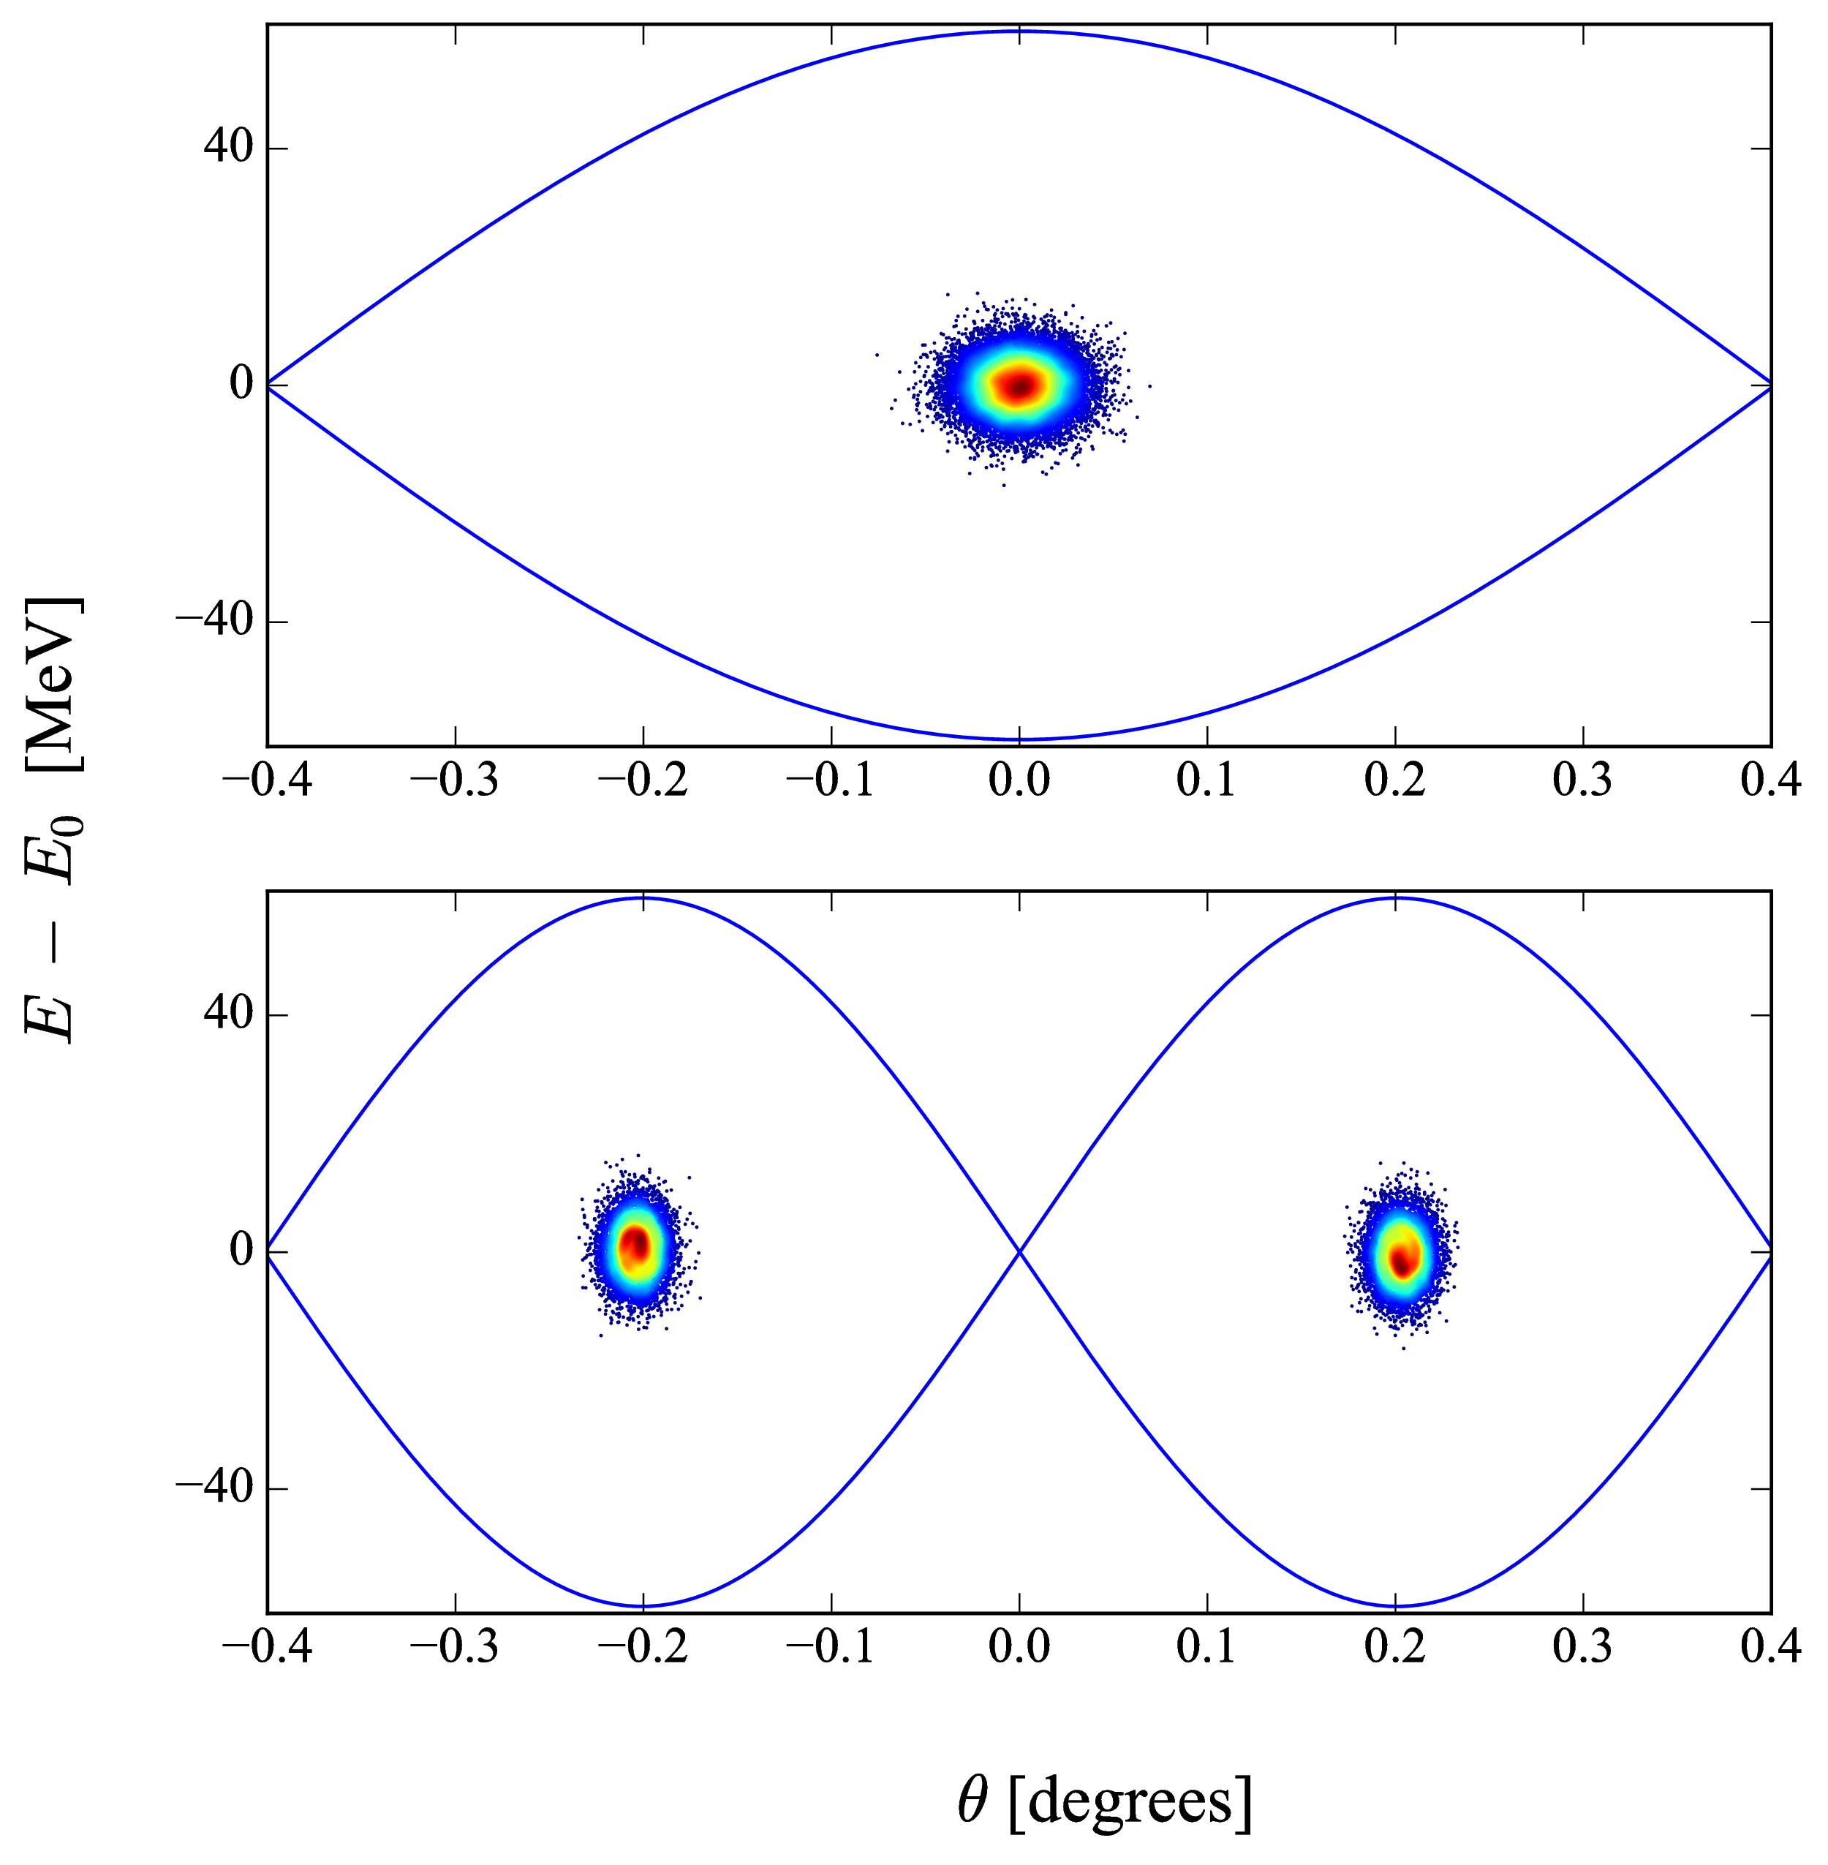
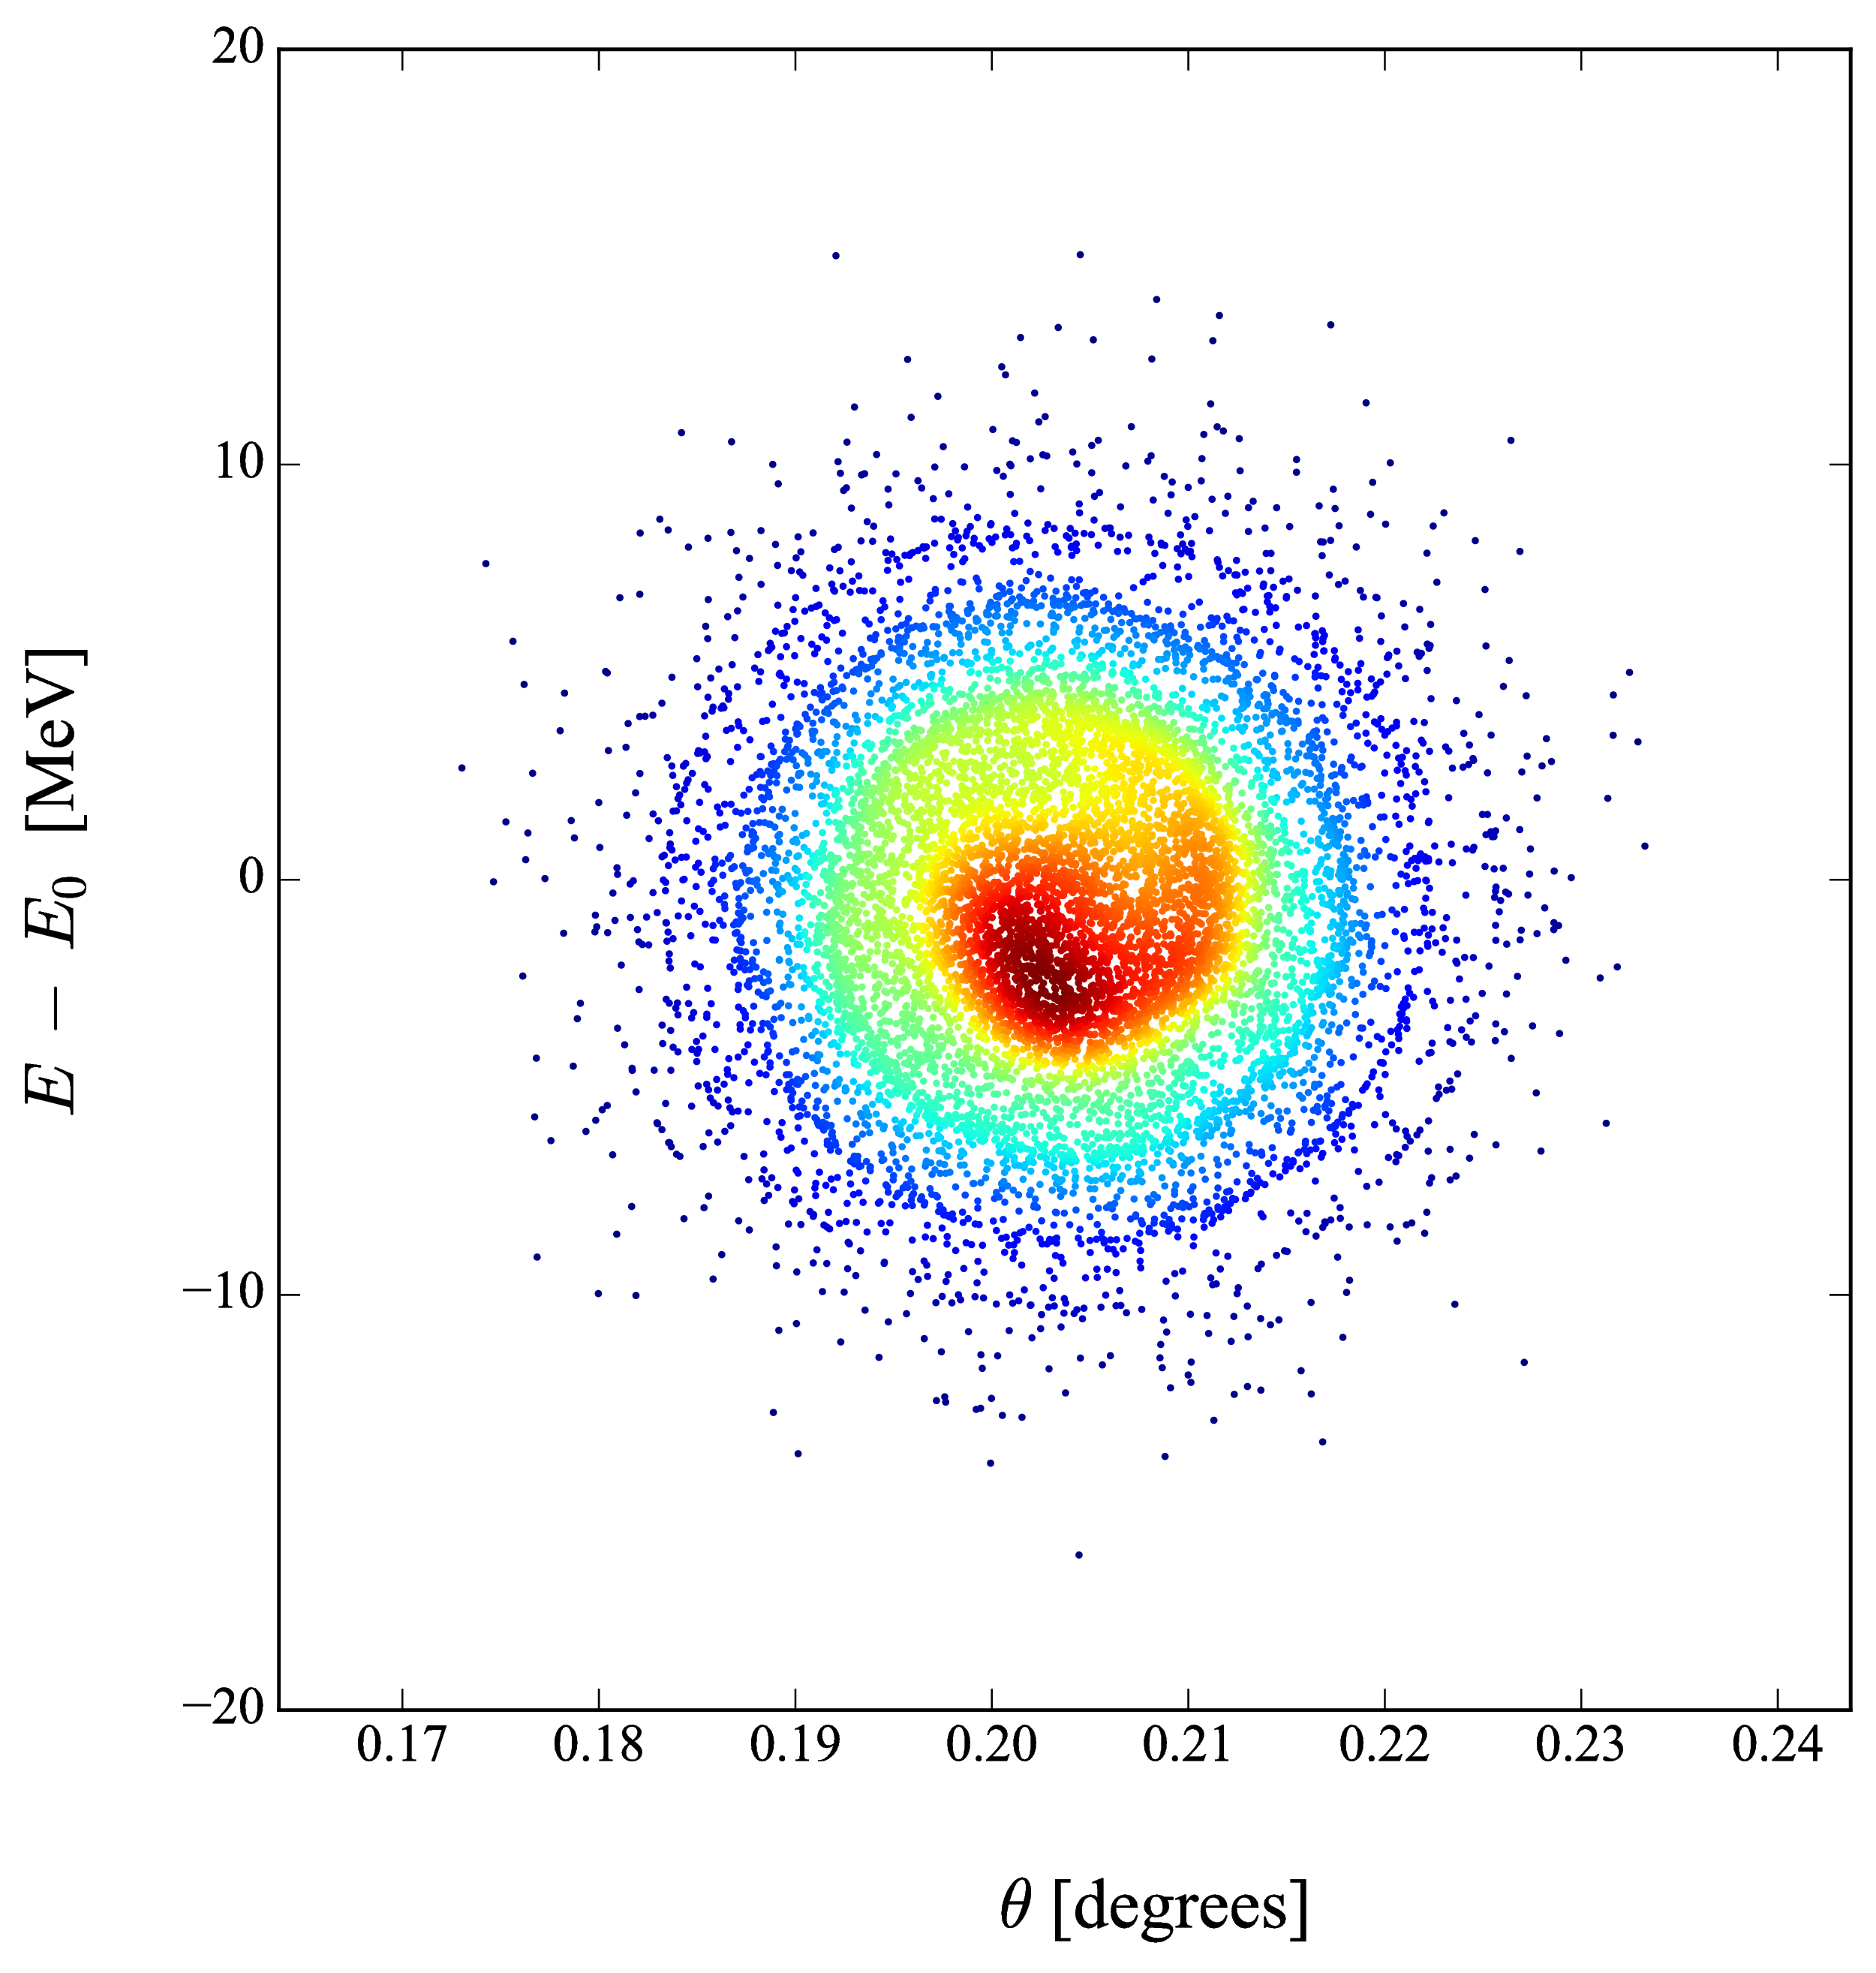
GA results
85 Synchrotron periods

Slide 47
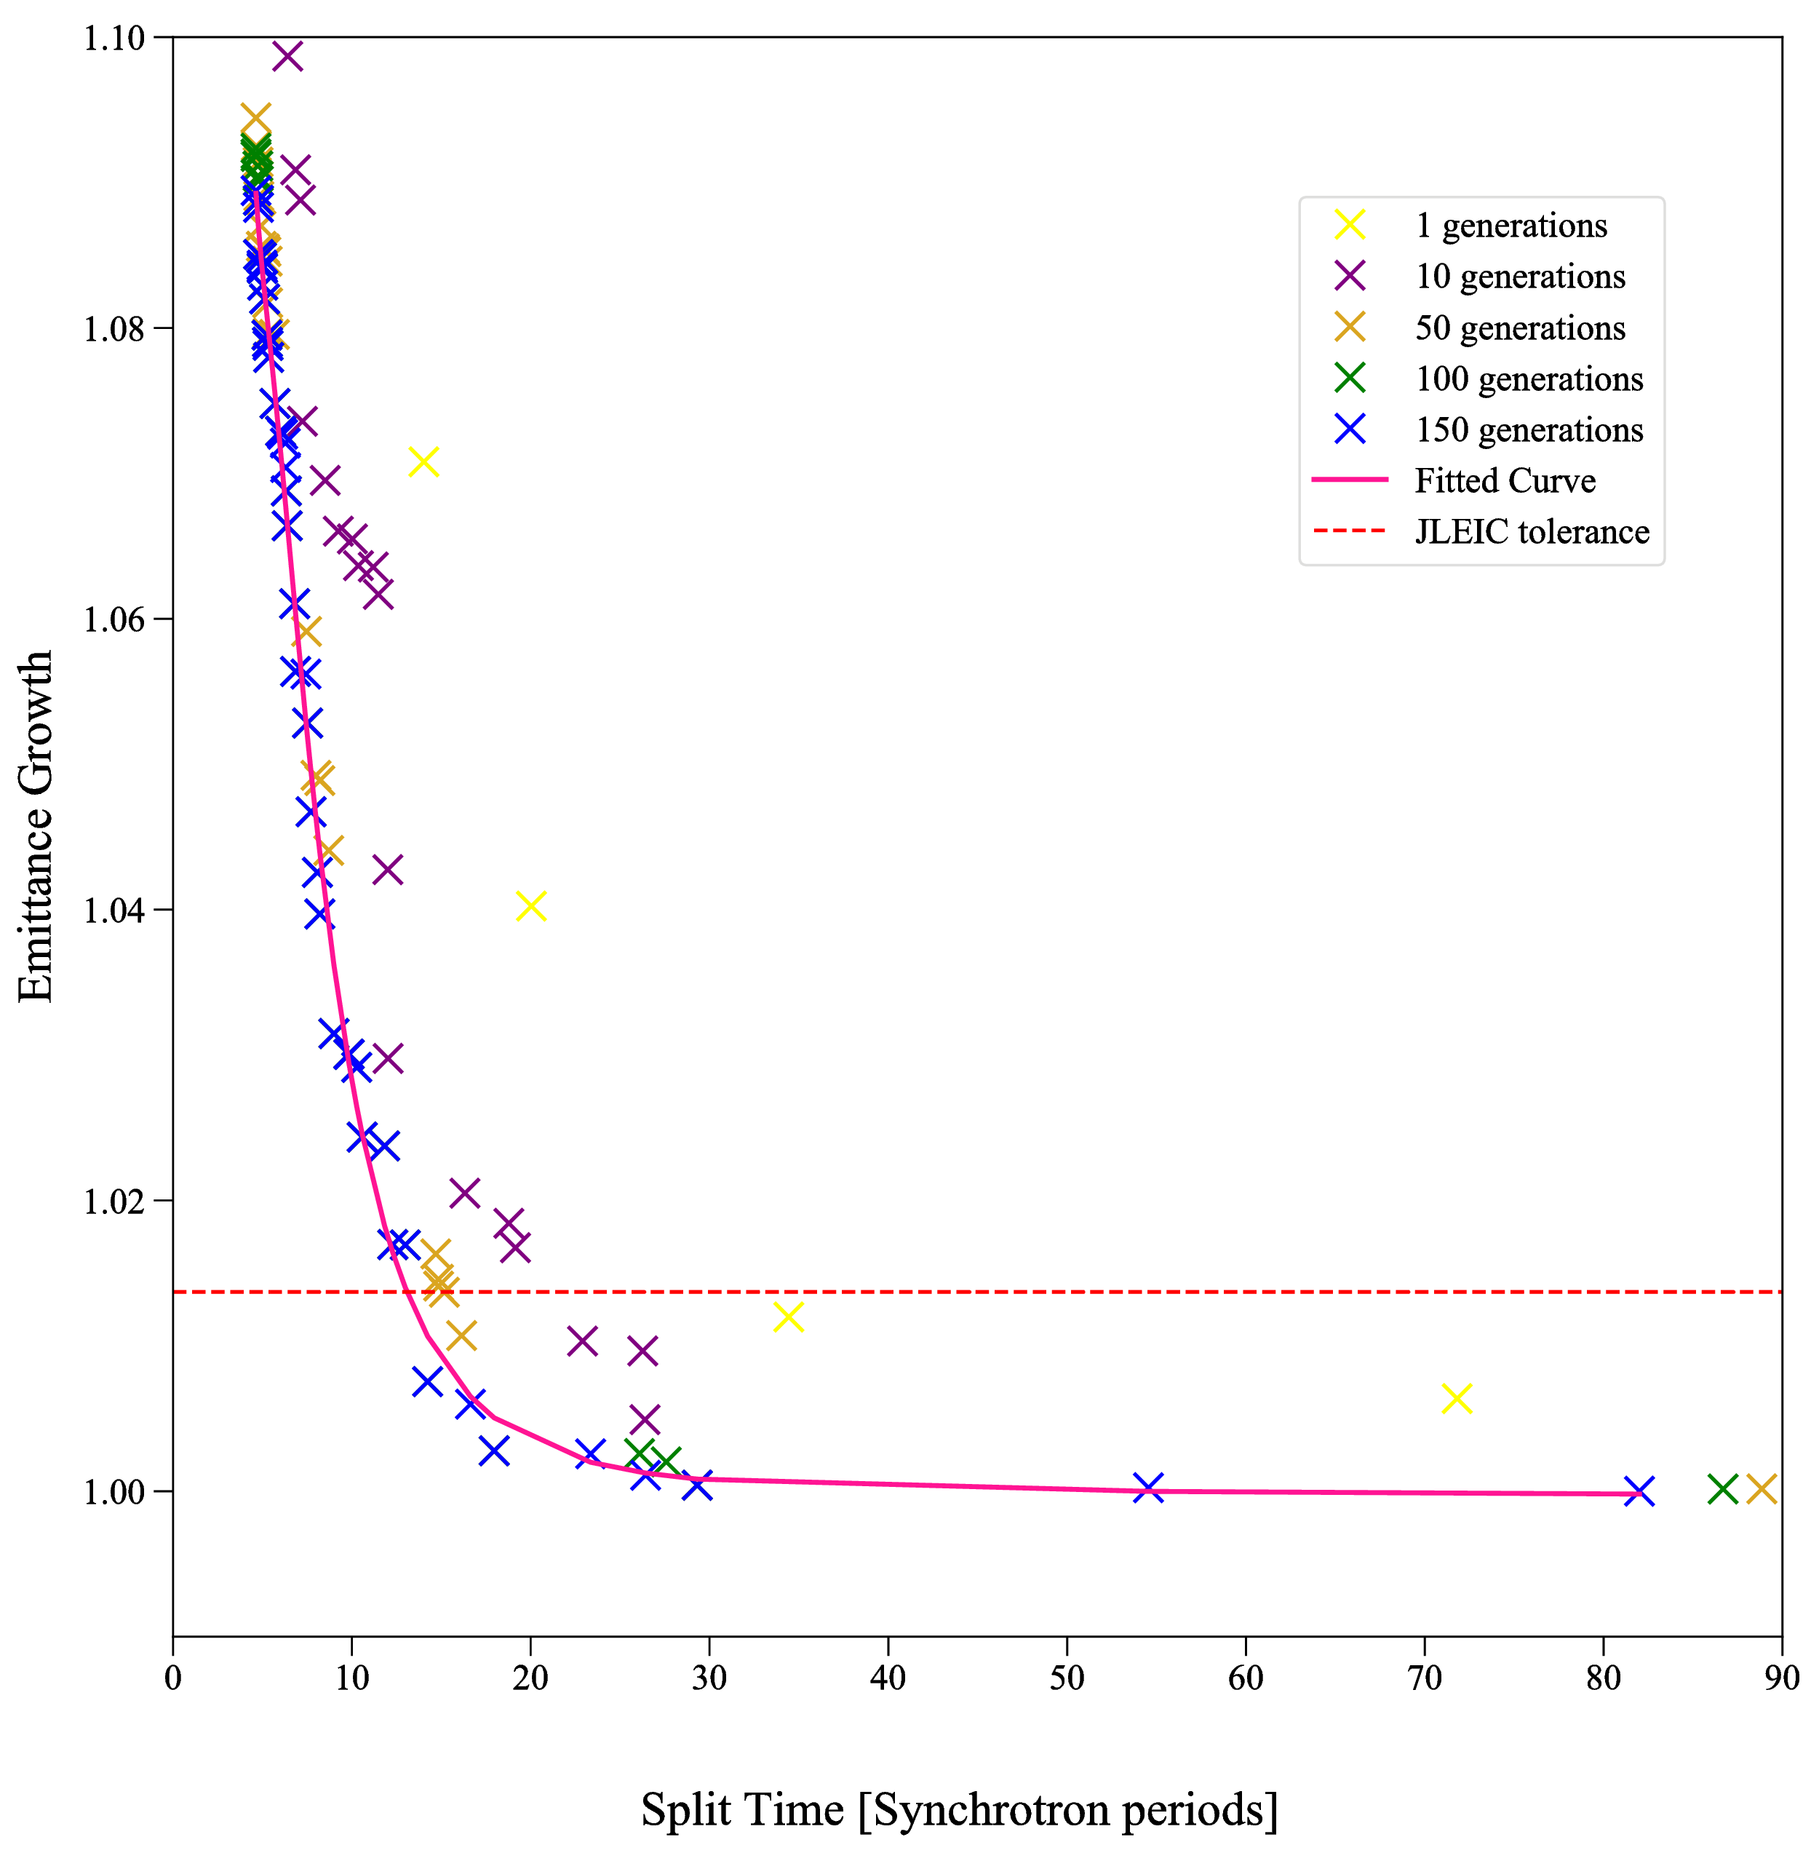
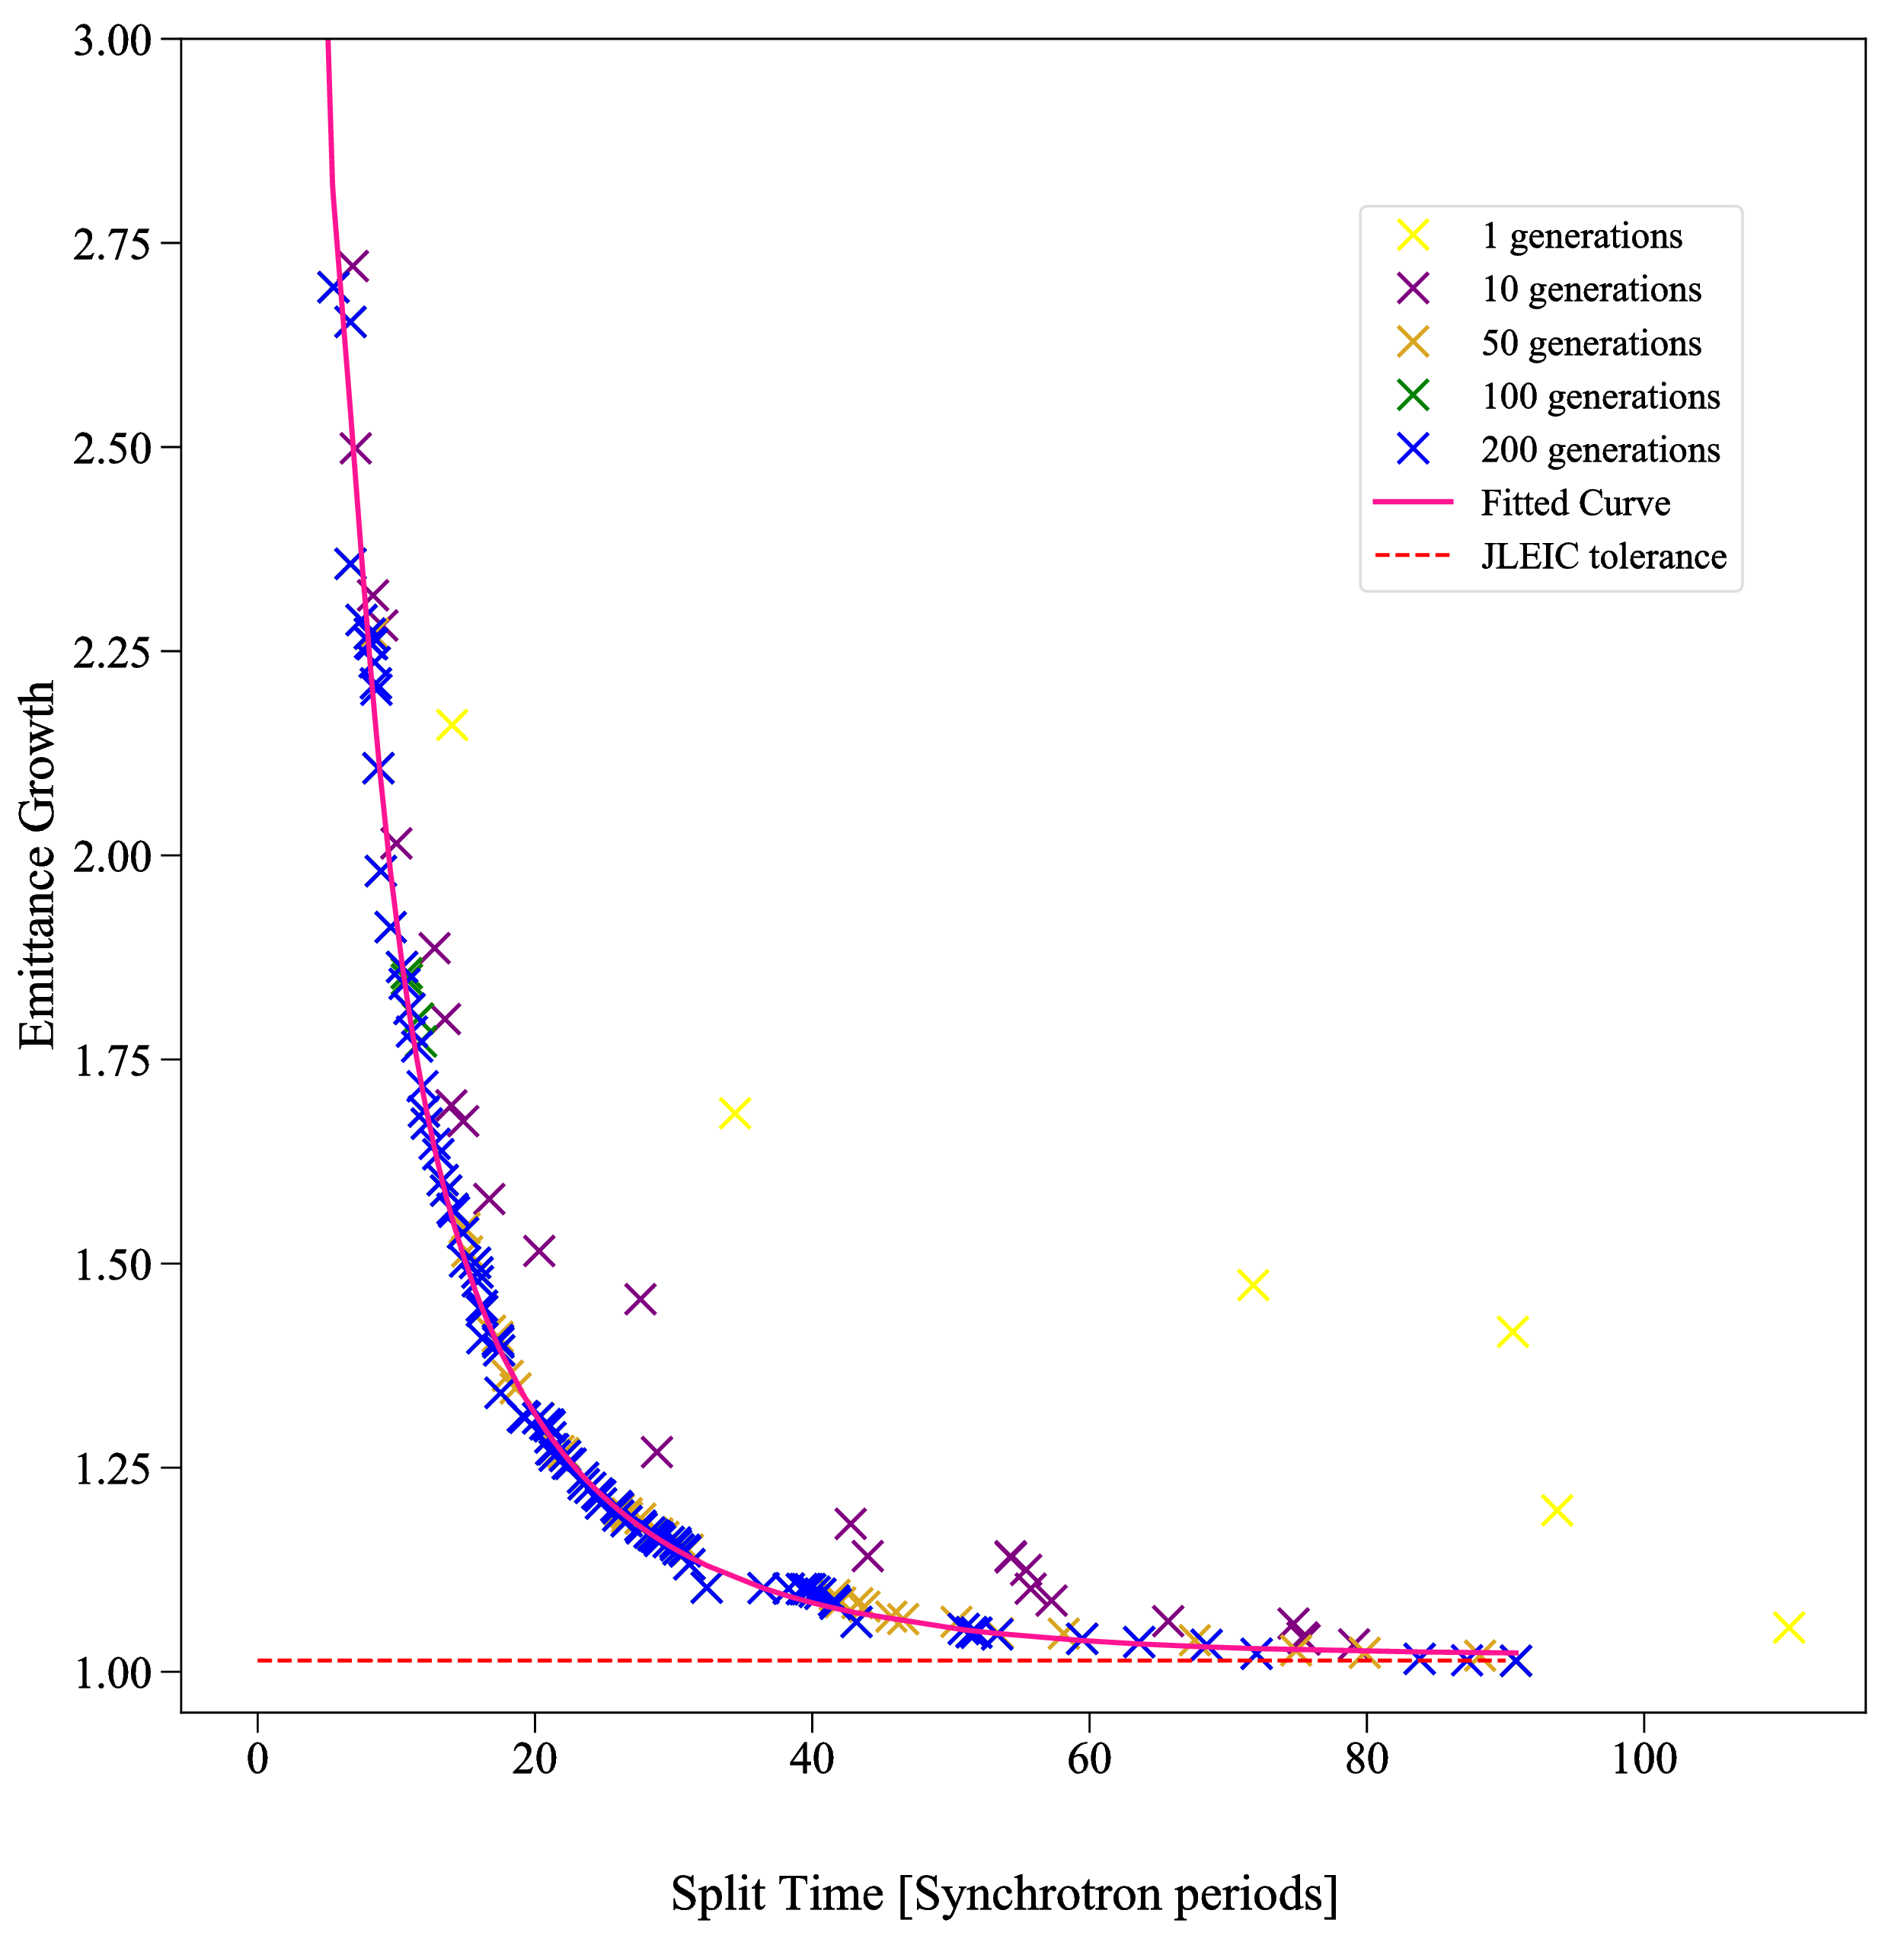
Linear voltage ramps
Bunch to bucket ratio ~0.3
Parameters : T1BEG, T1END, T2BEG, T2END, V2/V1
Bunch to bucket ratio ~0.05
Parameters : T1BEG, T1END, T2BEG, T2END, V2/V1

Slide 48
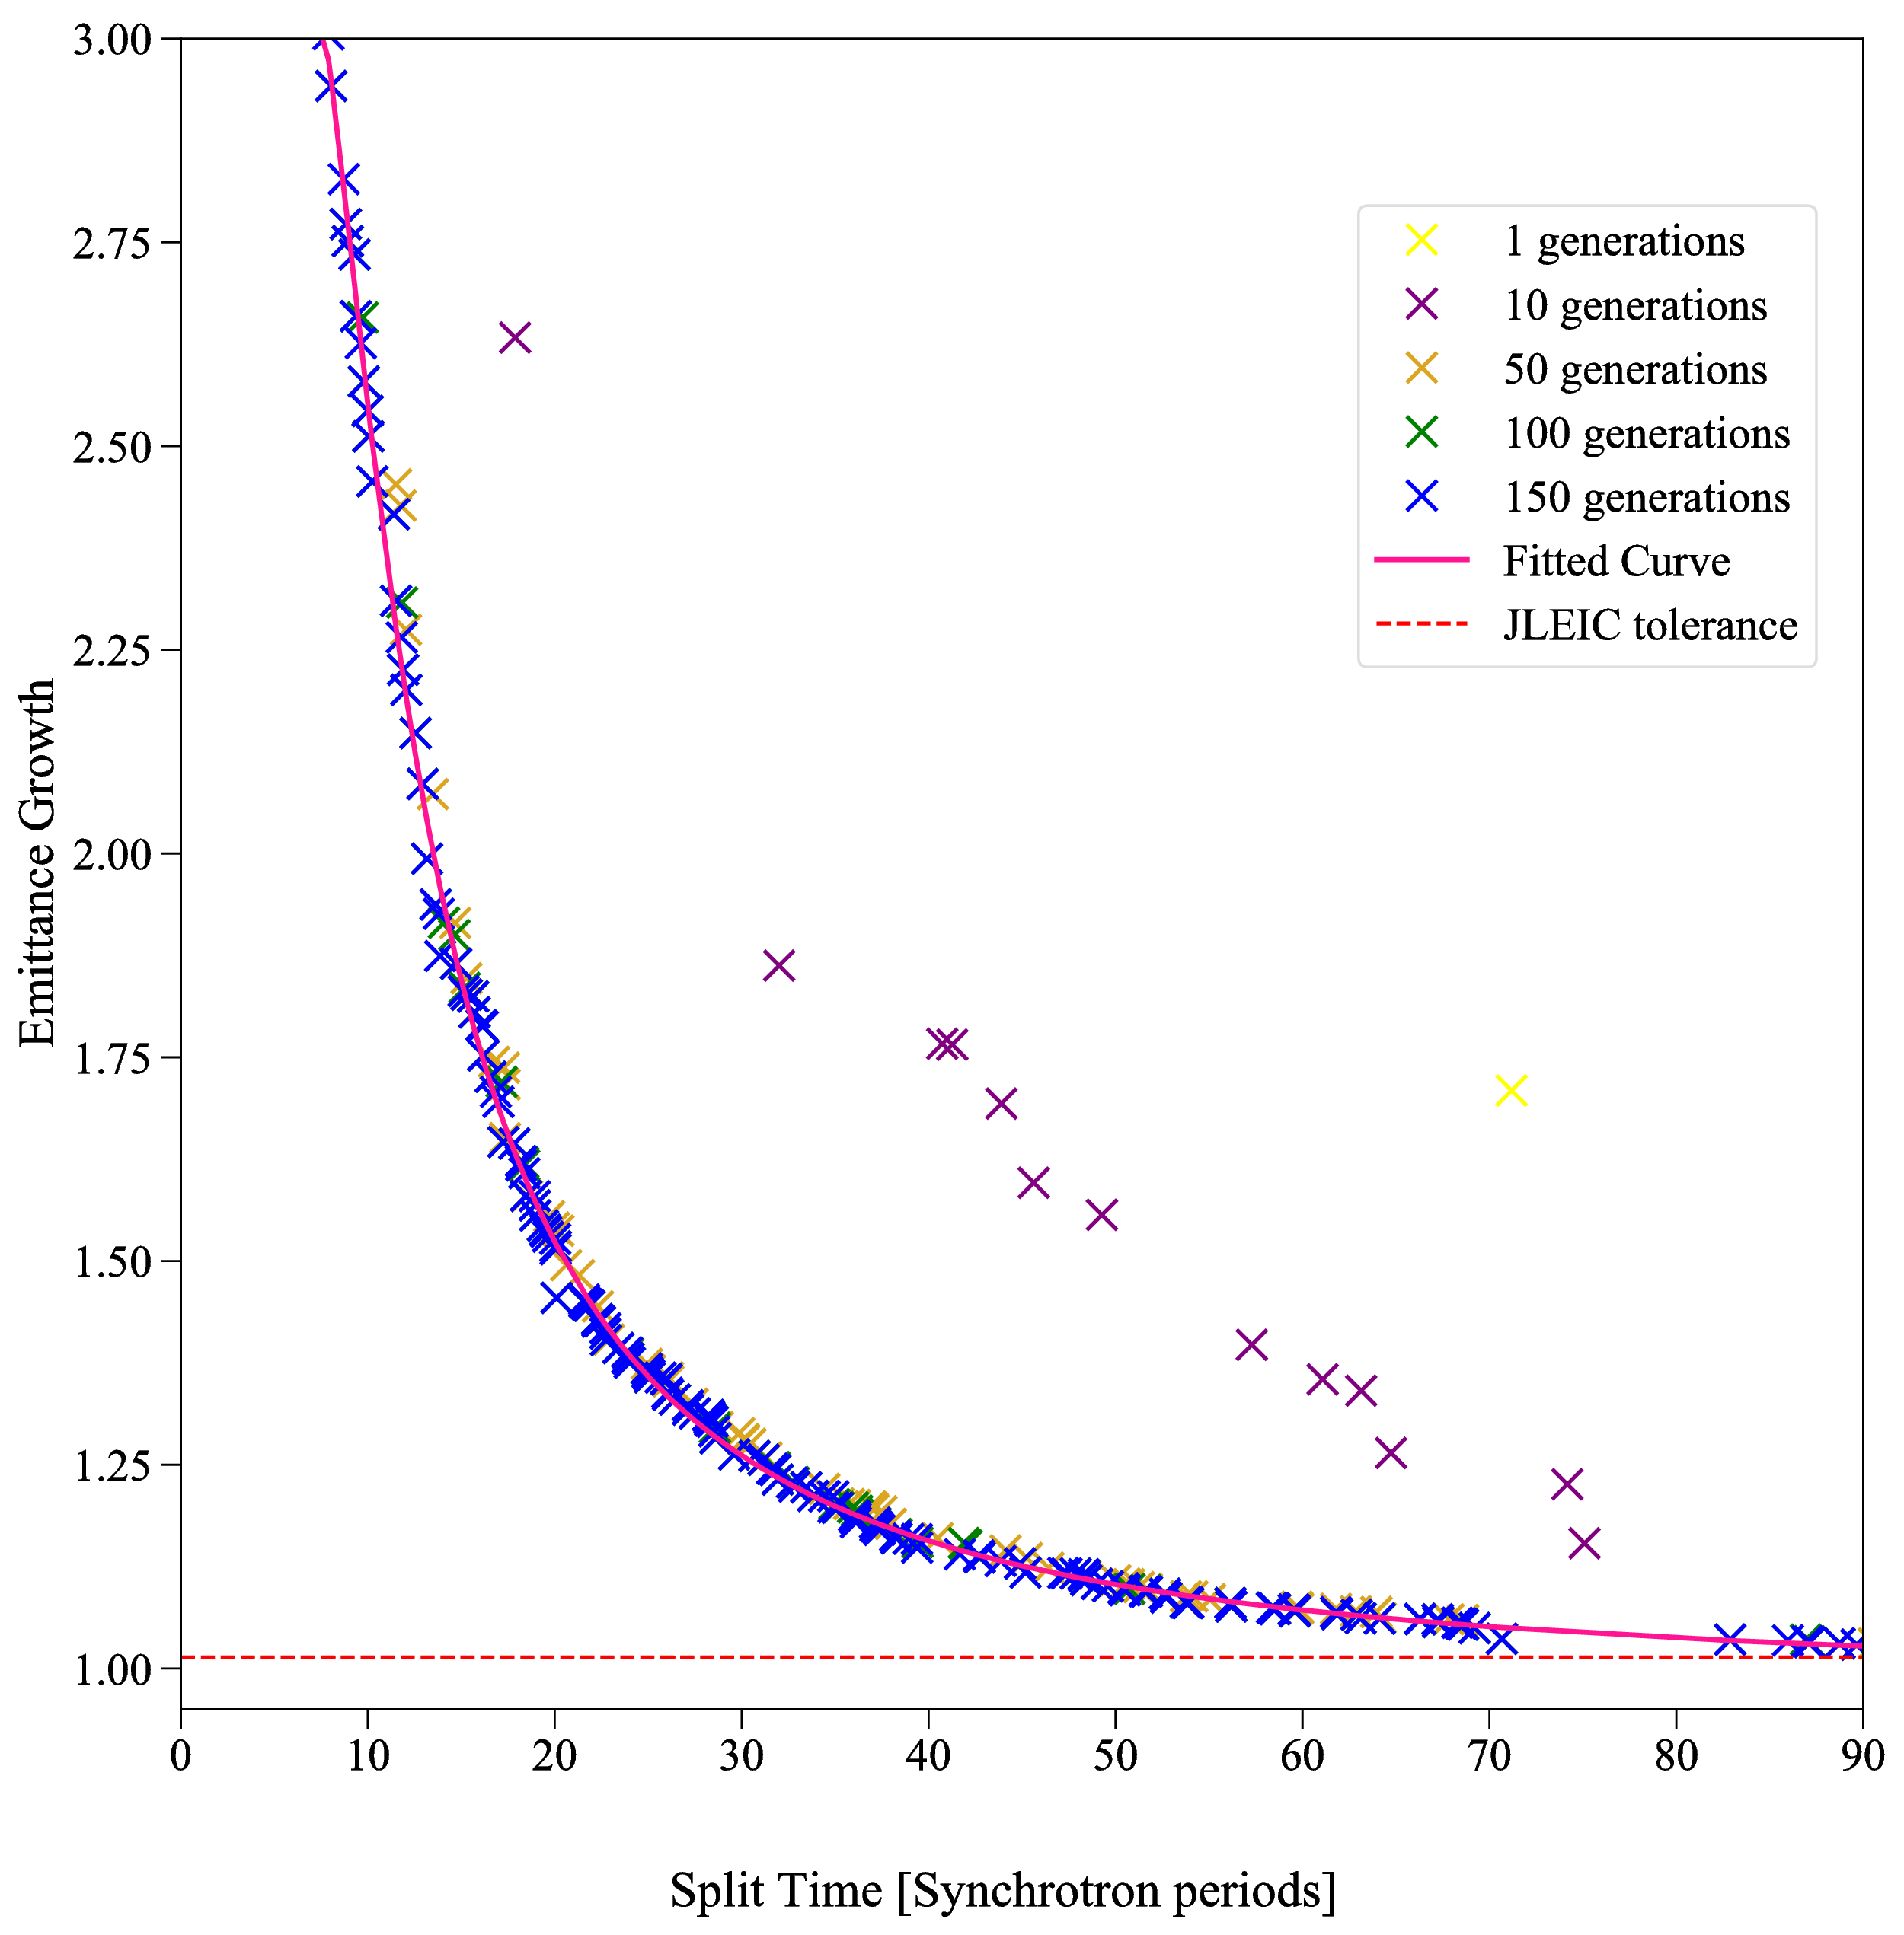
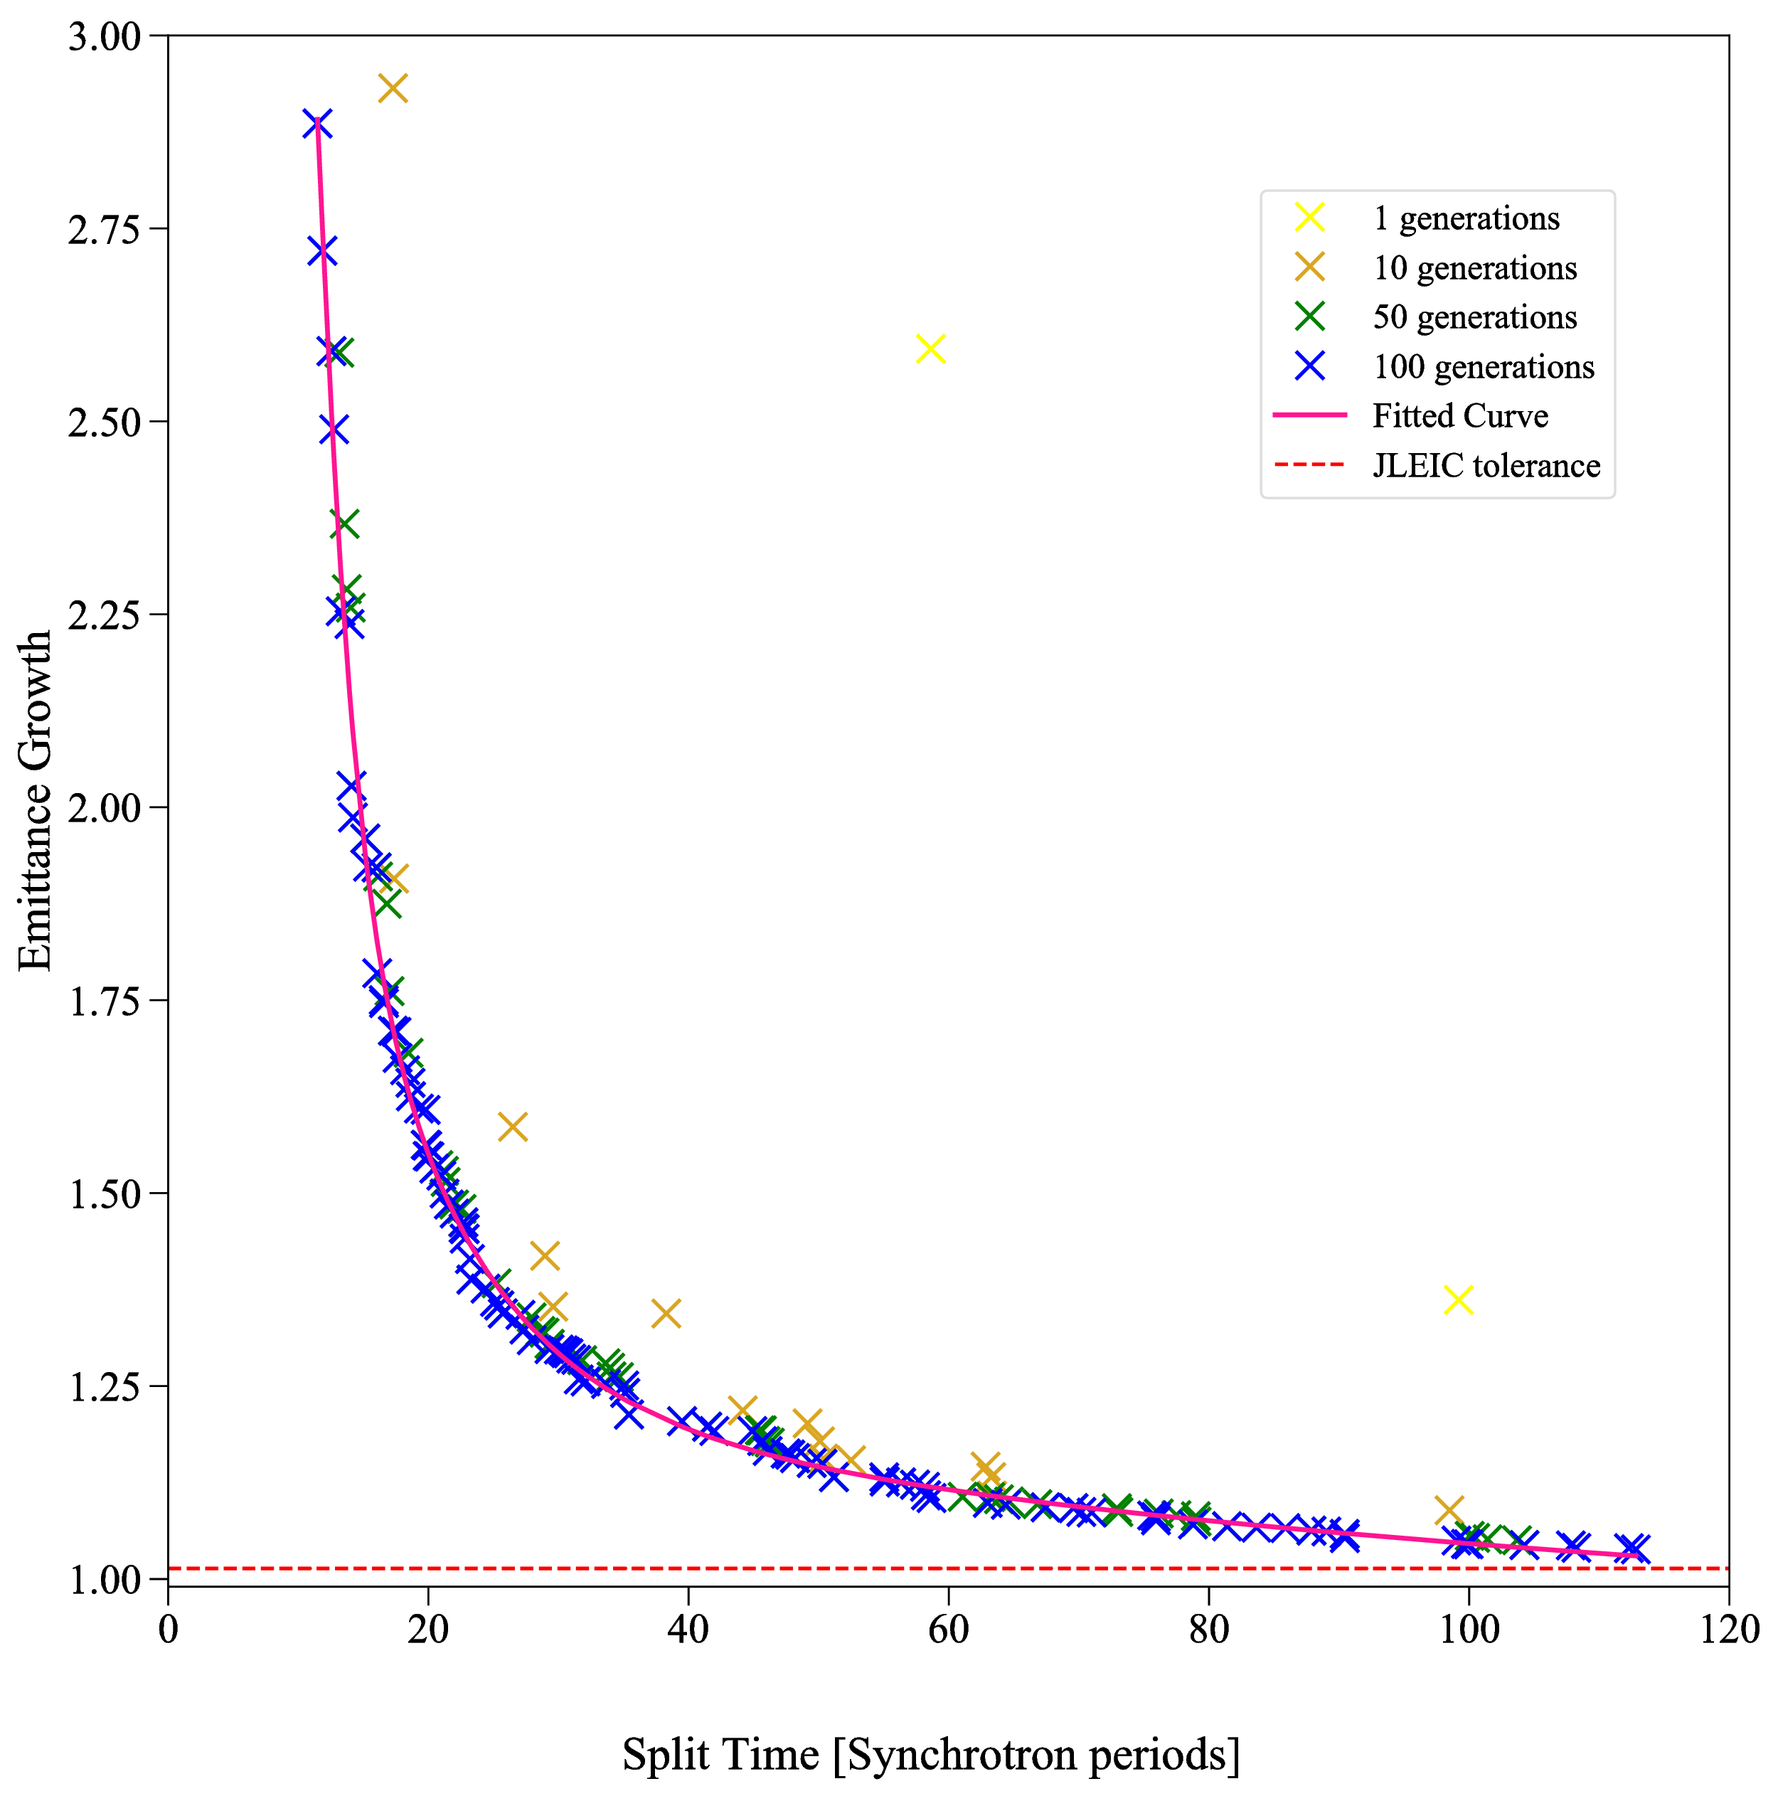
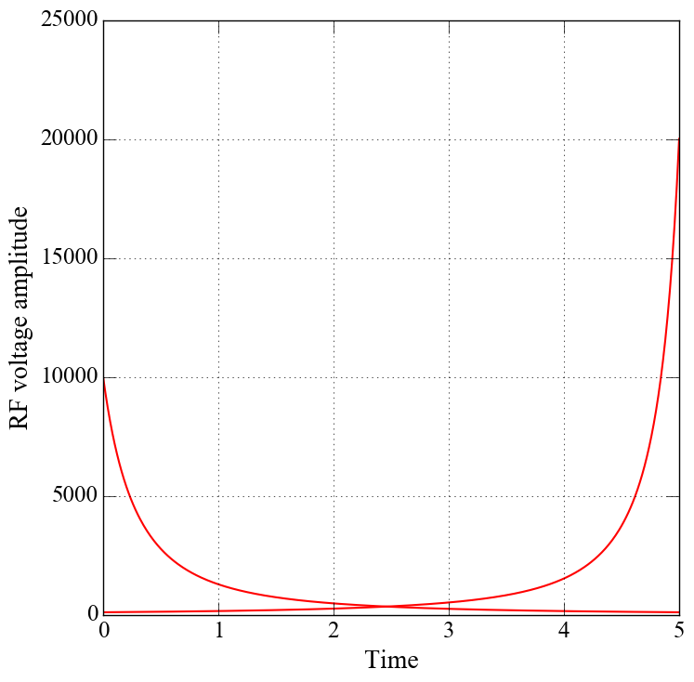
Iso-adiabatic voltage ramps
Bunch to bucket ratio ~0.3
Parameters : T1BEG, T1END, T2BEG, T2END
Bunch to bucket ratio ~0.05
Parameters : T1BEG, T1END, T2BEG, T2END

Slide 49
Summary
Debunch/Rebunch impedance threshold leaves a low margin for error
Even with adiabatic debunching, the emittance growth is still larger than the tolerance.
Bunch splitting is more feasible for the problem.
From GA split time was reduced to ~20 synchrotron periods

Slide 50
Acknowledgments
Funding Sources: Thomas Jefferson National Accelerator Facility
Advisor: Dr. Todd Satogata
Committee Members: Drs Alexander Gurevich, Geoffrey Krafft, Stephen Bueltmann and Desh Ranjan
Additional thanks: Drs Balša Terzić, Jiquan Guo, Rui Li, Subashini Desilva, & Kirsten Deltrick

Slide 51
Thank you!

Slide 52
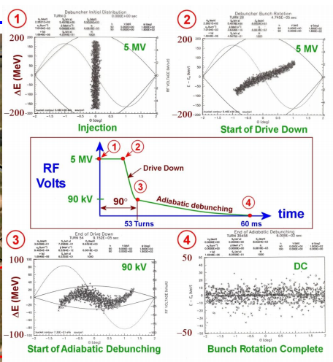
Bunch rotation
V.Nagaslaev talk

Slide 53
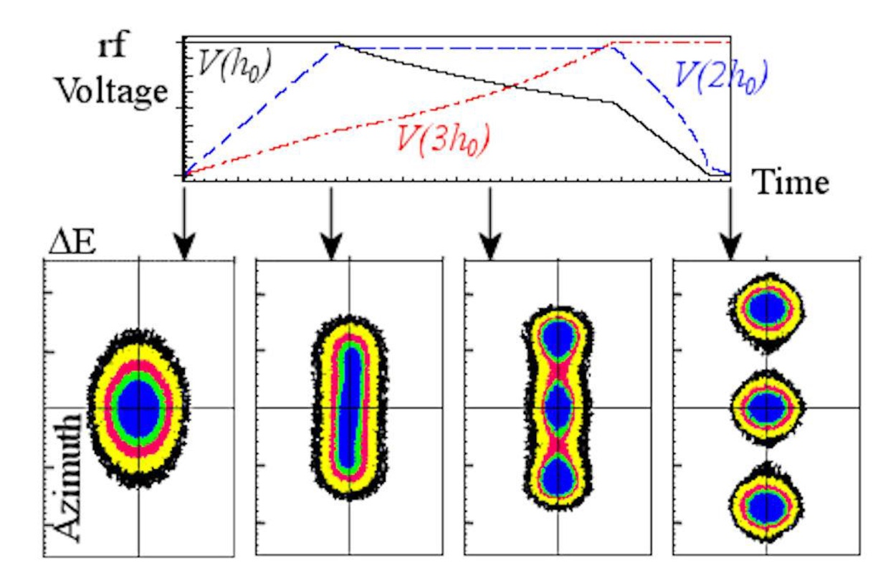
1 to 3 split

