Slide 1
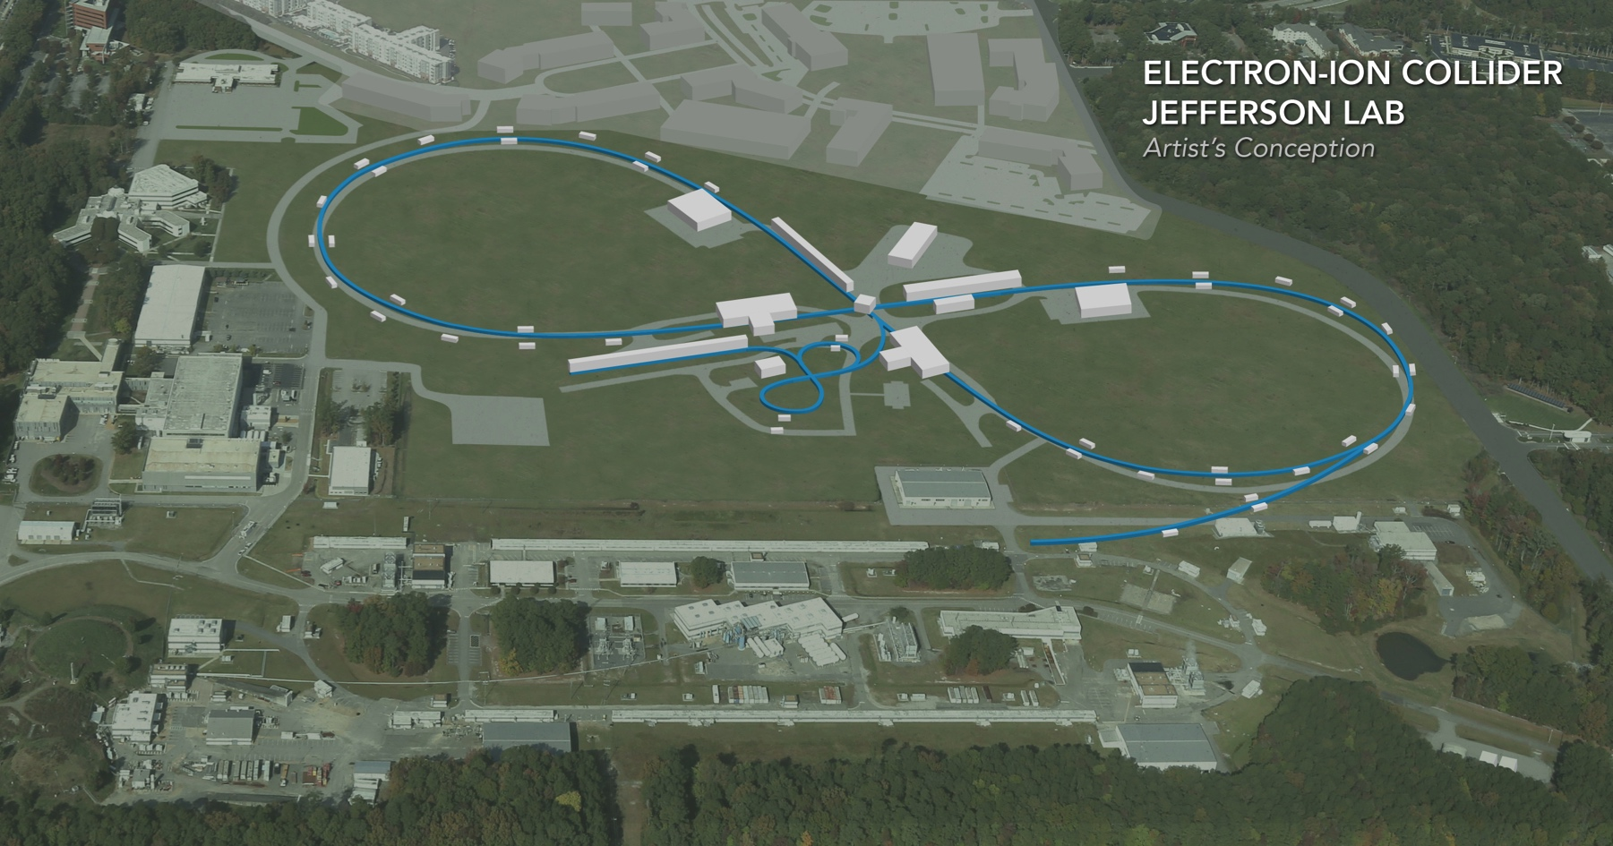
JLEIC Ion and Electron Polarization
Fanglei Lin
Collaborators:
Ya.S. Derbenev, V. Morozov, Y. Zhang (JLab), A.M. Kondratenko, M.A. Kondratenko (Zaryad), Yu.N. Filatov (MIPT), D. Barber (DESY)
EIC Accelerator Collaboration Meeting
October 29 - November 1, 2018

Slide 2
Polarization Requirements
Ion polarization design requirements
High polarization (> 70%) of protons and light ions (d, ³He⁺⁺, and possibly ⁶Li⁺⁺⁺)
Both longitudinal and transverse polarization orientations available at all IPs
Sufficiently long polarization lifetime
Spin flipping
Electron polarization design requirements
High polarization (> 70%)
Longitudinal polarization orientation at all IPs
Sufficiently long polarization lifetime
Opposite polarization states

Slide 3
Spin Resonances
Spin tune (number of spin precession per turn) in a conventional ring
$$ν_{s}=Gγ\text{, }G_{d}≈−0.143$$
A spin resonance occurs whenever the spin precession becomes synchronized with the frequency of spin perturbing fields
Imperfection resonances due to alignment and field errors
$$ν_{s}=k\text{, }E_{d}=13.12k \text{GeV}$$
Intrinsic resonances due to betatron oscillations
$$ν_{s}=k±ν_{y}$$
Coupling and higher-order resonances
$$ν_{s}=k+lν_{x}+mν_{y}+jν_{synch}$$
As $ν_{s}$ changes during acceleration, many resonances are crossed causing depolarization
Even at a fixed energy, a finite spread of $ν_{s}$ may overlap higher-order resonances limiting polarization lifetime

Slide 4
Siberian Snake
Device rotating spin by some angle about an axis in horizontal plane
A “full” Siberian snake rotates the spin by 180°
Overcomes all imperfection and most intrinsic resonances
Spin tune with a snake
$$ν_{s}=\frac{1}{π}\cos^{−1}\left[\cos\left(Gγπ\right)\cos{\frac{φ}{2}}\right]\text{, }φ=π ⇒ν_{s}=\frac{1}{2}$$
Solenoidal Siberian snake at low energies
No orbit excursion
Field integral grows with momentum
$$φ=\frac{Ze\left(1+G\right)}{p}∫B_{∥}ds$$
$$φ=π\text{, }p=9 \text{GeV}\text{/}\text{c} ⇒ ∫B_{∥}ds≈34 \text{Tm} \text{for} p \text{and}\text{ 110 }\text{Tm} \text{for} d$$
Dipole Siberian snake at high energies
Orbit excursion is inversely proportional to momentum
Almost energy-independent field integral
$$φ=\frac{Ze Gγ}{p}∫B_{⊥}ds$$
$$φ=π\text{, }p=100 \text{GeV}\text{/}\text{c} ⇒ ∫B_{⊥}ds≈5.5 \text{Tm} \text{for} p \text{and}\text{ 158 }\text{Tm} \text{for} d$$
In reality, orbit control requirements lead to an increase of the field integral by a factor of $\sim 3$ or so, e.g. to $\sim 20 \text{Tm}$ as in RHIC
Medium energies are still a problem
Full deuteron Siberian snake is not practical for medium to high energies

Slide 5
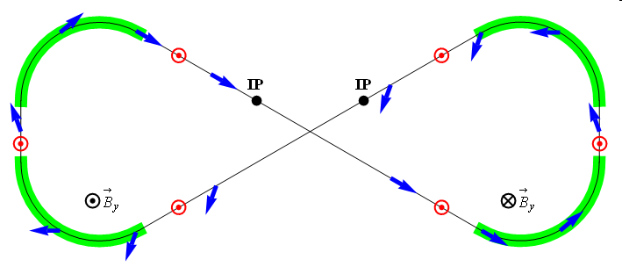
Figure-8 Scheme
Figure-8 ring is transparent to the spin motion: in an ideal structure, spin precession in one arc is cancelled by the other
Without additional fields, spin rotation is a priori unknown and occurs only due to closed orbit excursion and beam emittances
Additional fields are introduced to stabilize the spin motion by producing a spin rotation that is much greater than that due to imperfections
Required integrals of the additional fields are almost two orders of magnitude lower than those of full Siberian snakes
e.g. ~3 Tm vs. < 400 Tm for deuterons at 100 GeV
Figure-8 is an indispensable solution for deuterons in the whole EIC energy range and protons in the low-to-medium energy range as well as an excellent alternative solutions for high-energy protons and electrons
$${\vec{B}}_{y}$$
$${\vec{B}}_{y}$$
ν = 0
ν = 0

Slide 6
Zero-Integer Spin Resonance and Spin Stability Criterion
Total zero-integer spin resonance strength
$${\vec{w}}_{0}={\vec{w}}_{coherent}+{\vec{w}}_{emittance} , \left|{\vec{w}}_{emittance}\right|≪\left|{\vec{w}}_{coherent}\right|$$
is composed of
coherent part $w_{coherent}$ due to closed orbit excursions (due to imperfections); it does not lead to depolarization but causes coherent spin rotation about a priori unknown direction
incoherent part $w_{emittance}$ due to transverse and longitudinal emittances (proportional to beam emittance), it causes spin tune spread potentially leading to depolarization
Spin stability criterion
the spin tune induced by a spin rotator must significantly exceed the strength of the incoherent part of the zero-integer spin resonance
$$ν≫\left|{\vec{w}}_{emittance}\right|$$
for proton beam $ν_{p}={10}^{−2}$
for deuteron beam $ν_{d}={10}^{−4}$

Slide 7
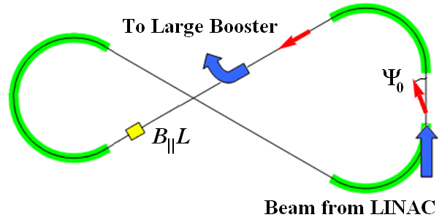
Ion Booster
Polarization in Booster stabilized and preserved by a single weak solenoid
0.6 T⋅m at 8 GeV/c
ν_{d} / ν_{p} = 0.003 / 0.01
Longitudinal polarization in the straight with the solenoid
Conventional 8 GeV accelerators require B||L of ~30 Tm for protons and ~100 Tm for deuterons
B_{II}L
Booster
beam from Linac
to Collider Ring

Slide 8
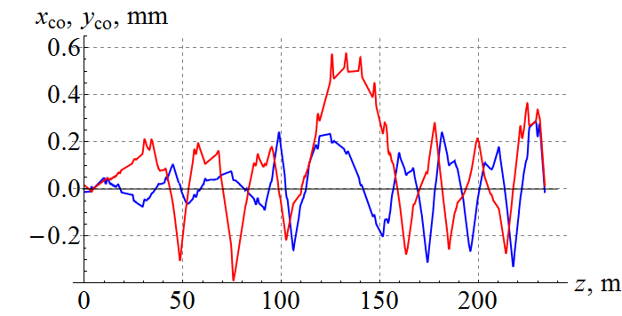
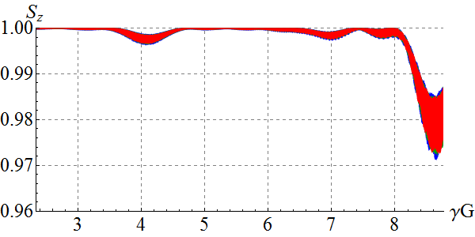
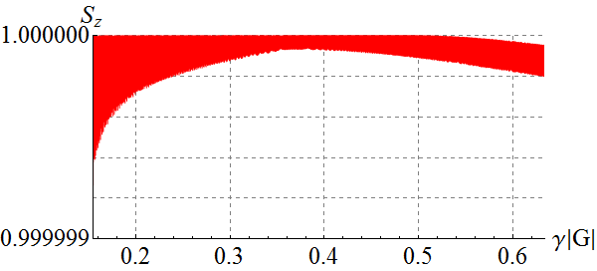
Spin Dynamics in Booster
Acceleration in figure-8 booster with transverse quadrupole misalignments
0.3 Tm (maximum) spin stabilizing solenoid
Spin tracking simulation using Zgoubi
protons
x₀ = y₀ = 1 cm
Δp/p = -0.1%, 0, +0.1%
deuterons
x₀ = y₀ = 1 cm
Δp/p = 0

Slide 9
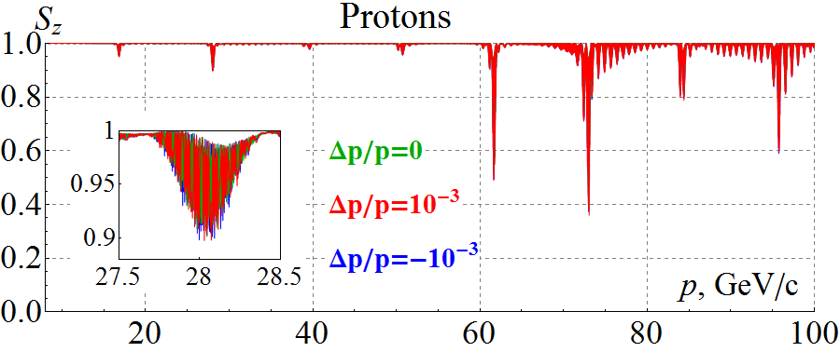
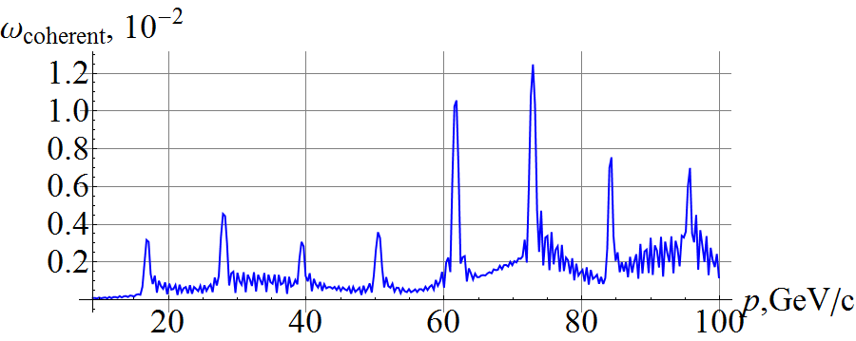
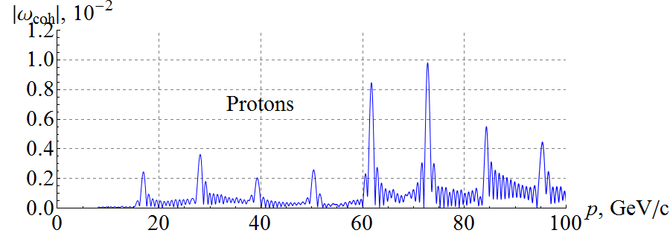
Start-to-End Proton Acceleration in Ion Collider Ring
Three protons with $ε_{x,y}^{N}=1 μm$ and ${Δp}/p=0, ±1⋅{10}^{−3}$ accelerated at ~3 T/min in lattice with 100 μm rms closed orbit excursion, $ν_{sp}=0.01$
Coherent resonance strength component
Zgoubi
simulation
Analytic prediction
Zgoubi simulation

Slide 10
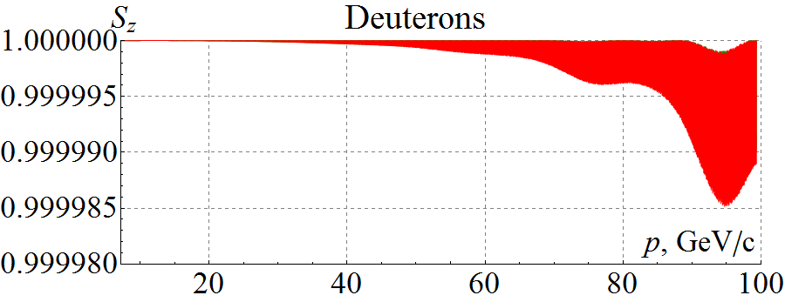
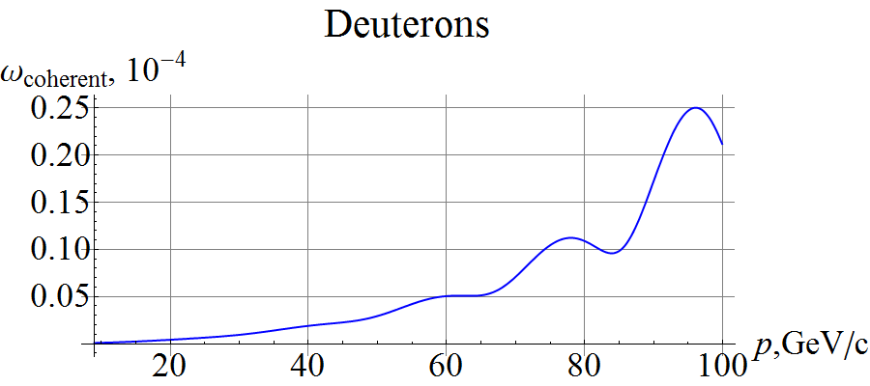
Start-to-End Deuteron Acceleration in Ion Collider Ring
Three deuterons with $ε_{x,y}^{N}=0.5 μm$ and ${Δp}/p=0, ±1⋅{10}^{−3}$ accelerated at ~3 T/min in lattice with 100 μm rms closed orbit excursion, $ν_{sp}=3⋅{10}^{−3}$
Deuteron spin is highly stable in figure-8 rings, which can be used for high precision experiments
(Zgoubi simulation)
Analytic prediction

Slide 11
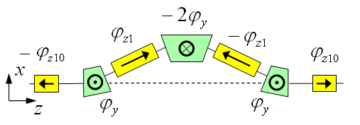
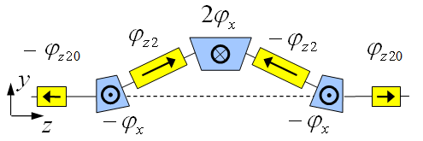
3D Spin Rotator in Ion Collider Ring
Provides control of the radial, vertical, and longitudinal spin components
Module for control of the radial component (fixed radial orbit bump)
Module for control of the vertical component (fixed vertical orbit bump)
Module for control of the longitudinal component
3D spin rotator
IP
ions

Slide 12
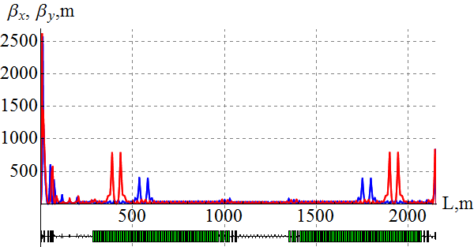
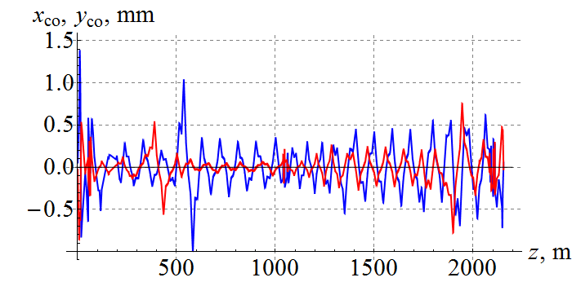
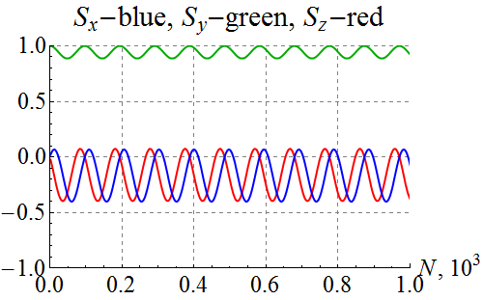
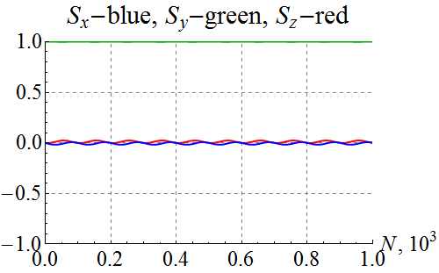
Polarization Control in Ion Collider Ring
100 GeV/c figure-8 ion collider ring with transverse quadrupole misalignments
Example of vertical proton polarization at IP. The 1st 3D rotator: ν = 10⁻² , n_{y}=1. The 2nd 3D rotator is used for compensation of coherent part of the zero-integer spin resonance strength
1st 3D rotator for control
2nd 3D rotator for compensation
without compensation
with compensation

Slide 13
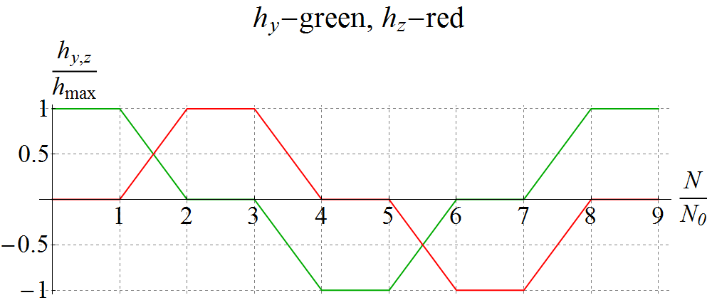
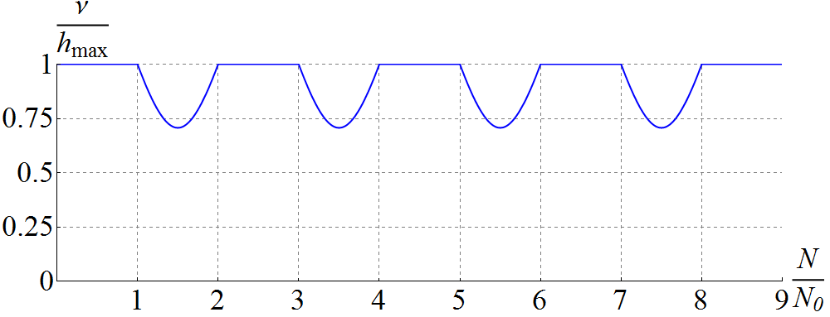
Spin Flipping
Adiabaticity criterion: spin reversal time must be much longer than spin precession period ⇒ τ_{flip} >> 1 ms for protons and 0.1 s for deuterons
Vertical (h_{y}) & longitudinal (h_{z}) spin field components as set by the spin rotator vs time ⇒ Spin tune vs time (changes due to piece-wise linear shape)
$N$ is the number of particle turns
Vertical & longitudinal components of proton polarization vs time at 100 GeV/c
$$\vec{P}:↑ → ↓ ← ↑$$
Zgoubi
simulation
$$N_{0}=50⋅{10}^{3}$$

Slide 14
Radiative Polarization Effects
Sokolov-Ternov polarization change rate
$$τ_{ST}^{−1}=\frac{5\sqrt{3}}{8}\frac{r_{e}γ^{5}h/2π}{m_{e}}\frac{1}{C}\oint{ds{\left\langle \frac{1−\frac{2}{9}{\left(\hat{n}⋅\hat{s}\right)}^{2}}{{\left|ρ\left(s\right)\right|}^{3}}\right\rangle }_{s}}$$
$\hat{n}$ is the invariant spin field, a 1-turn periodic unit 3-vector field over the phase space satisfying the T-BMT equation along particle trajectories, $\hat{s}$ is a unit vector along the particle velocity, and $2πℏ$ is Planck’s constant.
Depolarization rate due to spin diffusion
$$τ_{SD}^{−1}=\frac{5\sqrt{3}}{8}\frac{r_{e}γ^{5}h/2π}{m_{e}}\frac{1}{C}\oint{ds{\left\langle \frac{{11\left({∂\hat{n}}/{∂δ}\right)}^{2}}{18{\left|ρ\left(s\right)\right|}^{3}}\right\rangle }_{s}}$$
${∂\hat{n}}/{∂δ}$ is the spin-orbit coupling function
Total polarization change rate
$$τ_{DK}^{−1}=τ_{ST}^{−1}+τ_{SD}^{−1}$$
Equilibrium polarization
$$P\left(t\right)=P_{ens,DK}\left(1−e^{−t/{τ_{DK}}}\right)+P_{0}e^{−t/{τ_{DK}}}$$
where $P_{ens,DK}=P_{DK}{\left\langle \hat{n}\right\rangle }_{s}$ is the value of ensemble average of $P_{DK}$ independent of $s$ and $P_{0}$ is the initial polarization

Slide 15
Electron Polarization Strategies
Highly vertically polarized electron beams are injected from CEBAF
avoid spin decoherence, simplify spin transport from CEBAF to MEIC, alleviate the detector background
Polarization is designed to be vertical in the JLEIC arc to avoid spin diffusion and longitudinal at collision points using spin rotators
Universal spin rotator (fixed orbit) rotates the electron polarization from 3 to 12GeV
Desired spin flipping is implemented by changing the source polarization
Polarization configuration with figure-8 geometry removes electron spin tune energy dependence, significantly suppress the synchrotron sideband resonance
Continuous injection of highly-polarized electrons from CEBAF is considered to maintain high equilibrium polarization
Spin matching in some key regions is considered to improve polarization lifetime
Compton polarimeter provides non-invasive measurements of the electron polarization
Polarization configuration
bunch train & polarization pattern (in arcs)
2.1 ns
476 MHz
Empty buckets
Empty buckets
Spin Rotator
Magnetic field
…
…
…
…
Polarization
e⁻
Polarization (Down)
IP
Polarization (Up)

Slide 16
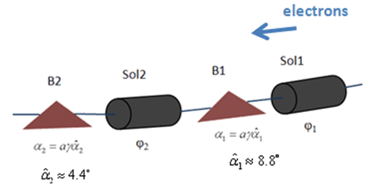
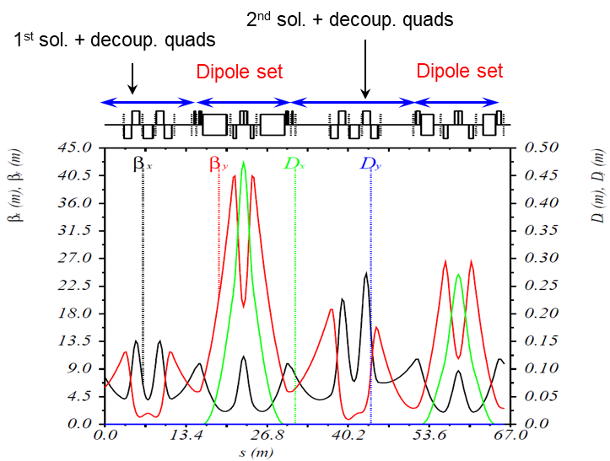
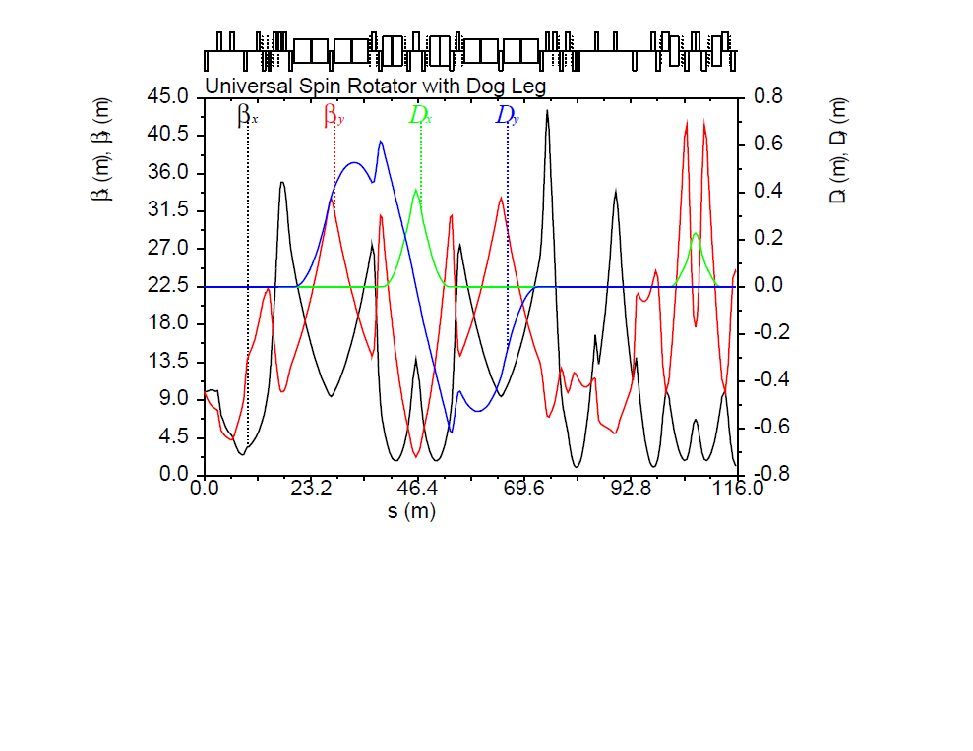
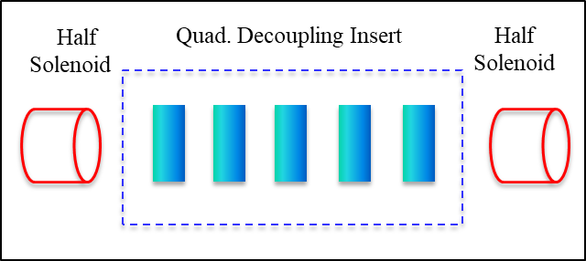
Universal Spin Rotator
Changes polarization from vertical in the arcs to longitudinal in the straights
Sequence of solenoid and dipole sections
Geometry independent of energy
Dispersion suppressed in solenoids and each solenoid is individually decoupled
Two polarization states with equal lifetimes
E | Solenoid 1 |  | Dipole set 1 | Solenoid 2 |  | Dipole set 2
 | Spin Rotation | BDL | Spin Rotation | Spin Rotation | BDL | Spin Rotation
GeV | rad | T·m | rad | rad | T·m | Rad
3 | π/2 | 15.7 | π/3 | 0 | 0 | π/6
4.5 | π/4 | 11.8 | π/2 | π/2 | 23.6 | π/4
6 | 0.62 | 12.3 | 2π/3 | 1.91 | 38.2 | π/3
9 | π/6 | 15.7 | π | 2π/3 | 62.8 | π/2
12 | 0.62 | 24.6 | 4π/3 | 1.91 | 76.4 | 2π/3
Arc
IP
$$\vec{s}$$
$$\vec{s}$$
1st sol. + decoup. skew quads
2nd sol. + decoup. skew quads
Vertical dogleg
Dipole set
Vertical dogleg
Dipole set

Slide 17
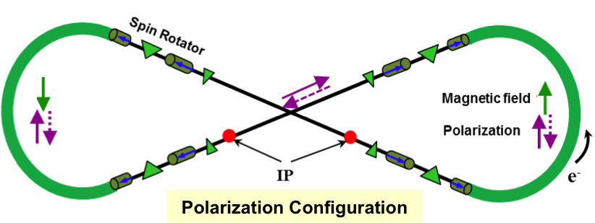
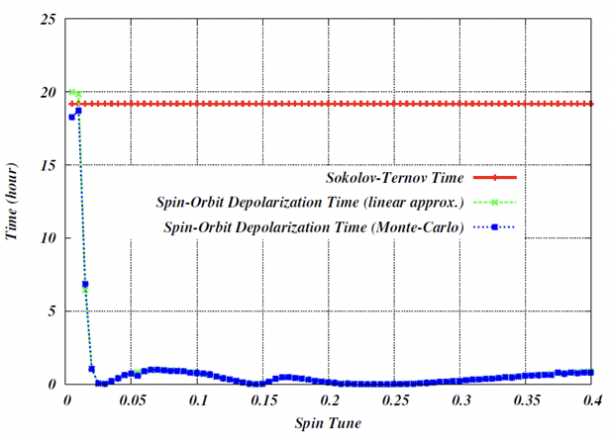
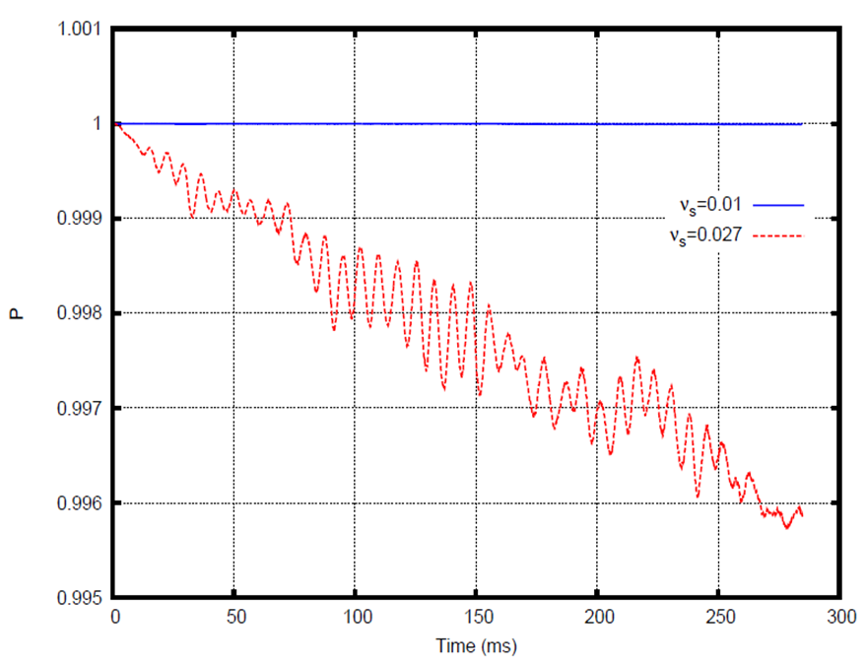
Spin Tracking
Spin tune scan using a spin tuning solenoid in SLICK/SLICKTRACK
Demonstrates suppression of synchrotron sideband spin resonances
Verified by Zgoubi’s Monte-Carlo spin tracking
Spin tuning solenoid
ν_{s}=0.01 (optimum spin tune)
ν_{s}=0.027 (synchrtron tune)
Spin tune scan using SLICKTRACK
Synchrotron sideband spin resonances suppressed compared to a racetrack
Spin tracking using ZGOUBI.
~ 3τ_{x,y}

Slide 18
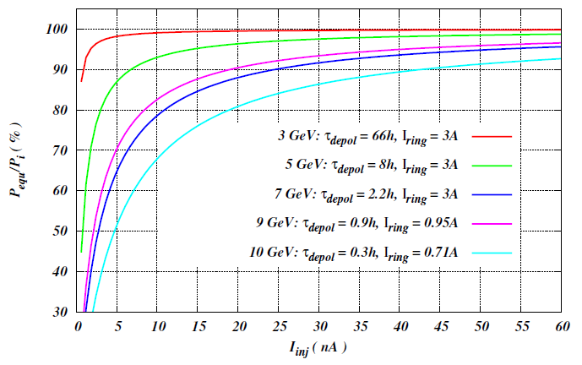
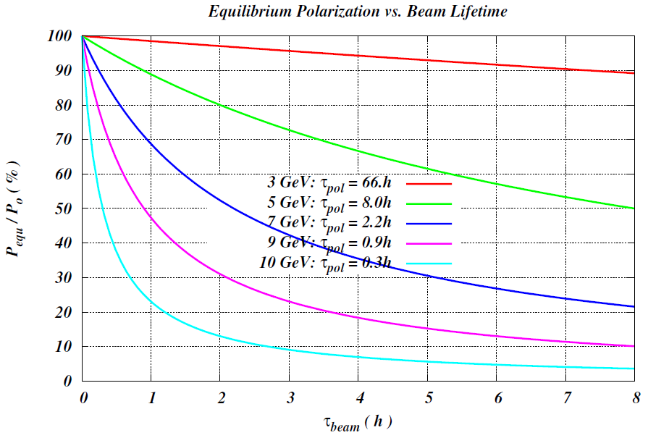
Polarization Lifetime and Continuous Injection
Estimated polarization lifetime
Constant polarization is maintained by continuous injection of highly polarized electron beam from CEBAF
Equilibrium polarization $P_{equ}=P_{0}{\left(1+\frac{T_{rev}I_{ring}}{τ_{DK}I_{inj}}\right)}^{−1}$
A relatively low average injected beam current of tens-of-nA level can maintain a high equilibrium polarization in the whole energy range
Beam lifetime must be balanced with the beam injection rate and $τ_{beam}≪τ_{pol}$
Energy (GeV) | 3 | 5 | 7 | 9 | 12
Lifetime (hours) | 116 | 9 | 1.7 | 0.5 | 0.1

Slide 19
Impact of Ion Energy Increase on Ion Polarization
Zero-integer spin resonance (see slide 6 for the detail)
incoherent part
due to transverse and longitudinal emittance
coherent part
due to closed orbit excursion
Spin stability criterion
spin tune induced by a spin rotator must significantly exceed the strength of the incoherent part of the zero-integer spin resonance
The coherent part of the zero-integer spin resonance does not depolarize the beam. But it determines the spin direction. In order to manipulate the polarization direction, the spin tune induced by the spin rotators must be sufficient to “compensate” the coherent part the zero-integer spin resonance.

Slide 20
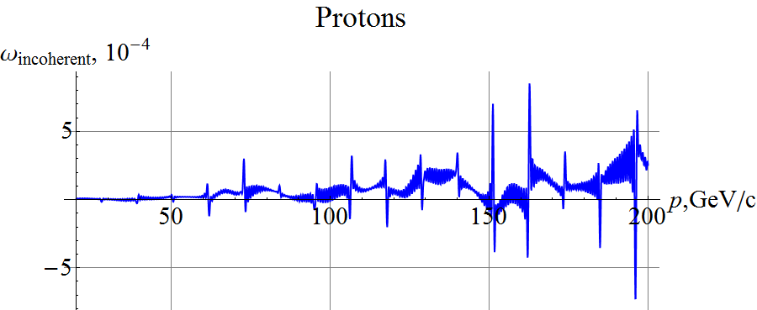
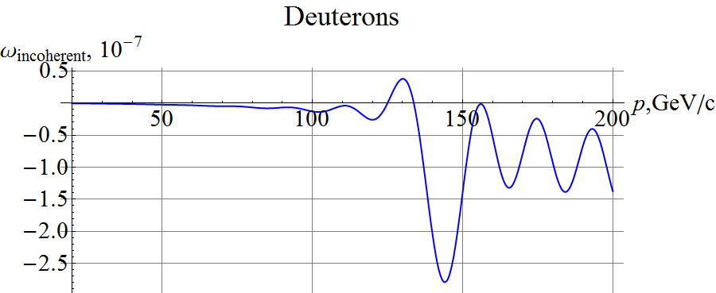
Incoherent Part of Zero-Integer Spin Resonance Strength
Protons
Deuterons
Assuming normalized vertical beam emittance of 0.07 μm rad
$ν_{p}^{max}={10}^{−2}$, $ν_{d}^{max}={10}^{−4}$ at 200 GeV/c are sufficient to stabilize the polarization

Slide 21
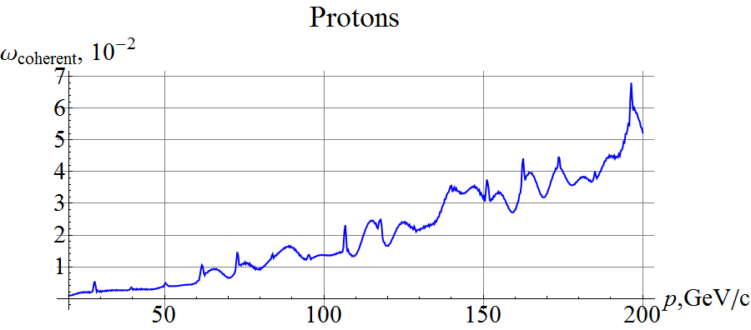
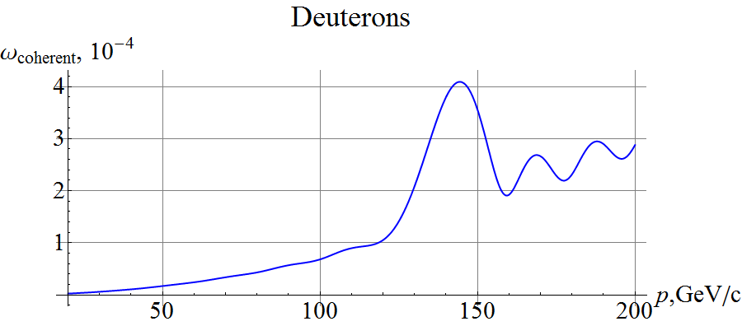
Coherent Part of Zero Integer Spin Resonance Strength
Protons
Deuterons
Assuming RMS closed orbit distortion of ~200 μm
Above ~100 GeV/c, the 3D spin rotator strength may not be sufficient to compensate the coherent part of the resonance strength that determines the polarization orientation
can consider a 3D spin rotator based on transverse fields
can consider a pair of compact longitudinal-axis transverse-field Siberian snakes for protons

Slide 22
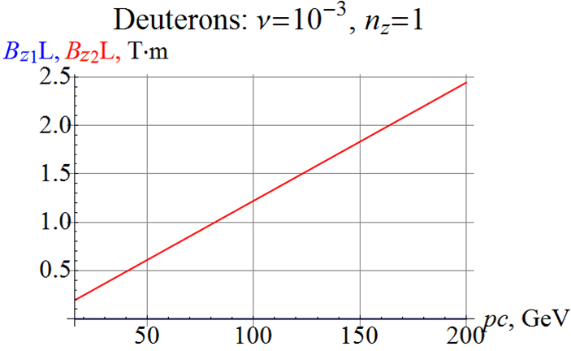
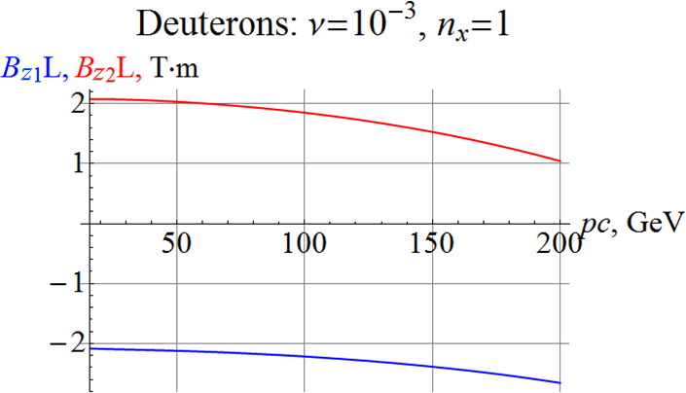
Deuteron Spin Rotator Utilizing Longitudinal Fields
4.4º
4.4º
Longitudinal Polarization at IP
Radial Polarization at IP

Slide 23
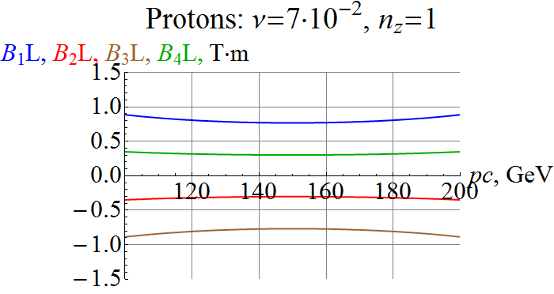
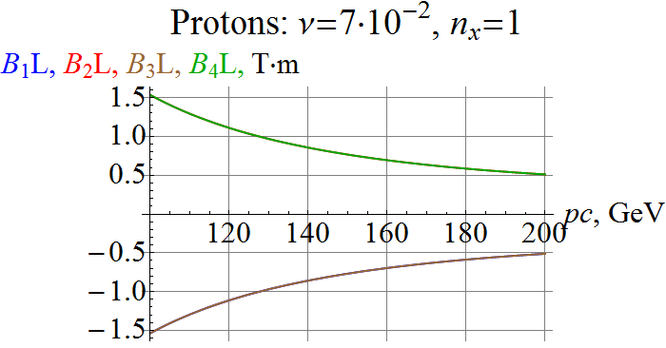
Proton Spin Rotator Utilizing Transverse Fields
Longitudinal Polarization at IP
Radial Polarization at IP

Slide 24
Summary
JLEIC rings adopt a figure-8 shape for better preservation and control of polarization by taking advantage of a spin transparency mode
Ion and electron polarization schemes have been designed. Spin tracking numerically validated a figure-8 based polarization control schemes for the whole JLEIC complex
Both ion and electron polarizations > 80% can be reached
Spin transparency mode will be studied in RHIC
Ion polarization with an energy increase up to 200 GeV (proton) can still be preserved and controlled. Preliminary designs of new spin rotators for both protons and deuterons are presented and will be further optimized

Slide 25
Thank you for your attention !

Slide 26
Back Up

Slide 27
Spin Response Function
The periodic spin response function $F\left(z\right)$ is the spin Green’s function; it describes spin response to a local perturbing radial field and resulting closed orbit excursion
$F\left(z\right)$ is determined by ideal linear lattice. For an uncoupled flat ring, it is expressed through the Floquet function of vertical betatron oscillations $f_{y}\left(z\right)$:
$$F\left(z\right)=\frac{e^{iΨ_{y}}}{2i}\left[f_{y}^{∗}\int_{−∞}^{z}{\left(\frac{de^{−iΨ_{y}}}{dz}\right)}\frac{df_{y}}{dz}dz−f_{y}\int_{−∞}^{z}{\left(\frac{de^{−iΨ_{y}}}{dz}\right)}\frac{df_{y}^{∗}}{dz}dz\right], Ψ_{y}=γG\int_{0}^{z}{\frac{B_{y}}{Bρ}}dz.$$
As orbit, spin is most sensitive to perturbations in large-$β$ areas
Beam-beam effect on the spin can be suppressed by minimizing the spin response function at IP
Contribution of a periodic radial perturbing field $δB_{x}$ to the coherent part of the resonance strength
$$w=\frac{γG}{2π}\oint{\frac{δB_{x}}{Bρ}F\exp\left(−iΨ_{y}\right)dz}$$
dipole roll $δB_{x}=B Δα$
vertical quadrupole misalignment $δB_{x}=\frac{∂B_{x}}{∂y}Δy$

Slide 28
Statistical Model
The rms strength of the spin resonance due to $Q$ uncorrelated segments of length $l_{k}$ with radial fields $h_{k}≡h_{x}(z_{k})$ normalized to $Bρ/R$ where $R$ is the average radius for circumference $C=2πR$
$$\overline{{{|ω}_{coh}|}^{2}}={\left(γG\right)}^{2}\sum_{k=1}^{Q}{{\left(\frac{l_{k}}{C}\right)}^{2}\overline{h_{k}^{2}} {\left|F_{k}\right|}^{2}}$$
The rms vertical excursion of the closed orbit
$$\overline{y^{2}(z)}=\frac{π^{2}β_{y}(z)}{2\sin^{2}{πν_{y}}}\sum_{k=1}^{Q}{{\left(\frac{l_{k}}{C}\right)}^{2}\overline{h_{k}^{2}} β_{k}}$$
Based on the expected closed orbit excursion, one can estimate the expected coherent component of the zero-integer spin resonance strength

Slide 29
Ion Polarization Measurement Strategy
Ion Polarimeter located downstream of IP
Orbital bending angle between the IP and polarimeter should be as small as possible to minimize polarization measurement error
Since ion polarimeter measures only transverse polarization component, complete “spin dance” to calibrate the polarization orientation at the polarimeter as a function of 3D spin rotator settings
Measure polarization of bunch trains that have identical polarizations of individual bunches
Calibrate fast polarimeter against absolute polarimeter
80 m
ion polarimeter
IP
e
Compton polarimetry
forward ion detection
ions
forward e detection
spectrometers
dispersion suppressor/
geometric match

Slide 30
Compton Polarimeter
Dipole chicane immediately downstream of the IP for detection of low-Q² electrons
Compton polarimeter located in the middle of the chicane
same polarization at the laser as at the IP due to zero net bend
non-invasive continuous monitoring of electron polarization
Compton photon
calorimeter
ν_{c}
Low-Q² tagger for low-energy electrons
Low-Q² tagger for high-energy electrons
Laser + Fabry Perot cavity
e⁻ beam to spin rotator
Compton electron
tracking detector
Luminosity monitor
e⁻ beam from IP
Compton- and low-Q² electrons are kinematically separated!
Photons from IP

Slide 31
RF feed-forward to correct voltage drooping
Pulsed RF input for a typical NL C100 cavity with feed-forward
(assuming on-resonance, need more power for off resonance)
Pulse-to-pulse feed-back will help to find the correct power level with microphonics etc.
If ~0.2% droop is allowed, the estimated extraction beam current will be ~2mA at various energy, depending on cavity coupling and microphonics.
Flat Vc=10.4MV, Ipulse=0.7mA, ΔV/V≈0 within bunch train
17-375ms
P1=8.1kW
0.88µs
17-375ms
Each bunch train 3.5µs
P0=0.97kW
From Jiquan Guo’s talk
25.4µs, 6 turns-0.88µs in CEBAF NL (4.375µs per turn)
Estimated JLEIC pulsed injection current and injection time (limited by injector current only) with RF feed-forward and varying number of passes
Assumes maximum kicker repetition rate 60 Hz
Assumes head-tail energy droop of 0.2% (1/2 of the ±0.2% arc acceptance)

