Slide 1
High precision magnets for the Electron Cooler
Peter McIntyre, Akhdiyor Sattarov, Jeff Breitschopf, Joshua Kellams, and James Gerity
Texas A&M University
Accelerator Technology Corp.

Slide 2
JLEIC needs magnetized bunch-beam e-cooling to sustain high luminosity
Sustaining high luminosity requires the use of bunched-beam electron cooling to control emittance growth in the circulating ion beam.
Electron cooling of ion beams requires precise alignment of the electron beam with the equilibrium trajectory of the ion bunch.
ion bunches

Slide 3
Magnetized electron cooling
Rest-frame velocity distributions of electrons (blue) and ions (red) in JLEIC
In magnetized cooling, the electrons are immersed in a strong solenoidal magnetic field.
Each electron is trapped on a line of force, and spirals with tiny Larmor radius (3 μm for 1 T).
An electron that scatters from an ion cannot recoil transversely, and so cooling is enhanced by a factor
But the magnetic lines of force must be precisely aligned with the ion bunch trajectory.
If the lines of force are misaligned in part of the solenoid, the electrons and ions will not superpose in velocity space and cooling will be inhibited.
The required alignment is

Slide 4
Suppress transverse magnetic fields using a stack of steel washers.
Steel flux return
1 T NbTi winding
LHe and LN2 refrigeration tubes
Steel is unsaturated at 1 Tesla.
A washer acts as a shunt to shield the region inside from transverse fields.
The washer stack is ~invisible to axial field of the solenoid.
Challenge: how to align all washers to be oriented precisely parallel.
Steel washer stack
Ti support structure

Slide 5
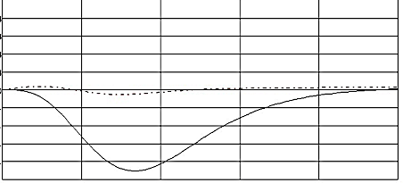
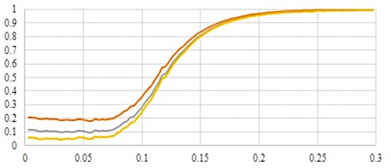
Simulation of transverse field shielding
B_{x}
8
4
0
-4
-8
with washer stack
without washer stack
Displace one turn of solenoid in x direction.
0 2 4 z (cm) 6 8 10
Transverse field B_{x}(z) along the solenoid axis when one error turn of the solenoid is displaced in the x direction.
Simulate B_{x}(z) with and without the washer stack.
10:1 suppression of B_{x}
$${B_{x}^{washers}}/{B_{x}^{no washers}}$$
----1010 steel
----1008 steel
----permalloy
z (m)
Shielding ratio for 3 choices of magnetic material.

Slide 6
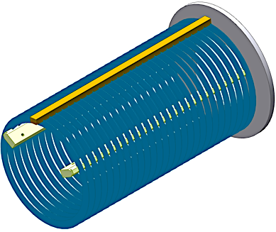
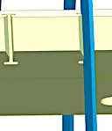
How to micro-align a washer stack
Fabricate 3 rails with equi-spaced slots.
Wire-EDM the array of slots on all 3 rails as one operation – each triplet of slots are micro-aligned.
Assemble 2 rails on support ring.
Insert each washer in its slots on the 2 rails.
Install the third rail on the assembled washers, using a comb tool to align them.
Attach all 3 rails to second support ring.

Slide 7
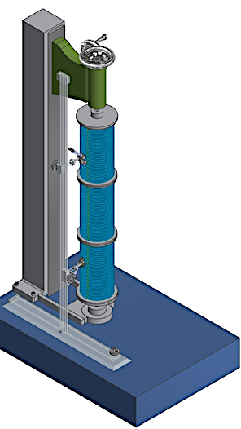
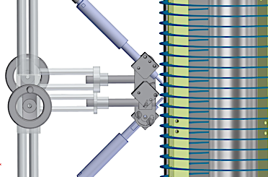
Metrology to measure micro-alignment
Mount washer stack on vertical spindle of bench center.
Mount 2 non-contact capacitive probes on a parallel track.
Capacitive probe gives reproducible precision ~3 nm.
Measure positions of 2 washers simultaneously, subtract to obtain washer spacing.
Rotate washer stack through 360º to measure alignment on short and long baseline.

Slide 8
ATC is building a 1-m model of the micro-aligned washer stack.
Phase 1 SBIR:
Build the stack.
Build the metrology setup.
Measure the alignment within the washer stack.
Phase 2 SBIR proposal:
Build a 5 m NbTi 1 T solenoid.
Install a 5 m washer stack.
Mount the washer stack and beam tube in solenoid.
Use a micro-electron beam, phosphor screen, and alignment telescope to measure field lines through the 5 m length.

Slide 9
Conclusions
We have devised a method to micro-align the lines of force in a long solenoid for magnetized cooling.
We have built a first model of the washer stack, now building a first segment.
We have devised a method to measure the alignment of the washers to the precision required for magnetized cooling in JLEIC.
In Phase 2 we will propose to build and measure alignment in a 5 m 1 T model solenoid.

