Slide 1
EIC Collaboration Meeting
Hadron Rings Modifications
Dejan Trbojevic
October 29-November 1, 2018

Slide 2
Outline
Requirements: Minimize efforts to modify RHIC
Assumptions: The functionality and performance of the RHIC complex is available for eRHIC.
Introduction
Injection
Upgrade of the RF
Higher maximum proton (hadron) energy
Additional spin snakes
e-p frequency matching
Copper-carbon coating
Upgrade beam position monitors
2

Slide 3
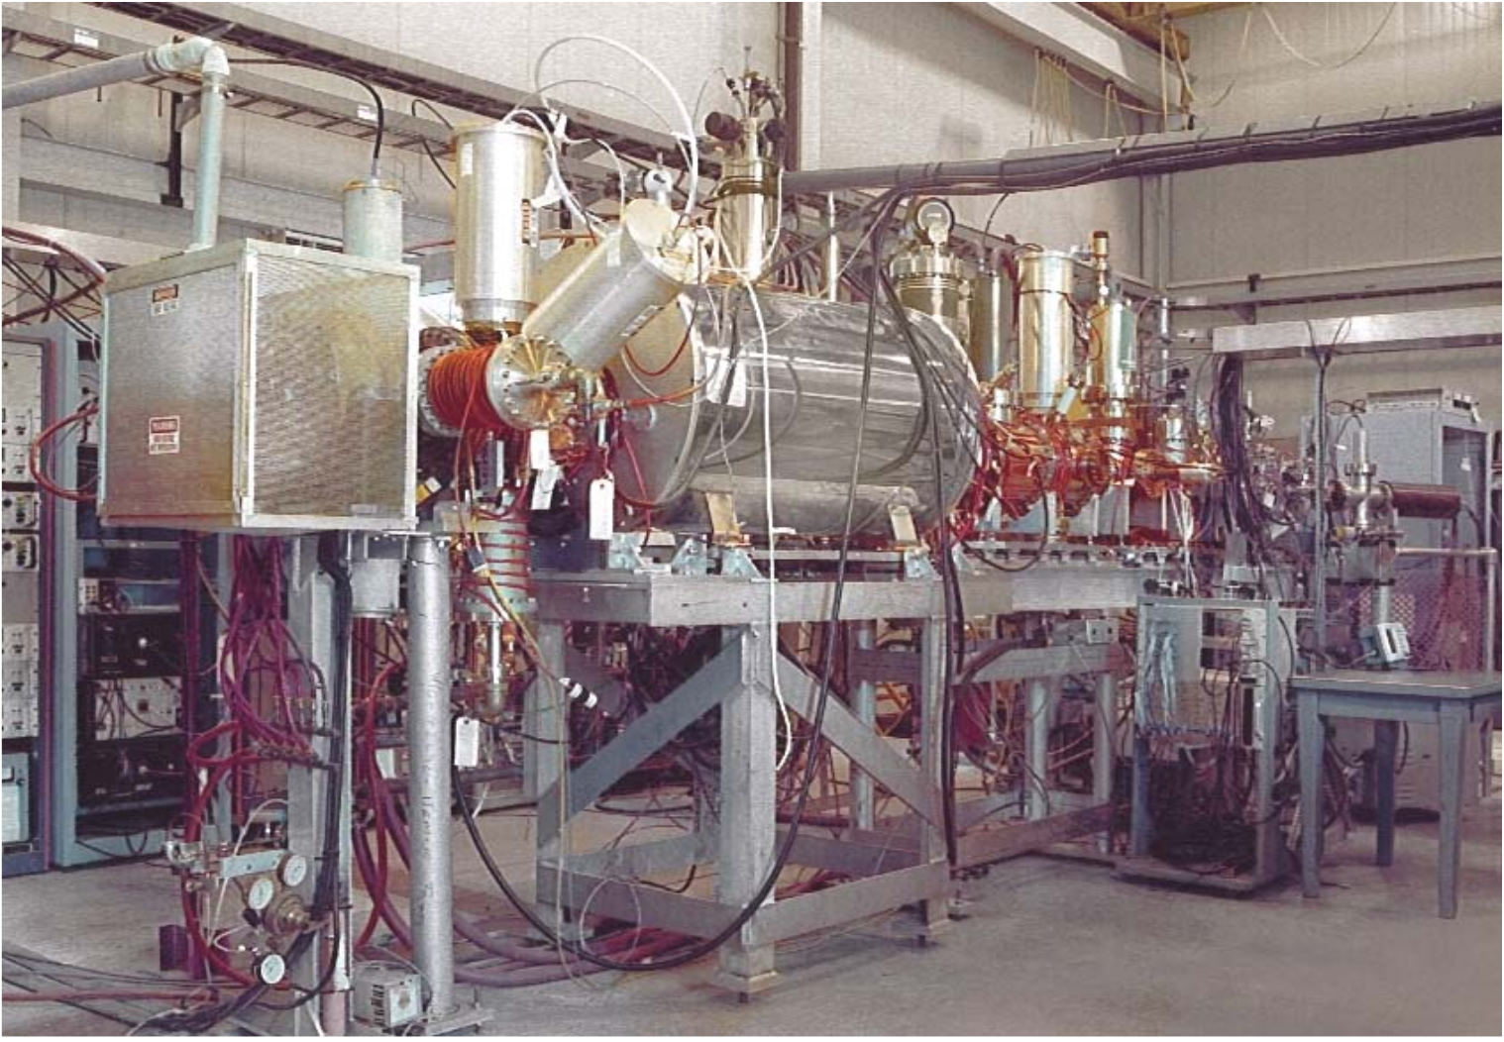
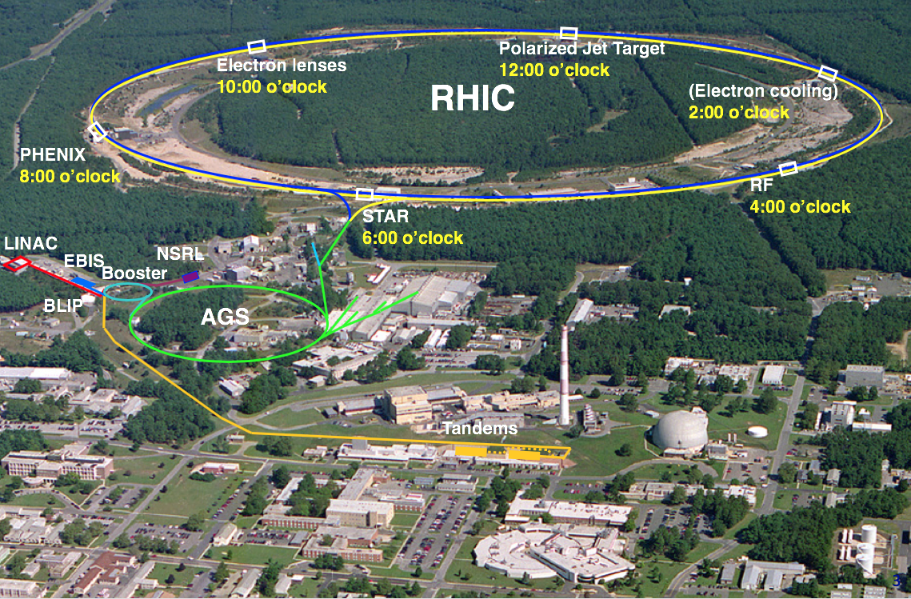
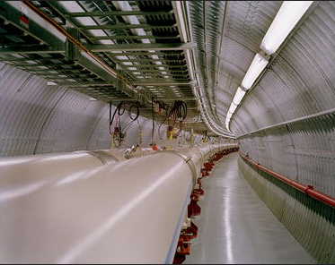
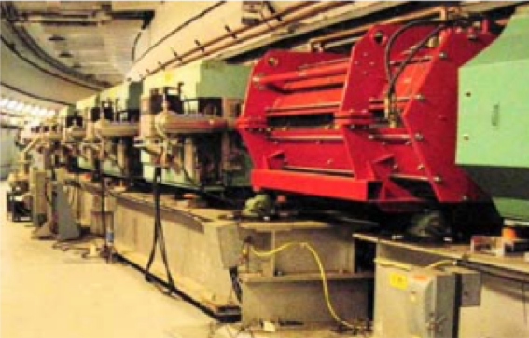
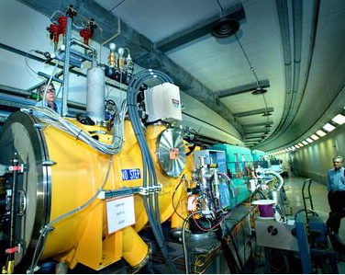
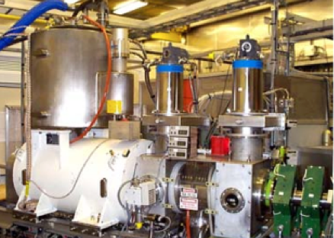
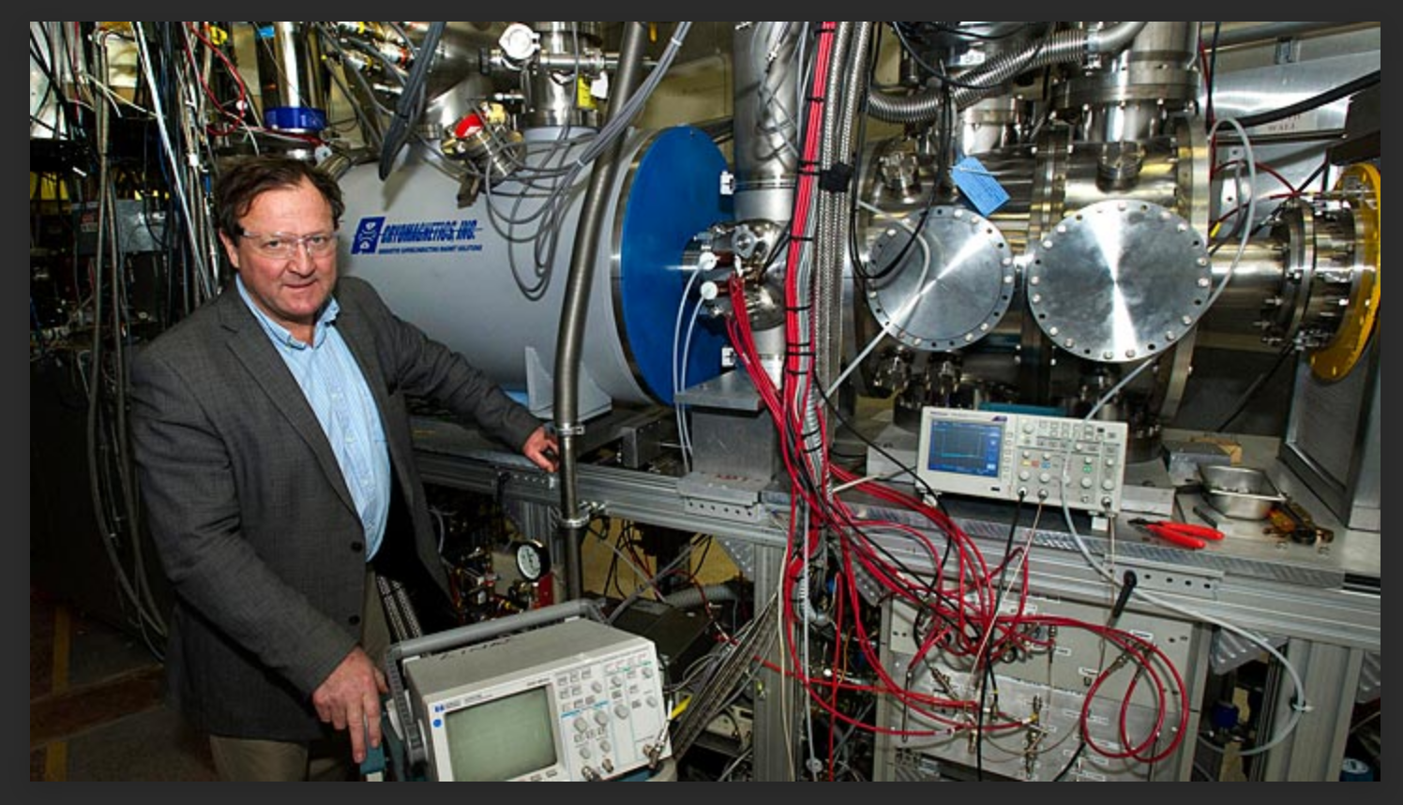
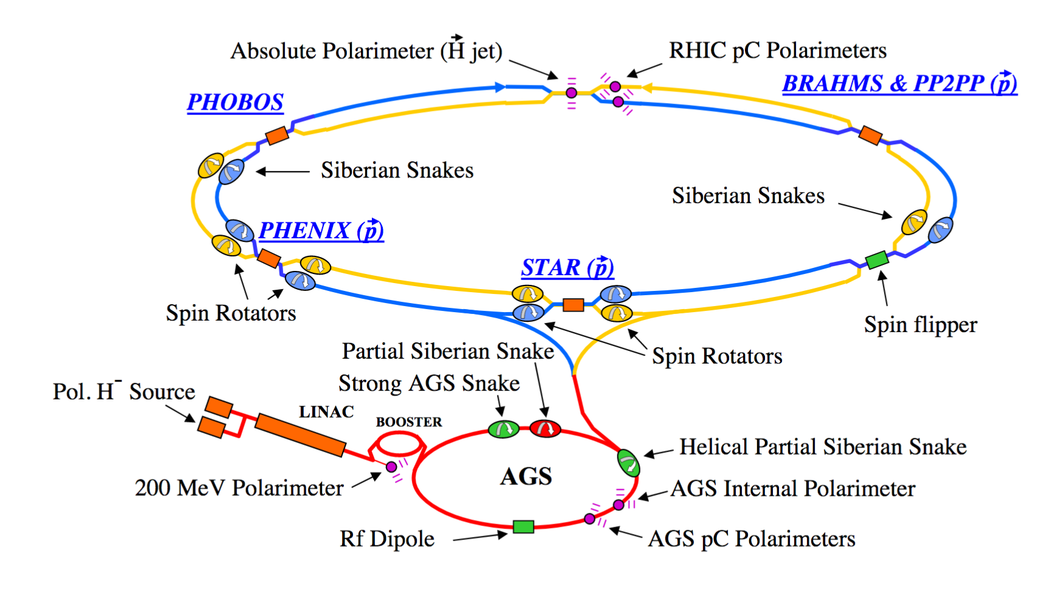
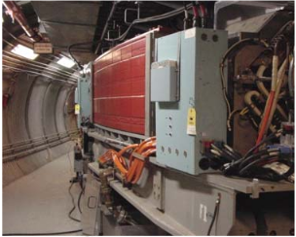
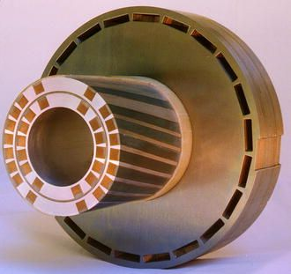
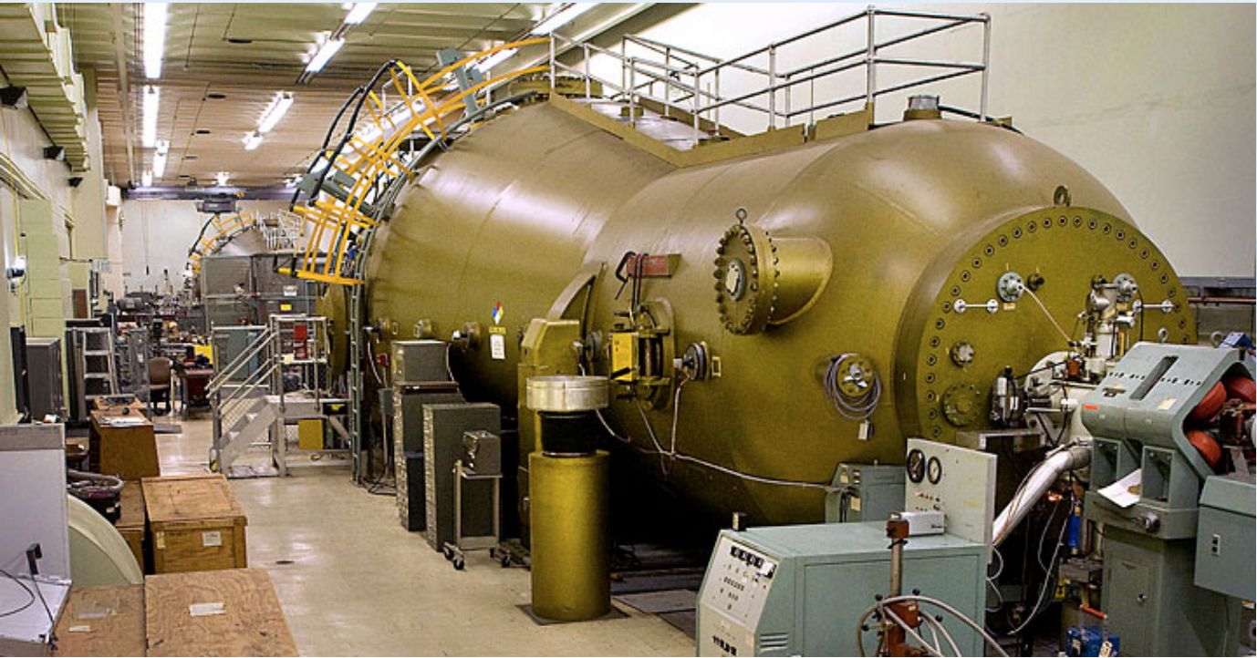
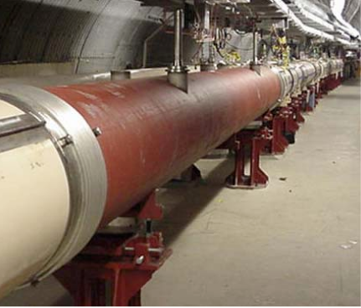
RHIC Hadron facilities for eRHIC
Record breaking polarized H⁻ ion source while the polarized He³ is in progress
The Tandem Van de Graaff Facility consists of two 15-megavolt electrostatic accelerators capable of delivering continuous, or
high-intensity pulsed ion beams in a wide range of ion species
RELATIVISTIC SUPERCONDUCTING COLLIDER -RHIC
Polarized source, Siberian snakes, Spin Rotators, Spin Flippers, Polarimeters, Tune Jump Quads, Helical Partial Snakes in BNL
ELECTRON BEAM ION SOURCE - EBIS

Slide 4
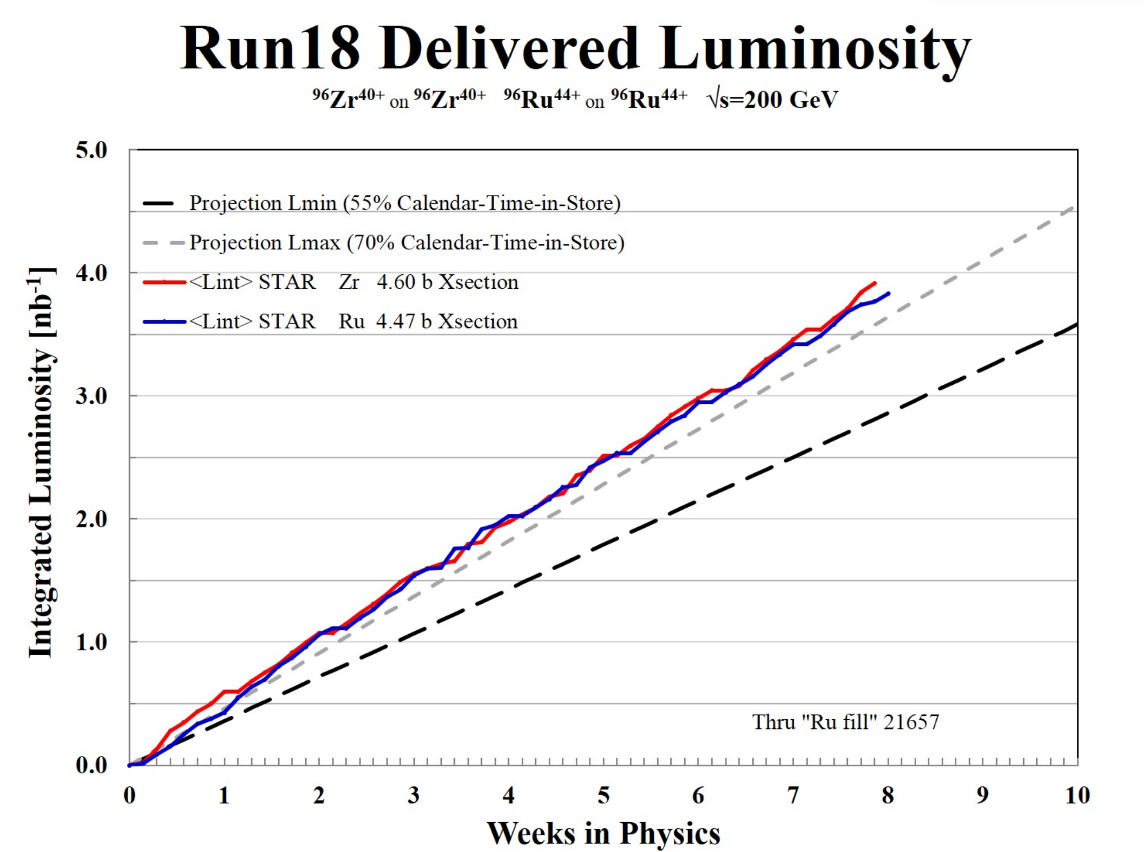
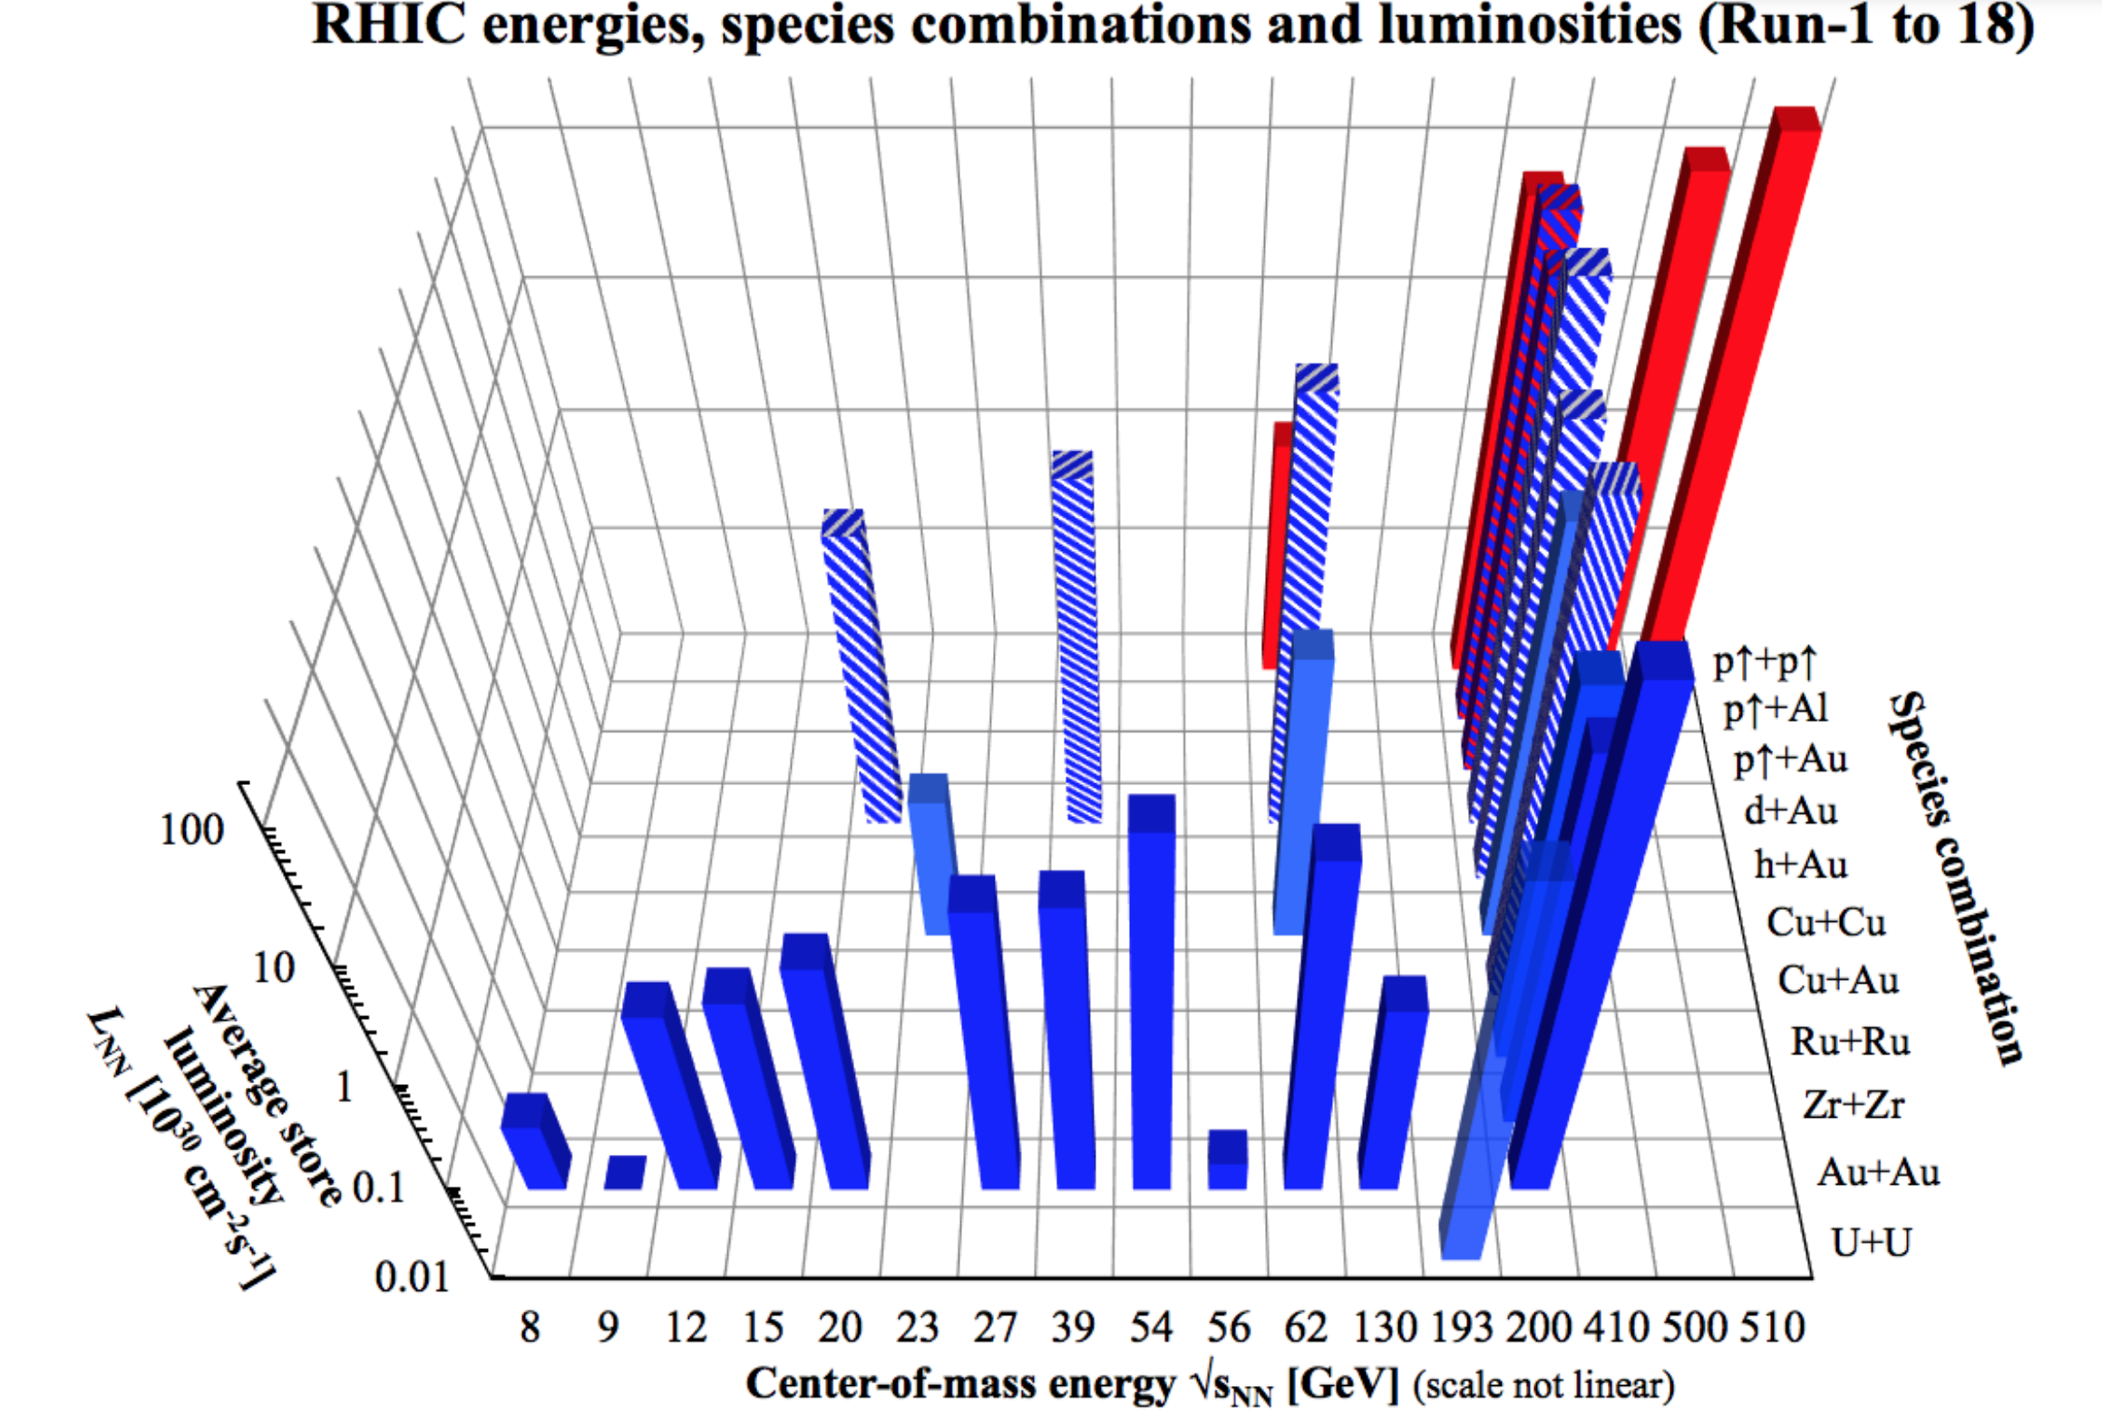
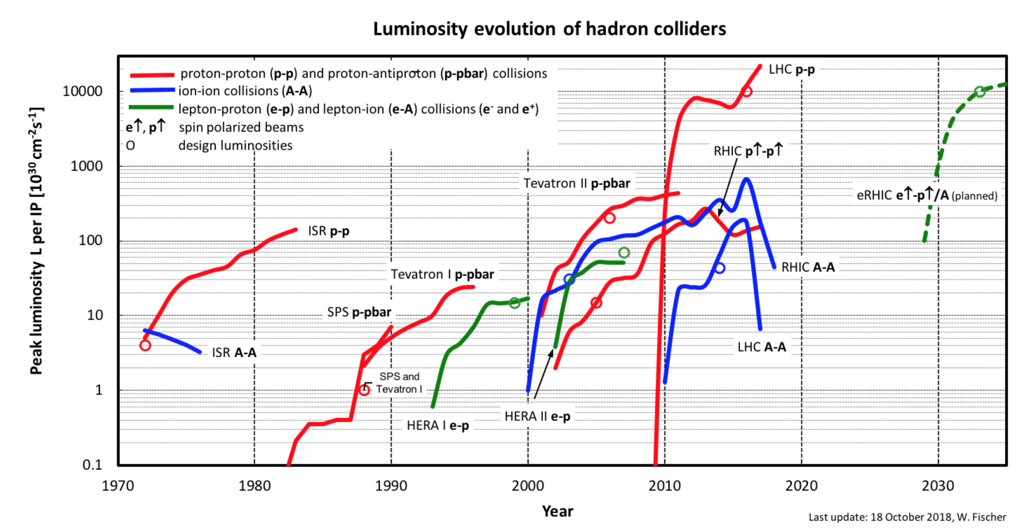
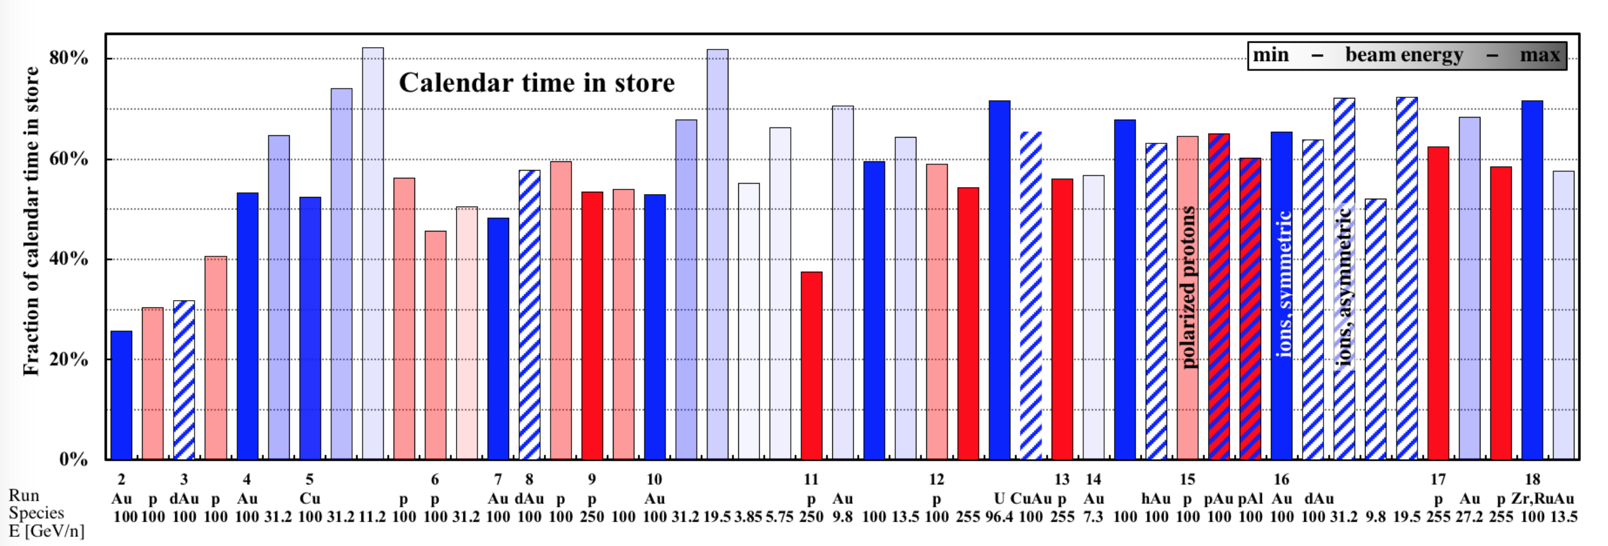
RHIC RUNS AND SPECIES
Operated modes (beam energies):
Au – Au 3.8/4.6/5.8/10/14/32/65/100 GeV/n
U – U 96.4 GeV/n
Cu – Cu 11/31/100 GeV/n
p↑ – p↑ 11/31/100/205/250/255 GeV
d – Au* 100 GeV/n
Cu – Au* 100 GeV/n
h – Au* 100 GeV/n
p – Au* 100 GeV/n
p – Al 100 GeV/n
d – Au 100-31.2 GeV/n
Zr – Zr 100 GeV/n
Ru – Ru 100 GeV/n

Slide 5
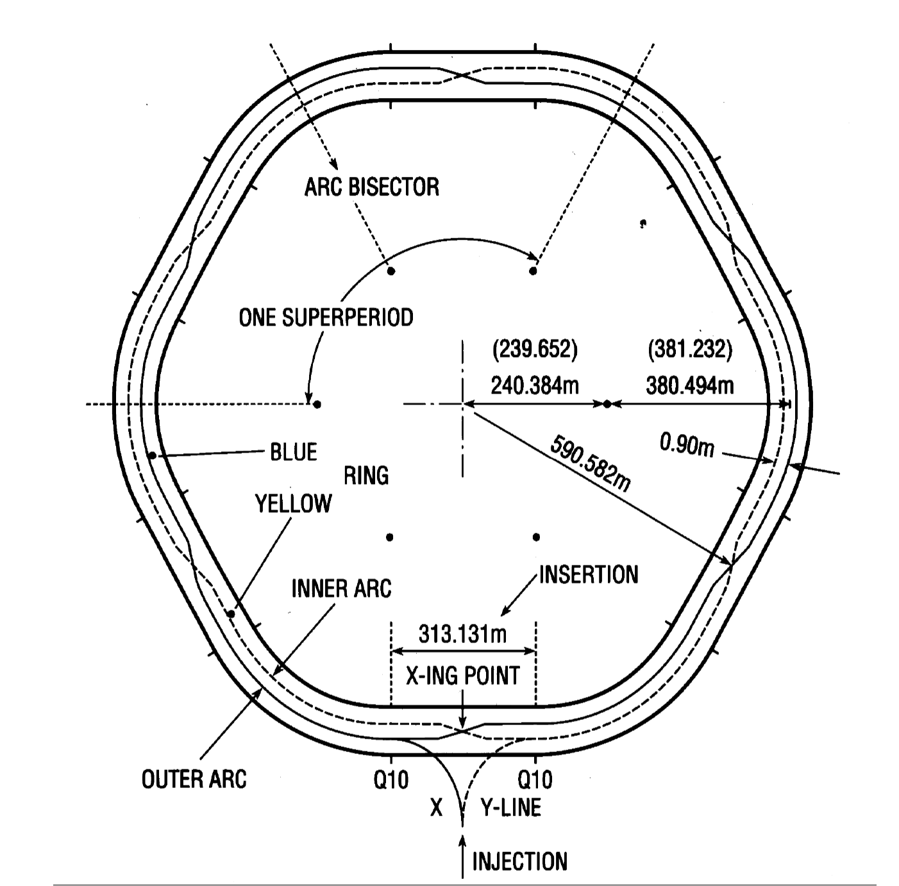
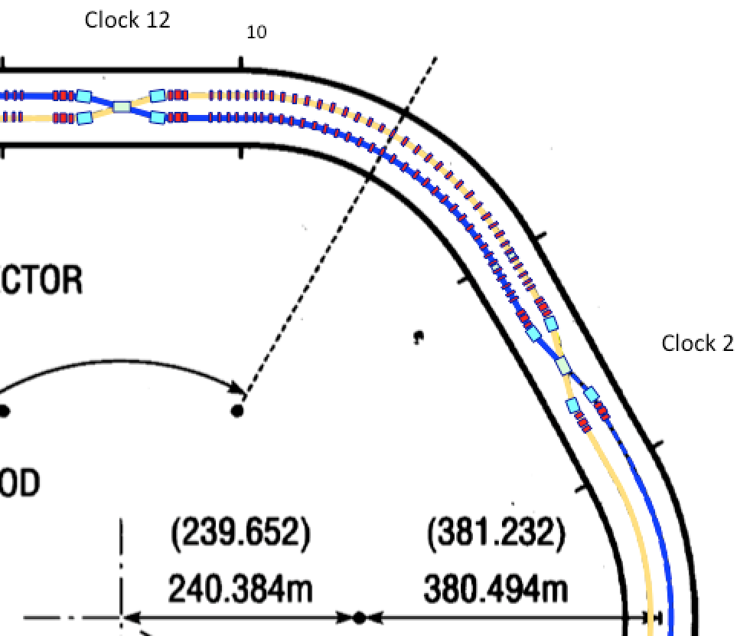
Delay Ion/Proton Line 12→2 o’clock
for the low energy ~40 GeV
Six Siberian Snakes
Clock2
Higher Maximum Energy
protons 250→275 GeV
Heavy ions 100-133 GeV/n
INJECTION FOR MORE ION/PROTON BUNCHES
New Injection @4 o’clock
Transfer through the blue arc 6→ 4 and injection septum and kickers at 4 o’clock (larger number of bunches)
5

Slide 6
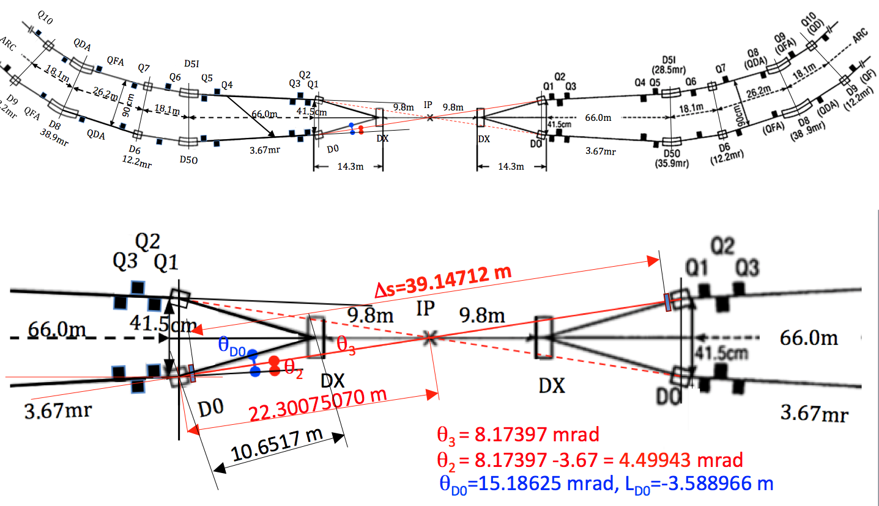
Removal of the DX magnets
Allows proton energy increase from 255 to 275 GeV or for heavy ions 100-133 GeV/n
IP
6

Slide 7
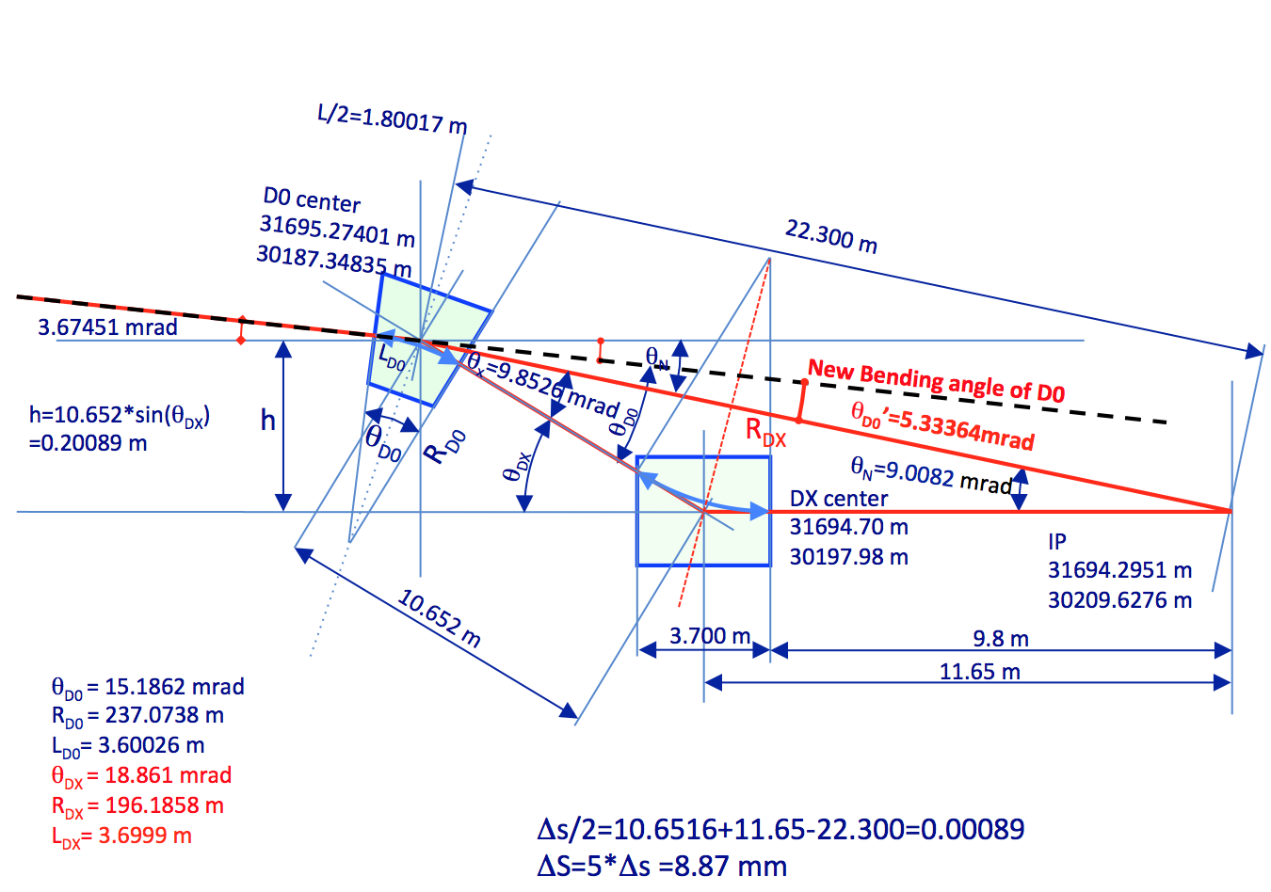
Details of the DX-D0 solution
D0
DX
7

Slide 8
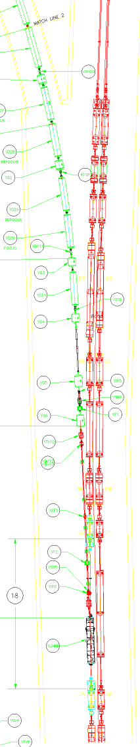
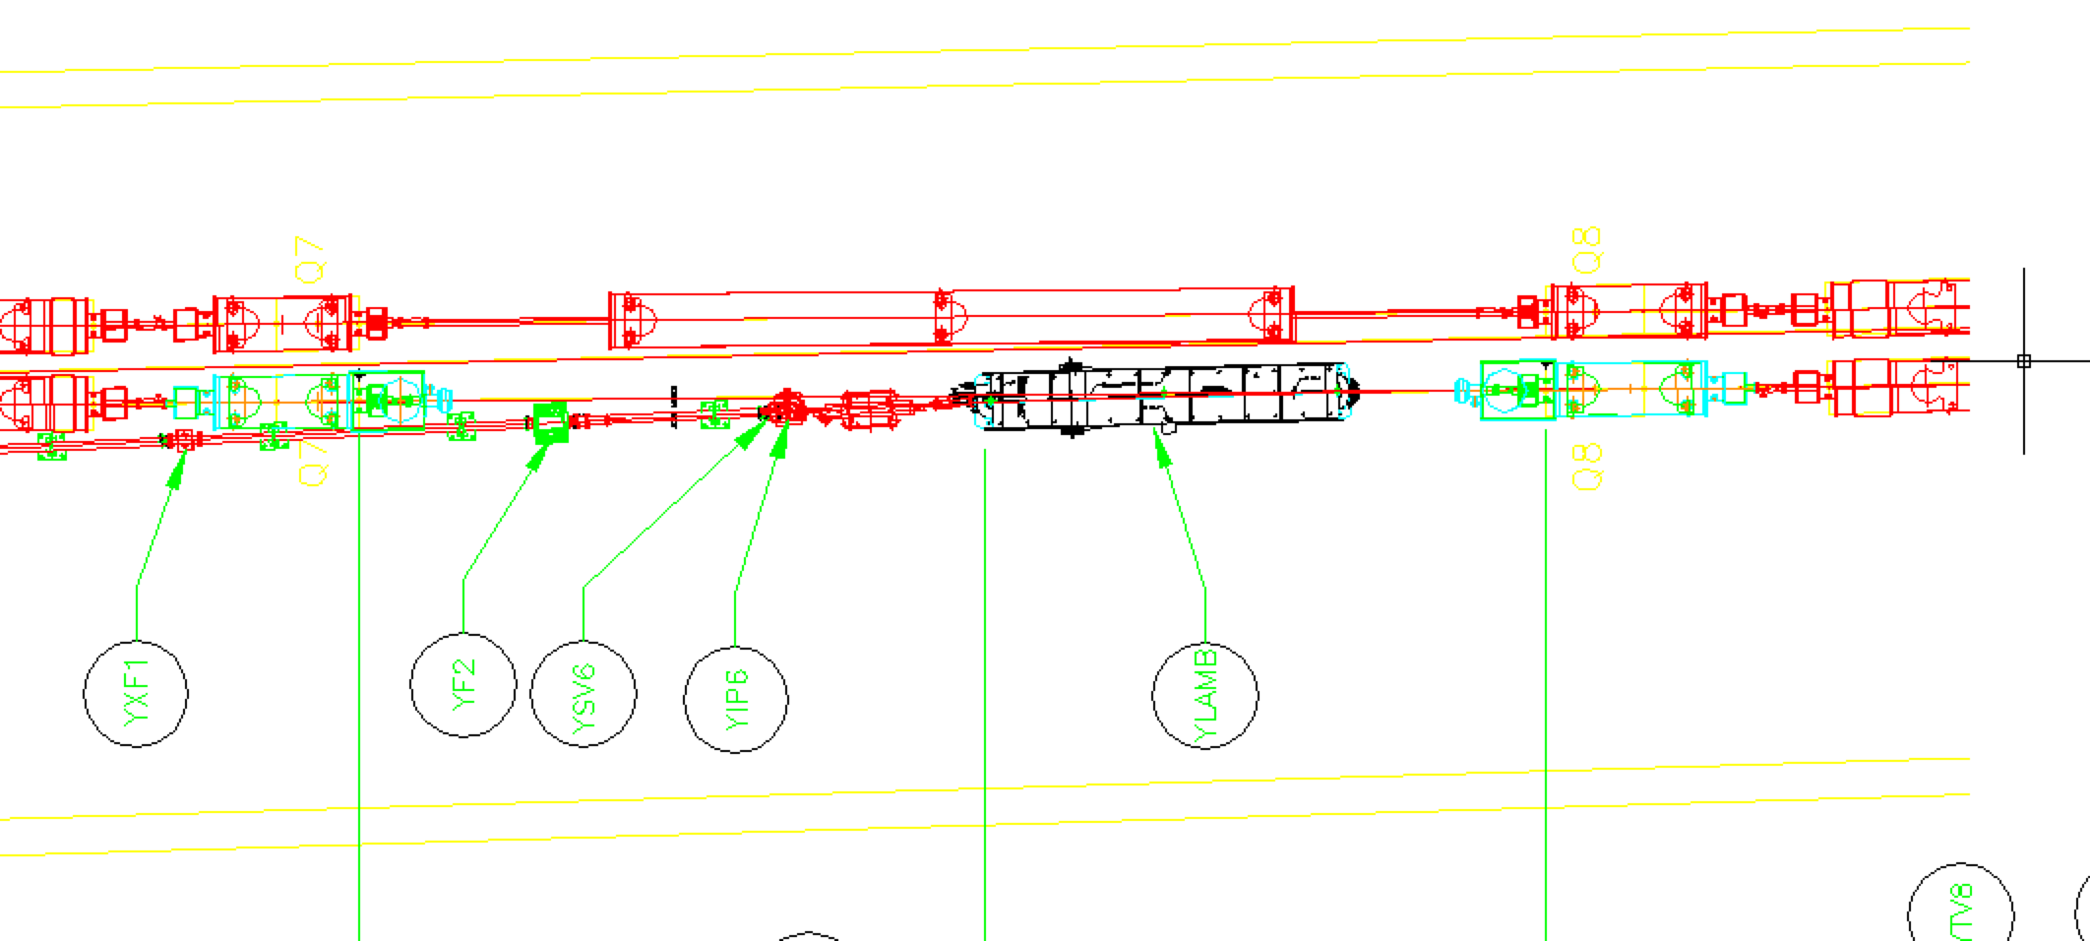
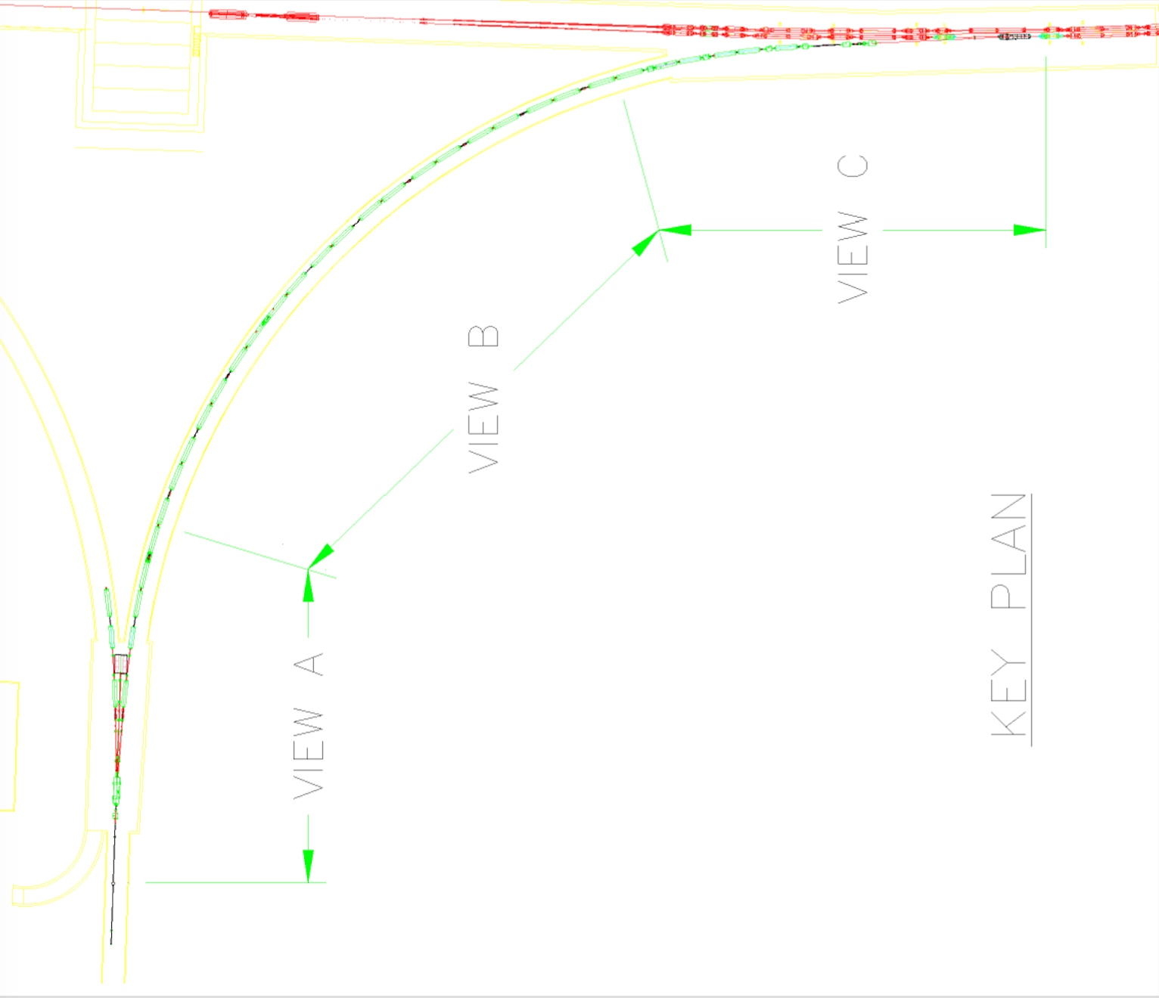
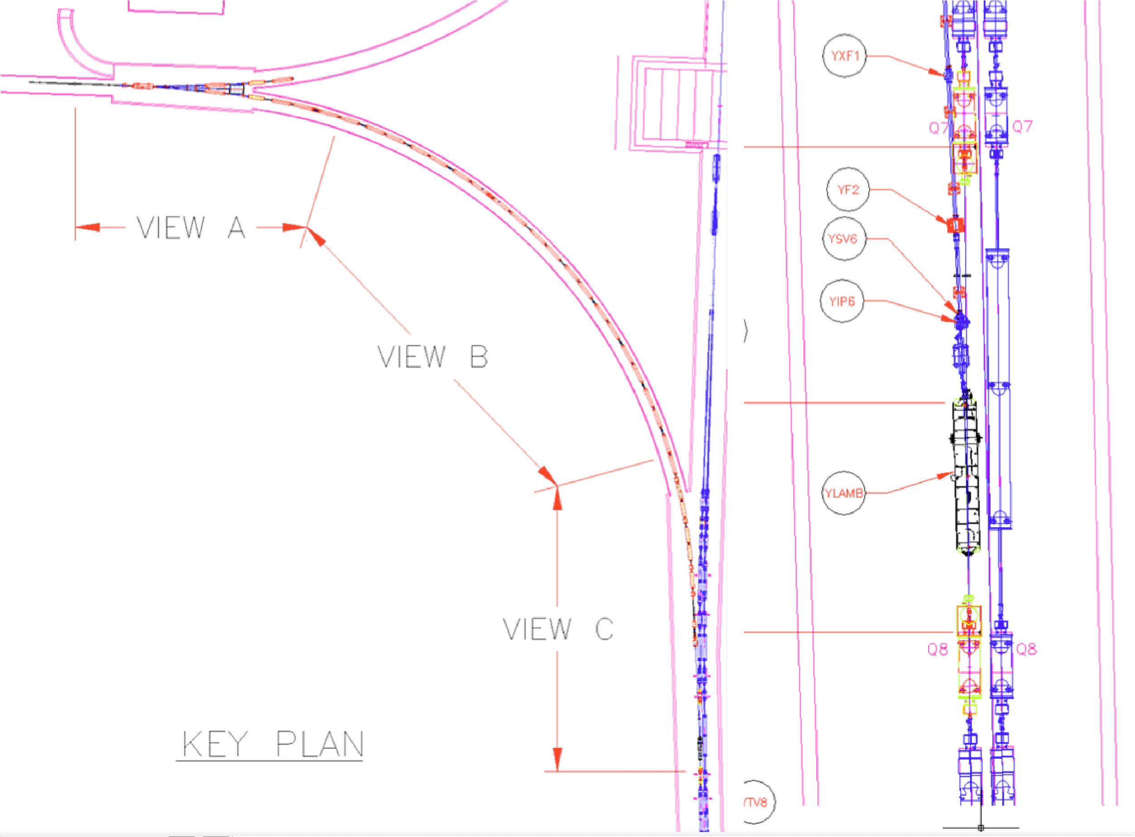

Injection system Upgrade
Injection Yellow Line modification and Lambertson magnet replacement by the Siberian snake magnet
The Blue ring arc is a transfer injection beam line
Hadron injection septum at 4 o’clock connects the Blue transfer line with the Yellow ring
New series of fast kickers are placed at 30 meters long straight area (between D0 magnets)
8

Slide 9
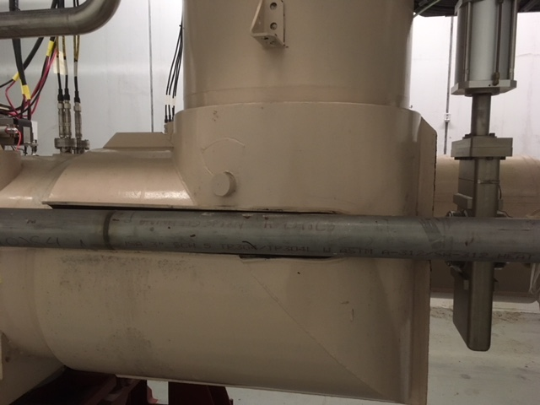
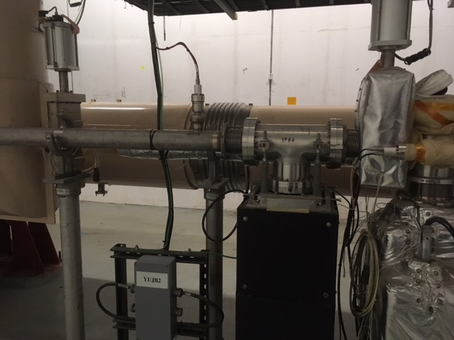
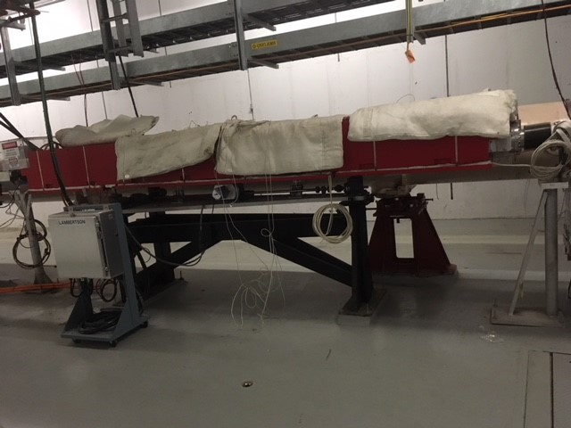
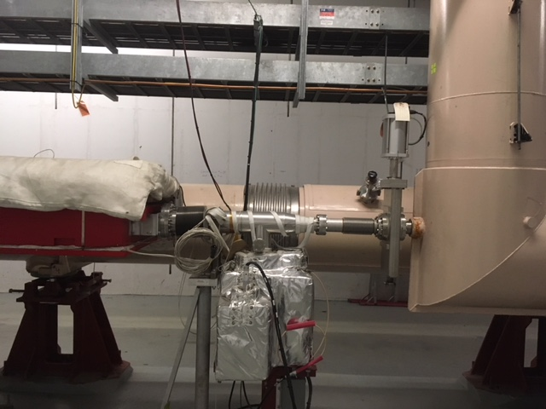
Present ATR to RHIC injection
From Nick Tsoupas
9

Slide 10
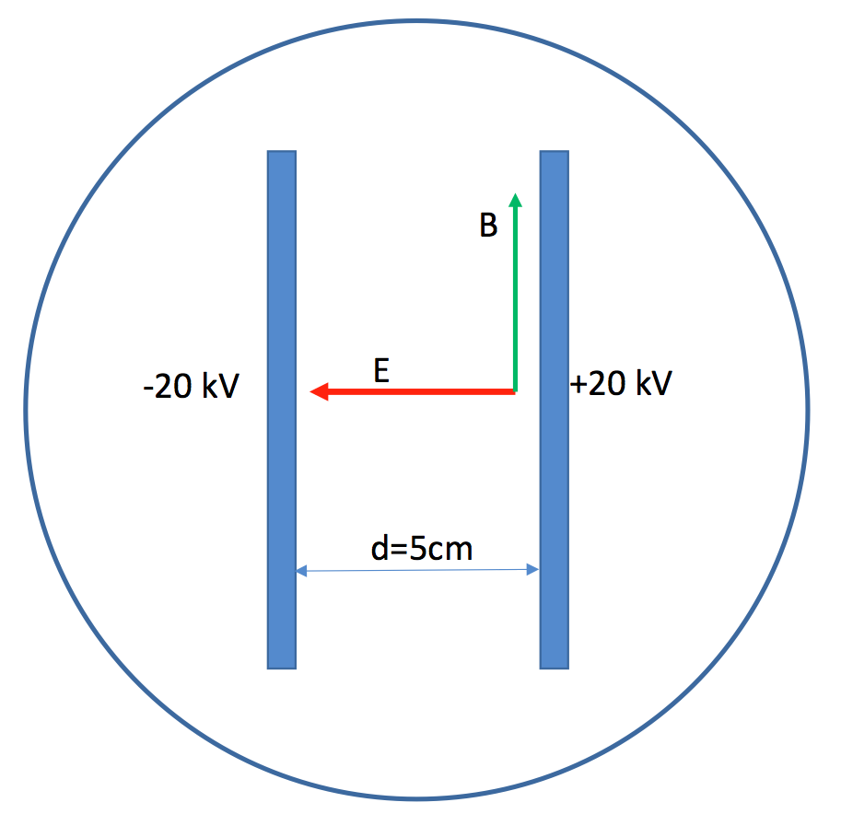
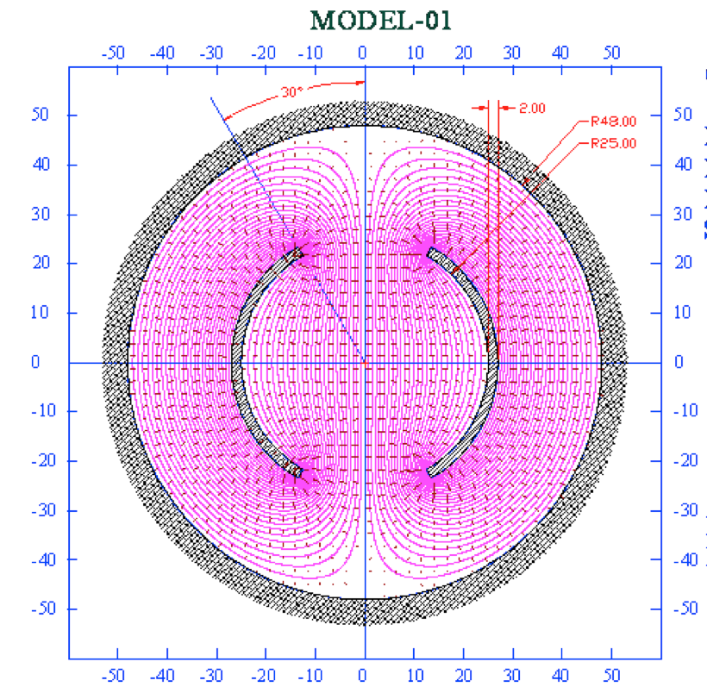
Injection Kickers
From Nick Tsoupas
28 MHz bunching frequency with bunch spacing of T_{s}=35 ns requires
The strip line 1.25 m long kicker has to have 10 ns rise time with a kick angle of 2 mrad corresponding to 30 kV on the characteristic impedance of 50 Ω, with a plates 5 cm apart, and a current of 600 A in each plate.
~25 m
10

Slide 11
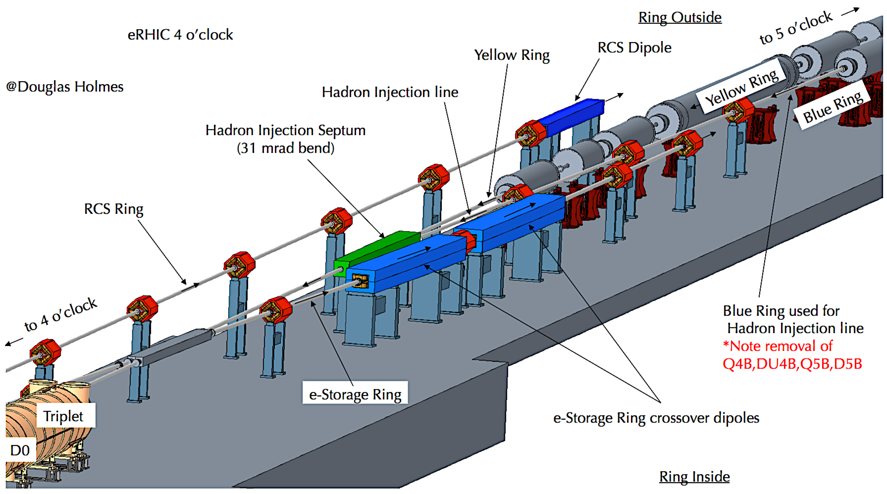
Injection System Upgrade
11

Slide 12
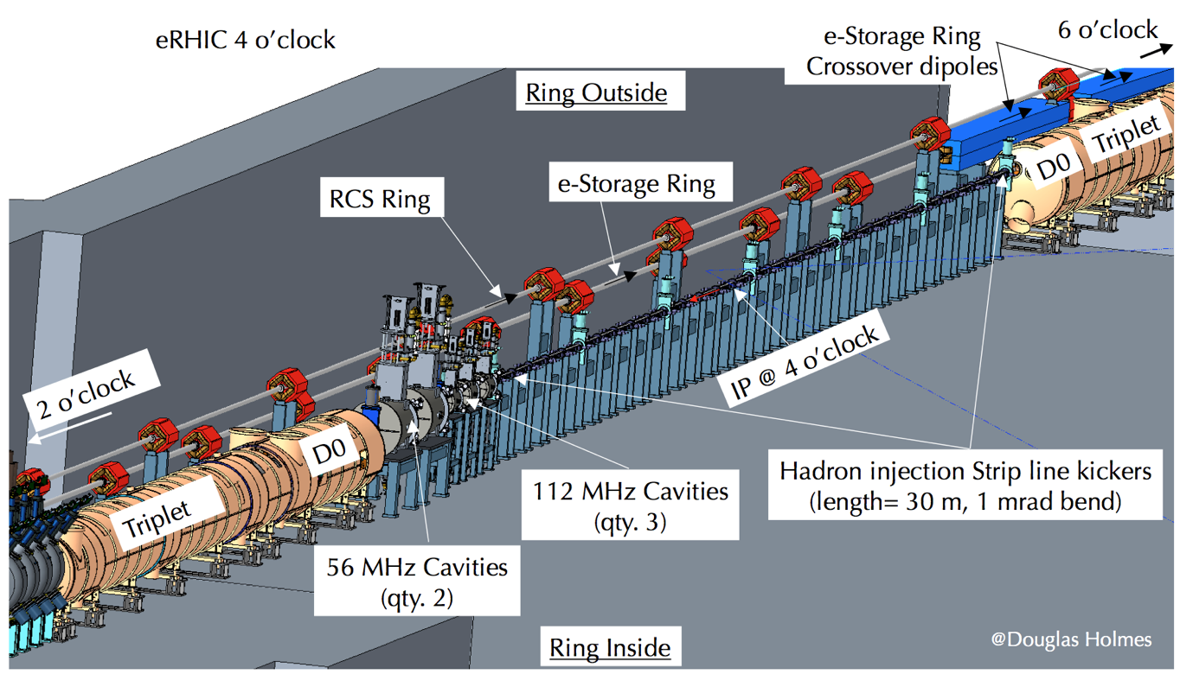
Injection System Upgrade
12

Slide 13
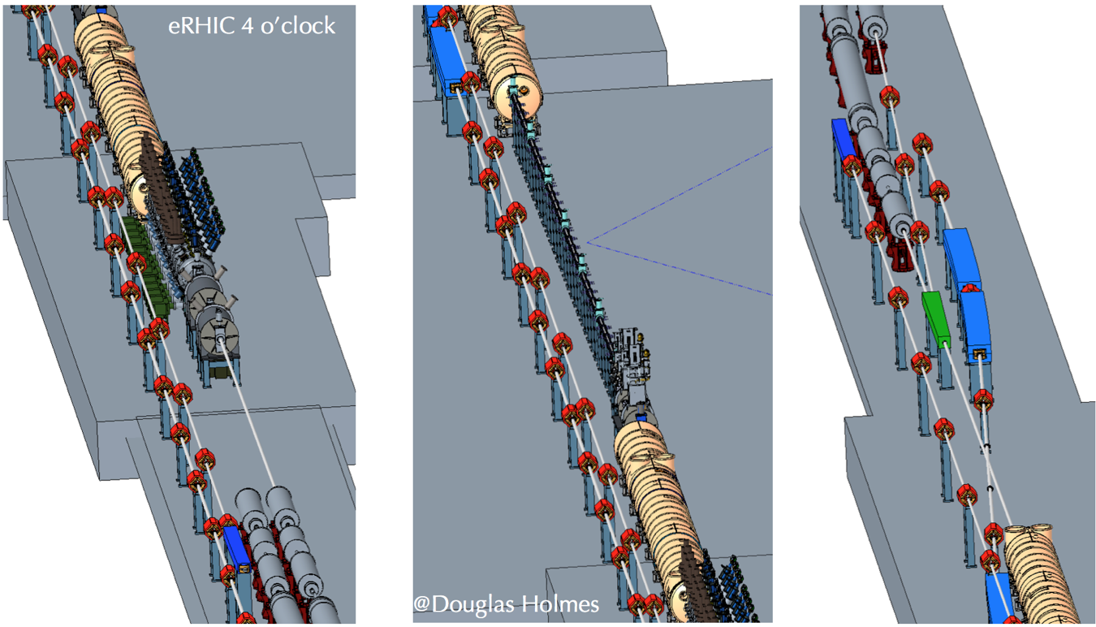
Injection System Upgrade
13

Slide 14
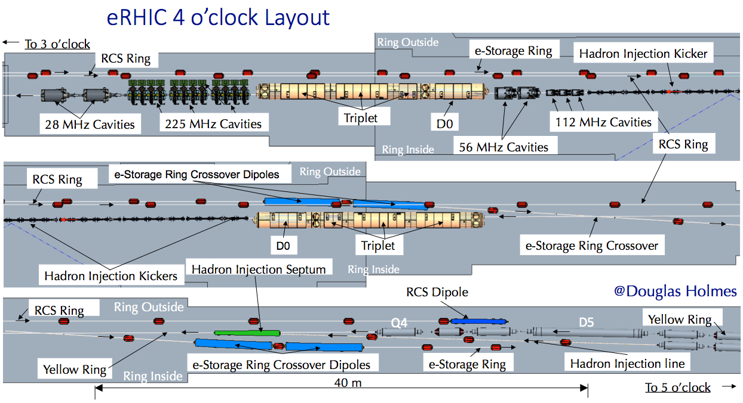
Injection System Upgrade
14

Slide 15
Injection System Upgrade
15

Slide 16
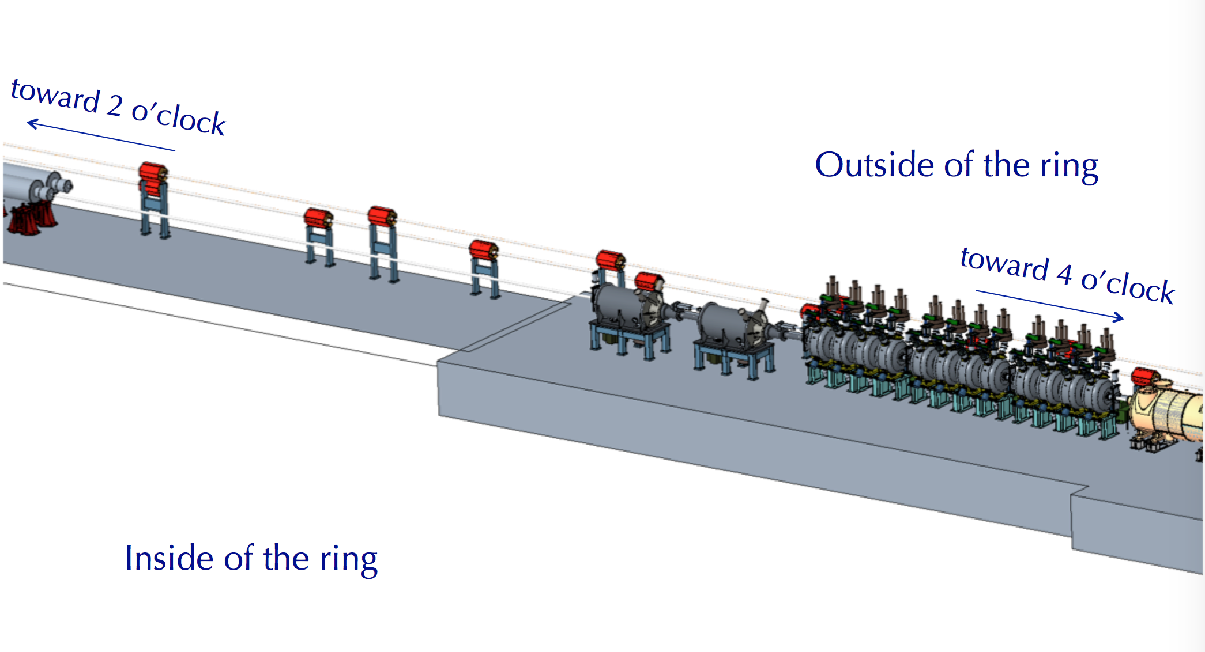
Hadron RF System Upgrade
The h = 360, 28MHz RF system upgrade is driven by the increase in the number of bunches injected into RHIC, from 110 to 330 for eRHIC. Intensity per bunch is slightly increased, with 2.4x10¹¹ per bunch maximum for eRHIC vs about 2.2x10¹¹ for typical RHIC operations. The average beam current seen by the RHIC Yellow Ring 28MHz RF system thus increases by about a factor of 3.3 to 1 A. Two of the 28 MHz RHIC cavities from the other ring will be reused for eRHIC. Possible store bunch patterns in RHIC are as follows: 330 Bunches in an h=360 pattern, 660 bunches in an h=720 pattern, or 1320 bunches in an h=1440 pattern. In order to generate the latter two patterns, new bunch splitting cavities at 56MHz (h=720) and 112MHz (h=1440) are required.
16

Slide 17
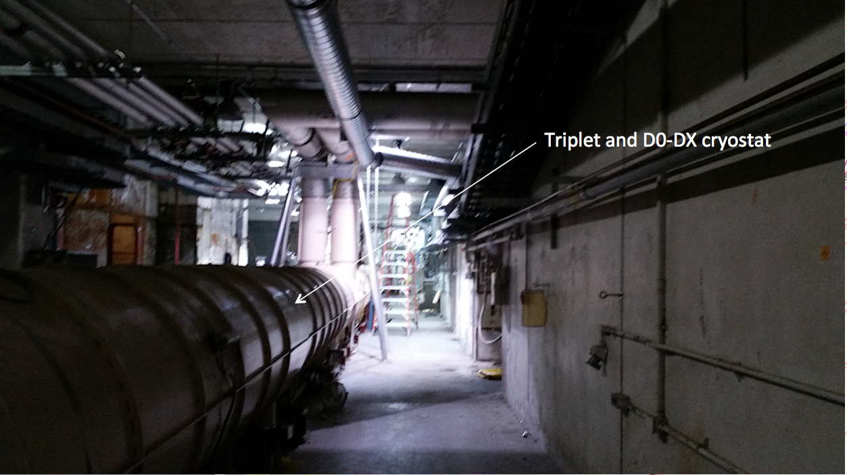
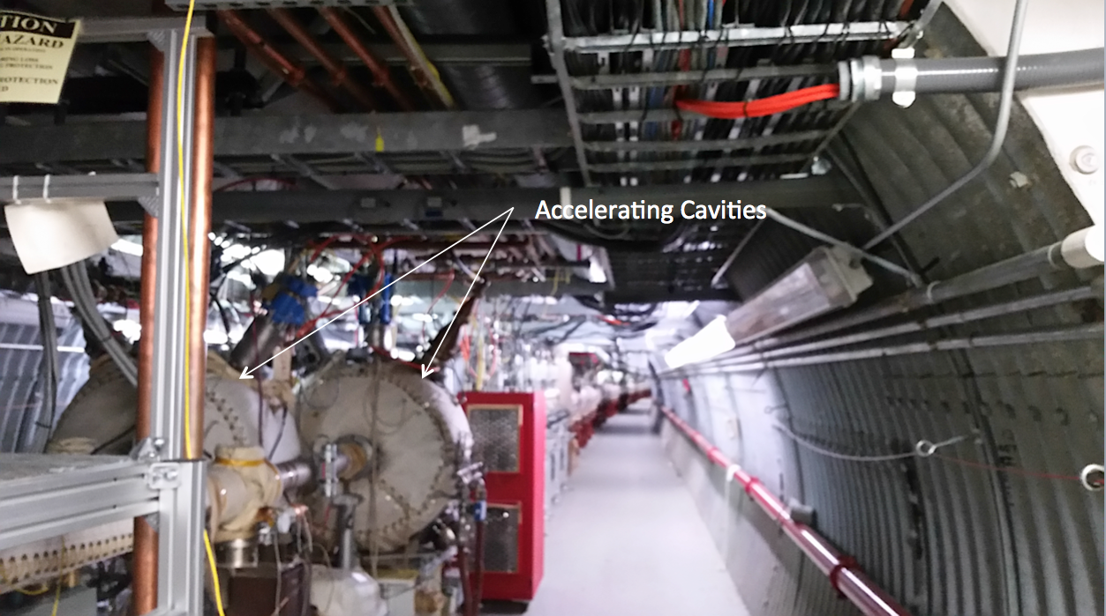
Present 4 o’clock
17
17

Slide 18
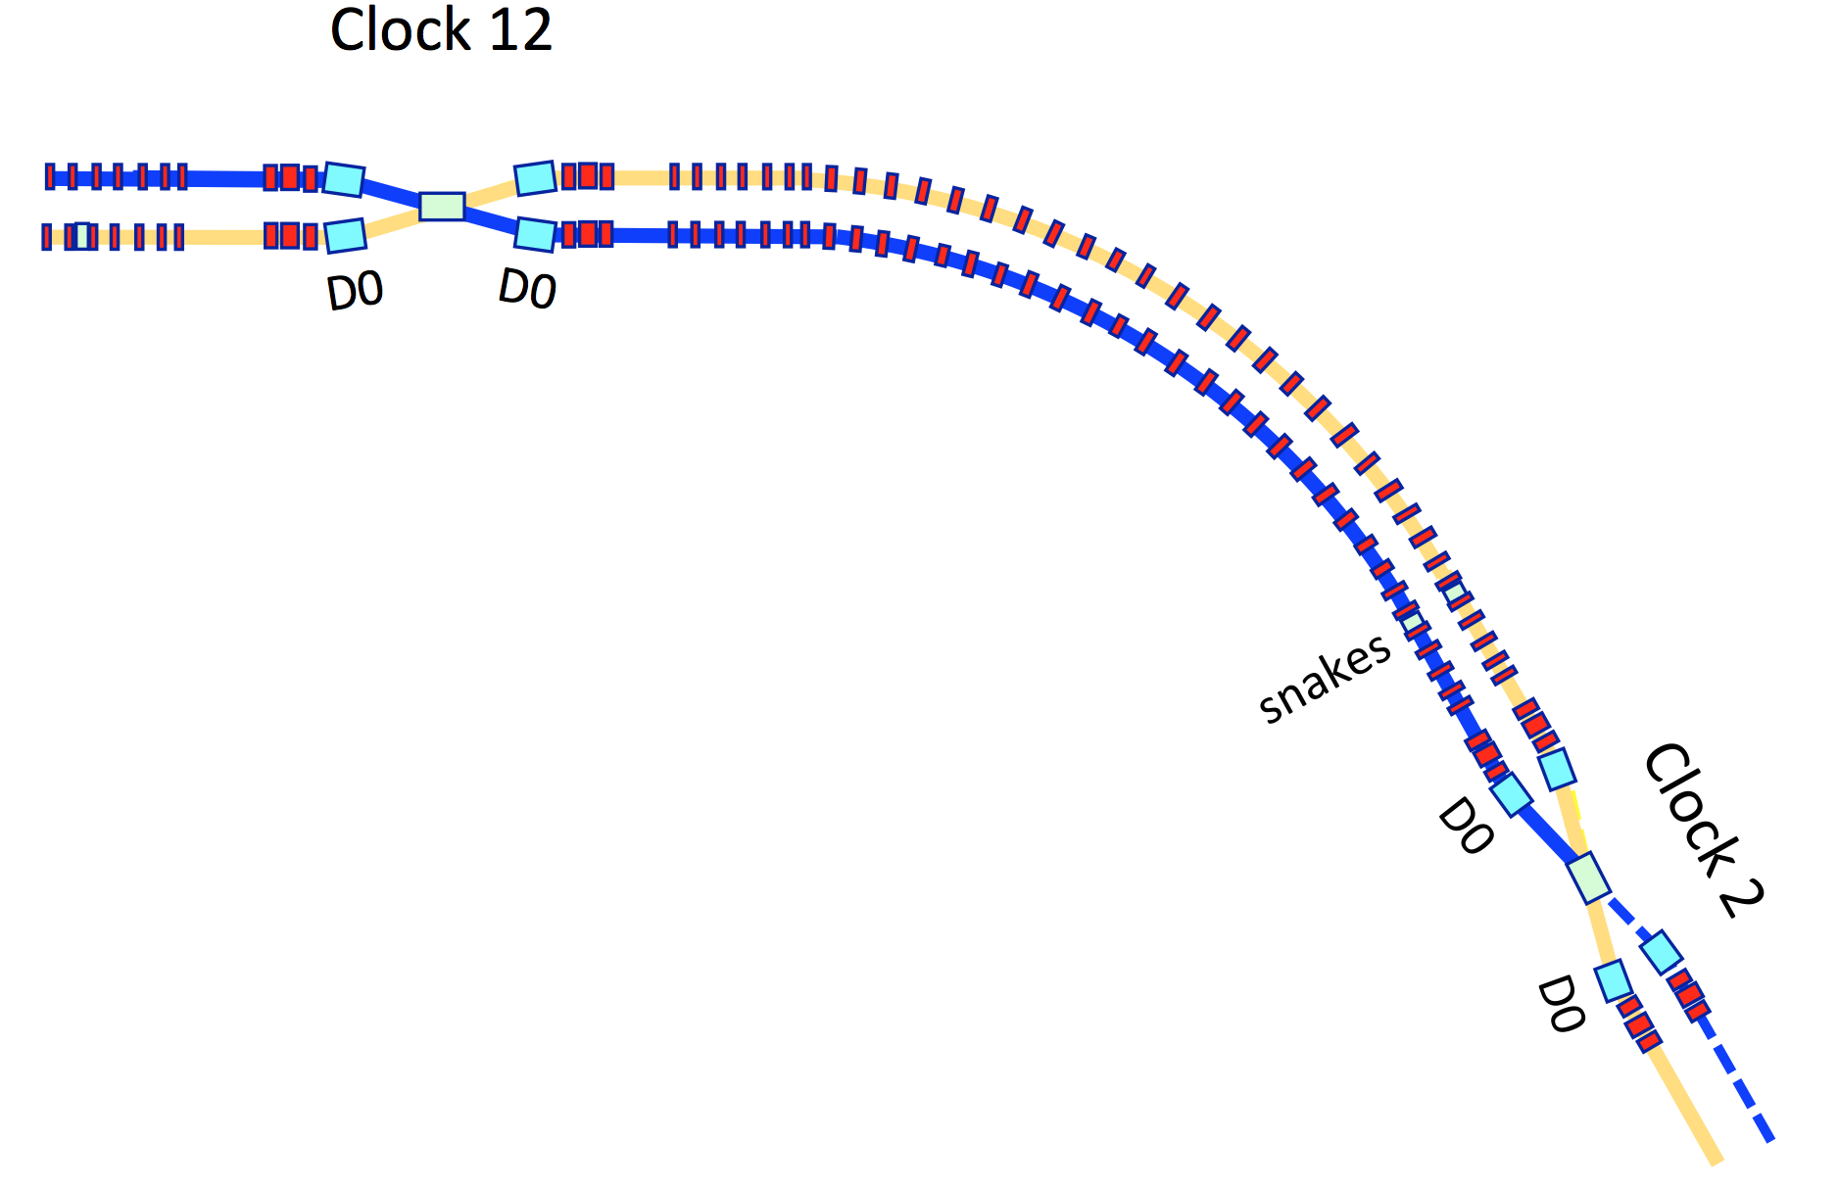
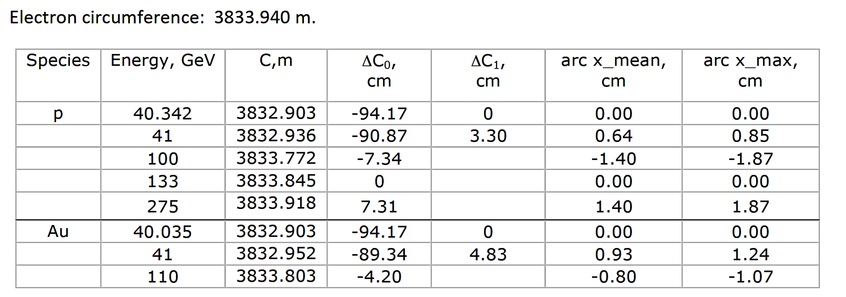
e-h synchronization and resulting circumferences
12-2 arc
Switching
magnet
High energy beamline, used for 100-275 GeV hadrons
Reverted
Central orbit circumference C₀=3833.845 m
Central orbit proton energy = 133 GeV
Blue ring
Low energy beamline,
used for ~41 GeV hadrons
Bl = 0.009 *133.39 =1.2 Tm
Central orbit circumference C₀=3832.903 m
Central orbit proton energy = 40.342 GeV
Electron circumference = 3833.940 m
Switching
magnet
18

Slide 19
RHIC Modifications: Additional Siberian Snakes
Presently in each ring (Blue and Yellow): 2 Siberian Snakes, 4 spin rotators (two spin rotators per experimental IR): Achieved RHIC proton polarization: 65% (100 GeV), 55% (250 GeV)
6 Sib. Snakes is planned for eRHIC: to reach 70% proton and He³ polarization over all energy range
To add 4 Siberian Snakes into Yellow ring helical magnets of Blue Snakes and Rotators will be used:
  2 Blue ring Snakes will be moved to Yellow ring
  Reconfigure the helical dipoles from Blue ring spin rotators to make another pair of snakes
  A total of 4 spin rotators, or 16 helical dipoles in the Blue ring. Among them, 8 are right handed, 8 are left handed
  Put all right handed helical dipoles to make one more pair of snakes. rotate all helical dipoles by 90 degrees to have vertical field at the entrance
H1 +
hor
H2 -
hor
H2 +
hor
H1 -
hor
H1 +
vert
H2 +
vert
H2 +
vert
H1 +
vert
The RHIC spin rotator consists of four helical magnets with horizontal field at the magnet entrance. The sign demonstrates the magnet helicity
("+" is right-handed, "-" is left-handed)
The RHIC Siberian Snake consists of four helical magnets with vertical field at the magnet entrance. The sign demonstrates the magnet helicity
("+" is right-handed, "-" is left-handed)
19

Slide 20
Copper coating of the beam pipe to reduce the cryo-heating and electron cloud effect
Resistive wall heating load for present RHIC stainless steel pipe
eRHIC
High Luminosity
eRHIC
Medium Luminosity
Cryo-limit
Present RHIC
20

Slide 21
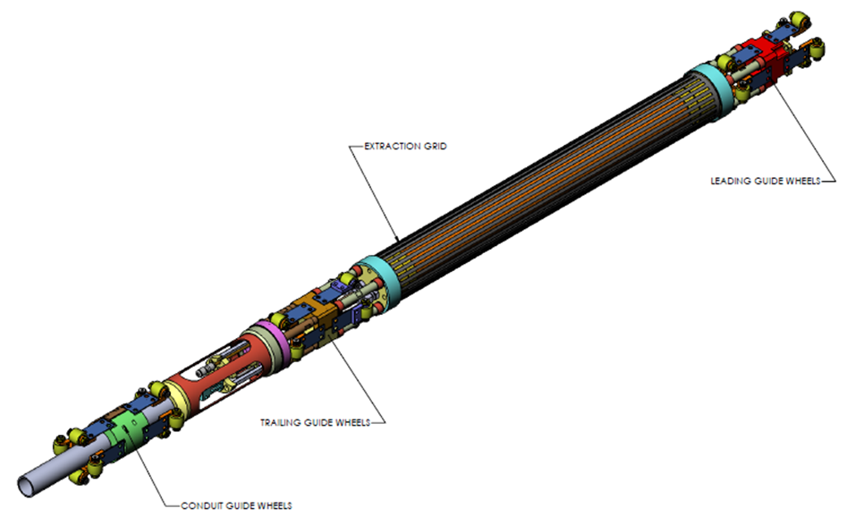
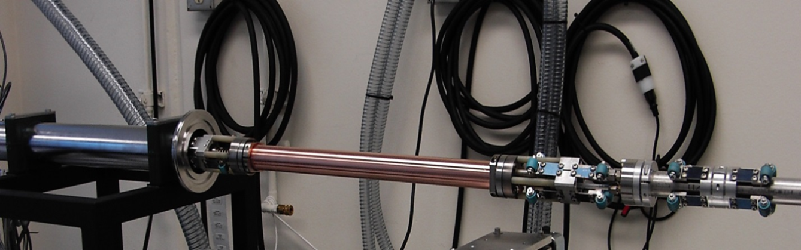
Copper coating of the beam pipe to reduce the cryo-heating and electron cloud effect
  Ady Hershcovitch: Develop technique for enhancing in-situ copper coating quality of RHIC cold bore beam pipes with energetic ions that result in pipes with compacted thick crystalline defect free copper. Basically incorporating ion assisted deposition (IAD) into an already developed magnetron mole.
  Coating adhesion of 10 μm Cu passed all industrial tests and even exceeded maximum capability of a 12 kg pull test fixture or at least 2.9x10⁶ N/m². Room temperature RF resistivity measurement indicated that 10 μm Cu coated stainless steel RHIC tube has conductivity close to copper tubing. The measurements of the copper tubing at cryogenic temperatures is in progress.
Integrated IAD magnetron for coating long narrow tubes. Insulators (in blue) are covered with overlapping shields to prevent exposure to plasma and metal deposition
The copper-coat the RHIC beam pipes in-situ to reduce their resistivity and
thus reduce the cryogenic heat load to less than > 1W/m.
21

Slide 22
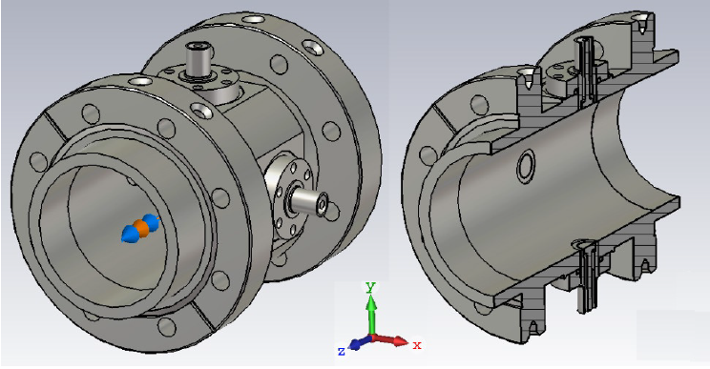
Instrumentation Improvements
BPM improvements (due to the higher currents we will either replace the existing BPM’s with the button BPM’s or make corrections on the existing ones.
Improvements on the ionization profile monitors.
Reposition the loss monitors.
A high bandwidth wall current monitor need to replace the existing ones.
Collimation system upgrade.
Schottky Monitor- The high frequency cavity will be upgraded to a high shunt-impedance design to maximize the signal to noise ratio.

Slide 23
Summary
All necessary requirements for the RHIC hadron rings modifications, required for eRHIC, are identified and technical solutions are found
The switching DX magnets are removed from RHIC as they are not required for eRHIC single hadron ring
Energy of eRHIC protons is raised from 255 to 275 GeV or from 100 to 133 GeV/n for heavy ions
The Yellow Ring will be upgraded for proton, He³⁺ and d spin with a total of 6 helical Siberian snakes modifying the existing blue ring spin elements
An upgrade of the RHIC injection system is designed by using the blue ring 6 - to - 4 o’clock arc as a new injection transport line
The cold RHIC vacuum beam pipe will be modified by the plasma deposition of copper and carbon layers
An upgrade of the RHIC BPM’s is under way
23

Slide 24
Back up slides
24

Slide 25
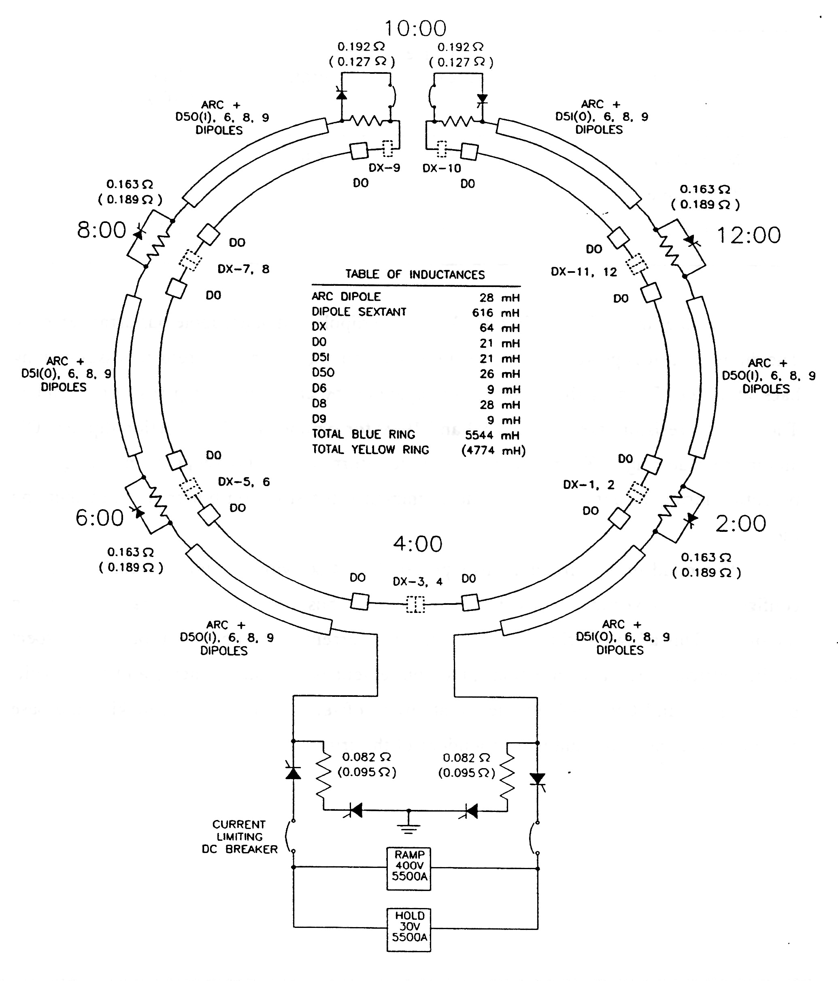
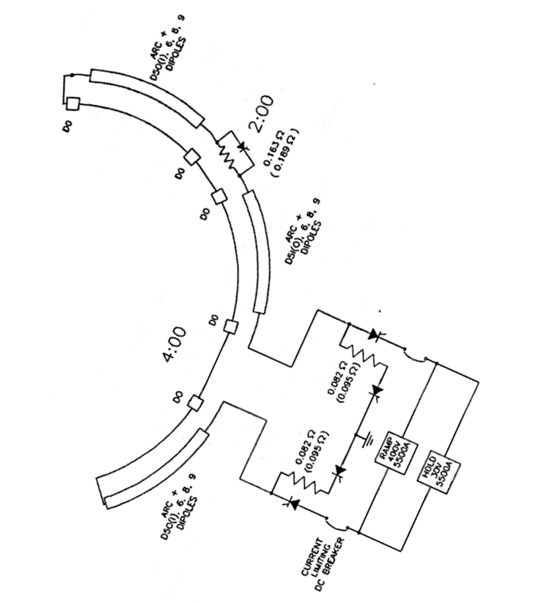
Power supplies present and future
DX’s removed
Main Bus returns
not at 10 o’clock
New switching magnet
NEW IR
NEW IR
DX’s removed
Injection kickers
DX’s removed
New switching magnet

