Slide 1
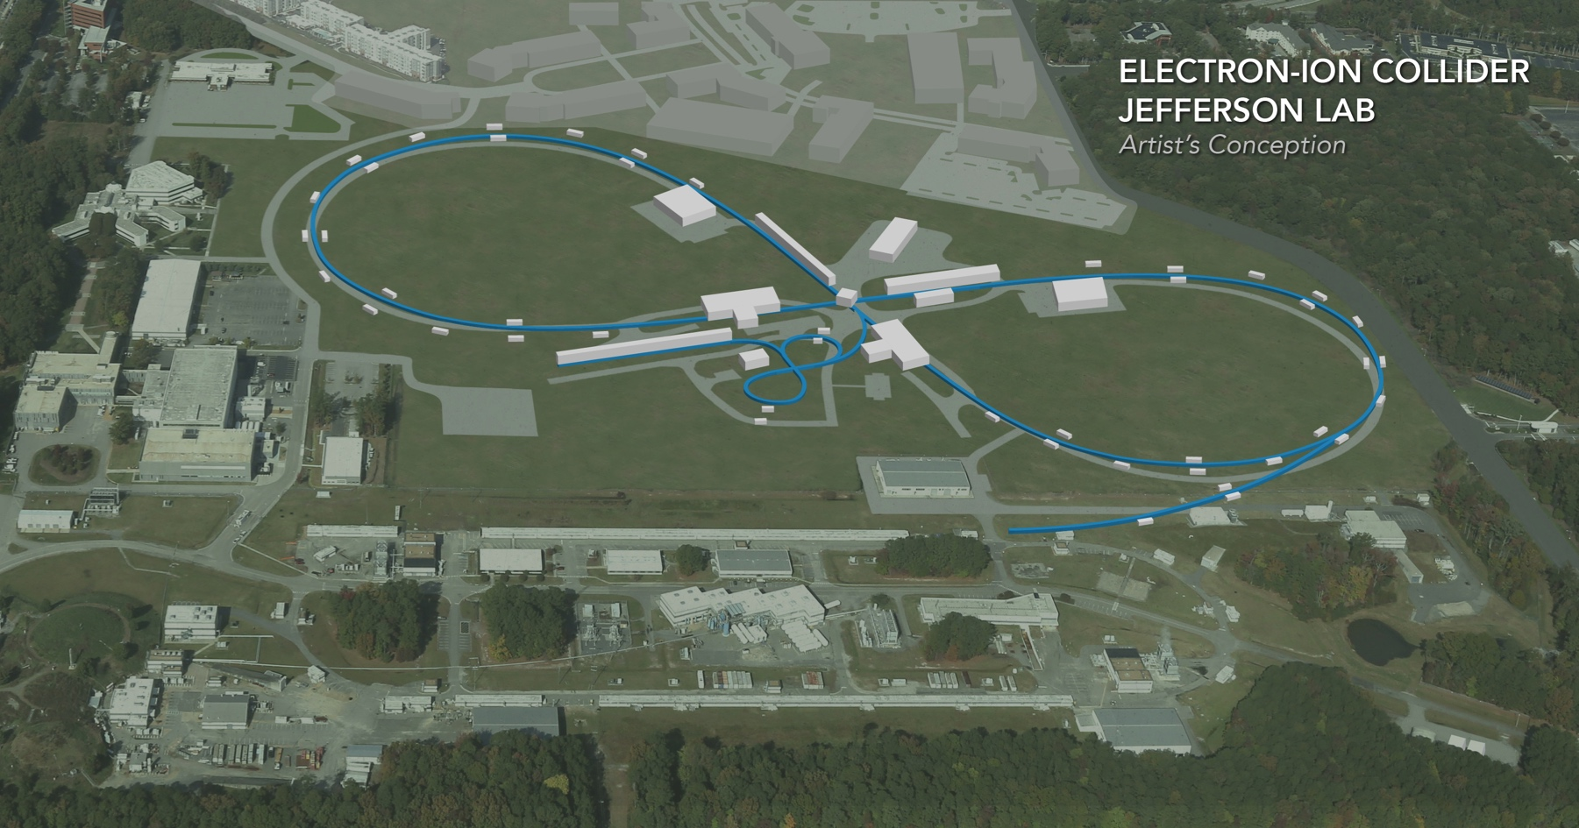
JLEIC Collider Rings
Vasiliy Morozov
on behalf of
JLEIC collaboration
Supported in part by DoE NP EIC R&D FOA funds
EIC Accelerator Collaboration Meeting
October 29 - November 1, 2018

Slide 2
Outline
Electron collider ring
  Requirements, overview, and main parameters
  Interaction region
  Optimized spin rotator
  Non-linear dynamics
Ion collider ring
  Requirements, overview, and main parameters
  Interaction region
  Electron cooling section
  Chromaticity compensation block housing crab cavities
  Spin rotator
  Non-linear dynamics
  Path towards 200 GeV design

Slide 3
Electron Collider Ring Design Requirements
Provide the necessary beam parameters
  3-12 GeV electron
  3A beam current up to 6-7 GeV, small emittance, short bunch length ~1cm, focusing at the IP
    Support luminosities above 10³⁴ cm⁻²s⁻¹
  Sufficient beam and luminosity lifetime
  Less than 10 MW total synchrotron radiation power
Capability of operating multiple detectors
  One full-acceptance detector incorporated
  Incorporate crossing angle and crabbing system
  Space for a second detector reserved
Maintain high polarization >80%
  Longitudinal polarization at the IP
  Sufficient polarization lifetime
Non-linear dynamics correction
  Distributed chromaticity correction scheme
  No extra space required, no emittance growth
Geometry
  Doglegs for vertical stacking with the ion collider ring in the arcs

Slide 4
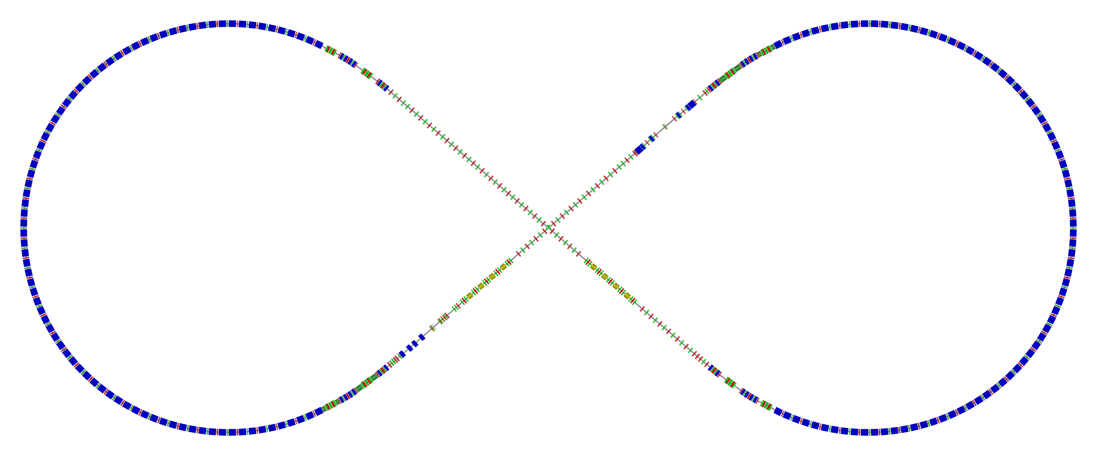
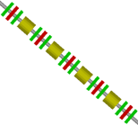
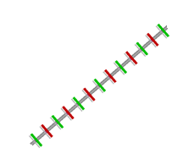
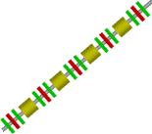
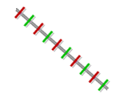
Electron Collider Ring Layout
Circumference 2256.6 m, arc 893.0 m, straight 235.3 m
Integrated IR
Spin rotators combined with doglegs for vertical stacking with the ion collider ring
Space for
Spin rotator
Spin rotator + dogleg
R=155.5 m
RF
RF
77.4°
e⁻
Arc, 257.4°
Space for 2nd IP
Spin rotator
+ dogleg
IP
Space for
Spin rotator
Forward e⁻ detection and polarimetry

Slide 5
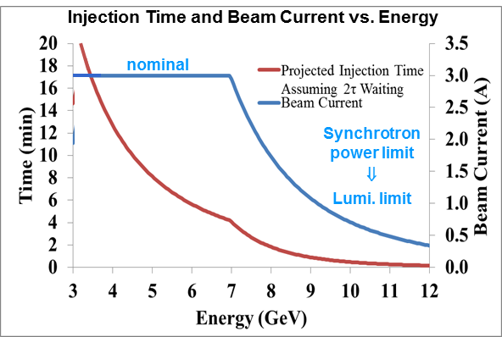
Electron Beam Parameters
Electron beam
  3 A at up to 7 GeV
  Normalized emittance
  58 µm @ 5 GeV
  Synchrotron power
  density < 10 kW/m
  Total power
  up to 10 MW
Beam energy | GeV | 3 | 5 | 6.9 | 9 | 10 | 12
Beam current | A | 3 | 3 | 3 | 1 | 0.69 | 0.33
Total SR power | MW | 0.4 | 2.7 | 9.6 | 9.3 | 9.8 | 9.7
Energy loss per turn | MeV | 0.12 | 0.88 | 3.2 | 9.3 | 14.2 | 29.4
Energy spread | 10⁻⁴ | 2.8 | 4.6 | 6.4 | 8.4 | 9.3 | 11.1
Transverse damping time | ms | 389 | 84 | 32 | 14 | 11 | 6
Longitudinal damping time | ms | 194 | 42 | 16 | 7 | 5 | 3
Normalized Emittance | um | 13 | 58 | 152 | 337 | 462 | 799

Slide 6
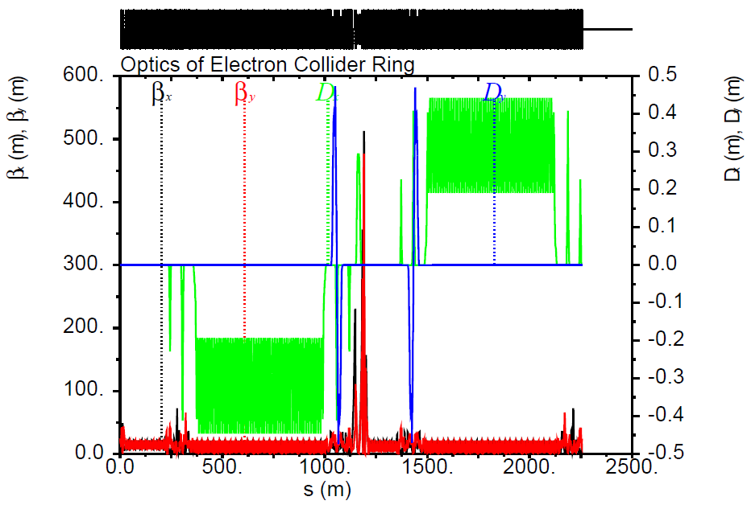
Complete Optics of Electron Collider Ring

Slide 7
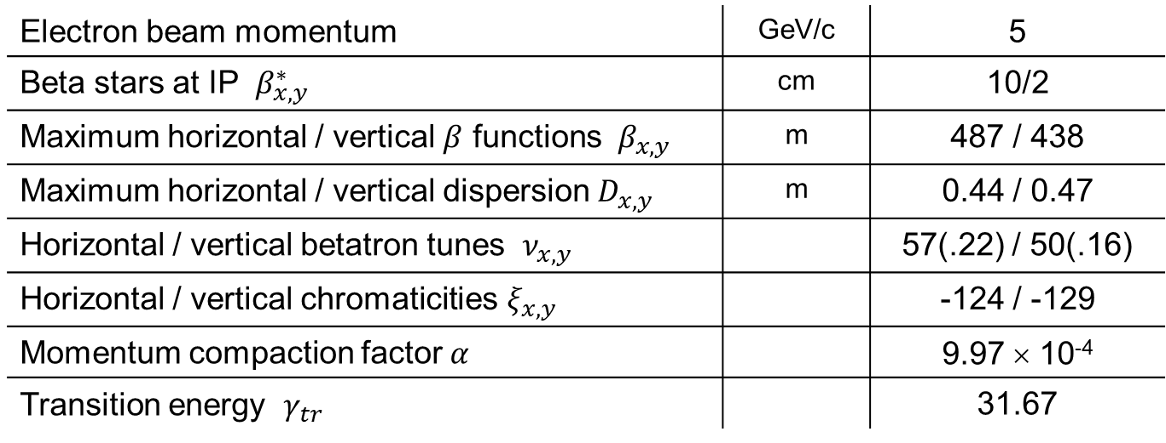

Parameters of Electron Collider Ring
$β^{∗}$ and $β_{max}$ scale as $β^{∗}β_{max}=const$ and can be adjusted as necessary,
e.g. $β^{∗}=4$ cm $→$ $β_{max}=1100$ m
Electron beam momentum | GeV/c | 5
Beta stars at IP $β_{x,y}^{∗}$ | cm | 10/2
Maximum horizontal / vertical $β$ functions $β_{x,y}$ | m | 487 / 438
Maximum horizontal / vertical dispersion $D_{x,y}$ | m | 0.44 / 0.47
Horizontal / vertical betatron tunes $ν_{x,y}$ |  | 57(.22) / 50(.16)
Horizontal / vertical chromaticities $ξ_{x,y}$ |  | -124 / -129
Momentum compaction factor $α$ |  | 9.97 × 10⁻⁴
Transition energy $γ_{tr}$ |  | 31.67

Slide 8
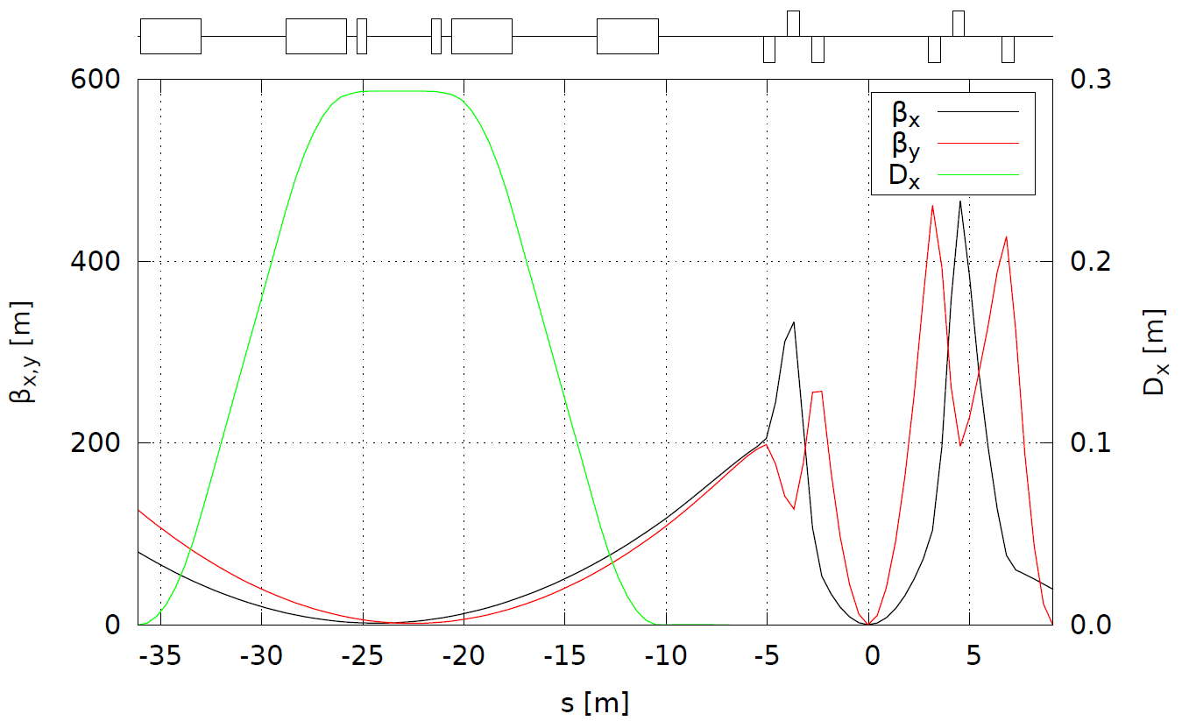

Electron IR Optics
Dipole chicane
Compton polarimeter
Low-$Q^{2}$ tagger
FFB
FFB
electrons
Secondary focus
IP

Slide 9
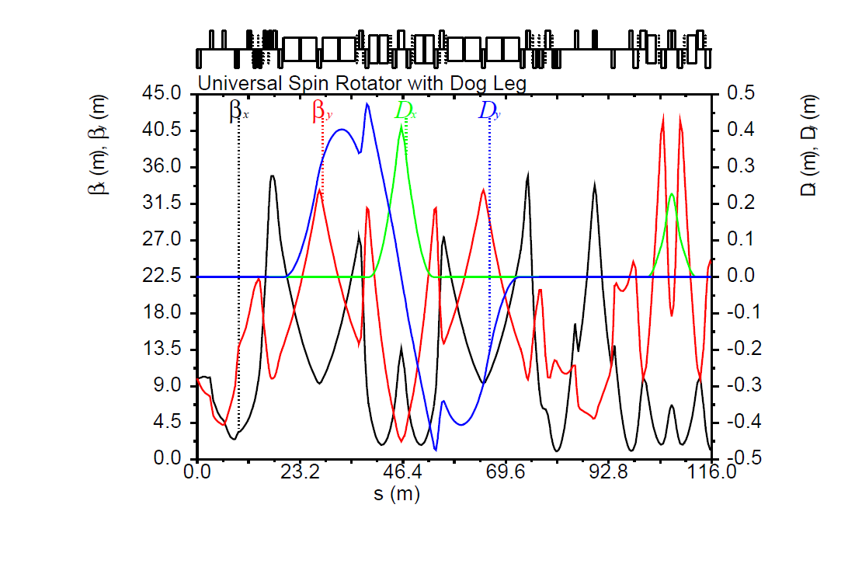
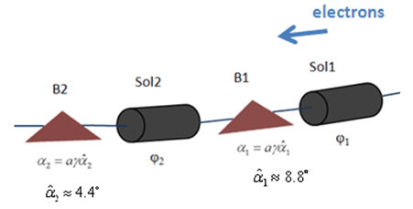
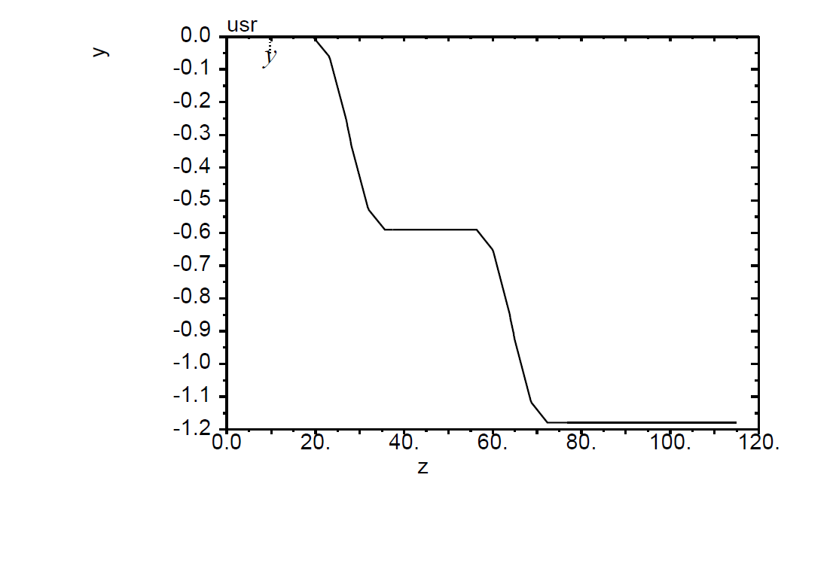


Electron Spin Rotators with Doglegs
Universal spin rotator
  Minimizes spin diffusion by
  switching polarization between
  vertical in arcs and longitudinal
  in straights
  Sequence of solenoid and dipole
  sections
  Geometry independent of energy
Arc
Sol. 1 + dec. skew quads + matching quads
Sol. 2 + dec. skew quads + matching quads
IP
Vertical dogleg 2
$$\vec{s}$$
$$\vec{s}$$
Vertical dogleg 1
Vertical dogleg 1
Horizontal DBA 1
Horizontal DBA 2
Vertical dogleg 2

Slide 10
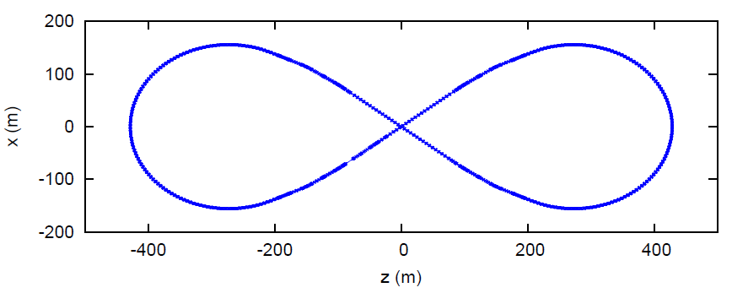
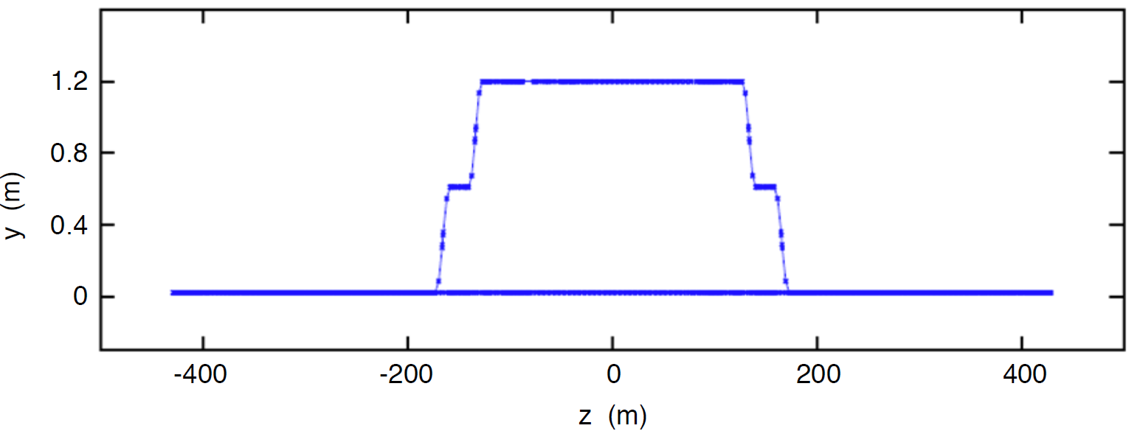
Geometry of Electron Collider Ring
Top view
Spin rotator
R=155.5 m
Arc
77.4°
Spin rotator
IP
Side view
1.2 m

Slide 11

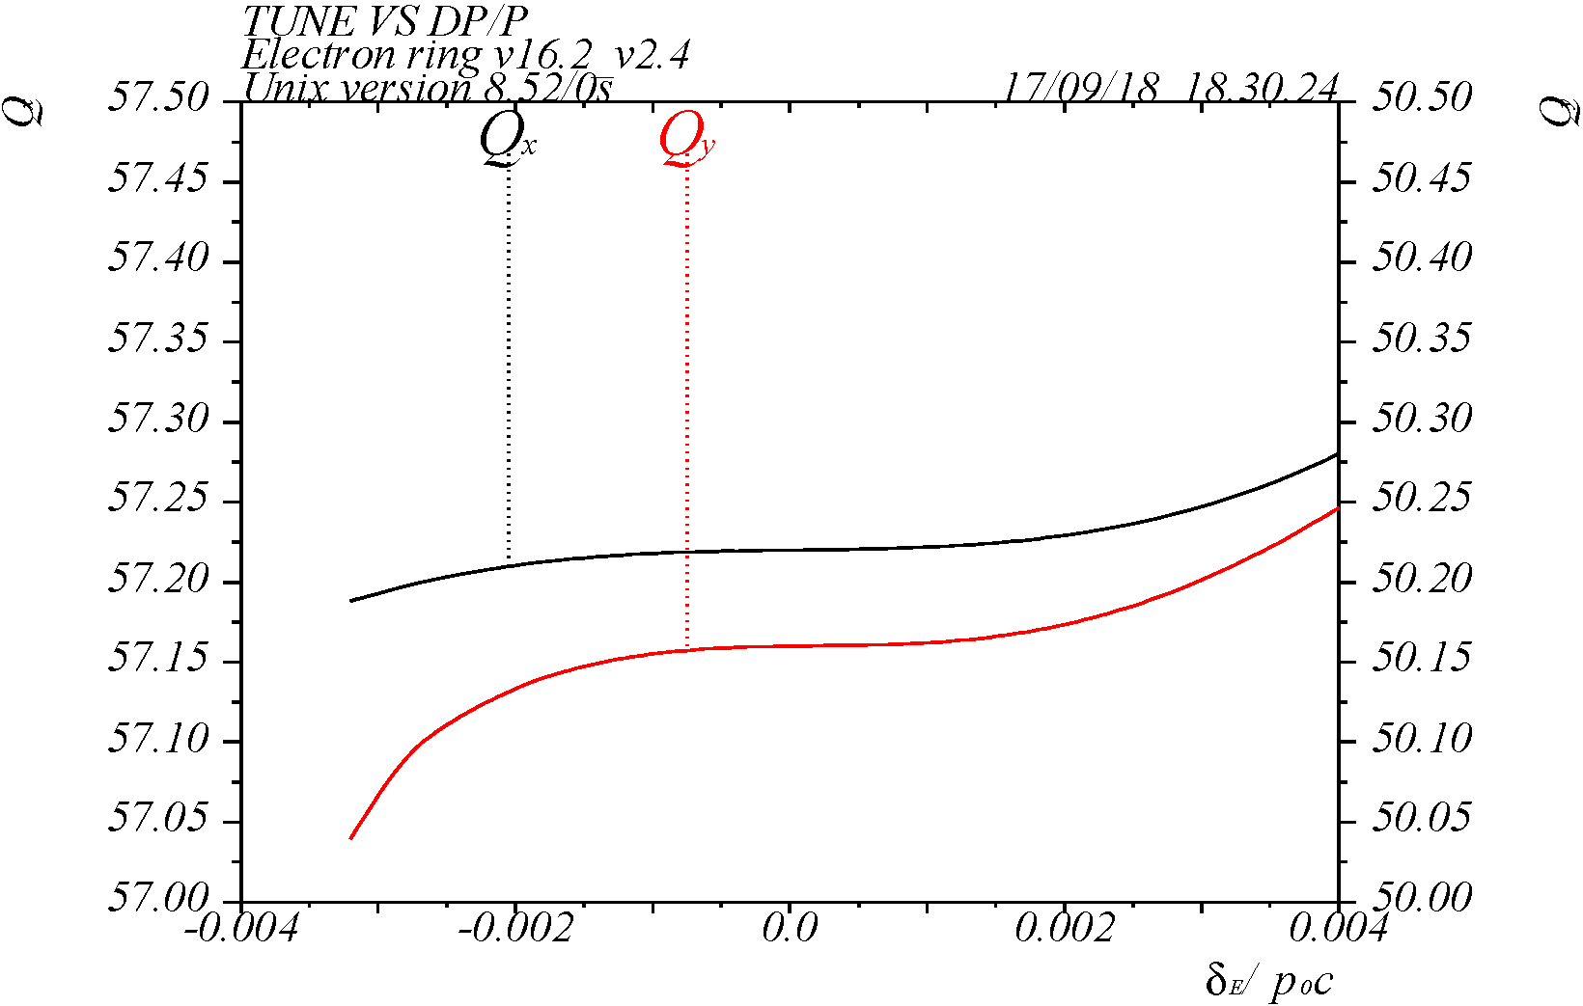
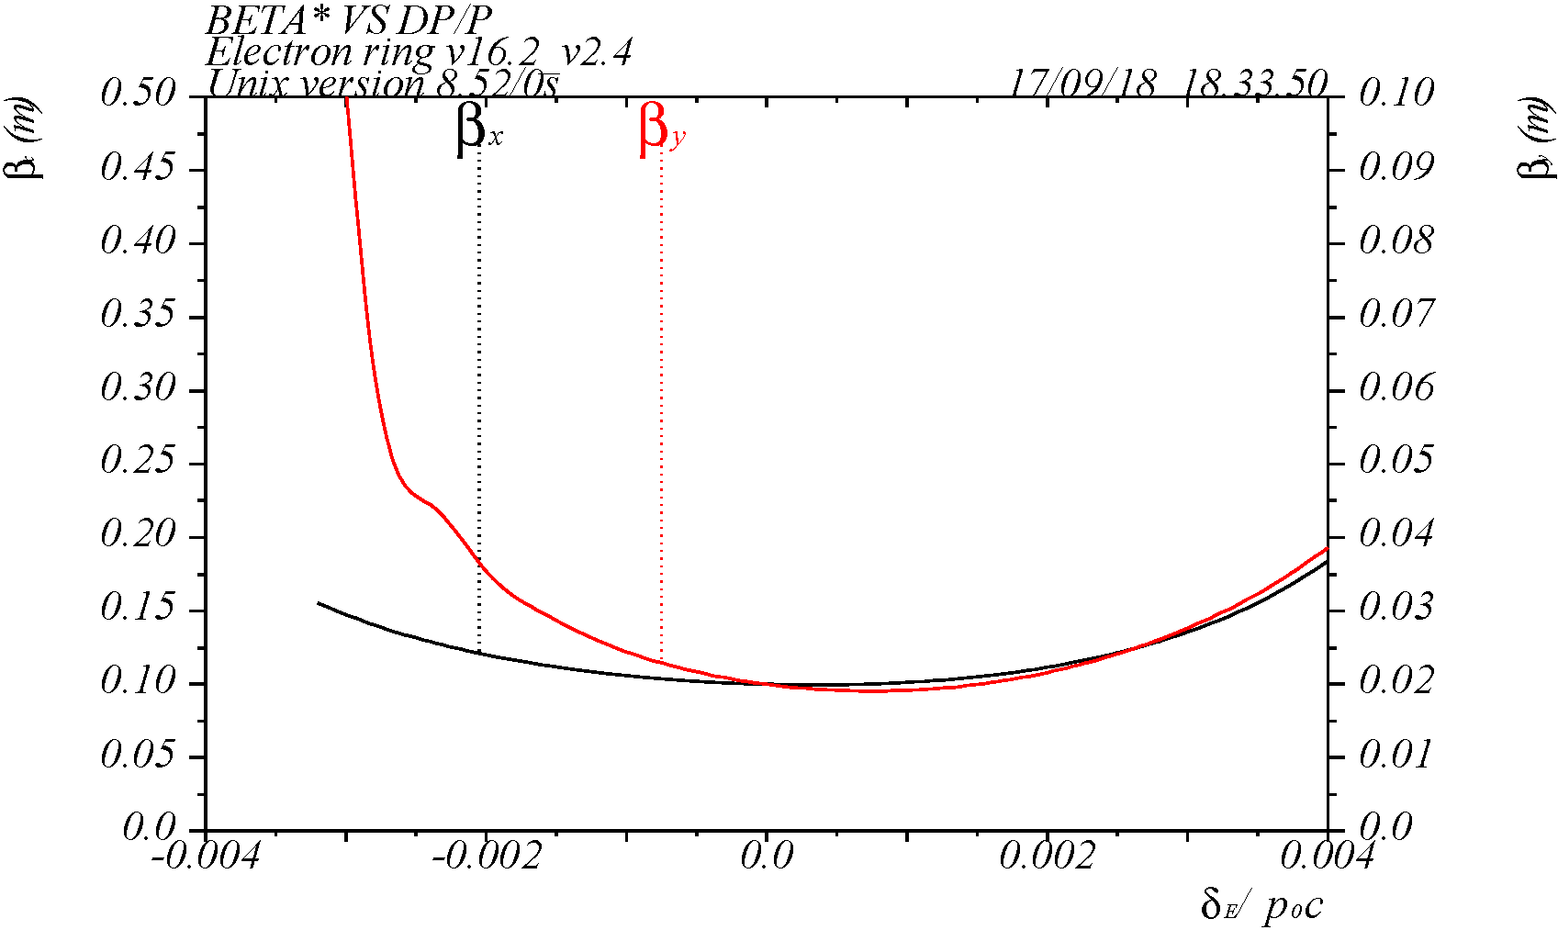
Non-Linear Dynamics in Electron Collider Ring
Distributed chromaticity compensation scheme
Working point (57.22, 50.16)

Slide 12
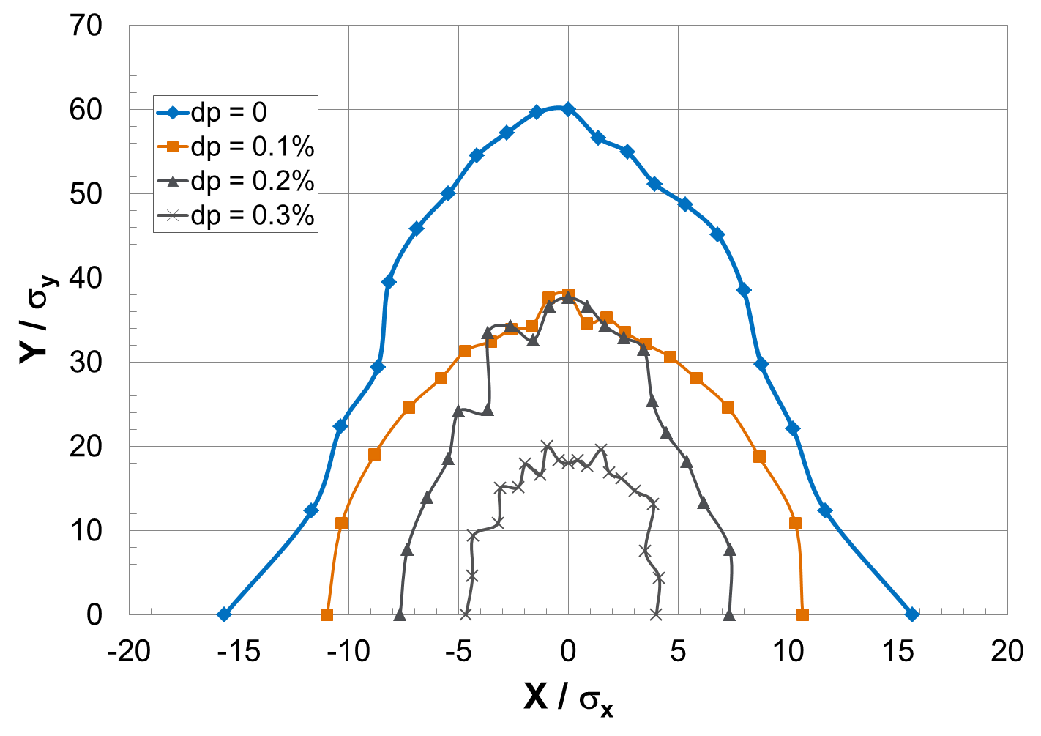
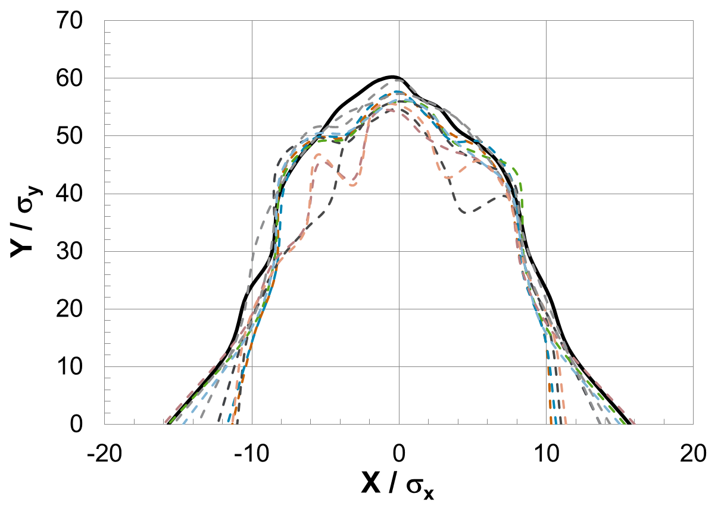
Dynamic Aperture of Electron Collider Ring
Bare lattice for different momentum offsets
PEP-II measured systematic and random non-linear field errors in all magnets for 10 random seeds
Solid black: no errors

Slide 13
Ion Collider Ring Design Requirements
Provide the necessary beam parameters
  20(8)-200 GeV protons, 12-80 GeV/u ions
  Focusing at the IP that supports luminosities above 10³⁴ cm⁻²s⁻¹
  Incorporate electron cooling
  Sufficient beam and luminosity lifetime
Capability of operating multiple detectors
  One full-acceptance detector incorporated
  Incorporate crossing angle and crab system
  Space for a second detector reserved
Polarization preservation and control using figure-8 geometry
  Light ion (p, d, ³He, and possibly Li) polarization above 70%
  Transverse and longitudinal polarization orientations adjustable at the IP
  Sufficient polarization lifetime
Match the electron collider ring geometry
  Same tunnel
Non-linear dynamics correction
  Local chromaticity correction scheme

Slide 14
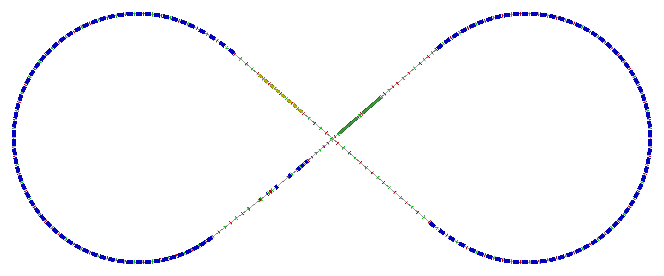
Ion Collider Ring Layout
Same circumference as the electron collider ring of 2256.6 m
6 T cosθ superconducting magnets supporting proton momentum of 200 GeV/c
disp. supp./
geom. match #3
disp. supp./
geom. match #2
CCB
norm.+
SRF
Crab cavities
elec. cool.
tune
tromb.+
match
Arc, 257.4°
77.4°
R = 155.5 m
space for 2nd IP
Polarimeter
det. elem.
ions
disp. supp.
Crab cavities
beam exp./
match
IP
disp. supp./
geom. match #3
CCB
disp. supp./
geom. match #1

Slide 15
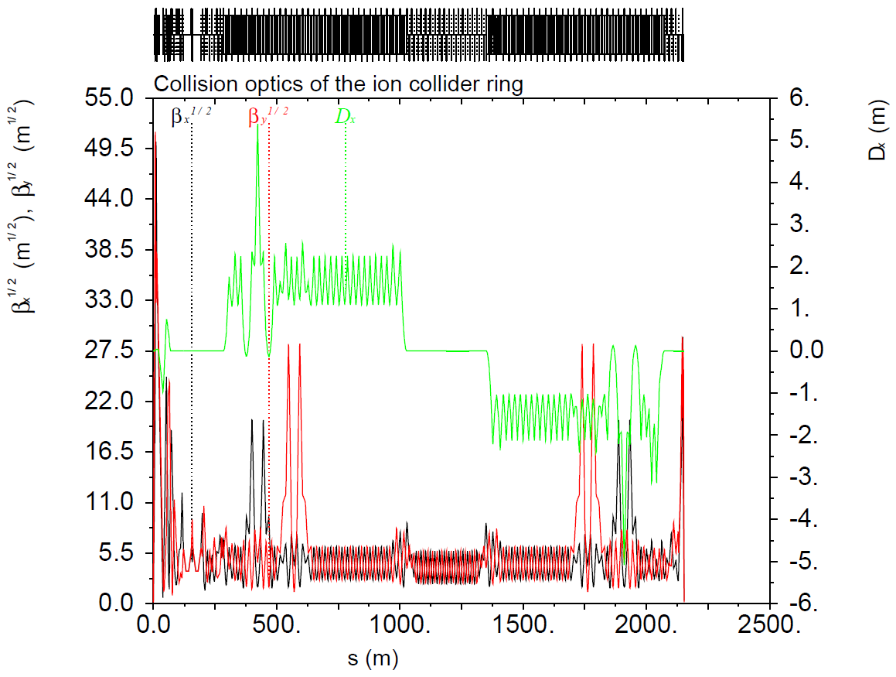




Complete Collision Optics of Ion Collider Ring
ions
Crab cavities
Crab cavities
IP
$$Δφ_{y}=11.5π$$
$$Δφ_{y}=8.5π$$
$$Δφ_{x}=9.5π$$
$$Δφ_{x}=4.5π$$
CCB
CCB

Slide 16
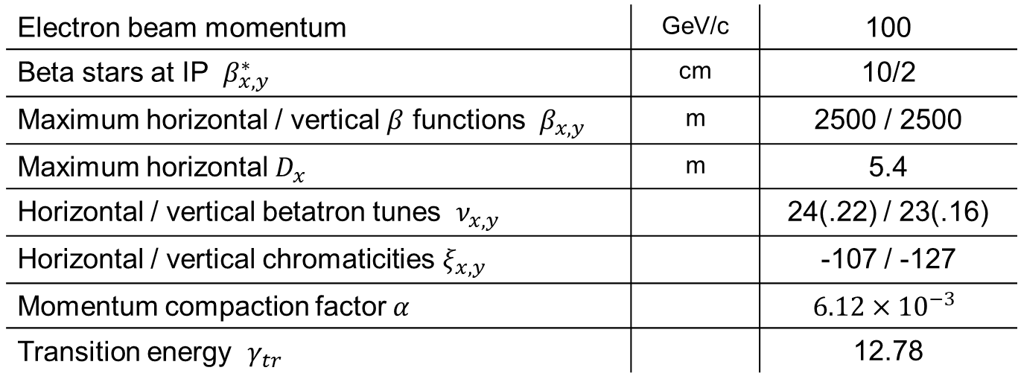

Parameters of Ion Collider Ring
$β^{∗}$ and $β_{max}$ scale as $β^{∗}β_{max}=const$ and can be adjusted as necessary,
e.g. $β^{∗}=6$ cm $→$ $β_{max}=4200$ m
Electron beam momentum | GeV/c | 100
Beta stars at IP $β_{x,y}^{∗}$ | cm | 10/2
Maximum horizontal / vertical $β$ functions $β_{x,y}$ | m | 2500 / 2500
Maximum horizontal $D_{x}$ | m | 5.4
Horizontal / vertical betatron tunes $ν_{x,y}$ |  | 24(.22) / 23(.16)
Horizontal / vertical chromaticities $ξ_{x,y}$ |  | -107 / -127
Momentum compaction factor $α$ |  | $$6.12×{10}^{−3}$$
Transition energy $γ_{tr}$ |  | 12.78

Slide 17
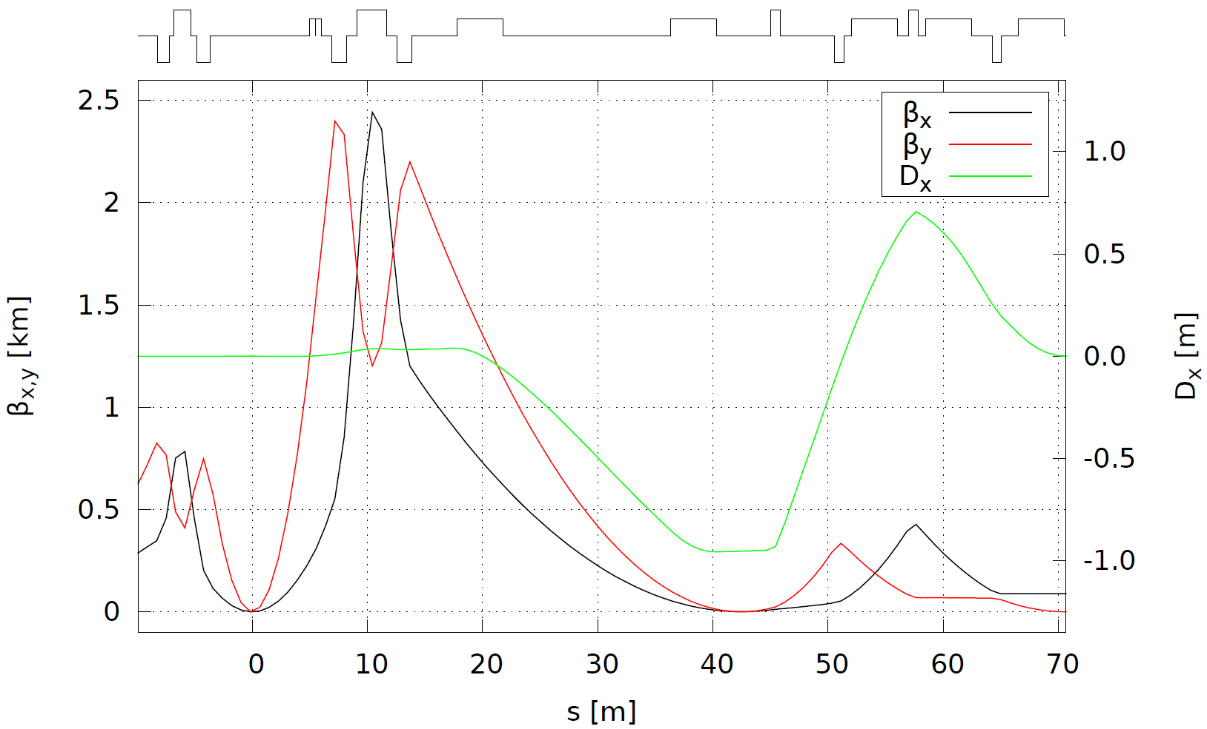
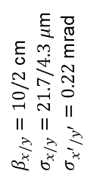
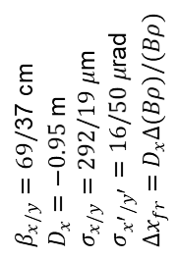
Ion IR Optics
iBDS1
Geometric match and dispersion suppression
FFB
IP
FFB
Far-forward detection
iBDS2
iBDS3
ions
$β_{x/y}=10/2$ cm
$σ_{x/y}=21.7/4.3 μ$m
$σ_{x^{′}/y^{′}}=0.22$ mrad
$β_{x/y}=69/$37 cm
$D_{x}=−0.95$ m
$σ_{x/y}=292/19 μ$m
$σ_{x^{′}/y^{′}}=16/50 μ$rad
$Δx_{fr}=D_{x}Δ(Bρ)/(Bρ)$
Secondary
focus
IP

Slide 18
IR Layout
Electron IR
  No net bend or transverse shift
Ion IR
  50 mrad crossing angle produced by shaping upstream ion arc
  Spectrometer and geometry matching dipoles provide net 50 mrad bend and ajust the separation of the ion and electron beam lines to 1.5 m
IP
e
Compton polarimetry
forward ion detection
ions
forward e detection
spectrometers
dispersion suppressor/
geometric match

Slide 19
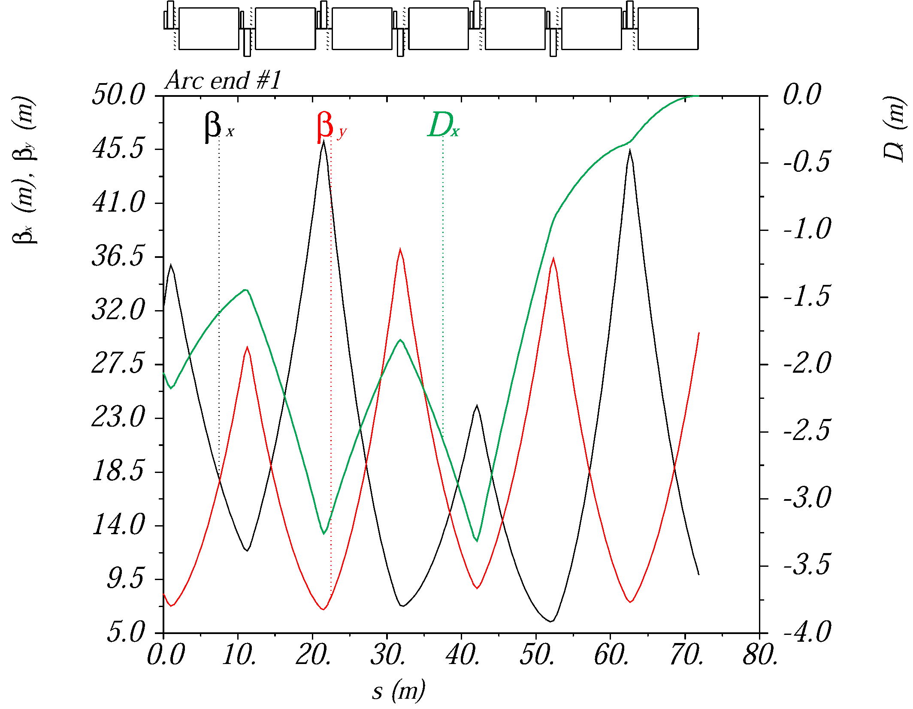
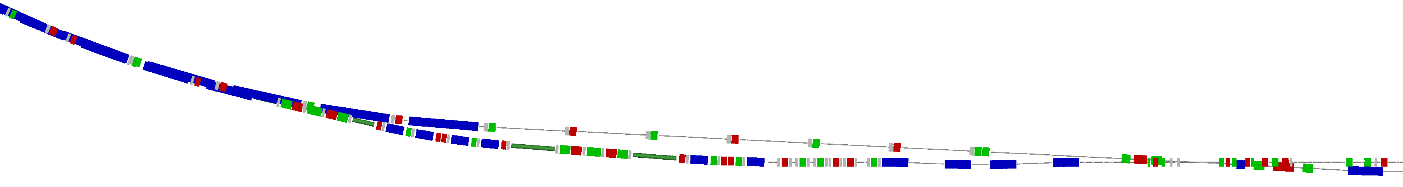
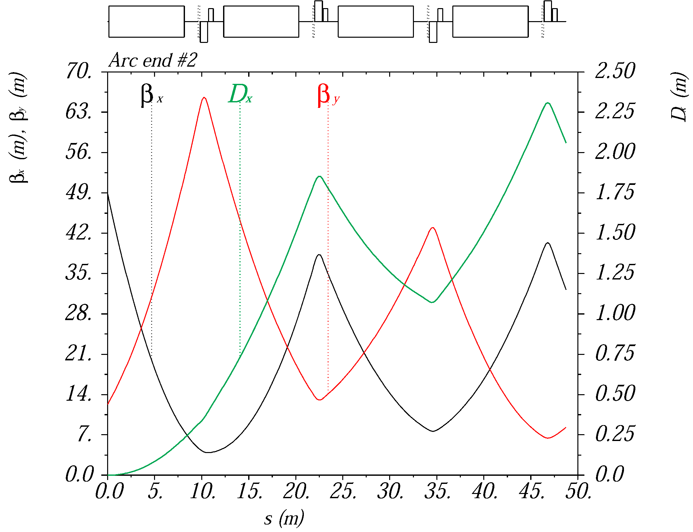
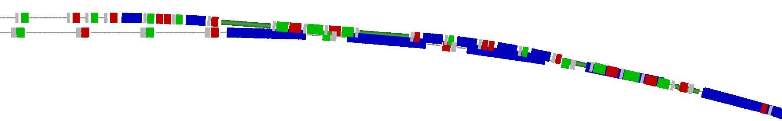
Ion Arc Ends
Provide dispersion suppression and geometric match to the electron ring
Arc end upstream of IP
  Shaped to provide
  50 mrad crossing angle
  at the IP
Arc end downstream of IP
  Shaped to provide
  1.5 m separation
5 m
20 m
ions
IP
2 m
10 m
ions

Slide 20
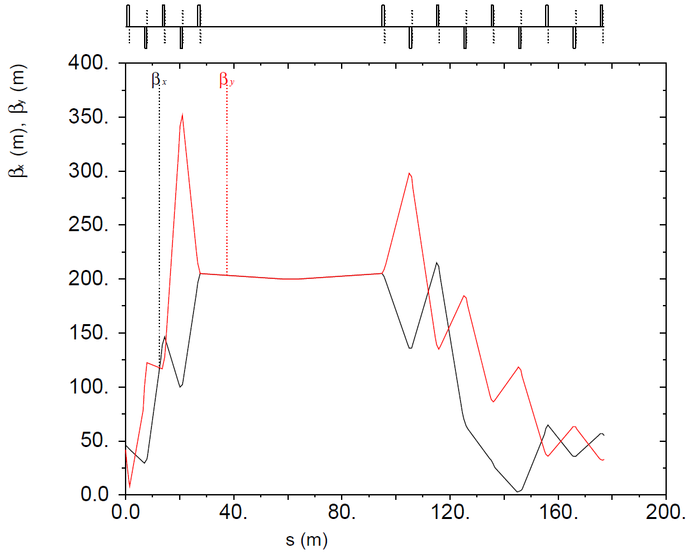

Electron Cooling Section
Four 15 m 1 T opposite-field cooling solenoids separated by 5 m
Large $β$-functions in the cooling section
Matching section
Matching section

Slide 21
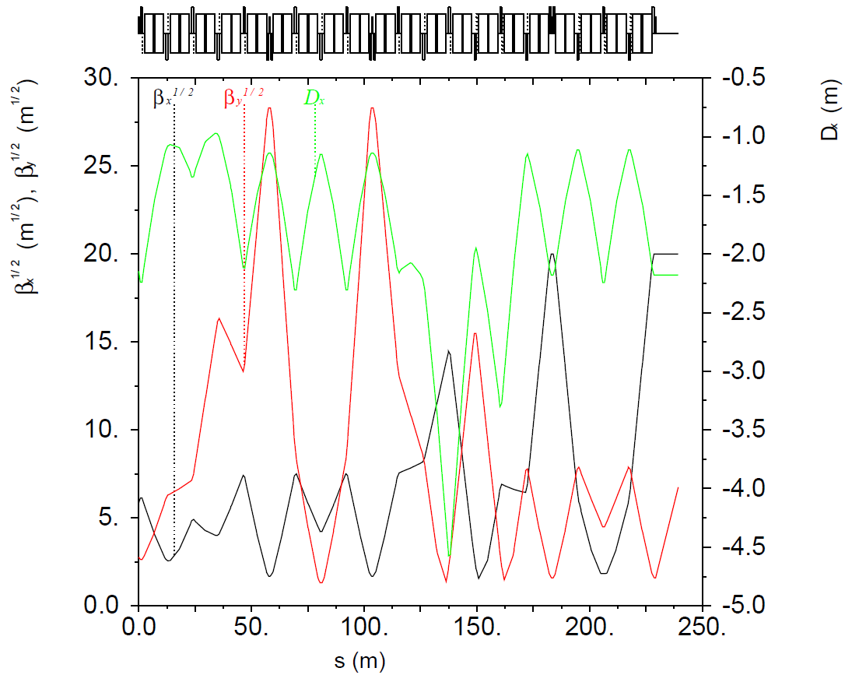



Chromaticity Compensation Block with Space for Crab Cavities
10 m reserved for crab cavities
Optics and space can be
optimized for crab crossing
Vertical sextupoles
Horizontal sextupoles
$$−I$$
$$−I$$
Crab cavities
$$α_{x}=0$$
$$D_{x}^{′}=0$$

Slide 22
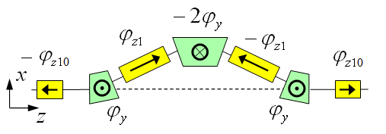
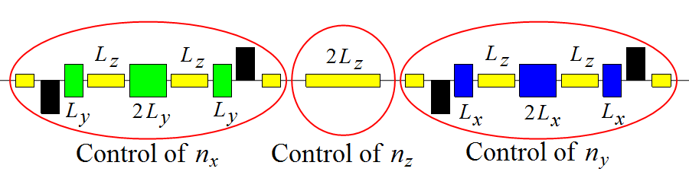
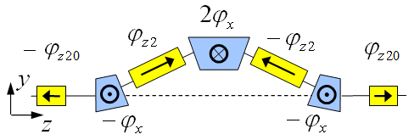
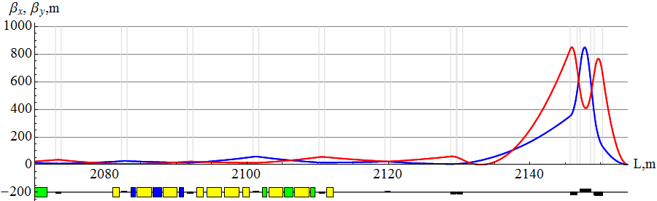


3D Spin Rotator in Ion Collider Ring
Provides control of the radial, vertical, and longitudinal spin components
Module for control of radial component (fixed radial orbit bump)
Module for control of vertical component (fixed vertical
orbit bump)
Module for control of longitudinal component
Can be placed anywhere and has no effect on optics
3D spin rotator
$$L_{tot}=7 m, Δx=16 mm, B_{dip}^{max}=3 T, B_{sol}^{max}=2 T$$
IP
ions
$$L_{x}=L_{y}=0.6 m, L_{zi}=2 m,$$
$$L_{zi0}=1 m, α_{orb}={0.31}^{∘}$$

Slide 23
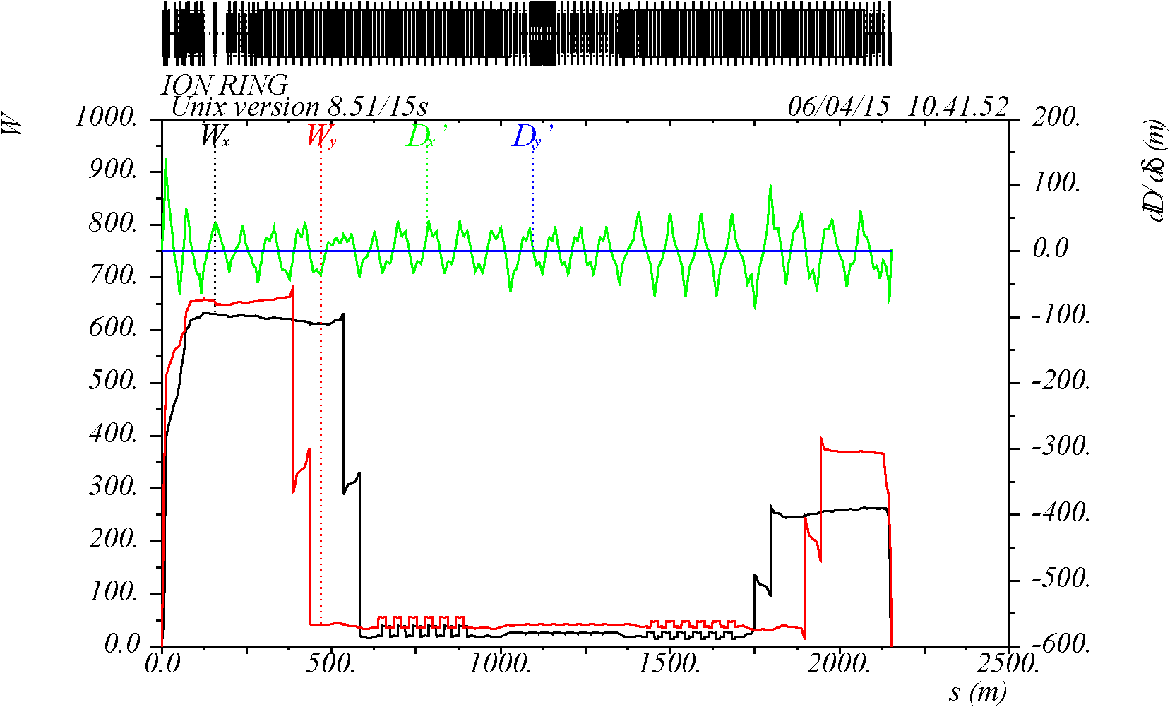
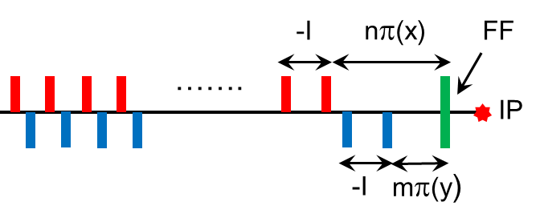
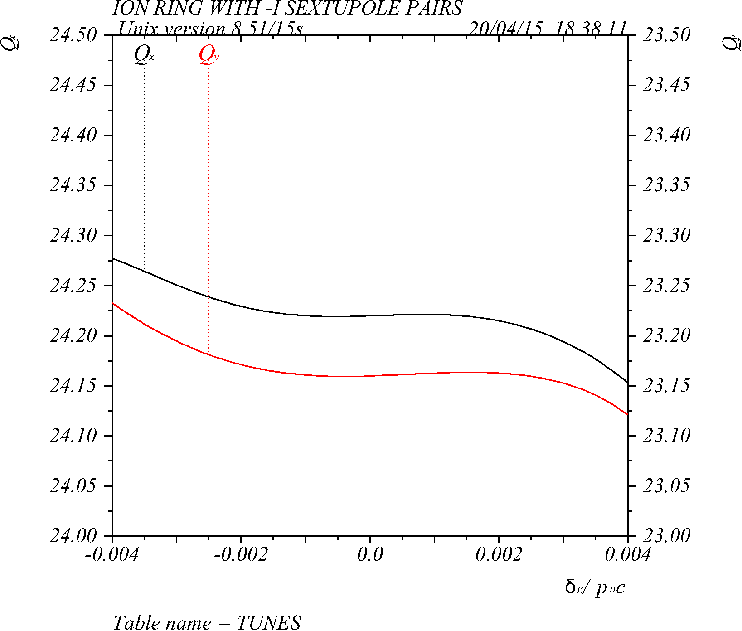
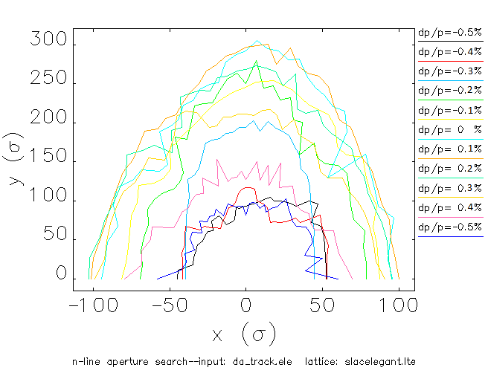
Non-Linear Dynamics in Ion Collider Ring
Chromaticity compensation
Momentum acceptance
Dynamic aperture
FF sext
Linear-ξ sext

Slide 24
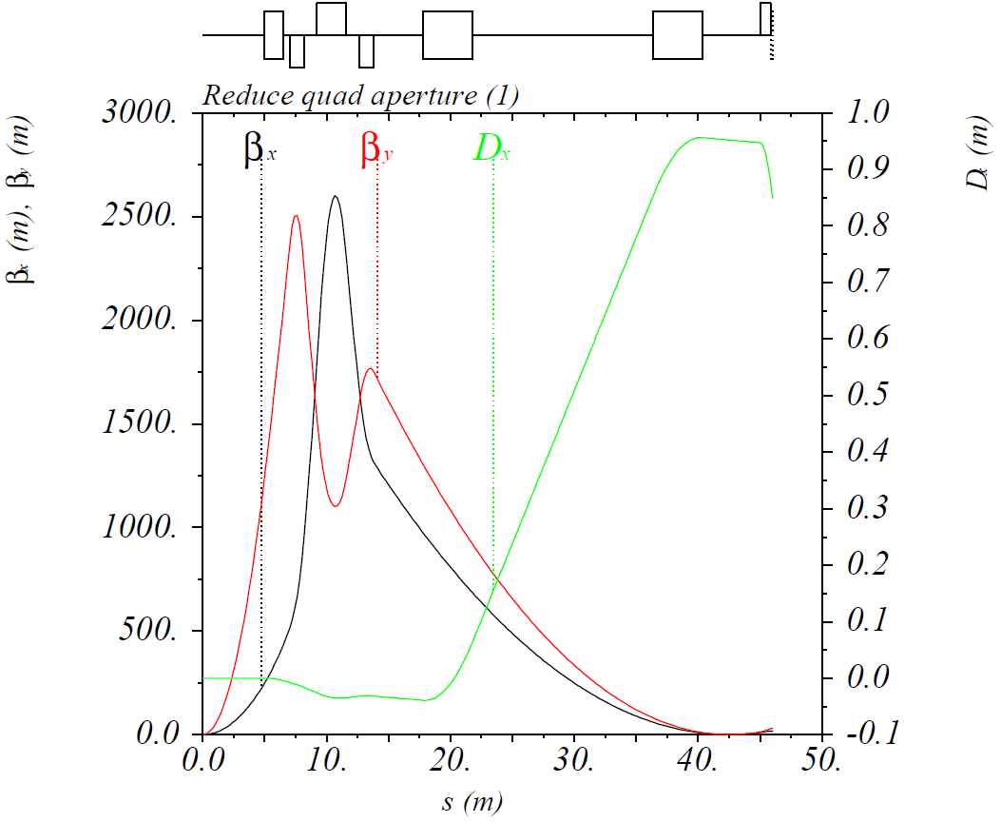
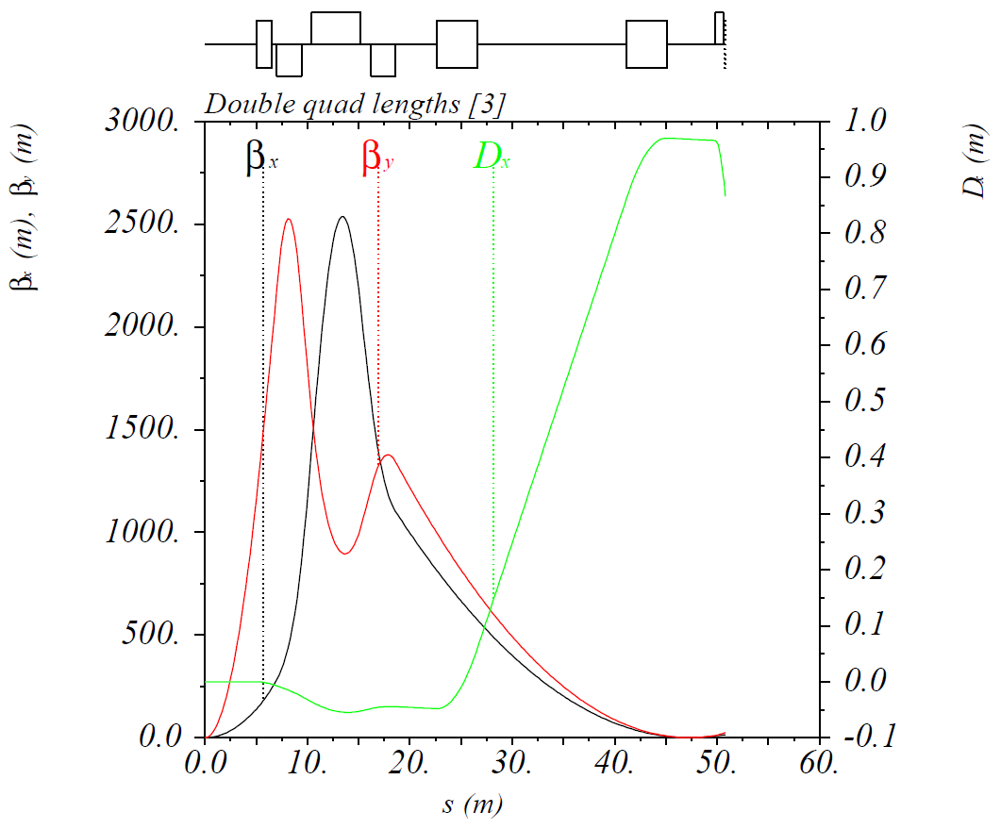
Towards 200 GeV Ion Complex
Not simply doubling of ion collider magnetic fields from 3 to 6 T
Consider crab cavity and bunching RF voltages
Consider impact on electron cooling
Doubling of FFQ lengths to preserve detector acceptance and keep their maximum fields at 6 T (to be discuss in more detail during the IR/MDI session)
Modification of ion spin rotators to use transverse fields for polarization control at higher energy

Slide 25
Conclusions
Optimization of the electron collider ring continued
  Spin rotator has been further optimized and now includes vertical doglegs
  Adopted distributed chromaticity compensation scheme
Further work on the electron collider ring
  Development of crab system
  Spin matching and spin tracking
  Non-linear dynamics design and optimization
  Development of the orbit diagnostics and control systems
Updates in the ion collider ring
  Optimization of electron cooling section
  Further development of the crab crossing system
  IR further optimized for detection requirements
Further work on the ion collider ring
  Update of the IR design for 200 GeV and its further optimization
  Further development of FFQ specifications
  Optimization of the crab crossing system
  Geometric match to the electron collider ring

