Slide 1
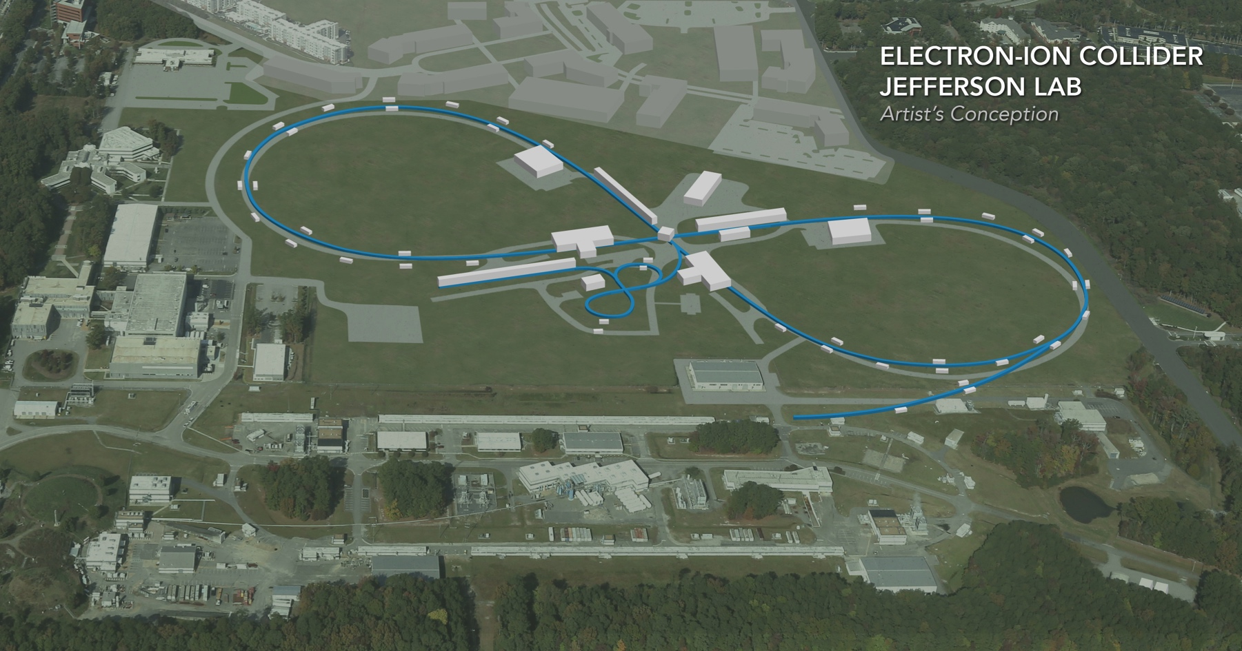
Jefferson Lab’s EIC Design
Fanglei Lin
on behalf of JLEIC collaboration
Outline:
Introduction
Design Concepts & Performance
Reference pCDR Design
Alternative Baseline Design
Summary
EIC Accelerator Collaboration Meeting
October 29 - November 1, 2018

Slide 2
JLEIC Collaboration
S. Benson, A. Bogacz, P. Brindza, A. Camsonne, P. Degtyarenko, E. Daly, Ya. Derbenev, M. Diefenthaler, K. Deitrick, D. Douglas, R. Ent, R. Fair, Y. Furletova, R. Gamage, D. Gaskell, R. Geng, P. Ghoshal, J. Grames, K. Jorden, J. Guo, F. Hanna, L. Harwood, T. Hiatt, H. Huang, A. Hutton, K. Jordan, A. Kimber, D. Kashy, G. Krafft, R. Lessiter, R. Li, F. Lin, M. Mamum, F. Marhauser, R. McKeown, T. Michalski, V. Morozov, E. Nissen, G. Park, H. Park, M. Poelker, T. Powers, R. Rajput-Ghoshal, R. Rimmer, Y. Roblin, T. Satogata, A. Seryi, M. Spata, R. Suleiman, A. Sy, C. Tennant, H. Wang, S. Wang, G. Wei, C. Weiss, M. Wiseman, R. Yoshida, H. Zhang, S. Zhang, Y. Zhang – JLab
Y. Cai, J. Fox, Y. Nosochkov, G. Stupakov, M. Sullivan, C. Tsai, M. Wang - SLAC
M. Blaskiewicz, H. Huang, Y. Luo, Q. Wu, F. Willeke – BNL J. Qiang, G. Sabbi - LBNL
Z. Conway, B. Mustapha, U. Wienands, A. Zholents – ANL D. Barber – DESY
Y. Hao, P. Ostroumov, A. Plastun , R. York - Michigan State University
S. Abeyratne, B. Erdelyi - Northern Illinois Univ., Z. Zhao - Duke Univ.
J. Delayen, C. Hyde, S. De Silva, S. Sosa, B. Terzic - Old Dominion Univ.
J. Gerity, T. Mann, P. McIntyre, N. Pogue, A. Sattarov - Texas A&M Univ.
P. Nadel-Turonski, - Stony Brook Univ., V. Dudnikov, R. Johnson - Muons, Inc.,
D. Abell, D. Bruhwiler, I. Pogorelov - Radiasoft, G. Bell, J. Cary - Tech-X Corp.,
A. Kondratenko, M. Kondratenko - Sci. & Tech. Laboratory Zaryad, Russia
Yu. Filatov - Moscow Institute of Physics and Technology, Russia
Y. Huang, X. Ma, L. Mao, Y. Yuan, H. Zhao, H.W. Zhao – IMP, China
F. Pilat – ORNL

Slide 3
Highlights on JLEIC Design Study
The design concepts (luminosity and polarization) have been stable over the last ~9 years
➔ It indicates they are mature and believed best for an EIC at Jefferson Lab
Implementation and choice of parameters have been continuously improved for better performance and reduction of technical risks
Latest major design optimization includes
Replacing super-ferric magnets by conventional cos-theta type SC magnets
(➔ risk reduction & CM energy increase)
Considered/studied/evaluated new magnets for the electron ring
(➔ performance enhancement)
Significant progress in many other areas of design study:
Booster redesign; electron vertical chicane for IR;
Polarized beam design/simulations; beam-beam simulations; analyses of collective effects;
Bunched beam cooling experiment; developed a magnetized photo gun; high current, high power ERL/circulator ring (found a technical solution for transporting 1.6 nC (half the design value) bunch in the ERL/circulator ring)
Explored an alternative baseline design for JLEIC to reach a 100 GeV CM energy
Yves Roblin’s talk
Rui Li’s talk

Slide 4
Key Design Concepts
High luminosity: high collision rate of short
modest-charge low-emittance bunches
Small beam size
Small β* ⇒ Short bunch length ⇒ Low bunch charge, high repetition rate
Small emittance ⇒ Cooling
Similar to lepton colliders such as KEK-B
with L > 2×10³⁴ cm⁻²s⁻¹
$$L=f\frac{n_{1}n_{2}}{4πσ_{x}^{∗}σ_{y}^{∗}}\sim f\frac{n_{1}n_{2}}{εβ_{y}^{∗}}$$
High polarization: figure-8 ring design
Net spin precession zero
Spin easily controlled by small magnetic fields for any particle species
Full acceptance primary detector including far-forward acceptance
Beam Design
High repetition rate
Low bunch charge
Short bunch length
Small emittance
IR Design
Small β*
Large beam-beam
Crab crossing
Damping Design
Synch. radiation
Beam cooling

Slide 5
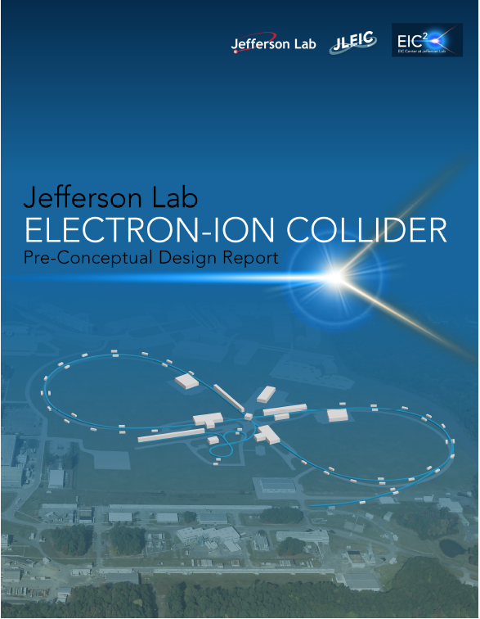
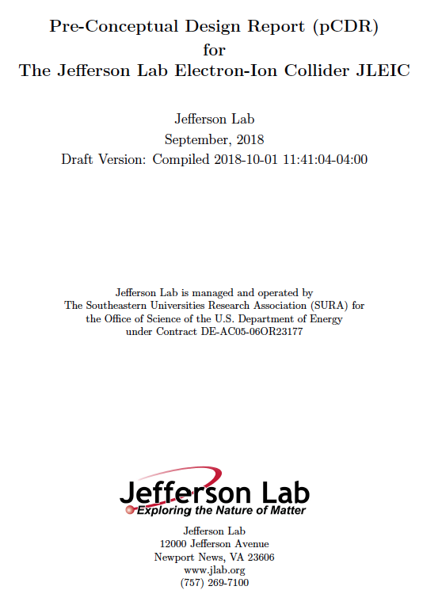
JLEIC pre-CDR
Objectives:
Document JLEIC self-consistent design (√s = 65 GeV)
Update, integrate, expand previous documents
Document enough detail for reasonable cost estimates
Establish infrastructure to maintain consistency
Establish documentation trail and reference tech note series
Balance deliverable scope with resources
399 page document delivered to lab leadership on Oct. 1, reviewed by external visitors Oct. 1-5
12 chapters → reference pCDR design
Appendix A: Higher Center-of-Mass Energy Alternative
with CM energy up to 100 and 140 GeV
Reference pCDR design has many strengths:
high polarization
high luminosity
high figure of merit
well-integrated hadron facility and IR for physics goals
Develop energy reach and optimize √s=100 GeV

Slide 6
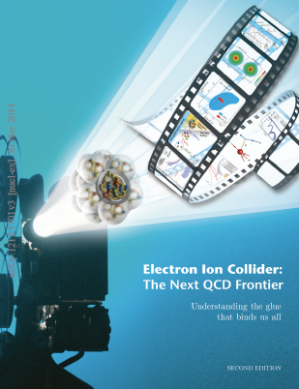
Achieved Goals in Reference pCDR Design
Consistent with the EIC White Paper requirements
Energy
Coverage of CM energy from 15 to 65 GeV
Electrons 3-12 GeV, protons 20-100 GeV, ions 12-40 GeV/u
Ion species
Polarized light ions: p, d, ³He, and possibly Li
Un-polarized light to heavy ions up to A above 200 (Au, Pb)
Support 2 detectors
Full acceptance capability is critical for the primary detector
Luminosity
10³³ to 10³⁴ cm⁻²s⁻¹ per IP in a broad CM energy range
Polarization
At IP: longitudinal for both beams, transverse for ions only
All polarizations >70%
Capability for upgrade to higher CM energy ~ 140 GeV
EIC Science White Paper
JLEIC pCDR

Slide 7
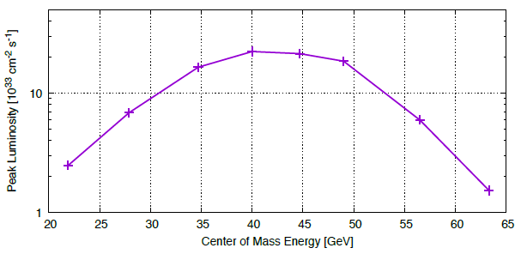
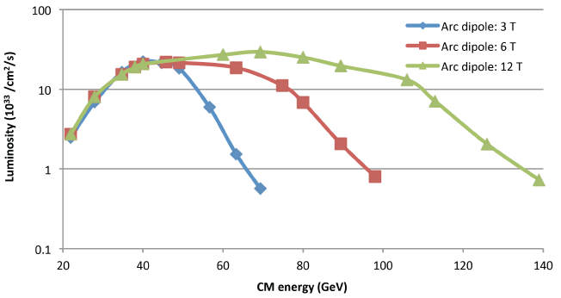
JLEIC e-p Parameters and Luminosity Performance
CM energy | GeV | 21.9 (low) |  | 44.7 (medium) |  | 63.3 (high)
 |  | p | e | p | e | p | e
Beam energy | GeV | 40 | 3 | 100 | 5 | 100 | 10
Collision frequency | MHz | 476 |  | 476 |  | 476
Particles per bunch | 10¹⁰ | 0.98 | 3.7 | 0.98 | 3.7 | 0.98 | 0.93
Beam current | A | 0.75 | 2.8 | 0.75 | 2.8 | 0.75 | 0.71
Polarization | % | 80 | 80 | 80 | 80 | 80 | 75
Bunch length, RMS | cm | 1 | 1 | 1 | 1 | 1 | 1
Norm. emitt., horiz./vert. | μm | 0.3 | 24 | 0.5/ 0.1 | 54/ 10.8 | 0.9/ 0.18 | 432/ 86.4
Horiz, & verti. β* | cm | 8/8 | 13.5/ 13.5 | 6/1.2 | 5.1/1 | 10.5/2.1 | 4/0.8
Vert. beam-beam param. |  | 0.015 | 0.09 | 0.015 | 0.068 | 0.002 | 0.009
Laslett tune-shift |  | 0.06 |  | 0.055 |  | 0.03
Detector space, up/down | m | 3.6/7 | 2.96/2.2 | 3.6/7 | 2.96/2.2 | 3.6/7 | 2.96/2.2
Hourglass(HG) reduction |  | 1 |  | 0.87 |  | 0.86
Lumi./IP, w/HG, 10³³ | cm⁻²s⁻¹ | 2.5 |  | 21.4 |  | 1.7
Beam-beam limit
Space charge limit
Syn. Rad. limit
Reference pCDR design
Similar high performance for electron-ion (e-A) collisions

Slide 8
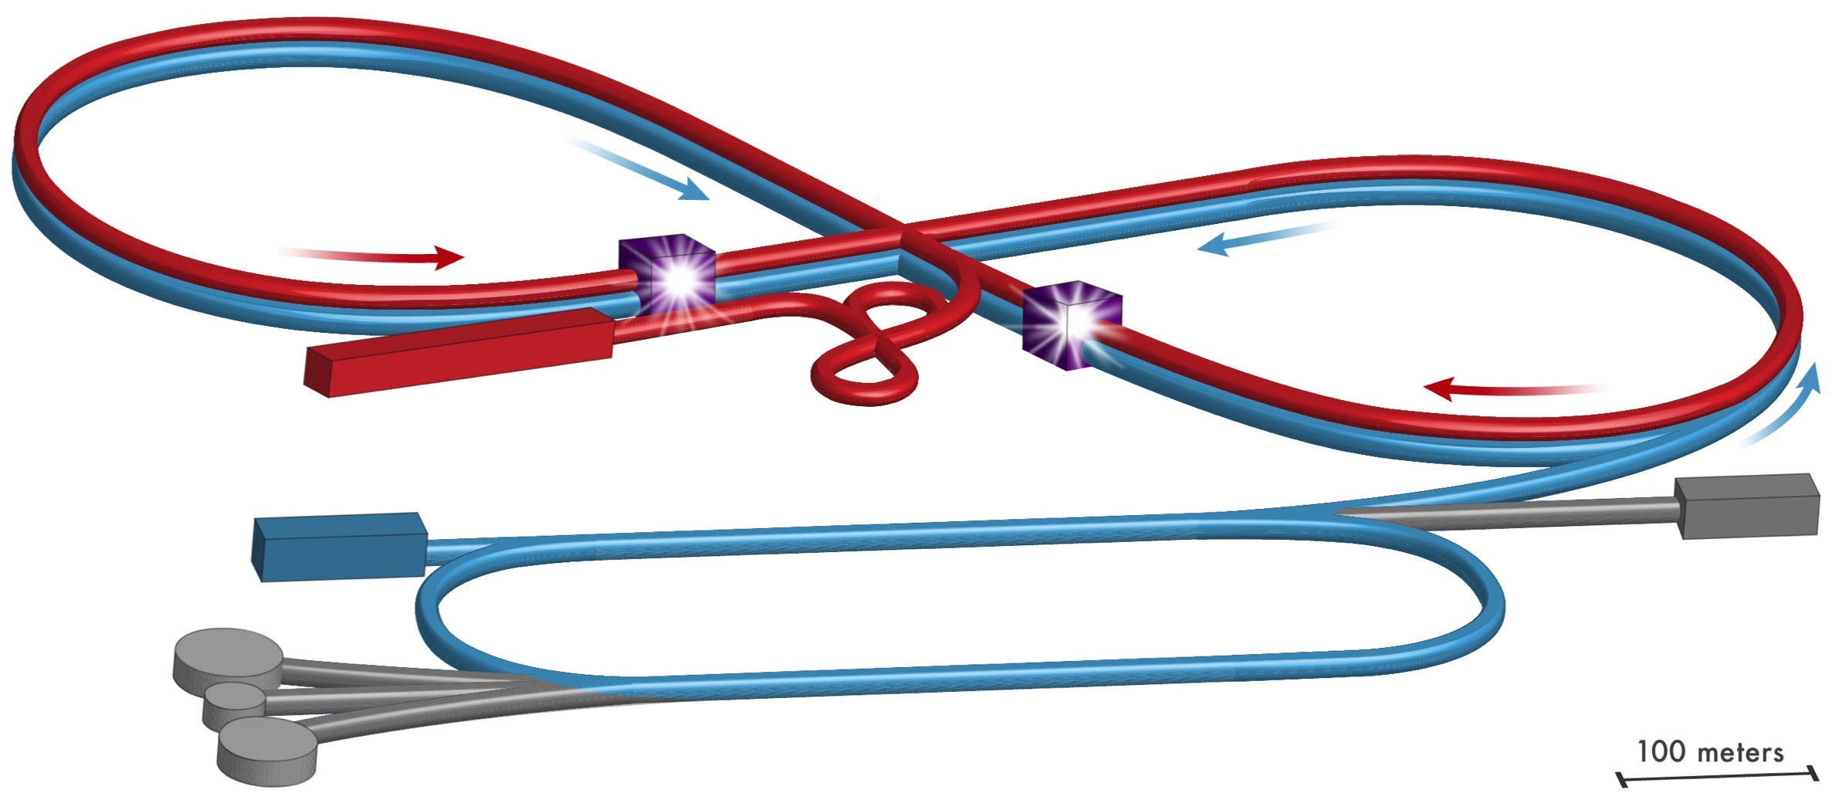
JLEIC Layout
Electron complex
CEBAF as a full energy injector
Electron collider ring
Ion complex
Ion source
SRF linac
Booster
Ion collider ring

Slide 9
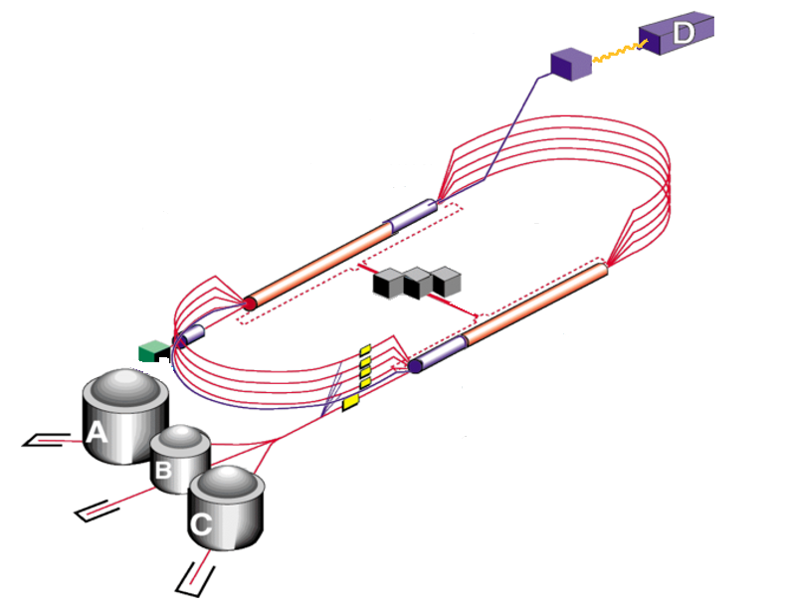
12 GeV CEBAF as a Full Energy Injector
Extensive fixed-target science program
Fixed-target program compatible with concurrent JLEIC operations
JLEIC injector
Fast fill of collider ring
Full energy
~90% polarization
Enables top-off
New operation mode but no hardware modifications
Up to 12 GeV
to JLEIC
Electron injection scheme --- Jiquan Guo’s talk

Slide 10
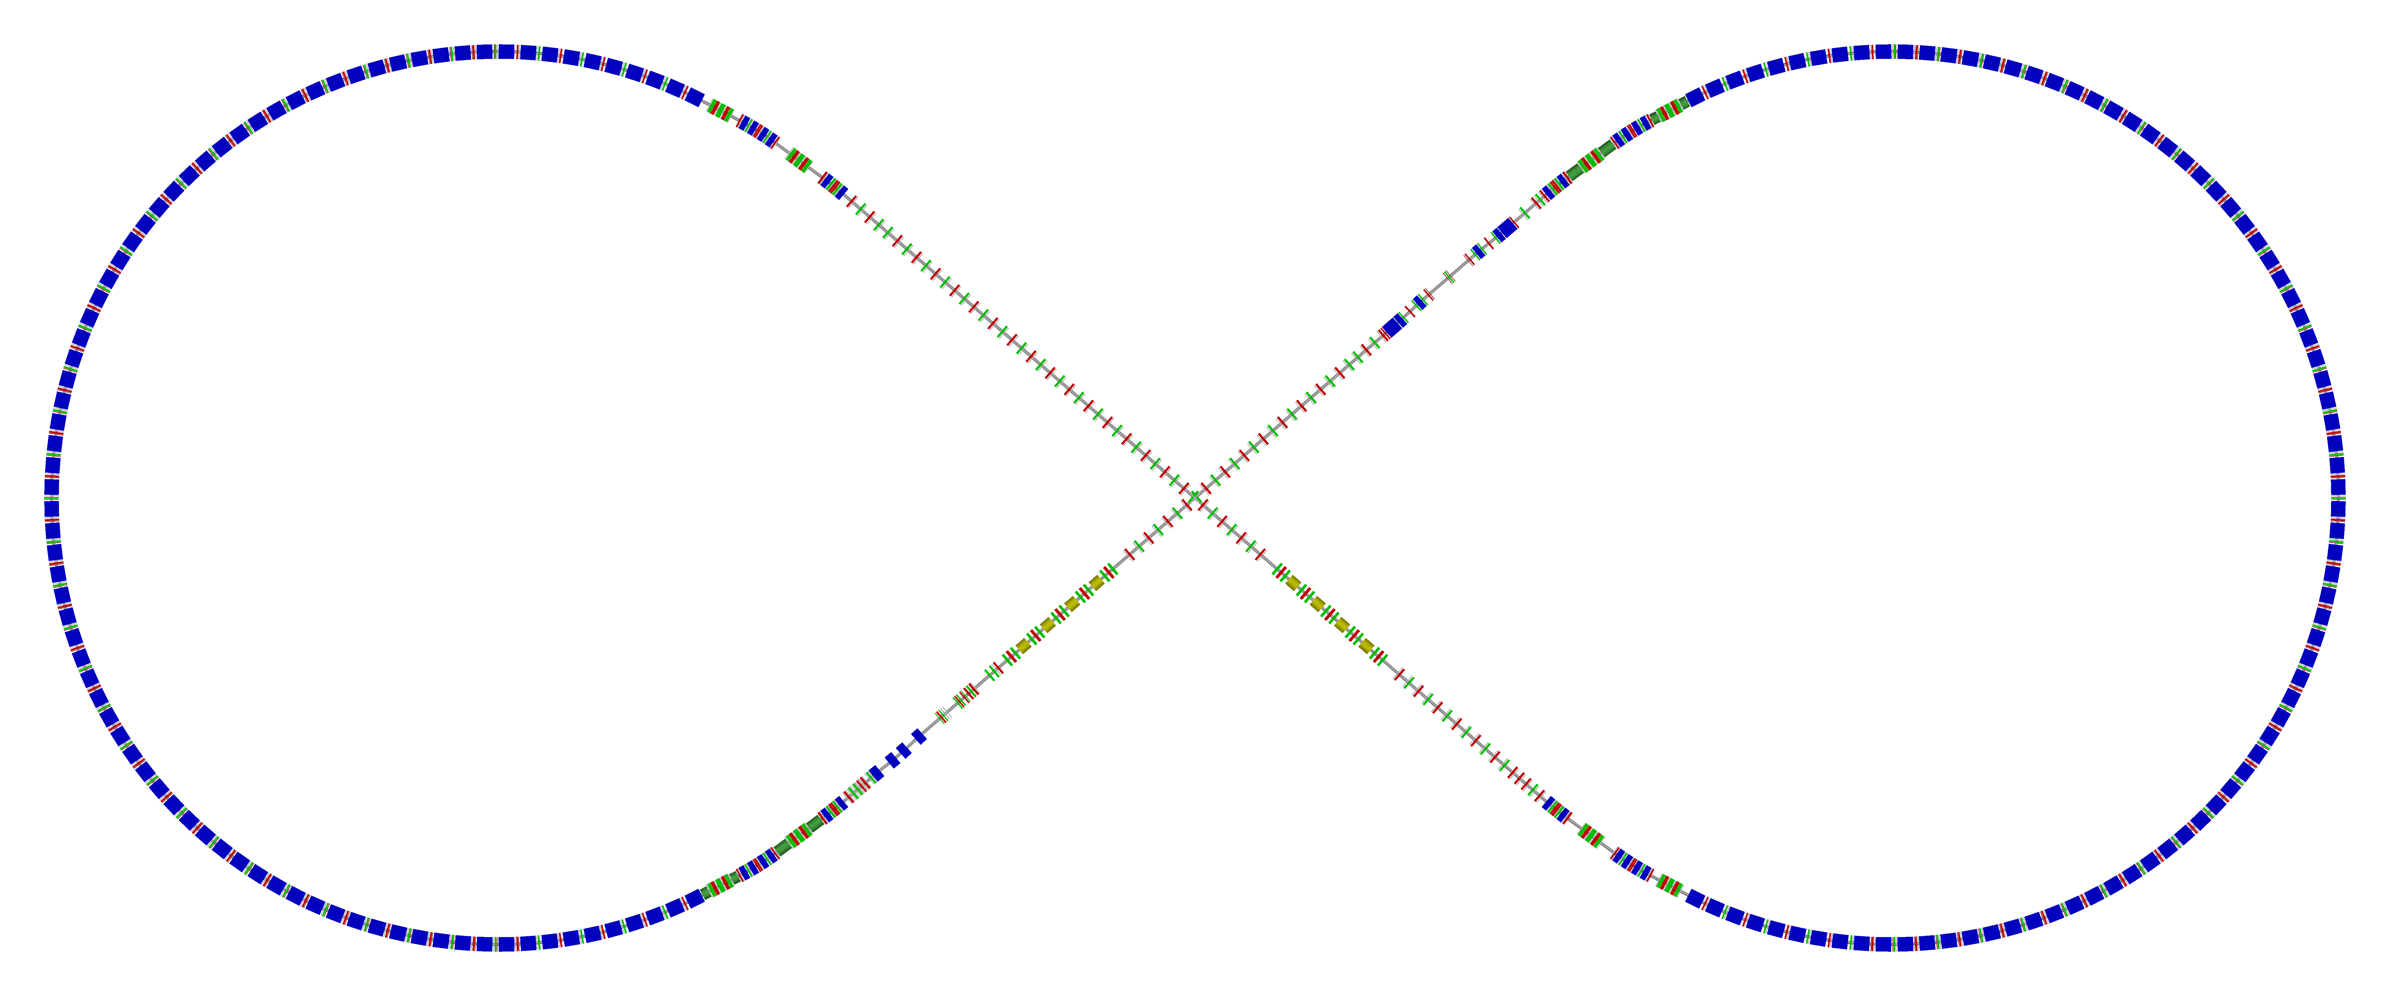
Electron Collider Ring Layout
Possible cost reduction by reusing PEP-II RF cavities, power sources and vacuum pipe
Spin rotator
Spin rotator
RF inserted
Tune trombone & Straight FODOs
R=155m
77.4°
e⁻
Arc, 257.4°
Future 2nd IP
Spin rotator
IP
Spin rotator
Forward e⁻ detection and polarimetry
Electron collider ring --- Vasiliy Morozov’s talk

Slide 11
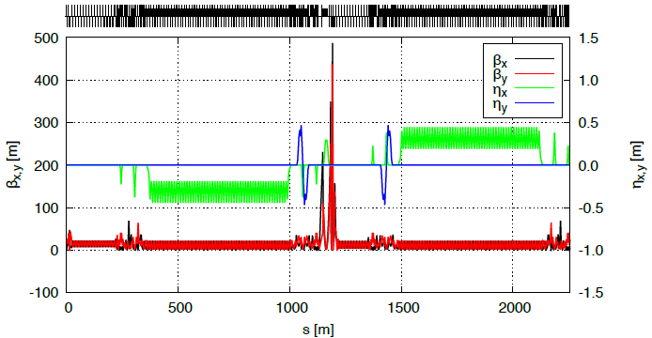
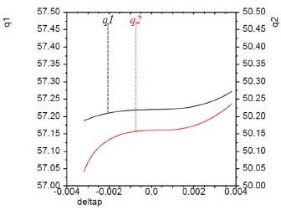
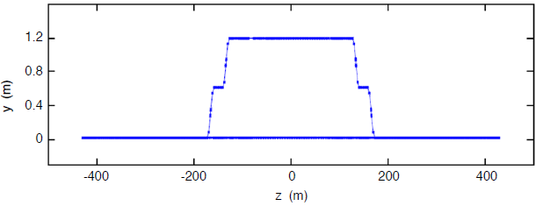
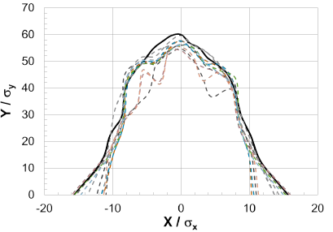
Electron Beam Dynamics
Linear optics
Global chromaticity compensation
Side-view layout
Dynamic aperture (w/ PEP-II systematic and random field errors)
w/o errors

Slide 12
Electron Beam
Electron beam
3 A at up to 6 GeV
Normalized horizontal emittance 44 µm @ 5 GeV
Synchrotron power density < 10 kW/m
Total power up to 10 MW
Nominal
SR limit
Beam energy | GeV | 3 | 5 | 6.9 | 9 | 10 | 12
Beam current | A | 3 | 3 | 2.6 | 1 | 0.67 | 0.17
Total SR power | MW | 0.4 | 2.9 | 8.8 | 9.8 | 10.0 | 5.3
Energy loss per turn | MeV | 0.12 | 0.93 | 3.4 | 9.8 | 14.9 | 30.8
Energy spread | 10⁻⁴ | 2.8 | 4.6 | 6.4 | 8.3 | 9.3 | 11.1
Transverse damping time | ms | 375 | 81 | 31 | 14 | 10 | 6
Longitudinal damping time | ms | 187 | 40 | 15 | 7 | 5 | 3
Normalized hor. emittance | um | 9.6 | 44 | 116 | 258 | 354 | 612
Normalized ver. emittance | um | 1.1 | 5.0 | 13.1 | 28.9 | 39.7 | 68.6

Slide 13
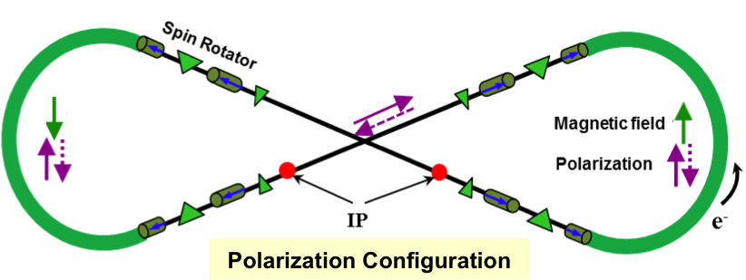
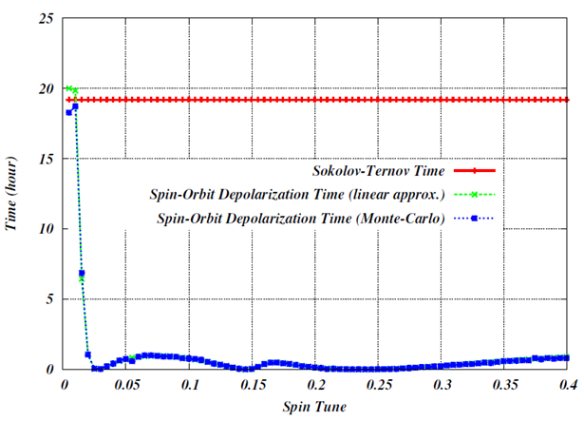
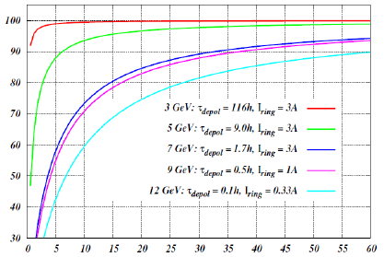
Electron Polarization
Two highly polarized bunch trains maintained by top-off
Universal spin rotator
Sequence of solenoid and dipole sections
Makes the spin longitudinal in the straights
Basic spin match
Lifetimes are the same for both states
Advantage of figure-8 geometry: minimum depolarization demonstrated by spin tracking
Optimum Spin Tune 0.01 with a 1 T.m solenoid
Time (hours)
P_{equ}/P₀ (%)
Energy (GeV) | 3 | 5 | 7 | 9 | 12
Lifetime (hours) | 116 | 9 | 1.7 | 0.5 | 0.1
Electron polarization --- Fanglei Lin’s talk
Electron polarimetry in EIC --- David Gaskell’s talk
Spin tune
Average injected current (nA)

Slide 14
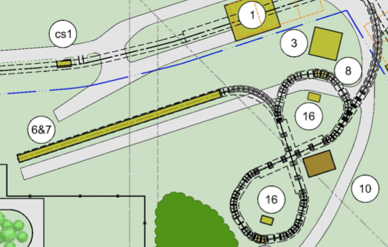
Ion Injector Complex Overview
Ion linac (280 MeV H-)
Booster (280 MeV- 8 GeV)
Ion sources
Ion injector complex relies on demonstrated technologies for sources and injectors
Atomic Beam Polarized Ion Source (ABPIS) for polarized or unpolarized light ions, Electron Beam Ion Source (EBIS) and/or Electron Cyclotron Resonance (ECR) ion source for unpolarized heavy ions
SRF linac is based on ANL design
8 GeV Booster with no transition energy crossing
Injection/extraction lines to/from Booster are designed

Slide 15
Ion Injector Linac Design
Two RFQs: One for light ions (A/q ≤ 2) and one for heavy ions (A/q ≤ 7)
Different emittances and voltage requirements for polarized light ions and heavy ions
Separate LEBTs and MEBTs for light and heavy ions
RT Structure: IH-DTL with FODO Focusing Lattice
Stripper section for heavy-ions followed by an SRF section
Pulsed Linac: up to 10 Hz repetition rate and ~ 0.5 ms pulse length
100 MHz
200 MHz
(Pb⁶⁷⁺) 100 MeV/u
(H-). 280 MeV
Normal conducting
Superconducting
JLEIC SRF --- Robert Rimmer’s talk

Slide 16
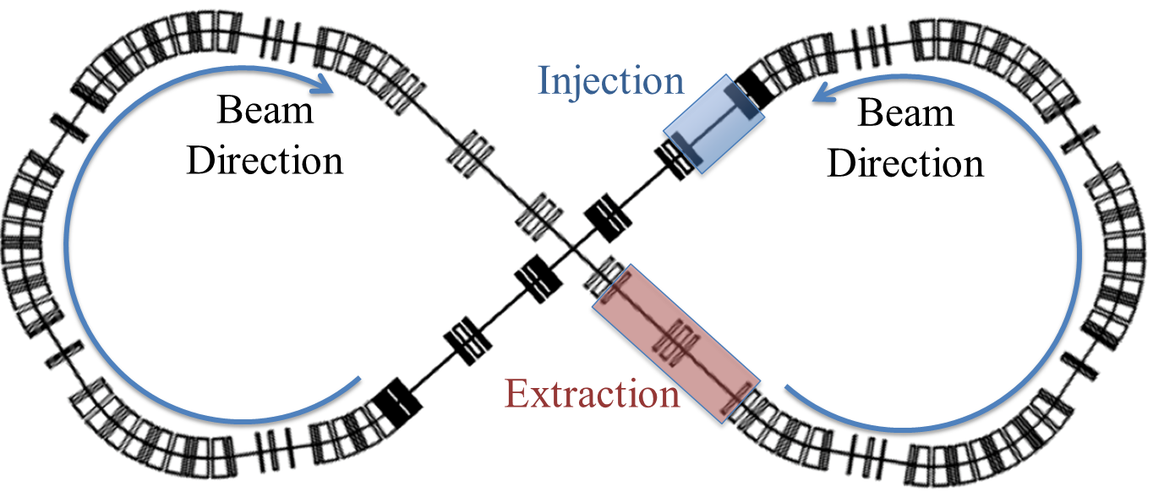
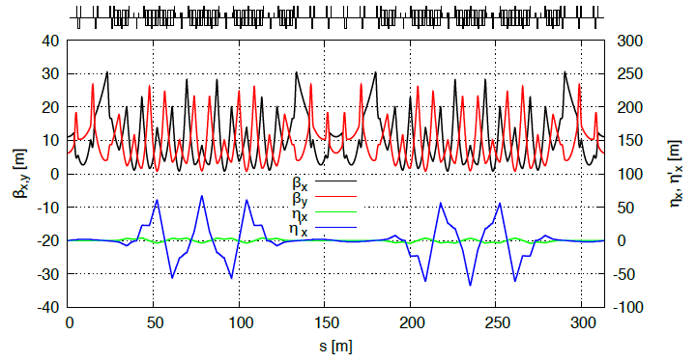
Booster
8 GeV/c Booster serves for
Accumulation of ions injected
from Linac Cooling
Acceleration of ions
Extraction and transfer of ions to the collider ring
Electron cooling for heavy ions
Injection
$H^{−}$ single pulse charge stripping at 280 MeV (pulse length is 0.5 ms long or 305 turns)
Phase-space painting
Design
Circumference of 313 m
No transition energy crossing, $γ_{t}=18.64$
Figure-8 shape for preserving ion polarization
Ion booster --- Edy Nissen’s talk

Slide 17
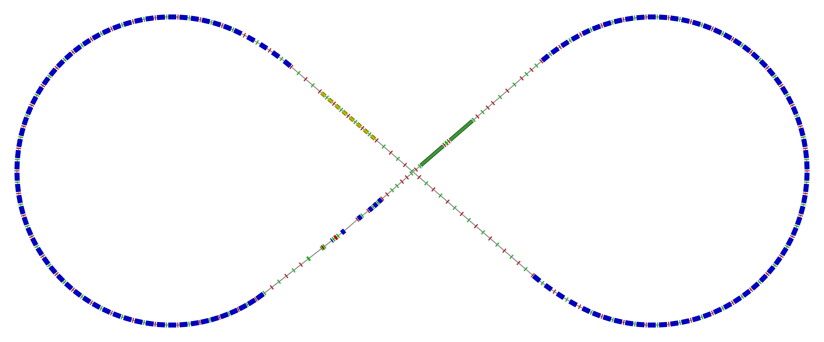
Ion Collider Ring Layout
Protons: 100 GeV/u (63 GeV/u in COM with 10 GeV e) Lead: 40 GeV/u (40 GeV/u in COM with 10 GeV e)
3 T $\cos{θ}$ conventional superconducting magnets
disp. supp./
geom. match #3
disp. supp./
geom. match #2
norm.+
SRF
Arc, 257.4°
elec. cool.
tune
tromb.+
match
77.4°
R = 155.5 m
future 2nd IP
Polarimeter
det. elem.
disp. supp.
ions
beam exp./
match
IP
disp. supp./
geom. match #3
disp. supp./
geom. match #1
Ion collider ring --- Vasiliy Morozov’s talk
Ion beam bunching splitting --- Randika Gamage’s talk

Slide 18
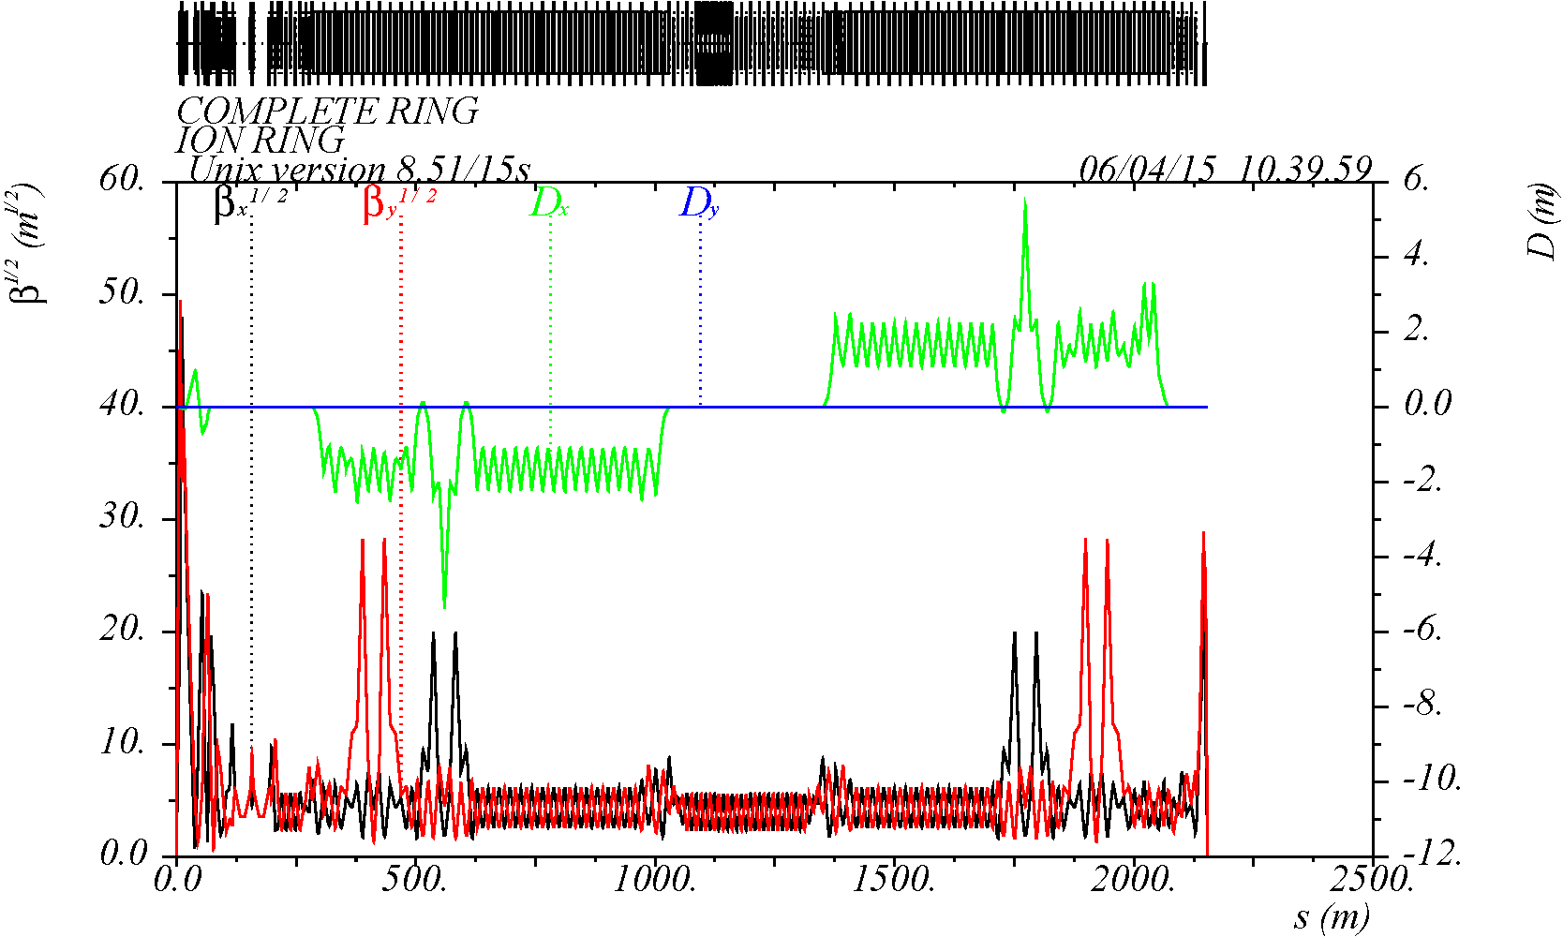
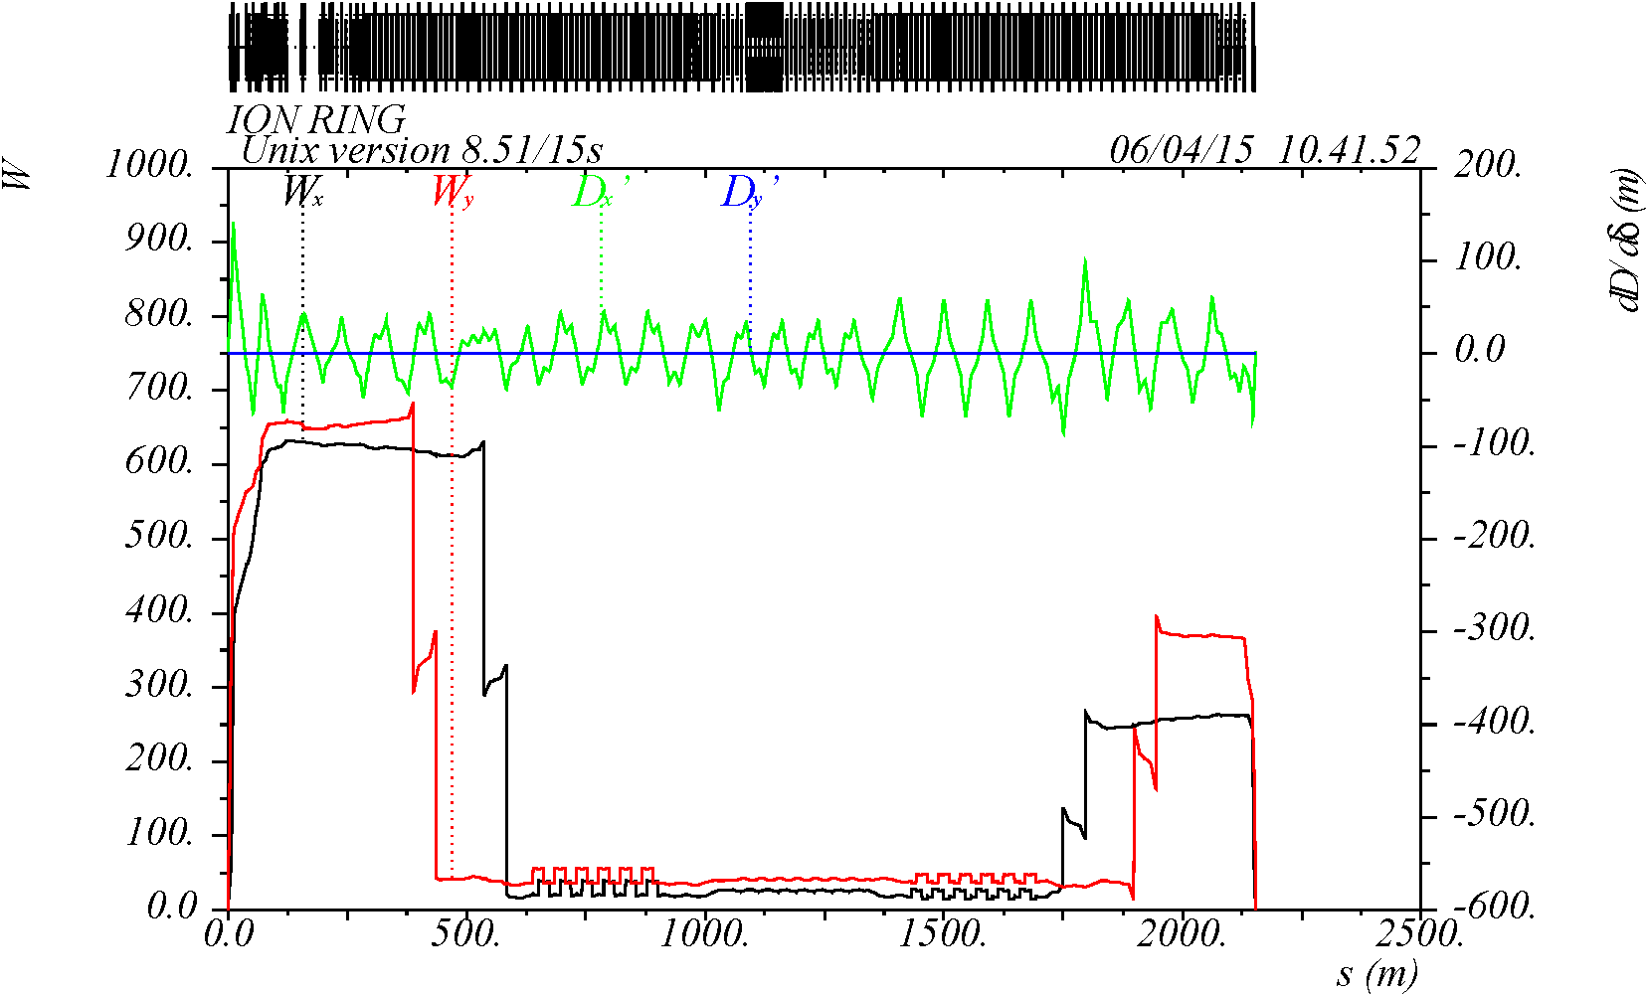
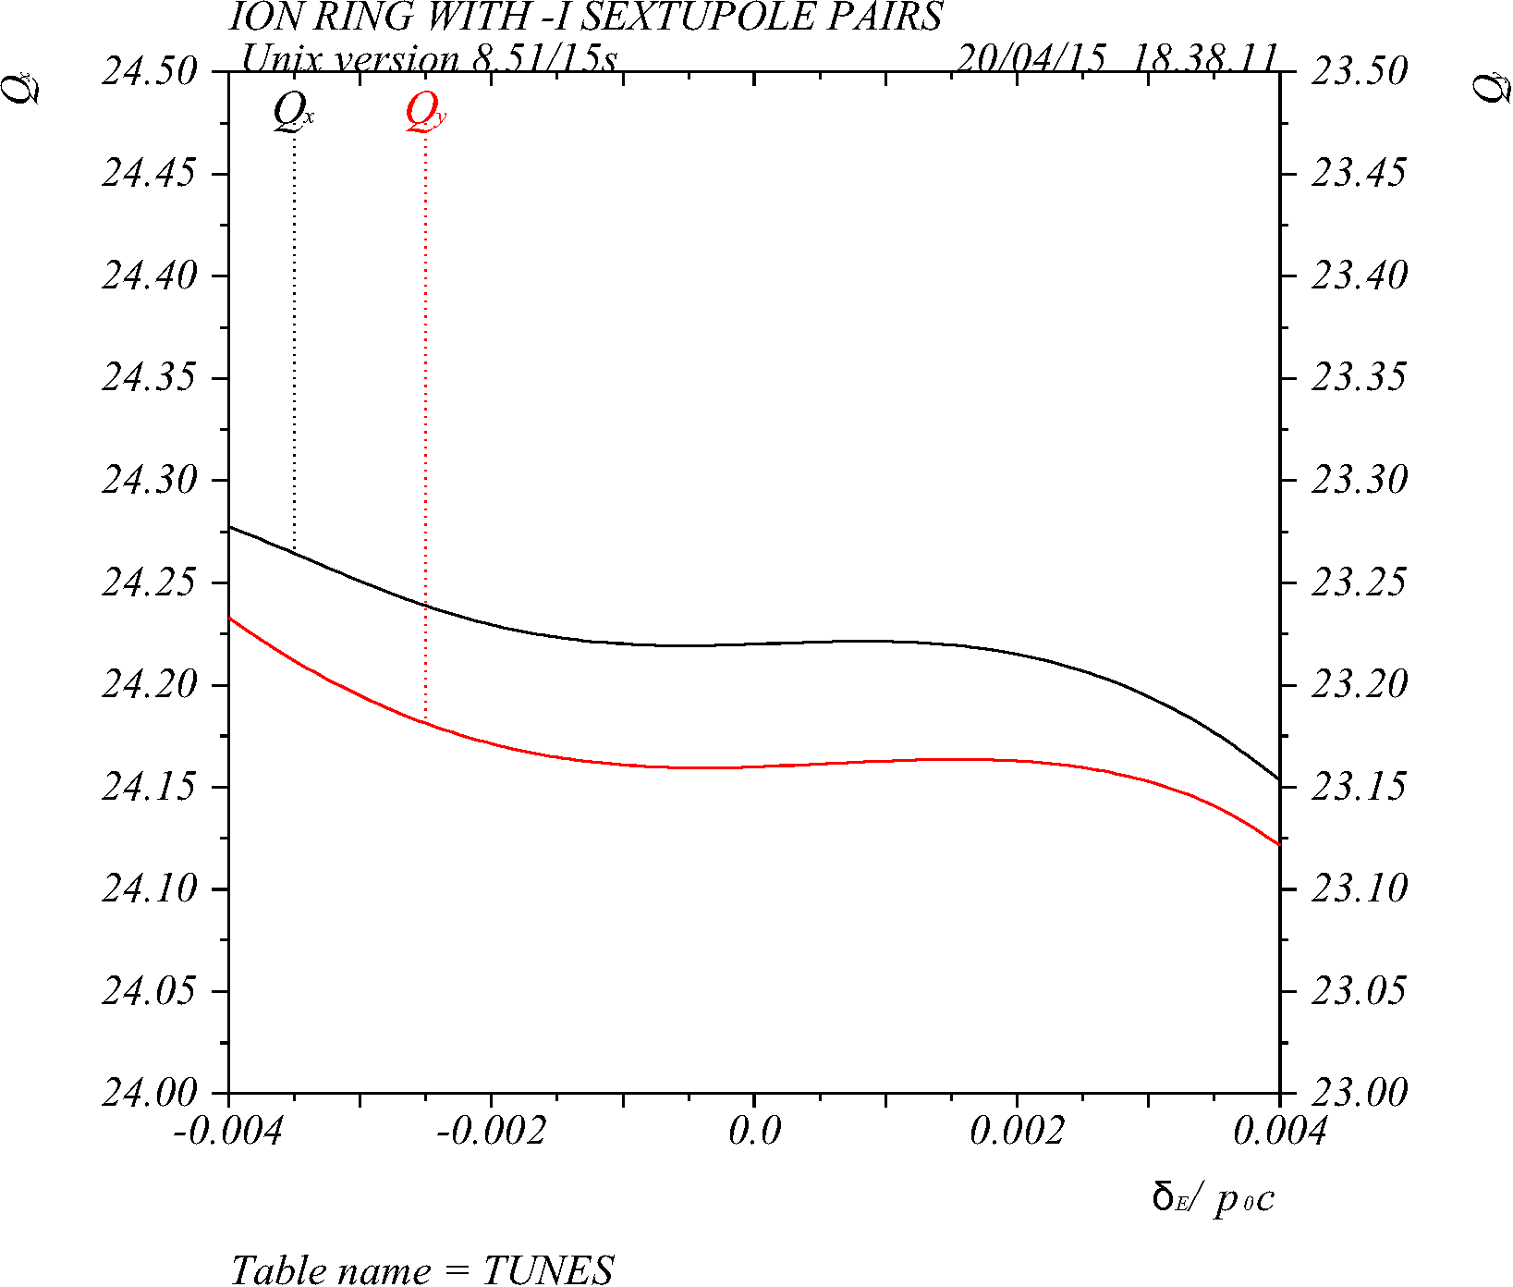
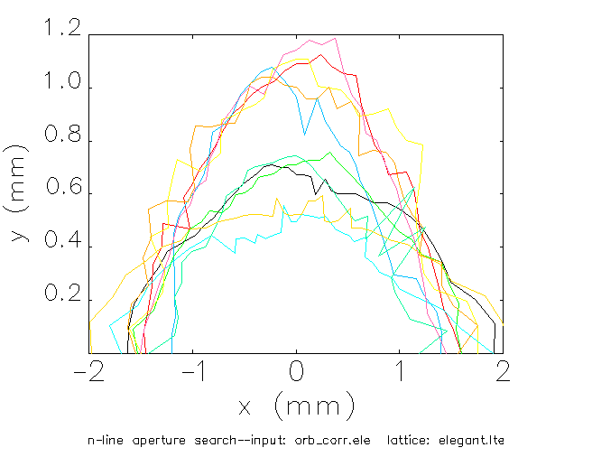
Ion Beam Dynamics
Linear optics
Momentum acceptance
Chromaticity compensation
Dynamic aperture
IP
with errors and correction 10 seeds
collaboration with SLAC
±50σ
-12 -6 0 6 12
σ_{Δp/p}

Slide 19
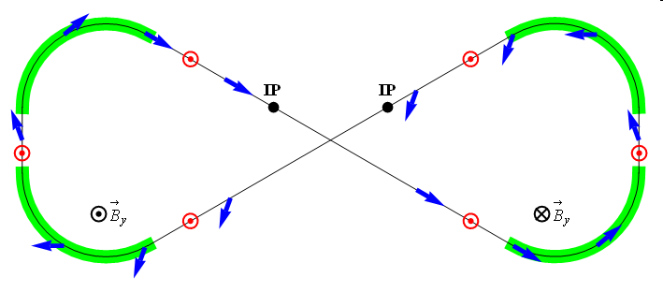
Ion Polarization
Figure-8 concept: Spin precession in one arc is exactly cancelled in the other
Spin stabilization by small fields: ~3 Tm vs. < 400 Tm for deuterons at 100 GeV
Criterion: induced spin rotation >> spin rotation due to orbit errors
3D spin rotator: combination of small rotations about different axes provides any polarization orientation at any point in the collider ring
No effect on the orbit
Polarized deuterons
Frequent adiabatic spin flips
$${\vec{B}}_{y}$$
$${\vec{B}}_{y}$$
ν = 0
ν = 0
Ion polarization --- Fanglei Lin’s talk
Spin transparency study and test --- Vasiliy Morozov’s talk

Slide 20
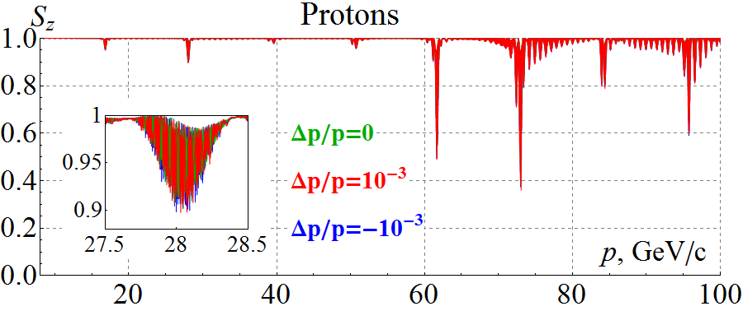
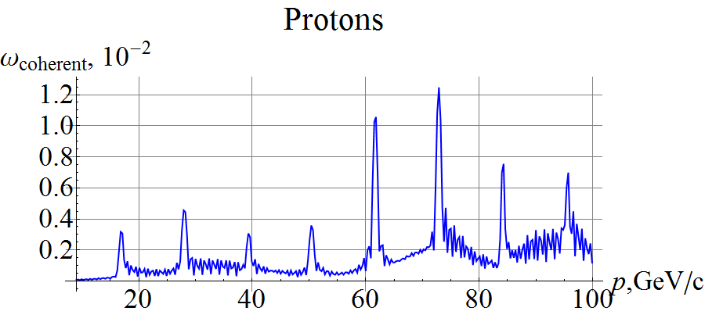
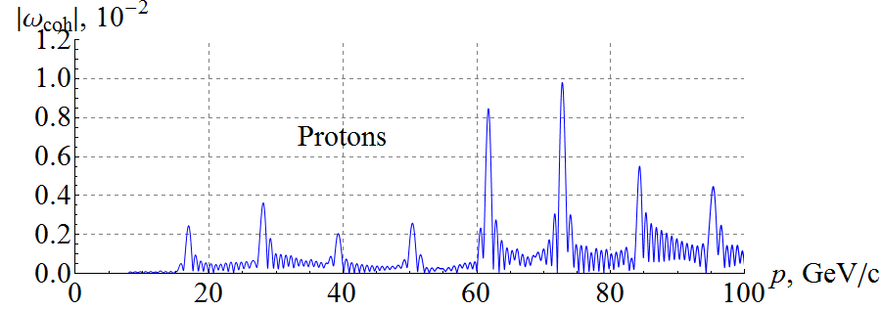
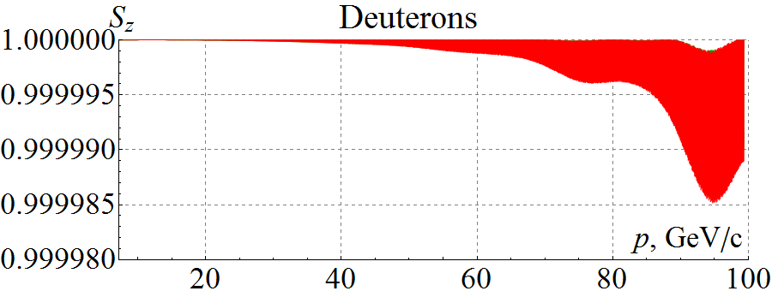
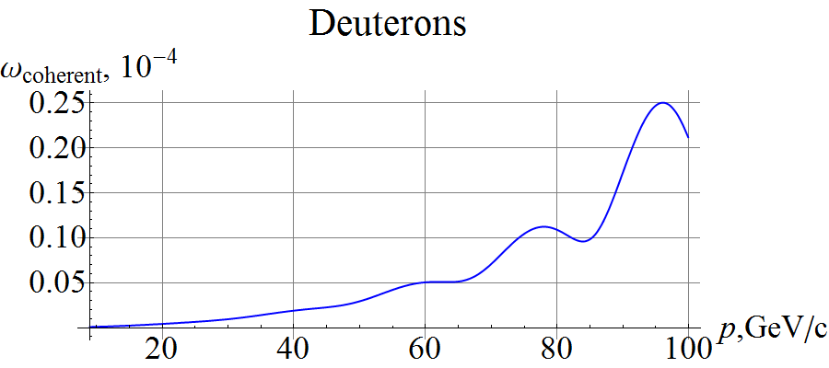
Start-to-End Proton and Deuteron Acceleration in Ion Collider Ring
Three protons with $ε_{x,y}^{N}=1 μm$ and ${Δp}/p=0, ±1⋅{10}^{−3}$ accelerated at ~3 T/min in lattice with 100 μm rms CO excursion, $ν_{sp}=0.01$ (1.2 Tm solenoid)
Coherent resonance strength component
Three deuterons with $ε_{x,y}^{N}=0.5 μm$ and ${Δp}/p=0, ±1⋅{10}^{−3}$ accelerated at ~3 T/min in lattice with 100 μm rms closed orbit excursion, $ν_{sp}=3⋅{10}^{−3}$
Deuteron spin is highly stable in figure-8 rings, which can be used for high precision experiments
Zgoubi simulation
Analytic prediction
Zgoubi simulation
(Zgoubi simulation)
Analytic prediction

Slide 21
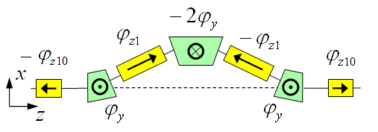
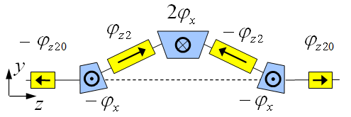
3D Spin Rotator in Ion Collider Ring
Provides control of the radial, vertical, and longitudinal spin components
Module for control of the radial component (fixed radial orbit bump)
Module for control of the vertical component (fixed vertical orbit bump)
Module for control of the longitudinal component
3D spin rotator
IP
ions

Slide 22
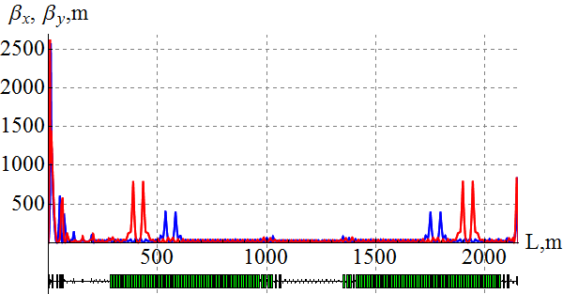
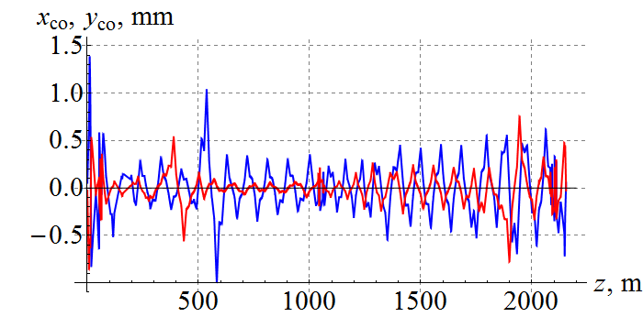
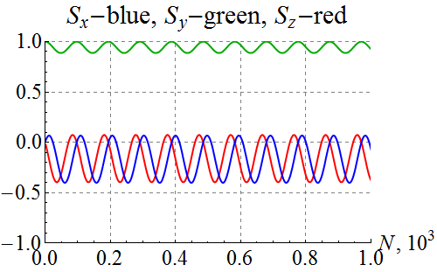
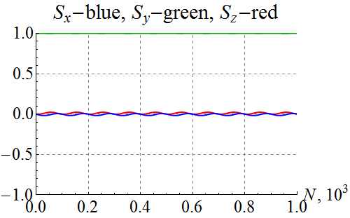
Polarization Control in Ion Collider Ring
100 GeV/c figure-8 ion collider ring with transverse quadrupole misalignments
Example of vertical proton polarization at IP. The 1st 3D rotator: ν = 10⁻² , n_{y}=1. The 2nd 3D rotator is used for compensation of coherent part of the zero-integer spin resonance strength
1st 3D rotator for control
2nd 3D rotator for compensation
without compensation
with compensation

Slide 23
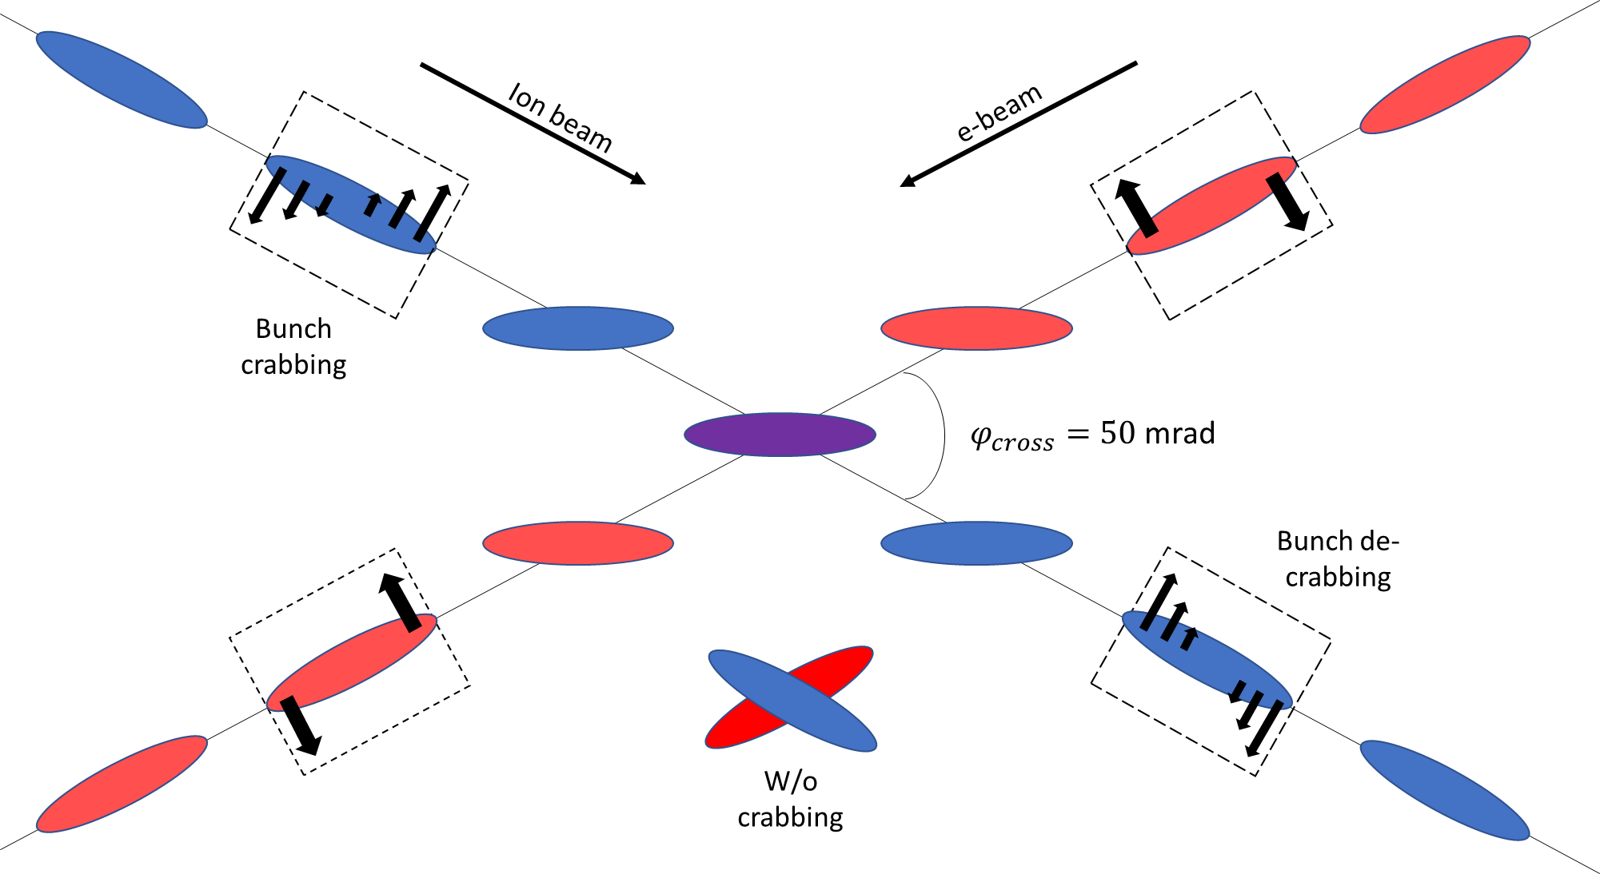
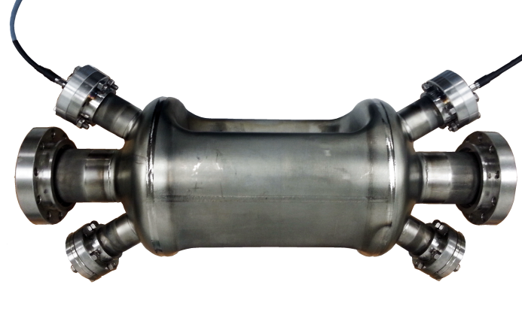
Crab Crossing
Electron and ion beams have to cross at an angle in an EIC
Create space for independent electron and ion IR magnets
Avoid parasitic collisions of shortly-spaces bunches
Improves detections
Improves detector background
Without compensation, geometric luminosity loss is about a factor of 12 and there is potential for dynamic instabilities
Crabbing restores effective head-on collisions
Local compensation scheme
Set of crab cavities upstream and downstream of IP
Deflective crabbing
Demonstrated at KEK-B
Tested with ions at LHC
Prototype developed at ODU
Crab-cavity tests of hadron beams in SPS --- HyeKyoung Park ’s talk

Slide 24
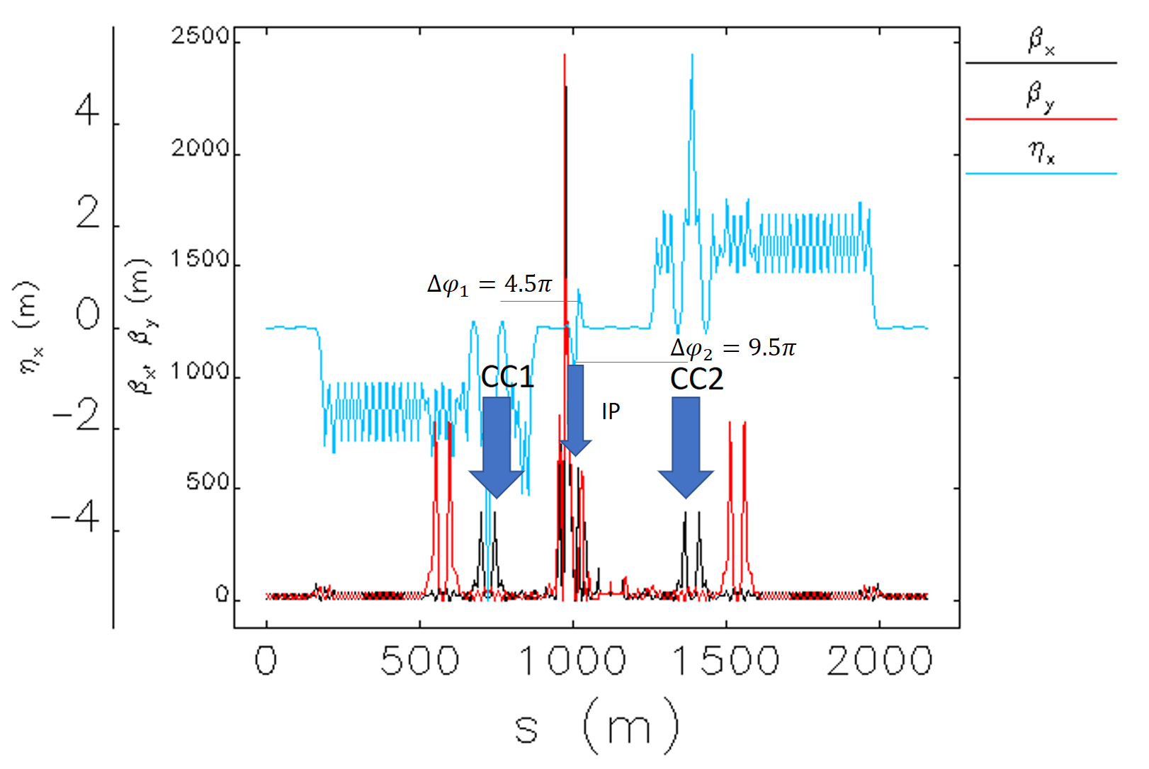
Crab Crossing Scheme of JLEIC
Local compensation scheme: set of crab cavities upstream and downstream of IP
Locations of horizontal chromatic sextupoles are also adequate for crab cavities:
Right phase advance
High $β_{x}$ values
Found that sextupoles between crab cavities may lead to emittance increase, avoid them
Dispersion at the crab cavities satisfies the beam stability criterion

Slide 25
Multi-Step Cooling Scheme
Cooling of JLEIC proton/ion beams for
Achieving small emittance (~10x reduction)
Reaching short bunch length ~1 cm (with SRF)
Suppressing IBS induced emittance degradation
Pre-cool when energy is low
Booster
0.280 to 8 GeV
Collider ring
8 to 100 GeV
Cool when emittance is small
(after pre-cool at low energy)
Ring | Functions | Kinetic energy (GeV / MeV) |  |  | Cooler type
 |  | Proton | Lead ion | Electron
booster ring | Accumulation of positive ions |  | 0.1 (injection) | 0.054 | DC
collider ring | Maintain emitt. during stacking | 7.9 (injection) | 2 (injection) | 4.3 (for proton) 1.1 (for lead) | DC
 | Pre-cooling for emitt. reduction | 7.9 (injection) | 7.9 (ramp to) | 4.3 | DC
 | Maintain emitt. during collision | Up to 100 | Up to 40 | Up to 54.5 | BBC/ERL

Slide 26
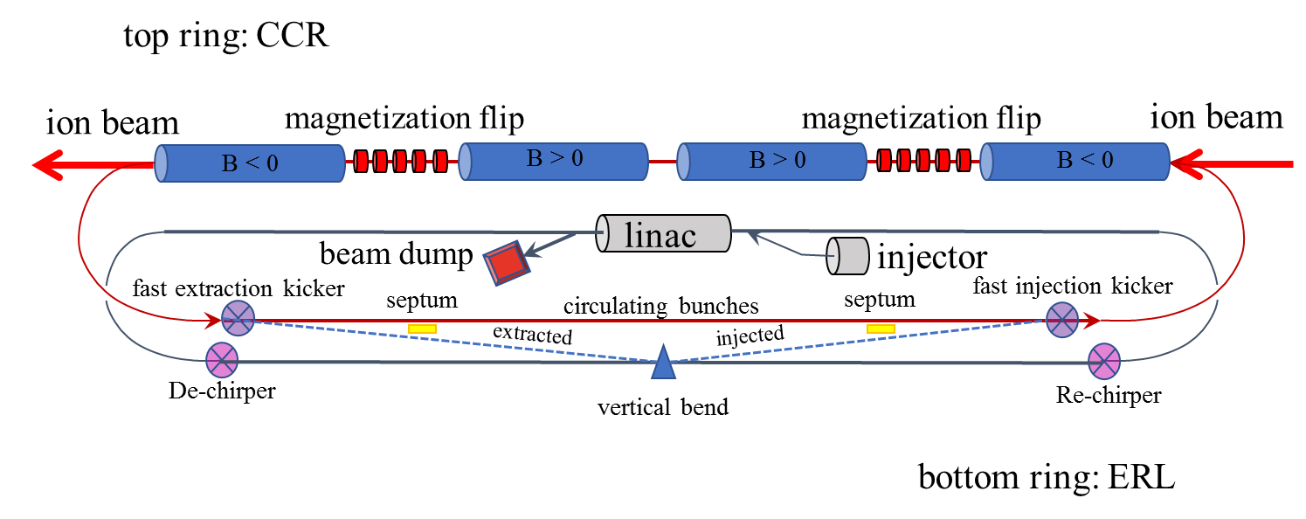
Cooling Ring Fed by ERL
Same-cell energy recovery in 952.6 MHz SRF cavities
Uses harmonic kicker to inject and extract from CCR (divide by 11)
Assumes high charge, low rep-rate injector (w/ subharmonic acceleration and bunching)
Use magnetization flips to compensate ion spin effects
Development of ERL electron cooler --- Stephen Benson’s talk
Bunched beam electron cooling --- Haipeng Wang’s talk
Magnetized electron source --- Md Abdullah Mamun’s talk
Beam dynamics in CCR --- Christ Tennant’s talk
Harmonic kicker --- Gunn Park’s talk
Straight merger test --- Kirsten Deitrick’s talk
Electron cooling simulation --- He Zhang’s talk
ERL cooler beam test at FAST --- Phillipe Piot’s talk

Slide 27
Interaction Region Concept
Possible to get ~100% acceptance for the whole event
Central Detector/Solenoid
Ion beamline
Scattered Electron
Electron beamline
Dipole
Dipole
Forward (Ion) Detector
Particles Associated with struck parton
Particles Associated
with Initial Ion
EIC detector requirement --- Rik Yoshida’s talk

Slide 28
Detector Region
Integrated detector region design developed satisfying requirements of detection, beam dynamics and geometric match
GEANT4 detector model developed, simulations in progress
IP
e
Compton polarimetry
forward ion detection
ions
forward e detection
spectrometers
dispersion suppressor/
geometric match
p
(top view in GEANT4)
e
low-Q² electron detection
and Compton polarimeter
Forward hadron spectrometer
ZDC
JLEIC IR design update --- Vasiliy Morozov’s talk
IR magnet layout/design – JLEIC --- Tim Michalski’s talk
Validation of EIC IR magnets --- Tim Michalski’s talk
Forward tagging --- Amy Sy’s talk

Slide 29
Exploration of High Energy JLEIC
Motivation: high CM energy √s=100 GeV expands science reach
Strategy: based on the same design concepts in pCDR (luminosity, polarization, IR)
Straightforward approach:
Electron collider ring: no change
Ion collider ring: double arc SC dipole field to 6 T
Proton: 200 GeV ⇒ CM energy: ~100 GeV
No changes to ERL cooling
Explored HE-JLEIC associated accelerator issues
ion ring SC magnet 6 T
high energy electron cooling
ion polarization
interaction region and detection acceptance
ion injection scheme and ion injector
RF system
crab crossing
Conclusion :
Transition to a high energy JLEIC should be straightforward
No show-stopper, there are technical solutions for all studied issues.
Same accelerator R&D, some of them are more challenging;

Slide 30
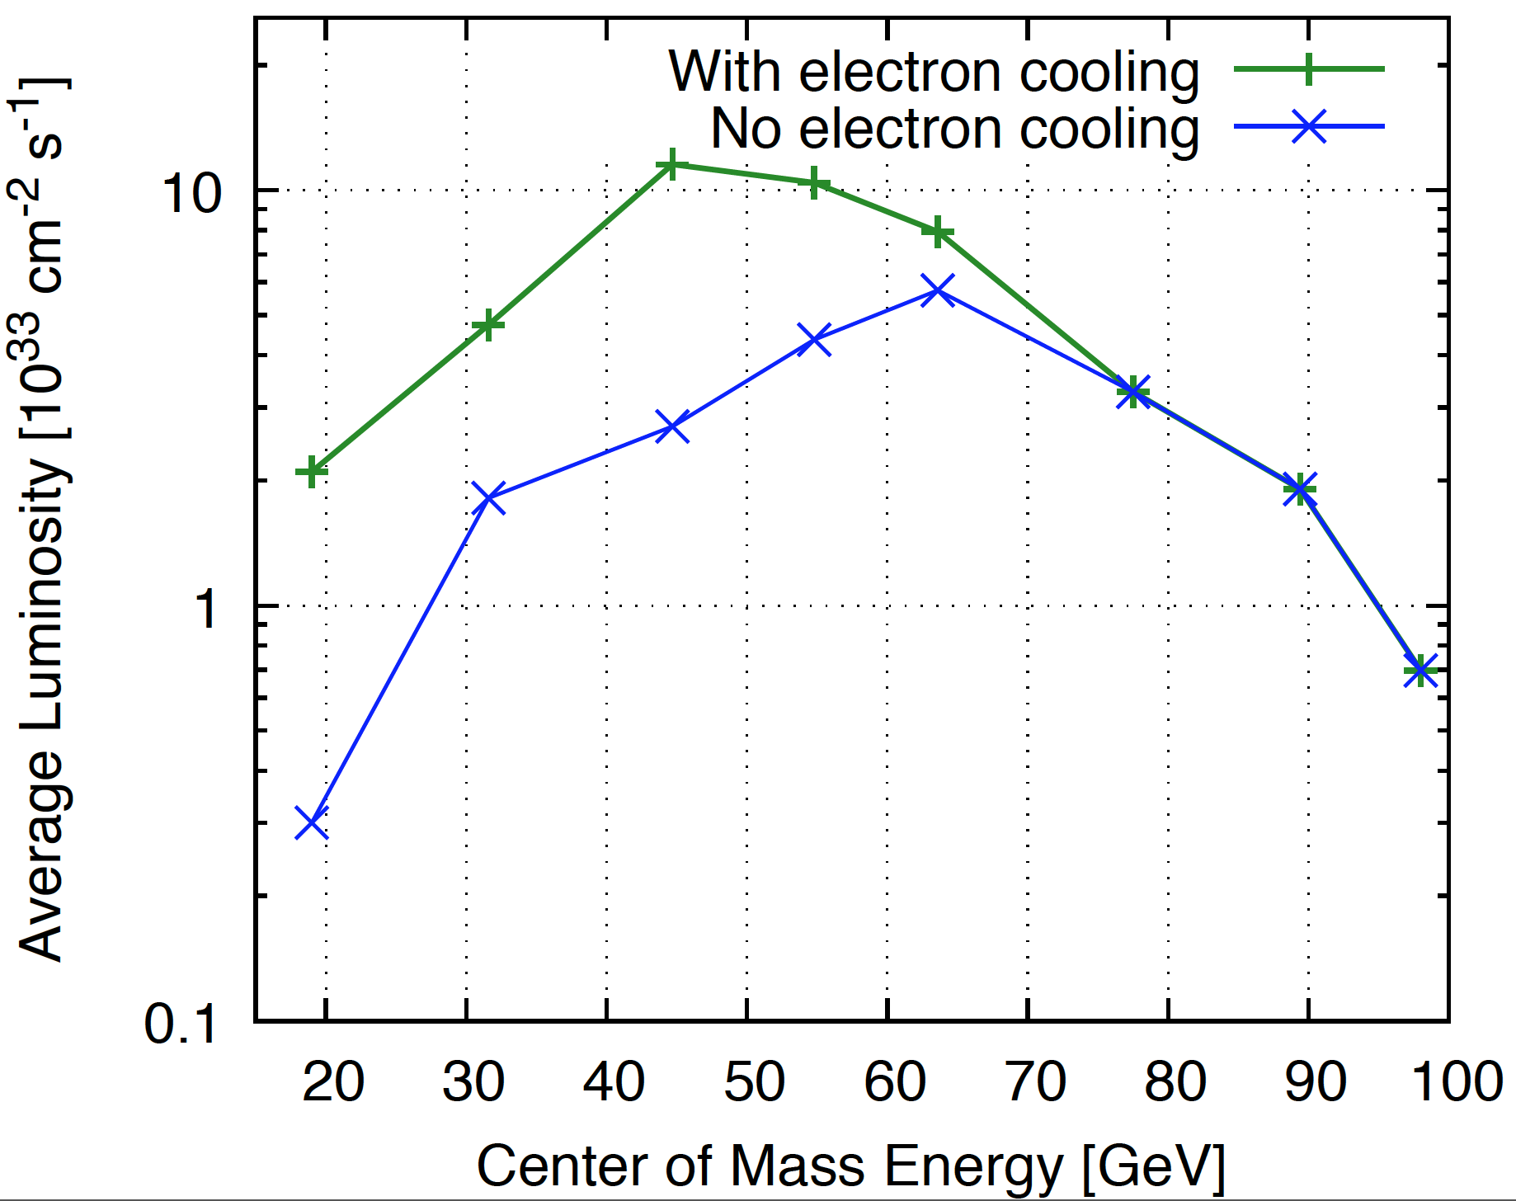
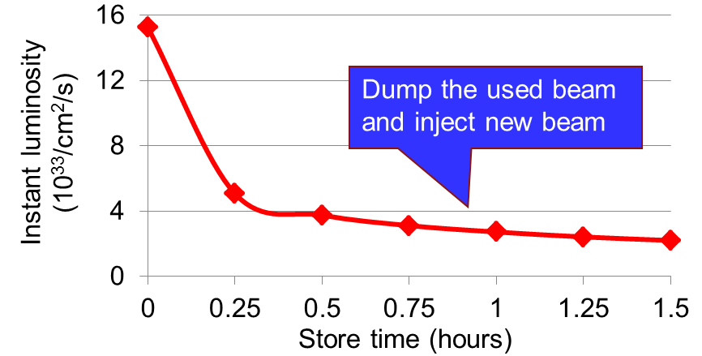
√s=100 GeV Energy Reach vs Luminosity Optimization
Luminosity curve for JLEIC is complex, it relies on
electron vs ion energy two-dimensional
ion beam size, beam-beam, ion cooling, electron SR power limited in various regions
tradeoffs affect kinematics, acceptance
Optimization efforts
Ion beam parameters
High energy cooling vs store lengths
Fill pattern, bunch length, beam-beam
Ion ring arc optics, fill factor
With DC and BB cooling +
With DC cooling only ×
Average Luminosity = $\frac{\text{Integrated} \text{Luminosity}\text{ (}\text{in}\text{ 1 }\text{hour}\text{)}}{\text{T}\text{ime} \text{of} \text{running}}$
Time of running takes into account the beam formation time (25 minutes), detector turning-on time (5 minutes) and effectively operational time (= operational efficiency 0.75).

Slide 31
Summary
We continued JLEIC design and improved the design performance. Significant progress has been made in many design aspects.
We completed documenting JLEIC self-consistent design with the CM energy up to 65 GeV. This 400-page pCDR has been delivered to lab leadership and reviewed by external visitors.
We explored an alternative baseline design with the CM energy up to 100 GeV. The study shows no show-stopper in all accelerator-associated issues.
Path forward for FY19
JLEIC with √s = 100 GeV optimization: injector complex, collider ring optimization, filling pattern, bunch parameters, HE electron cooling, etc.
Continue program development and RD towards CD0

Slide 32
Thank You for Your Attention !

