Slide 1
eRHIC polarized electron source and pre-Injector
Erdong Wang
Collider accelerator department eRHIC R&D
Brookhaven National Laboratory
EIC Collaboration meeting 2018

Slide 2
Outline
Outline
Polarized electron source and pre-injector requirements
eRHIC polarized DC electron gun concepts
Pre-injector concepts
Spin considerations
Laser, RF and Diagnostics
R&D activates
Summary

Slide 3
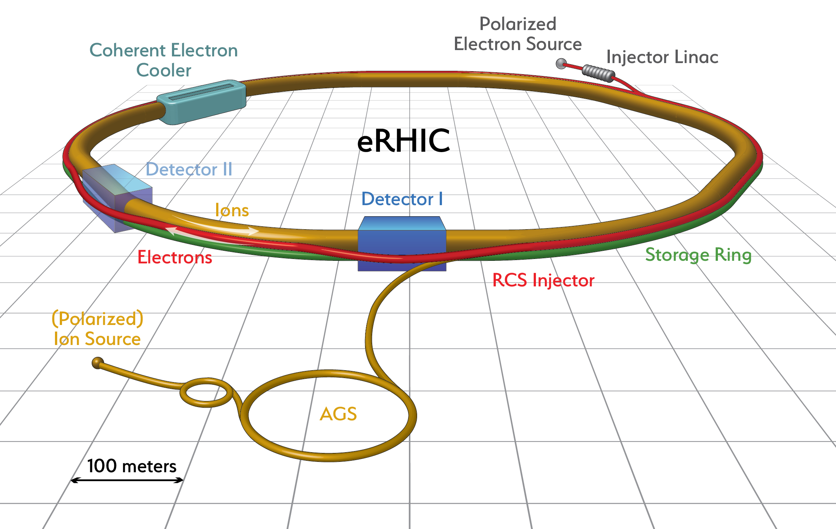
eRHIC pre-injector specifications
Low repetition rate, high charge
1Hz for 5nC and 10 nC
Short bunch length
3-6 ps for 2.856 GHz Linac
High peak current >2 kA
Good emittance
20 mm-mrad for high luminosity

Slide 4
eRHIC pre-injector parameters
 | Nominal: High luminosity with cooling | Moderate luminosity without cooling
Bunch charge [nC] | 5 | 10
RMS Bunch length [ps] | 6 | 6
RMS Emittance [mm-mrad] | 20 | 55
Frequency [Hz] | 1
Energy [MeV] | 400
Polarization [%] | 80%-85%

Slide 5
Overview of polarized electron DC guns
Laboratory | Photocathode | Polarization | Voltage | Bunch charge | I_pk | Repetition Frequency | I_avg
JLab[1] | GaAs-GaAsP | 85% | 100, 200kV | 2 or 2.7pC | 67~53mA | 1.5 GHz | 1~4mA
SLC[2] | GaAs-GaAsP | 86% | 120kV | 16nC max | 5 A | 120 Hz | 2uA
MAMI[3] | AlGaAs/InAlGaAs | 85% | 100kV | 0.02pC |  | 2.45 GHz | 50 uA
Bonn-ELSA[4] | AlGaAs/InGaAs | 80% | 50kV | 100nC | 100mA | 50 Hz | 5 uA
MIT-BATES[5] | GaAsP | 50-80% | 60kV | 250nC | 12mA | 600 Hz | 20 or 200uA
Nagoya[6] | GaAs-GaAsP | 92% | 200kV | 3.2 nC | 3.2 A | 20 Hz | 50 uA
NIKHEF[7] | InGaAsP | 80% | 100kV | 2 nC | 2 mA | 10 Hz | 0.04uA
BNL | GaAs-GaAsP | 85% | 350kV | 10 nC | 5 A | 1 Hz | 10 nA
16 nC was achieved by SLC DC gun. It is beyond our nominal injector design.
Can we make it better?
Minimize beam loss
Simplify maintenance
In operation
Shut down
In design

Slide 6
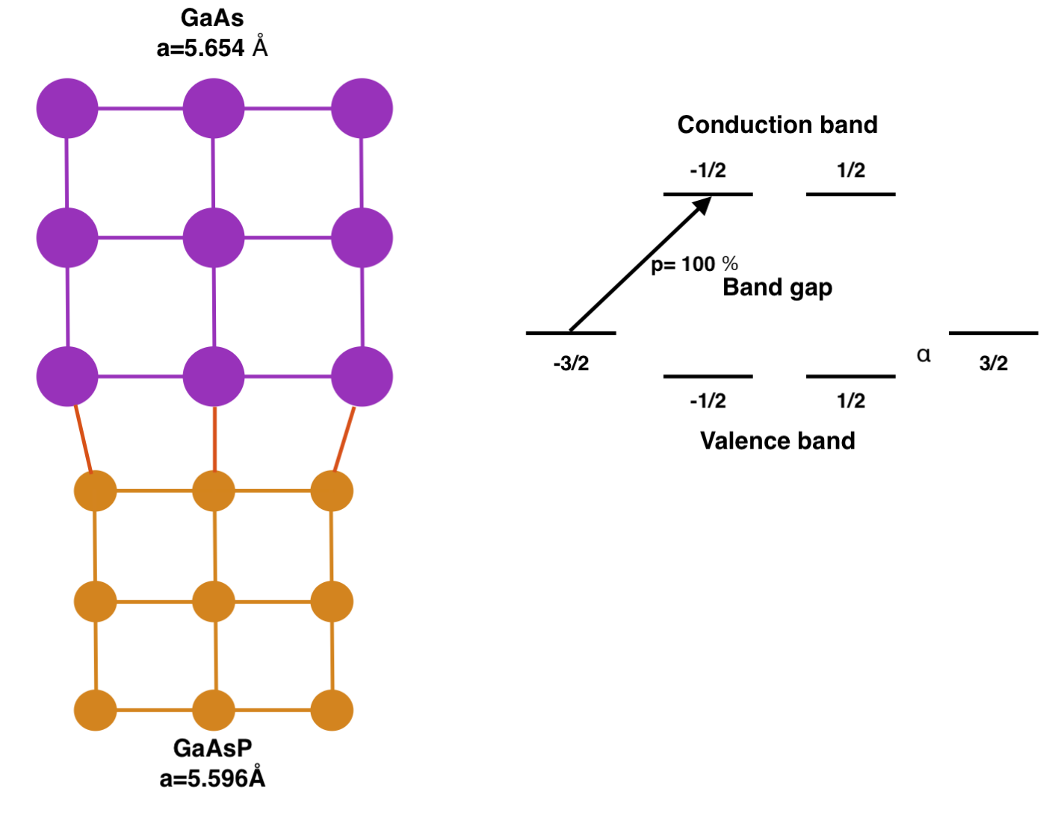
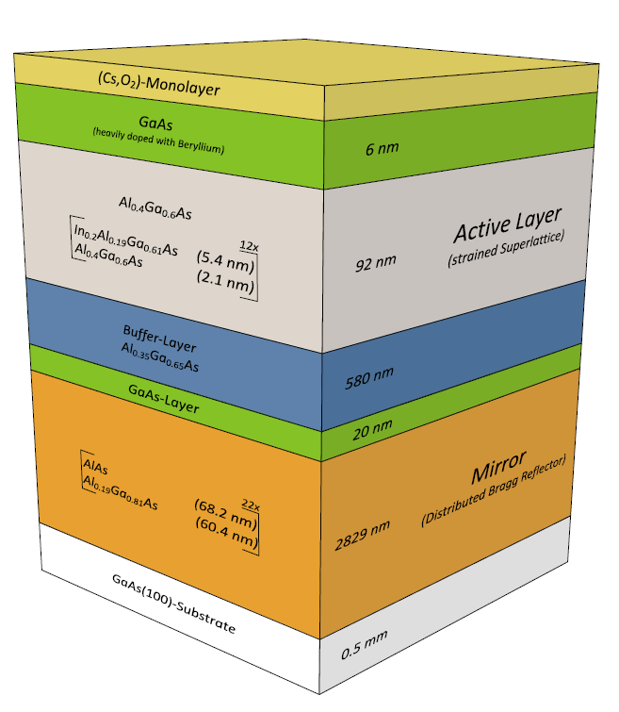
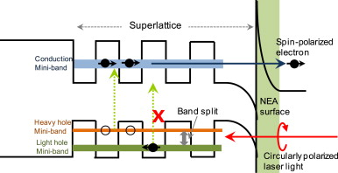
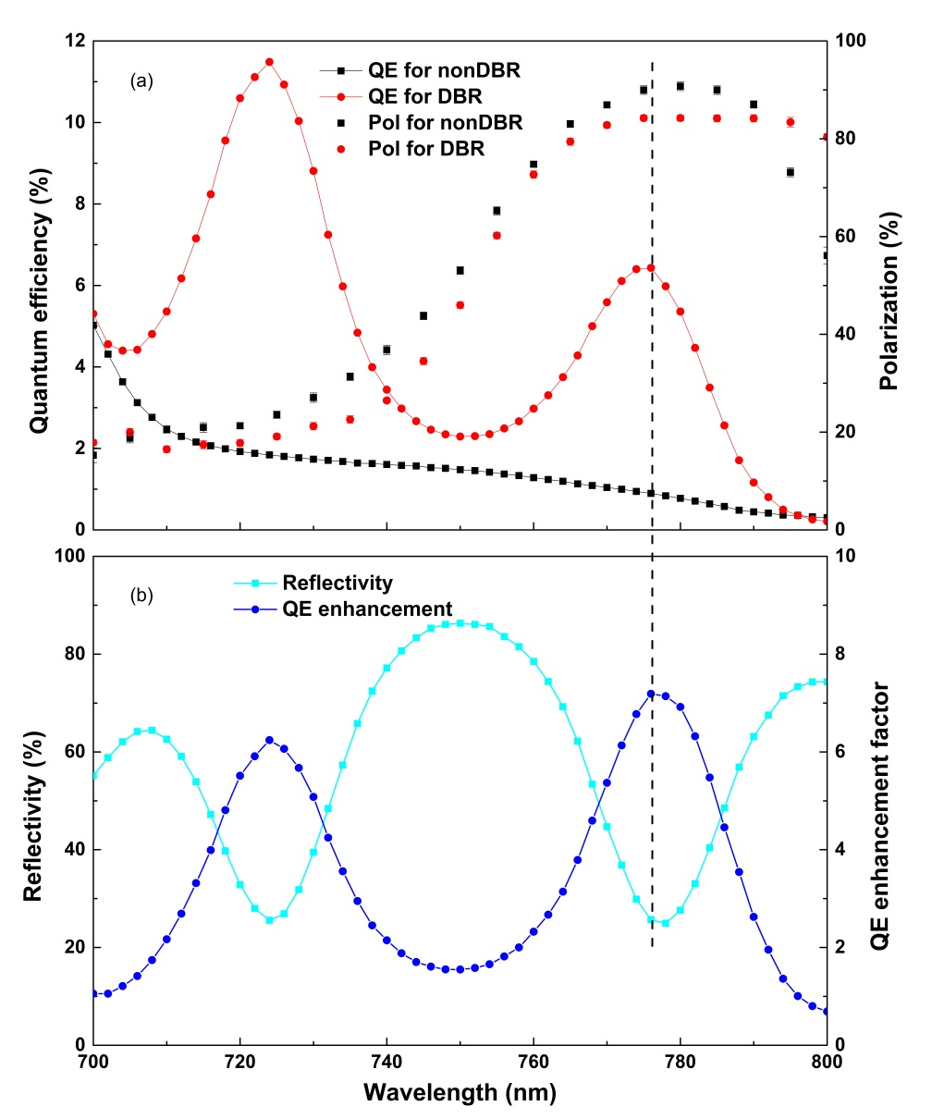
Superlattice GaAs photocathode
Recent results from SVT/JLab using DBR super lattice GaAsP photocathode.
QE is greater than 5%.
Achieved 86% polarization at the peak.

Slide 7
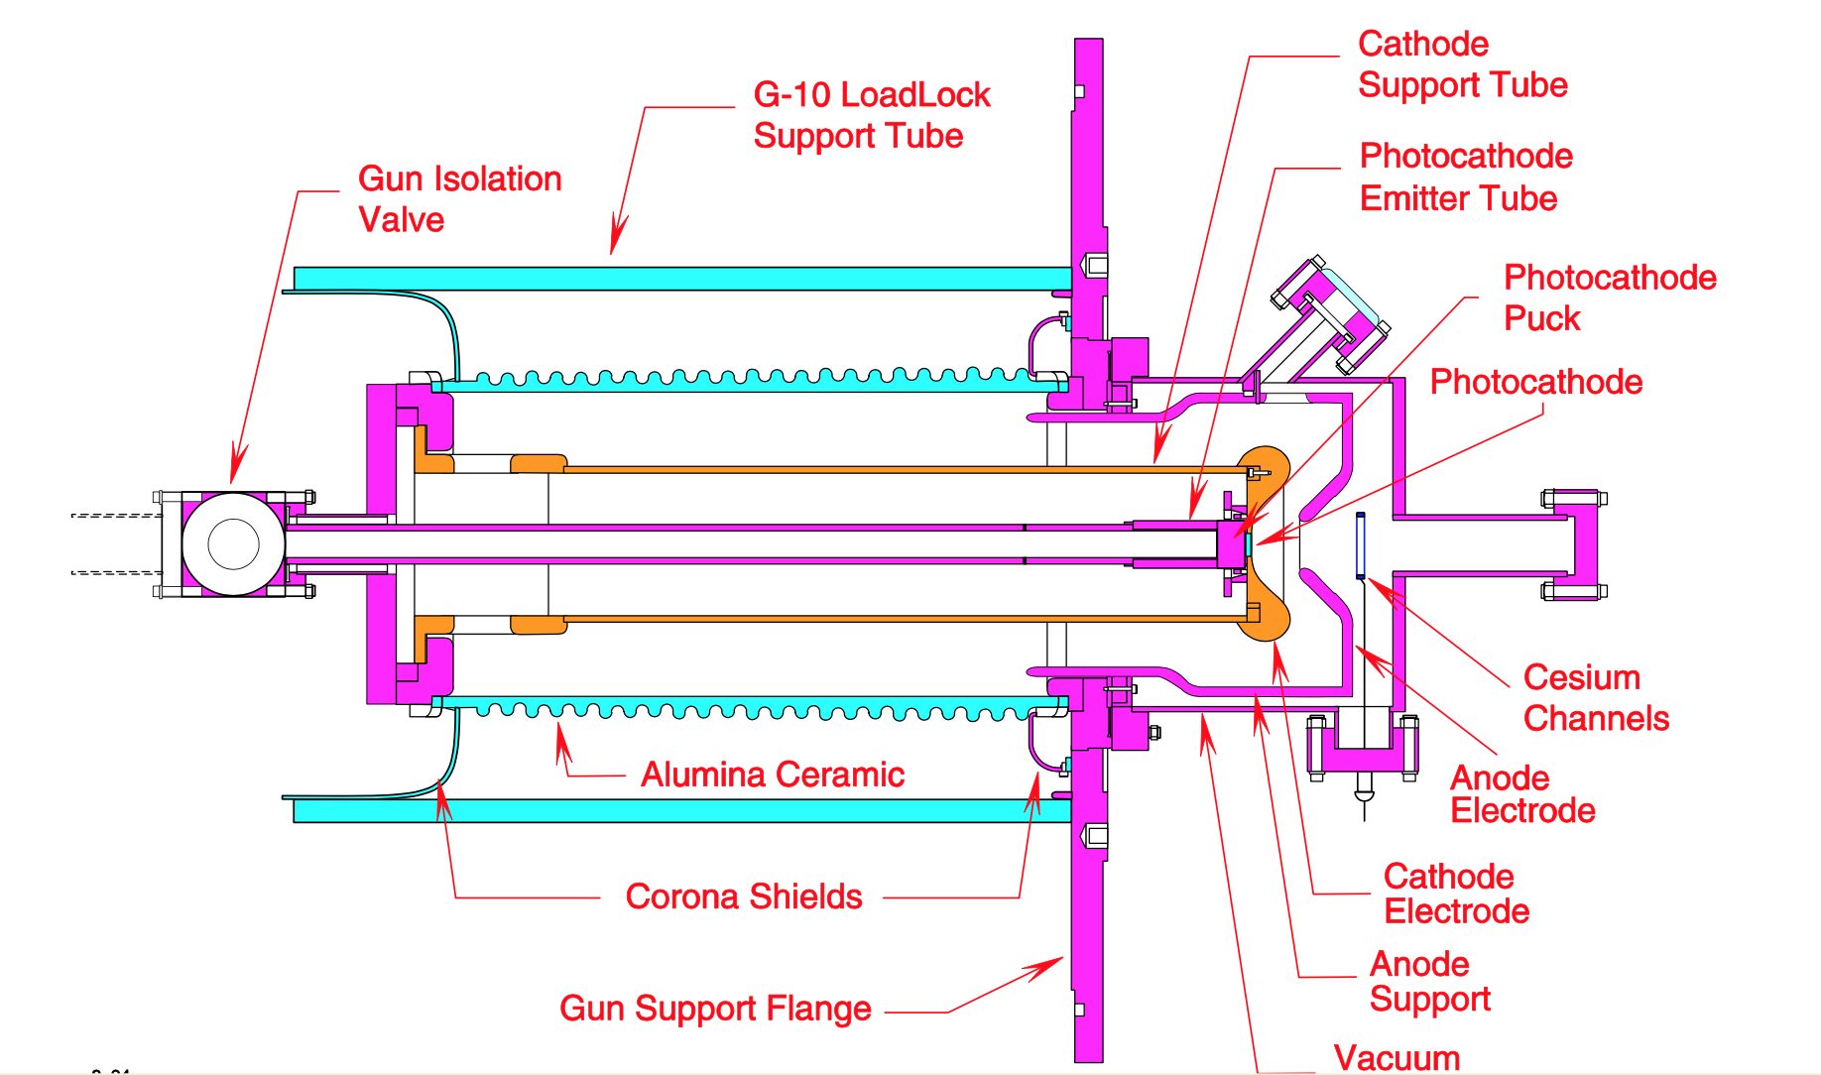
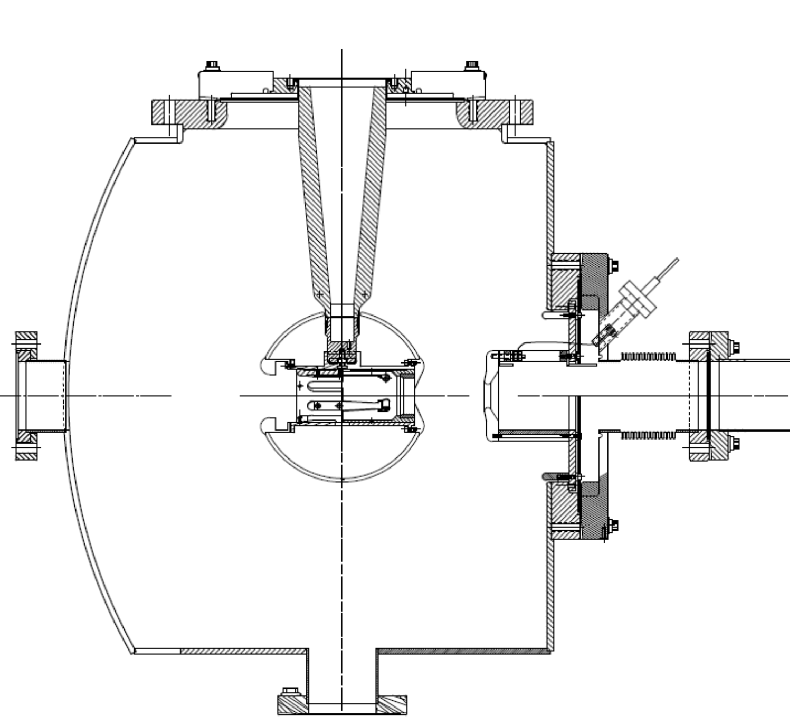
Existing Gun concepts for eRHIC injector
^{SLC PES 120 kV gun}
^{JLab 350 kV inverted gun}
First load-locked gun used at an accelerator
High bunch charge, low avg. current, very long operating lifetime 。
4 days to replace photocathode. No separate load lock...
Inverted shape has less out gassing surface and eliminated field emission to ceramic
High average current, long operating lifetime.
Separate load-lock for cathode replacement.
10 ⁻¹² torr scale vacuum

Slide 8
Comparison of guns
 | SLC | Inverted gun (JLab) | Inverted gun in fabrication (BNL)
Voltage [kV] | 120 | 350 | 350
Gradient [MV/m] | 1.8 | 3.4 | 4.2
Cathode size [cm²] | 3 | 1.13 | 4.98
Bunch charge [nC] | 16 | 0.003 | 10
Average current [uA] | 5 | 4000 | To be measured
Charge lifetime[C] | <1 | 80 | To be measured
In-situ Cs evap. | Y | N | N
Biasable Anode | N | Y | Y

Slide 9
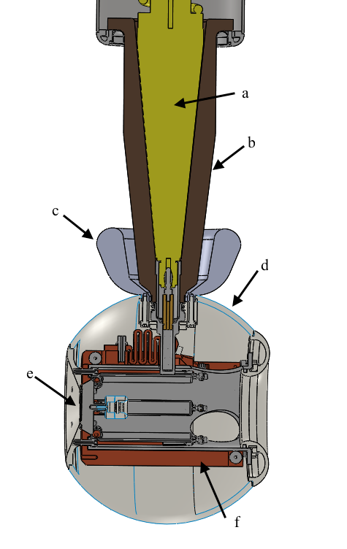
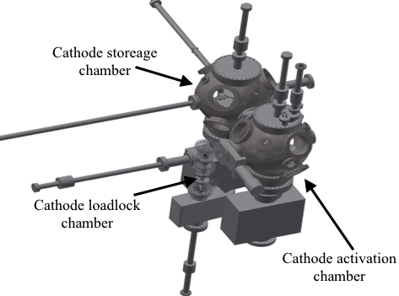
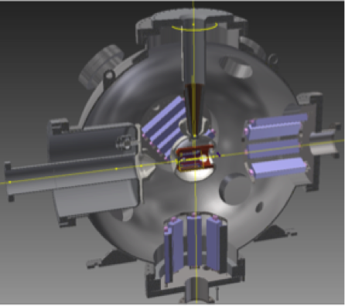
R&D Gun and cathode preparation
Cathode preparation system
HV DC Gun
The final gun will be similar to the R&D gun, except
Optimized gun chamber
Pumps locations and sizes
Optimized Pierce shape (similar to SLC gun)
Larger cathode
Gun electrode

Slide 10
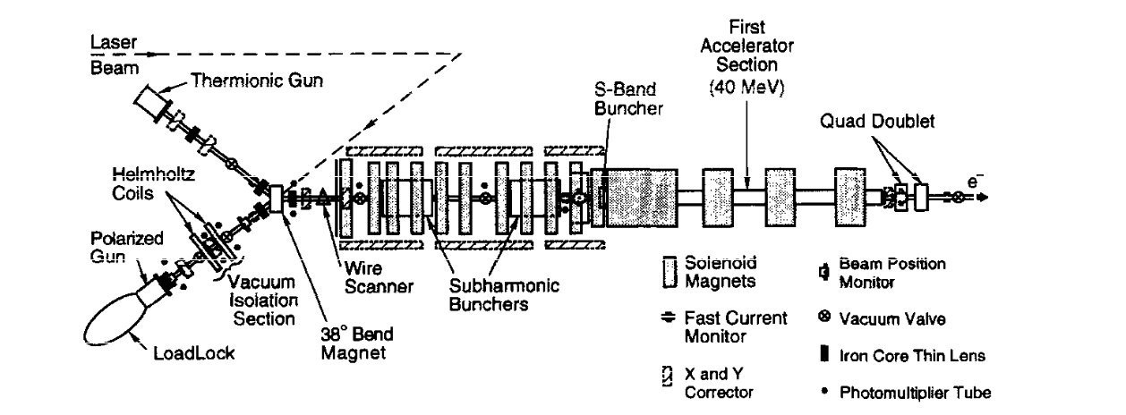
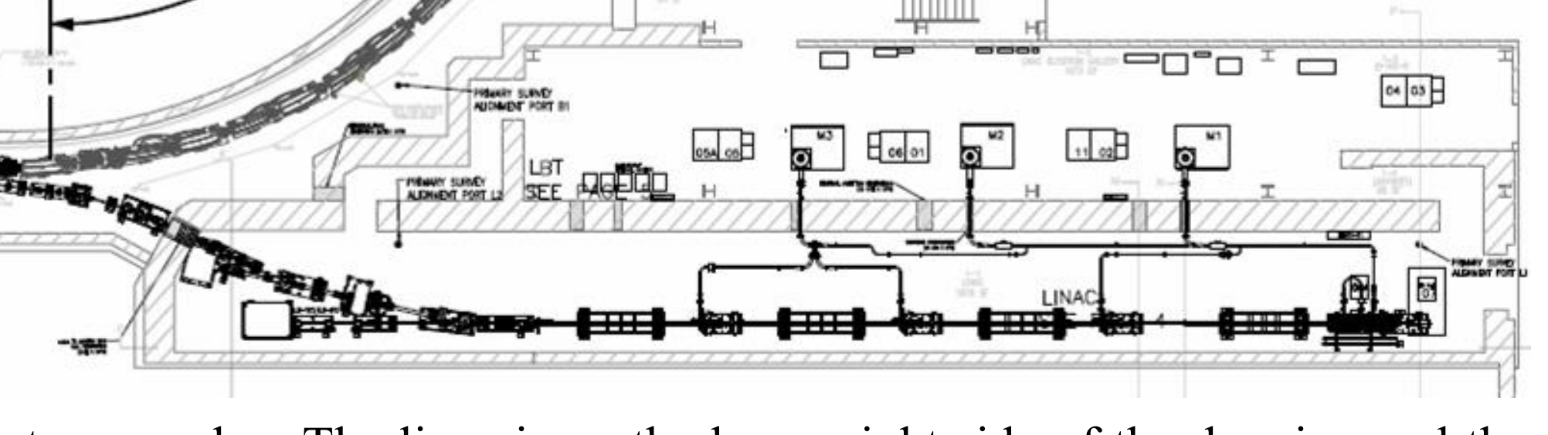
400 MeV pre-injector
SLC linac
12 nC
200 MeV
NSLS II linac
500 pC
200 MeV

Slide 11
Pre-injector Linac frequency choice
Frequency | RF | Aperture | Solenoid | Beam quality | In operation | Cost
563 MHz | SRF | Large | Compensated | Good | NA | High
1.3 GHz | NRF | Moderate | Compensated | Moderate | ANL … ✔ | Moderate
2.856 GHz | NRF | Small | Continuous | Acceptable | SLAC, BNL… ✔ | Low ✔
Considering the technical maturity and lower cost,
2.856 GHz Linac is our choice.

Slide 12
400 MeV beam line set up
350 kV gun
114MHz buncher
570 MHz buncher
Coil solenoids
Corrector
Laser
3GHz buncher
2.856 GHz buncher TWP (8 tanks)
Mott polarimeter
Both bunch charge 5n C and 10 nC cases have been simulated by Parmela 3.38.
➔ meets all the requirements.

Slide 13
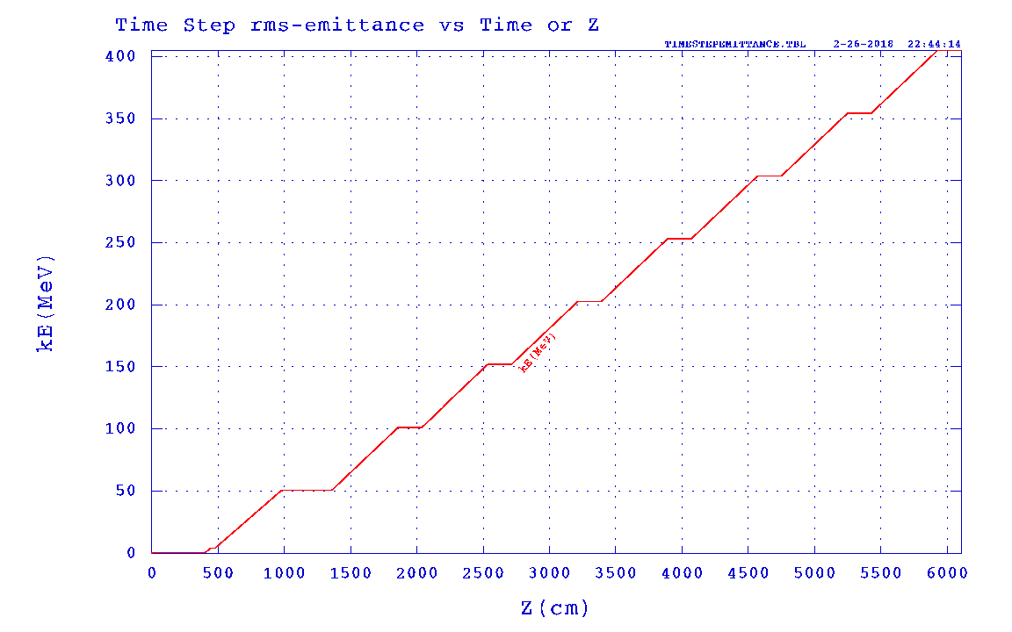
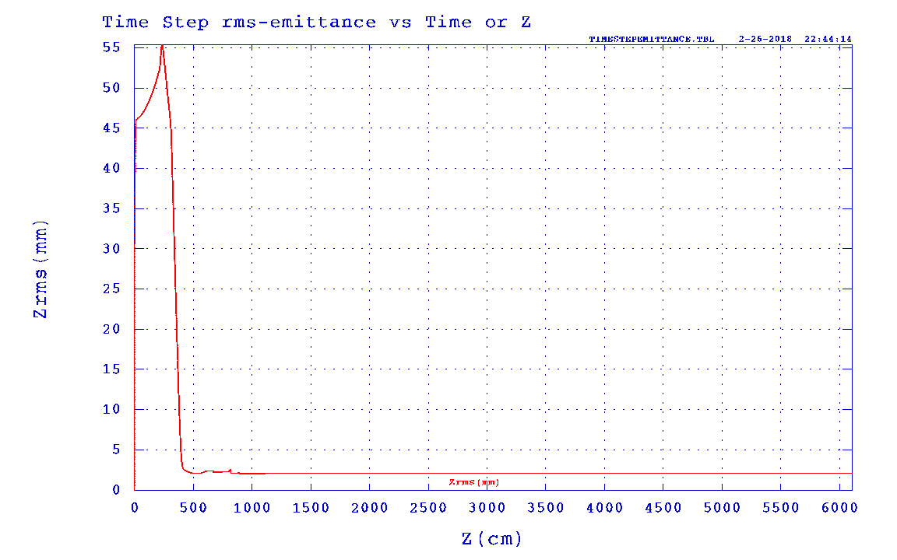
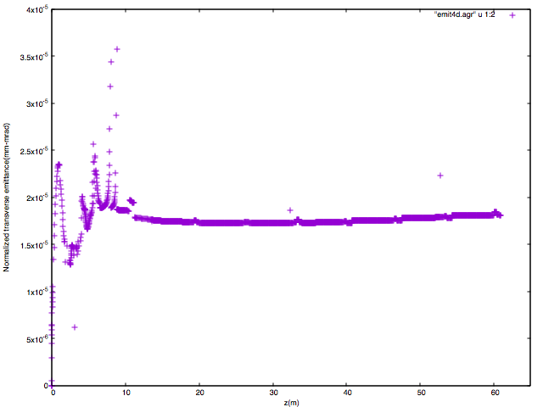
5nC: High luminosity with cooling
Beam Energy:400MeV
RMS bunch length 2 mm
RMS beam size
RMS N_ε _{x,y}:17mm-mrad

Slide 14
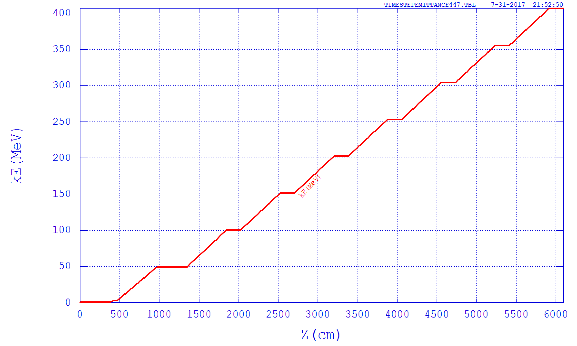
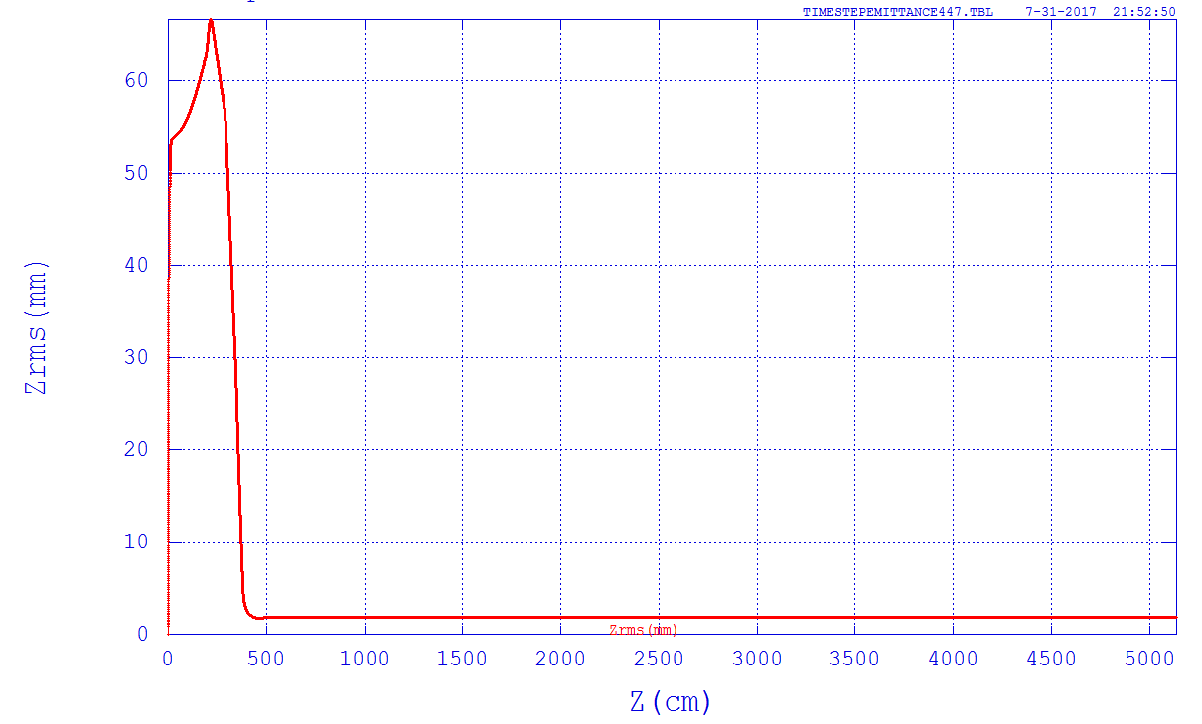
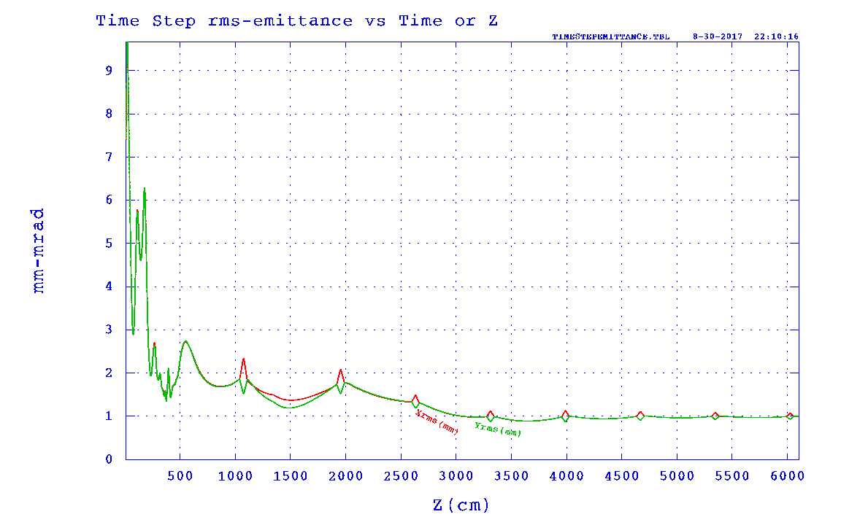
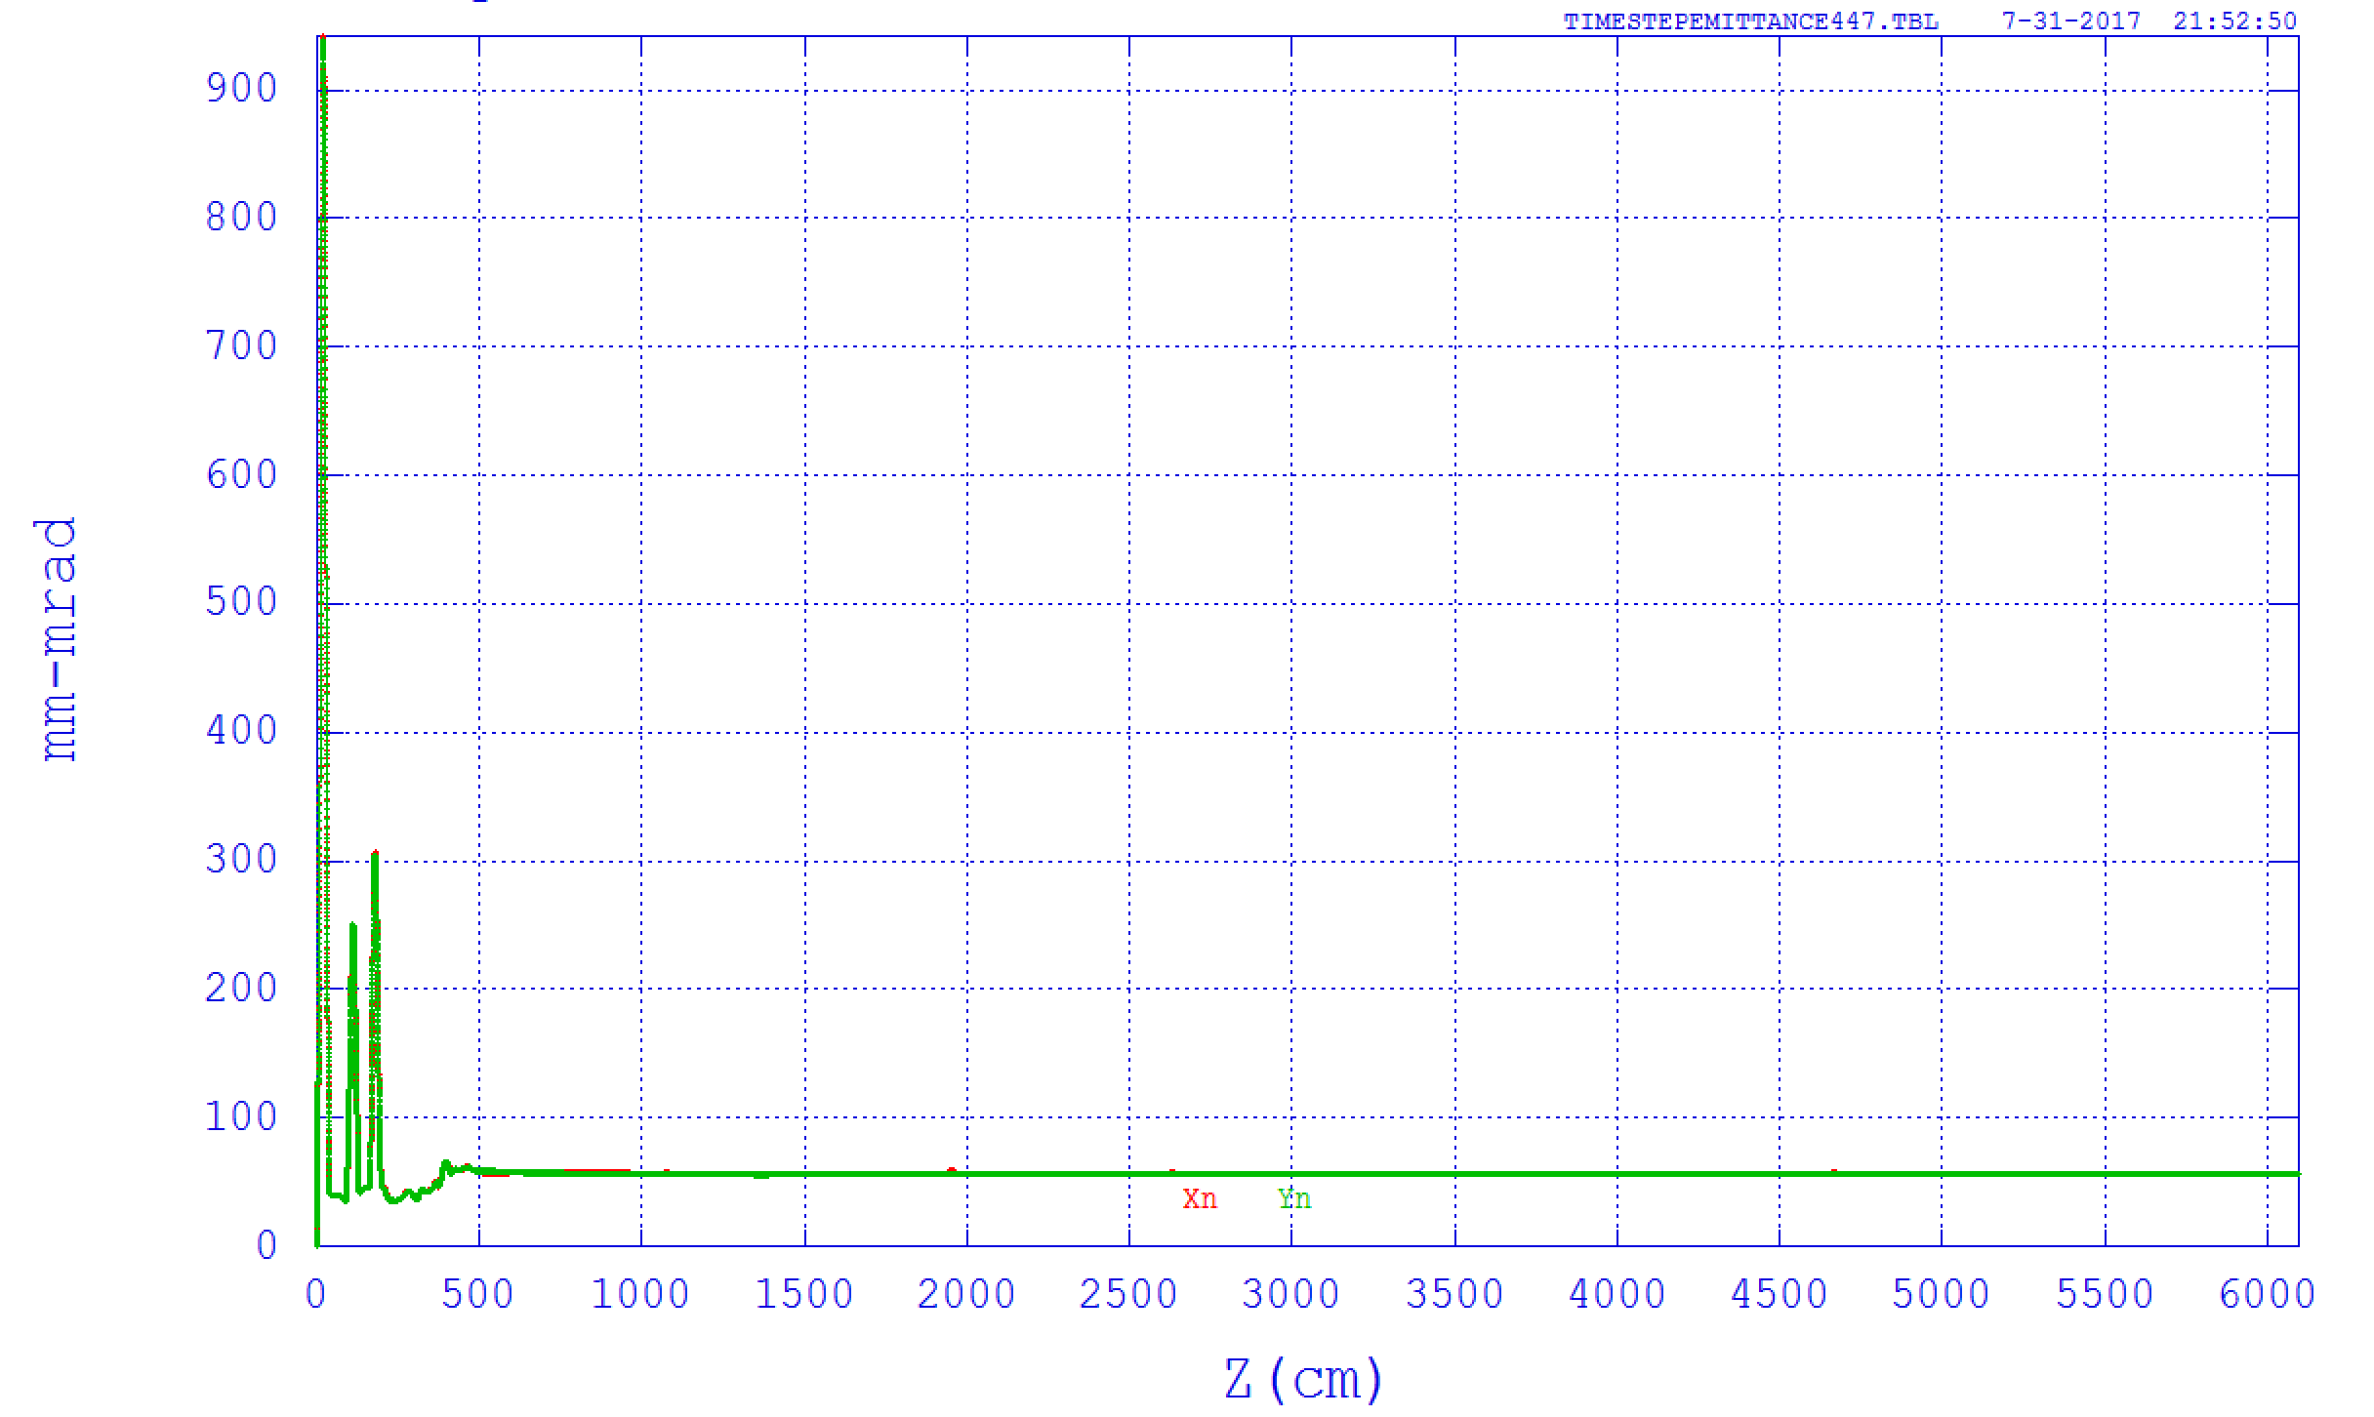
10 nC :Moderate luminosity
Beam Energy:400 MeV
RMS bunch length 2 mm
RMS beam size
N_ε _{x,y}:55mm-mrad

Slide 15
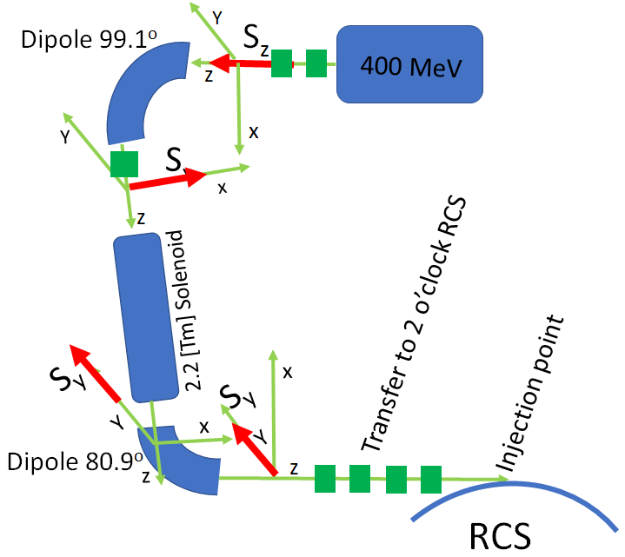
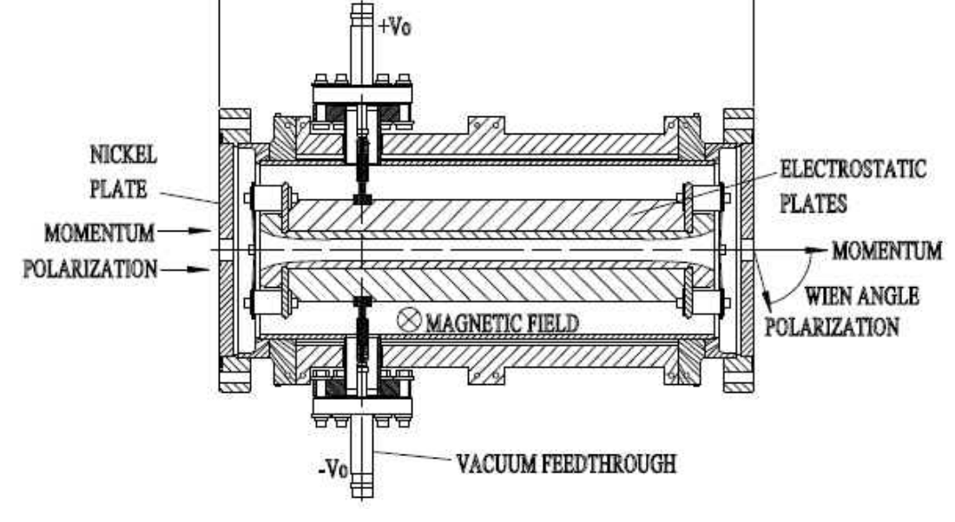
Spin considerations in pre-injector
Quads triplets
Quads triplets
Gun
Wien filter
 | Energy Range | Energy acceptance | Realizable
Dipole+solenoid | >100 MeV | Small | SLC
Wien filter | < 400 KeV | Large | Jlab, Mainz(small charge and small energy)

Slide 16
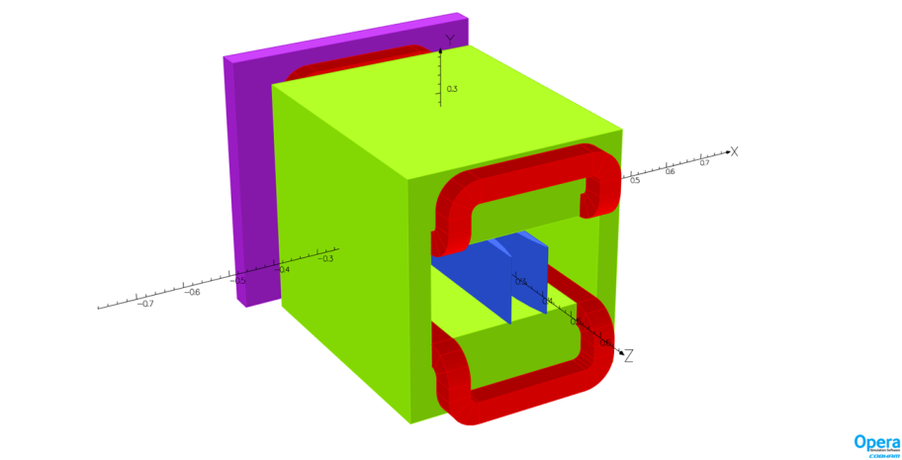
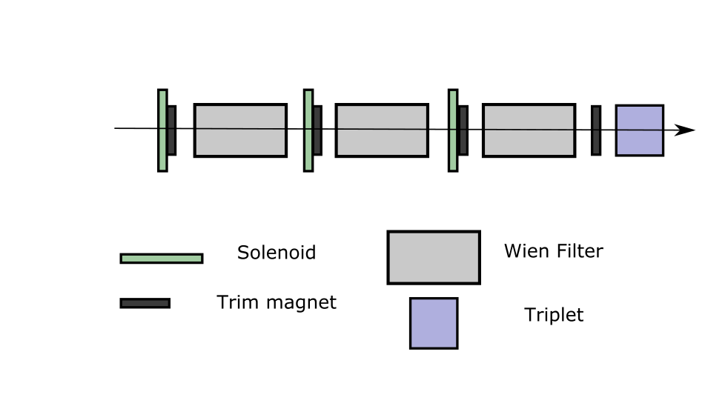
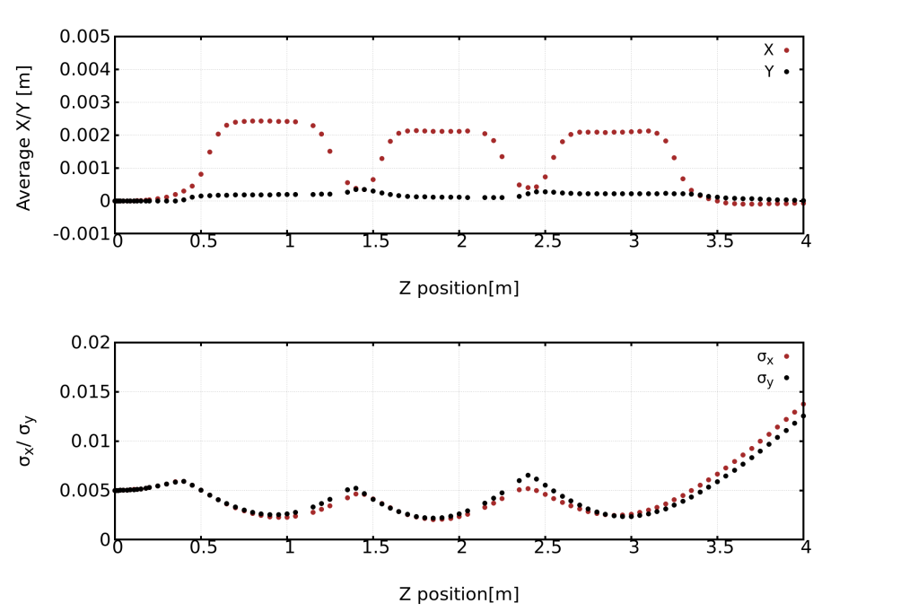
Wien filter
Parameter | Value
Bunch charge | 10 nC
Energy | 350 KeV
L | 0.5 m
E_{x} | 0.98 MV/m
B_{y} | 0.00407 T
Electrode gap | 5 cm
Three-segment Wien filter has been studied to rotate electron spin by 90°

Slide 17
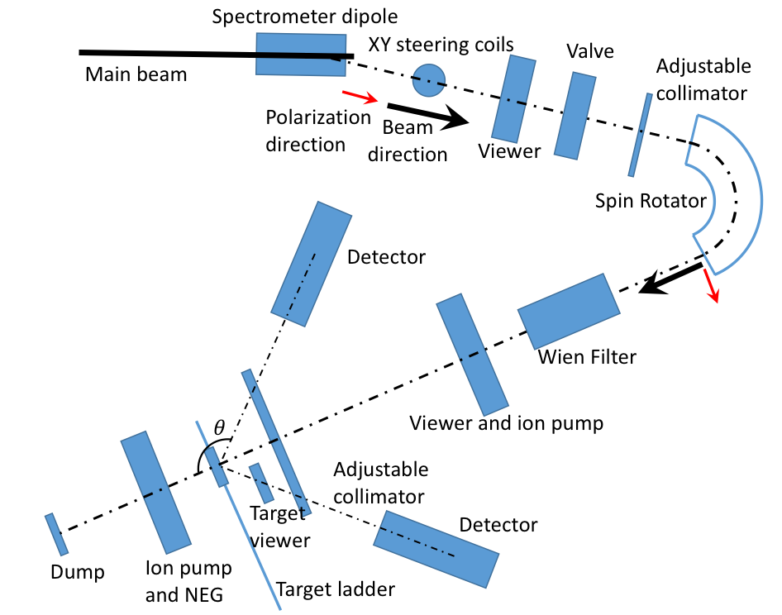
Mott polarimeter
High voltage Mott polarimeter placed at gun diagnostic beamline where beam energy is 300-350 keV.
Can be simplified if using Wien filter to rotate the spin.
Parameter name | value
Beam energy | 300-350 keV
Beam bend degree by spin rotator | 143°
Voltage of spin rotator | 244.5 d/R kV
Scattering degree, | 136°
Detector count rate | 1.69e3 Hz/(nA.um)
Corresponding time for P = 0.1% | 1.36 s

Slide 18
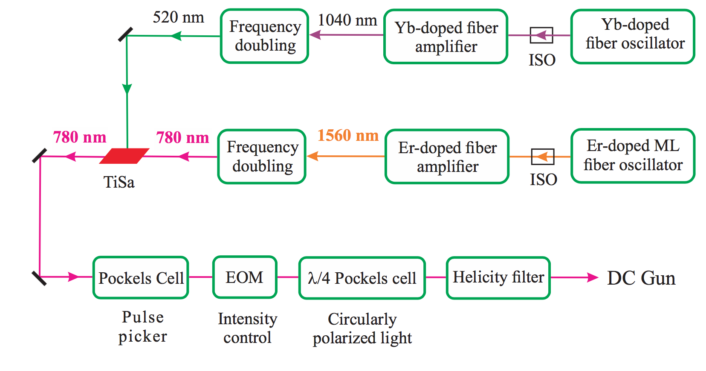
High pulse energy hybrid Laser
100 uJ
Parameter | Value
Pulse energy | 16 uJ
Length | 1-2.5 ns
Rep. Rate | 1 Hz ,up to 27.8 MHz
Wave length | 780 nm
Two lasers will be placed.
One for operation; another one for hot spare.

Slide 19
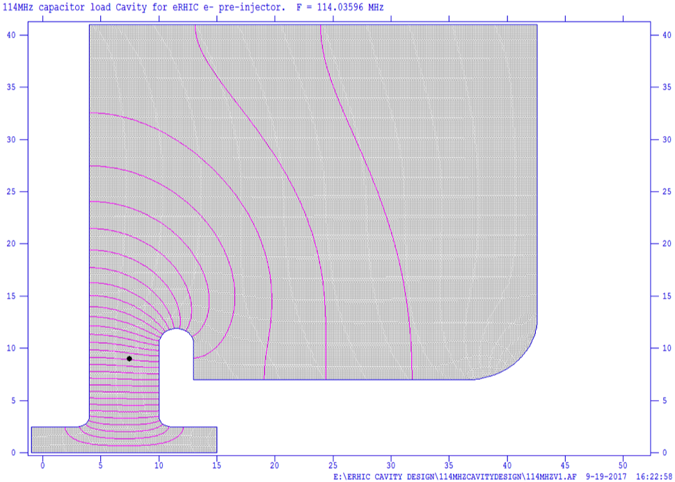
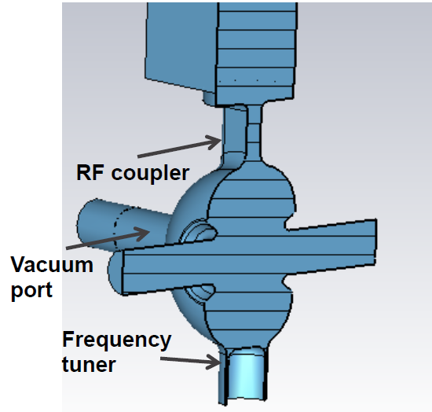
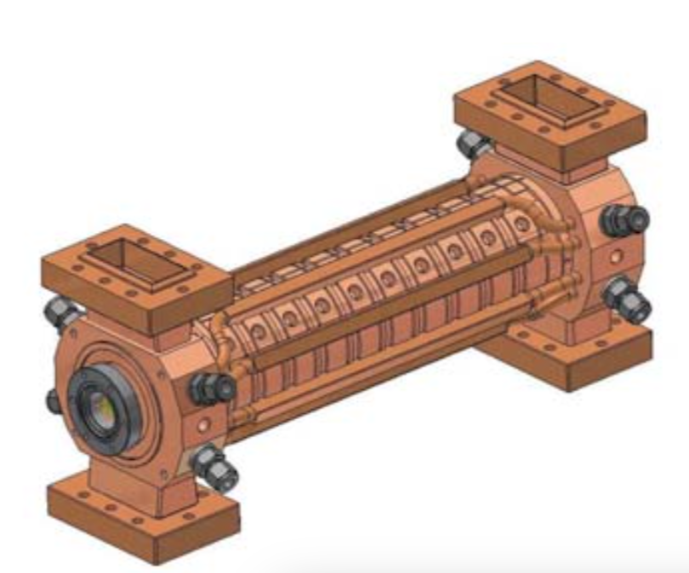
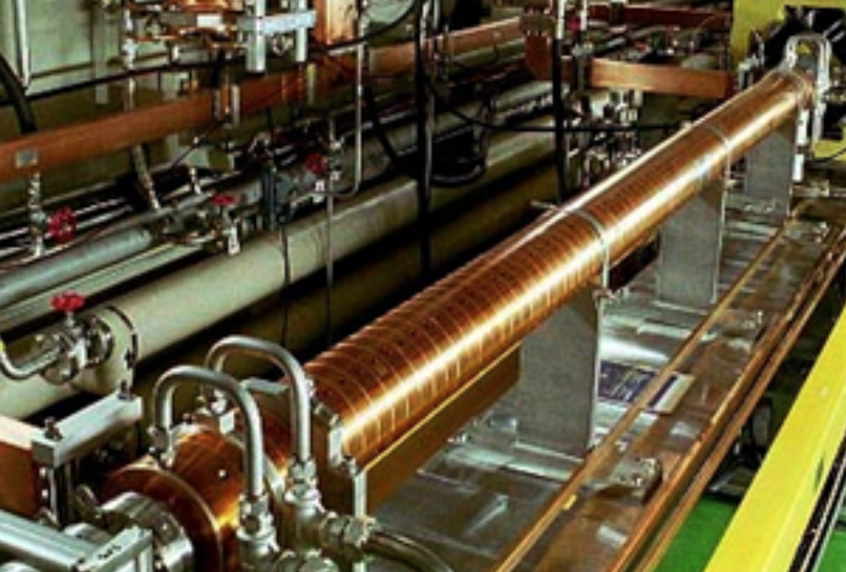
Linac cavities
 | 114 MHz | 571 MHz | 2.856 GHz | 2.856 GHz
Rep. Freq | 1Hz
Function | Buncher |  |  | Booster
Shape | Capacitor loaded | Re-entrance | Traveling wave | Traveling wave
Gap voltage | 500 kV | 600 kV/500 kV | 15 MV | 50 MV
Duty factor | 0.02%
Peak power | 52 kW | 35 kW

Slide 20
Potential R&D topics
Cathode lifetime modeling and experiments
New high polarization cathode and related simulation
Large cathode gun experiments
Extremely high vacuum studies
Beam halo induced beam loss, Beam dynamics studies
From EIC Collaboration meeting 2017

Slide 21
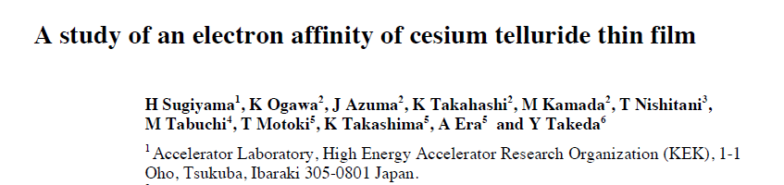
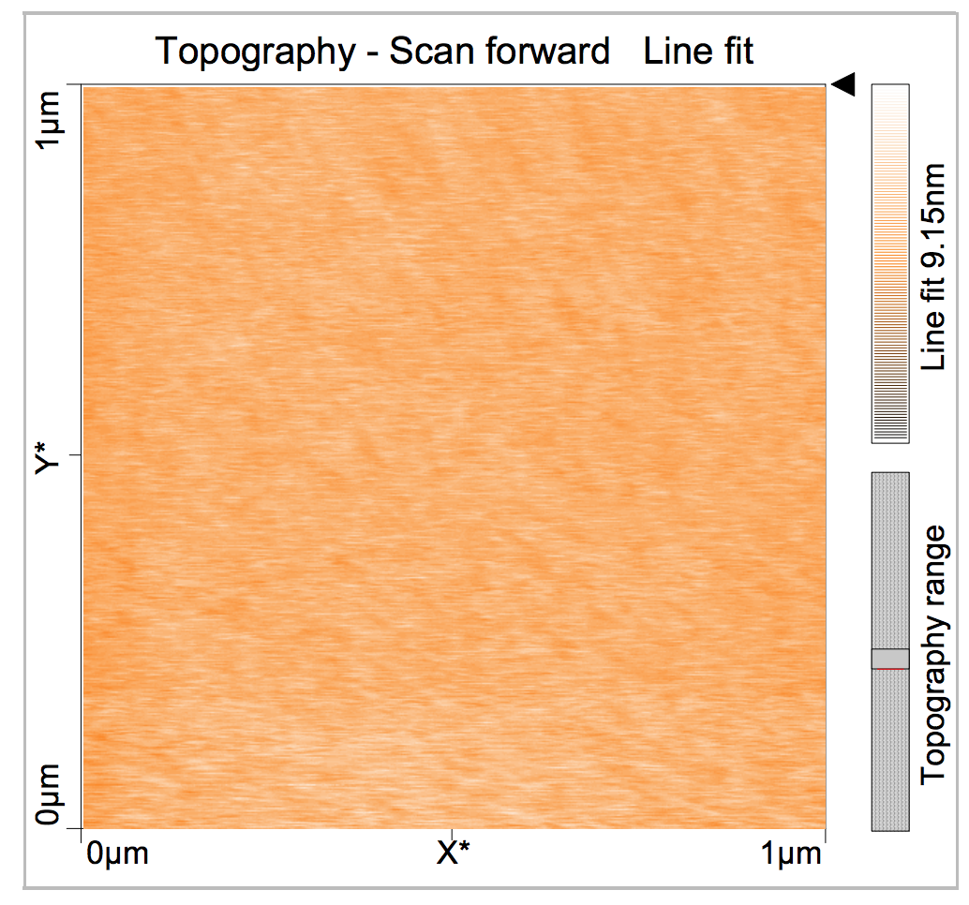
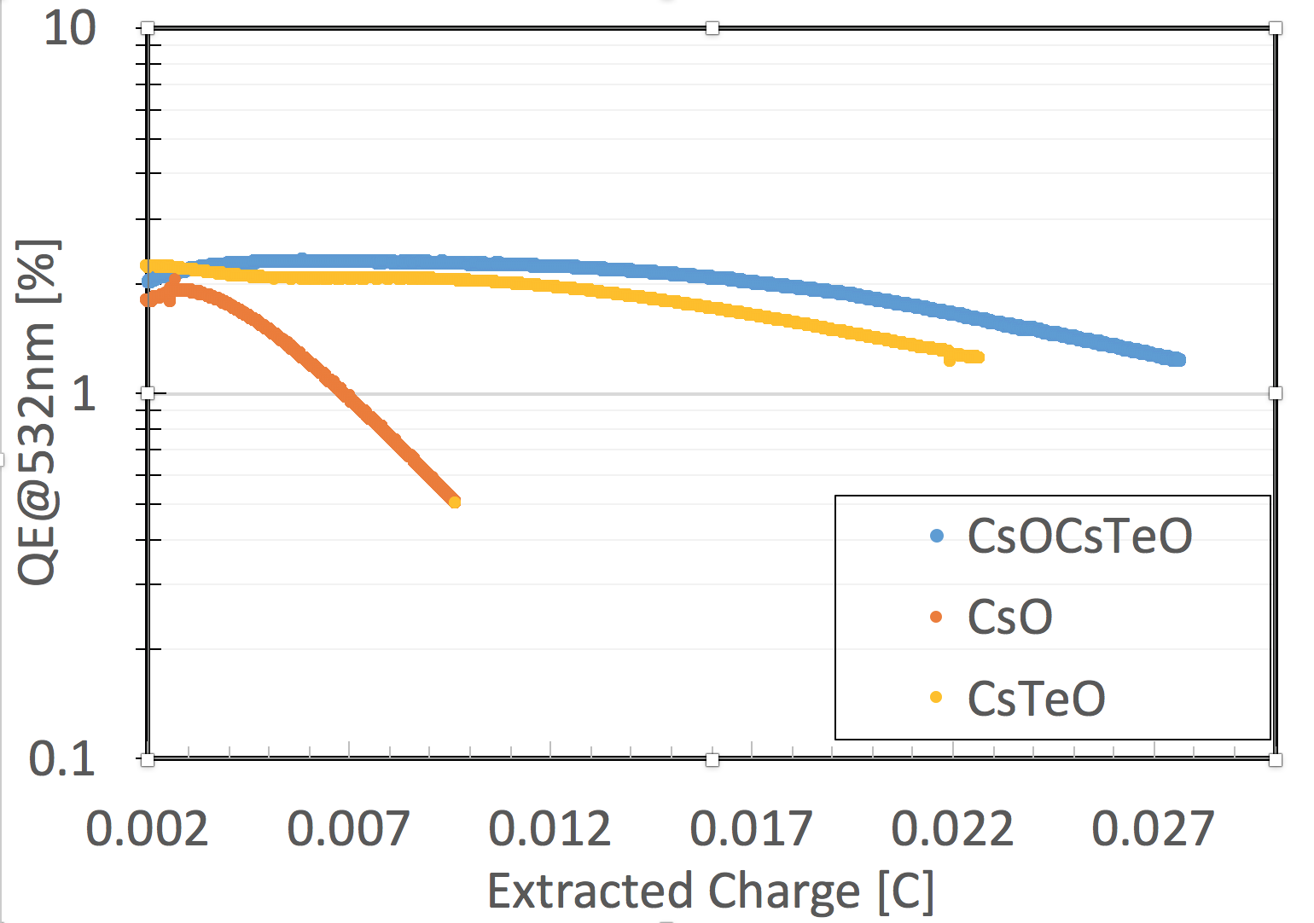

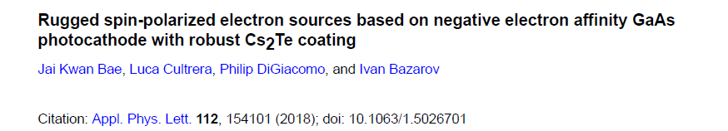
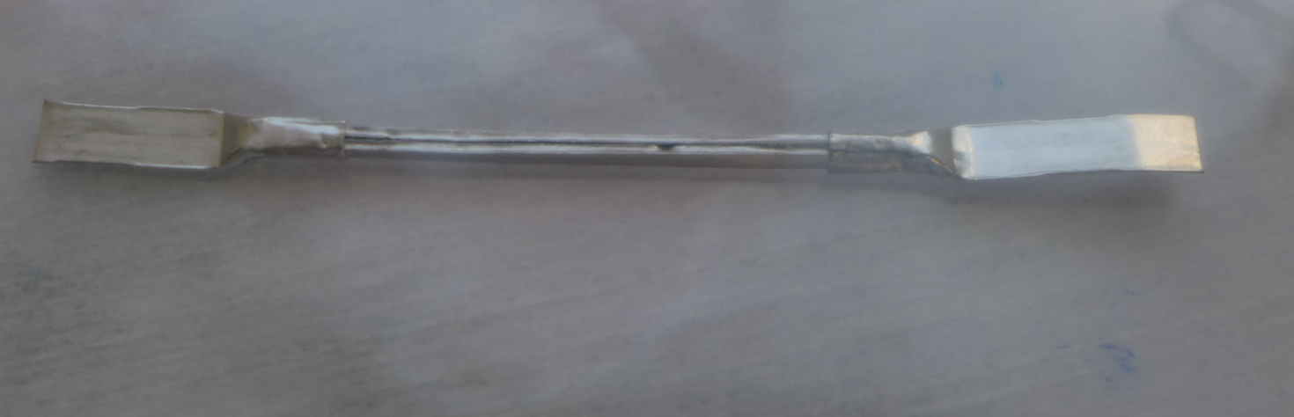
Lifetime study on Cs₂Te(CsO) coated GaAs
GaAs
7e-11 torr
x6
2e-11 torr
540 ºC heat treatment
Roughness:1.8-3.9 nm
Anode
Trying GaAs/GaAsP and CsI coating now.
Cathode
Te source in Saes dispenser
O. Rahman, J. Biswas, M. Gaowei, W. Liu, E. Wang

Slide 22
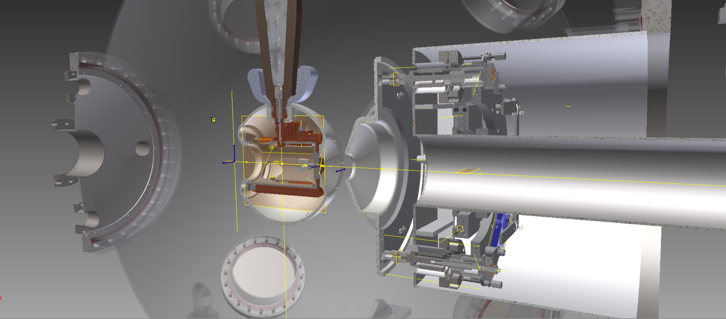
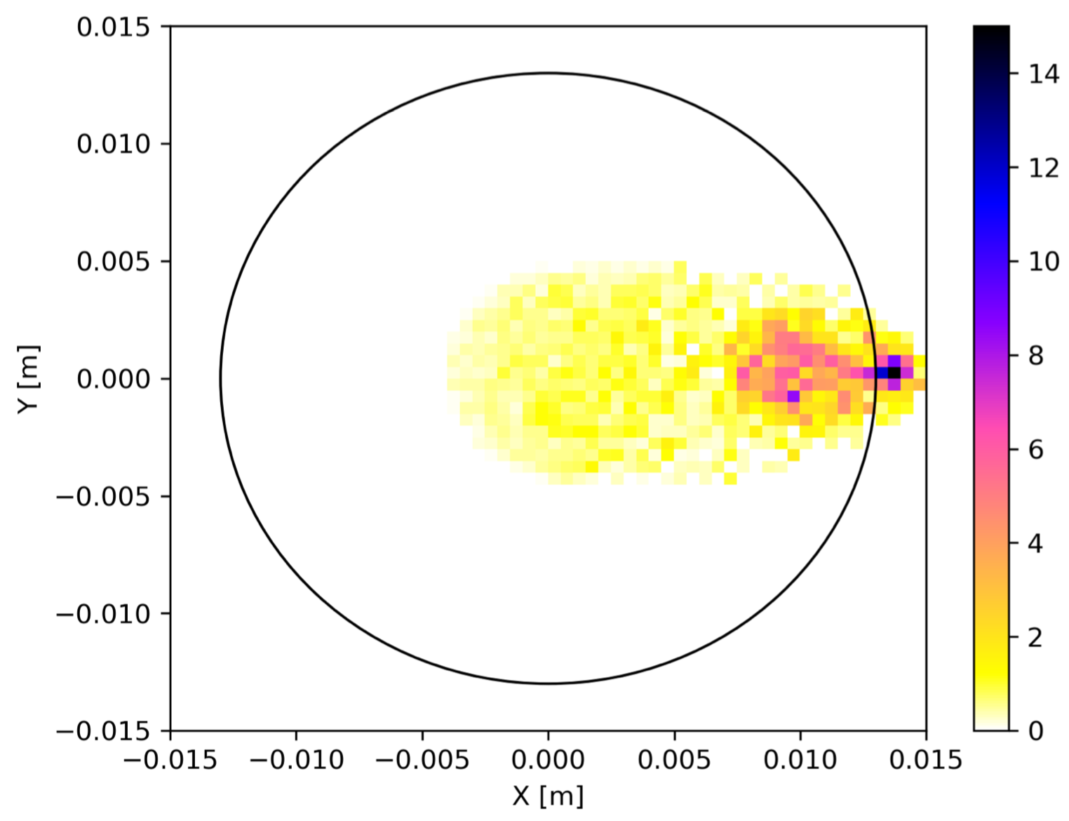
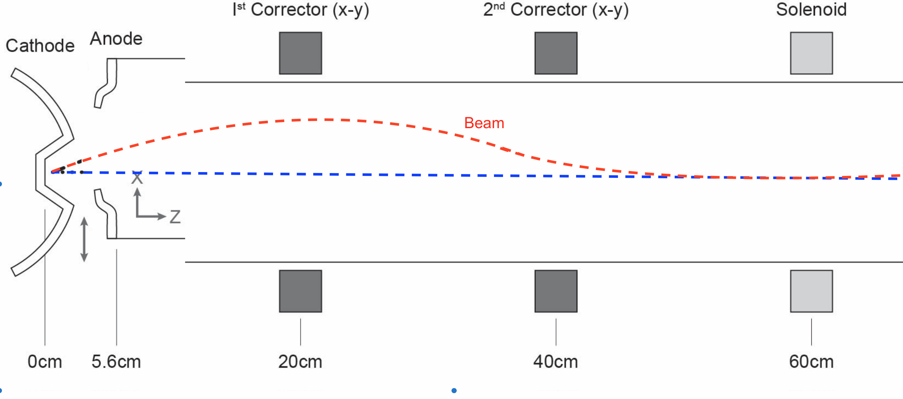
Extend the lifetime by kicking electrons
Lifetime will be at least doubled with off-center anode scheme.
Emittance increases only 20% compare to centered laser/anode.
O. Rahman, E.Wang, J. Skaritka, J. Biswas
Paper in preparation

Slide 23
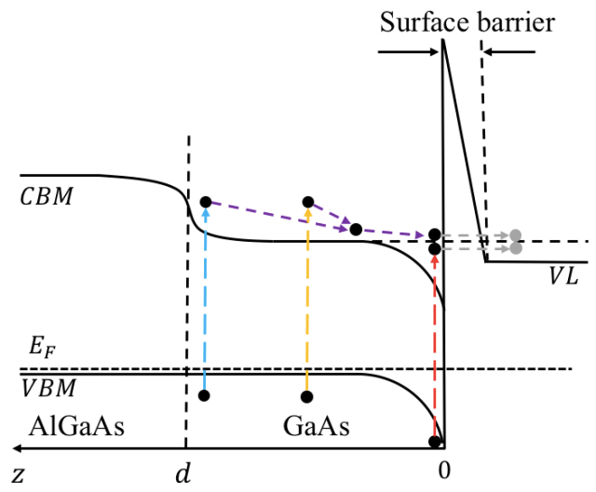
MC simulation of heterojunction GaAs cathode
Thinner and lower dopant density samples provide short electron bunches
Simulated photoemission spectrum response, matchs to experimental results well.
Considered the heterojuction between GaAs/AlGaAs, and surface barrier.
Once consider the spin dynamics, could simulate other spin electronics.
W. Liu M. Poelker, C. Sinclair, E. Wang
Paper in preparation

Slide 24
Summary
eRHIC source design has no risks:
Dr. Charles Sinclair: “If the ring-ring eRHIC parameters are really 10 nC and 1 Hz, then I think you will have no problem at all. Several laboratories have demonstrated performances well above this level”.
The eRHIC polarized electron source needs to generate high charge (10nC) and high polarization of the electron beam. Both SLC PES gun and JLab inverted guns are being considered. 12.5 nC bunch charge has been demonstrated from a DC gun using SL-GaAs photocathode.
400 MeV pre-injector has been simulated. Meets the requirements.
All electron spin requirements have been integrated into pre-injector design.
The gun R&D activates are in progress.

Slide 25
Thank you for your attention !

Slide 26
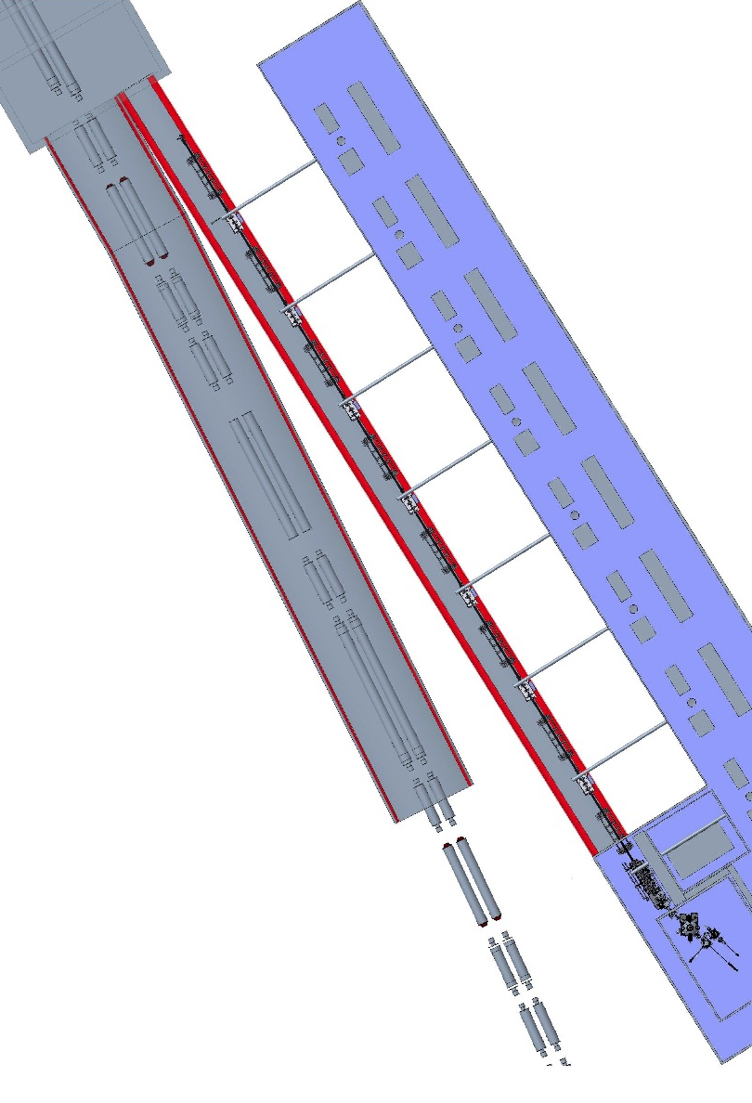
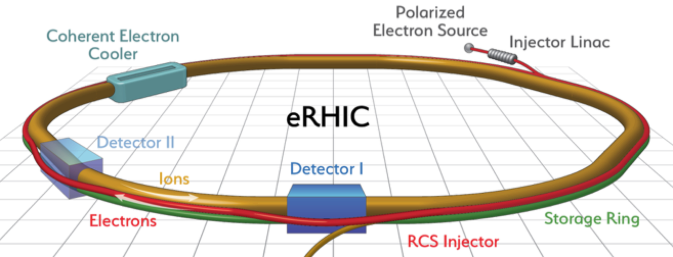
Back up

Slide 27
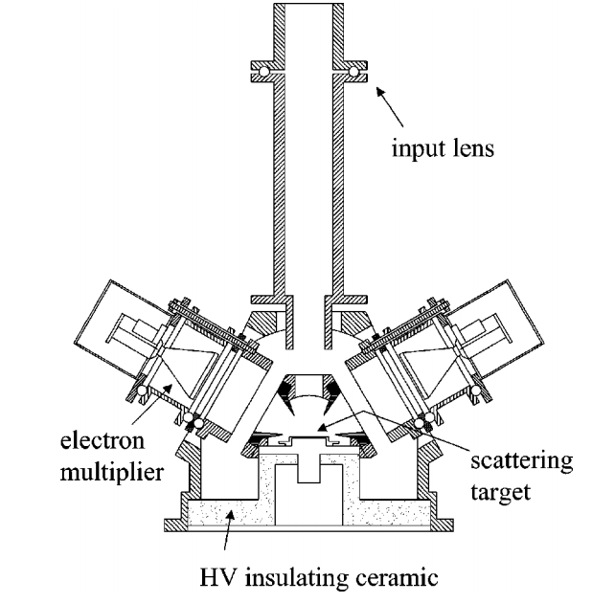
Retarding field Mott polarimeter
Measure the photocathode emission electrons polarization.
Place at preparation chamber.
Commercially available.
laser
Cathode
beam
Parameter name | value
Beam energy | 20 keV
Beam bend degree | 90°
Scattering degree, | 120°
Detector count rate | 3.8e5 Hz/(nA.um)
Electric lens

Slide 28

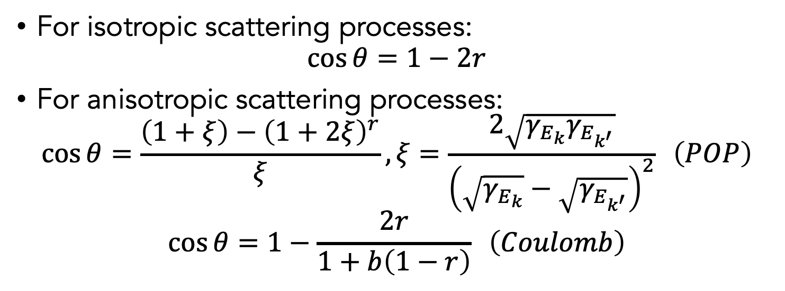
Electron transportation-scattering angle
$$θ$$
For isotropic scattering processes:
$$\cos{θ}=1−2r$$
For anisotropic scattering processes:
$$\cos{θ}=\frac{\left(1+ξ\right)−{\left(1+2ξ\right)}^{r}}{ξ}, ξ=\frac{2\sqrt{γ_{E_{k}}γ_{E_{k^{′}}}}}{{\left(\sqrt{γ_{E_{k}}}−\sqrt{γ_{E_{k^{′}}}}\right)}^{2}} \left(POP\right)$$
$$\cos{θ}=1−\frac{2r}{1+b\left(1−r\right)} \left(Coulomb\right)$$
C. Jacoboni and L. Reggiani, Rev. Mod. Phys. 55, 645 (1983)
D. Vasileska and S.M. Goodnick, https://nanohub.org/resources/9109

Slide 29
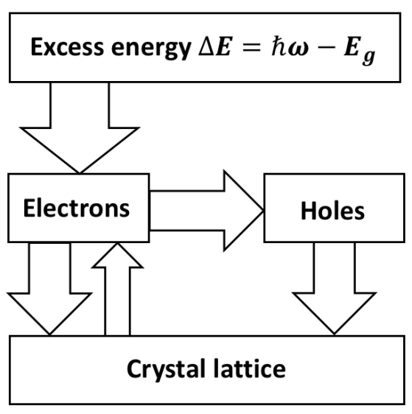
Electron transportation-energy flow
Electrons obtain energy from photon
Electrons exchange energy with holes and crystal lattice
Electron reach a steady-state distribution after a series of scattering
Notes:
the width of the arrows indicates the relative size of each energy-flow channel

Slide 30
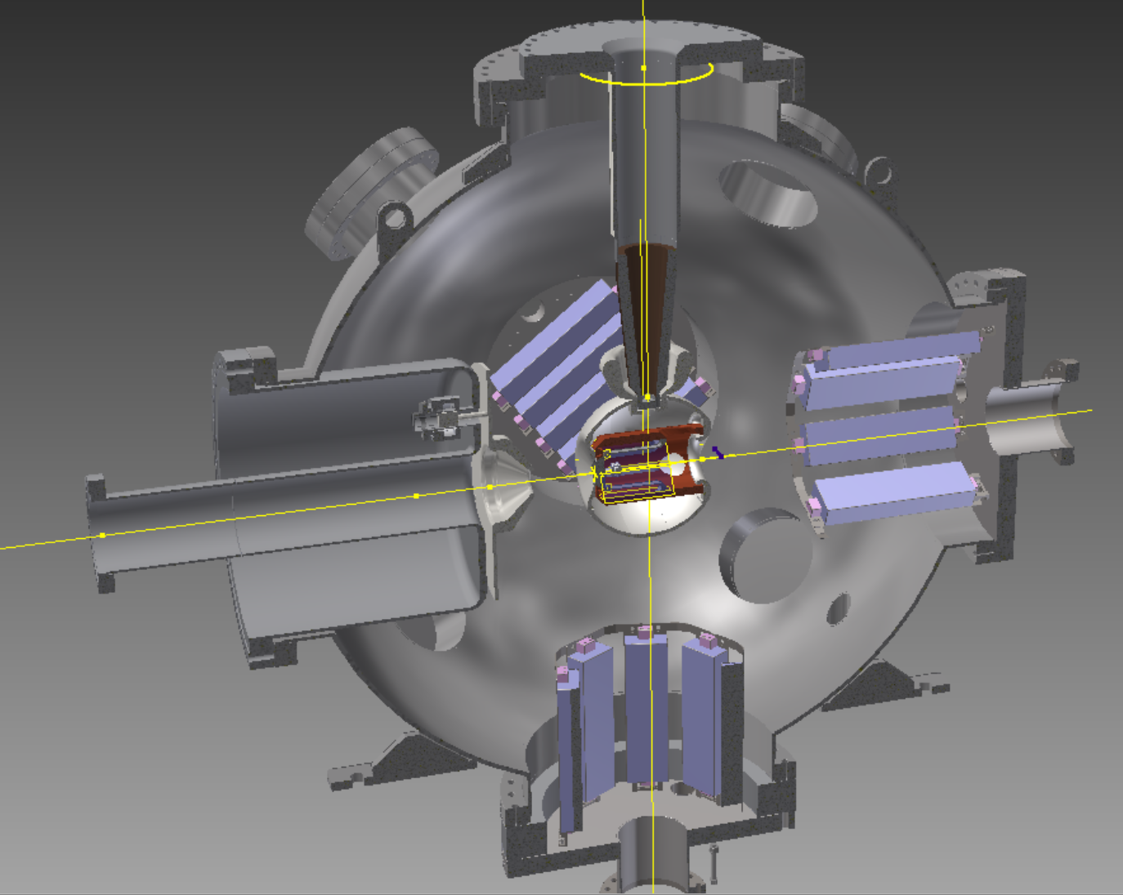
Polarized gun R&D
The polarized gun R&D goal:
High average current (6~50 mA), high bunch charge (5.3 nC) large cathode inverted gun for L-R eRHIC source.
High bunch charge (50 nC) for R-R eRHIC source.
Sub-R&D items:
Achieve and measure XHV
High power laser
Ion back bombardment
Surface charge limit measurement
Lifetime as the function of charge
Beam halo reduction studies
Cathode cooling
BNL 1ST inverted gun in fabrication

Slide 31
Vacuum
Cathode system 10⁻¹² torr
Gun 10⁻¹² torr
Beam line near the gun low 10⁻¹¹ torr
Linac 10⁻¹¹ torr
SIP+NEG

Slide 32
eSource Lab in CAD
Necessary to build a polarized electron source onsite.
Most of the floor space is dedicated for the ATF-II project. Recently it was determined the second experimental hall of the ATF-II project will not be constructed for at least the next 5 years. CAD management has agreed to lend this space to be used as the polarized source laboratory.
The Electron Source R&D facility will be located in the same building as other important facilities that will support it’s efforts.
  Two class 100 particle free clean rooms
  Large In-vacuum bake out oven
  Deionized water source and large high pressure rinsing facilities.
  2K system and Cryogenic refrigerator
  Technical work force
  Large overhead crane

Slide 33
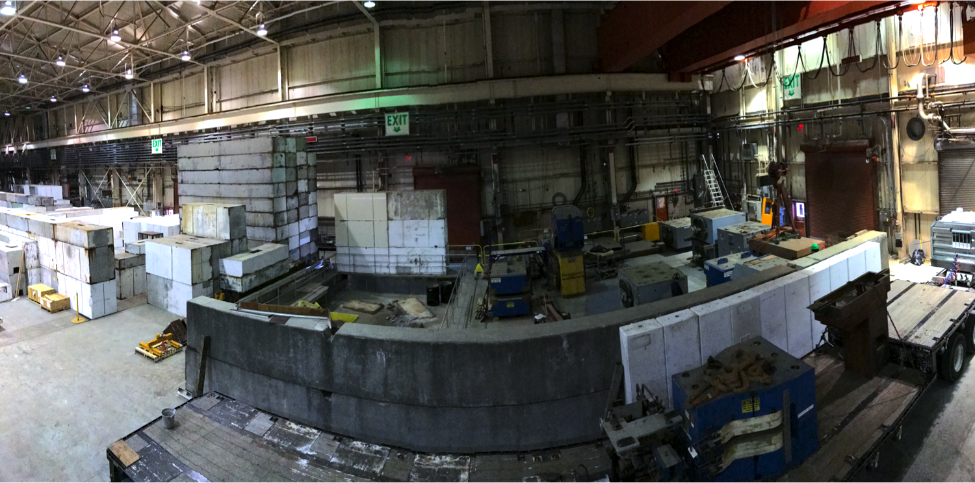


eSource Lab layout
Cathode
Clean room
Gun enclosure
Control room
Accum. Ring
Laser room
160 ft
40 ft
136 ft

