Slide 1
Beam-Beam with Crab-Crossing
Yue Hao
MSU / BNL
On be half of Beam-Beam study team

Slide 2
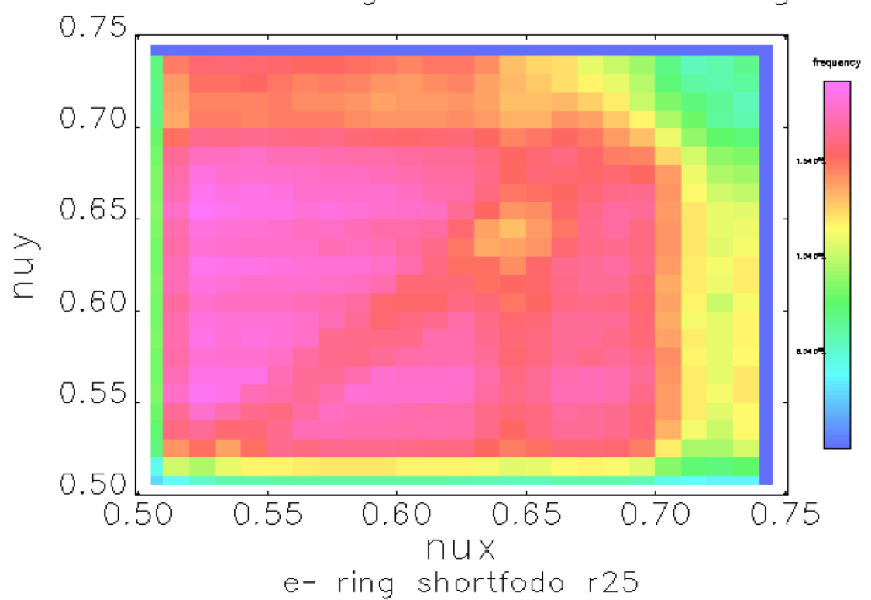
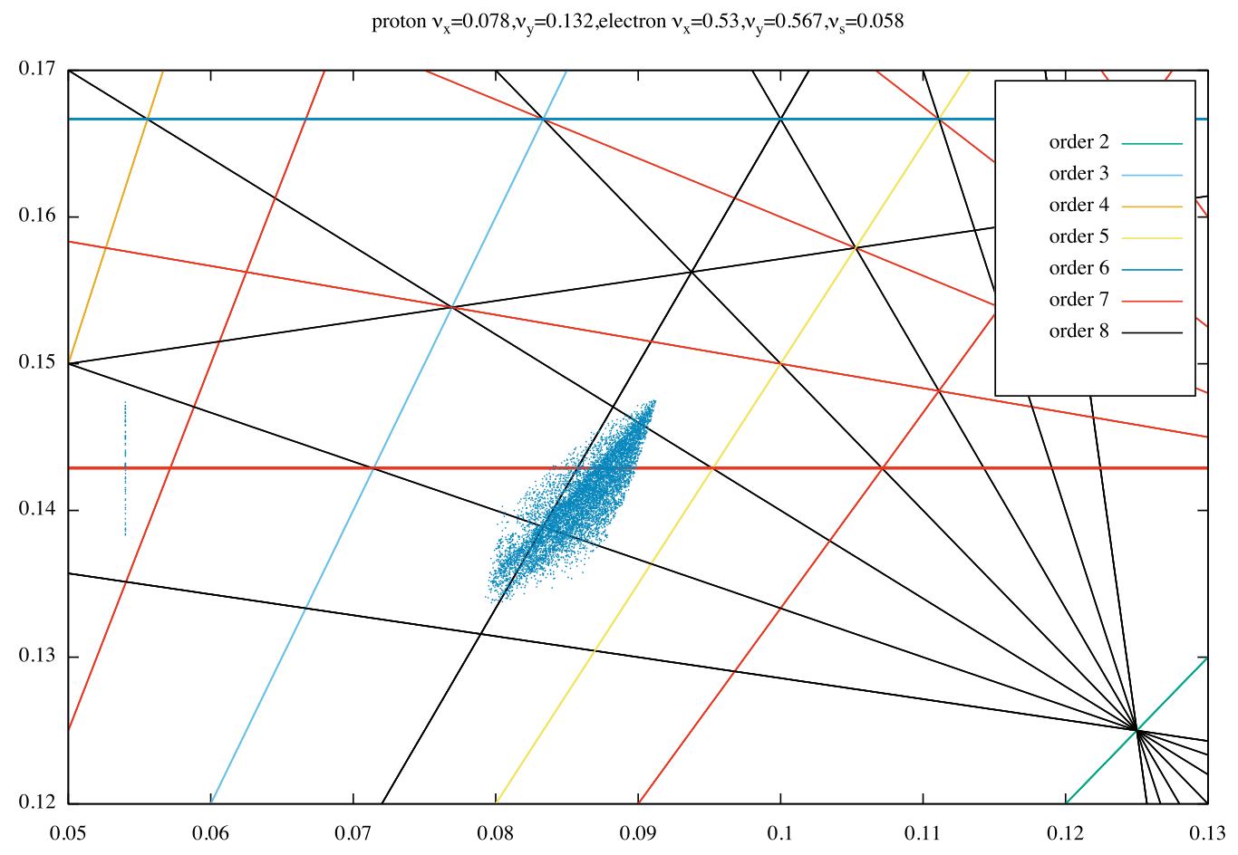
Crab-crossing and Head-on collision
An ideal crab-crossing scheme is design to fully recover the geometric luminosity loss due to crossing angle.
In simulation: Crab kick + Transfer to IP + Lorentz boost → Head-on Collision
Working point determined from weak strong simulation of Head-on case.
JLEIC working point | ν_{x} | ν_{y}
proton | 0.078 | 0.132
electron | 0.53 | 0.567
eRHIC working point | ν_{x} | ν_{y}
proton | 0.31 | 0.305
electron | 0.08 | 0.06

Slide 3
Crab-Crossing Beam Dynamics Checklist
Finite bunch length effect – Focus of this talk
Dispersion @ Crab cavity location
Betatron phase advance error IP⬄ Crab cavity
RF phase / amplitude error
Effect of crab cavity Higher Order Mode

Slide 4
Finite Bunch length effect
Figures of merit ?
Normalized bunch length in CC:
Piwinski Angle:
Notes:
\kappa_L= \frac{L(\sigma_x, \sigma_z, f_c)}{L(\sigma_x, \sigma_z, f_c=0)}

Slide 5
Where are we?
 | eRHIC | JLEIC
Horizontal Beam-Beam parameter | 0.015 (p) / 0.09(e) | 0.015 (p) / 0.06(e)
CC frequency [MHz] (Ion) | 294 | 952
Ion bunch length | 0.07 (1e11 / bunch) | 0.01 (1e10 / bunch)
κ_{cc} | 0.43 | 0.2
Half crossing angle, [mrad] | 12.5 | 25
Piwinski angle | 7.8 | 14.9

Slide 6
Simulation parameter
 | Ion (Proton) | Electron
Bunch population (x 10 ¹¹) | 1.11 | 3.05
Energy (GeV) | 275 | 10
Horizontal beam size at IP (um) | 123 | 123
Vertical beam size at IP (um) | 16 | 16
Bunch length (cm) | 7 | 0.43
Beta function at IP (cm) | 94/4.2 | 63/7.3
Crossing angle (half, rad) | 0.011
Beam-beam parameter (x/y) | 0.014/0.0048 | 0.092/0.084
Piwinski angle | 7.11 | 0.44

Slide 7
Strong-Strong Simulation Observation
Linear Fit of the Luminosity Degradation
Head on collision | - 1400% per hour
CC frequency = 112 MHz | - 2200% per hour
CC frequency = 224 MHz | - 3300% per hour
CC frequency = 336 MHz | - 3600% per hour
CC frequency = 448 MHz | - 3300% per hour
Using Beam-Beam 3D, self-consistent 3-D code by Dr. Ji Qiang.

Slide 8
Beam size growth

Slide 9
Separate cross checks
@ Results during Dr. Ohmi ‘s visit

Slide 10
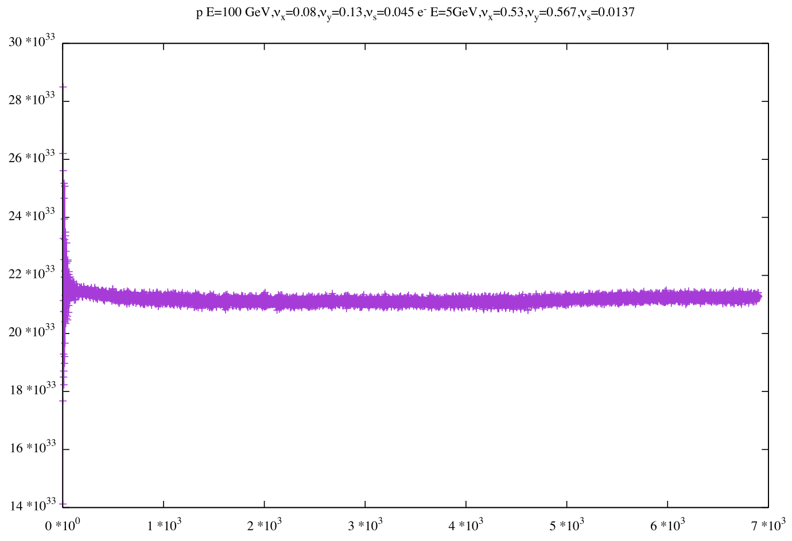
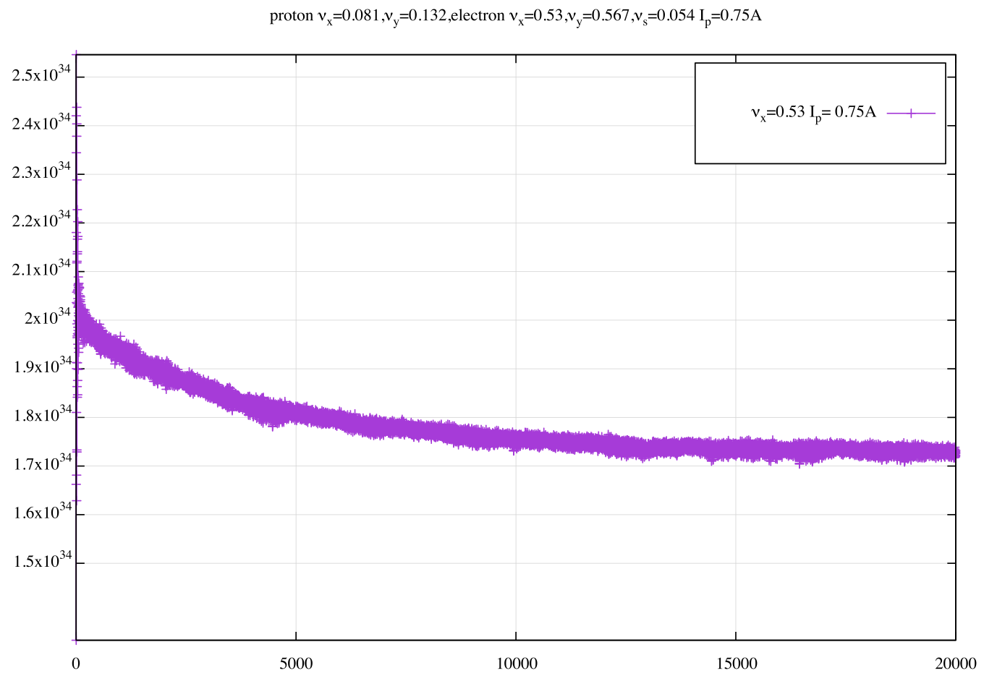
Similar Study for JLEIC
Head-on Collision
Crab Crossing
→ Detailed in Dr. Roblin ‘s talk

Slide 11
Synchro-beta resonance?
The luminosity degradation is largely improved by ‘freezing’ the electron beam.
This suggests:
The dynamics involve two beams
We need strong-strong (self-consistent) simulation to explore this effect.

Slide 12
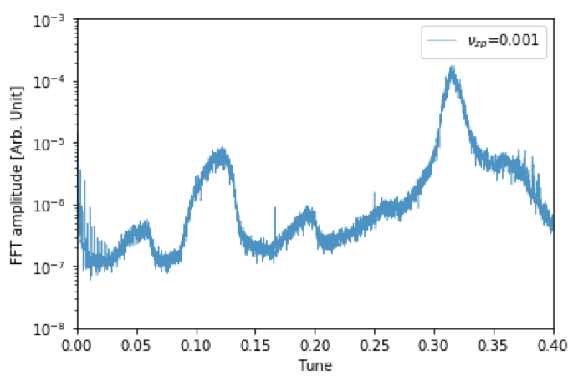
Synchro-beta resonance?
Decrease the synchrotron Tune to reduce the amplitude of synchrotron harmonics at electron tune imprint
→ JLEIC, similar behavior? Detailed in Dr. Roblin ‘s talk

Slide 13
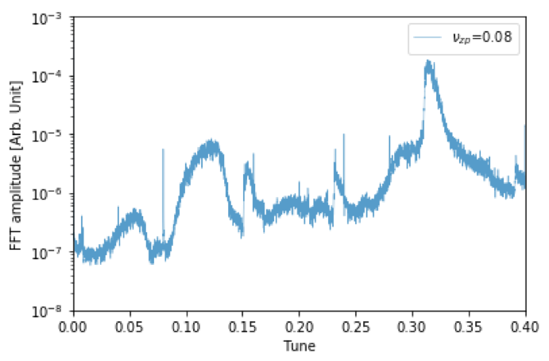
Synchro-beta resonance?
Increase the synchrotron Tune to fit the electron tune imprint between synchrotron harmonics.

Slide 14
Scaling, B-B parameter of Hadron

Slide 15
Scaling, B-B parameter of electron

Slide 16
Electron closed orbit
Using the fact that the electron trajectory has only small deviation from the reference orbit, We can Taylor expand the Bassetti and Erskine formula and create linear map. It is expected, the coherent motion of Gaussian beam is suppressed by the nonlinear beam-beam field.
Example parameter
JLEIC parameter

Slide 17
Electron closed orbit
Current simulation treatment assumes that after the crab cavity, there exist an extra kick to correct to closed orbit to the reference orbit.
We can change the closed orbit of the e-beam when it travels through the hadron beam, by varying the crab cavity voltage, ’over - crabbing’
Linear model predicts @8.7% more voltage produces 0 effect in closed orbit outside IP.

Slide 18
Summary
We found a potential luminosity degradation scheme due to the crab-crossing scheme.
It is likely caused by the synchro (ion) – betatron (electron) resonance.
The degradation rate is only sensitive to the beam-beam parameter of ion.
Potential mitigation method may rely on the detailed study of electron’s closed orbit.

Slide 19
More studies needed
We need implement the self-consistent closed orbit of the electron beam to study the best closed orbit.
Low noise strong-strong code is under developed. (Dr. Qiang)
Benchmark strong - strong results with the weak strong model with centroid motions.

Slide 20
Acknowledgement
The work is supported by FY18 NP FOA, and is collaborating with
  Dr. Yun Luo (BNL)
  Dr. Ji Qiang (LBNL)
  Dr. Yves Roblin (JLab)
We would like to thank:
M. Blaskiewicz, W. Fischer, C. Montag, V. Ptitsyn, F. Willeke
Vasiliy Morozov, He Zhang
For helpful discussion and materials in this talk.

