Slide 1
Ring-based High Energy Electron Cooler
Sergei Nagaitsev and Valeri Lebedev
Fermilab
Oct 30, 2018

Slide 2
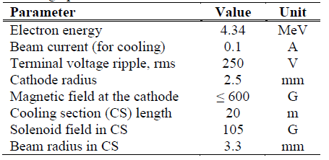
Introduction and acknowledgments
This is an on-going R&D project, funded by the DOE NP
  Project started in July 2018. This is our first report
Many thanks to our Fermilab colleagues, who helped us with conceptual and technical studies.
Fermilab has a long history in beam cooling
Fermilab electron cooler (1996-2005 R&D, 2005-2011 operations)
S. Nagaitsev et al., “Experimental Demonstration of Relativistic Electron Cooling”, Phys. Rev. Lett. 96, 044801 (2006).
S. Nagaitsev, L. Prost and A. Shemyakin, "Fermilab 4.3-MeV electron cooler," 2015 JINST 10 T01001.

Slide 3
Motivation
At the initial project stage, we are focusing on cooling of ~100 GeV, protons with a ~1 hour cooling time.
  Fermilab Recycler cooler: cooling time was < 0.5 hour
A well-known shortcoming of the electron cooling method is its unfavorable scaling of cooling time with energy (~γ^{2.5})
One can compensate by increasing the electron beam current.
We are aiming at a >100-A (DC) electron beam current at 50 MeV.
  DC beams have many advantages as well as some challenges, compared to bunched beams.

Slide 4
Proposed solution
Protons, 100 GeV
Cooling Section, 40-m, 2 kG
Electron ring (115 m circumference)
Beam dump
Electron Induction Linac
100 m, 55 MeV
We are considering a range of electron beam and linac parameters: 100-200 A beam current, 100 – 200 Hz rep. rate
Pulse length: 380 ns (to fill the ring)
Beam power to dump: 0.8 MW (worst case), 200 kW (best case)

Slide 5
Advantages compared to ERLs:
Better energy efficiency – more efficient due to a large number of turns
Use of a thermionic cathode:
  Conventional well-understood technology
  Expect long lifetime
Long beam storage time in a ring (limited by IBS only)
No problems with wake fields
No issues with variable bunch patterns/frequencies for a proton beam

Slide 6
Preliminary cooling system parameters
Proton beam energy | 100 GeV
Proton ring circumference | 3,000 m
Relativistic factor, γ | 107.58
Normalized rms proton beam emittance | 1 μm
Proton beam rms momentum spread | <2∙10⁻³
Beta-functions of proton beam in cooling section center | 40 m
Electron beam energy | 54.48 MeV
Electron ring circumference | 114 m
Cooling length section | 40 m
Electron beam current | 200 A
Electron beam thermal rms norm emittance | 6 μm
Longitudinal magnetic field in cooling section | 1.8 kG
Electron beam rms momentum spread, initial/final | (1.0/2.0)∙10⁻³
Rms electron angles in cooling section | 55 μrad
Electron beam radius in cooling section | 2 mm
Electron beam norm. rms mode emittances, ε₁/ε₂ | 440/0.083 μm
Number of cooling turns in the electron storage ring | 13,100
Longitudinal cooling time (amplitude) * | 0.6 hour
Transverse cooling time (amplitude) * | 3 hour

Slide 7
Effective beam emittance
Cathode
Beam line
Cooling section
B_{c} = 12 G
R_{cath} = 25 mm
B_{c} = 1.8 kG
R_{beam} = 2 mm
B_{z} = 0
(rms, normalized)
(rms, normalized)
(rms, normalized)
Increase with time because of IBS
The concept of a magnetized beam transport was employed in the Fermilab cooler
We also propose to use a “round-flat-round” optics in arcs
  Mode emittances (rms, norm): 440/0.083 μm
  Emittance ratio: ~5,300 (a bit challenging)

Slide 8
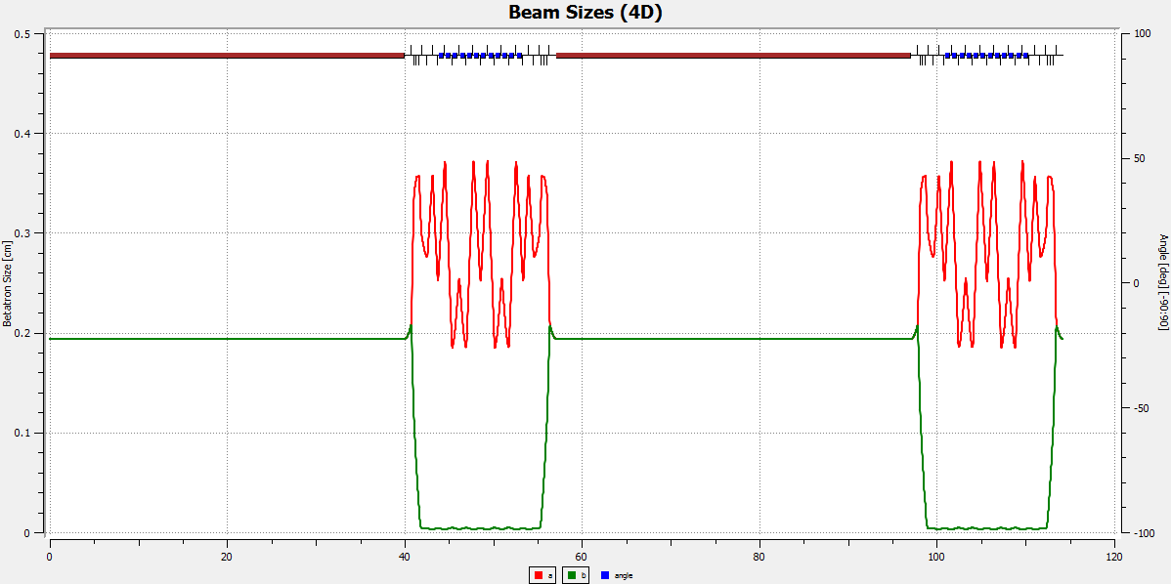
Electron beam main heating mechanism: IBS
E-beam IBS determines the rep rate of the induction linac
The effect of IBS – increases of momentum spread and horizontal emittance
  We propose to use two methods: keep beam density low, keep beam “flat” in arcs (horizontal plane)
Cooling section
Injection/extraction
Arc
Arc

Slide 9
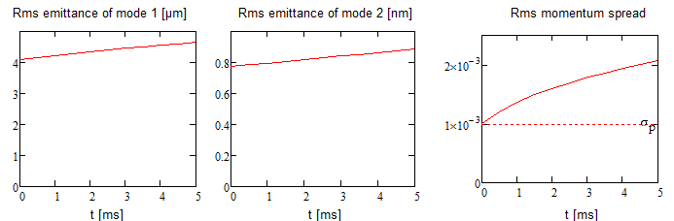
IBS growth in electron ring vs time (in msec)
The electron beam transverse “temperature” (mode 2) in the cooling section doesn’t grow.
x-y coupling is fully accounted for.
  As part of this project, we have developed a complete IBS model in fully coupled optics.

Slide 10
Electron Beam Stability
Longitudinal microwave instability
  Space charge is a major contributor for f>50 MHz: Zn/n~i90 mΩ
    Beam is stabilized by the momentum spread, if σ_{p}>10⁻³
  Resistive wall dominates at f<50 MHz
    Beam is stabilized by a longitudinal damper
Transverse stability is determined by the resistive wall impedance and should be suppressed by transverse dampers
  At the lowest frequency, the required damping time is ~ 6 turns
  It can be gradually increased at higher frequencies
Barrier bucket RF is used to create a short abort gap
  Fermilab has excellent experience with barrier buckets

Slide 11
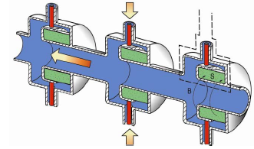
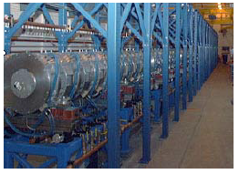
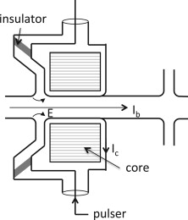
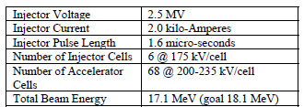
Induction linac
DARHT at LANL
H. Davis and R. Scarpetti, “Modern Electron Induction LINACs”, LINAC 2006,

Slide 12
Our proposed parameters for the Induction Linac
Energy 55 MeV
Current 100-200 A
Pulse duration 380 ns
Repetition rate up to 200 s⁻¹
Strict requirements for the emittance of the electron beam constitute the most challenging part of the injector and the linac optics design: ε (rms, norm) ~ 6 μm (thermal emitt)

Slide 13
Subsystems of the proposed linac
LINAC
PFN_G
PFN_AC
725 cells
PFN_AC
Electron Gun
Matching Section
Accelerating Cell
Accelerating Cell
Ring
Focusing System
Focusing System
Cooling System
Cooling System
Focusing in the linac is provided by solenoids. Must have nearly continuous magnetic field.

Slide 14
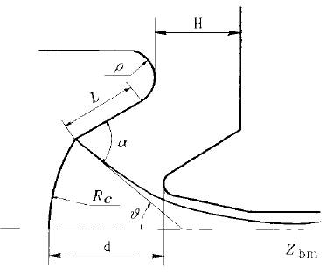
Electron gun:
Goal: generate the beam with uniform transverse current distribution
Use micro-perveance ~1.2 micro-perv*.
The gun voltage is 300 kV, which at the modest compression ratio will provide reasonable surface electric fields, which is necessary at high repetition rate.
To obtain reasonable cathode lifetime (20,000-30,000 hrs), the dispenser cathode diameter is chosen to be 50 mm, limiting loading (current density) to 12 A/cm²
This gun is optimized for low emittance and contains a special near-cathode molybdenum electrode (ring following the cathode edge), having a Pierce angle with respect to the cathode surface. It prevents emittance dilution caused by the gap between the electrode and the cathode (required for thermal insulation).
Scheme of a diode gun with improved electric strength*.
*V.P. Yakovlev, O.A.Nezhevenko, R.True, "Electron gun for a high-power X-band magnicon amplifier",
PAC97, Vancouver,1997, p.3186.

Slide 15
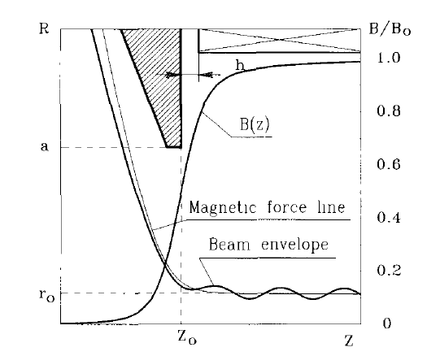
Electron gun:
A dispenser cathode at 1050 C, which provides acceptable normalized thermal emittance.
The cathode surface roughness does not contribute the emittance.
The beam in the accelerating channel has diameter of 20 mm, which gives very modest beam area compression in the gun, 6:1, and consequently, reasonable surface fields.
The gun is mounted in a compensation coil, which provides the required magnetic field at the cathode, 12 G.
Magnetic field line
The beam matching to the first focusing solenoid*
*Yu.V. Baryshev, I.V. Kazarezov, E.B. Kozyrev, G.I. Kuznetsov, I.G. Makarov, O.A. Nezhevenko, B.Z. Persov, M.A. Tiunov, V.P. Yakovlev, and I.A. Zapryagaev. "A 100 MW electron source with extremly high beam area compression", Nuclear Inst. and Methods in Phys. Research A 340 (1994), pp. 241-258.

Slide 16
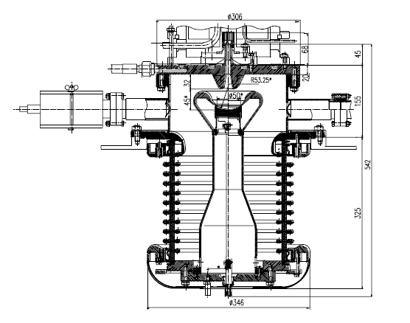
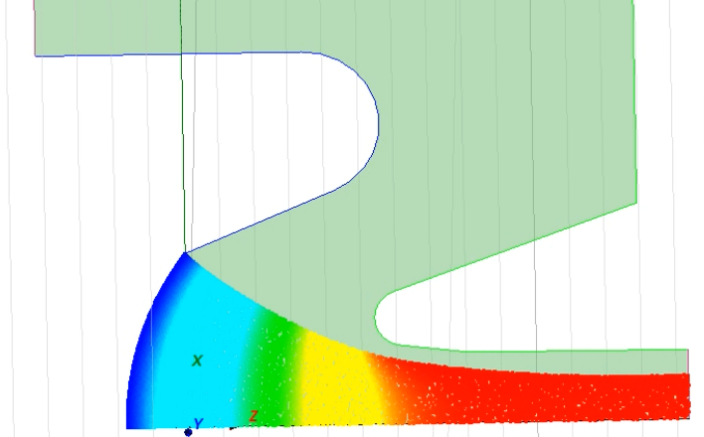
Electron gun:
The gun preliminary MICHELLE optimization (in progress)
The design concept of the gun*. All the critical elements are fabricated and assembled with accuracy < 0.1 mm.
*V.P. Yakovlev, O.A. Nezhevenko, J.L. Hirshfield, M.A. LaPointe, M.A. Batazova, G.I. Kuznetsov, “100 MW Electron Gun For A 34.3 GHz Magnicon,” PAC2001, Chicago, June 17-22, 2001, pp.1041-1043.

Slide 17
Focusing system:
The beam focusing is provided by solenoids, having gaps for acceleration.
Solenoids are the part of the acceleration cell. If the gaps are smaller than the solenoid lengths, the beam scalloping is relatively small, and the beam radius is close to Brillouin limit.
The focusing magnetic field in the beginning of the accelerator is ~450 G; it is gradually reduced to ~50 G towards the end of the accelerator (the beam diameter stays the same over the entire length of the beam line).
Heat losses < 100 W/cell

Slide 18
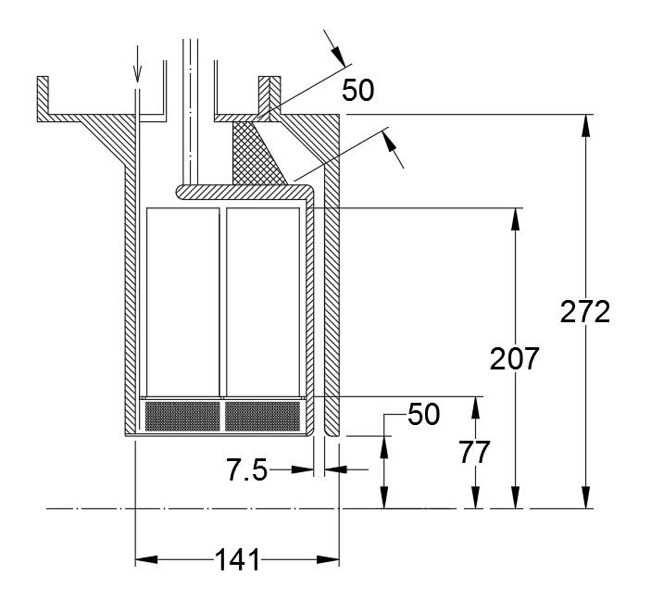
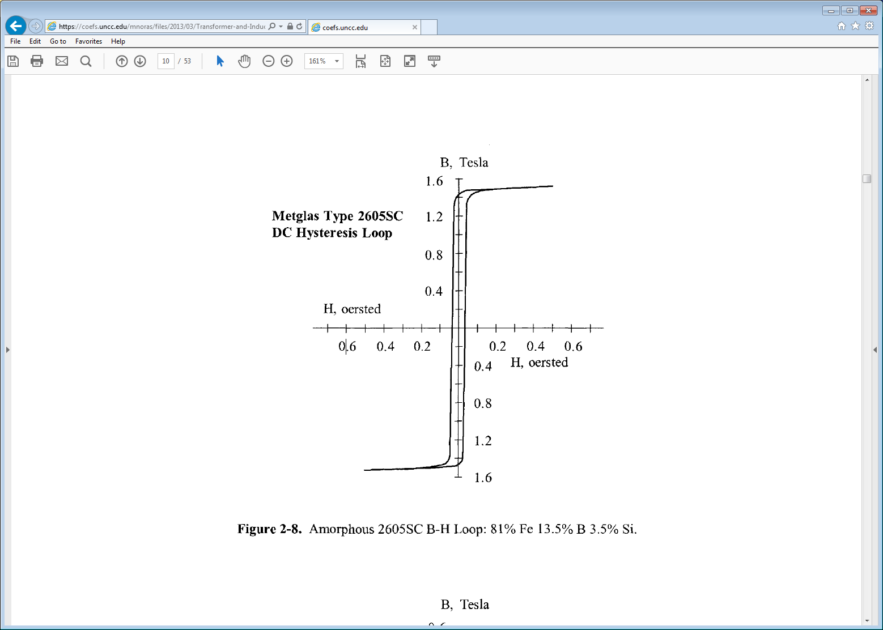
Accelerating Cell
Main parameters:
U_{cell} = 75 kV
Material – Metglas2605SC:
t = 25 μm
Flux density swing = 2.85 T
Volume – 9.3 dm³
Power loss in the cores – 5.4 kW
Maximum magnetic field – 700 G
Power loss in the windings – 100 W
Cooling Circuit
Insulator and HOM absorber
Metglas Core
Focusing System Winding
Dimensions in mm

Slide 19
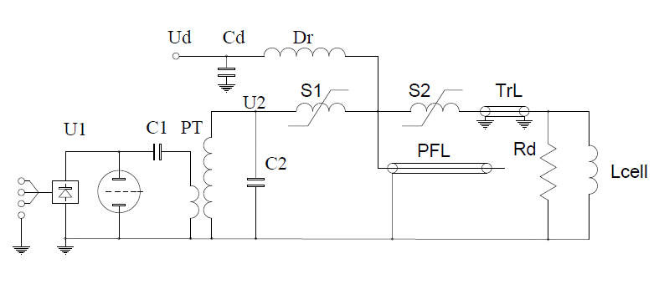
Pulse Forming Network of the LIA Cells
Perkin-Elmer thyratron
HY-5
Power loss in the cores is 27 W per one cycle; Z_{loss} = 79 Ohm;
I_{beam} = 200 A;
U_{cell} = 75 kV;
Z_{beam} = 375 Ω;
30 kV
R_{d} = 217 Ω → Z_{PFL} = 50 Ω
L_{PFL}= 40 m (oil-filled)
U_{PFL}= 150 kV
1:5 pulsed transformer
C1 = 95.5 nF
C2 = 3.8 nF
Saturating core switches will be used to condition the pulse: the first one, S1, to charge the oil-filled PFL and the second, S2, to connect the PFL to the cell. The switches must be designed to meet requirements for the accelerating cell voltage pulse rise and fall time. They can be made multi-staged and allow voltage step-up.
To demagnetize the cores of the accelerating cell and the cores of the saturating switches, a demagnetizing power supply is used. Required current for the DC operation is 4 A.

Slide 20
Summary for the linac concept:
The concept of the induction linac looks feasible.
The linac contains:
200 A, 300 kV electron gun with the beam area compression 6:1. The gun has the dispenser cathode 50 mm in diameter, operating at 1050C. The maximal current density is 12 A/cm2, which provides considerably long cathode life time, 20,000-30,000 hours.
The gun is matched to the first solenoid using the concept successfully used in RF sources. A compensation coil and a yoke are used to shape the magnetic field lines in the gun and to coincide the beam trajectories.
The solenoidal focusing is used to keep the beam maximal radius in the linac of 10 mm. The field in the first solenoid is < 500 G. The heat deposition in the solenoid is well below 200 W.
The linac contains 725 accelerating cells having the length of 141 mm. Each cell provides the energy gain of 75 keV.
The total length of the linac is ~100 m (without injector).
The power dissipation in the cores of each cell is ~5.4 kW. The total power dissipation is ~2.5 MW (at a 200-Hz pulse rate).
A concept scheme of a pulser to feed a linac cell is suggested that meets the requirements of the voltage and pulse length.

Slide 21
Conclusions
Our project aims at developing an electron cooling system capable of providing cooling times of ~ 1 hour for 100-GeV protons.
We have launched this R&D project in July 2018 and, so far, we identified no show-stoppers.
  Developed a detailed IBS model with full coupling
  Developed a simplified ring optics and determined the required linac and e-gun parameters to meet the cooling
  We developed preliminary concepts of the electron gun and the induction linac with suitable beam parameters.
Fermilab is very interested in being part of the EIC R&D and we are ready to start working with partner labs on more detailed concepts of the cooler ring and the linac.

