Slide 1
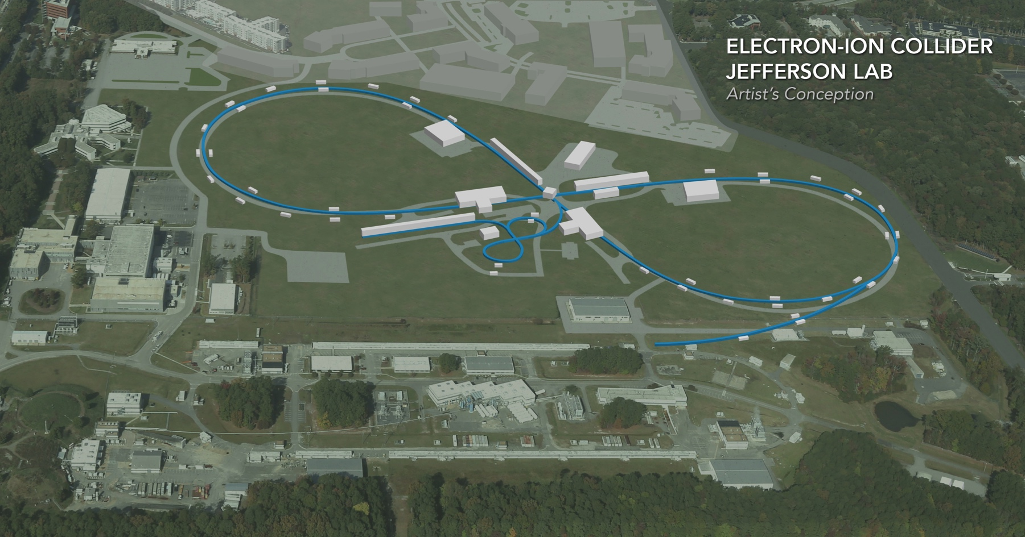
Beam-Beam effects in JLEIC
Yves Roblin, Jefferson Lab
He Zhang, Jefferson Lab
Balsa Terzic, ODU
EIC Accelerator Collaboration Meeting
October 29 - November 1, 2018

Slide 2
Outline
Current baseline
  Working points
  Head-on collisions
  Crabbing collisions
  Two-ips running, initial assessment.
Gear changing update
Benchmarking GHOST versus BB3D
FOA activity
  Modifications to BB3D for high-order tracking
Summary

Slide 3
Proton working point

Slide 4
Electron working point optimization
Shift to 0.54

Slide 5
Head-on configuration

Slide 6
Crabbing configuration
Implemented as two RF kickers on each side of IP
We made the following assumptions:
Cavities placed at beta=600m
One single RF kicker on each side (real implementation will have several)
No RF noise, perfect cavity, no incoming dispersion leakage

Slide 7
Crabbing on , some luminosity loss

Slide 8
Increasing $θ_{s }$ to move the synchrotron band

Slide 9



Increasing proton current
$$ξ_{e−}=0.09$$
$$ξ_{e−}=0.08$$
$$ξ_{e−}=0.06$$

Slide 10
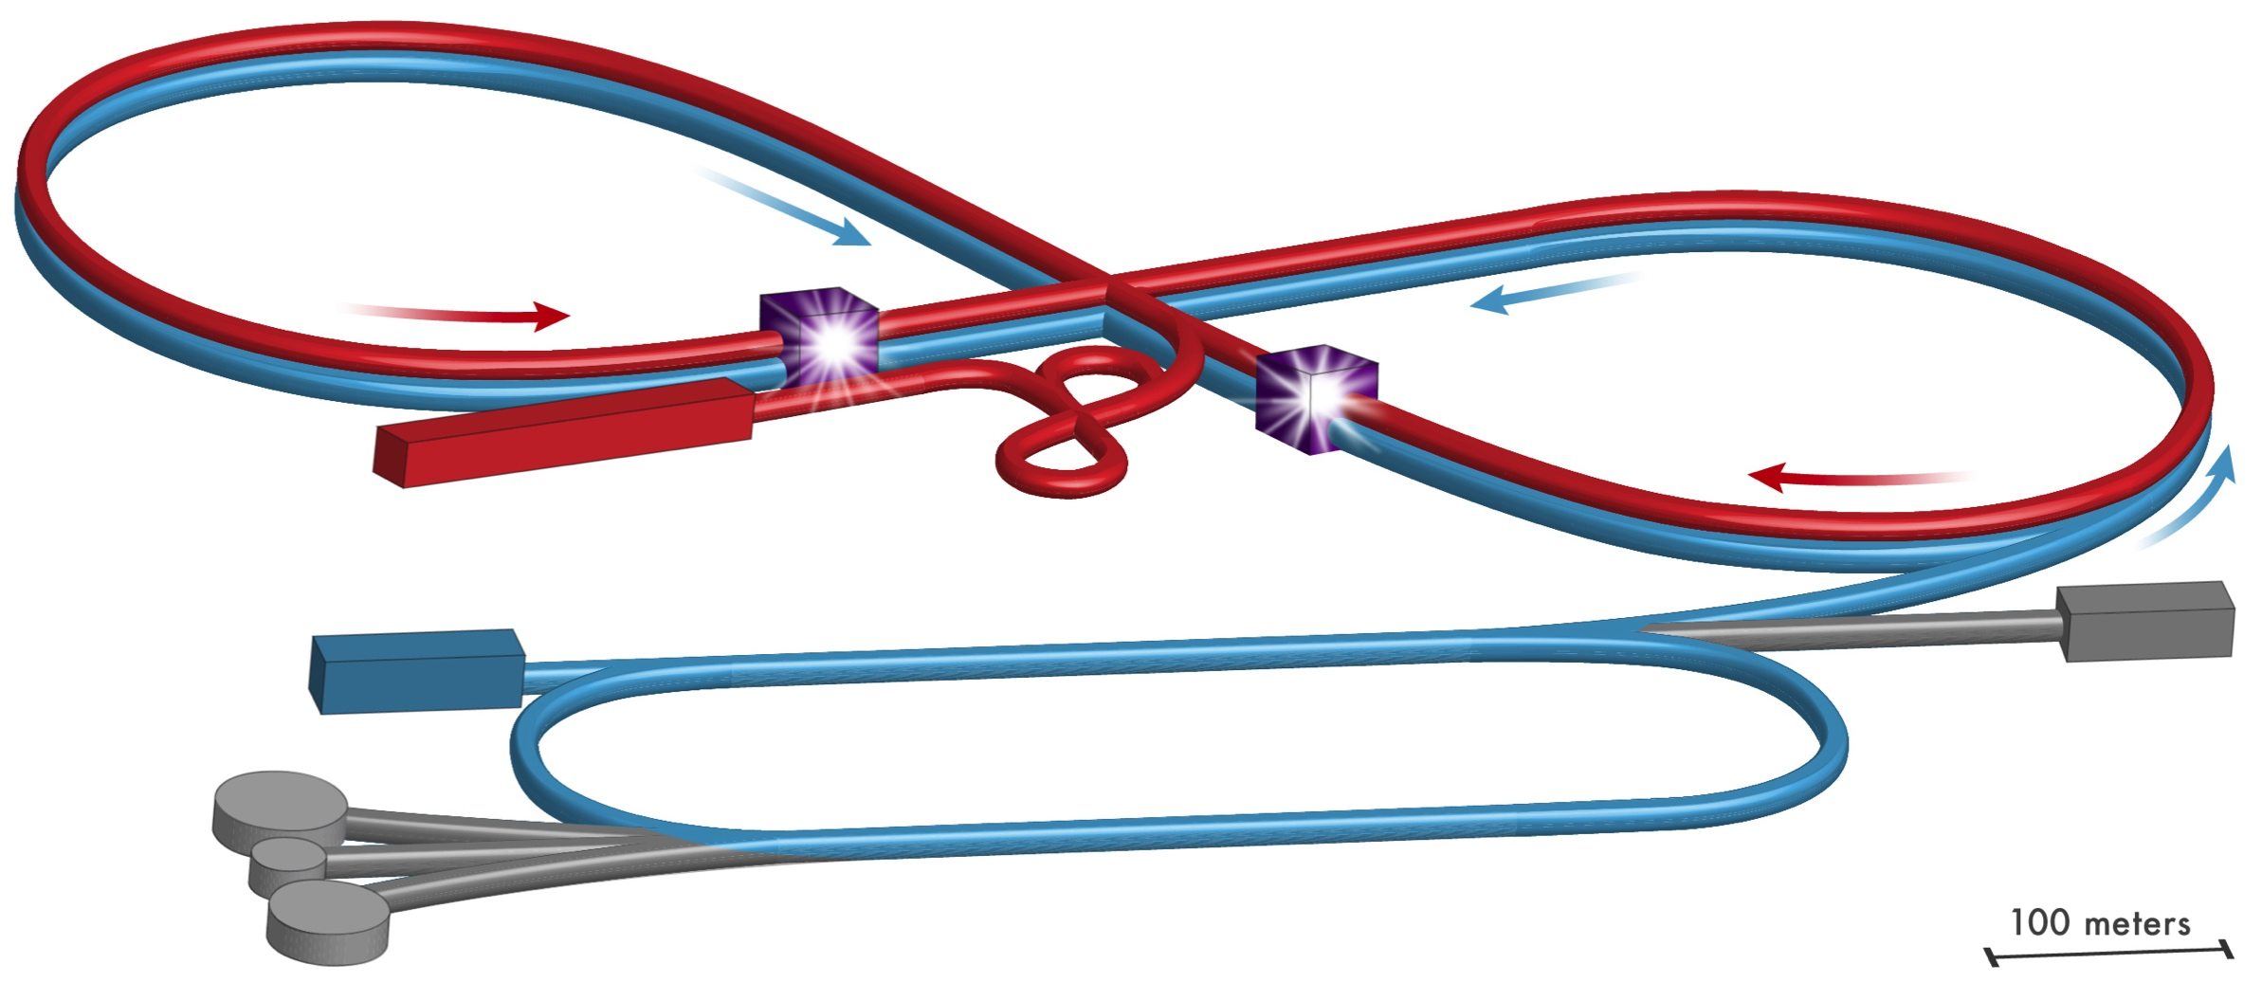
Two-IP running
Configure both IP’s with the same working points

Slide 11
Running with two interaction points
Expecting twice the incoherent tune spread.

Slide 12
Running with two interaction points, crabbing ON
Need to include
The optics between
The IPS using maps
Optimization of phase
Advance between IPS not
Done
We are using the same crabbing
setup for both IPS
No crabbing noise errors.
Preliminary

Slide 13
Update on Gear-changing simulations and benchmarking
Configured BB3D to perform simulations for a small number of bunches
Compared with GHOST for various scenarios up to 7x6
No attempt to optimize for good luminosity (that is year 2 FOA)

Slide 14
Gear changing simulations. 4p x 3e-, BB3D

Slide 15
Gear changing simulations 4px3e- BB3D (cont)

Slide 16
Gear changing simulations 4x3 luminosity, BB3D

Slide 17
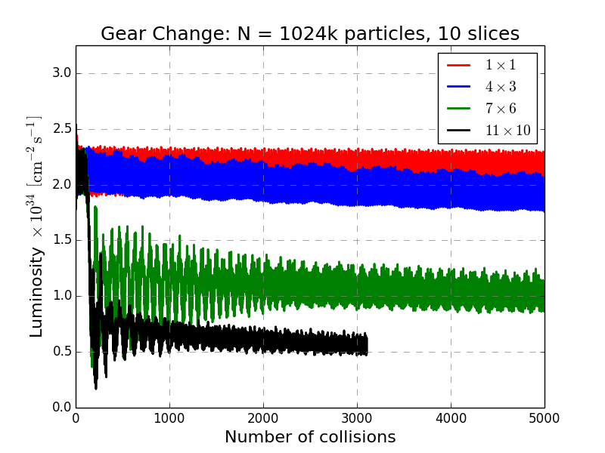
Gear changing simulations (GHOST)
Figure 8:Initial tests of gear changing with GHOST

Slide 18
Gear changing 7x6 BB3D versus GHOST (10 slices)

Slide 19
FOA “Development and test of simulation tools for EIC beam-beam interaction”
In collaboration with Brookhaven, MSU, LBNL . The JLAB part for year 1 is :
Q1:(task 2.1) Replace the linear ring map by a nonlinear map to up to a certain order. BB3D currently supports up to 4th order maps for describing the transport between interaction points. This task will consist in implementing a mechanism to support transfer maps to an arbitrarily high order. We will use truncated Taylor maps augmented by an extended Poincare method to provide symplectification on the fly.
Q2:(task 2.2) Implement high order non-linear field errors in the interaction region in BB3D. For both JLEIC and eRHIC, the field errors in the interaction region are a critical part of understanding the dynamics. We are proposing to implement this as supplemental non-linear kicks applied in the IR region.
Q3:(task 2.3) Implement Landau cavities for additional damping control in BB3D. The current model for longitudinal optics in BB3D is a linear synchrotron map. We are proposing to implement a model for real RF cavities including higher order harmonic cavities. Landau cavities which are third order harmonics are an important part of damping control in collider rings.
Q4:(task 2.4) In the last quarter, we will make use of the modifications to BB3D carried out in the first three quarters to study the effect of damping decrements in the JLEIC ring design.

Slide 20
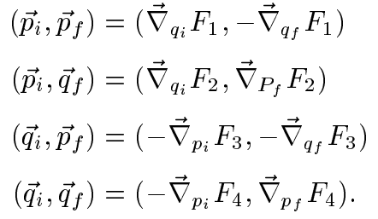
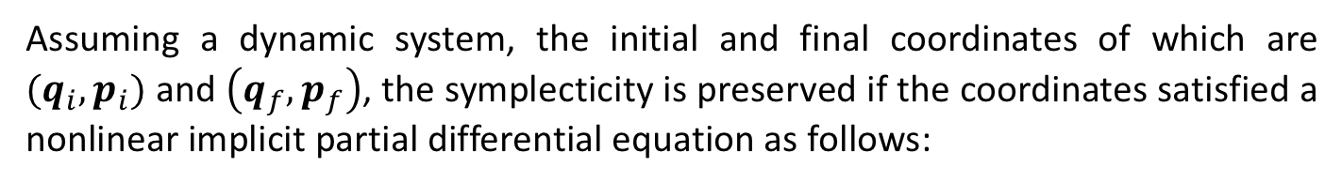
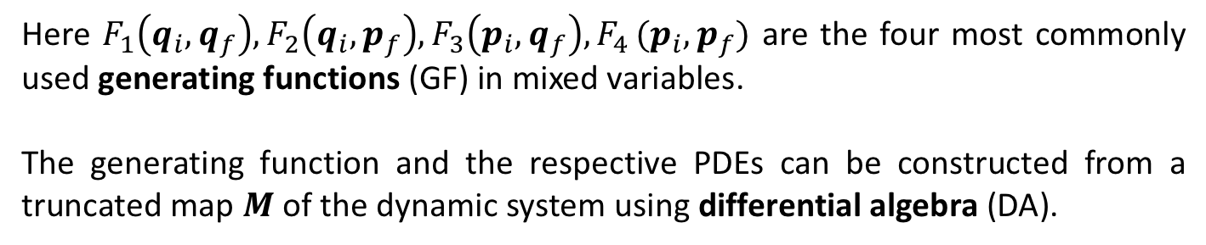
Methodology^{[1,2]}
Assuming a dynamic system, the initial and final coordinates of which are $(q_{i},p_{i})$ and $\left(q_{f},p_{f}\right)$, the symplecticity is preserved if the coordinates satisfied a nonlinear implicit partial differential equation as follows:
Here $F_{1}\left(q_{i},q_{f}\right), F_{2}\left(q_{i},p_{f}\right),F_{3}\left(p_{i},q_{f}\right), F_{4 }(p_{i},p_{f})$ are the four most commonly used generating functions (GF) in mixed variables.
The generating function and the respective PDEs can be constructed from a truncated map $M$ of the dynamic system using differential algebra (DA).
He Zhang

Slide 21
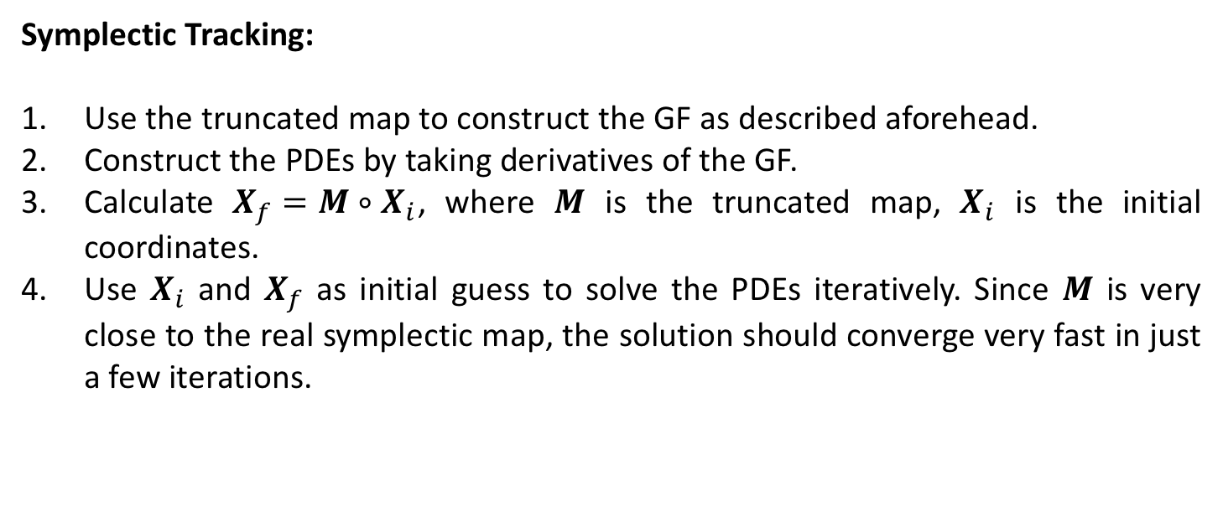
Methodology^{[1,2]}
Symplectic Tracking:
Use the truncated map to construct the GF as described aforehead.
Construct the PDEs by taking derivatives of the GF.
Calculate $X_{f}=M∘X_{i}$, where $M$ is the truncated map, $X_{i}$ is the initial coordinates.
Use $X_{i}$ and $X_{f}$ as initial guess to solve the PDEs iteratively. Since $M$ is very close to the real symplectic map, the solution should converge very fast in just a few iterations.
[1] Modern Map Methods in Particle Beam Physics, page 293
M. Berz, Academic Press, 1999, ISBN 0-12-014750-5
[2] Symplectic Tracking in Circular Accelerators with High Order Maps
M. Berz, in: "Nonlinear Problems in Future Particle Accelerators" (1991) 288-296, World Scientific
He Zhang

Slide 22
Code
A TPSA lib based on Dr. Lingyun Yang’s TPSA lib (C++):
  Revised the memory management for better efficiency
  Wrapped with a new DAVector data type for easier use
  Added and revised some intrinsic functions
  https://github.com/zhanghe9704/tpsa
Tracking (C++):
  Read the output file from COSY Infinity 9.1 or MAD-X for the truncated map
  Tracking with the truncated map
  Construct the GF from the truncated map, construct the PDEs, perform symplectic tracking
Fortran interface for tracking
  Load the truncated map
  Tracking with the truncated map
  Construct the PDEs
  Symplectic tracking
  Release the memory for the truncated map
He Zhang
Fall 2018 EIC Accelerator Collaboration Meeting

Slide 23
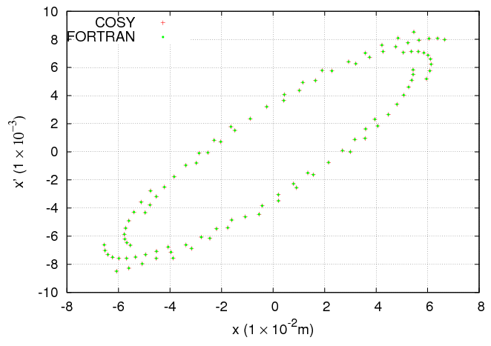
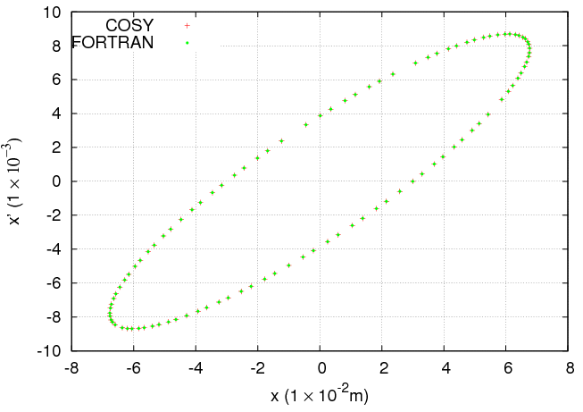
Code Verification
Verified for truncated map tracking and symplectic tracking with COSY Infinity using a 4D map with coupling for 1,000,000 turns.
Two codes agree very well.
Truncated map
GF2
He Zhang

Slide 24
Summary
There is an optimized set of working points and running configurations for the 44.5 GeV/c CM kinematics
Initial checks show that it is likely possible to run with two interaction points
GHOST is being benchmarked and showed to be yielding the same results as BB3D
BB3D is being modified within the framework of the collaborative FOA

Slide 25
Acknowledgments
I wish to thank Drs Yun Luo, Yue Hao, Ji Qiang, Balsa Terzic, Vasiliy Morosov, He Zhang and River Huang for fruitful discussions and/or material for this talk.

Slide 26
BACKUP SLIDES

Slide 27
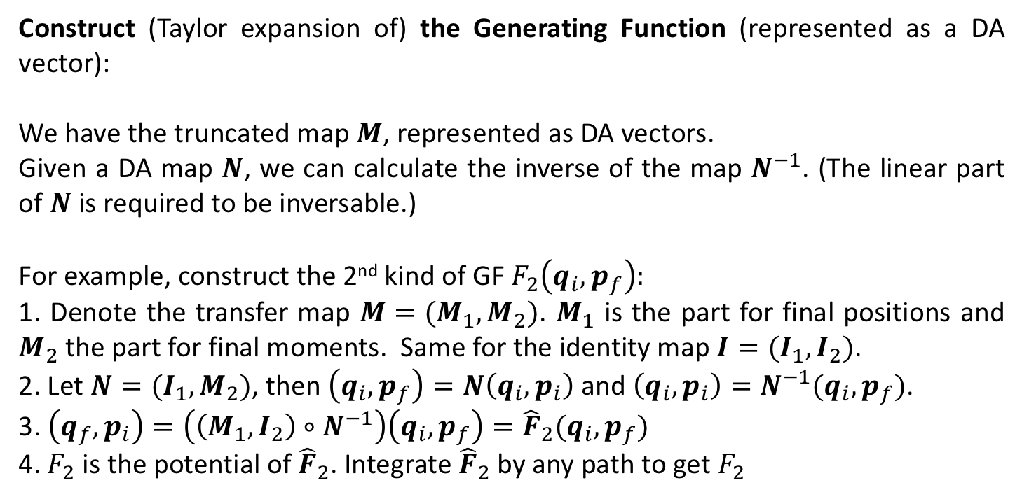
Methodology^{[1,2]}
Construct (Taylor expansion of) the Generating Function (represented as a DA vector):
We have the truncated map $M$, represented as DA vectors.
Given a DA map $N$, we can calculate the inverse of the map $N^{−1}$. (The linear part of $N$ is required to be inversable.)
For example, construct the 2nd kind of GF $F_{2}\left(q_{i},p_{f}\right):$
1. Denote the transfer map $M=(M_{1},M_{2})$. $M_{1}$ is the part for final positions and $M_{2}$ the part for final moments. Same for the identity map $I=(I_{1},I_{2})$.
2. Let $N=(I_{1},M_{2})$, then $\left(q_{i},p_{f}\right)=N\left(q_{i},p_{i}\right)$ and $\left(q_{i},p_{i}\right)=N^{−1}(q_{i},p_{f})$.
3. $\left(q_{f},p_{i}\right)=\left(\left(M_{1},I_{2}\right)∘N^{−1}\right)\left(q_{i},p_{f}\right)={\hat{F}}_{2}(q_{i},p_{f})$
4. $F_{2}$ is the potential of ${\hat{F}}_{2}$. Integrate ${\hat{F}}_{2}$ by any path to get $F_{2}$
He Zhang

Slide 28
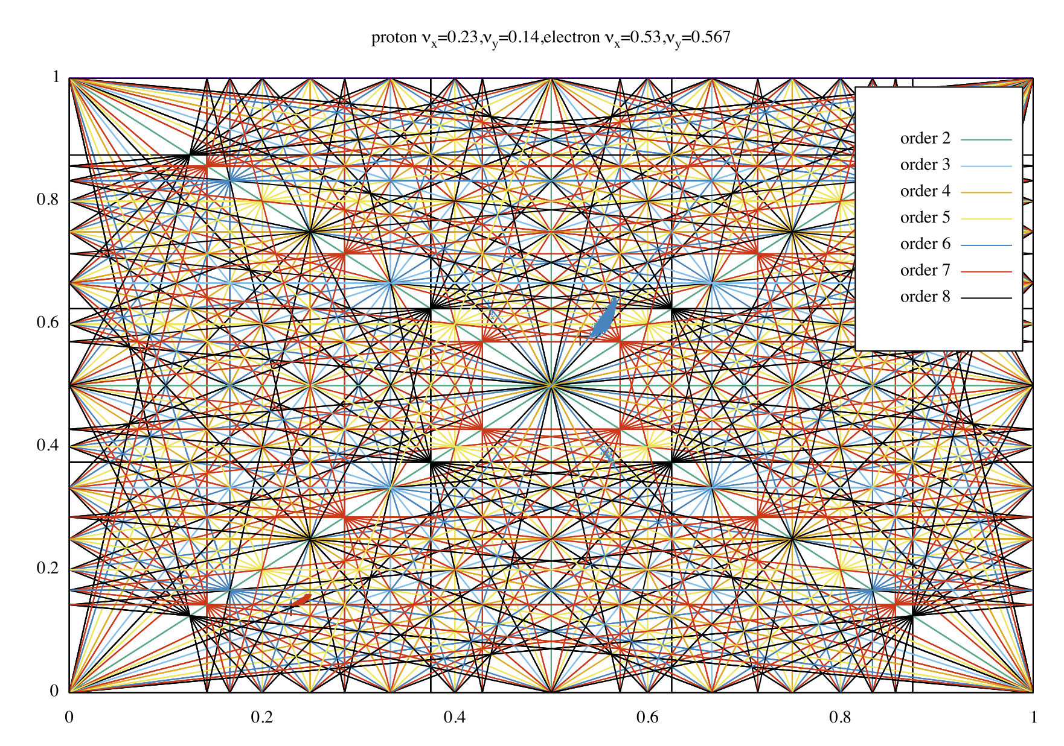
Current workpoints in resonance plot

Slide 29

Proton tune footprint for $υ_{s}=0.054$
$$4θ_{x}+θ_{s}=1.0$$

Slide 30

Proton tune footprint for $υ_{s}=0.04$5
$$4θ_{x}+θ_{s}=1.0$$

Slide 31


Proton tune footprint for $υ_{s}=0.0$58
$$4θ_{x}=1.0$$
$$4θ_{x}+θ_{s}=1.0$$

Slide 32
Footprint with Alternate working point

Slide 33
Adjusted further to get away from 5th order

