Slide 1
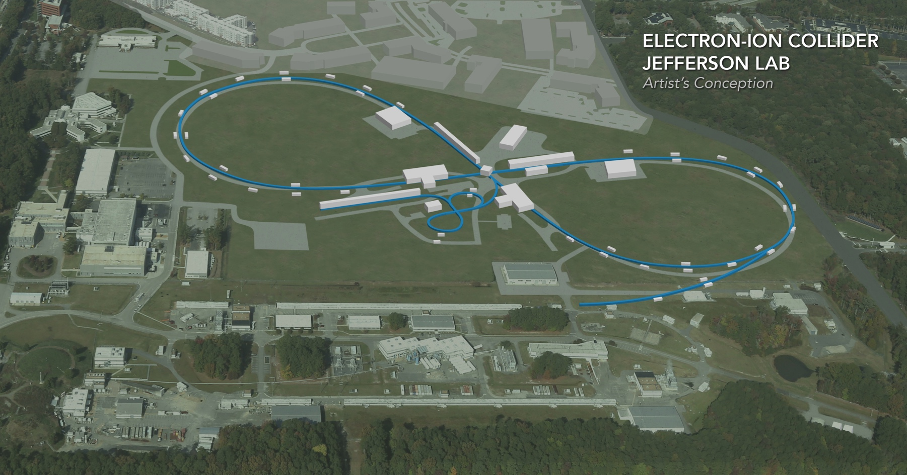
Development of an ERL Electron Cooler
Stephen Benson, Jefferson Lab
Collaborators: Slava Derbenev, David Douglas, Fay Hannon, Andrew Hutton, Rui Li, Bob Rimmer, Yves Roblin, Chris Tennant, Haipeng Wang, He Zhang, Yuhong Zhang
EIC Accelerator Collaboration Meeting
October 29 - November 1, 2018

Slide 2
Outline
Bunched beam Cooler design specifications
Cooling simulation status
CCR design.
Injection/extraction scheme
Injector design
Summary (future work)

Slide 3
Baseline Design is Cooling Ring Fed by ERL
Same-cell energy recovery in 952.6 MHz SRF cavities
Uses harmonic kicker to inject and extract from CCR (divide by 11)
Assumes high charge, low rep-rate injector (w/ subharmonic acceleration and bunching)
Use magnetization flips to compensate ion spin effects
top ring: CCR
ion beam
ion beam
magnetization flip
magnetization flip
B < 0
B > 0
B > 0
B < 0
linac
beam dump
injector
fast extraction kicker
septum
septum
fast injection kicker
circulating bunches
extracted
injected
De-chirper
vertical bend
Re-chirper
bottom ring: ERL

Slide 4
Strong Cooler Specifications (Electrons)
Energy 20–55 MeV
Charge 1.6 (3.2) nC
CCR pulse frequency 476.3 MHz
Gun frequency 43.3 MHz
Bunch length (tophat) 2 cm (23°)
Thermal (Larmor) emittance <19 mm-mrad
Cathode spot radius 3.1 mm
Cathode field 0.05 T ³
Normalized hor. drift emittance 36 mm-mrad
rms Energy spread (uncorr.)* 3x10⁻⁴
Energy spread (p-p corr.)* <6x10⁻⁴
Solenoid field 1 T
Electron beta in cooler 37.6 cm
Solenoid length 4x15 m
Bunch shape beer can

Slide 5
Cooler Specifications (protons)
Case 1 – 63.3 GeV center of mass energy
Energy 100 GeV
Particles/bunch 4.0 x10¹⁰
Repetition rate 119 MHz
Bunch length (rms) 2.2 cm
Normalized emittance (x/y) 0.9/0.18 mm-mrad
Betatron function in cooler 100 m (at point between solenoids)
Case 2 – 44.7 GeV center of mass energy
Energy 100 GeV
Particles/bunch 1.0x10¹⁰
Repetition rate 476.3 MHz
Bunch length (rms) 1.0 cm
Normalized emittance (x/y) 0.5/0.1 mm-mrad
Betatron function in cooler 100 m (at point between solenoids)
Ion ring lattice may be coupled or dispersed in solenoid. Ion beam may be partially offset from the electron beam.

Slide 6
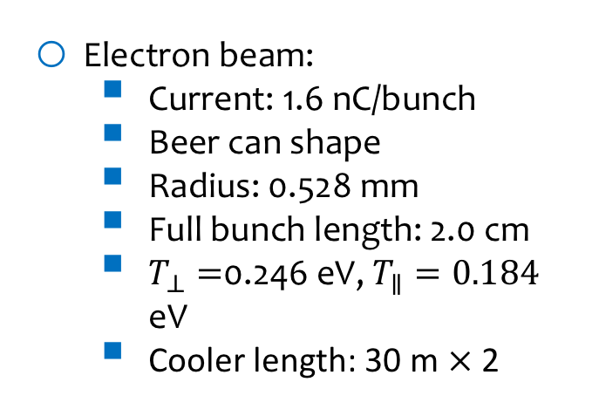
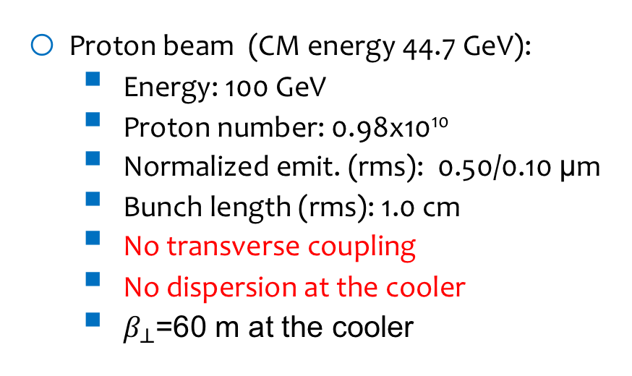
Cooling Rate is Not the Same in All Dimensions (see He Zhang’s talk)
Proton beam (CM energy 44.7 GeV):
  Energy: 100 GeV
  Proton number: 0.98x10¹⁰
  Normalized emit. (rms): 0.50/0.10 μm
  Bunch length (rms): 1.0 cm
  No transverse coupling
  No dispersion at the cooler
  $β_{⊥}$=60 m at the cooler
Electron beam:
  Current: 1.6 nC/bunch
  Beer can shape
  Radius: 0.528 mm
  Full bunch length: 2.0 cm
  $T_{⊥}=$0.246 eV, $T_{∥}=0.184$ eV
  Cooler length: 30 m $×$ 2
Rate | Rx (1/s) | Ry (1/s) | Rs (1/s)
IBS | 0.0125 | 0.00065 | 0.00096
Cooling | -0.0036 | -0.00664 | -0.00421
Total | 0.0089 | -0.00599 | -0.00324

Slide 7
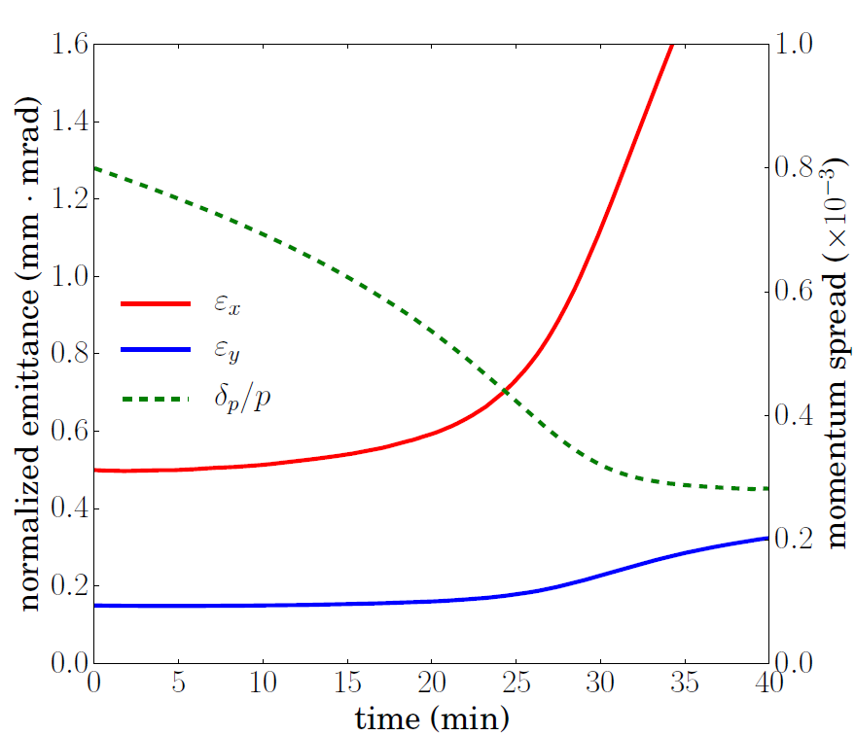
Consequence of Mismatch
Proton beam (CM energy 44.7 GeV):
  Energy: 100 GeV
  Proton number: 0.804x10¹⁰ (82%)
  Normalized emit. (rms):
  0.50/0.15 μm
  Beta function in cooler: 60/200 m
Electron beam 3.2 nC
Longitudinal overcooling reduces the bunch length, which increases the charge density and thus the IBS rate. Transverse equilibrium is broken.
Will try to decrease RF to keep bunch long.

Slide 8
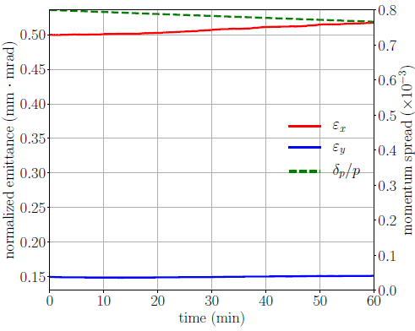
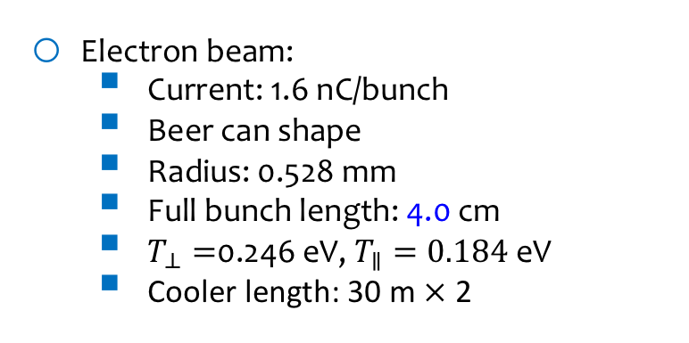
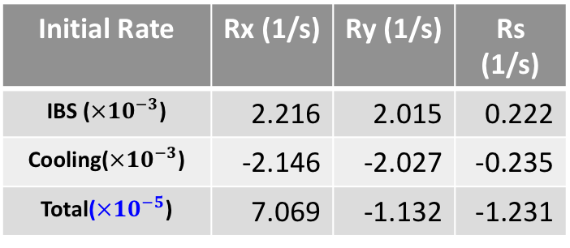
Maintain the emittance w. 1.6nC/bunch e⁻ beam
Proton beam (CM energy 44.7 GeV):
  Energy: 100 GeV
  Proton number: 0.421x10¹⁰ (43%)
  Normalized emit. (rms): 0.50/0.15 μm
  Beta function in cooler: 60/200 m
Electron beam:
  Current: 1.6 nC/bunch
  Beer can shape
  Radius: 0.528 mm
  Full bunch length: 4.0 cm
  $T_{⊥}=$0.246 eV, $T_{∥}=0.184$ eV
  Cooler length: 30 m $×$ 2
Initial Rate | Rx (1/s) | Ry (1/s) | Rs (1/s)
IBS ($×{10}^{−3}$) | 2.216 | 2.015 | 0.222
Cooling($×{10}^{−3}$) | -2.146 | -2.027 | -0.235
Total($×{10}^{−5}$) | 7.069 | -1.132 | -1.231

Slide 9
Circulating Cooler Ring Specifications (C. Tennant)
The proposed design is to use a Circulating Cooling Ring (CCR) to provide high current in the cooler (~1 A) without requiring such high current in the electron source.
The CCR has the following requirements:
  Isochronous.
  Achromatic
  Need RF compensation to counter SC and CSR
  High periodicity with rational tune
  Moderate size
  Local axial symmetry
  Local isochronicity ⬄small compaction oscillations (for µBI)
  Local dispersion suppression
  No tune resonances except for coupling resonance
We would also like the ring to use conventional magnet and vacuum chamber technology as far as possible. Should take advantage of CSR shielding.

Slide 10
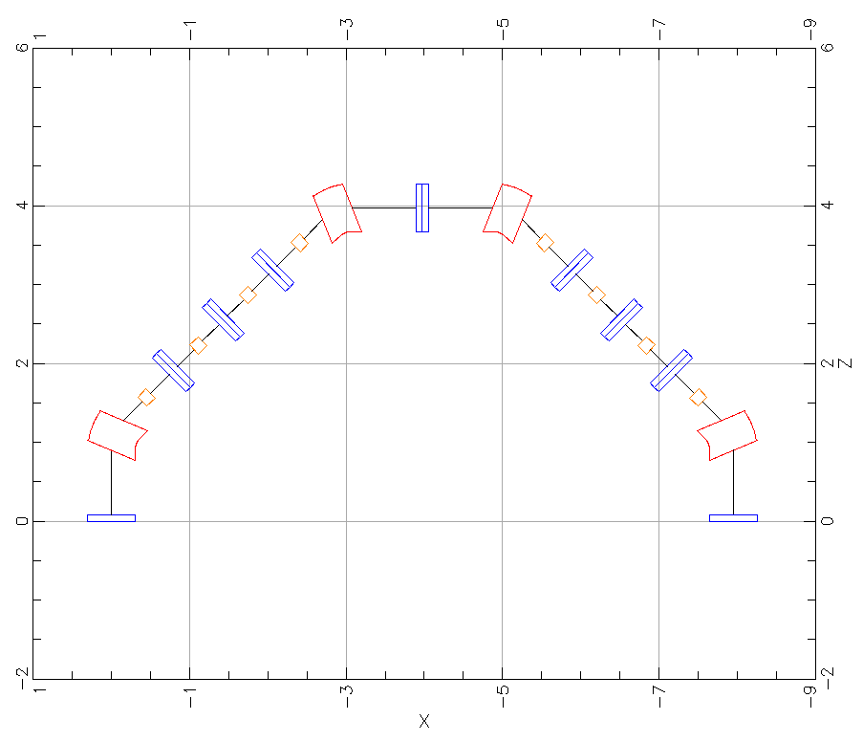
Simple Arc Layout
design by D. Douglas
dipole
quadrupole
sextupole

Slide 11
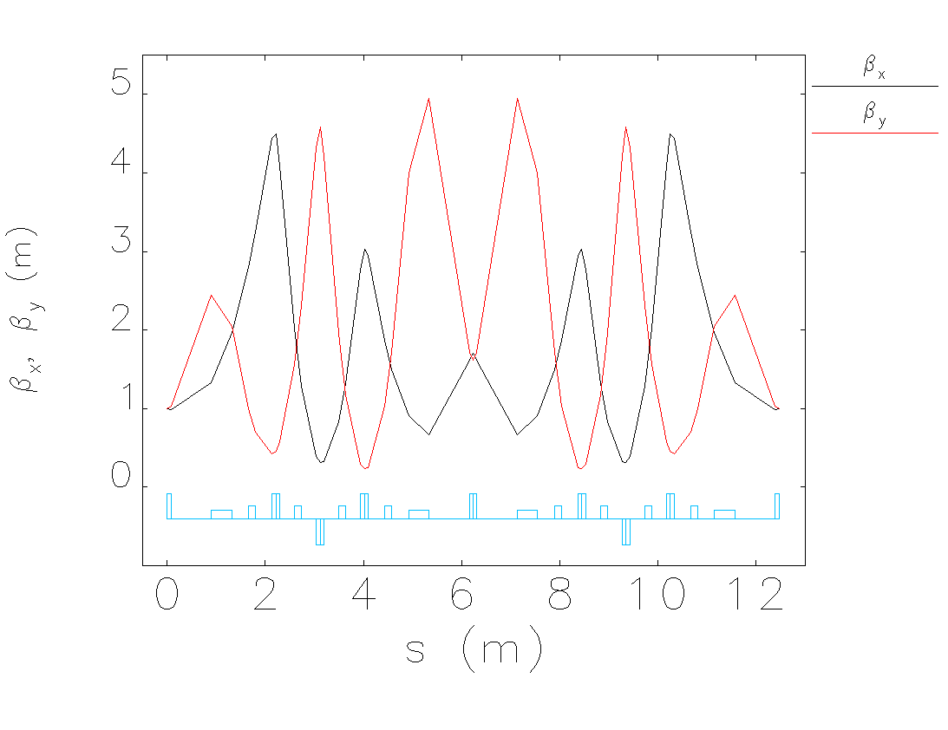
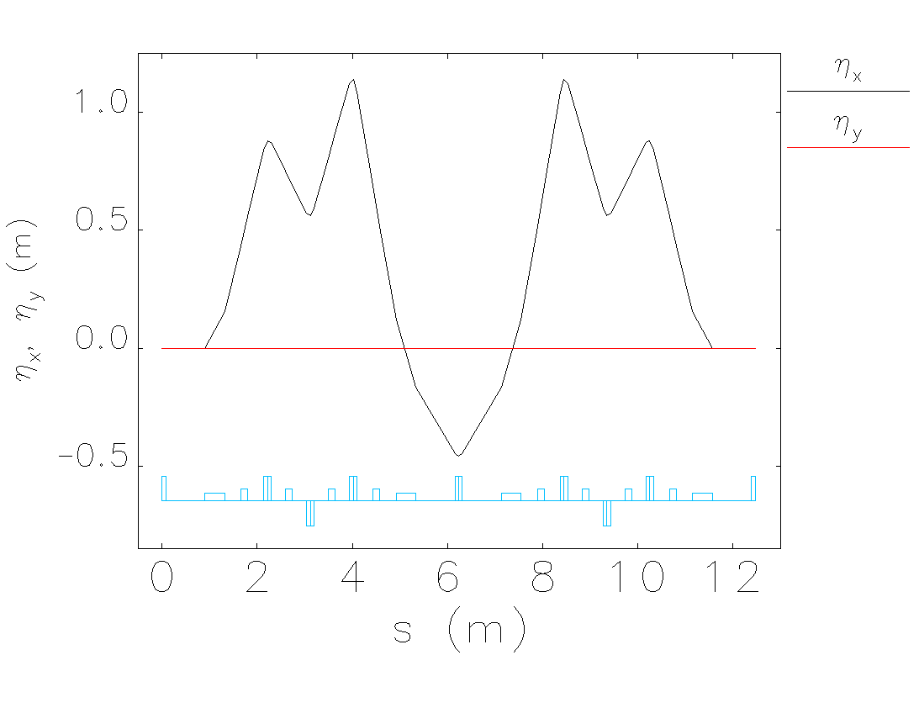
Lattice Functions
The intent of the design is to keep the beam area approximately constant throughout the arc.

Slide 12
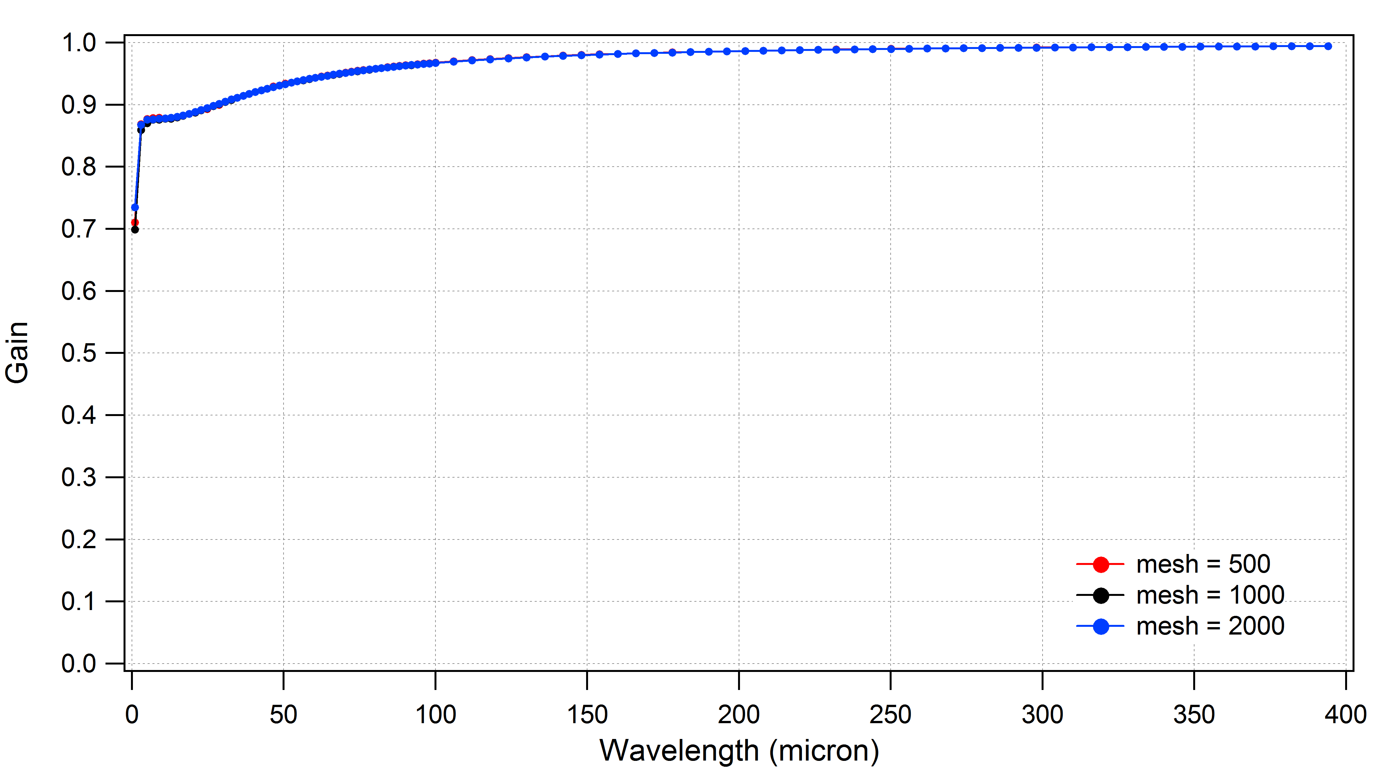
Microbunching Gain for Simple bend
μBI gain is ≤ unity
needs to be less than unity for multiple passes (gain grows exponentially)

Slide 13
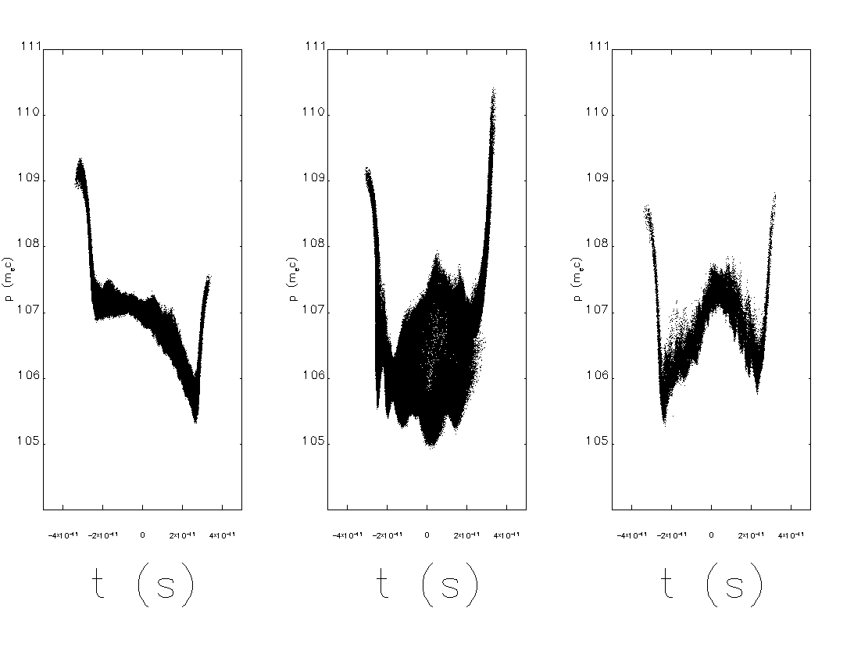
Longitudinal Phase Space Comparison: After 10-Turns 3.2 nC
elegant – Stupakov + RF correction
elegant – without csrdrifts
Bmad – with shielding

Slide 14
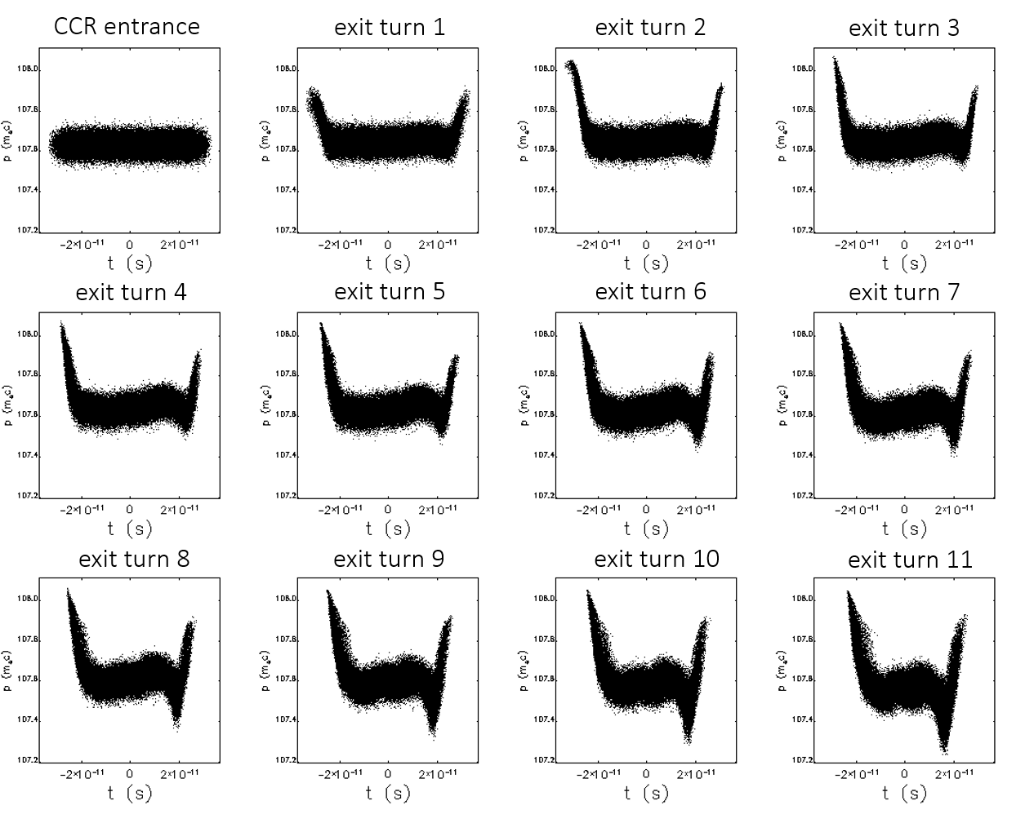
Performance of CCR at 1.6 nC

Slide 15
Exchange Region Layout
CCR back leg

Slide 16
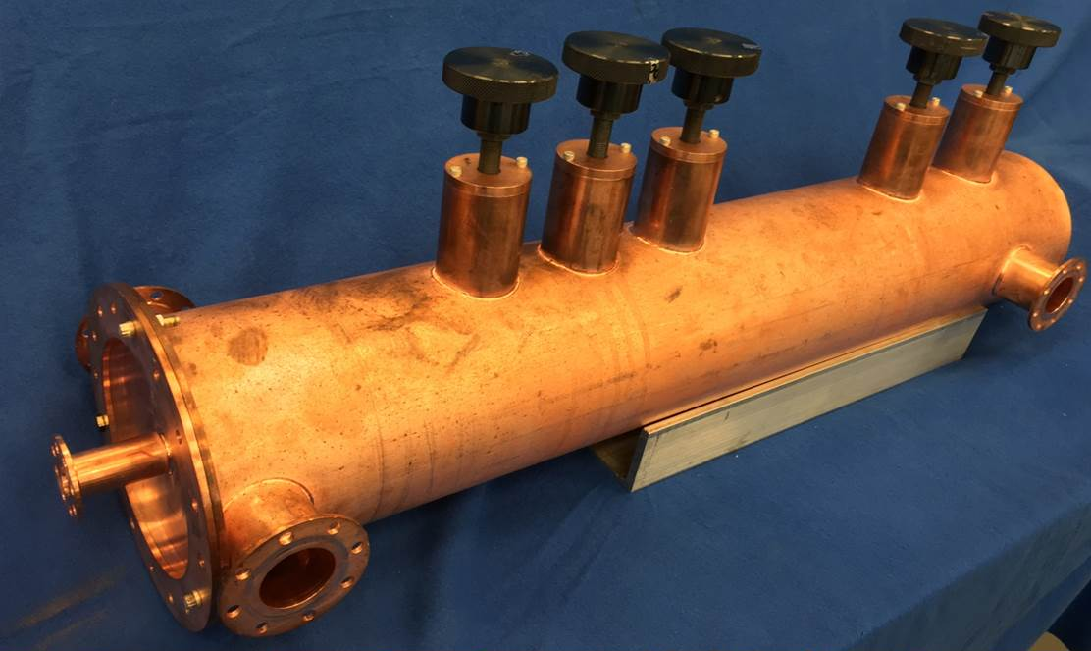
Harmonic Kicker (G. Park)
Harmonic Beam Kicker. A first 952.6 MHz copper cavity has been prototyped, bench measured, and satisfies beam dynamic requirements for a Circular Cooler Ring design for the bunched electron cooler.

Slide 17
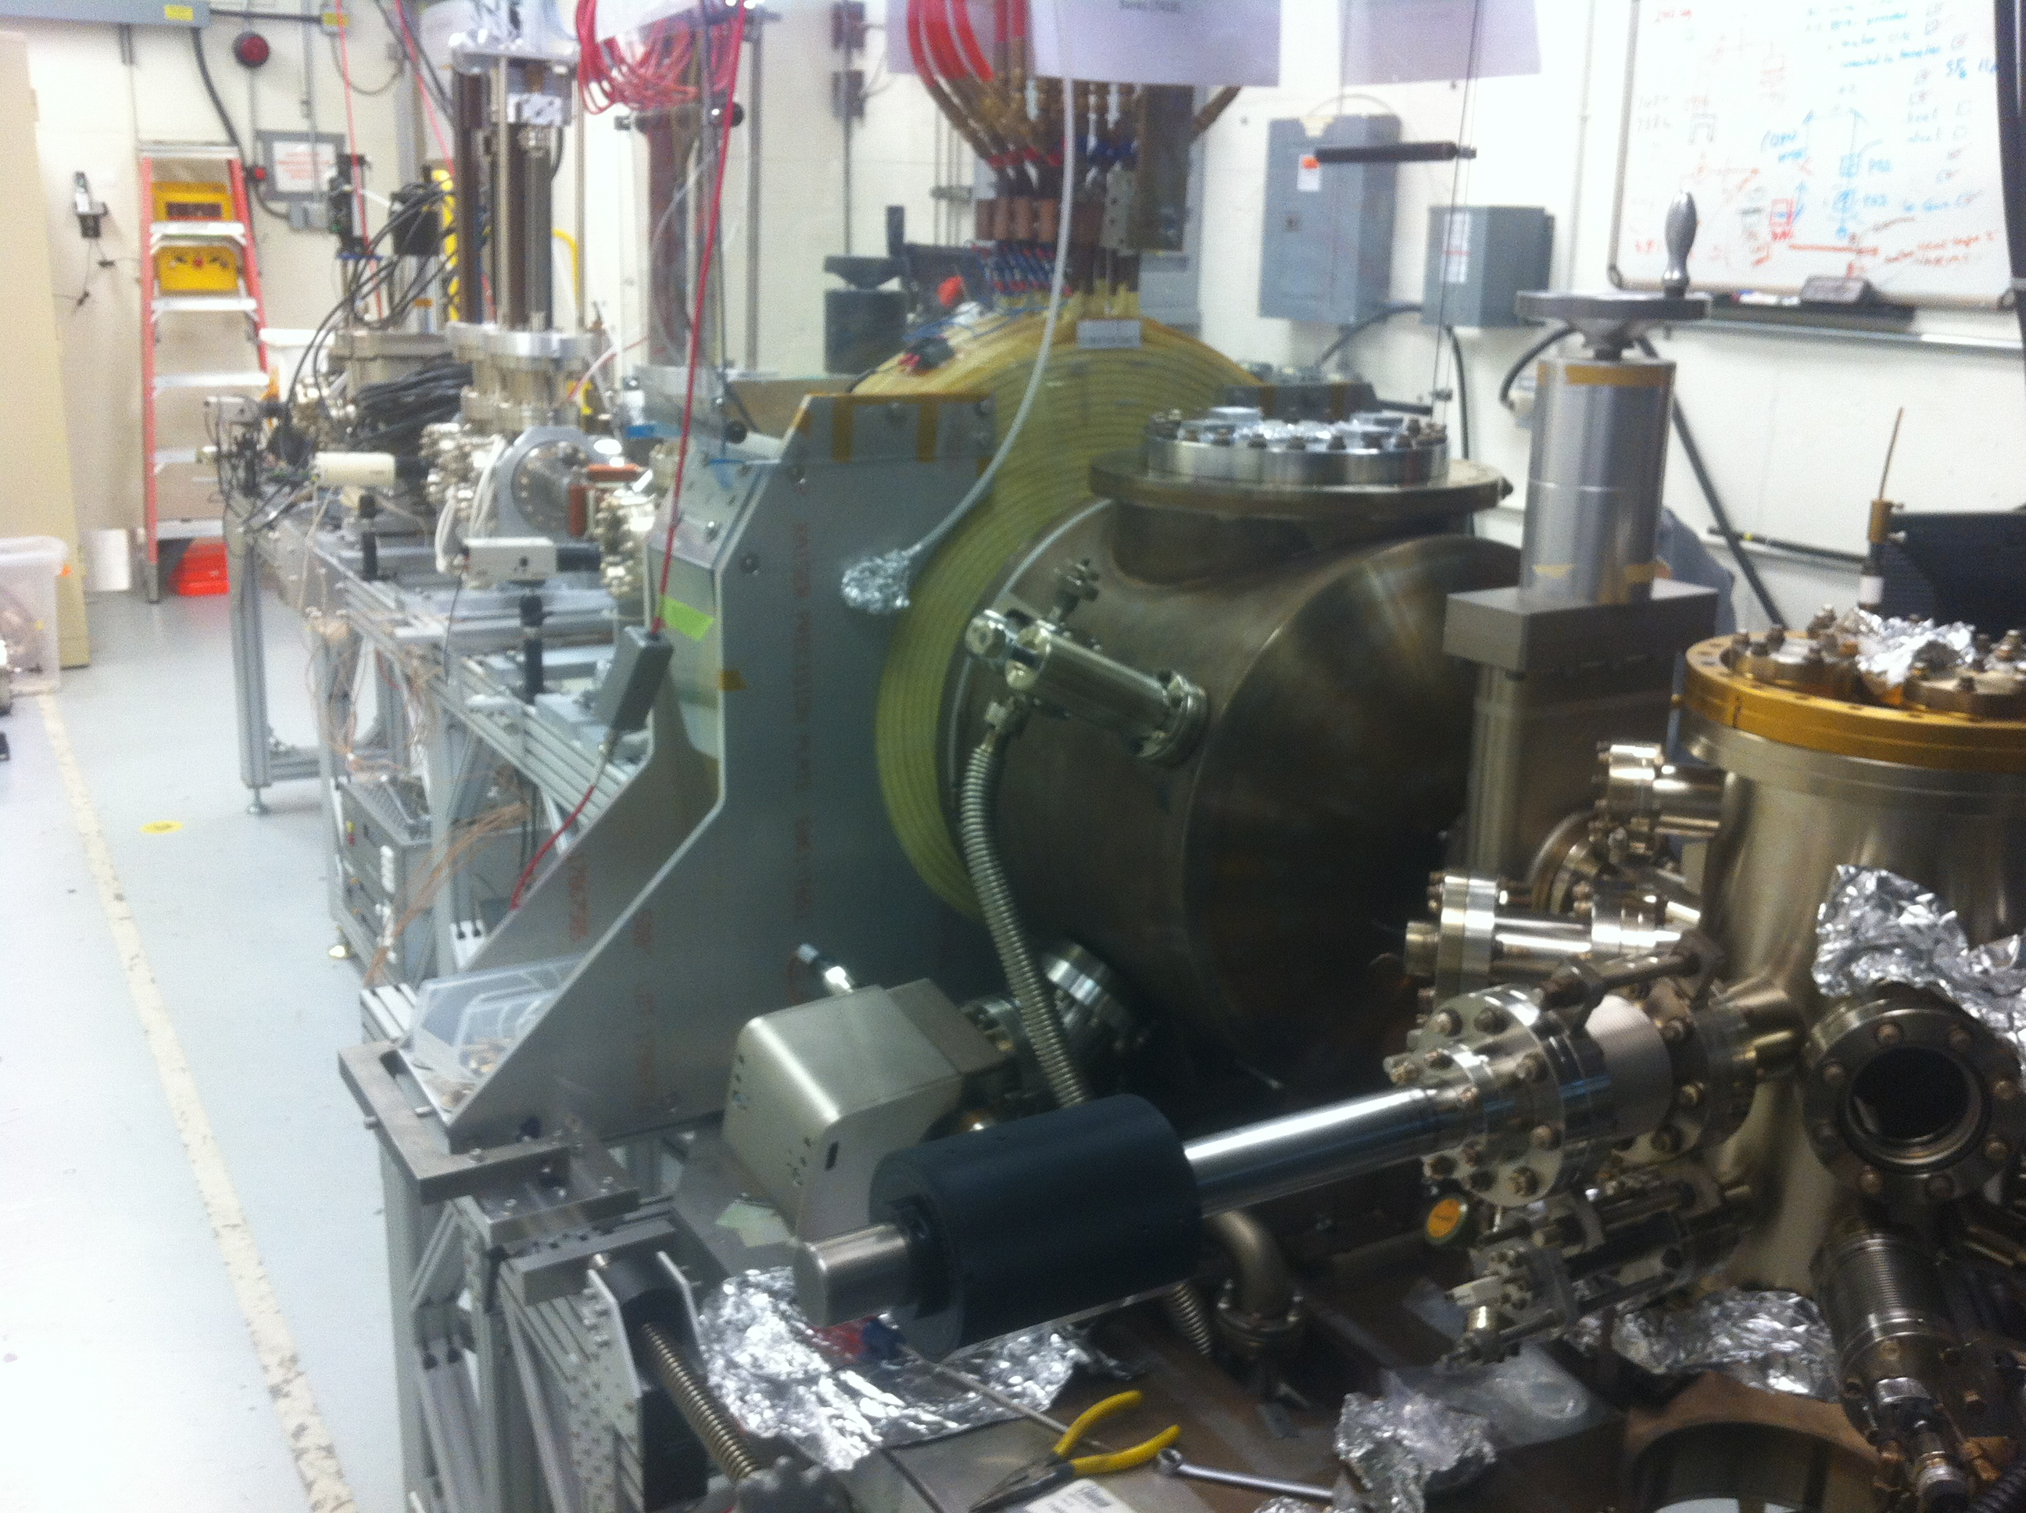
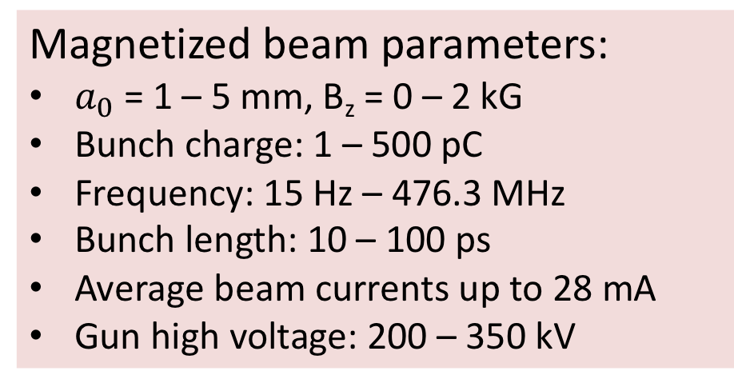
Magnetized Source (M. Mamun’s talk)
Magnetized Source for e-cooler at 28 mA: A high charge (420 pC) magnetized source is funded by the Jefferson Lab LDRD program and has operated up to 28 mA avg. current.
Magnetized beam parameters:
$a_{0}$ = 1 – 5 mm, B_{z} = 0 – 2 kG
Bunch charge: 1 – 500 pC
Frequency: 15 Hz – 476.3 MHz
Bunch length: 10 – 100 ps
Average beam currents up to 28 mA
Gun high voltage: 200 – 350 kV

Slide 18
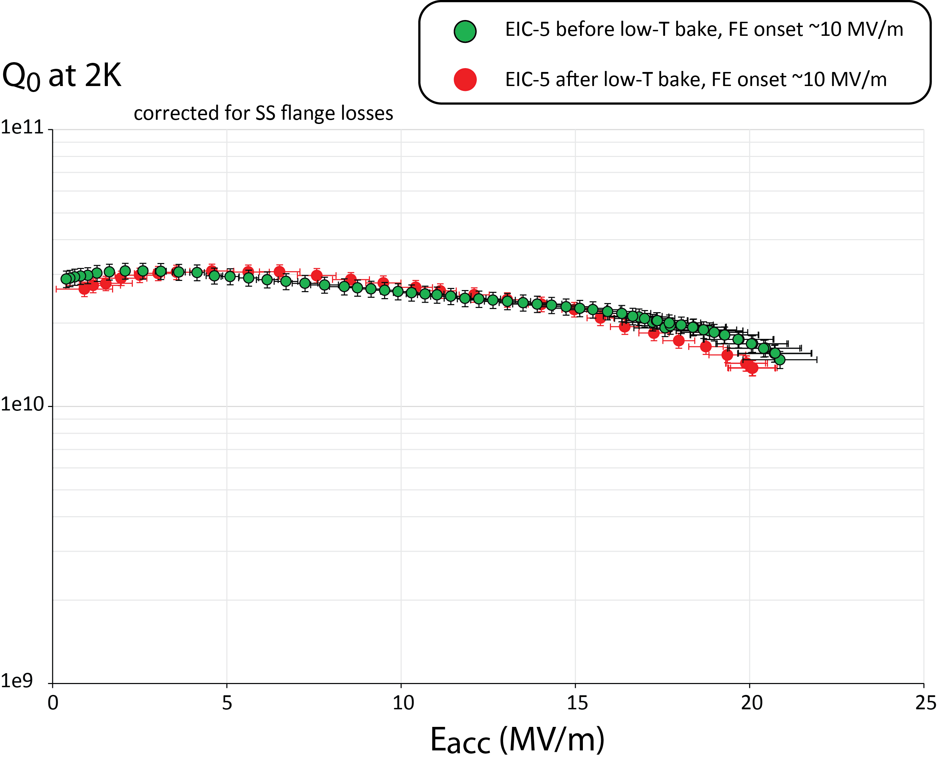
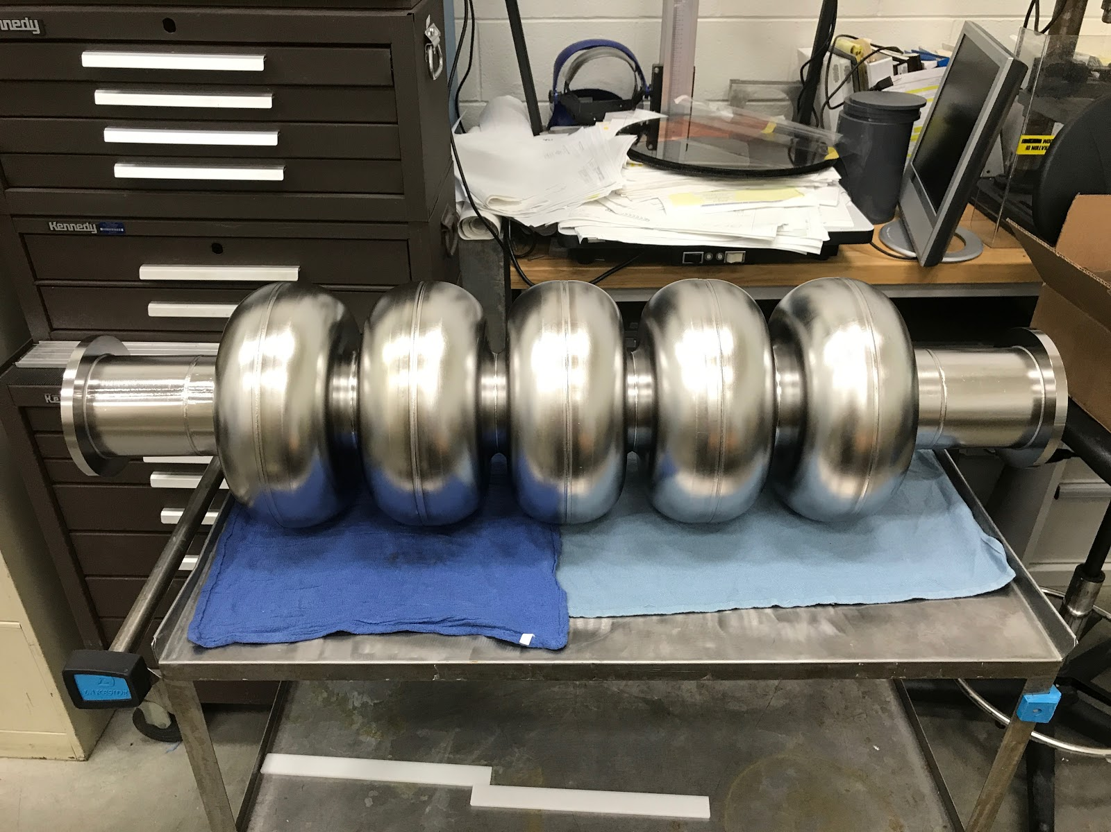
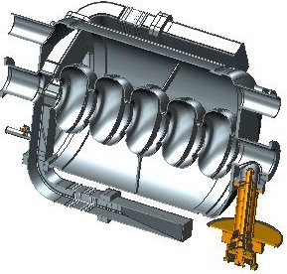
SRF cavities (R. Rimmer)
Need 952.6 MHz cavities for ERL.

Slide 19
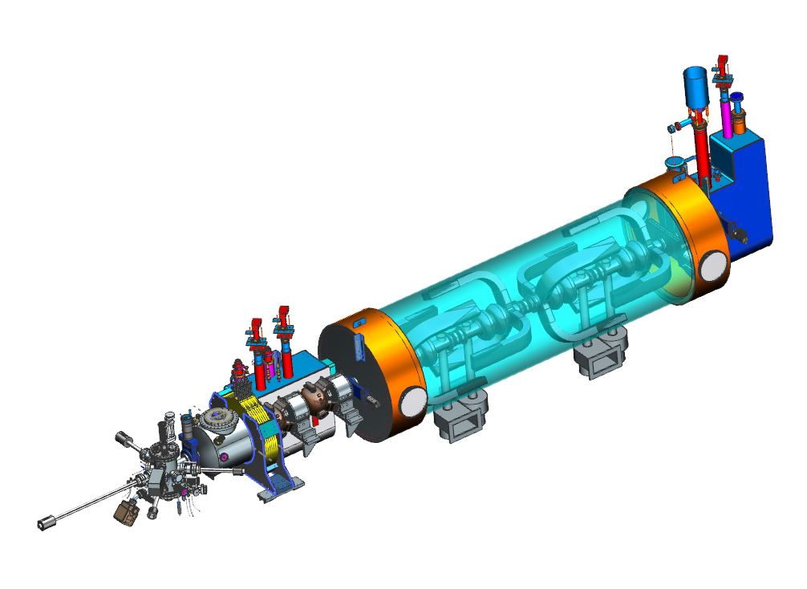
Injector Design

Slide 20
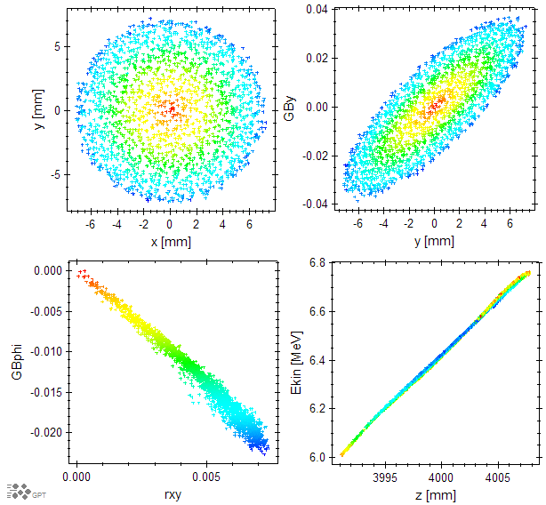
Start to Merge Simulation
Magnetization is preserved but the longitudinal shape is not

Slide 21
Merger Options
We are looking at several ideas for mergers:
RF separator based merger (see K. Deitrick’s talk)
Off axis injection
Magnetic merger
  Penner Bend
  Double bend achromat
  W-bend
  Chicane
Double barrel linac cavities
Each of these has advantages and disadvantages. We are exploring both to find the best solution.

Slide 22
Issues and Potential Solutions
Injector bunch is not a top hat
  Lower frequency and add harmonic RF
Linac acceptance is too small
  Lower frequency and add harmonic RF
CSR and space charge accelerate the bunch ends
  Go to longer bunch
Simple arc does not preserve magnetization
  Try FFFAG arc if microbunching gain can be reduced.

Slide 23
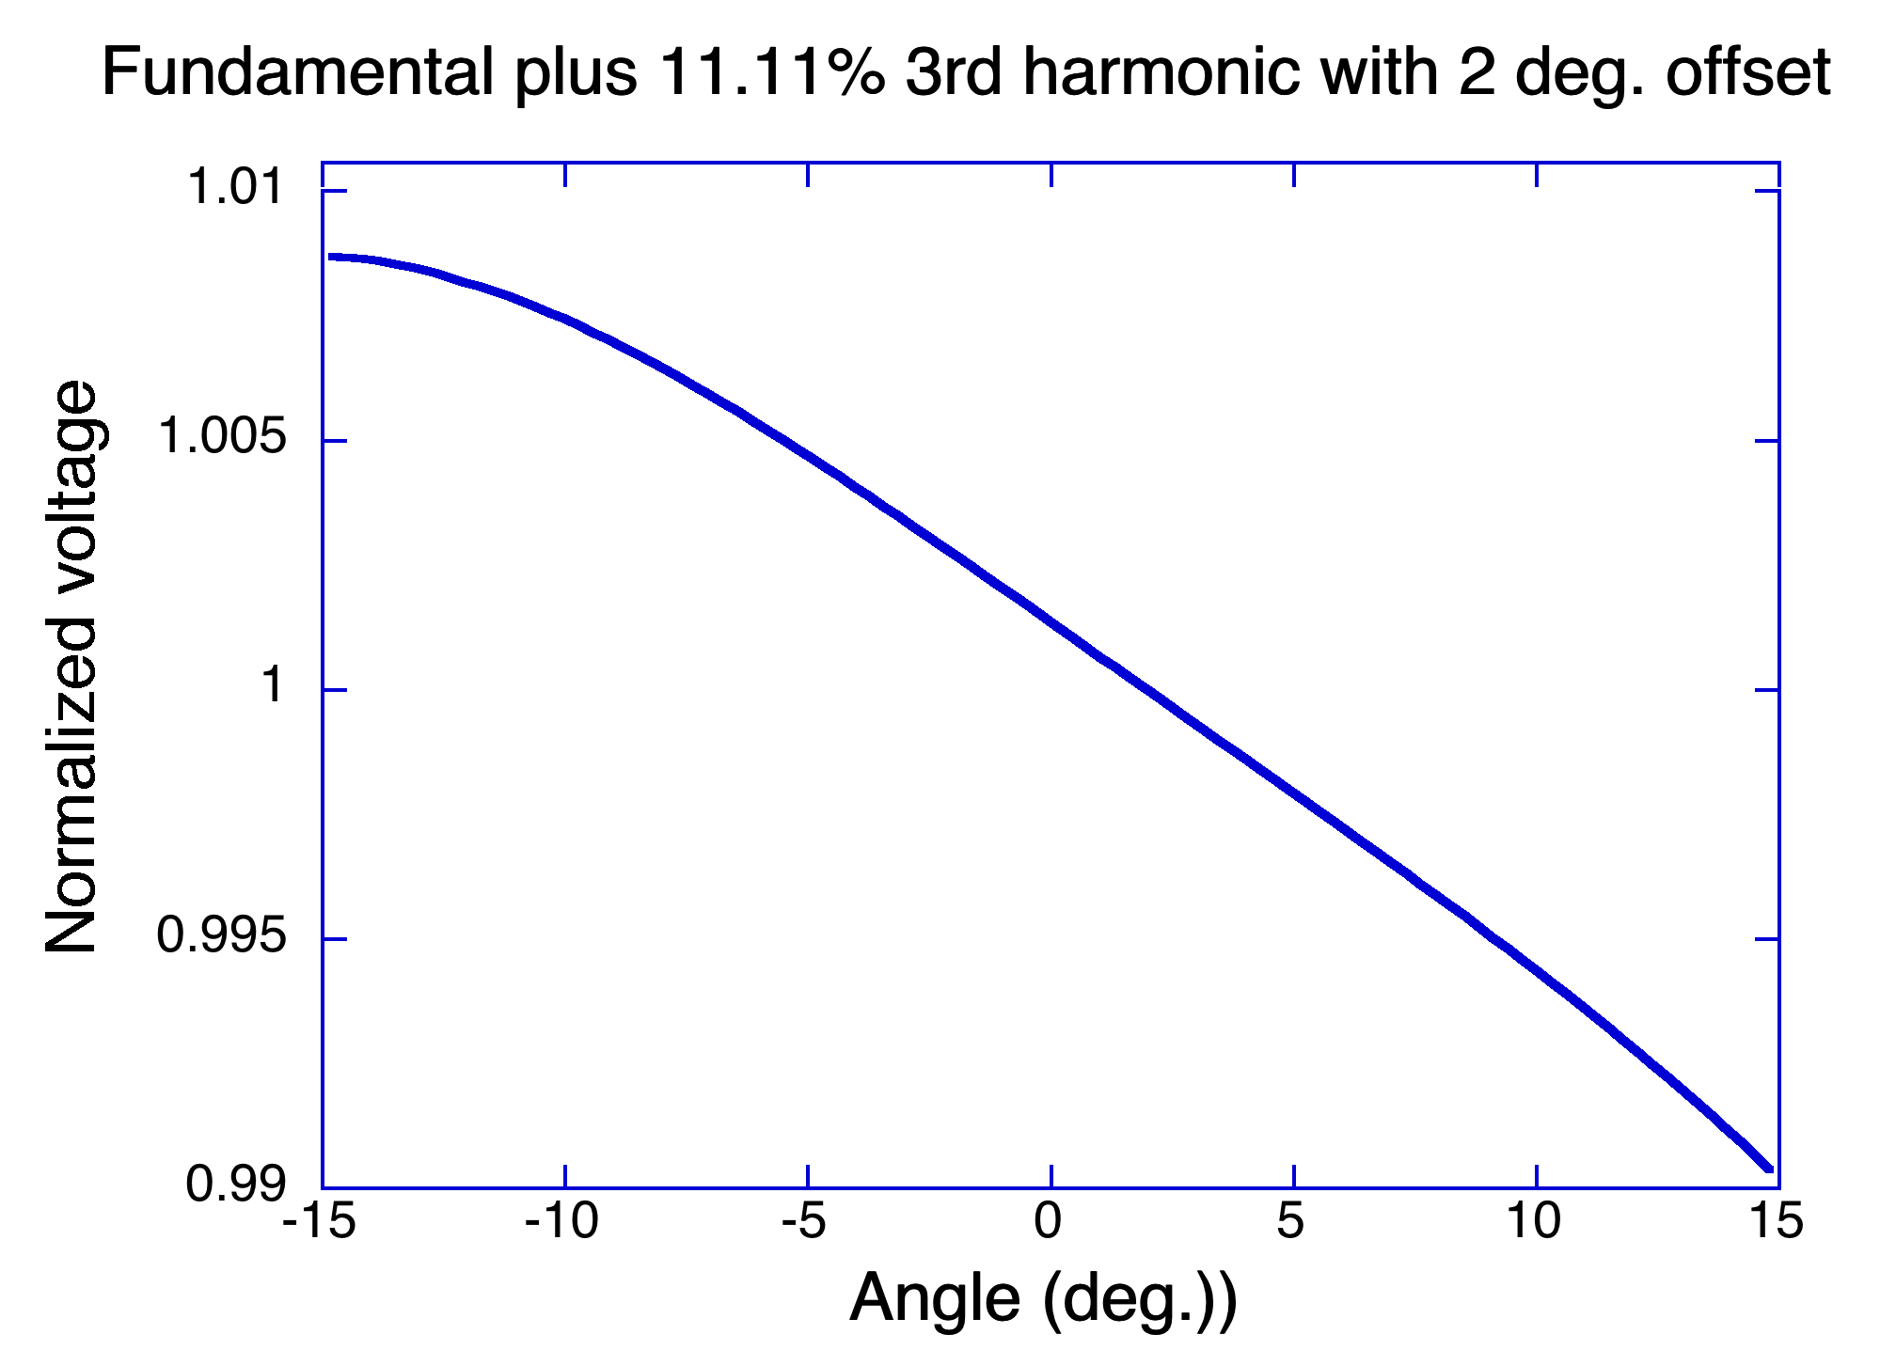
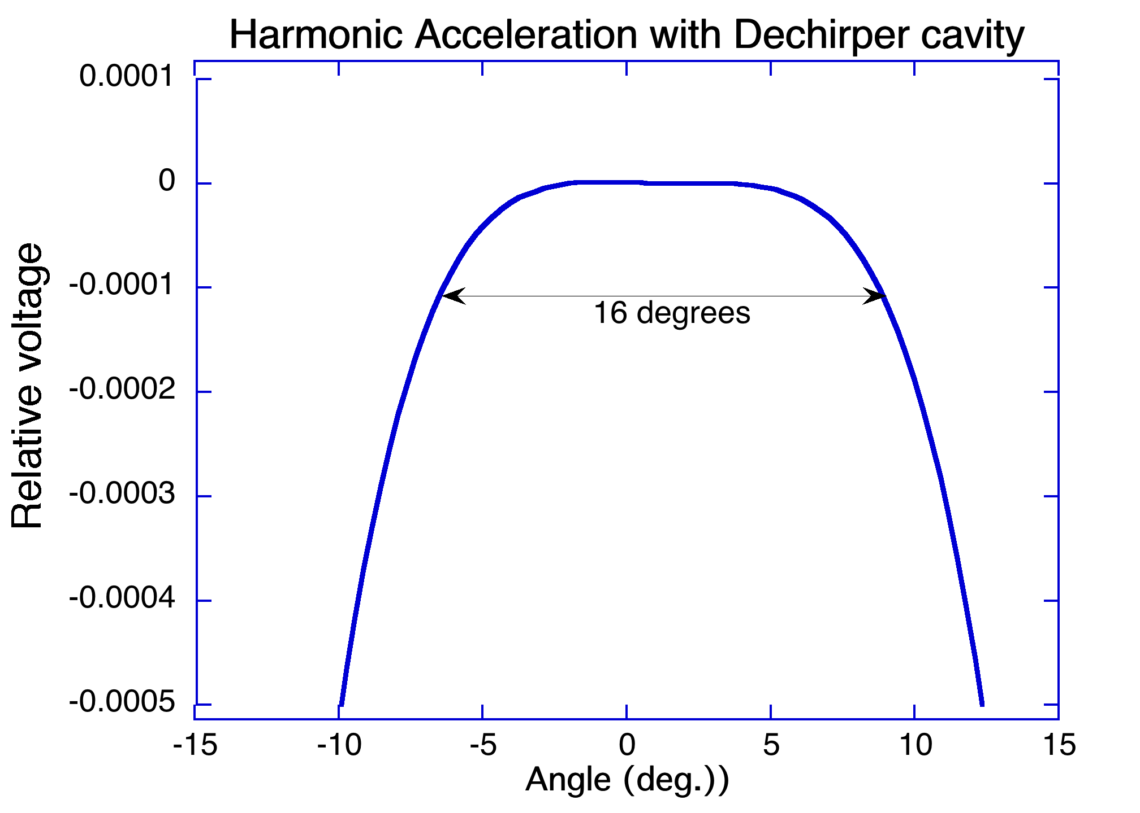
Voltage with 3rd Harmonic and phase and amplitude offsets
If we want to accelerate a very long bunch and then stretch it out even more we can use 3rd harmonic cavities in the linac.
Before going into the CCR, take out the slope using a 952.6 MHz de-chirper.
We can also put in a quartic correction if necessary by changing the amplitude

Slide 24
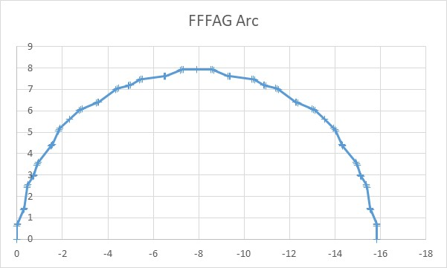
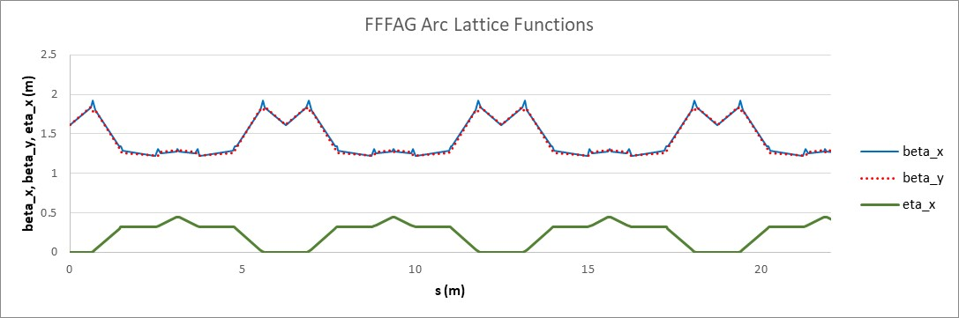
FFFAG Design
FFFAG is Faux Fixed Focus Alternating Gradient lattice

Slide 25
200 GeV Beam Cooling
It is not clear whether cooling at 200 GeV is absolutely necessary:
  Might want to just ramp down and cool for a few minutes at a lower energy then return to 200 GeV.
  Luminosity if not as important at the highest CM energies.
Note that the cooling decreases by at least a factor of two between 100 GeV and 200 GeV. 3.2 nC is even more important.
If we do need cooling at 200 GeV we must modify the following:
  Add another linac cryomodule with RF.
  Upgrade the magnets to operate at twice the field.
  Upgrade the harmonic kicker to operate at twice the gradient
  Double the field in the chirper and de-chirper cavities

Slide 26
Summary: Where are We, and Where Do We Go?
ERL Design
  Add doglegs and update injector design.
  Calculate collective effects (BBU, ion trapping, halo formation)
Beam exchange design
Linac design
  Optimize HOM damping.
  Lower frequency and add 3rd harmonic cavities
Cooling Insertion
  Balance cooling partition
  Specify solenoid tolerances (P. McIntyre)
CCR Design
  Microbunching gain is low.
  Optimize vs. tune and explore FFFAG
  Calculate collective effects (ion trapping, wakes, resonances)
Injector design
  Magnetization is preserved up to end of booster
  Need to try lower frequency and harmonic RF
Merger Design
  Still many options to explore.

