Slide 1
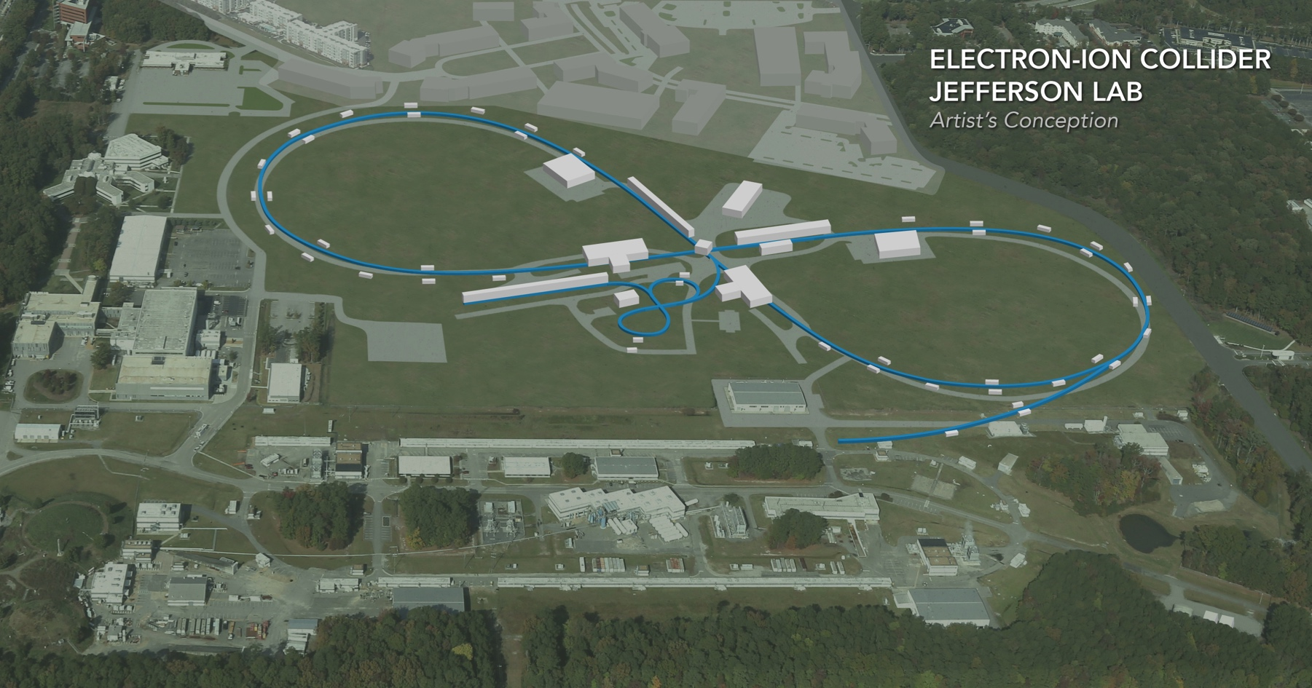
JLEIC ELECTRON COOLING SIMULATION
Speaker: He Zhang
(present for JLEIC design team)
Electron cooling simulation study and code development is supported by 2019 FOA and collaborated with BNL.
EIC Accelerator Collaboration Meeting
October 29 - November 1, 2018

Slide 2
Outline
JLEIC Multi-Stage Electron Cooling Scheme
Attempts to Enhance the Cooling Efficiency
JSPEC development and latest updates

Slide 3
JLEIC Multi-Stage Electron Cooling Scheme
JLEIC’s approach to high luminosity: high bunch repetition rate + short bunch colliding beams
JLEIC relies on conventional electron cooling for providing a damping mechanism for the ion beam
Cooling of JLEIC proton/ion beams
Achieving very small emittance (~10x reduction) & very short bunch length ~1 cm (with SRF)
Suppressing IBS induced emittance degradation
high cooling efficiency at low energy & small emittance
A multi-stage cooling scheme has been proposed.
Pre-cool when energy is low
ion linac
booster
(0.285 to 8 GeV)
ion sources
DC cooler
DC/ERL cooler
collider
(8 to 100 GeV)
Cool when emittance is small
(after pre-cool at low energy)

Slide 4
JLEIC Multi-Stage Cooling Scheme
Three coolers (2 DC, 1 ERL) and four cooling stages
Booster: low energy DC cooler: help accumulation of ions
Collider:
Medium energy DC cooler: maintain emittance during stacking and pre-cooling
High energy ERC cooler: maintain emittance during collision
Ring | Functions | Proton kinetic E (GeV) | Lead ion kinetic E (GeV/u) | Electron kinetic E (MeV) | Cooler type
booster ring | Accumulation of positive ions |  | 0.1 (injection) | 0.054 | DC
collider ring | Maintain emitt. during stacking |  | 2 (injection) | 1.1 | DC
 | Pre-cooling for emitt. reduction | 7.9 (injection) | 7.9 (ramp to) | 4.3 | DC
 | Maintain emitt. during collision | Up to 100 | Up to 40 | Up to 54.5 | ERL
Can’t reduce emittance due to space charge limit
Pre-cooling both protons and lead ions
ERL cooler can’t reach energy below 20 MeV

Slide 5
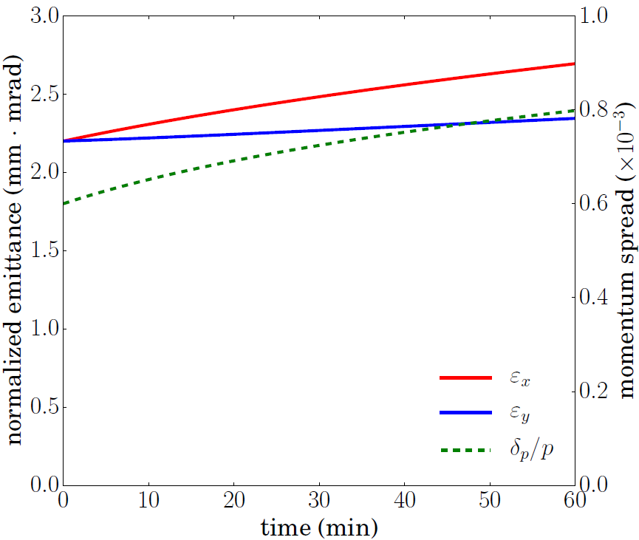
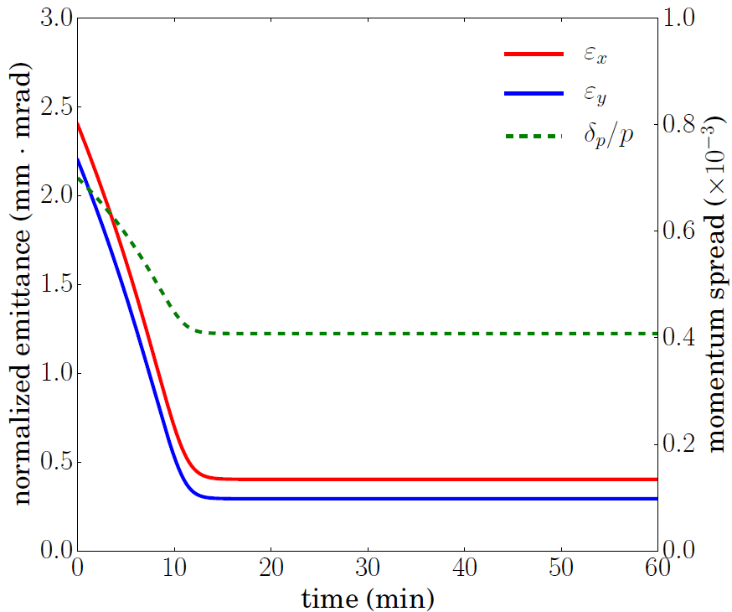
Stacking and Pre-Cooling for Proton Beam
Proton beam:
Injection Energy: 8 GeV
Proton number: 6.58x10¹¹
Normalized emit. (rms): 2.2 μm
Bunch size (rms): 2.1 mm
Momentum spread: 6x10⁻⁴
Bunch length (rms): 7 m
Stacking
Pre-cooling
Cooling
Stacking
Pre-cooling
Cooling
IBS expansion during stacking (~10 mins).
Pre-cooling after stacking.
DC cooler, 3A, 30 meter, 1T

Slide 6
JLEIC Baseline Parameters
CM energy | GeV | 21.9 (low) |  | 44.7 (medium) |  | 63.3 (high)
 |  | p | e | p | e | p | e
Beam energy | GeV | 40 | 3 | 100 | 5 | 100 | 10
Collision frequency | MHz | 476 |  | 476 |  | 476
Particles per bunch | 10¹⁰ | 0.98 | 3.7 | 0.98 | 3.7 | 0.98 | 0.93
Beam current | A | 0.75 | 2.8 | 0.75 | 2.8 | 0.75 | 0.71
Polarization | % | 80 | 80 | 80 | 80 | 80 | 75
Bunch length, RMS | cm | 3 | 1 | 1 | 1 | 1 | 1
Norm. emitt., horiz./vert. | μm | 0.3/0.3 | 24/24 | 0.5/0.1 | 54/10.8 | 0.9/0.18 | 432/86.4
Horizontal & vertical β* | cm | 8/8 | 13.5/13.5 | 6/1.2 | 5.1/1 | 10.5/2.1 | 4/0.8
Vert. beam-beam param. |  | 0.015 | 0.092 | 0.015 | 0.068 | 0.002 | 0.009
Laslett tune-shift |  | 0.06 | 7x10⁻⁴ | 0.055 | 6x10⁻⁴ | 0.03 | 7x10⁻⁵
Detector space, up/down | m | 3.6/7 | 3.2/3 | 3.6/7 | 3.2/3 | 3.6/7 | 3.2/3
Hourglass(HG) reduction |  | 1 |  | 0.87 |  | 0.86
Luminosity/IP, w/HG, 10³³ | cm⁻²s⁻¹ | 2.5 |  | 21.4 |  | 1.7

Slide 7
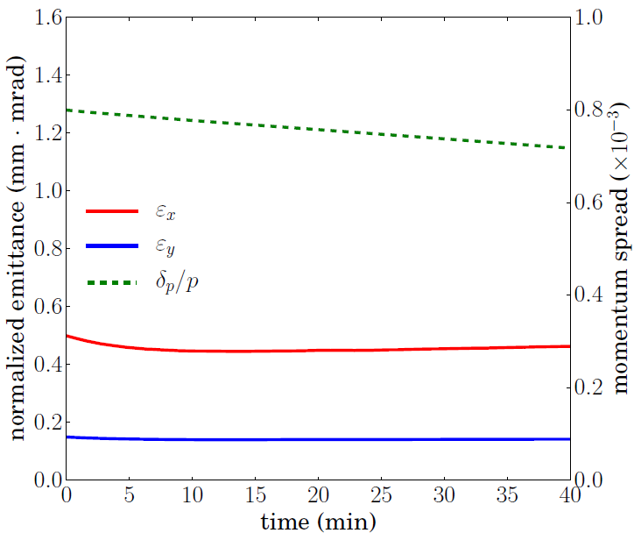
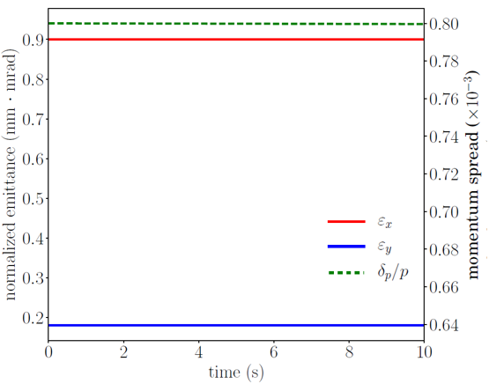
Cooling During Collision for Proton Beam
Proton beam (CM energy 44.7 GeV):
Energy: 100 GeV
Proton number: 0.804x10¹⁰ (82%)
Normalized emit. (rms): 0.50/0.15 μm
Bunch length (rms): 1.5 cm
Transverse coupling: 40%
Proton beam (CM energy 63.5 GeV):
Energy: 100 GeV
Proton number: 0.451x10¹⁰ (46%)
Normalized emit. (rms): 0.90/0.18 μm
Bunch length (rms): 2.0 cm
Transverse coupling: 42%
Stacking
Pre-cooling
Cooling
Stacking
Pre-cooling
Cooling

Slide 8
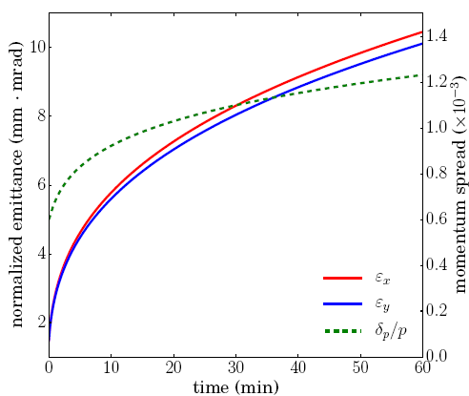
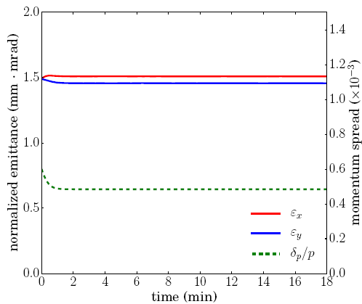
Stacking for Lead Ion Beam
Pb⁸²⁺ beam:
Injection Energy: 2 GeV/u
Particle number: 8.26x10⁹ /bunch
Normalized emit. (rms): 1.5 μm/ 1.5 μm
RMS bunch length: 7 m
Cannot reduce emittance due to space charge effect!
Stacking
Pre-cooling
Cooling
Stacking
Pre-cooling
Cooling
Emittance increase very fast due to strong IBS effect during stacking without cooling.
With cooling ($I_{e}=0.62 A, R_{e}≫3σ)$, emittances can be maintained.

Slide 9
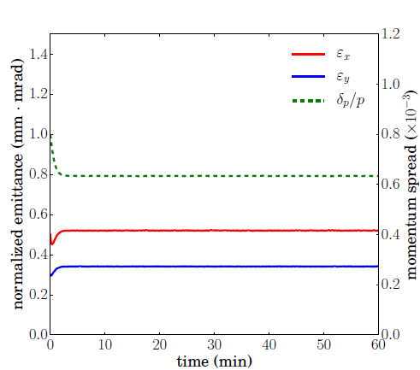
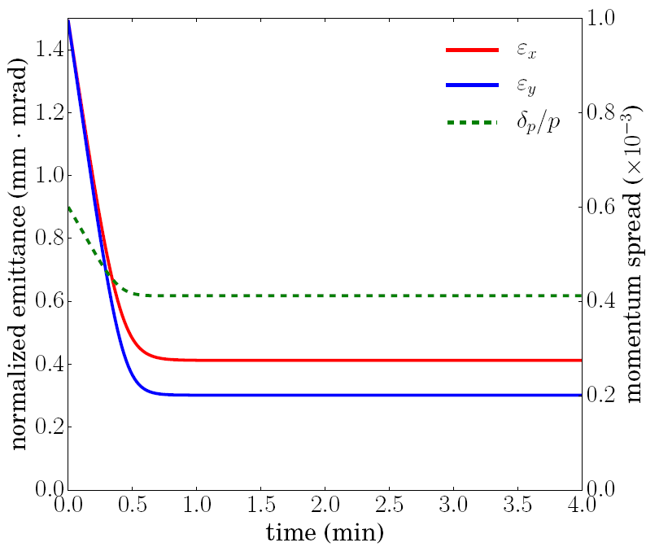
Pre-Cooling and Cooling During Collision for Lead Ion Beam
Pb⁸²⁺ beam:
Injection Energy: 8 GeV/u
Particle number: 8.26x10⁹ /bunch
Normalized emit. (rms): 1.5 μm/1.5 μm
RMS bunch length: 7 m
Pb⁸²⁺ beam:
Injection Energy: 40 GeV/u
Particle number: 1.20x10⁸ /bunch
Normalized emit. (rms): 0.5 μm/ 0.3 μm
RMS bunch length: 1 cm
Stacking
Pre-cooling
Cooling
Stacking
Pre-cooling
Cooling
Electron beam current: 2A
Electron beam size: R = 5.7 mm (2$σ)$
Electron beam 0.8 nC/bunch

Slide 10
Notes on the JLEIC Electron Cooling Simulation
Cooling of the proton beam during collision is very challenging.
One big issue is the imbalance of the IBS expansion rates and the electron cooling rates in different directions.
In the horizontal direction, IBS is much stronger than cooling.
In longitudinal, cooling is much stronger than IBS.
Transverse coupling and dispersion at the cooler helps to mitigate the problem but so far not a satisfactory solution, and their effects on beam dynamics need to be studied.
We are investigating methods to enhance the cooling efficiency.

Slide 11
Outline
JLEIC Multi-Stage Electron Cooling Scheme
Attempts to Enhance the Cooling Efficiency
JSPEC development and latest updates

Slide 12
Cooling with Flat Electron Beam
Round Beam
$r=σ_{x}=σ_{y}$, $σ_{x,y}$ is the rms bunch size of the ion beam.
$A_{round}=πr^{2}=πσ_{x}σ_{y}$
Flat Beam (Same emittance with the round beam)
$r_{x}=σ_{x}\sqrt{\frac{σ_{x}}{σ_{y}^{′}}}$, $r_{y}={σ′}_{y}\sqrt{\frac{σ_{x}}{σ_{y}^{′}}}$
$A_{flat}=πr_{x}r_{y}=πσ_{x}^{2}=πσ_{x}σ_{y}=A_{round}$
Cooler:
Length: 30 m x 2
Magnetic field: 1 T
Beta function: 60 m/300 m (round)
Beta function: 60 m/ 60 m (flat)
Electron beam:
Current: 3.2 nC/bunch
Beer can shape
Radius: 0.528 mm (round)
Axis: 0.790/0.353 mm
Full bunch length: 3.0 cm
$T_{⊥}=$0.246 eV, $T_{∥}=0.184$ eV
Cooler length: 30 m $×$ 2
Proton beam (CM energy 44.7 GeV):
Energy: 100 GeV
Proton number: 0.98x10¹⁰ (varies in simulation)
Normalized emit. (rms): 0.50/0.10 μm
Bunch length (rms): 1.0 cm (design) 1.5 cm (simulation)
transverse coupling: (varies in simulation)
No dispersion at the cooler

Slide 13
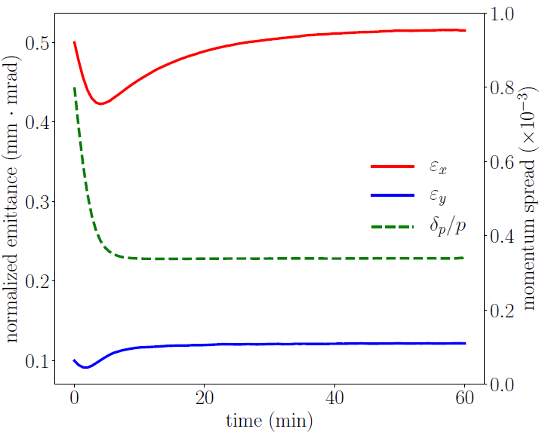
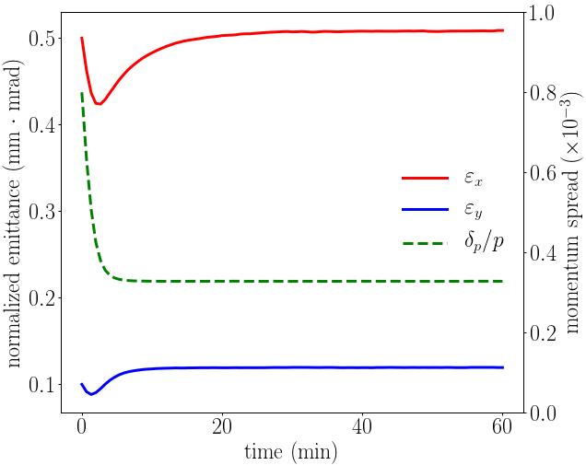
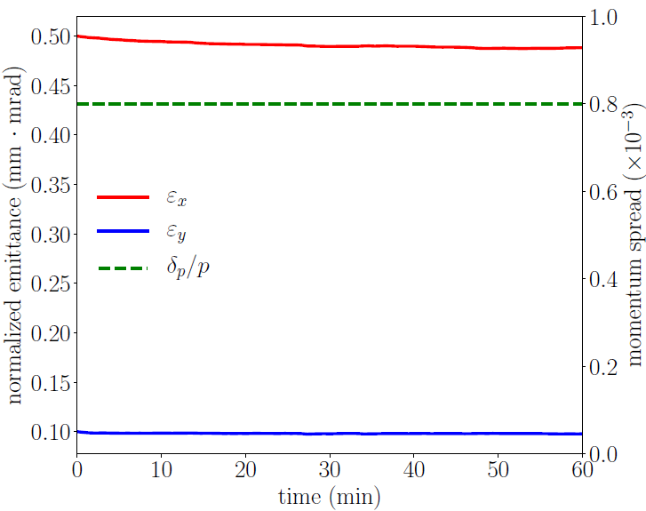
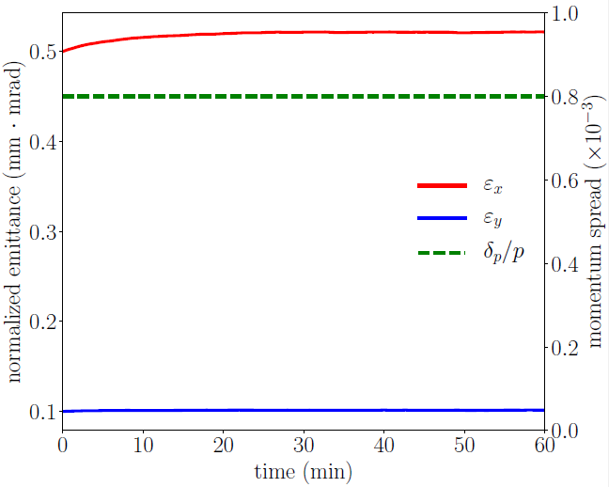
Cooling with flat electron beam
Assuming no dispersion at the cooler, we will have to reduce the proton current due to the very strong horizontal IBS.
Check which (round or flat) electron beam can hold higher electron current.
Assume constant bunch length (top) or constant momentum spread and bunch length (bottom), which helps to mitigate overcooling in the longitudinal direction.
If compared with the the round beam, we still received a significant gain using the flat beam.
Flat beam is preferred to round beam for JLEIC cooling.
Round beam
Proton current: 40%
Flat beam
Proton current: 52%
Round beam
Proton current: 58%
Flat beam
Proton current: 84%

Slide 14
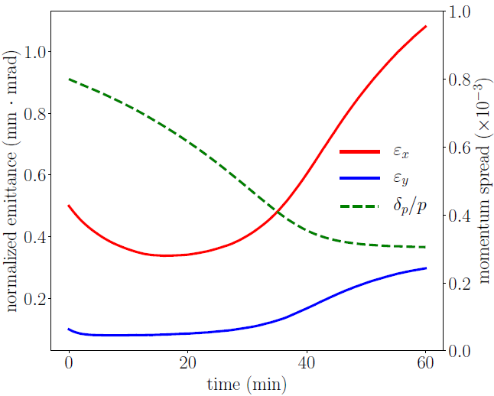
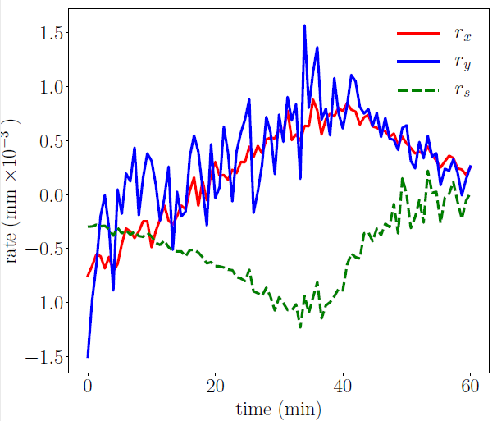
Cooling with fixed proton bunch length and/or fixed proton momentum spread
Besides the very strong horizontal IBS, overcooling in the longitudinal direction is another difficulty for JLEIC.
Strong cooling in the longitudinal direction increases the proton density in phase space, which makes the transverse cooling even more difficult.
If we can intentionally maintain the bunch length (adjusting RF voltage) or the momentum spread (introducing heating), overcooling can be mitigated, which helps to enhance the cooling efficiency and reduce the dispersion needed at the cooler.
An example of overcooling in longitudinal direction.
Proton number: 0.98x10¹⁰ *0.5
Dispersion: 0.9 m/ 0.9 m
Coupling: 74%

Slide 15
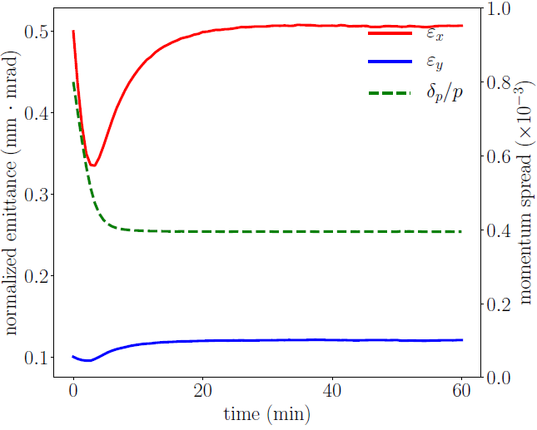
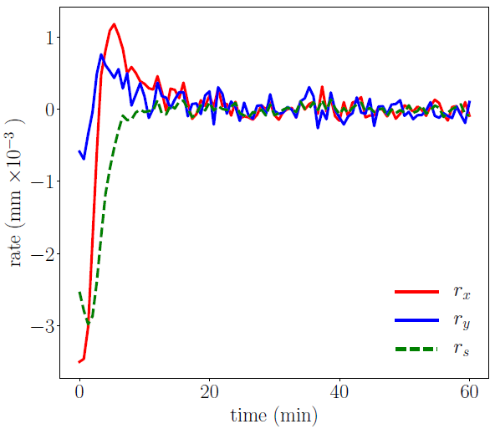
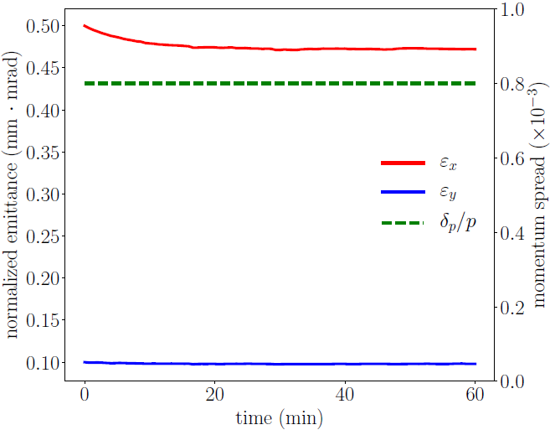
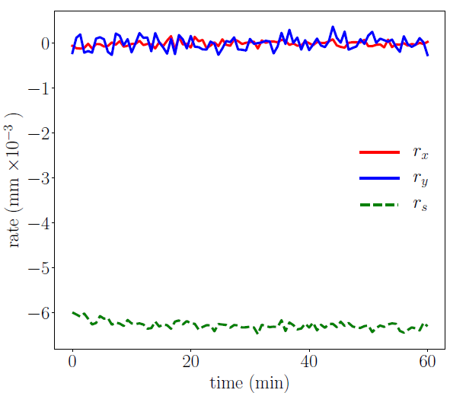
Cooling with fixed proton bunch length and/or fixed proton momentum spread
Fixed bunch length
Proton number: 0.98x10¹⁰ *0.84
Dispersion: 0.9 m/ 0 m
Coupling: 43%
Fixed dp/p and bunch length
Proton number: 0.98x10¹⁰
Dispersion: 0.2 m/ 0 m
Coupling: 50%

Slide 16
Notes
Flat beam, producing stronger cooling than the round beam, is preferred for JLEIC.
A dispersion less than 1 m at the cooler actually transfer enough cooling from the longitudinal direction to the transverse direction, and
What really makes the trouble is the overcooling in the longitudinal direction.
Fixed bunch length/ momentum spread helps to mitigate the overcooling

Slide 17
Outline
JLEIC Multi-Stage Electron Cooling Scheme
Attempts to Enhance the Cooling Efficiency
JSPEC development and latest updates

Slide 18
JSPEC
Jlab Simulation Package for Electron Cooling
JSPEC development started in 2015 supported by JLab LDRD.
Goal: Enhance the simulation capability on electron cooling for JLEIC project (more physical model, high efficiency)
Ion beam model: coasting or bunched
Electron beam model: DC or bunched with various shapes, e.g. Gaussian, Beer can, hollow beam, etc.
Friction force: Parkhomchuk formula (magnetized cooling)
Cooling rate calculation: Monte Carlo model
IBS expansion rate calculation: Martini model (no vertical dispersion)
Cooling process simulation:
RMS model: Ion beam represented by emittance, bunch length, momentum spread, assuming Gaussian distribution.
Particle model: Ion bema represented by particles, any distribution.
Text-based user interface
Online version by Radiasoft (https://beta.sirepo.com/#/jspec )
Open source (https://github.com/zhanghe9704/electroncooling)

Slide 19
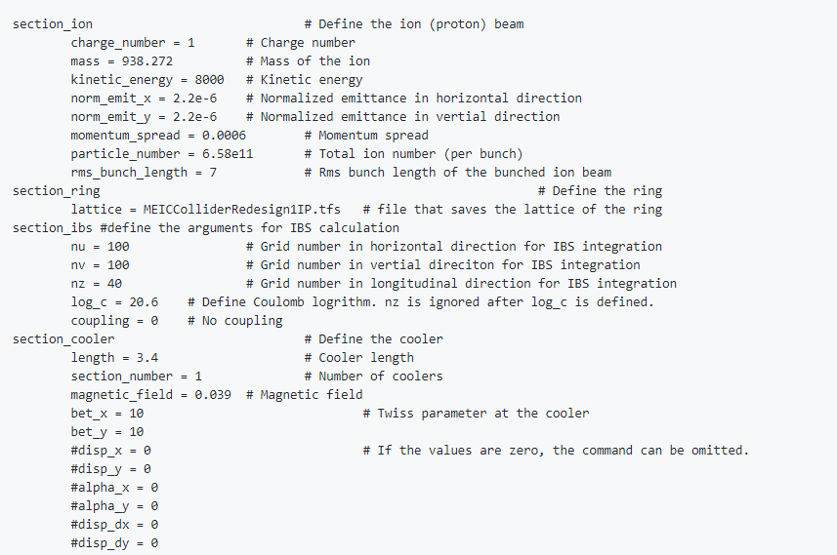
An Example of JSPEC Input File
Anything follows a “#” is a comment.
A list of the key words for all the sections can be found in the user manual on Github.

Slide 20
Verify the Particle Model for JLEIC Cooling
The particle model works well when the electron bunch is larger than the ion bunch.
JLEIC employs an electron bunch smaller than the ion bunch to achieve a higher cooling rate with a fixed electron bunch charge.
Does the particle model work when the electron bunch is smaller than the ion bunch?
Ions outside the electron bunch are considered not cooled during the whole time step.
But in reality, they meet the electrons due to their betatron motion and get cooled.
Can the particle model catches the deviation from Gaussian distribution?
If the particle model works, what are the proper parameters?
Verify the particle model with the turn-by-turn model, which simulates the betatron motion of the ions.

Slide 21
Verify the Particle Model for JLEIC Cooling
Turn-by-turn simulation: ~10s, 1,350,000 turns
Particle: step size 0.1s, 0.5s, 1s
Parameters:
Cooling was artificially increased by 100 times in order to see the deviation from the Gaussian distribution in 10s by turn-by-turn simulation.
Beer can shape electron beam covers 2 sigma area at the center of the Gaussian proton beam
Proton beam (CM energy 63.5 GeV):
Energy: 100 GeV
Proton number: 0.998x10¹⁰
Normalized emit. (rms): 1.25/0.38 μm
Beta function in cooler: 60/300 m
Cooling electron beam:
Charge: 200 nC
Bunch length (total length): 2 cm
Length: 2 cm
Radius: 0.835 mm
Transverse temperature: 0.246 eV
Longitudinal temperature: 0.184 eV
Bunch size (rms): 0.835/0.841 mm
Momentum spread: 8x10⁻⁴
Bunch length (rms): 2.5 cm
Cooler parameters:
Length: t0 m
B = 1T

Slide 22
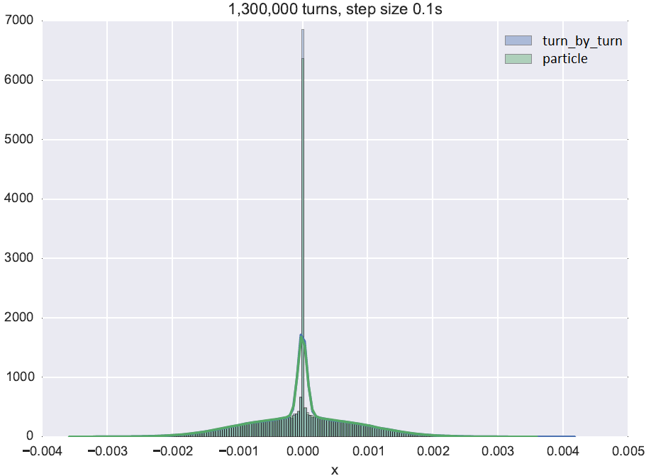
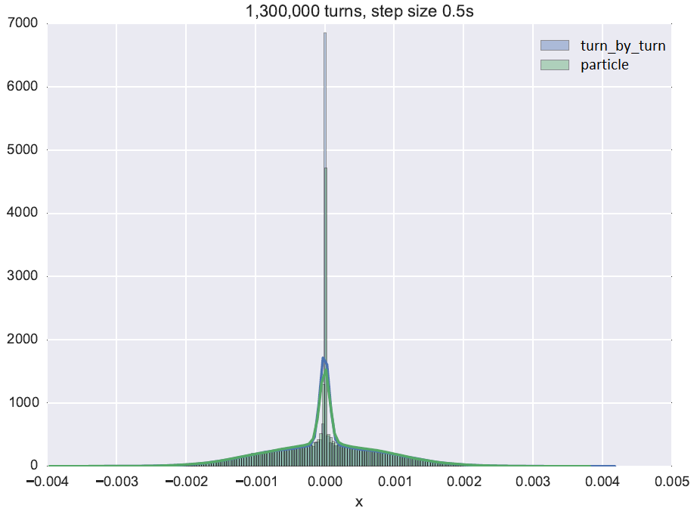
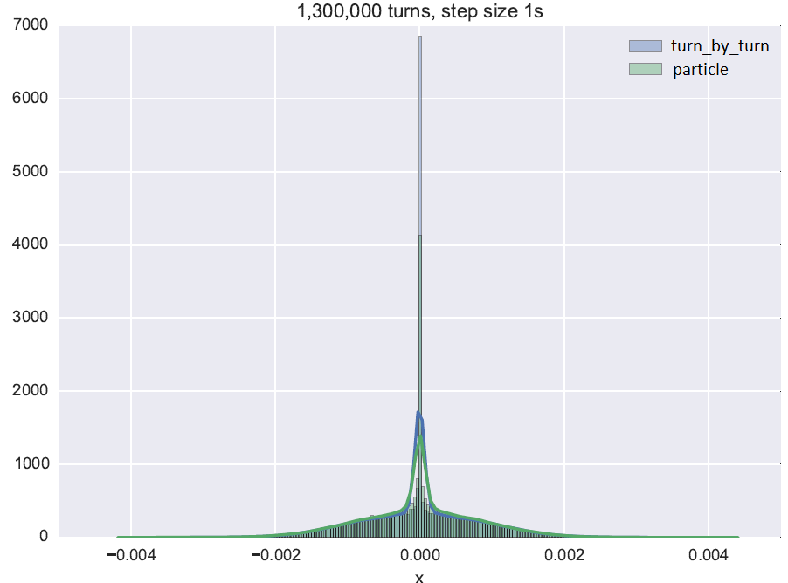
Verify the Particle Model for JLEIC Cooling
Particle model works！
dt = 0.1s, results are almost identical.
dt = 0.5 s, the deviation starts to show, but not large.
dt = 1s, the deviation becomes larger.
Taking a step size between 0.1 s – 0.5 s is acceptable.

Slide 23
JSPEC: User-Defined Electron Bunch
JSPEC had electron models such as beer can shape, Gaussian, hollow beam, etc.
But for JLEIC cooling scheme, the electron beam may not maintain an ideal shape due to the strong collective effect during transition
A detailed description of the electron bunch may also be needed to simulation advanced cooling technique, e.g. sweeping effect, dispersive cooling, etc.
A new module has been developed，which allows to use a user-defined electron bunch with arbitrary shape and density in cooling simulations.
The electron bunch is defined by sample particles with 6D coordinates (x, y, z, vx, vy, vz) saved in a asci/binary file. (x, y, z) is the position of a sample particle in the lab frame. (vx, vy, vz) is the velocity of the a sample particle in the beam frame.

Slide 24
JSPEC: User-Defined Electron Bunch
Tree-based algorithm
Decompose the whole domain into small boxes. The number of electrons inside each small box is smaller than a predetermined number $S$. Calculate the local density/temperature in each small boxes.
Locate the ion in a box and use the local density/temperature of that box to calculate the friction force on the ion.
The relation between boxes are represented by a tree, which helps to identify the location of an ion fast.
Many cooling simulations assume electron bunch does NOT change, while the ions do move. Need only once of tree construction and density/temperature calculation.

Slide 25
JSPEC: User-Defined Electron Bunch
Tree-based algorithm and its computational cost
Construct the tree.
Calculate the local density/temperature.
Find which box an ion belongs to.
Repeat 3 for all ions for cooling rate calculation.
Repeat 3-4 for cooling simulation assuming a constant electron bunch.
Or Repeat 1-4 for cooling simulation assuming a varying electron bunch.
$$O(N_{e}\lg{N_{e}})$$
$$O(N_{e})$$
$$O(\lg{N_{e}})$$
$$O(N_{i}\lg{N_{e}})$$
$$O\left({(N}_{e}+N_{c}N_{i})\lg{N_{e}}\right)$$
$$O(N_{s}(N_{i}+N_{e})lg{N_{e}})$$

Slide 26
JSPEC: User-Defined Electron Bunch
Compare the cooling rate of a perfect Gaussian bunch with one that is represented by sample particles.
 | Rx (1/s) | Ry (1/s) | Rz (1/s)
Perfect Gaussian | -0.000156628 | -0.000204170 | -0.000274953
$$N_{e}={10}^{6}, S=50$$ | -0.000167931 | -0.000219561 | -0.000307613
$$N_{e}={10}^{6}, S=100$$ | -0.000160644 | -0.000210011 | -0.000288947
$$N_{e}={10}^{6}, S=200$$ | -0.000156659 | -0.000203634 | -0.000276979
$$N_{e}={10}^{6}, S=300$$ | -0.000155772 | -0.000202327 | -0.000275269
$$N_{e}={10}^{6}, S=400$$ | -0.000155078 | -0.000201428 | -0.000273384
$N_{e}={10}^{6},S=200$ gives the best result.
Good to see the results is not very sensitive to the change of $S$, which means even if $S$ deviates from the optimal value a little, the result will not be too bad.

Slide 27
Summary
JLEIC multi-stage cooling scheme: reduce the emittance at the low energy; maintain the emittance at the higher energy.
Heavy ion beam cooling is relatively easy.
Proton beam cooling is challenging due to the imbalance between the IBS and electron cooling (very strong horizontal IBS effect and very strong cooling at the longitudinal direction).
Simulation suggests the nominal parameters are achievable after deeper study.
Flat electron beam provides stronger cooling than the round electron beam.
Fixed bunch length/momentum spread helps to mitigate the overcooling in the longitudinal direction.
JSPEC is under active development.

