Slide 1
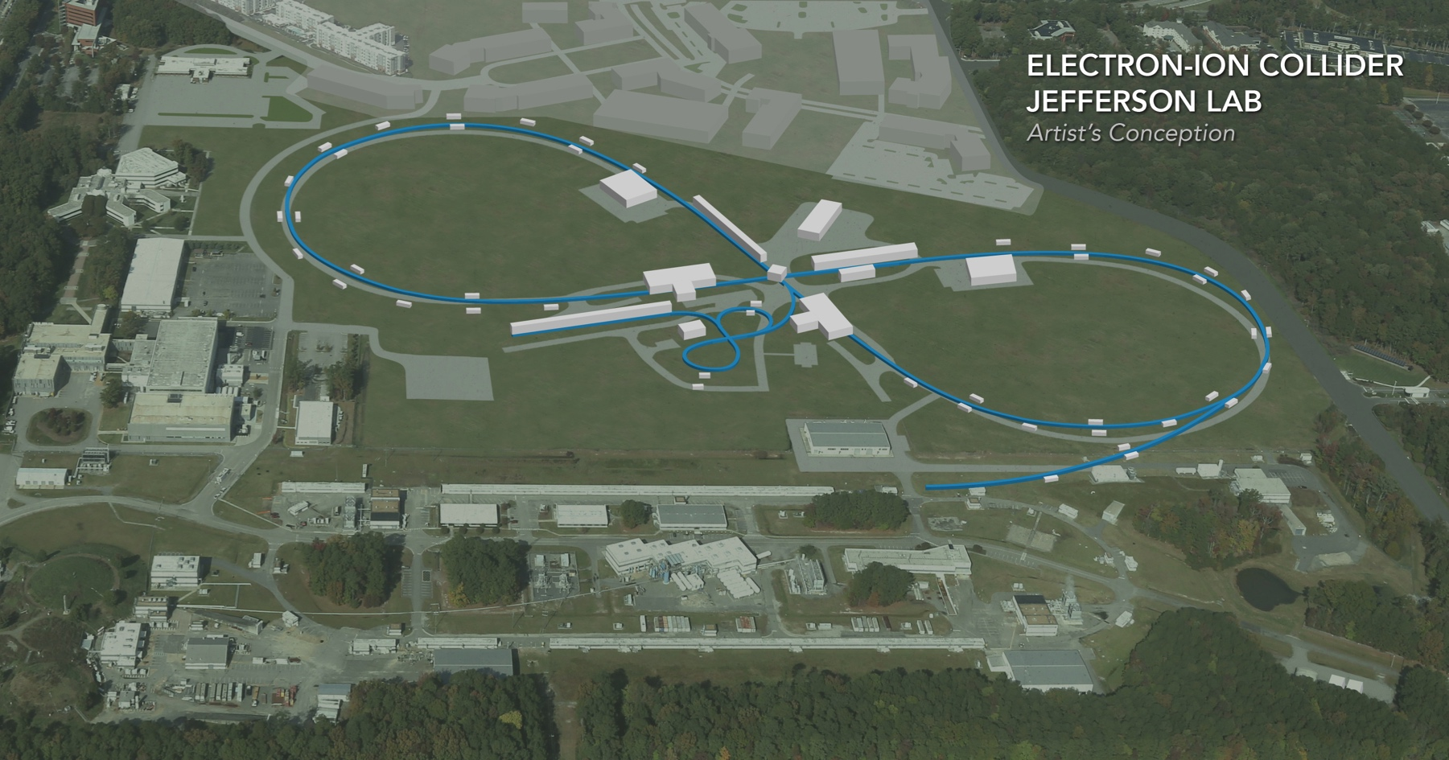
Beam Dynamics in the CCR
Speaker: Chris Tennant, Jefferson Laboratory
Collaborators: Slava Derbenev, David Douglas, Fay Hannon, Andrew Hutton, Rui Li, Bob Rimmer, Yves Roblin, Chris Tennant, Haipeng Wang, He Zhang, Yuhong Zhang
EIC Accelerator Collaboration Meeting October 29 - November 1, 2018

Slide 2
Outline
Why a CCR?
transition from weak to strong cooling
What is the CCR?
cooling channel
drives system requirements (beam energy, emittance, match, distribution, etc.)
recirculation arcs
intersection of many beam dynamical processes
beam exchange
possible with development of fast kickers
Summary
current status
path moving forward

Slide 3
Background
initial design effort focused on “weak cooling”
single pass ERL
moderate charge (420 pC)
preliminary injector design developed
generated ERL design with acceptable performance with “ideal” injected beam
in late 2016 the specifications were changed to “strong cooling”
extremely high charge (3.2 nC)
extremely high current via CCR (1.5 A)
retain the ERL solution as a driver for CCR
relaxes average current burden on ERL in exchange for increased bunch charge

Slide 4
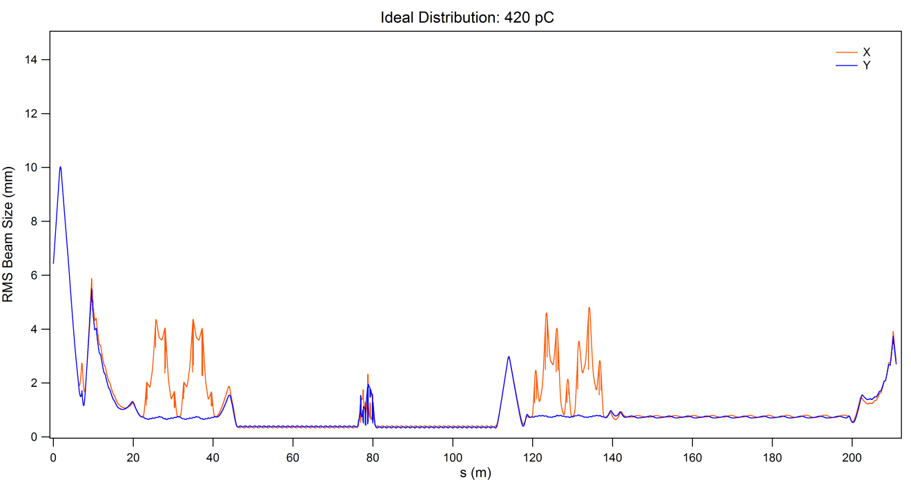
Weak Cooling
magnetization flip
ion beam
cooling solenoid
cooling solenoid
chirper
booster
de-chirper
magnetized gun
beam dump
linac
Parameter | Value
Injected momentum | 5 MeV/c
Momentum at cooling channel | 55 MeV/c
RF fundamental frequency | 952 MHz
Bunch repetition frequency | 476 MHz
Bunch charge | 420 pC
Bunch length at cooling channel (full) | 2 cm / 66.7 ps / 22.9°
Energy spread at cooling channel (rms) | 3×10⁻⁴
Cooling solenoid strength | 1 T
Normalized horizontal drift emittance | 36 mm-mrad
Normalized Larmor emittance | <19 mm-mrad
arc
arc
flip
solenoid
solenoid

Slide 5
Strong Cooling
ERL (bottom)
magnetized gun
linac
beam dump
chirper
booster
chirper
dipole
dipole
CCR (top)
ion beam
cooling solenoids
magnetization flip
magnetization flip
DC & RF kicker
septum
DC & RF kicker
DC & RF kicker
DC & RF kicker
CCR
chirper
injected bunch orbit
extracted bunch orbit
chirper
ERL
dipole
Beam Exchange (side)
dipole
harmonic kicker exchanges every 11th CCR bunch between ERL and CCR

Slide 6
Background
top level requirements are “standard” for an ERL
generate, accelerate, and deliver to user a properly configured beam
recover (possibly degraded) beam after use
preserve beam quality, avoid instabilities and limit losses
unique features of JLEIC cooling system:
magnetized beam
axially symmetric transport
high charge
collective effects aggravated
long bunch
samples large(r) part of RF waveform
small momentum spread
susceptible to wake-induced distortion

Slide 7
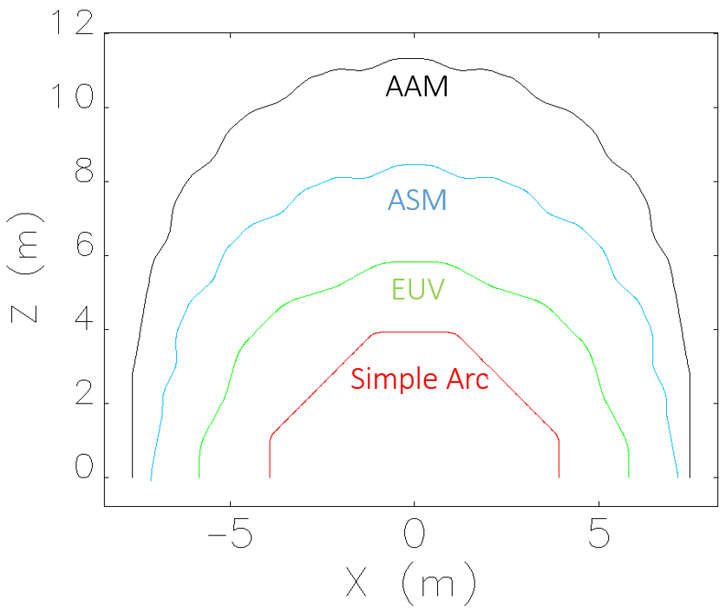
Recirculation Arcs
ERL has 360° of bending
CCR has 11 × 360° of bending
the CCR arc has the following requirements:
local axial symmetry – preserve magnetization
globally isochronous – longitudinal match
locally isochronous - manage CSR and mBI
locally achromatic – manage CSR and mBI
high periodicity – suppress aberrations and error sensitivities
moderate size – avoid space charge degradation
not easy to satisfy all conditions simultaneously

Slide 8
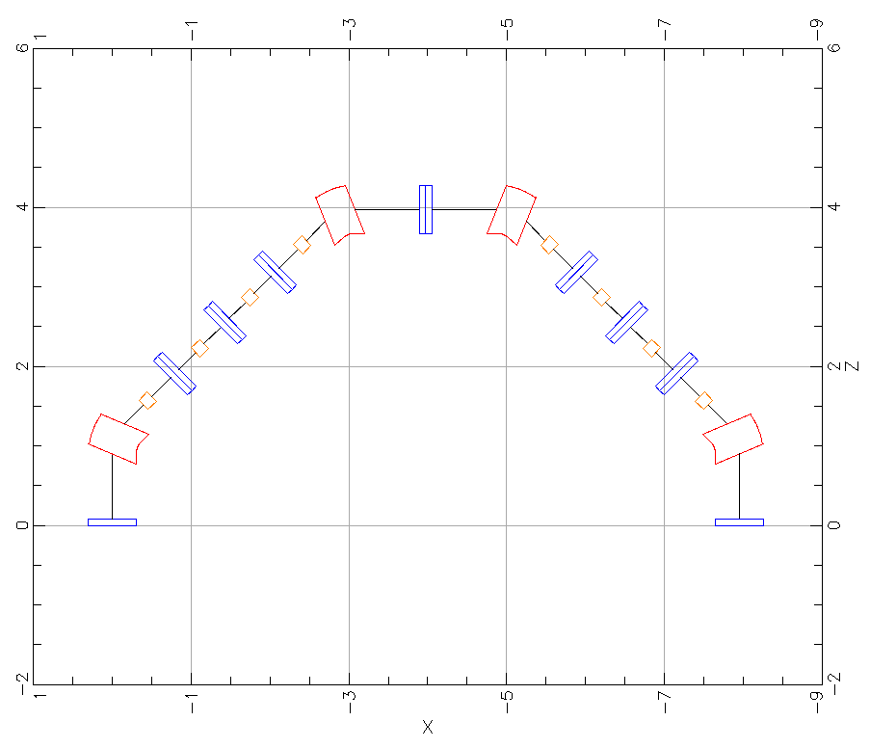
Arc Layout
design by D. Douglas (JLAB-TN-18-009)
do not force the conditions of
high periodicity
local axial symmetry
start with a simple baseline arc, analyze and determine level of increased complexity required
dipole
quadrupole
sextupole

Slide 9
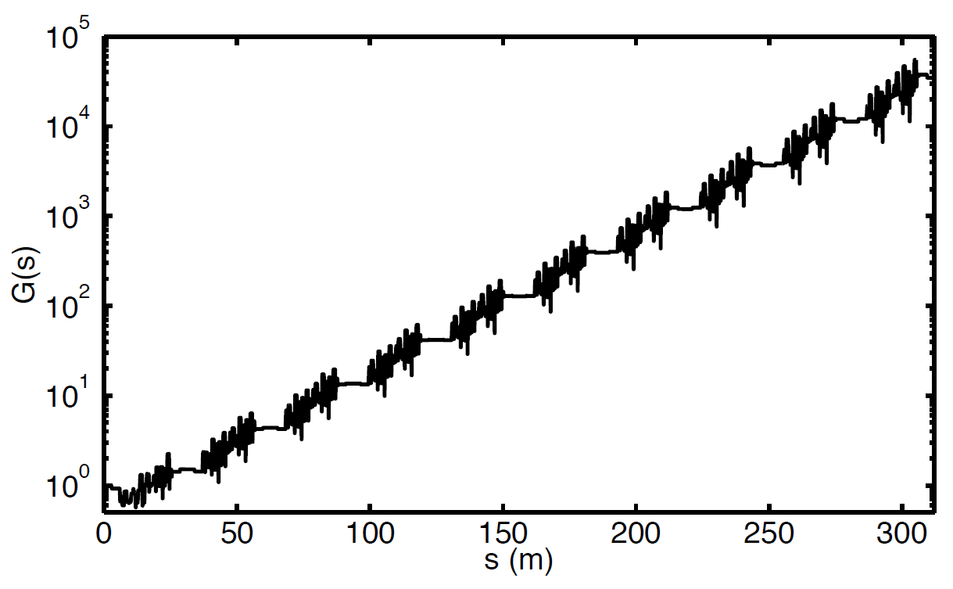
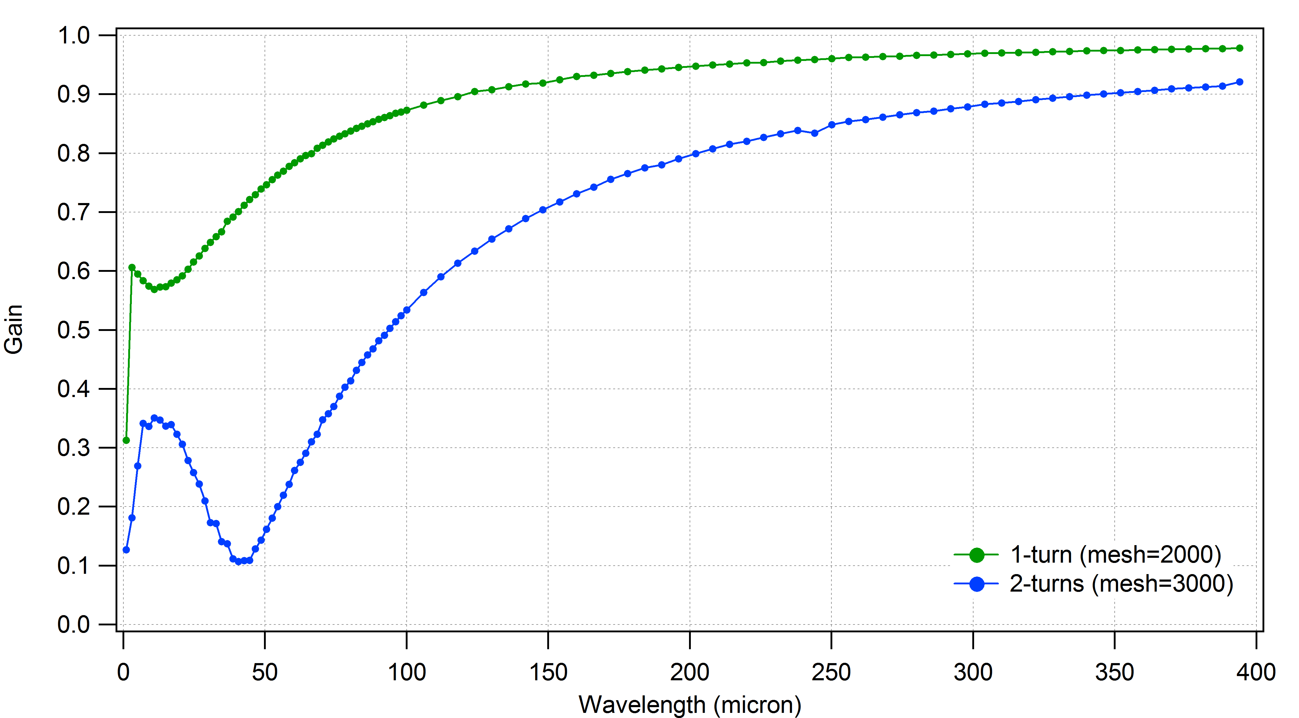
Microbunching Gain
needs to be less than unity for multiple passes
total gain goes as gain(1-turn)^{Number Passes}
consider the gain for multiple turns in a “CCR ring” (two arcs put together)
modest gain for 1-arc ~ 5

Slide 10
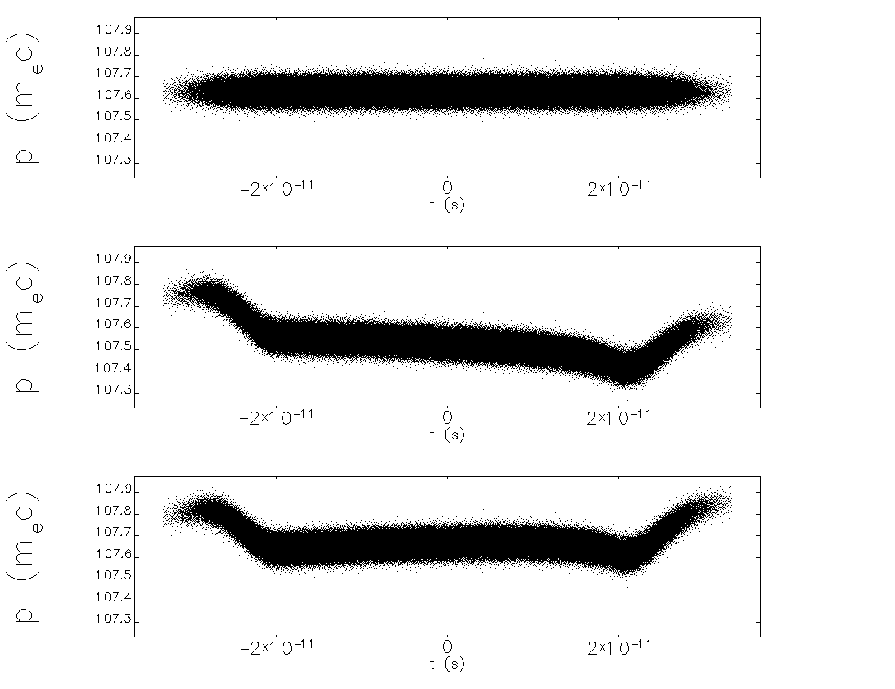
Effect of CSR on Longitudinal Phase Space
no CSR
CSR
CSR “corrected”

Slide 11
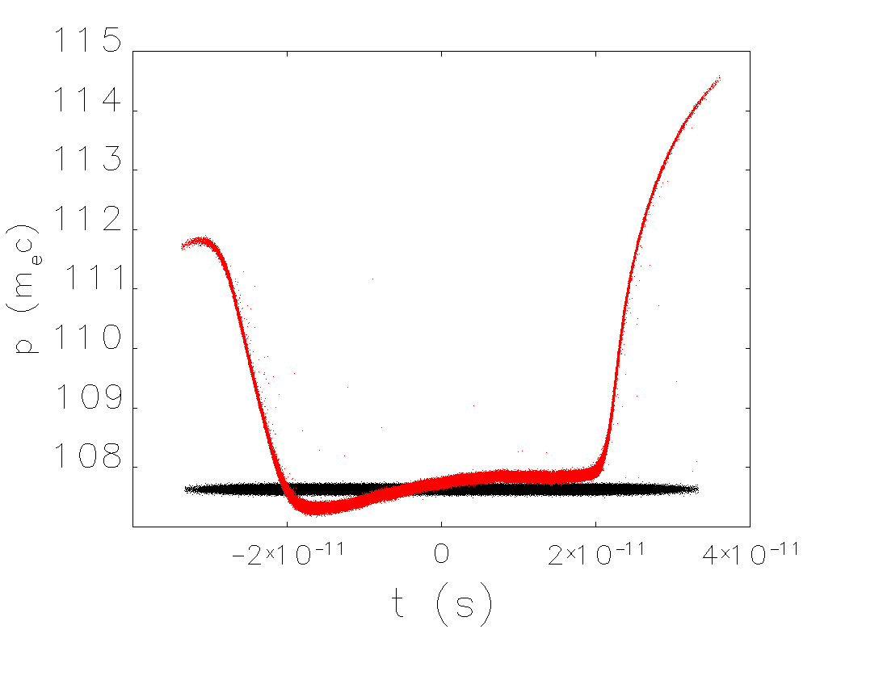
RF Correction for 20 Turns
cannot compensate head/tail effects
will need to explore collimation schemes
after 20 turns
initial

Slide 12
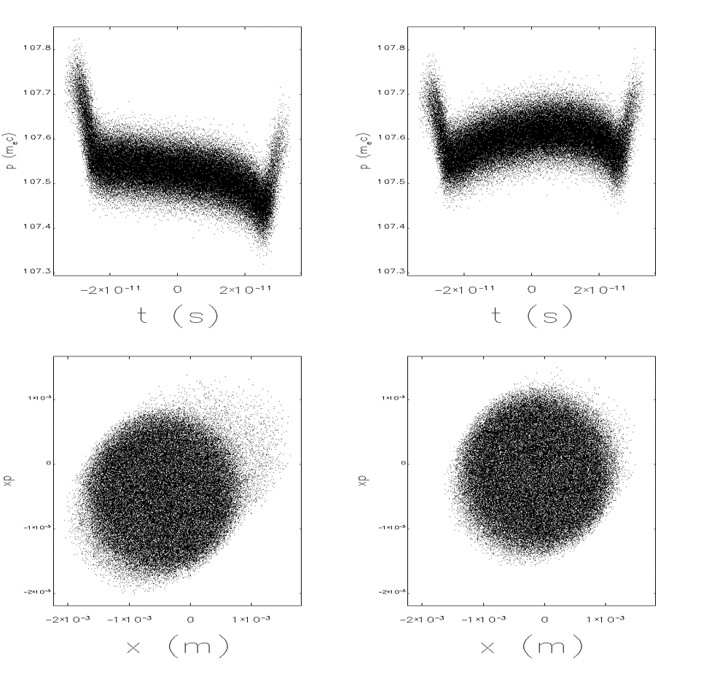
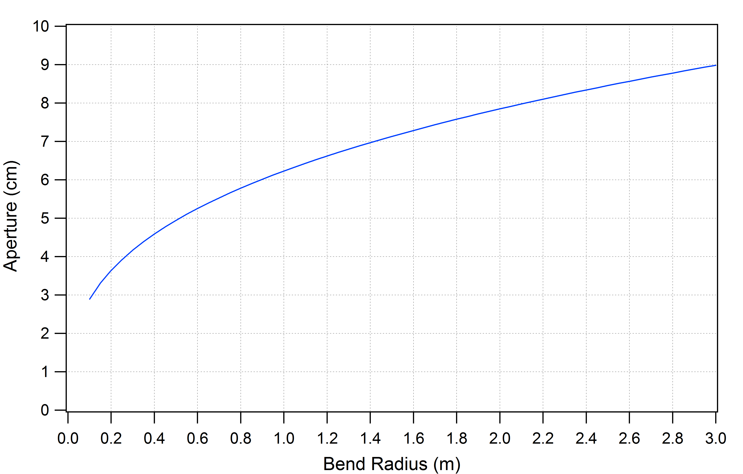
CSR Shielding
shielding of CSR is effective when the full aperture size is less than $R^{1/3}{\left(πσ_{z}\right)}^{2/3}$ where R is the bend radius and σ_{z} is the rms bunch length
for R = 0.53 m and σ_{z} = 4.95 mm, the (full) aperture needs to be less than ~2 inches (5.04 cm)
with CSR
with CSR + shielding
for σ_{z} = 4.95 mm

Slide 13
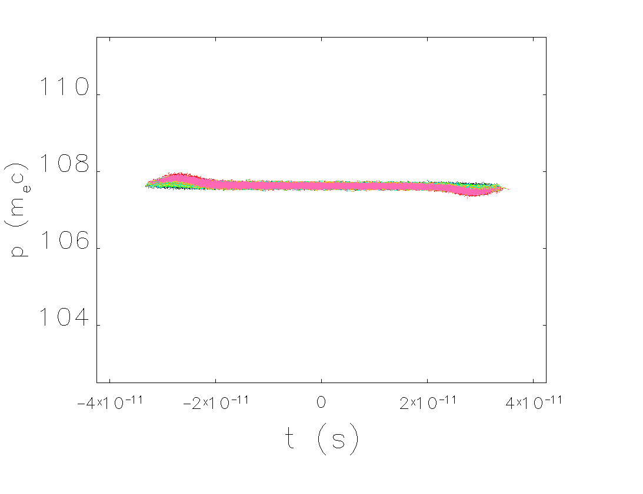
TStep – Multiturn Tracking
space charge only

Slide 14
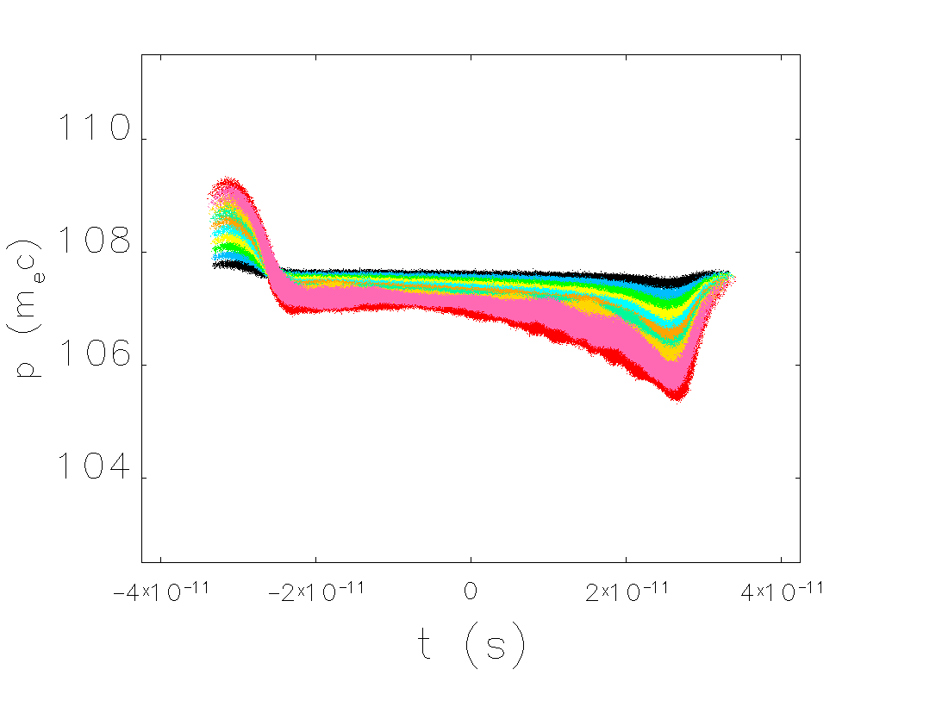
elegant – Multiturn Tracking
CSR only

Slide 15
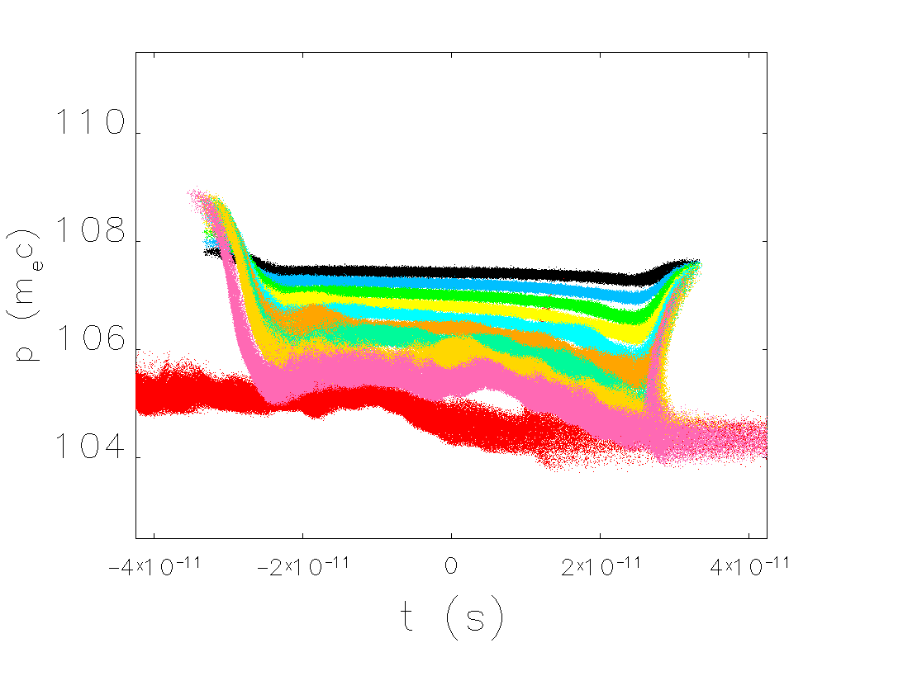
elegant – Multiturn Tracking
CSR with csrdrifts

Slide 16
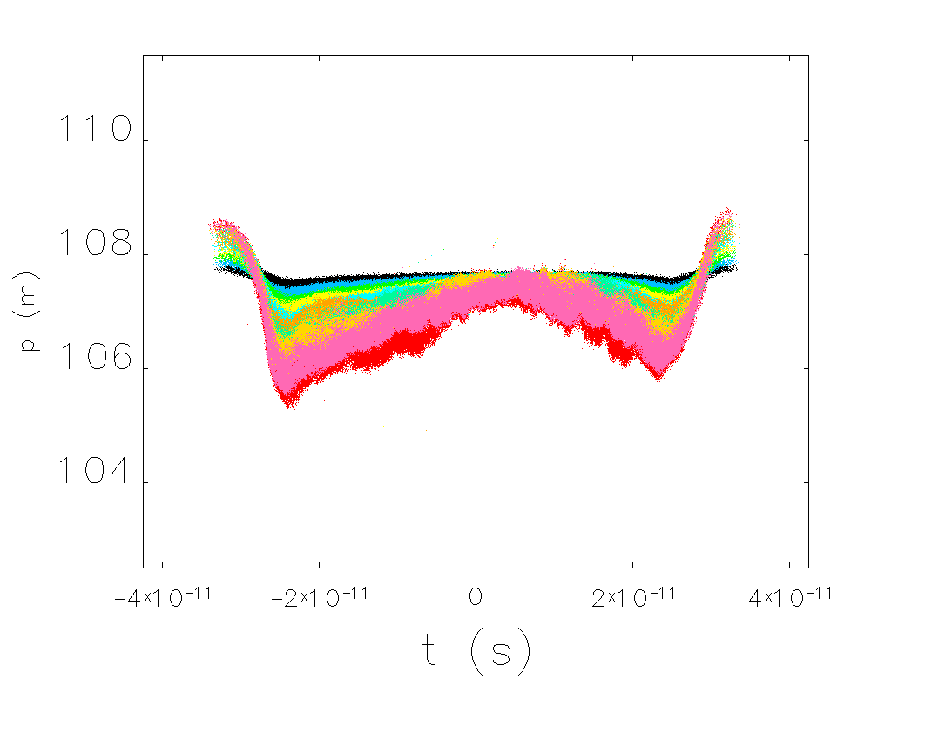
Bmad – Multiturn Tracking
CSR with csrdrifts and with CSR shielding (5 cm)

Slide 17
Putting It All Together: “S2E”
incorporate beam exchange, recirculation arcs, cooling solenoids, magnetization flips
track distribution through entirety of the CCR
use reduced charge (1.6 nC)
Simple Arc
pathlength = 194.5973 m ~ 618λ_{RF}
Simple Arc
15 m
4.8 m
15 m
5.4 m
15 m
4.8 m
15 m
0
-10
X (m)
solenoid
solenoid
solenoid
solenoid
-40 -20 0 20 40
Z (m)

Slide 18
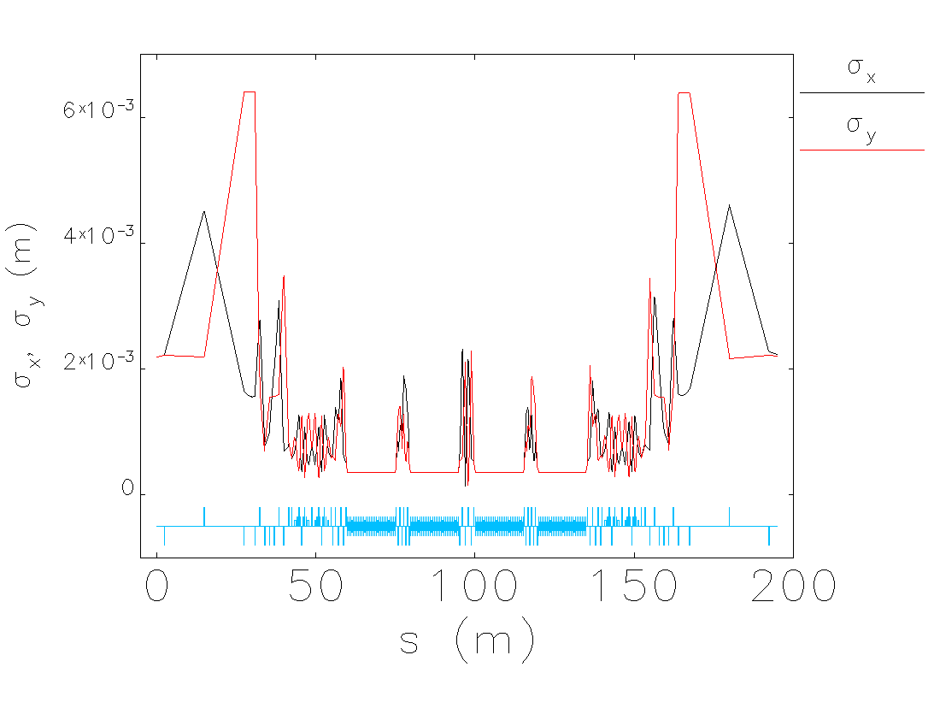
RMS Beam Sizes

Slide 19
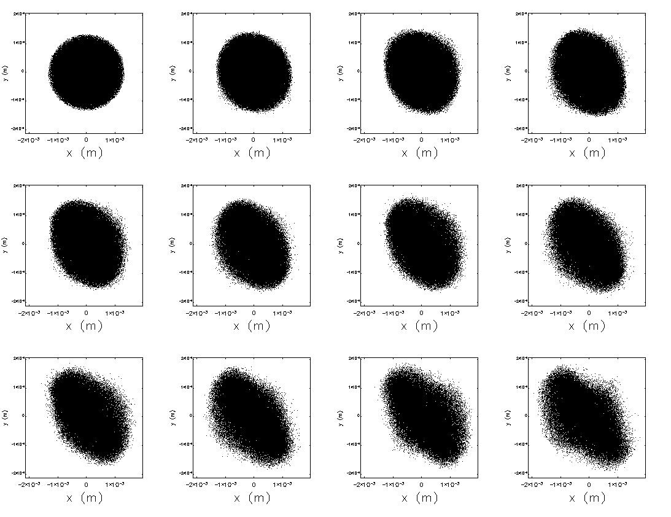
(x,y) Phase Space
CCR entrance
exit turn 1
exit turn 2
exit turn 3
exit turn 4
exit turn 5
exit turn 6
exit turn 7
exit turn 8
exit turn 9
exit turn 10
exit turn 11

Slide 20
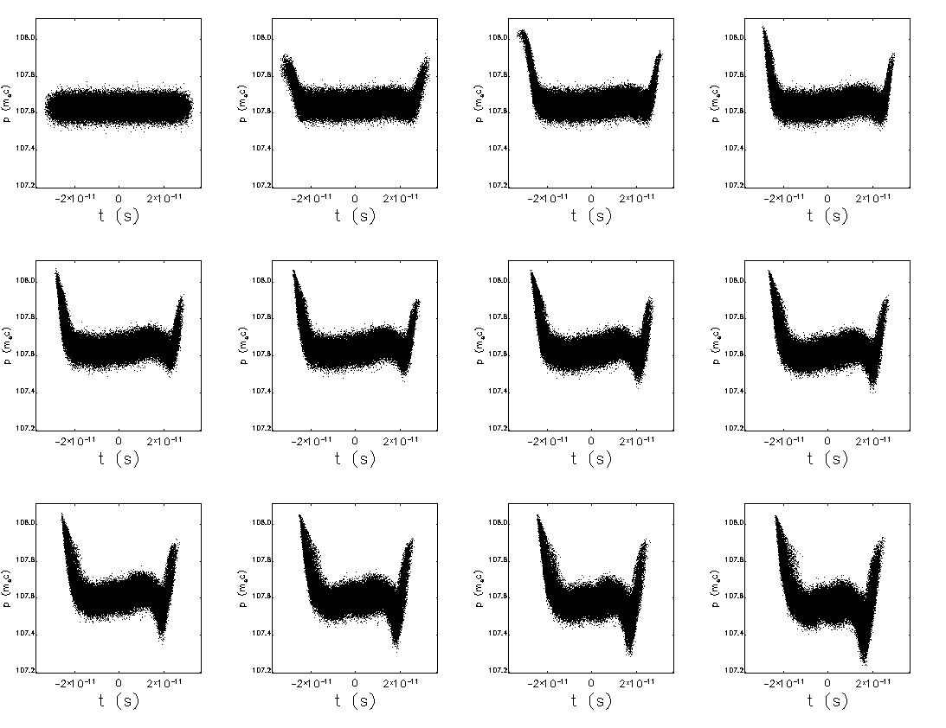
(t,p) Phase Space
CCR entrance
exit turn 1
exit turn 2
exit turn 3
exit turn 4
exit turn 5
exit turn 6
exit turn 7
exit turn 8
exit turn 9
exit turn 10
exit turn 11

Slide 21
Summary: Beam Dynamics Issues
CSR, space charge, mBI: machine lives in unique part of parameter space
beam breakup (BBU): well understood, need full system to assess impact
halo: serious problem, not yet addressed, need good simulation statistics
halo formation effects: IBS, Touscheck, beam dynamical processes
ion trapping: potential problem
environmental wakes, impedances, etc.
collimation
not demonstrated in high power, CW operation
other…

Slide 22
Summary
system design has proceeded in a piecemeal fashion → time for iterations
ERL was designed around a 420 pC solution
short injected bunch, use longitudinal match to stretch and de-chirp before cooling channel
strong cooling requires 8x higher bunch charge (3.2 nc)
forces injector solution to much longer bunch length
consequently,
need lower frequency RF for sufficient phase acceptance (476 MHz)
require different momentum compaction tunings for arcs (isochronous)
need large momentum acceptance
(longer bunch → larger projected energy spread → exacerbates chromatic aberrations)

Slide 23
Path Forward
process of iterating/re-working has begun
have initial designs for all of the major cooler sub-systems
identify appropriate ERL arc
low mBI gain
large momentum acceptance
isochronous
explore options for mitigating CSR-induced insult to beam (ERL and CCR arcs)
longer bunch length
CSR shielding
put all the pieces together, begin S2E tracking studies and evaluate performance

Slide 25
BACKUP

Slide 26
Cooling Channel
the ion beam and electron beam co-propagate through the channel where thermal energy is transferred from the ions to the electrons and are “cooled”
separate the 60 m active cooling length into 4 × 15 m solenoid sections
magnetization flip
I-transform
magnetization flip
B < 0
B > 0
B > 0
B < 0
Parameter | Value
Energy | 55 MeV
Charge | 3.2 nC
CCR Pulse Freq. | 476.3 MHz
Bunch Shape | Beer can
Bunch Length | 2 cm (full)
Thermal emittance | <19 mm-mrad
Parameter | Value
Norm. Tran. Drift Emittance | 36 mm-mrad
RMS Energy Spread (uncorr.) | 3x10⁻⁴
Energy Spread (p-p corr.) | <6x10⁻⁴
Solenoid Field | 1 T
Electron Beta in Cooler | 0.37 m
Solenoid Length | 4x15 m

Slide 27
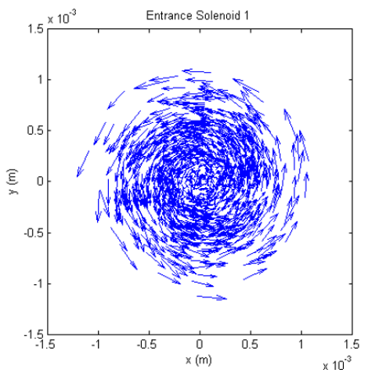
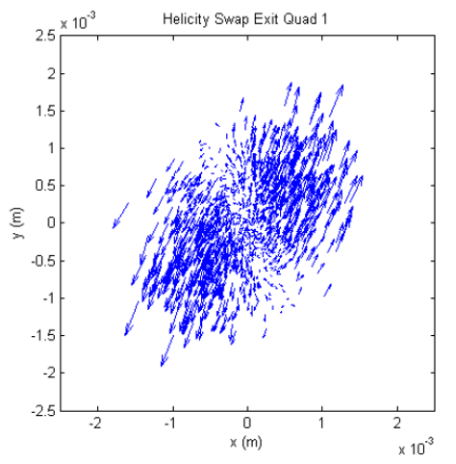
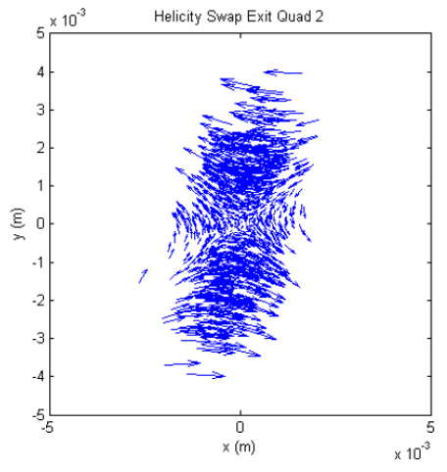
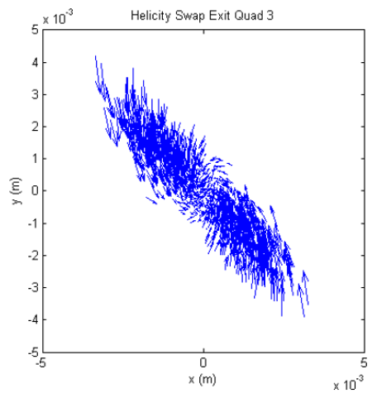
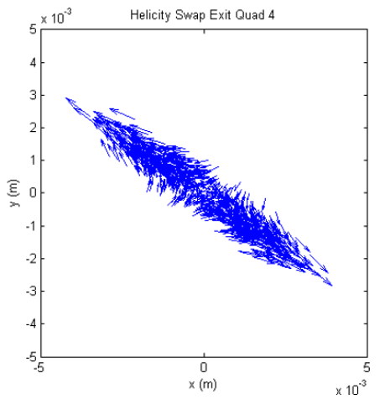
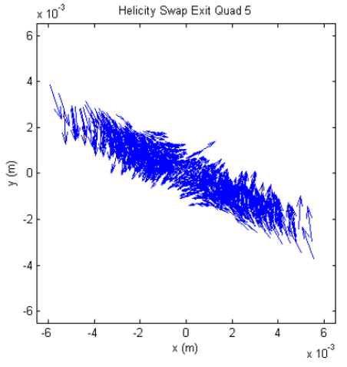
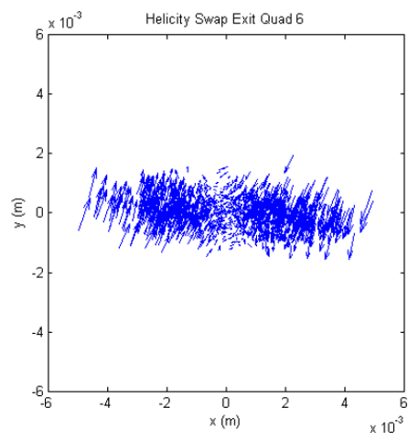
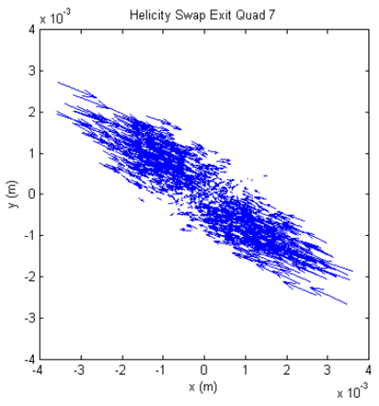
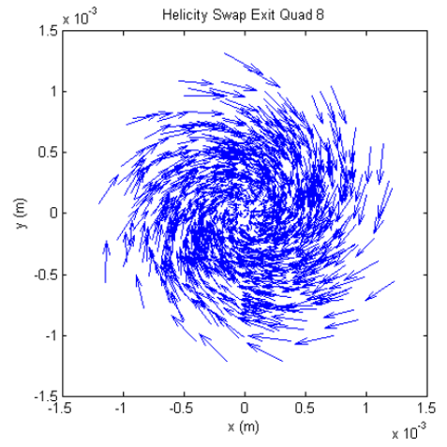
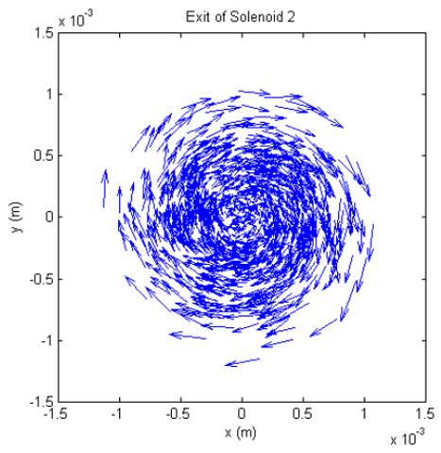
Magnetization Flip Transformation
preserving ion polarization requires running solenoids with opposite signs
however, electron beam has a specific sign of angular momentum which must be matched to the sign of the solenoid
need to flip the magnetization between solenoids and ensure appropriate transverse match
entrance
$$\left(\begin{matrix}\begin{matrix}0 & 0 \\ 0 & 0\end{matrix} & \begin{matrix}1 & 0 \\ 0 & 1\end{matrix} \\ \begin{matrix}1 & 0 \\ 0 & 1\end{matrix} & \begin{matrix}0 & 0 \\ 0 & 0\end{matrix}\end{matrix}\right)$$
exit

Slide 28
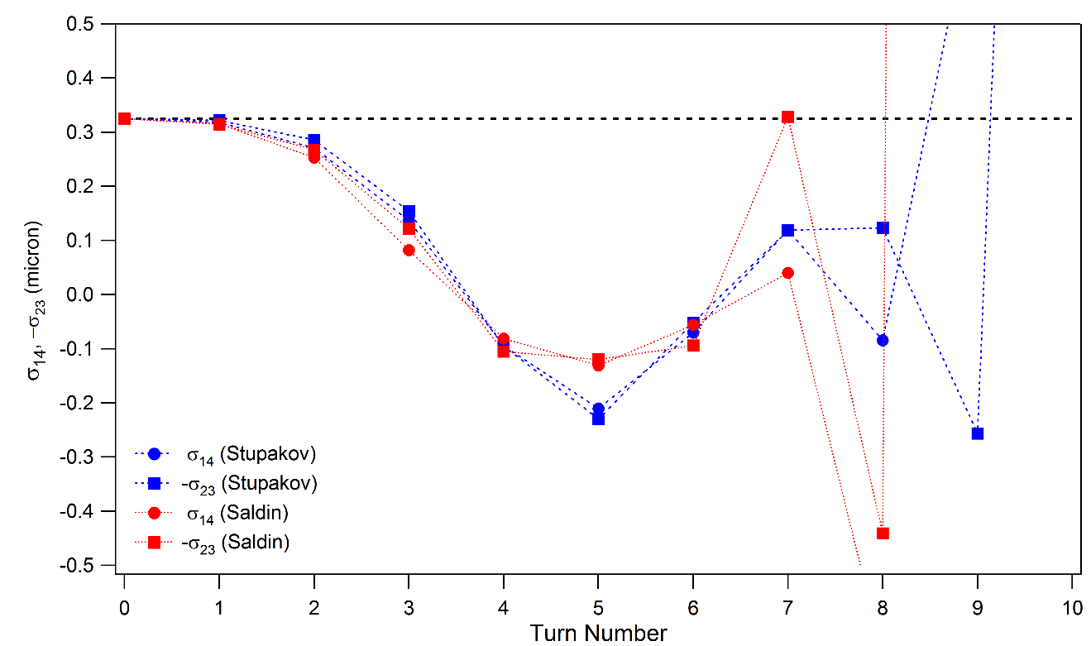
Magnetization
quantify the magnetization (or lack thereof) as a function of turn number

Slide 29
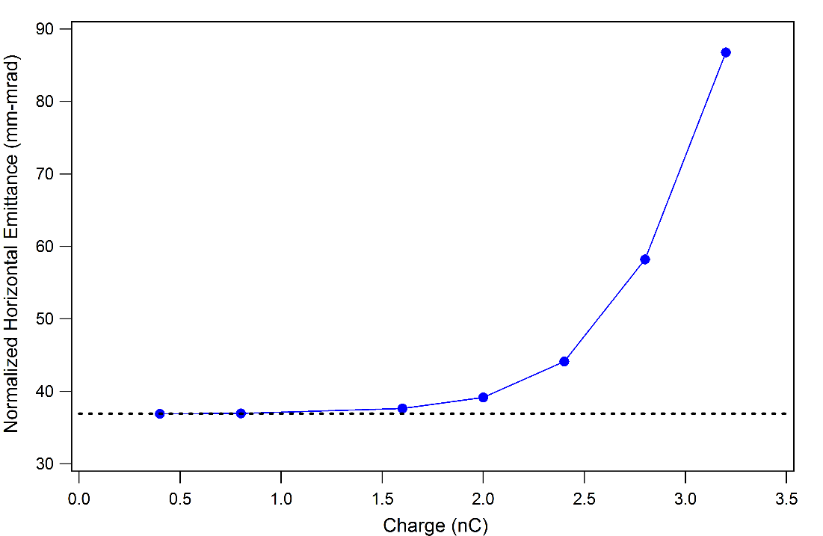
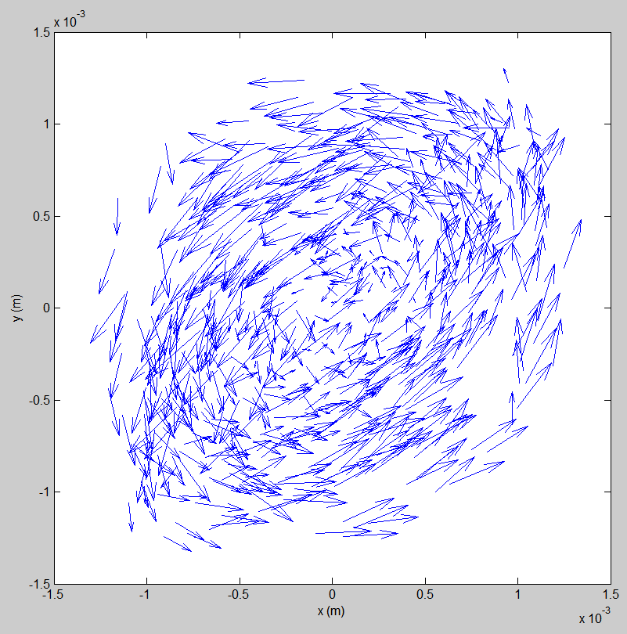
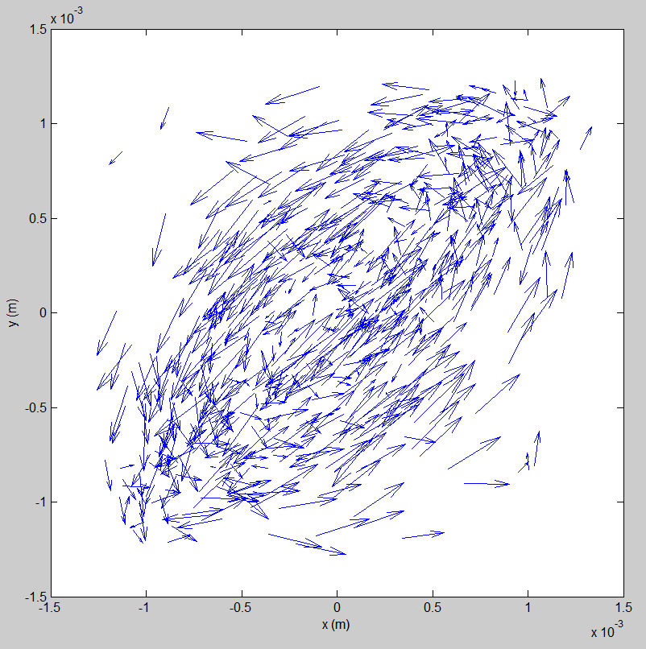
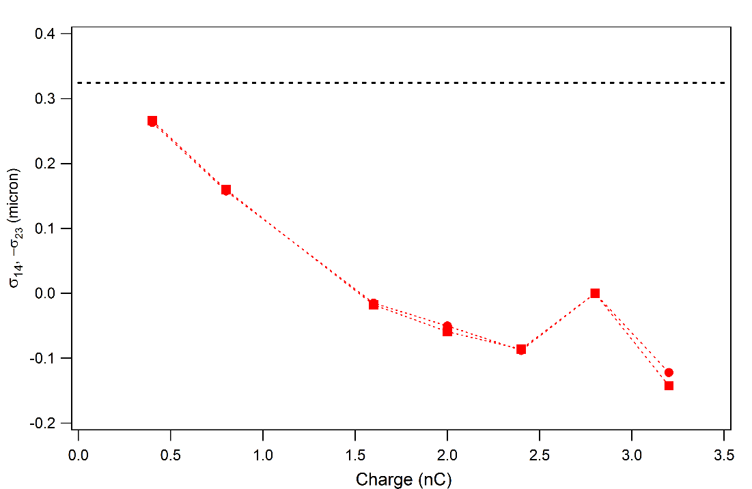
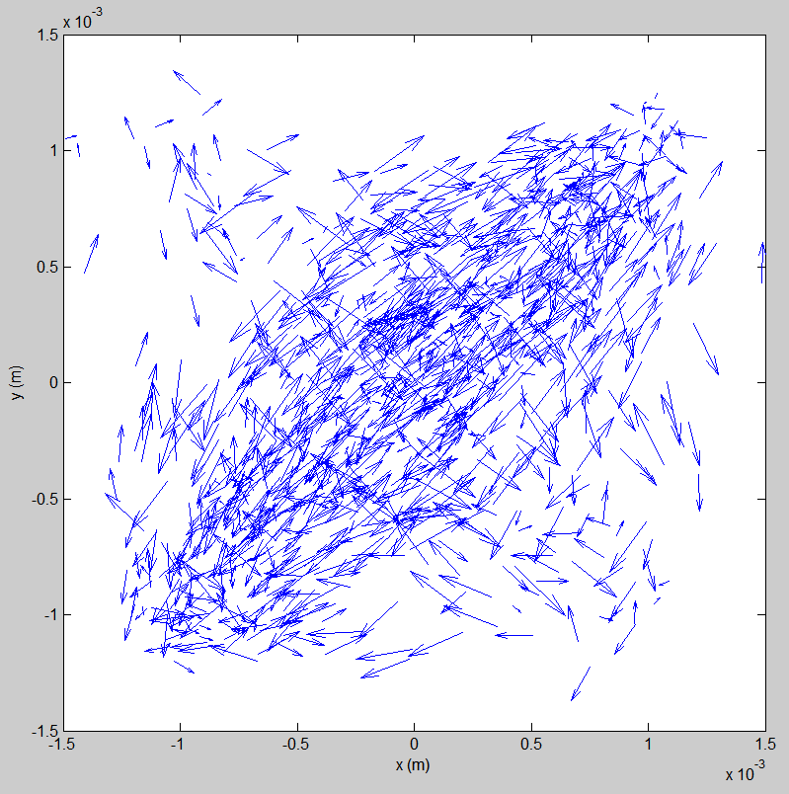
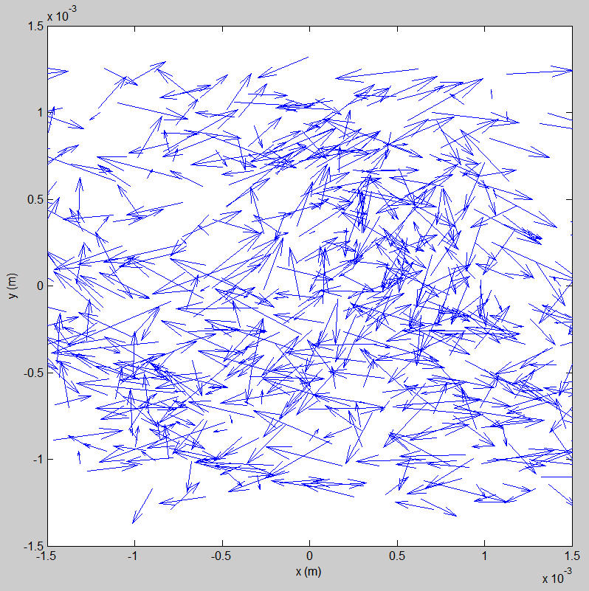
Charge Scan
0.4 nC
0.8 nC
1.6 nC
3.2 nC

Slide 30
Beam Exchange v1.0
reference orbit defined by injected/extracted beams
septum bending field lies on axis of exchange region (septum wall above axis)
all bunches are deflected upward - with DC kicker - to clear elevated septum wall
exchanged bunches kicked downward via RF kicker back onto axis
sequence for recirculated beam
DC kick up + extraction kicker at (near) zero kick
bunches follow orbit offset through exchange, clear septum, return to CCR axis at node downstream
DC kick up + injection kicker at (near) zero kick at node and re-steers bunch train to CCR reference orbit
IK cancels any remnant (x’-t) correlation from EK
DC & EK
IK & DC
CCR
ERL
injected bunch orbit
extracted bunch orbit
dipole
dipole

Slide 31
Beam Exchange v1.0
sequence for injected beam
DC kick up + “pre-kicker” down
pre-compensates any (x’t) correlation induced by IK
on-axis through vertical achromatic translation up to plane of CCR → cross septum to bend onto CCR axis
on-axis transport to IK (down) and DC kick (up), merging with circulating beam
sequence for extracted beam
DC kick up + extraction kick down → on-axis transport to septum
bend down and vertical achromatic transport to plane of ERL, bending onto plane of ERL
“post-kicker” down + DC kick up
post-kicker cancels any bunch distortion (x’t correlation) due to EK
DC & EK
IK & DC
CCR
DC & pre
injected bunch orbit
extracted bunch orbit
post & DC
ERL
dipole
Beam Exchange (side)
dipole

Slide 32
Twiss Parameterization
CCR back leg
ERL to CCR

Slide 33
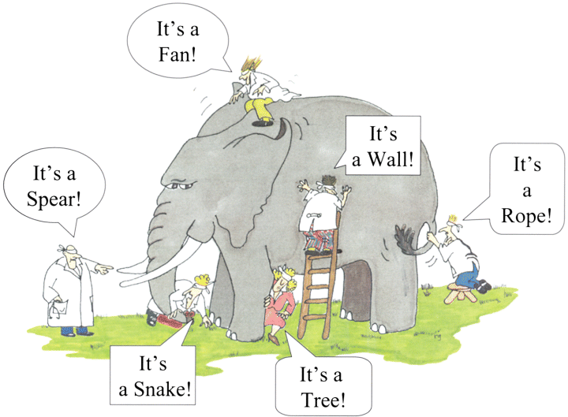
Probing the Parameter Space
DIMAD
lattice design
elegant
CSR
GPT
space charge
CSR
Bmad
CSR
CSR shielding
Vlasov-Solver
microbunching
TStep
space charge
CSR

Slide 34
Why Magnetized Electron Cooler?
At cathode immersed in solenoid, a gun generates almost parallel (laminar) beam state of a large size (electron Larmor orbits are very small compared to beam size)
This beam state is then transplanted to the solenoid in cooling section
(while preserving the canonical emittances: the drift and the Larmor
emittances)
The solenoid field can be controlled to make e-beam size properly match the ion beam size
Magnetization results in the following critical advantages
(compared to a non-magnetized gun/cooling solenoid):
Tremendous reduction (by a factor 20 – 30) of the regional and global deleterious Space Charge transverse impact to dynamics in CCR (tune shift)
Strong mitigation (suppression) of the CSR microbunching/ energy spread growth
Suppression of deleterious impacts of high electron transverse velocity spread and short-wave misalignments to cooling rates (thanks to ion collisions with “frozen” electrons at large impact parameters)
Notes:
At cathode immersed in solenoid, one can generate almost parallel (laminar) beam state after the gun

Slide 35
CCR Backleg
requires idealized systems and mitigation schemes to transport bunch 11-turns
CSR correction cavity modeled as a matrix to fix longitudinal phase space (R₆₅ = 0.025 m, T₆₅₅ = 2.5 m) plus an energy shift (33 keV)
“collimator” used to filter high energy tails (deltaLimit = 3×10⁻³)
DC kicker
RF kicker
CSR correction
collimation
qccrm1
qccrm1
qccrm3
qccrm7
qccr2
qccr2
qccrm7
qccrm3
septum
qccrm2
qccrm6
qccr1
qccr1
qccr1
qccr1
qccrm8
qccrm5
qccrm2
qccrm4
qccrm4
qccrm5
qccrm8
qccrm6
85.0 m

Slide 36
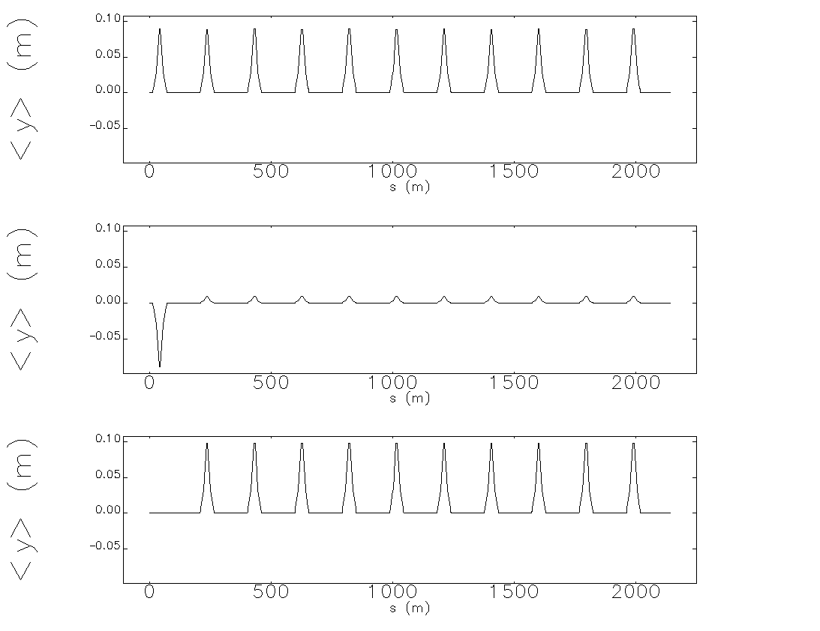
Multi-Turn Tracking with Kickers
DC kickers only
11 revolutions in CCR
1 2 3 4 5 6 7 8 9 10 11
harmonic kickers only
1 2 3 4 5 6 7 8 9 10 11
DC + harmonic kickers
1st bunch is extracted
1 2 3 4 5 6 7 8 9 10 11

Slide 37
Beam Exchange v2.0
(courtesy D. Douglas)

