Slide 1
Beam-beam Studies, Tool Development and Tests
EIC Collaboration Meeting, Jlab, Oct. 29-Nov. 1, 2018
Yun Luo for eRHIC beam-beam study team

Slide 2
Content
New eRHIC Beam-beam Studies
Modified Weak-strong Simulation
Simulation Tool Development and Tests
Summary

Slide 3
Beam-beam Studies for eRHIC
Main beam-beam study activities in the past year
FOA Lab-1848 proposal
eRHIC pre-CDR writing and finalization
eRHIC pre-CDR review in April
Dr. Ohmi visited BNL for two weeks in Sept.-Oct.
New eRHIC beam-beam studies
Repeated all simulations for Pre-CDR with v5.1 parameters
Extensive / fine tune scans for both rings
Parameter dependences of numeric noises
Parameter dependences of luminosity degradation
Effects of artificial random/oscillating noises
Modified weak-strong BB simulations
Revisited head-on BB simulations
Currently focusing on ‘slow’ emittance growth

Slide 4
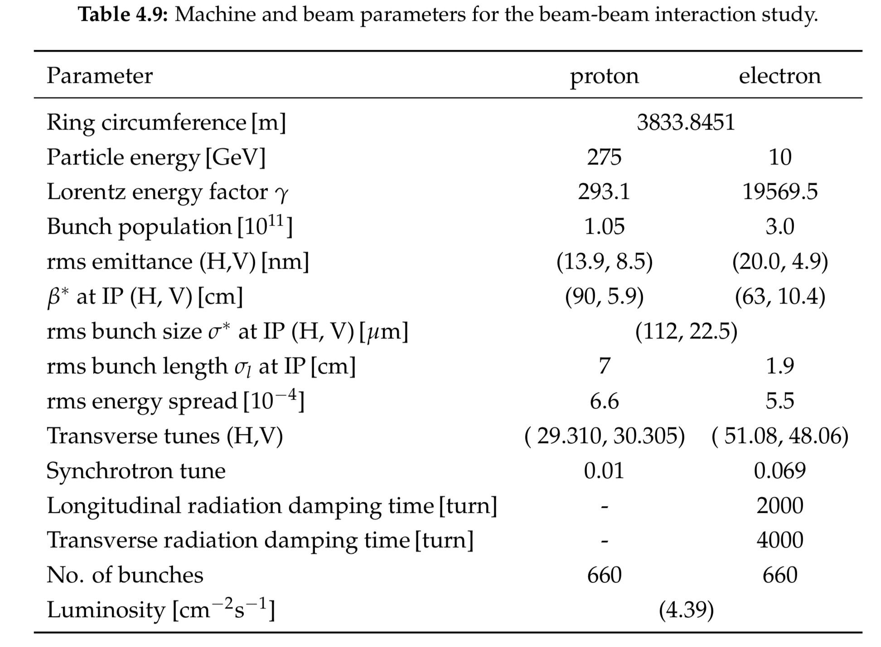
Beam-beam Related Machine & Beam Parameters ( v5.1 )

Slide 5
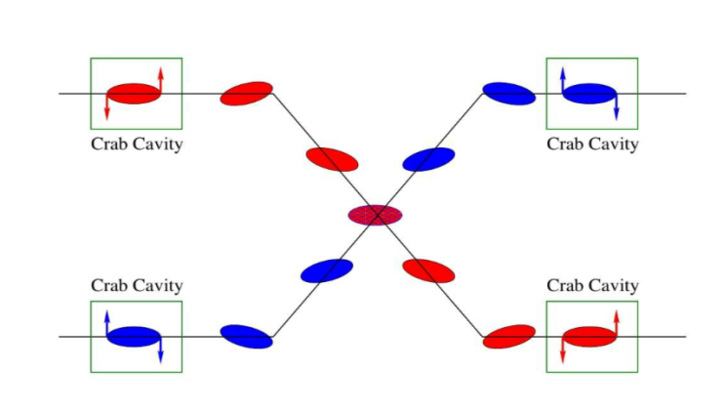
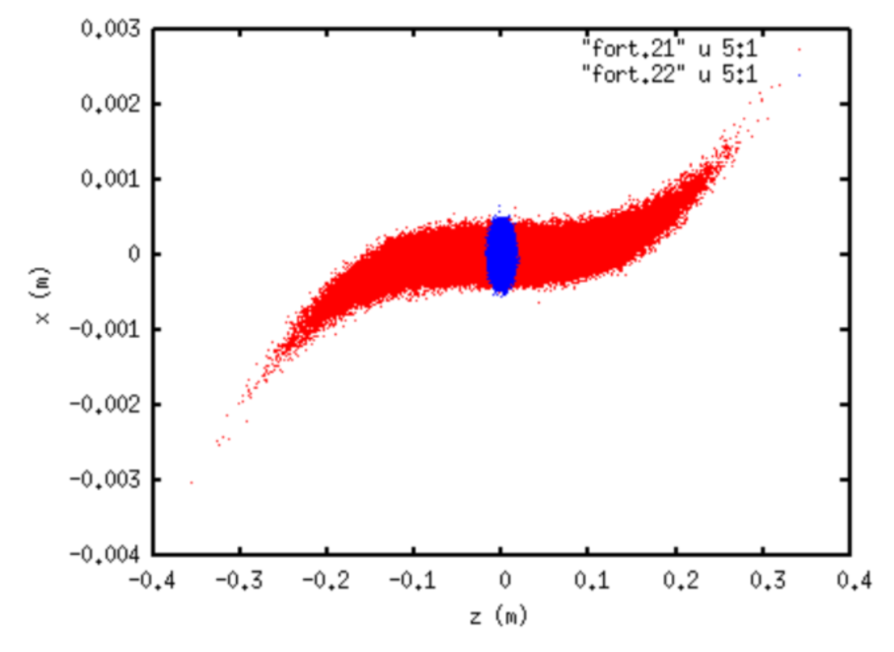
Crabbed Collision
To compensate geometric luminosity loss, crab cavities are used to tilt both beams in the x-z plane to recover head-on collision at IP.
However, due to finite wave length of crab cavities, protons in the bunch head and tail are not perfectly crabbed. Beam-beam interaction may generate synchro-betatron resonance and head-tail instability.
head-on frame
local crabbing scheme

Slide 6
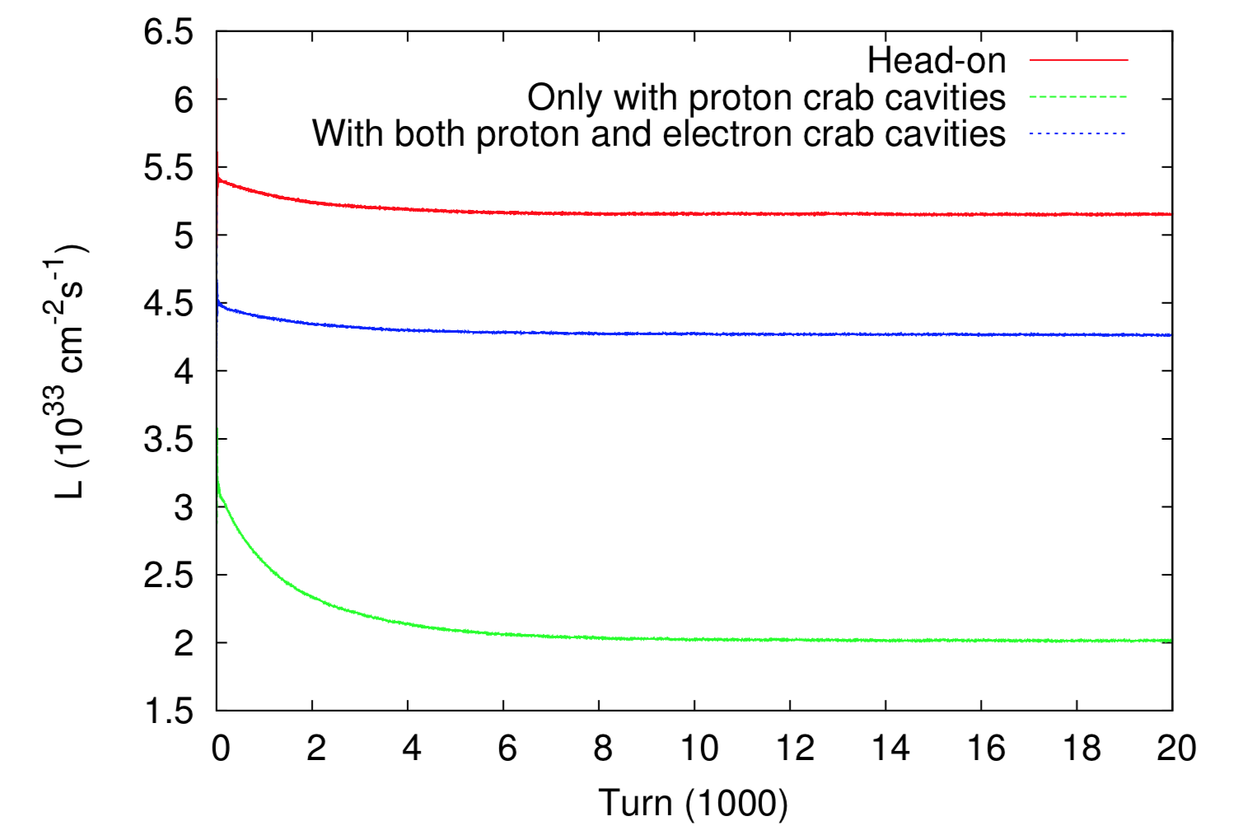
Luminosity w/o Crab cavities
For current eRHIC design, crab cavities are needed for both proton and electron rings to obtain a high luminosity.
Following plot shows luminosities w/o crab cavities. Here we assumed 338MHz for both proton and electron beams.
With C.C. in both rings, luminosity is 83% of that with head-on collision.
Only C.C. in proton ring, luminosity is 47% of that with C.C. in both rings.

Slide 7
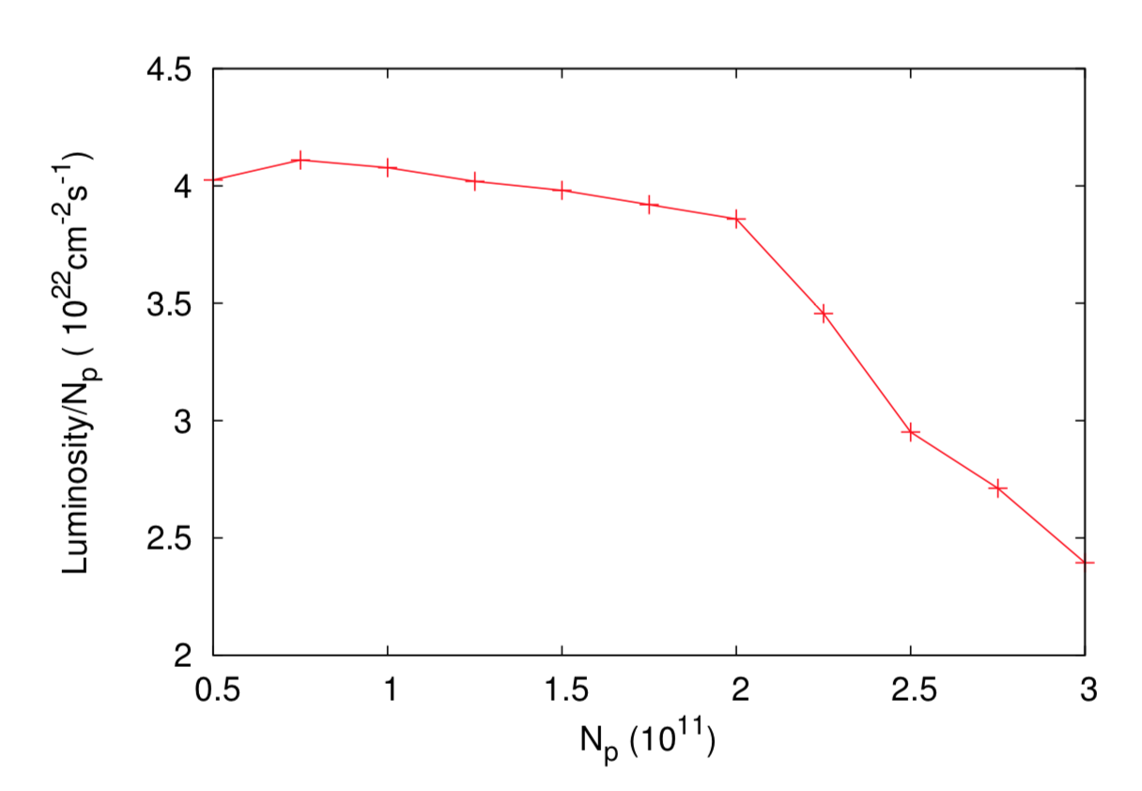
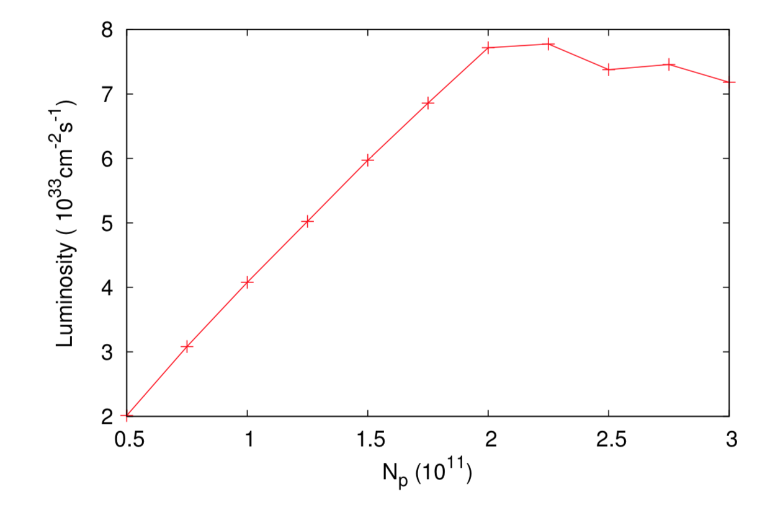
Beam-beam Limit
When the beam-beam limit is reached, due to the coherent motion and/or emittance blowup, the luminosity will not linearly increase with the bunch intensity.
For current eRHIC design, based on strong-strong simulation, the design beam-beam parameter is at about half the beam-beam limit.
Luminosity vs N_{p}
Luminosity/Np vs N_{p}

Slide 8
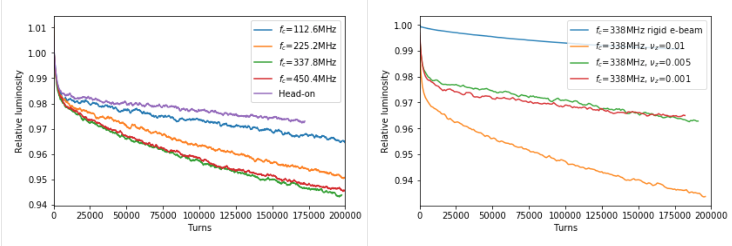
Parameter Dependence of Luminosity Degradation with Crabbed Collison
998
With self-consistent strong-strong simulation, we found that the luminosity degradation rate depends on proton crab cavity frequency, proton synchrotron tune, proton bunch length, and so on.
Following plots show the luminosity dependence on the crab cavity frequency (Left) and the synchrotron tune of the proton ring (Right).
(See Y. Hao’s talk for details)

Slide 9
Modified Weak-strong BB Simulation
To understand the sources of emittance growth and luminosity degradation and to determine their realistic growth/degradation rates, we carried out a modified weak-strong simulation.
Modified weak-strong will answer that incoherent or coherent motion or both cause the emittance growth.
The procedure as following:
First perform strong-strong simulation to extract ‘equilibrium’ positions and beam sizes of the electron bunch.
Secondly perform a weak-strong simulation with above electron bunch information to calculate proton emittance growth.

Slide 10
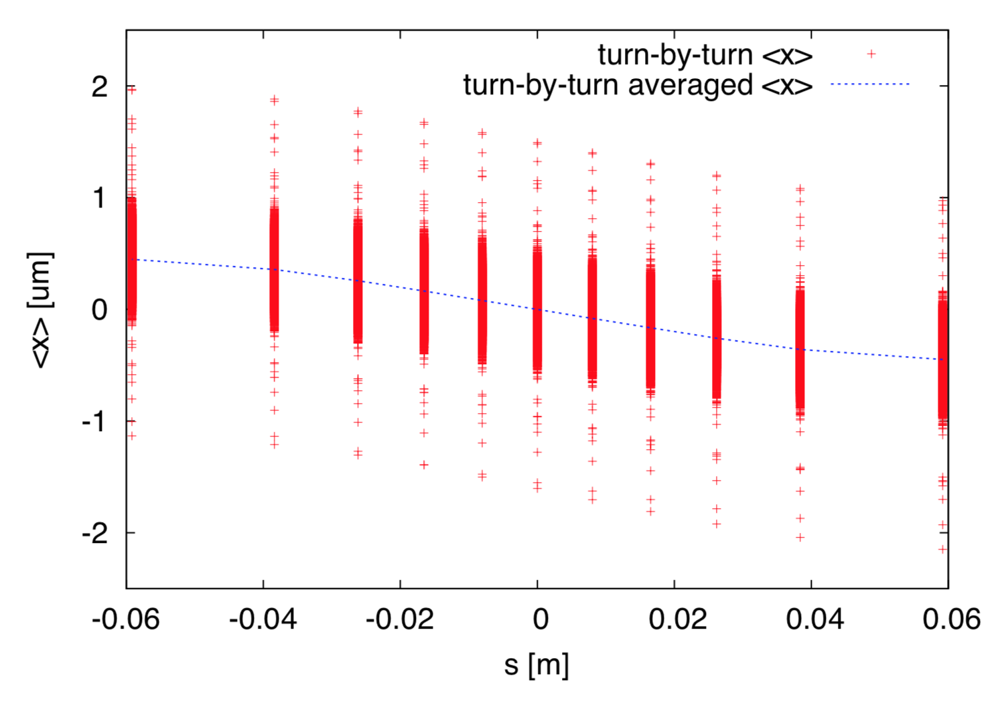
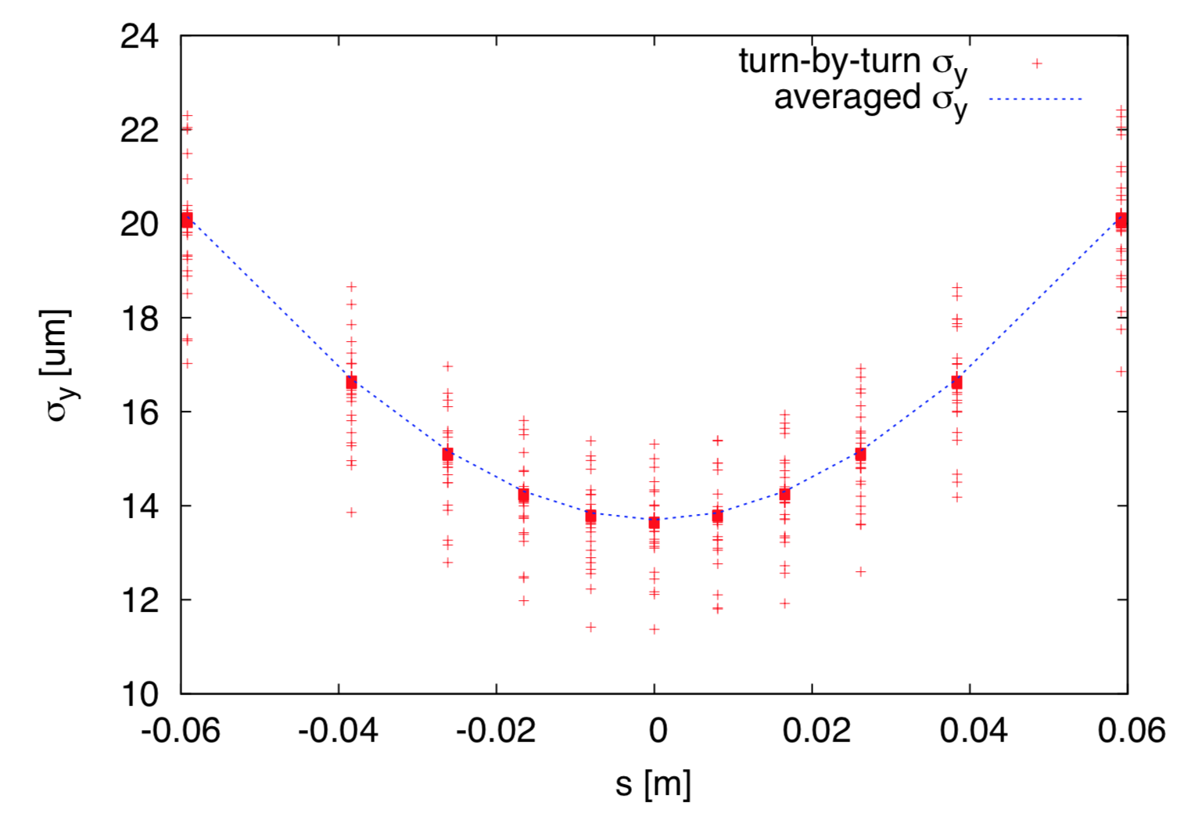
This work is on-going. Here we show some preliminary results.
Electron bunch information from the strong-strong beam-beam simulation
Left: electron bunch centroid <x>. Right: electron vertical bunch size.
The horizontal axis is s coordinate with respect to IP.

Slide 11
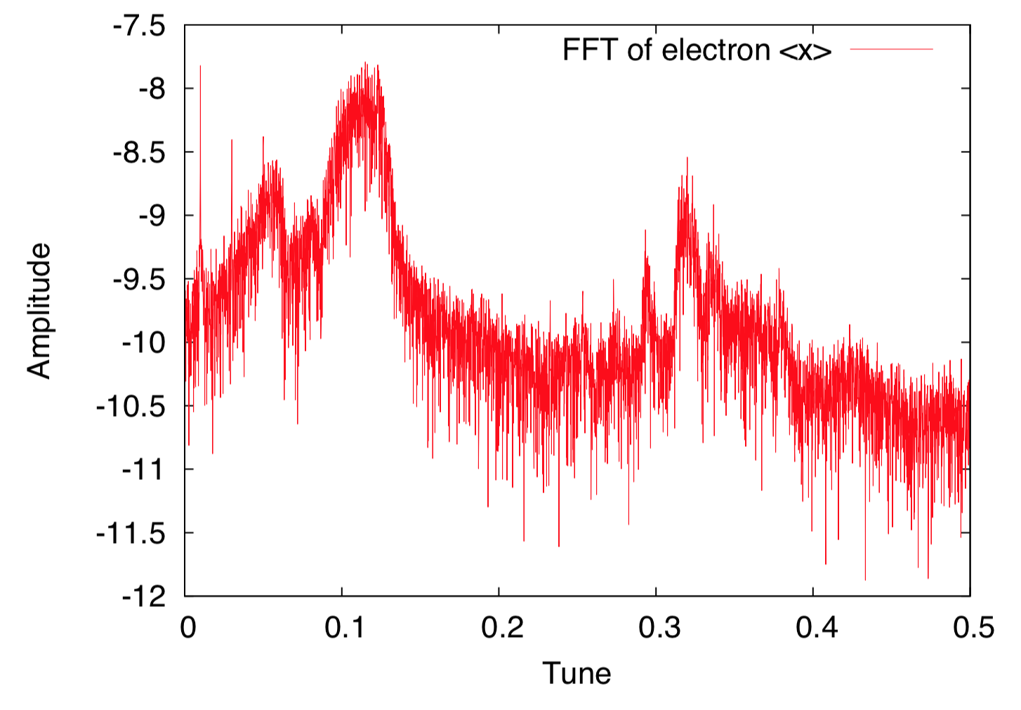
Spectrum of the horizontal centroid of the electron bunch. Multiples of proton synchrotron tunes are visible. The proton synchrotron tune is 0.01.

Slide 12
Simulation Tool Development & Tests
Beam-beam interaction was identified as one of the high priority R&D items to reduce the overall design risk in the 2016 NP Community EIC Accelerator R&D Panel Report.
In our FOA Lab-1848 proposal, 4 beam-beam related R&D items are selected for further studies:
Beam dynamics study and numerical simulation of crabbed collision with crab cavities ( for both eRHIC and JLEIC )
Quantitative understanding of the damping decrement to the beam-beam performance ( for both eRHIC and JLEIC )
Impacts on protons with electron bunch swap-out in eRHIC ring-ring design, ( for eRHIC only )
Impacts on beam dynamics with gear-changing beam-beam interaction in JLEIC design (for JLEIC only).
FOA 18 beam-beam proposal involves expertise from BNL, Jlab, LBNL, and MSU, and will last two years.

Slide 13
Dynamics study and numerical simulation of crabbing collision with crab cavities
For eRHIC strong-strong beam-beam simulations, we used following 2 codes: BeamBeam3D by J. Qiang (LBNL), BBSS by K. Ohmi (KEK) .
In both codes particle-in-cell (PIC) method with FFT is used to solve 2-d Poisson equation to obtain the beam-beam force.
Besides a deeper understanding of the involved physics, we have to greatly reduce the numeric noise in the strong-strong beam-beam simulation.
There are other methods for space charge force calculation: 1) Spectral Method, 2) Fast Multipole Method (FMM), 3) Adaptive Mess Size, and so on.
13

Slide 14
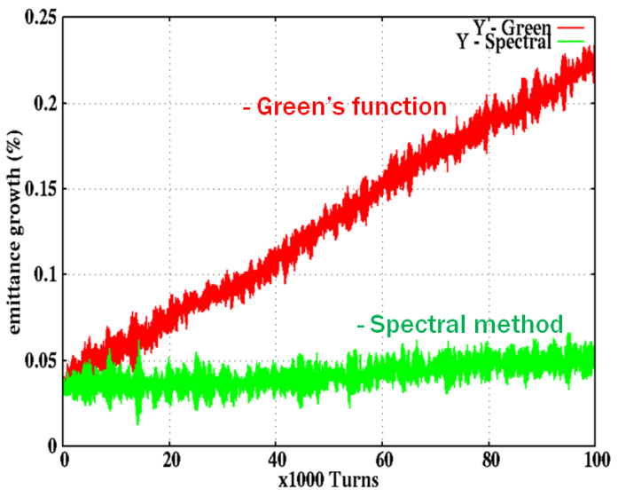
In our FOA 18 proposal, we planned to implement spectral method to solve the Poisson equation. In this method, the particle charge distribution will be approximated with a finite number of global basis functions.
( J. Qiang )
An example of 2 slice interaction is shown above with LHC parameter.
In this case, the actual beam-beam caused emittance growth is negligible.
14

Slide 15
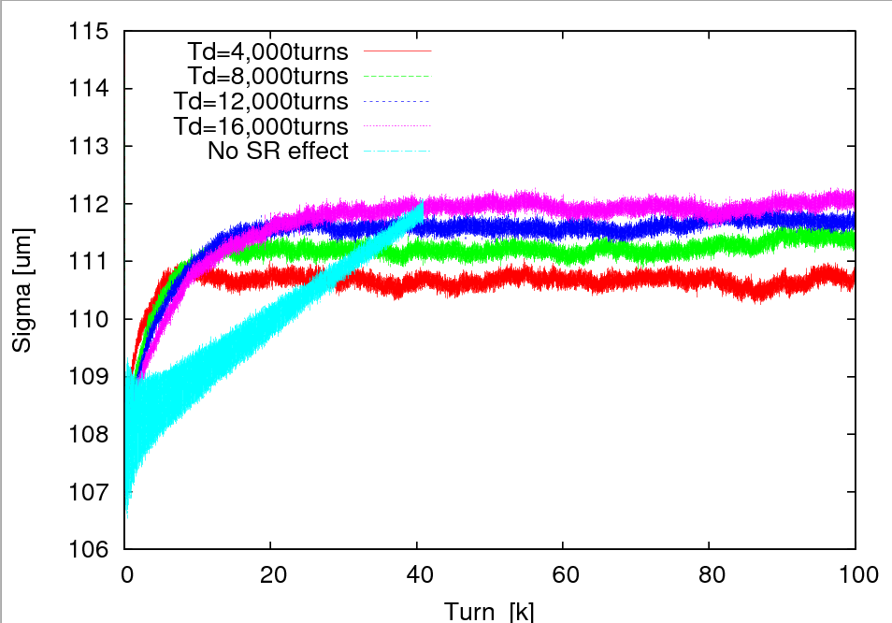
Quantitative understanding of the damping decrement to the beam-beam performance
To reach the beam-beam parameter 0.1 for the electron ring, based on KEKB experience, it requires radiation damping decrement 1/4000, or the radiation damping time 4000 turns in transverse plane.
Strong-strong simulations with different codes show that there are little difference in the equilibrium beam sizes of electron beam and the final luminosity even when the damping time increased by a factor of 4 !
15

Slide 16
As we know, both beam-beam interaction and the lattice nonlinearity generate particle amplitude diffusion. The equilibrium emittances and stability of particles are determined by both the lattice nonlinearity and beam-beam interaction.
In most of the existing strong-strong codes, for computing speed consideration, the lattice nonlinearity is not included.
In our FOA 18 proposal, we planned to :
replace the linear ring matrix with a higher order symplectic map,
include the IR multipole field errors,
use exact RF sinuous waves in longitudinal plane.

Slide 17
Impacts on protons with electron bunch replacement in eRHIC design
At physics store, to maintain a high electron polarization, each electron bunch will be replaced in 5 minutes. After an electron bunch is kicked out, 5 smaller electron bunches will be injected into the same bucket from the RCS injector.
During the electron bunch replacement, the beam-beam parameter of the corresponding proton bunch is altered, which may cause the proton bunch emittance growth.
Analytically, the emittance growth due to beam-beam introduced lattice mis-match can be calculated according to:
17
( by M. Blaskiewicz)

Slide 18
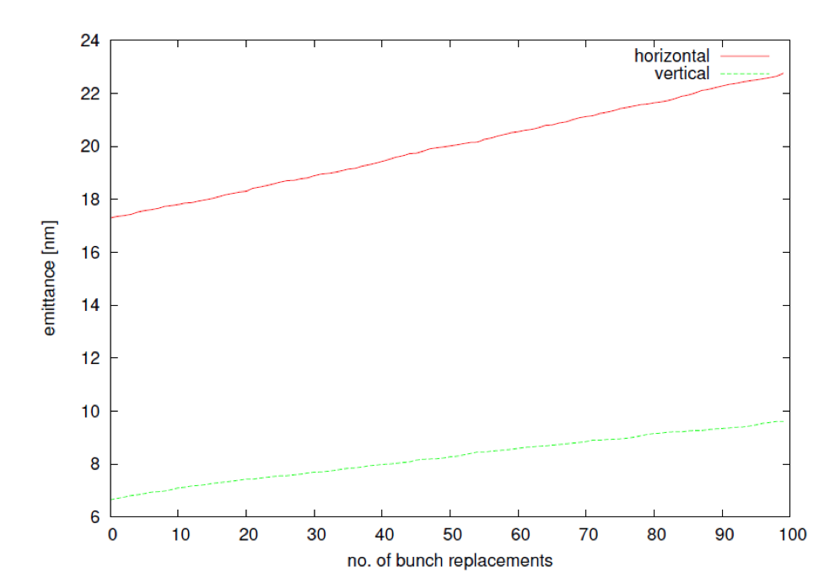
Weak-strong Beam-beam simulation was performed to evaluate the proton bunch emittance growth during the electron bunch replacement. In the simulation, proton bunch represented by macro-particles, electron bunches by rigid distribution. The simulated proton emittances are shown below.
To fully study the effects, in our FOA 18 proposal, we planned to carry out a 6-d strong-strong beam-beam simulation. For this purpose, we plan to re-structure BeamBeam3D for this task.
BTW, beam experiment using electron lenses was performed in RHIC to study this effect and for simulation code benchmarking.
( C. Montag )
W-S simulated emittance evolution
18

Slide 19
Summary
We repeated all the beam-beam simulations for the eRHIC pre-CDR with v5.1 machine and beam parameters.
We carried new simulations to understand and to calibrate the emittance growth and luminosity degradation observed in the strong-strong beam-beam simulations.
In the next 2 years, we will address 4 simulation challenges for beam-beam interaction to reduce the overall EIC design risk.

Slide 20
Acknowledgements
Thanks to all of you:
BNL: G. Bassi, M. Blaskiewicz, W. Fischer,
C. Montag, V. Pytitsyn, V. Smalyuk, F. Willeke
LBNL: J. Qiang
JLAB: Y. Roblin, H. Zhang
MSU: Y. Hao

