Slide 1
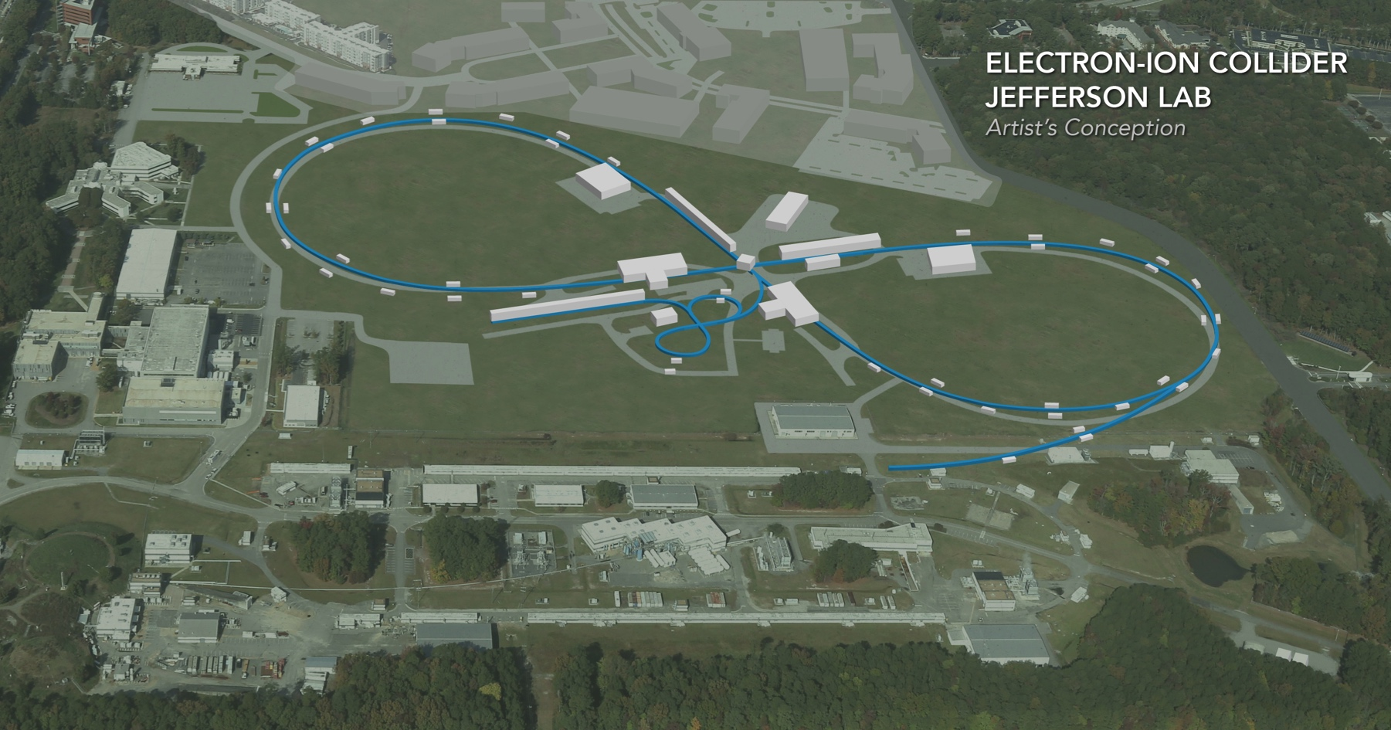
IR Magnet Layout/Design - JLEIC
Tim Michalski
Mark Wiseman, C. Hutton, F. Lin, V. Morozov, Renuka Rajput-Ghoshal: Jefferson Lab
Michael Sullivan: SLAC
EIC Accelerator Collaboration Meeting
October 29 - November 1, 2018

Slide 2
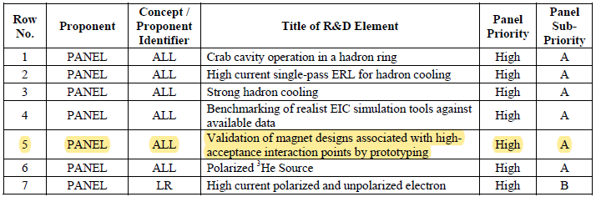
Importance Defined by the Jones Report
The IR magnet design and construction challenge has been recognized by the Report of the Community Review of EIC Accelerator R&D for the Office of Nuclear Physics

Slide 3
Interaction Region (IR) Magnet Design Verification (FY’17 Base R&D)
Description
  There are 12 Final Focus Quadrupole (FFQ) and 2 Spectrometer Dipole (SD) high field, large aperture superconducting magnets located within the JLEIC interaction region.
  Baseline parameters have been defined.
  Modeling, simulation, and 3D layouts are required to verify designs which satisfy sound magnet design, beam transport and beam physics requirements, and detector background requirements.
Goals
  Each of the IR magnets is designed and analyzed in 3D TOSCA to verify the design is feasible and required performance parameters are attainable.
  3D models representing the magnet designs are added to the JLEIC layout for verifying space allocation, mechanical support, and cryostat placement.
  Beam studies and detector background simulations of the resultant designs will define any required changes.
  Iterations on designs will be performed such that all involved groups agree on an acceptable design solution.
Deliverables
  3D TOSCA models for all magnet designs shall be generated to demonstrate field strength, magnet size, impact to the adjacent beam, magnet current, etc.
  3D CAD models for all magnet designs shall be generated to demonstrate space allocation, structural support, and IR vacuum space for background simulations.
  Iterations of specific magnet designs will be performed as required.

Slide 4
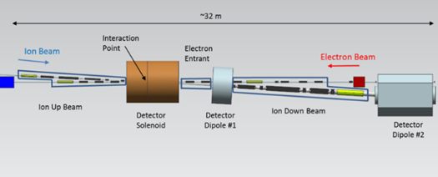
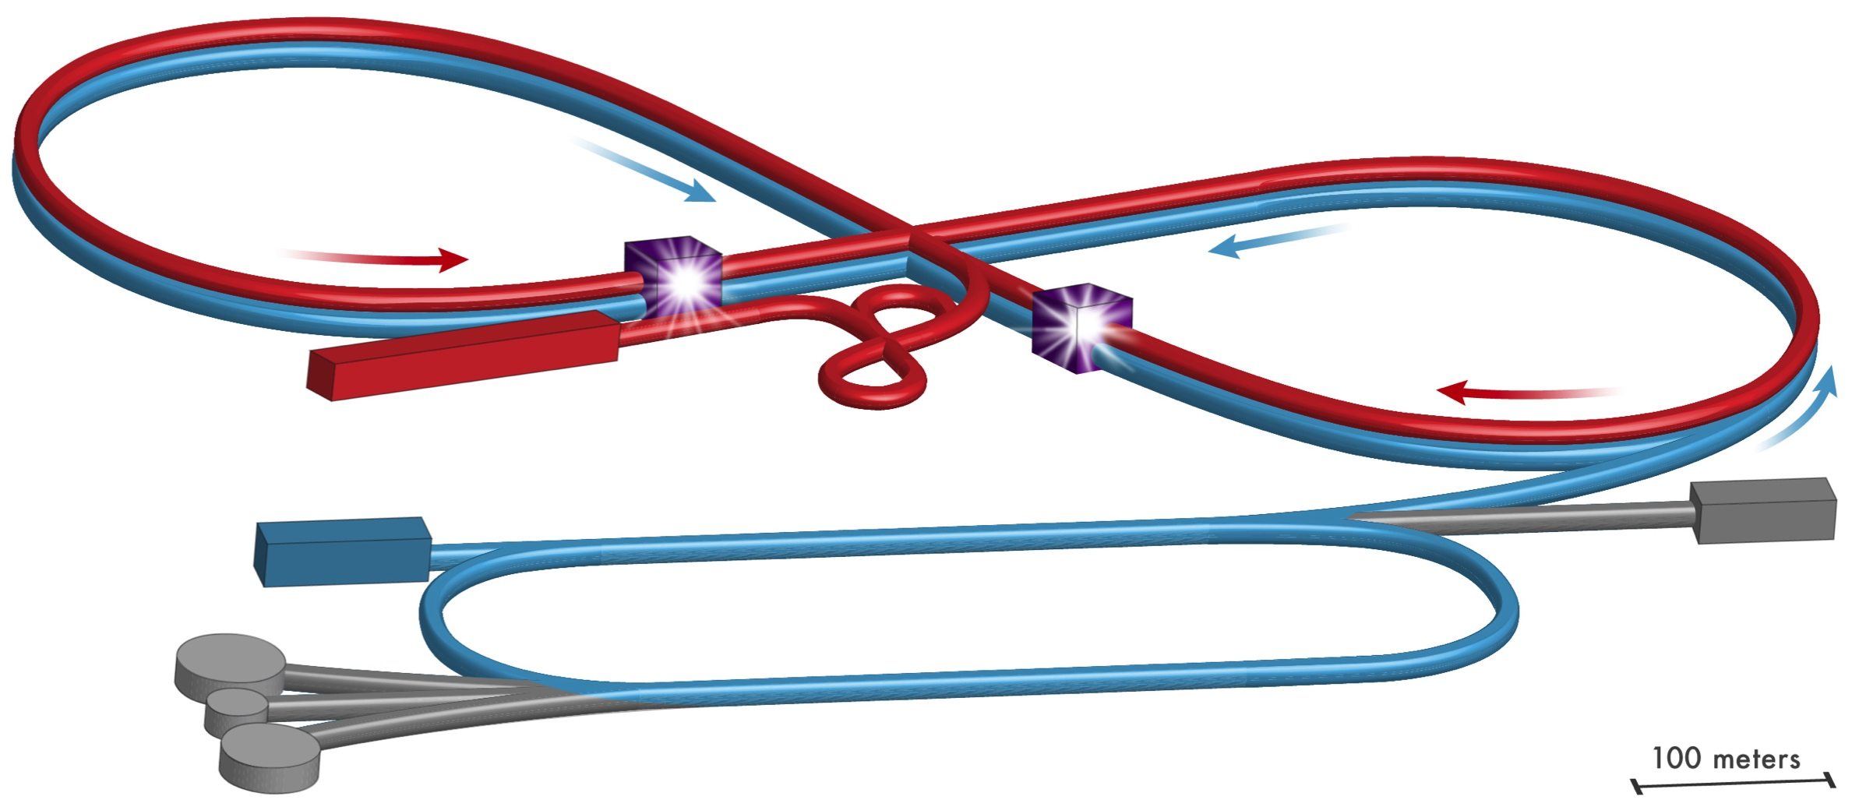
What part of JLEIC are we looking at?

Slide 5
Outline
Interaction Region Overview Layout
Magnet Design
Magnet Optimization
Magnet-Magnet Interactions
Beam Transport Area and Cryostat Designs
Summary and Outlook

Slide 6
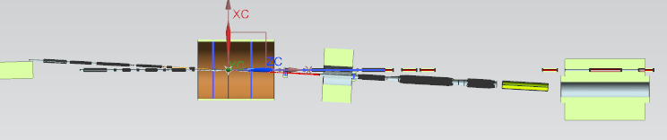
Interaction Region (IR) Overview Layout
The design thus far considered six distinct areas of magnets
  Detector Solenoid ( 4 m)
  SB1 dipole (1.5 m)
  SB2 dipole (~4.6 m)
  Ion entrant side cryostat (~8.7 m)
  Electron entrant cryostat, between the Detector Solenoid and SB1 (~2.6 m)
  Ion down beam cryostat between the two spectrometer dipoles (~10.4 m)
This talk will focus on the three beam transport sections, 4-6
~32 m
Ion Up Beam
Electron Entrant
Ion Down Beam
i
e
3
4
5
1
2
6

Slide 7
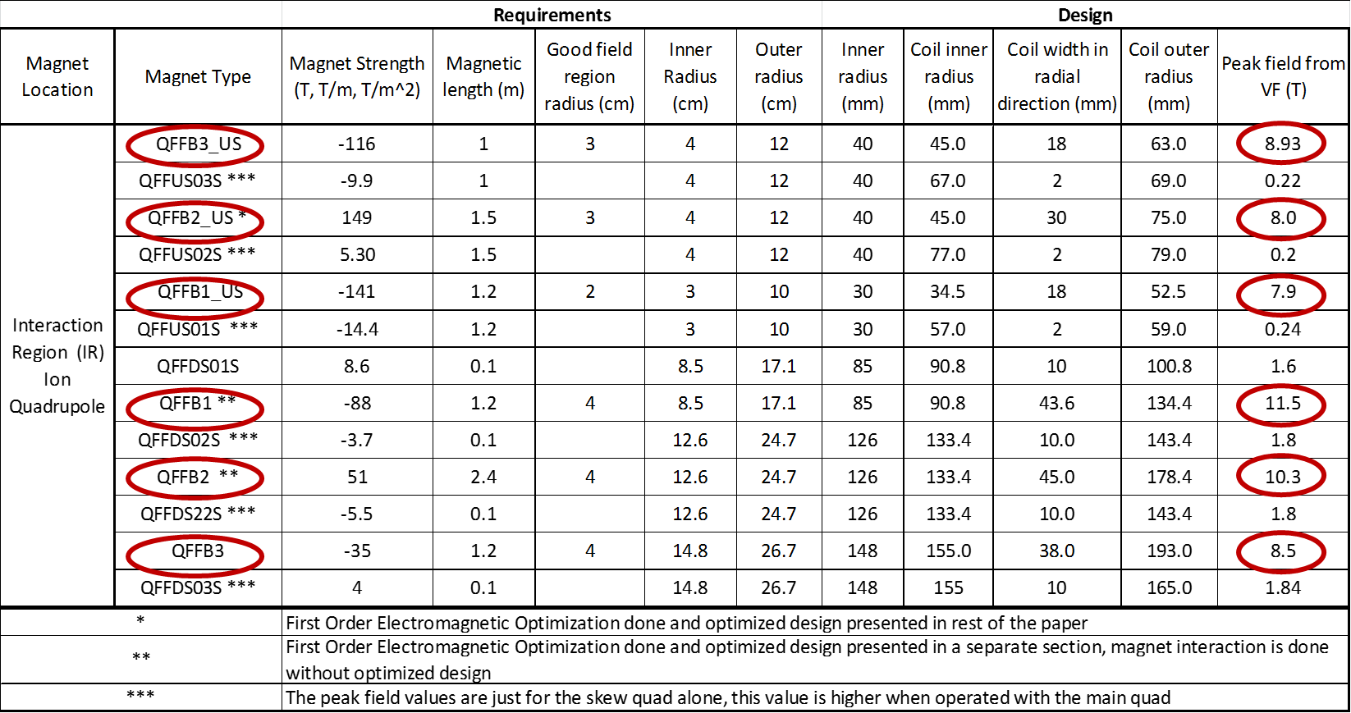
Magnet Design – Ion Magnet Parameters
All 6 QFFB magnets require Nb3Sn due to peak field
3 downstream magnets are most challenging due to aperture size
Each FFQ has a corresponding skew quadrupole. FFQ fields are too high to allow nesting in the three down beam quadrupoles.

Slide 8
Magnet Design – Electron Magnet Parameters
Each of the quadrupoles will need a corresponding skew quadrupole.

Slide 9
Magnet Design
All of the magnets for both the ion and electron beam lines are based on cold bore designs.
This is primarily to lower the field requirements on the ion beam quadrupoles.
The magnets in the electron beam line could be either warm or cold bore.
The cold bore designs in the electron line do reduce the radial space needed which is a plus as you get closer to the IP.
Expectation is to use existing, proven conductor – LARP for Nb3Sn, Standard Rutherford cable for NbTi

Slide 10
Magnet Design – Electron and Ion Upstream Quad
Peak Field in Upstream Ion Quad (QFFB2_US) The conductor is envisaged to be stranded, Nb₃Sn cable with 20-30 strands per cable using 0.7 mm diameter strands. This type of Nb₃Sn conductor is also being used for the LARP magnets.
Peak Field in Electron Quad
The coils will be operated at 4000 A and will use 9.73 mm x 1.2 mm Rutherford cable.

Slide 11
Magnet Design – Ion Downstream Quad
Coil field in QFFB2 Before Optimization
Von-Mises Stress in QFFB2 Before Optimization
First Order Optimization brings the peak coil field down from 10.3 T to 8.8 T.

Slide 12
Magnet Design – Skew Quad, Solenoid, Corrector Magnet
Peak field in Skew quad is 4.6 T(this will change after optimization)
Peak Field in the Solenoid is 6T (this will change after including the shielding)
Peak Field in the Corrector is 3.5 T (this will change after finalizing the specification and conductor)

Slide 13
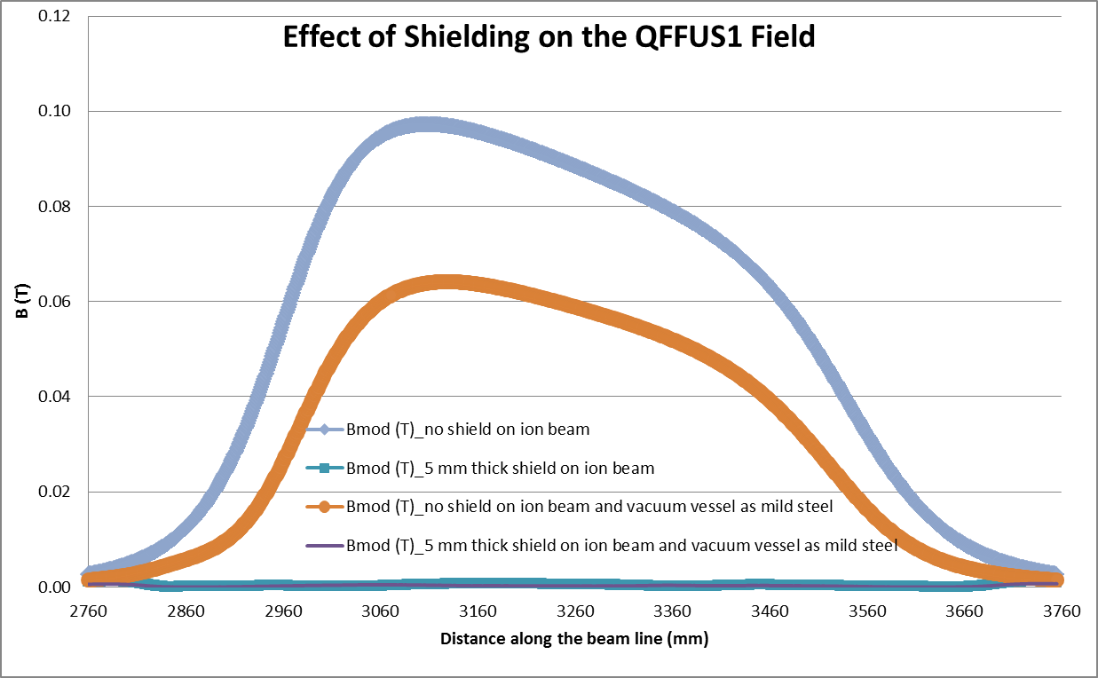
Magnet-Magnet Interaction
In order to study the magnet-magnet interactions, the following combinations were selected for the initial study:
  QFFUS1 with Ion beam line
  QFFB2 with electron beam line
  QFFB1, QFFUS3 and EL SOL_ANTI_US
  QFFDS2 and QFFB1_US
QFFUS1- (i) ion beam tube wrapped with 5 mm mild steel passive shield (ii) the vacuum vessel for the QFFUS1 is assumed to be made of mild steel, and (iii) a combination of the above two options

Slide 14
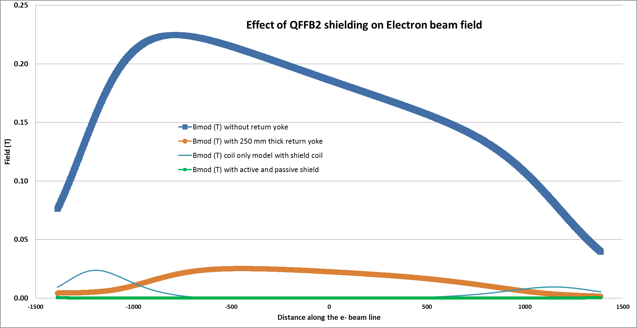
Magnet-Magnet Interaction
In order to study the magnet-magnet interactions, the following combinations were selected for the initial study:
  QFFUS1 with Ion beam line
  QFFB2 with electron beam line
  QFFB1, QFFUS3 and EL SOL_ANTI_US
  QFFDS2 and QFFB1_US
QFFB2- This magnet is simulated with return yoke thicknesses of 200 mm and 250 mm around the magnet, active shield around the magnet, a combination of iron yoke and an active shield coil
Corrector magnet and 2 transport quadrupoles have not been simulated with QFFB2 for now

Slide 15
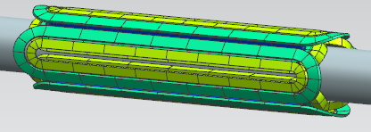
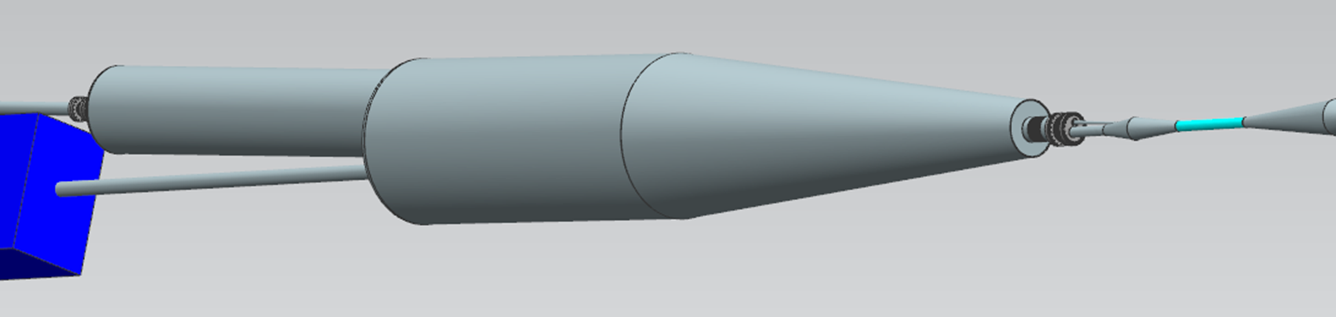
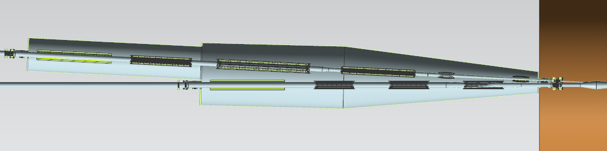
Ion Up Beam Area
‘Z’ spacing of the magnets
  Reserve 10 cm on each magnet end for field optimization, coil clamps, etc.
  Reserve 30 cm for a warm to cold transition and 10 cm for a bellows at the end of the cryostats
Eighteen plus multipole correctors and shielding coils in a single ~8.7 m long cryostat
  Three identical quads in electron line with nested skew quads
  Three quads in ion line with nested skew quads
  1.2 m solenoid in each line (same design)
  Two horizontal/vertical correctors in ion line near IP
Both the cryostat and cold mass will be supported in at least three locations with a minimum of twelve typical support rods on the cold mass.
A thermal shield will be included inside of the vacuum vessel and surround the entire cold mass.
The cryogenic feed and magnet lead can will be positioned on one side of the cryostat away from the detector elements.
Quad with nested skew quad
1st dipole in Compton chicane
AASOLEUS
i
QFFB3_US
QFFB2_US
QFFB1_US
IPUSCORR1
IPUSCORR2
e
EL SOL ANTI_DS
QFFDS3
QFFDS2
QFFDS1
~8.7 m

Slide 16
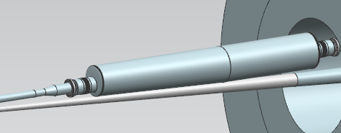
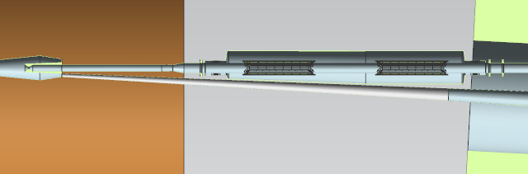
Electron Entrant Area
Four magnets plus shield coils in a ~2.6 m long cryostat
The cryostat will be tapered near the IP to avoid interference with the ion vacuum beam line and to allow for the maximum acceptance angle for the detector elements.
To avoid interference with the ion beam vacuum line, the vacuum vessel and thermal shield will centered eccentrically from the cold mass.
The warm to cold transition will extend into the detector dipole on one end and stop just short of the detector solenoid on the other.
Intercept needed for synchrotron radiation in the electron line
  We can move the synchrotron intercept outside of the warm to cold transition area
  The cold bore heat loads appear to be acceptable
e beam
QFFUS1
QFFUS2
Detector Solenoid
ion beam
~2.6 m
SB1

Slide 17
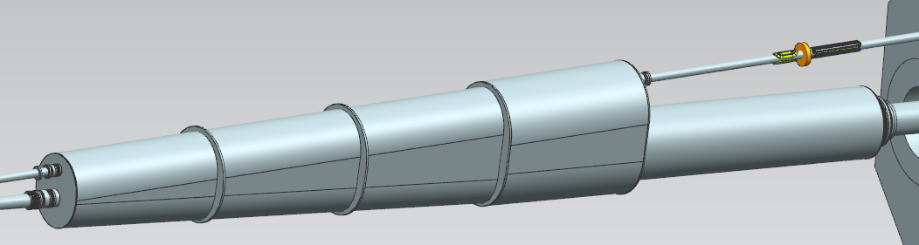
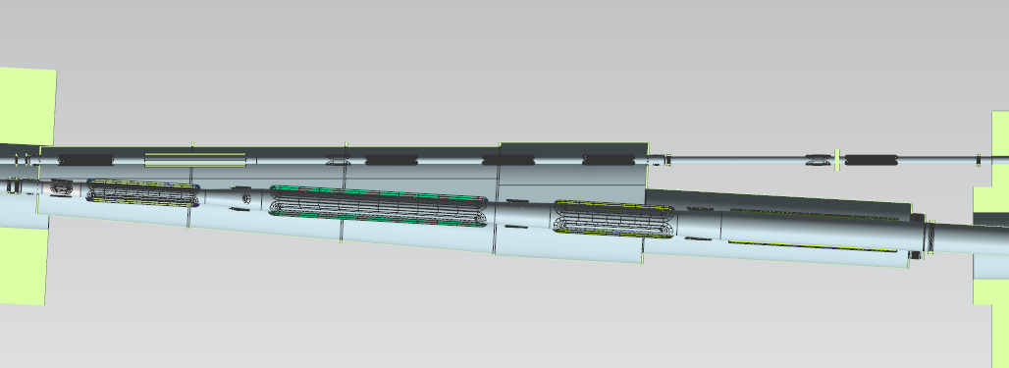
Ion Down Beam Area
Fourteen magnets plus multipole correctors and shield coils in a single ~10.4 m long cryostat
Transport quads are superconducting as warm magnets impinge on the radial space of the ion beamline – same design as the other electron FFQs
Three large bore, high strength quads in ion line (QFFB1, 2, 3)
Large bore solenoid in ion beam line (AASOLEDS)
Four separate skew quads in ion line – (QFFDS01S, 02S, 22S, 03S)
Looking at shielding design and magnet support structure near the QFFB2 magnet
SB1
QFFUS3
EL SOL ANTI_US
Transport Quads
e
Warm Quad Girder
QFFB1
QFFB2
QFFDS01S
QFFB3
AASOLEDS
QFFDS02S
QFFDS22S
QFFDS03S
i
SB2
~10.4 m

Slide 18
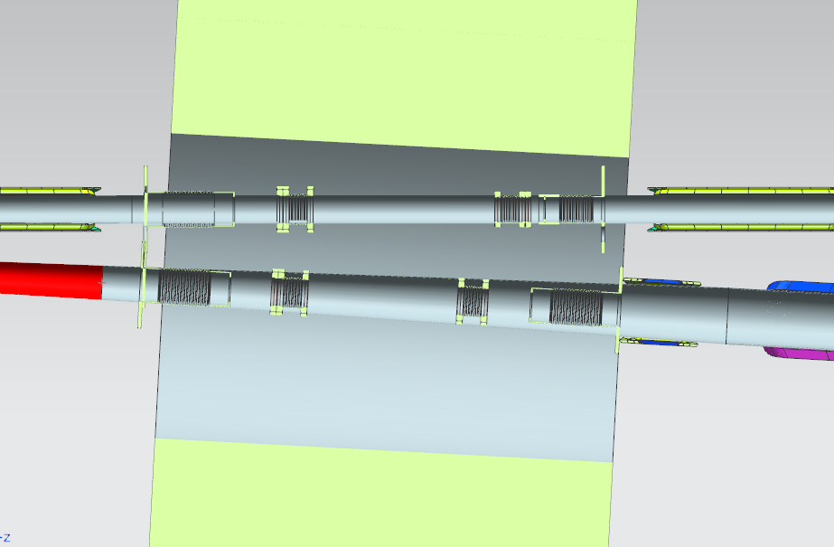
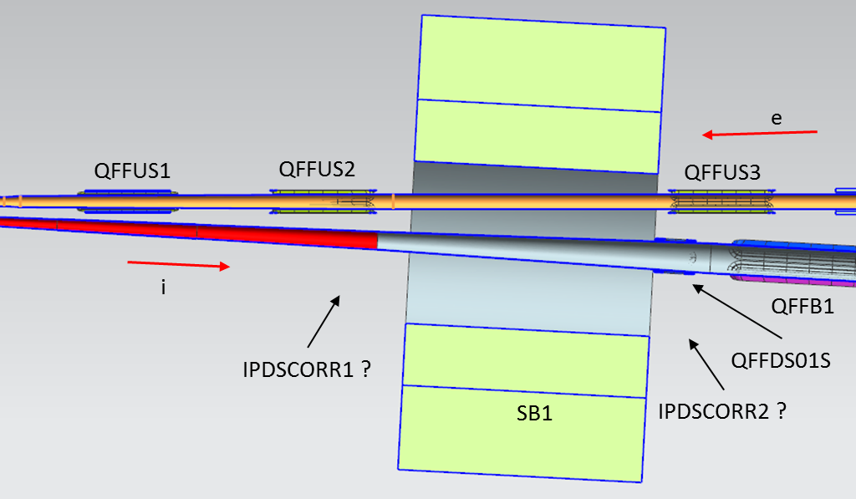
Integration with detector dipole
Designs of beamlines will be closely coupled to the SB1 spectrometer dipole design
Two H/V correctors (IPDSCORR1&2) still to be placed in ion beam line
  Combined dipole/corrector specification and location selection in progress
In the preliminary designs both cryostat beam lines extended into the SB1
  This will probably change as we incorporate the new corrector requirements
Physics detectors are also desired between this magnet bore and the vacuum beam line.
The adjacent electron beam line will also require shielding from this combined function magnet.
Warm to cold transitions and RF bellows inside SB1
1.5m
SB1

Slide 19
Summary and Outlook
A thorough first layout and magnet analyses have been performed on all IR magnets.
Further review of the shielding requirements is underway.
Cryostat definition is also underway in order to outline space available for detectors.
Additional cryostat detail is required to insure magnets can be supported, accommodate cooldown, withstand magnetic loads, and integrate into detector space designs
Continue work on shielded bellows concepts that can be used for beam impedance studies
Possibly add shielded bellows inside the cryostats to ease assembly and alignment.
Work on shielded vacuum pump designs that can be used in the area that would be compatible with the physics detectors.
A separate group is studying the vacuum requirements within the IR needed to limit the impact from background noise on the detectors.
The information presented here is for √s = 65 GeV. Further modifications are required to accommodate √s = 100 GeV. The main alteration will be to double the length of the Ion IR quadrupole magnets.

Slide 20
Thank you for your attention.
Are there any questions?

