Slide 1
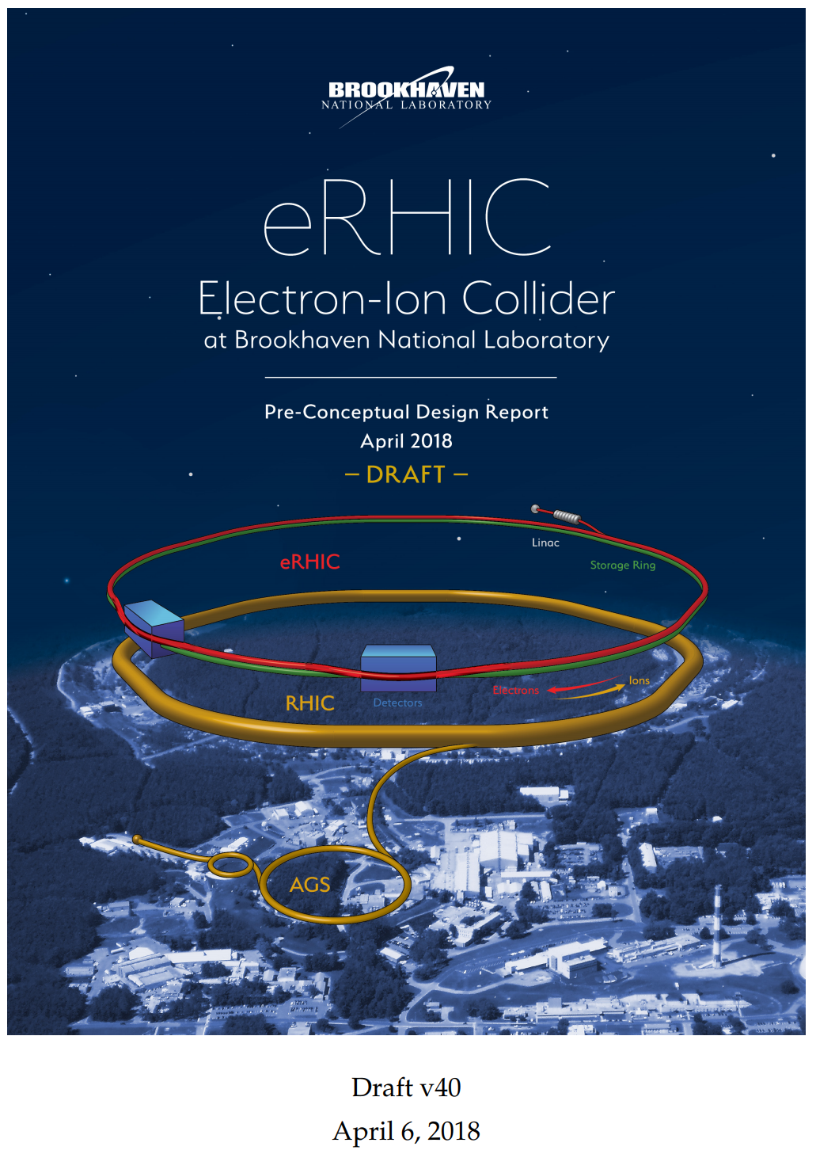
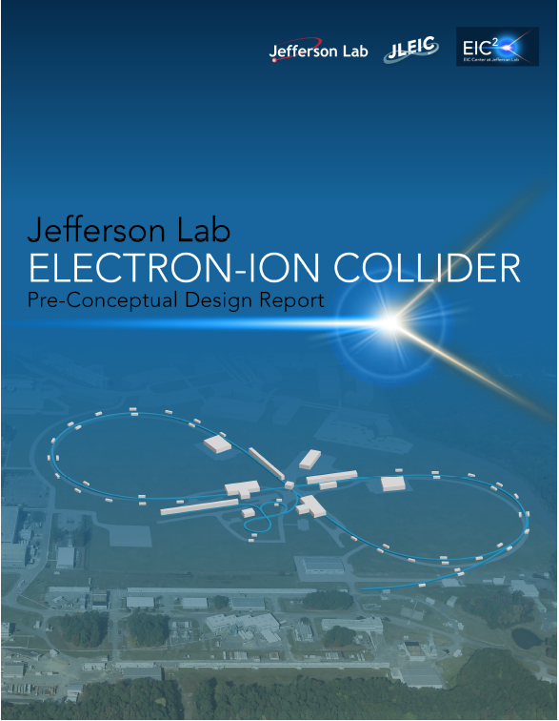
Wrap-Up Discussion: EIC R&D and Future Collaborations
Andrei Seryi and Ferdinand Willeke
With input and ideas from many colleagues
EIC Accelerator Collaboration Meeting
October 29 - November 1, 2018

Slide 2
EIC collaboration
A lot of opportunities to strengthen EIC collaboration
With national labs and universities (as described by Ferdinand)
With worldwide nuclear physics / particle physics / accelerator centers
Many areas of collaboration opportunities
Machine Detector Interface
Beam cooling
SRF technology
SC magnets
…
Opportunities and synergy with ongoing and planned projects
IR / SRF – HE-LHC, Super-B, LCLS-HE, FCC, LHeC, ILC, CEPC, …

Slide 3
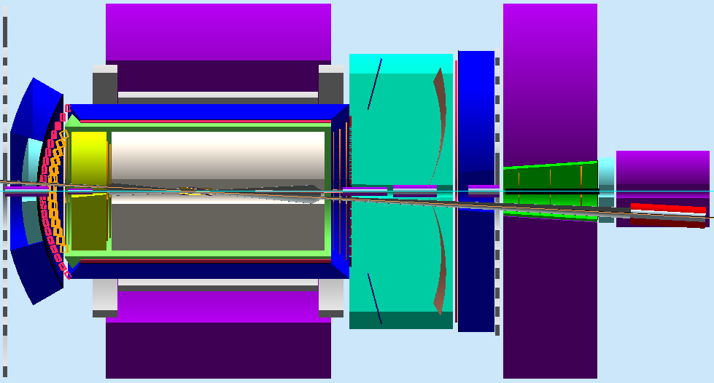
Detector & MDI – collaboration opportunity
IR designed to support ~full-acceptance detection ⬅ unprecedented requirement
Satisfy geometric match (elements) and beam dynamics (chromatic compensation)
Crab crossing: large (25-50 mrad), avoiding parasitic collisions, optimizing detections
IP
spectrometers
electron
IR Layout
Compton polarimetry
forward e detection
forward ion detection
ions
Central Detector
dispersion suppressor/
geometric match
Significant need/ opportunities for collaboration on EIC detector and Machine Detector Interface

Slide 4
MDI & IR – expanding collaboration efforts
Work on common set of physics channels to define detector acceptance
Work on ”Machine – Detector interface requirement document”
Possible title:
Functional Requirements on the Design of the Detectors and the Interaction Region of EIC
This paper aims to separate the functional requirements of an EIC interaction region and machine detector interface from any particular conceptual or technical solution that might have been proposed to date by design teams, and to document the requirements.
EIC User group / MDI team– opportunity to lead the efforts
Opportunity to engage European and world-wide collaborators
European Strategy update for particle physics

Slide 5
Machine – Detector interface requirement document
Functional Requirements on the Design of the Detectors and the Interaction Region of EIC
MDI interface document:
Complementary to pre-CDR (CDR), Detector Handbook
Focus only on requirements, not solutions
Opportunity to be lead by EIC UG MDI team – potential for large international collaboration

Slide 6
European Strategy update for particle physics
Every few years, the European particle physics community reviews the roadmap and priorities of the field, updating the European Strategy for Particle Physics (ESPP)
The update process has been launched by the CERN Council in September 2018 and is scheduled to be completed in May 2020
Submissions (10 pages) are due by 18 December 2018
EIC is planning to make two coordinated submissions:
EIC Physics (coordinated by EIC User Group)
EIC Accelerator Science and Technology (coordinated by F.W. and A.S.)
The goals of submissions is to enhance collaboration on EIC

Slide 7
https://indico.cern.ch/event/729871/

Slide 8
ESPP Open Symposium – May 2019
Extract from agenda of ESPP Open Symposium 2012:
We hope EIC will get on the agenda of Accelerator Science and Technology section in May 2019 symposium
https://indico.cern.ch/event/182232/

Slide 9
“EIC Accelerator Science and Technology” - submission to European Strategy
Sections of the 10-pager draft:
The Physics Motivation of the Electron Ion Collider (1p)
Lessons learned from previous/existing machines & path forward (0.5p)
The JLEIC design of the EIC (~3p)
The eRHIC design of the EIC (~3p)
Common table of JLEIC and eRHIC parameters (0.5p)
Research and Development for the electron ion collider (~1p)
EIC R&D synergies with European projects (~1p)

Slide 10
EIC Accelerator Science and Technology – from the draft:

Slide 11
Backup slides

Slide 12
Examples of projects synergies between EIC and European projects
Examples of ongoing collaboration (incomplete list)
HL-LHC crab cavity system (ODU and JLab) – CERN, UK, …
PERLE ( LHeC ER demo) – cavities, optics – LAL & IPN Orsay, …
Muon Collider (e+e- threshold version) FFAG optics – INFN, …
Next slides - illustrations for some of this work
Thanks for materials for slides:
Alex Bogacz, Jean Delayen, Frank Marhauser, Vasiliy Morozov, Tony Reilly, Bob Rimmer, Todd Satogata, Yuhong Zhang and many other

Slide 13
LHC High Luminosity Upgrade and crab cavities
Design of crabbing system
ODU involvement since 2009
S. De Silva , PhD student,
now scientist
H. Park, PhD student
R. Olave, post-doc
Collaboration with Z. Li (SLAC)
and N. Huque (JLab)

Slide 14
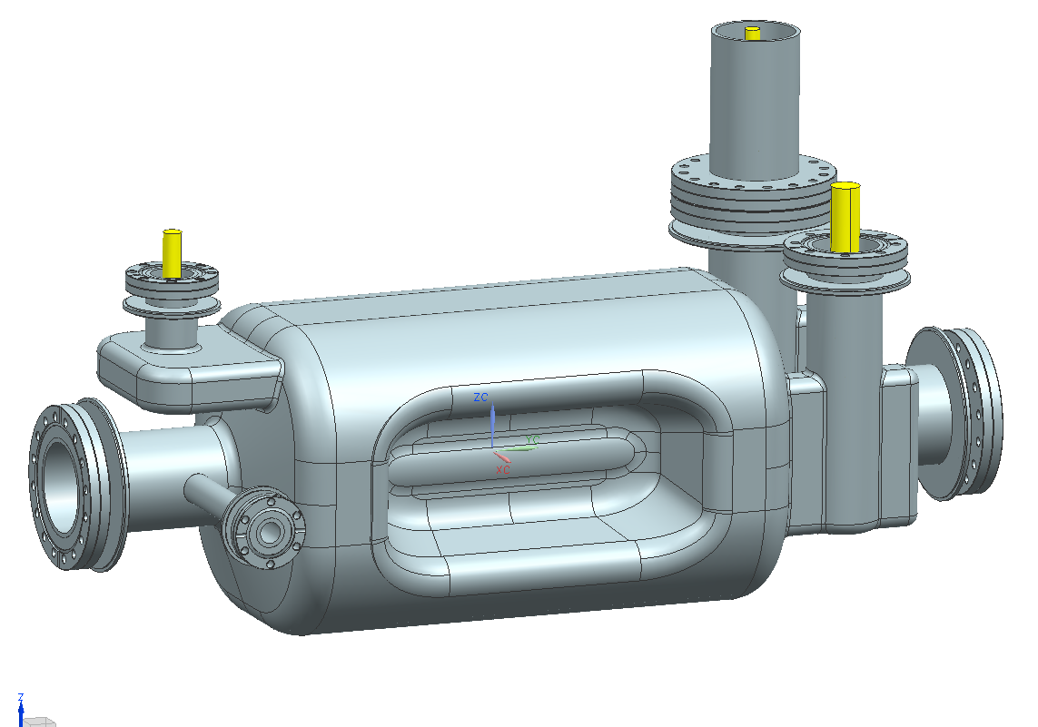
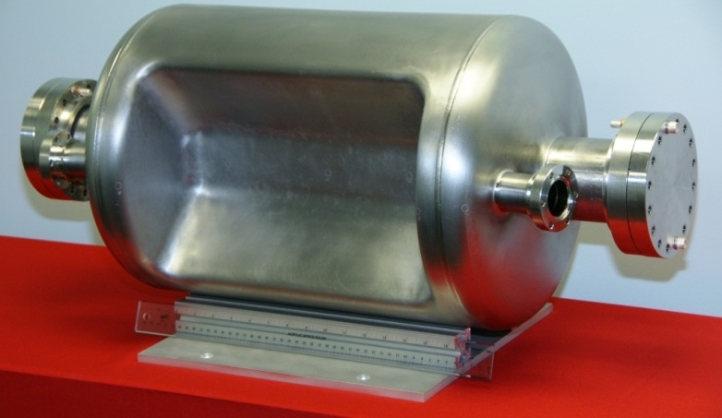
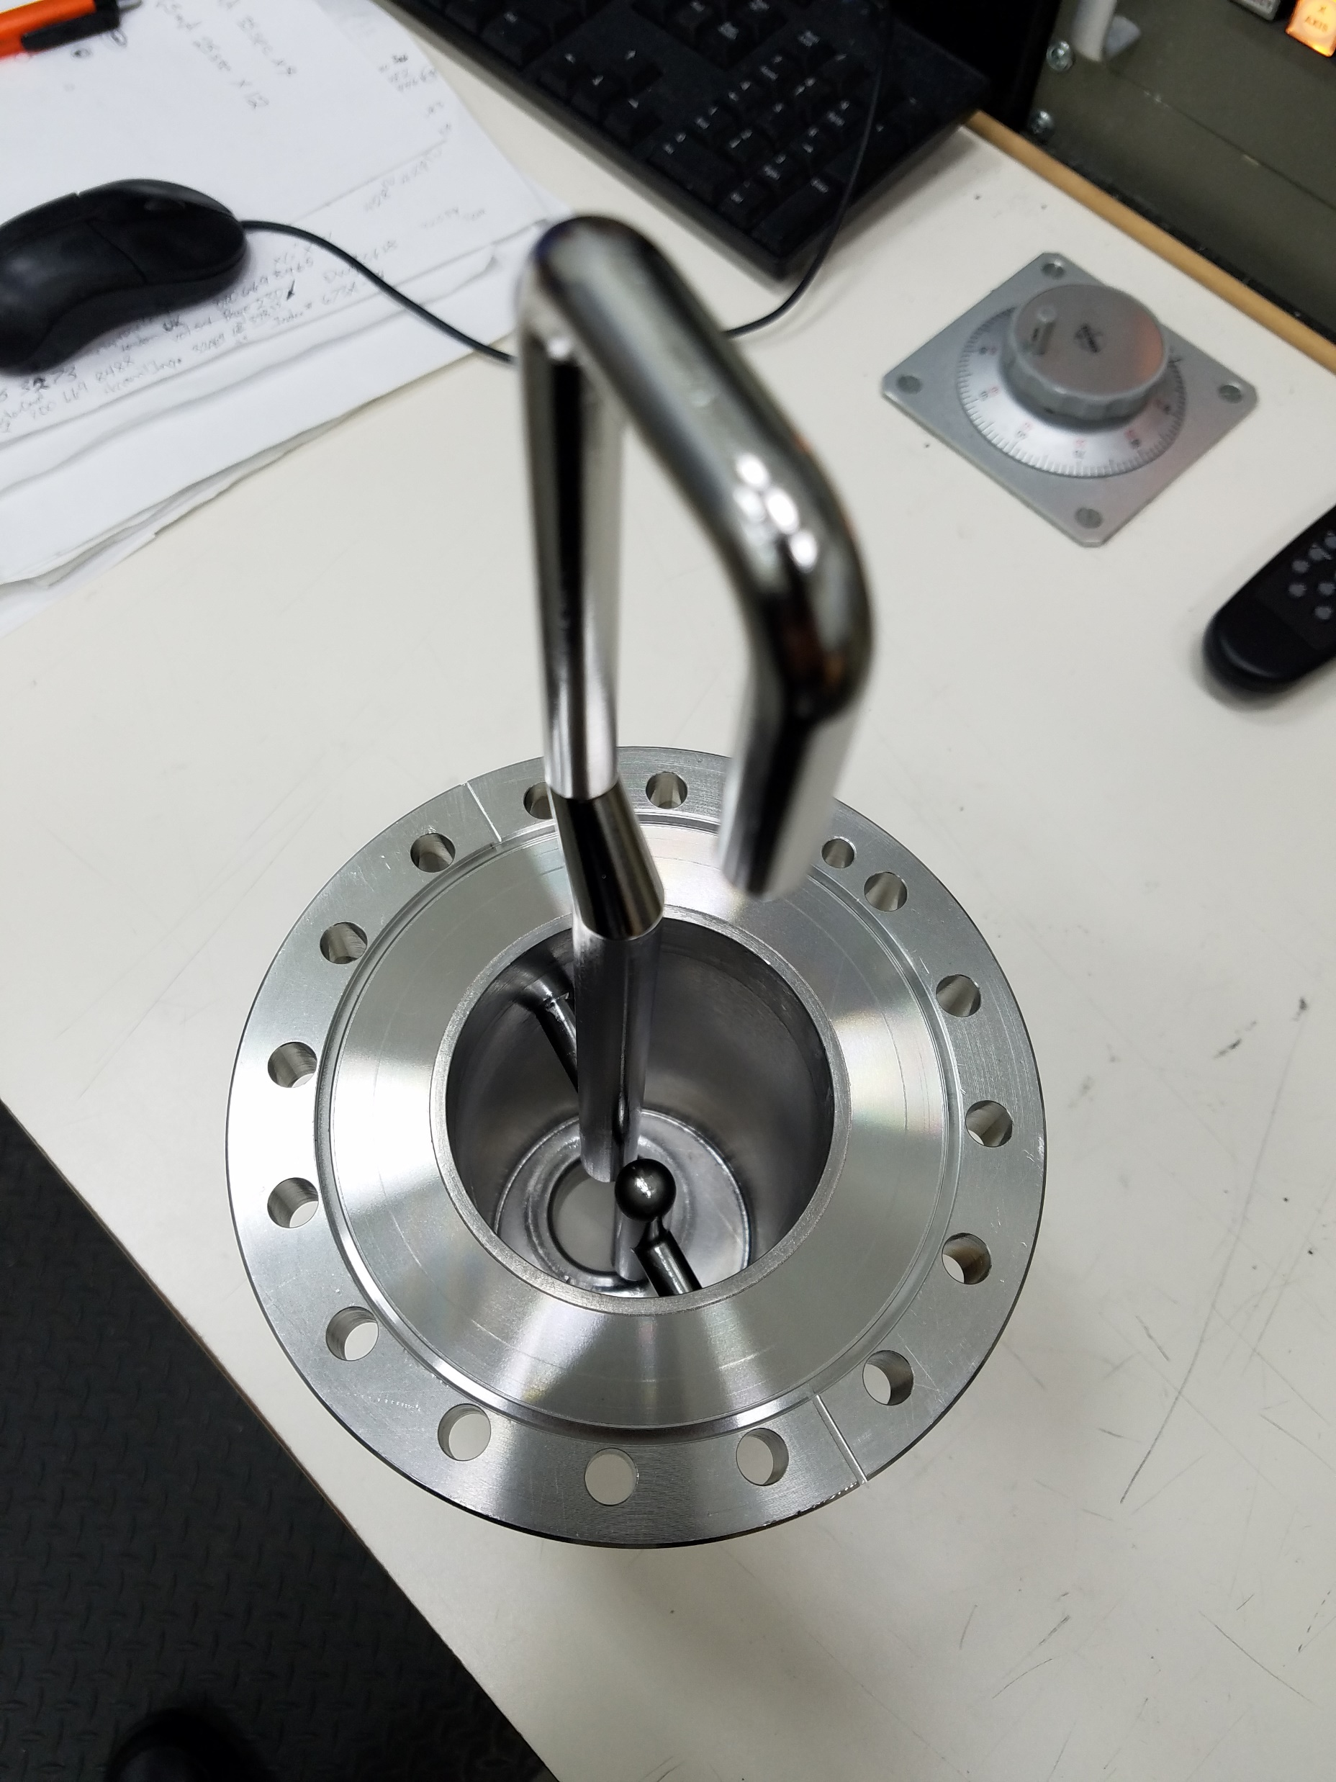
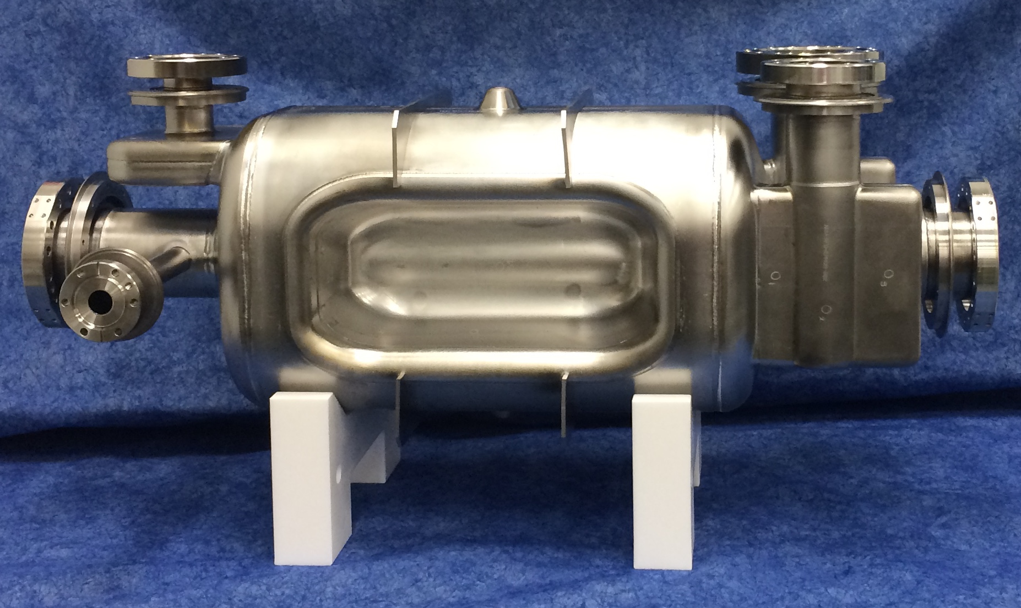
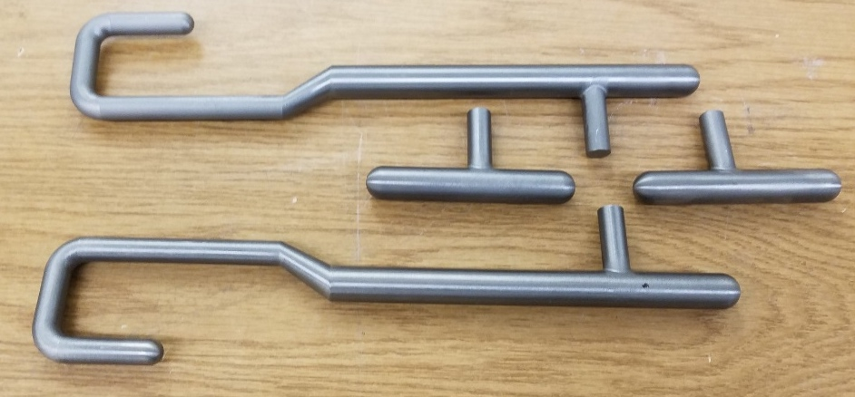
Crabbing System for LHC High Luminosity Upgrade
Proof-of-Principle Cavity
S. De Silva’s ODU PhD work
Prototype Cavity
ODU/SLAC
HOM Couplers
ODU/SLAC/JLab

Slide 15
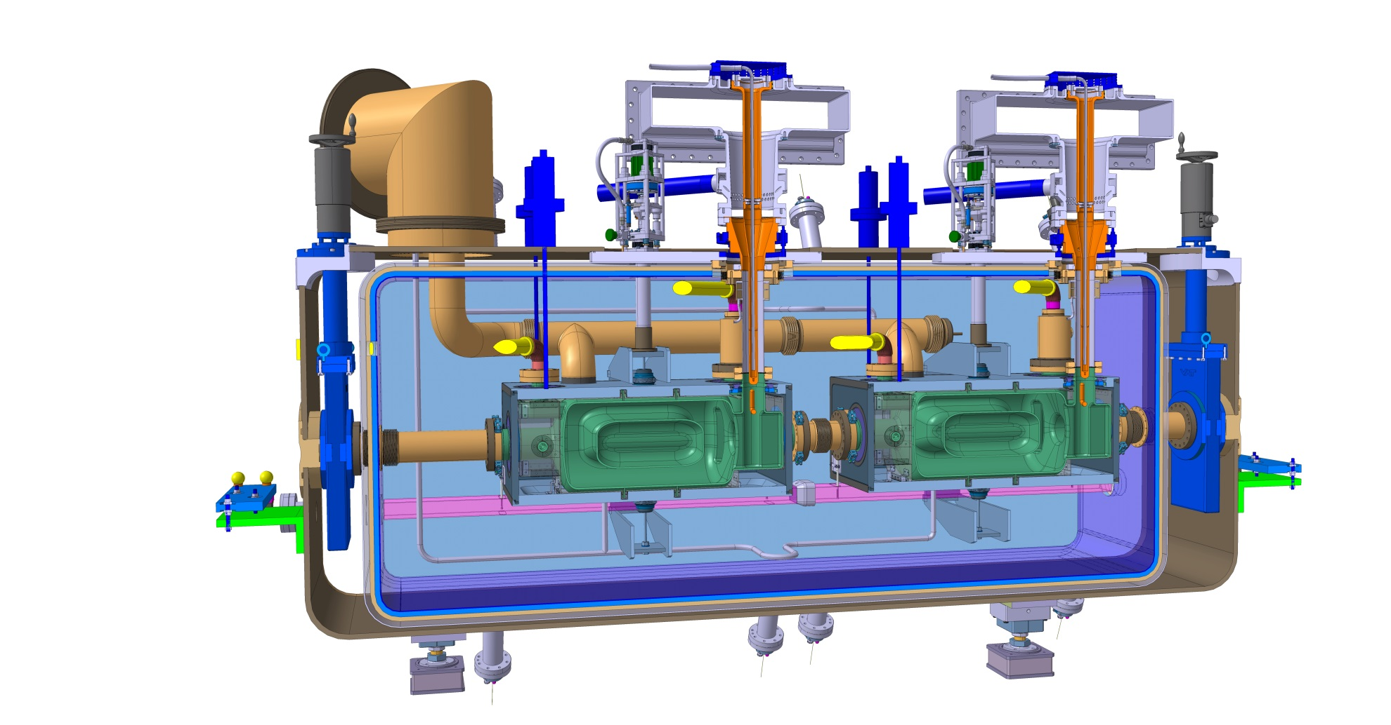
Test on the CERN SPS
Cryo Jumper
Tuning System
HOM Couplers
Fundamental Power Coupler
Crab Cavity Operation in a Hadron Ring
ODU/BNL/Jlab Collaboration
Supported by DOE-NP grant

Slide 16
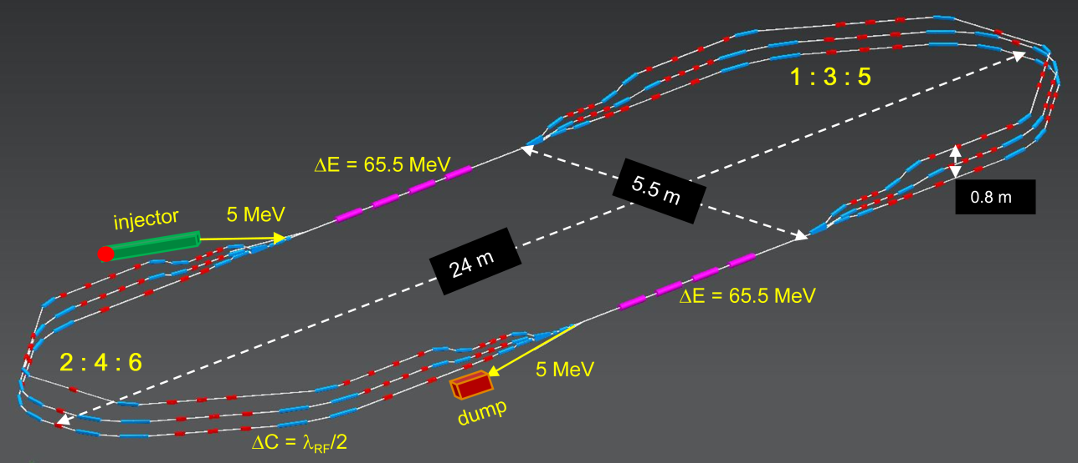
PERLE – ‘Stepping Stone’ for 100 MW ERLs
400 MeV
PERLE with 10 MW beam power is a unique ‘test bed’ for next generation of high power ERLs
Testing multi-pass beam dynamics in energy recovery mode. Demonstrator for the LHeC/FCC_eh ERLs
Probing limits of transporting non-equilibrium beams with high ratio of beam power to installed RF power
Mitigation of longitudinal phase-space distortion due to wakes, including CSR and longitudinal S-C
Preservation of beam quality/stability in presence of collective effects, errors and imperfections
3 passes ‘up’ + 3 passes ‘down’
Multi-lab collaboration expanding on JLab’s core competencies in:
Operation of present state-of-art MW scale ERLs (IR/UV FELs)
Beam dynamics and accelerator design for multi-pass ERLs
Cavity modeling and cryo-module design
Synergy between PERLE and JLEIC Cooler, where similar beam dynamics issues need to be solved

Slide 17
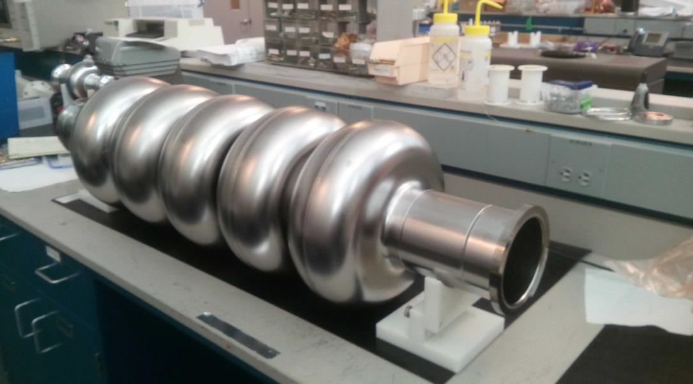
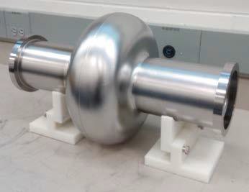
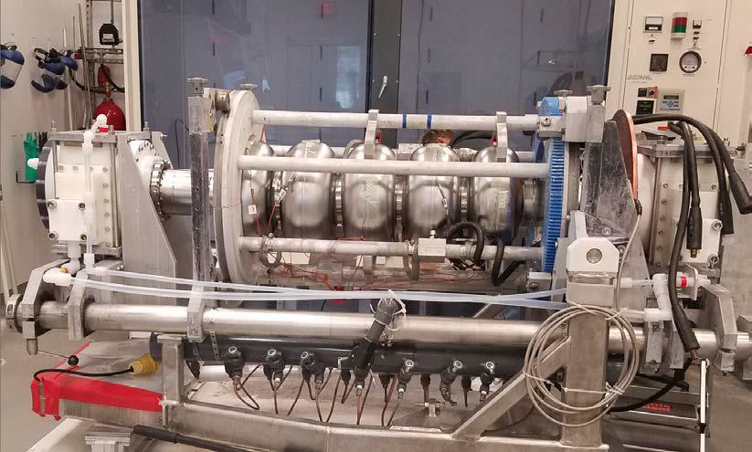
SRF technology development – PERLE cavity
First Nb 802 MHz 5-cell cavity – Oct 2017
802 MHz Niobium single cell cavity – completed in Aug 2017
5-cell cavity being electropolished

Slide 18
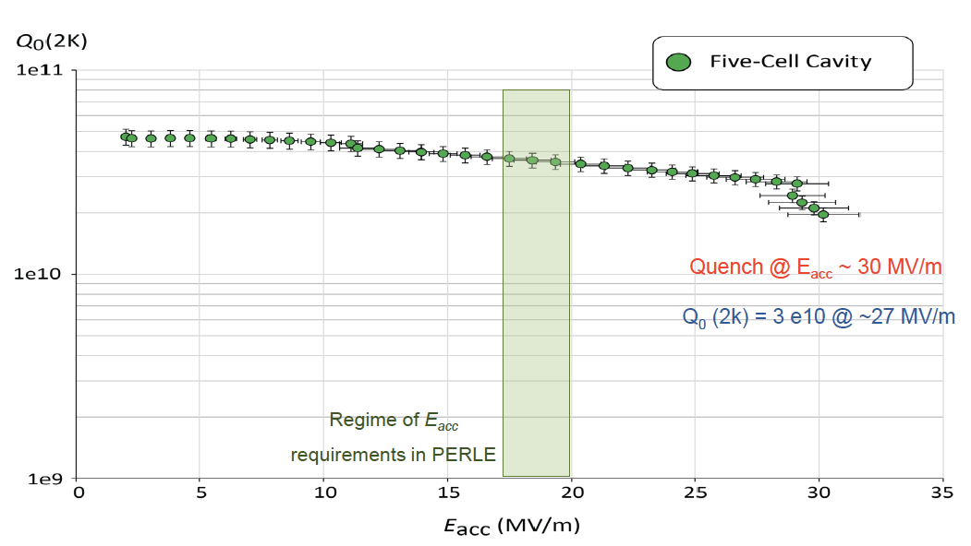
SRF technology development – PERLE cavity
Beautiful results on Q and gradient

Slide 19
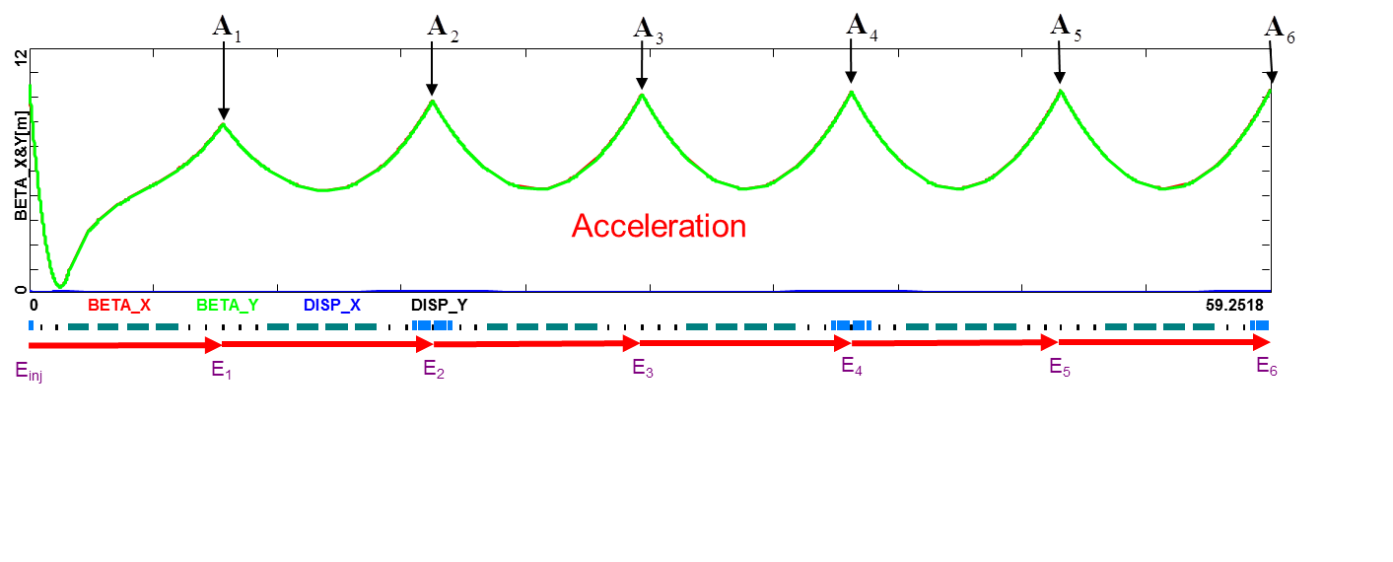
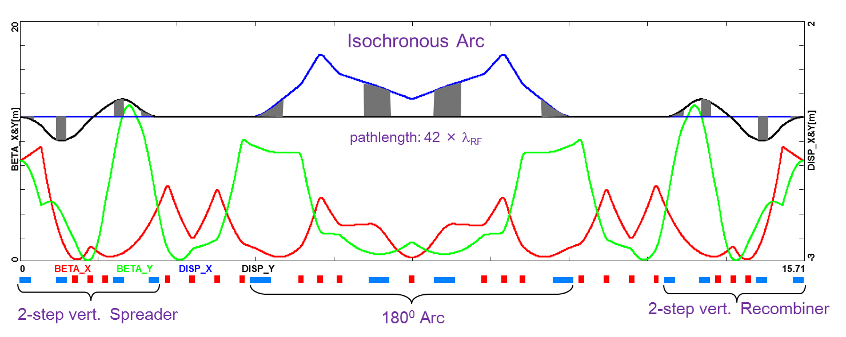
PERLE – Optics, Lattices
3-pass up + 3-pass down linac optics with energy recovery

Slide 20
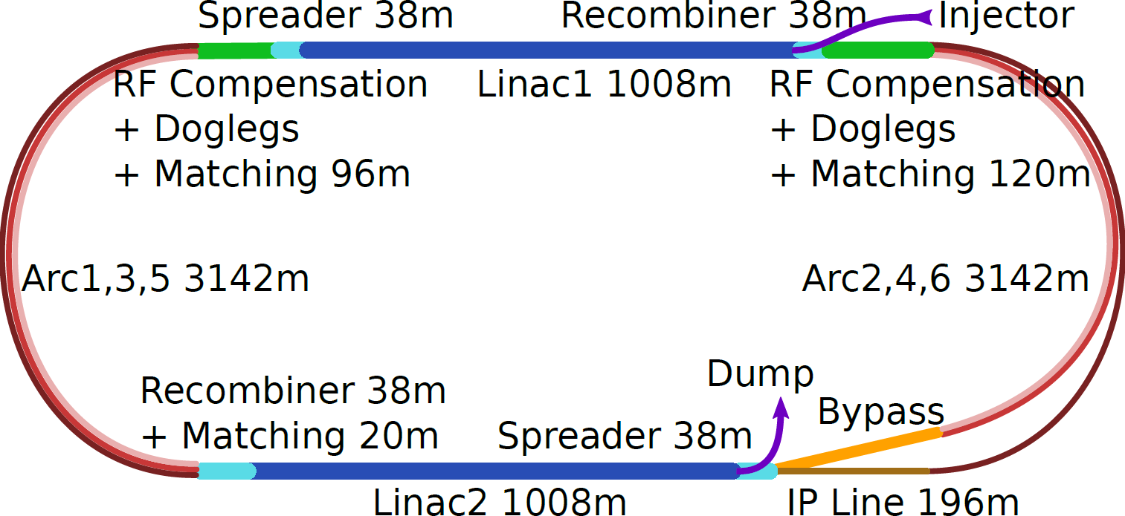
60 GeV Emittance Preserving ERL for the LHeC
Ongoing collaboration between JLAB and CERN encompasses:
Accelerator design and beam dynamics studies
Lattice design and performance optimization
802 MHz 5-cell cavity modeling and cryo-module design
Future studies will include design of a lower energy 50 GeV ERL option.

Slide 21
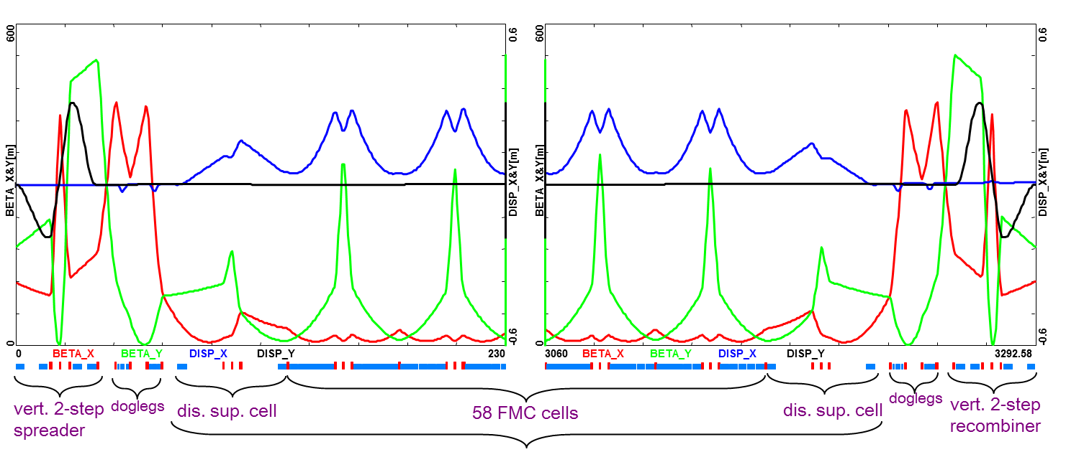
Arc Optics – Emittance preserving FMC cells
Arc 3 Optics (30 GeV)

Slide 22
Muon Acceleration via ‘Dogbone’ RLA
Fixed field multi-pass (4.5) RLA based on SRF linac suitable for multi GeV acceleration of fast decaying muons features:
Simultaneous acceleration of both μ⁺ and μ⁻ charge species
‘Dogbone’ topology offering high efficiency of RF usage (close to factor of 2 higher than a corresponding racetrack)
“Bisected” linac optics allowing for accelaration in both directions: the quadrupole gradients are scaled up with momentum for the first half of the linac, then they are mirror reflected in the second half.
Compact nested droplet arcs, since no sizable synchrotron radiation
Extension to multi-pass FFA-like arcs
All the bulling blocks of muon RLA developed at Jlab within Muon Accelerator Program:
Engineering design of beamlines, magnet specs
Beam dynamics studies of the longitudinal and transverse emittance preservation
End-to-end 6D simulation with magnet errors
Our pioneering work on muon acceleration is quite applicable to newly emerging path to low emittance muon collider via muon production from electron-positron annihilation (LEMMA). Initial collaboration with INFN Frascati has started to adapt the above scheme to low emittance muon beams and extend the energy range beyond tens of GeV.

Slide 23
In summary
A lot of opportunities to strengthen and expand EIC collaboration

