Slide 1
EIC Collaborations EIC Collaboration Workshop, JLAB Oct 28-Nov 1st
F. Willeke
BNL
October 30, 2018

Slide 2
Opportunities for Collaborations
Accelerator Development and Design Studies
Activity: Develop low risk Ring-Ring based eRHIC which demonstrates EIC design goals, resolves beam dynamics questions and issues and remains within cost expectations
Open questions:
Alternative Chromaticity correction schemes e, p
IR design, e,p
Complex dynamic aperture tracking electrons, e,p
Spin Transparency
Existing collaborations: BNL-NSLS-II
eRHIC Beam Dynamic Studies and Development of Simulation codes
Activity: Develop/adapt computer code for critical EIC beam dynamics issues, benchmark codes by comparing different codes and by comparing simulations with experimental results, apply to EIC
Topics: Dynamic Aperture, Electron cloud effect, polarization tracking, Crab cavity effects in bb
Open Questions:
Systematic spin tracking with beam-beam and iteration on parameters
Dynamic aperture improvement and assurance by tracking
Ecloud simulation with realist SEY
SEY measurements
Quest of real vs artificial emittance growth in strong-strong beam-beam
Existing collaborations:
BNL-LBNL-MSU (beam-beam)
BNL-FNAL (polarization optimization)

Slide 3
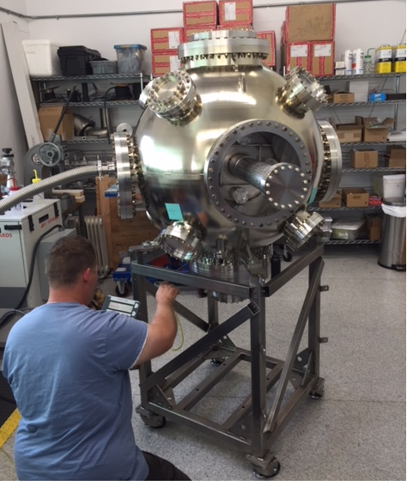
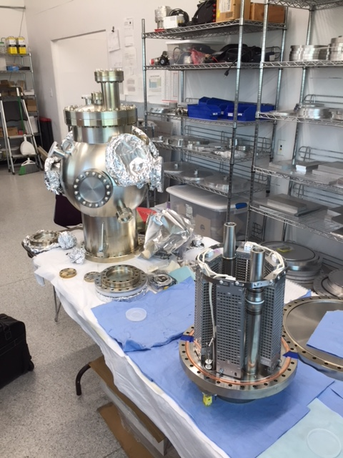
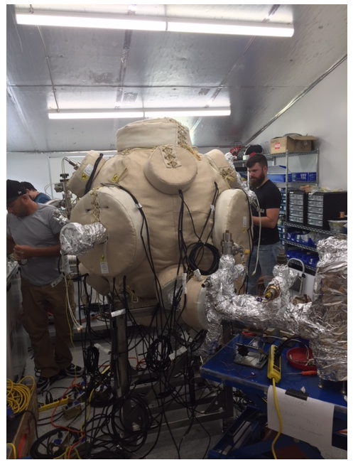
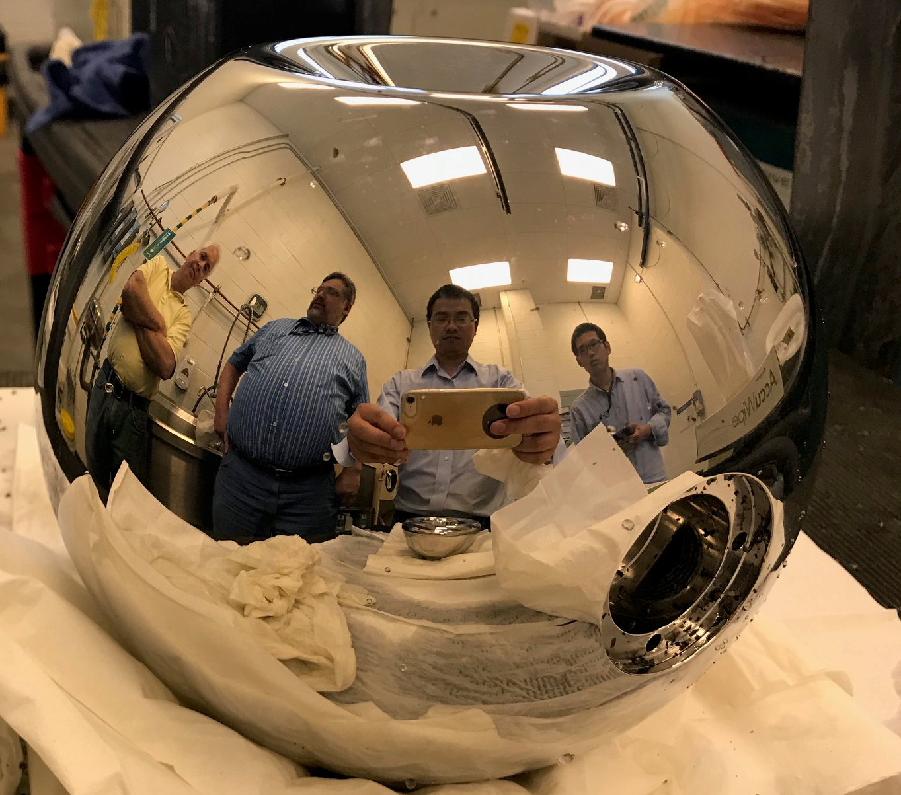
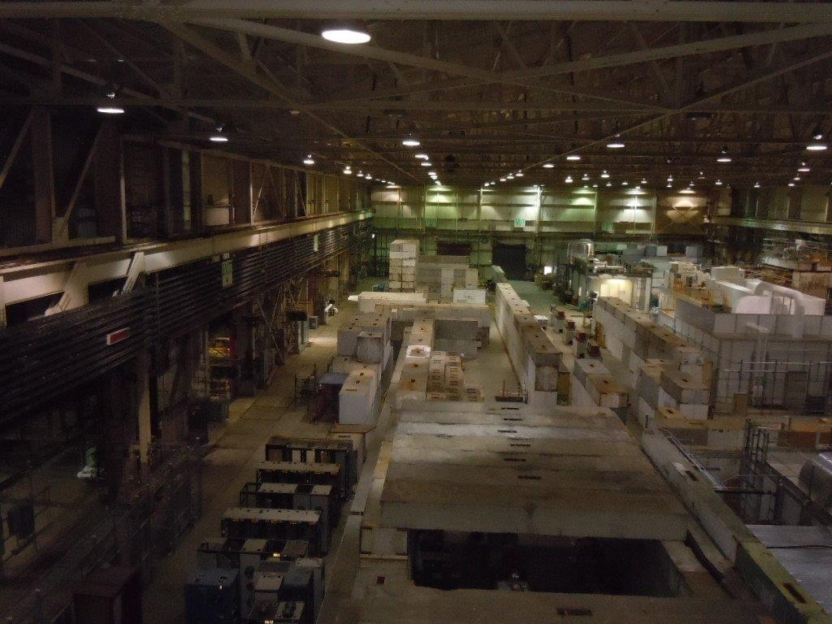
Opportunities for Collaborations
eRHIC Development of polarized Electron Guns
Goal: - Develop polarized electron gun for high bunch charge (>15 nC), high average ……...current (>50 mA@ 1nC), high reliability, and long cathode lifetime
Results: -XUV scale vacuum (10⁻¹² torr) demonstrated with existing Gatling gun
-Diagnostic beamline designed, assembled, vacuum tested
-New inverted gun design with minimum ion back-bombardment
-Parts for new gun procured, assembly started
Open topic
Systematic measurements on new BNL gun starting in 2018
Collaborations: MIT, JLAB

Slide 4
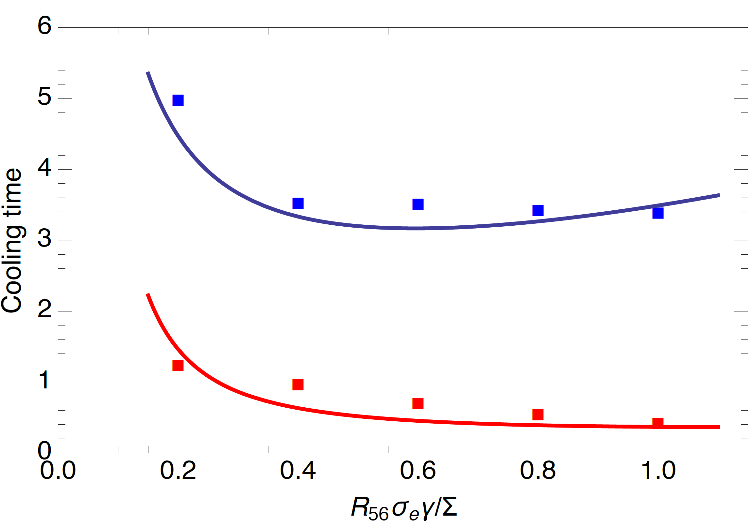
Opportunities for Collaborations
R&D on Advanced Hadron Cooling
1. Goals: Demonstrate coherent electron cooling in PoP experiment
Open questions: See Vladimir’s talk
Existing collaborations: BNL –Stonybrook University NY
2. Goal: Coherent electron cooling with μ−bunch amplification
Develop 6-D-theory for cooling of flat hadron beam by short electron bunches,
Confirm by simulation
Example layout of the cooling facility
Open question: Simulation including all relevant physical effects
Existing collaborations: BNL–JLAB-SLAC-ANL
3. Goal: e Storage Ring based electron cooling
Open Question: Develop strategies to control e IBS
Existing Collaborations:
Cooling time theory/simulation
With/without plasma amplification

Slide 5
CBETA Project
Recirculating ERL test accelerator being build at Cornell
by a BNL-Cornell Collaboration
funded by NYSERDA
- Demonstration of effective electron acceleration for advanced hadron cooling
Project on track for completion in FY20
40% of permanent magnets completed, ~25% of the magnet girders complete
Opportunity for collaborations:
Use CBETA as a tool to test EIC related design issues, such as ERL for strong hadron cooling
➔ See tomorrow’s workshop

Slide 6
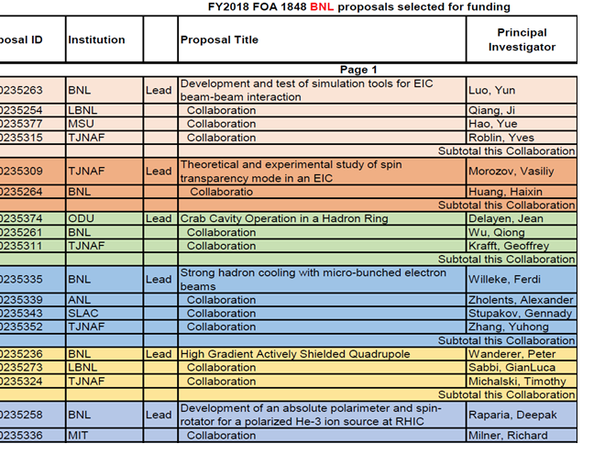
FY18-19 NP BNL FOA funded collaborative R&D

Slide 9
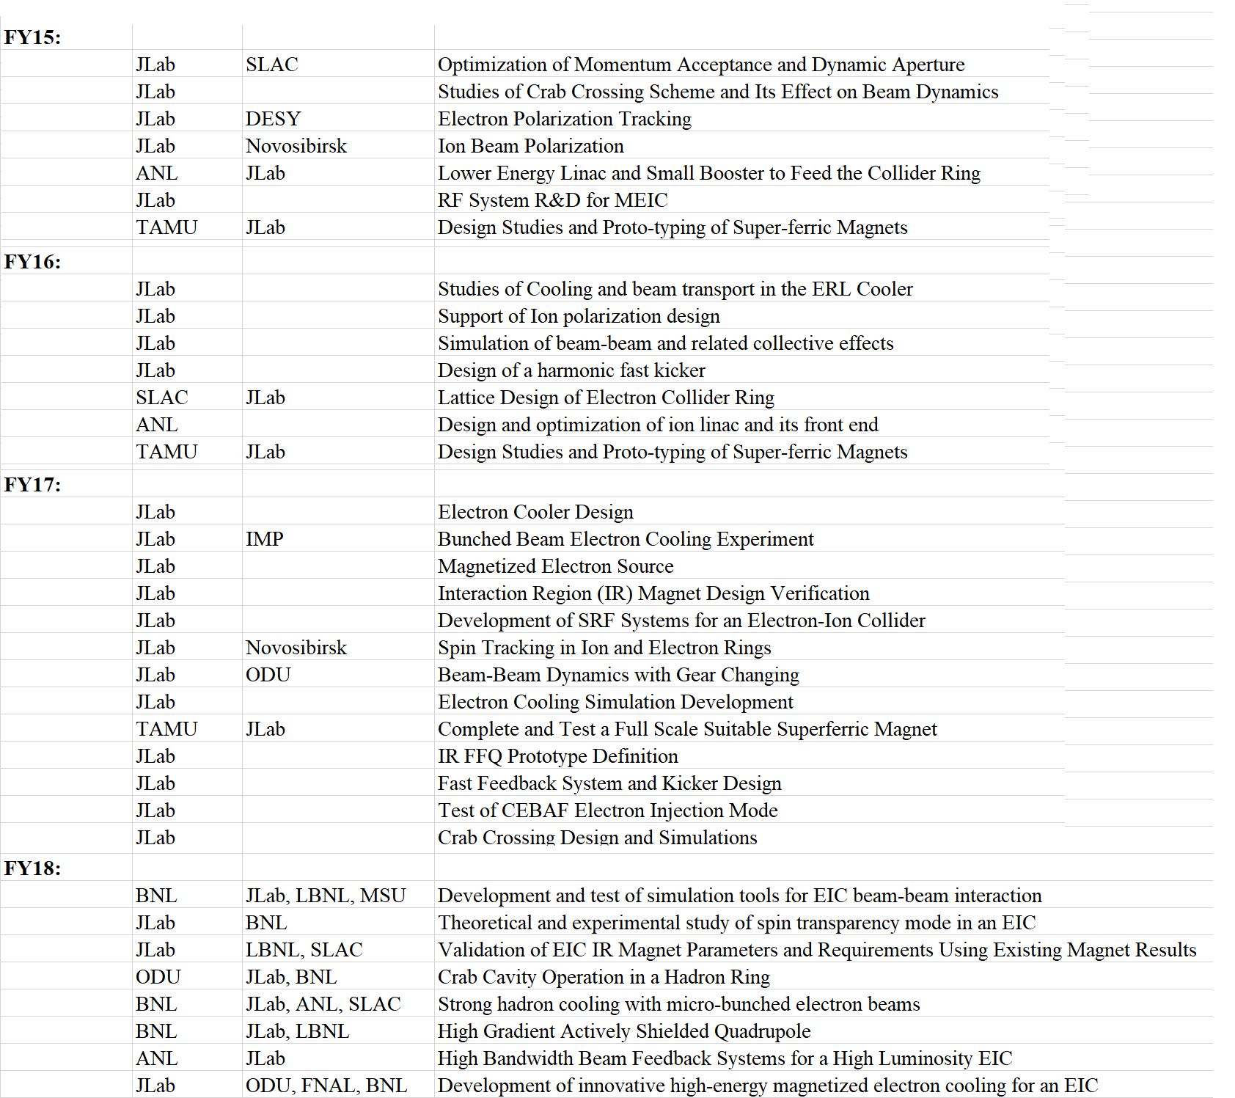
JLAB Collaborations

Slide 10
Future collaborative R&D projects for EIC
Test cryostate for horizontal test of several EIC related RF developments: Crab cavity, SC-SR Cavity, Hadron short bunch compression RF …
Goal: Design, built, use
Interested: BNL-JLAB- ?
Secondary Emission Yield measurements for e-cloud simulations
Interested: BNL
Potential contributors: Cornell, FNAL, CERN?
Development of affortable IR magnets
Development of EIC IR requirements from physics point of view
Alternative strong hadron cooling schemes

