Slide 1
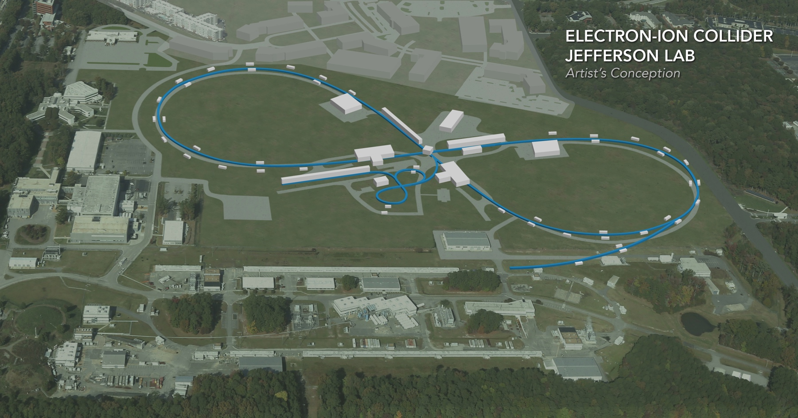
CEBAF Pulsed Operation for JLEIC Electron Injection
Jiquan Guo
Also Contributed by: J. Grames, R. Kazimi, F. Lin, T. Plawski, R. Rimmer, H. Wang
Funded by the FY17 EIC additional R&D funding
EIC Accelerator Collaboration Meeting
October 29 - November 1, 2018

Slide 2
Outline
JLEIC electron injection scheme using CEBAF as injector
Gradient droop estimate for CEBAF pulsed operation
CEBAF pulsed operation tests
Summary

Slide 3
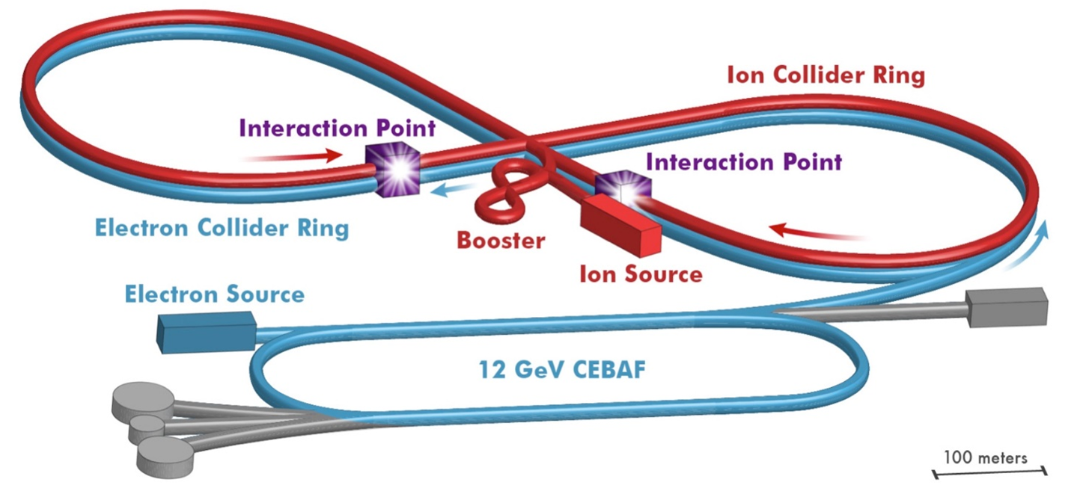
JLEIC layout
Electron complex
3-10(12) GeV electron collider storage ring
CEBAF as full energy injector
Ion complex
Ion source
SRF linac
Booster
Ion collider ring

Slide 4
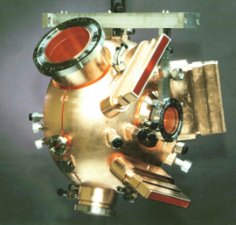
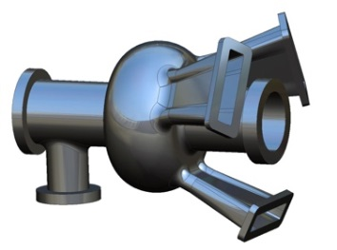
JLEIC Electron Collider Ring
Circumference 2255.4-2256.1 m (variate to sync with ions of wide velocity range)
3-10 GeV, possible upgrade to 12GeV. Full energy injection and top-off using CEBAF
Reuse PEP-II NCRF cavities in the initial phase, frequency tuned to 476.3MHz (1497×7/22), Nh=3584, and upgrade to 952.6MHz SCRF cavities later (Nh=7168)
Two flipping polarization in the ring; each section ~1047m (3.49μs) with two gaps of ~80m (128 buckets) each.
Gaps matching ion ring due to ion beam formation process, also serve for injection/abort kicker rise time
Baseline injection scheme requires 1047m bunch trains from CEBAF at the interval of the max of transverse damping time (6-375 ms) and kicker recovery time (up to 60 Hz)
Beam current 0.7-3A, limited by either synchrotron radiation power (∝Iγ⁴) or instabilities related to cavity impedance
Down polarized bunch train
Up polarized bunch train
476.3 MHz cavity (NCRF PEP-II)
gaps
Bunch train pattern in JLEIC electron ring
952.6MHz SCRF cavity under development

Slide 5
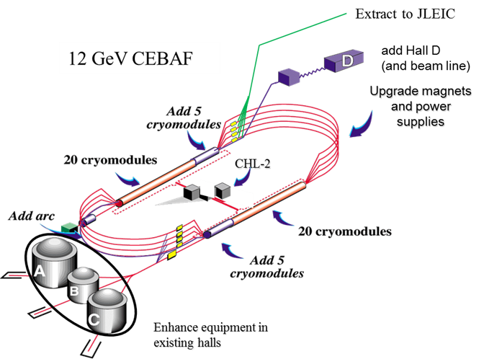
CEBAF as JLEIC Injector
Designed for CW operation with 1MW extracted beam power
Recirculating linac, newly upgraded to 12GeV
Beam gets accelerated 6 passes in north linac, 5 passes in south
~0.5MW RF to beam power in each of north and south linacs
1.05-1.09 GeV energy gain per linac pass with 10 new C100 cryomodules, 40 original C50/C25 cryomodules
RF frequency 1497MHz, ~1311m per pass
Needs to provide intense bunch trains with 2-60Hz repetition rate
Voltage droop in the SRF cavities would be the main challenge
Voltage droop ultimately limited by CEBAF arc energy spread acceptance ±0.2%
Timing of each bunch train is another topic needs R&D
Gun needs to operate at 17-68MHz, with up to 30 pC/bunch. 2 orders of magnitude higher than the current CEBAF gun but not beyond state-of-the art

Slide 6
CEBAF Voltage/Energy Droop with CW RF
When a pulse train passes an RF cavity operating on-crest on-resonance with CW forward power and a small droop, $∆V_{c}=I_{b}T_{train}\frac{ω}{2}\frac{R}{Q}=Q_{train}\frac{ω}{2}\frac{R}{Q}$
Absolute total droop is independent of cavity voltage and coupling.
Relative droop and energy spread is inversely proportional to cavity voltage
Need to maximize cavity voltage to minimize droop
Reduce number of passes when energy is low
CEBAF arc magnets can be adjusted to the beam energy at the center of the one pass bunch train, so relative energy droop equals the relative per pass voltage droop.
Injection time <20 min except for energy range of 3.3-4 GeV
Could improve with RF feedforward, or higher rep-rate with damping wiggler/shorter bunch train
Estimated JLEIC pulsed injection current and injection time (limited by injector current only) with CW RF and varying number of passes
Cavity type | Cavity # per linac | R/Q (Ω) | ΔVc with 1.14mA 3.49μs 4μC beam
C100 | 40 | 868.9 | 16.2 kV
C50/C25 | 160 | 482.5 | 9.03 kV
Per linac sum | 200 |  | 2.10 MV (0.20% of 1.05GeV)
Assumes maximum kicker repetition rate 60 Hz
Assumes head-tail energy droop of 0.2% (1/2 of the ±0.2% arc acceptance)

Slide 7
Gradient droop for C100 with CW RF input (not to scale)
Drooping Vc=10.4MV, ΔV/V≈0.94%
P_{RF}=1kW CW (assuming on-resonance drive)
17-375ms
17-375ms
Each bunch train ~3.5µs
0.88µs
25.4µs, 6 turns-0.88µs in CEBAF NL (4.375µs per pass), 1mA

Slide 8
RF feed-forward to correct voltage drooping
Pulsed RF input for a typical NL C100 cavity with feed-forward
(assuming on-resonance, need more power for off resonance)
Pulse-to-pulse feed-back will help to find the correct power level with microphonics etc.
If ~0.2% droop is allowed, the estimated extraction beam current will be ~2mA at various energy, depending on cavity coupling and microphonics.
Flat Vc=10.4MV, Ipulse=0.7mA, ΔV/V≈0 within bunch train
17-375ms
P1=8.1kW
0.88µs
17-375ms
Each bunch train 3.5µs
P0=0.97kW
25.4µs, 6 turns-0.88µs in CEBAF NL (4.375µs per turn)
Estimated JLEIC pulsed injection current and injection time (limited by injector current only) with RF feed-forward and varying number of passes
Assumes maximum kicker repetition rate 60 Hz
Assumes head-tail energy droop of 0.2% (1/2 of the ±0.2% arc acceptance)

Slide 9
CEBAF pulsed operation test: beam set-up
A 250μs 2μA “probe” bunch train for the BPMs in CEBAF injector and arcs (can’t see 4 μs beam), generated with laser B at 250MHz using CEBAF “tune beam” mode; tested to be sufficient for BPMs
4μs JLEIC beam generated with laser A+C in “viewer limit” mode, 100μs after the tune beam
Might increase to 10μs to accommodate linac BPMs to differentiate beams of different passes
2×499MHz to increase beam current with moderate charge per bunch
60 Hz bunch train rep-rate
1-2mA desired
250μs 1μA tune beam
On laser B (250MHz)
~100μs delay
0.4mA generated in gun
0.3mA sent to 4D on 08-21-2018
0.2mA passed 3R on 04-30-2018
3.8-10μs “Viewer limit” mode beam on laser A+C (2×499MHz)
Bunch train structure for current CEBAF tests

Slide 10
1.5 pass CEBAF test (04/30/2018)
Beam setup
Hall B tune beam 1μA + Hall A/C 499MHz VL beam, 13-200μA, 60Hz
Terminated at 3R with 3.8-10μs VL beam
After reducing M56 gain to 0 (avoiding saturation), NL beam current (terminated at 3R) showed no pass-to-pass beam loss at 100 μA set up (measured at Faraday cup)
When beam current increased to 150μA, M56 saturated and could not provide a proof of no pass-to-pass beam loss.
Will install attenuator on M56 pickup for next beam study
Gradient droop and energy spread measurement not successful in this beam study
M56 measured beam current with laser C set to 100μA 4μs
M56 measured beam current with laser A/C set to 150μA (saturated)

Slide 11
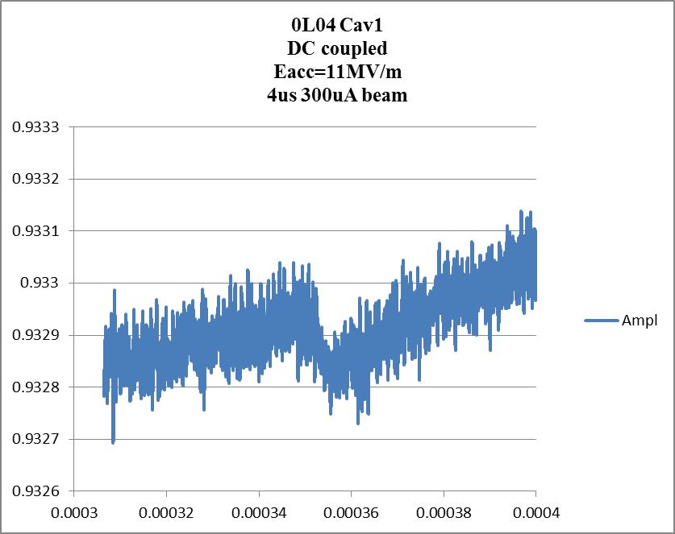
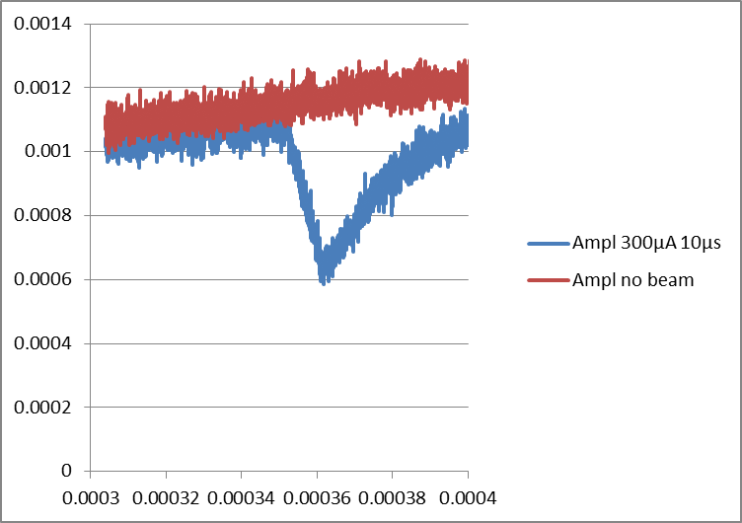
Injector gradient droop measurement (08/20/2018-08/21/2018)
0L04 cav1 (R100)
AC 1MΩ coupled
Eacc=11MV/m, Vc=7.7MV
Measured gradient droop in the CEBAF injector R100 cryomodule
Δamp≈0.45mV (0.05%) for 10μs 300μA bunch train AC coupled measurement, ≈0.15mV (0.016%) for 4μs 300μA DC coupled measurement
Calculation (on crest, no detuning, without any feedback/feed forward) shows 0.064% voltage droop for 4 μs 300μA, 0.16% for 10 μs, a factor of 3-4 difference for both DC and AC coupling.
No solid explanation for the discrepancy yet, although the experimental results are in favor of faster injection. More study needed.

Slide 12
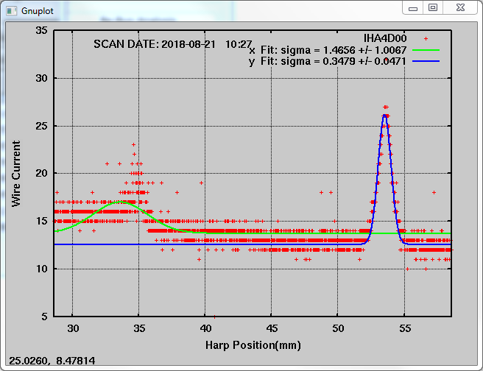
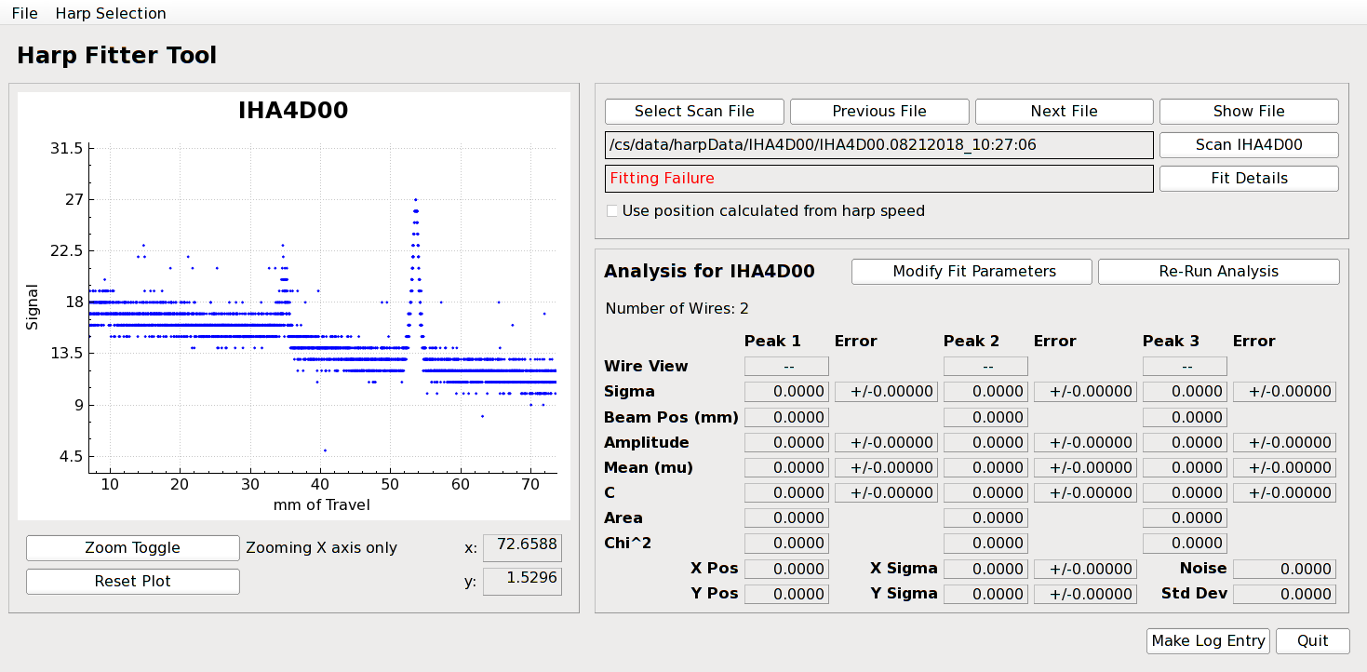
Energy spread measurement in CEBAF injector (08/20/2018-08/21/2018)
Tried to do HARP scan in the 4D spectrometer to measure the energy spread, but the horizontal signal is too noisy for fitting
Investigating how to improve the fit

Slide 13
Summary
The scheme for JLEIC electron injection using CEBAF is developed with reasonable injection time and top off rate
Gradient droop is the main concern of CEBAF pulsed operation, but can be limited to an acceptable level
Preliminary CEBAF multi-pass beam test saw 100μA pulsed beam passing through without no loss. Future experiment will improve instrumentation for higher beam current.
Preliminary gradient droop measurement does not agree with the analytical estimate, but in in favor of fast injection. Future test will try to resolve this discrepancy.

