Slide 1
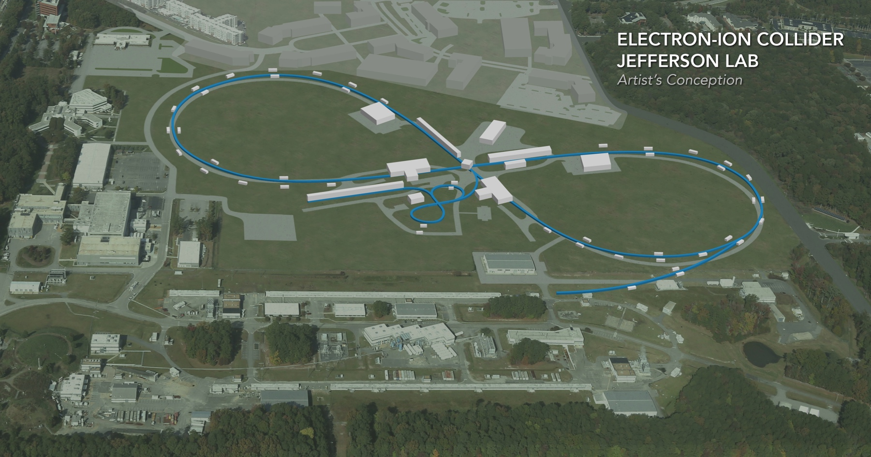
Geometry Tagging for Heavy Ions at JLEIC
A. Sy, A. Accardi, M. Baker, W. Brooks, R. Dupre, M. Ehrhart, C. Fogler, K. Hafidi, C. Hyde, V.S. Morozov, P. Nadel-Turonski, K. Park, J. Stukes, T. Toll, G. Wei, L. Zheng
JLab LDRD LD1706 and LD1804
EIC Accelerator Collaboration Meeting
October 29 - November 1, 2018

Slide 2
Key EIC measurements with heavy nuclei
Coherence and gluon saturation
At low x and Q², the probe interacts coherently with all gluons in its path
The gluon density can be increased by going to lower x (higher CM energy), or increasing the nuclear thickness
Heavy nuclei + selection of large path lengths through geometry tagging
Extra boost from non-spherical nuclei?
Quark propagation and hadronization
Knowing the path length will greatly improve our understanding of what happens when a quark propagates through nuclear matter
Energy loss, p_{T} broadening, etc.

Slide 3
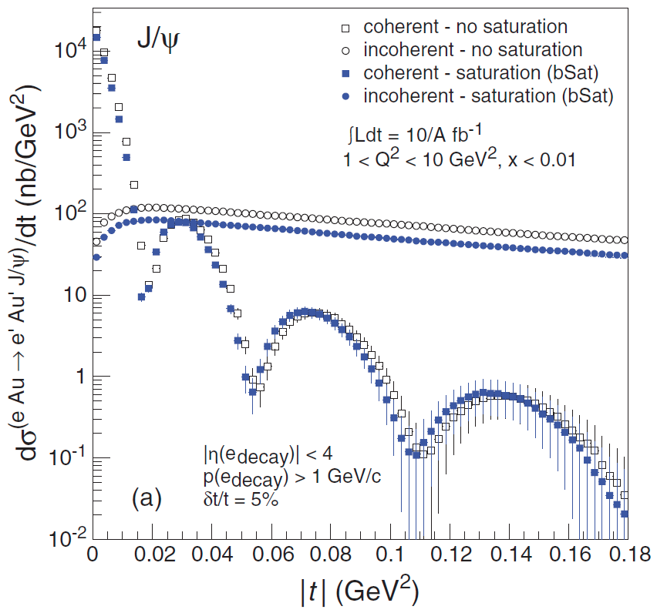
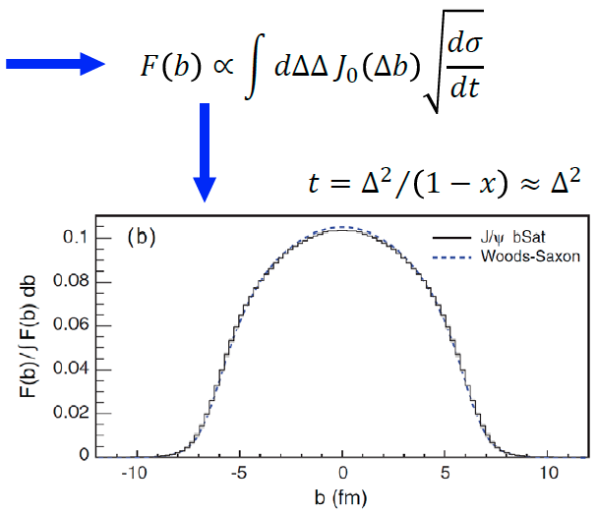
Coherent diffraction can reveal the spatial gluon distribution
Coherent diffraction may be the only way to image the transverse gluon distribution in nuclei, but the incoherent background is large
Efficient veto is needed
Momentum transfer t is conjugate to transverse coordinate b T. Toll and T. Ullrich, Phys. Rev. C 87, 024913 (2013)
Notes:
Coherent distributions can be used to obtain info about gluon distribution in impact parameter space by taking fourier transform of cross-section

Slide 4
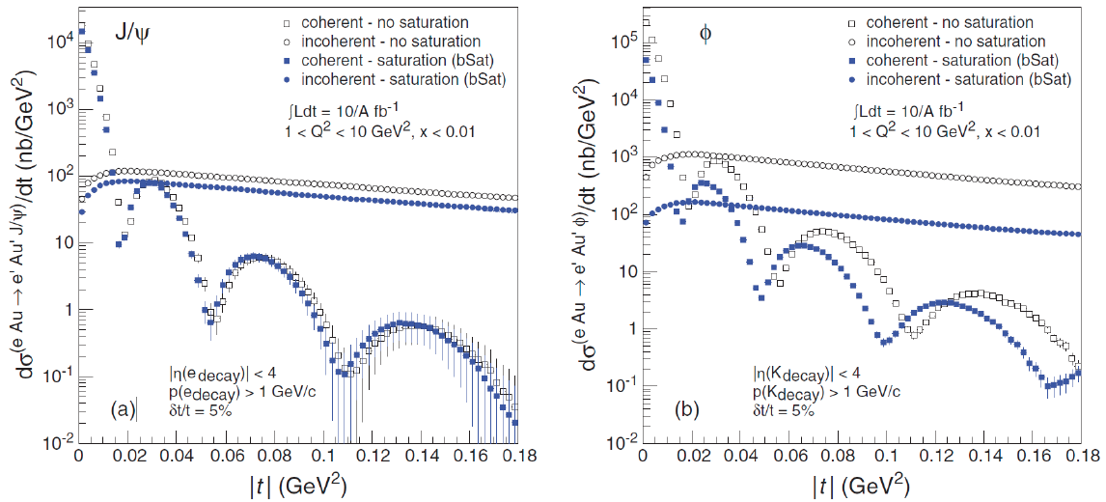
Coherent diffraction is also sensitive to gluon saturation
(Smaller) $J/ψ$ shows little sensitivity and can serve as a reference for (Larger) $φ$, which shows significant sensitivity to saturation (at moderate Q²) T. Toll and T. Ullrich, Phys. Rev. C 87, 024913 (2013)

Slide 5
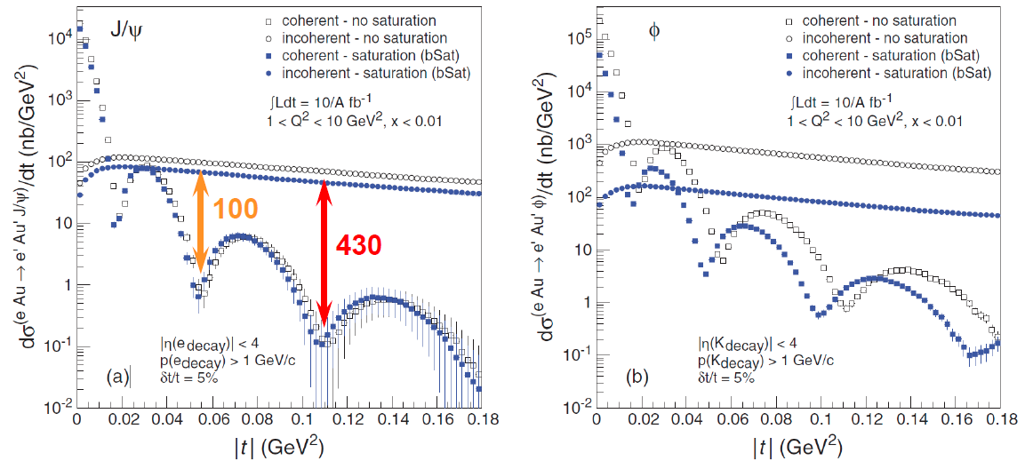
Incoherent diffraction cross-section dominates
The challenge for coherent diffraction is to suppress the much larger incoherent background; requires a combination of detection methods
Signal-to-noise ratio of 2:1 at the 3rd dip requires a veto efficiency of 99.9% (M. Baker, 2017)

Slide 6
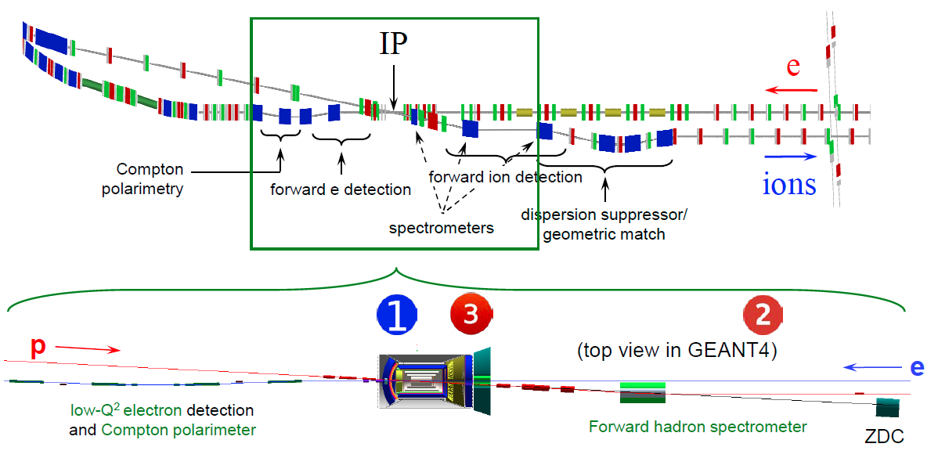
JLEIC detector region
Integrated detector region design developed satisfying requirements of detection, beam dynamics, and geometric match
GEANT4 detector model developed, simulations in progress

Slide 7
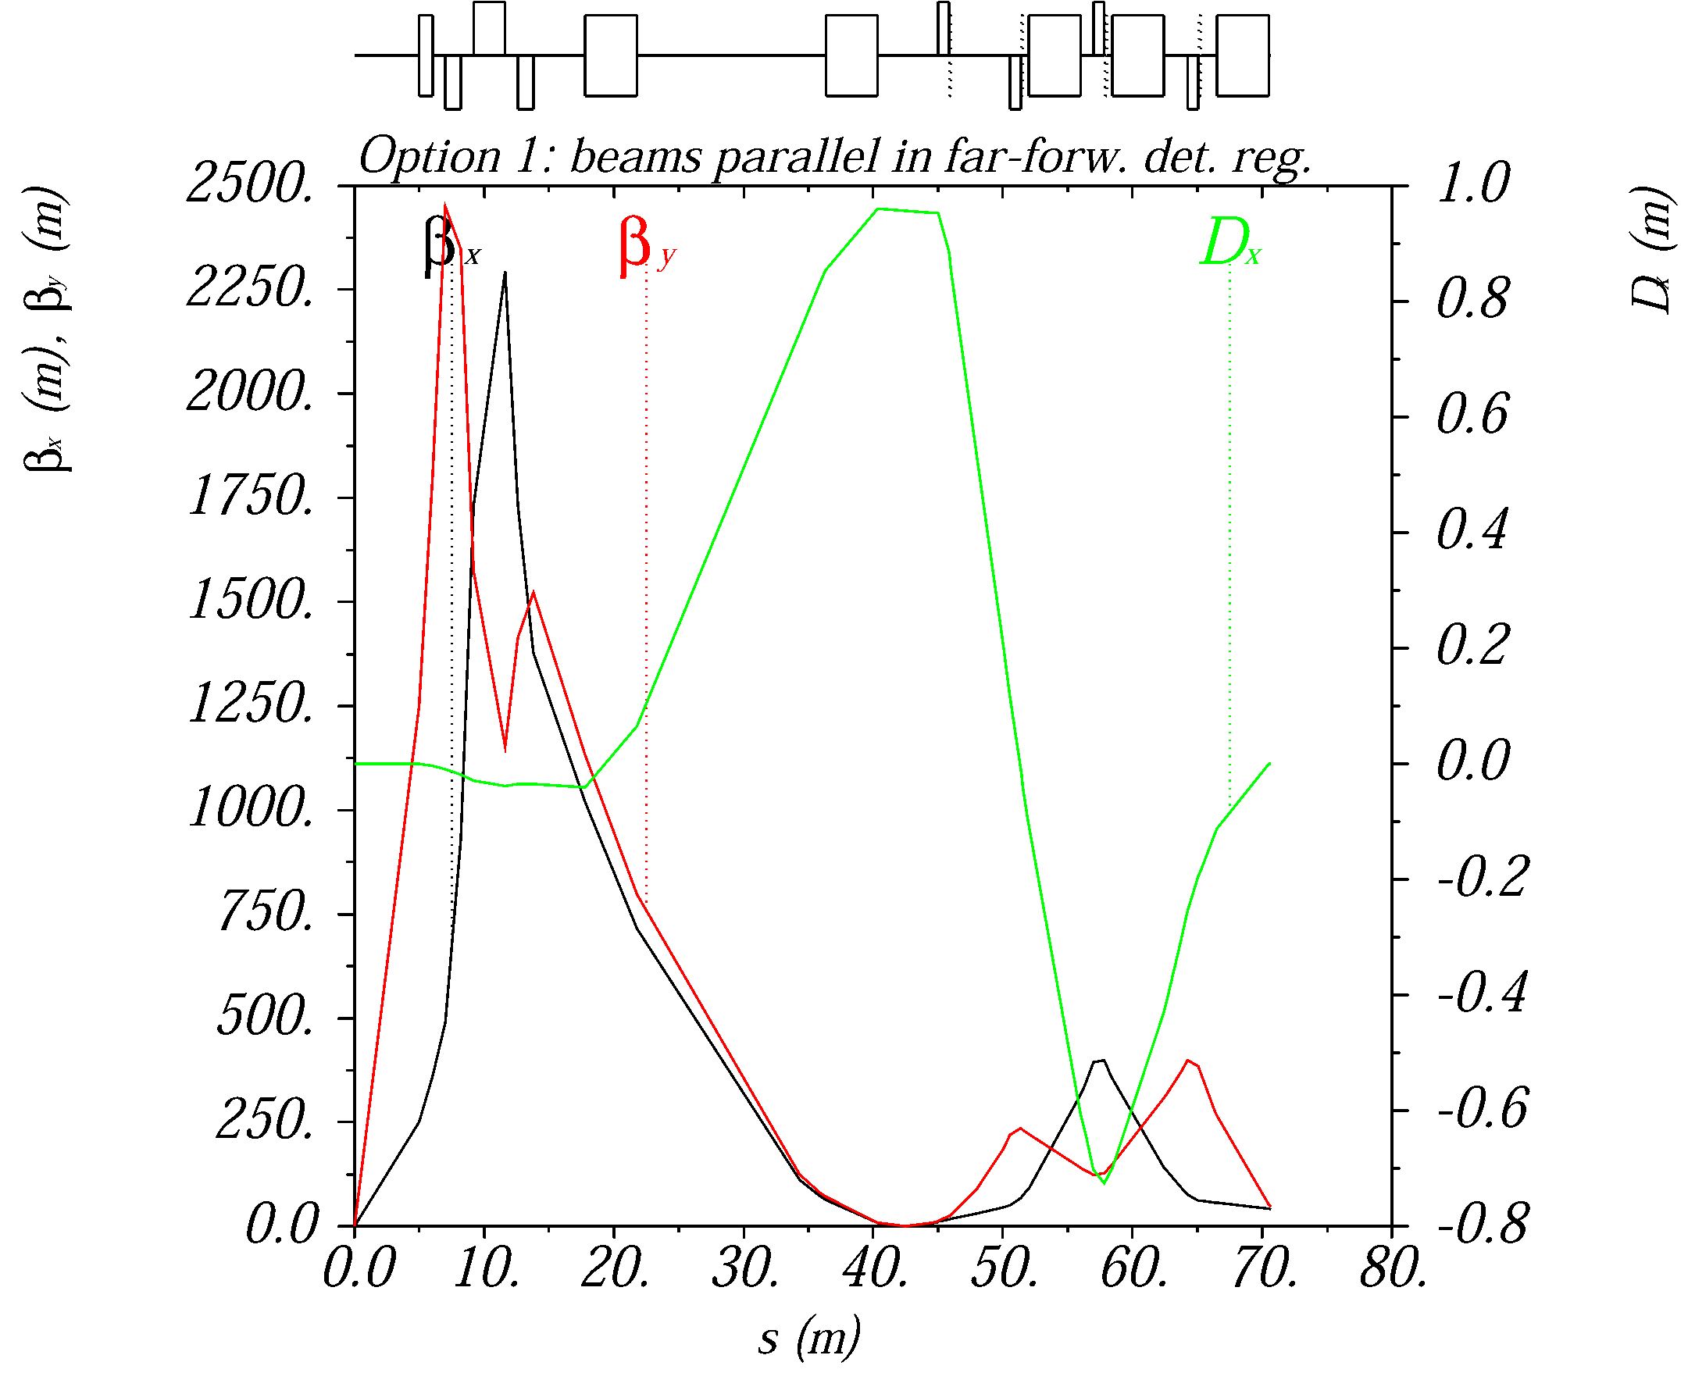
Forward ion side of JLEIC IR
$β_{x,y}^{∗}=$ 10 / 2 cm, $D^{∗}=$ 0 m, $D^{′∗}=$ 0
Three spectrometer dipoles (SD)
Large-aperture final focusing quadrupoles (FFQ)
Secondary focus with large $D$ and small $D^{′}$
geom. match/
disp. suppression
IP
SD1
SD2
SD3
FFQ
~14.4 m
4 m
D’ ~ 0
D = 0, D’ = 0
forward detection
β_{x} , β_{y} < ~0.6 m
middle of straight
limit β_{x} and β_{y}

Slide 8
Event generators
We also want to thank M. Ungaro for adding support for the event generator formats in the GEMC (Geant4) package

Slide 9
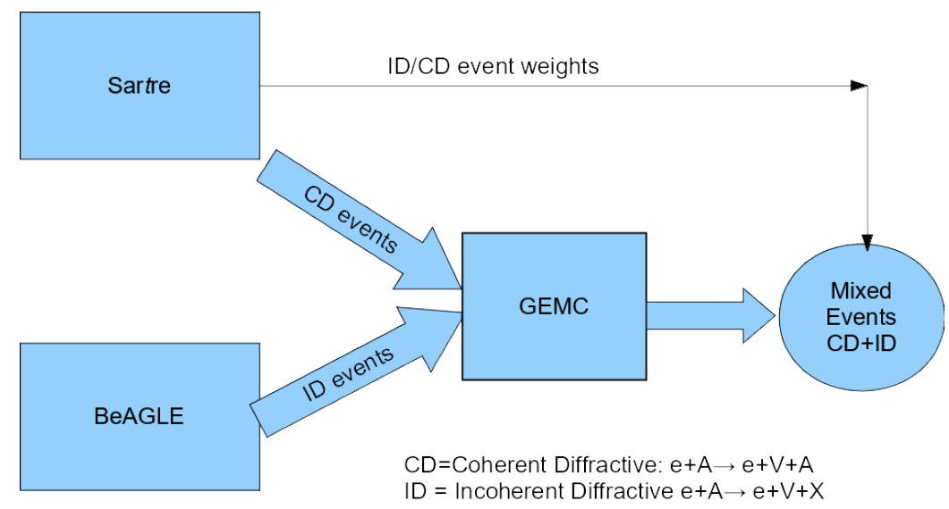
Simulation process flow
Coherent events and their relative contribution from Sartre
Incoherent events from BeAGLE
GEMC for simulation of background suppression efficiency

Slide 10
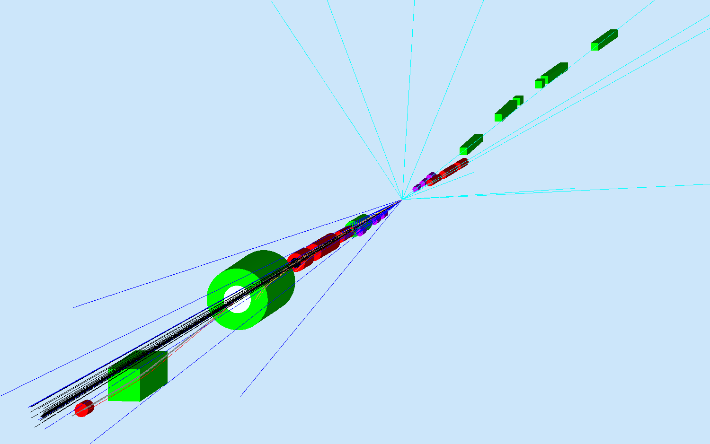
Tracking generated events in detector
BeAGLE and Sartre event generators interfaced to a GEMC detector model
e+Pb²⁰⁸ collisions at 10 x 40 GeV/u
10 mrad acceptance through FFQs
20 mrad acceptance through first spectrometer dipole
Cyan: electrons
Blue: neutrons
Black: photons
Red: protons
Grey: residual ion

Slide 11
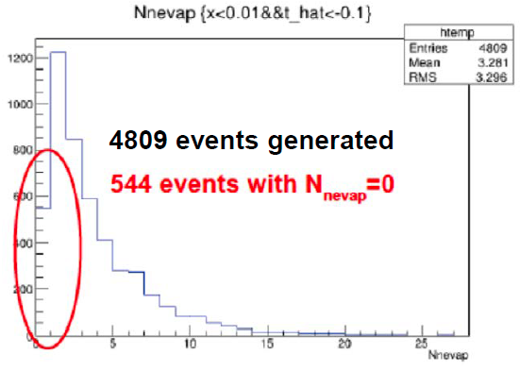
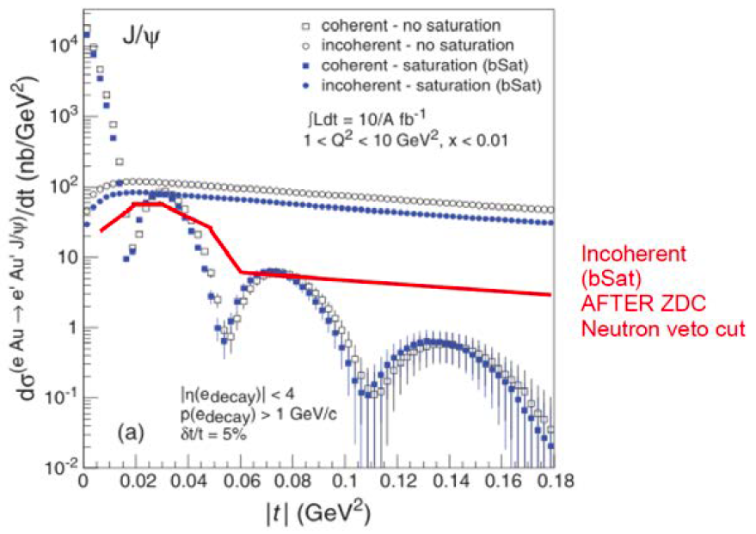
Vetoing incoherent diffractive events
Exclusive vector meson incoherent diffraction for 10 x 40 GeV e+Pb in BeAGLE
Sample includes any vector meson: $J/ψ$, $φ$, $ρ$, $ω$
$τ_{0}$ = 9 fm
$σ_{dipole}=\left\langle σ\left(J/ψ\right)\right\rangle =$ 5.7 mb
Significant fraction of the incoherent background events have no evaporation neutron: P(N_{n} = 0) = 11.3%
Rejection factor using a ZDC alone is two orders of magnitude too low

Slide 12
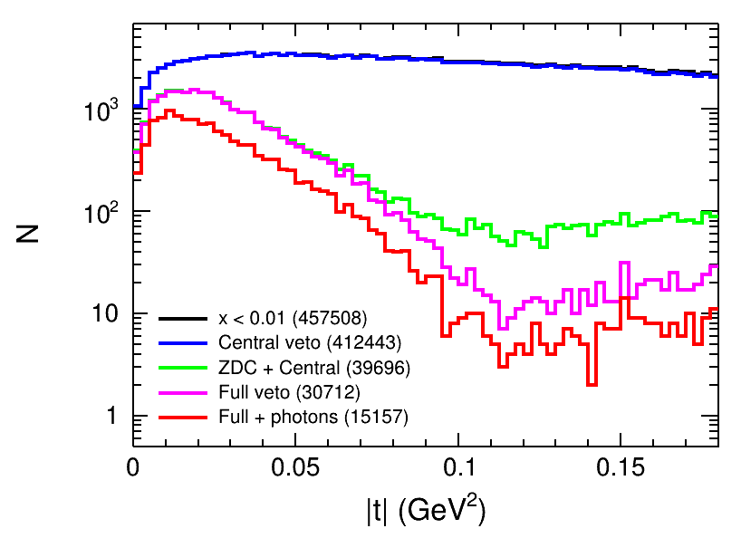
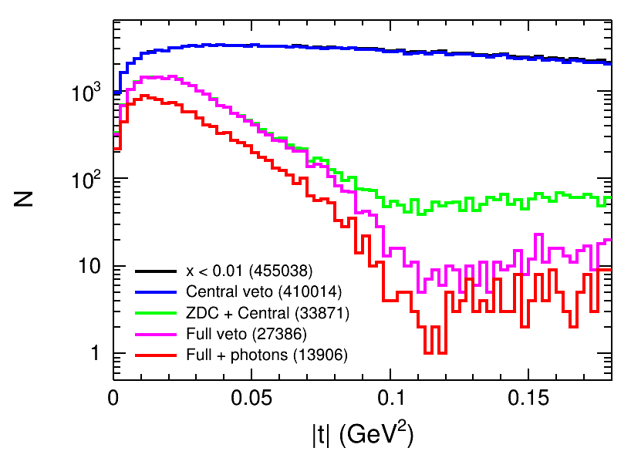
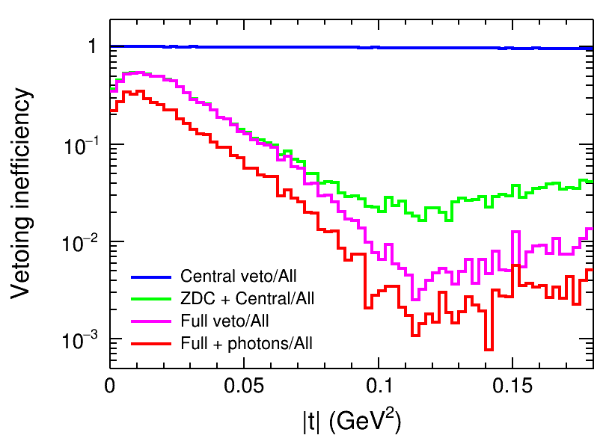
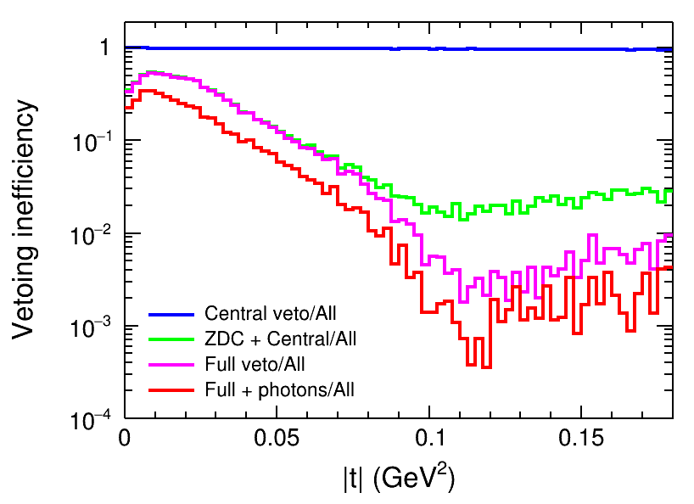
Vetoing inefficiency
Central veto: any of $γ$ ($E_{γ}>500$ MeV), $π^{+/−}$, $K^{+/−}$, $p/\overline{p}$, or $n/\overline{n}$ at $θ>100$ mrad
ZDC: any of $γ$ ($E_{γ}>40$ MeV), $π^{+/−}$, $K^{+/−}$, $p/\overline{p}$, or $n/\overline{n}$ through FFQs
Full veto: Central + ZDC + any of $π^{+/−}$, $K^{+/−}$, or $p/\overline{p}$ after the first dipole
Full + photons: Full + $γ$ ($E_{γ}>40$ MeV) through the first dipole
$τ_{0}=7$ fm
$τ_{0}=2$ fm

Slide 13
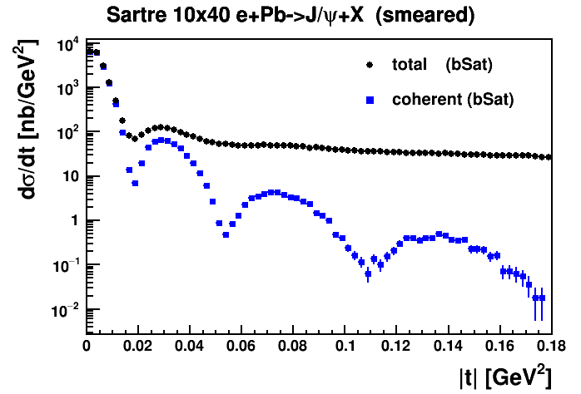
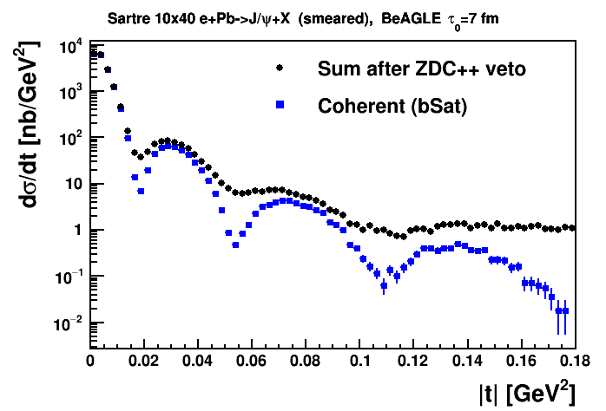
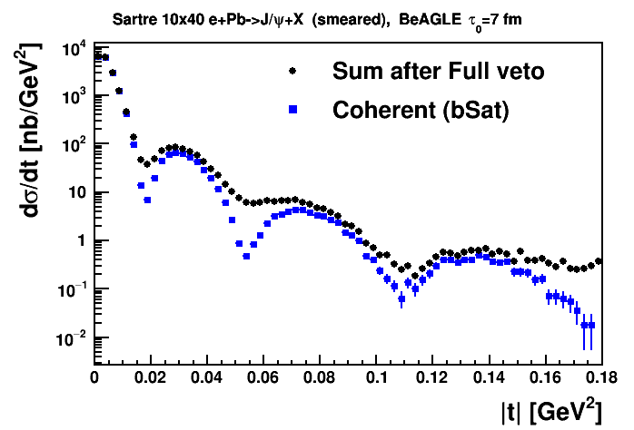
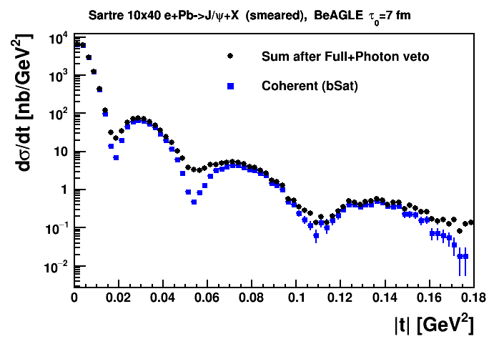
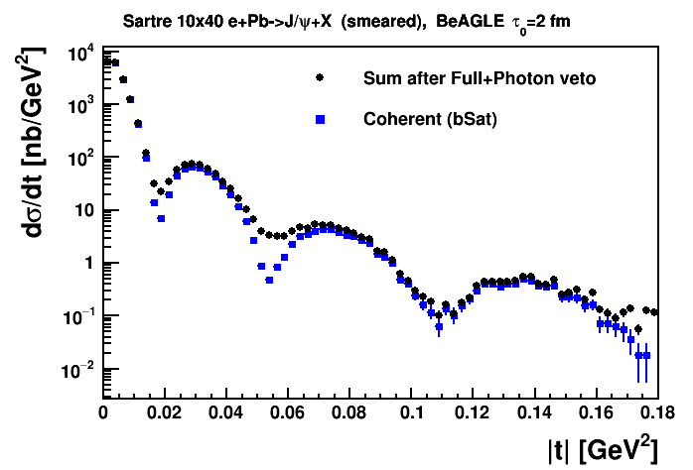
Applying the veto
$τ_{0}=7$ fm
$τ_{0}=2$ fm

Slide 14
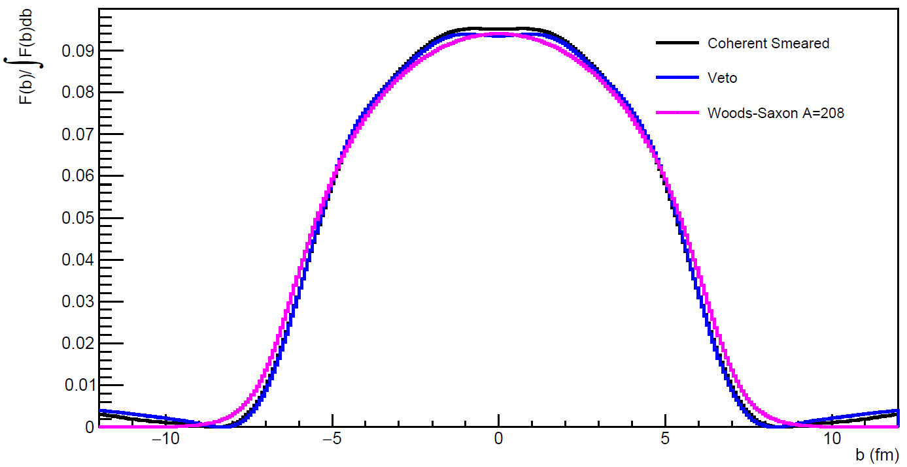
Gluon spatial distribution
Full veto + photons reproduces model distribution fairly well
Detection of A-1 nuclei, photons can also improve the veto efficiency
Notes:
Magenta: reference input distribution; black: bSat model with including errors in t measurement; blue: full veto + photons with geometry tagging

Slide 15
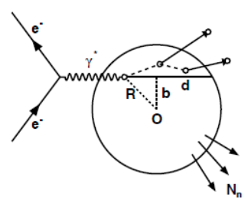
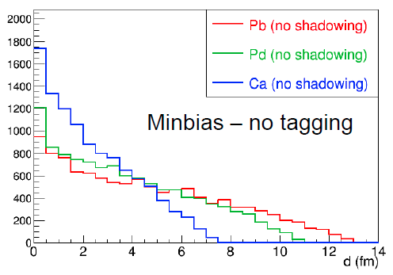
Collision geometry can be reconstructed from final state
Geometry tagging is the use of information from the nuclear breakup to categorize the geometry of the collision
By detecting nuclear fragments and particles in the ion direction, we can:
Determine the impact parameter b and the effective nuclear thickness T(b) at lower x
Determine the path length d in the nucleus after the primary interaction
Tagging allows us to select events for which the average T(b) and d are very different from their averages over the entire nucleus
Intra-nuclear cascading increases with d (forward)
Evaporation of neutrons from excited nucleus (very forward)
Without tagging, average d in a nucleus scales as the radius (A^{1/3})

Slide 16
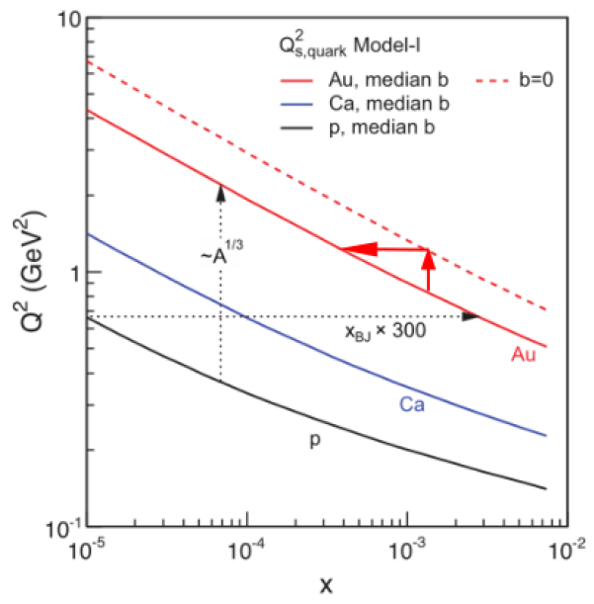
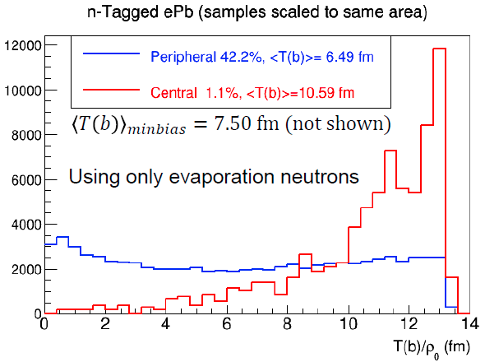
Tagging in b and T(b)
Geometry tagging using only evaporation neutrons: can select events with larger average nuclear thickness, at cost of lower statistics
Selecting 1.1% of events with largest average nuclear thickness (measured by evaporation neutrons only) equivalent to increasing the accelerator energy by a factor 3.2
e+Pb²⁰⁸ collisions at 10 x 40 GeV, Q² > 1 GeV², y < 0.95, x < 0.002
Notes:
Plot on left shows saturation scale Q^2 as a function of x for ep, eCa, eAu for min bias and central (eAu only). For fixed Q2, eAu collision has similar saturation reach as ep collision but with 300x larger energy. At fixed x, geometry tagging to isolate central events from min bias events enhances saturation reach -

Slide 17
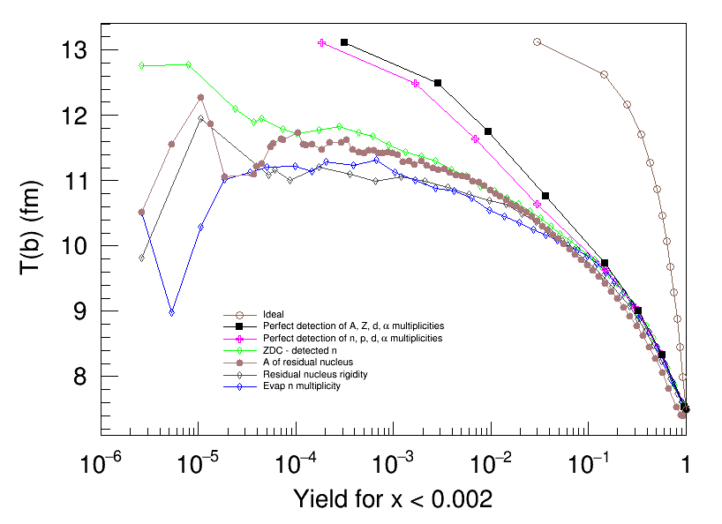
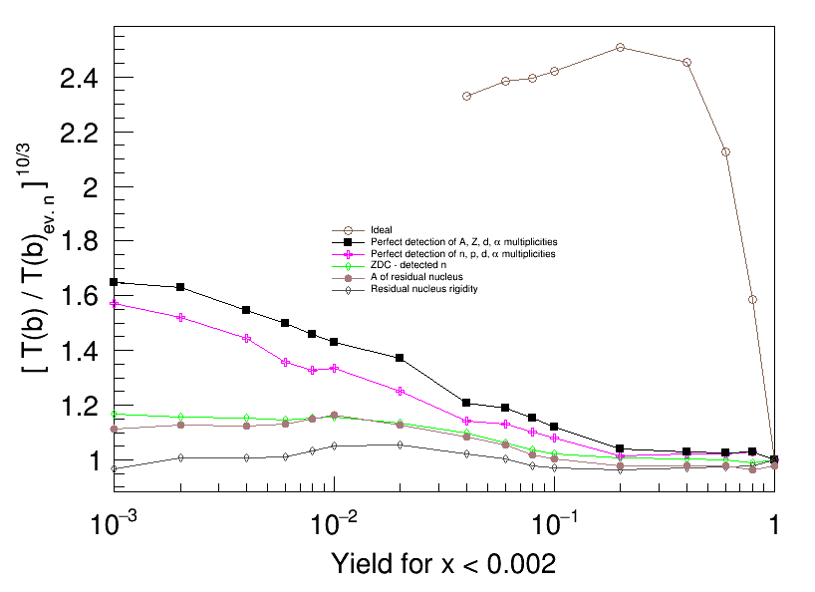
What if we also detect the charged particles?
Detecting protons and light ions (d and ⁴He) in addition to neutrons increases the selectivity in b and the effective nuclear thickness T(b)
For a 1% yield cut, the increase in equivalent collision energy is about 40% (magenta curve on right) compared with using evaporation neutrons only
Compared to no geometry tagging, the total energy increase factor is 4.5
n, p, d, $α$ multiplicities

Slide 18
What if we identify the residual ion?
Kinematic reach can be extended by detecting the residual ion together with charged particles
Best result: measurement of Z in addition to A/Z (inferring A) – this would require a PID system for the ion (e.g. additional dE/dx if the dE/dx from the tracker is insufficient)
Further energy boost is possible with using Uranium ions: additional 1.4x factor gives total effective energy increase of 6.7
A, Z and d and $α$ multiplicities

Slide 19
Detection requirements
Best results obtained by detecting the residual ion (tracking + dE/dx) and light ions (easy for all except Z = N nuclei)
A neutron ZDC can provide additional information or a useful measurement on its own
Also beneficial to detect protons – requires larger magnet apertures but is also needed for spectator tagging with light nuclei
A, Z and d and $α$ multiplicities

Slide 20
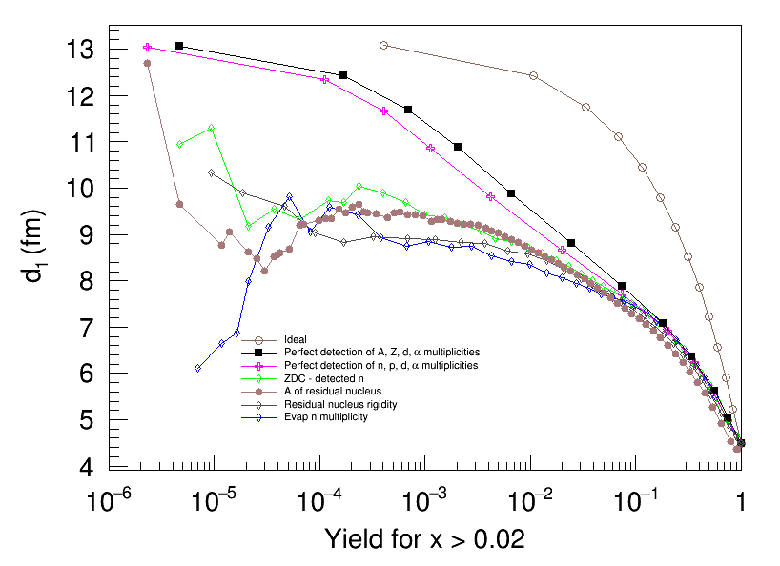
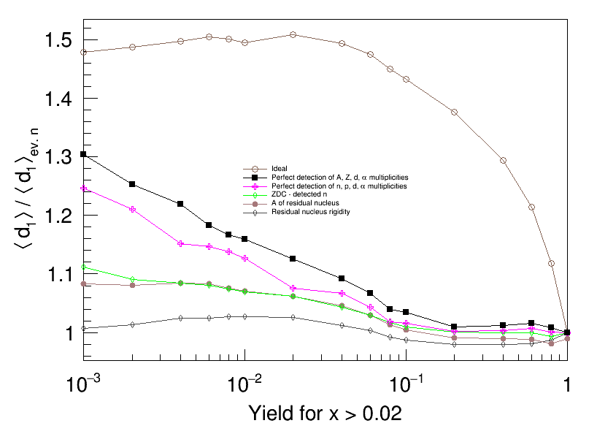
Tagging in d at higher x
Not necessary to maximize distance d but important to measure it
Plots below illustrate d sensitivity with yield
Same detection criteria apply
A, Z and d and $α$ multiplicities

Slide 21
Summary
Coherence, gluon saturation, and quark propagation and hadronization are some of the key studies with heavy nuclei in an EIC
Under JLab LDRD projects (LD1706 and LD1804), we improved event generators BeAGLE and Sartre, made them available at JLab, and generated incoherent exclusive diffraction data for $J/ψ$ and $φ$in the JLEIC kinematic range
The event generators were interfaced to GEMC model of the JLEIC detector
The incoherent diffraction veto efficiency of the JLEIC full acceptance detector was studied; full veto and veto of high energy photons gives veto efficiency near the 99.9% necessary – resultant gluon spatial distribution close to dipole model prediction
A comprehensive study of the geometry tagging resolution considering various combinations of forward neutral and charged particles was completed
Possible effective energy boost of factor: 3.2 (evaporation neutrons) x 1.5 (charged forward hadrons) x 1.4 (using Uranium) = 6.7

