Slide 1
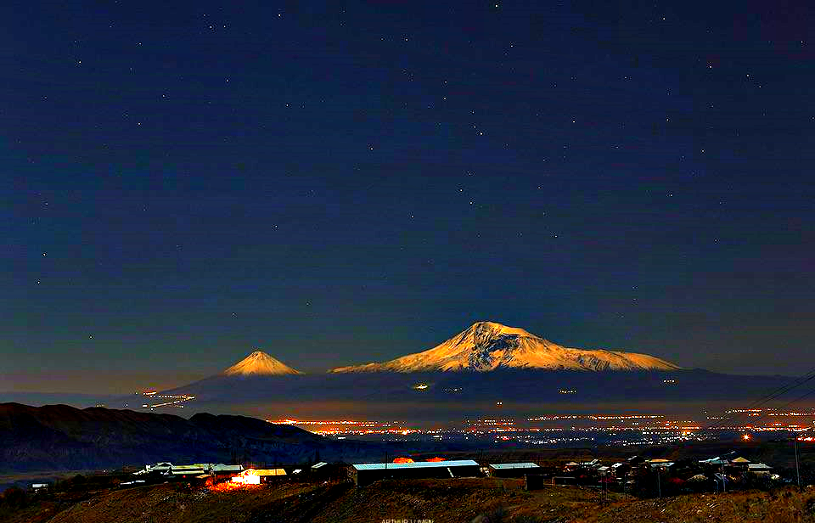
Nuclear Astrophysics in Armenia
Experimental possibilities with cyclotrons
Michael Wiescher
Joint Institute for Nuclear Astrophysics and University of Notre Dame
1: Nuclear Physics and Astrophysics
2: From the chemical evolution of the Cosmos to the evolution of stars
3: Theoretical questions and experimental response
4: Experimental facilities and opportunities
5: From stable to radioactive beams and back
6: Examples and opportunities (probing the threshold)

Slide 2
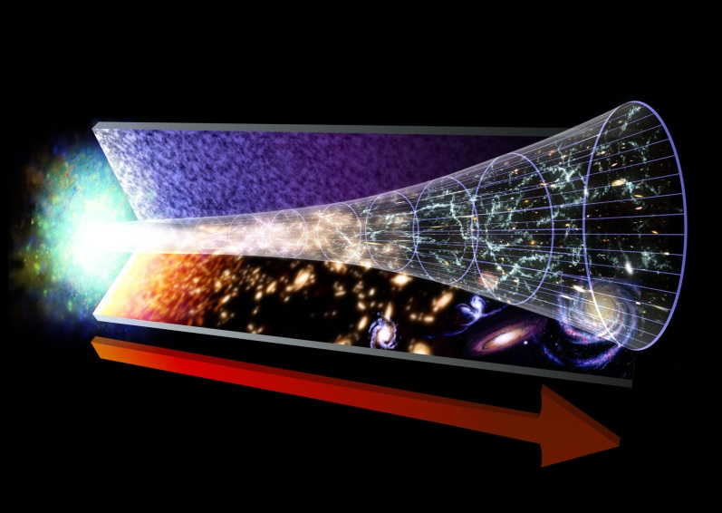
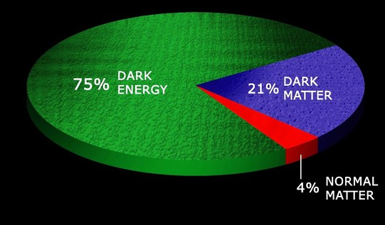
Nuclear Physics and Astrophysics
Four forces govern the physical phenomena in our universe since the Big Bang
The balance between the four forces
generates stable configurations of matter
We know that there are different kinds of matter, dark energy, dark matter, and baryonic matter
Nuclear physics considers the smallest component, the evolution of baryonic matter
The Micro-Cosmos drives
the Macro-Cosmos!

Slide 3
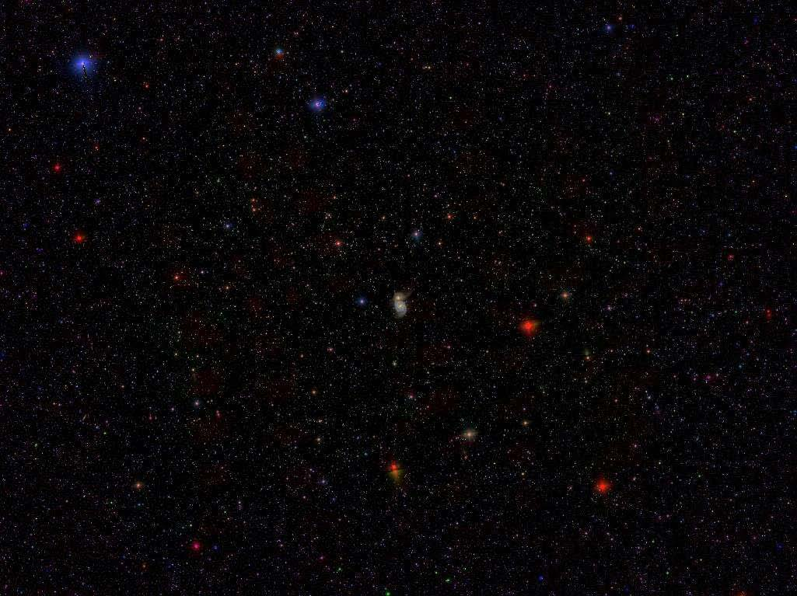
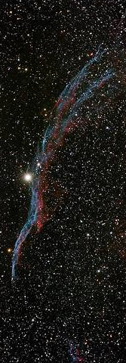
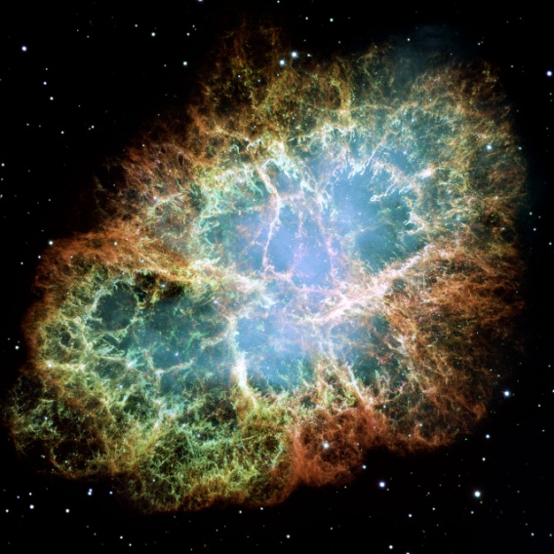
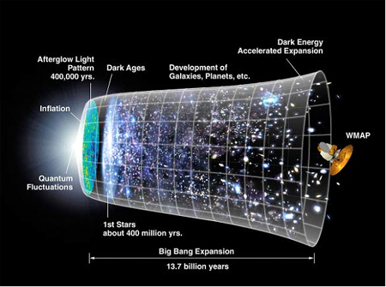
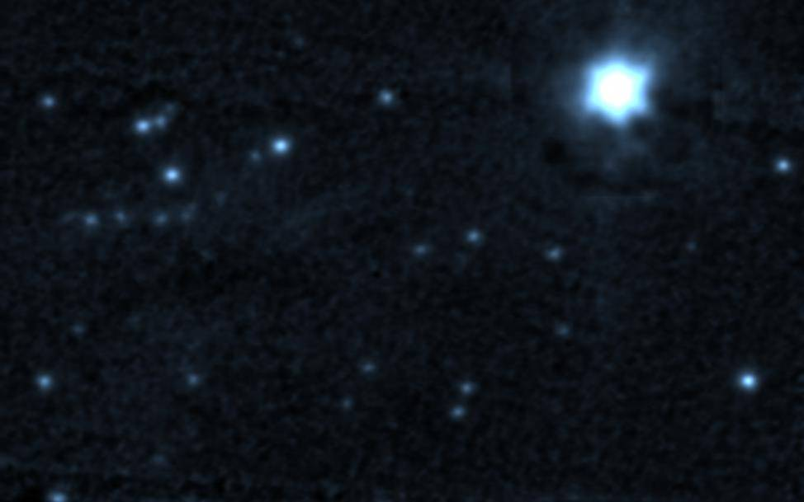
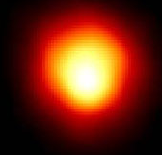
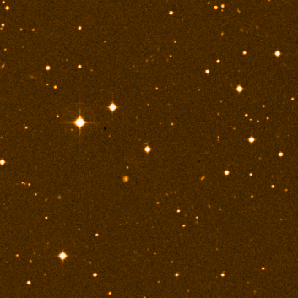
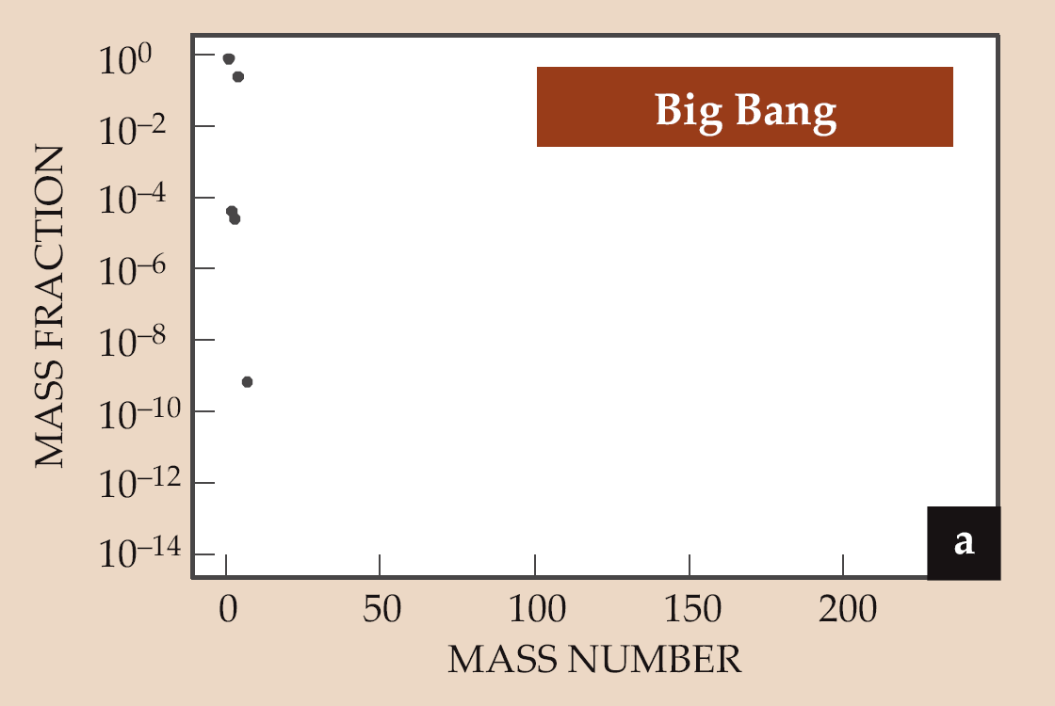
Galactic Chemical Evolution

Slide 4
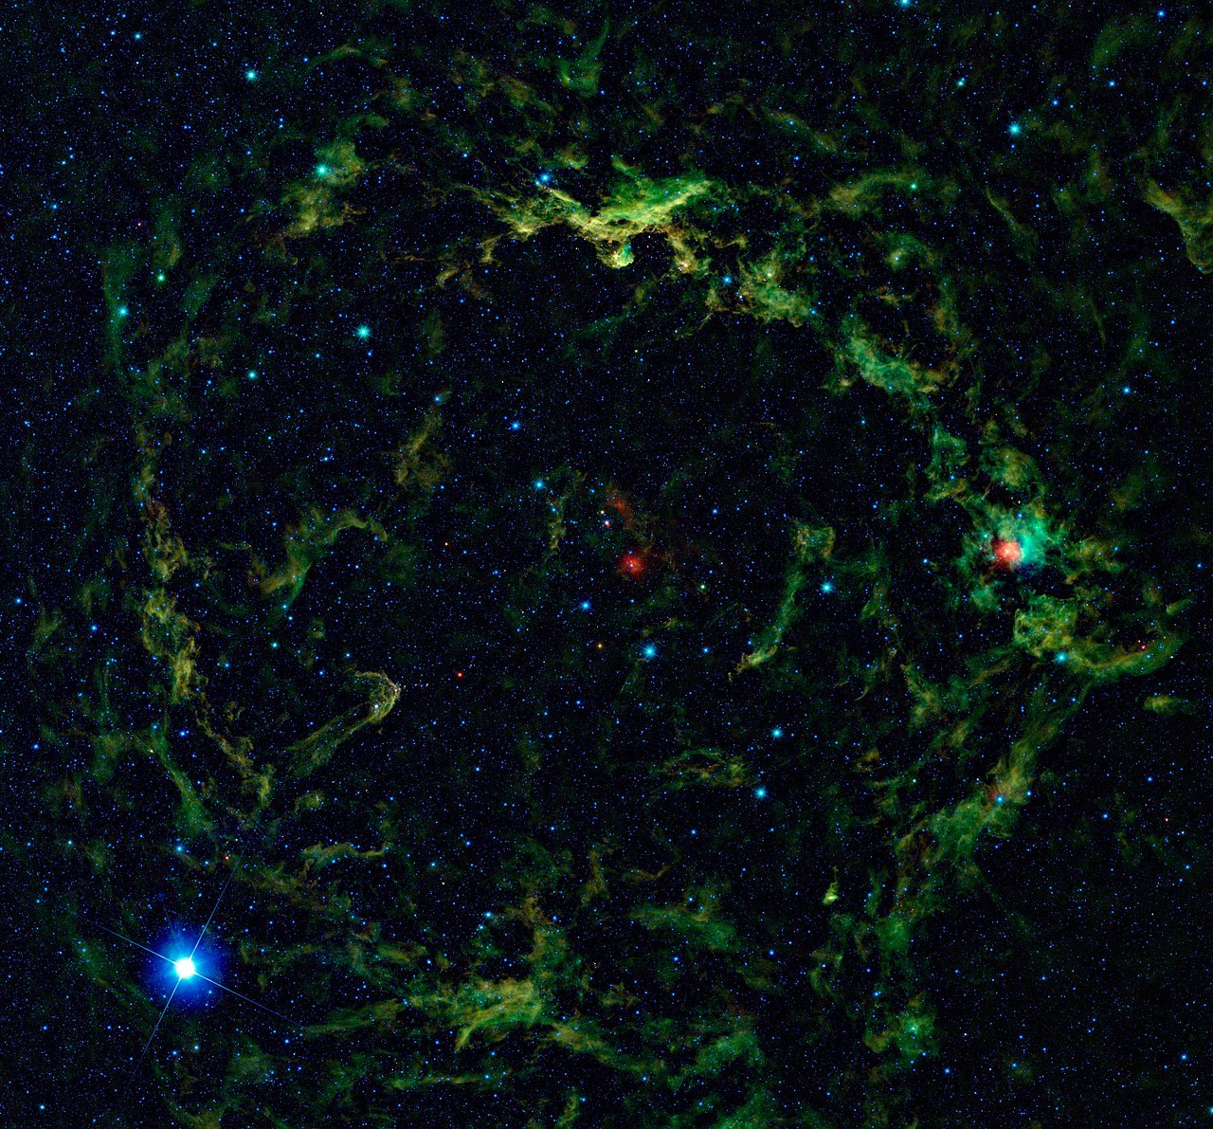
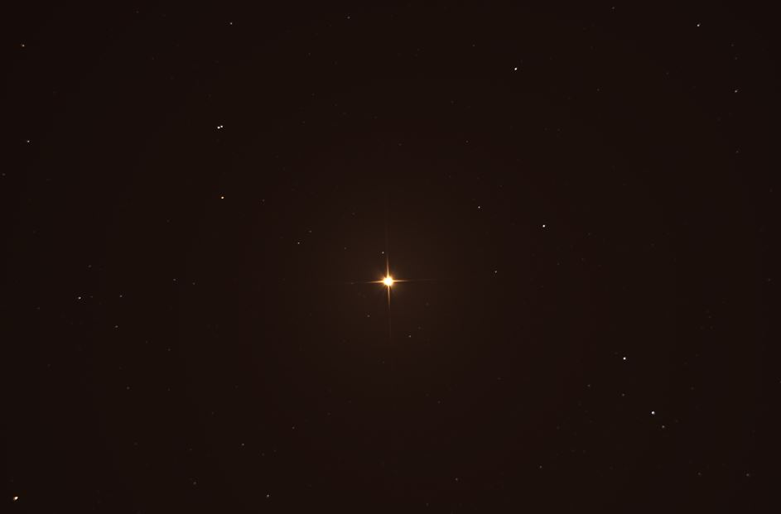
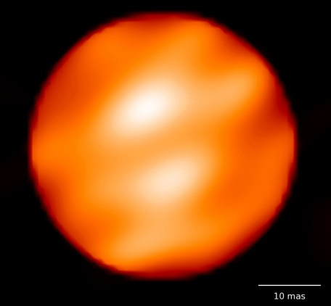
The engine of stars
Nuclear physics determines life and death of stars

Slide 5
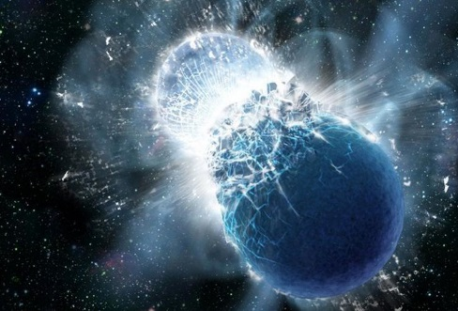
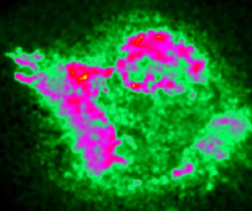
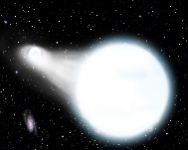
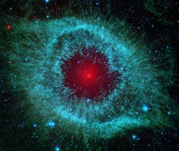
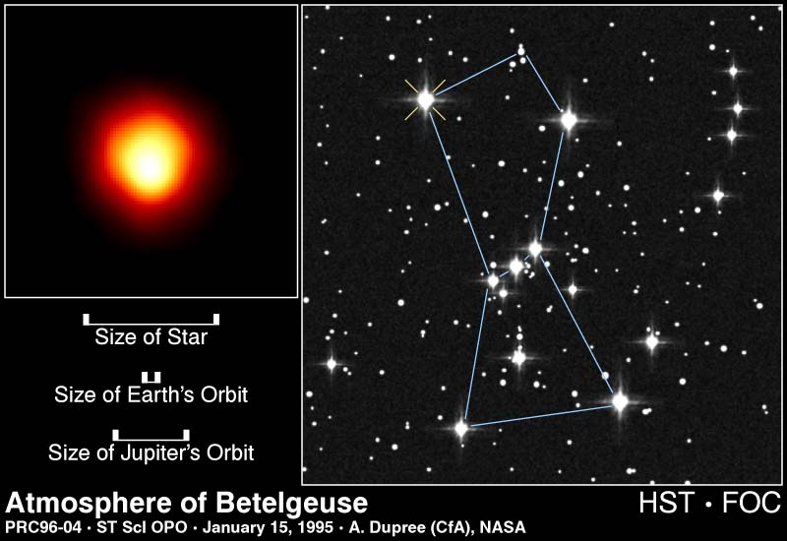
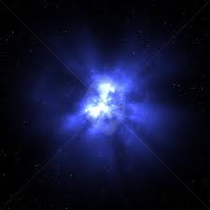
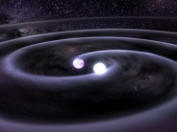
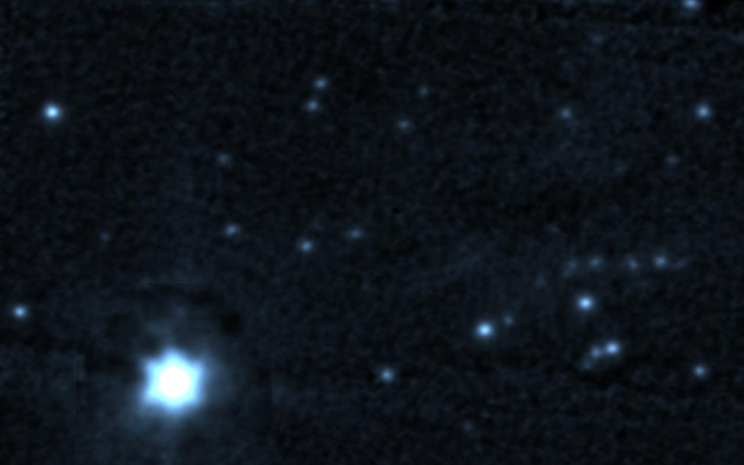
Stellar Evolution
10
Si-ignition
is characterized by low energy reaction sequences at different temperature and density conditions:
pp-chains,
CNO cycles
triple alpha process
s-process
Carbon/Oxygen fusion
rp-process
r-process
producing energy for maintaining stability, and provide seed for subsequent explosion in novae, supernovae, and X-ray bursts!
O-ignition
Ne-ignition
9
C-ignition
log (T_{c})
He-ignition
8
H-ignition
7
0
2
4
4
6
8
10
log (ρ_{c})

Slide 6
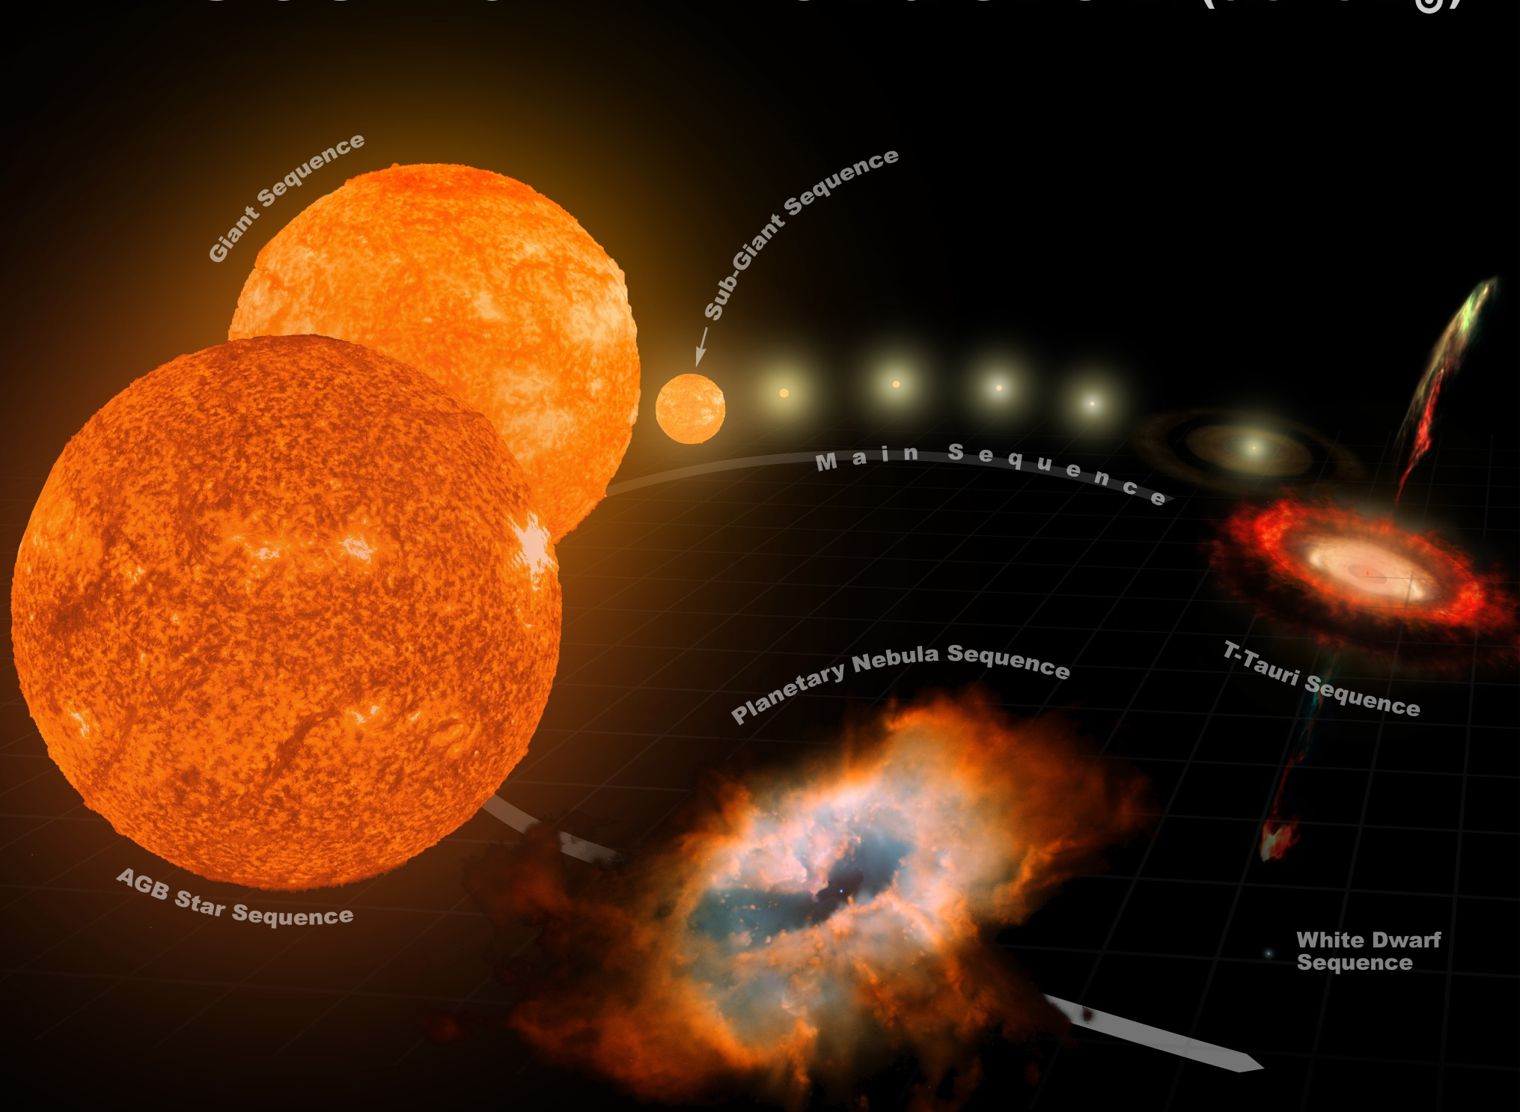
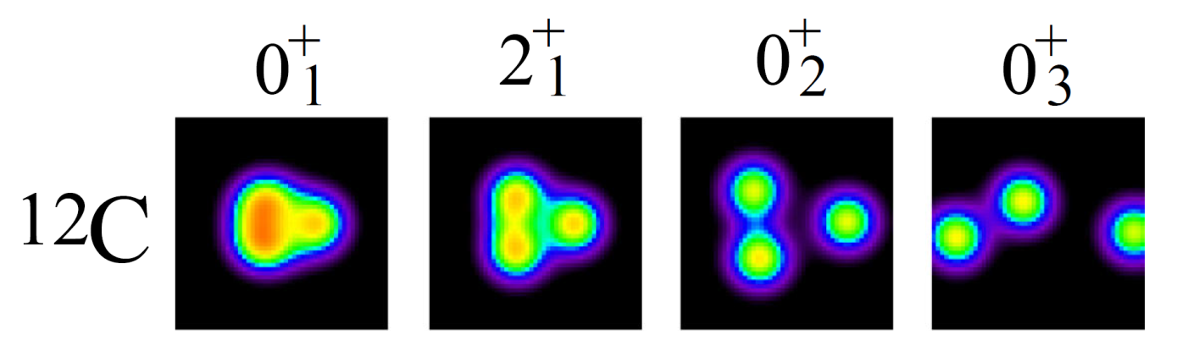
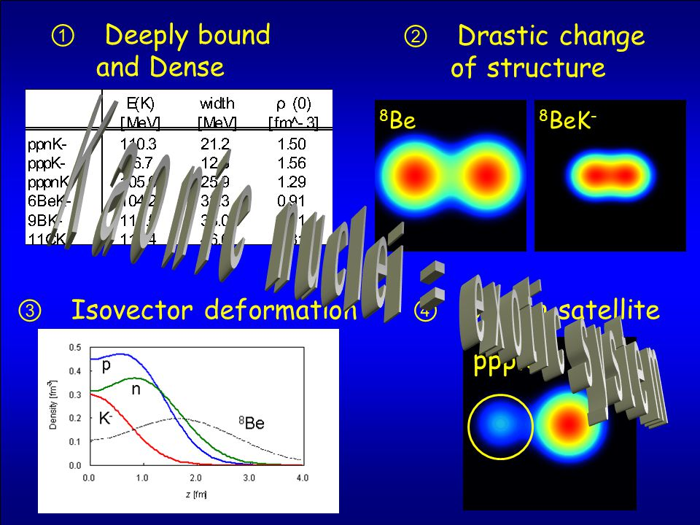
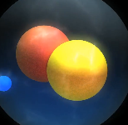
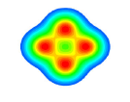
The nuclear physics of stellar evolution
¹²C Hoyle
State
²H
¹²C
¹⁶O
²⁴Mg

Slide 7
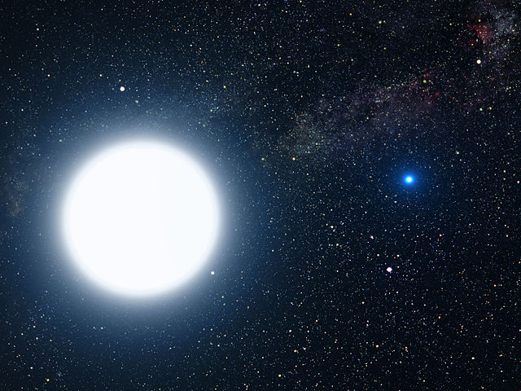
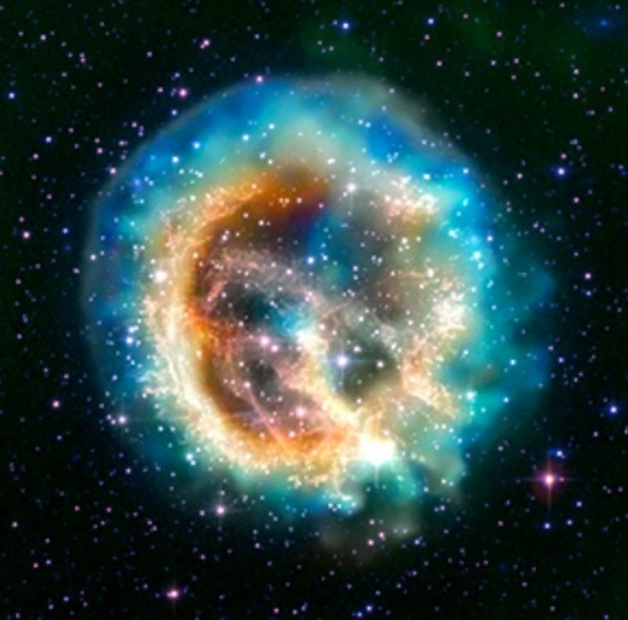
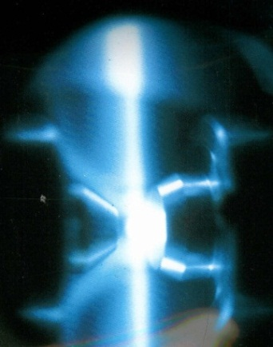

Mapping nucleosynthesis at a multitude of stellar environments

Slide 8
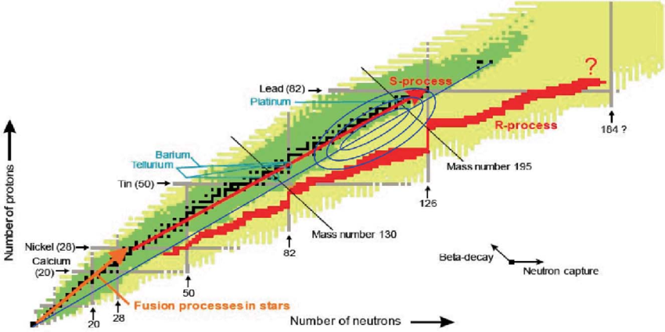
Nuclear reaction and reaction sequences
More than 60,000 nuclear reactions
On nearly 6000 isotopes,
Most of them based on models
Challenge of experiment
Slow and rapid neuton capture
rp-process
Light ion capture of protons and alphas

Slide 9
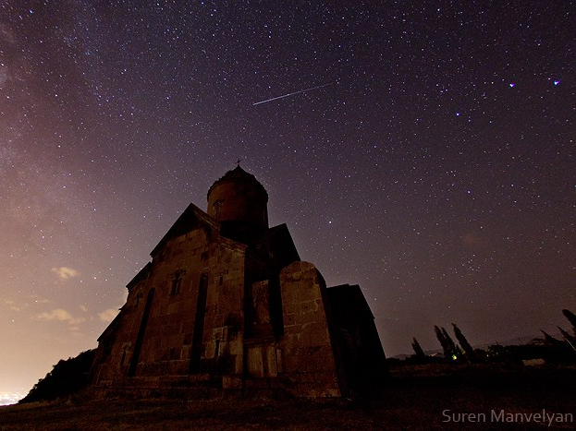
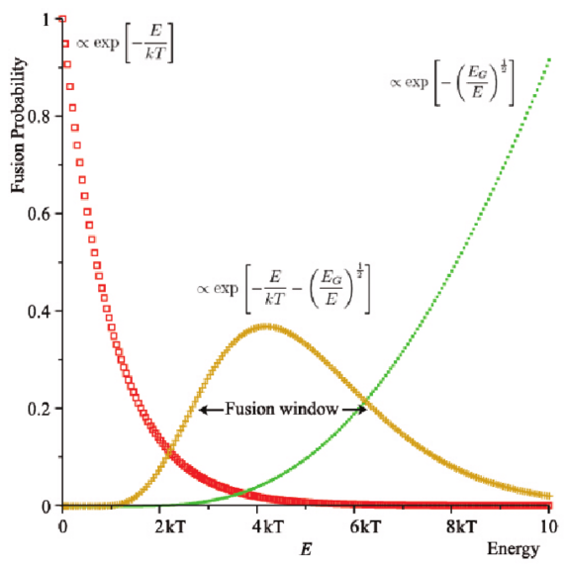
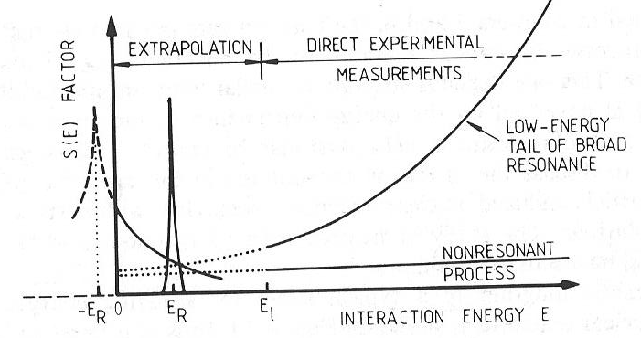
Theoretical questions and experimental response
Nuclear reactions at stellar energies is a quantum mechanical threshold problem, which depends sensitively on nuclear potentials and the wave functions of very low energy particles. Neither one is determined with sufficient accuracy! Also experiments are extremely challenging because of sub-pico-barn cross sections.
Gamow range defines the energy range
Reaction complexities such as threshold and subthreshold resonances with complex interference patterns
Phenomenological models, preferably multi-channel, multi-level R-matrix
Statistical models, preferably Hauser-Feshbach approach,
First principle models, are not developed far enough to get beyond reactions with A>12.

Slide 10
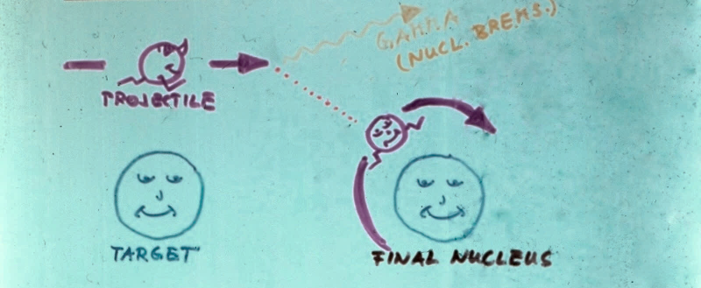
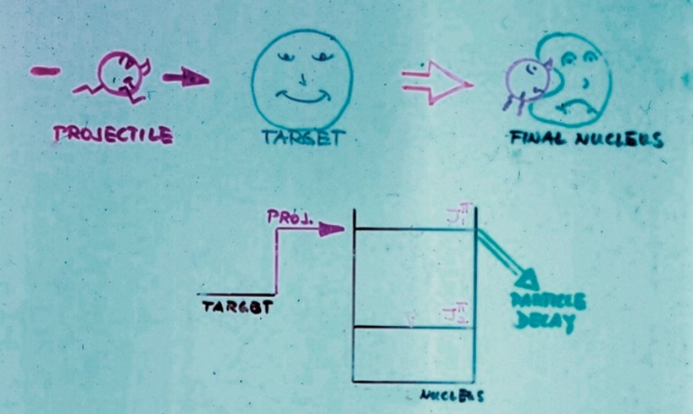
Transition from bound to continuum states
Often crude assumptions on wave functions at the threshold
Progress is handicapped by previous assumptions and approximations!
New theoretical models & techniques in reaction and structure modeling are necessary for progress in models near threshold and beyond stability!

Slide 11
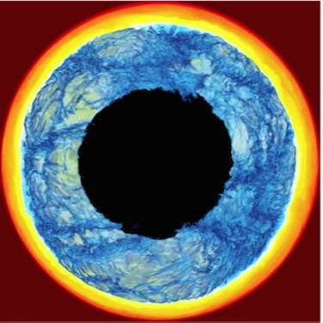
Coupling microphysics to 3d simulation
3D-Hydrodynamics simulation of the inside of a red giant star, where hydrogen rich fluid is ingested into a helium rich layer that undergoes an explosion driven by helium fusion reactions producing neutrons via ¹³C(α,n) and ²²N(α,n) reactions for the s-process.. (Herwig F, Woodward PR, Lin P-H, et al. (2014) ApJ 792 L3).

Slide 12
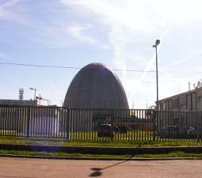
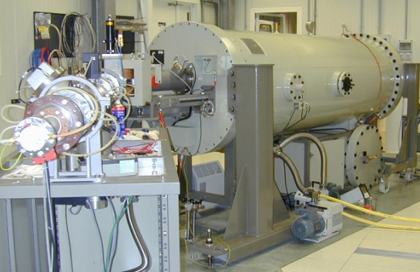
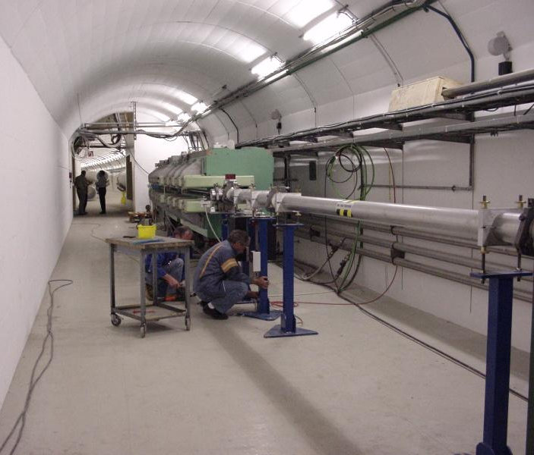
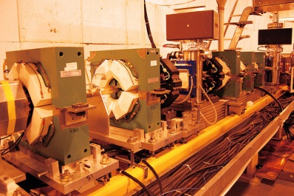
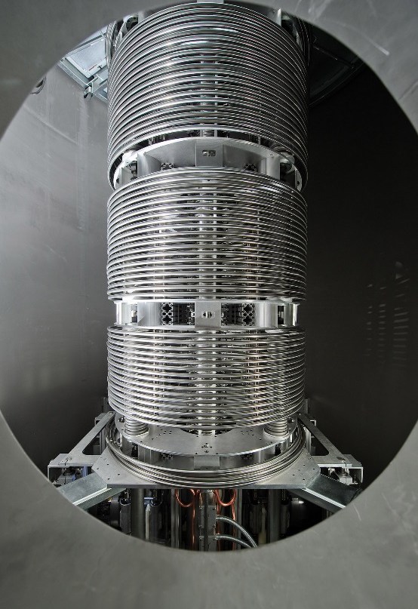
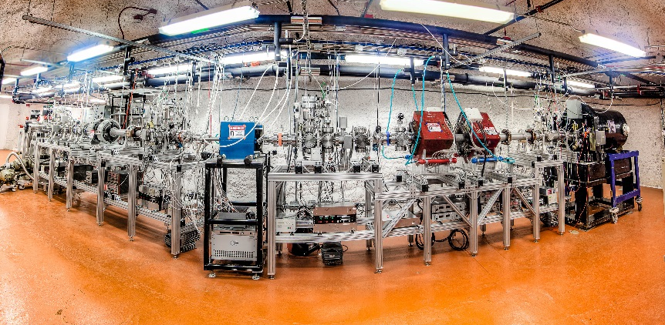
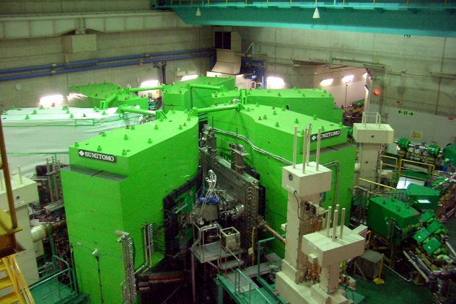

Experimental Techniques
The broad diversity of environments requires a broad diversity of tools

Slide 13
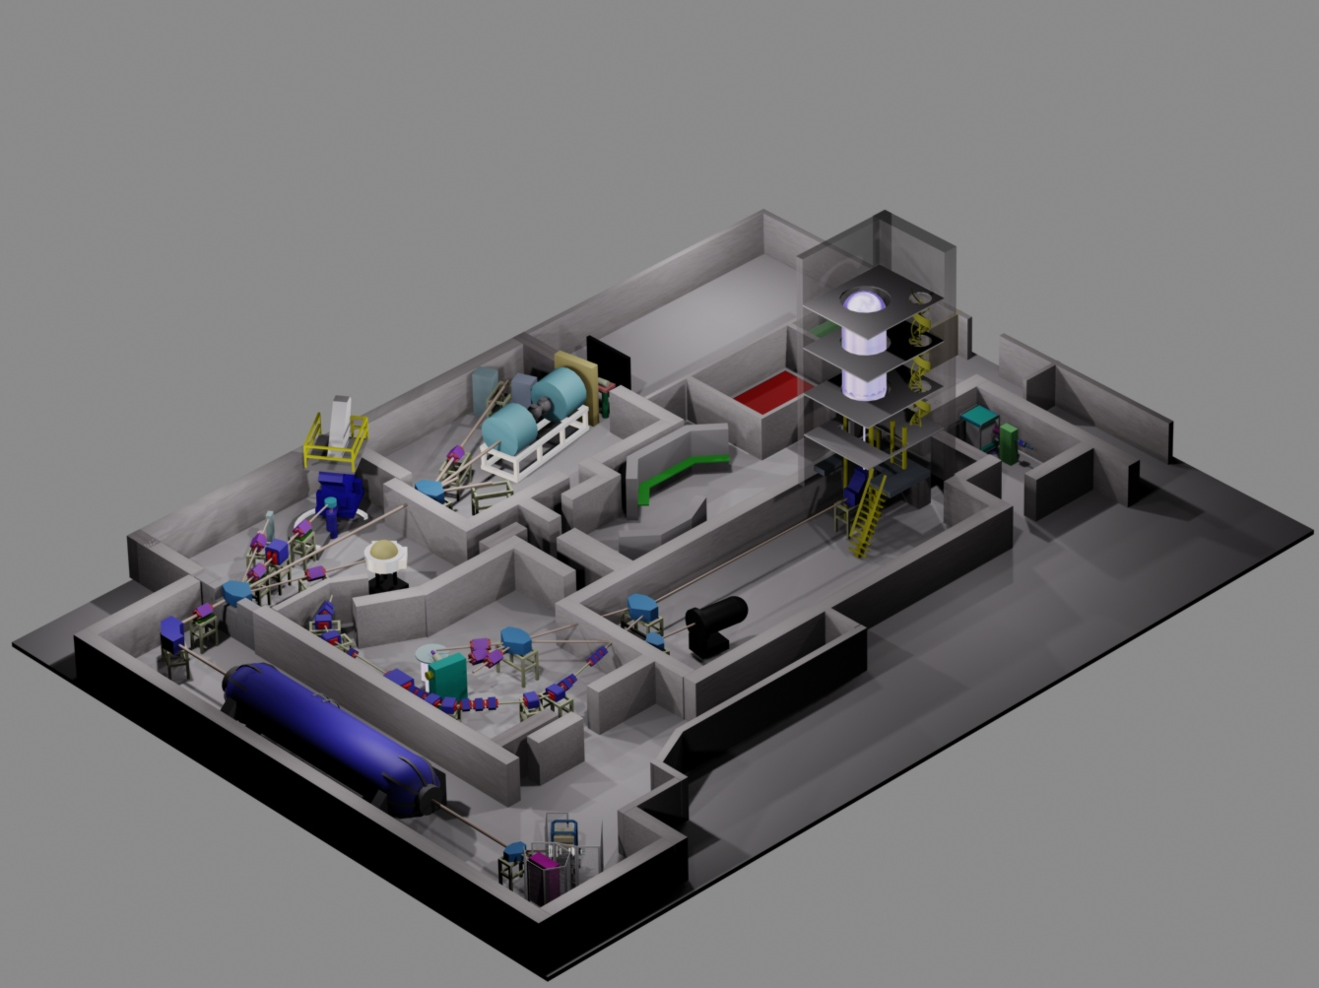
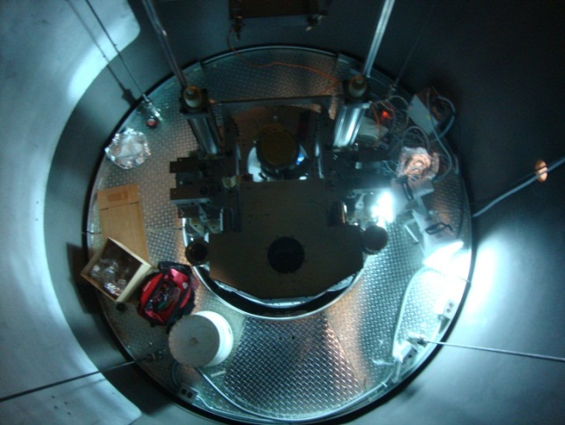
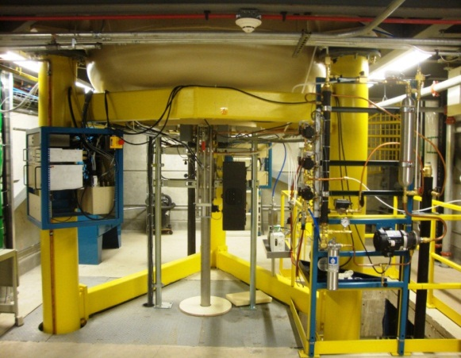
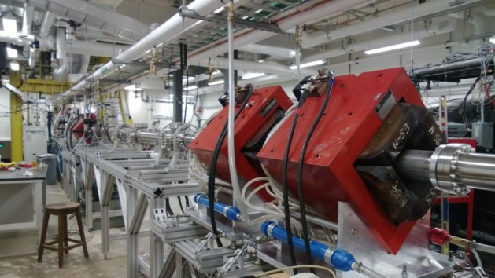
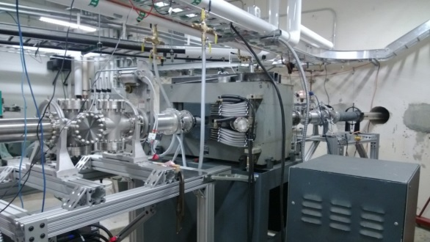
The NSL at Notre Dame
5 MV Pelletron accelerator with ECR source at the terminal for high (2⁺-3⁺) charge state beams
Provides beams in the
100 μA range in ¹H, ⁴He, ¹⁴N, ¹⁶O, ⁴⁰Ar, …

Slide 14
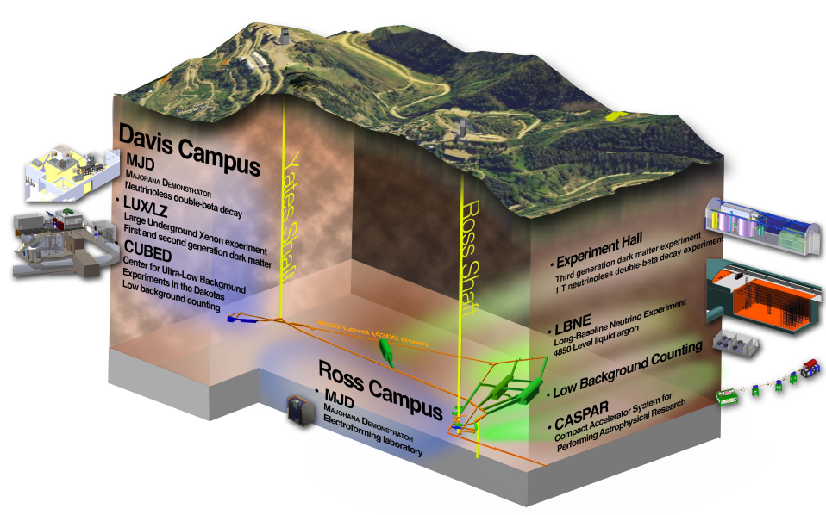






CASPAR underground accelerator
Compact Accelerator for Performing Astrophysical Research
Environmental Radioactivity
CR induced neutron spectrum
CR induced γ spectrum
underground gamma spectrum
(Gran Sasso)
underground neutron spectrum
(SURF, Soudan)
reduction by up to 5 orders of magnitude

Slide 15



Stellar Explosions
Shock driven explosion
core collapse supernovae
νp-process, r-process,
p-process: fuel is
determined by dissociation
and recombination processes
in collapse and seed abundance
in stellar layers!
Accretion driven explosion
- novae, type SN Ia, XR-bursts
Hot CNO, αp-process, rp- process, weak interaction, pycno-nuclear burning: fuel
is determined by accreted matter and by seed distribution in accreted layers!

Slide 16





RIKEN, GANIL, NSCL - cyclotrons for the production of high intensity radioactive beams
Nuclear astrophysics experiments in inverse kinematics using recoil separator techniques!

Slide 17





From brute force to surrogate processes
Using small scale cyclotrons (or other machines in the 18MeV range ) for direct single particle or alpha cluster transitions studies at sub-Coulomb energies – THM method, ANC approached with the goal of determining specific reaction characteristic through surrogate reaction channels
¹²C
¹²C
²⁴Mg
¹²C(¹⁴N, α²⁰Ne)²H and ¹²C(¹⁴N, p²³Na)²H
As surrogate for ¹²C+¹²C fusion in late stellar evolution and type Ia supernova ignition.
¹H
⁴He
²³Na
²⁰Ne

Slide 18






Transfer reactions as surrogates
¹²C(α,$$)¹⁶O α capture replaced by
¹²C(⁶Li,d) ¹⁶O α transfer
The ¹²C(α,γ)¹⁶O
¹²C(α,$$)¹⁶O determines ¹²C/¹⁶O ratio in our universe
Other, proton induced transfer studies provide powerful tools through (p,d), (p,p’γ)
for near threshold studies.
New beam developments!
¹⁶O
Facilitated by the cluster structure of bound and unbound ¹⁶O states

Slide 19




Conclusion
A few key reactions determine the origin of the elements, mostly dictated by nuclear structure as reflected in the characteristic features of the abundance distribution in our universe.
Low energy nuclear physics experiments, using direct and indirect techniques provide the key to many of the associated questions
Better theories are needed to provide intellectual and technical guidance for interpreting the data and deriving the nuclear reaction rates.
Երևանի երկինքը 2800 տարի առաջ
Երևանի երկինքը հիմա

