Slide 1
Overview of Studies of
Short Range Correlations in Nuclei
Misak Sargsian
Florida International University, Miami
Correlations in Partonic and Hadronic interactions
September 24 –28 2018, Yerevan, Armenia

Slide 2
#motivations:
High Density Fluctuations in Nuclei
Can such fluctuations be probed? – 2N, 3N SRCs
What they tell us about the nuclear forces at short distances
QCD/ Hadron transitions
Partons in the nuclear medum/EMC effects
Nature of the nuclear core
Nature of 3N forces
Astrophysical Implications

Slide 3
Conceptually: How to probe nuclei
at short nucleon separations
- Probe bound nucleons at large internal momenta
Need high energy probes to resolve such nucleons in nuclei
first such measurements have been done with 2GeV e beams
in Yerevan in 1980s

Slide 4
Emergence of Short-Range Correlations
-- Back to Lipmann-Schwinger Equation
-- Assume: system is dilute
-- Assume:
Amado, 1976
-- For large
Frankfurt, Strikman 1981

Slide 5
1.Short-Range Correlations
Frankfurt, Strikman Phys. Rep, 1988
Day,Frankfurt, Strikman, MS, Phys. Rev. C 1993
- Experimental observations
Egiyan et al, 2002,2006
Fomin et al, 2011

Slide 6
Nuclear Scaling in QE Inclusive A(e,e’)X reaction at x>1 region
Day, Frankfurt, MS, Strikman, PRC 1993

Slide 7
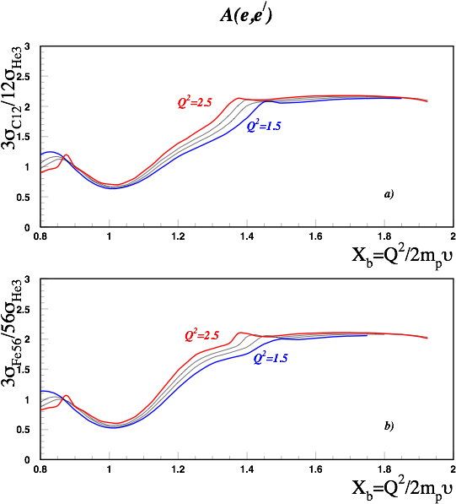
Day, Frankfurt, MS, Strikman, PRC 1993

Slide 8
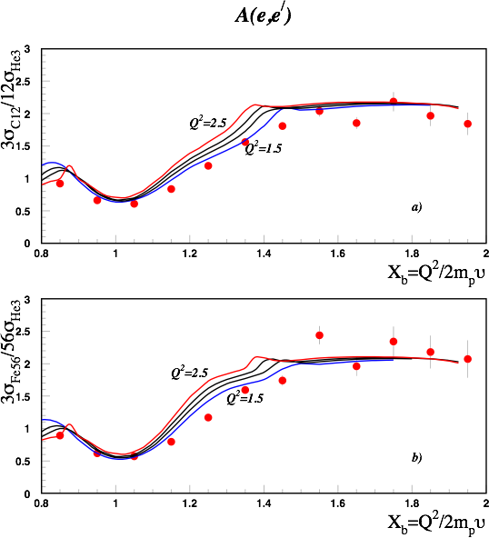
Egiyan, et al PRC 2004

Slide 9
Fomin et al PRL 2011

Slide 10
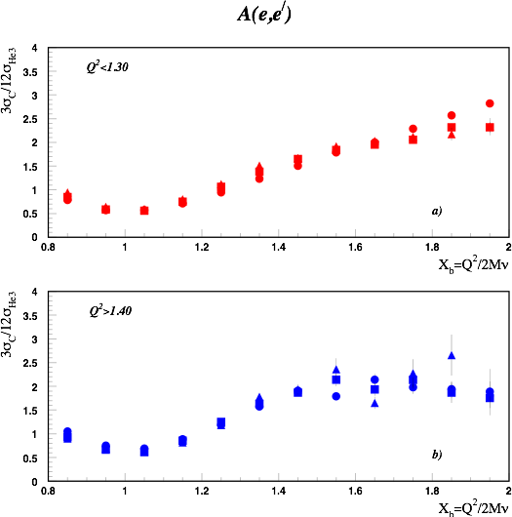

Slide 11


Meaning of the scaling values
Day, Frankfurt, MS, Strikman, PRC 1993
Frankfurt, MS, Strikman, IJMP A 2008
Fomin et al PRL 2011
Egiyan, et al PRL 2006, PRC 2004

Slide 12
a2’s as relative probability of 2N SRCs

Slide 13

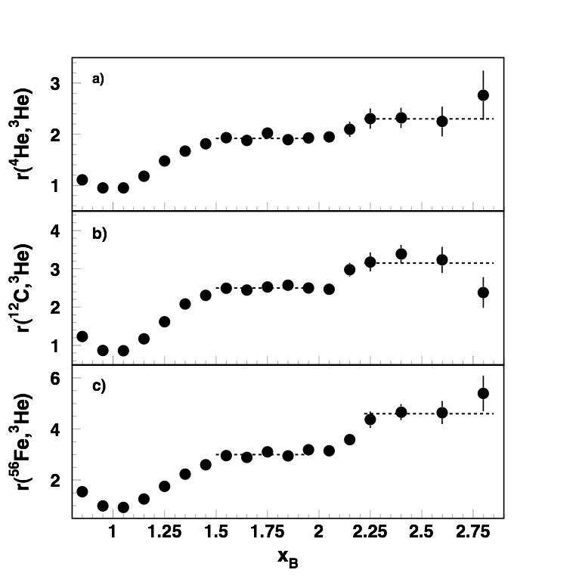
Towards Three Nucleon Short Range Correlations
Looking for the Plateau in Inclusive Cross Section Ratios x>2
Egiyan, et al PRL 2006

Slide 14
3N SRCs
Z. Ye, at al, 2017
Looking for the Plateau in Inclusive Cross Section Ratios x>2
Egiyan, et al PRL 2006
Egiyan, et al PRC 2004

Slide 15


2. Dominance of the (pn) component of SRC
Theoretical analysis of BNL Data
E. Piasetzky, MS, L. Frankfurt,
M. Strikman,J.Watson PRL , 2006
Direct Measurement at JLab
R.Subdei, et al Science , 2008
pn
Factor of 20
pp
Expected 4
(Wigner counting)

Slide 16
Theoretical Interpretation

Slide 17
Implication of pn SRC Dominance in Different
Nuclear Phenomena
1. Momentum sharing in asymmetric nuclei
Two New Properties of High Momentum Component
- Energetic Protons in Neutron Rich Nuclei

Slide 18
3. Two New Properties of Nuclear High Momentum Component
-- Dominance of pn Correlations
(neglecting pp and nn SRCs)

Slide 19
First Property: Approximate Scaling Relation
-if contributions by pp and nn SRCs are neglected and
the pn SRC is assumed at rest
MSargsian
Phys. Rev. C 2014

Slide 20
Be9 Variational Monte Carlo Calculation:
Robert Wiringa 2014
http://www.phy.anl.gov/theory/research/momenta/

Slide 21
Second Property: Fractional Dependence of
High Momentum Component
with
In the limit
Momentum distributions of p & n are inverse
proportional to their fractions

Slide 22
Predictions: High Momentum Fractions
MSargsian
Phys. Rev. C 2014
A Pp(%) Pn(%)
12 20 20
27 23 22
56 27 23
197 31 20
Requires dominance of pn SRCs
in heavy neutron reach nuclei
O. Hen et.al. Science, 2014
Direct Measurement
M. Duer et al. Nature 2018

Slide 23
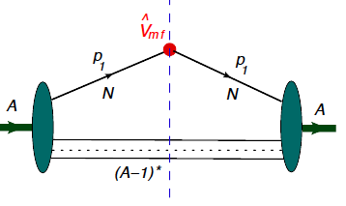
Spectral Function Calculations

Slide 24
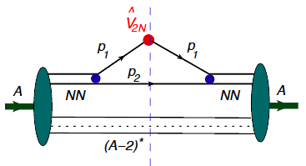
2N SRC model
O. Artiles & M.S. Phys. Rev. C 2016

Slide 25
2N SRC model
Non Relativistic Approximation

Slide 26
2N SRCs:
Proper Variables of 2N SRC are
the Light Front Momentum Fraction:
transverse momentum:

Slide 27
Nuclear Scaling in QE Inclusive A(e,e’)X reaction at x>1 region
Day, Frankfurt, MS, Strikman, PRC 1993

Slide 28
Back to inclusive A(e,e’)X scattering
J.Arrington, D.Higinbotham
G.Rosner, M.S. Prog. PNP 2012
N.Fomin, D.Higinbotham
M.S., P.Sovignon ARNPS, 2017

Slide 29
Three Nucleon Short Range Correlations
Z. Ye, at al, 2017
Looking for the Plateau in Inclusive Cross Section Ratios x>2

Slide 30
3N SRCs:
Proper Variables of 3N SRC are
the Light Front Momentum Fraction:
transverse momentum:

Slide 31
3N SRC model

Slide 32
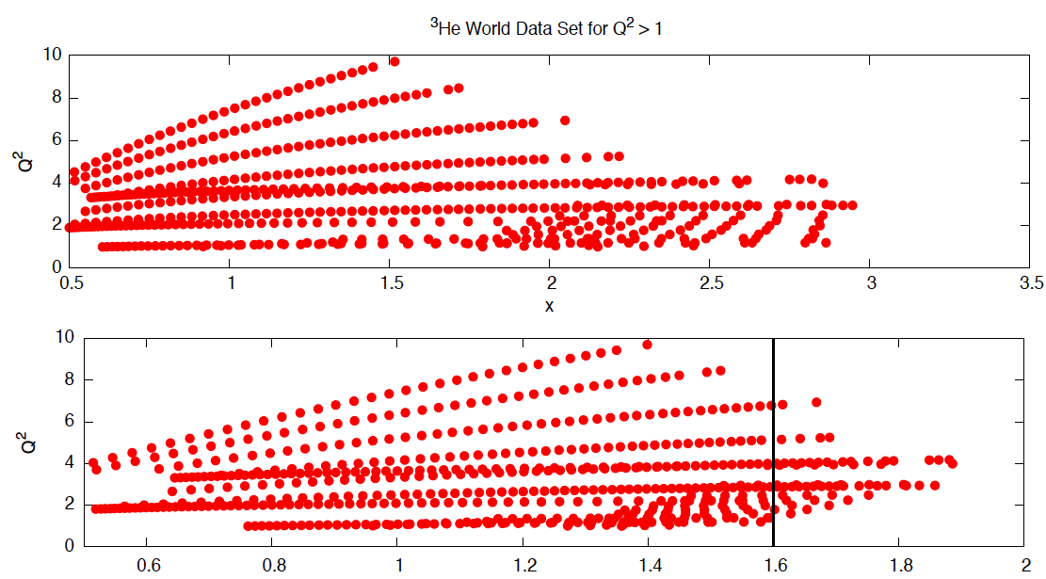
3N SRC model
Donal Day, M.S., Frankfurt, Strikman 2018

Slide 33
3N SRCs
JLab - E02019 - Data

Slide 34
3N SRC model
JLab - E02019 - Data

Slide 35
3N SRC:
Light-Cone Momentum Fraction Distribution
A.Freese, M.S., M.Strikman, Eur. Phys. J 2015
O. Artiles M.S. Phys. Rev. C 2016

Slide 36
3N SRC:
Light-Cone Momentum Fraction Distribution

Slide 37
3N SRC:
Light-Cone Momentum Fraction Distribution
- For A(e,e’) X reactions:
- Defining:
- We predict:
- Where:
where:

Slide 38
3N SRC:
Light-Cone Momentum Fraction Distribution

Slide 39
3N SRC model

Slide 40
3N SRC model
D.Day, L.Frankfurt,M.S, M.Strikman
ArXiv 2018

Slide 41
3N SRC model
Defining:
One relates:
D.Day, L.Frankfurt,M.S, M.Strikman
ArXiv 2018

Slide 42
3N SRC Summary & Outlook
- Proper variable for studies of 2N and 3N SRS are
Light-Cone momentum fractions:
- It seems we observed first signatures of 3N SRCs in the form of the “scaling”
- Existing data in agreement with the prediction of:
- Unambiguous verification will require larger Q2 data to cover larger
region
- Reaching Q2 > 5 GeV2 will allow to reach:

Slide 43
3N SRC Outlook

