Slide 1
Correlations
in
Hadronic and Partonic Interactions
Sept 24-28, 2018
Armenia
Notes:
Good Morning…It is my great pleasure to welcome you to Armenia for this international conference on Correlations in Partonic and Hadronic Interactions…
It is an exciting time for your field and I hope you will have a very successful meeting.

Slide 2
US NAS study Co-chairs: August, 2018
Ani Aprahamian
Gordon Baym
Notes:
The US National Science Academy just released its report in August of 2018 on the science of the electron ion collider….and this chart for the general enthusiast….but for your group ..the more technical aspects of the questions as a function of COM energy and luminosity

Slide 3
Bottom Line
The committee unanimously finds that the science that can be addressed by an EIC is compelling, fundamental, and timely.
The unanimous conclusion of the Committee is that an EIC, as envisioned in this report, would be a unique facility in the world…
The project is strongly supported by the nuclear physics community.
The technological benefits of meeting the accelerator challenges are enormous, both for basic science and for applied areas that use accelerators, including material science and medicine.
Notes:
The last piece in understanding the nature of matter….visible matter in the universe…and the emergent interaction of gluonic matter

Slide 4
Welcome to Yerevan, Armenia
Notes:
Yerevan is now celebrating its 2800th anniversary…but there are artifacts here dating back to 8000BC…it is one of the longest continuously occupied cities in the world…..I was very fond of telling my nieces and nephews…that “we are the ancient ones”…..

Slide 5
1943 as Yerevan Physics Institute
2011 National Science Laboratory of Armenia

Slide 6
DESY
HERMES
CERN – ATLAS, CMS, LHC
Armenia had the highest energy electron synchrotron (6 GeV) in the Soviet Union. In 1967, Armenia had built a 6 GeV electron accelerator.
CEBAF accelerator at 6 GeV at Thomas Jefferson National Laboratory in Newport News, the team of physicists from Armenia became one of the most important external collaborating groups at that laboratory.
Notes:
Armenia had the highest energy electron synchrotron (6 GeV) in the Soviet Union. With the construction of the CEBAF accelerator at 6 GeV at Thomas Jefferson National Laboratory in Newport News, the team of physicists from Armenia became one of the most important external collaborating groups at that laboratory. Particle physicists from Armenia designed, tested and performed the commissioning of the TOF system for the OLYMPUS spectrometer at DESY and continue with the data analysis from the HERMES and H1 experiments. There are also robust groups from YerPhi on the CMS, ALICE, and ATLAS experiments located at the LHC. The groups from Armenia work on the construction, performance optimization, and calibration of various ATLAS and CMS systems.

Slide 7
Present Science Areas
High Energy Physics & Astrophysics
Medium Energy Nuclear Physics
Cosmic Ray Physics, High Energy Physics in Atmosphere
Instrumentation Development (Applications)
Center of Theoretical physics named after Matinyan
Solid state Physics
Notes:
Only cosmic ray physics in Armenia;;

Slide 8
US Patent received by Prof. V.G. Gurzadyan on an invented method of study of human genome
Patent number: 10068050; Date of Patent: Sep 4, 2018
US patent entitled “Revealing somatic sequences in human genome via Kolmogorov-Arnold technique” is received by inventors Vahagn Gurzadyan and Branislav Vlahovic (Chapel Hill, NC, USA). The document states that Kolmogorov-Arnold analysis is invented as a tool for the study of tumor and normal coding in human genomics sequencing to identify tumor-specific (somatic) sequences and copy number alterations. The technique enables to reveal quantitatively somatic sequences in the dataset of the genomic DNA purified from tumor and normal specimens. The computer power requirements for an analysis are modest ones.
Prof. Gurzadyan with students and collaborators have previously used that method for the analysis of the Cosmic Background radiation.

Slide 9
Gurzadyan and Margaryan

Slide 10
FERMILAB: September 18, 2018
First particle tracks seen in prototype for international neutrino experiment
The Long-Baseline Neutrino Facility and Deep Underground Neutrino Experiment is the largest particle physics project ever built in the United States.
ARMENIA

Slide 11
“Space Environment Viewing and Analysis Network” (SEVAN) aims to improve the fundamental research on particle acceleration in the vicinity of sun, Space Weather environments, high-energy physics in atmosphere and lightning initiation.

Slide 12
Armenian Geophysical Network

Slide 14
Low Energy Nuclear Science
Nuclear Energy
New Programs
+ Areas of traditional
expertise
Cosmic Ray Physics
High Energy Physics
Collaborations
JLAB, DESY, CERN, DUBNA
BELLE-2, DUNE
Nuclear Medicine
Nuclear Methods for studying
Art & Cultural Heritage
National Laboratory of Armenia

Slide 15
18 MV Cyclotron from IBA

Slide 16
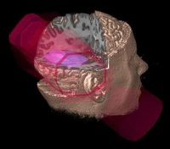
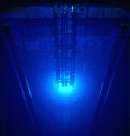
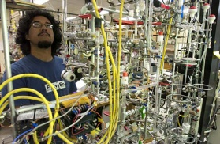
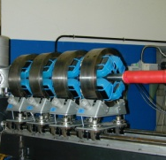
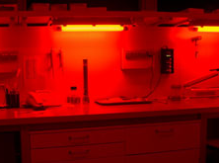
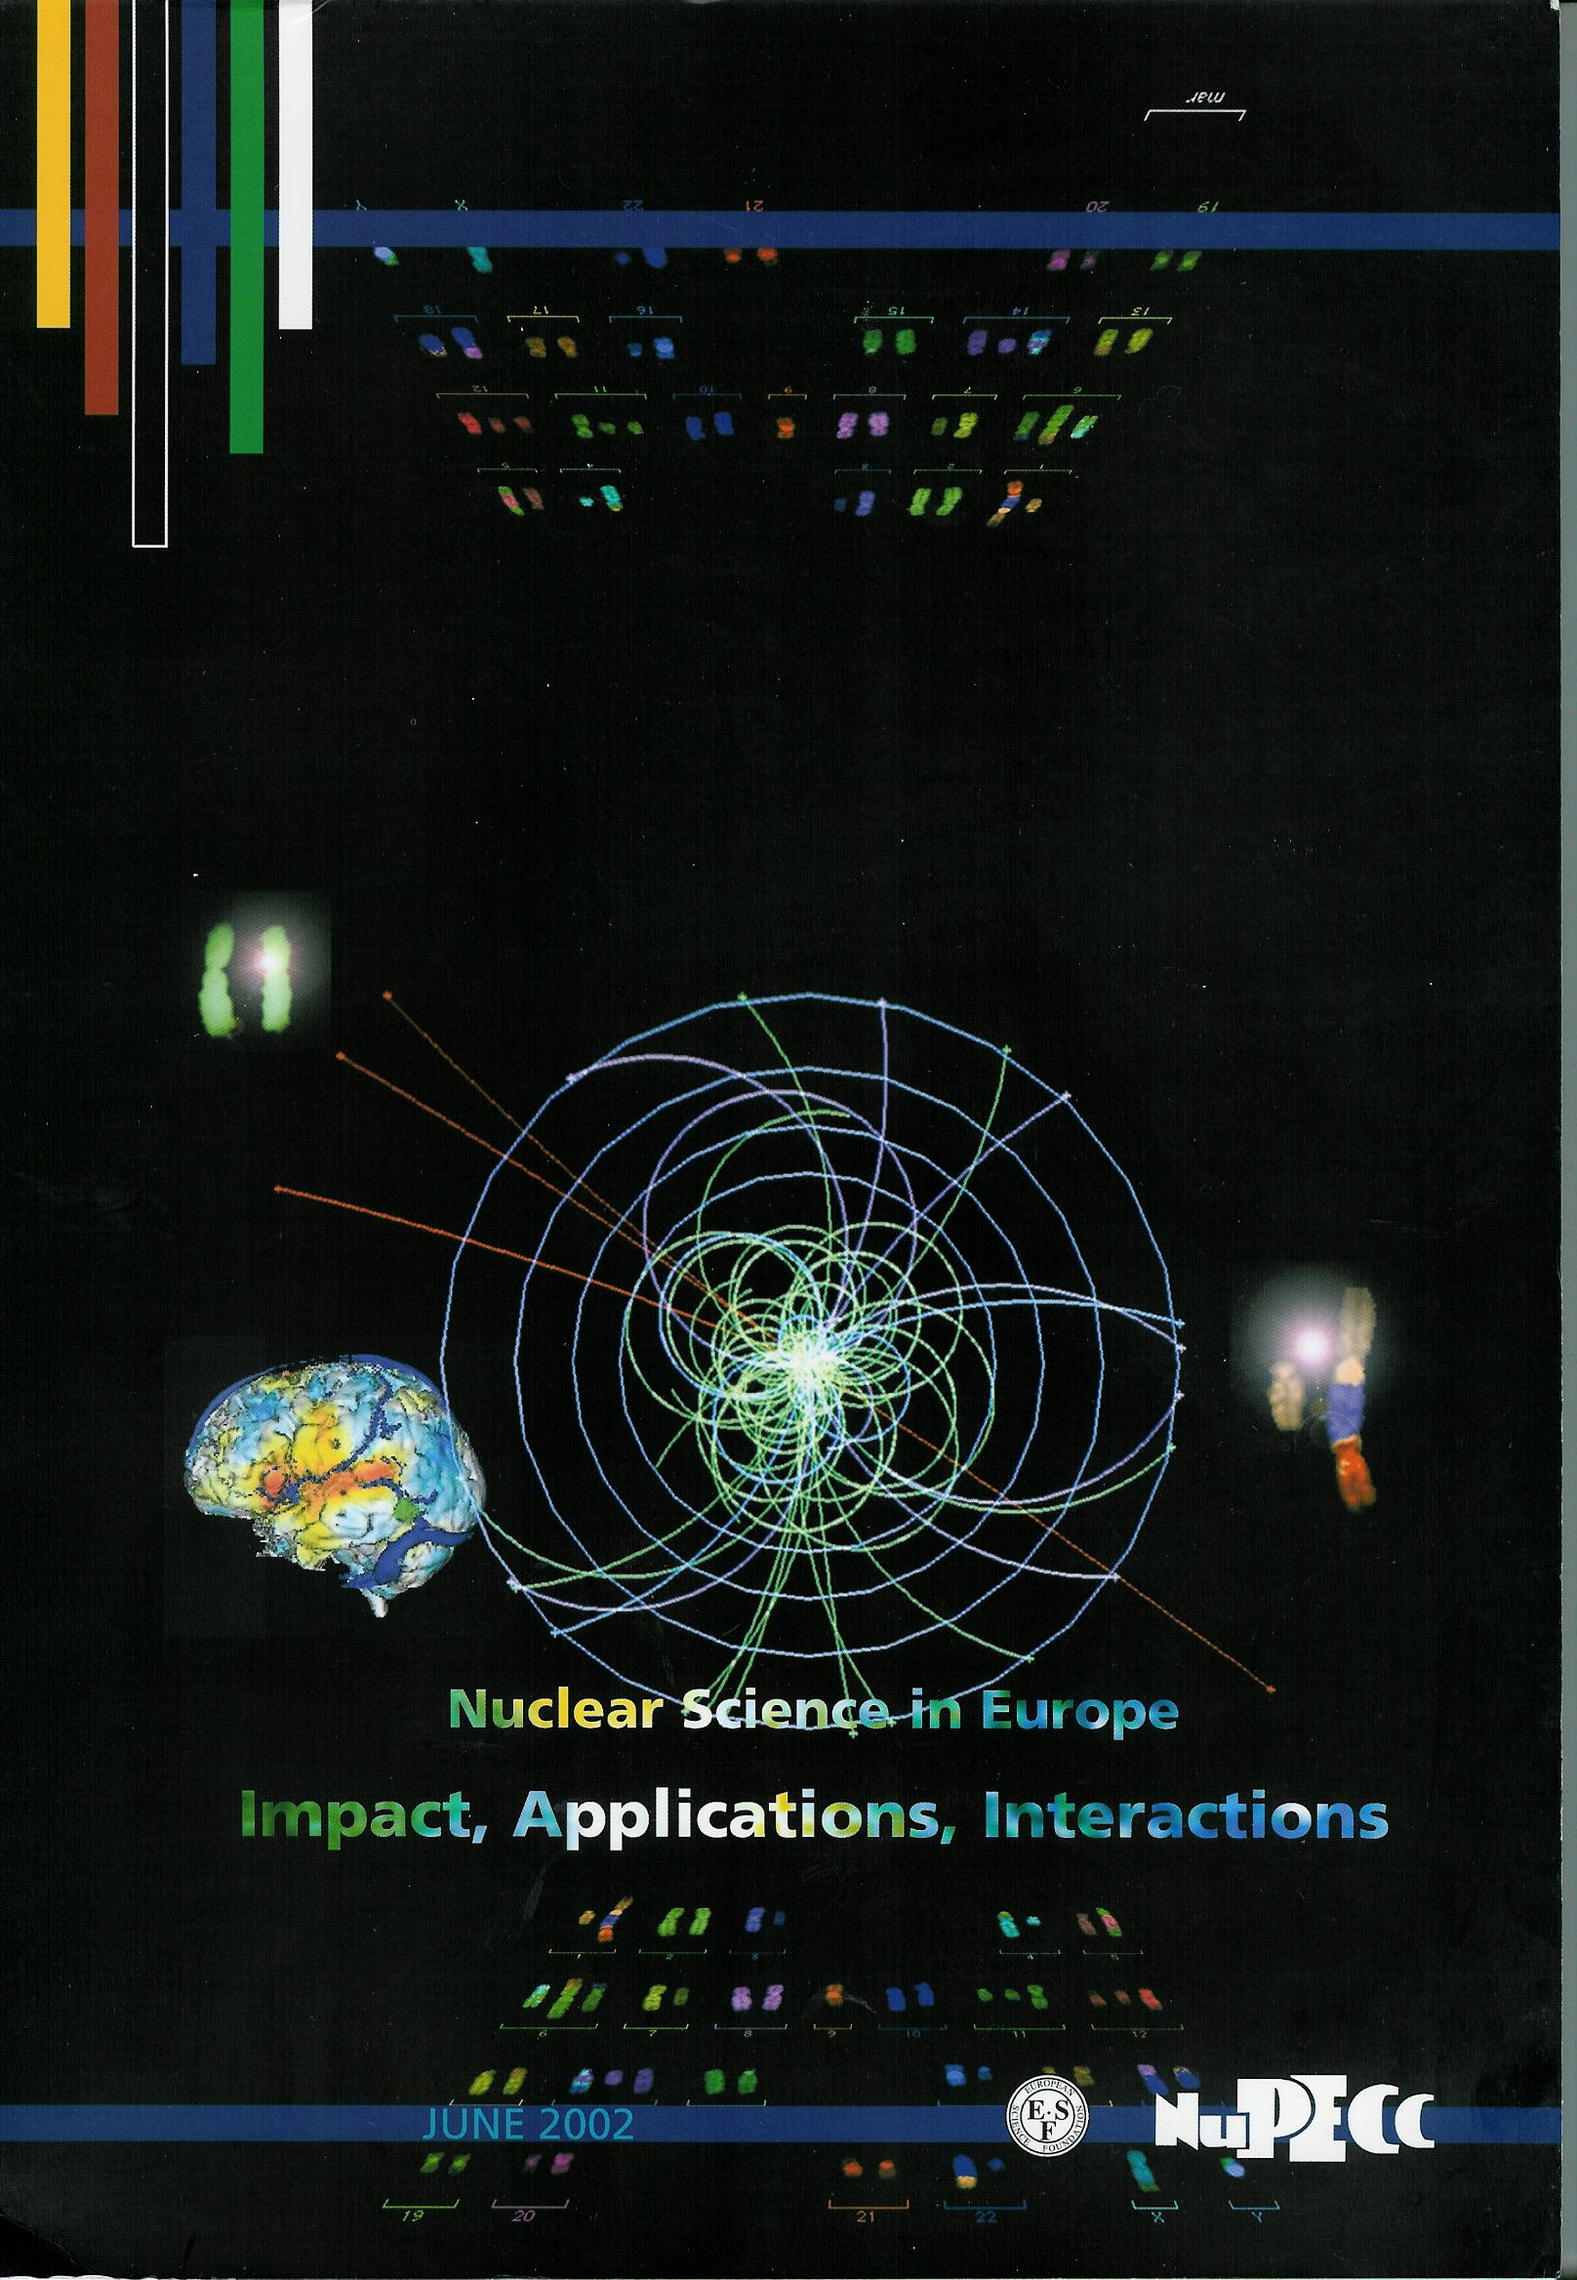
Nuclear Physics Applications
Energy
ADS systems
Fusion confinement
Nuclear Waste
Nuclear Data
Nuclear Forensics
Homeland Security
Risk Assessments
Nuclear Trafficking
Proliferation
Climate Change
Mining- Environment
Electronics
Health
Life Sciences
Medical Diagnostics
Medical Therapy
Radiobiology
Biomedical tracers
Material Analysis
Ion Implantation
Material Structure
Geology & Climate
Environment
Art & Archaeology
Nuclear Defense
Weapon Analysis
Functionality Simulation
Long-Term Storage

Slide 17
Welcome to Armenia
…..
75th Anniversary of Founding of the Laboratory
Hands-on Outreach event
Saturday Sept. 29, 2018
10:20am

