Slide 1
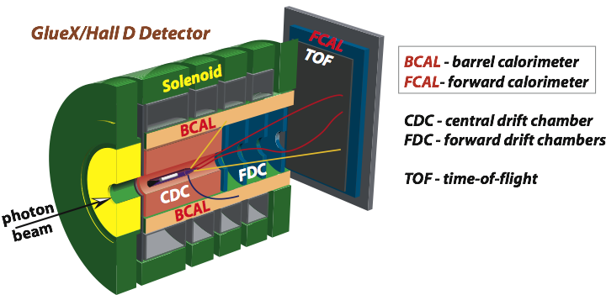
Photoproduction of Vector Mesons off Nuclei
A. Somov (JLab)
A. Gasparyan (NC A&T), L. Gan (UNCW), S. Gevorkyan (JINR), I. Larin (UMas, ITEP)
and GlueX Collaboration
PR 12 -18 -001
P AC 46, July 17, 2018
Physics motivation
Theoretical predictions
Reconstruction of vector mesons
Projected errors
Run conditions and beam request

Slide 2
Goals of the Experiment
Measure photoproduction cross sections of vector mesons ω, ρ, and φ
on C, Si, Sn and Pb targets in the energy range of 6-9 GeV with the
GlueX detector
Extract nuclear transparency (A_{eff} = σ_{A} / σ_{N} ) at different energies
Extract spin density matrix elements
Extract cross section of longitudinally polarized ω mesons on
nucleon, σ_{L} (ω N), using two measurements:
- nuclear transparency A_{eff}
- spin density matrix element ρ^{A}₀₀

Slide 3
Why is it Important ?
According to theoretical predictions, hadronic structure of
photon leads to the decrease of the nuclear transparency A _{eff}
with energy (increase of the coherence length )
- observed decrease of the nuclear transparency in
photoproduction of π⁰ mesons is smaller than theoretically
predicted. The same discrepancy takes place in ρ meson
photoproduction, where experimental data are scarce
l_{c}= $\frac{2ν}{M^{2}+Q^{2}}$
There are experimental indications that σ_{L} (VN) < σ_{T} (VN),
but there have been no direct measurements of σ_{L} (VN) so
far. Measurements of σ_{L} are important for:
- comparison between different theoretical approaches
- interpretation of the color transparency in vector meson
electroproduction

Slide 4
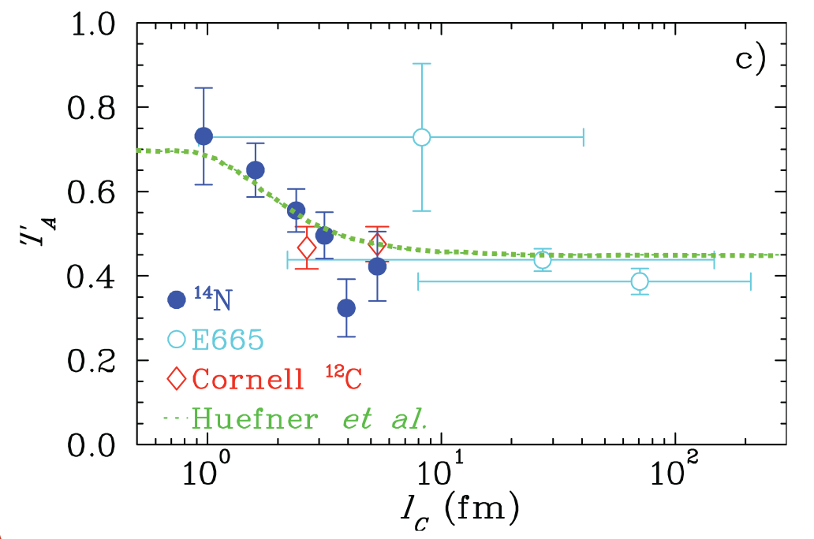
Hadronic Part of Photon: Dependence on the Coherence Length
Dependence of the nuclear transparency on the coherence length in electroproduction
K.Ackerstaff et al., Phys. Rev. Lett.,
82, 3025 (1999)
Coherence length
Hermes
e
l_{c}
ρ
A_{eff} / A
e
N
N′
e
l_{c}
ρ
e
Coherence length (fm)
N
N′
Hadronic structure of photon appears in electroproduction

Slide 5
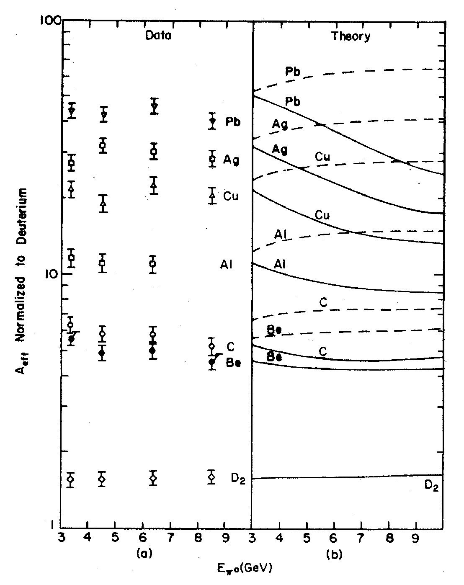
Energy Dependence: Photoproduction of π⁰ Mesons
Cornell experiment Meyer , et al. Phys. Rev. Let. 28, 1972
Data
Theory
Point-like photon
(no photon shadowing)
Hadronic component of photon
(photon shadowing)
A _{eff}
Incoherent production of π⁰ mesons
0.1 < | t | < 0.25 GeV²
The data indicate shadowing of
photon
Energy dependence weaker than
predicted
E (π⁰) (GeV)

Slide 6
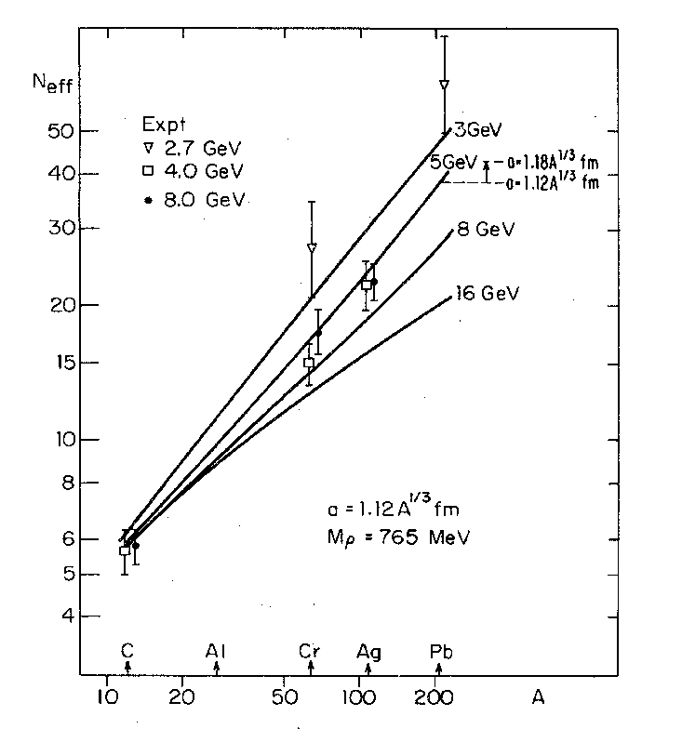
Energy Dependence: Photoproduction of ρ⁰ Mesons
Cornell: McClellan, et al. Phys. Rev. Let. 554, 1969
DESY: Asbury, et al. Phys. Rev. Let. 19, 1968
∇ 2.7 GeV
4.0 GeV
8.0 GeV
3 GeV
5 GeV
8 GeV
The existing data indicate shadowing
Weak energy dependence
Small statistics
- need more data to study energy
dependence
16 GeV
A _{eff}

Slide 7
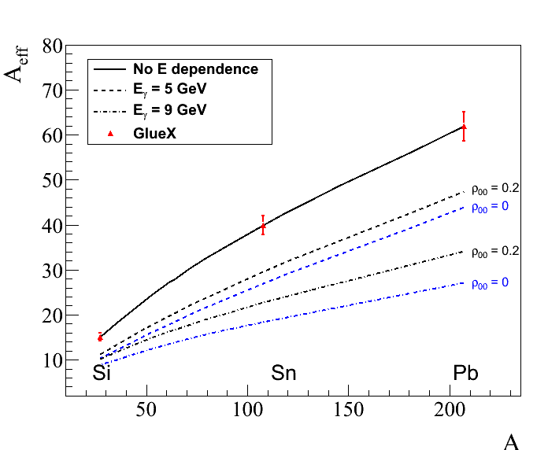
Measurements Proposed in GlueX
Predicted energy dependence of the nuclear transparency
for ρ and ω mesons Phys. Rev. C 93, 015203 (2016)
ρ-mesons ( ρ₀₀ = 0 )
Measure energy dependence
of the nuclear transparency for
ρ, ω, and φ mesons
on ¹²C, ²⁸Si, ¹²⁰Sn, and ²⁰⁸Pb
targets
Incoherent production:
0.1 < |t| < 0.5 GeV²
5 GeV
9 GeV

Slide 8
Extraction of σ_{L} (ω N) from the Photoproduction
of ω Mesons
There are no beams of ρ, ω, and φ mesons. Studying interactions with nuclear matter provides a unique possibility to measure meson-nucleon cross sections
We propose to extract for the first time the ω-nucleon cross section of
longitudinally polarized ω mesons using photoproduction on nuclei

Slide 9
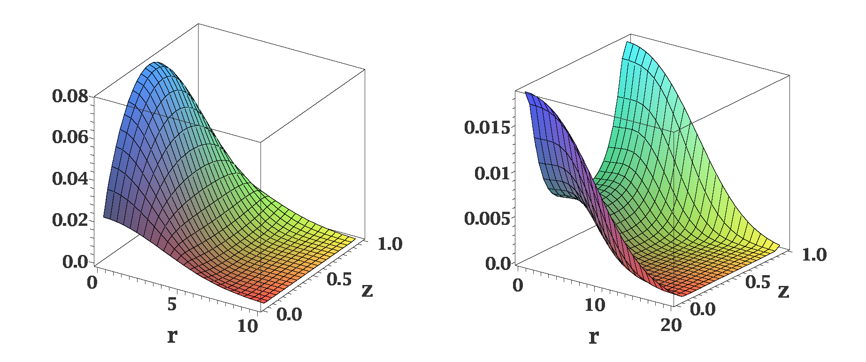
Distribution of Quarks in Vector Meson
Different distributions of quarks in the transversely and longitudinally polarized
mesons
ρ_{L}
ρ_{T}
In AdS/QCD (Brodsky & G.Teramond)
light-cone wave functions depend on
meson polarization
Light-cone wave functions for ρ mesons:
J.Forshaw and R.Sandapen
Phys.Rev. Lett. 109,081601,2012
Color dipole model of strong interaction
different cross sections for interactions of transversely and longitudinally
polarized mesons

Slide 10
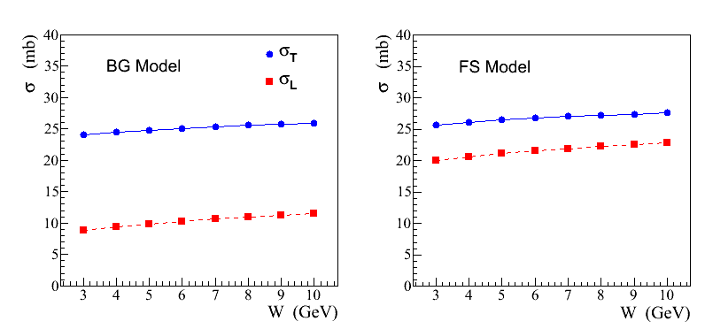
Recent Theoretical Calculations
σ_{L,T} (ρ N) cross sections predicted in a color dipole model using different
parameterizations of wave functions:
AdS / QCD holographic wave function (FS)
J.Forshaw and R. Sandopen,
Phys.Rev.Let. 109, 2012
Boosted Gaussian (BG) wave function
B.Kopeliovich et al., Phys.Rev. C65, 2002
FS model
BG model

Slide 11
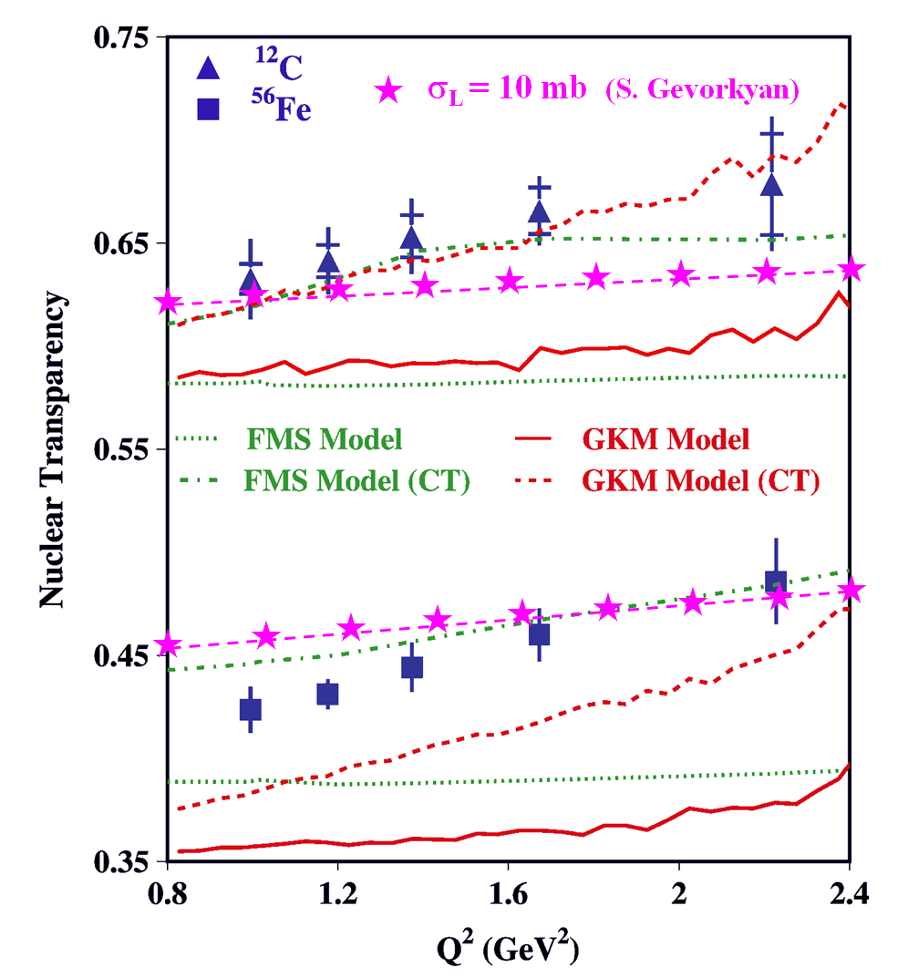
Impact of σ_{L,T} (VN) on Color Transparency
Color Transparency
measurements at CLAS
Phys. Lett. B 712 (2012)
At large Q ² photon couples to a qq
configuration with a small transverse size
The small-size configuration interacts less
with the nuclear medium
Recent theoretical calculations
σ_{L} (VN) = 10 mb
σ_{T} (VN) = 26 mb
The fraction of longitudinally polarized ρ mesons increases at larger Q²
Nuclear transparency depends on the polarization of the meson
- different absorption if σ_{L} (VN) ≠ σ _{T} (VN)
The Color Transparency effect is ‘screened ‘ if σ_{T} (VN) > σ_{L} (VN)

Slide 12
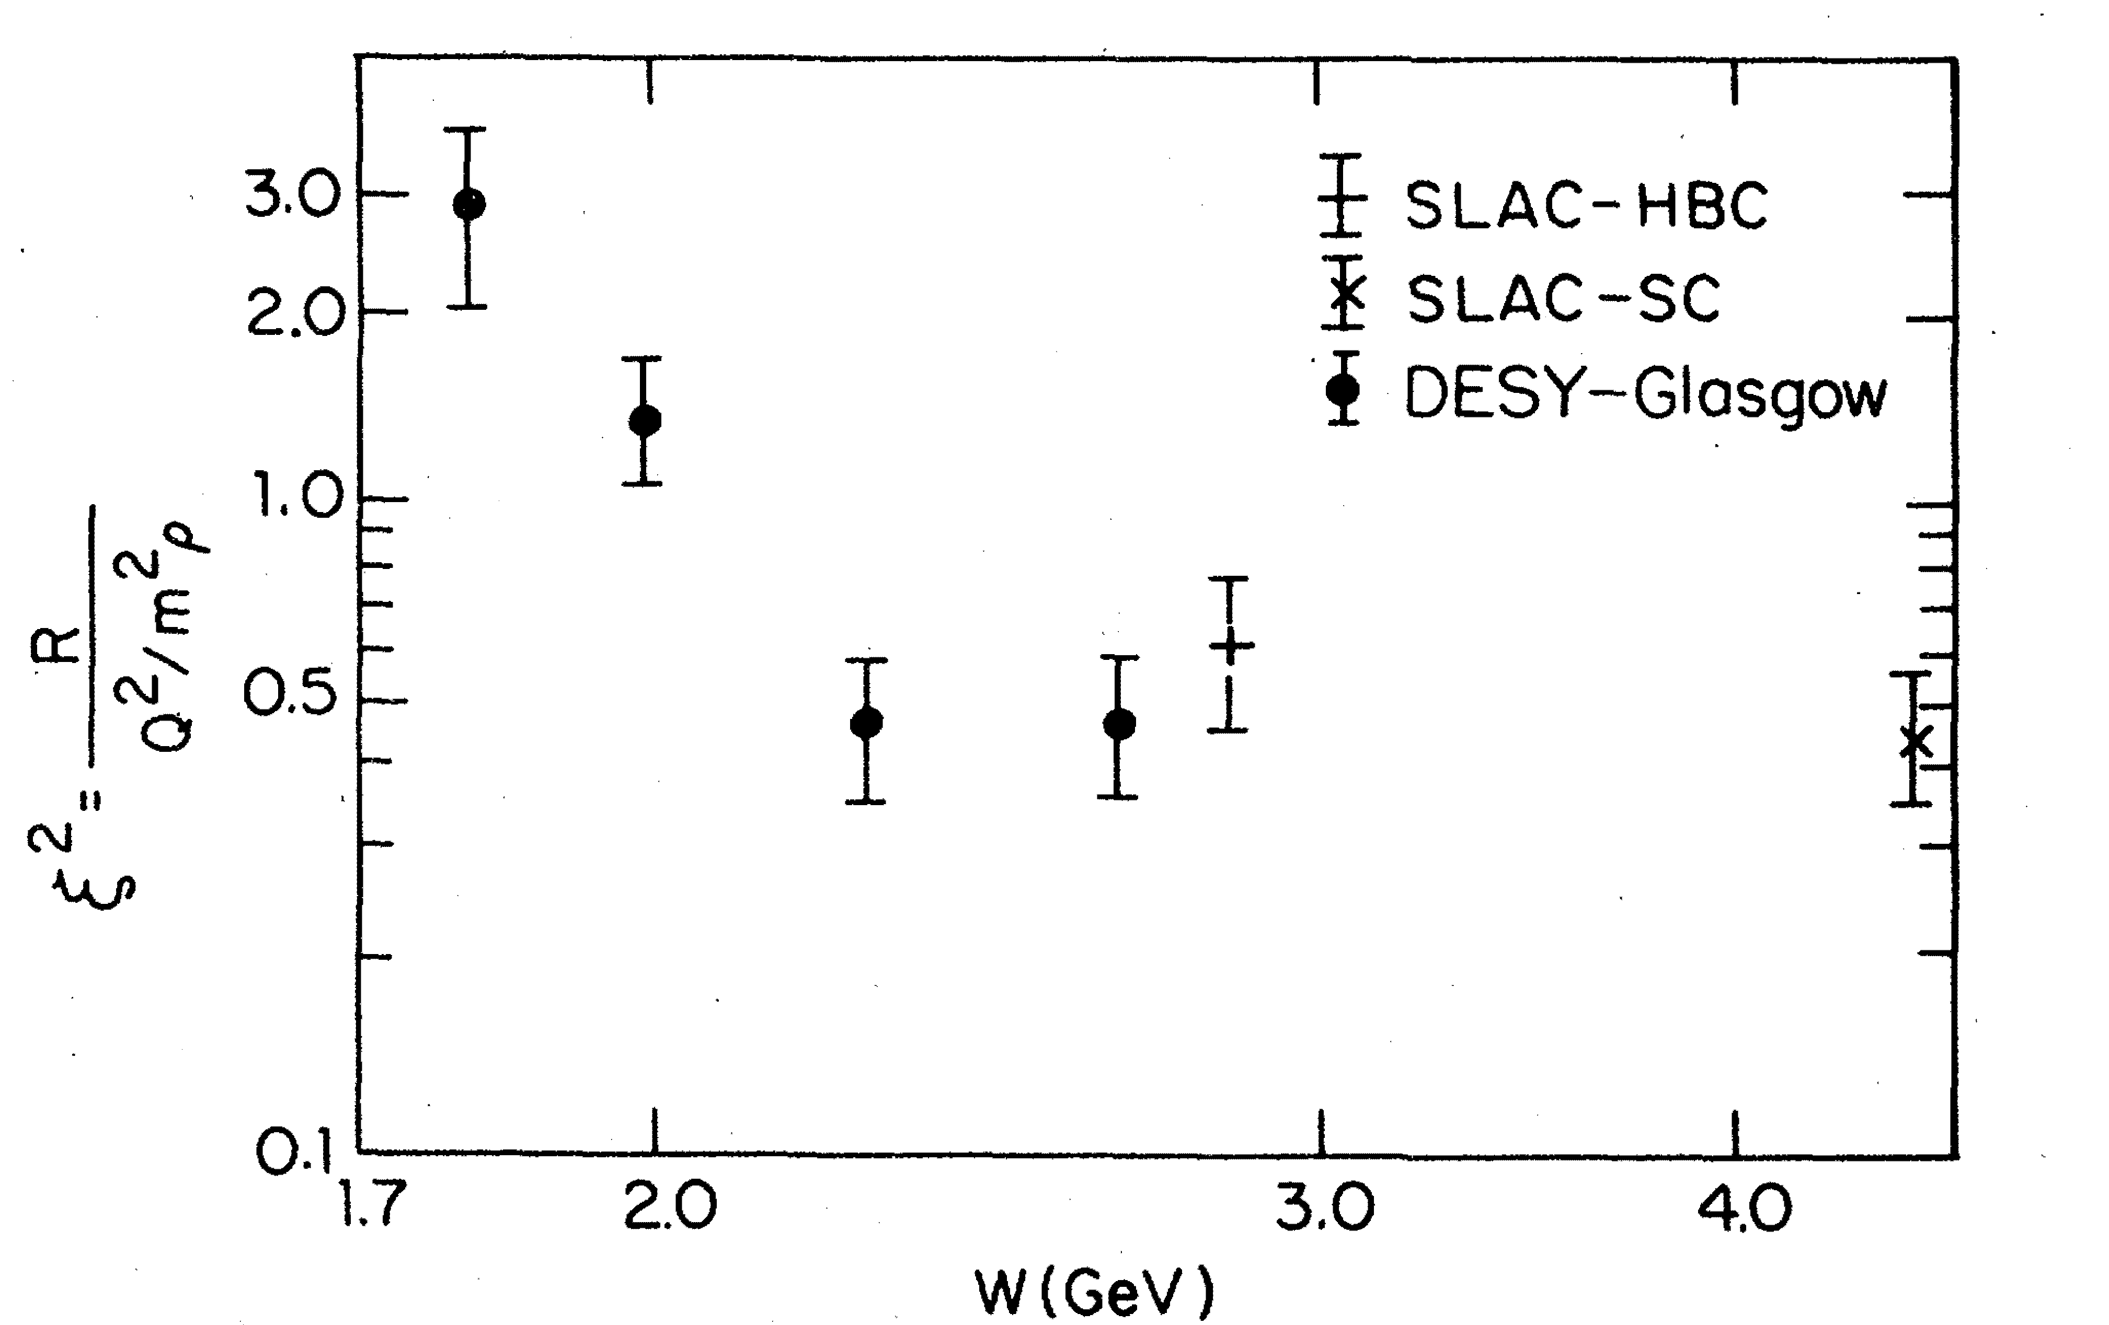
Polarization-Dependent Interactions: Experimental Observations
Hints from the electroproduction of vector mesons:
where
ρ mesons: ξ ~ 0.7 Nucl. Phys. B113, 53 (1976)
φ mesons: ξ² ~ 0.33 Phys. Rev. Let. 39, 516 (1977)
Similar observations of the polarization-dependent
interactions of deuterons with Carbon targer
- measured in Dubna and Juelich
Phys. Part. Nucl. Lett. 7, 27, 2010 Phys. Rev. Lett. 104, 2010
Measurements in the charge exchange process at Argonne:
π⁺ + Ne → ρ + Ne′
Nucl. Phys. B67, 333 (1973)
Measurements of σ_{L} are proposed for COMPASS experiments using π/K beams
(beyond 2020), letter of intent
We propose to measure σ_{L} (VN) using photoproduction on nuclei

Slide 13
Coherent and Incoherent Production of ω Mesons
In the coherent γ + A → ω + A production at JLab energies the essential
contribution of pion exchange cancels out. From the absorption of ω’s one
can extract σ_{T} (ω N)
- it has been measured by several experiments (σ_{T} ~ 26 mb)
In the incoherent process γ + A → ω + A′ the cross section is given by
- N (0, σ_{L}) and N (E, σ_{T}) are absorptions of the longitudinally and transversely
polarized mesons predicted by theoretical models
- Sensitivity to σ_{L} through the absorption N (0, σ_{L})
- ρ₀₀ is the spin density matrix element measured in γ p → ω p reaction

Slide 14
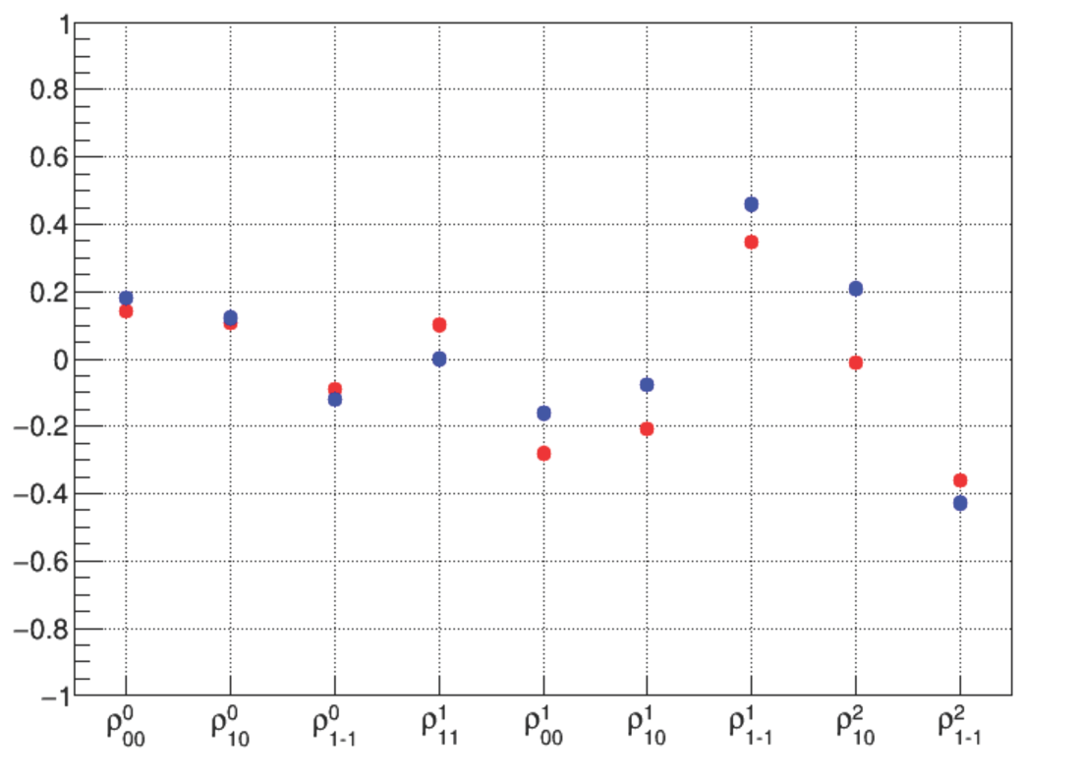
Why ω Mesons ?
Unlike ρ and φ mesons, some fraction of ω mesons is produced longitudinally
polarized at GlueX energies (6-9 GeV)
ρ₀₀ measured by SLAC is 0.2 ± 0.07
J.Ballam et al., Phys. Rev. D7, 3150 (1973)
Spin density matrix elements measured by
GlueX using a γp→ωp reaction
Preliminary GlueX results indicate
that ρ₀₀ is relatively large ( ∼ 0.2 )
GlueX preliminary
- measured in the energy range
8.4 – 9.1 GeV
- ρ₀₀ can be larger at smaller
energies (larger contribution
from pion exchange)
M. Staib, PhD tesis GlueX-doc-3357

Slide 15
How to Extract σ_{L} (ωN) ?
σ_{L} (ωN) can be extracted from the measurements of:
Method 1: Nuclear transparency ( A_{eff} )
Method 2: Spin density matrix element (ρ^{A}₀₀ )
Make use of the different absorption predicted for interactions of
longitudinally and transversely polarized mesons

Slide 16
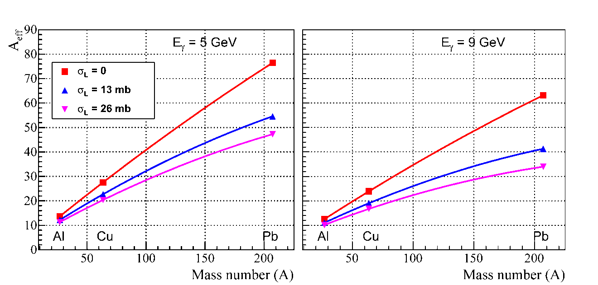
Extraction of σ_{L} (ωN): Method 1
Measure nuclear transparency A_{eff} for each nuclear target
A_{eff} depends on σ_{L} (see plot)
- N (0, σ_{L}) and N (E, σ_{T}) are predicted by theoretical models.
- N (E, σ_{T}) will be independently measured for ρ mesons
Predictions for A_{eff}
Calculations for GlueX
by S. Gevorkyan
Phys. Rev. C 93, 015203
(2016)

Slide 17
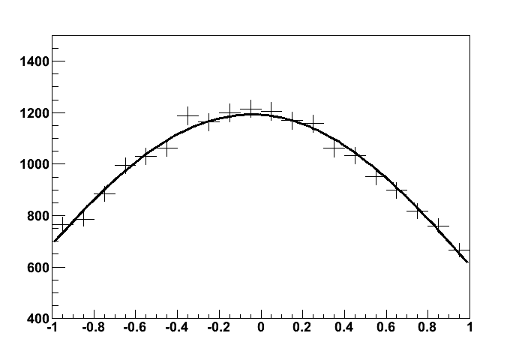
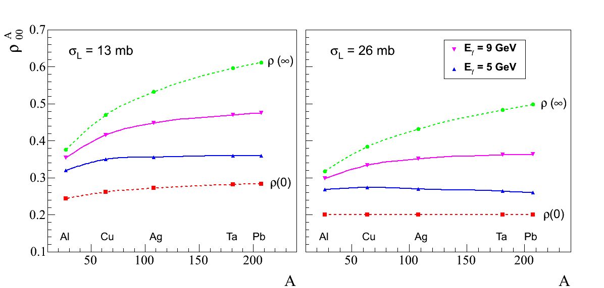
Extraction of σ_{L} (ωN): Method 2
Measure ρ^{A}₀₀ for each target from the
fit to the ω decay angular distribution
ρ^{A}₀₀ depends on σ_{L}
- extract σ_{L}
cos θ
Predictions for ρ^{A}₀₀
Phys. Rev. C 93, 015203 (2016)
Input value: ρ₀₀ = 0.2

Slide 18
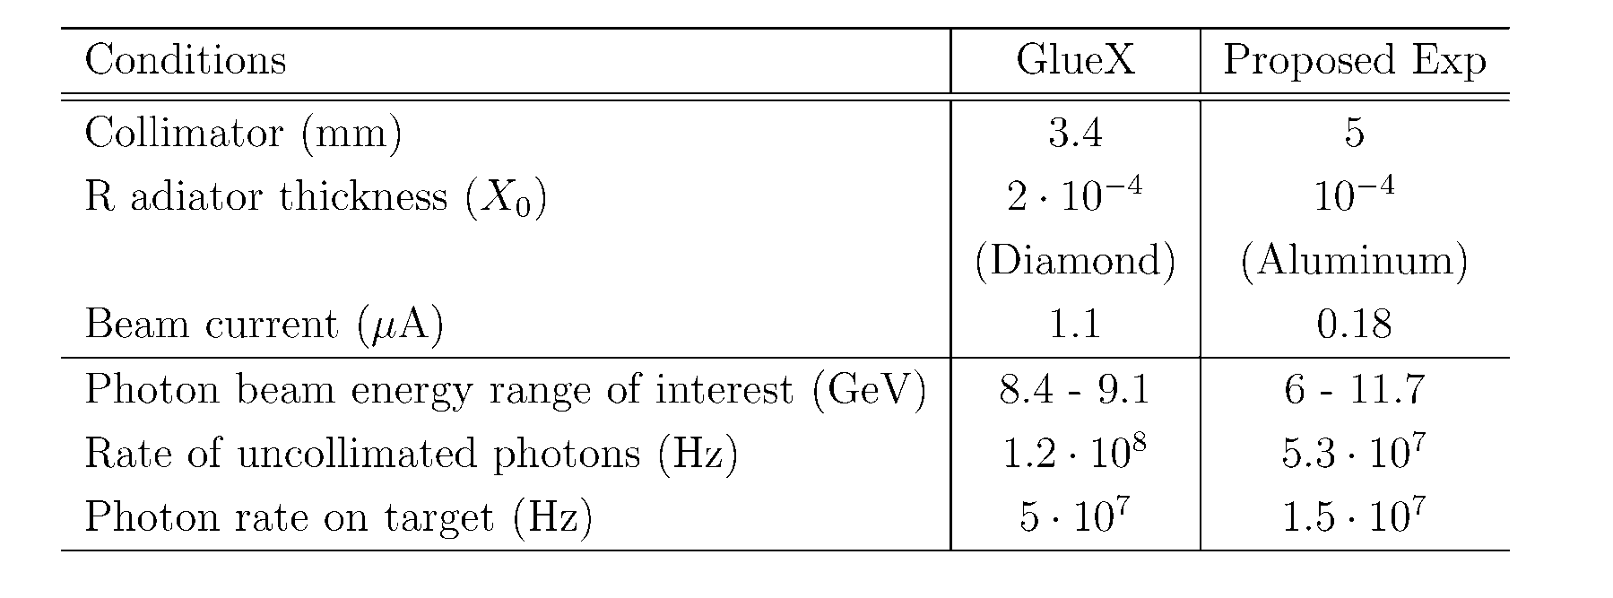
Beamline Conditions
Energy range of interest 6 GeV < E_{γ} < 12 GeV
Use amorphous radiator (incoherent bremsstrahlung)
Decrease the flux (factor of 12 compared with the GlueX flux at high lumi)
Use four nuclear targets: C, SI, Sn, Pb with the thickness of 7 % R.L.
- small electromagnetic background compared with GlueX, neutron
background will not exceed the GlueX level (JLAB-TN-11-005, 2011)

Slide 19
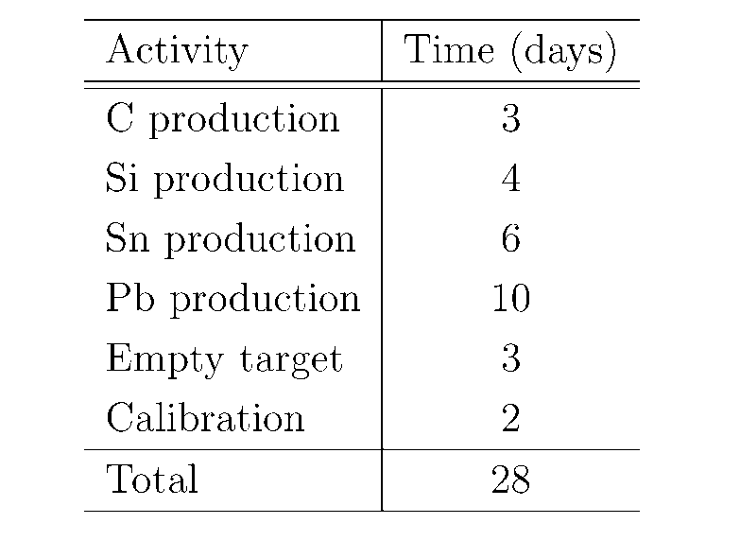
Beam Time Request
Propose to take data for 28 days
(one run)
No modifications of the GlueX
detector except for the target
installation

Slide 20
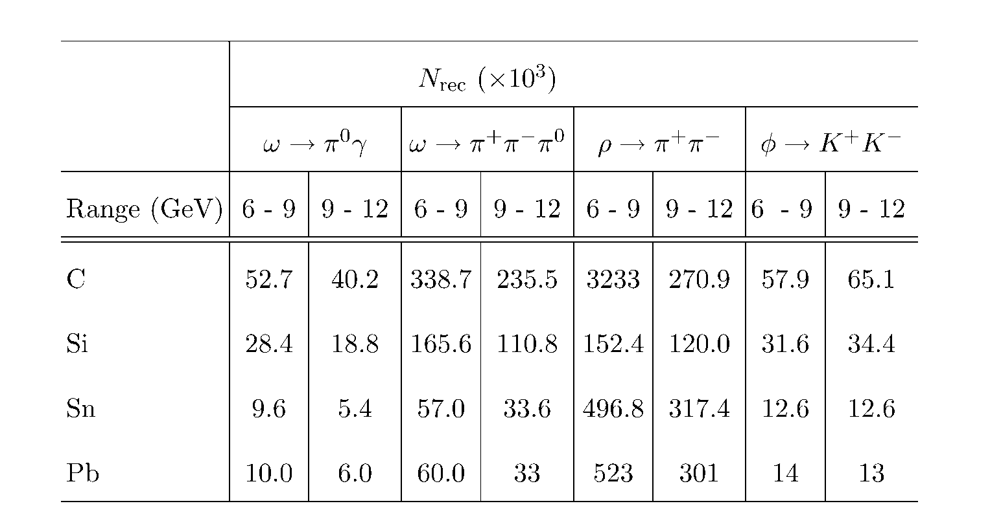
Expected Yields of Vector Mesons
Expected number of reconstructed ρ, ω, and φ mesons in the proposed
experiment (0.1 < |t| < 0.5 GeV ² )
Statistical uncertainties on nuclear transparency better than 2 %

Slide 21
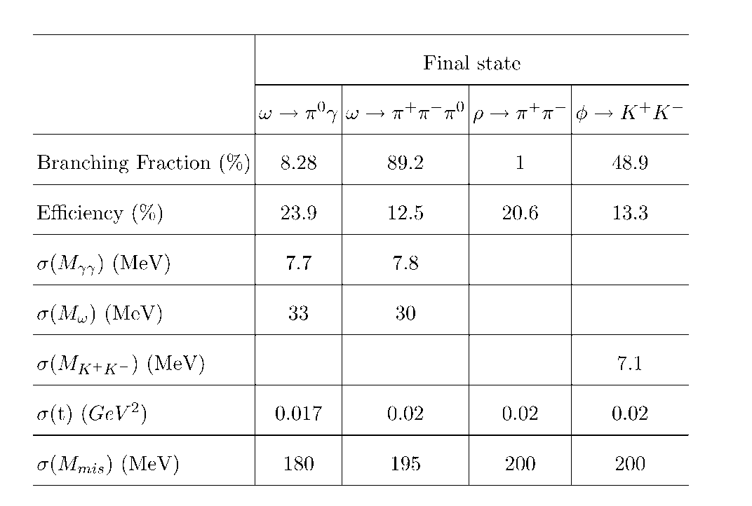
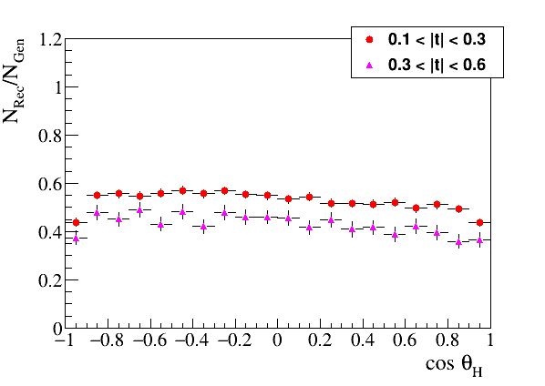
Reconstruction of Vector Mesons
Reconstruction properties of ω, ρ, and φ mesons
Reconstruction efficiency of
ω → π⁰ γ decays as a function of
the polar angle in the helicity frame
Uniform angular acceptance
- important for polarization
measurements

Slide 22
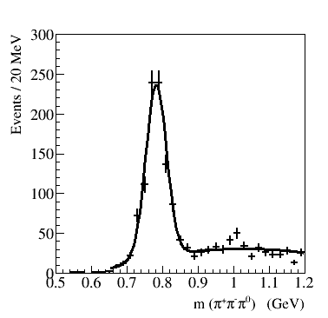
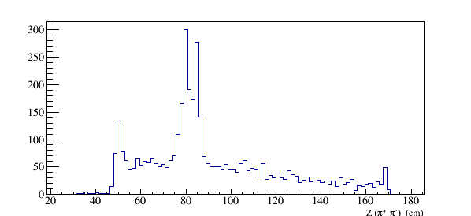
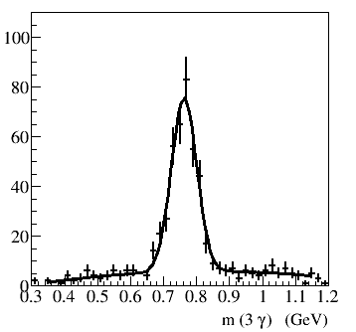
Production of Vector Mesons on Target Walls
GlueX Data
ω → π⁺ π⁻ π⁰
Runs with empty target
Production vertex for ω → π⁺ π⁻π⁰
Target cell walls
Vacuum window
Air
ω → π⁰ γ
Cold H₂ gas
Z (π⁺ π⁻) (cm)
Kapton
Kapton
Air

Slide 23
Uncertainties on Measurements of A_{eff} and Extraction of σ_{L} (ωN)
Statistical errors on A_{eff}
δ (A_{eff}) / A_{eff} = 1.4 % (6 – 9 GeV)
= 1.8 % (9 -12 GeV)
smallest data sample of ω → π⁰γ
reconstructed decays
systematic uncertainties on A_{eff}
Systematic uncertainties dominate
- conservatively assume that S/B = 1
- measure the ratio of cross section σ_{A} / σ_{N}
some uncertainties related to reconstruction
efficiencies will be canceled out
Target thickness | 1.2 %
Photon flux determination | 1.5 %
Signal yield (bg subtraction) | 5.0 %
Total measured | 5.4 %
Uncertainties on the extracted σ_{L} (for σ_{L} = 16 mb)
Polarization of | Error on σ_{L} (mb)
ω mesons | 6 – 9 GeV | 9 – 12 GeV
ρ₀₀ = 0.2 | 0.9 (stat) 3.4 (syst) | 0.9 (stat) 3.1 (syst)
ρ₀₀ = 0.1 | 1.1 (stat) 4.6 (syst) | 1.1 (stat) 4.2 (syst)
Measued by
SLAC

Slide 24
Uncertainties on Measurements of ρ^{A}₀₀ and Extraction of σ_{L} (ωN)
Obtain ρ^{A}₀₀ from the fit to the decay angular distribution in the helicity frame
Statistical errors : σ(ρ^{A}₀₀ ) = 0.011 (6 – 9 GeV)
(from the fit) = 0.014 (9 -12 GeV)
Signal yield (bg subtraction) | 0.008
Acceptance determination | 0.019
Total | 0.02
Systematic uncertainties on ρ^{A}₀₀
Uncertainties on the extracted σ_{L} (for σ_{L} = 16 mb) for ω → π⁰γ decays
Polarization | Error on σ_{L} (mb)
of ω mesons | 6 – 9 GeV | 9 – 12 GeV
ρ₀₀ = 0.2 | 3.7 | 3.6
ρ₀₀ = 0.14 | 4.8 | 4.7

Slide 25
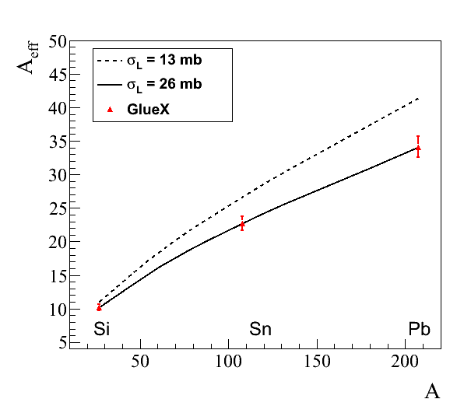
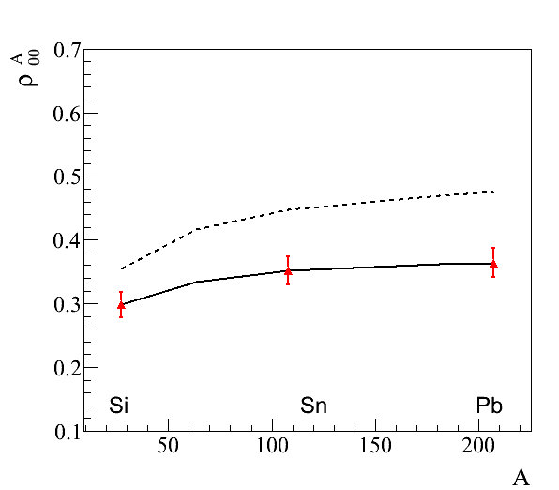
Projected Errors on Measured A_{eff} and ρ^{A}₀₀
Projected errors on measurements of A_{eff} and ρ^{A}₀₀ for ω → π⁰ γ decays
(input values: σ_{T} = 26 mb, ρ₀₀ = 0.2)
A_{eff}
ρ^{A}₀₀
9 GeV

Slide 26
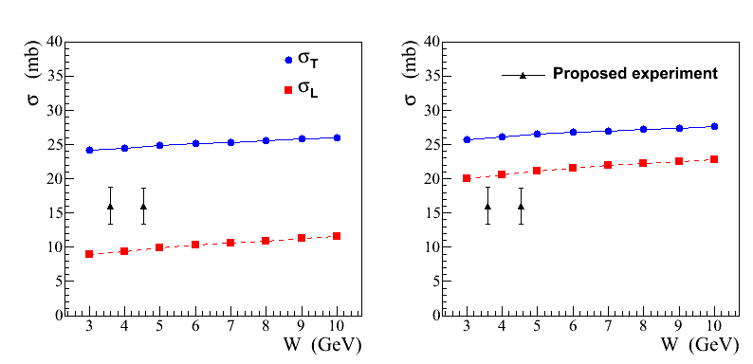
Projected Errors on σ_{L} (ωN)
FS model
BG model
ρ₀₀ = 0.2
Predicted cross section σ_{T}
is consistent with experimental
measurements (σ_{T} ∼ 26 mb)
σ_{L} extracted from the combined measurement of A_{eff} for two decay channels
ω → π⁰ γ and ω → π⁺ π⁻ π⁰
- for ρ₀₀ = 0.14 uncertainty on the extraction of σ_{L} is ∼ 3.5 mb ( 9-12 GeV )
σ_{L} will be separately extracted from the measurement of ρ^{A}₀₀

Slide 27
Summary
We propose to use the GlueX detector to study photoproduction of light mesons
on nuclear targets: C, Si, Sn, and Pb in the large beam energy range between
6 GeV and 12 GeV. The primary goal is:
Measure nuclear transparency of light mesons such as ρ, ω, ϕ. Study the
dependency of the nuclear transparency on the beam energy, predicted by
theoretical models. The results will provide a sensitive probe to the degree of
photon shadowing in nuclear matter
Measure nuclear transparency and the SDME for omega mesons in incoherent
photoproduction and extract the total cross section of the longitudinally
polarized ω mesons with nucleon. The knowledge of σ_{L} is important for many
theoretical models. Measurements are important in interpreting color transparency
effects.
The expected length of the experiment is 28 days of taking data. The detector
will be operated at small luminosity. No modifications of the GlueX detector
is required

Slide 28
Backup Slides

Slide 29
PAC45
Response

Slide 30
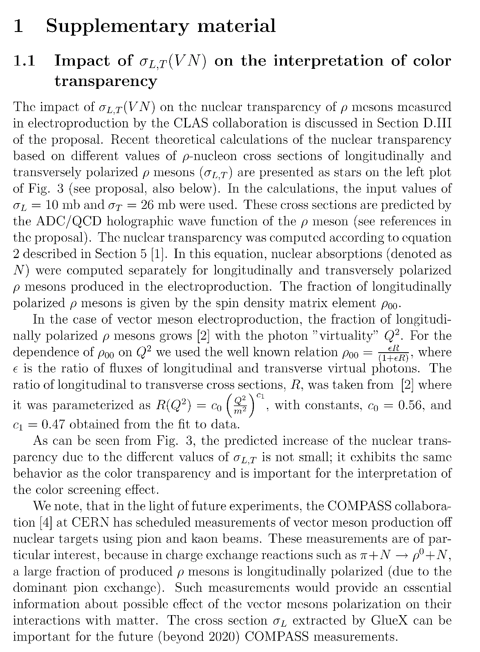

Slide 31
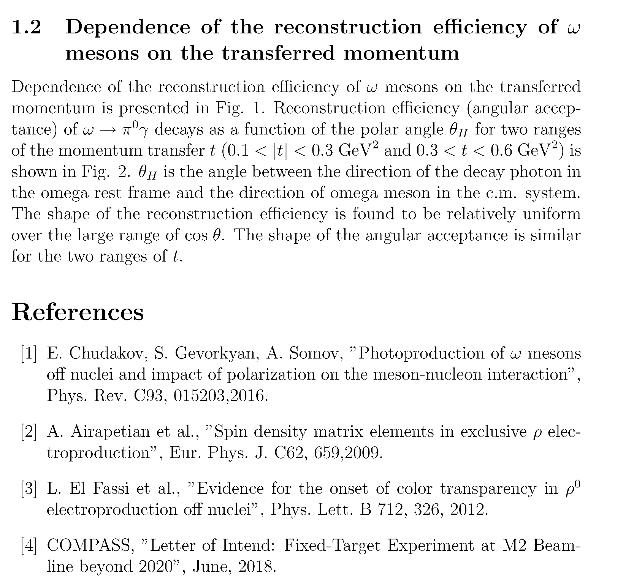

Slide 32
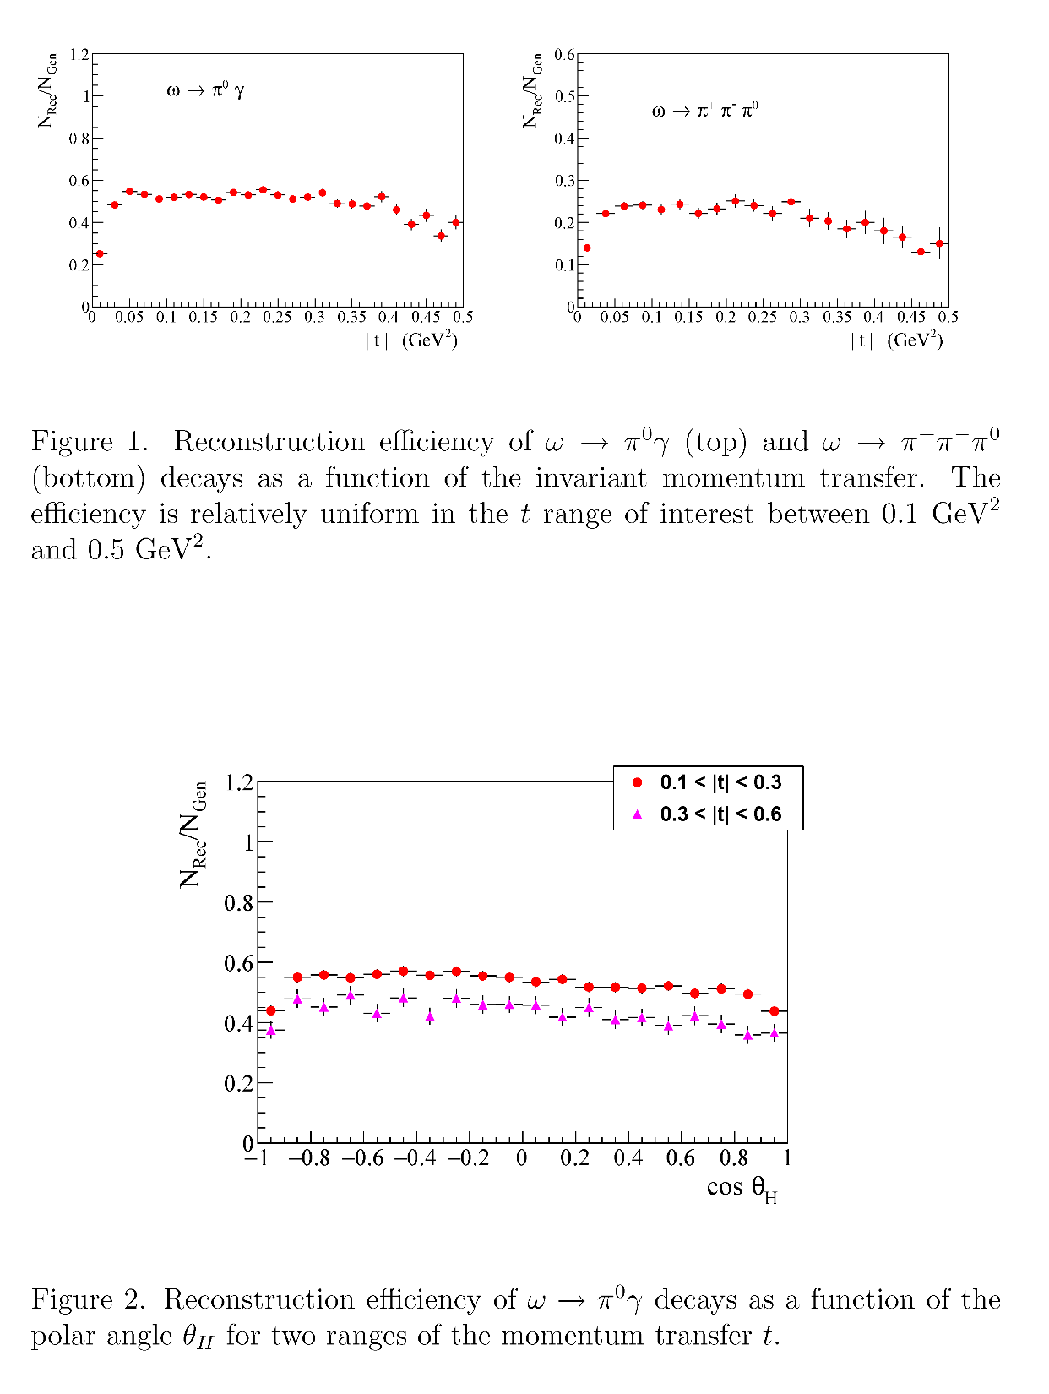

Slide 33
Reconstruction of Vector Mesons
We studied reconstruction capabilities for ρ, ω, and φ mesons using detailed GlueX
detector simulation
Signal events were generated by Pythia (with the Fermi motion taken into account) in
the energy range between 6 GeV – 12 GeV
Momentum transfer t
Δ t = 0.017
ω → π⁰ γ
 | π⁰ γ | π⁺π ⁻π⁰
M _{γγ} (MeV) | 7.7 | 7.8
M _{ω} (MeV) | 33 | 30
Δ t (GeV²) | 0.017 | 0.02
γ γ invariant mas
3γ invariant mas
σ (m) - 7.7 MeV
σ (m) - 33 MeV
σ (M_{mis}) ~ 190 MeV

Slide 34
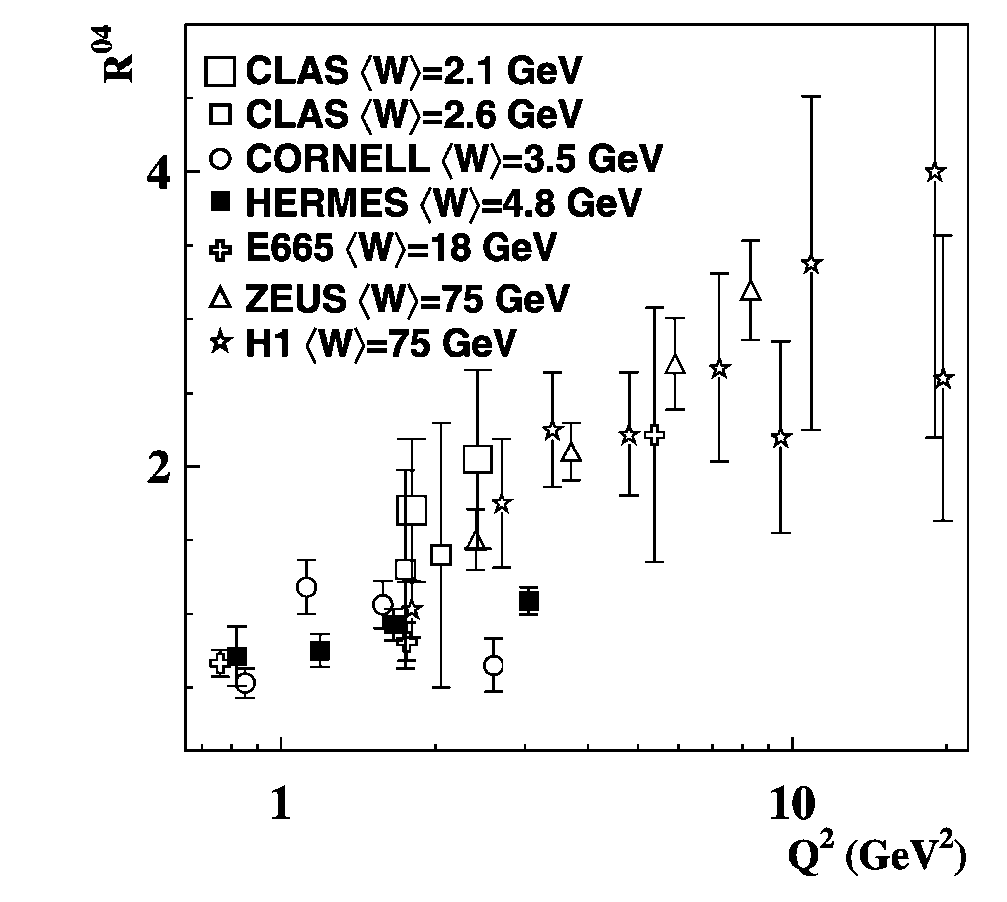
Impact of σ_{L,T} (VN) on Color Transparency
Q² dependence of the longitudinal-to-
transverse cross section ratio for ρ mesons
Eur. Phys. J. C 62, 659-695 (2009)
Larger fraction of longitudinally polarized ρ mesons produced at larger Q²

Slide 35
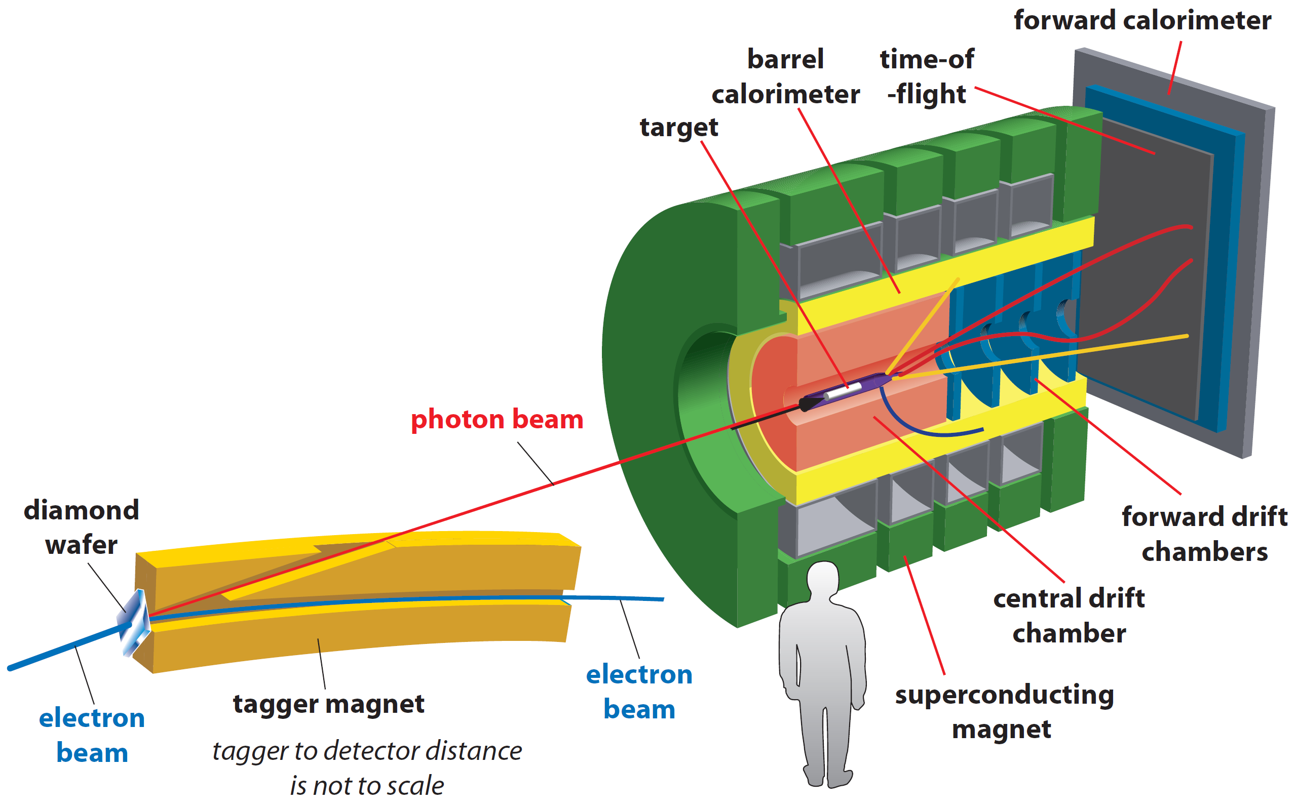
GlueX Spectrometer
• Optimized to detect multi-particle final states
• Hermetic, large/uniform acceptance for
charged and neutral particles, good energy
and momentum resolution
Tracks: σ_{p} / p ~ 2 – 5 %
Photons: σ_{E} / E = 6 % /√E ⊕ 1.6 %
Acceptance: 1° < θ < 120°
new PID (k/π)
Proposed experiment:
- install nuclear targets
- no modifications to the
existing detector

Slide 36
S/B Estimates
Estimate background using photoproduction on target walls
and air ( runs with empty target )
Production vertex for ω → π⁺ π⁻π⁰
Vacuum cell and window:
75 , 100 μm Kapton
Cold H₂ gas:
ρ = 1.8 ⋅10⁻³ g /cm³
Air:
ρ = 1.2 ⋅ 10⁻³ g /cm³
Target cell walls
Vacuum window
Air
Cold H₂ gas
Z (π⁺ π⁻) (cm)
Kapton
Kapton
Air

Slide 37
Timeline
Nuclear Photoproduction with GlueX Workshop, Jefferson Lab, April 28 - 29, 2016
https://www.jlab.org/conferences/photoproduction16/
- interesting discussions, motivated further theoretical studies
Photoprodiction of ω mesons of nuclei and impact of polarization on the
meson-nucleon interactions, Phys. Rev. C93, 1, 015203, 2016
Topic presented at several conferences / workshops

