Slide 1
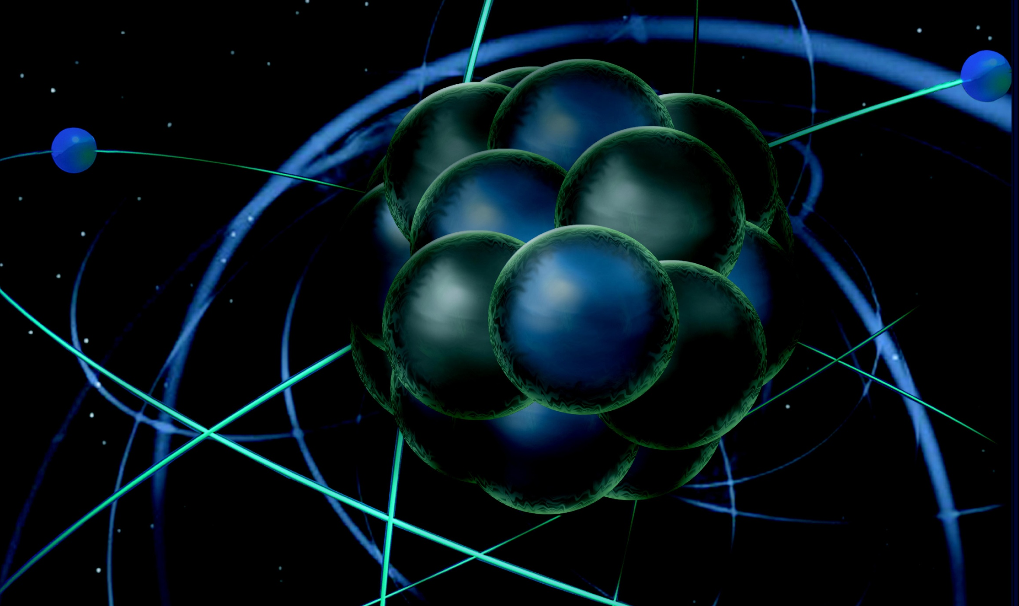
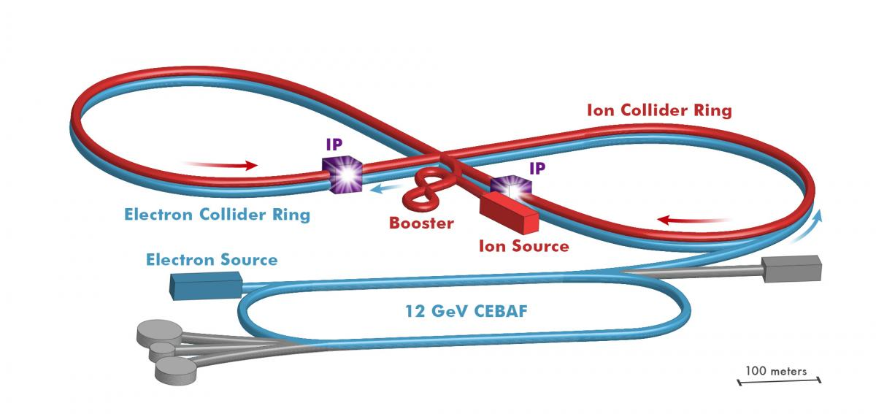
12 GeV Program Overview
You already heard about:
12-GeV project completion
Accelerator operations progress
Hall A
Hall B
Hall C
Hall D
So, here more about:
12 GeV Schedule
JLEIC progress and activities
JLEIC
Rolf Ent
JLab PAC46 Meeting
July 16, 2017

Slide 2
FY18-FY20 JLab Physics Priorities
Complete the first GlueX run in Hall D to search for hybrids
Prepare for GlueX-II run in Hall D with increased DAQ/photon flux and DIRC-based Cherenkov for Particle Identification – strange quark spectroscopy
Resolve if the LHC-B observed state is a hidden-charm pentaquark in Hall C (or perhaps in Hall B)
Initiate SBS Science Program to map Nucleon Form Factors
Aim for resolution of ratio of down to up quark parton distributions at large x, by
use of isospin symmetric 3H and 3He nuclei, in Hall A
detecting spectator proton to tag DIS e-n process with BONuS in Hall B
Initiate GPD and TMD imaging program
basic reaction mechanism test for DVCS in Hall A
basic reaction mechanism tests for SIDIS/TMDs and DVMP in Hall C
large-acceptance survey of GPDs (DVCS) and of TMDs in Hall B
Measure the neutron skin in Lead and Calcium, by PREX-II/CREX in Hall A
Measure the short-range tensor correlations in asymmetric nuclei in Hall A
Complete the High-Impact part of the Heavy-Photon Search in Hall B, hope to include APEX in Hall A
2

Slide 3
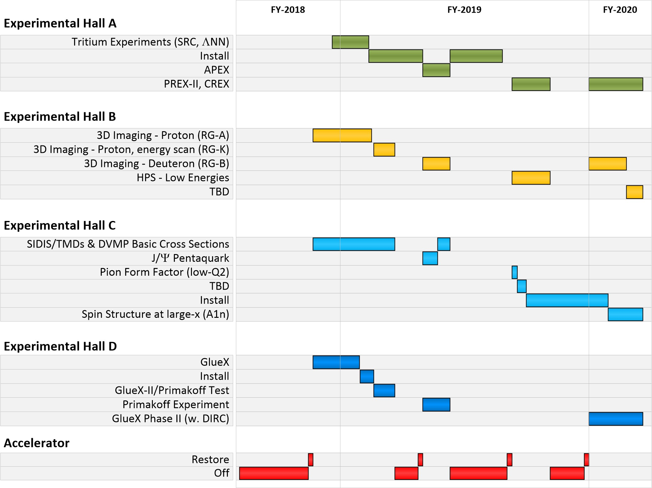
Projected Schedule
Note: Summer 2020 a long ~6-month down for CHL-2K installation and commissioning
Still studying if Summer 2020 low-energy running is a possibility

Slide 4
Near Term CEBAF Schedule
We have released a schedule of experiments to be run during the next 18 months that includes many “high impact” nuclear physics topics:
Completion of first phase of GlueX (search for exotic mesons)
PREX-II/CREX neutron skin radius (relevant to LIGO/VIRGO studies of neutron star mergers)
Heavy Photon Search (HEP detectors and electronics) and APEX, searches for dark photons
Search for Λnn resonance (evidence from GSI)
Search for charmed pentaquark (evidence from LHCb)
Quark dynamics: transverse polarization of quarks inside an unpolarized nucleon (3D/TMD)
Neutron Spin Structure (precision study)
4

Slide 5
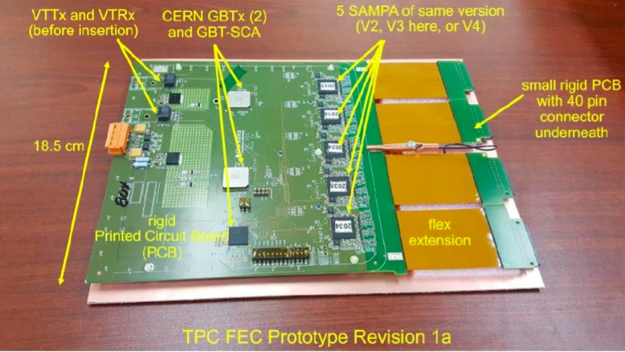
Towards Streaming and Advanced Computing
GEM development and testing (with UVA, INFN) for SBS, but also TDIS, SoLID, beyond…
SBS TDIS/general high rate GEM test stand (with JLab DAQ & FE groups) to:
understand the candidate “SAMPA” chip front end response to detector signals
learn how to utilize the complex SAMPA functionality to reduce data volume
demonstrate with a continuous readout data stream and link it with triggered data streams from other sources
The last point goes beyond the SAMPA chip alone…. Continuous readout systems are expected to be used in future experiments at JLab, the EIC, and elsewhere.
ALICE TPC Upgrade Front End Card with SAMPA chips - will modify slightly for testing
5

Slide 6
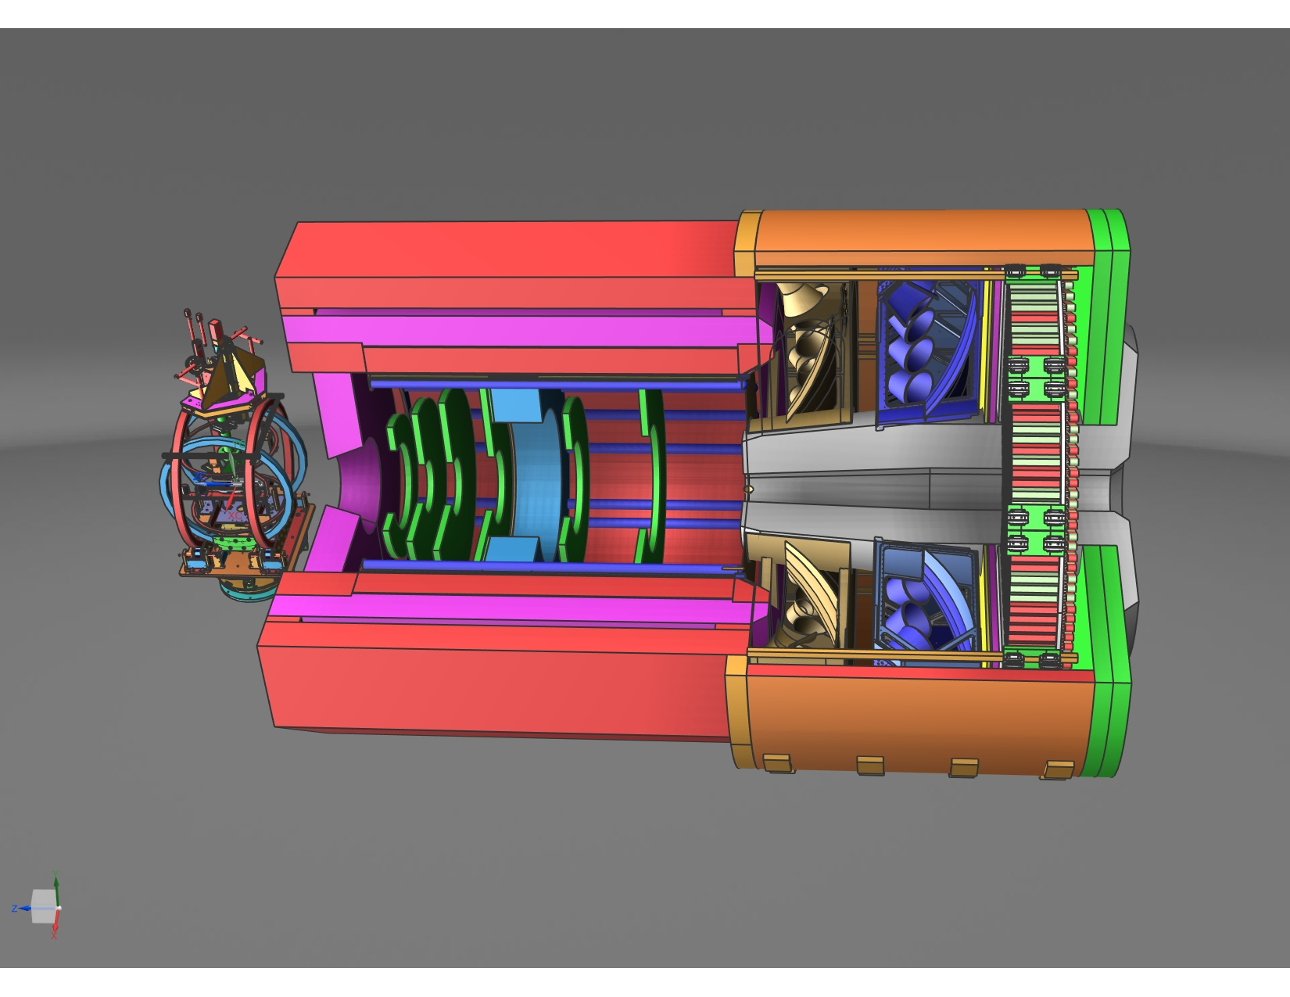
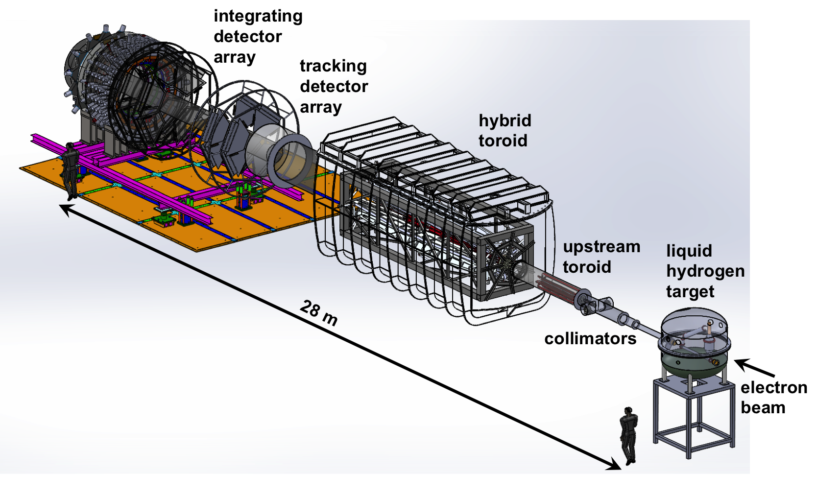
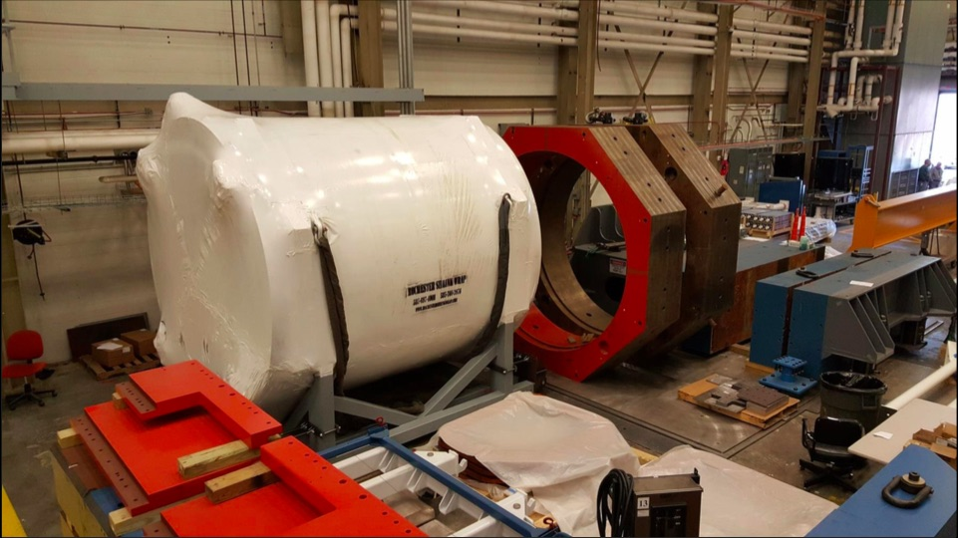
Towards SoLID and MOLLER
High power target development for MOLLER, SoLID, possibly SBS (with target group)
SoLID magnet static tests and common instrumentation (I&C, CCR) development, and as needed preparation for cold test
Parity quality beam instrumentation (polarimetry, charge monitoring, DAQ,..) (with accelerator)
MOLLER magnet development (with magnet group)
6

Slide 7
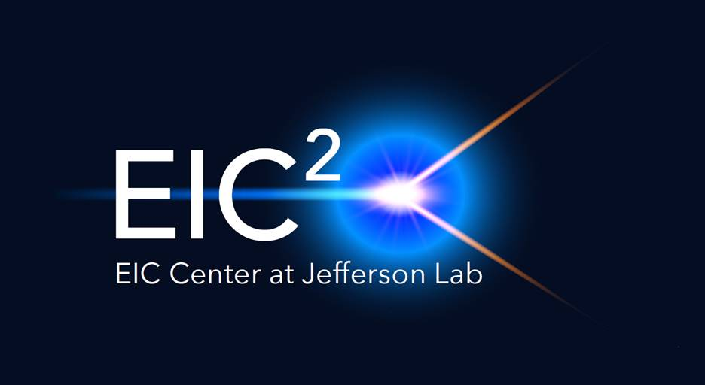
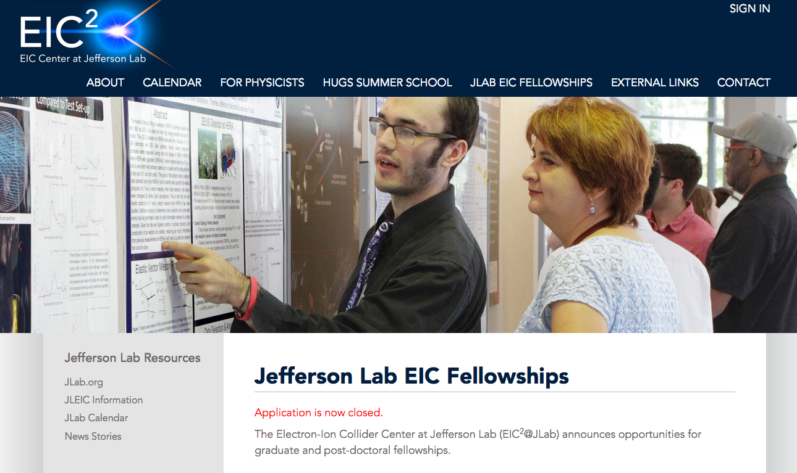
EIC²@JLab
eiccenter.org
The Electron-Ion Collider Center (EIC²@JLab) is an organization to advance and promote the science program at a future electron-ion collider (EIC) facility.
Particular emphasis is on the close connection of EIC science to the current Jefferson Lab 12 GeV CEBAF science program.
EIC themed seminars
Enhanced EIC content in HUGS summer school.
Graduate Fellowships
2 selected CUA & ODU
π/K structure & Pol. eD
Post-doc Fellowships
2 selected MIT & SMU
Machine learning & pdfs
7

Slide 8
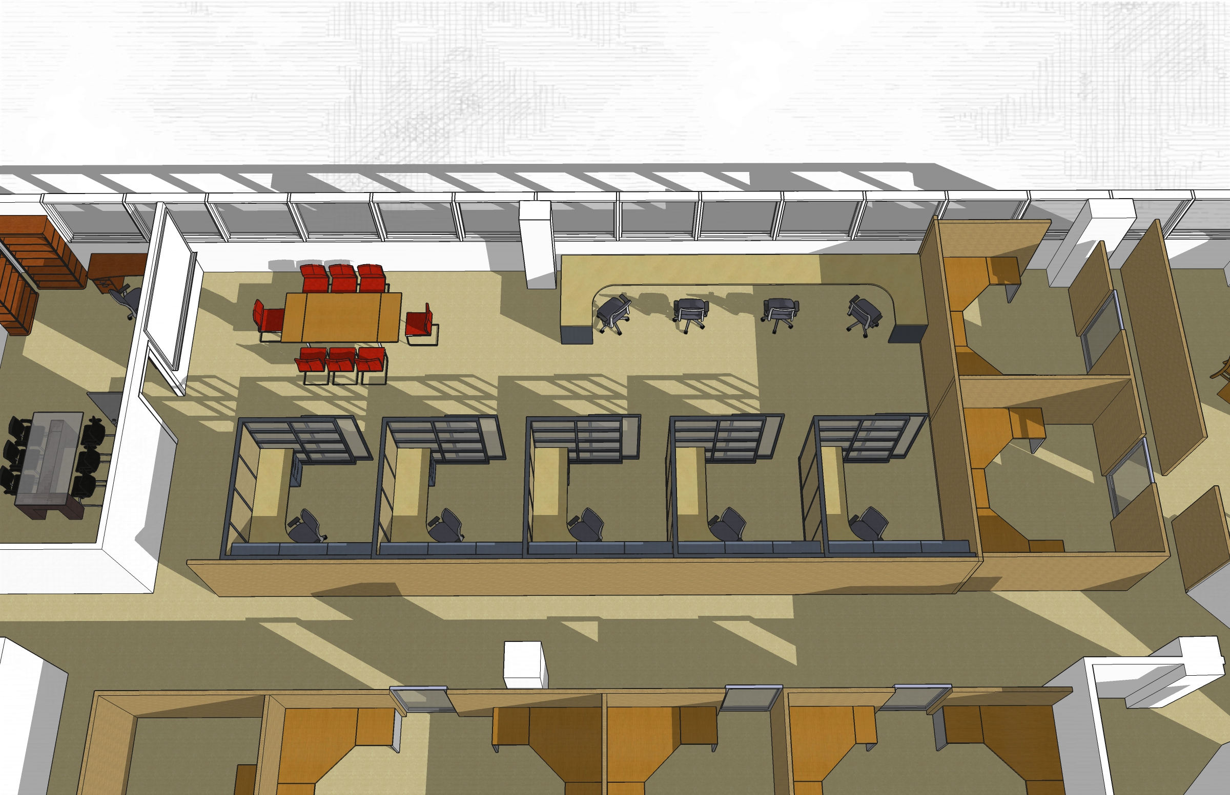
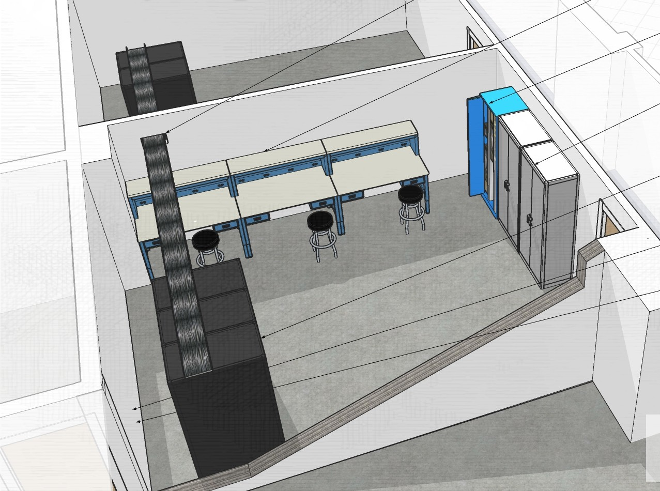
EIC² Space
EIC² Space at CEBAF Center F-wing 3rd Floor: Plan to complete end of July
EIC² Space at CEBAF Center F-wing 1st Floor for DAQ/Streaming Lab: Plan to complete in ~2 months
8

Slide 9
Recent EIC related workshops
Polarized Light Ion Physics with EIC
5-9 February, 2018, Ghent University
Organizers: W. Cosyn, A. Deshpande, J. Ryckebusch, C. Weiss
Importance of polarized deuteron emphasized
Whitepaper in preparation
Pion and Kaon structure at an EIC
24-25 May, 2018, CUA
Organizers: I. Cloet, T. Horn, C. Keppel, C. Roberts
origin of mass, connection to LQCD
Whitepaper in preparation
Streaming readout workshop
29-30 January, 2018, MIT
Led to monthly meetings organized by MIT
Formation of streaming-readout consortium (MIT, SBU, CUA, INFN Genova, JLab)
Submission to the EIC Detector R&D committee (accepted for presentation in July R&D meeting)
Also: Next Generation of GPD studies with exclusive meson production at EIC
June 4-6, 2018, CFNS Stony Brook
Organizers: C. Weiss, L. Szymanowski, M. Boer, S. Fazio
9

Slide 10
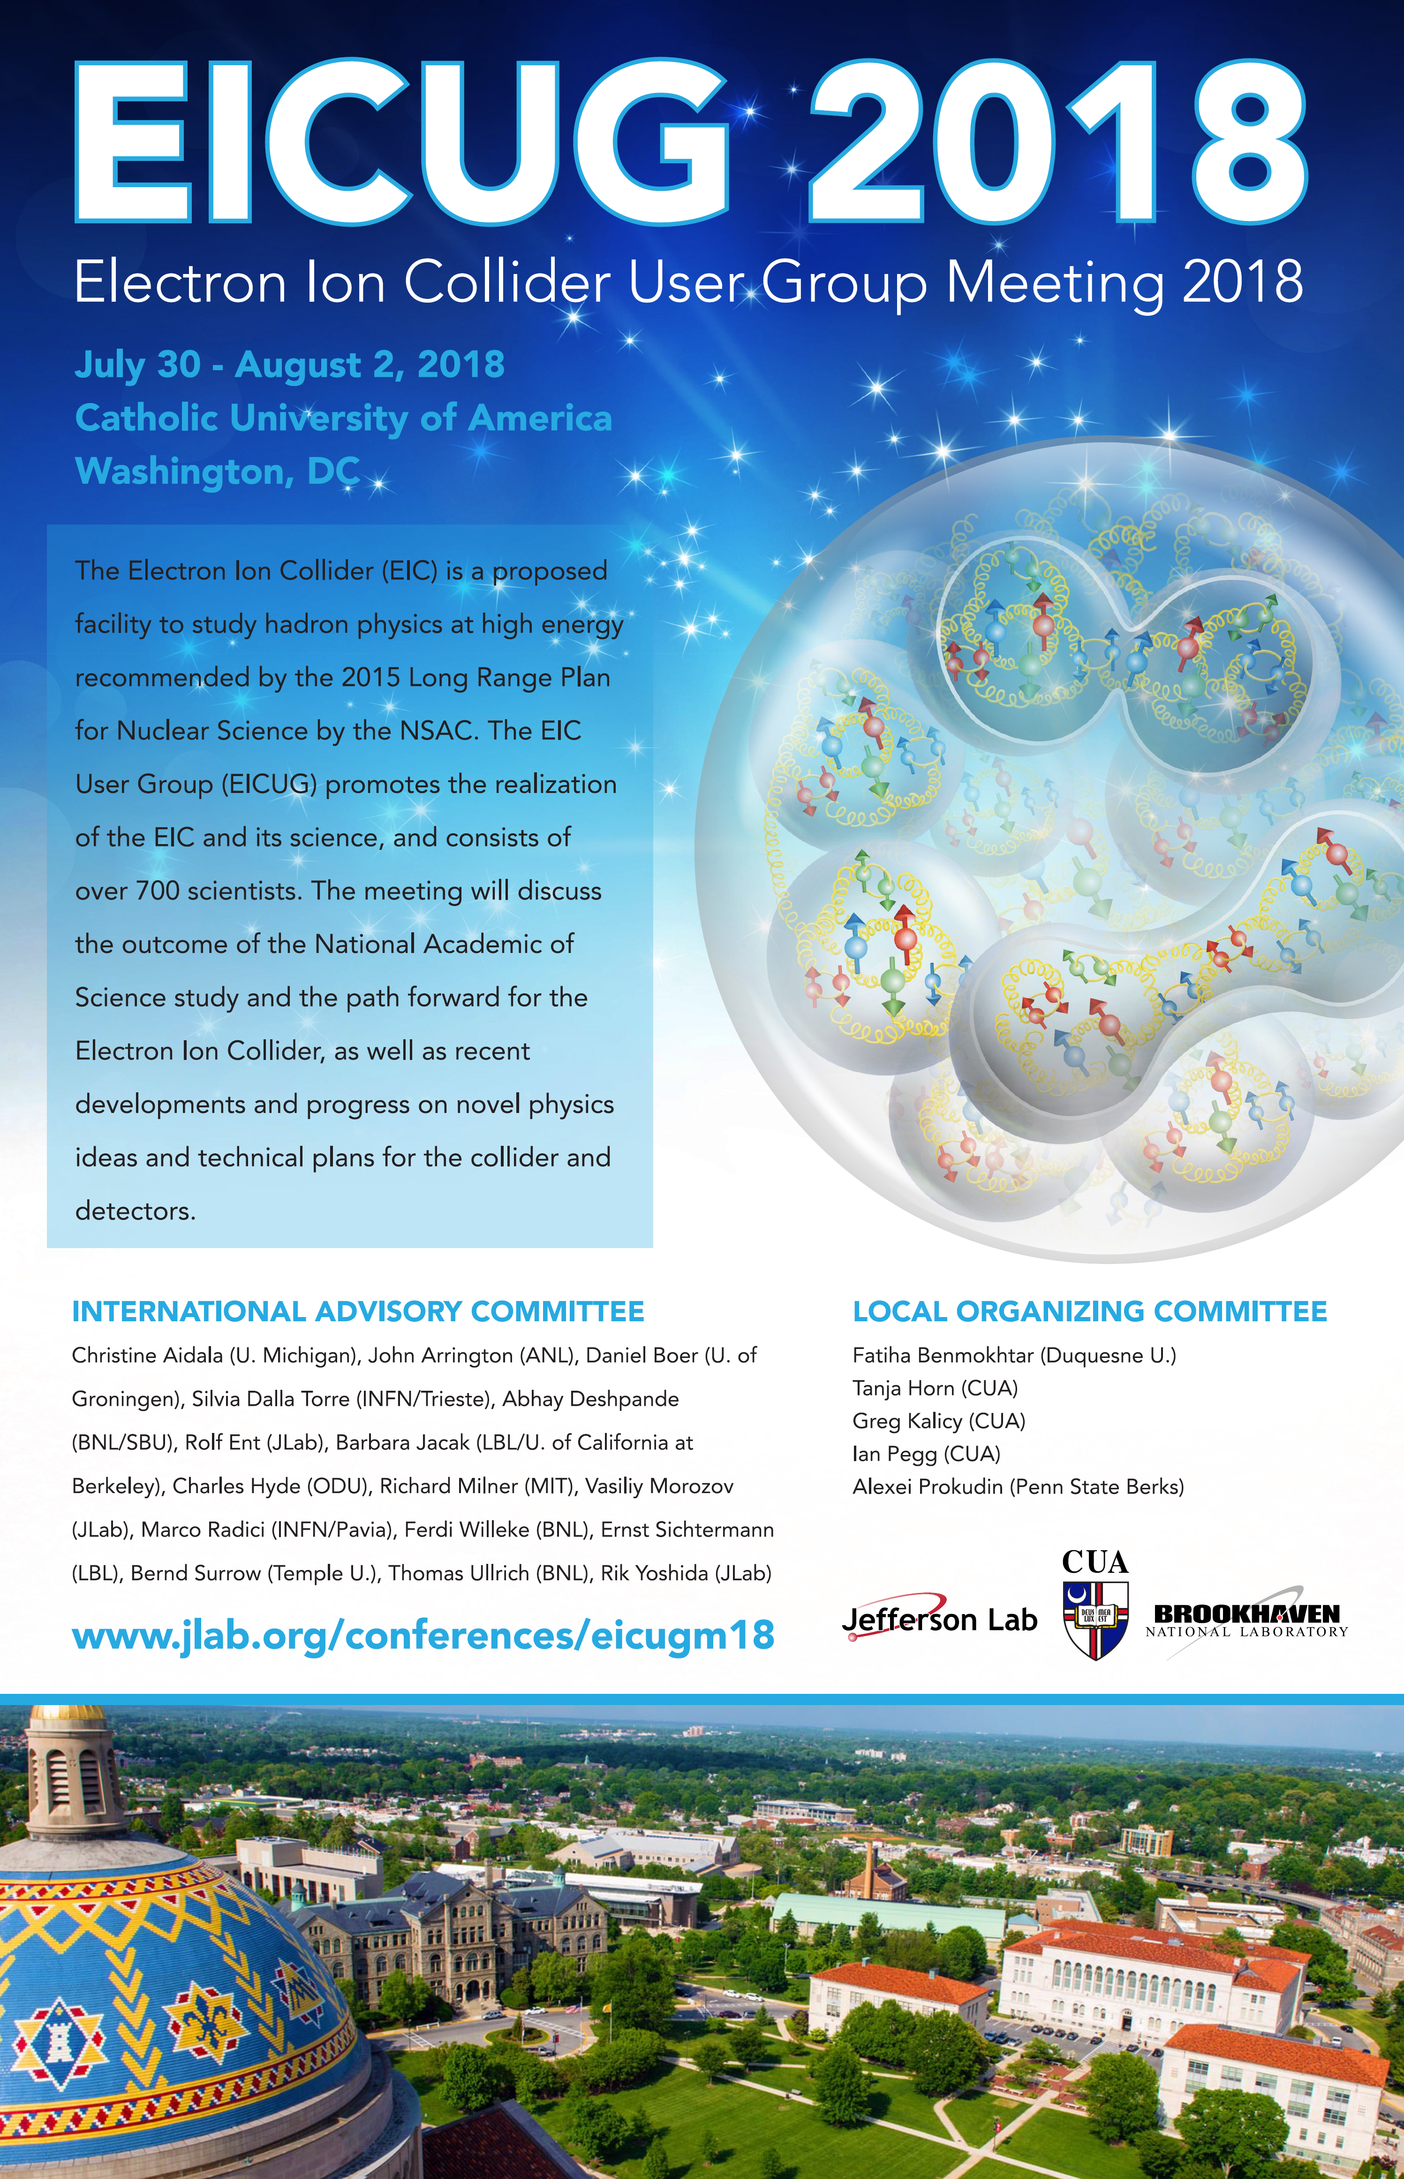
Next up: EIC Users Group Meeting

Slide 12
EIC Streaming Readout Consortium
Catholic University of America - S. Ali, V. Berdnikov, T. Horn, I. Pegg, R. Trotta
INFN - M. Battaglieri (Co-PI), A. Celentano
MIT - J.C. Bernauer* (Co-PI), D.K. Hasell, R. Milner
* Also Stony Brook University, Stony Brook, NY
Jefferson Lab - C. Cuevas, M. Diefenthaler, R. Ent, G. Heyes, B. Raydo, R. Yoshida
Proposal for streaming readout R&D targeted at EIC
Deliverable is a document/publication containing:
Reports on the relevant aspects of the performance of the prototypes studied.
A list and definition of streaming-readout parameters relevant to the EIC.
Initial estimates of some of the parameters with current technology as well as extrapolations to the time period of EIC detector construction phase.
A list and definitions of relevant parameters for detector technologies (e.g. TPC, Crystal Calorimeter..etc.) when considering streaming readout.
Initial estimates of some of these parameters.
Projects
TPC in streaming-readout at JLab
Crateless-Streaming at JLab
FEE and Circuit Designs for Streaming Readout at MIT
Streaming readout for an EIC Calorimeter at INFN Genoa and CUA
Multilayered Architecture for Streaming Readout at Stony Brook
Growing list…

