Slide 1
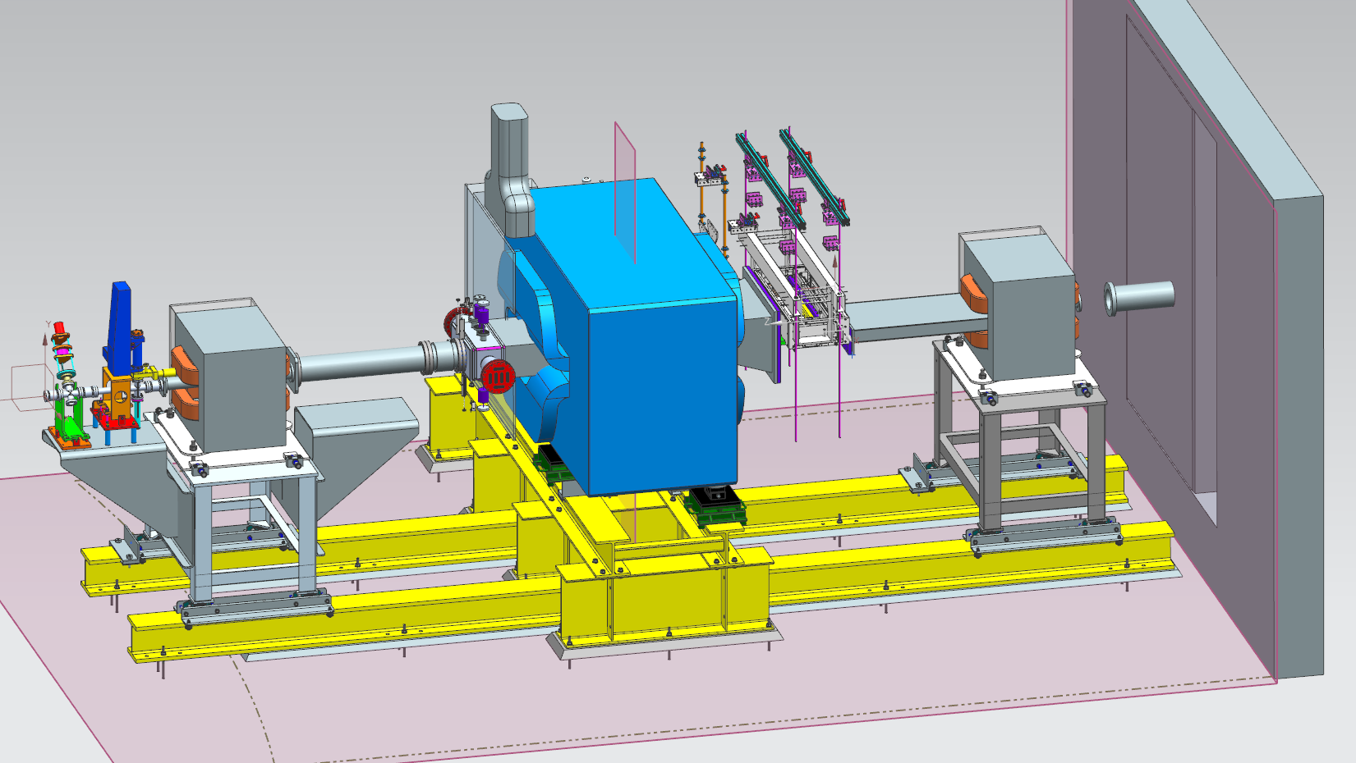
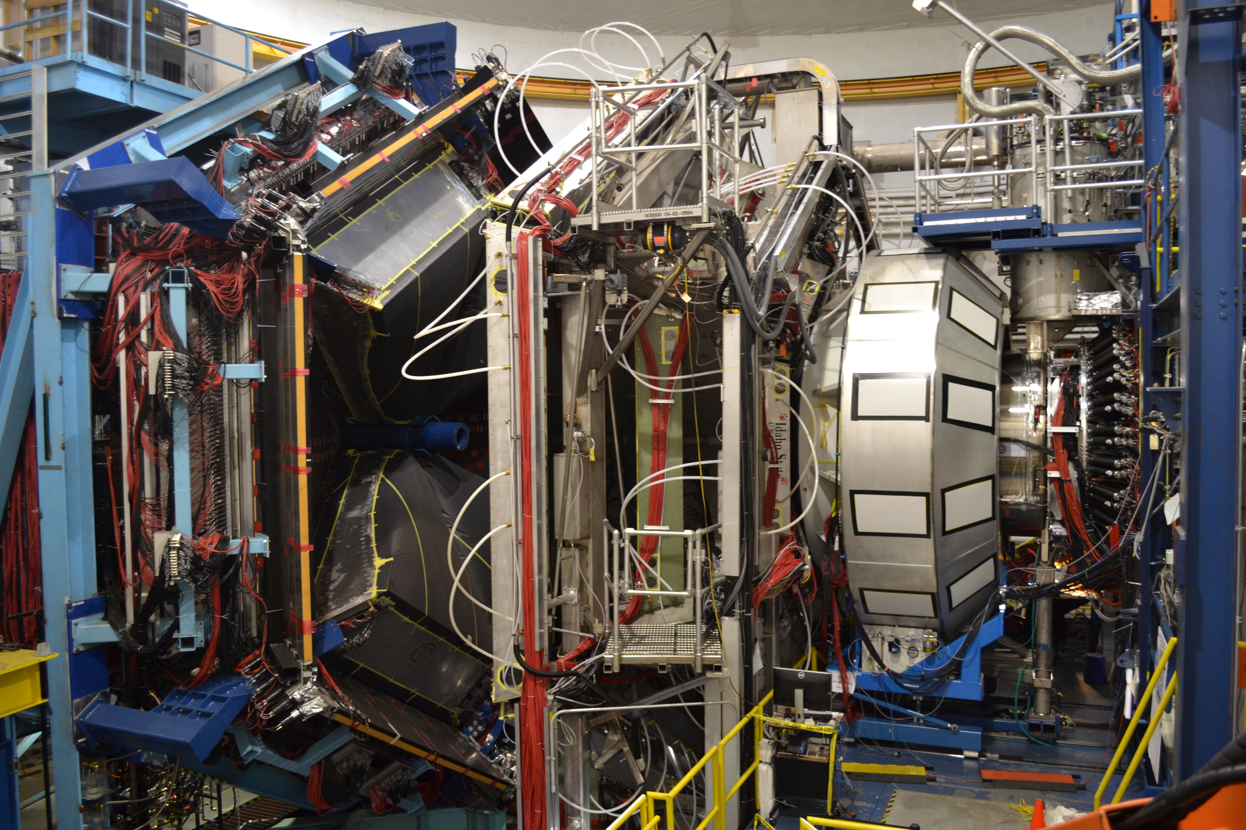


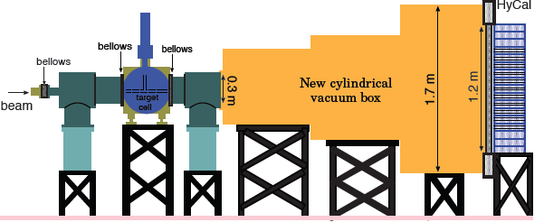

Status of Hall B
HPS
CLAS12
Hall B Publications & impact
CLAS12 status
  Spring 2018 run
  Preliminary data
Future run groups
Summary
Volker D. Burkert
Jefferson Lab
PAC46 Meeting 07/16/2018

Slide 2
Evidence for Nucleon & Delta States
Multiple nucleon resonances now confirmed; highlighted in Particle Data Group (PDG) tables.
Obtaining an accurate account of the nucleon resonance spectrum is essential for connecting QCD to the light quark sector.
State N((mass)J^{P} | RPP 2008 | RPP 2018
N(1710)1/2⁺ | *** | ****
N(1880)1/2⁺ |  | ***
N(2100)1/2⁺ | * | ***
N(1895)1/2⁻ |  | ****
N(1900)3/2⁺ | ** | ****
N(1875)3/2⁻ |  | ***
N(2120)3/2⁻ |  | ***
N(2060)5/2⁻ |  | ***
Δ(1900)1/2- | ** | ***
Δ(2200)7/2- | * | ***
Tremendous progress in solving the “Missing Resonances” problem in employing PWA to high precision data
Also electroproduction transition form factors included in N* & Δ review.
http://pdg.lbl.gov/2018/reviews/rpp2018-rev-n-delta-resonances.pdf
**** Existence is certain
*** Existence is very likely
** Evidence of existence is fair
* Evidence of existence is poor
updated: 3/17/2018
Notes:
This slides shows a summary of the results in this analysis. The green column shows the rating by the PDG. The two columns show the importance of the strangeness channel in this results.

Slide 3

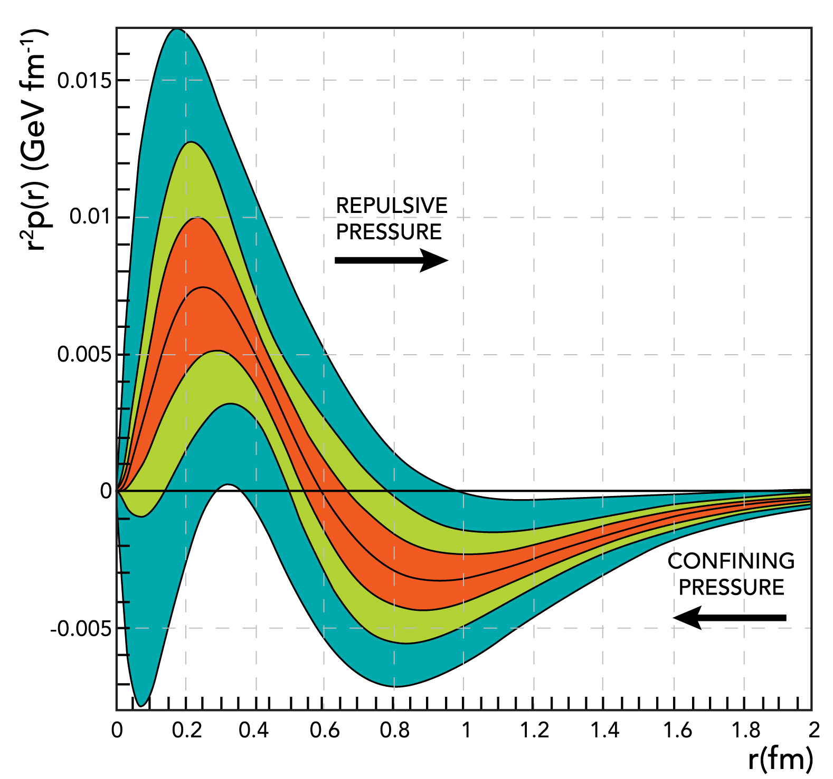
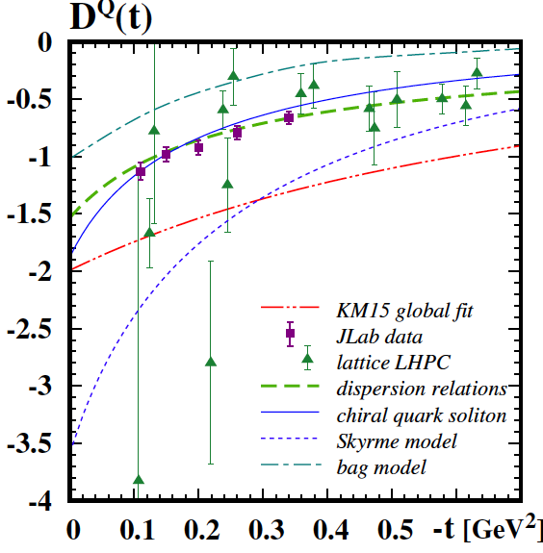

First gravitational FF of the proton
From CLAS DVCS-BH beam spin asymmetry.
First determination of basic proton property.
world data
CLAS6 data
CLAS12 proj.
D(t)
V.B., L. Elouadrhiri, F.X. Girod,
Nature 557 (2018) 7705, 396
PAC44 approved 12 GeV program E12-16-10B
The beginning of a new direction in nuclear and hadronic physics.

Slide 4
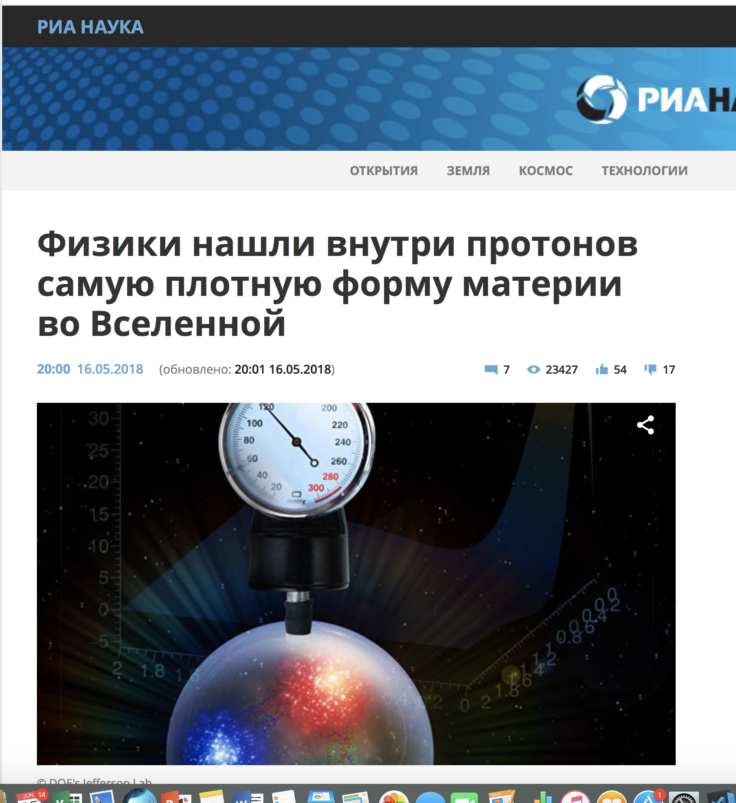
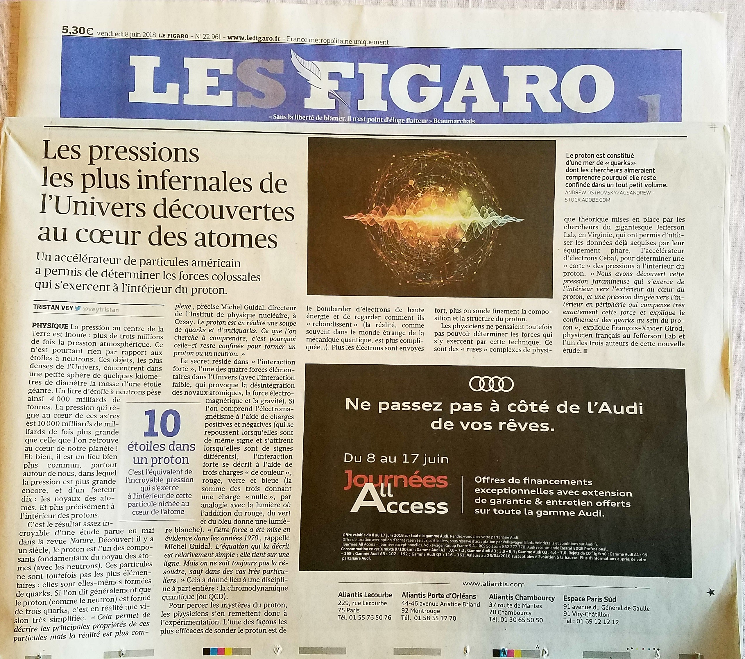
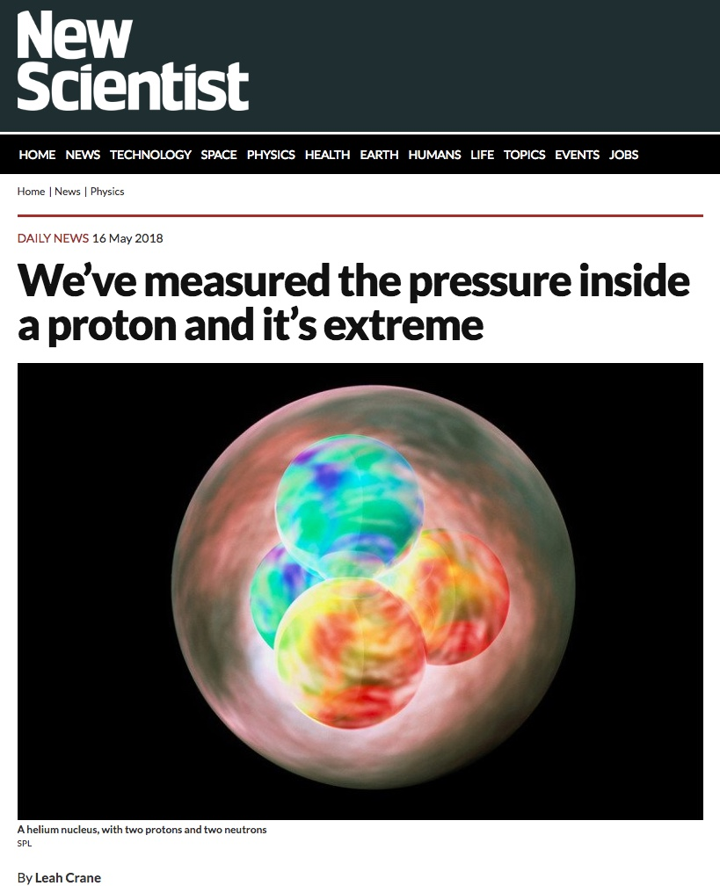
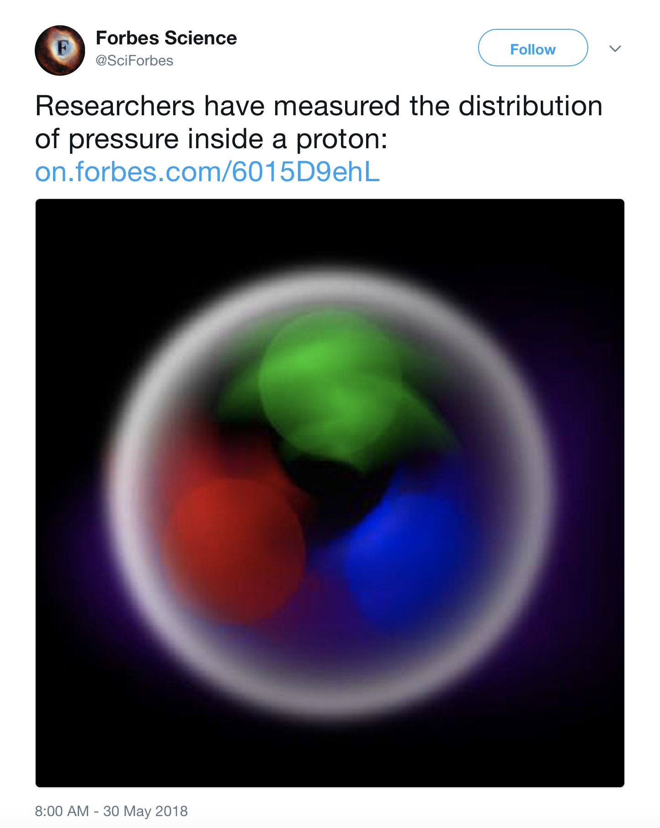
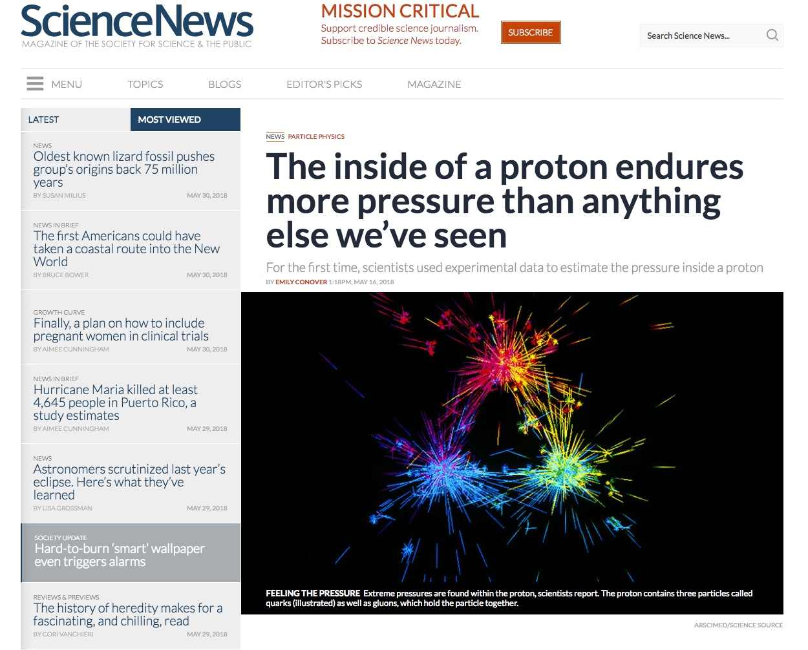
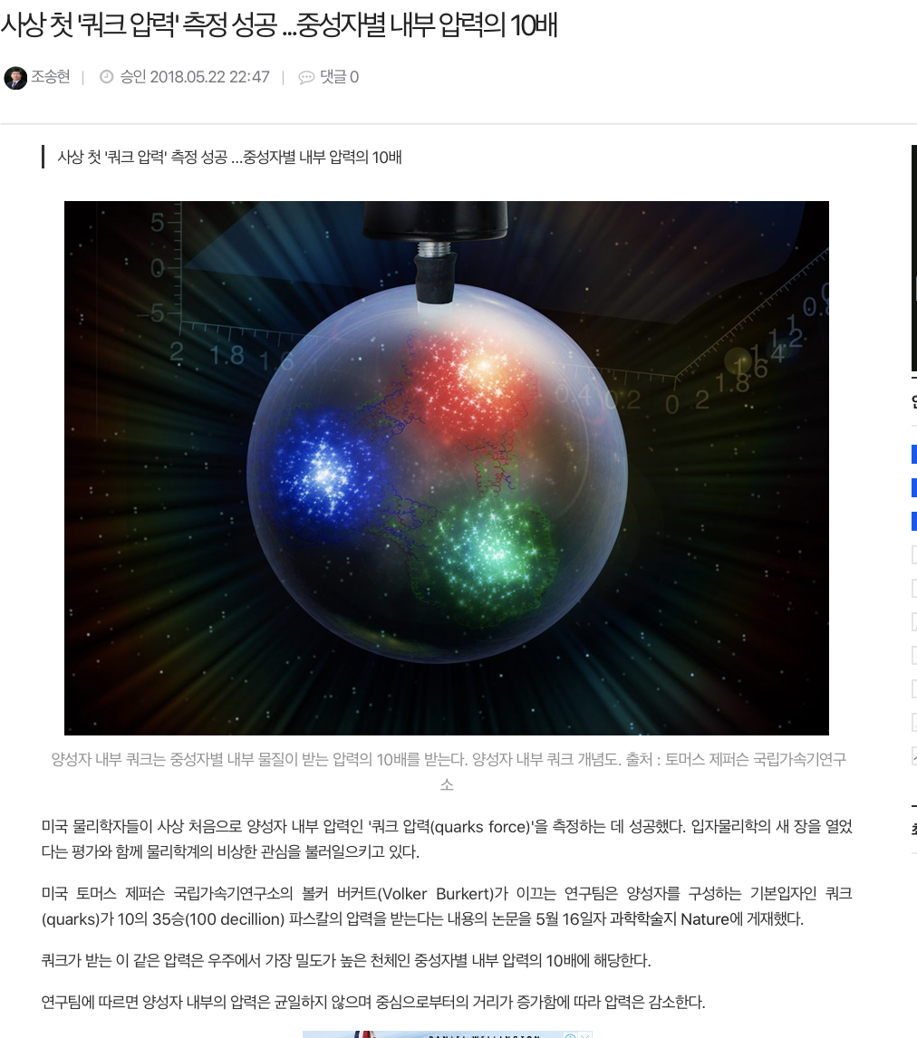
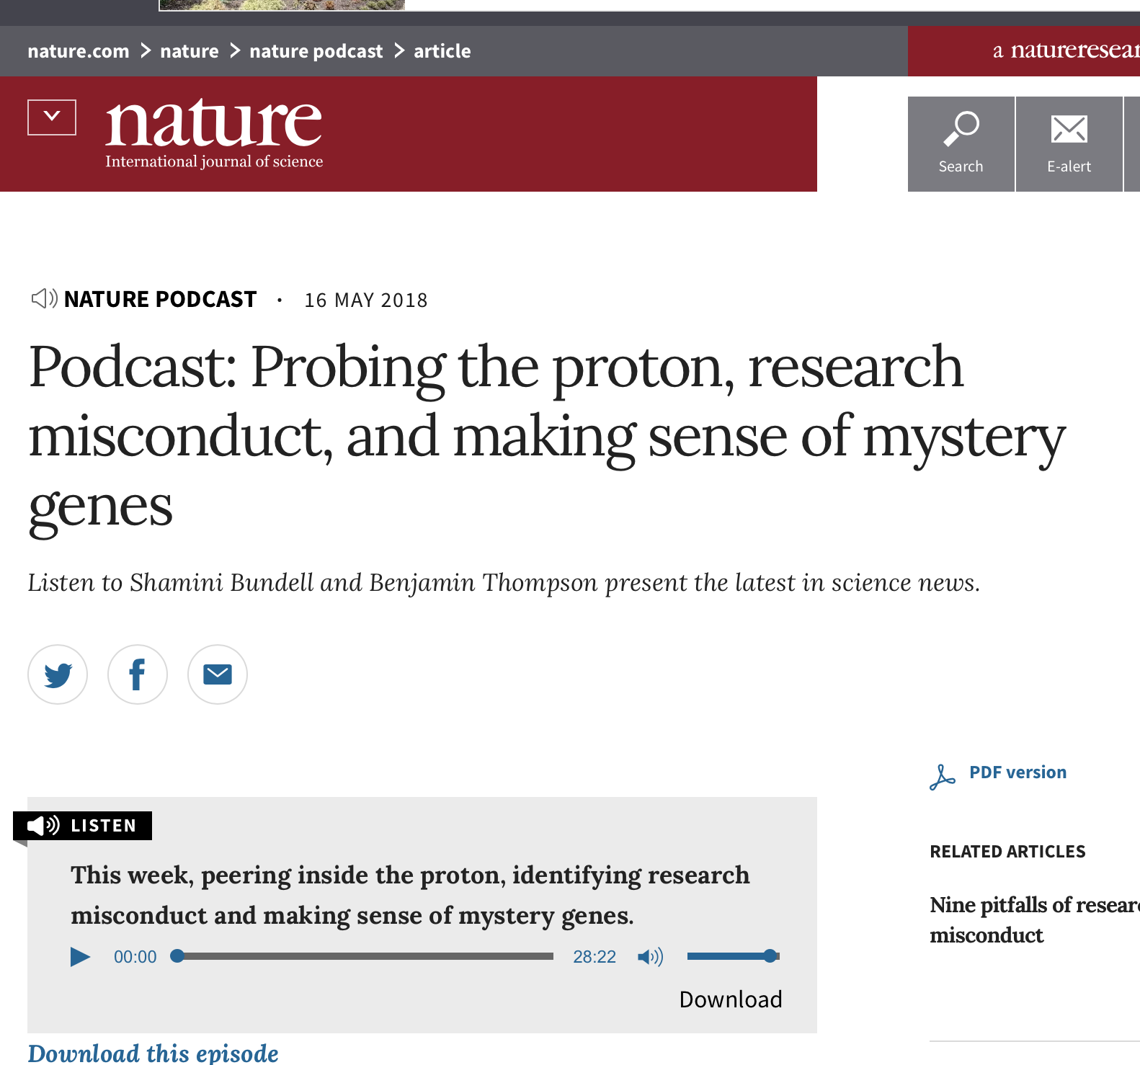
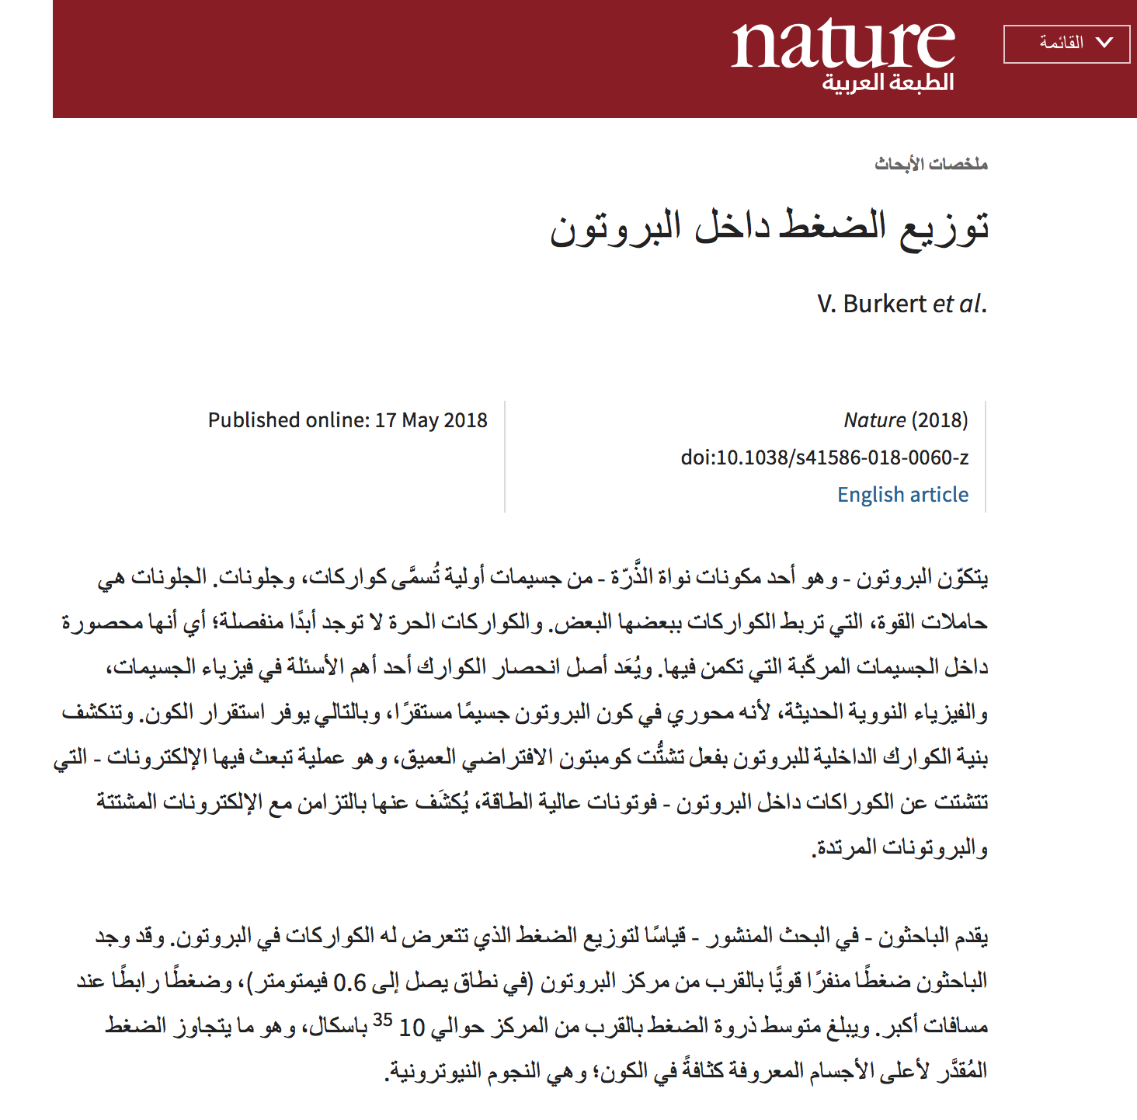
In the News May/June 2018

Slide 5

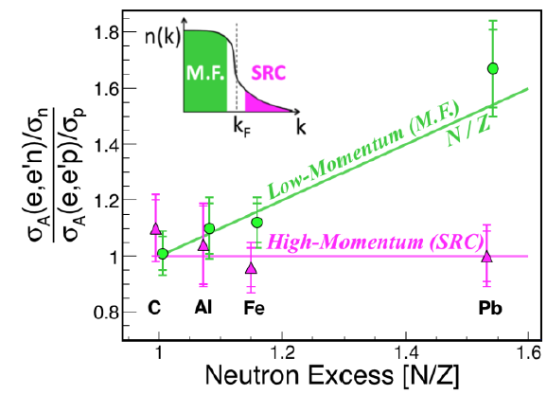
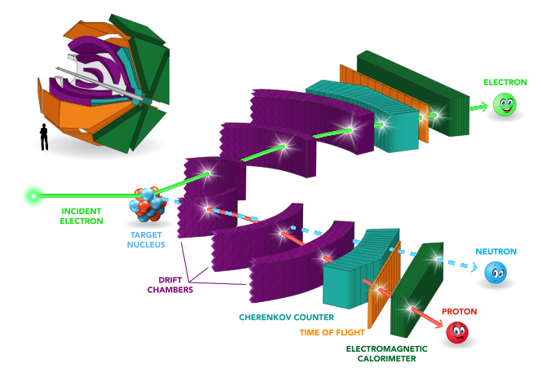
Abundance of hi/lo momentum protons/neutrons
EG2/Data Mining
M. Duer et al. (accepted in Nature)
Ratio of neutron/proton abundances ~ independent of neutron excess in SRC
~ linearly rising for M.F. nucleons.

Slide 6
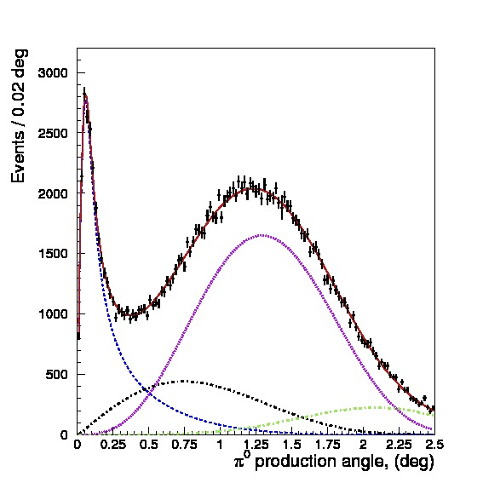
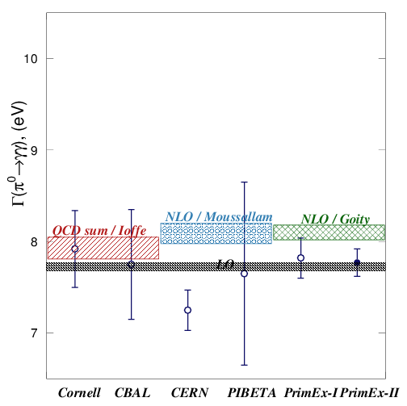
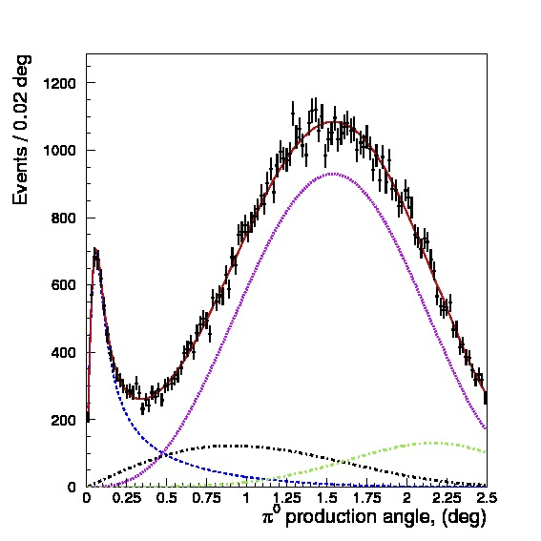
PrimEx-II results
²⁸Si
  Primakoff measurements of Γ(π⁰→γγ)
  Γ(π⁰→γγ)
  = 7.795eV ± 1.6%
¹²C
PrimEx-I
PrimEx-II

Slide 7
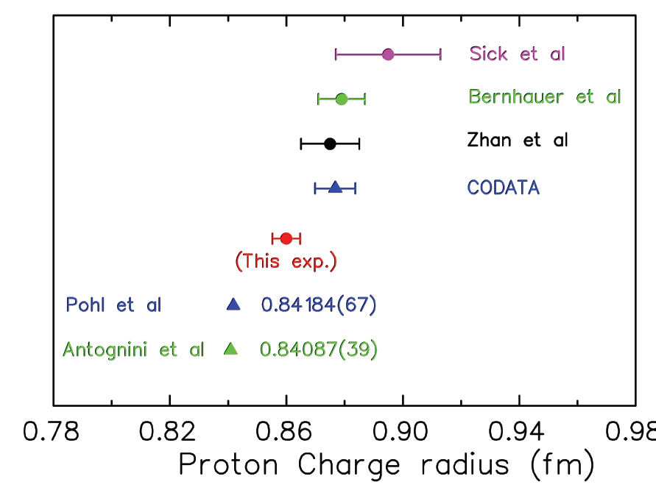
Proton Radius Experiment
Experiment ran in 2016
Elastic e-p
scattering
Atomic H
PRad@JLab:
(projected)
Muonic H
Goal: Resolve the discrepancy with
non-magnetic detection system,
higher precision and lowest min. Q²
Preliminary G_{E} slope seems
to favor smaller radius

Slide 8

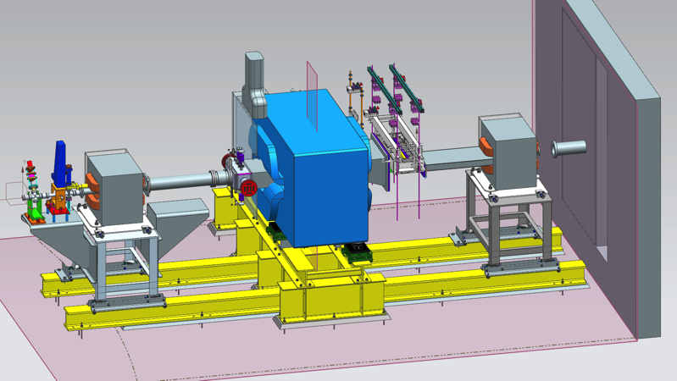
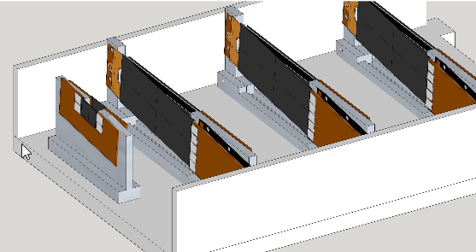
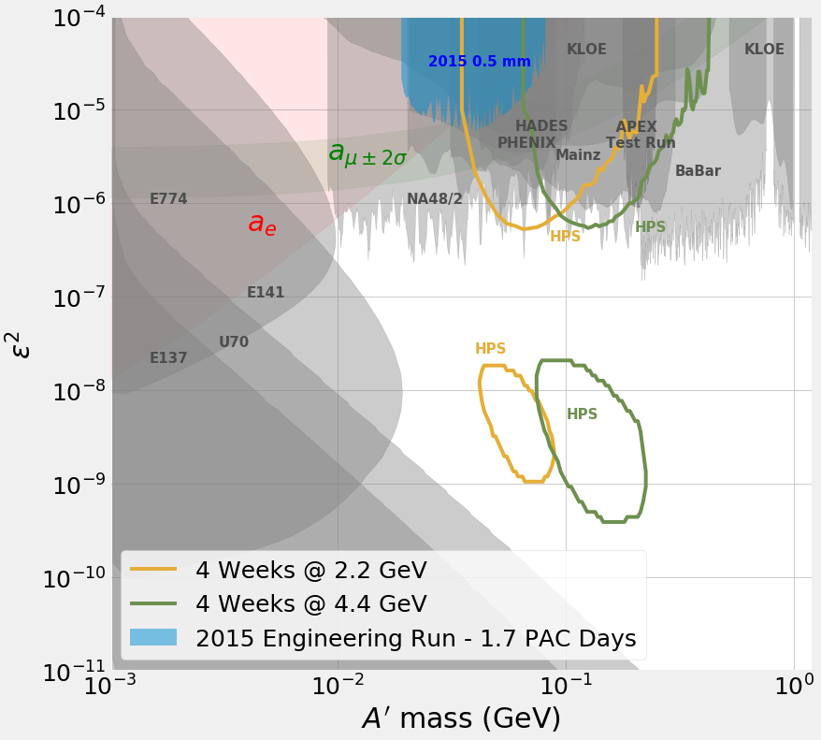
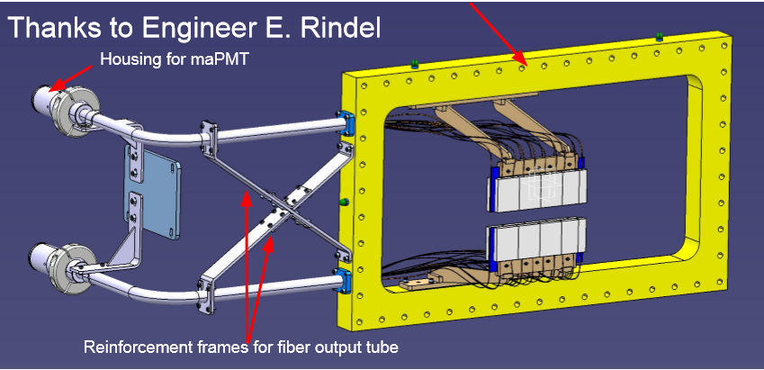
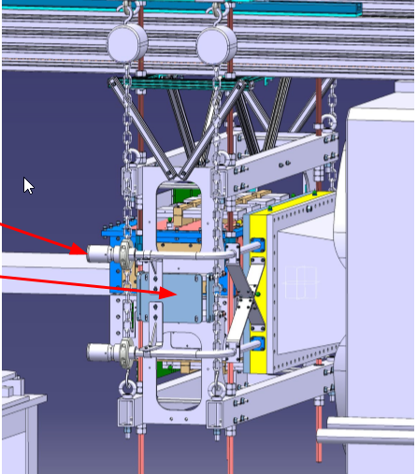
Heavy Photon Search (A’)
The final bump hunt results from 2015 are close to publication. 2016 Bump hunt and vertex search analyses are under way.
HPS upgrades ready for 2019 running.
New Positron Trigger will double e⁺e⁻ pairs
yield and reduce backgrounds.
HPS will resume A’ search in well-motivated, unexplored parameter space in 2019
Updated HPS Reach Plot

Slide 9

Detector Systems
CLAS12
Forward Detector (FD)
TORUS magnet
HT Cherenkov Counter
Drift chamber system
LT Cherenkov Counter
Forward ToF System
Pre-shower calorimeter
E.M. calorimeter
Forward Tagger
RICH detector
Central Detector (CD)
Solenoid magnet
Silicon Vertex Tracker
Central Time-of-Flight
Central Neutron Detector
  - MicroMegas
Beamline
Photon Tagger Dump
Shielding
Targets
Moller Polarimeter
Faraday Cup
MM
CND
FT
Number of readout channels ~100,000
RICH
https://www.jlab.org/Hall-B/clas12-web/

Slide 10
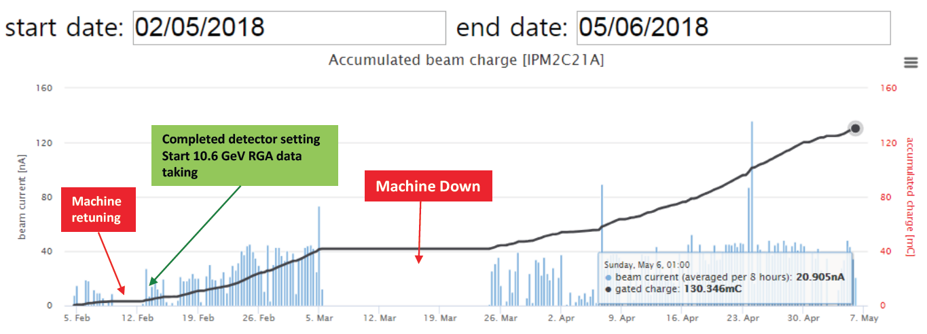
CLAS12
RG-A 2018 Spring Run
118mCb collected charge of high luminosity
At L = 10³⁵cm⁻²s⁻¹ this corresponds to: 18.2 PAC days
Low luminosity for 7 scheduled days: 3.5 PAC days
Total: 21.7 PAC days
Proposal | Physics | Contact | Rating | Days | % complete | comment
E12-06-108 | Hard exclusive electro-production of π⁰, η | Stoler | B | 80 | 24
E12-06-108A | Exclusive N*->KY Studies with CLAS12 | Carman | NR | (60) | 35
E12-06-108B | Transition Form Factor of the η’ Meson with CLAS12 | Kunkel | NR | (80) | 24
E12-06-112 | Proton’s quark dynamics in SIDIS pion production | Avakian | A | 60 | 11 | 1 LTCC, 1 RICH
E12-06-112A | SIDIS Λ productiuon in target fragmentation region | Mirazita | NR | (60) | 11 | 1 LTCC, 1 RICH
E12-06-112B | Colinear nucleon structure at twist-3 | Pisano | NR | (60) | 11 | 1 LTCC, 1 RICH
E12-06-119(a) | Deeply Virtual Compton Scattering | Sabatie | A | 80 | 24
E12-09-003 | Excitation of nucleon resonances at high Q² | Gothe | B+ | 40 | 48
E12-11-005 | Hadron spectroscopy with forward tagger | Battaglieri | A- | 119 | 19
E12-11-005A | Photoproduction of the very strangest baryon | Guo | NR | (120) | 19
E12-12-001 | Timelike Compton Scatt. & J/ψ production in e+e | Nadel-Turonski | A- | 120 | 19
E12-12-001A | J/ψ Photoproduction & study of LHCb pentaquarks | Stepanyan | NR | (120) | 19
E12-12-007 | Exclusive φ meson electroproduction with CLAS12 | Girod | B+ | 60 | 31
Average completion (%) |  |  |  |  | 22.7

Slide 11
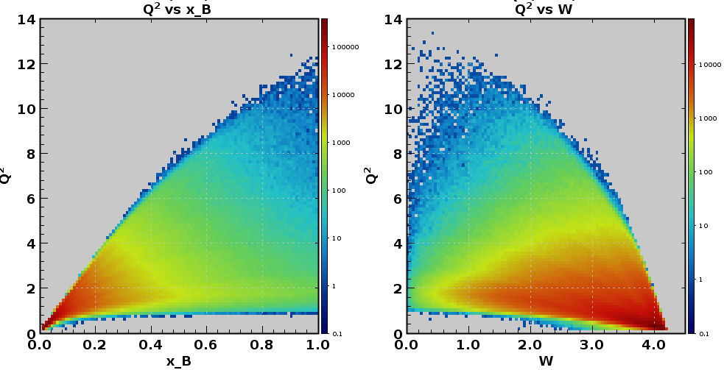
Kinematic reach
CLAS12
Beam energy at 10.6 GeV Torus current 3770 A, electrons out-bending, Solenoid magnet at 2416 A.
p(e,e’)X
Θ_{max}
e’ minimum energy threshold
Q² (GeV²)
x_{B}
W (GeV)

Slide 12
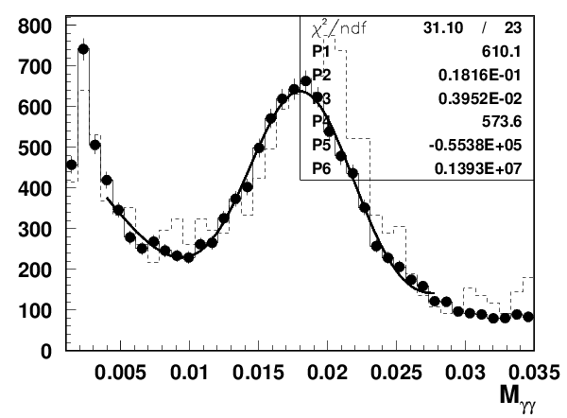
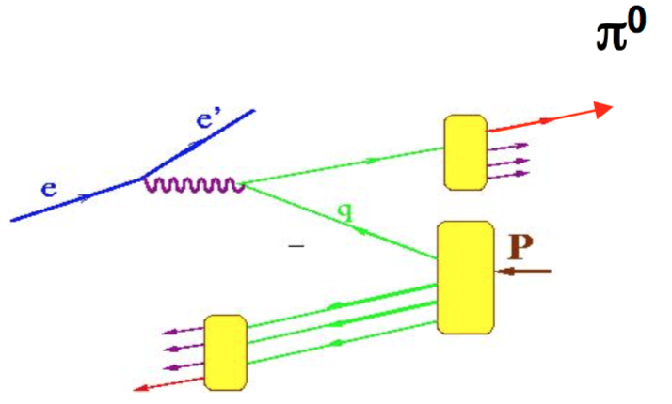

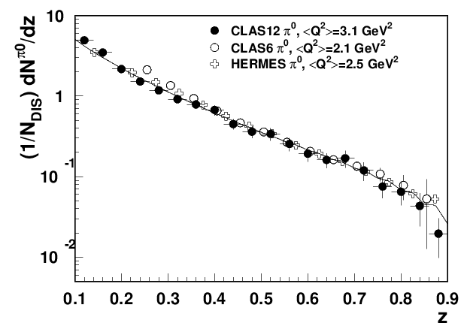
CLAS12
First SIDIS results e’πºX
Extraction of e’π⁰X/ e'X ratio (ratio of semi-inclusive pi0 to inclusive electron) requires good control over the acceptance of photons.
Eγ > 0.7 GeV
~0.5% of spring 10.6 GeV data.
Background
in SIDIS MC
VERY PRELIMINARY
At large x, when sea contribution can be neglected e’π⁰X/ e'X should follow the z-dependence of the fragmentation function (after integration over P_{T})
FF(DSS2007,LO)

Slide 13
Hall B 12 GeV Publication Schedule
Heavy Photon Search (HPS) 2015 data - expect in one month
2016 data - end of 2019
Proton Radius (PRAD) End of 2018
RG-A (13 proposals) Release first results at DNP 2019
First publication after that.

Slide 14
Future Run Groups
RG-A (RG-K) - to continue this fall until end of 2018
RG-B - scheduled to run during the spring and the fall of 2019
- Liquid deuterium target
- BAND detector for backward angle neutron detection
HPS - scheduled to run summer of 2019 with upgraded detector and trigger system
BONuS12 - projected to run spring/fall of 2020
  A new low energy recoil detector based on GEM technology, to replace SVT
RG-C - Polarized target for CLAS12 - on track for installation to support spin program in 2020/21

Slide 15
Summary
Continuous flow of data from CLAS lead to discovery of new baryon states and first insight into the nucleon gravitational properties.
The data mining initiative has been very successful leading to several publications, including publication in Science and Nature Journals.
Several dedicated experiments addressing fundamental properties of hadrons (π⁰ LT, proton charge radius) and search for the messengers of dark matter.
CLAS12 had successful first production run achieving projected luminosity and providing data for 13 individual proposals.
Data runs after 2018 focus of neutron structure properties RG-B (7 experiments), HPS, BoNuS12, and spin physics with RG-C (6 experiments).

Slide 16
Run Groups
Hall B
Proposal | Physics | Contact | Rating | Days | Group | Equipment | Energy | Run Group | Target
E12-06-108 | Hard exclusive electro-production of π⁰, η | Stoler | B | 80 | 139 | RICH (1 sector) Forward tagger | 11 | A F. Sabatié | liquid H₂
E12-06-108A | Exclusive N*->KY Studies with CLAS12 | Carman |  | (60)
E12-06-108B | Transition Form Factor of the η’ Meson with CLAS12 | Kunkel |  | (80)
E12-06-112 | Proton’s quark dynamics in SIDIS pion production | Avakian | A | 60
E12-06-112A | SIDIS Λ productiuon in target fragmentation region | Mirazita |  | (60)
E12-06-112B | Colinear nucleon structure at twist-3 | Pisano |  | (60)
E12-06-119(a) | Deeply Virtual Compton Scattering | Sabatie | A | 80
E12-09-003 | Excitation of nucleon resonances at high Q² | Gothe | B+ | 40
E12-11-005 | Hadron spectroscopy with forward tagger | Battaglieri | A- | 119
E12-11-005A | Photoproduction of the very strangest baryon | Guo |  | (120)
E12-12-001 | Timelike Compton Scatt. & J/ψ production in e+e | Nadel-Turonski | A- | 120
E12-12-001A | J/ψ Photoproduction & study of LHCb pentaquarks | Stepanyan |  | (120)
E12-12-007 | Exclusive φ meson electroproduction with CLAS12 | Girod | B+ | 60
E12-07-104 | Neutron magnetic form factor | Gilfoyle | A- | 30 | 90 | Neutron detector RICH (1 sector) Forward tagger | 11 | B S. Niccolai | liquid D₂ target
E12-09-007(a) | Study of partonic distributions in SIDIS kaon production | Hafidi | A- | 30
E12-09-008 | Boer-Mulders asymmetry in K SIDIS w/ H and D targets | Contalbrigo | A- | 56
E12-09-008A | Hadron production in target fragmentation region | Mirazita |  | (60)
E12-09-008B | Colinear nucleon structuer at twist-3 | Pisano |  | (60)
E12-11-003 | DVCS on neutron target | Niccolai | A | 90
E12-11-003A | In medium structure functions, SRC, and the EMC effect | Hen |  | (90)
E12-11-003B | J/Psi Photoproduction off the Deuteron | Ilieva |  | (80)
Beam time partial sum |  |  |  | 765 (1475) | 229

Slide 17
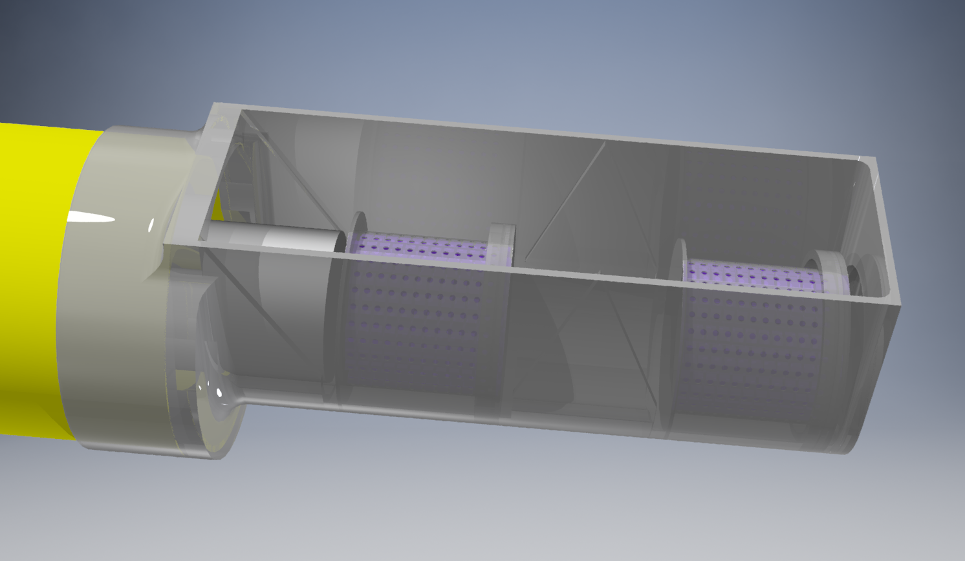
CLAS12
Longitudinally Polarized Target
Courtesy of J. Brock
Coils
1A
& 1B
Coils
2A & 2B
-80 gauss
+80 gauss
BEAM
negative
positive
Construction of the 1K refrigerator anticipated completion date: Sept. 30, 2018

Slide 18
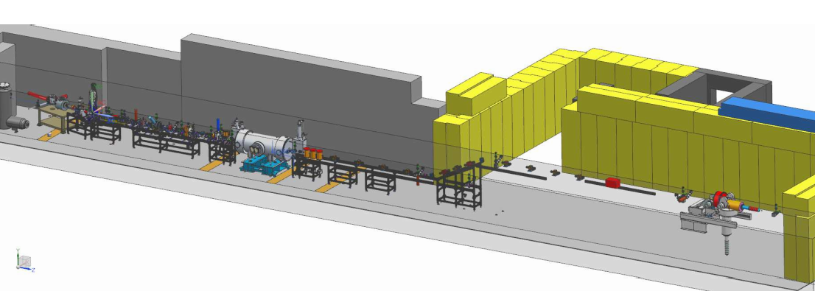
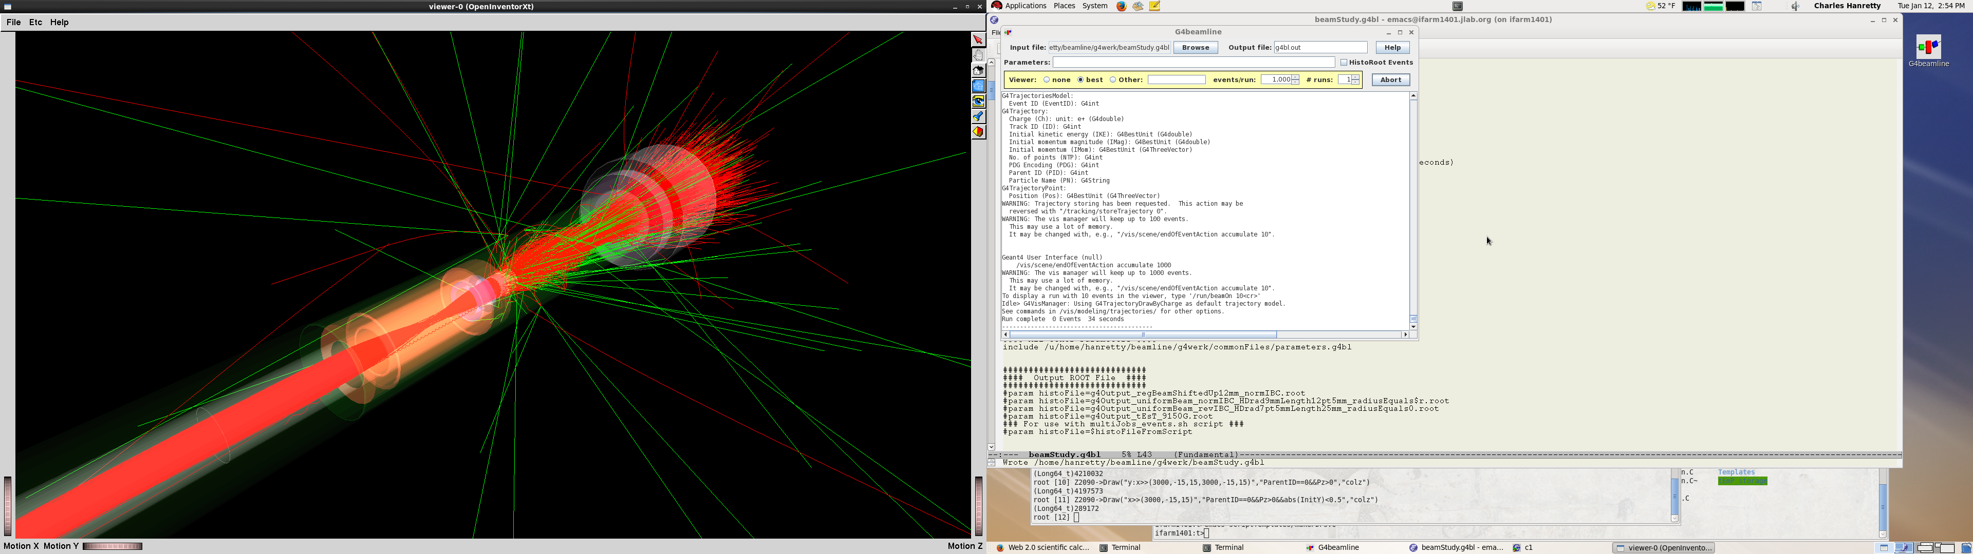
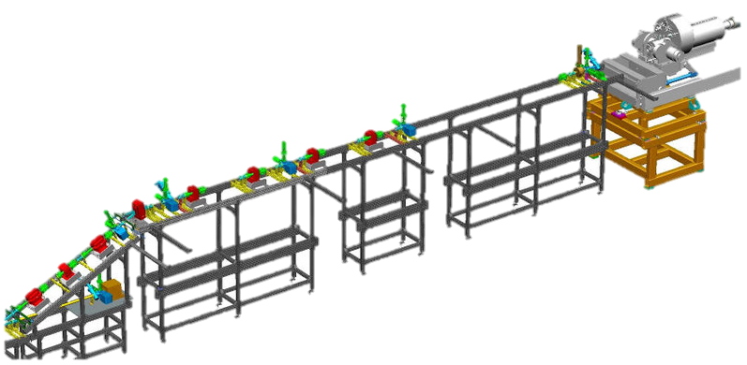
e+HD studies at the UITF – a prelude to e+H_{transverse}
H.
D.
ice
UITF ⬄ 10 MeV accelerator in the TestLab
• energy deposition in HD ~ as with 10 GeV ⬄ testbed for transverse e+HD
• keV beams in cave 1 in Dec/17 ✓ • ¼ CM cooled in Apr/18 ✓
• PSS-RadCon under construction
Next Steps:
Klystron installation & commissioning ~ Fall/18
beamline to HDice under construction; 1st beam studies in cave-2 ~ Spring/19
1st eHD test with polarized targets ~ Summer/19
Cave 1
Cave 2
HD

Slide 19
Physics Publications
Hall B
 | HSWG | DPWG | NPWG | ALL
2000 | - | 1 | 1 | 2
2001 | 2 | 3 | - | 5
2002 | 3 | - | 1 | 4
2003 | 7 | 4 | 1 | 12
2004 | 3 | 3 | 4 | 10
2005 | 7 | 3 | 2 | 12
2006 | 8 | 4 | 3 | 15
2007 | 7 | 2 | 3 | 12
2008 | 4 | 6 | 2 | 12
2009 | 8 | 7 | 4 | 19
2010 | 4 | 2 | 4 | 10
2011 | 3 | 1 | 4 | 8
2012 | 6 | 3 | 2 | 11
2013 | 8 | 6 | 2 | 16
2014 | 5 | 6 | 1 | 12
2015 | 4 | 5 | 3 | 12
2016 | 7 |  |  | 7
2017 | 12 | 7 | 1 | 20
2018 | 5 | 4 | 1 | 10 + 4
SUM | 103 | 67 | 39 | 209+4
5
10
15
publ
subm.
updated 07 July 2018

Slide 20
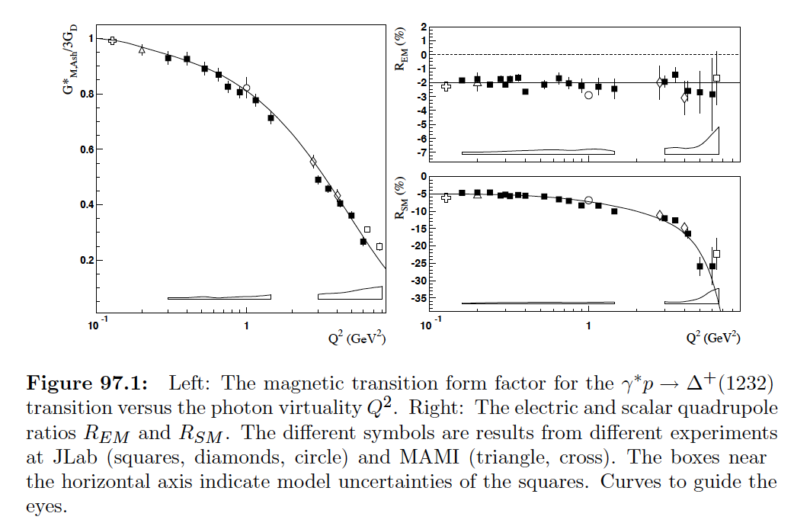
JLab Δ(1232) transition FF in RPP 2018

Slide 21
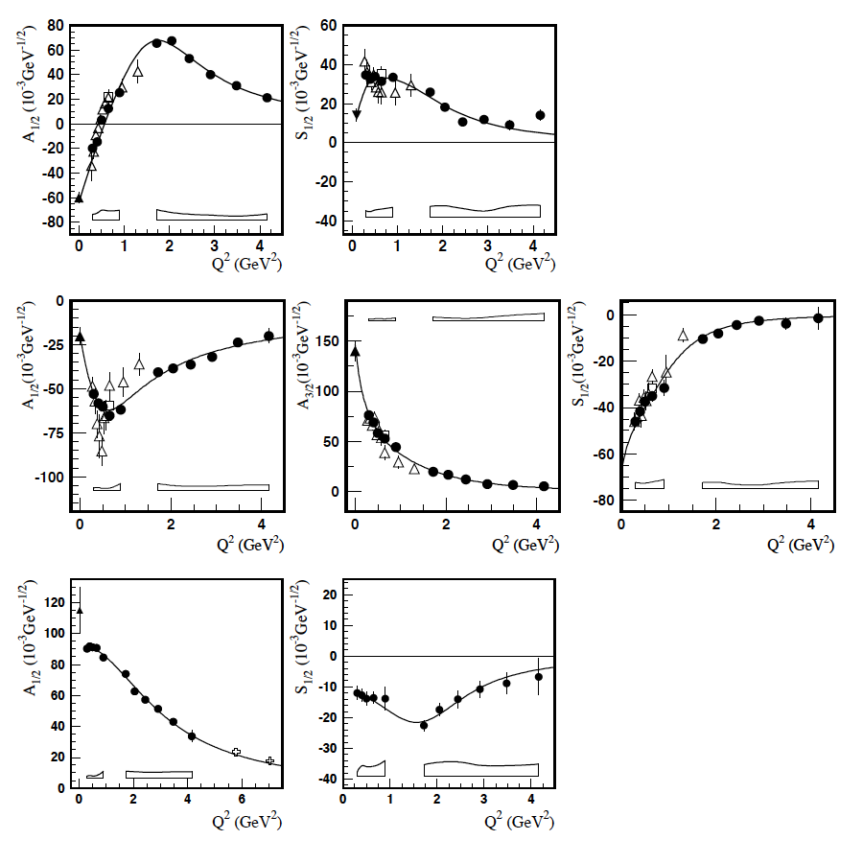
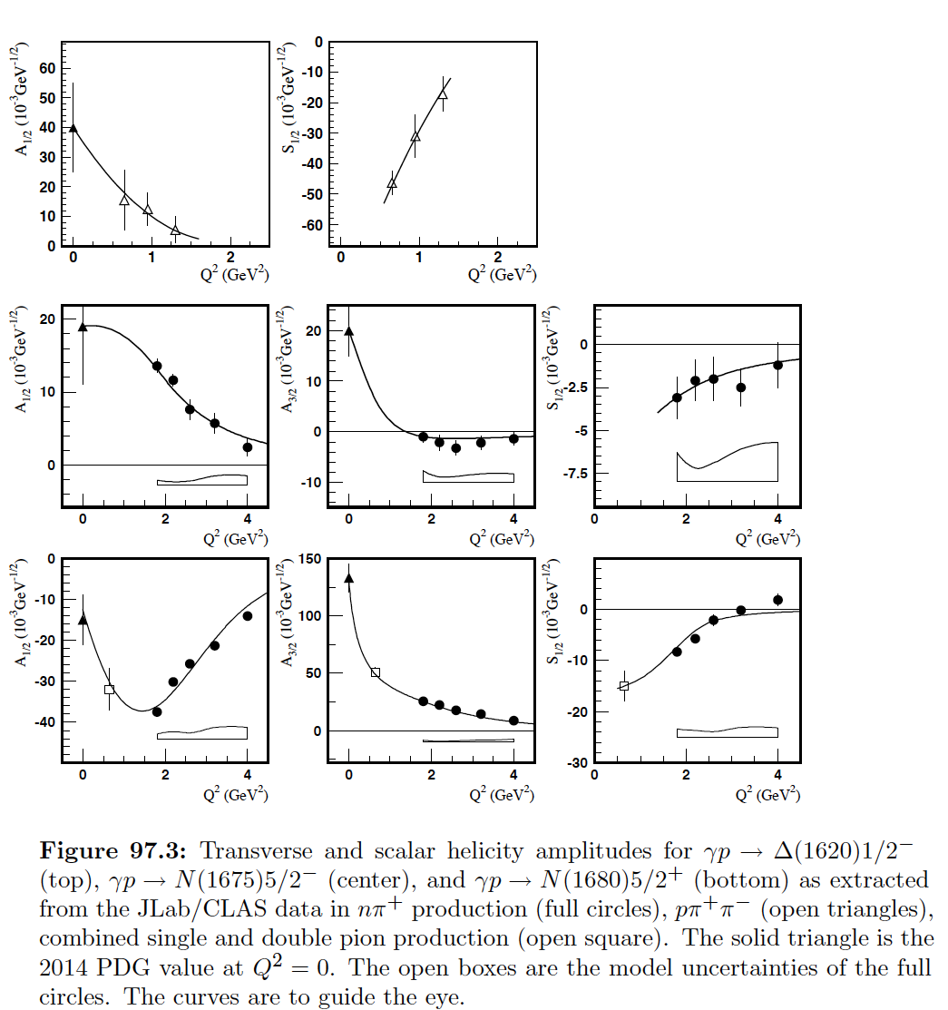
JLab N* transition FF in RPP 2018
N(1440)
“Roper”
Δ(1620)
N(1520)
N(1675)
N(1535)
N(1680)

