Slide 1
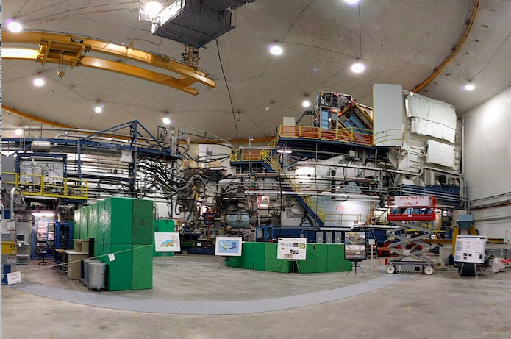
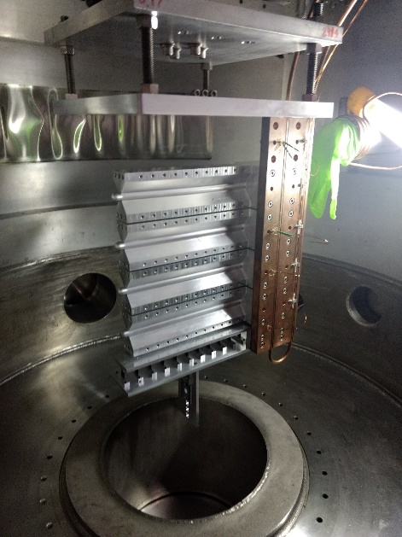
Hall A Report
Thia Keppel
PAC 46
July 2018

Slide 2
Hall A Status and Plans
Completed 5* planned experiments:
DVCS, scaling test for GPD science (*50% planned)
GMp, high precision proton elastic for factor
Ar(e,e’p), fundamental nuclear input for neutrino experiments
MARATHON, enabling extraction of d/u at large x
Exclusive SRC, nucleon momentum distributions in A=3 nuclei
Currently using first tritium target available for electron scattering in ~30 years – 2 more experiments planned for Fall 2018
Near term future: septum experiments
APEX Spring 2019
PREX2 and CREX (common installation) Summer/Fall 2019
SBS in 2020
MOLLER, SoLID (ongoing support, not discussing below)

Slide 3
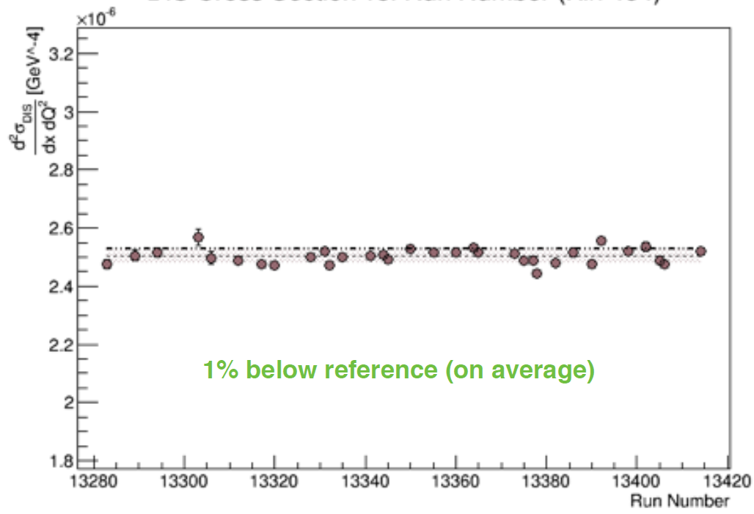
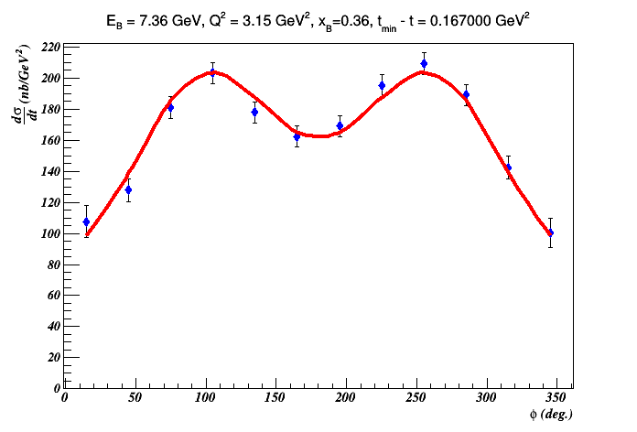
E12-06-114: Deeply Virtual Compton Scattering
100 PAC days approved:
High impact experiment for nucleon 3D imaging program
High precision scaling tests of the DVCS cross section at constant x_{B}
CEBAF12 will allow to explore for the first time the high x_{B} region
HRS acceptance well under control (despite the multiple hardware issues)
DIS cross section within 1% of world data (E. Christy et al.)
50% of experiment planned & completed in 2014-2016
Data under final stages of analysis
Publication drafts expected by the end of the year
Preliminary
Analysis path:
Jun’18: Preliminary results on π⁰ at x_{B}=0.36
Oct’18: Preliminary results on DVCS
Nov’18: Short paper submitted to PRL on π⁰
Jan’19: Letter to PRL on DVCS
Jul’19: Long paper to PRC (DVCS & pi0)
π⁰ electroproduction cross section
Notes:
Suggested rework
Add bullet on What we are doing
Rolf to find another plot

Slide 4
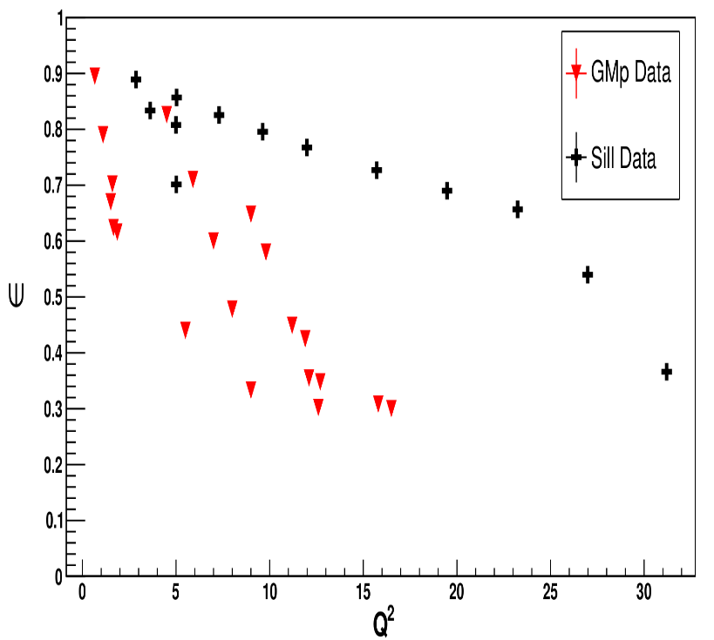
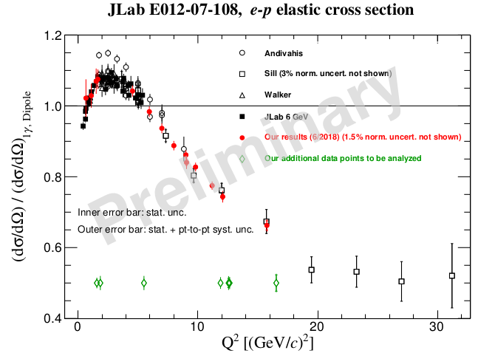
GMp Experiment E12-07-108
Precision Measurement of the Proton Elastic Cross Section at High Q²
Precision e-p elastic cross-section necessary for:
Baseline cross section for many 12 GeV hadronic physics measurements
Determination of G_{E}^{p}, G_{M}^{p}, 2−γ effects at high Q² in combination with SBS
Publication with all data including further reduced systematics in ~3 months
ε
JLab data critical for Q² > 6 GeV²
Q² [(GeV/c)²]
Prior to E12-07-108 only one set of (SLAC) data above Q² > 6 GeV²
One epsilon, NO range for two photon checks
Hall A GMp data provides a large range of epsilon up to Q² ~ 16 GeV²

Slide 5
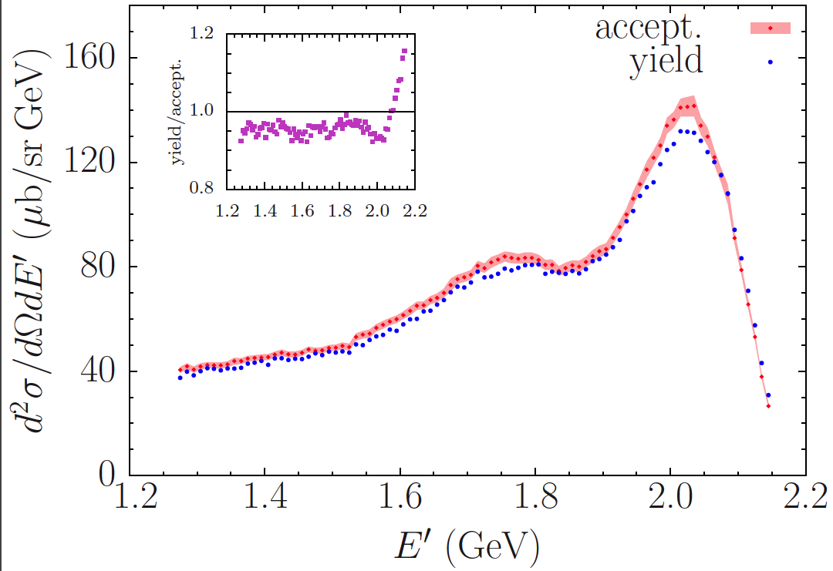
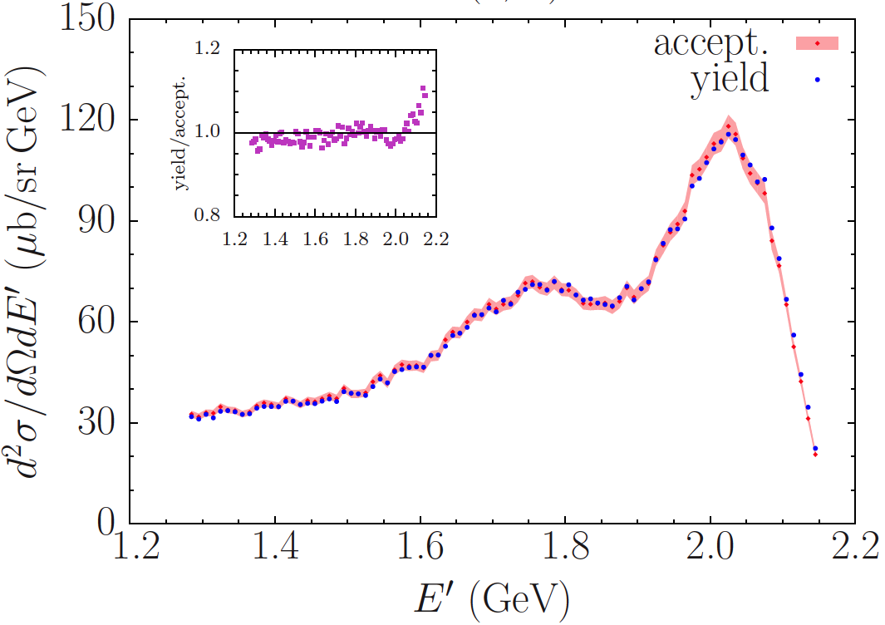
E12-14-012: Ti and Ar (e,e’p) Measurements – completed Spring 2017
Will further our understanding of these many body systems and reduce uncertainties for neutrino science.
Three Ph.D. students (2 Virginia Tech, 1 University of Virginia)
Inclusive Ti and C cross sections paper submitted to Phys Rev. C.
Completed (e,e’) analysis on Ar, paper in preparation to be circulated by middle of July.
Right: Inclusive Titanium cross sections obtained with two different methods, yield ratio and acceptance
Left: Inclusive Argon cross sections obtained with the two different methods
Yield ratios include both statistical and systematical uncertainties.
Next steps: exclusive (e, e’p) analysis for Ar and Ti.

Slide 6
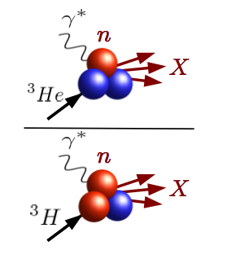
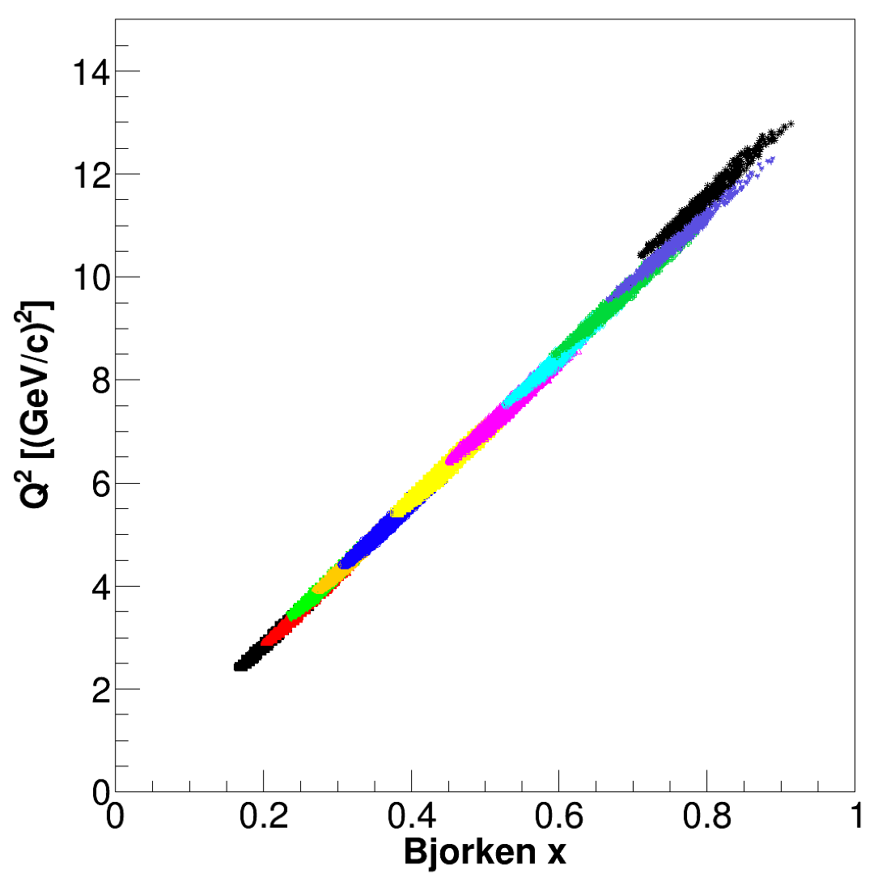
MARATHON: The first Hall A tritium target experiment
Extract F₂^{n}/F₂^{p} from ratio of measured ³He/³H structure functions
11 GeV beam was used with 3H, 3He and 2H targets.
Tritium gas target system (and spectrometers/detectors) performed to expectation
Preliminary offline analysis in progress.
Current analysis projects include tracking studies, beam current calibrations, beam-induced gas target density changes, radiative corrections
Preliminary results expected by Fall 2018
MARATHON is providing Ph.D. thesis topics for six students.
Final MARATHON kinematics (.15 < x < .85) – completed Spring 2018

Slide 7
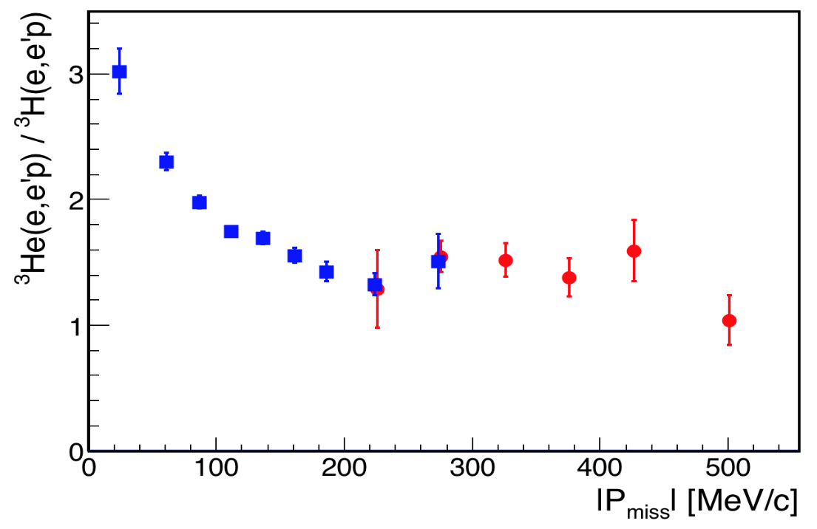
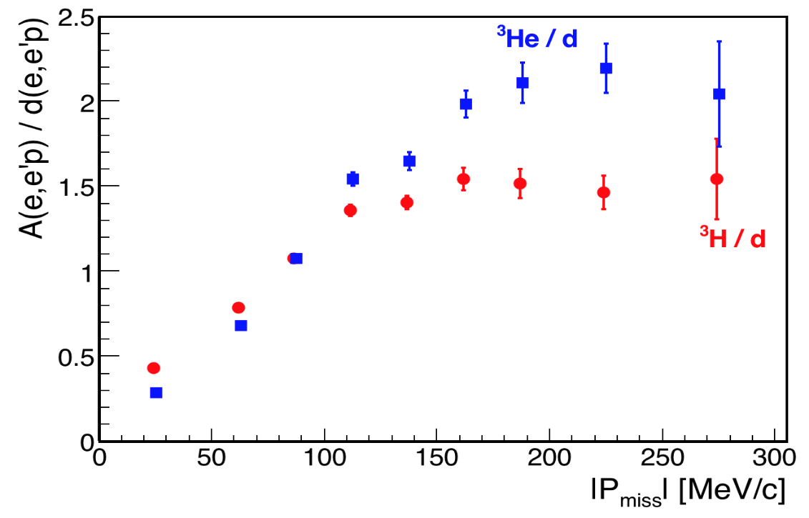
Tritium (e,e’p) SRC experiment – completed Spring 2018
actual data shown!
Analysis Plan:
1) Calibrations: ~done*
beamline, detectors, timing, optics, …
2) Physics:
SRC
low-P_{miss} kinematics
high-P_{miss} kinematics
Original Goal:
‘Bonus’ observable:
* Majority of calibrations completed by GMp and MARATHON students, allowing this experiment to move forward with the physics analysis in a short period of time.
SRC

Slide 8
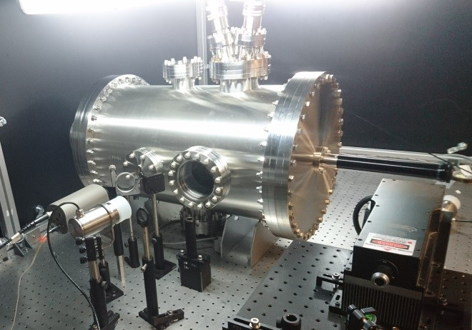
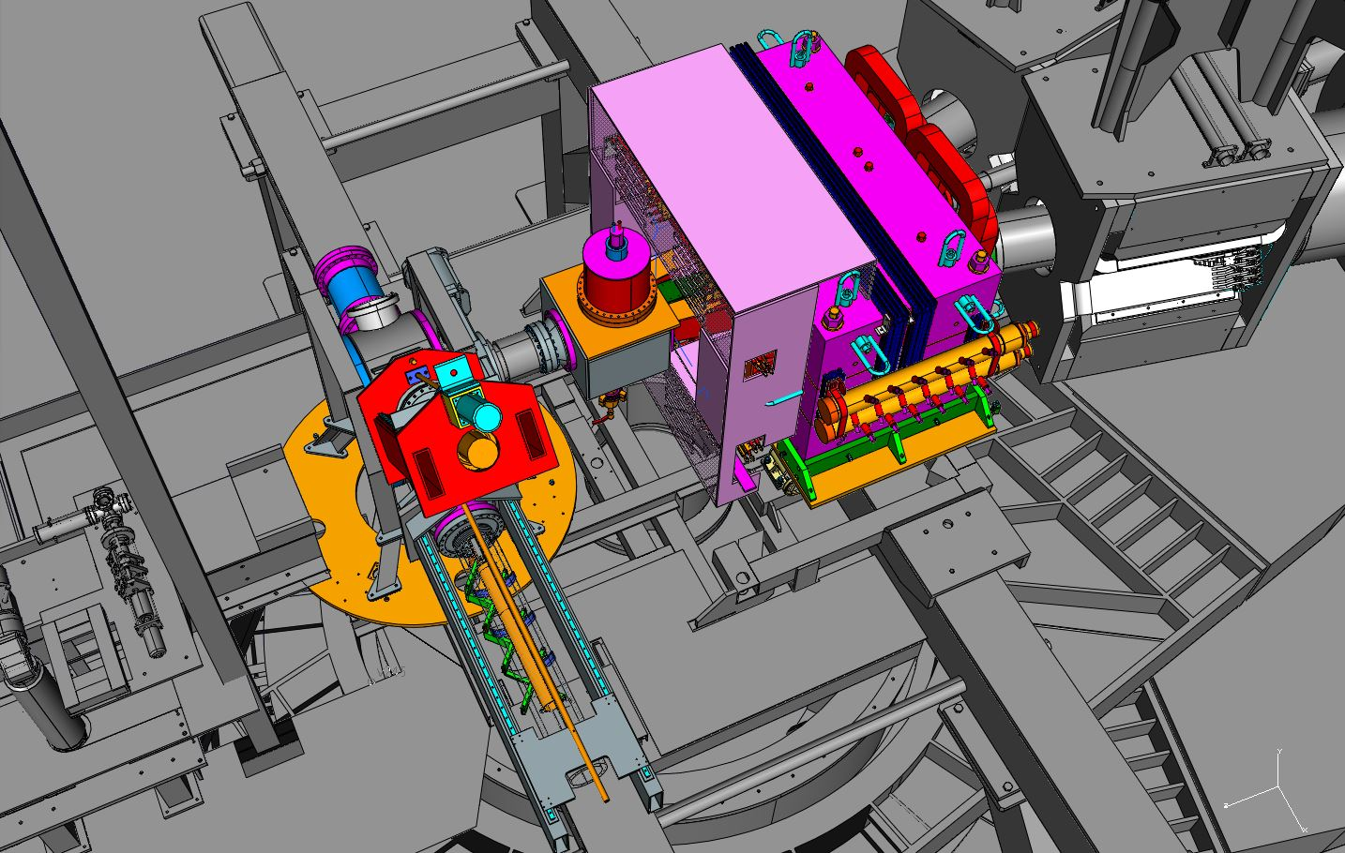
2019 Run Preparations
APEX
The septum magnet is in the Hall, ready to install vacuum channels and field test.
Nearly all equipment on site
Target construction underway
Looking towards February 2019 run (but only 2.2 GeV)
target heating tests in LERF
PREX2/CREX
Combined target chamber, new target position
Beam dump modifications this summer
Substantial shielding in design/engineering/procurement
Computation fluid dynamics for target design, target heating tests
Polarimetry – Moller now removed from Hall for upgrades
Regular parity quality beam meetings
Looking towards Summer 2019 run
combined PREX2/CREX design assembly in Hall

Slide 9
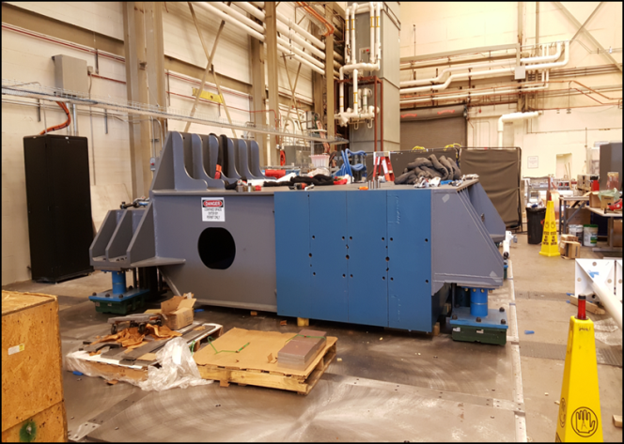
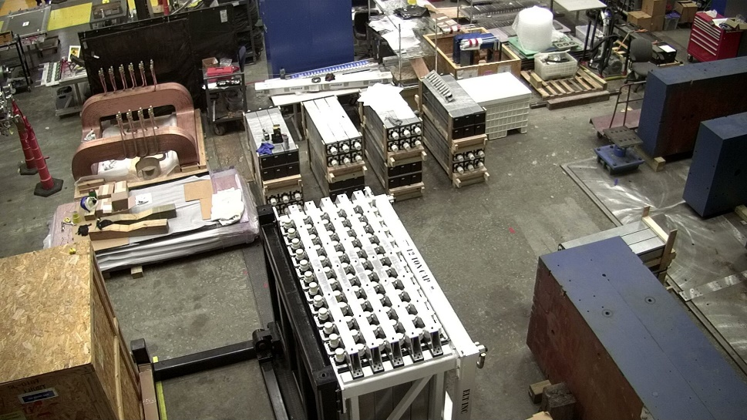
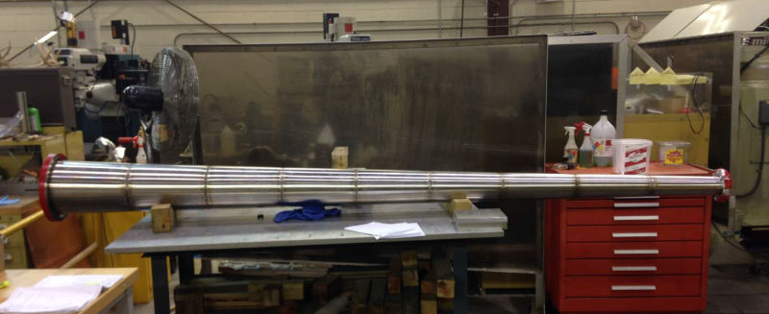
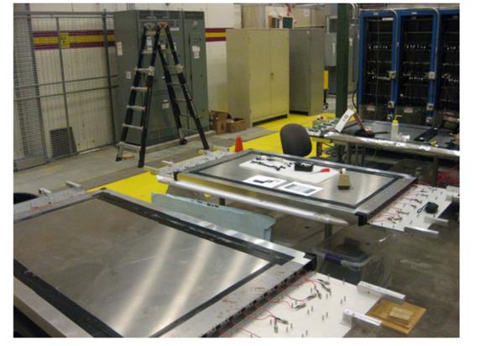
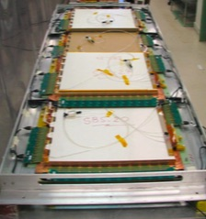
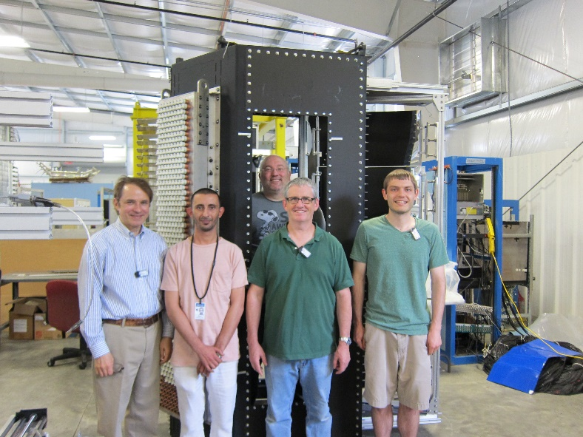
Looking Towards 2020: All Major SBS Components Now at JLab – time to integrate, test!
Beam pipe
HCal
Counterweight on floor plates
GRINCH
Coordinate Detector
GEM BT Modules

Slide 10
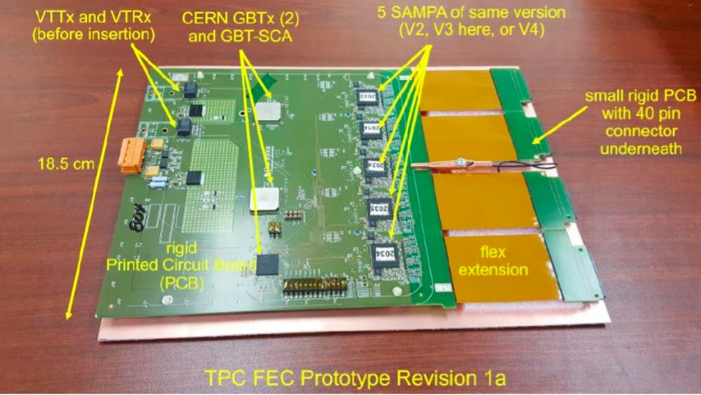
JLab SBS Activities
Currently:
Supporting HCal, GEM, Cdet, GRINCH tests and development
Investigating HCal floor plates, movement
Testing beamline assembly
ECal stand and heating/cooling engineering
BigBite assembly and integration
DAQ development
Project Management
Quarterly Reporting to DOE/NP on progress on dependencies.
Developing high power cryotarget (MOLLER, SoLID and GEp)
SBS TDIS/general high rate GEM (SAMPA chip) test stand under development
ALICE TPC Upgrade Front End Card with SAMPA chips - will modify slightly for testing

Slide 11
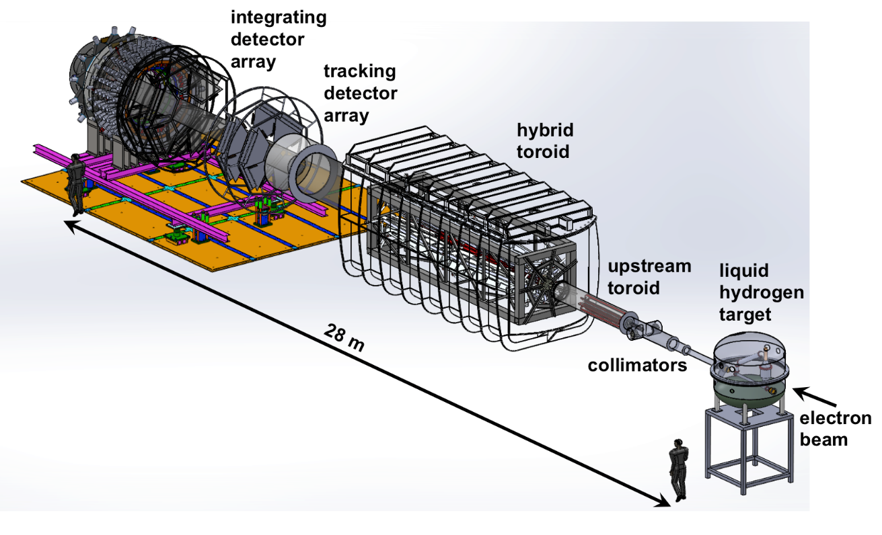
MOLLER Status/Timeline
2014: DOE Science Review, Strong Endorsement
December 2016: Director’s Technical Cost and Schedule Review
“scientific case … remains as strong as ever”, “...Committee finds that the substantial progress since the last Director’s Review suggests that the experiment is ready to move to the next stage”
CD-0 achieved on Dec. 21, 2016 with caveat that project is “paused”
Work proceeding to address recommendations from 12/16 Director’s Review
Pre-R&D continues to refine design choices and reduce risk
Project management organization
Spectrometer magnet and collimator systems conceptual design, coil prototyping
(new JLab magnet group)
Radiation shielding optimization
Continued detector development
Parity quality beam working group with parasitic studies
High power target development

Slide 12
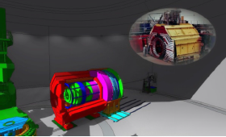
Proposed QCD & Fundamental Symmetries MIE
SoLID Timeline Overview
Unique Capability:
High luminosity (10³⁷⁻³⁹)
Large acceptance detector with full φ coverage
Item | Date
Director’s Review | February 2015
SoLID User Meeting with DOE/NP | November 2015
Director’s Review Recommendations affecting science reach; progress: simulations of core measurements, DAQ rate capability, detector/magnet integration | February 2016
CLEO-II Magnet Disassembly at CESR | Summer 2016
Follow-Up Director’s Review | Late 2016
Draft MIE Submission – proposed | February 2017
DOE/NP-led Science Review – proposed | Spring 2017
Annual Budget Briefing – proposed budget profile | February 2018
MIE Start - proposed | FY2020
DOE discussions last week
2019?
Notes:
BMcK revised 05Feb; AL format edits 06Feb; Dry Run edits 12Feb

Slide 13
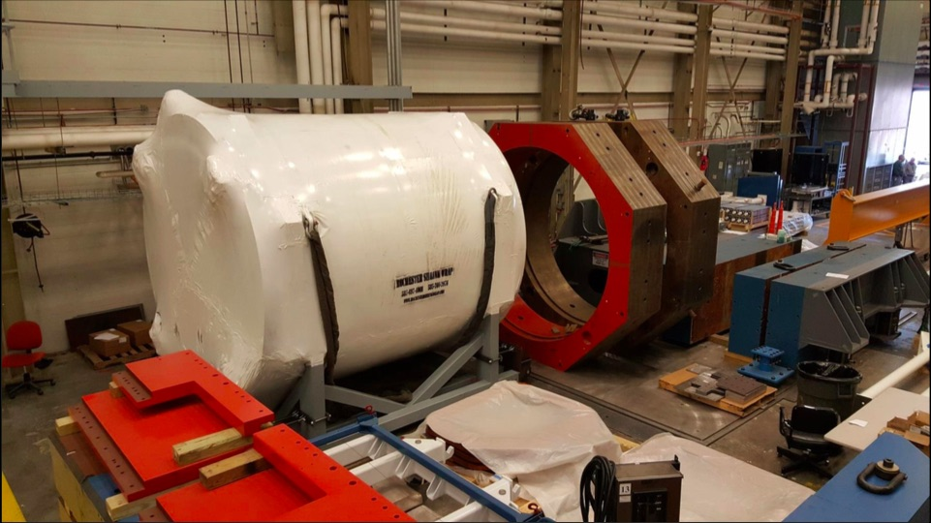
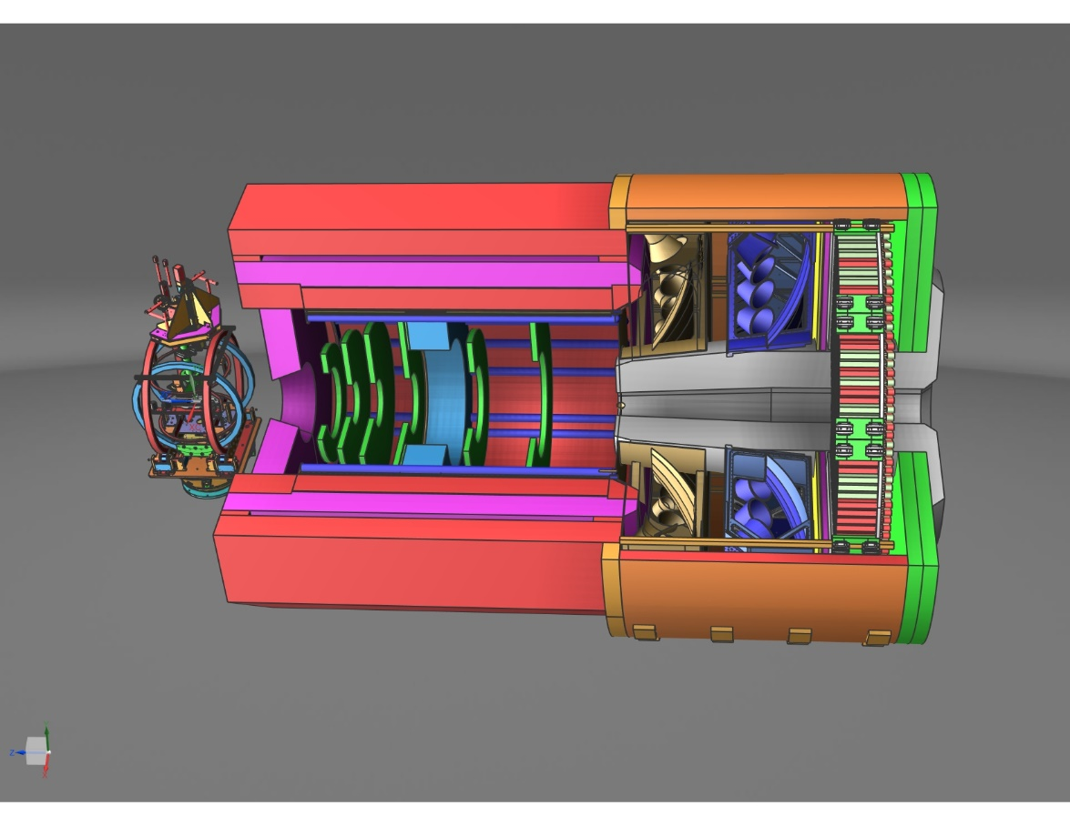
SoLID at JLab
Engineering and design
Magnet testing (P. Brindza et al)
Looking towards cold test
Will begin purchasing instrumentation and controls (reduce highest schedule risk)
Data acquisition
High rate GEM test stand (TDIS+)
Slow controls
Software development
Polarized ³He target development
Polarimetry
Regular parity quality beam meetings
Magnetic field analysis
Project planning
10

