Slide 1
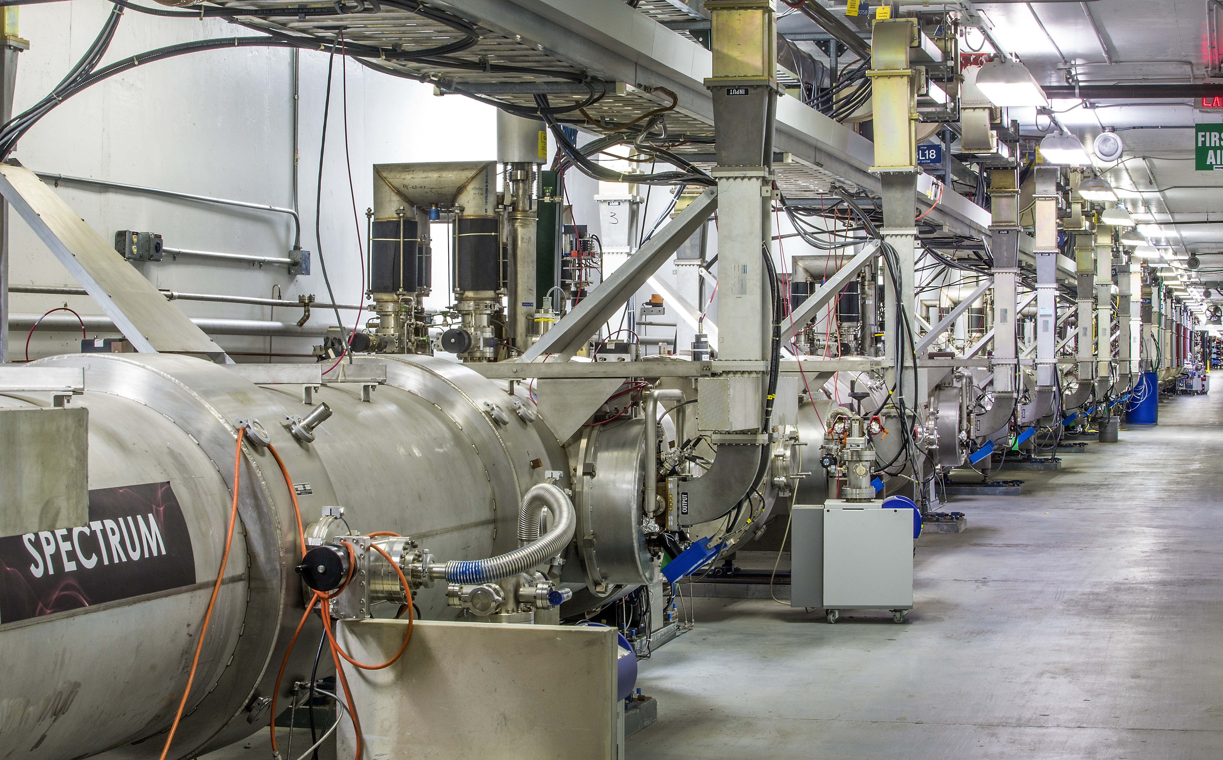
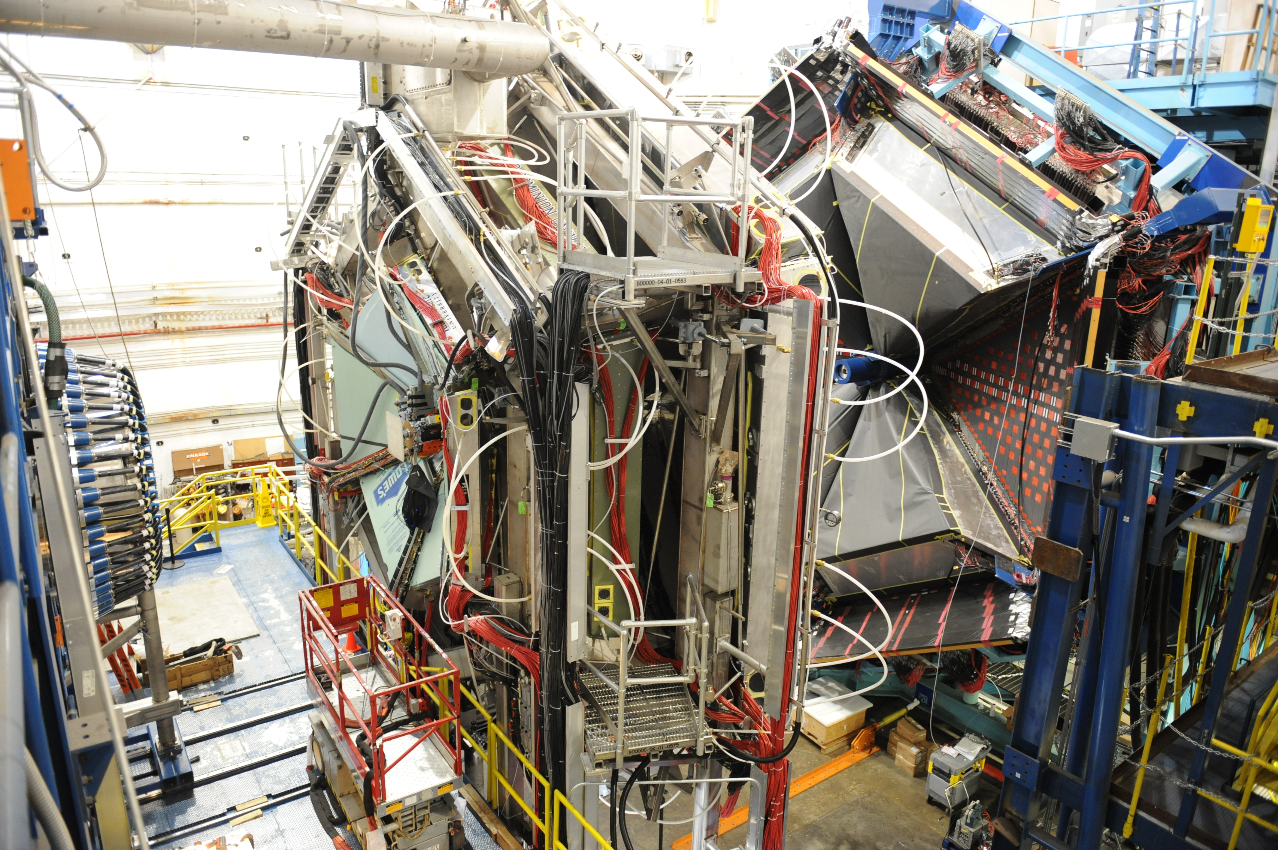
Jefferson Lab Status
Stuart Henderson
Laboratory Director
July 16, 2018

Slide 2
Outline
Staff News
The Lab’s Future
CEBAF Upgrade and Operations
Electron-Ion Collider
Budget Update
Director’s Perspective

Slide 3
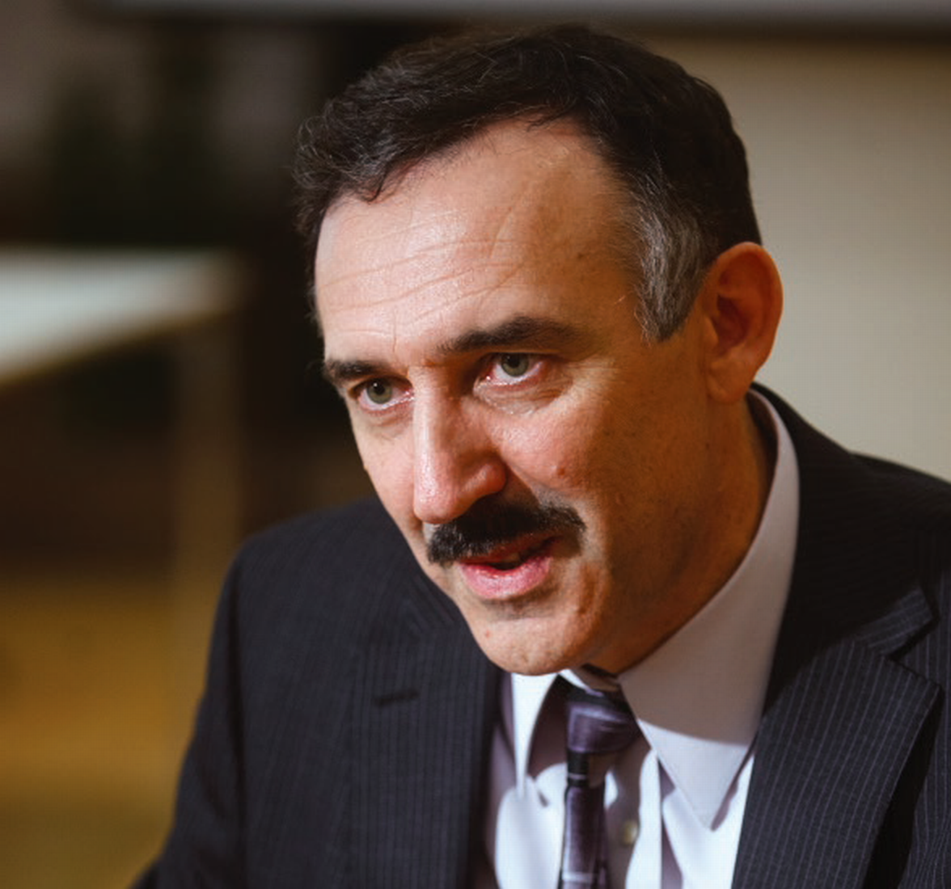
Andrei Seryi: New Associate Director for Accelerators
Background
Director, John Adams Institute for Accelerator Science, University of Oxford, UK
Stanford Linear Accelerator Center (SLAC) Senior Scientist
Fermi National Accelerator Laboratory
Protvino, Russia
Ph.D., Accelerator and Beam Physics, Novosibirsk State University, Budker Institue for Nuclear Physics, Russia
Fellow, American Physical Society

Slide 4
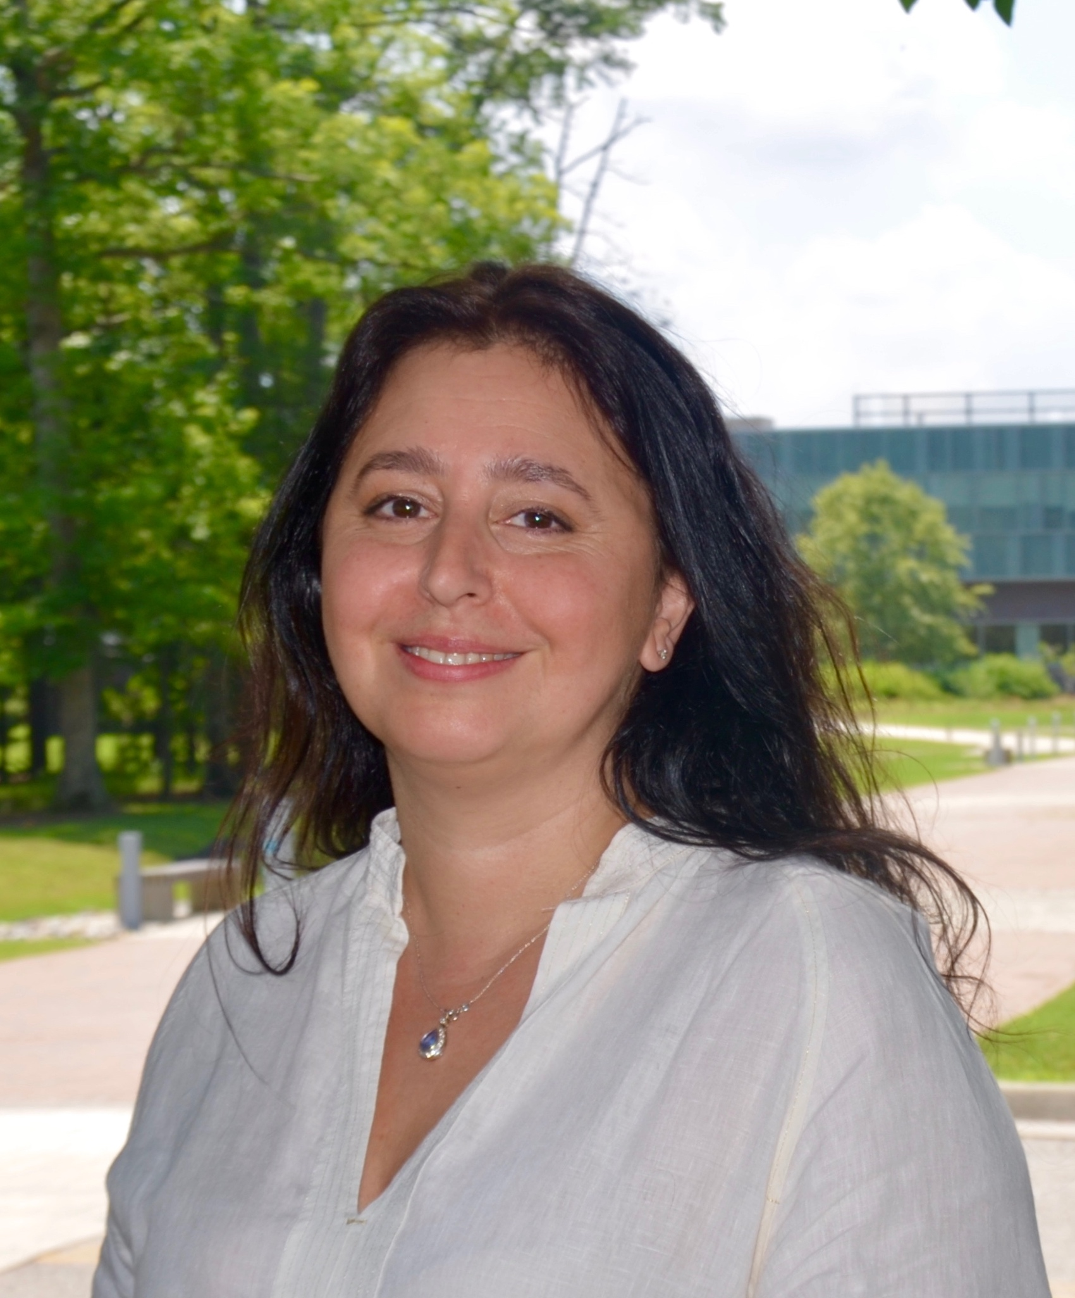
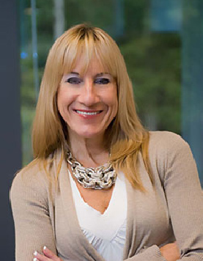
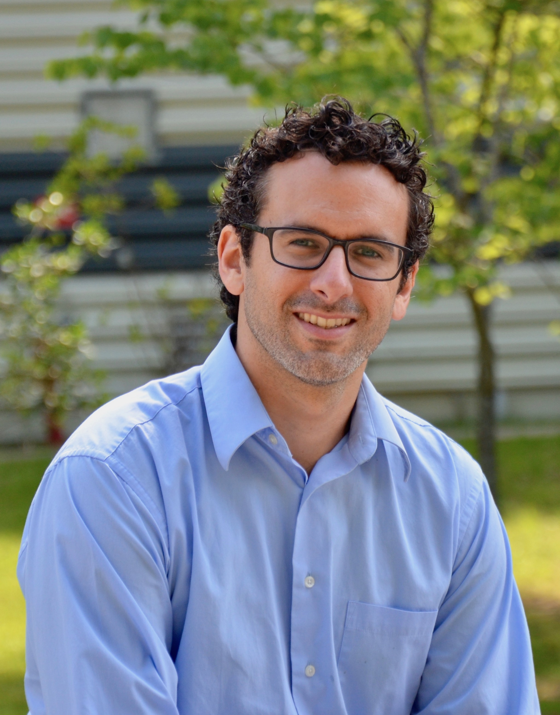
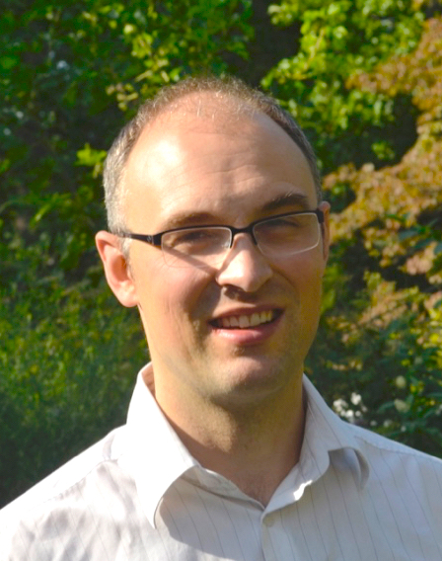
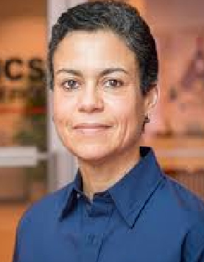
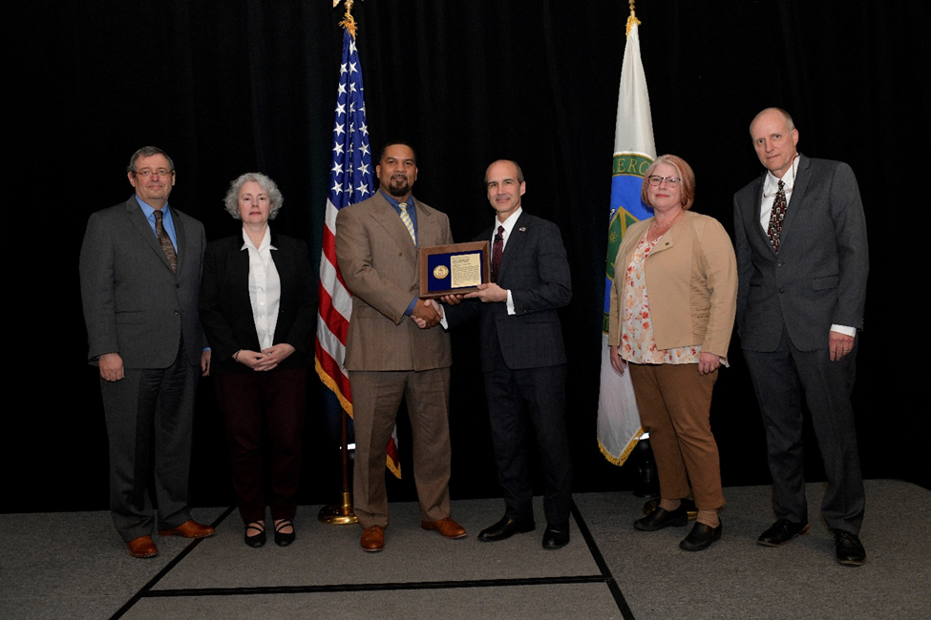
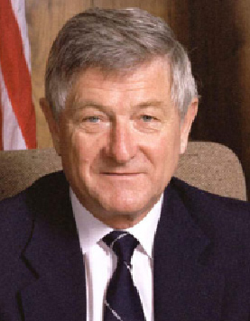
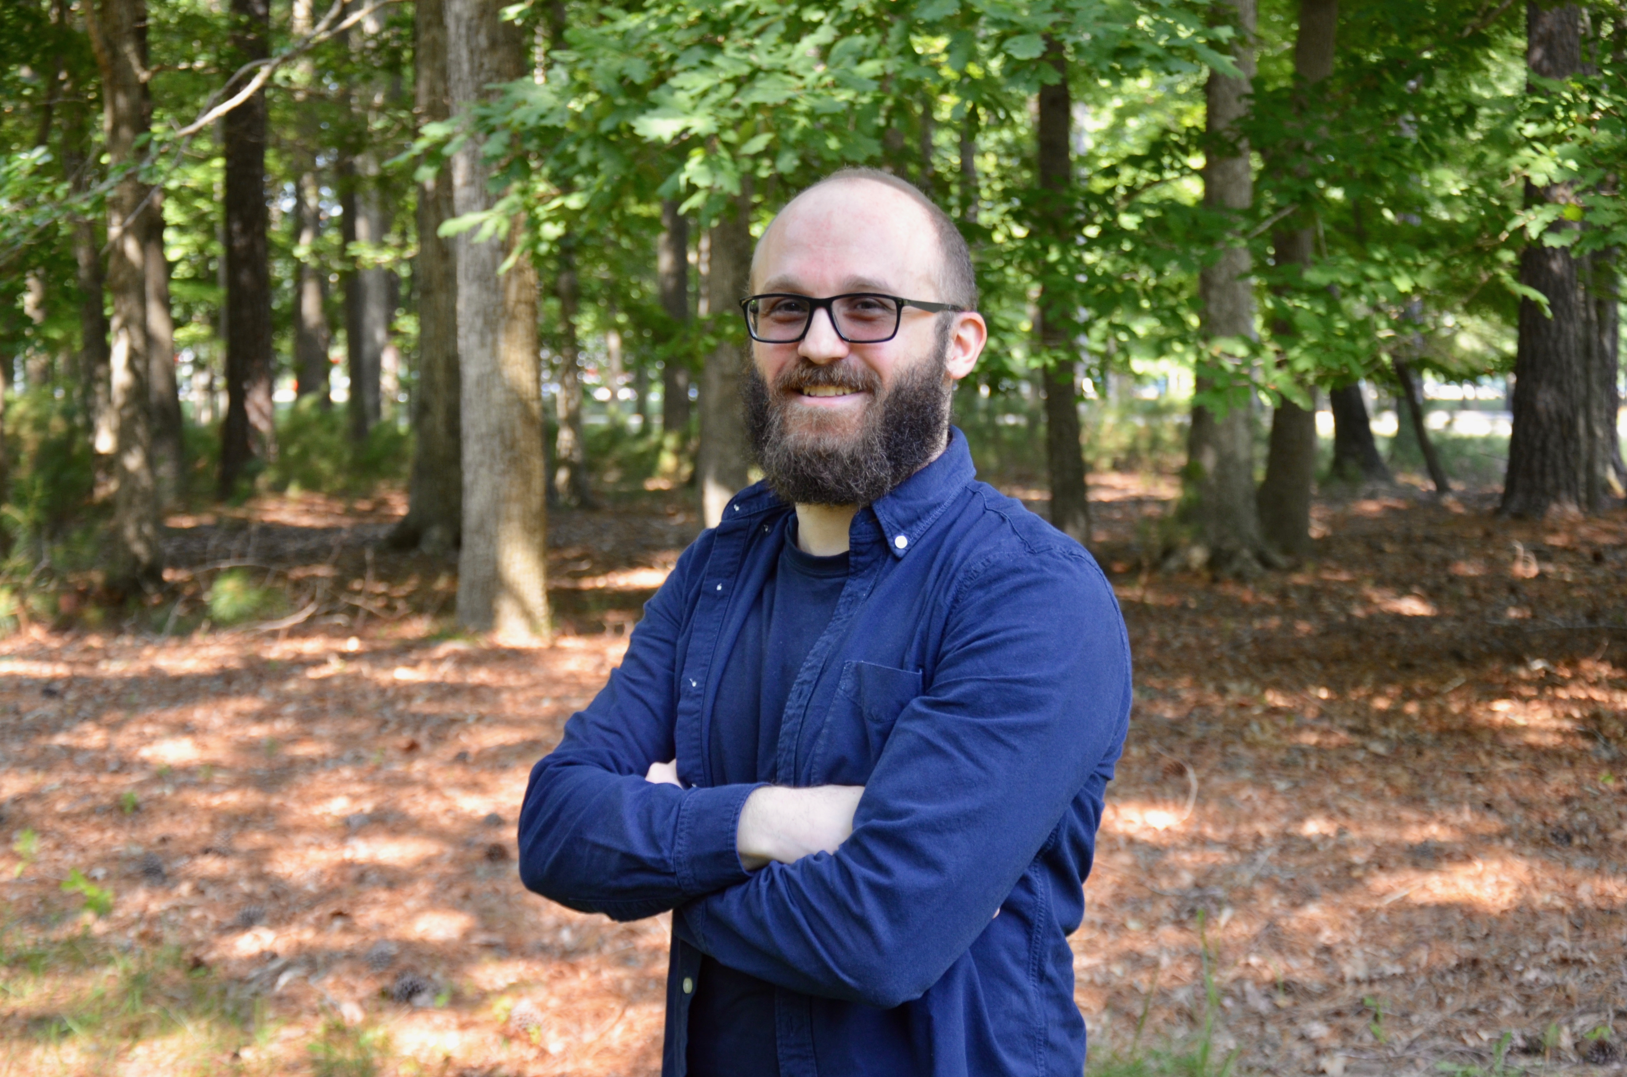
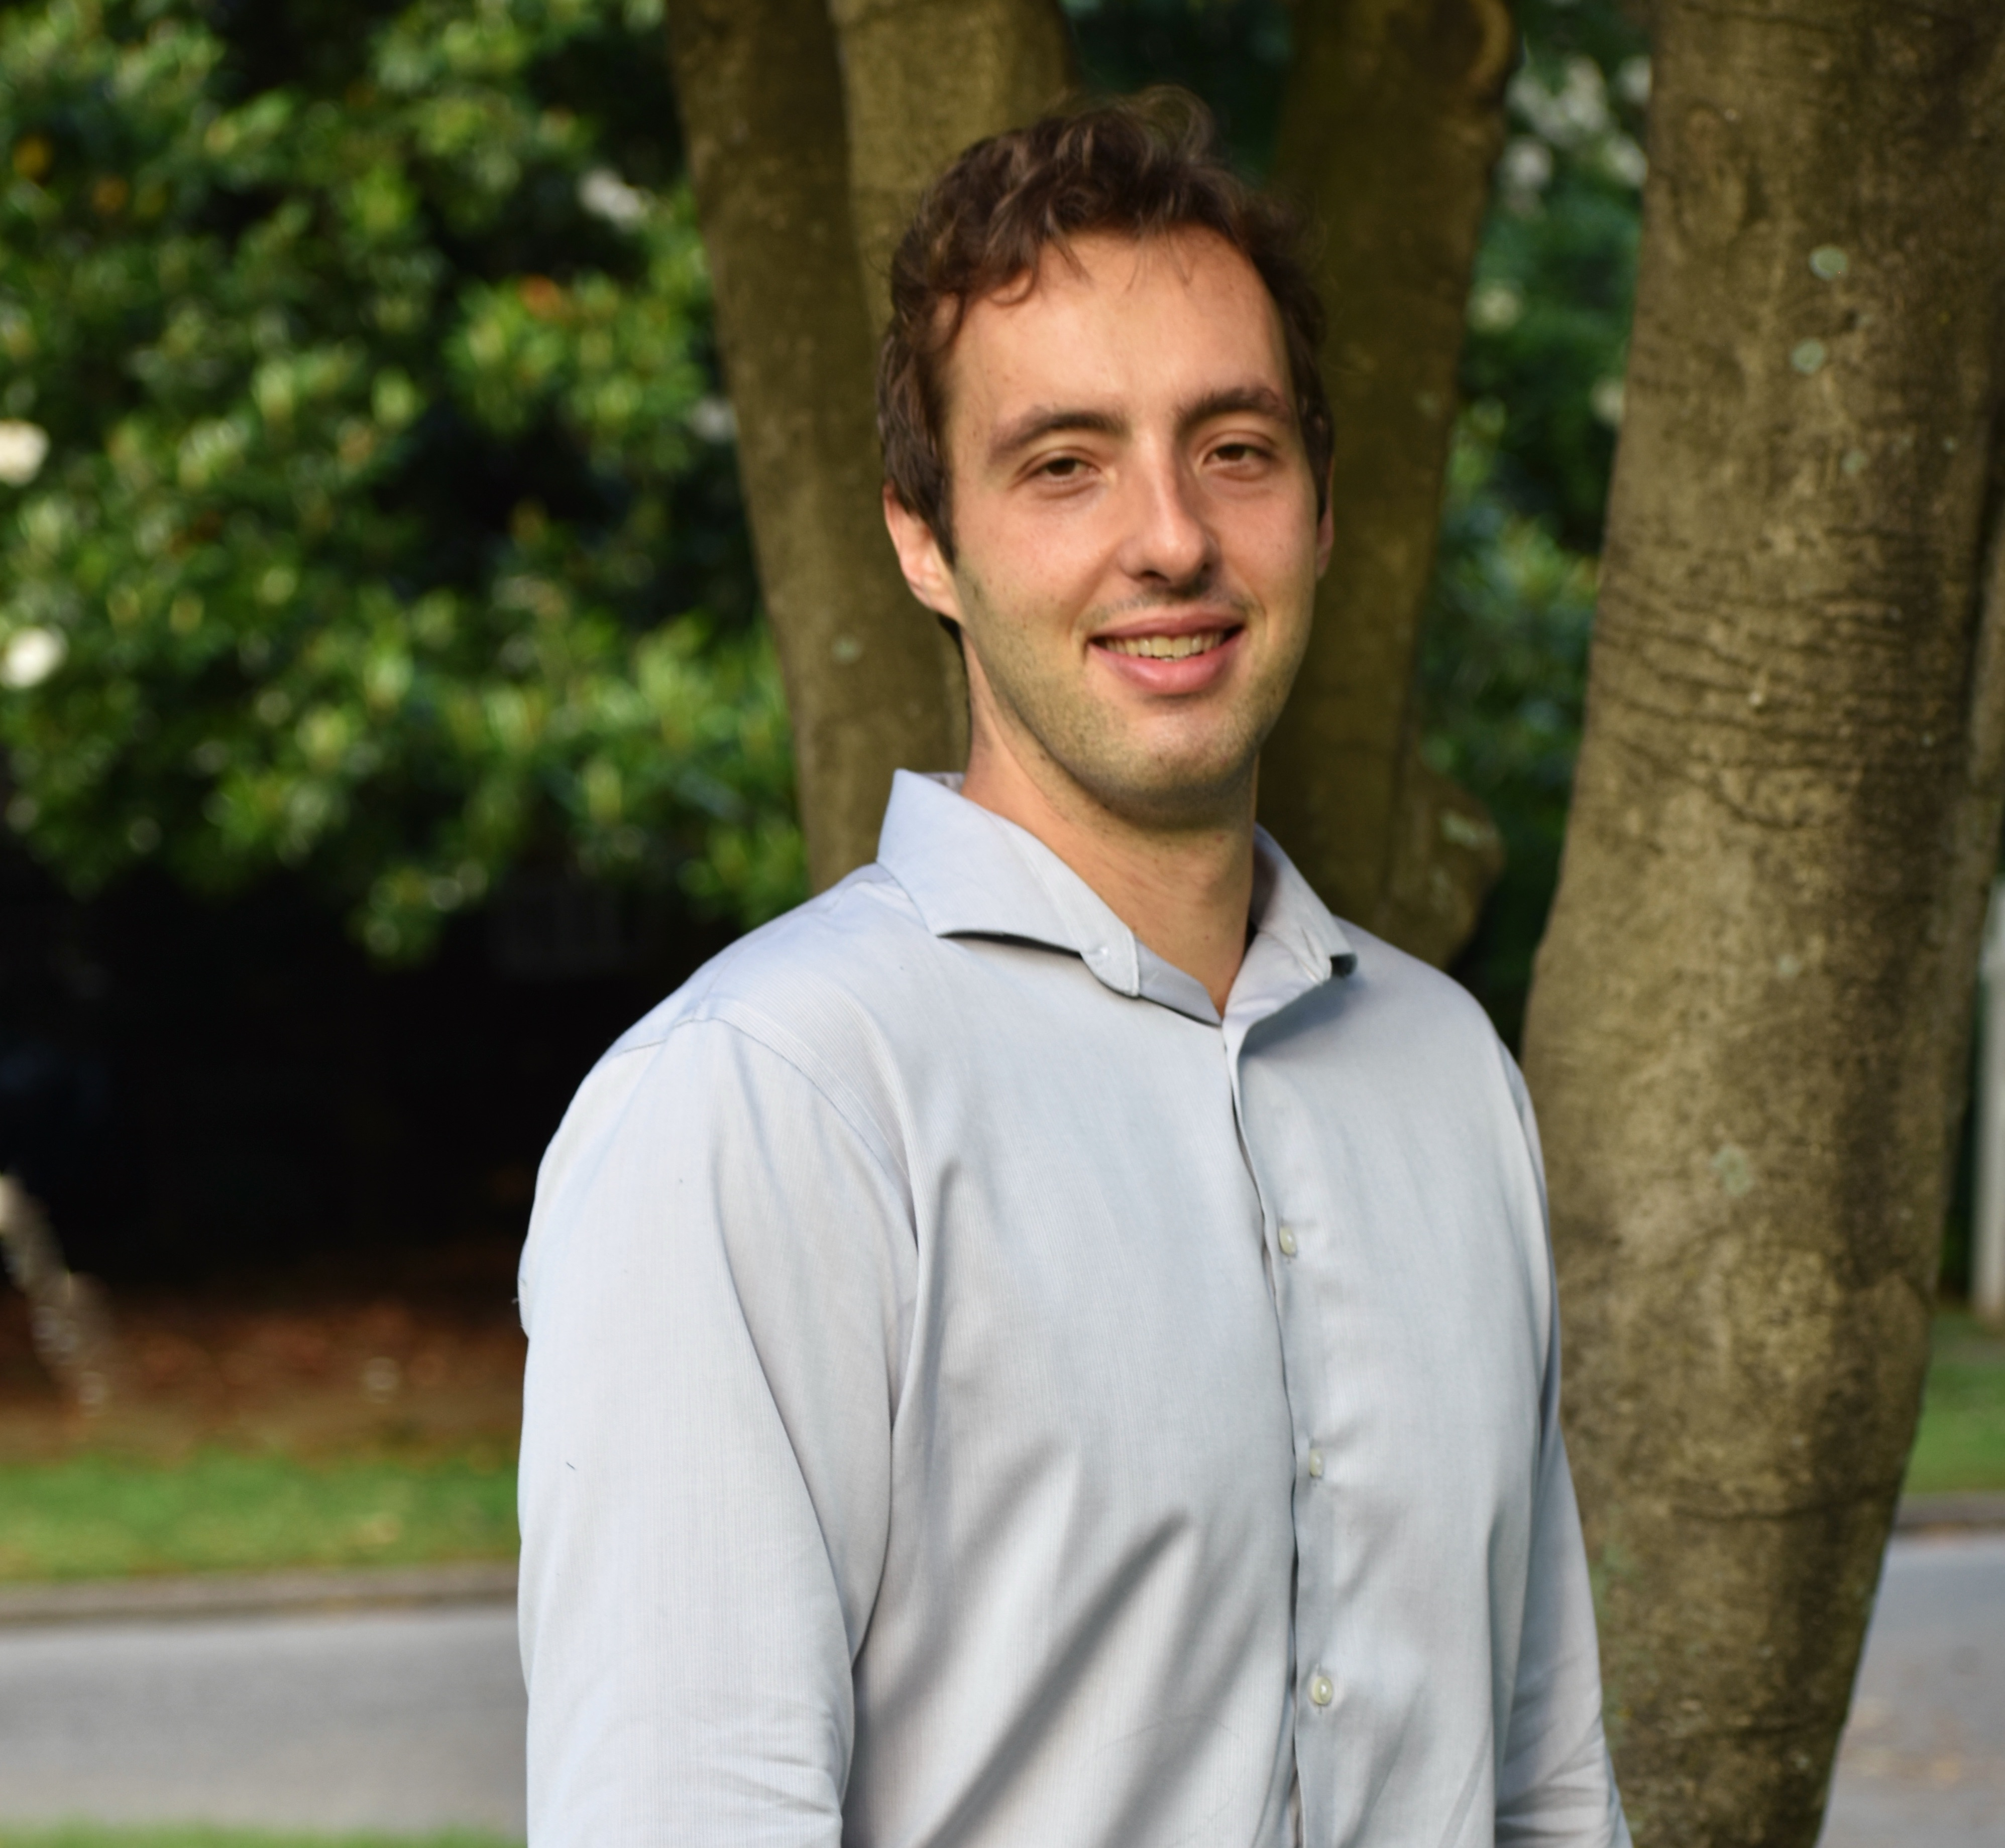
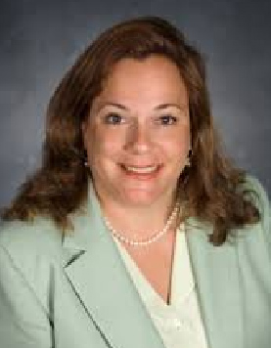
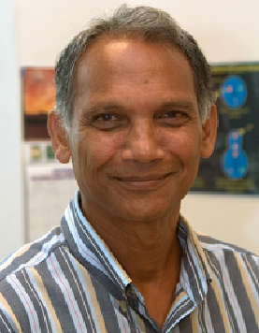
Jefferson Lab Staff and Users Continue to be Recognized for their Accomplishments
2018 DOE Early Career Award
APS Fellowship
2018 DOE Early Career Award
2018 DOE Early Career Award
…for scientific leadership in the JLEIC effort at Jefferson Laboratory, contributions to the successful commissioning of CEBAF accelerator's 12 GeV upgrade…
…for engaging the incredible computationall power of supercomputers to unravel the secrets of subatomic particles and how they interact…
…for hunting for the formula to produce better accelerators for research, industry and medicine…
…for developing experimental and analysis techniques that make full use of the new generation of high-precision experiments...
Anne-Marie Valent-Feliciano
(Jefferson Lab)
Fulvia Pilat
(Jefferson Lab)
Raul Briceno
(Jefferson Lab/Old Dominion University)
Anselm Vossen
(Jefferson Lab/Duke University)
APS Fellowship
DOE Project Management Achievement Award
IEEE NPSS Particle Accelerator
Science and Technology (PAST) Award
For leadership of experimental programs using the nucleus to probe the nature of QCD at HERMES, the Thomas Jefferson National Accelerator Facility, and the Electron Ion Collider, ….
For the Office of Science’s
12 GeV CEBAF
Upgrade Project
…for far reaching contributions to accelerator science and technology…
Kawtar Hafidi
(Argonne National Lab)
Hermann Grunder
(as Jefferson Lab Director)
JSA Postdoctoral Prize
JSA Thesis Prize
Medical Device Engineering
Breakthrough Award 2018
Frances G. Slack Award Prize
…for studying nuclear processes that contribute to scientists’ understanding of nuetrinos…
Awarded to RadiaDyne, Inc.
for OARtrac® patient dose monitoring technology to improve cancer treatment outcomes. T. Keppel
(patent contributions)
…for the advancement of accelerator science and physics… efforts to engage and mentor students in the field
…for exploring the use of machine learning in particle identification in GlueX …
Cristiano Fanelli
(Massachusetts Institute of Technology)
Alessandro Baroni
(University of South Carolina)
Thia Keppel
(Jefferson Lab/Hampton University)
Hari Areti
(Jefferson Lab - retired)

Slide 5
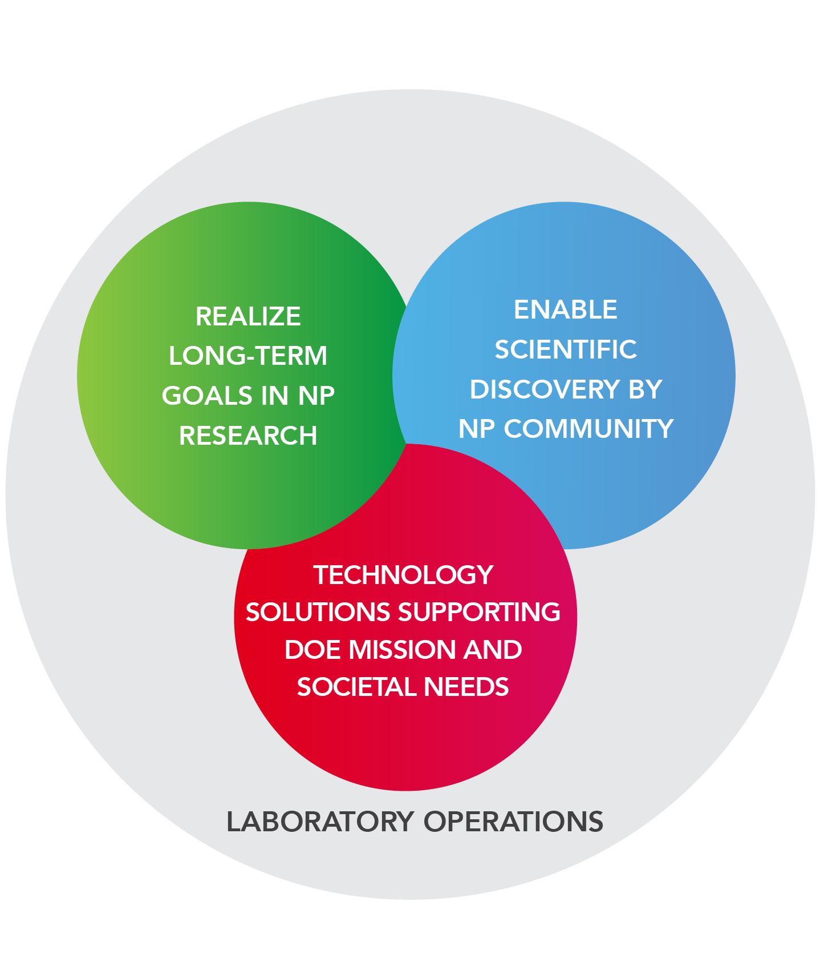
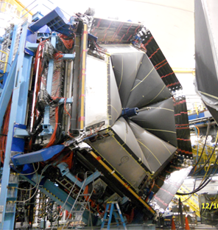
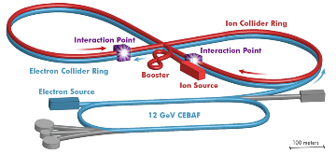
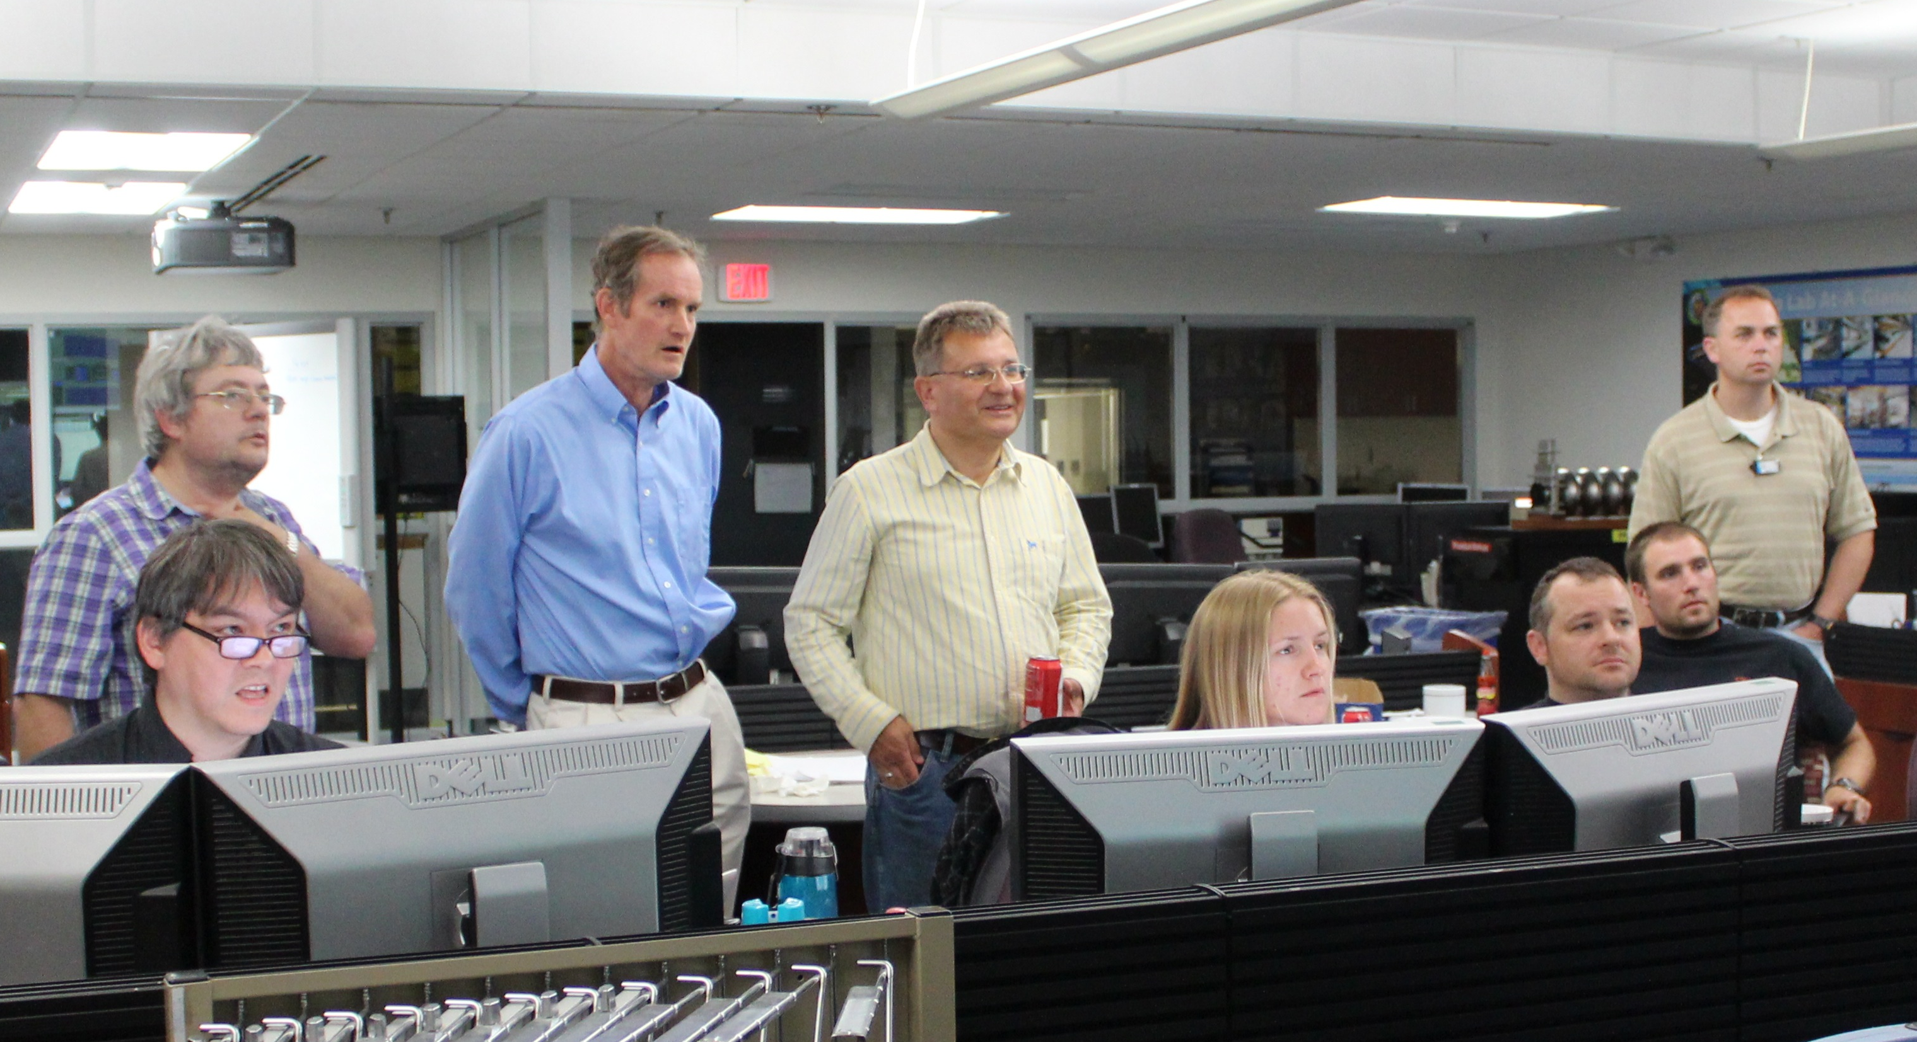
Long-Term Vision for Jefferson Lab
Jefferson Lab supports the DOE Office of Science and serves the Nuclear Physics user community as a world-leading center for fundamental nuclear science and associated technologies
1. Deliver on 12 GeV Scientific Program
2. Provide a long-term path for the field via an Electron-Ion Collider
3. Provide technology solutions supporting DOE mission
4. Enable world-class science through excellence in Laboratory Operations

Slide 6
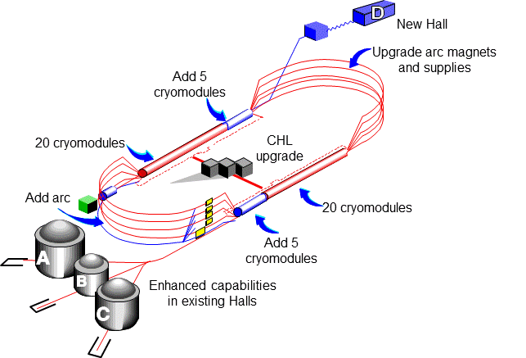
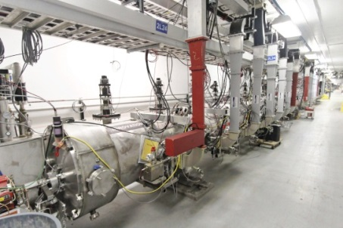
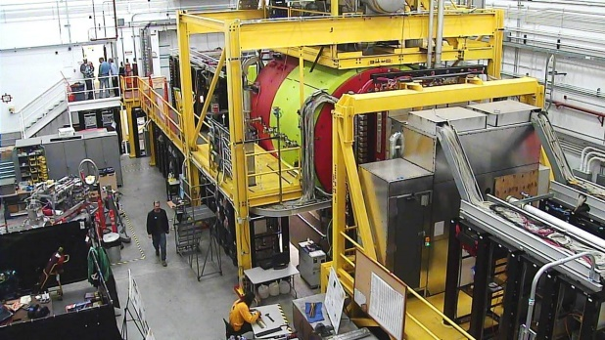
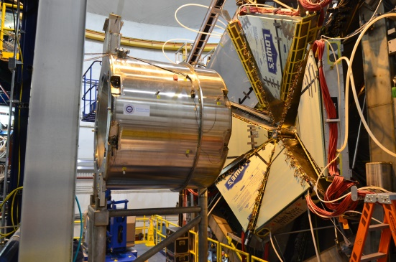
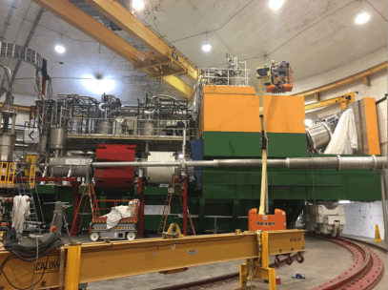
12 GeV CEBAF Upgrade Project is Complete, On-time and On-Budget!
Secretary of Energy Project Management Achievement Award
Project Completion Approved September 27, 2017

Slide 7
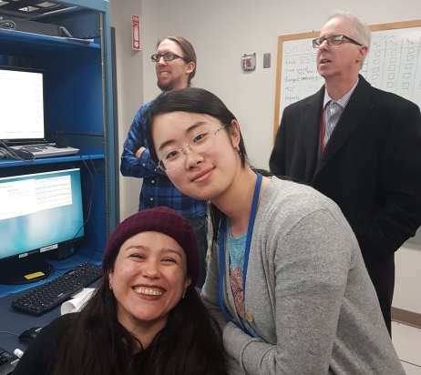
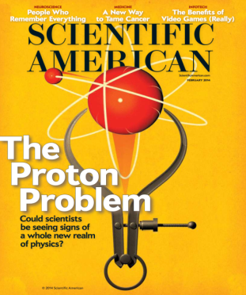
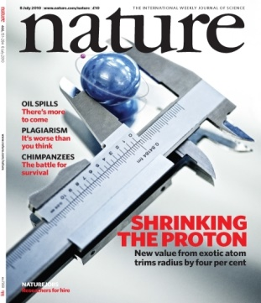
12 GeV Science Era is Here!
Hall A: In physics operations
  December 15, 2017: First Beam on Tritium Target!
  First 12 GeV era publications this year
Hall B: In physics operations
  Start of CLAS12 Physics in February
  Publications anticipated from Proton Radius and Heavy Photon Search experiments
Hall C: In physics operations
  Spectrometer engineering run completed
  Physics data-taking started January
  Initial measurements will lead to early publications.
First beam on ³H Target in Hall A
Hall D: In physics operations (GlueX)
  Dozens of papers at 2016/2017 American Physical Soc. Div. Nuclear Physics meetings
  First 12 GeV era publication (April, 2017) Working on several other publications

Slide 8
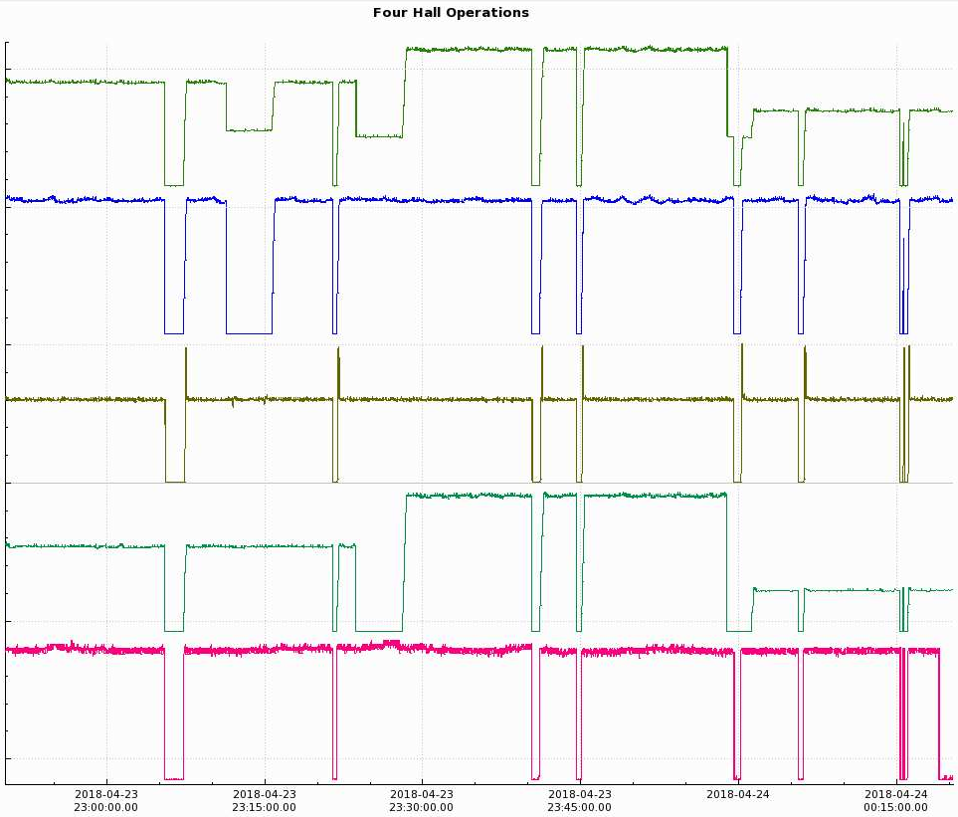
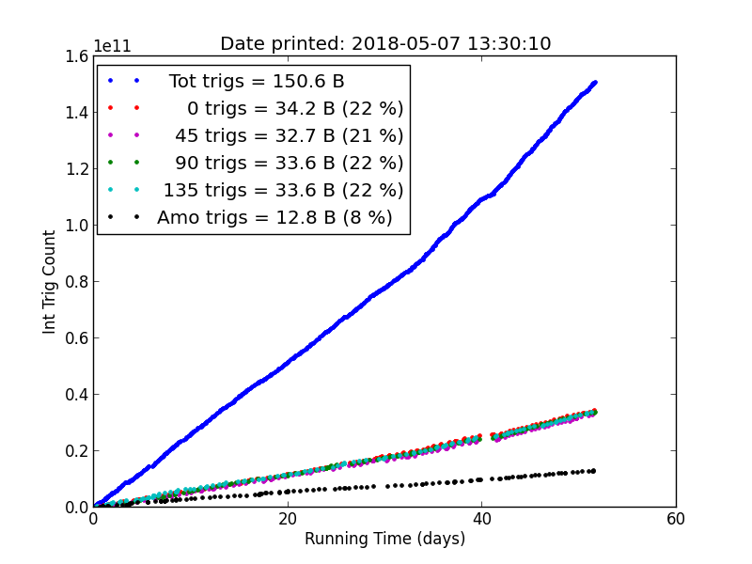
Highlights of FY2018 Run
Resumed operation in Fall 2017
FY18 plan has 22 weeks of operation
Began formal operations to all 4 Halls
Completed engineering runs in Halls B and C: all 4 Halls in physics operation
Achieved simultaneous beam delivery to all 4 Halls at full power
Adjusted run period and downtime planning to operate 22 weeks, 10 weeks more than originally scheduled, as a result of Omnibus appropriations
Formulated and began executing CEBAF Reliability Plan
Simultaneous beam delivery to all 4 Halls
Injector
65 μA
Hall A
22 μA
Hall B
150 nA
Hall C
40 μA
Hall D
150 nA
Spring 2018: ~150B events collected in 2018; GlueX-I ~80% complete

Slide 9
Achieving Sustainable Long-term CEBAF Operation is a Very High Priority
While 12 GeV Upgrade Project provides important capabilities for the future, many components and systems are “original equipment”
  Some are difficult to maintain, require adequate spare parts, will reach obsolescence
We have developed a “CEBAF Reliability Plan” to improve reliability of the facility and energy performance of the accelerator
We are making a significant investment in FY18
  Immediate investments enabled in part by remaining 12 GeV Project contingency
Cryogenic infrastructure investments are key
This continues as a high-priority in our out-year planning
We have assembled a CEBAF Reference Operations Plan, in preparation for an upcoming DOE NP Operations Review

Slide 10
Restoring weeks of reliable CEBAF operations has been our highest priority
12 GeV Construction

Slide 11
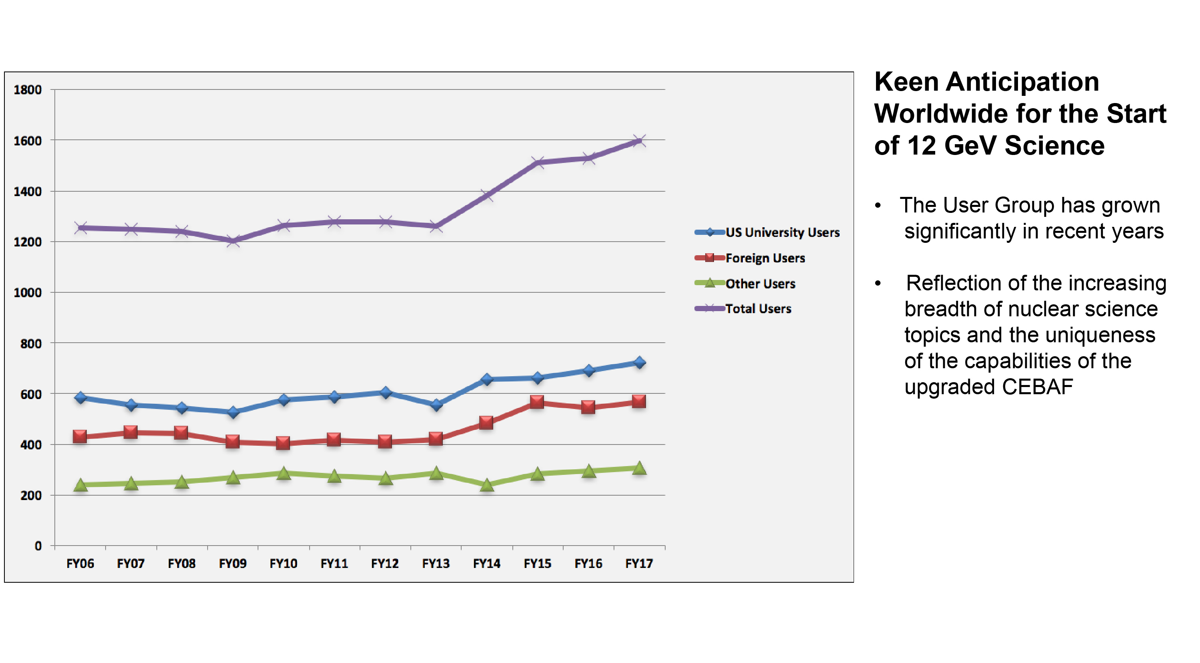
We support a vibrant and growing user community

Slide 12

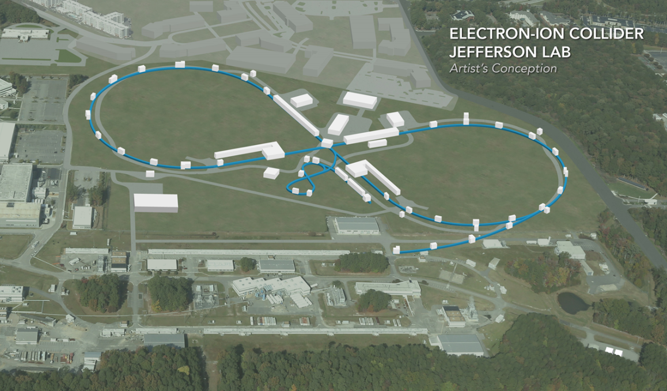

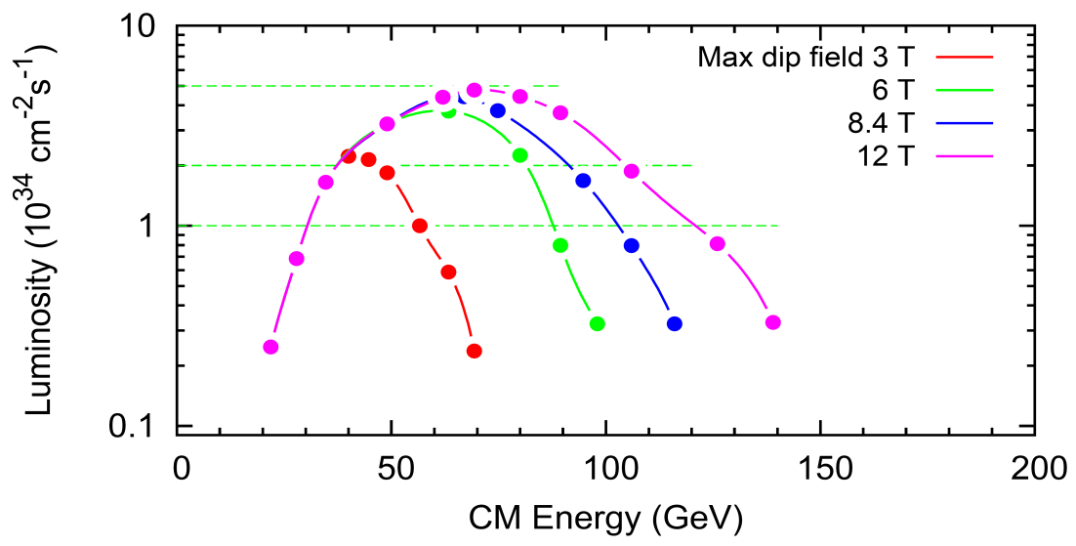
Electron Ion Collider at Jefferson Lab
JLab EIC Figure 8 Concept
    High Polarization
    High Luminosity
    Energy Range: √s : 20 to 65-140 GeV (magnet technology choice)
    Flexible timeframe for construction
    consistent w/running 12 GeV CEBAF
    High performance, low-risk, well-reviewed
    Cost effective operations
    Fulfills White Paper Requirements
10³⁵
LHC
Strong multi-institutional effort including:
ANL, BNL, FNAL, LBNL, SLAC
(
10³⁴
National Academies Panel report will be published soon
10³³

Slide 13

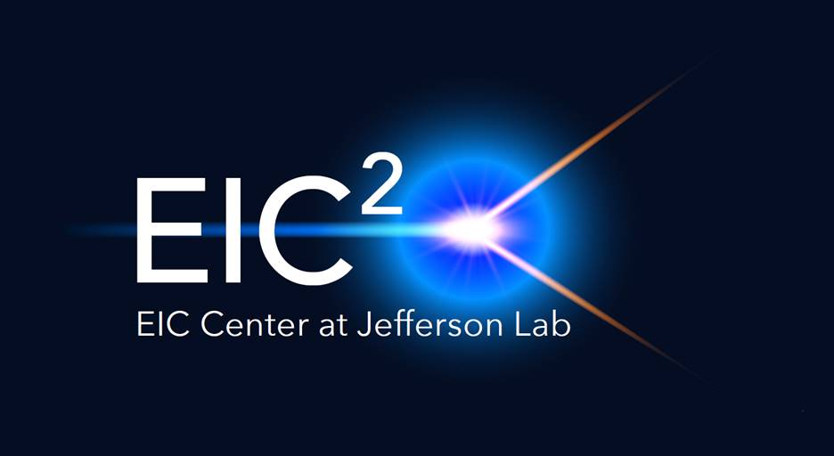
New Centers at Jefferson Lab
Center for Nuclear Femtography:
Proposal to Commonwealth of Virginia
  Initial request of $0.5M for pilot study awarded; funding of ~$2M/year envisioned
Consortium of Virginia universities
  Strong support from Presidents of CW&M, ODU, Hampton, VCU, VaTech
Theoretical physics, experimental physics, computation, data science, statistics – interdisciplinary effort
Benefit to 12 GeV program and future EIC studies
Electron-Ion Collider Center:
EIC²@JLab is an organization to advance and promote the science program at a future EIC facility through education, collaboration, and outreach
Particular emphasis is on the close connection of EIC science to the current Jefferson Lab 12 GeV CEBAF science program
Graduate and postdoctoral fellowships available!
5D
3D

Slide 14
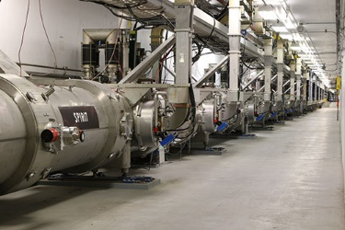
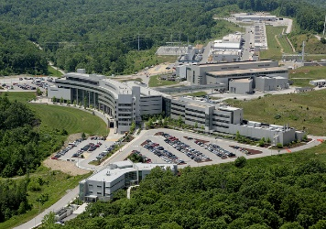
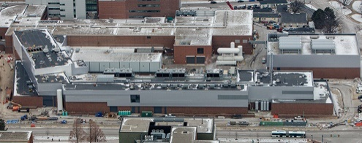
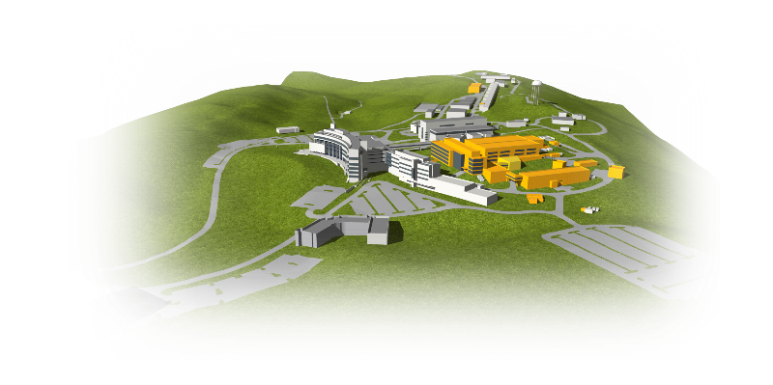

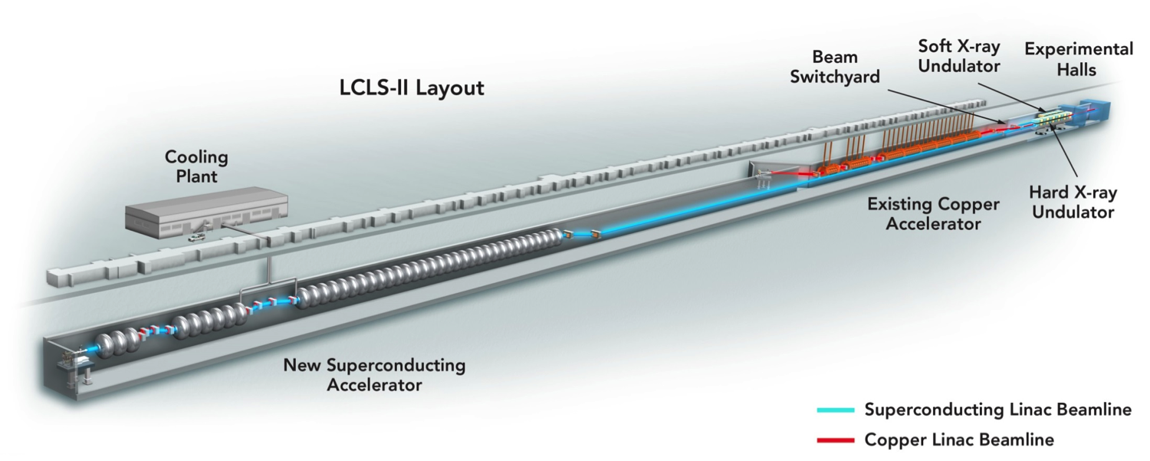
Jefferson Lab Plays a Vital Stewardship Role for “Big Science” Projects Within the Department Of Energy
Jefferson Lab is a world-leader in Superconducting Radiofrequency particle accelerators and cryogenic technologies
CEBAF - 1994
12 GeV Upgrade - 2017
Facility for Rare Isotope Beams (MSU) - 2021
Spallation Neutron Source (ORNL) - 2006
Linac Coherent Light Source II (SLAC) 2021
SNS Proton Power Upgrade
LCLS-II High Energy Upgrade

Slide 15
Budget Status
FY18
  President’s Budget Request called for 18% reduction in DOE Office of Science, 19% in Nuclear Physics and 12% reduction for Jefferson Lab
  Omnibus Appropriations includes
    $684M (+$62M) for Office of Nuclear Physics
    +$14M for Jefferson Lab Nuclear Physics
    +$9.9M in Science Laboratory Infrastructure funding to upgrade aging End Station Refrigerator cryogenic system (funds arrive in FY19)
FY19
  President’s Budget Request called for $600M Office of Nuclear Physics, $109M for Jefferson Lab
  Congressional budget marks are more favorable for Science and Office of Nuclear Physics:
    House: $690M
    Senate: $710
Jefferson Lab Nuclear Physics funding ($M)
FY16 | FY17 | FY18
107.6 | 111.2 | 124.2

Slide 16
Getting Work Done Safely is Our Highest Priority
Nothing is more important than accomplishing our work safely Safety and Quality before Schedule! Focus areas include: Incorporating Human Performance Improvement (HPI) concepts and methods into ISM Assuring service subcontractors are able to meet expectations
Nearly 2.5 Million hours worked prior to recent DART case

Slide 17
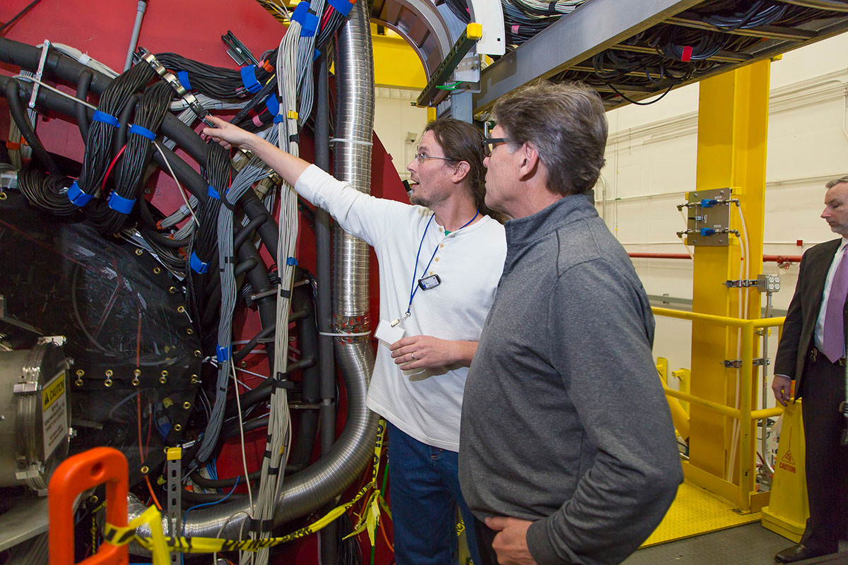
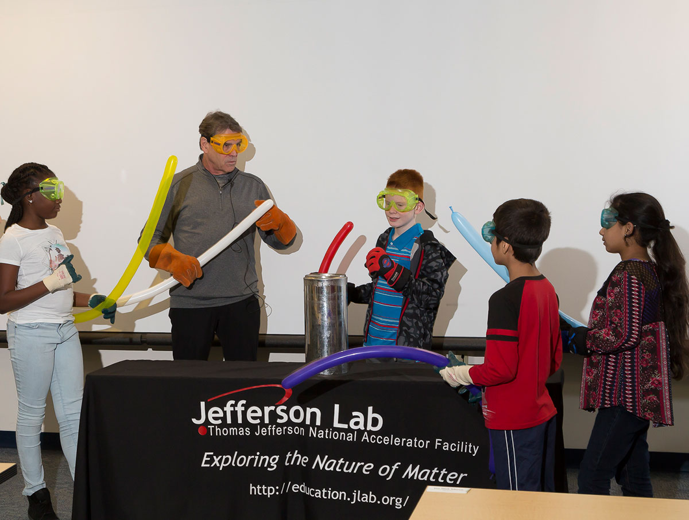
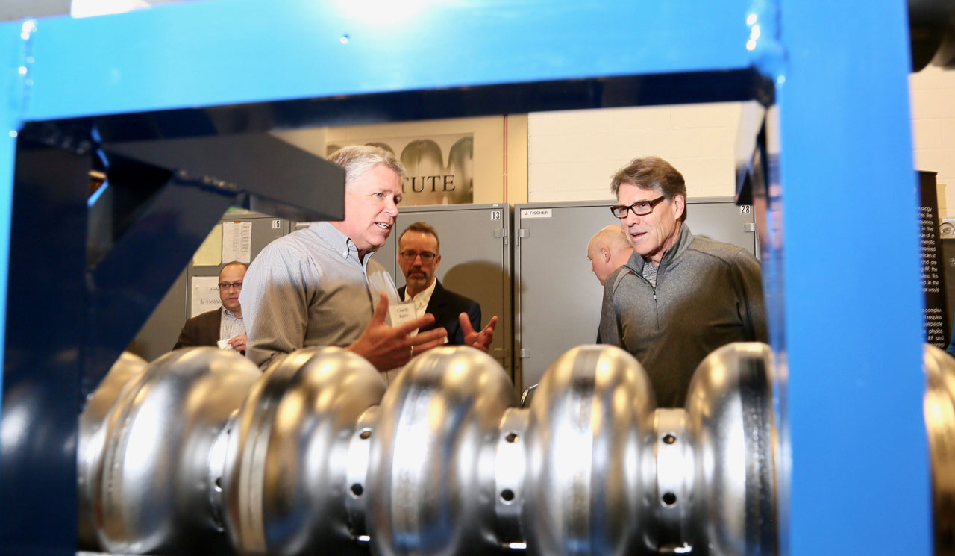
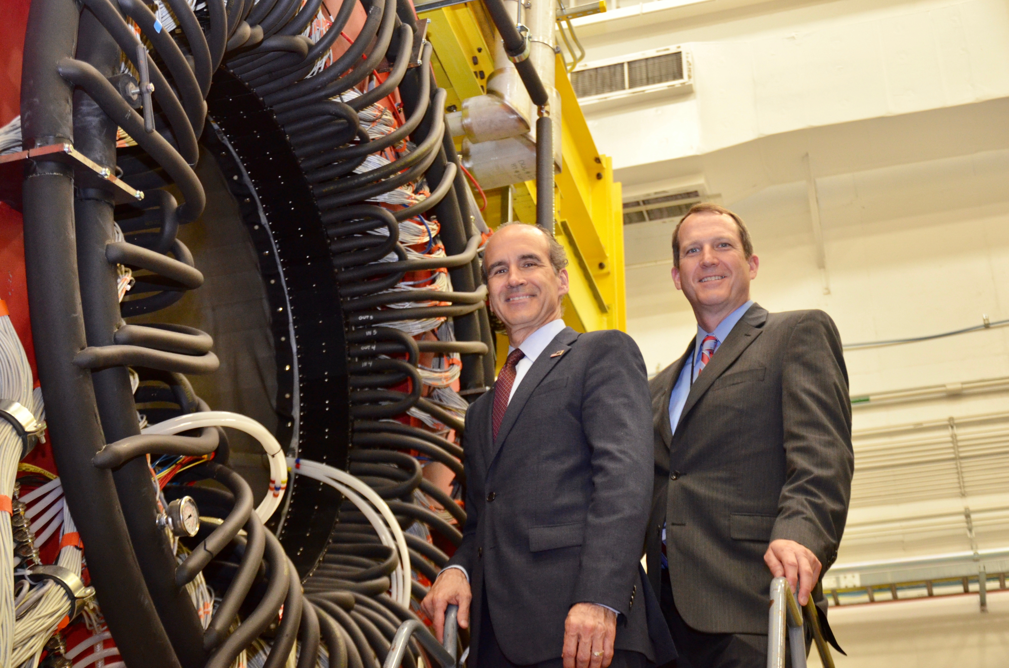
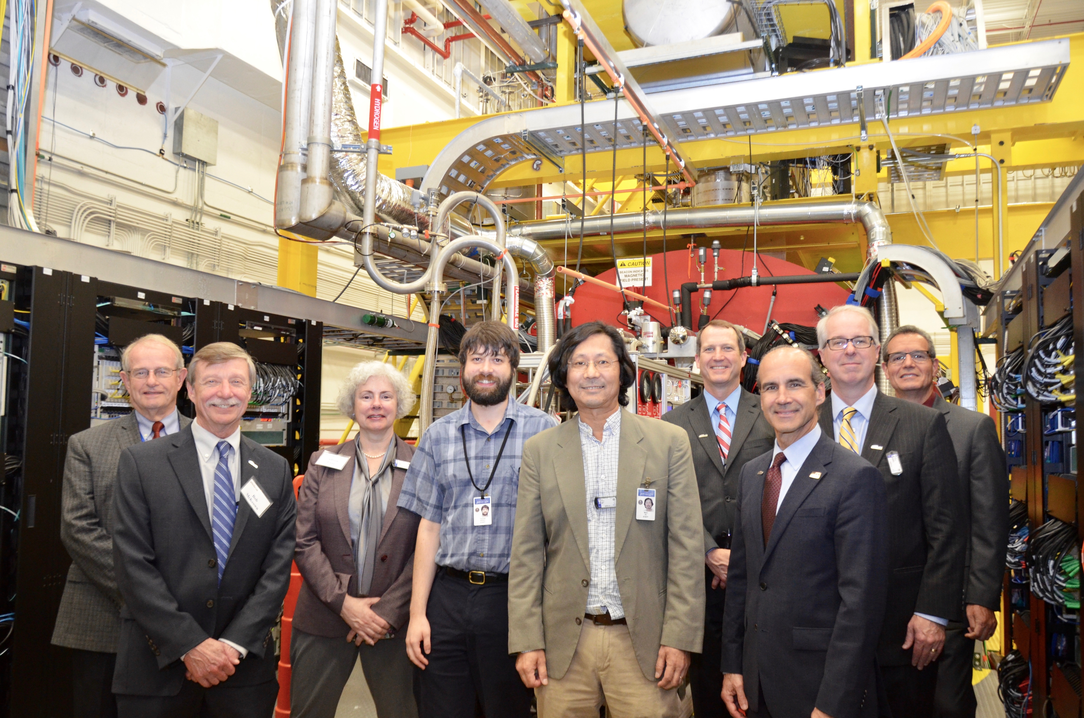
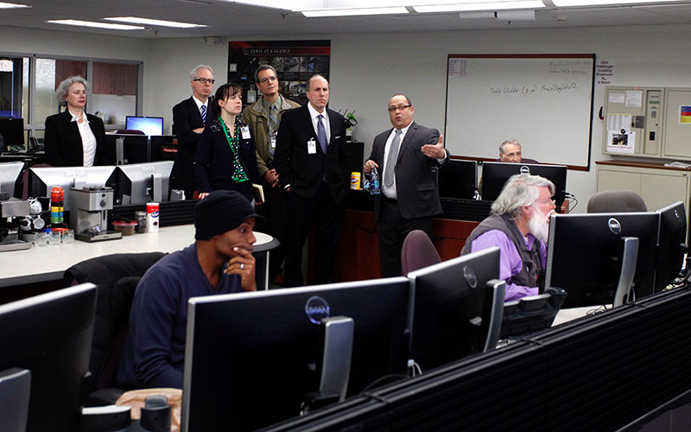
Keeping Jefferson Lab front and center:
DOE Secretary and Under Secretary visits

Slide 18
Finally...
The Lab is in good shape and in a strong position moving forward
High priority for the lab and community:
  Demonstrating the value of the 12 GeV investment by delivering high-impact scientific results in a timely manner
  Keeping up the strong support for CEBAF and Jefferson Lab to achieve > 30 weeks operation per year
  Successful execution of our CEBAF Reliability Plan
  Preparing for next steps for the U.S. Electron-Ion Collider
  Thank you for the role that you play in ensuring that we build the strongest and most impactful scientific program at Jefferson Lab

Slide 19
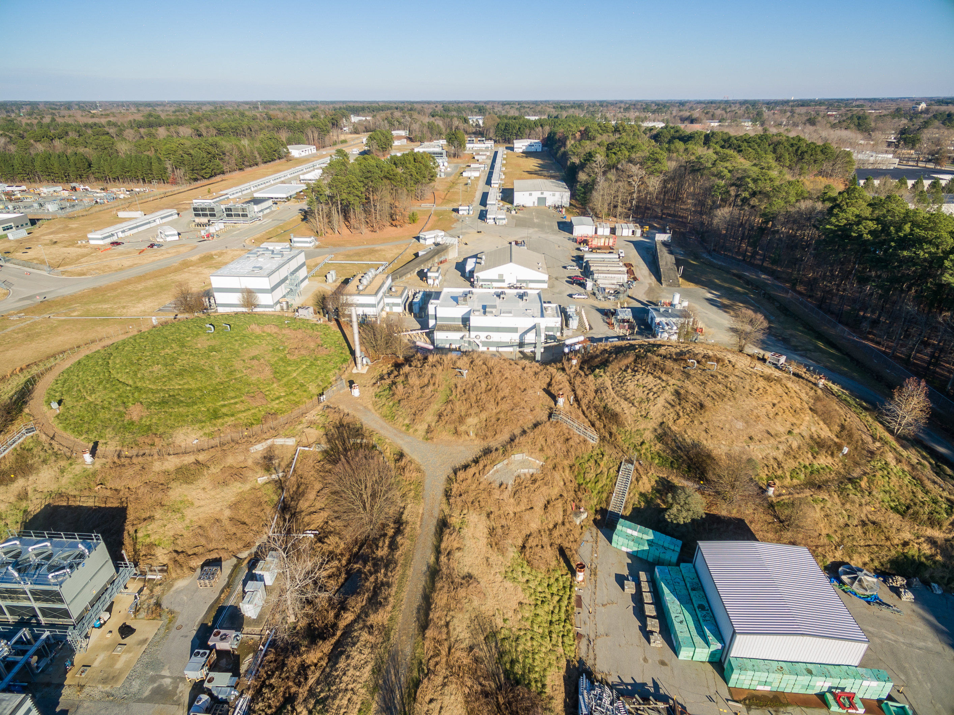
Welcome!

Slide 20

Jefferson Lab is an Integral Part of the 2015 Nuclear Science Advisory Committee Long Range Plan
RECOMMENDATION I
The progress achieved under the guidance of the 2007 Long Range Plan has reinforced U.S. world leadership in nuclear science. The highest priority in the 2015 Plan is to capitalize on the investments made.
With the imminent completion of the CEBAF 12-GeV Upgrade, its forefront program of using electrons to unfold the quark and gluon structure of hadrons and nuclei and to probe the Standard Model must be realized.
Operate 12 GeV CEBAF – highest priority
RECOMMENDATION II
We recommend the timely development and deployment of a U.S.-led ton-scale neutrinoless double beta decay experiment.
RECOMMENDATION III
We recommend a high-energy high-luminosity polarized EIC as the highest priority for new facility construction following the completion of FRIB.
Jefferson Lab EIC (JLEIC) development
National Academy of Sciences report expected in Spring
RECOMMENDATION IV
We recommend increasing investment in small-scale and mid-scale projects and initiatives that enable forefront research at universities and laboratories.
· MOLLER (CD-0), SoLID (pre-conceptual)

Slide 21
JSA Organization
Jefferson Science Associates LLC
Jerry Draayer, SURA
Timothy Sands, Virginia Tech
Chico Moline, PAE
Internal Audit
Gail Lucento
Director’s Office
Laboratory Director
Stuart Henderson
LCLS II
Project Office
J. Preble
CPO
CRO
COO
Communications
Lauren Hansen
CCO
Planning
Allison Lung
Deputy Director for Science and Tech
Bob McKeown
Operations
Mike Maier
Tech Transfer and Commercialization
Drew Weisenberg
CTO
Legal Counsel
Rhonda Scales
Experimental Physics
Rolf Ent
Accelerator
Andrei Seryi
Theoretical and Comp Physics
Jianwei Qiu
Engineering
Will Oren
CIO
CHRO
CFO
ESH&Q
Mary Logue
Information Technology
Amber Boehnlein
Human Resources
Rhonda Barbosa
Contracts and Finance
VACANT
Facilities and Logistics
Rusty Sprouse

Slide 22
