Slide 1
Departamento de Física Teórica. Universidad Complutense de Madrid
pion-kaon scattering at KLF
J. R. Peláez
For KLF Collaboration
PR-12-18-002
PAC46, July 17, 2018

Slide 2
Motivation to study πK scattering
π,K appear as final products of almost all hadronic strange processes:
Examples: B and D decays, CP violation studies, etc…
π,K are Goldstone Bosons of QCD → Test Chiral Symmetry Breaking
Many light resonances appear → Strange SPECTROSCOPY
Particularly interesting at KLF:
${κ/K}_{0}^{∗}(800)$ light scalar meson. “Needs confirmation”@PDG.
Light scalar mesons longstanding candidates for non-ordinary mesons.
Settle multiplet classification?
Scattering lengths for SU(3) Chiral Perturbation Theory (ChPT)
$K_{1}^{∗}$(892) interesting for CP violation studies
$K_{1}^{∗}$(1410) and $K_{0}^{∗}$(1430) smaller discussion on parameters and nature

Slide 3
The light scalar controversy. The theory side... classification
Scalar lightest SU(3) nonet controversial for decades
… but a picture is emerging
σ
a₀
$K_{0}^{∗0}$(800) $K_{0}^{∗+}$(800)
$K_{0}^{∗−}$(800) ${ K}_{0}^{∗0}$(800)
f₀
f₀(500)
f₀(980)
Non-strange heavier!!
Inverted hierarchy problem
For quark-antiquark
f₀(500) and f₀(980) are
really octet/singlet mixtures
a₀(980) a₀(980)
a₀(980)
Oldest candidates for non-ordinary $q\overline{q}$ mesons (Jaffe 76)
Only the κ(800) or K0*(800) still “Needs Confirmation” @ PDG

Slide 4
The resonance is NO LONGER the κ nor the $K_{0}^{∗}\left(800\right),$
Still “Needs
Confirmation” !
Best analysis:
Roy-Steiner
dispersion relations
Plenty of room
for improvement
on parameters
Pade sequences

Slide 5
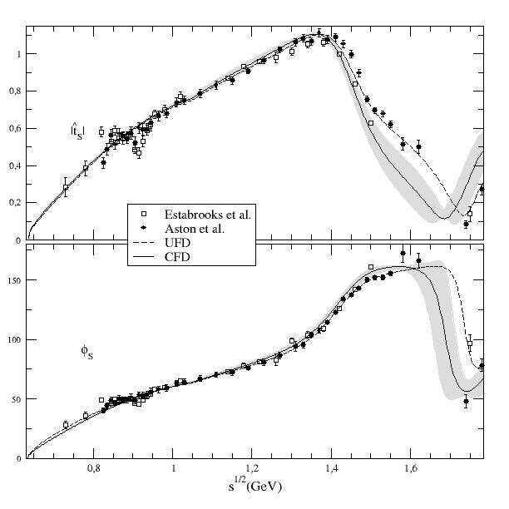
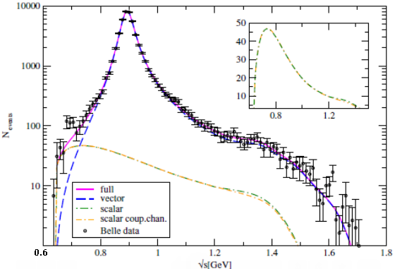
The problem with the kappa
It is a very wide resonance close to threshold
Either from scattering (SLAC)
Or produced in decays (Belle)
No clear “peak” or phase movement for ${κ/K}_{0}^{∗}(800)$ resonance, less so $K_{0}^{∗}(700)$
Definitely NO BREIT-WIGNER shape
Mathematically correct to use POLES

Slide 6
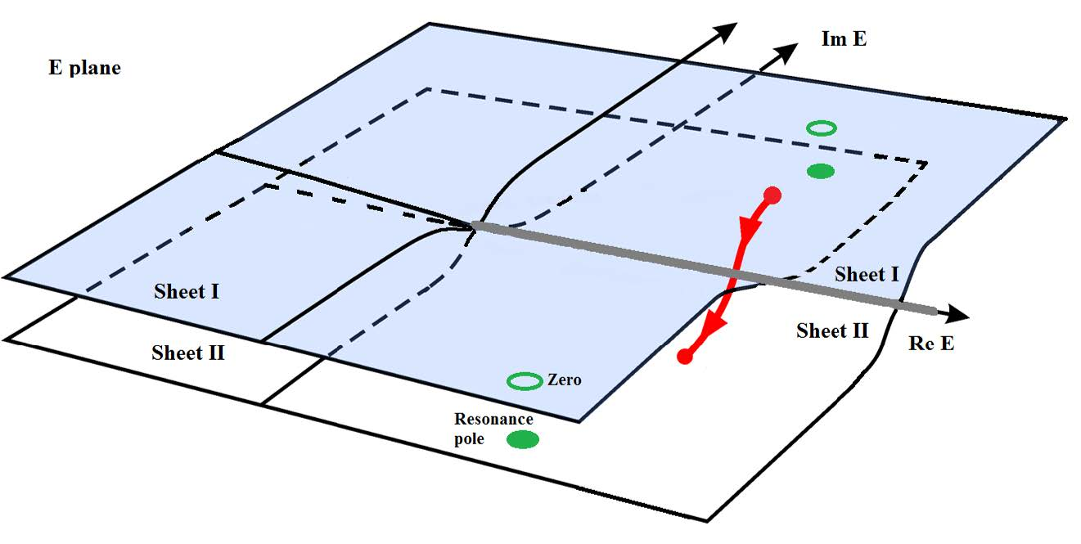
Resonances as poles
The Breit-Wigner shape is just an approximation for narrow and isolated resonances
The universal features of resonances are their
pole positions and residues *
$\sqrt{s_{pole}}≈$M-i Γ/2
*in the Riemann sheet obtained from an analytic continuation through the physical cut
Im s
s-plane
Re s

Slide 7
Why so much worries about low energy and CORRECT ANALYTIC STRUCTURE?
Analyticity is expressed in the s-variable, not in $\sqrt{s}$

Slide 8
Why so much worries LOW ENERGY and CORRECT ANALYTIC STRUCTURE?
Analyticity is expressed in the s-variable, not in $\sqrt{s}$
$$s−plane$$
(MeV²)
|s|=$m_{K}^{2}−m_{π}^{2}$
NO LASS data here
Just 2 Estabrooks points
with huge uncertainties
LASS data
$$Adler$$
zero
$$0$$
$${(m_{K}−m_{π} )}^{2}$$
$$πK$$
$$7002$$
$$8002$$
$$8902$$
$$ηK$$
$$K^{∗}(892)$$
$$κ/K_{0}^{∗}(800)$$
Important for
the $κ/K_{0}^{∗}(800)$
Threshold behavior (Theory: chiral symmetry)
Subthreshold behavior (Theory: chiral symmetry →Adler zeros)
Other cuts (Theory: Left & circular)
LOW ENERGY REGION data very relevant for the kappa

Slide 9
The problem with data on S-WAVE
Most reliable sets:
Estabrooks et al. 78 (SLAC)
Aston et al.88 (SLAC-LASS) Largest statistics. But measures t_{1/2}+t_{3/2}/2
No LASS Data below 825 MeV. Only 2 points with huge uncertainties
from Estabrooks et al. 78 below 800 MeV
No data below 725 MeV
KLF will improve this

Slide 10
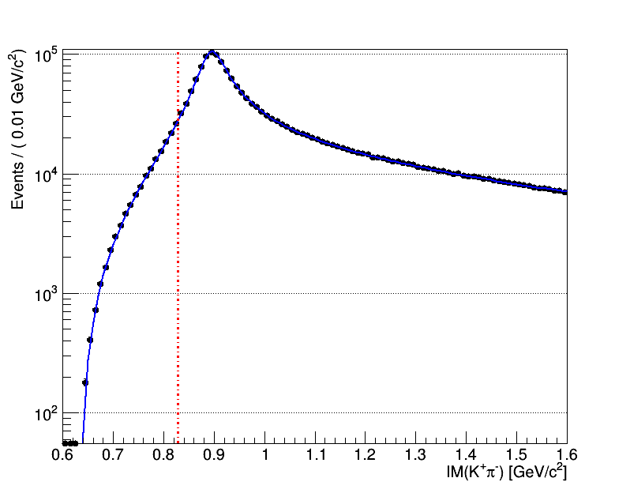
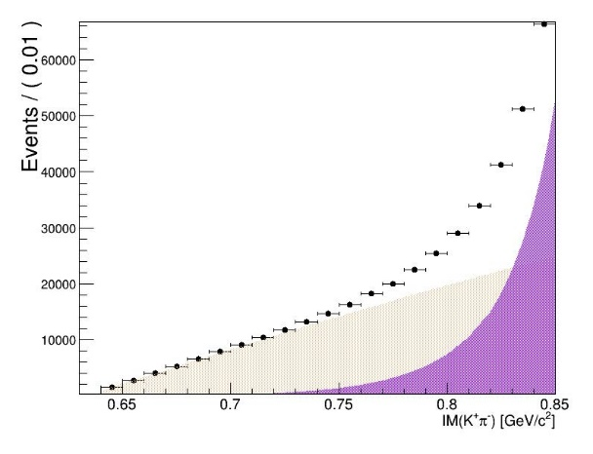
Expected number of events after 100-day run @ KLF
FOUR ORDERS of MAGNITUDE larger tan previous data set
t_{1/2}-t_{3/2}
Low-s dominated
by s-wave
2) 18 NEW energy bins below 825 MeV (there were 2)
3) 11 NEW energy bins below 725 MeV (there were NONE)

Slide 11
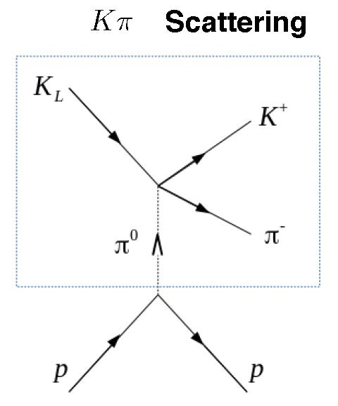
Isospin separation @KLF
KLF will measure
which are sensitive to t_{1/2}-t_{3/2}.
But also
which are sensitive to t_{1/2}+2 t_{3/2} We concentrate on the former. Further studies needed for the latter
$$K_{L}p→(K^{∗0})p→K^{+}π^{−}p$$
$$K_{L}p→({\overline{K}}^{∗0})p→K^{−}π^{+}p$$
$$K_{L}p→(K^{∗0})p→K_{L}π^{0}p$$
$$K_{L}p→\left(K^{∗0}\right)p→K_{L}π^{−}∆^{++}$$
In this way the two isospin states can be separated.
For the latter the $K_{L}$ will be reconstructed from the missing mass of the proton and
the $π^{0}$ and the invariant mass of the $K_{L}π^{0}$ in the missing mass of the proton.

Slide 12
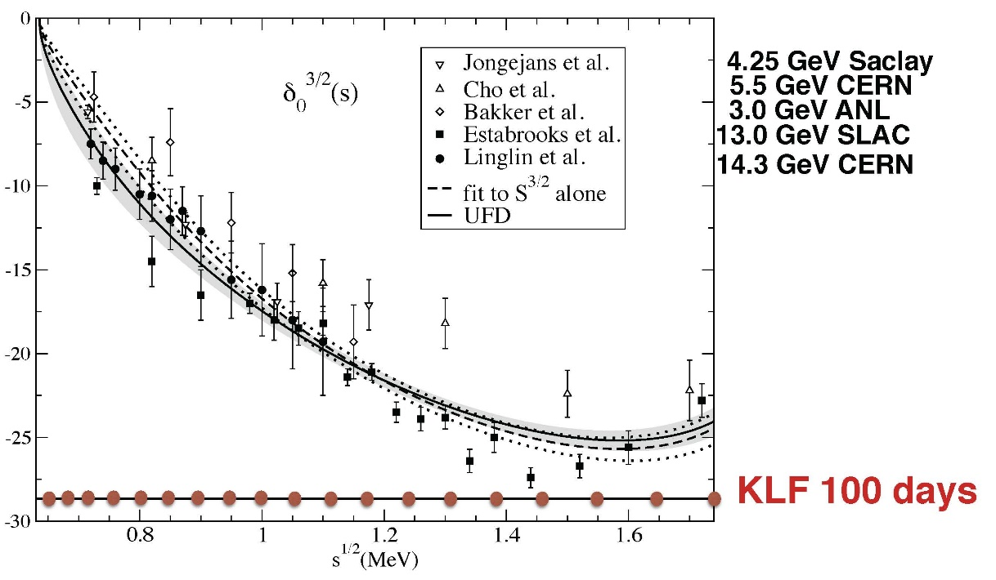
With the missing mass reconstruction one expects 5 points below 825MeV
3 points below the existing data.
With some timing improvement KLF could double the points.
100 x statistics than Estabrooks et al. Stat. Error bars invisible with KLF.
Systematic uncertainties expected at $\sim$5% level

Slide 13
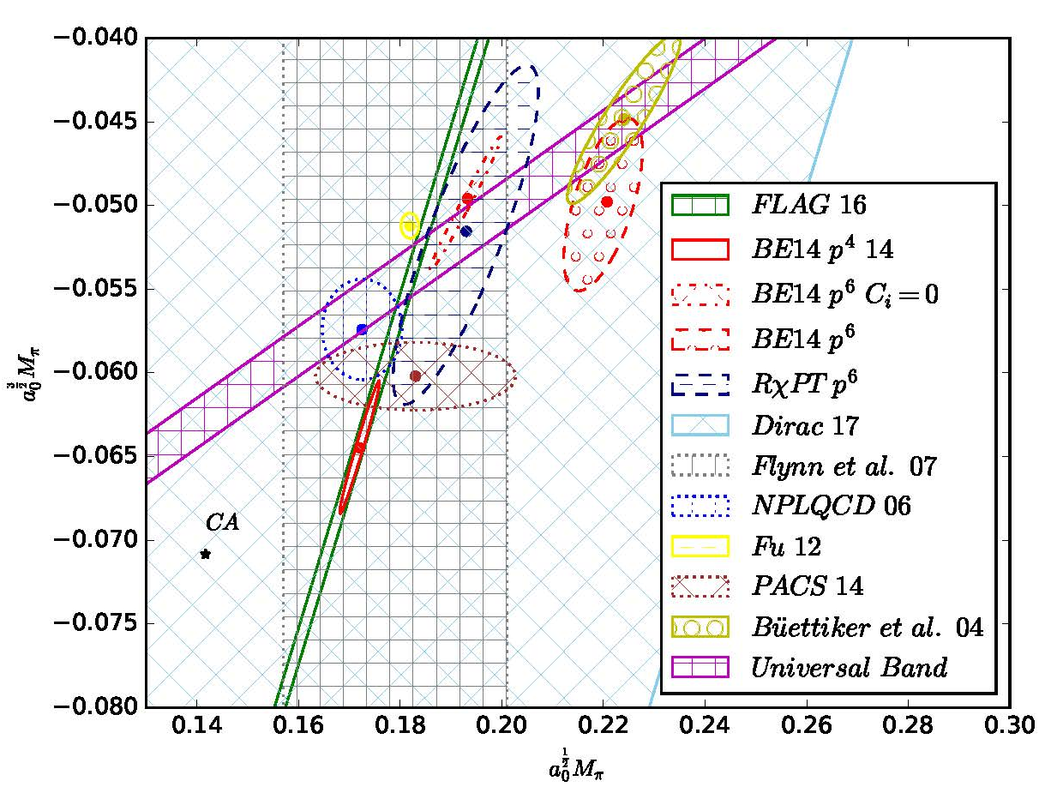
Relevance for threshold parameters and ChPT
Present tension between exp+dispersion theory vs. lattice.
Important to understand applicability of SU(3) ChPT & size of strange condensate.
Ruiz de Elvira, Colangelo, Maurizio Proceedings KPI2018
Dispersive solution
or with dispersive constrained fit to data
Lattice
No reliable extraction from DATA. All rely on extrapolations from 750MeV to threshold
Low-enery and isospin separation @KLF crucial

Slide 14
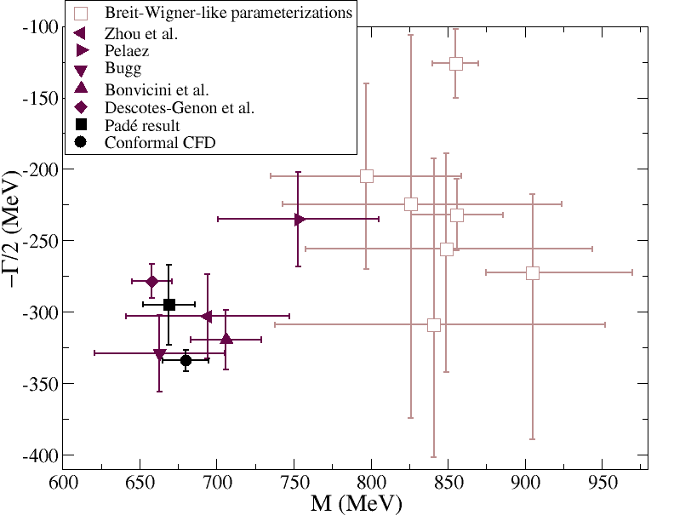
The theory problem for the kappa
Much confusion from
too simple theoretical models:
Breit Wigners !!
No Adler zeros
No left cuts, no circular cuts, etc…
The rigorous way to extract the pole is
with partial wave dispersión relations
(Roy-Steiner eqs.)
The only Roy-Steiner calculation
so far DOES NOT USE DATA
on S-wave below 900 MeV
(In a sense is a prediction)

Slide 15
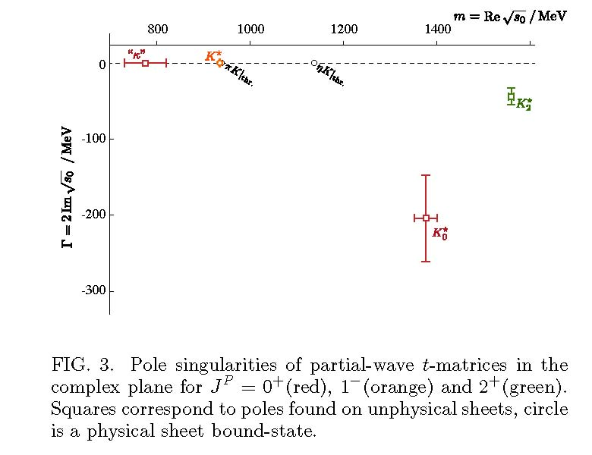
Even Lattice + K-matrix gets a kappa
Phys.Rev.Lett. 113 (2014) 18, 182001
M_{π}=391 MeV
M_{K}=549 MeV
So, there seems to be a virtual kappa on the lattice…
but at high masses!!

Slide 16
The theory problem for the kappa
There are some sound extractions,
with good chiral and analyticity properties,
but still with some model dependence
and without low-energy data…
NOT GOOD FOR PRECISION

Slide 17
Ongoing dispersive study USING EXISTING DATA
Impose Forward Dispersion Relations on fits to data.
(García-Martín, Kaminski,JRP, Ruiz de Elvira, Ynduráin, Rodas)
Use any parameterization to fit DATA imposing FDR within uncertainties.
(But you can use physical inspiration for clever choices of parameterizations)
Also needs input on other waves and high energy.
USE ROY-STEINER EQUATIONS TO DETERMINE THE POLE
(but not the parameterizations)

Slide 18
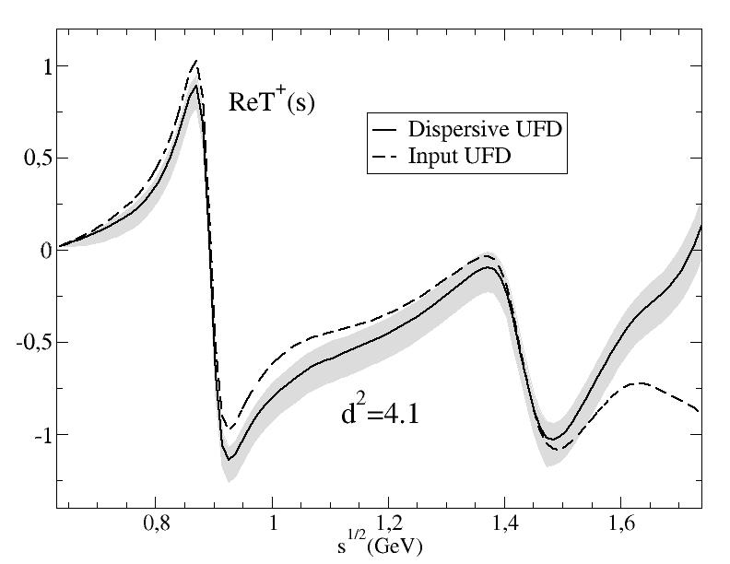
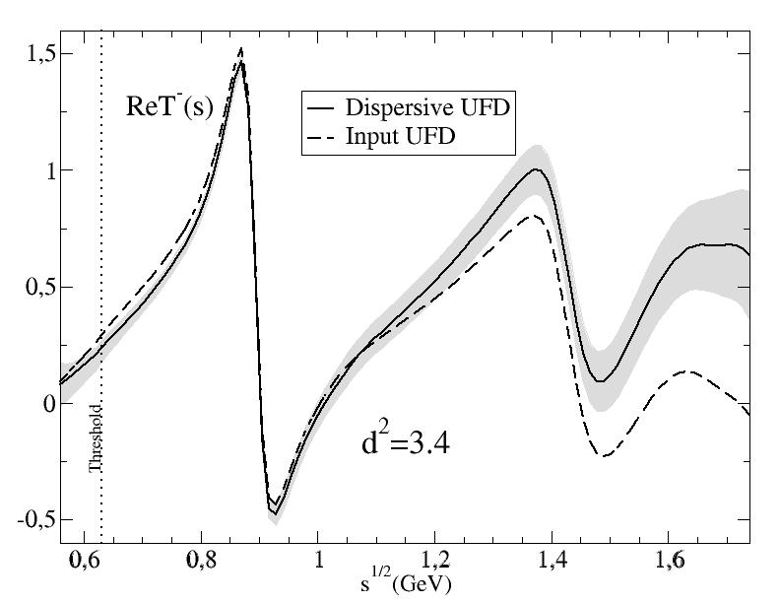
(not a solution of dispersión relations,
but a constrained fit)
A.Rodas & JRP, PRD93,074025 (2016)
Dispersive analysis of
πK scattering DATA
up to 1.6 GeV
First observation:
Forward Dispersion relations
Not well satisfied by data
Particularly at high energies
So we use
Forward Dispersion Relations as CONSTRAINTS on fits

Slide 19
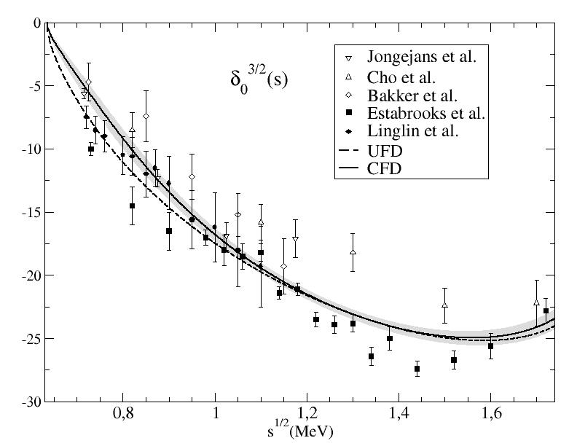
From Unconstrained (UFD) to Constrained Fits to data (CFD)
S-waves. The most interesting for the K₀* resonances
Largest changes from UFD to CFD
at higher energies

Slide 20
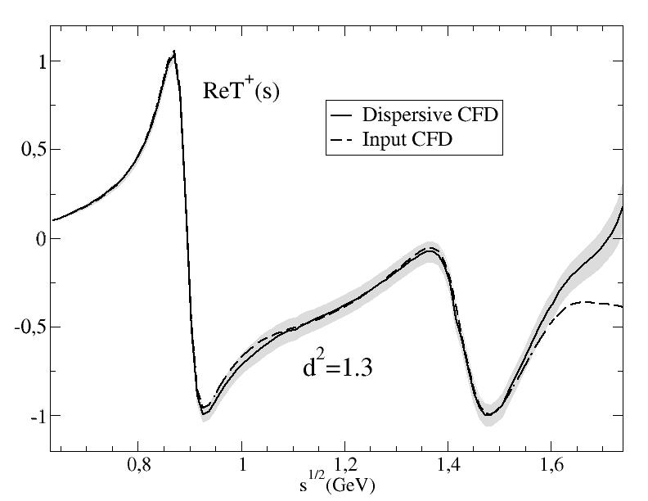
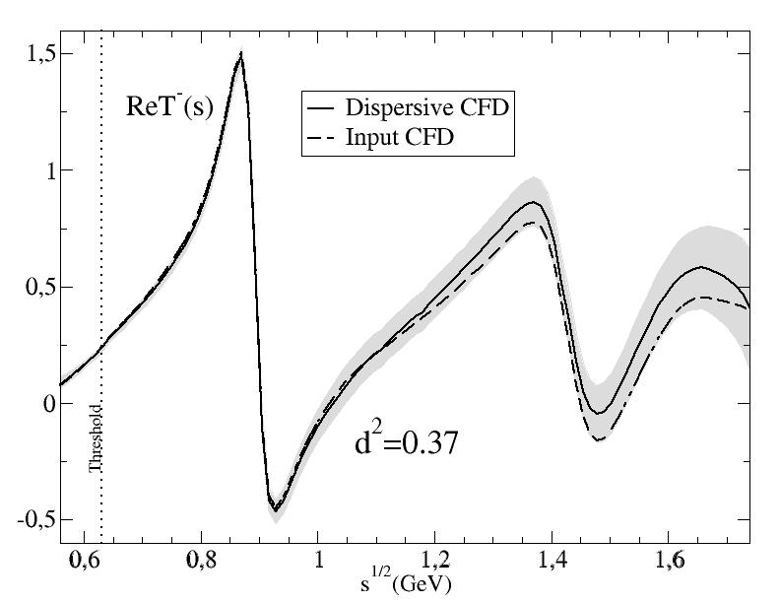
Consistency up to 1.6 GeV!!
Consistency up to 1.74 GeV!!

Slide 21
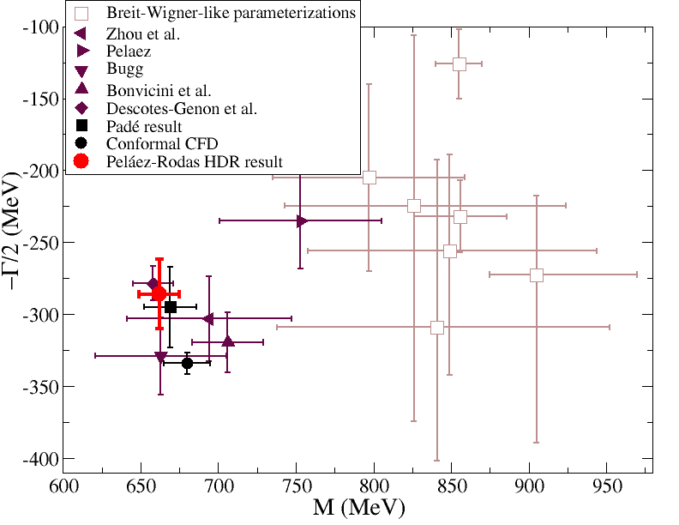
Model independent analysis with existing data
Roy-Steiner SOLUTION from Paris group
Decotes-Genon-Moussallam 2006
(658±13)-i(278.5±12) MeV
Our Roy-Steiner analysis of FIT to data
JRP, A. Rodas, in preparation
(663±14)-i(288±27) MeV
NEW!!
Preliminary
We have:
Constrained Fit to data (not solved)
Improved P-wave (data OK)
Used Hyperbolic DR both in real axis and complex plane.
Improved Pomeron
Constrained ππ→KK input with DR
Other technicalities
Independent dispersive K₀*(800) determination
USING EXISTING DATA

Slide 22
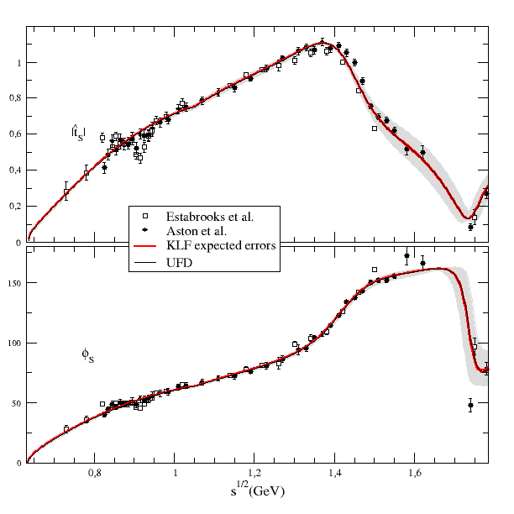
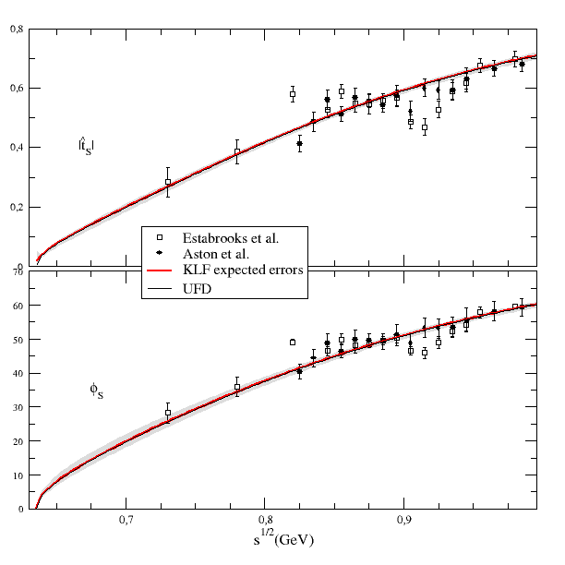
Model independent analysis WITH EXPECTED KLF DATA
We have run the same procedure but with 50x statistics of KLF on LASS data
Uncertainty bands of the size of red line (not vanishing due to systematics)
Note we are NOT CONSIDERING NEW POINTS AT LOW ENERGIES
(that will decrease systematics)

Slide 23
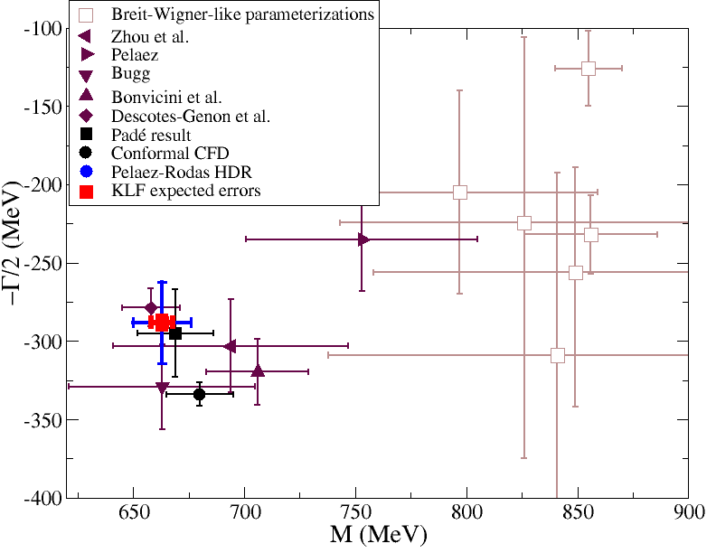
Model independent analysis WITH EXPECTED KLF DATA
with EXISTING DATA
(663±14)-i(288±27) MeV
WITH KLF
(663±6)-i(288±5) MeV
HUGE IMPROVEMENT!!
Systematic errors should be reduced with further points near threshold

Slide 24
Remarks: Alternative/simpler methods
Dispersion relations needed to extract pole, but also to complete the region where there is no data.
They need data from other partial waves, high energies, etc… which induce systematic uncerrtainties
However, with additional points below 800 or 750 MeV one might not even need to use Dispersion Relations in the real axis or to continue to the complex plane.
Other analytic methods, like sequences of Padé approximants, which need dense grids of data points, could be used.
In that case, kappa determinations based on KLF data alone, will become competitive with dispersion relations.

Slide 25
Summary I
KLF plans to measure Kπ with very high statistics (estimated 50x existing data)
Will provide isospín 1/2 and 3/2 separation. This will require K_{L} reconstruction
Will provide: 18 data points below 825 MeV (LASS reach) for charged final state.
11 of them below 725 where data does not exist
Will provide: 5 data points below 825 MeV (LASS reach) for neutral final state.
3 of them below 725 where data does not exist
The points near threshold and the large statistics will determine precisely the value of the scattering lengths and determine the convergence radius and applicability of SU(3) ChPT, size of the strange condensate, etc…

Slide 26
Summary II
Just with the statistical improvement + dispersion theory+ other input, a model independent analysis of the much debated ${κ/K}_{0}^{∗}(800)$ will reduce the uncertainties in its mass by more than 2 and the width (coupling) by more than 5
Systematic effects will be reduced with the new data points close to threshold.
This may allow for a precise determination with KLF data only with other
rigorous methods based on analyticity.
This should finally settle the controversy confirming the existence of the ${κ/K}_{0}^{∗}(800)$ and determining precisely the value of its parameters. It will also fix the controversy about the existence of a light scalar nonet and its non-ordinary nature.
KLF will also improve the precision of the $K_{1}^{∗}$(892), $K_{1}^{∗}$(1410) and $K_{0}^{∗}$(1430)

Slide 27
SPARE SLIDES

Slide 29
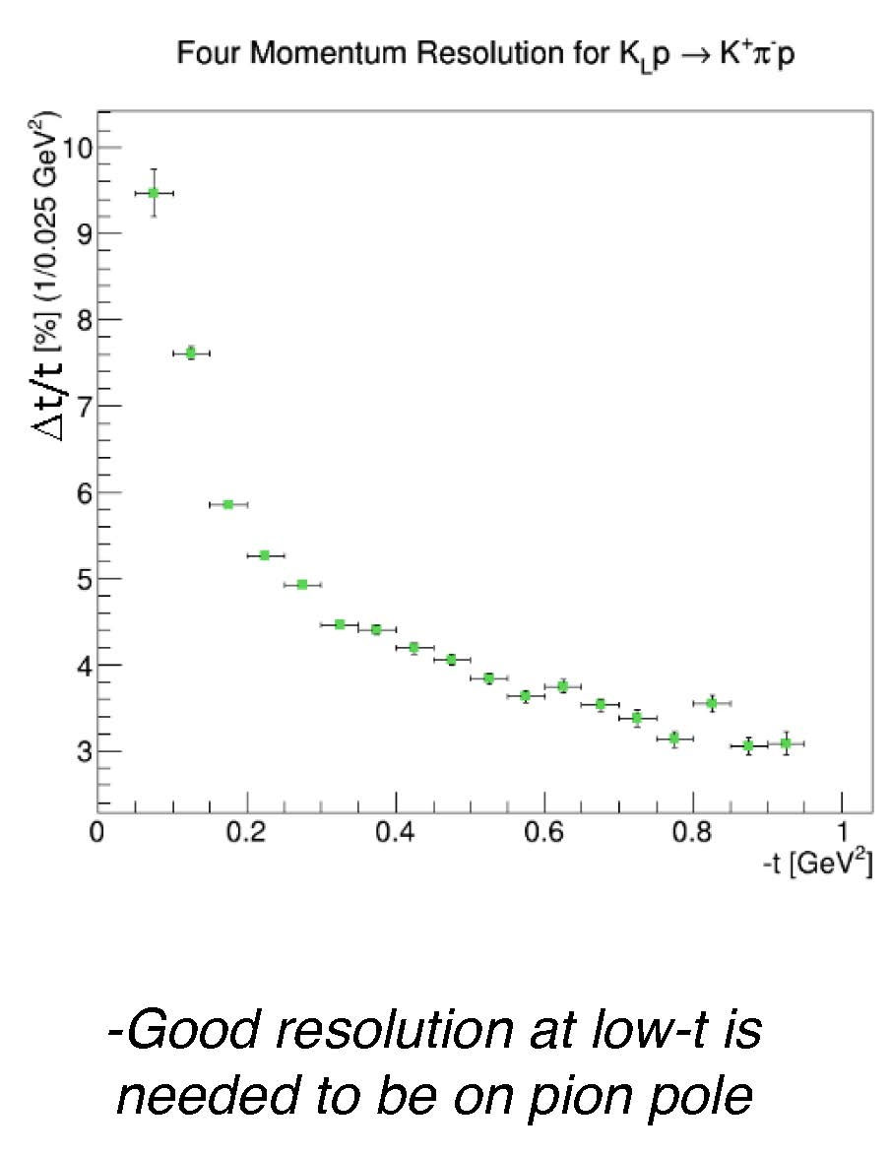
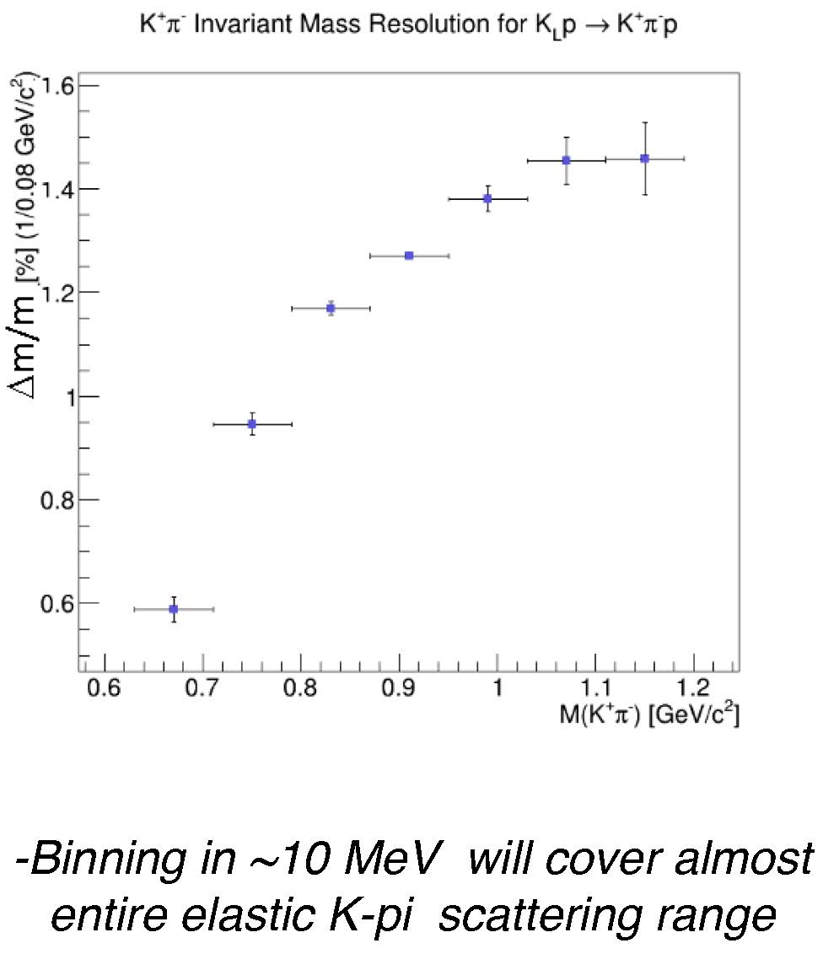
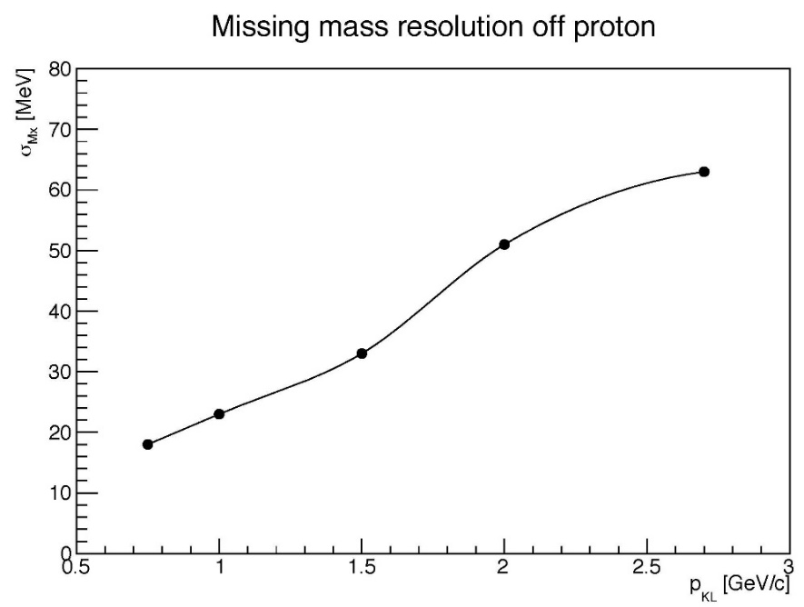

Slide 30
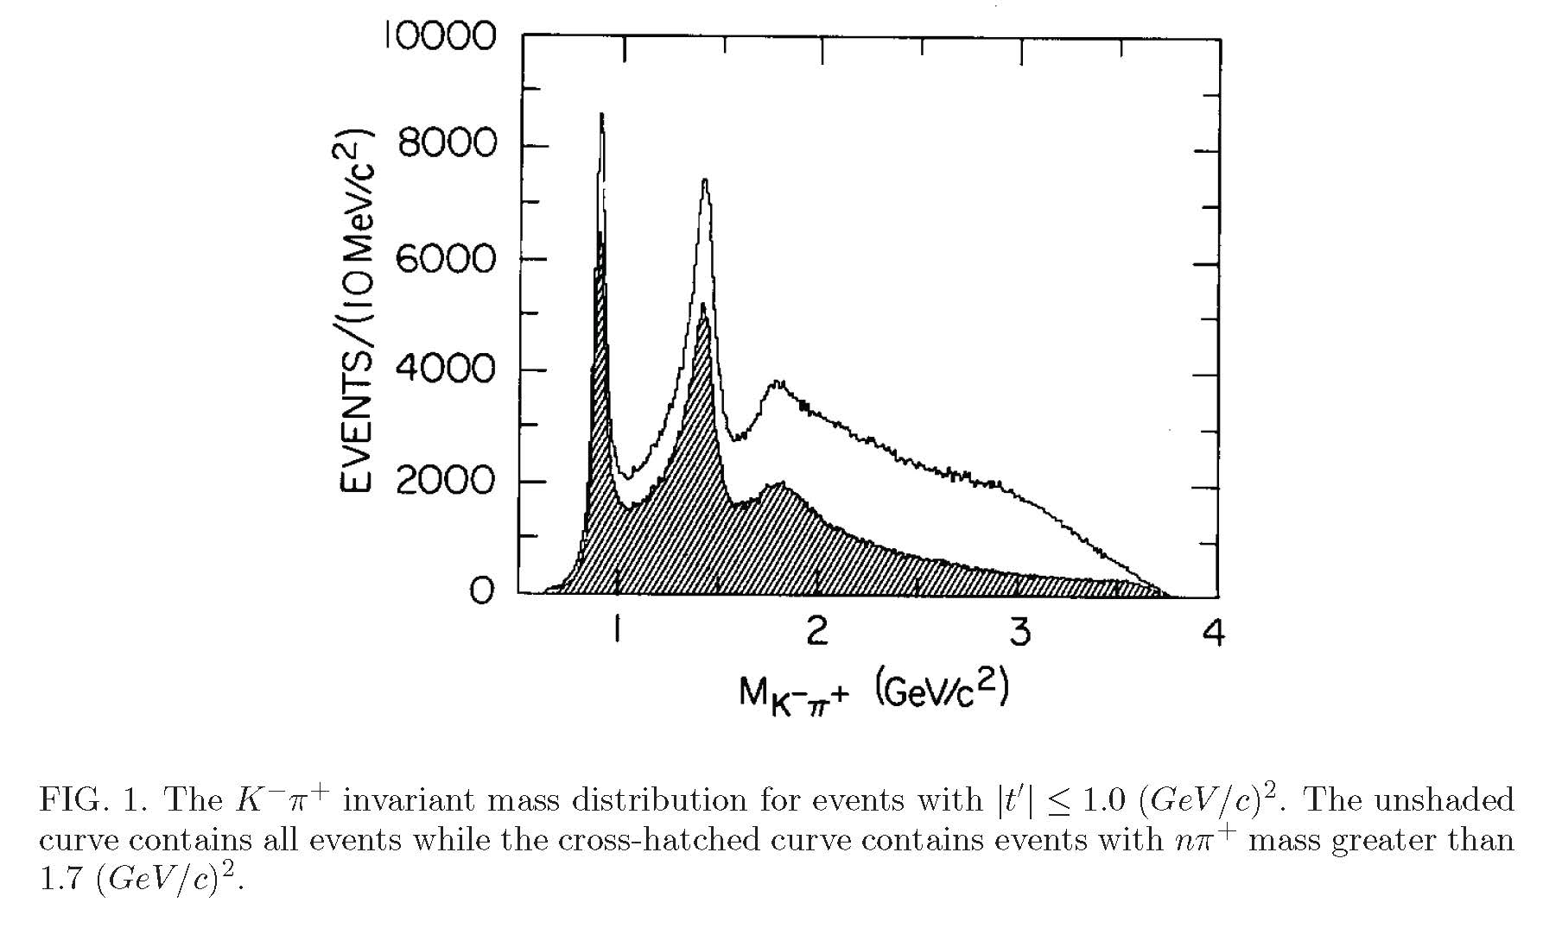
LASS 730000 events 4x more than previous

Slide 31
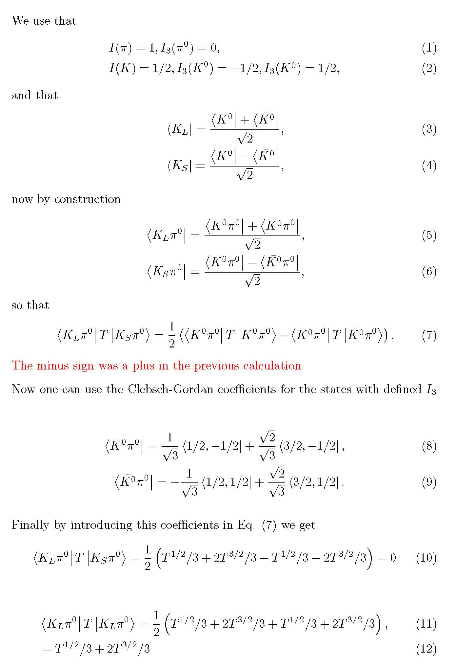

Slide 32
S0 wave: UNconstrained fit to data (UFD).
Global fit, averaging all sets where they roughly coincide

Slide 33
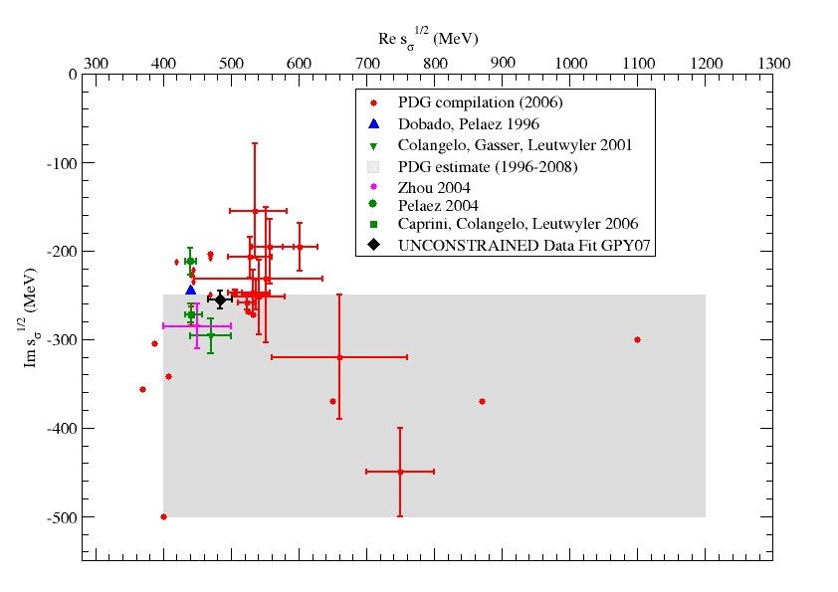
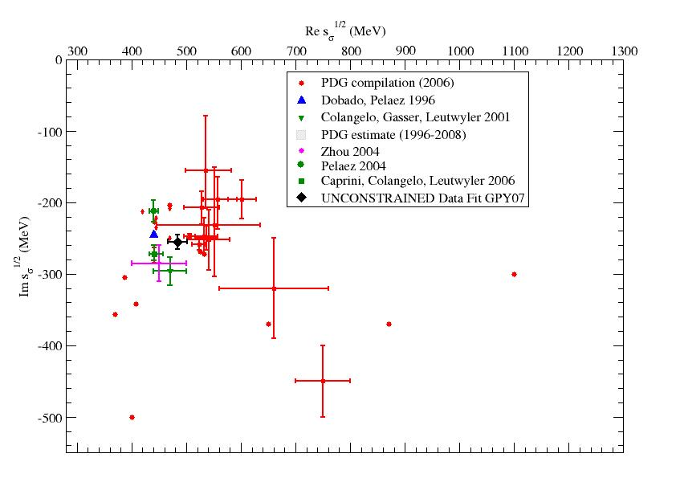
These and other experimental results triggered a
LONG AWAITED CHANGE ON “sigma” RESONANCE @ PDG!!
The f0(600) or “sigma”
in PDG 1996-2010
M=400-1200 MeV
Γ=500-1000 MeV
Becomes
f0(500) or “sigma”
in PDG 2012
M=400-550 MeV
Γ=400-700 MeV
To my view…
still too
conservative,
but quite a good improvement

