Slide 1
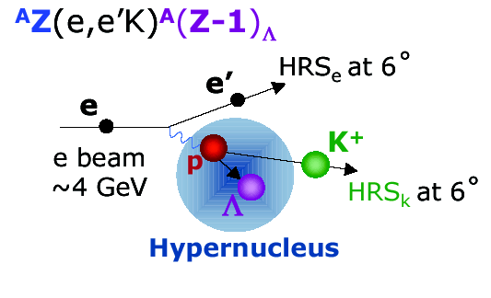
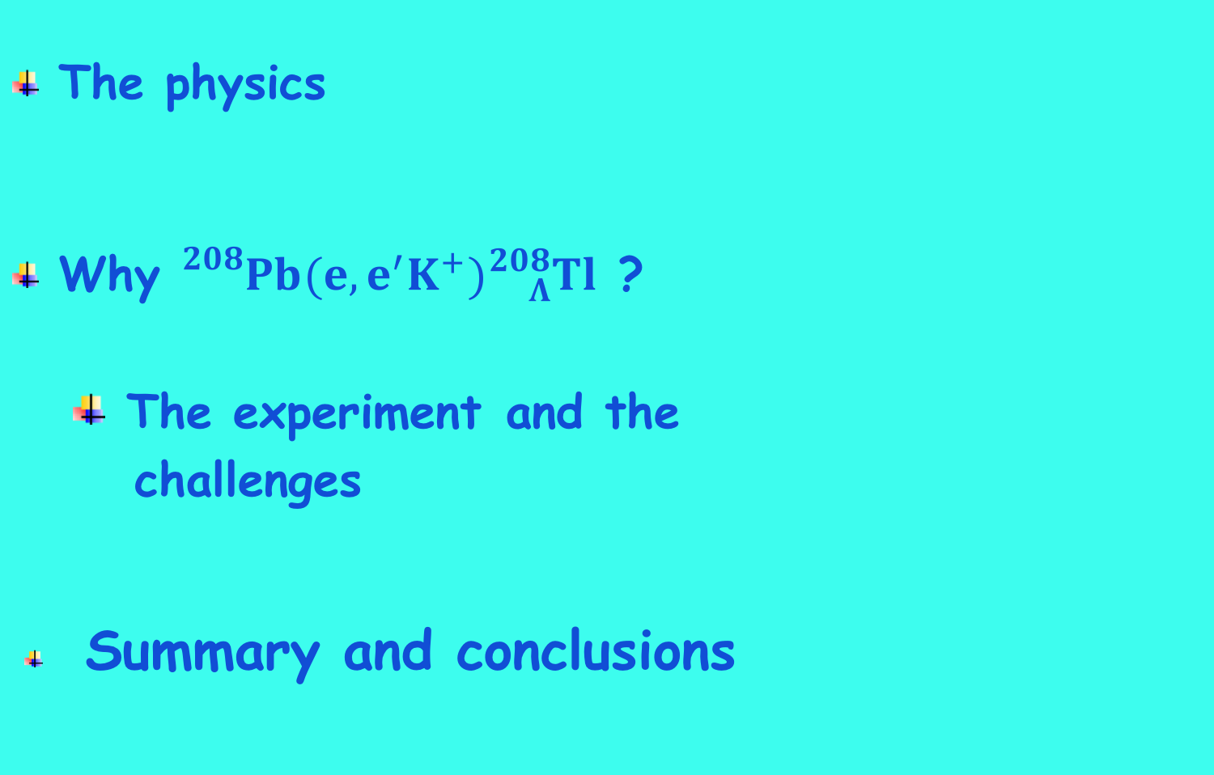

Studying Λ interactions in nuclear matter with
the ${}_{}^{208}{Pb}(e,e^{′}K^{+}){}_{Λ}^{208}{Tl}$
F. Garibaldi – PAC 46 – Jefferson Lab – July 17 -2018
The physics
Why ${}_{}^{208}{Pb}(e,e^{′}K^{+}){}_{Λ}^{208}{Tl}$ ?
  The experiment and the
  challenges
  Summary and conclusions

Slide 2
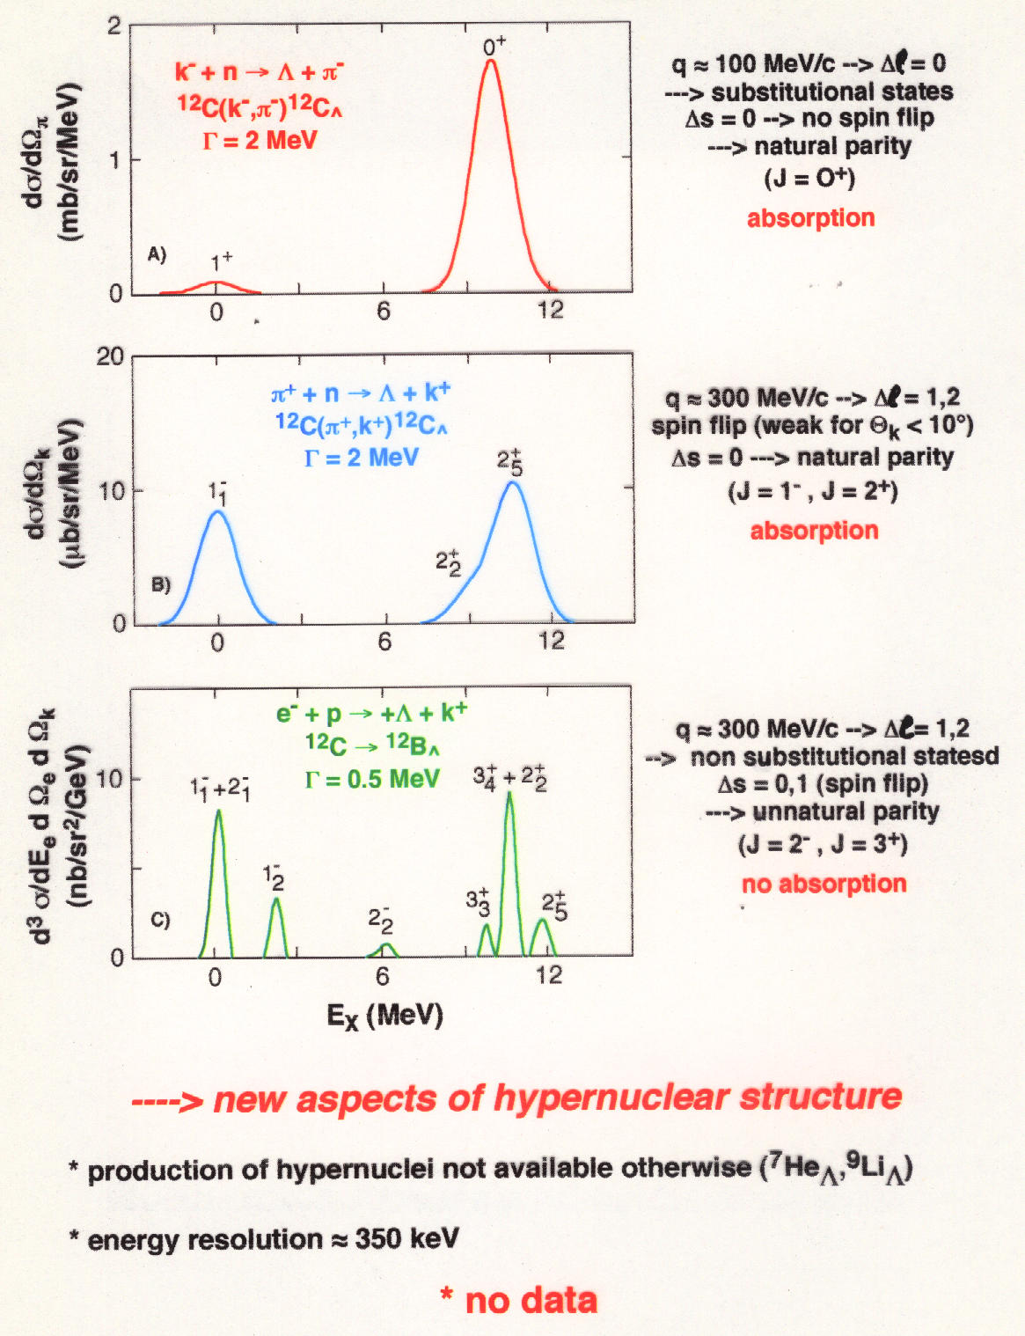
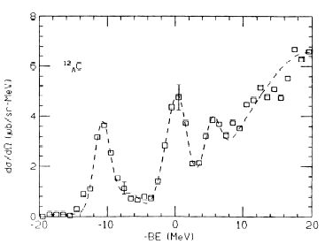
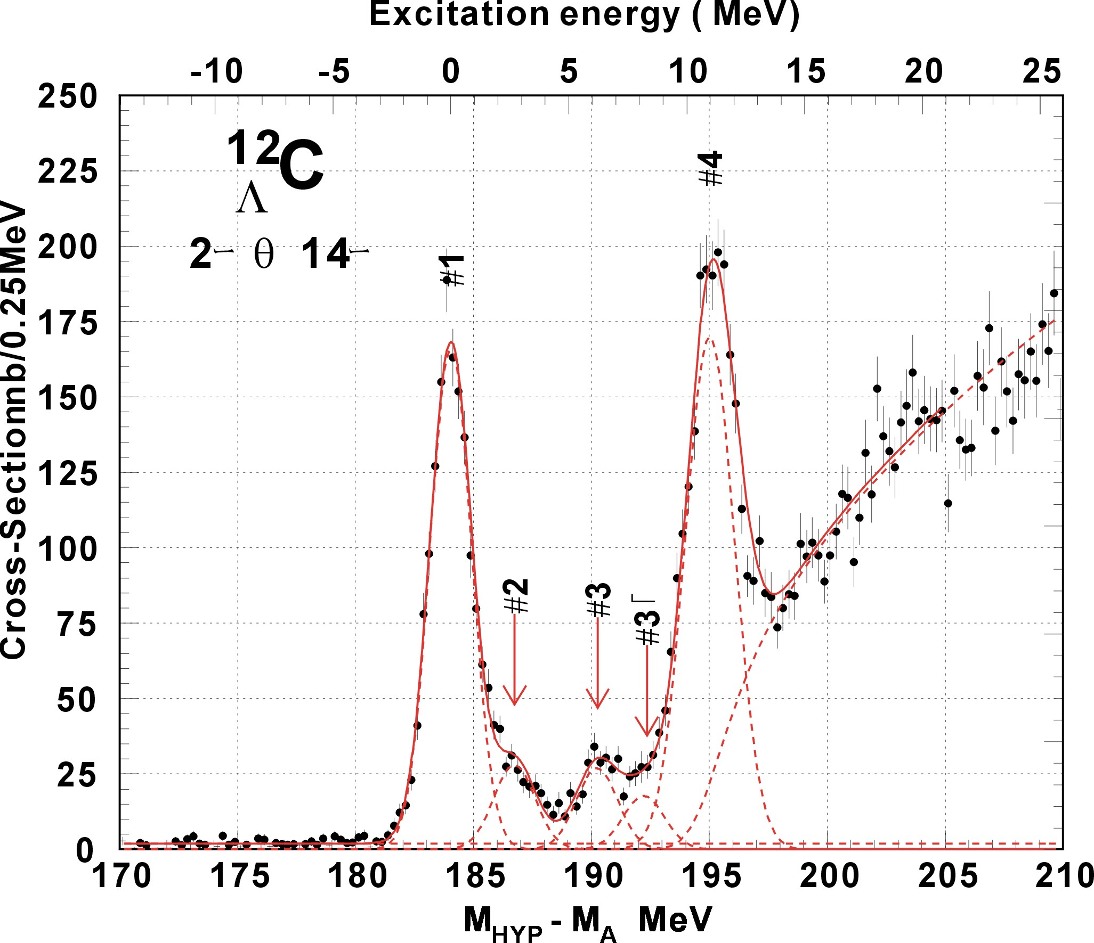
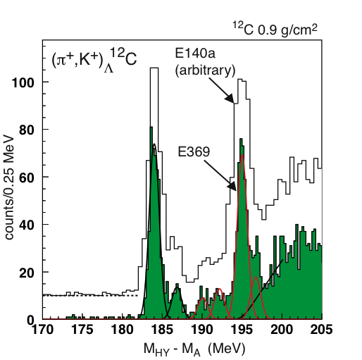
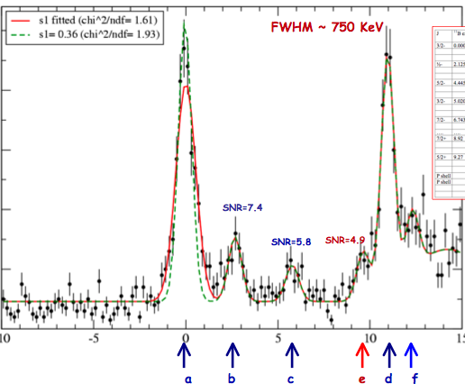
BNL 3 MeV
KEK336 2 MeV
Improving energy resolution
~ 1.5 MeV
and
using electromagnetic probe
635 KeV
635 KeV
new aspects of hyernuclear structure
High resolution, high yield, and systematic study is essential
production of mirror hypernuclei
energy resolution ~ 500 KeV

Slide 3
Energy calibration IS important !

Slide 4
The hyperon puzzle
They are excellent observatories to test fundamental properties of nuclear matter under extreme conditions and offer interesting interplay between nuclear processes and astrophysical observables
Neutron stars are remnants of the gravitational collapse of massive stars having masses of (1-2 Mo ~ 2 x 10³³ Kg)
Hyperons are expected to appear in their core at ρ ~ (2-3)ρ_{o} when μ_{N} is large enough to make conversion of N to Y energetically favorable
but
The relief of the Fermi pressure due to its appearance → EoS softer → reduction of the mass to values incompatible with observation (~ 2 Mo that requires much stiffer EoS)
Strong softening of the EoS of dense matter due to the appearance of hyperons which leads to maximum masses of compact stars that are not compatible with the observations

Slide 6
I. Vidana, “ Hyperons, the strange ingredient of nuclear equation of state
arXiv:1803.00504v1 [nucl-th] 1Mar 2018

Slide 7
The present understanding of the nuclear interactions involving hyperons is far from being complete. The reason is in a combination of an incomplete knowledge of the forces governing the system (in the hypernuclear case both two- and three-body forces), and in the concurrent use of approximated theoretical many-body techniques.
Natural solution based on the known importance of three body forces in nuclear physics
When additional information on the three-nucleon interaction is inferred from saturation properties of symmetric nuclear matter (Urbana IX force [PUD95]), the resulting PNM EOS turns out to be stiff enough to be compatible with astrophysical observations
Nucleons without 3 body forces
Nucleons with 3 body forces
Λ and N with 3 body forces(ΛNN)
Λ and N without 3 body force
It clearly appears that the inclusion of YNN forces (curve 3) leads to a large increase of the maximum mass, although the resulting value is still below the two solar mass line.

Slide 8
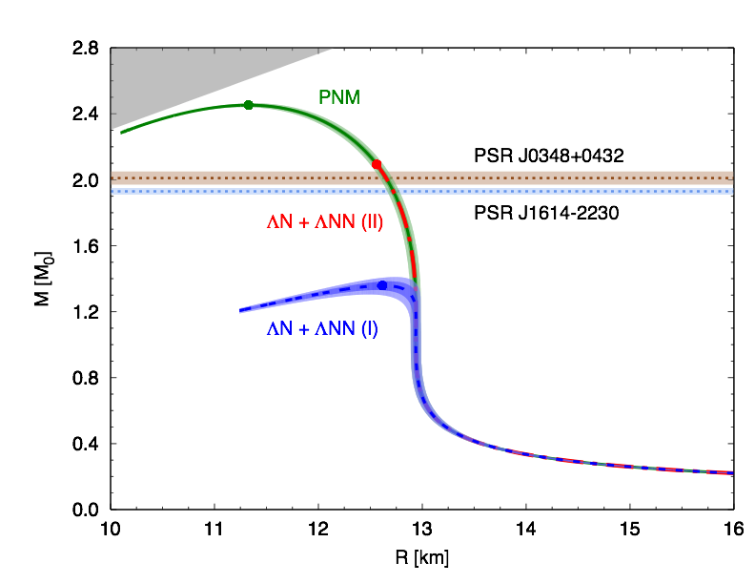
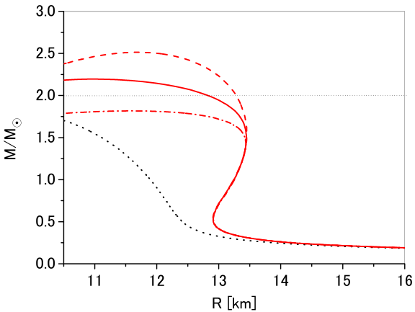
AFDMC: Argonne + Urbana
G-Matrix: ESC08 + MPa
D.Lonardoni et al., Phys. Rev. Lett. 114, 092301 (2015)
Y. Yamamoto et al., Phys. Rev. C 90, 045805 (2014)
The new parametrization of AFDMC (normalization of (π,k) data (shifts of 0,54 MEV)) of Mcarlo calculation brings to the right mass
Important role played by the experiment on ¹⁰_{Λ}Be performed in Hall C by this collaboration: High resolution spectroscopic study of ¹⁰_{Λ}Be T. Gogami et al. (HKS(JLab E05-115) Collaboration) Phys. Rev. C 93, 034314 (2016) – Published 10 March 2016
See also: Gal, Hugenford and Millener, “Strangeness in Nuclear Physics”, Rev of Mod. Phyisics 88
July 2016

Slide 9
Hypernuclear spectroscopy is the only method that can measure the absolute binding energy for ground and excited states with an high accuracy (< 100 KeV)
We are proposing to extend the experimental study of kaon electroproduction to the ²⁰⁸Pb(e,e’K⁺)²⁰⁸_{Λ}Tl reaction.
It is a complementary (to the ⁴⁰_{Λ}Κ and ⁴⁸_{Λ}Κ experiment that was approved by PAC 45) way to address the same problem (“hyperon puzzle”). In fact E12-15-008 will allow us to extract isospin dependence of the 3-body ΛNN force
Three-body ΛNN forces are known to be strongly A-dependent, making the ²⁰⁸Pb target uniquely suited to study Λ interaction in a uniform nuclear medium with large neutron excess

Slide 10
B. Frois and C.N. Papanicolas, Ann. Rev. Nucl. Part. Sci. 37, 133 (1987)
The measured charge density distribution of ²⁰⁸Pb clearly shows that the region of nearly constant density accounts for a very large fraction (~70 %) of the nuclear volume, thus suggesting that its properties largely reflect those of uniform nuclear matter in the neutron star.The validity of this conjecture has been long established by a comparison between the results of theoretical calculations and the data extracted from the ²⁰⁸Pb(e,e´p)²⁰⁷Tl cross sections measured at NIKHEF in the 1990s

Slide 11
Exploiting K⁺ electroproduction data to constrain the models of hyperon dynamics requires a quantitative understanding of the nucleon sector
A framework is being developed (O.Benhar, P. Bydzowsky, I.Vidana,..) to carry out calculations of the nuclear (e,e’K⁺) cross section within the formalism of nuclear many-body theory, which has been extensively and successfully employed to study the proton knockout, (e,e’p) reaction. In fact, the clear connection between (e,e’p) and (e,e’K⁺) processes that naturally emerges from the proposed analysis, shows that the missing energy spectra measured in (e,e’p) experiments provide the baseline for a model-independent determination of the hyperon binding energies
The hyperon binding energies are given by the difference between the missing energies measured in (e,e´K⁺) and the proton binding energies obtained from the (e,e´p) cross sections. Hence, (e,e´p) data will provide the baseline needed to extract information on hyperon binding energies

Slide 12
Short-range correlations appear to be the most important mechanism leading to the observed quenching of the spectroscopic factor, while surface and shell effects only play an important role in the vicinity of the Fermi surface.
Deeply bound protons in the ²⁰⁸Pb ground state largely behave as if they were in nuclear matter

Slide 13
The results of AFDMC calculations show that the difference between the Λ binding energies predicted by different models of the three-body ΛNN force, while being still rather small in ⁴⁰Ca, rapidly increases with A
(b) Experimental results for Λ in s, p, d, f and g waves. Red open circles are the AFDMC results obtained including the most recent 2-body plus 3-body hyperon-nucleon phenomenological interaction model (updated from [PED15]).
Figure 2-4: Λ separation energies as a function of A^{-2/3}. Predicted results for ⁴⁰_{Λ}K and ⁴⁸_{Λ}K are also included.
Experimental B_{Λ} values in s wave and AFDMC calculation results with 2-body ΛN interaction alone, and two different parametrizations of the 3-body YN interaction (updated from [LON14]).
The use of a ²⁰⁸Pb target appears to be uniquely suited to study Λ interactions in a uniform nuclear medium with large neutron excess
Jlab is the only lab where to make this experiment

Slide 14
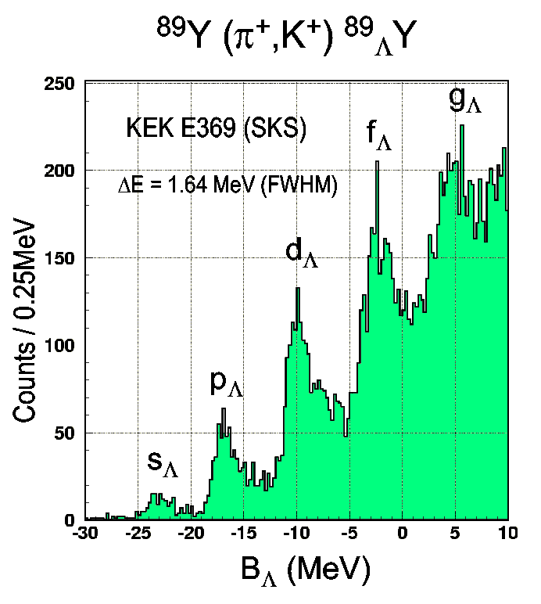
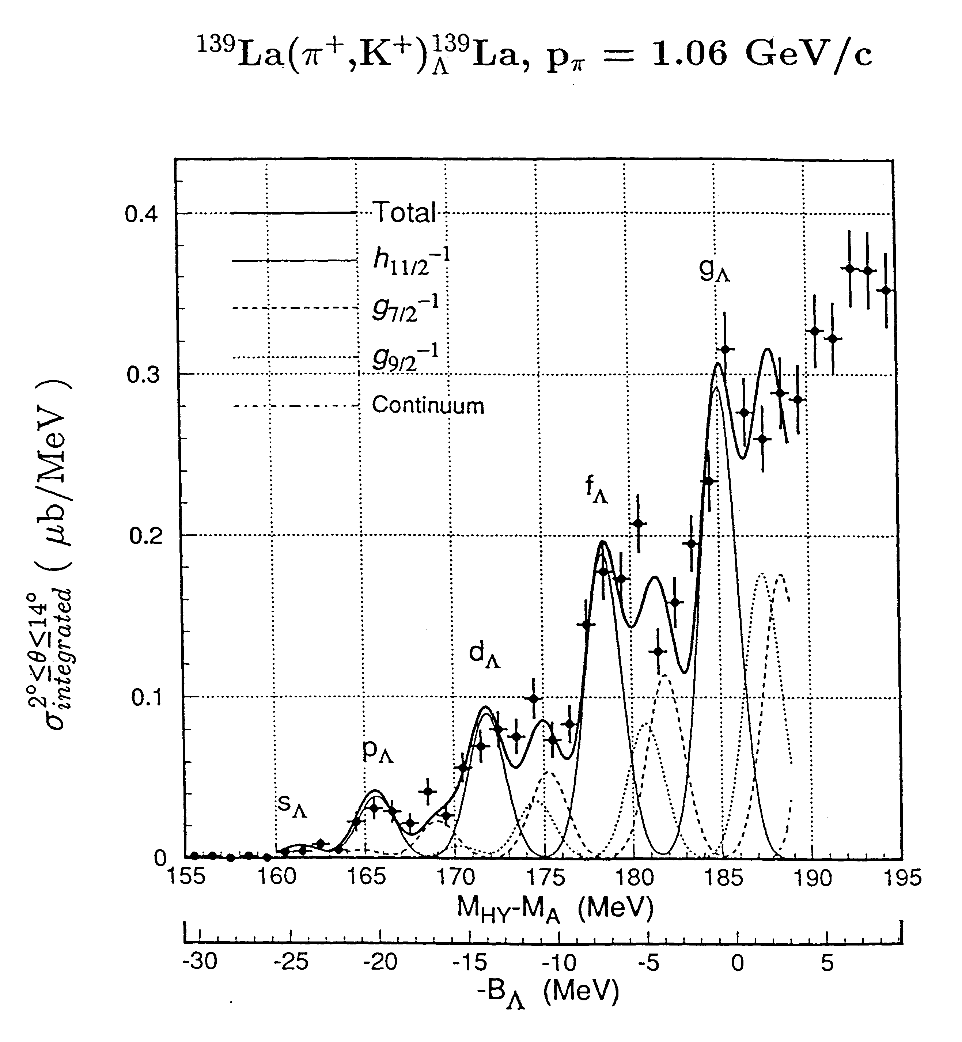
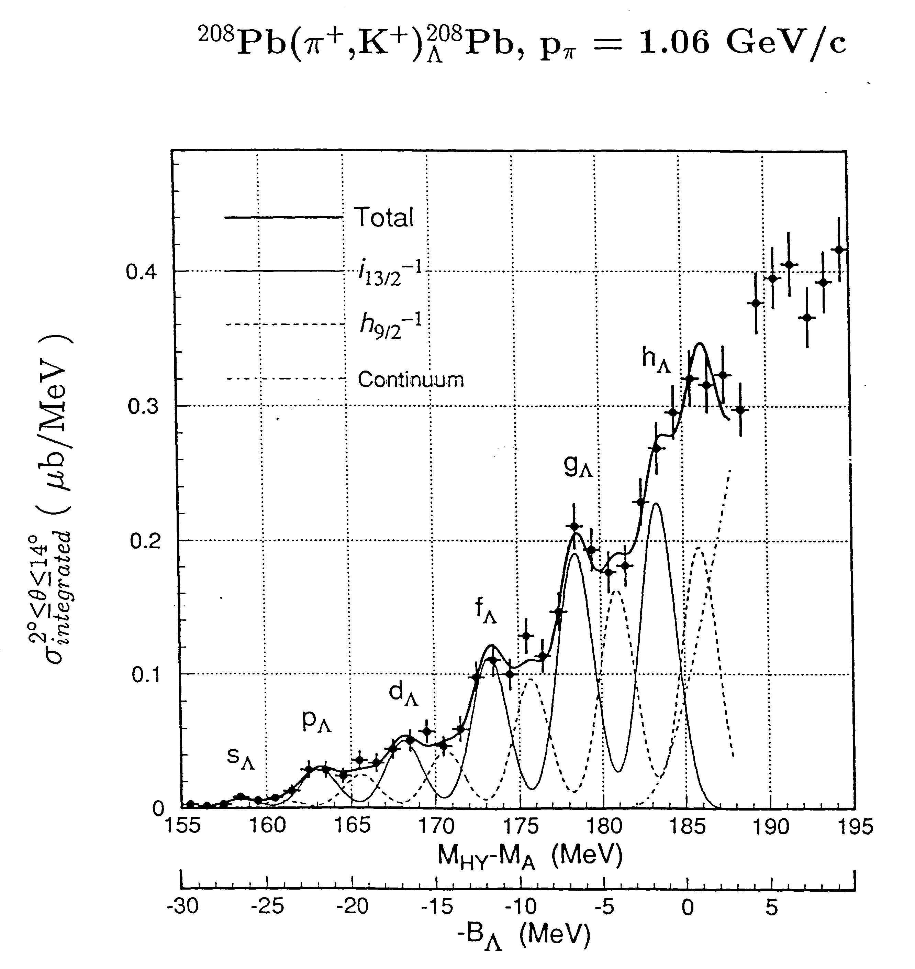
Λ Hyperon in heavy nuclei – ²⁰⁸(e,e’K+)²⁰⁸_{Λ}Ti
✔ Mass spectroscopy to its extreme
✔ (π,k) reaction, levels barely visible (poor energy resolution)
Hasegawa et. al., PRC 53 (1996)1210
Hotchi et al., PRC 64 (2001) 044302
“Up to now these data are the best proof ever of quasi particle motion in a strongly interacting system” (Review paper by Hashimoto and Tamura)
(e,e’K) reaction can do much better
Energy resolution → Much more precise Λ single particle energies. Complementary to (π,k) reaction

Slide 15
Millener-Motoba calculations
Particle hole calculation, weak-coupling of the Λ hyperon to the hole states of the core (i.e. no residual Λ-N interaction).
One can extract Λ single-particle energies from each of the observed peaks. Each peak does correspond to several levels based on two closely-spaced proton-hole states

Slide 16
Background free spectroscopy while maintaining good signal/accidental ratio for the heavy mass region.
The most important feature of the new configuration is the low accidental background.
This is a significant difference from the previous Hall C experiments. In other words, the new configuration can be considered a significant upgrade of the Hall A experiment and increases its physics yield rate by a factor of five.
The results based on the previous experiments in Hall A and Hall C are consistent and their average is about 0.55 counts/hr/(1.0 nb/sr). A GEANT simulation using more precise information about the HKS and HRS predicted similar yield rates, 0.54 counts/hr/(1.0 nb/sr).

Slide 17
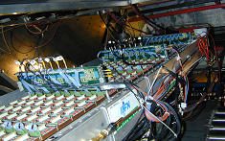
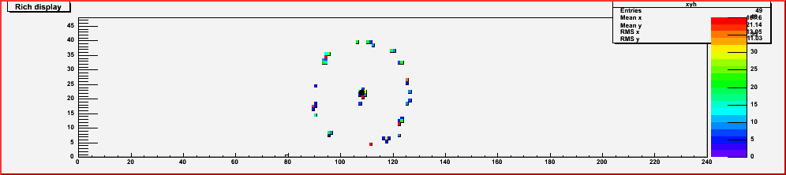
Kaon identification
HKS
We might add theRICH detector
RICH Detector
The RICH detector has been upgraded for the neutron Transversity experiment. Easy calculation show that the new layout would allow us to get an added factor of 10⁶ as π/K rejection factor
3 TOF, 2 water Cherenkov,
three aerogel Cerenkov
pK=1.2 GeV/c)
(π/k rejection ratio: 4.7 x 10⁻⁴)
(T. Gogami et al, NIM (2018) 69-83 )

Slide 18
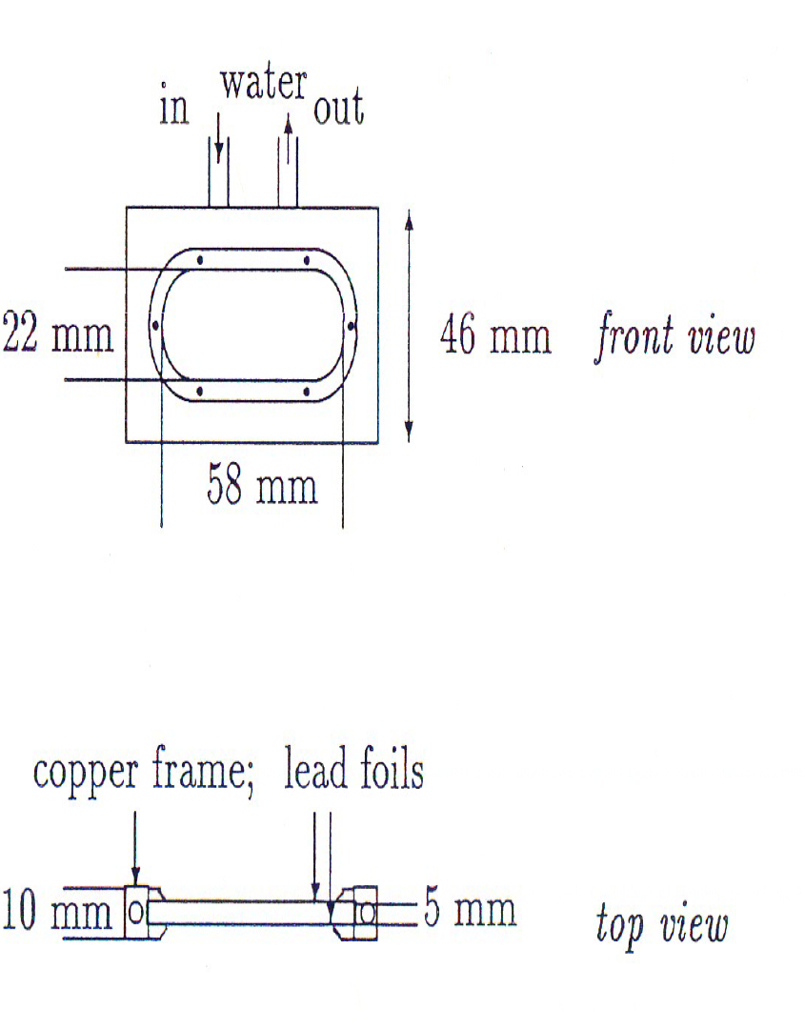
Target
Water - 15º - 60—70 l/h
Heath transfer calculation show that the conduction cooling becomes competitve as compared to increase radiation cooling by rotating the target for thick target

Slide 19
Simulations by Silviu Covrig

Slide 21
Counting rates and beam time request
Thickness (mg/cm²) | <I> (mA) | (e,e’) (kHz) | (e,K’) (kHz) | (e,p') (kHz) | Accid. (e,e’)(e,k’)DT | Back. (c/h/MeV) | Coinc. | Peak Sig. | peak
100 | 25 | 37 | 0.07 | 16 | 0.01 | 0.10 | 0.06 | 6.3 | s-shell g.s
100 | 25 | 37 | 0.07 | 16 | 0.01 | 0.10 | 0.21 | 20.8 | p-shell g.s
The calculations assume a beam time request of 840 hours (5 weeks).
We used the Sotona and Millener - Motoba calculations.The rate of K⁺ and the rate of background hadrons in HKS as function of Z and A are known and measured. The cross-section is ~ six times lower than the same reaction on ¹²C target. We estimated the coincidence counting rate for signal and background, assuming a rate of electrons in HRS to be comparable to the value measured in the E94-107 experiment for the same weighted thickness and beam current. This is confirmed by calculation and test measurement performed in Hall A for APEX experiment

Slide 22
Summary and conclusions
PAC45 approved a proposal on ⁴⁰_{Λ}Κ and ⁴⁸_{Λ}Κ on isospin dependence of ΛNN force to study the “hyperon puzzle”
We submitted to the last PAC a LOI to extend the experimental study of kaon electroproduction to the ²⁰⁸Pb(e,e’K)²⁰⁸_{Λ}Tl reaction to study the hyperon puzzle in a complementary way. The PAC encouraged us to submit a proposal
We show that the connection with proton knockout reactions and the availability of accurate ²⁰⁸Pb(e,e’p)²⁰⁷Tl data may be exploited to achieve a largely model-independent analysis of the measured cross section, based on the well established formalism of nuclear many-body theory
The Λ binding energies obtained from the analysis will provide valuable new information on three-body ΛNN forces, whose contributions are known to be strongly A-dependent
ΛNN could provide additional repulsion making the EOS stiffer enough to help solving the hyperon puzzle. Moreover they rapidly increase with A, making the ²⁰⁸Pb target uniquely suited to study Λ interaction in a uniform nuclear medium with large neutron excess
In conclusion, even if the typical baryon density inside a neutron star is much higher than in a hypernucleus a precise knowledge of the ²⁰⁸Pb level structure can, by constraining the hyperon-nucleon potential, contribute to more reliable predictions regarding the internal structure of neutrons stars, and in particular their maximum mass

Slide 23
Questions/comments by the JTechnical commiteee
The proposal pulls text from previous proposals and LOIs and could have used more copy editing. This leads to some confusion about technical details such as requested beam current, requested beam time, target design, etc.
Except for target, the apparatus for this proposal is the same as for experiment E12-15-008 (hypernuclear spectroscopy with 40Ca and 48Ca targets.) and the proponents assume that this proposal would be scheduled to run with that experiment. If this experiment were scheduled to run standalone, it would require installation time (months), commissioning time (weeks?) and about 6 days for calibration measurements
Yes the apparatus is the same as E12-15-008. The experiment is not supposed tio run standalone
It is proposed to use a cryo cooled rotating lead target. This is different than the PREX2 lead target which does not rotate. The lab does not currently have experience with rotating cryogenically cooled targets. Presumably it is desired to have a target system in which the calibration targets, the calcium targets and the lead target are all available simultaneously. Such a unified target system will be complicated to design and fabricate (particularly because of the 48Ca target.) Alternatively, if the calcium and lead targets are not installed at the same time, will additional calibration running be required after a target changeout?
We are not proposing to rotate the target. We don’t need this. In fact static target is safe enough. The lead target will be installed in the same target ladder than the Ca targets. All targets will be available simultaneously. We will not need additional calibration running.
Some lead data was taken during E05-115. Does that data provide any useful information for this proposal? (Backgrounds, single rates)
We took data for Pb very short period during the E01-011 experiment Though statistical errors were too large to use the obtained information directly to evaluate the background rate, our rate estimation is consistent with the data within error

Slide 24
The experiment requests a beam energy of 4.5238 GeV. The current achievable two pass energy is 4.32 GeV. Event when the accelerator reaches full 12 GeV performance, the two pass energy will be 4.48 GeV. Does this experiment need three pass operations (with a non-standard energy) to reach 4.5238, or is a lower beam energy acceptable? What is the impact on estimated event rate from a lower beam energy?
The beam energy of 4.32 GeV with two pass is good for the experiment. There isn’t any impact on estimated event rate
A beam energy spread of 5×10⁻⁵ is requested? Is this RMS or FWHM? Accelerator setup time will be needed achieve and measure this.
The requested beam energy spread is 3x10⁻⁵ RMS
It is what we had both in Hall A and Hall C, obtaining an energy resolution of ~ 500 KeV
Due to the high-Z target, in-hall and site-boundary radiation could be an issue. This should be evaluated
We are aware of the in –hall and site-boundary radiation. We will evaluate the radiatun budget, that, on the other hand hand, will be evaluated also by the PREX experiment (worse condition (higher current, thicker target)) that will run before our experiment.

Slide 25
backup

Slide 30
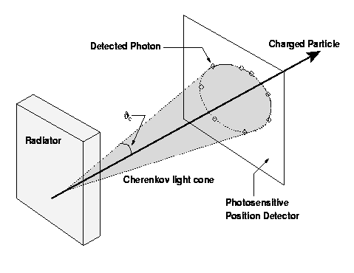
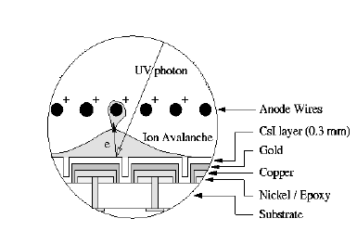
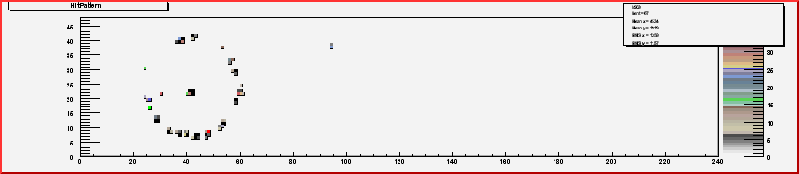

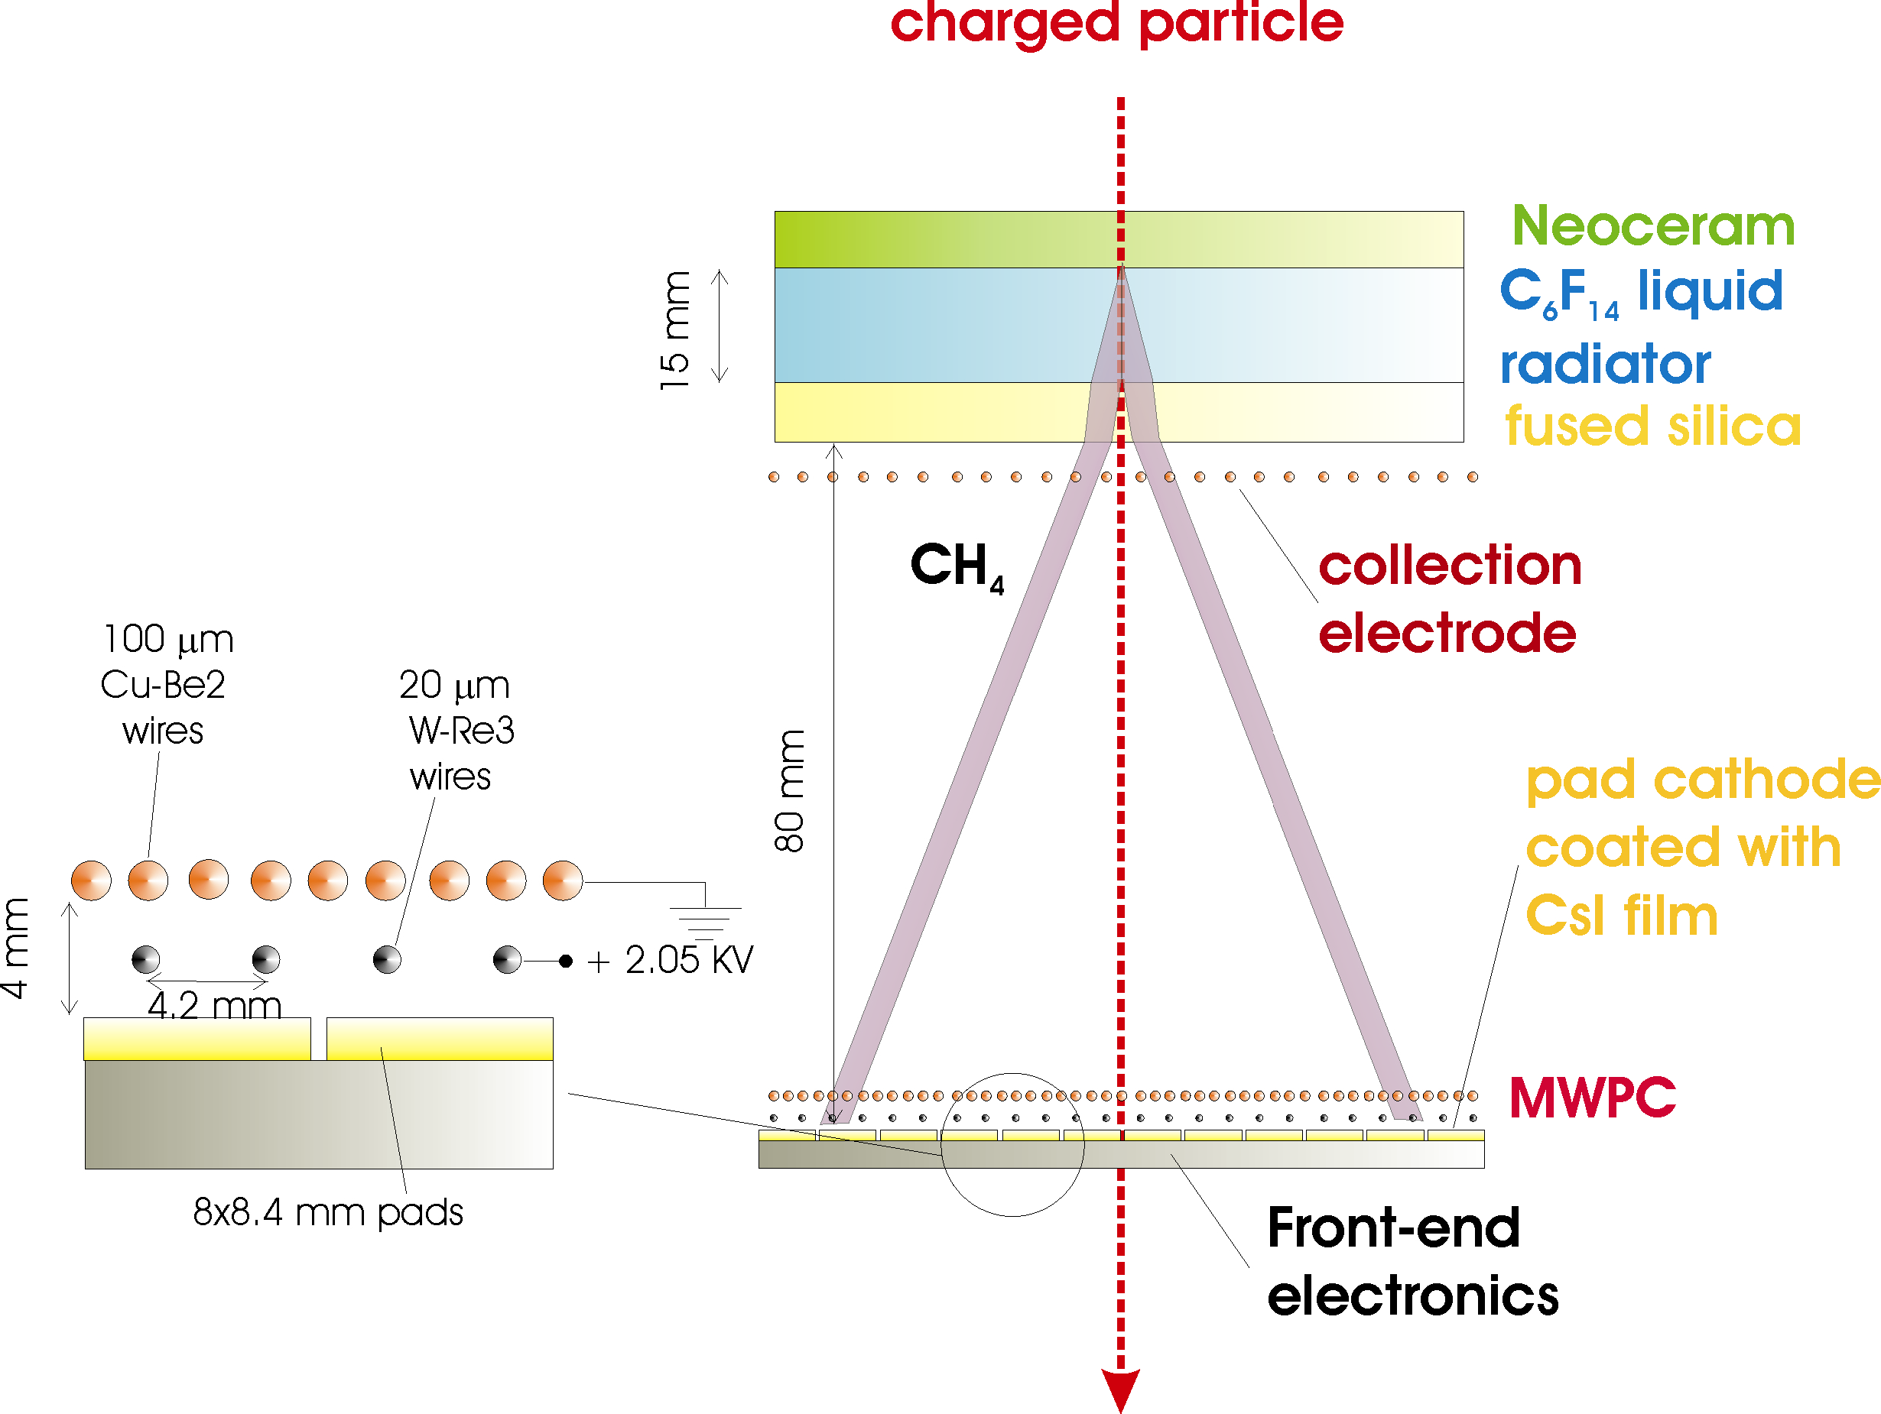
RICH detector –C₆F₁₄/CsI proximity focusing RICH
“MIP”
Cherenkov angle resolution
Separation Power
N. of detected photoelectrons
Performances
- N_{p.e.} # of detected photons(p.e.)
- and  (angular resolution)
maximize
minimize

Slide 31
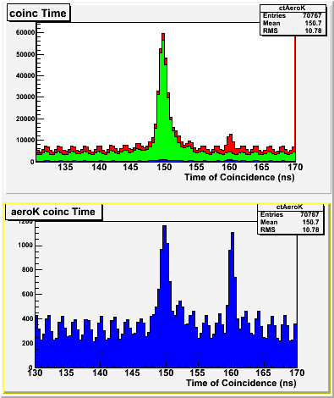
The PID Challenge
Very forward angle ---> high background of p and p
TOF and 2 aerogel in not sufficient for unambiguous K identification !
Hall A (long path of K in HRS → (pk = ~ 2 GeV/c)
Kaon Identification through Aerogels
p_{h} = 1.7 : 2.5 GeV/c
p
p
All events
k
k
p
p
AERO1
n=1.015
AERO2
n=1.055
k
Pions = A1•A2
Kaons = A1•A2
Protons = A1•A2

Slide 32
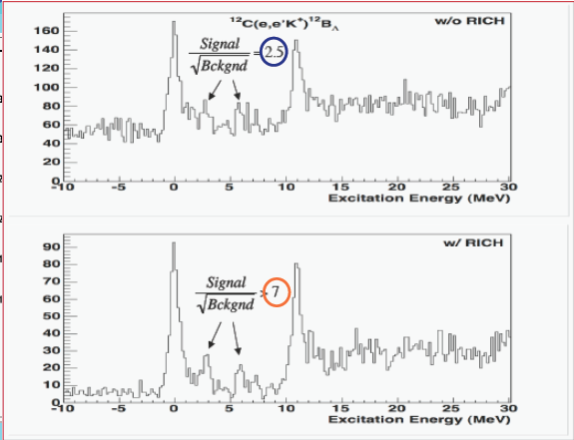
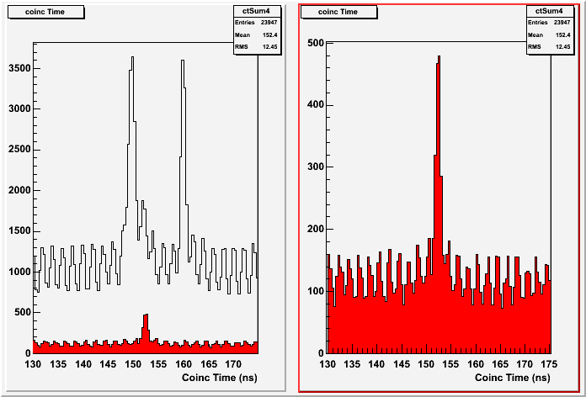
RICH – PID – Effect of ‘Kaon selection
Coincidence Time selecting kaons on Aerogels and on RICH
AERO K
AERO K && RICH K
p
P
K
Pion rejection factor ~ 1000

Slide 33
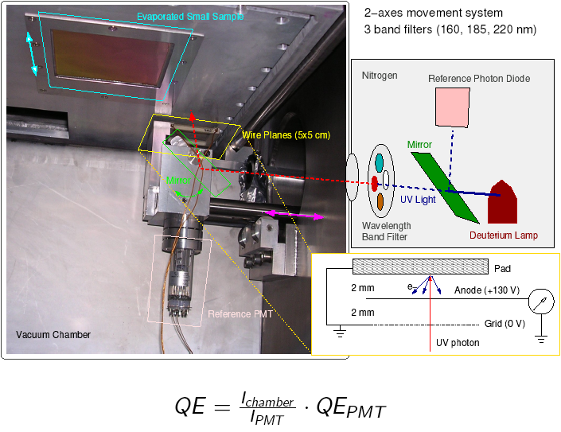
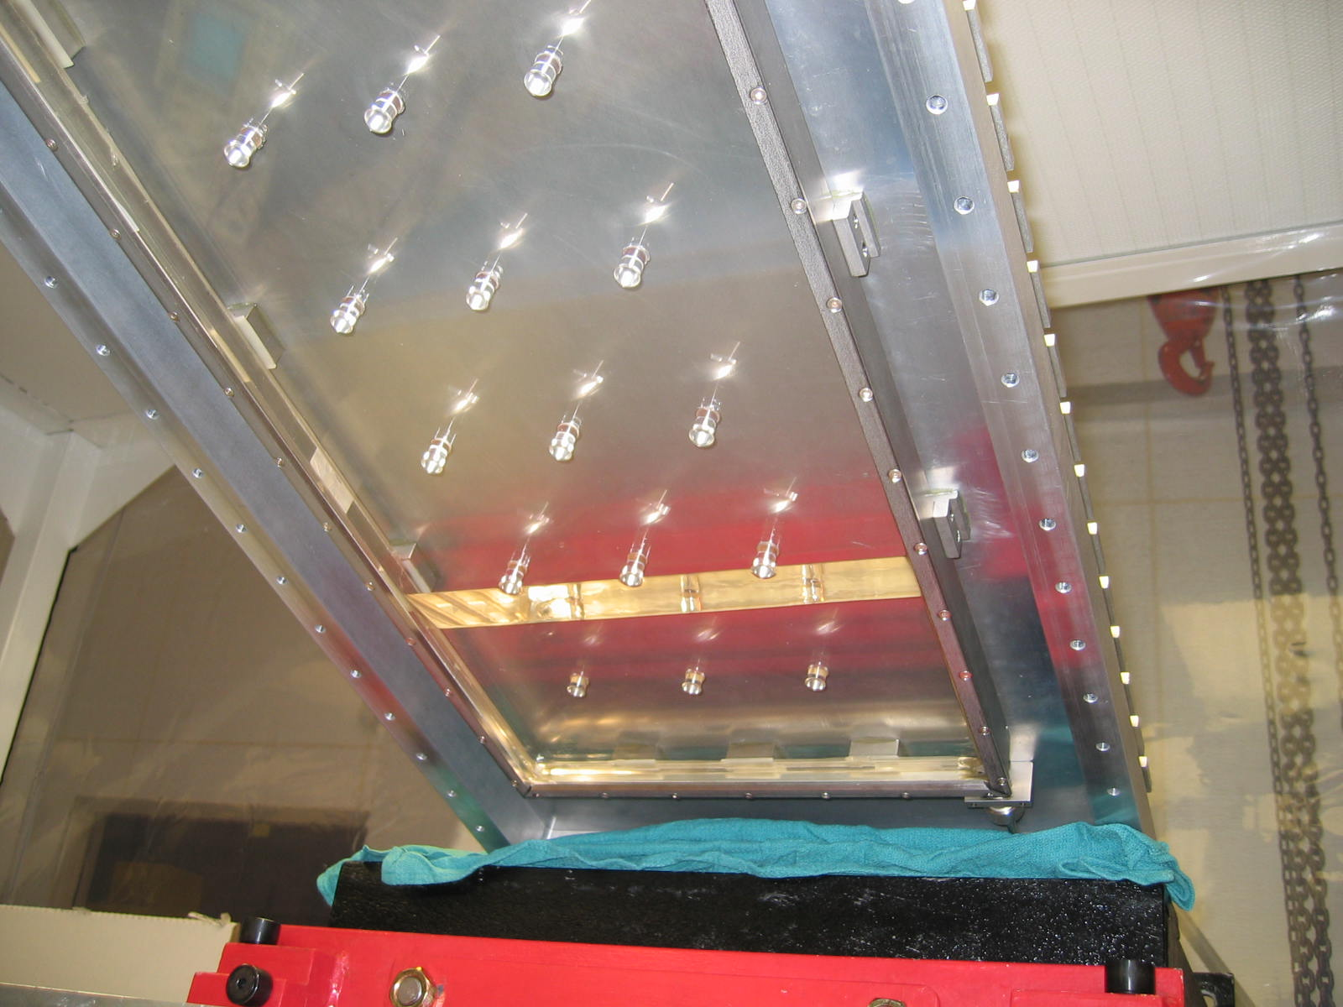
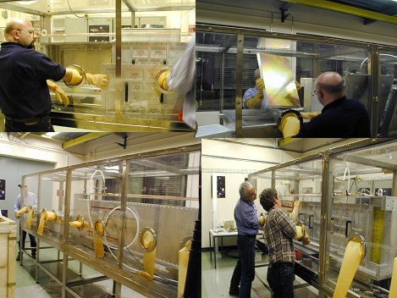
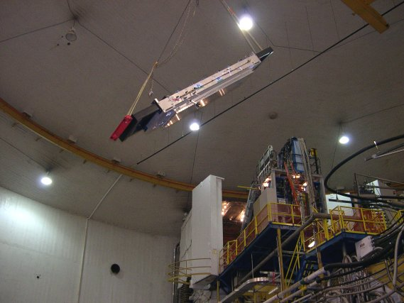
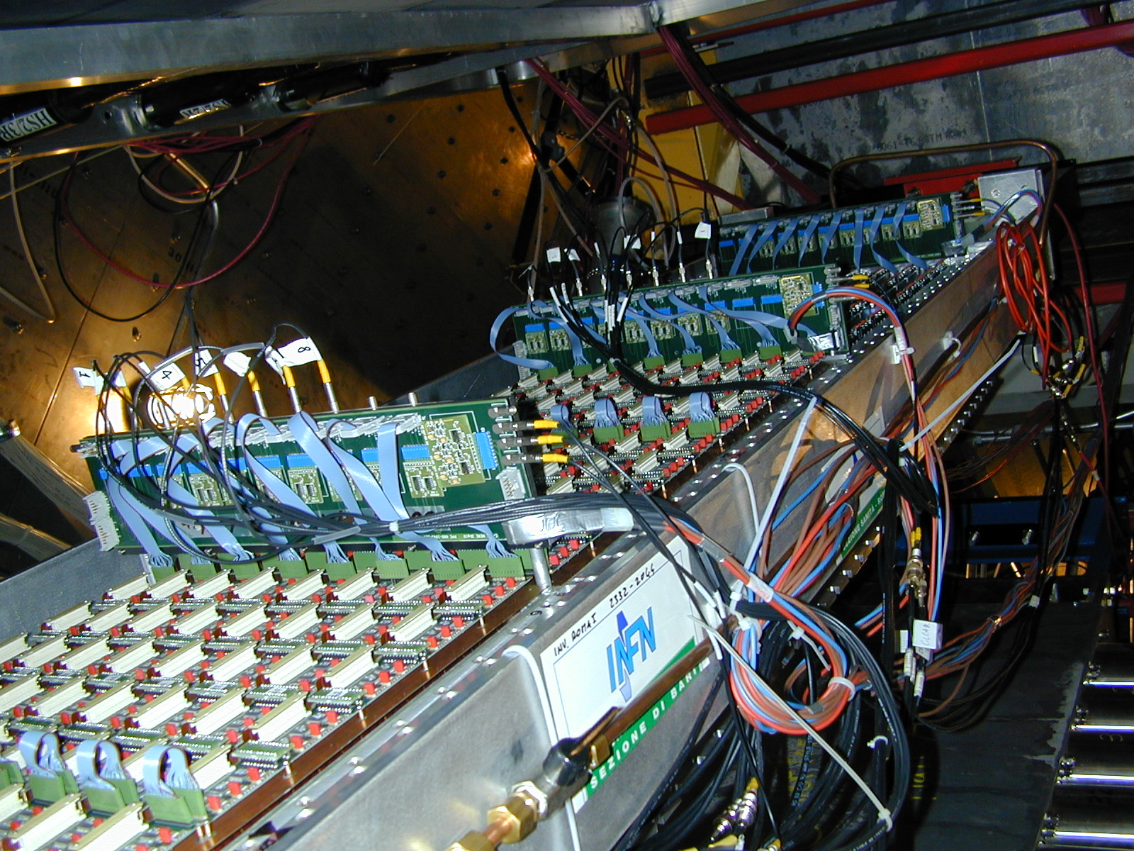
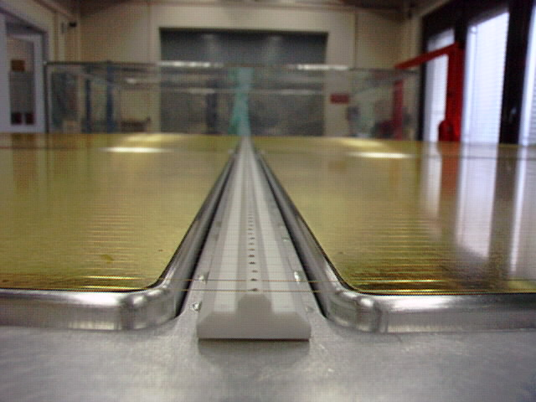
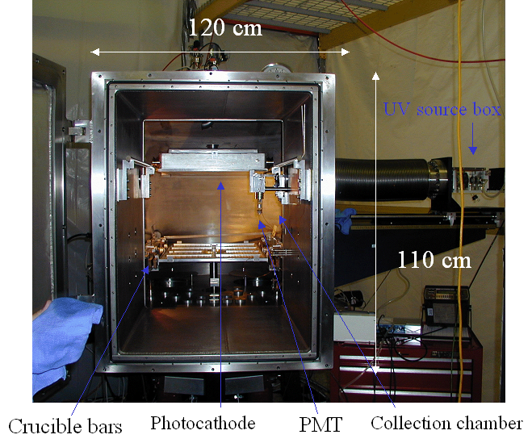
The RICH detector at Jefferson Lab
RICH flying to hunt kaons
into the detector hut

Slide 39
10⁹-10¹⁰

Slide 40
We will have to raster the beam...
Raster correction (from the experiment E06-007)

Slide 41
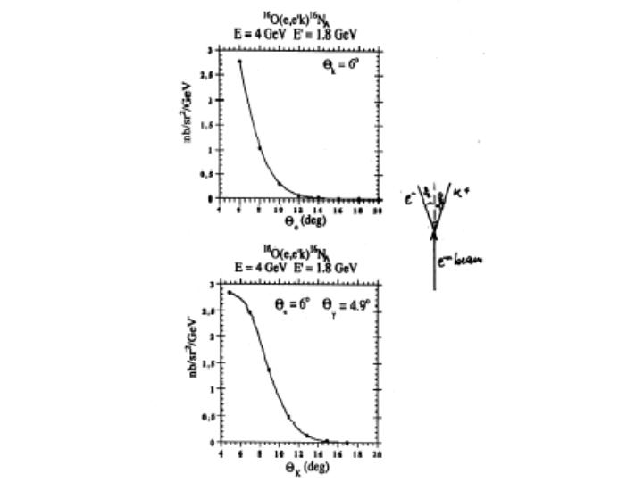
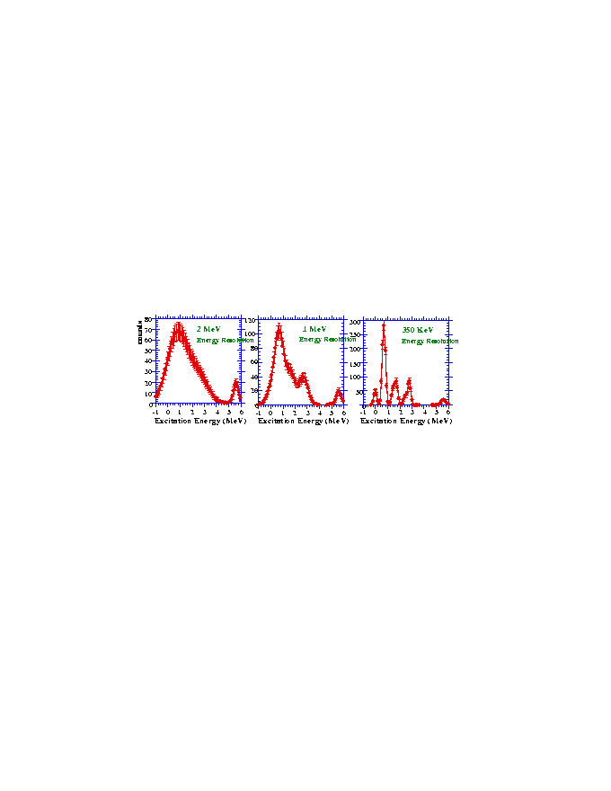
reasonable counting rates
forward angle
DE_{beam}/E : 2.5 x 10⁻⁵
2. DP/P : ~ 10⁻⁴
3. Straggling, energy loss…
septum magnets
~ 600 keV
good energy resolution
do not degrade HRS
minimize beam energy instability
“background free” spectrum
unambiguous K identification
High P_{k}/high E_{in} (Kaon survival)
RICH detector

Slide 43
Spectral function

Slide 45
N and Λ spectral function in nuclear matter

Slide 51
Courtesy of Diego Lonardoni

Slide 52
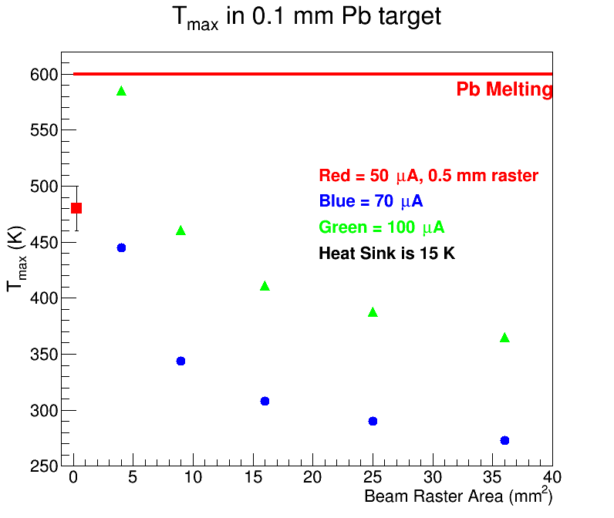
Summary plot of maximum temperature in the Pb target vs. electron beam raster area at two beam currents. The red point is for unrastered electron beam of intrinsic diameter 0.5 mm at 50 μA beam current. The target rotates at 0.5 Hz.

Slide 53
Scaling the maximum temperature difference at 70 μA beam current at a beam raster area of 4 mm² to a beam current of 25 μA we estimate a maximum temperature in the Pb target at 25 μA beam current for the target rotating at 0.5 Hz of 170 K. CFDFAC has developed a prototype rotating target which has been operated with a graphite foil in air.
Preliminary temperature measurements on the graphite foil being heated with a laser beam indicate that the average temperature in the foil decreases by between 50 K and 100 K depending on the rotation frequency with respect to a static target foil, see Figure Assuming that the Pb target foil is static than its temperature would increase from 170 K to at most 270 K. This shows that conservatively the Pb target will stay below room temperature with a 25 µA electron beam rastered on a square of side 2 mm on the target when cooled with 15 K coolant even if the target were static. Rotating the target would decrease its temperatrure by between 50-100 K.

