Slide 1
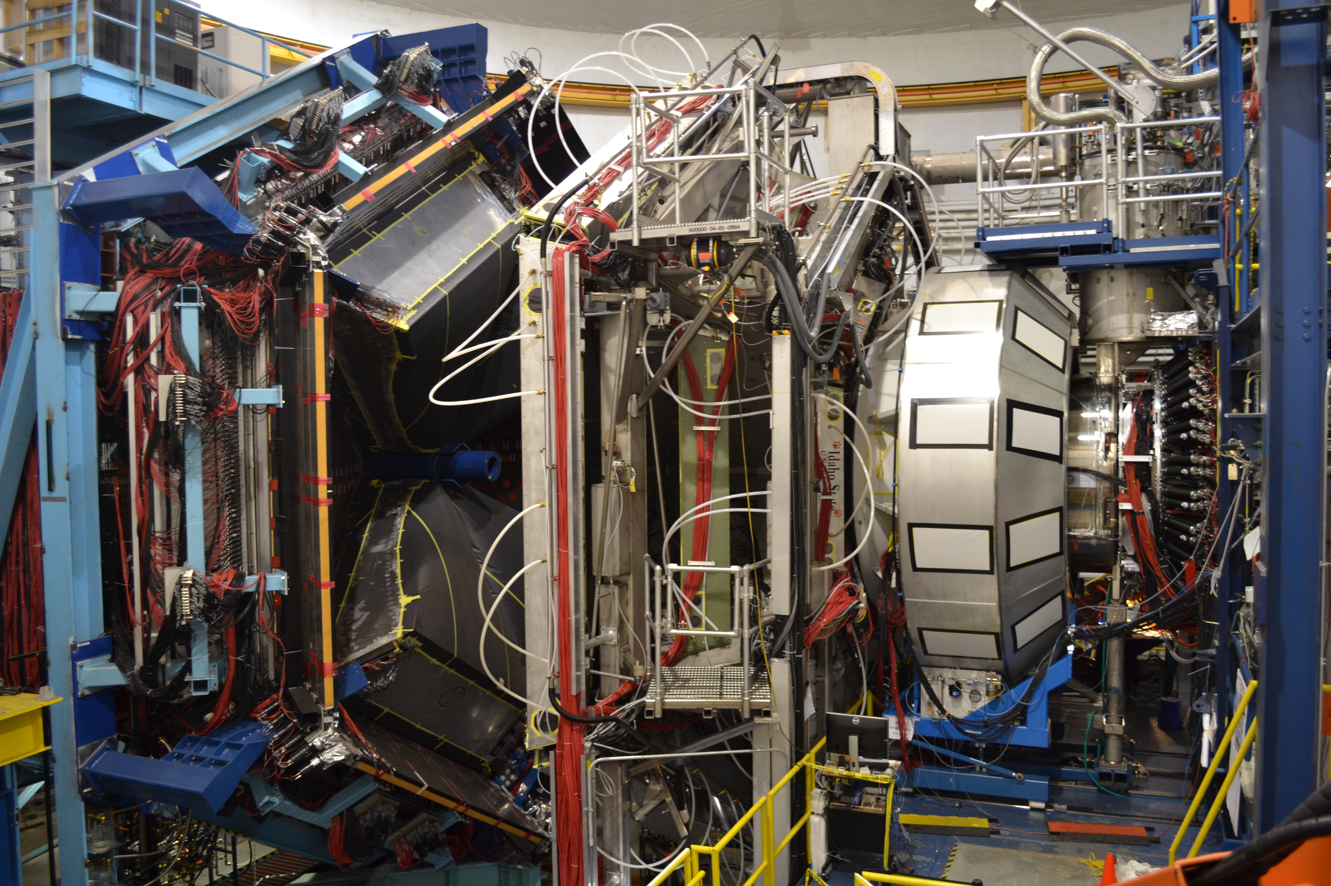

Hall B Run Group Addition
Volker D. Burkert
Jefferson Lab
CLAS12
JLab PAC46 Meeting 07/18/2018

Slide 2
PAC46 – Hall B proposals/LOI
Proposals Contact Days
New RG Proposal RG-M
C12-17-006 Electrons for Neutrinos Hen 25.5
PR12-18-003 Exclusive Studies of SRC in Nuclei using CLAS12 Hen 35
Total Beam Time requested when run as RG Hen 46.5
RG-B Addition
P12-12-003B J/Psi Photoproduction off the Deuteron Ilieva (80)
Total RG-B beam time remains unchanged Niccolai 90
LOI12–18-004 Physics with Positron Beams at JLab 12 GeV Grames
(Hall A, B, C) Hall B: DVCS & 2γ-physics in e⁺p/e⁻p elastic Voutier N/A
New beam time requested for Hall B Proposals: 46.5

Slide 3
Run Groups A & B
Proposal | Physics | Contact | Rating | Days | Group | Equipment | Energy | Run Group | Target
E12-06-108 | Hard exclusive electro-production of π⁰, η | Stoler | B | 80 | 139 | RICH (1 sector) Forward tagger | 11 | A L. Elouadrhiri F. Sabatié | liquid H₂
E12-06-108A | Exclusive N*->KY Studies with CLAS12 | Carman |  | (60)
E12-06-108B | Transition Form Factor of the η’ Meson with CLAS12 | Kunkel |  | (80)
E12-06-112 | Proton’s quark dynamics in SIDIS pion production | Avakian | A | 60
E12-06-112A | SIDIS Λ productiuon in target fragmentation region | Mirazita |  | (60)
E12-06-112B | Colinear nucleon structure at twist-3 | Pisano |  | (60)
E12-06-119(a) | Deeply Virtual Compton Scattering | Sabatie | A | 80
E12-09-003 | Excitation of nucleon resonances at high Q² | Gothe | B+ | 40
E12-11-005 | Hadron spectroscopy with forward tagger | Battaglieri | A- | 119
E12-11-005A | Photoproduction of the very strangest baryon | Guo |  | (120)
E12-12-001 | Timelike Compton Scatt. & J/ψ production in e+e | Nadel-Turonski | A- | 120
E12-12-001A | J/ψ Photoproduction & study of LHCb pentaquarks | Stepanyan |  | (120)
E12-12-007 | Exclusive φ meson electroproduction with CLAS12 | Girod | B+ | 60
E12-07-104 | Neutron magnetic form factor | Gilfoyle | A- | 30 | 90 | Neutron detector RICH (1 sector) Forward tagger | 11 | B S. Niccolai | liquid D₂ target
E12-09-007(a) | Study of partonic distributions in SIDIS kaon production | Hafidi | A- | 30
E12-09-008 | Boer-Mulders asymmetry in K SIDIS w/ H and D targets | Contalbrigo | A- | 56
E12-09-008A | Hadron production in target fragmentation region | Mirazita |  | (60)
E12-09-008B | Colinear nucleon structure at twist-3 | Pisano |  | (60)
E12-11-003 | DVCS on neutron target | Niccolai | A | 90
E12-11-003A | In medium structure functions, SRC, and the EMC effect | Hen |  | (90)
E12-11-003B | J/Psi Photoproduction off the Deuteron | Ilieva |  | (80)
Beam time partial sum |  |  |  | 765 (1555) | 229

Slide 4
Study of J/ψ Photoproduction off Deuteron
PR12-11-003B
M.D. Baker, A. Freese, L. Guo, Ch. Hyde, Y. Ilieva, B. McKinnon, P. Nadel-Turonski, M. Sargsian, V. Kubarovsky, S. Stepanyan, N. Zachariou, Zh.W. Zhao

Slide 5
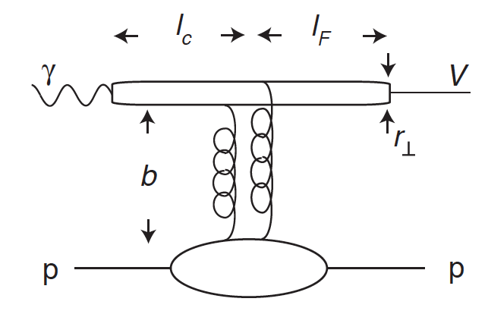

Near Threshold J/ψ Production off Deuteron
Why J/ψ?
Small transverse size: r⊥∼1/mc=0.13 fm
Ethr=8.2 GeV, lc≃2Eγ^{lab}/4mc²=0.36 fm
At threshold, large |tmin|=2.2 (GeV/c)²
At threshold, small b∼1/|t|^{1/2} =0.2 fm
The couples to the gluon field in the target. Process dominated by multi-gluon exchange. Concept of gluonic Van der Waals potential in QCD.
J/ψ production probes the short-range, gluon structure of the target.
S.J. Brodsky, E. Chudakov, P. Hoyer, J.M. Laget, Phys. Lett. B 498, 23 (2001).

Slide 6
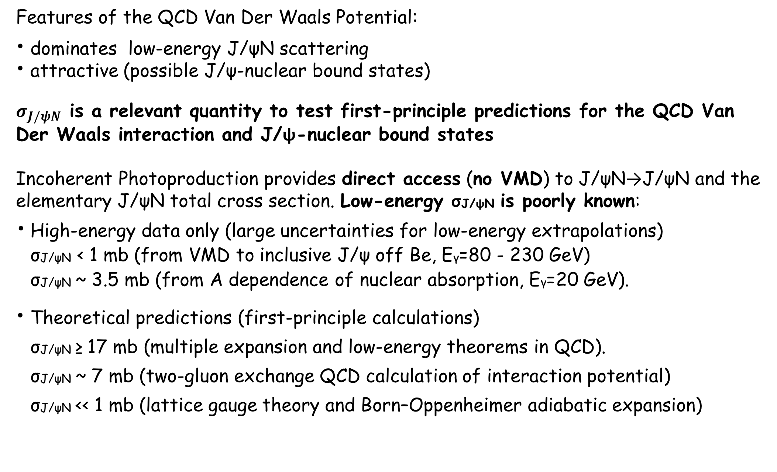
Near-Threshold J/ψ Production off Deuteron
Incoherent Photoproduction: J/ψN FSI

Slide 7
Near-Threshold J/ψ Production off Deuteron
Quasi-Free Photoproduction off the Neutron

Slide 8
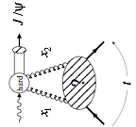
Near-Threshold J/ψ Production off Deuteron
Coherent Photoproduction
The t-dependence of the cross section can provide access to the deuteron gluonic structure (gluon form factor)
Ethr=5.66 GeV →|tmin|=3.31 (GeV/c)²
E=11 GeV →|tmin|=0.26 (GeV/c)²
Large skewness
Hard scale set by the distance r⊥∼1/mc=0.13 fm. Probe is hard for all Q².
GPD Based Description, |t| ≤ 1–2 GeV²
Unique opportunity for first glimpse at nuclear gluon distributions prior to EIC.
Universal Fgg expected, independent of μ²; m²2g~1 GeV²
L. Frankfurt and M. Strikman, Phys. Rev. D 66, 031502(R) (2002).

Slide 9
Near-Threshold J/ψ Production off Deuteron with CLAS12
The Experimental Configuration is Compatible with Run Group B
Unpolarized LD2 target and 11-GeV electron beam, L=10³⁵ s⁻¹cm⁻².
Standard CLAS electron trigger and a Muon trigger (new, established during RGA).
Charged-hadron detection in the Forward and Central Detectors.
Neutron detection in the Forward Detector.
Forward Tagger On (not needed in trigger).
Full torus field, electrons in-bending.
Expected Yields
Quasi-free production off neutron: ~30 J/ψ per day (including both, e+e- and μ+μ- decays).
Pentaquark total yields: 31 - 975 (Pc (4380)), 45 - 1430 (Pc (4450))
Incoherent production: < 3 J/ψ per day (including both, e+e- and μ+μ- decays).
Coherent production: ~ 0.3 – 1 J/ψ per day (including both, e+e- and μ+μ- decays).

Slide 10
Near-Threshold J/ψ Deuteron Photoproduction with CLAS12
Experimental Method
  Exclusive Incoherent Quasi-Real Photoproduction
  Detected: both scattered nucleons, J/𝜓 decay products
  Undetected: scattered electron
  Reaction identified by reconstructing the beam photon from final state particles
  Exclusive Quasi-Free Quasi-Real Photoproduction off Neutron (Proton)
  Detected: strike neutron (proton), J/𝜓 decay products
  Undetected: scattered electron, spectator proton (neutron)
  Reaction identified by reconstructing missing scattered electron assuming target nucleon was at rest.
  Exclusive Coherent Quasi-Real Photoproduction
  Detected: scattered deuteron, J/psi decay products
  Undetected: scattered electron
  Reaction identified by reconstructing the beam photon from final state particles

Slide 11

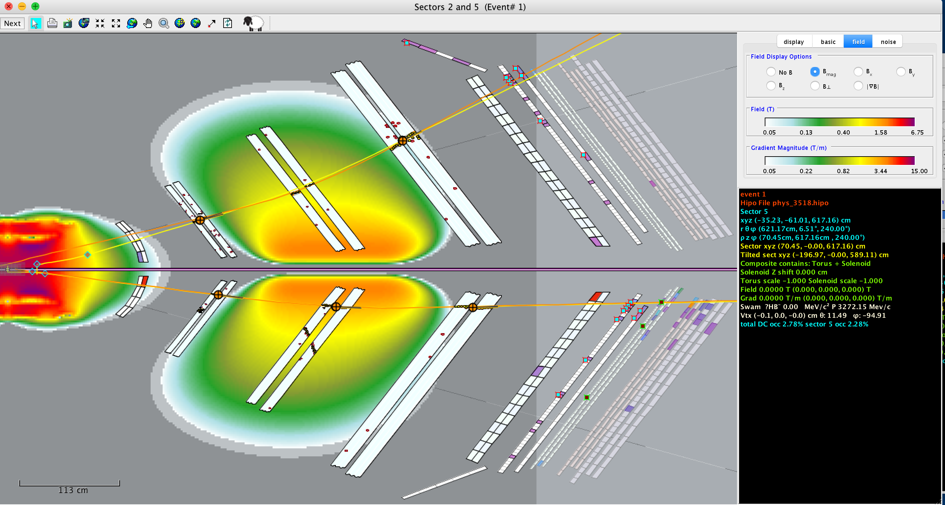
Q.F. event illustration
CLAS12
positron
neutron
electron
proton

Slide 12
Run Group Review Procedure
Experiment will use already approved beam time
Run conditions are identical to the already approved experiment (beam & target conditions, magnetic fields, detector settings, etc.)
Chair of PWG assigns review committee
Committee reviews the proposal, communicates with proponents and with contact person of possibly affected approved experiment
If committee is satisfied it issues report to the working group chair
Working group chair informs CLAS chair about result of the review
Internal CLAS review aims to address the subject with same rigor as a PAC review would, both in terms of science and feasibility

Slide 13
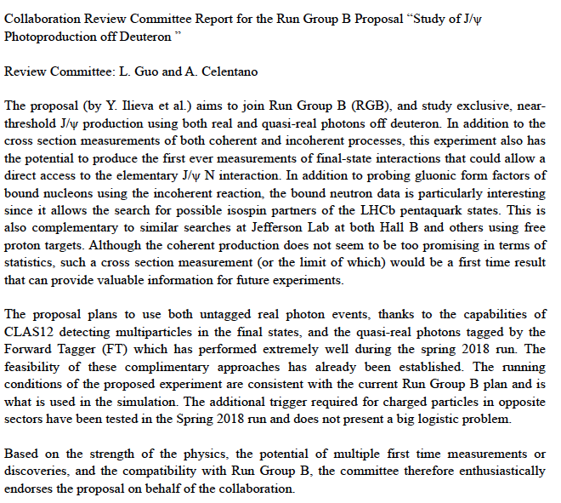
Report from Review Committee

Slide 15
Hall B Run schedule
Schedule | Run Group | Energy (GeV) | Polarization | PAC Days | PAC days used | Remaining PAC days
2/05 -5/06/18 | RG-A | 2.2 - 10.6 | 0.85 | 21.7
10/22 – 11/15/18 | RG-A | 10.6 | 0.85 | 42 | 63.7 | 75.3
11/19 – 12/19/18 | RG-K | 7.5/6.5 | 0.85 | 14 | 14 | 86
2019
01/30 – 03/10/19 | RG-B | 10.6 | 0.85 | 20
06/10 – 08/04/19 | HPS | 4.55 | - | 28 | 43 | 137
10/01 – 11/24/19 | RG-B | 10.6 | 0.85 | 27 | 47 | 43
11/24 – 12/20/19 | Installation

