Slide 1
SIDIS/TMD Program Using BigBite/Super-BigBite in Hall A
Andrew Puckett
University of Connecticut
Hall A/C Summer Workshop
June 21, 2018

Slide 2
Outline
Physics Motivation:
  Semi-Inclusive DIS (SIDIS) and TMDs
JLab Detector Landscape in the 12 GeV era
SIDIS program using BigBite and Super BigBite spectrometers (current and future):
  Transverse Target SSAs and Nucleon 3D spin structure
  Experiment E12-09-018: SIDIS on transversely polarized ³He: Collins + Sivers effects
  Longitudinal Target DSAs and nucleon spin-flavor decomposition
  Experiment E12-06-122 update (Jeopardy proposal, 2019, in preparation): A1n and longitudinally polarized SIDIS using BB+SBS
Summary, Conclusions, Outlook

Slide 3
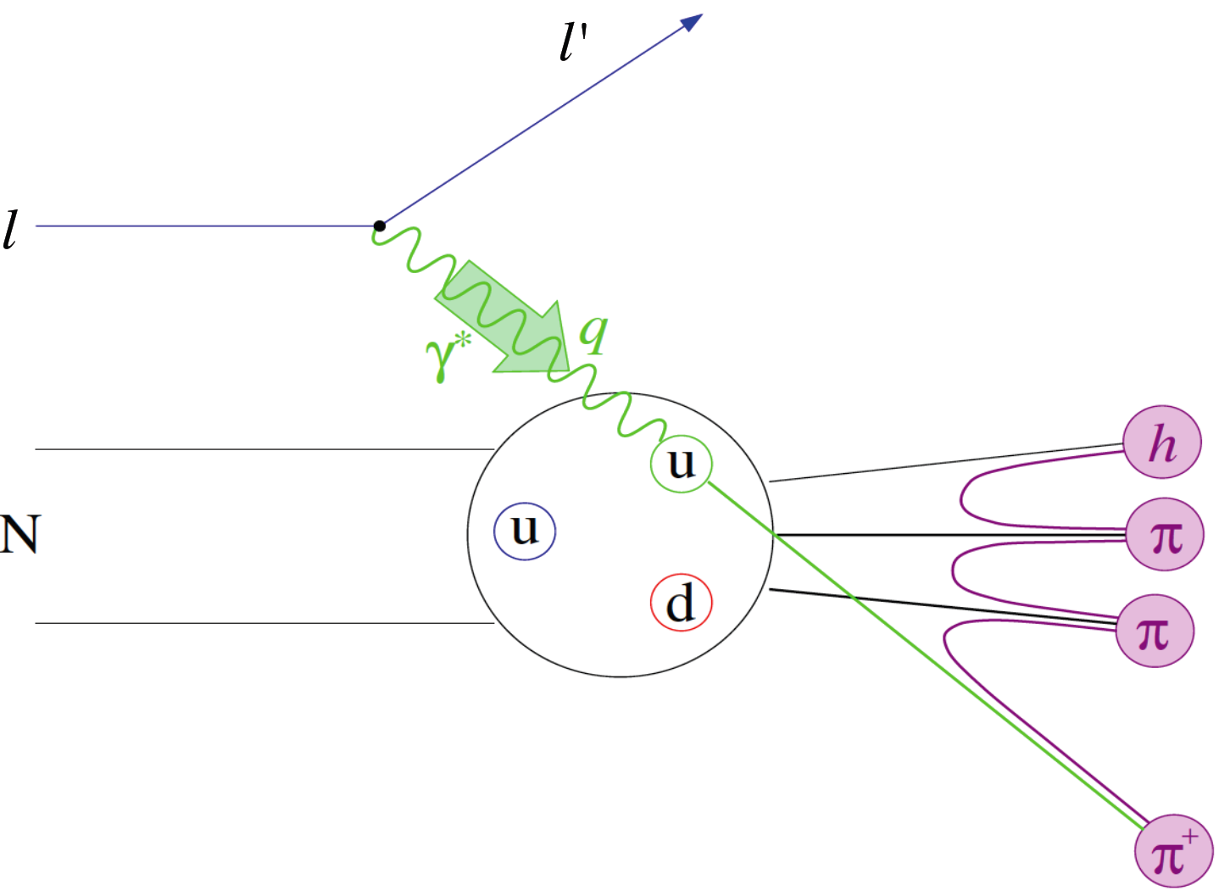
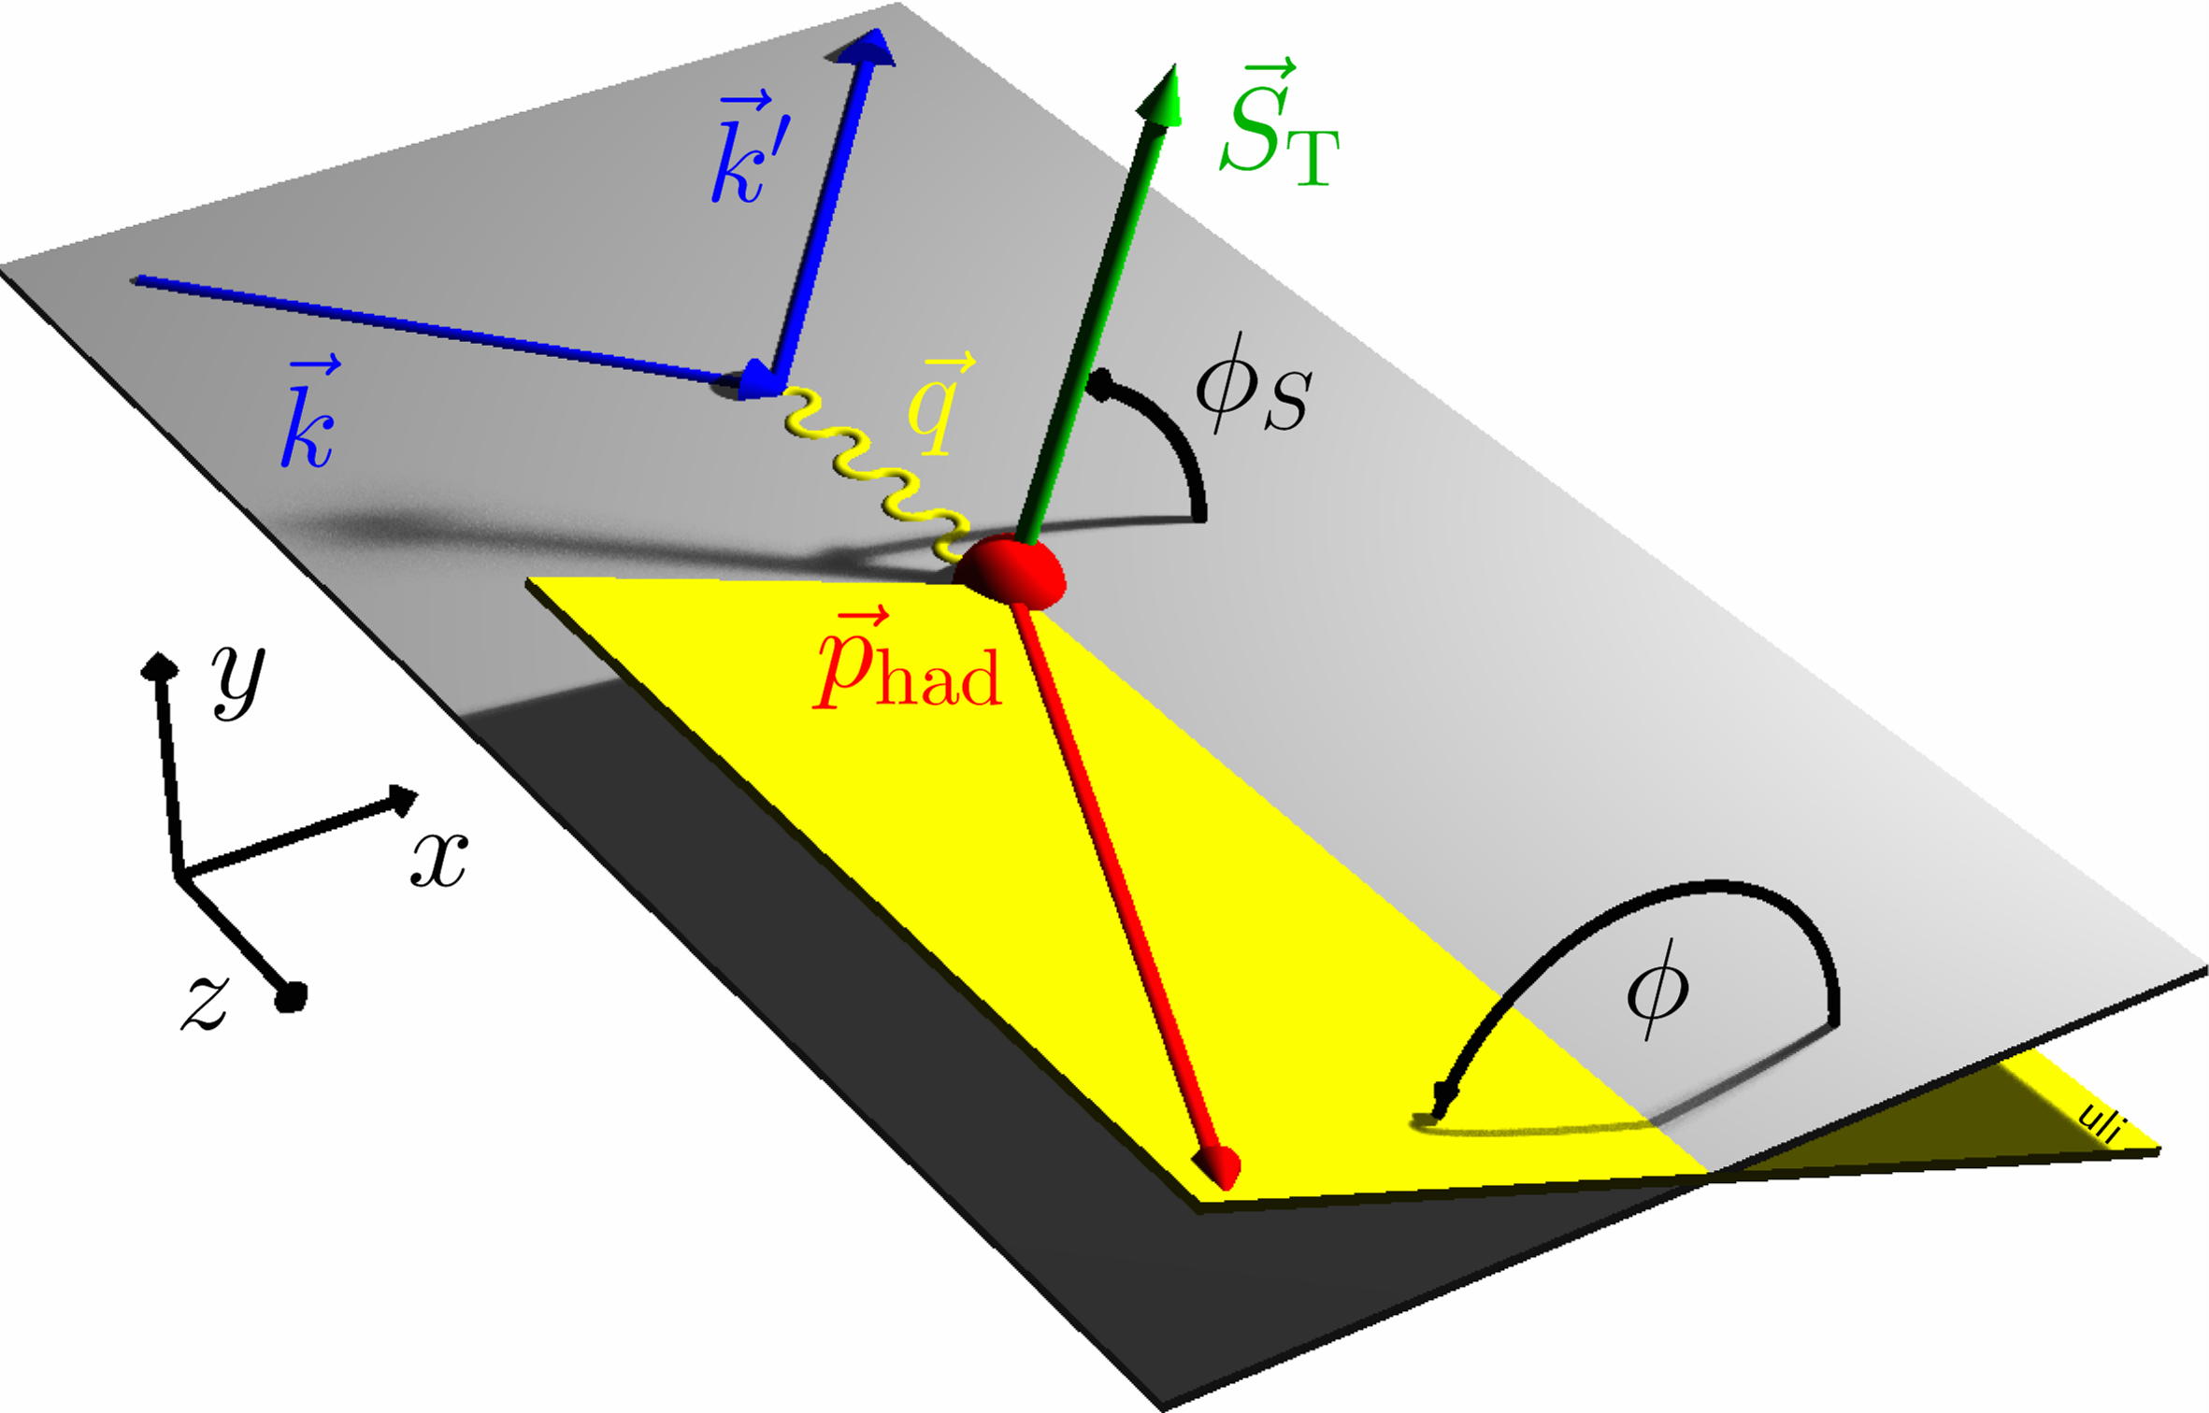
Semi-Inclusive Deep Inelastic Scattering
Detecting leading (high-energy) hadrons in DIS, N(e,e’h)X provides sensitivity to additional aspects of the nucleon’s partonic structure not accessible in inclusive DIS:
  quark flavor
  quark transverse motion
  quark transverse spin
Goal of SIDIS studies is (spin-correlated) 3D imaging of nucleon’s quark structure in momentum space.
Transverse Momentum Dependent (TMD) PDF formalism: Bacchetta et al. JHEP 02 (2007) 093, Boer and Mulders, PRD 57, 5780 (1998), etc, etc...

Slide 4
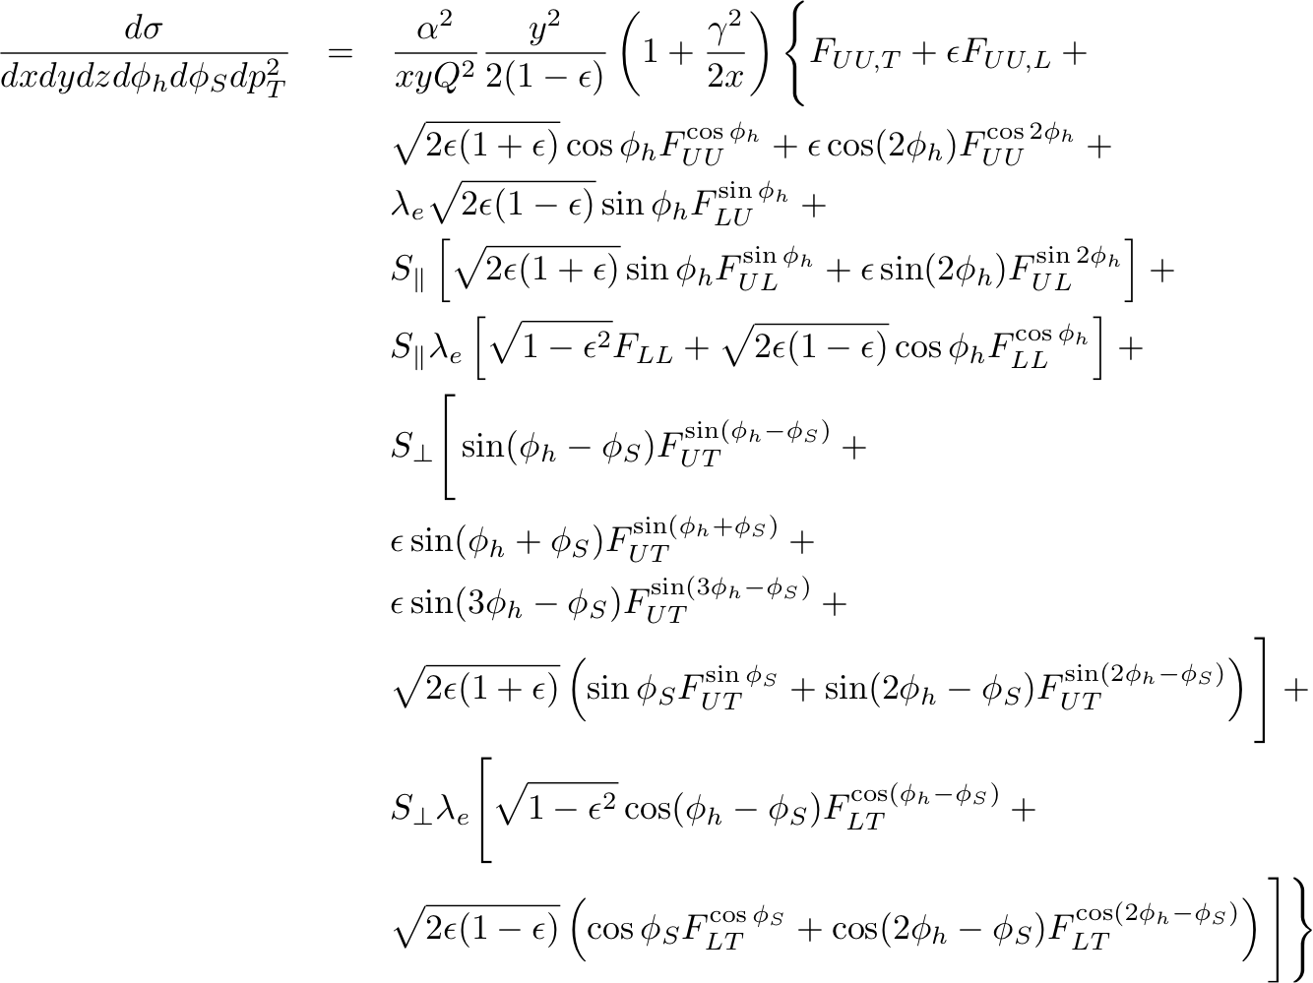
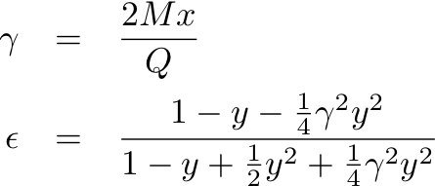
General Expression for SIDIS Cross Section: Bacchetta et al. JHEP 02, 093 (2007)
SIDIS structure functions F depend on x, Q², z, p_{T}
U, L, T subscripts indicate unpolarized, longitudinally and transversely polarized beam, target, respectively
S = nucleon spin
λ = lepton helicity
Eight terms survive at leading twist; the rest are M/Q suppressed
Sivers
Collins
“Pretzelosity”

Slide 5




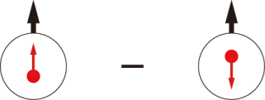
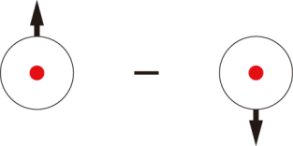
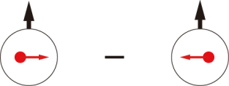
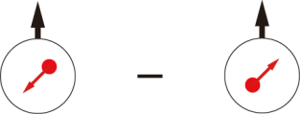
Quark-parton Model Interpretation of SIDIS: Transverse Momentum Dependent PDFs (TMDs)
 |  | Quark polarization
 |  | Unpolarized (U) | Longitudinally Polarized (L) | Transversely Polarized (T)
Nucleon Polarization | U
 | L
 | T

Slide 6

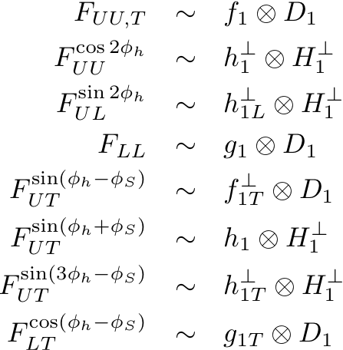
SIDIS Structure Functions in Terms of TMDs
Only f₁, g₁, h₁ survive integration over quark k_{T}
All eight leading-twist TMDs are accessible in SIDIS with polarized beams/targets via azimuthal angular dependence of the SIDIS cross section
Physical observables are convolutions over two (unobserved) transverse momenta:
  Initial quark k_{T}
  Hadron p_{T} relative to recoiling quark, generated during fragmentation

Slide 7
Figure credit: B. Wojtsekhowski (JLab)
LH₂/LD₂
SoLID-SIDIS (6-22 deg)
Polarized ³He
Polarized NH₃/ND₃
Complementary equipment in Halls A, B, C allows optimizing Luminosity x Acceptance of detectors to luminosity capabilities of state-of-the-art polarized target technology.

Slide 8
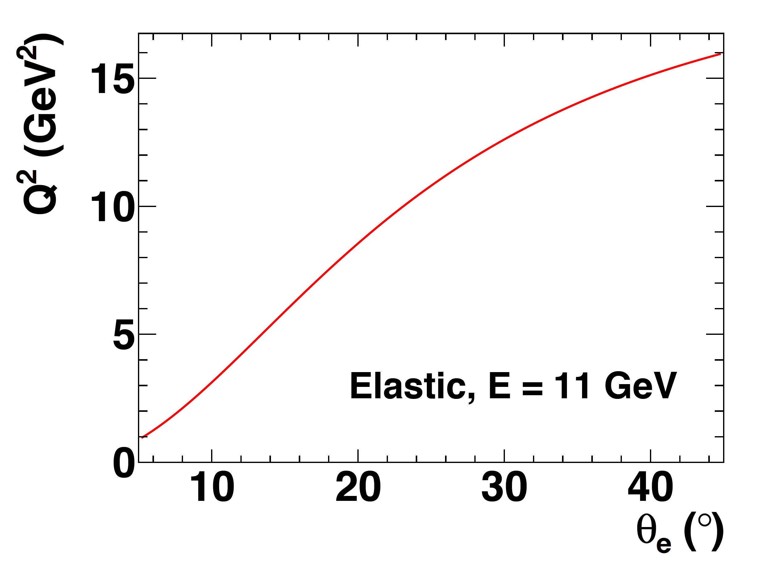
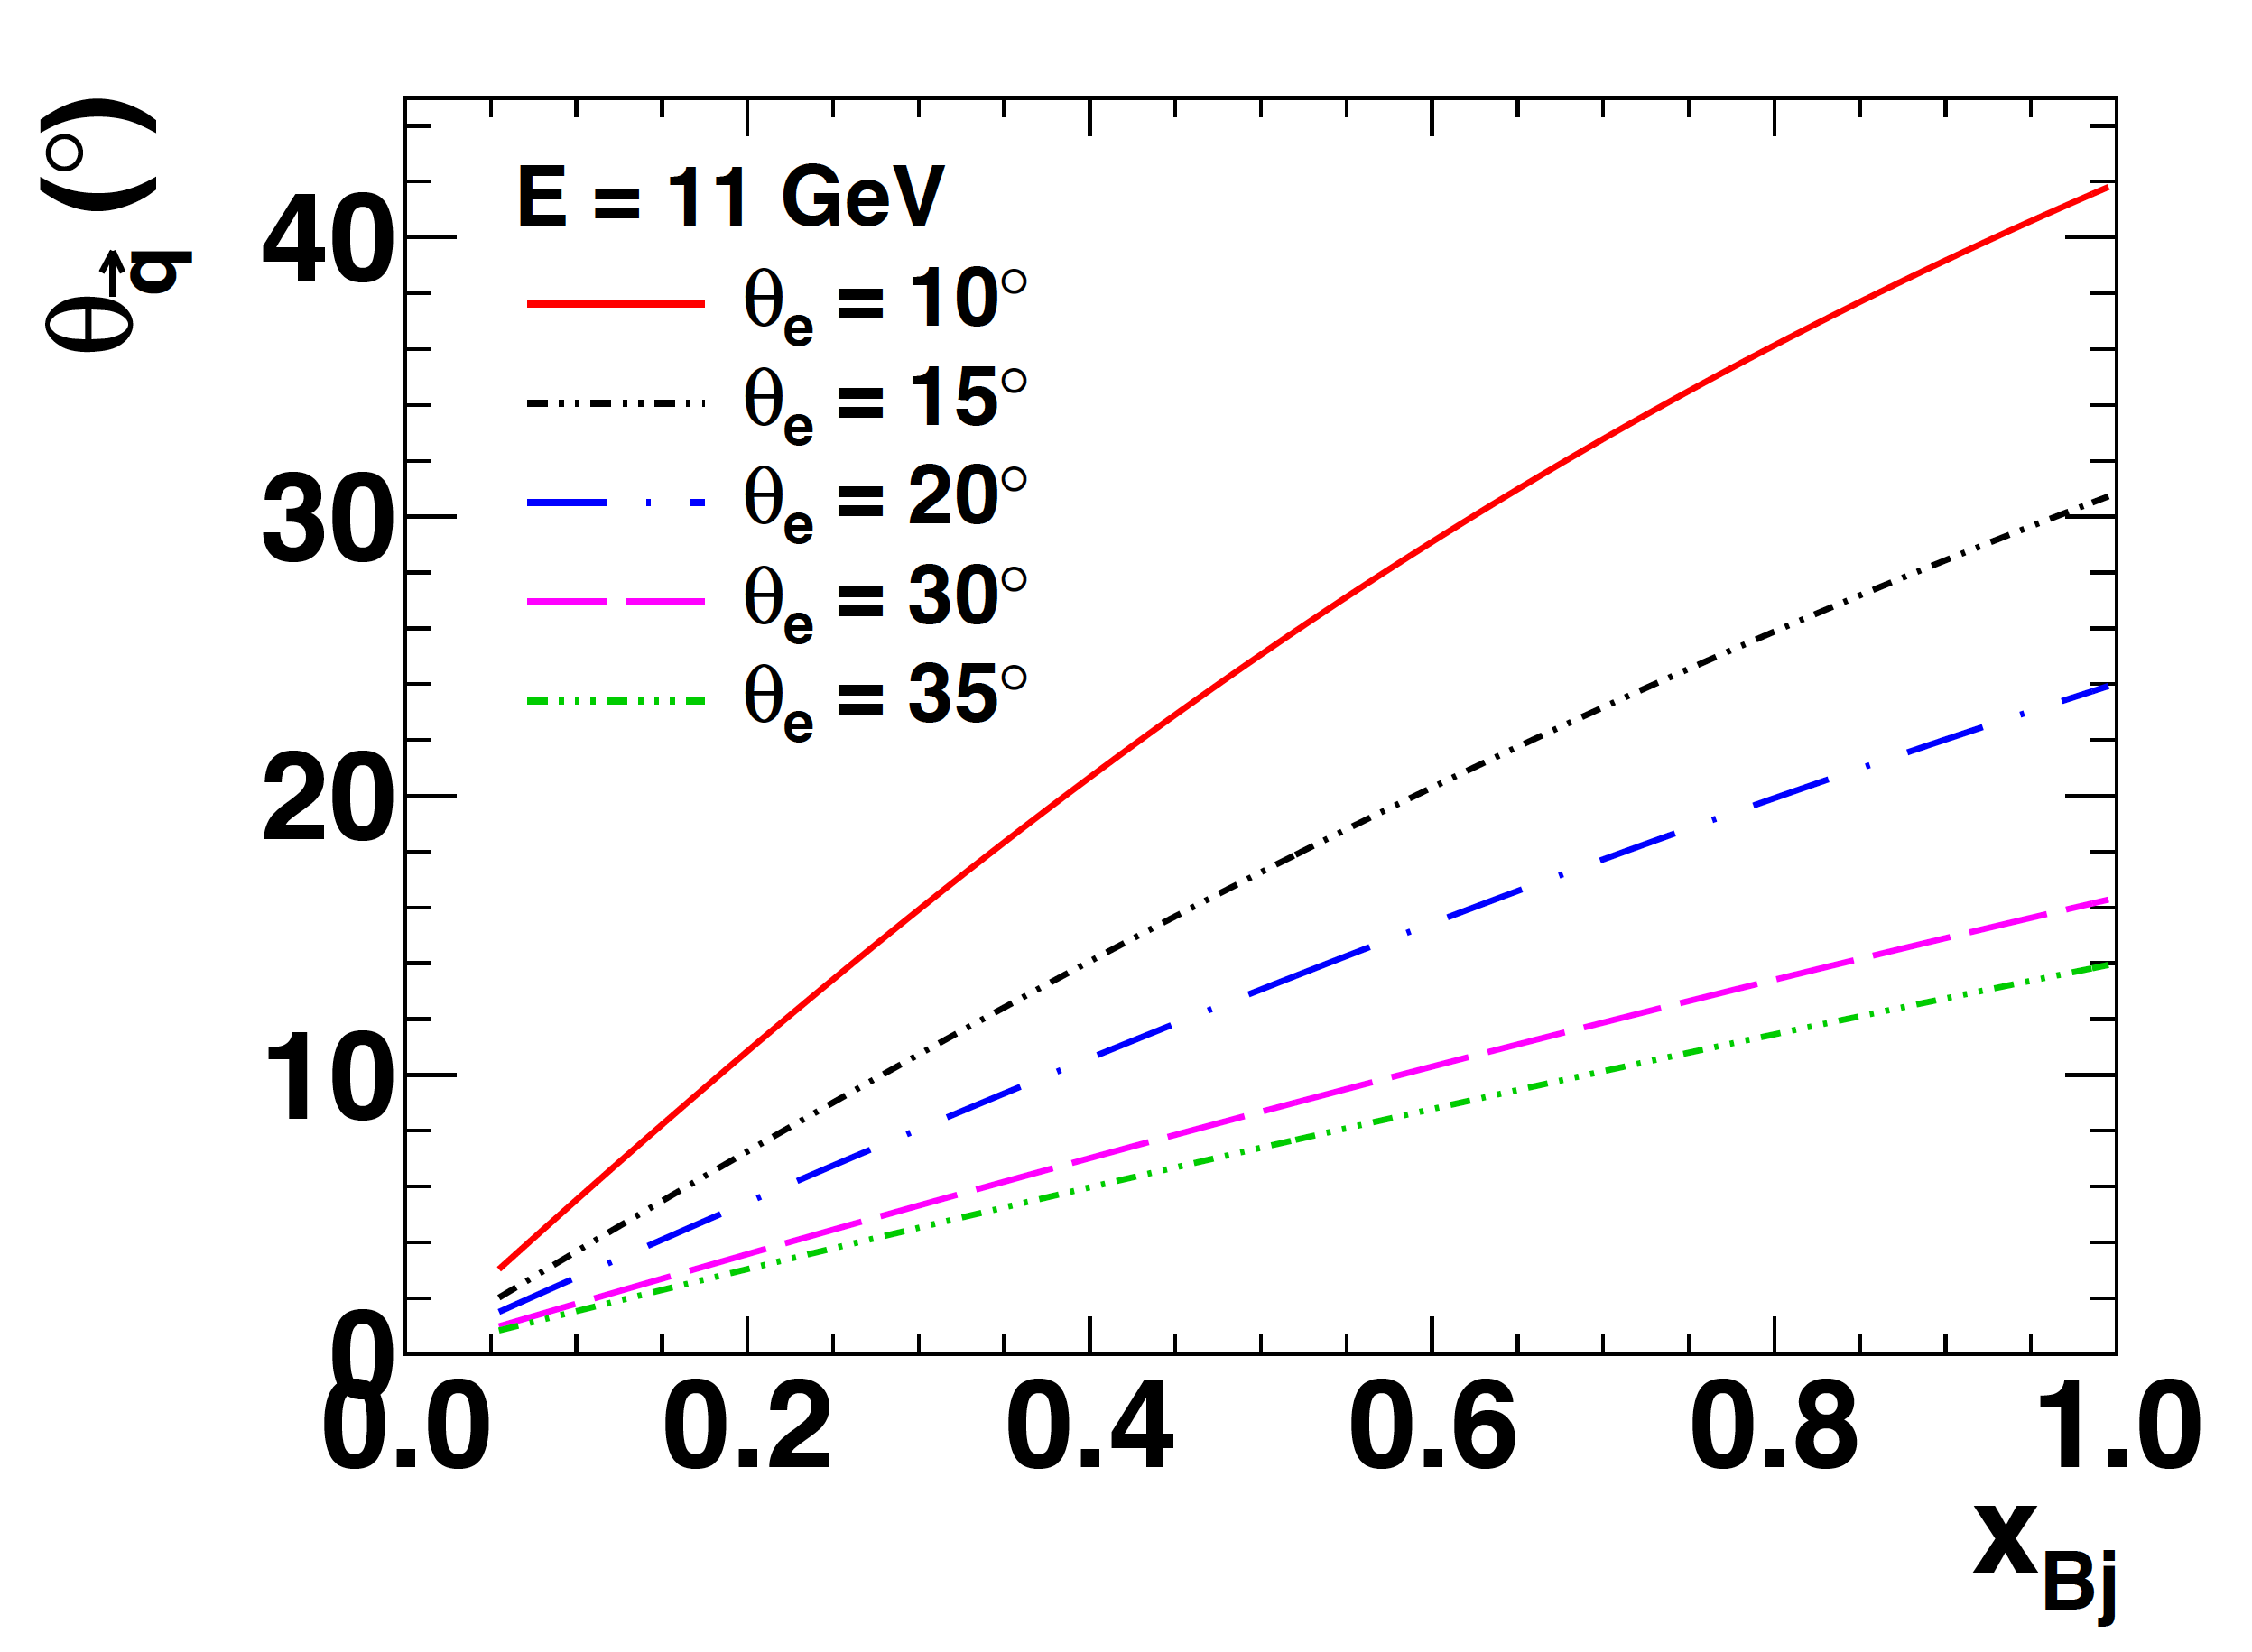
Electron Scattering Kinematics @11 GeV
Measurements of elastic FFs, SIDIS, DVCS, etc involve coincidence N(e,e’X) (electroproduction) reactions, where X =
  N’ (elastic or quasi-elastic)
  h (SIDIS or DVMP)
  γ (DVCS)
Virtual photon angle decreases as “inelasticity” increases:
Particles associated with the partonic (or other) degree of freedom that absorbed the virtual photon are found predominantly near the direction of the momentum transfer q
Partonic interpretation of electron scattering data is accessible at large Q²→ hadrons of interest (fragmentation products of struck quark) are located at forward angles and high momentum

Slide 9
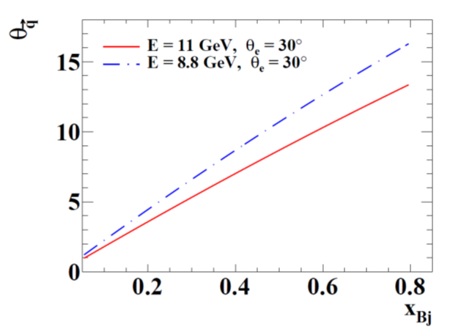
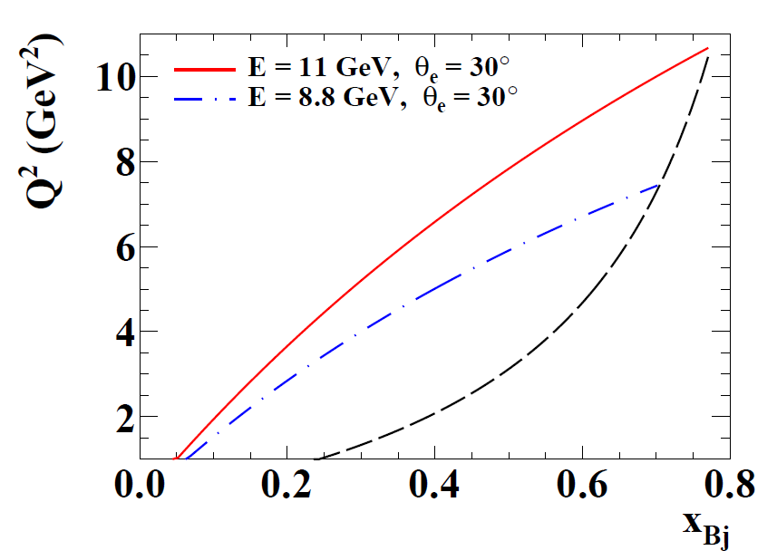
JLab 11/8.8 GeV SIDIS Kinematics
W > 2 GeV
Optimal orientation of hadron arm is along virtual photon direction—q-direction varies ~linearly with x for fixed electron scattering angle
Need forward-angle hadron detection capability!
To reach high x in the DIS regime, need large scattering angles/high-Q²:
  Small xsec → High Luminosity!
  Large detector background rate/occupancy

Slide 10
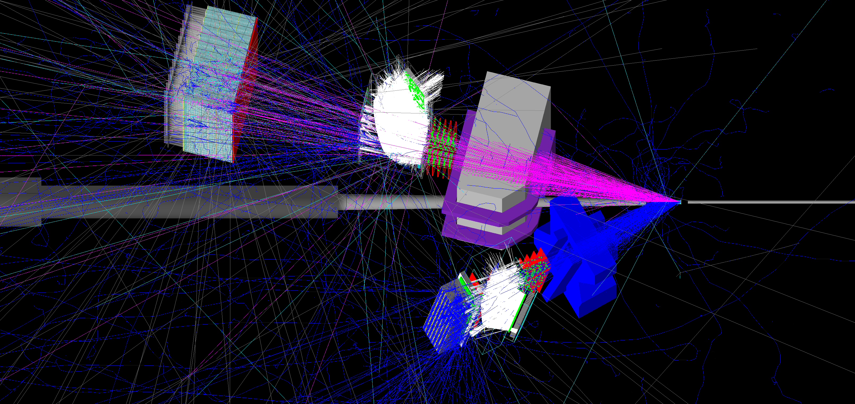
E12-09-018—Transversely Polarized SIDIS
Hadron Arm: Super BigBite Spectrometer @14 deg.
High-luminosity Polarized ³He Target (1.2 × 10³⁷ cm⁻² s⁻¹)
JLab E12-09-018 in Hall A: Approved for 64 beam-days, A⁻ rating by PAC38 (2011)
Electron Arm: BigBite Spectrometer @30 deg.
E12-09-018 in Hall A: transverse spin physics with high-luminosity polarized ³He.
40 (20) days production at E = 11 (8.8) GeV—significant Q² range at fixed x
Collins, Sivers, Pretzelosity, A_{LT} for n(e,e’h)X, h = 𝝅⁺/𝝅⁻/𝝅⁰/K⁺/K⁻
Re-use HERMES RICH detector for charged hadron PID
Reach high x (up to ~0.7) and high statistical FOM (~1,000X Hall A E06-010 @6 GeV)

Slide 11
Unique Advantages of SBS+BB for SIDIS Physics
The combination of moderate solid angle, large momentum acceptance and high-rate capability at forward angles is ideal for high-luminosity experiments (e.g., polarized ³He), SIDIS at high Q²
Independent electron and hadron arms—straight-line tracking in “field-free” regions behind dipole magnets
  Simple, reliable reconstruction and data analysis
  Change magnet polarity of e(h) arm without changing h(e) acceptance:
    Accurate measurement of pair-production contamination of DIS electrons (important background for ³He targets w/thick glass walls, especially at low x)
    SBS polarity reversals to increase ϕ_{h} coverage and make h⁺/h⁻ acceptances identical
    Full azimuthal coverage at high-x, where the measurements are statistically challenged
  Ability to measure charged K and π⁰ simultaneously in addition to charged pions
  Excellent systematics control for charge-sum and difference asymmetries used to separate valence/sea quark polarizations
Complementarity with CLAS12/SOLID/Hall C experiments—precise, timely neutron data w/unique kinematic coverage; can run within first few years of 12 GeV era—part of DOE-funded SBS program, starting 2020: SIDIS run = 2022-2023?
For polarized proton SIDIS at lower luminosity, competitiveness of SBS+BB less clear; large acceptance detectors have a bigger advantage

Slide 12
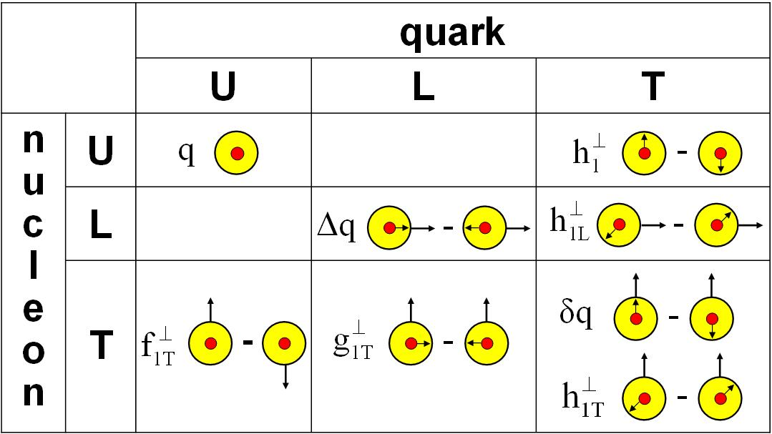
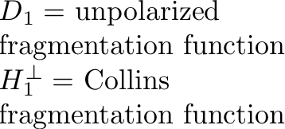
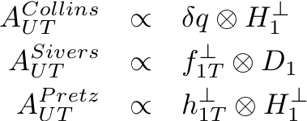
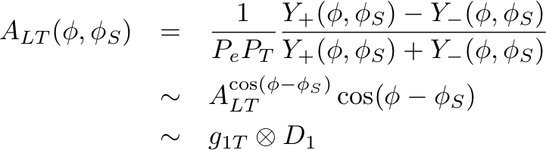
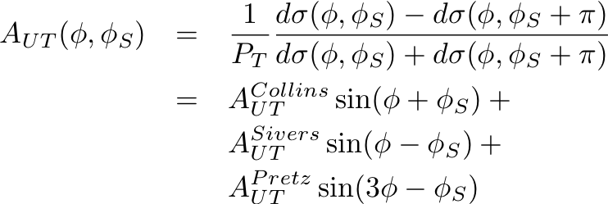
Transverse target spin effects in SIDIS
Transverse target spin-dependent cross section for SIDIS
Collins effect—chiral-odd quark transversity DF; chiral-odd Collins FF
Sivers effect—access to quark OAM and QCD FSI mechanism
“Transversal helicity” g_{1T}—real part of S wave-P wave interference (Sivers = imaginary part) (requires polarized beam)
“Pretzelosity” or Mulders-Tangerman function—interference of wavefunction components differing by 2 units of OAM

Slide 13
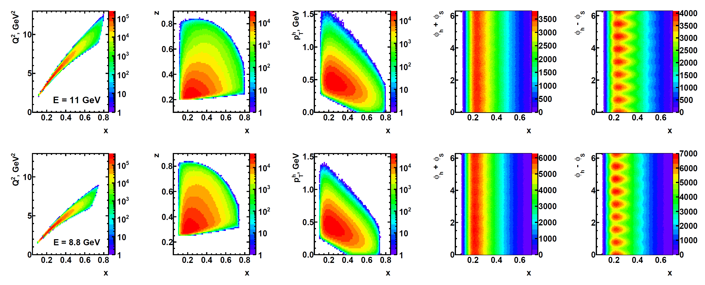
SIDIS Kinematic Coverage in E12-09-018
Wide, independent coverage of x, z, p_{T}, ϕ_{h} ± ϕ_{S} in a single spectrometer configuration.
At least four (preferably 8) target spin directions to achieve full ϕ_{S} coverage
Q², x strongly correlated due to dimensions of BigBite magnet gap.
Data at E = 11, 8.8 GeV provide data for significantly different Q² at same x
Systematics control → independent spectrometers, detectors in field-free regions, straight-line tracking, simple, well-defined (but adequately large) acceptance, etc.

Slide 14
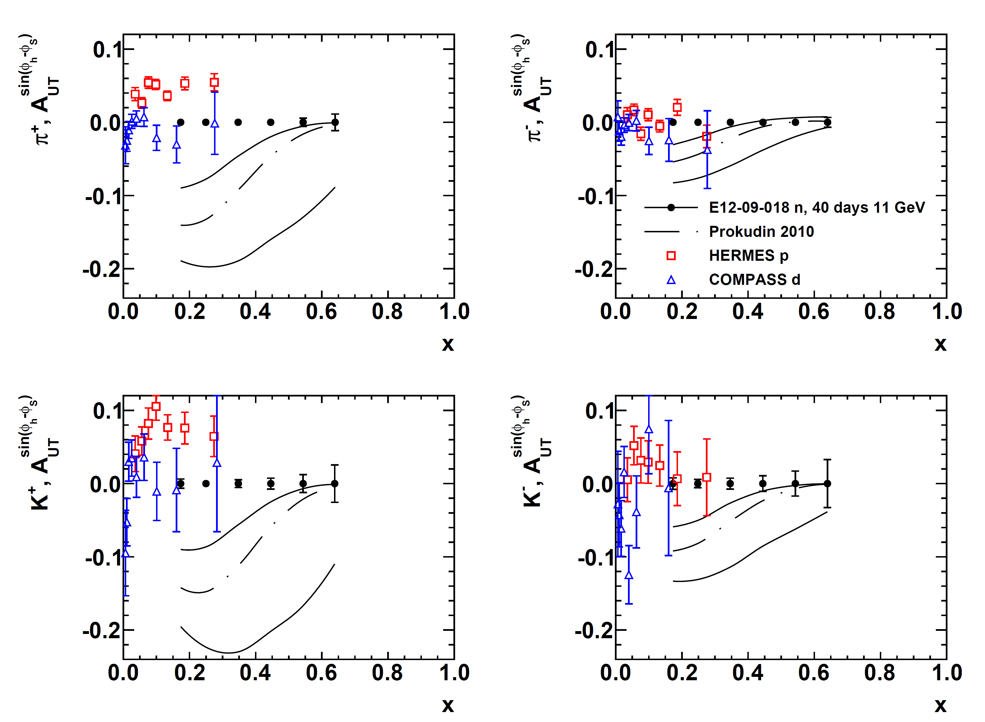
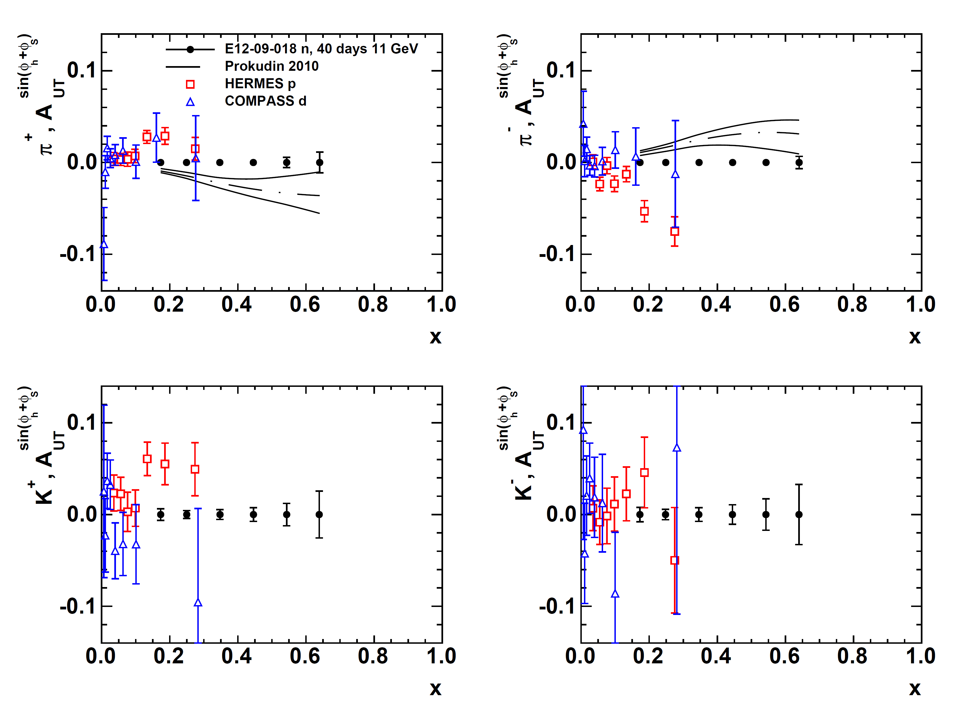
SBS+BB Projected Results: Collins and Sivers SSAs
Projected A_{UT}^{Sivers} vs. x (11 GeV data only)
Projected A_{UT}^{Collins} vs. x (11 GeV data only)
E12-09-018 will achieve statistical FOM for the neutron ~100X better than HERMES proton data and ~1000X better than E06-010 neutron data.
Kaon and neutral pion data will aid flavor decomposition, and understanding of reaction-mechanism effects.

Slide 15
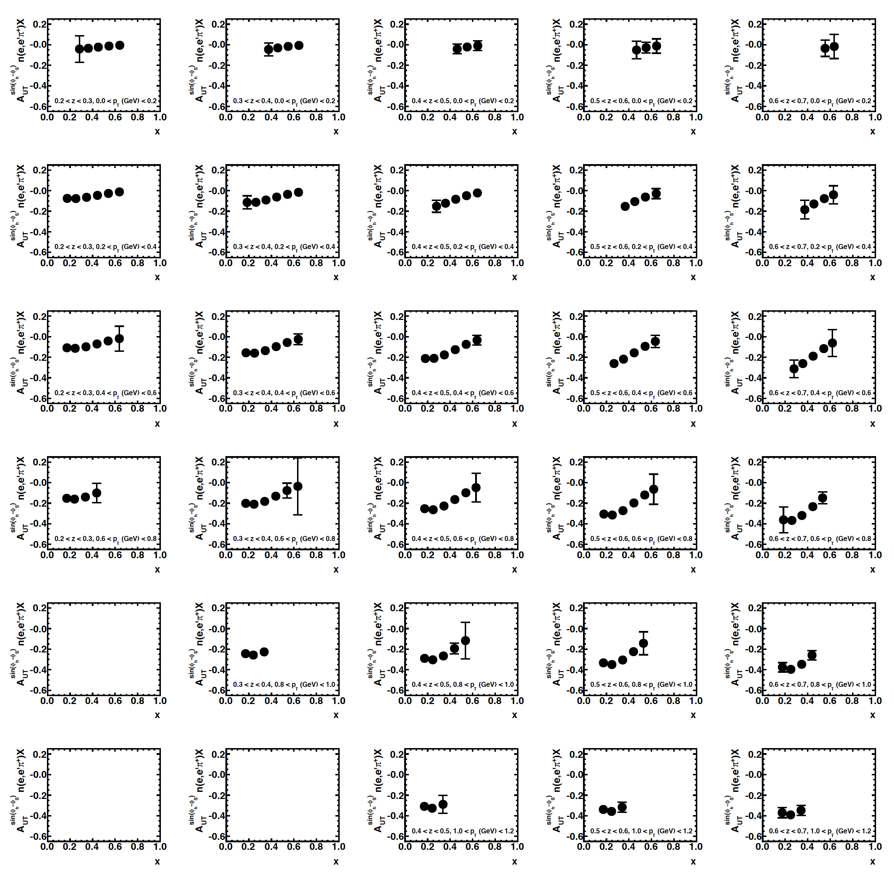
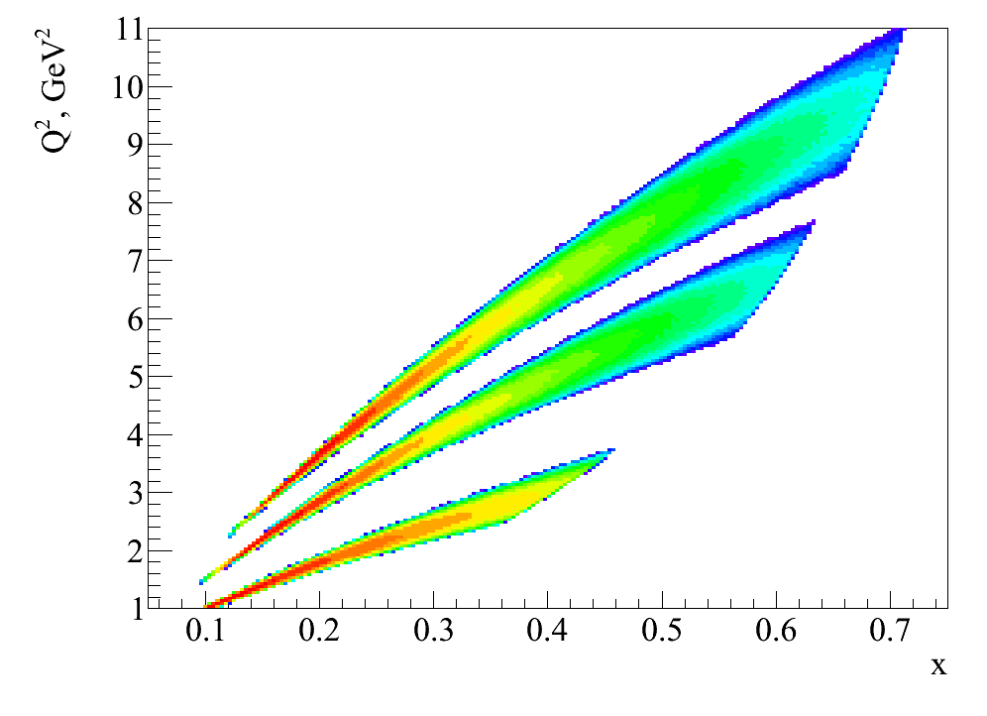
3D and “4D” extraction of SIDIS SSAs with SBS
Example result for 3D binning (x,z,p_{T})
E = 11 GeV, 40 days
Increasing z ➔
“4D” with Q² dependence from 20 days at 8.8 GeV:
⬅ Increasing p_{T}
E = 11 GeV
E = 8.8 GeV
E = 5.9 GeV (E06-010 Hall A)

Slide 16
Example Impacts of SBS SIDIS Experiment
2011 impact study by A. Prokudin, global fit with E12-09-018 projected results, π⁺ Sivers moments at E = 11 GeV, ½ of projected statistics.
Left: >5X shrinking of n(e,e’ π⁺)X Sivers A_{UT} band
Right: reducing the uncertainty in d quark Sivers in six-flavor extraction
E12-09-018 will provide π±/π⁰/K± at similar precision (Kaon errors 2-3X pion errors) for both E = 8.8 GeV and E = 11 GeV Collins/Sivers (and Pretzelosity)

Slide 17
Example Impacts of SBS SIDIS Experiment
2011 impact study by A. Prokudin, global fit with E12-09-018 projected results, π⁺ Sivers moments at E = 11 GeV, ½ of projected statistics.
Left: >5X shrinking of n(e,e’ π⁺)X Sivers A_{UT} band
Right: reducing the uncertainty in d quark Sivers in six-flavor extraction
E12-09-018 will provide π±/π⁰/K± at similar precision (Kaon errors 2-3X pion errors) for both E = 8.8 GeV and E = 11 GeV Collins/Sivers (and Pretzelosity)

Slide 18
Inclusive DIS and SIDIS physics with BB+SBS+Longitudinally polarized ³He target

Slide 19
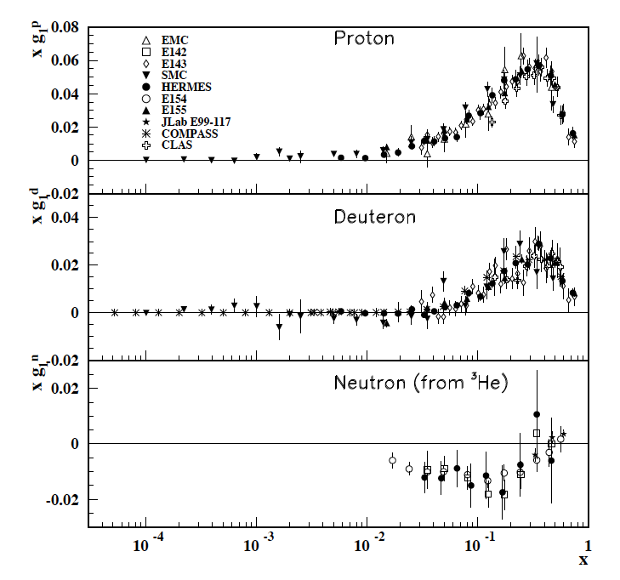
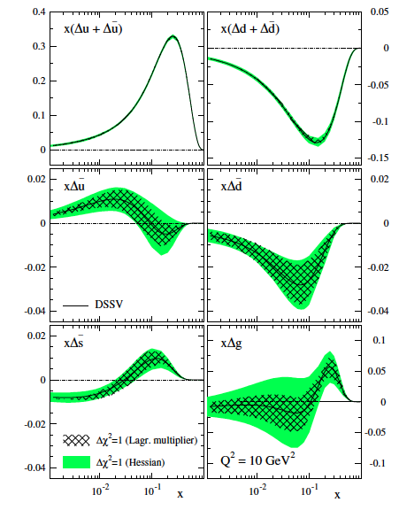
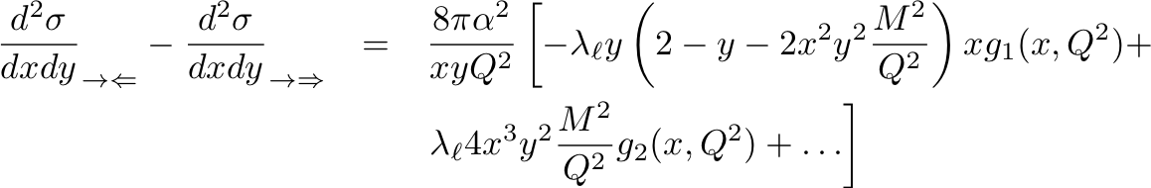

Polarized DIS and Nucleon Spin Structure
PDG2010 compilation of g₁ data
DSSV NLO global fit:
PRD 80, 034030 (2009)

Slide 20
Polarized DIS and Spin Structure Functions
Helicity asymmetries in the scattering of longitudinally polarized electrons on longitudinally and transversely (in the scattering plane) polarized nucleons provide access to spin structure functions g₁, g₂.
The longitudinal virtual photon asymmetry A₁ is defined as the asymmetry between parallel and antiparallel virtual photoabsorption cross sections and is related to the spin structure function g₁(x,Q²):
In the naïve parton model, g₁ is an incoherent sum over parton helicity distributions Δq_{i}, defined as the differences in number density between quarks polarized parallel and antiparallel to the nucleon spin:

Slide 21
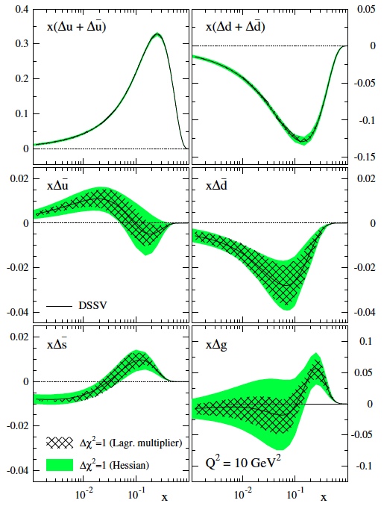
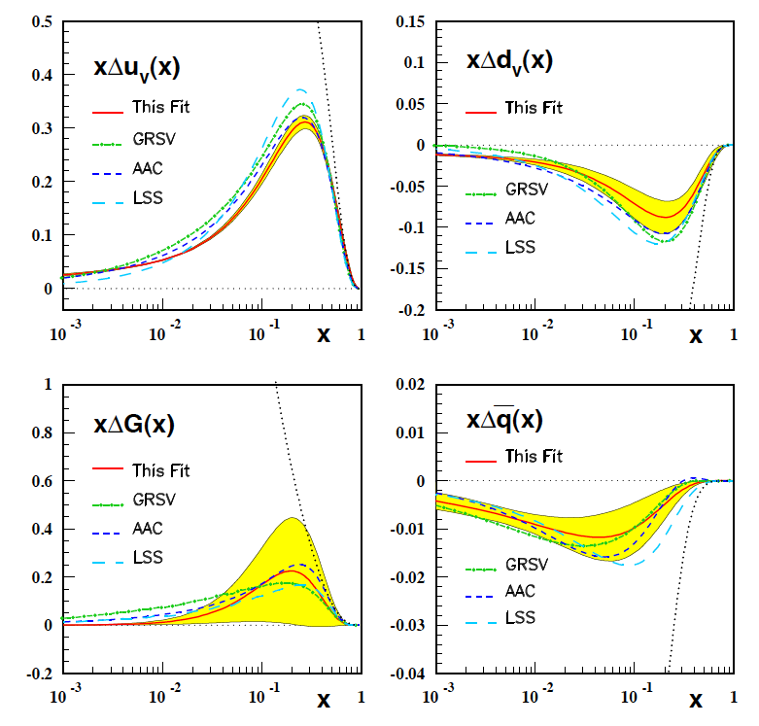
Experimental Status of Δq
Blumlein and Bottcher, hep-ph/1005.3113
Recent Global Analyses:
  DSSV, includes SIDIS and pp data, asymmetric sea
  BB, DIS data only
DSSV: PRD 80, 034030 (2009)

Slide 22
A1n in Hall A—E12-06-122
Hall A A_{1n} BigBite proposal was originally envisioned as an early “commissioning” experiment for Hall A/BigBite, that would run before the Hall C proposal
Given the evolution of apparatus/capability and the Hall A schedule since 2006, it may no longer make sense to run E12-06-122 as originally proposed.
The current spokespeople of Hall A A_{1n} are reoptimizing the experiment around using 11 GeV beam and BB+SBS, in anticipation of the PAC jeopardy process beginning in 2019.
  Bonus: longitudinally polarized SIDIS “for free”
Hall C A_{1n} appears likely to go forward ~2019-2020, and will run before Hall A version
As proposed to PAC30 in 2006, with BigBite. E12-06-122
Still approved, on the books. A- rating.
Jeopardy process for previously approved 12 GeV proposals starts 2019, per Bob McKeown, 2018 JLab UGM

Slide 23
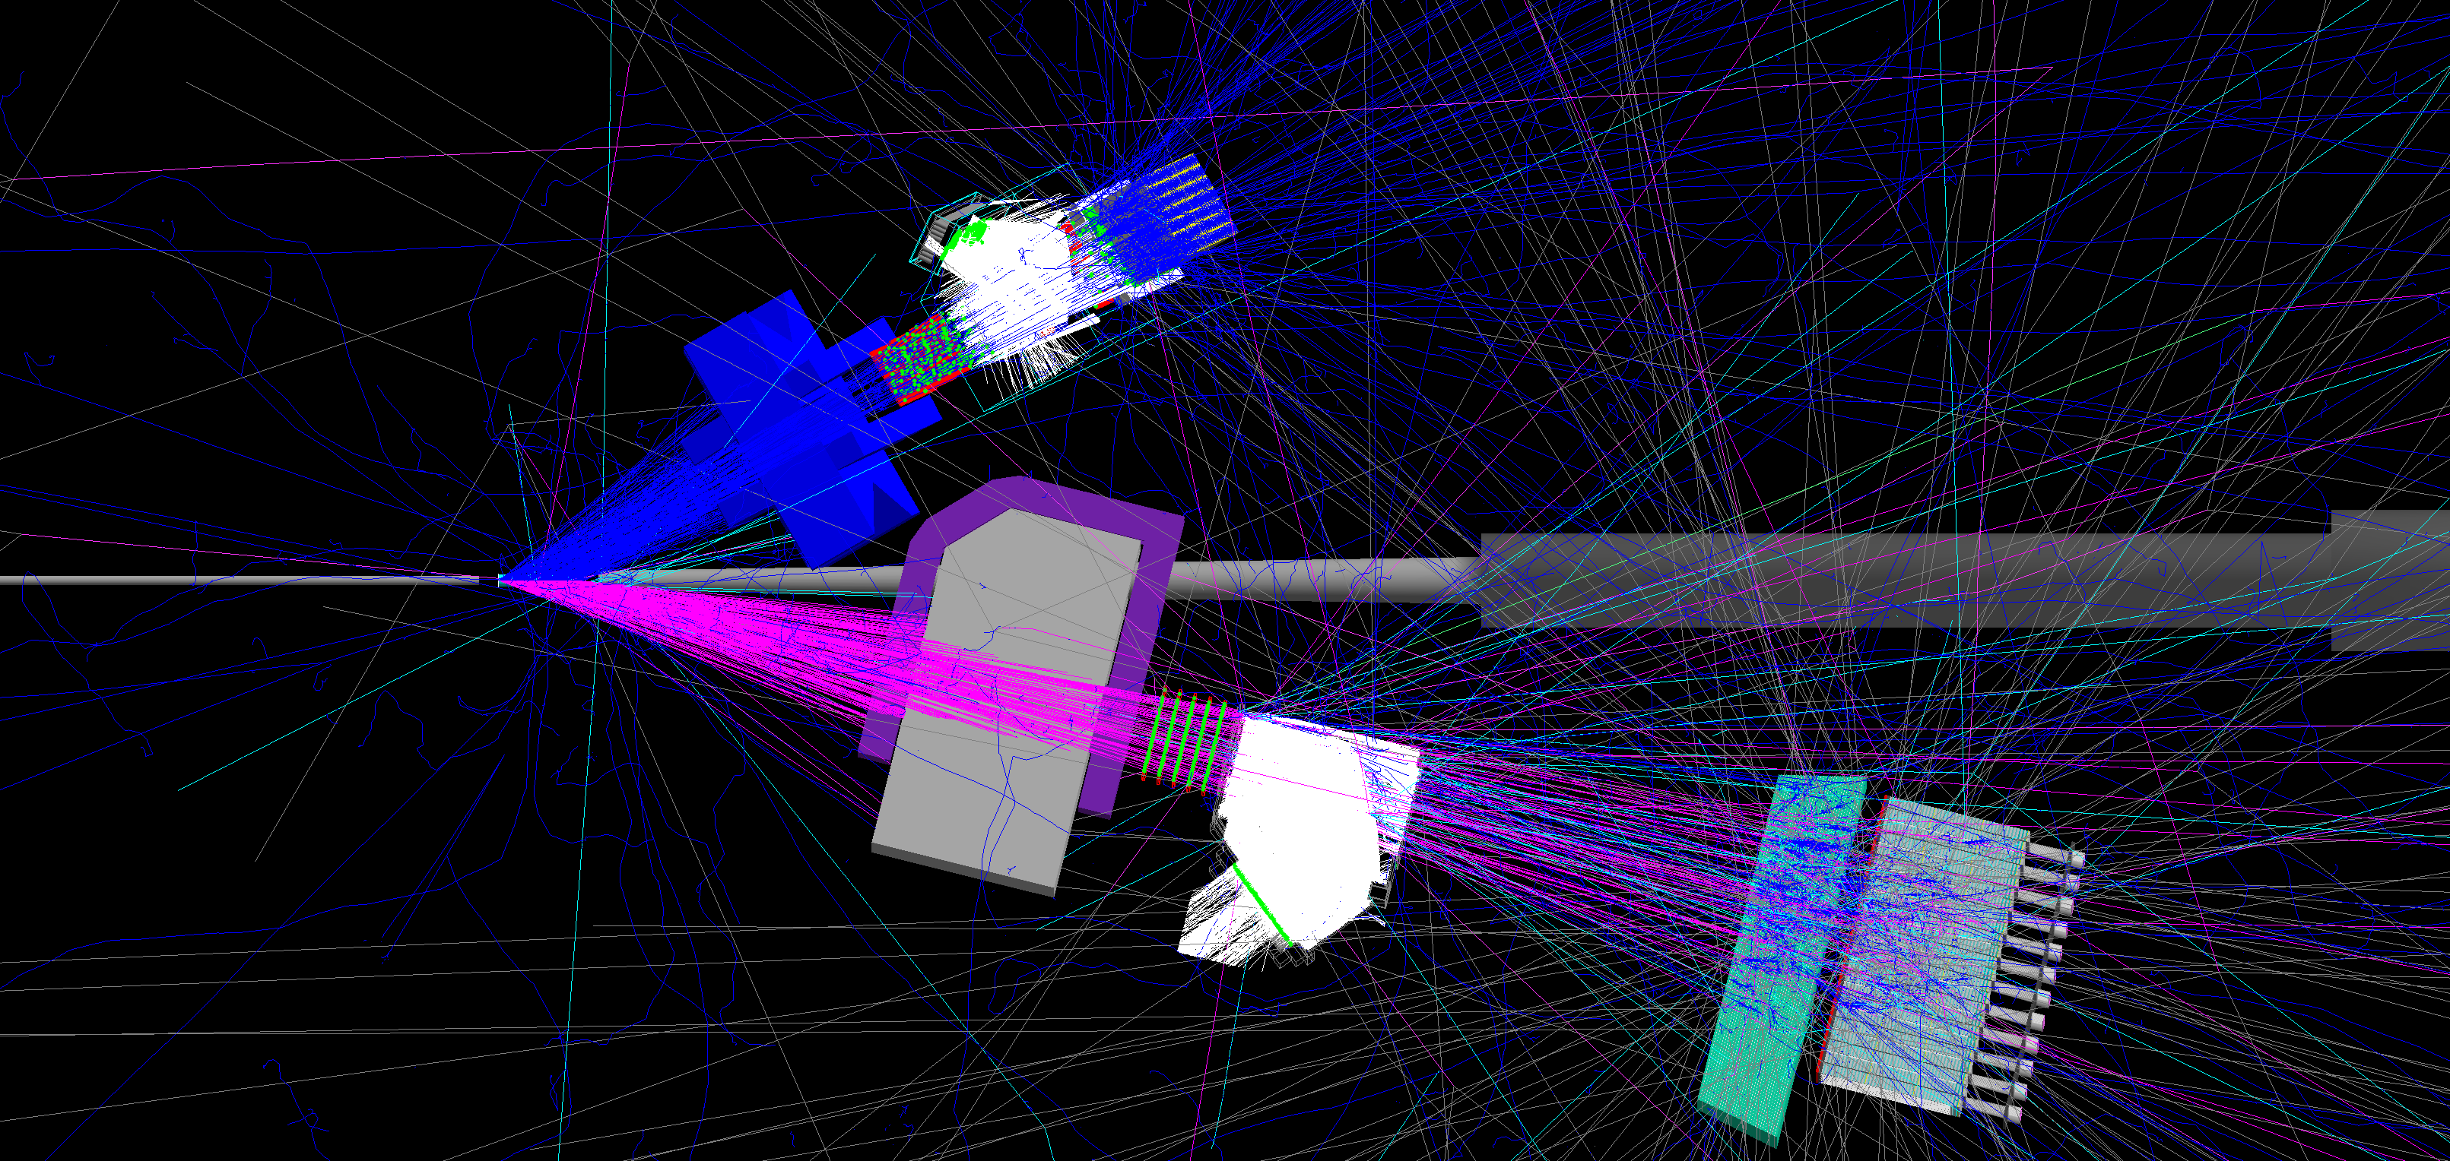
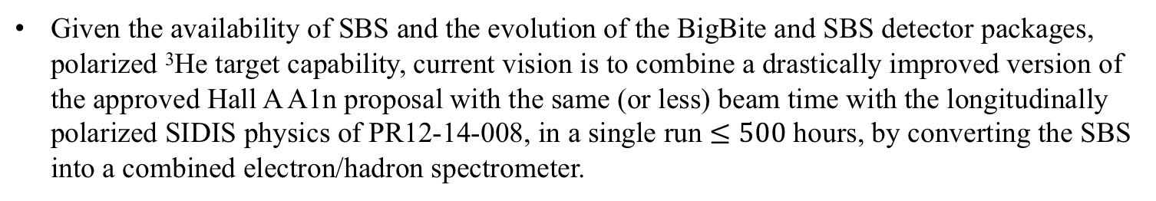
A1n redesign: A_{1n}+ SIDIS A_{1n}^{h} with 11 GeV and BB+SBS
Electron Arm: BigBite Spectrometer @30 deg, high Q²/high-x DIS/SIDIS data
A1n redesigned: SBS as combined electron/hadron spectrometer with LAC+HCAL+RICH
High-luminosity (longitudinally) Polarized ³He Target (1.2 × 10³⁷ cm⁻² s⁻¹)
Electron/Hadron Arm: Super BigBite Spectrometer @12 deg. High-x/Resonance region inclusive ³He(e,e’) and charged hadron detection for longitudinally polarized SIDIS ³He(e,e’h) X
Given the availability of SBS and the evolution of the BigBite and SBS detector packages, polarized ³He target capability, current vision is to combine a drastically improved version of the approved Hall A A1n proposal with the same (or less) beam time with the longitudinally polarized SIDIS physics of PR12-14-008, in a single run $≤500$hours, by converting the SBS into a combined electron/hadron spectrometer.

Slide 24
A1n SBS+BB PRELIMINARY projections
BigBite
SBS
W = 2 GeV
Very crude estimates of A1n statistical precision, with inclusive ³He(e,e’)X rates computed from Christy-Bosted parametrization of inclusive structure functions, basic Fermi smearing model

Slide 25
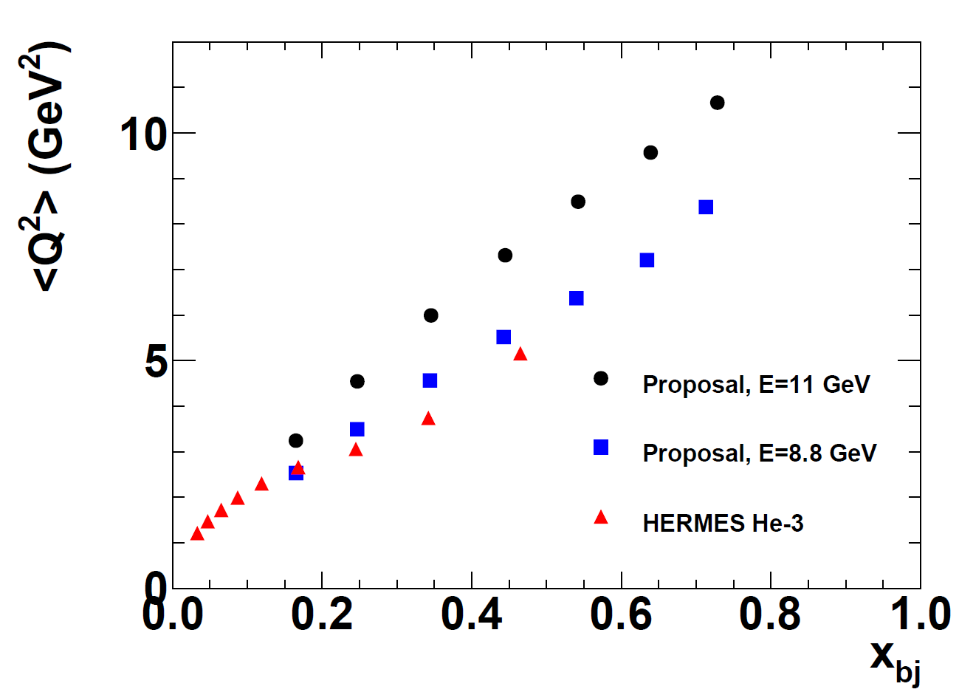
<Q²> of SBS+BB SIDIS: > HERMES, < COMPASS

Slide 26
General Expression for SIDIS Cross Section: Bacchetta et al. JHEP 02, 093 (2007)
SIDIS structure functions F depend on x, Q², z, p_{T}
U, L, T subscripts indicate unpolarized, longitudinally and transversely polarized beam, target, respectively
S = nucleon spin
λ = lepton helicity
Eight terms survive at leading twist; the rest are M/Q suppressed
TMDs accessible in SIDIS with longitudinally polarized

Slide 27
SIDIS Structure Functions in Terms of TMDs
Only f₁, g₁, h₁ survive integration over quark k_{T}
All eight leading-twist TMDs are accessible in SIDIS with polarized beams/targets via azimuthal angular dependence of the SIDIS cross section
Physical observables are convolutions over two (unobserved) transverse momenta:
  Initial quark k_{T}
  Hadron p_{T} relative to recoiling quark, generated during fragmentation
Leading-twist TMDs accessible in SIDIS with longitudinally polarized target

Slide 28
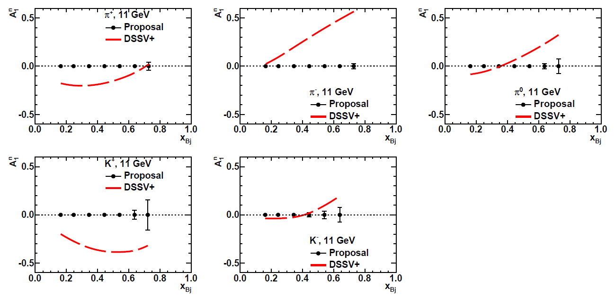
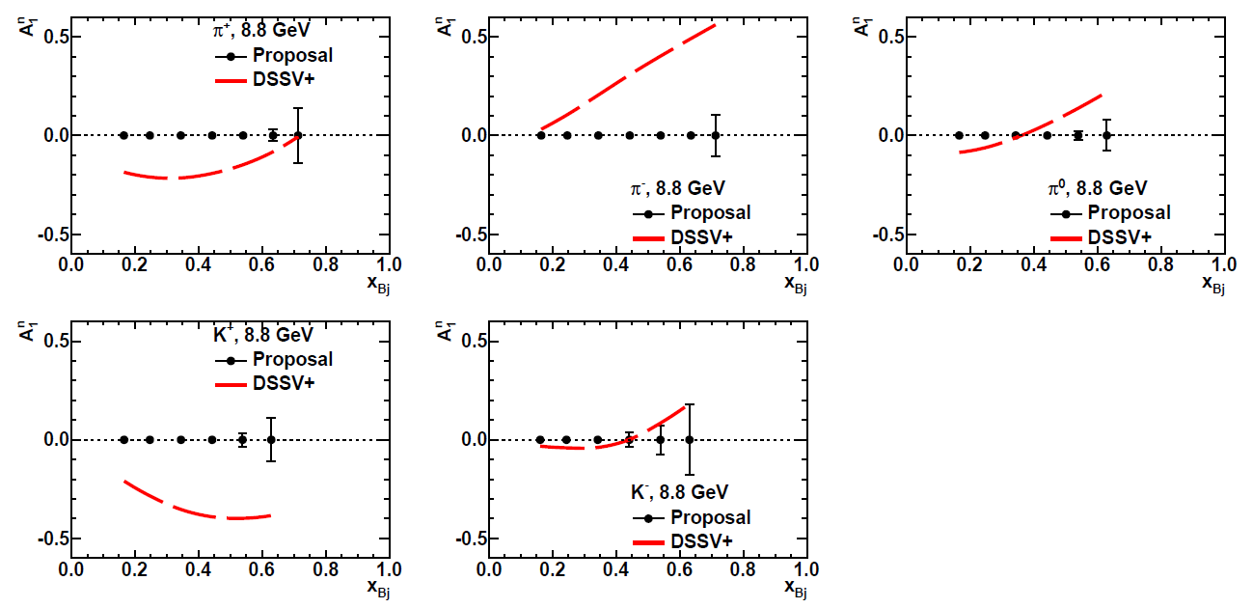
Projected SIDIS Asymmetry Precision—1D for all hadrons
Projected asymmetry precisions (stat. only) in A_{1n}^{h} vs x, integrated over z, p_{T}, compared to prediction of “DSSV+” NLO global fit: http://arxiv.org/abs/1108.3955
Fit includes COMPASS 2010 p and d data: http://arxiv.org/abs/1007.4061
<Q²> between HERMES and COMPASS
More details, numerical tables available at: https://userweb.jlab.org/~puckett/PAC42_deltad/projections/

Slide 29
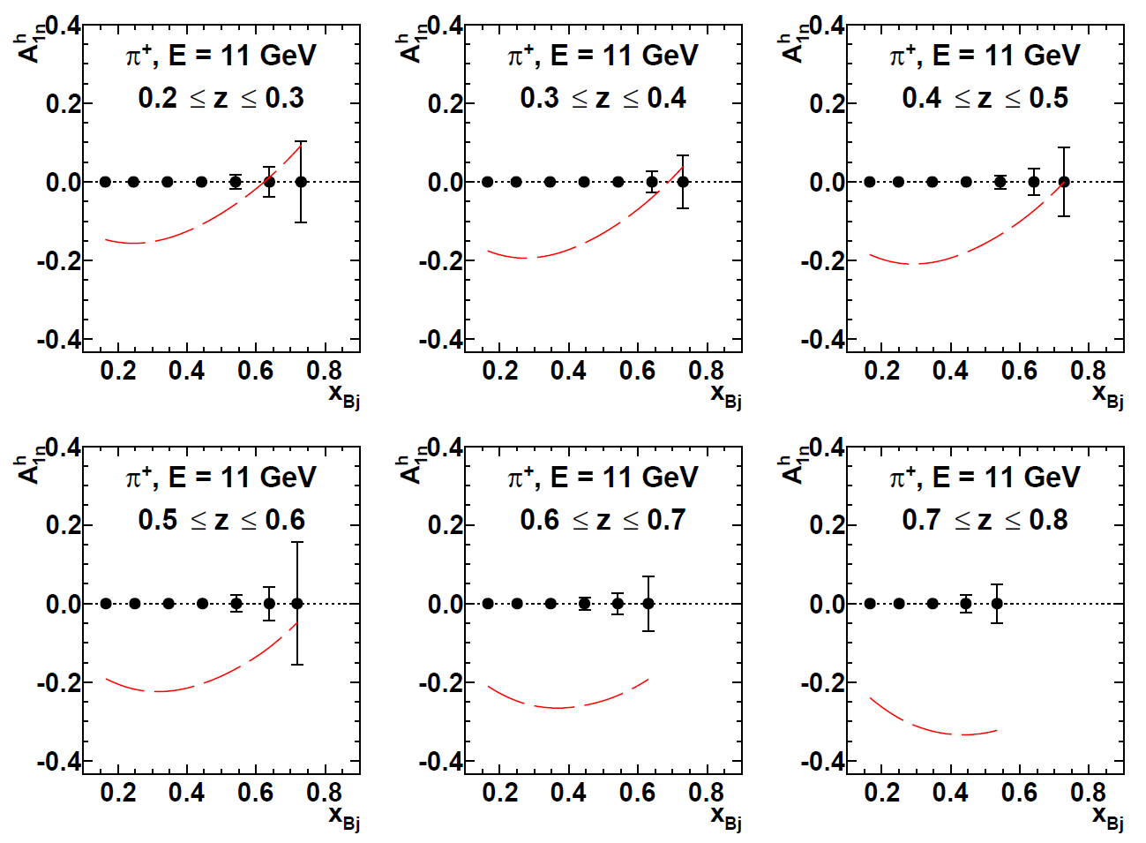
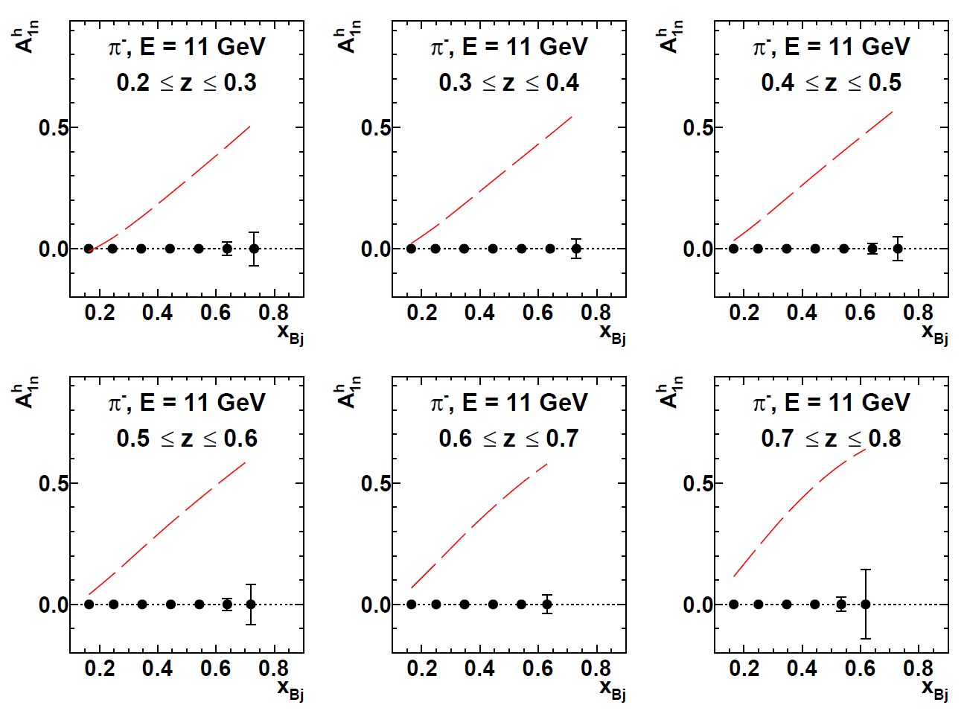
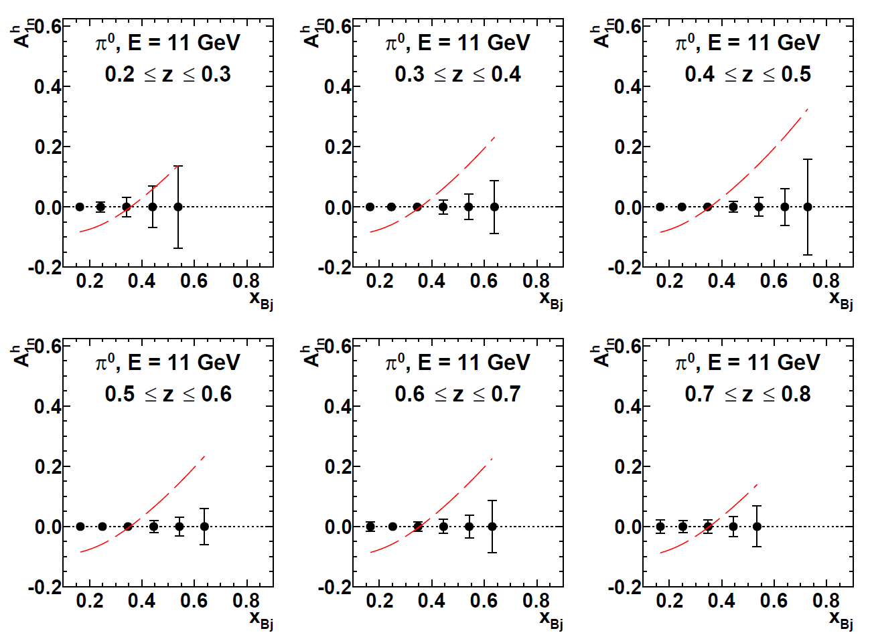
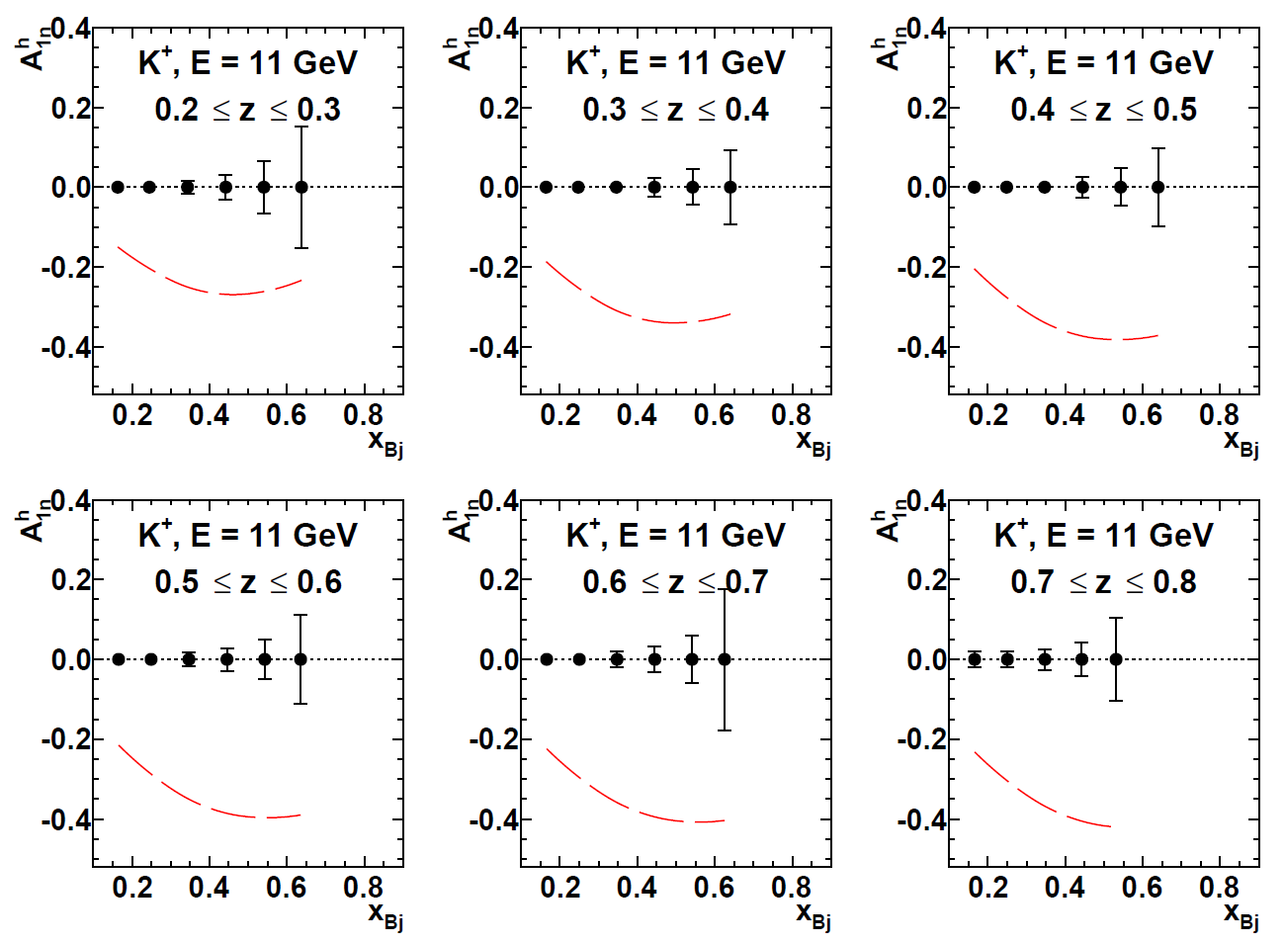
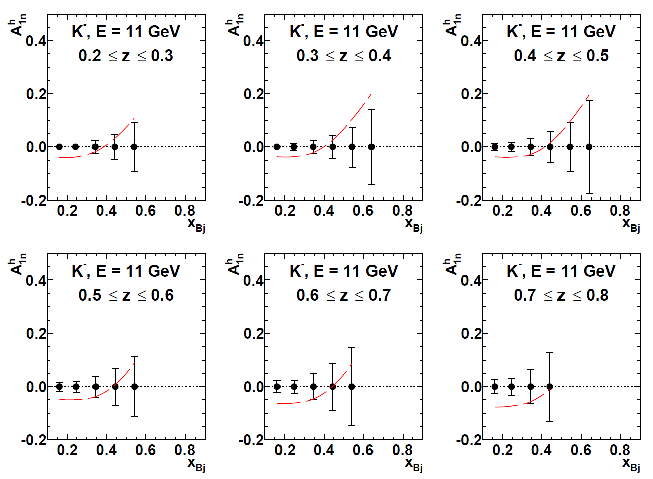
Projected SIDIS Asymmetry Precision, 2D (x,z), E = 11 GeV
Left-right, top-bottom: π⁺, π⁻, π⁰, K⁺, K⁻.
Curves: “DSSV+”: http://arxiv.org/abs/1108.3955
More details including numerical tables at: https://userweb.jlab.org/~puckett/PAC42_deltad/projections/
Relatively weak z dependence of DSSV+ curves is a NLO QCD effect.
Strong hadron dependence of A_{1n}^{h} clear indication of flavor sensitivity of SIDIS

Slide 30
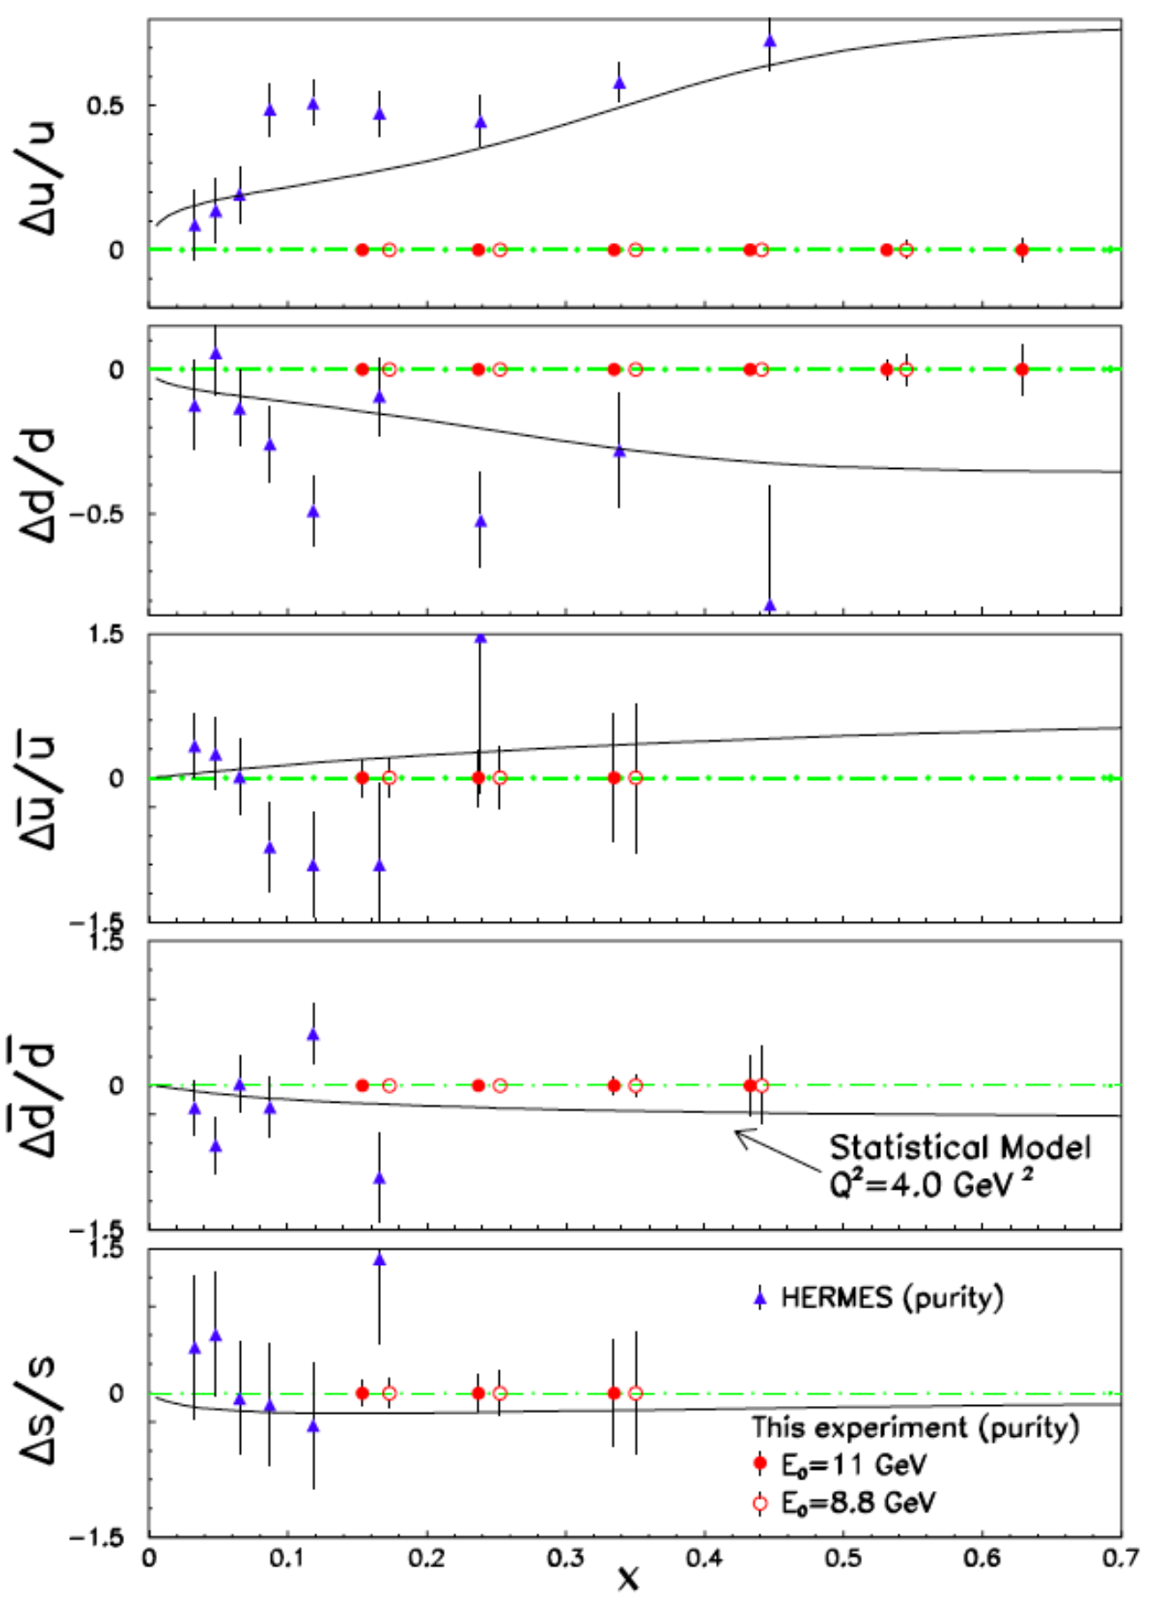


Impacts on Nucleon Spin-Flavor Decomposition
Left: Projected precision of five-flavor Δq/q extraction using LO “purity” method
  Excellent precision/sensitivity to d and dbar, as expected.
Below: existing data, from DSSV2008 analysis: http://journals.aps.org/prd/abstract/10.1103/PhysRevD.80.034030

Slide 31
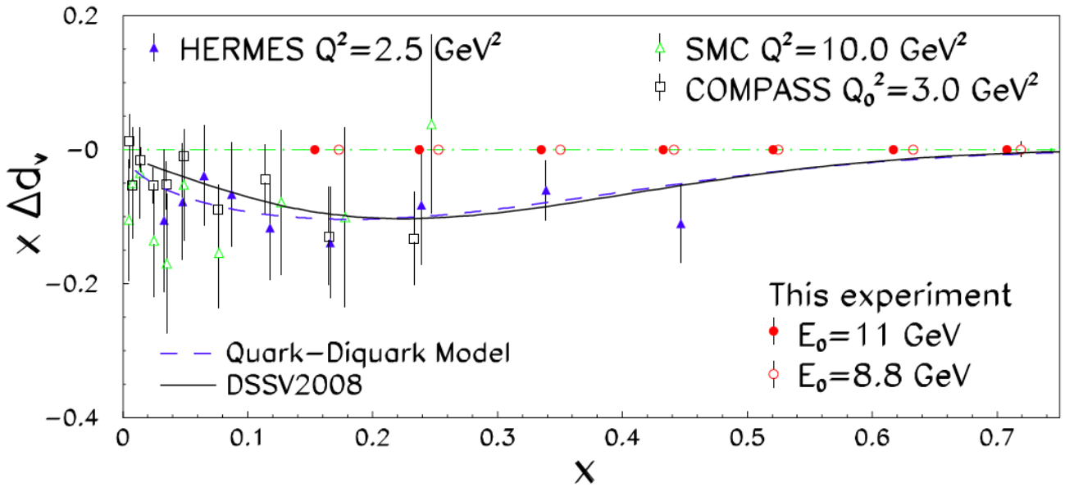
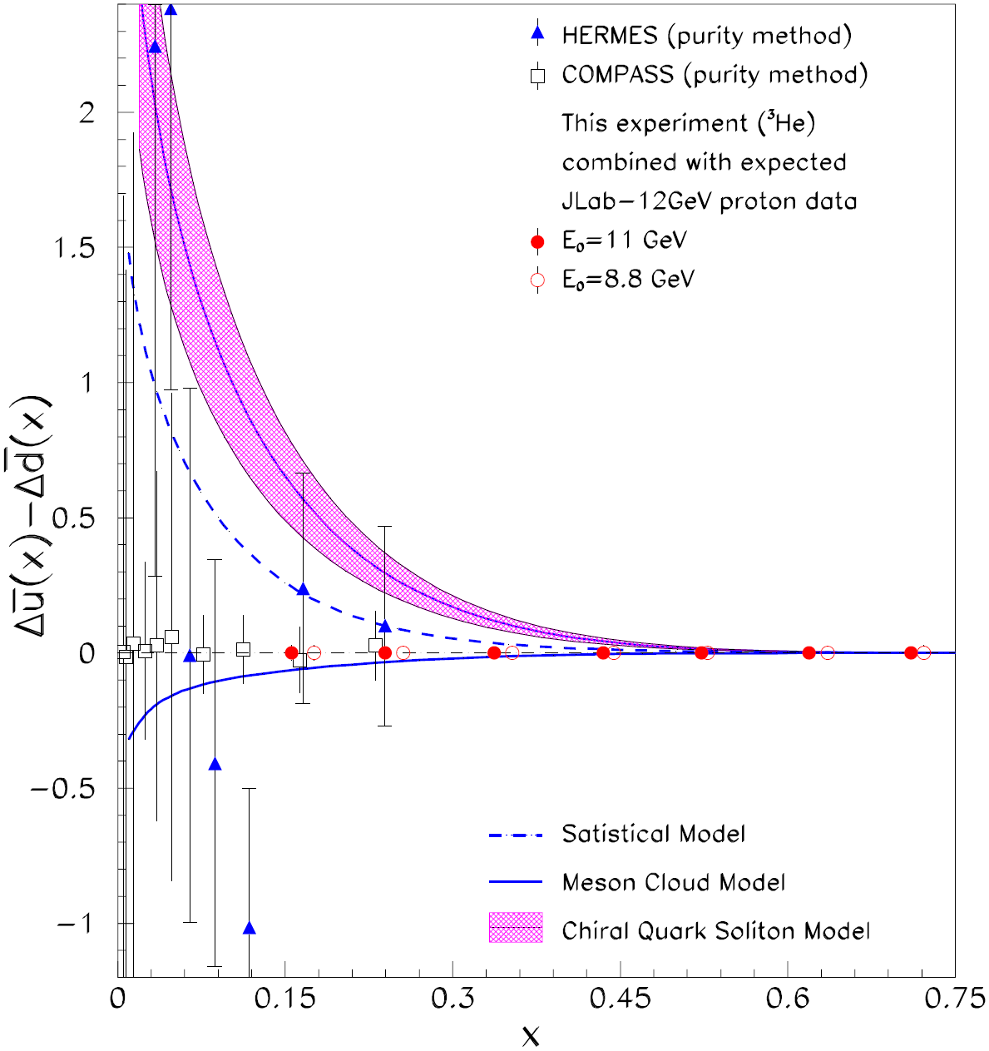
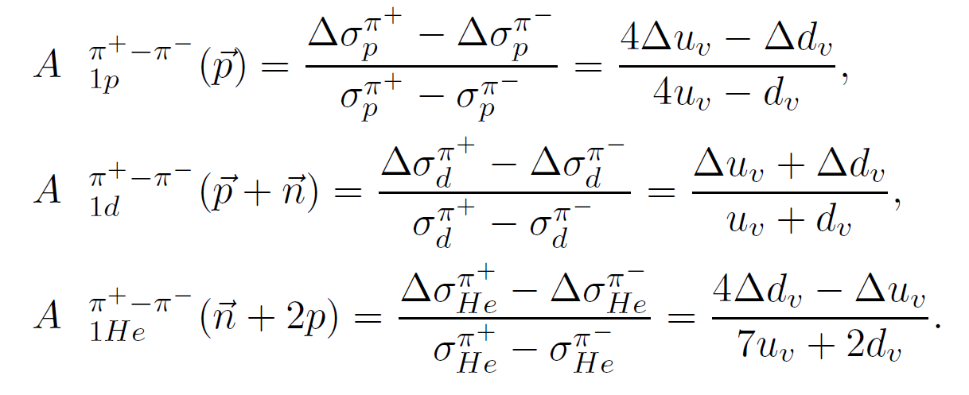
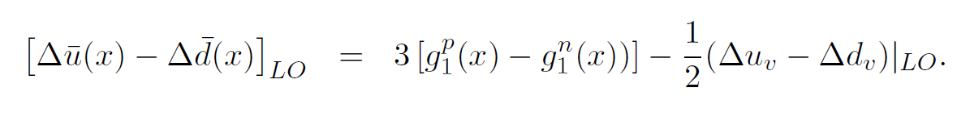
Impacts on Spin-Flavor decomposition, II
Left: valence d polarization from Helium-3 charge-difference asymmetries using LO Christova-Leader method.
Below: polarized sea asymmetry assuming proton data of comparable precision to this proposal

Slide 32
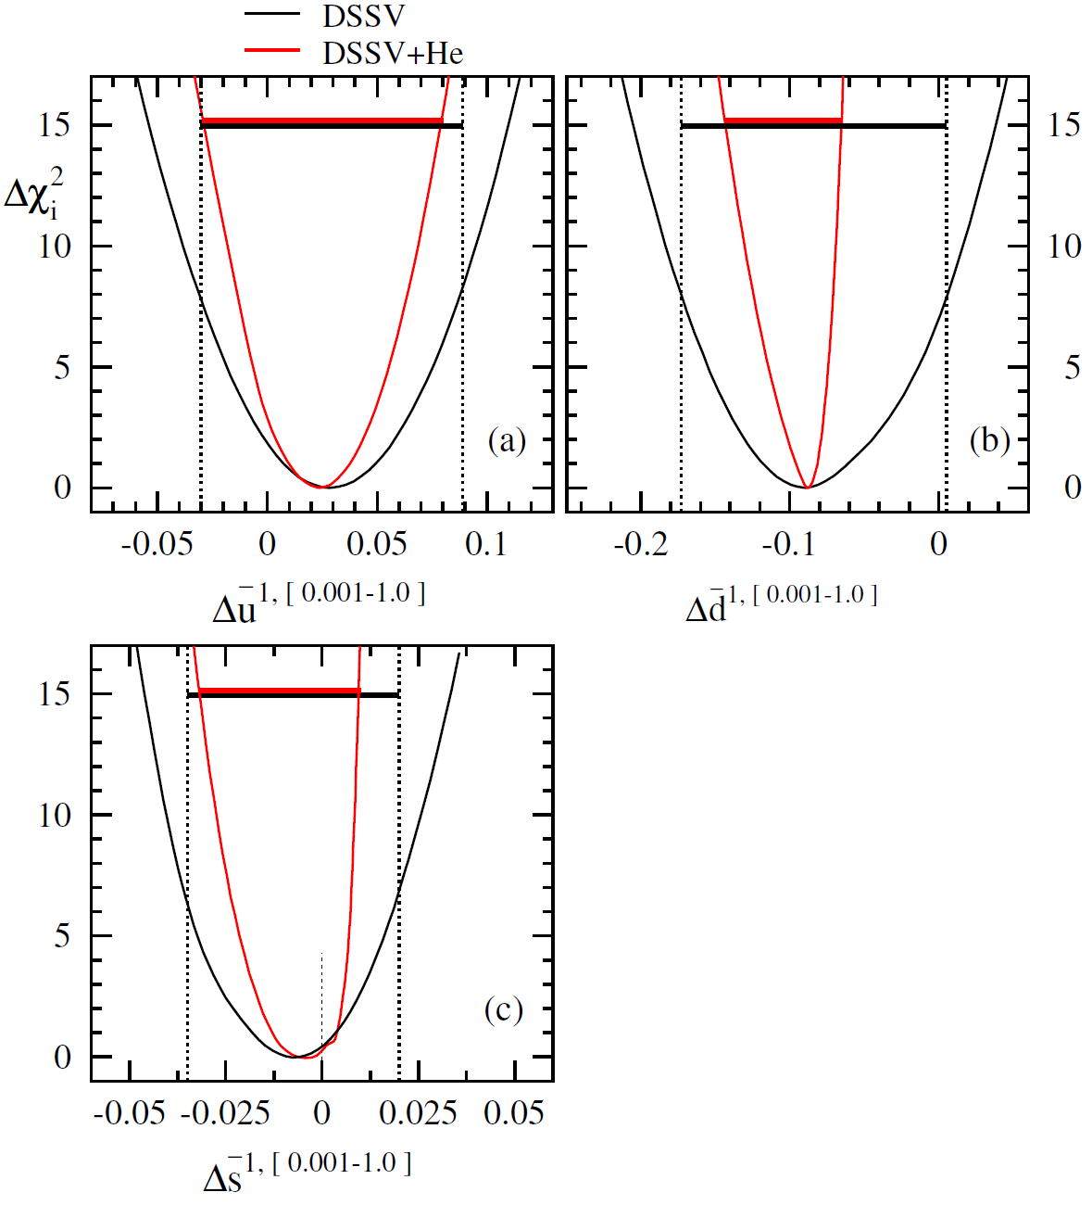
Impact on Spin-Flavor Decomposition, III
Results of DSSV impact study of proposed BB+SBS data → suggest dramatic impact to dbar, significant impacts to ubar, sbar polarization

Slide 33
Summary and Conclusions
E12-09-018, approved with A- rating and 64 PAC days at PAC38, will improve in FOM for neutron transverse single-spin asymmetries in SIDIS by ~100 cf. HERMES proton and ~1,000 cf. E06-010, which used HRS as hadron arm
  No other planned experiment will address this physics for a neutron target before SoLID
Approved A1n experiment using BigBite in Hall A faces jeopardy in 2019. Jeopardy proposal will amount to a redesign using 11 GeV beam and the addition of SBS. Current spokespersons are Todd Averett and Andrew Puckett (and any of the original spokespeople who want to remain spokespeople). Without approving any new beam time:
  Dramatic improvement in statistical precision, especially at high-x, compared to the Hall C measurement
  Cover DIS and resonance region up to (and beyond) x = 1
  Highly competitive measurement of longitudinally polarized target SIDIS single and double spin asymmetries without approval of any new beam time.

Slide 34
Backups

Slide 35
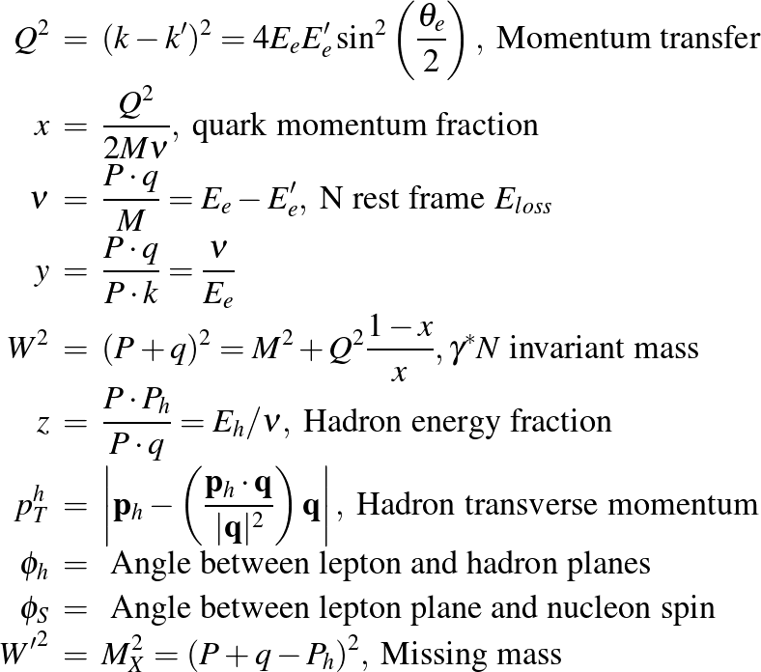
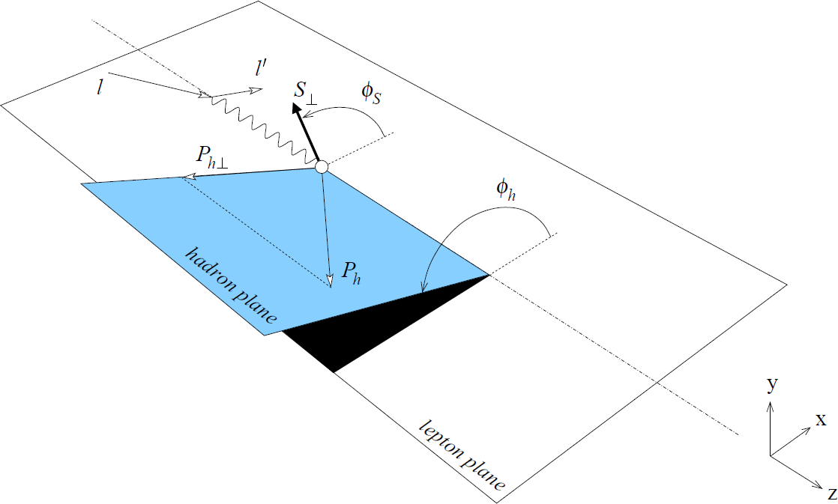
SIDIS Kinematics—Notation and Definitions

Slide 36
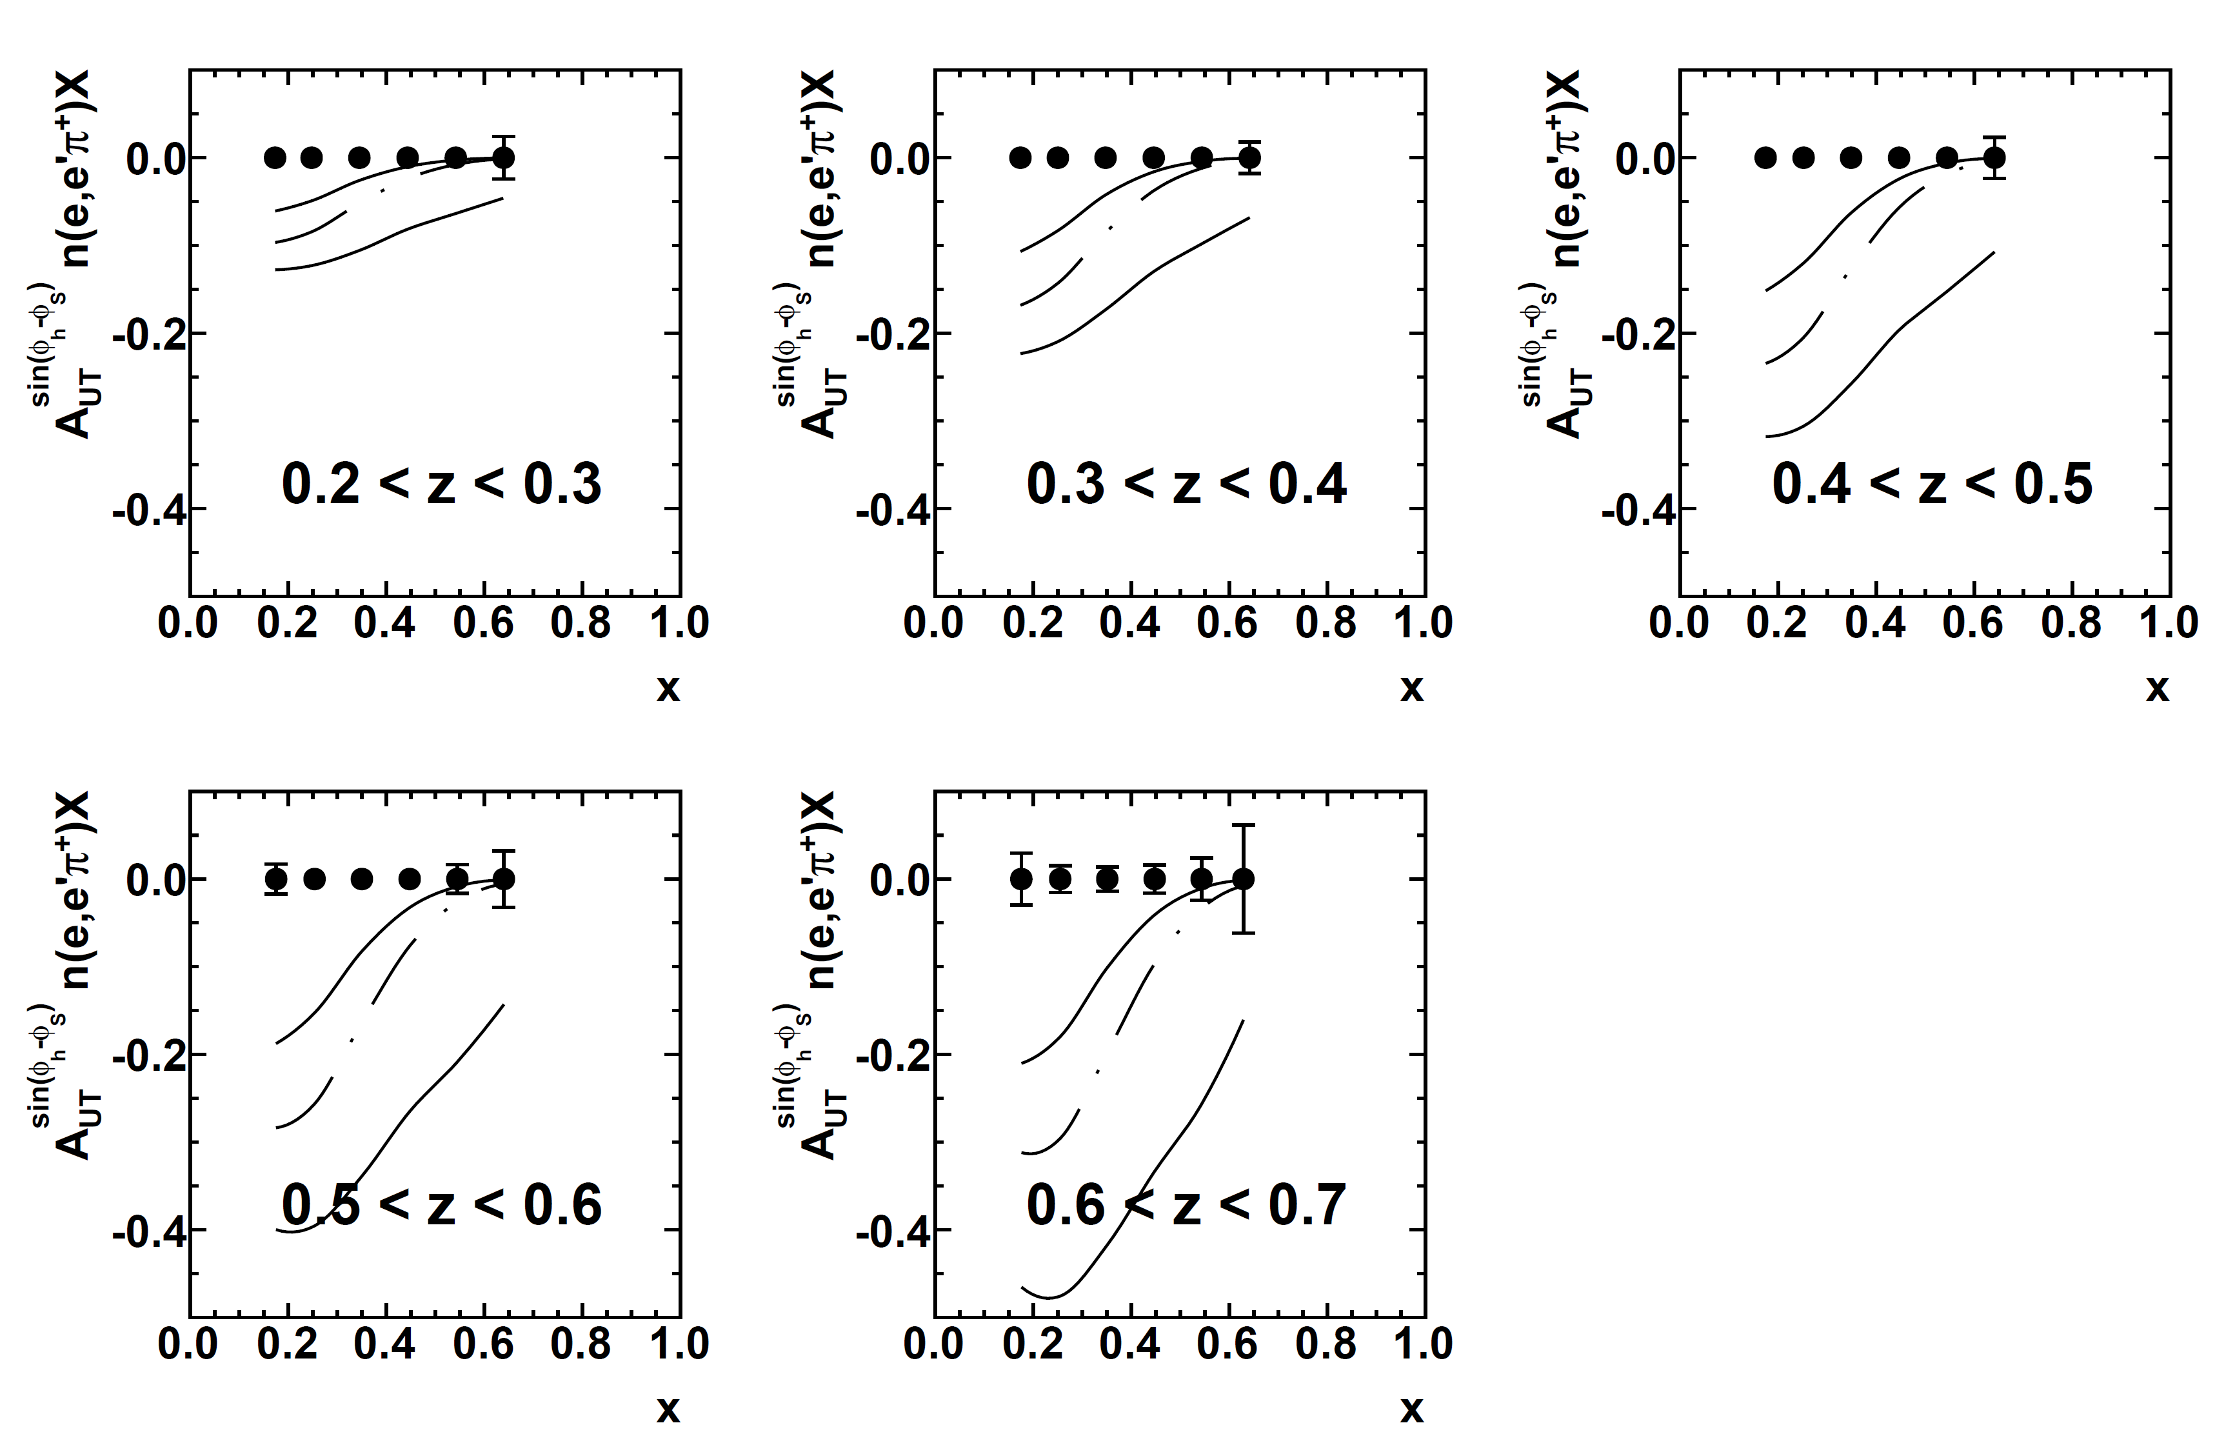
SBS+BB Projected Precision in 2D (x,z) binning
Uncertainty in this x, z bin ~ 0.6%
Large neutron π⁺ asymmetry expected at high z, large uncertainty in global fit
2D Extraction: Sivers A_{UT} in n(e,e’π⁺)X, 6 x bins 0.1<x<0.7, 5 z bins 0.2<z<0.7
Curves are phenomenological predictions from global analysis (Anselmino et al.) with central value and error band

Slide 37
Kinematic coverage: SBS+BB vs. SoLID
Left: Complementarity of Q² coverage: SBS+BB experiment focuses on higher luminosity and larger scattering angles to reach higher Q²/higher x.
Right: SBS+BB solid angle coverage (θ vs ϕ) for electron/hadron compared to SoLID:
  Green = BigBite electron scattering angle coverage
  Cyan = SBS hadron scattering angle coverage
  Magenta = SoLID large-angle coverage
  Black = SoLID forward angle coverage

Slide 38
Azimuthal coverage: SBS+BB vs SoLID
With BigBite at 30 degrees and SBS at 14 degrees, SBS is centered with respect to the q-vector when x ~ 0.7-0.8. While the SBS+BB phi coverage is less complete at lower x, it is more nearly complete at higher x, where the SIDIS asymmetry measurements are more statistically challenged, and in this sense is optimized for the high-x/high-Q² region

Slide 39
Statistical FOM: SBS+BB vs. SoLID

Slide 40
Hall C A1n—Projections presented in PAC36 update
Upgraded polarized ³He target technology based on convection-driven circulation of polarized gas
HMS+SHMS spectrometers in Hall C—HMS (SHMS) focused on DIS (resonance) region
Figure credit: X. Zheng, from PAC36 update to PR12-06-110

Slide 41
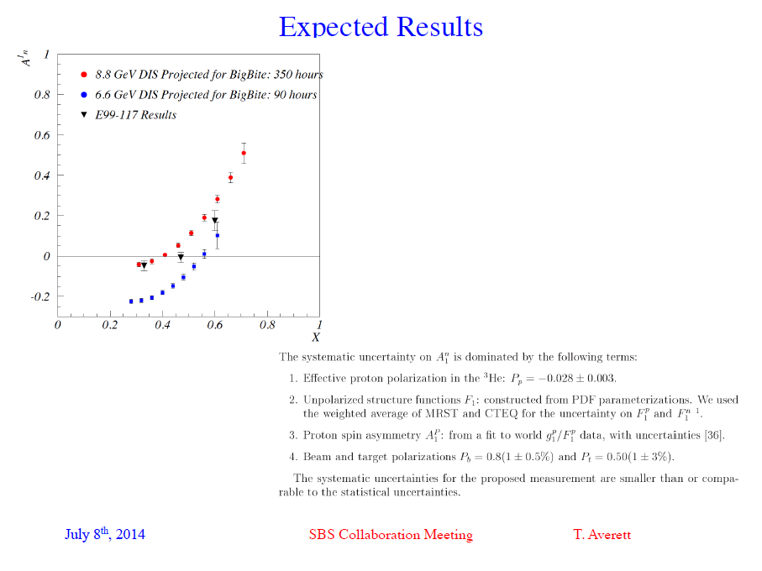
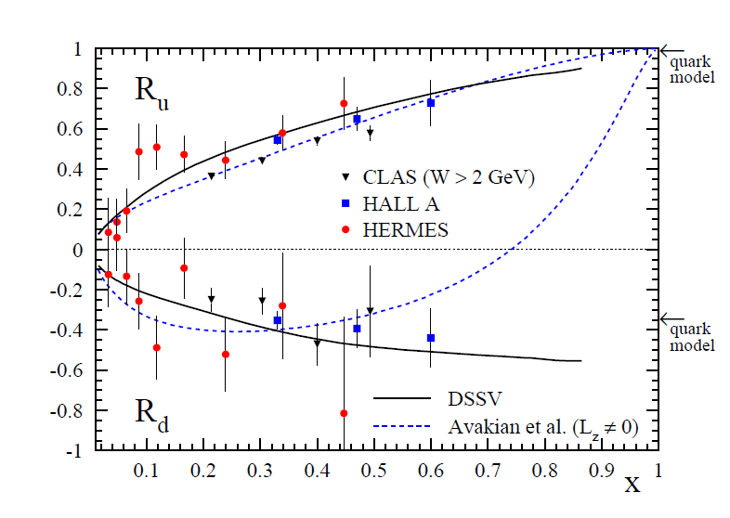

Slide 42

Accessible (SI)DIS phase space in fixed-target at 6 GeV
Above: phase space with canonical “SIDIS” cuts (before considering any detector acceptances), E=6 GeV

Slide 43

Accessible (SI)DIS phase space in fixed-target at 11 GeV
Above: phase space with canonical “SIDIS” cuts (before considering any detector acceptances), E=11 GeV

